Slide 1
Probability of burn-through of defective 13 kA joints at increased energy levels
Arjan Verweij
TE-MPE
3.5 TeV | 6000 A
4 TeV | 6800 A
4.5 TeV | 7600 A

Slide 2
Probability flow (for I<9 kA)
P_{G},P_{B},P_{J}
Spurious trips/heater firings, ….
Training
Beam losses
Cable/bus movement
Resistive losses in the splice
P>0
P→0
P>0
P→0
P→0
P=0
P_{B}>0
Thermal prop.
through the
bus (1 joint)
Prompt quench
of a joint
Quench of a magnet
Delayed quench
of a joint
P_{J}>0
Thermal prop.
through GHe
(3 joints)
Burn-out of the joint
P_{G}>0

Slide 3
“To burn or not to burn” depends on:
P_{G},P_{B},P_{J}
Current (Ampl and t)
Defect size (represented by R_{addit})
RRR of the bus, the diode lead, and the cable
Geometry “Dipole-Bus-Diode”
Heating up of the magnet coil.
Heating up of the diode
Heat transfer to helium (bus, diode lead, joint area)
GHe propagation time
Resistance of the ‘half moons’
Conclusion:
A worst case approach for all parameters would give an unrealistic result.
Therefore, all parameters will be fixed to best known (default) values (realistic, but somewhat conservative), and the burn-out current is calculated as a function of the (single sided) defect size for energy levels of 3.5, 4, and 4.5 TeV.

Slide 4
Assumptions (default values)
P_{G},P_{B},P_{J}
 | Default values | Sens. study for 4 TeV
RRR of the bus | 200 * | 100
RRR of the cable | 80
Decay time constant | 50 s (3.5 and 4 TeV) 68 s (4 and 4.5 TeV)
Geometry Magnet-Diode-Joint | Type A-upper, Type A-lower, Type B-upper, Type B-lower
Heating up of the magnet coil (outer layer midplane) | 20, 22, 26 K (3.5, 4, 4.5 TeV) ** | 44 K
Heating up of the diode | see later | 2x smaller
Heat transfer between bus and LHe | Fit from FRESCA and SM18 tests ***
Heat transfer between joint area and LHe | Almost adiabatic
Heat transfer between bus inside diode and LHe | Kapitza + film boiling | Adiabatic
GHe propagation | 20 s (see later)
‘Half moon’ resistance | 2.5 μΩ (see later) | 0.5 & 5 μΩ
* Recent analysis by M. Koratzinos
** Papers by Maroussov, Sanfilippo, Siemko and Roxie calculation by B. Auchmann
*** Including also the analysis by P.P. Granieri on heat transfer from a bus

Slide 5
Estim. nr. of joints in the LHC with R_{addit}>R_{lim}
P_{G},P_{B},P_{J}
Results of the analysis by J. Strait & M. Koratzinos based on the R16 measurements

Slide 6
Propagation time for GHe
P_{G},(P_{B},P_{J})
Analysis by K.C. Wu & R. van Weelderen (Nov 2009) on 16 quenches during HWC 2008.
Results are not (yet) fully conclusive!!
I will assume that the joint is in LHe for t<20 s and in GHe for t>20 s (same as in Chamonix 2010).

Slide 7
Burn-out current vs R_{addit}
P_{G}
1.7%
P_{G}=0.03%
0.01%
0.001%
0.0002%

Slide 8
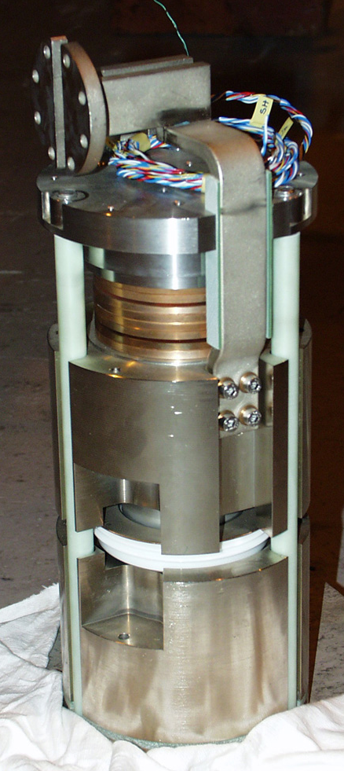
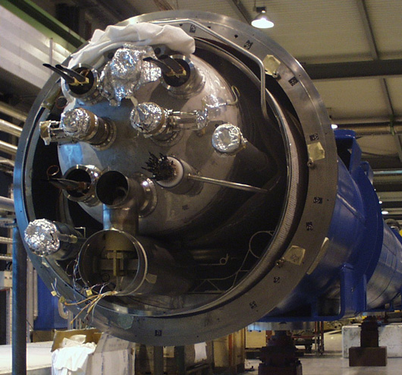
Thermal propagation through the bus
P_{B}
Half moons
Non-insulated
diode bus
M3 line
Upper heat sink
Diode box
Lower heat sink

Slide 9
Schematic view of “Dipole – Bus – Diode” model
P_{B}
4 configurations: MBA+upper HS, MBA+lower HS, MBB+upper HS, MBB+lower HS
∼195 mm
335 mm (type A)
232 mm (type B)
Dipole
(type A or B)
(Defective) joint
455 mm (type A)
150 mm (type B)
‘Half moon’
Non insulated
Standard bus insulation
Double insulation
Heavy insulation
Adiabatic
62 mm
Diode heat sink
(Upper or Lower)
205 mm (upper heat sink)
395 mm (lower heat sink)
Dimensional data from P. Fessia and H. Prin

Slide 10
Typical powers (6 kA, 30 K, “40 μΩ defect”)
P_{B}
T_{M}=f(I,t)
I_{M}=I₀e^{(-t/τ2)}
35 W
8-12 W
I_{C}=I₀e^{(-t/τ1)}
Dipole
Q=1.8 MJ
(Defective) joint
5-20 W
T_{HS}=f(I,t)
100 W
Non insulated
Standard bus insulation
Double insulation
Heavily insulated
Adiabatic
Diode, 6 kW
7-15 W
I_{D}=I_{C}-I_{M}

Slide 11
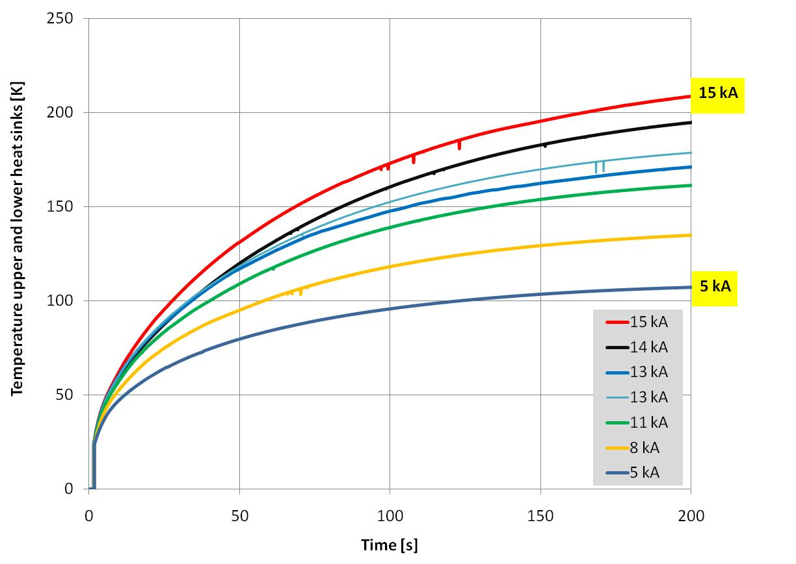
Heating up of the diode heat sinks
P_{B}
Data from R. Denz (1997)
Diode the same as used for the LHC, but helium environment is different
Decay time constant has a small effect on T_{HS} during the first 50 s

Slide 12
Half moon resistance
P_{B}
SM18 data
2.5 μΩ
Data from industry (at warm) give R_{aver}=0.45 μΩ with ‘σ’=0.4 μΩ.

Slide 13
Results for “MBB-upper HS” geometry
P_{B}
2%
P_{G}=0.1%
0.05%
0.01%
0.002%

Slide 14
Results for the 4 different geometries
P_{B}
±4 μΩ
±2 μΩ

Slide 15
Sensitivity to the main parameters (for 4 TeV)
P_{B}
±4 μΩ

Slide 16
“Magnet-Bus-Diode” test in SM18
P_{B}
Purpose: To measure under realistic conditions the thermal propagation from magnet coil and diode towards the joint.
Dedicated temperature probes and voltage taps will be mounted to measure the thermo-electric behavior of the system.
Test will be done on magnet 3128 (type B).
Tests consist of quenching (by heater firing) at various current levels (5-12 kA), resulting in a current bypass through the diode. At the same moment of the heater firing, the current will be ramped down with a few different time constants (50-100 s).
Test foreseen for April 2011.
People involved: M. Bajko, N. Bourcey,
G. Dib, P. Fessia, L. Grand-Clement, H. Prin, Th. Renaglia, A. Verweij, G. Willering, ……

Slide 17
Burn-out current vs R_{addit}
P_{J}
P_{G}=0.12%
0.05%
0.012%
0.003%

Slide 18
Probability for burn-out: Sum-up
P_{G},P_{B},P_{J}
Beam energy | τ | Ι²∗τ [10⁶As] | P_{G} * | P_{B} * | P_{G}+P_{B} * | P_{J} **
3.5 TeV | 50 s | 1800 | 3 x 0.0002 | 0.002 | 0.0026 | 0.003
4 TeV | 50 s | 2300 | 3 x 0.001 | 0.01 | 0.013 | 0.012
4 TeV | 68 s | 3150 | 3 x 0.01 | 0.05 | 0.08 | 0.05
4.5 TeV | 68 s | 3900 | 3 x 0.03 | 0.1 | 0.19 | 0.12
* P_{G} and P_{B} given in % per MB quench.
** P_{J} given in % per prompt joint quench.
P_{year} = N_{M} * (P_{G}+P_{B}) + N_{J} * P_{J} ≈ N_{M}*(P_{G}+P_{B})
(N_{J} << N_{M})
Probability per year
for joint burn out
Number of dipole
quenches per year
Number of prompt joint
quenches per year

Slide 19
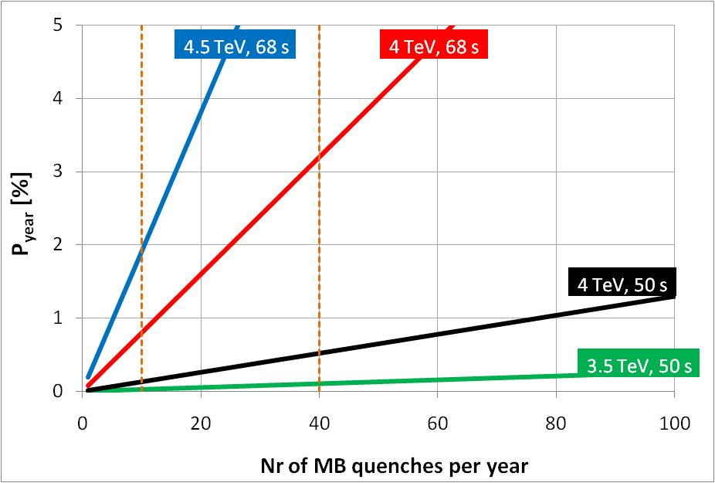
P_{year}
1 quench/month
1 quench/week

Slide 20
Final remarks
The probability figures hold under the assumptions that:
  R_{addit} measurements are representative for the entire machine,
  the joints did not deteriorate over the last 2 years.
A ‘thermal amplifier test’ in all sectors could qualify the safe operating current in situ (see talk Mike K.) .
Up to now, only the RB circuit is analysed. The RQD/F circuits are safer, due to the small decay time constant (9-15 s), the slightly smaller current, and the longer distances between joint/magnet/diode.
Sensitivity studies and results of the 4 different geometries show that especially the GHe propagation and the thermal propagation from the diode & half moons to the joint have a large impact.
The scheduled “Dipole – Bus – Diode” test in SM18 can improve our understanding of these thermal propagations. If slower than foreseen, then low-risk operation at 4.5 TeV could be envisaged.

Slide 21
Annex

Slide 22
Probability for burn-out in case of a magnet quench
P_{G}

Slide 23
P_{B}
Probability for burn-out in case of a magnet quench

Slide 24
P_{J}
Prob. for burn-out in case of a prompt joint quench

