Slide 1
Radiation To Electronics:
Reality or Fata Morgana .
(Mirage)
… thanks Ralph …
M. Brugger for the R2E Project
www.cern.ch/r2e
!!! Many Thanks To Everybody !!!

Slide 2
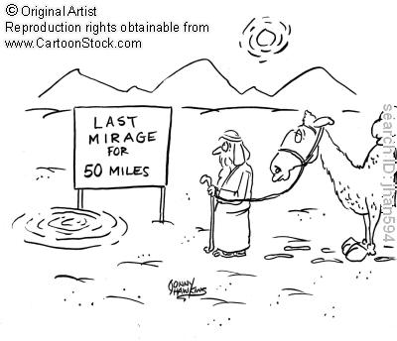
Next
Shutdown
2012/13/
14/15/…

Slide 3
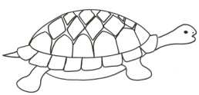
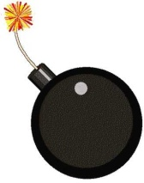
Radiation Issues - Effects
Thanks to Y. Thurel
  Total Ionizing Dose (TID) + Displacement Damage (DD)
  ☺ Cumulative effect (Effect will be seen after given time, giving some freedom to react)
  ☺ Low stress level (50 Gy max in 2030 when “standard component” can survive 20-30 Gy)
  Single Event Effects [SEE]
  ☹ Stochastic Effect (“Events scale with number of affected components”)
  ☹ Very High stress level (Failures observed <1x10⁶cm⁻²)
Component Stress Conditions
100%
Easy
Medium
Hard
now
0
10
100
1%
50
2010
2030
LHC Tunnel:
2009
time
2030
some
Condition severity vs time
Critical Areas:
( after shielding )
2009
2030
Component Stress Conditions
100%
Easy
Medium
Hard
now
0
1E6
1E8
0.1%
1E9
2010
2030
Critical Areas (as today):
Condition severity vs time
2009
2012-15 up to 2030
LHC Tunnel (well tested and “safe”):
2030
2009

Slide 4
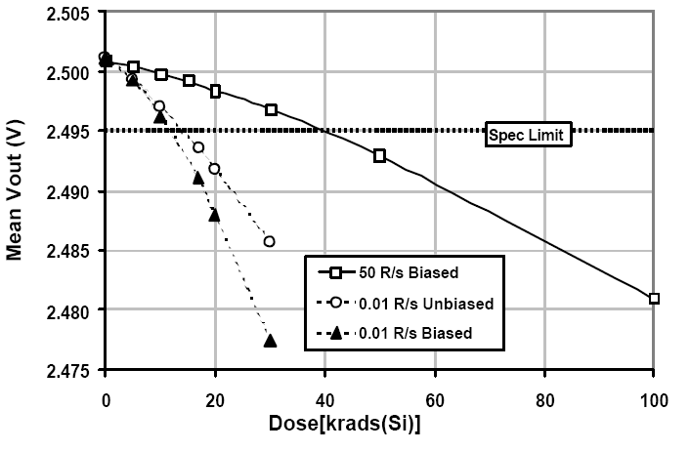
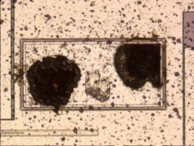
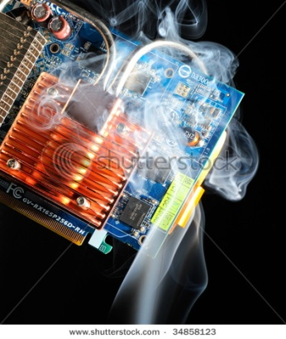
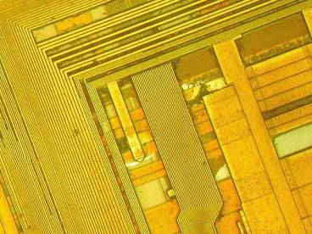
Radiation Issues – Failure Observation
  TID + Displacement Damage
  ☺ Devices get slowly out of tolerance
  (final failure can often be anticipated; access not immediately required)
  ☺ No ‘early’ failures (due to radiation)
  Single Event Effects
  ☹ Failures will appear and rapidly increase in frequency
  (destructive failures possible; access often required)
  ☹ ‘Early Operation ’ problem (observation might falsify reality)
Thanks to Y. Thurel
Possible Scenario:
Failures
Anomaly
Observed
Expert/CCC
Informed
2000
2030
Correction/
Steering
Access at later Stage
Failure Rates
Possible Scenario:
Failures
Sudden Problem
Expert/CCC
Informed
Unclear Situation
Access Required
2010
2030
Failure Rates

Slide 5
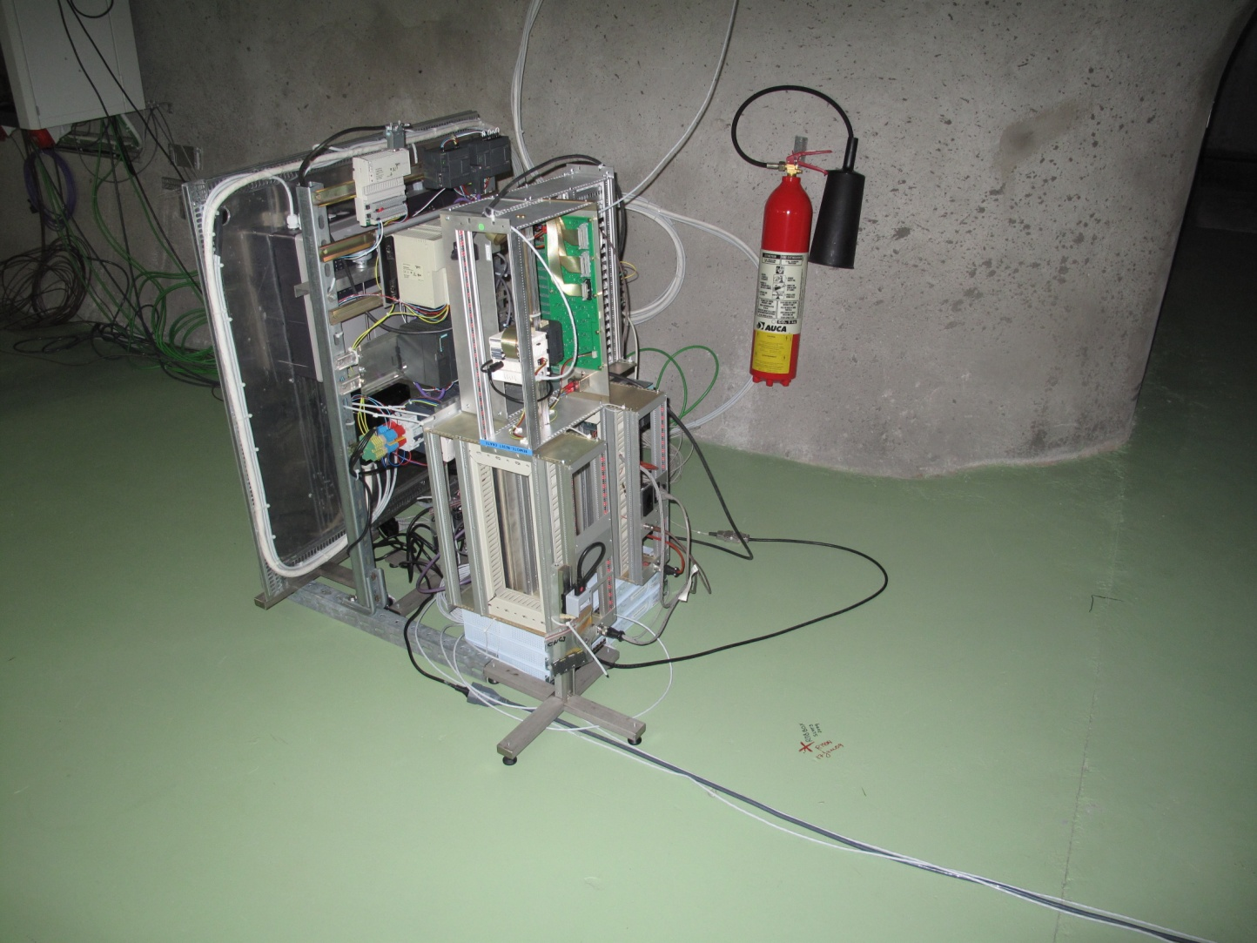
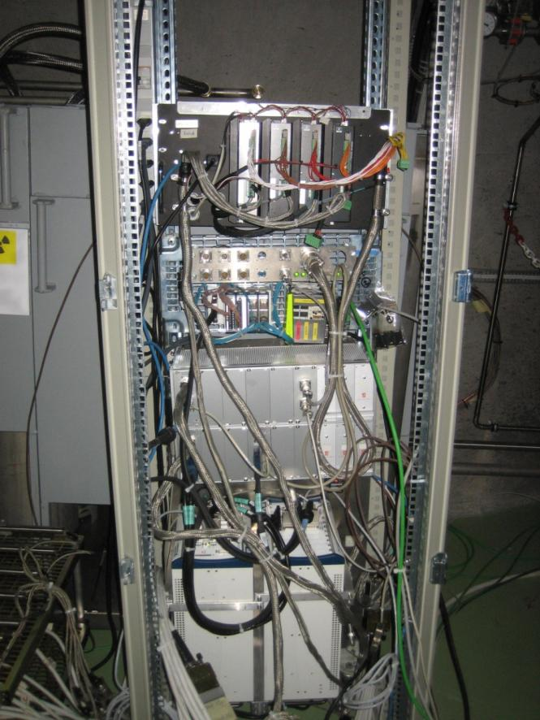
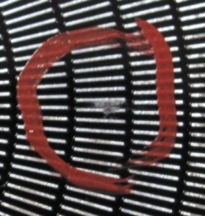
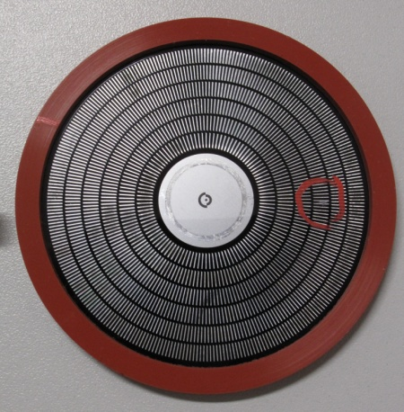
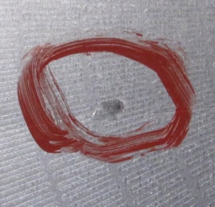
Confidence: CNRAD Update
Tested Equipment:
PLC-S7-200 (CV)
[profibus lost, reset needed]: 1.8x10⁻⁷ cm²
24V DC Power Supply (CV) [burned]: 1.1x10⁻⁸ cm²
PLC-S7-300 (CV)
[blocked, reset needed]: 7.8x10⁻⁸ cm²
PLC-Schneider (CV) [PS burned]: 1.1x10⁻⁷ cm²
WIC Rack [beam dump and access]:
PLC S7-300 + FM352-5 Siemens 1.1x10⁻⁷ cm²
Fire Detectors ASD [power cycle]: 1.0x10⁻⁹ cm²
Ethernet Switch
[blocked, reset needed]: 1.4x10⁻⁸ cm²
…
Failure xSection:
~200 failures in a nominal year in UJ14/16
“Reset Req.”: 1 every 10⁶-10⁹cm⁻²
“Damaged”: 1 every 10⁷-10¹⁰cm⁻²
Uncertainty: up to one order of magnitude (but both directions!)
© D. Kramer

Slide 6
Confidence: FLUKA Calculations
Location | Monitors | Source | Agreement | Comments
CERF, CNGS, … | RadMon, RAMSES, TLDs | Beam on target | Within 10-20% | Benchmark setup
TI2/8 | RadMon | Controlled loss on TED and TCDI | Within 30% | Source term well controlled
UX/US85 | RadMon, RAMSES | LHCb collissions | Within 30-50% | Detector update required
IR7/UJ76/RR77 | RadMon | Losses on Collimators | Mostly within a factor of two | Very sensitive on loss distribution
IR1/5 | RadMon | Collisions | Within a factor of 2-3 | Only QUALITATIVE check
Uncertainty: Dominated by the source term and the considered details!

Slide 7
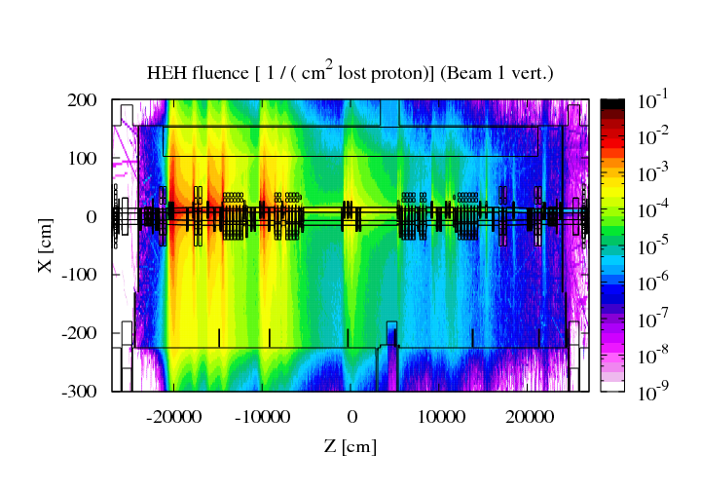
IR7 FLUKA Application Benchmark
Loss-Term (SixTrack [R. Assmann et al.])
© K. Roeed
TCP
TCAP
MBW
TCS
MQW
TCLA
Assumptions
FLUKA Calculations
Normalisation
>500m
Summary (Protons)
In | 6.02E+15
Dumped | 5.82E+15 | 96.70%
Lost in Machine | 1.99E+14 | 3.30%
Of Lost protons
Collisions | 2.33E+13 | 11.73%
Elsewhere | 1.76E+14 | 88.27%
RR73
UJ76
RR77
LM01
LM02
LM03
RM03
RM04
RM05
RM06
RadMon | Dcum | Rth | SEU (3V) Measured | Beam contribution | SEU (FLUKA) Expected | Error [%] Stat. only | Exp./Mes.
6L7.7LM03S | 19846 | 5 | 14401 | B1 | 15015 | 3 | 1.04
5L7.7LM02S | 19904 | 3 | 5253 | B1 | 9765 | 3 | 1.86
4L7.7LM01S | 19991 | 5 | 2689 | B1+B2 | 3116 | 6 | 1.16
4R7.7RM03S | 20045 | 3 | 950 | B1+B2 | 401 | 6 | 0.42
5R7.7RM04S | 20133 | 5 | 18727 | B2 | 13032 | 4 | 0.70
6R7.7RM05S | 20208 | 31 | 303 | B2 | 962 | 8 | 3.17
RR77.7RM06S | 20241 | 1 | 13 | B1+B2 | 17 | 22 | 1.33
BLM ratio IR7 / IR3
 | Ratio | % Loss in IR7
TCSG.A6L7.B1 / TCSG.5L3.B1 | 3.1 | 76
TCSG.A6R7.B2 / TCSG.5R3.B2 | 5.6 | 85

Slide 8
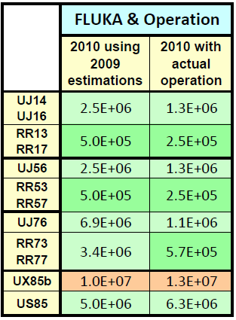
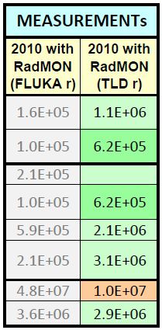
Radiation Levels 2010
Source terms, operational conditions as well as monitor readings have to be carefully evaluated
Tracking/BeamGas/etc.
FLUKA Predictions
Operation Assumptions
Rad-Level Estimate
Monitor Readings
Calibration
Assumptions
Final Values
Threshold of monitors is ~10⁶!
(lower values only by ‘trick’ [big uncertainties!])
VERY GOOD AGREEMENT (given the underlying uncertainties)
!!! Amazing !!!

Slide 9
Possible SEE Failures Observed in 2010
WIC crate failure in TI8
  Observed in 2009
  Known problem with moderate x-section
CONFIRMED or very LIKELY
  CRYO tunnel card SEE in 8L2
  1 Fault in uFip
  (as observed in CNRAD 2010)
  SEE confirmed
QPS Tunnel Card Failures
(2x in 9L7 [ions], 2x in 8R8 [inj.], + others)
  ISO150 -> permanent PM trigger
  SEE confirmed (EMC has same effect)
TE/EPC power supply burnout in UA87
  Same effect observed in CNRAD
  SEE is very likely the cause
  (Streaming through Maze)
QPS tunnel Card Failures
in 9R7 & 9L7
uFip communication lost (2x)
SEE confirmed (seen in CNRAD)
NOT CONFIRMED (unlikely)
  VAC power supply burn out
  In UA23 between maze and duct
  (TDI losses + TCDI losses )
  SEE rather unlikely
PXI power supply burnout in UJ16
  To be confirmed by producer (comparison with CNRAD burnouts)
  SEE unlikely (early 2010 operation)

Slide 10
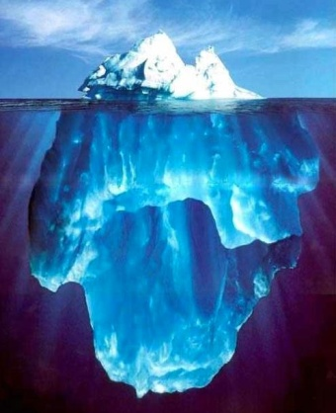

Radiation Issues – 2010 Summary
Single Event 2010 Review
  Levels in the machine
      Only 10⁵-10⁸ cm⁻² “measured” around
      (UJ, RR, Tunnel) equipments
      Only ~0.1% of nominal integrated luminosity, up to 2% of peak luminosity, ~1% of nominal lost beam,
      “no” scrubbing (yet)
  What is good?
      Simulations correctly verified in many places (controlled tests & standard operation)
      Not too many failures occurred

Slide 11
Radiation Issues – 2010 Summary
Single Event 2010 Review
  What is worrying?
      Critical areas: previsions beginning of 2010
      expected quite some events in critical areas
      (several candidate/s, within error margins)
      Tunnel: 5-10 SEE events already seen in 2010 causing Machine Stop (mostly mitigated)
      ”we are already wrong” … in the bad direction
  What can make things worse
      equipments can be more sensitive (most is untested)?
      we didn’t see “critical” levels (mostly < 1x10⁶)
      losses can also be higher than expected
      (e.g., electron cloud, injection losses, life-time for ions)

Slide 12
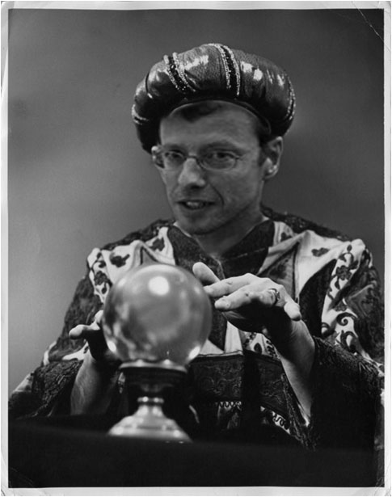
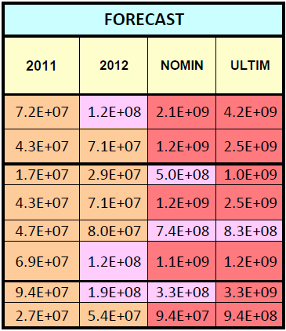
2010/2011/2012 Radiation Levels
© D. Kramer
2011/2012/Nominal/+++ ???
!!! Amazing !!!
Close to ‘Threshold’
Critical
Dramatic

Slide 13
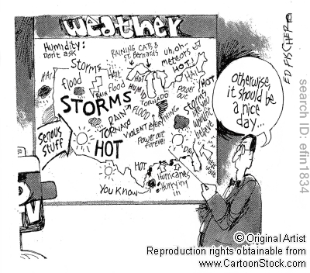
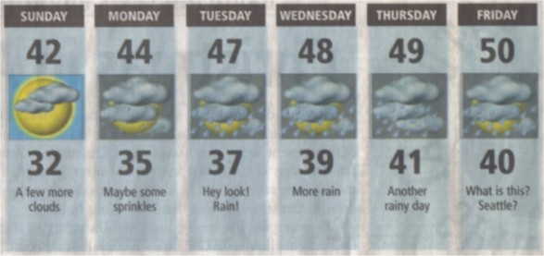
Failure Rates 2010/2011/2012++
For 2010 we expected already some failures (estimate of July)
Adding real operation, measured radiation levels and xSections
Refined estimate possible based on:
HIGH BUT OK
Radiation Levels
Rough Failure xSec
First Rate Estimate
Updated
Rad. + xSecs
Rescaled
xSections
Operation Assumption
Expected Rad-Levels
Failures
Rates
0.05fb⁻¹
Xsect. rescaled
2010 (from Meas.)
SUM | MTBF [days]
20 | 18
7 | 53
11 | 33
7 | 56
2010
SUM | MTBF [days]
2 | 150
1 | 570
2 | 220
1 | 480
2011
SUM | MTBF [days]
98 | 4
19 | 19
35 | 10
30 | 12
2012
SUM | MTBF [days]
166 | 2
33 | 11
60 | 6
52 | 7
nominal
SUM | MTBF [days]
2500 | 0.14
440 | 0.8
740 | 0.5
740 | 0.5
immediate dump and access
immediate dump
Scheduled access
Other
R2E Mandate-> radiation induced MTBF <= 1 per week for Ultimate Intensities, losses and luminosities (a long way to go, even with uncertainties)

Slide 14
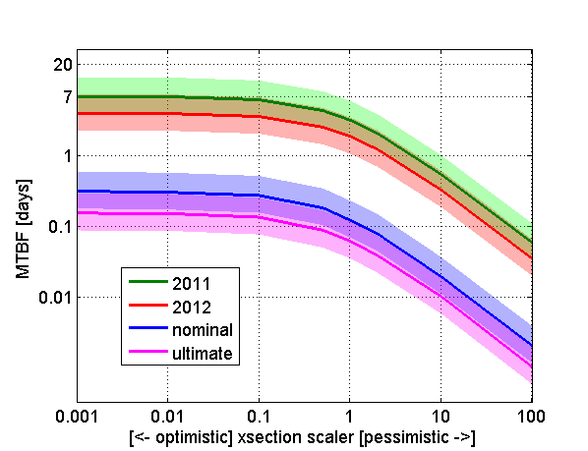
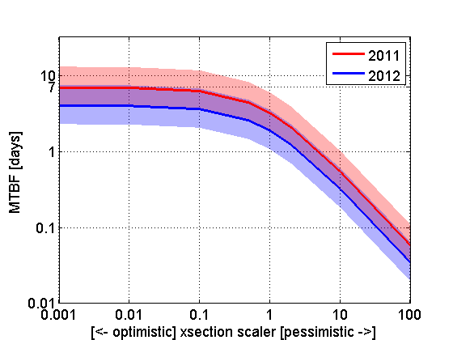
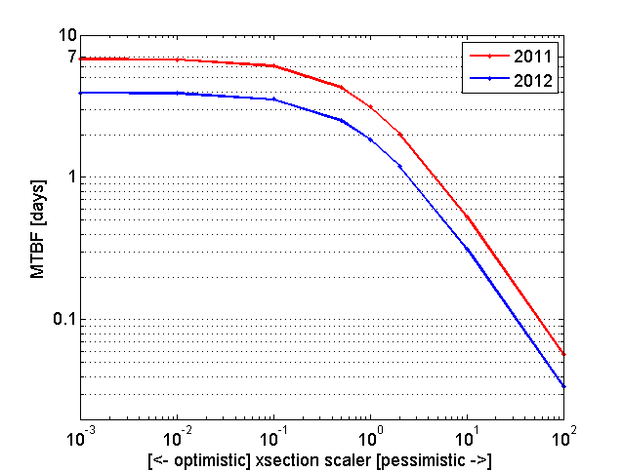
Failure Rates 2010/2011/2012++
Sensitivity analysis based on failure xSections
Uncertainties: LHC operation & machine behavior, radiation levels, equipment sensitivities
© D. Kramer
We’re missing a Factor 100
Monitor Calibration
Unknown
Equipment Sensitivity

Slide 15
2011 LHC Energy/2012 Operation
Energy greater than 3.5TeV:
Only minor impact on radiation levels, thus not an issue from the R2E point-of-view
Impact of 2012 operation
Will lead to a delay of R2E mitigation measures (shielding/relocation)
Impact on operation not to be excluded
Risk of destructive failures
Failure rate expected to be (just) acceptable

Slide 16
What We Will Do…
Preparation of shielding & relocation measures
2011 experience together with detailed monitoring & scheduled radiation tests (full power-converters) will allow us a further optimization step
Monitoring and preparation of patch solutions
Our Strategy:
Anticipate problems whenever possible
Aim to be ready for 2012 shutdown in any case
Optimize the long-term solution

Slide 17
To be kept in mind…
Tests with (LHC) beam
Field-calibration (for detectors) measurements:
  quench-test location would be ideal for additional loss/radiation-field studies
  TCDI near UJ87 would be an additional good spot
Scrubbing & Beam-Gas
(So far) very low radiation levels in most of the ARC/DS locations (only specific loss locations [including some surprises] are concerned already ~1Gy in some cases!)
Minor effect on shielded areas
Tunnel equipment will be exposed
Ion-Operation
One month of ions is in some locations worse than one year of nominal!
© V. Baglin

Slide 18
R2E Global Strategy & Dates
  Panic
  Study Phase (2008-2010)
  Calculations, Early Actions, Strategy
  Evaluation
  Project Proposal (2010)
  Testing, Evaluation, Mitigation Plan
  Resources
  Struggling
  R2E Mitigation Project (2011-2016)
  Medium Term
  R&D For Long-Term
  Evaluation
  Long-Term
  Shielding &
  Relocation
  P1, P5, P7, P8
  (+ small items)
  Collimation
  Betatron in IR3
  Power-Converters
  Rad-Tol Solution
  SCLs
  Horizontal/
  Vertical Links
  Monitoring
  Analysis, Calibration
  Testing
  Component & System Tests
  Combination
  Relocation
  Rad-Tol Equipment
  SCLs
  (Civil Engineering)
Key Dates (Status 01.2011):
02.11. (Cables)
03.11. (SafeRoom1)
06.11. (SafeRoom2)
07.11. (Orders for SD)
11.11. (1st Test Results) 12.11. (1st CD Review)
2012 (FGCs Production)
2013 (Prototype)
2014 (Production)
2010 Operation
06.11. (UX/UL@P1)
10.11. (Refine)
08.11. (CE pre-study)
06.12. (CE Study)
2013 (Hori-SCLs)
2014 (PCs and/or SCLs)

Slide 19

Chamonix Valley
Next
Shutdown
2012/13/
14/15/…
THANK YOU
R2E Seminar (+Drink)
Tent. Date: February 18th

Slide 20
Backup

Slide 21
R2E Mitigation Project Plan
LHC
Shutdown
Mitigation Actions
Purpose(s)
R&D
I <=10%
L <=1%
E = 1/2
Hor.
SCLs
  Fire/ODH Control Racks + EN/EL RTUs
  Preparations for long shutdown
R2E Safety & Patch
  (Anticipate)
Development
Development
2010
Development
2010
  Relocation US85 + Shielding
  Shielding: UJ14/16/56 (23/87)
  Relocation UJ76 (remaining)
  Fire Detectors (UJ14/16/56/76,RR13/17/53/57)
  Shielding: RR13/17/53/57 (mid/long-term)?
  Relocation P1 (UJ14/16)
  Relocation P5 (UJ56)
  Betatron Collimation @ Point-3 (???)
X
I <=30%
L <=15%
E ~= 1/2
2012
or
2013
R2E
Time Gain
Rad-Tol
Power-
Converters
2011
R2E
Long-Term
I <=50%
L <=25%
E ~= 1/2
X
LHC Performance
Vert.
SCLs I
2012
X
Design Reviews
I <=100%
L <=100%
E = 1
Procurement
  Horizontal SCLs for RRs @P7
  Vert. (or Hor.) SCLs for RRs at P1/5 ???
  Radiation Tolerant Power-Converter
  Civil Engineering – New Caverns
  Additional shielding upgrades where required
  Tunnel equipment upgrades (if needed)
Vert.
SCLs II
(high-curr.)
OR
2016
or
???
OR
R2E
Long-Term
2014 ->
OR
LHC
Long-Term
X
I >=100%
L >=100%
E = 1
  Vertical SCLs
  (LHC Upgrade UJs @P1/5, R2E only @P1)
  Additional shielding
  (e.g., RA/UA ducts, TI2/8, UJ/UA Junctions)
  Further radiation tolerant equipment
???
LHC Upgrade
???
R2E
Long-Term

Slide 22
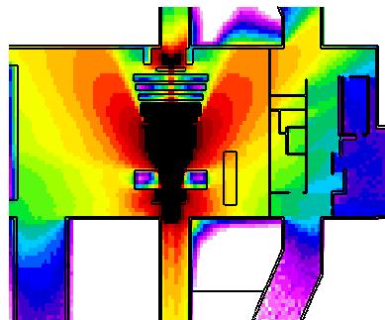
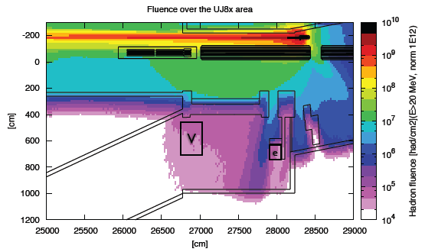
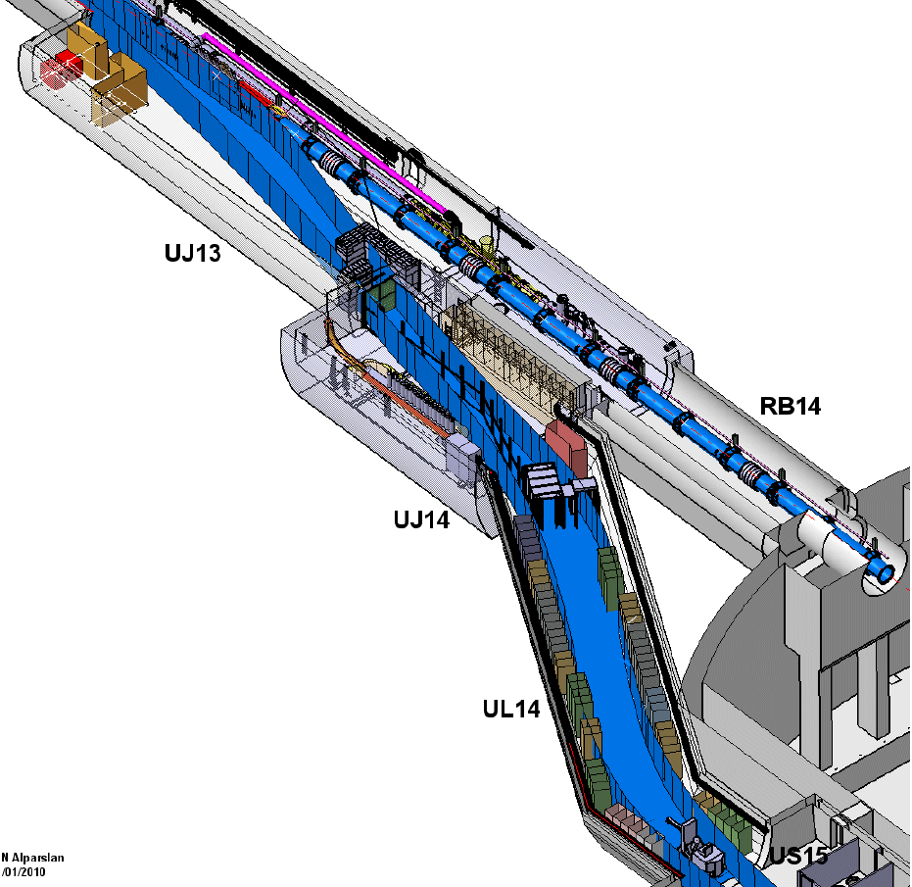
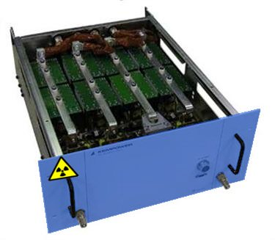
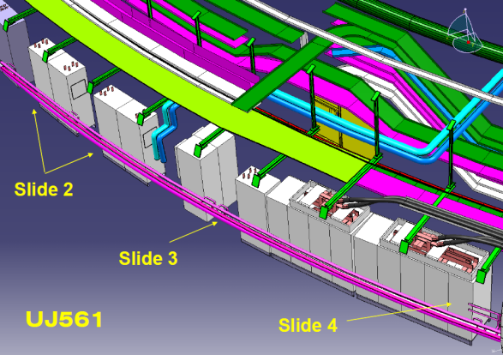
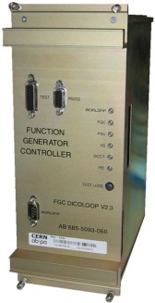
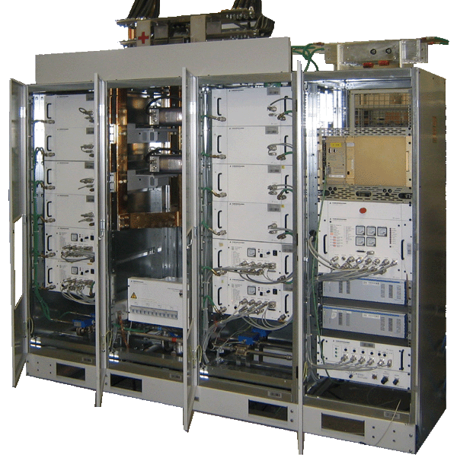
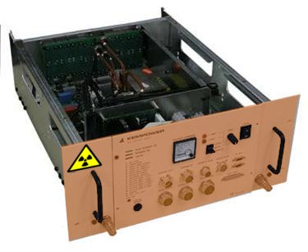
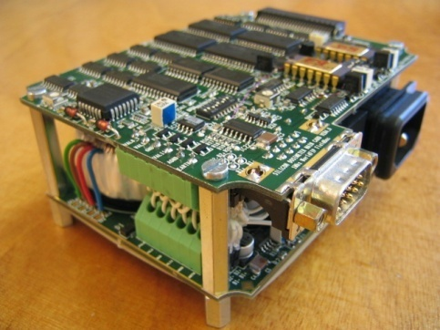
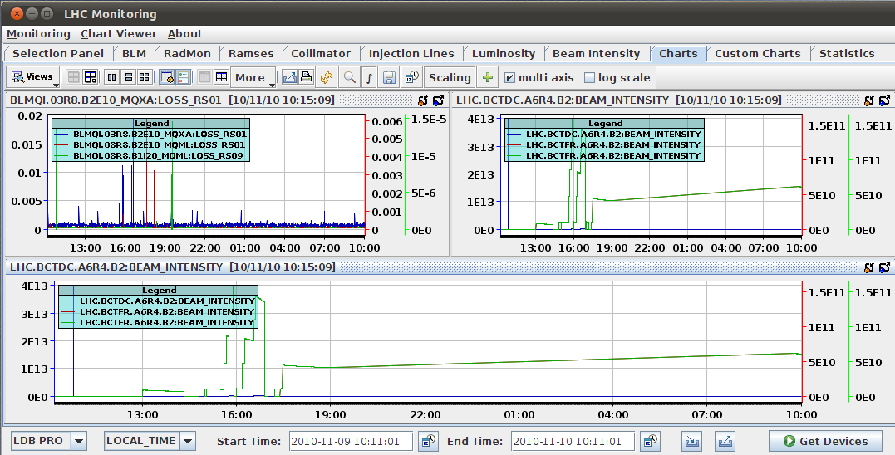
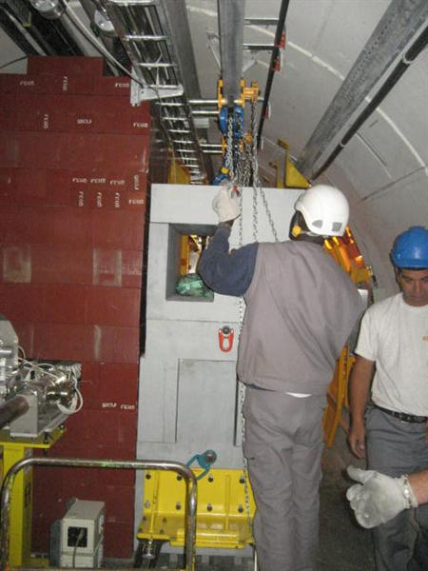
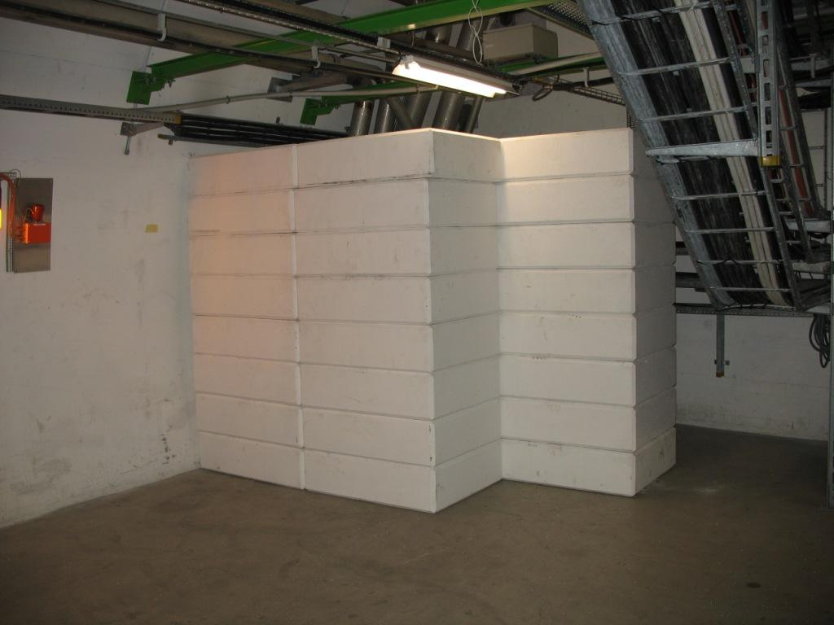
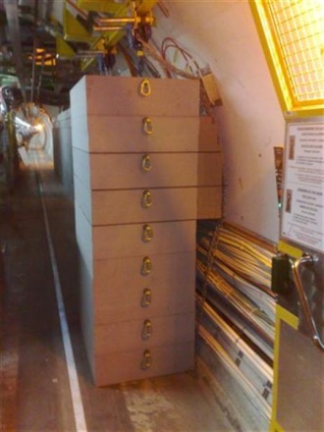
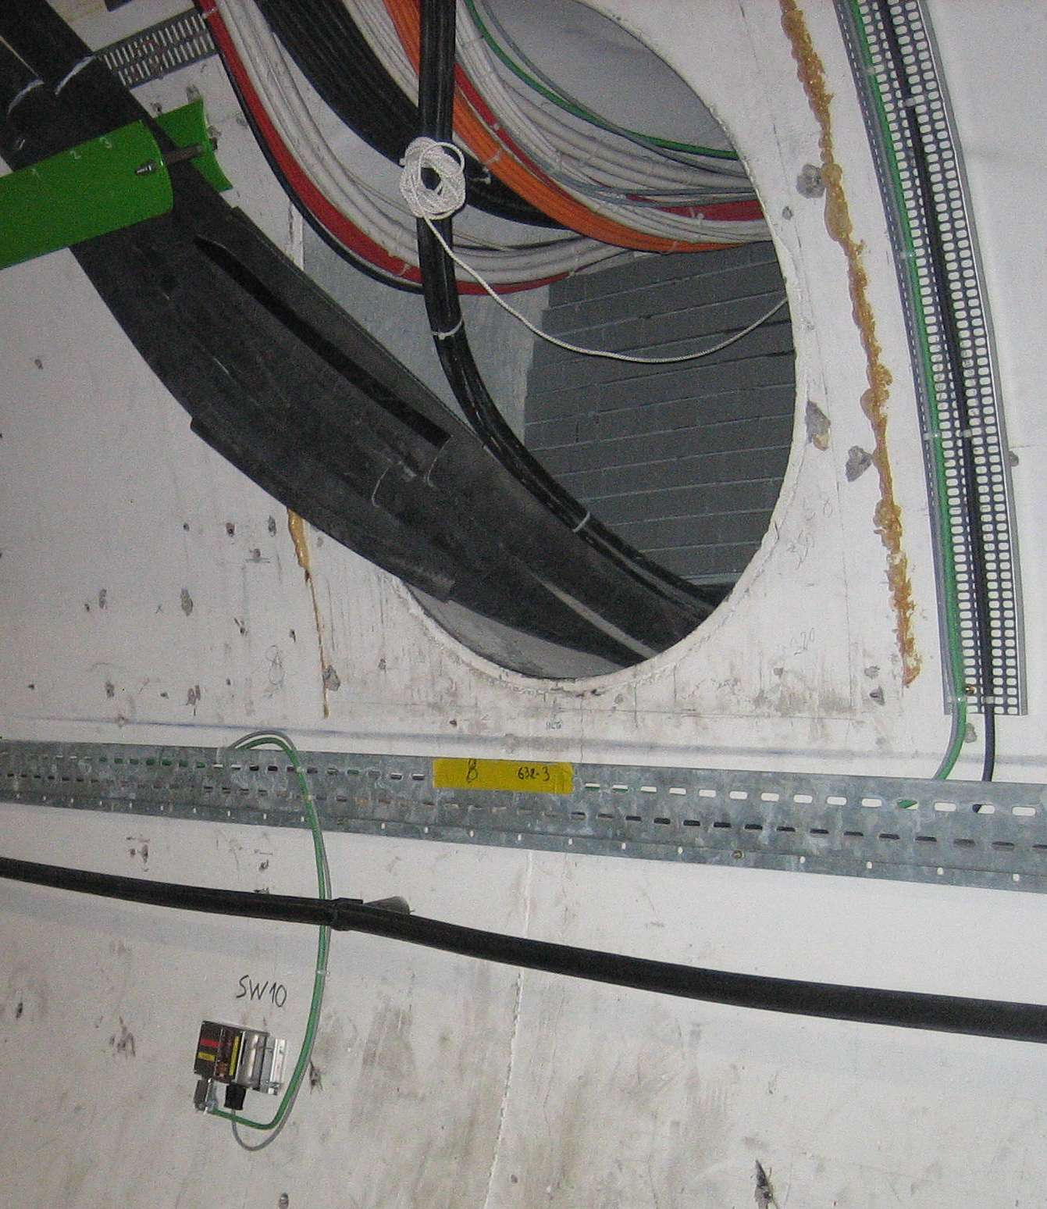
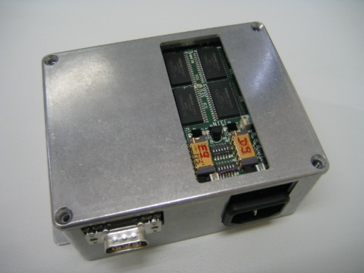
R2E Mitigation Project Building Blocks
Radiation Tests
Calculations
Integration
Developments
Monitoring
Implementation
People, Planning & Money

Slide 23
Building Blocks for the R2E Project
Integration &
Implementation
Radiation Testing
Civil Engineering
Monitoring
LHC Planning:
Shielding
Relocation
Coordination
Radiation-WG:
Failure Analysis Radiation Tests
Patch Solutions & New Developments
Radiation Policy
Pre-Studies
Impact on Long-Term
Monitoring & Calculations WG:
MC Calculations
Monitoring & Benchmarking
Radiation Levels in Critical Areas
J. Osborne
A.L. Perrot
G. Spiezia
GS/SE
Project Support
EN
TE
EN/MEF
GS
DGS
BE/OP
EN/EL
BE
PH
DG
FP
GS/ASE
EN/STI
IT/CS
EN/CV
Organization
Planning
Safety
BE/BI
BE/CO
TE/MPE
TE/VSC
M. Calviani
DG/PRJ
BE/OP
R2E Mitigation Project
DGS/RP
S. Weisz K. Foraz
S. Roesler C. Jach
Power Converters
M. Brugger
TE/EPC
TE/CRG
TE/MSC
DGS/SEE
BE/CO
FP/PI
Test Facilities
Radiation Tolerant Power-Converter WG:
R&D & Concept
Development
Testing
(Procurement)
Super Conducting
Links
PH/DT
BE/ABP
New-Irradiation Facilities WG:
PS East-Area Facility
SCLs -WG:
R&D & Tests
Hor. SCLs
Vert. SCLs
(Procurement)
Collimation
Collimation-WG:
Betatron @ Point-3
Y. Thurel
M. Moll
A. Ballarino
R. Assmann

Slide 24
R2E Approach
Constraints & Mandate:
  Minimize (Avoid) any risk of radiation induced failure to electronics
  Foresee a mitigation plan fitting in the planned shutdown periods
  Optimize with respect to planning and costs
Strategy:
  Monitor and benchmark to refine actions and planning
  Prepare “Patch-Solutions” where available
  (not many left!)
  Shield and Envisage/Prepare/Perform Relocations
  Study/Pursue Major Long-Term Solutions
  (R&D for SCLs and Rad-Tol PCs, CE as backup)
  … cross fingers, review, optimize, cross fingers…

Slide 25
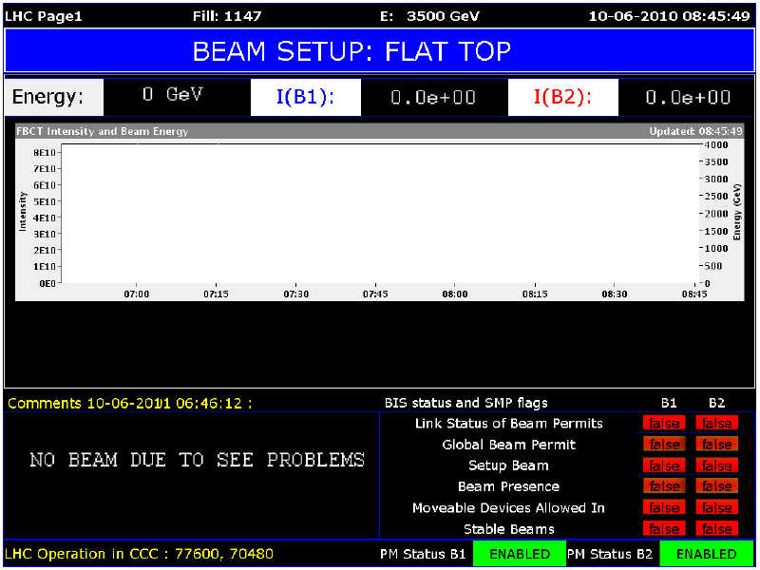
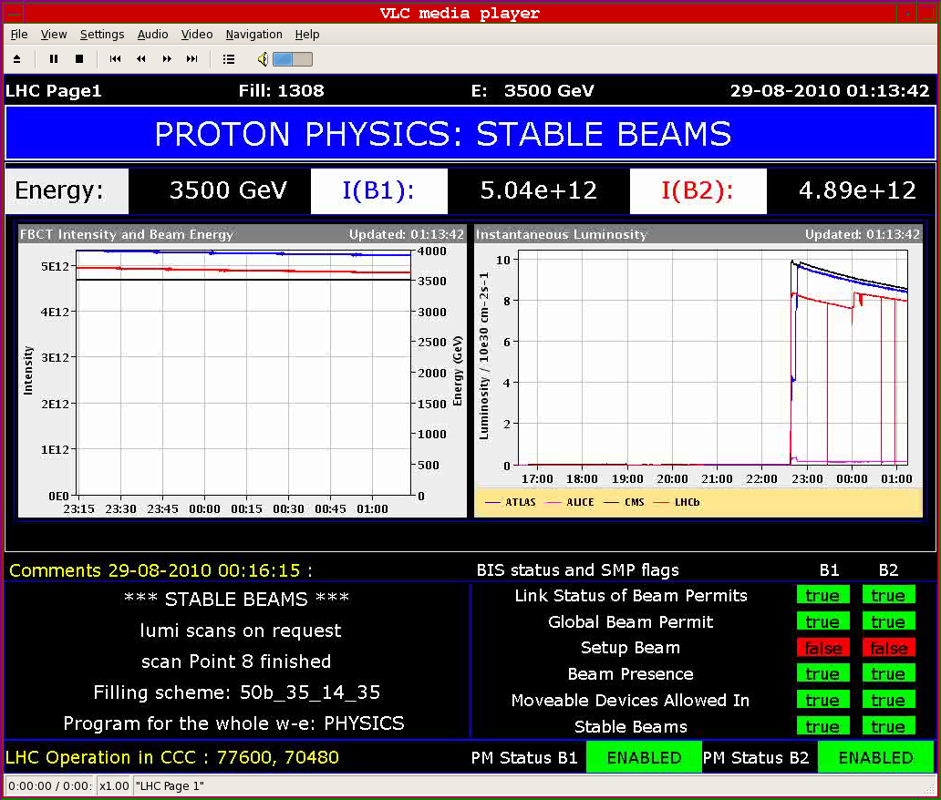
What’s to Be Avoided
ACCESS: LHC REPAIR

Slide 26
R2E Work 2010/11 xMasBreak
LHC Point-7:
UJ76 shielding wall; done
UJ56-TZ76: relocation of the ODH and fire detection control central; done
UJ56-TZ76: RTUs relocation; (done) 24th January;
LHC Point-5:
UJ56-USC55: relocation of the fire detection control central; done (reception on the 25th January)
UJ56- USC55: RTUs relocation; (to be done) 31rd January;
LHC Point-8:
EN/EL: advance on the cables installation work foreseen during the next long shut down;
LHC Point-1: (optional and kept in pipeline)
UJ/UL: relocation of the fire detectors

Slide 27
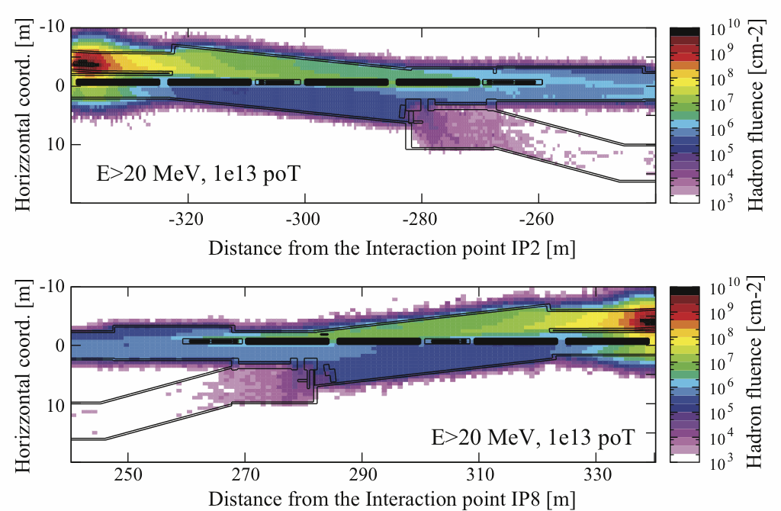
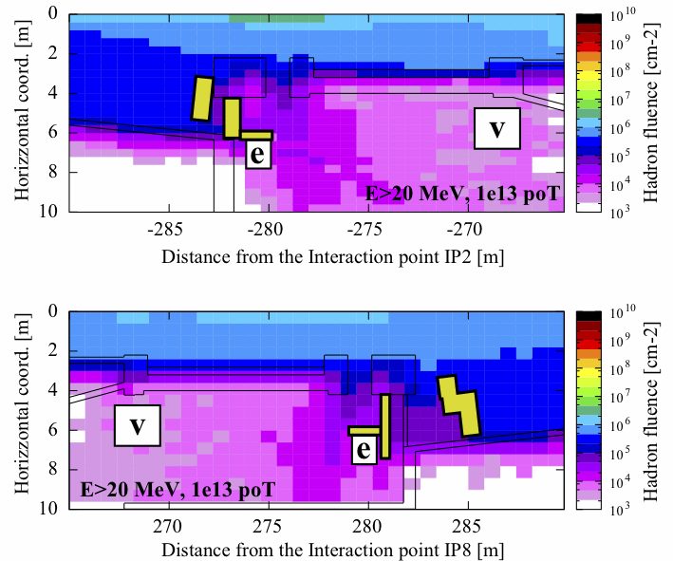
What Would Happen If…
Injection lines - High Energy Hadron fluence - Beam on the TEDs:
TI2 – UJ22/23
R2E shielding
shielding factor >10
TI8 - UJ87/88
shielding factor >10
Installed shielding improves situation by ~<= a factor of 10!
Reminder: installed shielding for UJ23, UJ87, UJ76, RR73/77, UA63/67

Slide 28
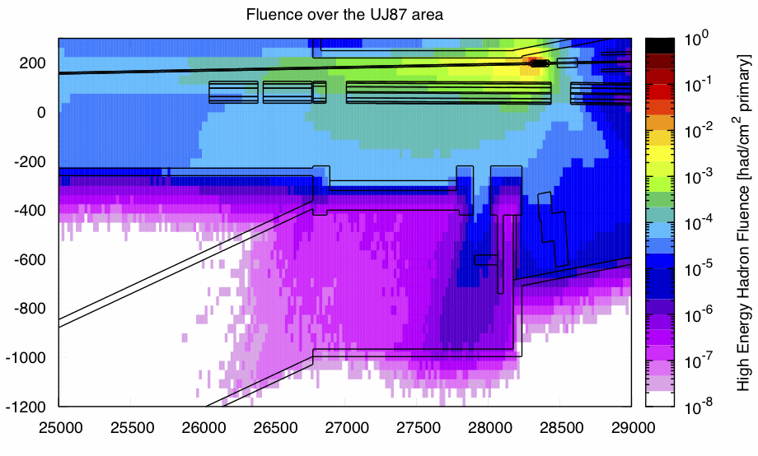
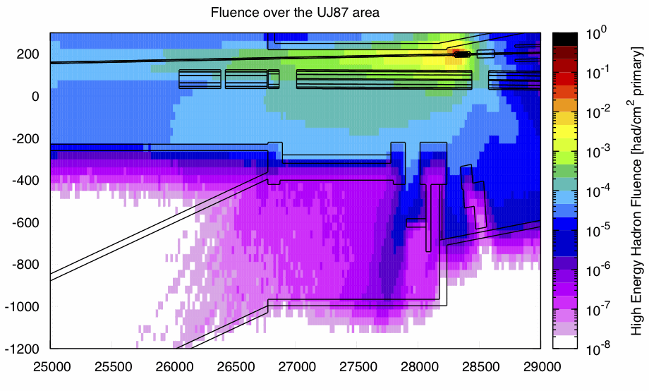
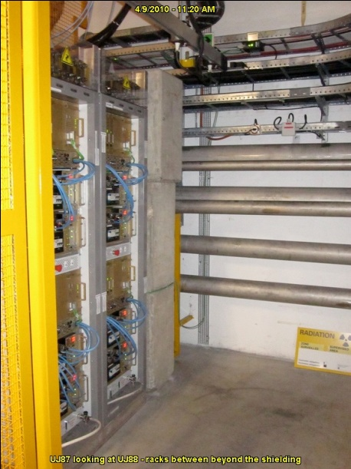
What Would Happen If…
Injection lines - High Energy Hadron fluence - Beam on the TCDI:
UJ87 – no shielding
UJ87 –R2E shielding
Installed shielding improves situation by ~<= a factor of 10!
Reminder: installed shielding for UJ23, UJ87, UJ76, RR73/77, UA63/67

Slide 29
Failure Rate Estimate

Slide 30
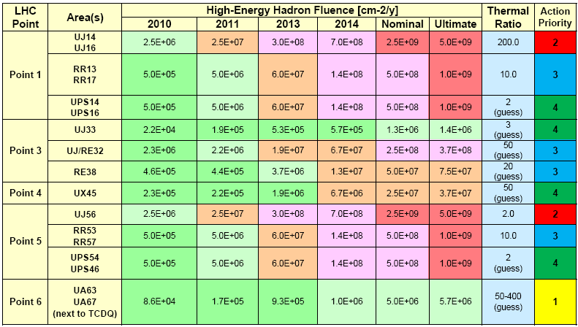
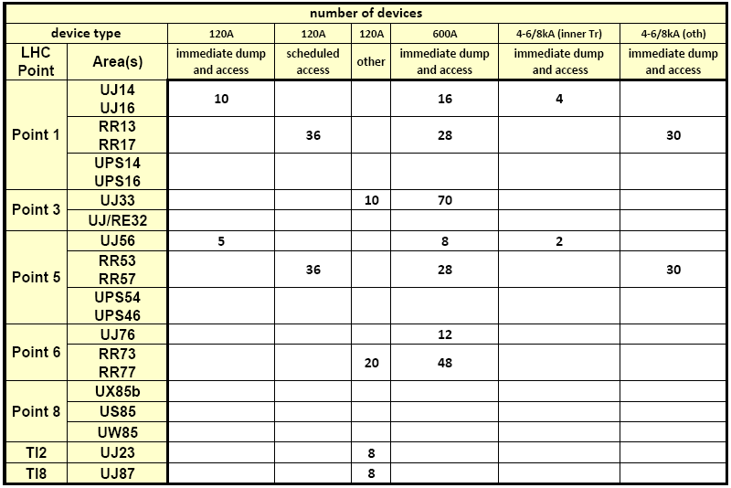
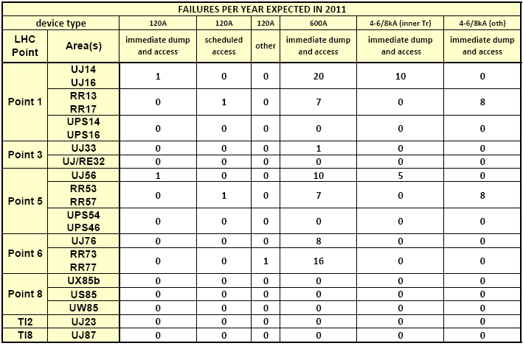
Failure Rate Approach
(1) Use the ‘Aging’ Radiation Level Table
(2) Check for each equipment in each area
(3) Apply the expected failure cross section
(4) Result: failures per equipment/area
 | LHC60A-08V | LHC120A-10V | LHC600A-10V | LHC4-6-8kA-08V | Inner-Triplet
Type | RPLA | RPLB | RPMB | RPH | RPxx
Cross Section | [1E-10..1E-11] /cm² | [5E-9..1E-11] /cm² | [5E-8..5E-9] /cm² | [5E-8..5E-9] /cm² | [2E-8..1E-9] /cm²
Hypothesis & Comments (DCCTs being excluded since redundant and low risk) | power part relatively safe, with some SEGR on some Power MosFets FGC cross section @ 1E-11 is correct | Not Rad Tested power part relatively safe, with some SEGR on some Power MosFets Converter more complex than 60A (more components) CPLD in Digital control board only 1x CPLD, then not adding too high extra failure FGC cross section @ 1E-11 is correct | Not Rad Tested power part relatively safe, with some SEGR on some Power MosFets 5x CPLD in Digital control board only 1x CPLD, not adding too high extra failure FGC cross section @ 1E-11 is correct 3x DC-DCs unknown AC-DC unknown but high AC voltage range 48x Power Mosfets used in 4QLS | Not Rad Tested power part relatively safe, with some SEGR on some Power MosFets 8x CPLD in Digital control board only 1x CPLD, adding extra failure FGC cross section @ 1E-11 is correct 1 DC-DC no AC-DC | Not Rad Tested power part relatively safe, with some SEGR on some Power MosFets 8x CPLD in Digital control board only 1x CPLD, adding extra failure FGC cross section @ 1E-11 is correct no AC-DC Sigma delta + 1 CPLD Additional Thyristor + 1 DCDC
Risk factor (DCCTs being excluded since redundant and low risk) | No High Risk. Well tested in CNGS. | No high Risk since CERN Design, and very few critical or unknown components. A security hole remains on current lead protection (CPLD based). | High Risk since some unknown integrated devices: 5x CPLD + 1x AC-DC + 3x DC-DC in power part. | High Risk since some unknown integrated devices + 8x CPLD + 1x DC-DC in power part | High Risk since some unknown integrated devices + 8x CPLD 1x DC-DC in power part + Inner-Triplet additional components with DC-DC or CPLD
Rad Status | Well tested. | Converter not Tested under radiation. Estimation provided assuming no unexpected very high sensitive device included in unknown / untested parts, which would completely change the situation.

Slide 31
2011 Estimation
Failure Mode | EXPECTED FAILURES PER YEAR - LHC ALCOVES
 | CV | Pconv Opt | Pconv Pess | CRYO | BPWIC | Fire/ODH | QPS | CL heaters | IT | VAC | SURVEY | Collim | EN/EL | TIMING | REM RESET | BI | RP
immediate dump and access | 1 | 29 | 544 | 13 | 35 |  | 14 |  | 4 |  |  | 0.2 | 0.6
immediate dump |  |  |  | 9 | 3 |  |  |  |  |  |  | 7 | 0.3 | 0.0
Scheduled access | 8 | 0.0 | 15 | 0.0 |  | 13 |  | 0.4 |  | 9 |  |  | 3 |  | 0.9
other | 3 | 0.0 | 9 | 8 |  |  |  |  |  |  | 0.0 | 12 | 1.3 |  |  | 0.1 | 5
Optimistic |  | Pessimistic |  | Guess/Tested
SUM | MTBF [days] | SUM | MTBF [days] | Ratio
98 | 4 | 614 | 1 | 2.7
19 | 19 | 19 | 19 | 0.02
35 | 10 | 50 | 7 | 0.6
30 | 12 | 39 | 9 | 0.4

Slide 32
2012 Estimation
Failure Mode | EXPECTED FAILURES PER YEAR - LHC ALCOVES
 | CV | Pconv Opt | Pconv Pess | CRYO | BPWIC | Fire/ODH | QPS | CL heaters | IT | VAC | SURVEY | Collim | EN/EL | TIMING | REM RESET | BI | RP
immediate dump and access | 2 | 48 | 912 | 22 | 60 |  | 24 |  | 8 |  |  | 0.4 | 1.1
immediate dump |  |  |  | 14 | 5 |  |  |  |  |  |  | 12 | 0.7 | 0.0
Scheduled access | 14 | 0.1 | 26 | 0.0 |  | 22 |  | 0.7 |  | 16 |  |  | 5 |  | 1.6
other | 7 | 0.0 | 16 | 14 |  |  |  |  |  |  | 0.0 | 21 | 2.4 |  |  | 0.2 | 8
Optimistic |  | Pessimistic |  | Guess/Tested
SUM | MTBF [days] | SUM | MTBF [days] | Ratio
166 | 2.2 | 1031 | 0.35 | 2.6
33 | 11 | 33 | 11 | 0.02
60 | 6 | 86 | 4 | 0.5
52 | 7 | 68 | 5 | 0.5

Slide 33
Relocation and Shielding Improvements
NOMINAL OPERATION | No Changes | Additional Shielding | + relocation
UJ14 UJ16 | 1666 | 17 | 8
RR13 RR17 | 376 | 75 | 75
UJ33 | 1 | 1 | 1
UJ/RE32 | 3 | 3 | 3
UJ56 | 265 | 265 | 0
RR53 RR57 | 376 | 75 | 75
UA63 UA67 | 4 | 4 | 4
UJ76 | 85 | 85 | 0
RR73 RR77 | 166 | 33 | 33
UX85b | 8 | 8 | 0
US85 | 25 | 25 | 0
UW85 | 2 | 2 | 2
UJ23 | 0 | 0 | 0
UJ87 | 0 | 0 | 0
SUM | 2977 | 594 | 201
MTBF [d] | 0.12 | 0.61 | 1.82
Most systems (QPS,MKS etc) excluded from UA63/7 list as duct shielding can be added if necessary
Only few equipments included in UW85 list
Power converters 120A in UJ23/87 classified as “other” SEE => no DUMP

Slide 34
Nominal Estimation (After Shielding & Relocation)
Failure Mode | EXPECTED FAILURES PER NOMINAL YEAR - LHC ALCOVES
 | CV | Pconv Opt | Pconv Pess | CRYO | BPWIC | Fire/ODH | QPS | CL heaters | IT | VAC | SURVEY | Collim | EN/EL | TIMING | REM RESET | BI | RP
immediate dump and access | 2 | 108 | 2001 | 3 | 0 |  | 60 |  | 3 |  |  | 0.1 | 0.0
immediate dump |  |  |  | 20 | 0 |  |  |  |  |  |  | 2 | 0.0 | 0.0
Scheduled access | 39 | 0.2 | 90 | 0.0 |  | 9 |  | 1.6 |  | 0 |  |  | 2 |  | 0.0
other | 21 | 0.1 | 64 | 2 |  |  |  |  |  |  | 0.0 | 4 | 2.4 |  |  | 0.3 | 0
Failure Mode | Optimistic
 | SUM | MTBF [days]
immediate dump and access | 176 | 2.1
immediate dump | 22 | 17
Scheduled access | 52 | 7.0
other | 29 | 13

Slide 35
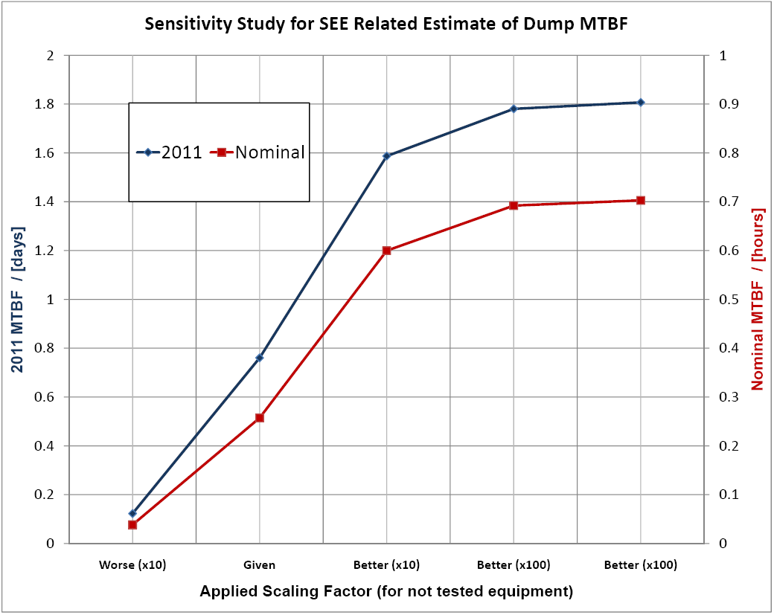
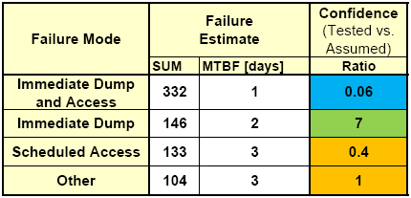

Expected SEE Failure Rates (status 08/10)
2011 LHC Operation:
Nominal LHC Operation:
Best possible estimate today
Uncertainties: LHC operation & machine behavior, radiation levels, equipment sensitivities
-> see next slides
2011 will be at the edge (and above) and possibly show first limitations
In order not to have problems with nominal LHC operation we would have to be wrong by a factor 500-1000 !

Slide 36
Radiation Tests

Slide 37


‘Only’ a selection could be tested!
CNRAD, some pictures: The ‘Tower of Pisa’

Slide 38
Radiation Tests in 2011
CERN:
  CNRAD (Mar-Nov 2011)
    Tests on Power converters, QPS equipment, Cryogenics
  H4IRRAD (start May)
    Tests on Power Converters and EN/EL equipment.
Outside CERN:
  PSI - Villigen (2011)
    Agreement with PSI to get 1 weekend test per month;
    Test of Amplifier, ADC buffers, and ADC for the PC redesign;
    Continue calibration of the RADMONs.
  CEA – Valduc (Feb 2011)
    Calibration of PinDiodes (RADMON) for the Displacement Damage measurements.
  TRIGA– Rome (or Prague facility) (2011)
    RADMON memory calibration with a thermal neutron beam.

Slide 39



What Equipment Is/Was Tested
Cooling and Ventilation (H. Jena)
  Siemens S7-300, S7-200
  Schneider Telemecanique Premium
Warm Interlock Rack (P. Dahlen)
  PLC 315F 2 DP, Ethernet controller
  24 DI safety input modules, 2 x DO
  Relay modules, 2 x 32 DO modules
  IM153.1 - ET 200M
  Boolean Processor - FM 352-5
Ethernet (E. Sallaz)
  Three Ethernet Switches
  3Com 4400

Slide 40


What Equipment Is/Was Tested
Fire Detectors (S. Grau and Team)
  4 Detectors (different types)
Collimation (G. Spiezia and Team)
  Full Rack with Drivers, I/O RIO
  National Instruments PXI MDC + PRS
  (ADC, DAC, FPGA card, power supply)
  Europa crate (custom electronic
  for LVDTs and Resolvers
  excitation/acquisition,
  power supply)
Timing & Remote Reset (R. Chery)

Slide 41
Benchmarks

Slide 42


Operation & Normalisation
Summary (Protons)
In | 6.02E+15
Dumped | 5.82E+15 | 96.70%
Lost in Machine | 1.99E+14 | 3.30%
Of Lost protons
Collisions | 2.33E+13 | 11.73%
Elsewhere | 1.76E+14 | 88.27%
Summary (Ions)
In | 7.46E+13
Dumped | 6.36E+13 | 85.25%
Lost in Machine | 1.10E+13 | 14.75%
Of Lost protons
Collisions | 3.77E+10 | 0.34%
Elsewhere | 1.10E+13 | 99.66%

Slide 43

IR7 Benchmark - Loss Scenario 2010
Summary (Protons B1)
In | 3.53E+15
Dumped | 3.44E+15 | 97.26%
Lost in Machine | 9.67E+13 | 2.74%
Of Lost protons B1
Collisions | 1.17E+13 | 12.07%
Elsewhere | 8.50E+13 | 87.93%
Summary (Protons B2)
In | 2.49E+15
Dumped | 2.38E+15 | 95.89%
Lost in Machine | 1.02E+14 | 4.11%
Of Lost protons B1
Collisions | 1.17E+13 | 11.42%
Elsewhere | 9.05E+13 | 88.58%
BLM ratio IR7 / IR3
 | Ratio | % Loss in IR7
TCSG.A6L7.B1 / TCSG.5L3.B1 | 3.1 | 76
TCSG.A6R7.B2 / TCSG.5R3.B2 | 5.6 | 85

Slide 44

IR7 Benchmark - Loss Scenario 2010

Slide 45


Shielding Benchmark:
© C. Adorisio, S. Roesler
T. Nakamura, Journal of Nuclear and Radiochemical Sciences, Vol. 4, No.2, pp. R15-R24, 2003

Slide 46







IP8/TI8 Radiation Detectors
© V. Boccone
5RM07S
PMIL8812
Current location not known in full detail of the Radmon and RAMSES positions
5RM05S
PMIL8811
Large Gradient:
4-5 orders
of magnitude
PATL8711
5RM06S
5RM08S

Slide 47


TED Loss: RadMon Downstream
© V. Boccone

Slide 48


UJ87: Loss on TCDIH.87904
© V. Boccone

Slide 49

Point-8 Application Benchmark
FLUKA/RAMSES benchmark
Detector | Measured dose (μSv/h) @10.6MHz | Ratio (meas/simu)
PMI8501 (UX85) | 24.0 | 1.1
PMI8511 (UX85) | 120.0 | 0.8
PAT8511 (US85) | 36.7 | 0.6
US85
UX85
UW85
FLUKA Simulations provide high energy hadron fluence, dose and 1 MeV Si equivalent in the LHCb cavern according to the Phase-2 shielding implementation proposed in the R2E Project
FLUKA/RadMon benchmark
Detector | Ratio (FLUKA exp/measure)
8LE10S | 1.6
8LE07S | 2.0
8LE04S | 1.6
8LE08S | 2.2
Very good agreement with PMIs and PATs RAMSES detectors
RadMons set at 3V more difficult (at low count rates)
Significant uncertainties to be considered (thermal neutron contribution, detector geometry, etc…)
Uncertainty at least a factor of 2

Slide 50


RadMon/FLUKA @ CNRAD
© D. Kramer, K. Roeed
Very Complex Geometry
Large Distances, ‘unknown’ materials, …
Area | High energy hadron fluence |  |  | Dose
 | RadMon [cm⁻²/pot] | Fluka [cm⁻²/pot] | Fluka/ RadMon | RadMon [Gy(Si)/pot] | Fluka [Gy(Air)/pot] | Fluka/ RadMon
455 | 4.3e-9 | 3.2e-9 | 0.74 | 1.4e-18 | 1.9e-18 | 1.36
456 | 1.8e-9 | 9.2e-10 | 0.50 | 7.4e-19 | 1.1e-18 | 1.48
467 | 3.7e-10 | 3.0e-10 | 0.81 | 1.2e-19 | 2.0e-19 | 1.67
463 | 1.7e-8 | 1.9e-8 | 1.12 | 3.3e-18 | 3.9e-18 | 1.18
451 | 1.8e-7 | 2.1e-7 | 1.17 | 2.8e-17 | 4.2e-17 | 1.50
off-axis
line-of-sight
to TSG4

Slide 51


Benchmark Simulations for TI2/8
© V. Boccone
Large Gradient

Slide 52

Injection: TED – High-E Fluence
© S. Roesler
RADMON
1.2 x 10¹⁰ cm⁻²
8RM08S, 26.5cm behind dump
2cm off beam axis
FLUKA
0.96 x 10¹⁰ cm⁻² ± 3.2%
protons: 9.8%
neutrons: 34.1%
pos. pions: 21.9%
neg.pions: 22.4%
others: 11.8%
(scoring in a volume of 2 x 2 x 2cm³)
(1.03 x 10¹⁰ cm⁻² ± 3.2%
scoring in a volume of 5 x 5 x 5cm³)

Slide 53
Injection: TED – 1MeV N-Equiv.
© S. Roesler
RADMON
2 x 10¹⁰ cm⁻²
FLUKA
2.1 x 10¹⁰ cm⁻² ± 2.5%
protons: 4.6%
neutrons: 81.6%
pos. pions: 5.3%
neg.pions: 5.6%
others: 2.9%
(scoring in a volume of 2 x 2 x 2cm³)
(2.25 x 10¹⁰ cm⁻² ± 1.8%
scoring in a volume of 5 x 5 x 5cm³)

Slide 54
Injection: TED - Dose
© S. Roesler
RADMON
4.73 Gy (Si)
FLUKA
5.0 Gy (air) ± 10%
(scoring in a volume of 5 x 5 x 5cm³)

Slide 55

TCDQ Losses 07-09.11.2009

Slide 56

TCDQ Losses 07-09.11.2009

Slide 57

TCDQ Losses 07-09.11.2009
~3x10¹⁰ cm⁻² high-E hadrons for 7TeV and 2.6x10¹³
rough scaling: ~2x10⁹ cm⁻² at 450GeV
this results in ~4x10⁵ per 5x10⁹ shot
We had about 50 (full) shots on the TCDQ -> ~2x10⁷ expected
5.6x10⁷ measured at the tunnel location (~30counts!)
In the UA, the monitor is set to 3V (factor of 10 more sensitive) -> nothing measured -> confirms the expected attenuation factor of ~1000

Slide 58
Remarks

Slide 59
Remark 0
In all our estimates and predictions we try being as ‘accurate’ as possible (conservative but fairly close to reality), thus uncertainties strictly apply in all directions
  NO BIG SAFETY MARGINS LEFT
Safety factors usually used in the field of SEE estimates are in the order of 10-100 and more (depending on the application: space missions, airplanes,…)
This we can’t do (afford) at the LHC, even after the mitigation actions are applied

Slide 60

Remark 1
Uncertainties go in both directions, thus as we try to be ‘as accurate as possible’, it’s not necessarily conservative!
  Example: LHCb (UX/US85: measurements versus ‘expectation’):
                PMI sees up to 30μSv/h at a luminosity of 10³¹cm⁻²s⁻¹
                (expected: 10μSv/h)
                PAT sees a few μSv/h
                (expected: less than one)
                RadMons: see equivalent counts, however less statistics
                (expected: first count only)
Reason: old detector geometry and magnetic field (in work!)
Other areas: low-energy neutrons not to be forgotten!
(then our estimates would be even less conservative)
Updated FLUKA Simulations, ‘old’ detector
X(PMI)
X(PAT)
RADMONS
© M. Calviani, C. Theis

Slide 61
Remark 2
In our estimations, we have to be ‘wrong’ by a factor of 500-1000 (only in one direction) in order to reach acceptable SEE induced failure rates for the LHC (if nothing is done)!
All test results we get, all the analysis from the available early monitoring (some shown today), make this impossible
SEE induced problems happened already once or twice
(WIC in injection line, QPS during ‘dirty’ injection [unlikely])
Nominal LHC Operation:
We’re looking for a MTBF of 150-300h what concerns ‘acceptable’ SEE induced problems
(tunnel equipment not included!)

Slide 62

Remark 3
Seeking maximum LHC performance, we’re bound to fit all R2E related work in the shutdown planning. Operational periods between long shut-downs will be challenging and require the possibility to react in case of problems
  Needed:
  preparation of patch-solutions
  (equipment level)
  radiation tolerant developments (R&D for power converters)
  strong RadWG
  radiation test possibilities at CERN

Slide 63


Left of IR7 “Bad Ion Fill (1488)”
- Beam intensity for ions -> ‘equivalent’ of Ions/Protons to be scaled (208/82) -> ~9x10¹¹
- At the same time, this corresponds to 68bunches, thus about 10% of nominal.
- RadMons nicely ‘counting’ at uneven MQs (9-17), below Interconnects
- this dataset: RM9-11 set to 5V, RM13-17 set to 3V
this fill: with th. neut. ratio of 1: ~1E6cm⁻² (@Q9), ~1E7cm⁻² (@Q17) >20MeV
VERY simplified scaling to nominal (7TeV) and 1 month of Ions: ~1E10cm⁻²

Slide 64

Left of IR7 “Good Proton Fill (1450)”
To be compared with ~9x10¹¹ as equivalent number of protons of previous ion fill
Again running at about 10% of nominal
- RadMons have low statistics (2 counts in critical locations)
- Voltage settings are the same as before RM9-11 @5V, RM13-17@3V
VERY simplified scaling to nominal (7TeV) and 1 LHC year: ~5E9cm⁻² >20MeV
(nicely agreeing with the simulation estimates: 1E9-1E10cm⁻²/year)

Slide 65


Right of IR7 “Bad Ion Fill (1488)”
- Beam intensity for ions -> ‘‘equivalent’ of Ions/protons to be scaled (208/82) -> ~9x10¹¹
- At the same time, this corresponds to 68bunches, thus about 10% of nominal.
- RadMons nicely ‘counting’ at different locations (mainly Q9 and Q11)
- this dataset: RM9-11 set to 5V, RM13-17 set to 3V
this fill: with th. neut. ratio of 1: ~7E6cm⁻² (@Q9) , ~1E7cm⁻² (@Q11) >20MeV
VERY simplified scaling to nominal (7TeV) and 1 month of Ions: ~1E10cm⁻²

Slide 66

Right of IR7 “Good Proton Fill (1450)”
To be compared with ~9x10¹¹ as equivalent number of protons of previous ion fill
Again running at about 10% of nominal
- RadMons have VERY low statistics (only one has 1 count)
- Voltage settings are the same as before RM9-11 @5V, RM13-17@3V
VERY simplified scaling to nominal (7TeV) and 1 LHC year: ~4E9cm⁻² >20MeV
(still nicely agreeing with the simulation estimates: 1E9-1E10 cm⁻²/year)

Slide 67
Ions: Preliminary ‘Conclusion’
Ions (at least during ‘bad fills’) lead to high losses in the DS/ARC -> ratio Ion/Proton based on Radmon signal and normalized to proton equivalent is in the order of 600
Scaling for nominal
  Protons: coherent with simulation estimates
  (bad statistics, can be improved by looking at more fills, ongoing) -> levels might reach up to 1E10cm⁻² per year
  Ions: similar levels can be ‘achieved’ within one month of ions in case ‘bad fills’ would become ‘nominal’
QPS crates affected from Q9-Q17, firmware upgrade possibly needed soon (under investigation - R. Denz)
Quickly checked for P3, and DSs adjacent to experiments -> only little counts so far, levels significantly lower but more statistic/time needed to give some estimates

