Slide 1
Heavy Ions in 2011 and Beyond
Thanks to all who contributed to the
“Ions for LHC” project, now dissolved,
many others involved in the 2010 operation.
Contributions to this talk from: R. Assmann, P. Baudrenghien, G. Bellodi, O. Berrig, T. Bohl, R. Bruce, C. Carli, E. Carlier, H. Damerau, S. Hancock, B. Holzer, D. Kuchler, D. Manglunki, T. Mertens, A. Nordt, T. Risselada, M. Sapinski, R. Steerenberg, D. Wollmann

Slide 2
Plan of talk
The 2010 lead-lead run
The 2011 lead-lead run
The 2012 X-lead run
Critical upgrades

Slide 3
The 2010 lead-lead run

Slide 4
Lightning summary (should be a talk on this)
Lightning commissioning plan, expounded to politely sceptical audiences at previous Chamonixes, worked.
  Collisions within 50 hours of first injection
  Stable beams within 4 days (… and physics)
  Most filling schemes used once and thrown away
The LHC worked with Pb beams
  No rapidly decaying, invisible beams
  No quenches, so far
Rich/novel beam physics, much as predicted, but
  Emittances blown-up
  Some new losses and radiation problems

Slide 5
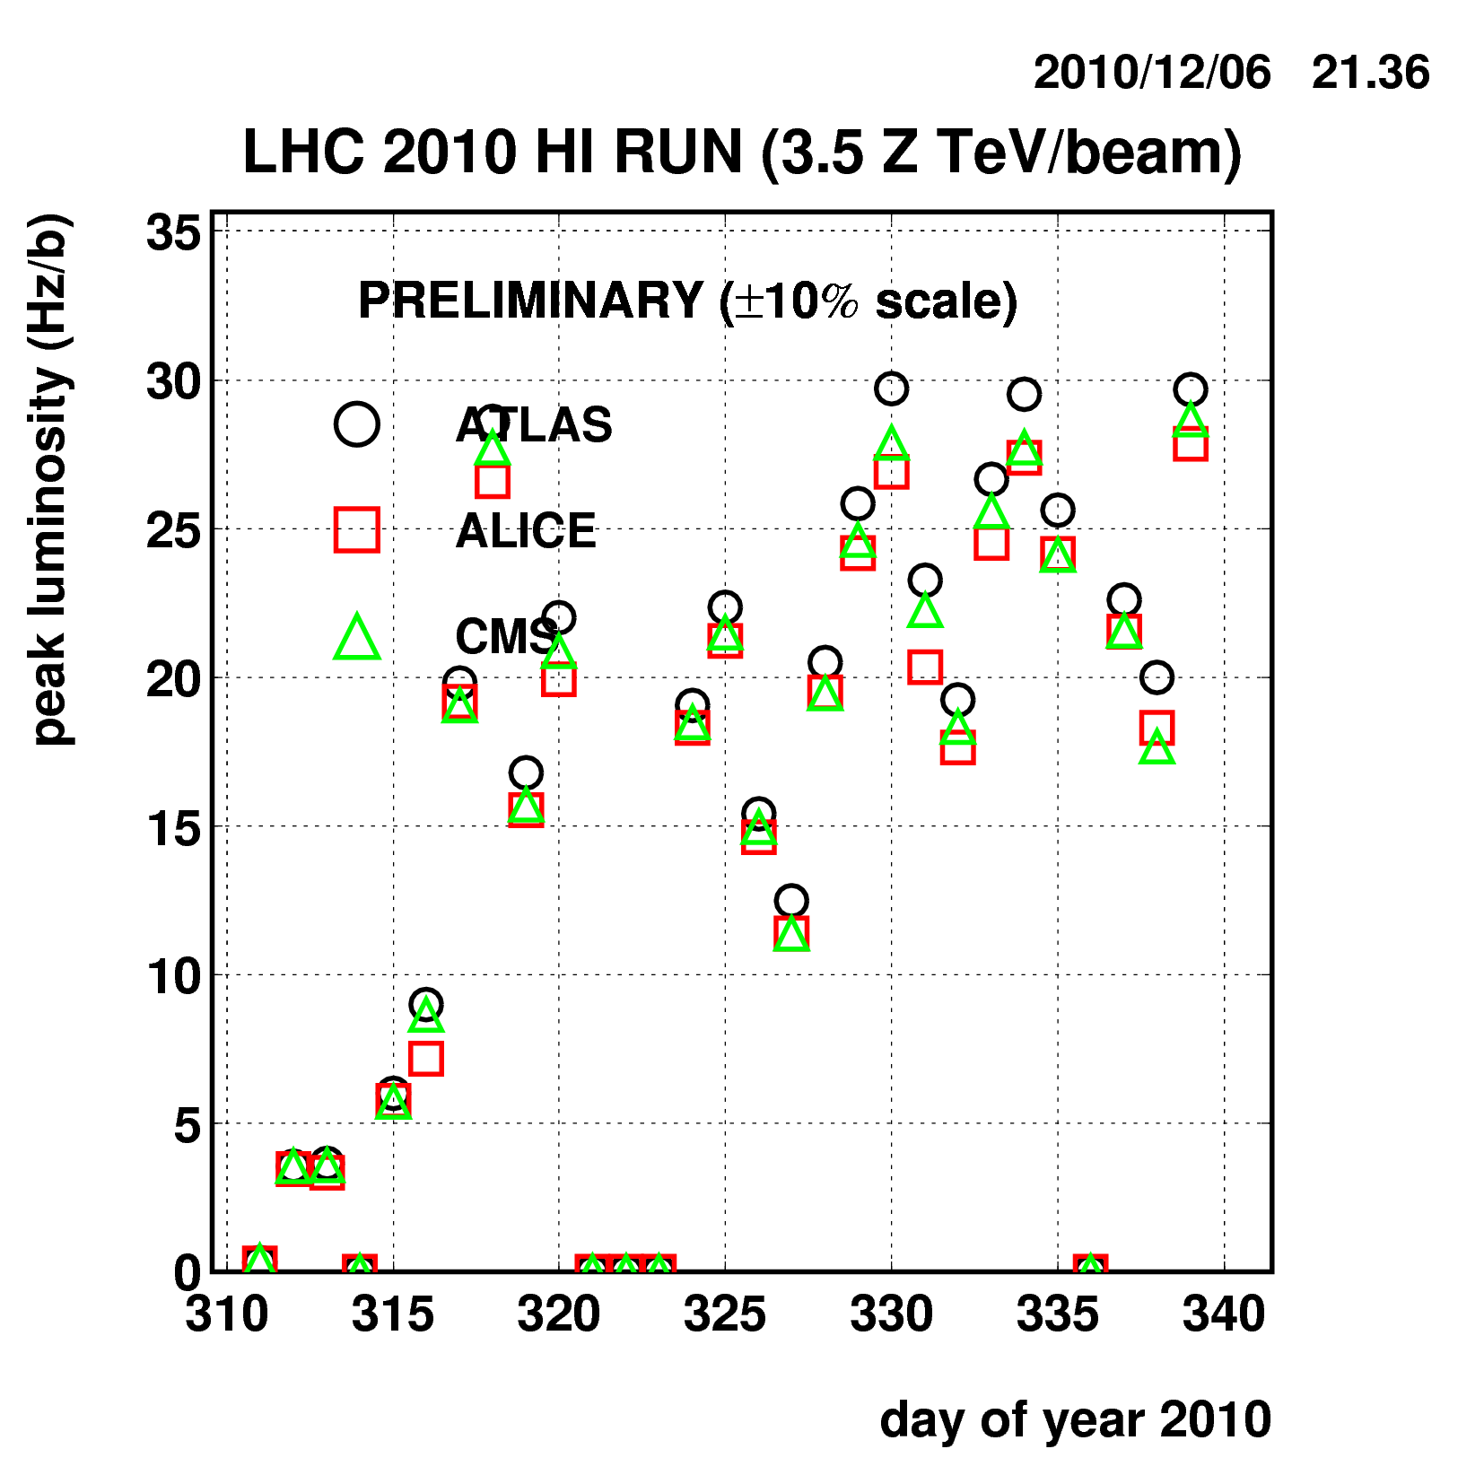
Peak luminosity in fills
Peak performance reached very quickly.
Interrupted twice by source refills (+ few days “parasitic” proton MD), some time to recover source performance.
Last few days, bunch number increased again to 137 with 8-bunch/batch from SPS.
As far as possible, we should adopt similar commissioning plan (magnetic machine as close as possible to protons, …) for every heavy ion run.
But never completely identical (even in 2010).

Slide 6
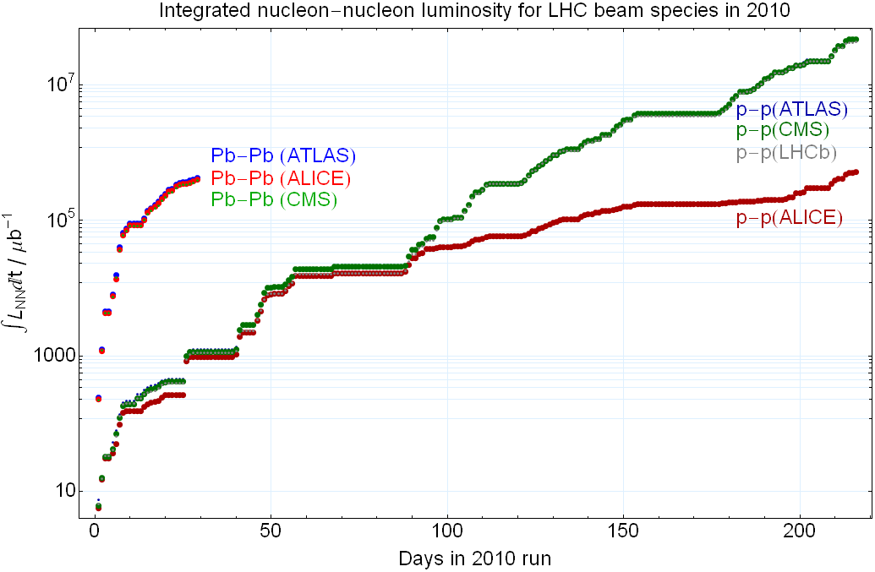
This is NOT the reason why we need longer p-p runs.

Slide 7
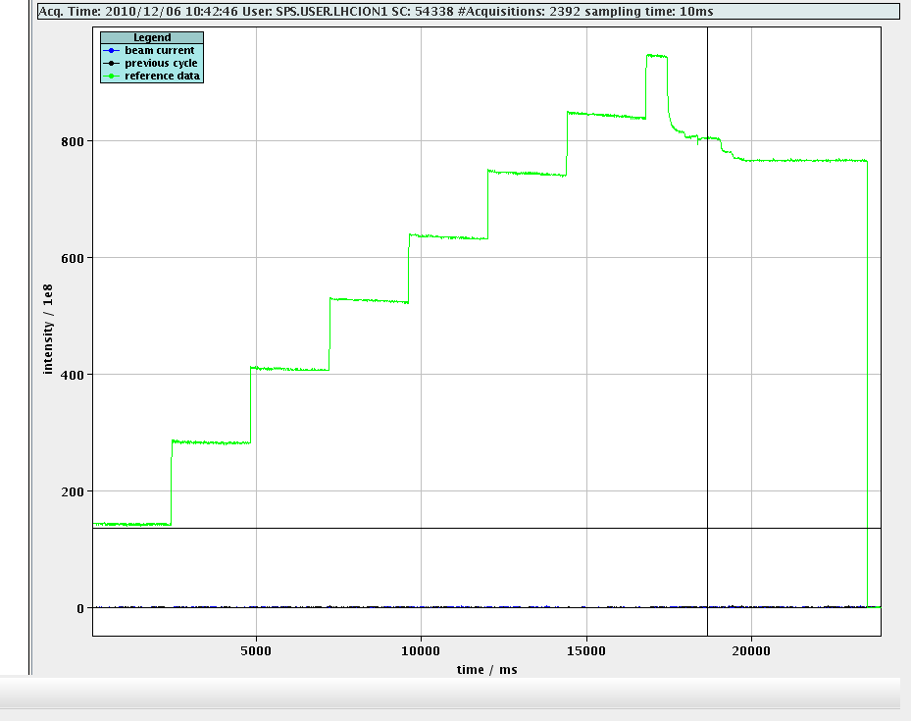
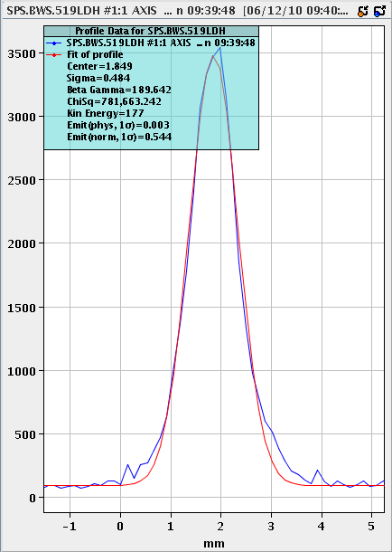
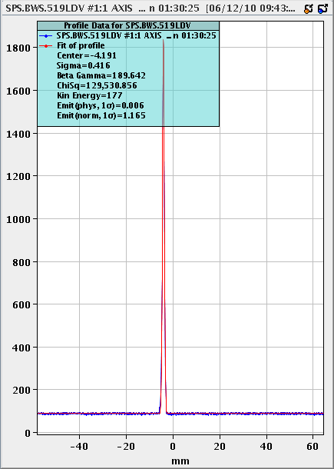
Injectors for last LHC ion fill of the year
8 bunches × 17 × 2 from SPS to LHC
Despite shorted source intermediate electrode
Thanks to LEIR double injection
1.15×10⁸ ions/bunch (64% above design)
ε_{H} = 0.5μm (<design/2) ; ε_{V} = 1.1μm (<design)

Slide 8
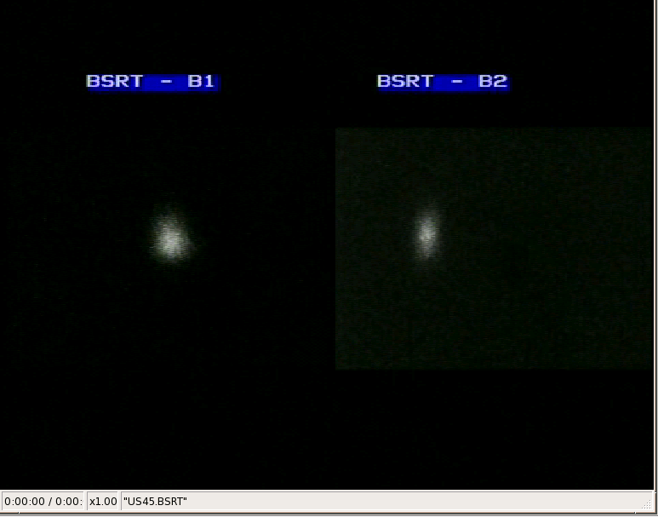
Beam instrumentation
Major concern in some people’s minds
  BPMs intensity threshold – no problem
  Emittance: harder than protons
    WS: Wire scanner at low energy and intensity – best absolute calibration
    BSRT: synchrotron light
    appeared in ramp (world first!),
    only bunch-by-bunch –
    typical large spread in
    emittance set in at injection
    Beam-gas ionisation (BGI)
    commissioned during ion run,
    provides continuous monitoring of average emittance, some calibration questions still being resolved

Slide 9
Performance limits so far
IBS
  Simulation comparison – transform to superposed bunches
Hump
Vacuum ?
    not much to say from the vacuum side During the run with ions, pressures were recovering all around the ring (following the run with protons) and the only pressure rise observed with ions are in the injections at the TDI and linked to losses.
Losses in squeeze
  Larger emittances – must watch this.

Slide 10
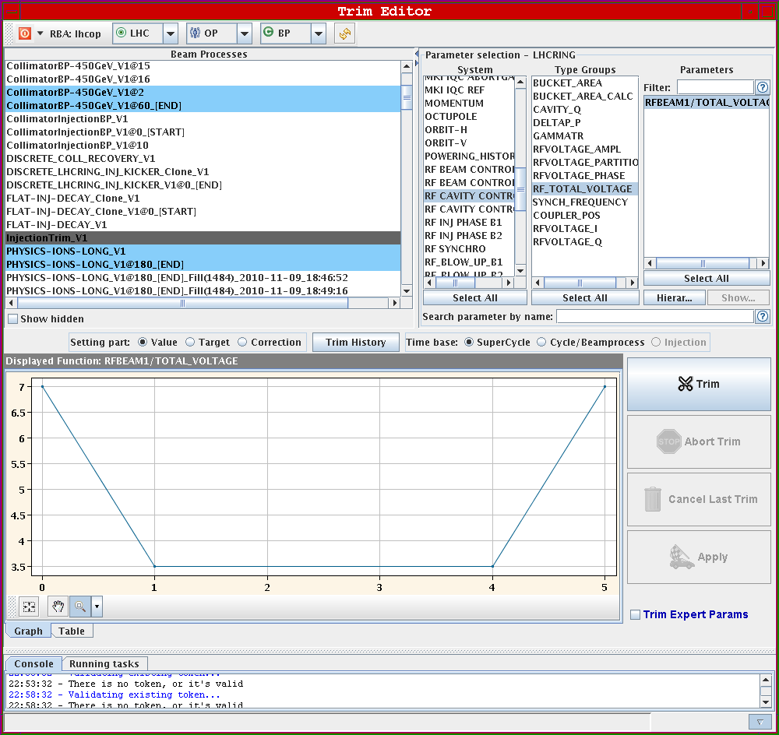
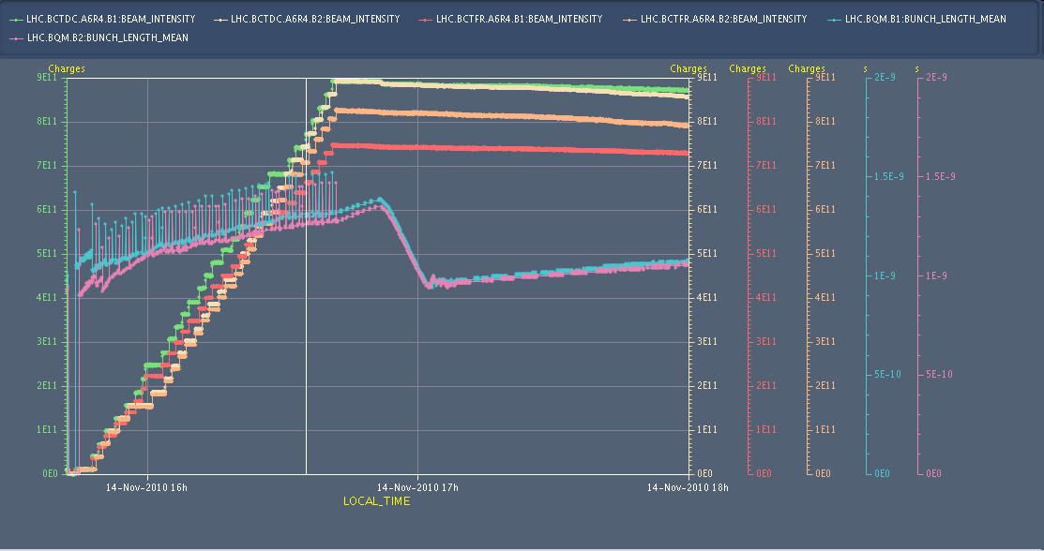
P. Baudrenghien et al
12-13 Nov
  7 MV at flat bottom with voltage reduction to 3.5 MV at each injection
Very small capture loss
19% L increase at each V reduction
The 7 MV voltage is linearly reduced to 3.5 MV in 1 s just before injection, kept at 3.5 MV for the 3 seconds following the injection, then raised back to 7 MV in 1 s
The higher (7 MV) voltage on the long flat bottom reduces the lengthening caused by IBS. There is no more loss at start ramp. No more debunching on flat bottom.
However, the RF modulation creates ghost bunches : We have debunching at each voltage reduction followed by recapture in nearby buckets when the voltage returns to 7 MV
Later moved to constant large voltage to avoid ghost bunches.

Slide 11
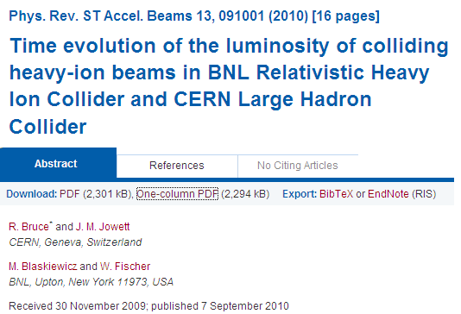
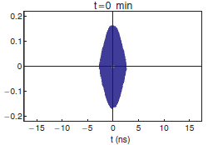
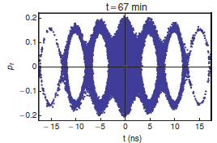
Luminosity evolution models
Luminosity models, extensively benchmarked on many RHIC fills.
Systems of ODEs or simulation “CTE”. CTE includes:
IBS, various methods beyond Gaussian approximation, predicts debunching effects
Luminosity burn-off (BFPP, EMD, inelastic nuclear, etc.)
Synchrotron radiation damping etc
Also used now to simulate injection and analyse fills
+ RB’s thesis
RHIC longitudinal IBS

Slide 12
Injection plateau fill data vs. simulation
Beam instrumentation gives us:
  Bunch length bunch-by-bunch
  BSRT beam size bunch-by-bunch at physics only, (almost) nothing at injection
  Wire scanners: emittance at low intensity/energy
    Best absolute, use to calibrate BGI (linear fit)
  BGI: average beam size over all bunches
    Calibration questions, threshold intensity, …
    Fit simulation of single bunch evolution to average of bunches accumulated over ~ 1 h injection FORMULA
    Never quite know the initial emittance
Tom Mertens

Slide 13
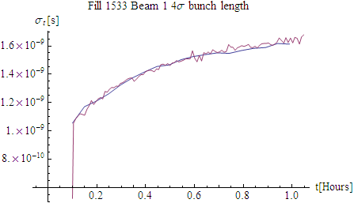
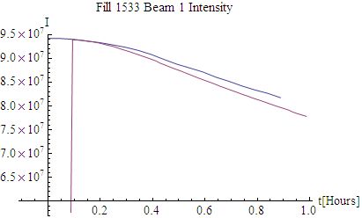
Fill 1533: 1st bunch longitudinal
simulation
FBCT
Moving averages over 50 s (50 data points)
Initial longitudinal emittance chosen to fit initial bunch length and RF voltage 7 MV.
Transverse emittance chosen to fit initial IBS growth rate.
Debunching and bunch lengthening from IBS are predicted very well.
Tom Mertens

Slide 14
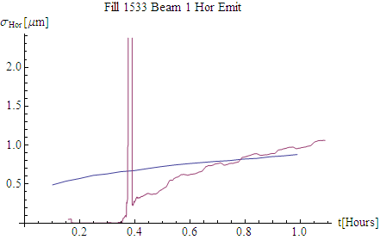
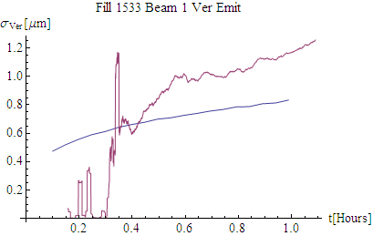
Fill 1533: transverse emittances
BGI switches on
BGI turns on
Plausible initial emittance from fit to longitudinal growth.
BGI calibration via WS ?
Possible other source of vertical emittance growth.
Periodic variation ( ~ 5 min) of horizontal emittance superposed on growth ?? Feature of all fills.
Work continues to resolve these questions.
Will also do luminosity analysis with these tools.
Tom Mertens

Slide 15
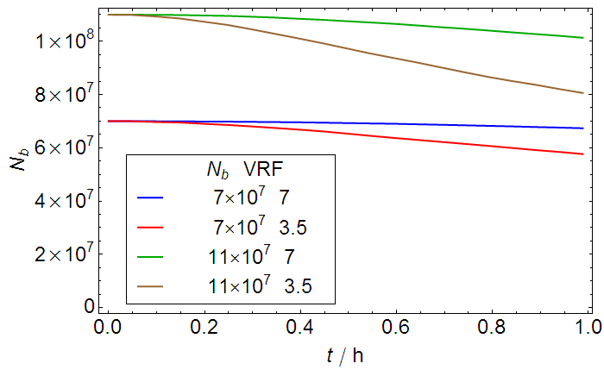
Other results
Simulations reproduce effects of changing RF voltage on IBS and debunching rates
Will/should be applied to protons in LHC, Pb in SPS, as well …

Slide 16
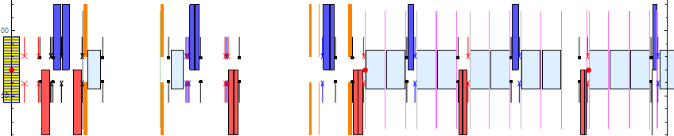
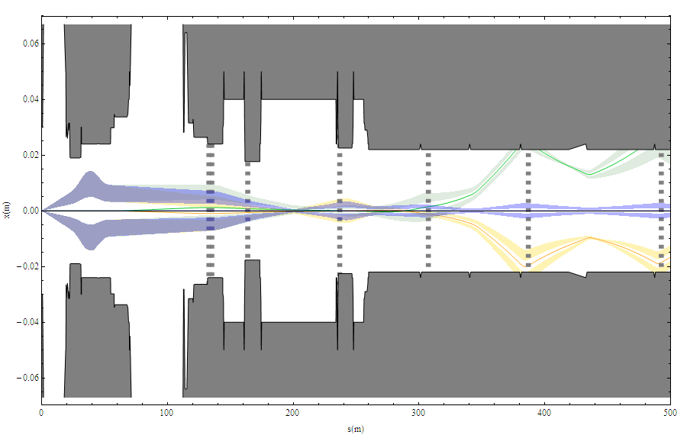
Main and secondary Pb beams from ALICE IP
Losses can quench superconducting magnets
Large EM cross sections. Similar in ATLAS, CMS

Slide 17
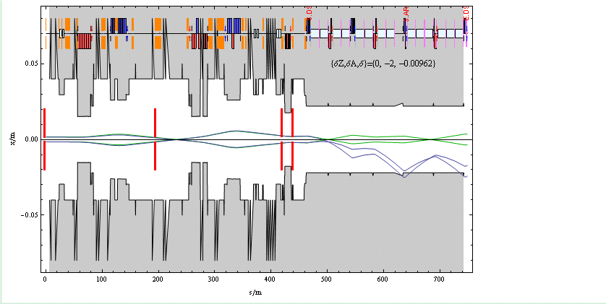
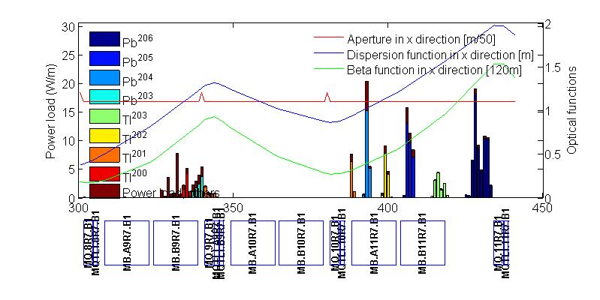
Example of ²⁰⁶Pb created by 2-neutron EMD
Green rays are ions that almost reach collimator
Blue rays are ²⁰⁶Pb rays with rigidity change
Beam pipe in IR7 of LHC
Primary
collimator
G. Bellodi
Notes:
Dispersion suppressor section acts as spectrometer

Slide 18
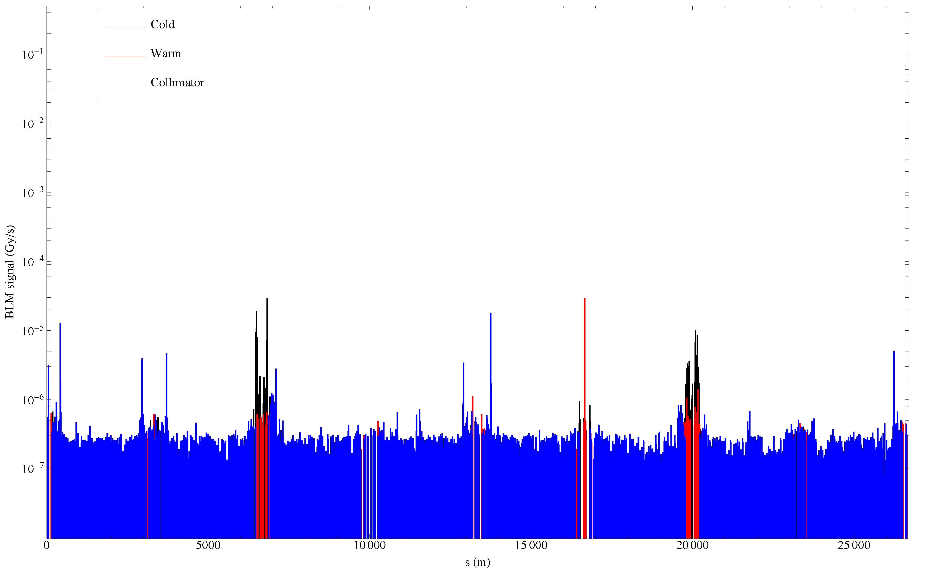
Global view of losses, Pb-Pb stable beams
Momentum collimation: ²⁰⁸Pb⁸²⁺ (IBS)
²⁰⁷Pb⁸²⁺ (EMD1)
Betatron collimation: ²⁰⁶Pb⁸²⁺ (EMD2 in TCP)
+ many other nuclides from hadronic fragmentation and EMD in TCPs
²⁰⁸Pb⁸¹⁺(BFPP at ATLAS)
²⁰⁸Pb⁸¹⁺ BFPP at CMS
²⁰⁸Pb⁸¹⁺(BFPP at ALICE)
Possibly: ²⁰⁶Pb⁸²⁺ (EMD2 at IPs), other nuclides from collimation ??
Generally according to predictions, detailed analysis under way as time allows …
Record luminosity, the last fill of 2010

Slide 19
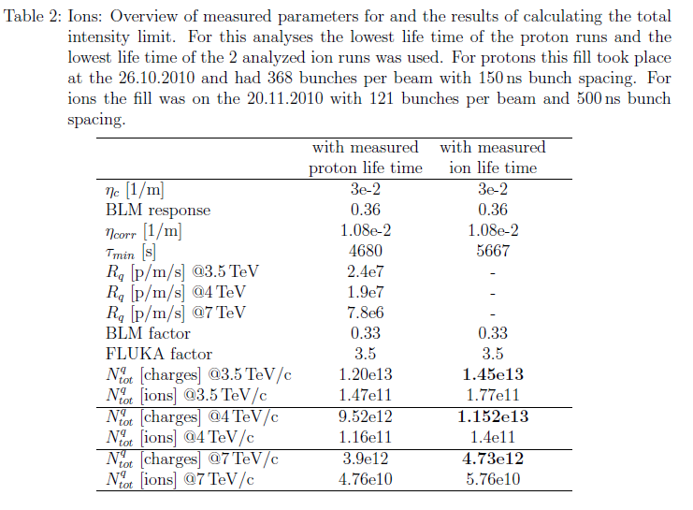
Intensity limit from collimation (tentative)
D. Wollmann, extending method used in Evian to estimate proton intensity limit to ions.
But higher intensity may be within reach from injectors!

Slide 20
Luminosity limit (mainly BFPP)
Unlike p-p, where most losses (collimation, cleaning efficiency, …) are proportional to total beam intensity, Pb-Pb collisions will ultimately be limited by losses proportional to luminosity itself
  Quenches
  Rapid intensity burn-off
    A preview of HL-LHC

Slide 21
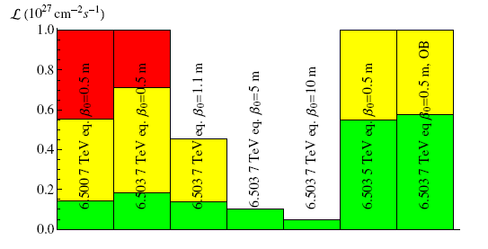
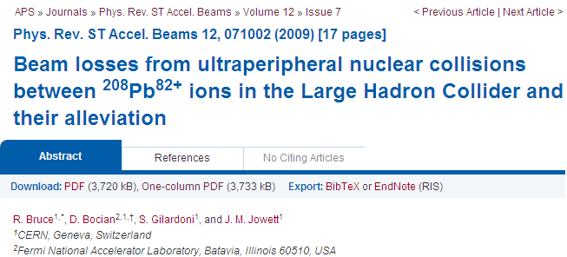
Propensity to quench from BFPP
Various operating conditions, see paper for details.
Elaborate chain of calculations with several uncertainties from IP to liquid He flow.
Some improvement might be possible with orbit bump method.

Slide 22
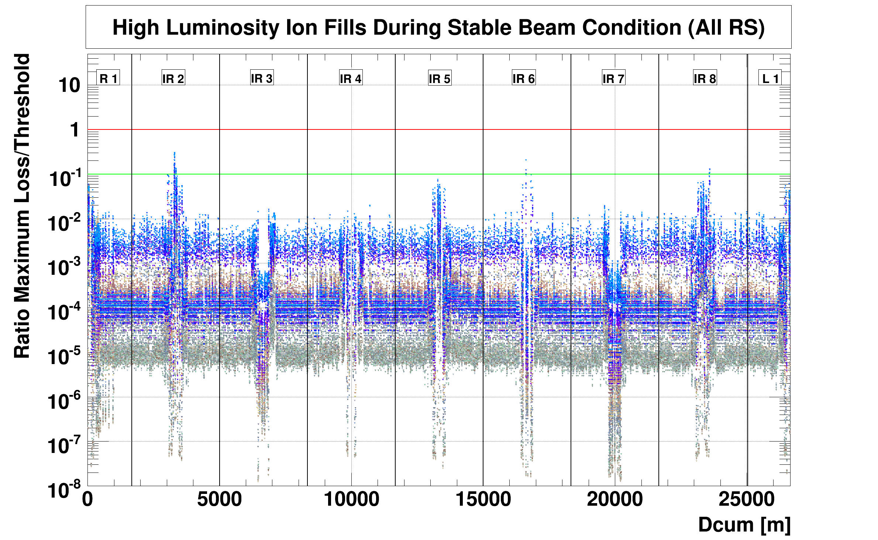
Estimating luminosity limit
High lumi fills,
3.5 ZTeV.
40 μs integration
…
…
…
1.3 s integration
A. Nordt,
M. Sapinski,
B. Holzer
Max loss signal versus applied threshold during stable beams.
We are factor 30 short of design luminosity, factor 2 in energy.
Need factor 60 at BFPP loss points in dispersion suppressor.
Further analysis necessary – but looks comparable to predictions, depending on thresholds that are set.

Slide 23
The 2011 lead-lead run

Slide 24
Physics conditions
Number of bunches vs Nb
  Injectors, Early or Nominal
  Alternative backup 75 ns scheme
Optics and orbits
  Take over ATLAS and CMS β* from pp
    Possibly reduce crossing angles ? Quick in 2010.
  Squeeze ALICE to same value β*= 1.5 m
    2 days setup, unless done previously with protons
  Crossing angles in ALICE
    ZDC preferences
TCTVBs open in IR2
  Awaiting green light from Machine Protection
Low β* in 3 IPs, as established for p-p

Slide 25
Nominal Filling scheme
Nominal beam has been prepared in injectors up to PS
  Intensity/bunch N_{b} close to design (but: we had better with the Early scheme in 2010)
In LHC, 592 bunches of Nominal described in LHC Design Report reduced to 540 by present abort gap keeper requirement
There are concerns about behaviour of beams (IBS, space-charge, …) on long (~40 s) injection plateau in SPS
  No clear data with recent definitive RF configuration

Slide 26
Intermediate filling scheme
Based on “Early” mode of operation of injectors
Two bunches at 200 ns in PS but no splitting
  “Can set up in an afternoon” S. Hancock
Inject up to 15 times into SPS
  Work on SPS injection kicker should give gap of 225 ns (E. Carlier)
  Batches of up to 30 bunches to LHC – can optimise the length, mixture of 200 and 225 ns spacing, ~300 bunches
Potential to retain higher bunch intensity (70% beyond design) already realised with Early scheme

Slide 27
Predictions for Pb-Pb at 4 Z TeV/beam
Luminosity factors w.r.t. 2010
  1.5/3.5 from β*
  2-2.5 from bunch number and intensity
Very sensitive to lost time in short run
Some prospects for doing better

Slide 28
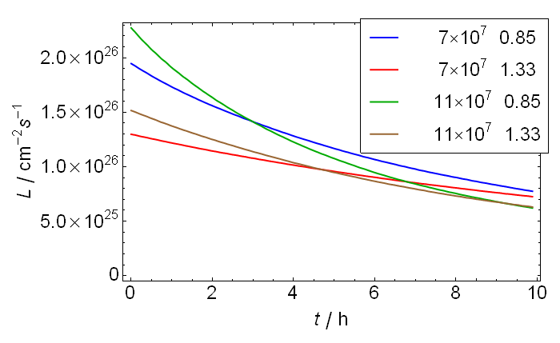
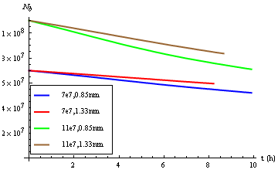
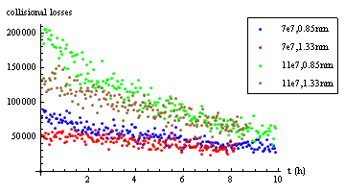
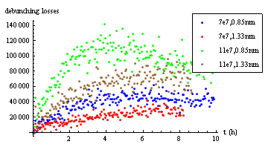
2011 Luminosity evolution (R. Bruce)
Luminosity burn-off
Debunching from IBS

Slide 29
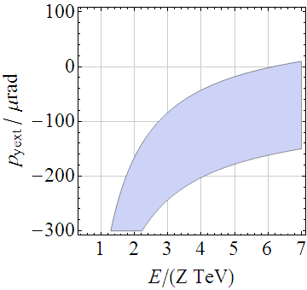
Crossing angles for Pb-Pb physics
ALICE: need to avoid shadowing of spectator neutrons to ZDC by TCTVBs
  Hope we can keep TCTVBs fully open as last year
  Even so, crossing angle is constrained by 28 mm gap (until the “old” TCTVs are taken out)
ATLAS, CMS:
  consider retaining crossing angle used in p-p (or reduce)
LHCb: spectrometer off, injection optics and separation (as 2010)
Accessible external crossing angle for ALICE ZDC

Slide 30
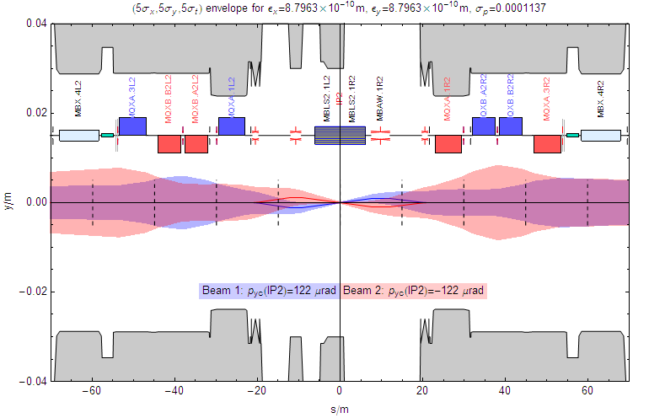
ALICE spectrometer alone (full field, 4 Z TeV)
A little bump with a big lever arm

Slide 31
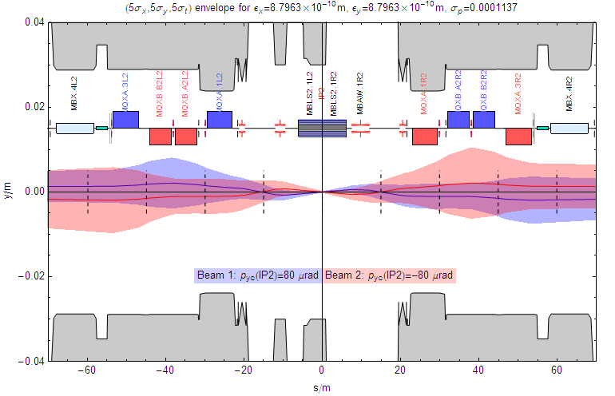
One extreme (fully open TCTVB, 4 Z TeV)
External bump partially cancels spectrometer – beams cross again, poor separation (but good aperture!)

Slide 32
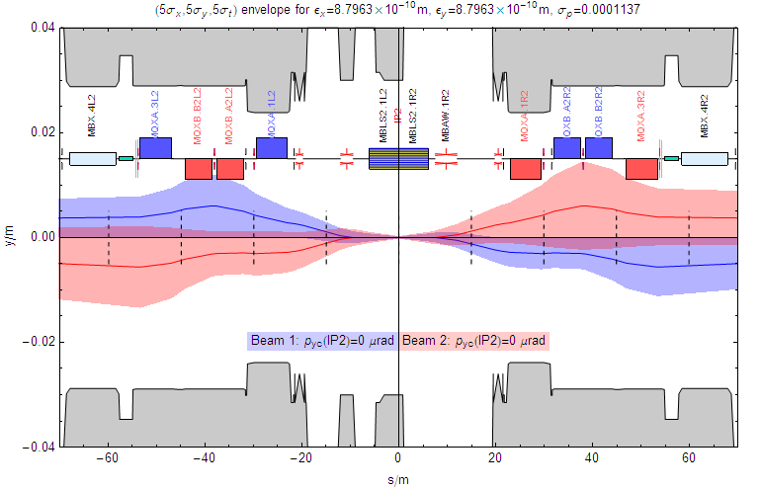
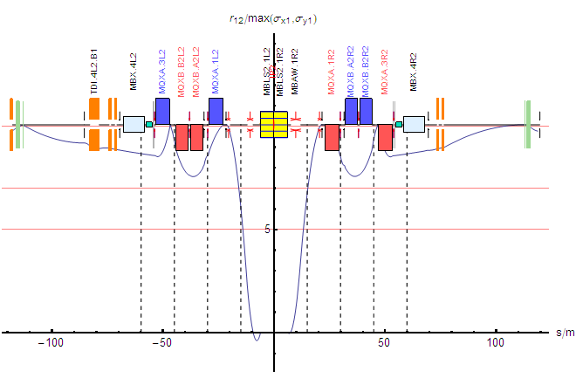
Zero crossing angle (4 Z TeV) - ideal for ZDC
Separation probably adequate for beam-beam at these intensities, but more comfortable at 200 ns.
10σ separation can be obtained by pushing on to -40 μrad if necessary.

Slide 33
The 2012 X-lead run
Pb
X

Slide 34
Continue Pb-Pb in 2012
Obvious possibility
  it will still be a long way to 1 nb⁻¹
Review further factors in luminosity obtainable between 2011 and 2012 after 2011 run

Slide 35

Something new: p-Pb in 2012
Physics interest
  C.f. deuteron-gold at RHIC
No resources available to study so far, nevertheless:
  pA workshop at CERN in 2005
    http://ph-dep-th.web.cern.ch/ph-dep-th/content2/workshops/pAatLHC/pAworkshop2.html
  Paper at EPAC 2006:
  Forthcoming CERN report contains accelerator chapter (approved in 2005)

Slide 36
Momentum offset required to equalise frequencies
Would move beam by 35 mm in QF!!
Limit with pilot beams
Limit in normal operation
Revolution frequencies must be equal for collisions.
Lower limit on energy of p-Pb collisions, E_{p} ~ 2.7 TeV
Energy where RF frequencies can become equal in ramp.
Notes:
Straightforward engineering solution: fill SPS with some extra LHC dipoles to boost injection energy

Slide 37
Summary of key facts about p-Pb
Modes of operation of injectors worked out
  Some concern about 80 MHz cavities in PS
  Priority protons in Beam 1
4 Z TeV gives comparison data for Pb-Pb at full energy
  Unlikely to be another opportunity to run at this energy
Important to resolve uncertainties regarding feasibility, Pb intensity limit from unequal revolution frequencies at injection, ramp
  Modulation of long-range beam-beam, excitation of overlap knock-out resonances, transverse feedback, tune-control …

Slide 38
Accessible energies and CM rapidities
Possible range of collision energies
Minimum p-Pb energy for equal revolution frequency.
Relations between these numbers are a simple consequence of the two-in-one magnet design
Present energy
gives comparison
data for full energy

Slide 39
Testing p-Pb in 2011
Crucial questions are related to injection and ramping
  Effects of protons (say 10% of nominal) on one Pb bunch
  Inject few Pb bunches against some convenient p filling scheme
  Possible in 2011 (small LLRF upgrade needed to collide, OK in 2012)
  Detailed planning of MD strategy needs to be done: study and overcome intensity/emittance blow-up

Slide 40
Main and secondary Pb beams from ALICE IP
Collimators in dispersion suppressors around experiment(s) are almost certainly needed to approach design luminosity for Pb-Pb collisions.
Optimal position for one “cryo”-collimator/beam.
Less work than IR3 ?

Slide 41
Upgrades important for heavy ions
LLRF upgrade – p-Pb collisions in 2012
  OK
New TCTVAs in IR2 – ZDC + triplet protection
  Intervention to be planned
  Then remove old TCTVBS asap
DS collimators in IR3 – intensity limitw
  2013
DS collimators in IR2 – luminosity limit
  2016 ?
  Highest priority for heavy ion physics
  If IR3 postponed, can we do this in 2012 ?
DS collimators in IR7 – intensity limit

Slide 42
Long-term possibilities
IR2 DS collimators open up possibilities for Pb-Pb luminosity beyond design in ALICE
IR3 DS collimators also very important
  See other presentations (eg 2009 Collimation Review)
Lighter ions (Ar, …) made available in synergy with SPS fixed target programme
  N.B. first indications are that Ar collimation will make heaviest demands on DS collimators

Slide 43
Conclusions
The 2010 Pb-Pb run showed that the LHC can work well with heavy ions
  Operation very efficient in beam time
Beam physics is complex!
  Needs more resources for study, analysis of data
Substantial factor in luminosity possible for 2011
  Options for filling etc, will be clarified in injector commissioning, experiments are flexible
2012 appears to be a good opportunity for p-Pb
  Otherwise it will be a long time … interesting energy
  Feasibility test in MD can be tried in 2011
Upgrades critical to sustain performance ramp
  Installation of DS collimators in IR2 should not be allowed to slip too far into the future

Slide 44
Backup slides

Slide 45
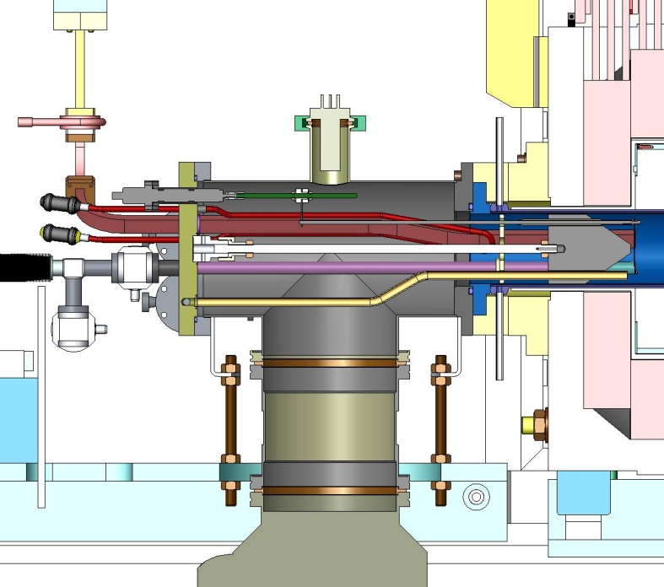
Two ovens operational
The first oven filling lasts for around two weeks, the second for only one week (due to plasma heating of the oven)
Oven refill takes around 36 hours
In 2010 only the first oven was used, the second one was used as hot spare in case of problems
In principle one can extend the period between two oven refills to three weeks, but the third week may suffer from instabilities and intensity fluctuations
The switch between the two ovens is normally transparent to the operation, it takes several hours to bring up the second oven to operational conditions (big thermal mass)
Mechanical movement of the oven disturbs the source vacuum and needs several hours of recovery time afterwards
oven

