Slide 1
How low can we go?
Getting below β*=3.5m
R. Bruce, R.W. Assmann
Acknowledgment:
T. Baer, W. Bartmann, C. Bracco, S. Fartoukh, M. Giovannozzi,
B. Goddard,W. Herr, S. Redaelli, R. Tomas, G. Vanbavinckhove,
J. Wenninger, S. White, D. Wollmann

Slide 2
Introduction
Main limitations when going to smaller β*
  Magnetic limits: max gradient in quadrupoles and chromaticity
  Beam-beam limit …
  Aperture limit: decreasing margins in triplet when decreasing β. Present limit!
IP1

Slide 3
Protection hierarchy
IV
III
II
Triplet
I
Absorbers
Tertiary
Secondary
Dump Protection
Primary
17.5 σ ??
Dump Kicker
15 σ
5.7
8.5
17.7
9.3-10.6 σ
beam
Courtesy D. Wollmann
Hierarchy between cleaning stages must be preserved to guarantee protection – limits β-beat and orbit variation
To optimize β*, we have to review
  Triplet aperture
  Margin TCT/triplet
  Margin Dump protection/TCT
  Settings and margins for other collimators and dump protection

Slide 4
Triplet aperture
Aperture traditionally calculated with MAD-X using n1
  Takes into account mechanical tolerances and most pessimistic case of beta beating and orbit shifts
  safe but possibly pessimistic approach
Global aperture measured at injection energy:
aperture larger than expected
( from M. Giovannozzi, R. Assmann, R. Giachino, D. Jacquet, L. Ponce, S. Redaelli, and J. Wenninger, presentation LHCCWG 2010.09.14)
Can we use this information to better estimate the triplet aperture?
 | Horizontal | Vertical
Beam 1 | 12.5 | 13.5
Beam 2 | 14.0 | 13.0
Global aperture in nominal beam σ. Expected: 8.4 σ

Slide 5
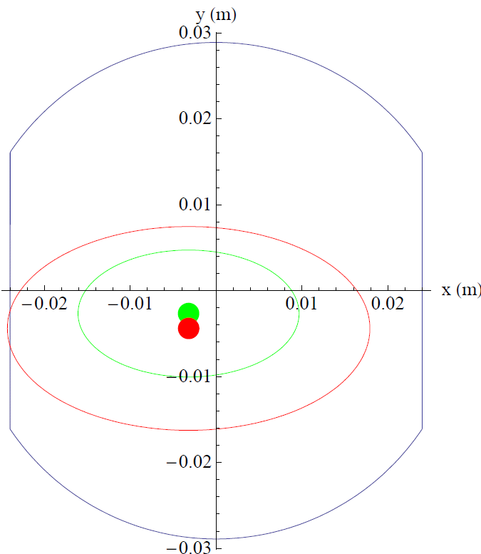

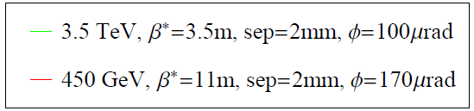
Simplistic calculation procedure
Find s-value of limiting triplet
aperture with MAD-X (h and v)
Assume pessimistically
injection aperture=global limit+2 σ
Only one plane matters with good approximation - reduce to 1D
Scale beam size to pre-collision
(larger β_{x} and γ), add orbit
offsets in relevant plane
Solve for top energy aperture
Additional assumption: reduce
separation to nominal value 0.7 mm
MQXB.B2L1
s= -40.8 m
2mm separation

Slide 6
Margins in aperture calculation
All mechanical and alignment errors already included in measurement – nothing changes between injection and top energy
Orbit variations must be accounted for
  Up to 2mm difference in orbit shift from injection to top energy between measurement and MAD-X at BPMs close to triplets
  1 mm fill-to-fill variations at top energy at BPMs close to triplets
  Using total orbit uncertainty of 3mm going in pessimistic direction
β-beat must be accounted for
  High reproducibility from fill to fill
  Using the measured beam size at injection and top energy
Calculating aperture both with traditional n1 (3mm orbit as worst case observed in triplet and 10% method and β-beat) aperture scaling

Slide 7
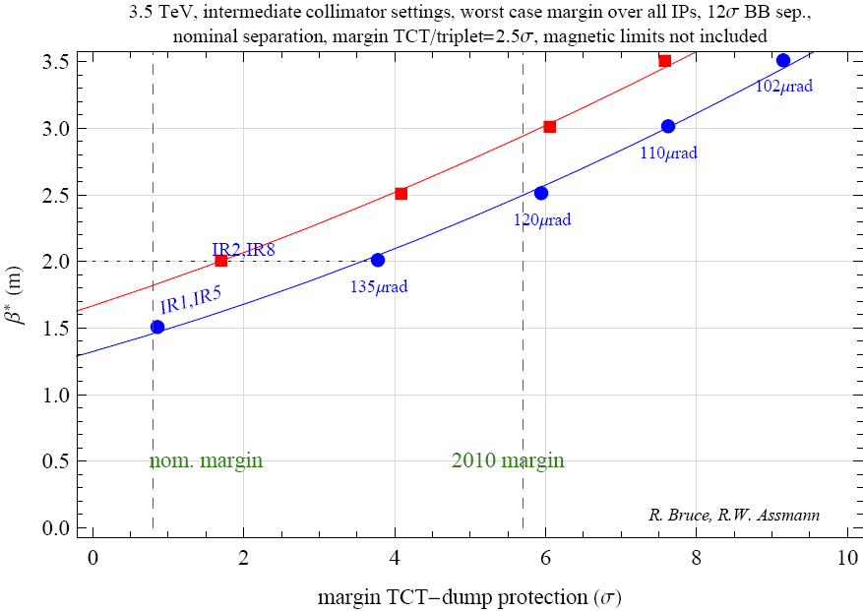
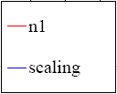
Result 3.5 TeV, 2010 margins
(half crossing angle)
Without reducing present margins,
we could reach β*≈2.5 m

Slide 8
Margin TCT/triplet
Presently 2.5 σ margin used. Can this be reduced?
Orbit at TCTs seen to deviate up to 2 σ (seen in IR2) during stable beams (see talk S. White)
  Large deviations partly due to luminosity leveling in ALICE – different strategy possible?
  Other IPs stable within around 1 σ
Except during scans and levelling, orbits at TCT and triplet are closely correlated. Movements follow within 0.3 σ
  During small scans, orbit moves by less than 0.2 σ at the TCT. This is within tolerances. During van der Meer scans, TCTs must follow orbit. Implementation?
Beta beat mainly increases margins TCT/triplet in present machine
(ratio β_{meas}/β_{model} larger at TCT)
  Some exceptions, IR8 vertical plane worst. Use margin optimization as constraint for beta beat correction: input to β-beat team (R. Tomas et al.)
  Taking into account a possible 5% drift of the β-beat
Proposal: Margins can be decreased to 1.5 σ (0.7-1.3mm at β*=1.5m)

Slide 9
Achieved stability 2010
Investigating 2010 performance to conclude on collimators margins
Feasible global β-beat: 10%
Reproducibility of β-beat: better than 5%
Worst orbit in fills that reached stable beams since September 18 shows up to 2σ deviations from reference orbit at TCTs (but mean < 1σ deviation for all IRs except IR2)
Input: R.Tomas, G. Vanbavinckhove, S. White
Device | orbit | beta beat (5%) | positioning (40 um) | setup (10 um) | lumi scans | uncertainty (sum) | uncertainty (quadratic sum)
TCT | 2 | 0.4 | 0.1 | 0.02 | 0.2 | 2.7 | 2.0
TCSG IR6 | 0.4 | 0.2 | 0.1 | 0.01 |  | 0.7* | 0.5
TCSG IR7 | 1.2 | 0.2 | 0.2 | 0.04 |  | 1.6 | 1.2
TCP IR7 | 1.2 | 0.1 | 0.1 | 0.03 |  | 1.5 | 1.2
Observed uncertainty 2010 (σ at 3.5 TeV, β*=3.5m)
Are we overly cautious if we add all uncertainties ?
*interlocked at end 2010 to 1.2 sigma…

Slide 10
Margin TCT-dump protection
Asynchronous dump test with TCTs moved in from 15 σ to 13 σ carried out (C. Bracco, B. Goddard , R. Assmann, et al.).
  No direct proton leakage from IR6 to TCTs even with reduced setting
Adding uncertainties linearly gives 3.4 σ margin between dump protection (TCSG at 9.3 σ ) and TCT. This would imply TCT at 12.7 σ (2.1 σ margin to TCDQ) in present optics
Proposal: Reduce margin TCT-dump protection from 5.7 to 3.4 σ (a little less than qualified in 2010).
Margins reduced correspondingly if orbit variations at the TCTs are reduced
All dump protection settings to finalised with beam dump team
Validation (systematic study of leakage from TCDQ to TCT during asynchronous dumps as function of retraction would be useful)

Slide 11
Moving other collimators
Nominal collimator settings:
  TCT at 8.3 σ
  TCSG6/TCDQ at 7.5/8.0 σ
    => Orbit stability of 0.2-0.3 σ required. We’re not quite there yet…
Adding uncertainties linearly, present margin between TCP and TCS in IR7 seems to be needed
Emittance is smaller than nominal – could we collimate closer to the beam, keeping intermediate settings?
  Impacts on impedance and efficiency
  To be discussed later (Chamonix)

Slide 12

So how low can we go?

Slide 13
So how low can we go?
Minimum β* calculated for three options, using n1 and scaling method:
  Conservative: Keep 2010 margins
  Moderate: Keep intermediate collimator settings. Reduce margins to aperture-TCT=1.5 σ and TCT-TCDQ=2 σ
  Nominal collimator settings with increased beam-beam separation
Assumptions in calculations:
  Always taking min margin over all IPs, planes and beams
  Minimum β* given by intersection between interpolation and desired margin (see slide 9)
  Using nominal 0.7 mm separation
  Using measured β-beat at injection and top energy with 5% reproducibility, 10% β-beat in n1 calcualtion
  Assuming max 3 mm orbit shift in pessimistic direction between measurement at injection and top energy
  Assuming 12 σ beam-beam separation (larger than nominal)
  Triplet aperture at injection assumed 2 σ larger than global limit

Slide 14
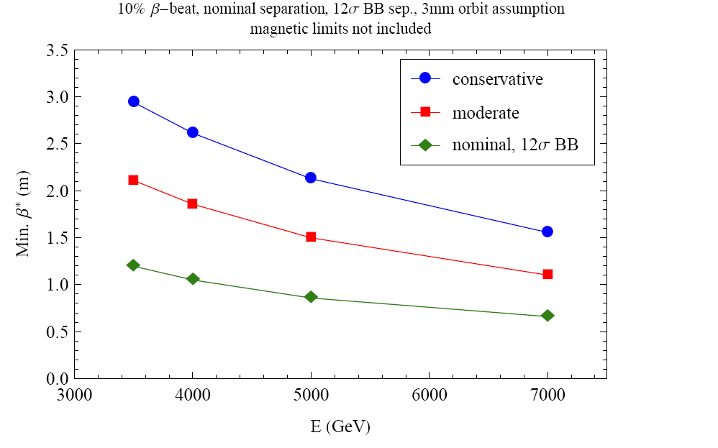
Results n1
N1 calculation

Slide 15
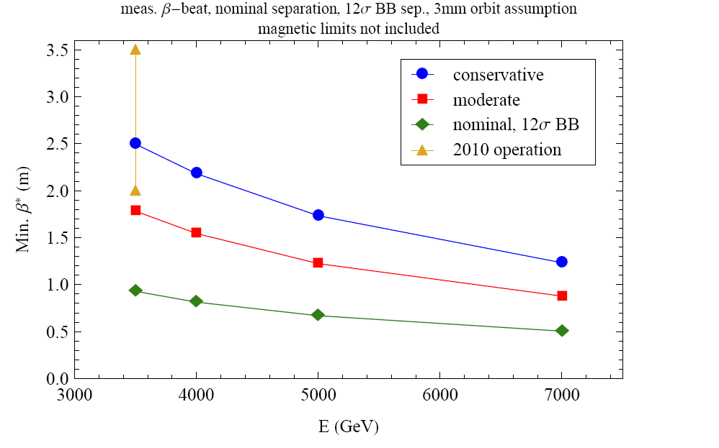
Results with aperture scaling
Aperture scaling
Smaller emittance, nominal BB separation,
better orbit etc could bring us below
0.55m at 7 TeV (only aperture considered)

Slide 16
Conclusions (1)
Squeeze limited by available triplet aperture
Measurements at injection show that real aperture is larger than predicted by n1, implying more margins. Used to calculate top energy aperture besides usual n1 method. Gain ≈ 0.5m in β*
Analysis shows that 2010 running was conservative: We could have run at β*=3.0m (n1) or β*=2.5m (scaling) instead of β*=3.5 m
Reducing separation to nominal increases aperture margin
Margins between triplet, TCT and TCDQ can be reduced but not to nominal
Three sets of margins evaluated. Possibilities at 4 TeV:
  Keeping 2010 margins: β*=2.5 m with scaling
  Moderate, reducing margins to feasibility level observed in 2010 operation: β*=1.5 m with scaling
  Nominal: not possible with present orbit stability

Slide 17
Conclusions (2)
Proposal for 2011 running: β*=1.5 m, intermediate settings, margins: 1.5 σ aperture-TCT, 2.1 σ TCT-TCDQ. n1 gives slightly more pessimistic results but we have seen that aperture is larger than predicted
Any β* and collimator settings will be qualified through provoked losses before being used during runs!
Propose to start like this but will try gain more in 2011 (IR aperture measurement, move towards nominal collimator settings etc.)
Ongoing work on TCT damage limits (Chamonix): could lead to reduced further TCT-TCDQ margin

Slide 18
Wishlist
Detailed measurements of the local triplet aperture in all IRs
  Calculations presented here still rely on pessimistic assumptions
  Global emittance blowup method can be used with addition of local bumps in the Irs
Detailed study to fully understand discrepancy between n1 calculation and measurements
Detailed analysis of all collimator margins based on stability
Better orbit and β-beat
β-beat corrected to increase margins TCT-triplet
Study of leakage TCDQ-TCT during asynchronous dumps for different retractions (needs 1 ramped/collided beam per measurement point)

Slide 20
Min β* (m) from n1 method for different margins
2010 margins, 3.5 TeV |  |  |  |  |  | 2010 margins, 4 TeV
 | orbit beta beat | 1mm | 2mm | 3mm |  |  | orbit beta beat | 1mm | 2mm | 3mm
 | 10.00% | 2.5 | 2.7 | 2.9 |  |  | 10.00% | 2.2 | 2.4 | 2.6
 | 5.00% | 2.4 | 2.6 |  |  |  | 5.00% | 2.1 | 2.3
Moderate, 3.5 TeV |  |  |  |  |  | Moderate, 4 TeV
 | orbit beta beat | 1mm | 2mm | 3mm |  |  | orbit beta beat | 1mm | 2mm | 3mm
 | 10.00% | 1.8 | 2 | 2.1 |  |  | 10.00% | 1.6 | 1.7 | 1.9
 | 5.00% | 1.7 | 1.9 |  |  |  | 5.00% | 1.5 | 1.6
Nominal margins, 3.5 TeV |  |  |  |  |  | Nominal margins, 4 TeV
 | orbit beta beat | 1mm | 2mm | 3mm |  |  | orbit beta beat | 1mm | 2mm | 3mm
 | 10.00% | 1 | 1.1 | 1.2 |  |  | 10.00% | 0.9 | 1 | 1
 | 5.00% | 1 | 1.1 |  |  |  | 5.00% | 0.9 | 0.9

