Slide 1
Status and plans of the CLIC detector study
Outline:
Introduction to the CLIC physics/detector study
CLIC CDR preparations
Status of detector simulations and software tools
Hardware R&D
Summary
Lucie Linssen
Luminosity + polarization workshop, Tel Aviv, Oct^{4th} 2010

Slide 2
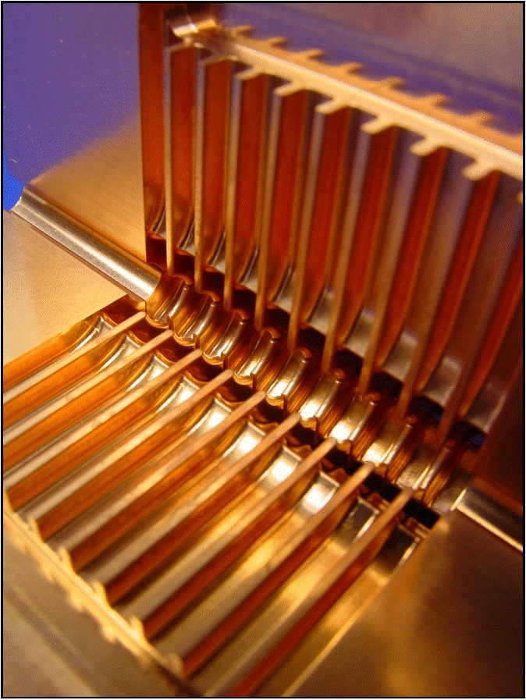
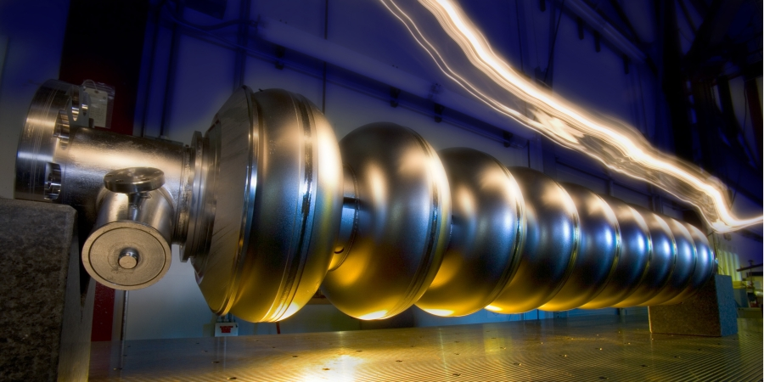
ILC and CLIC in a few words…
linear collider, producing e⁺e⁻ collisions
CLIC
ILC
Based on superconducting RF cavities
Gradient 32 MV/m
Energy: 500 GeV, upgradeable to 1 TeV (lower energies also considered)
Detector studies focus mostly on 500 GeV
Based on 2-beam acceleration scheme
Gradient 100 MV/m
Energy: 3 TeV, though will probably start at lower energy (~0.5 TeV)
Detector study focuses on 3 TeV
Luminosities: few 10³⁴ cm⁻²s⁻¹

Slide 3
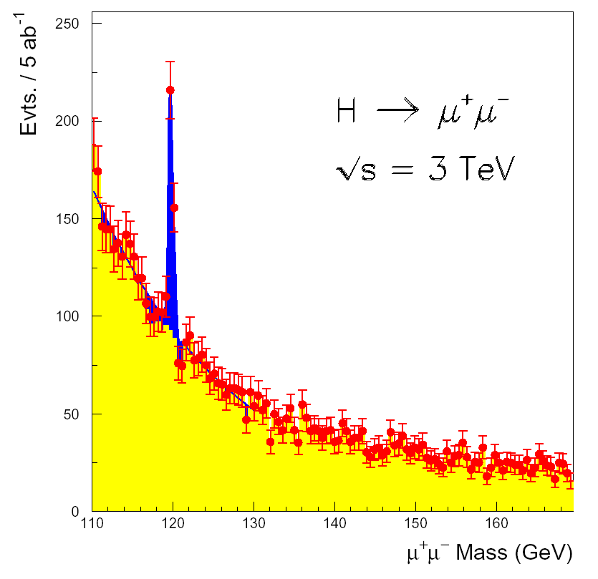
CLIC physics up to 3 TeV
What can CLIC provide in the 0.5-3 TeV range?
In a nutshell…
Higgs physics:
Complete study of the light standard-model Higgs boson, including rare decay modes (rates factor ~5 higher at 3 TeV than at 500 GeV)
  Higgs coupling to leptons
  Study of triple Higgs coupling using double Higgs production
Study of heavy Higgs bosons (supersymmetry models)
Supersymmetry:
Extensive reach to measure SUSY particles
And in addition:
Probe for theories of extra dimensions
New heavy gauge bosons (e.g. Z’)
Excited quarks or leptons

Slide 4
(S)LHC, ILC, CLIC reach
 | LHC 100 fb⁻¹ | ILC 800 GeV 500 fb⁻¹ | SLHC 1000 fb⁻¹ | CLIC 3 TeV 1000 fb⁻¹
Squarks (TeV) | 2.5 | 0.4 | 3 | 1.5
Sleptons (TeV) | 0.34 | 0.4 |  | 1.5
New gauge boson Z’ (TeV) | 5 | 8 | 6 | 22
Excited quark q* (TeV) | 6.5 | 0.8 | 7.5 | 3
Excited lepton l* (TeV) | 3.4 | 0.8 |  | 3
Two extra space dimensions (TeV) | 9 | 5-8.5 | 12 | 20-35
Strong W_{L}W_{L} scattering | 2σ | - | 4σ | 70σ
Triple-gauge Coupling (95%) | .0014 | 0.0004 | 0.0006 | 0.00013
Gian Giudice CLIC09

Slide 5
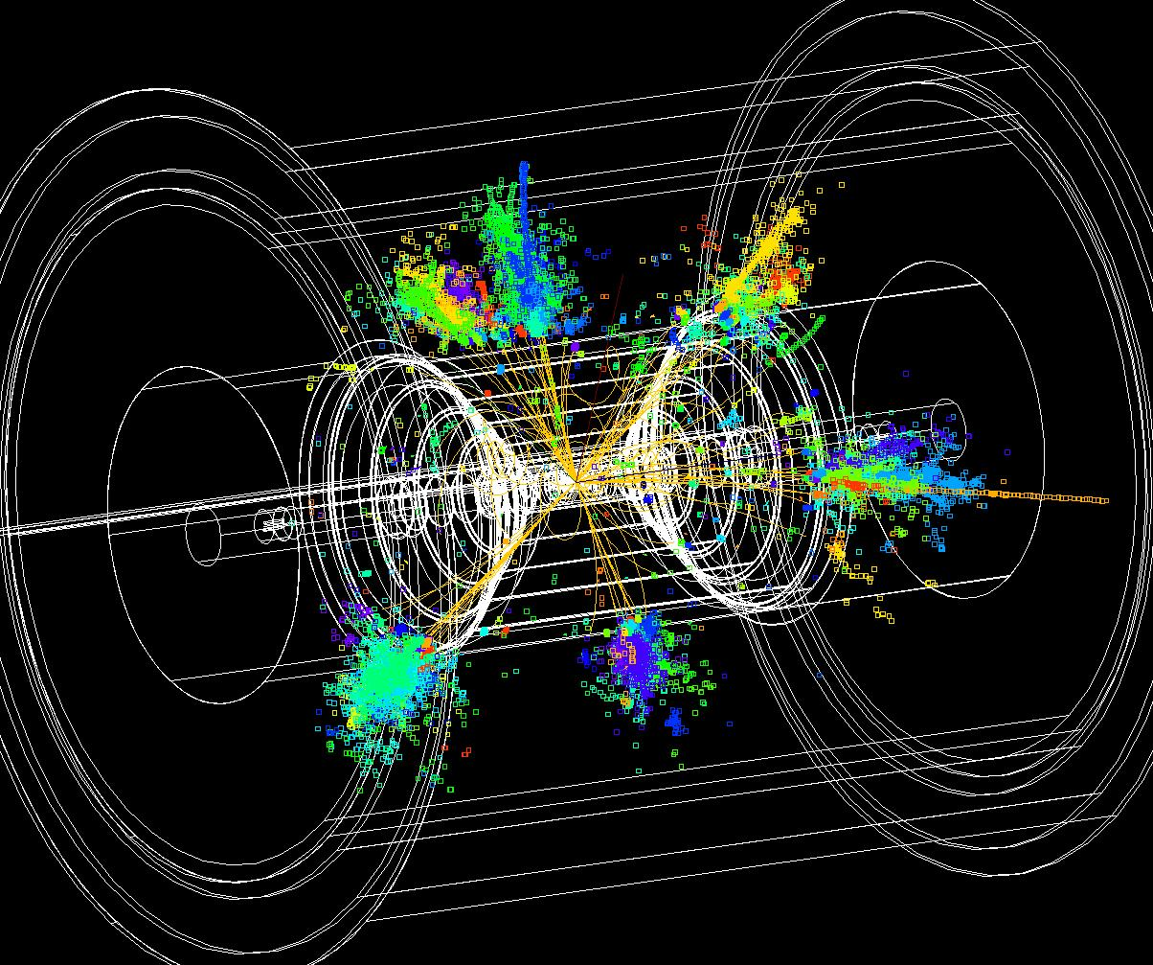
ILC and CLIC detector studies
In several aspects the CLIC detector will be more challenging than ILC case, due to:
  Energy 500 GeV => 3 TeV
  More severe background conditions
    Due to higher energy
    Due to smaller beam sizes
  Time structure of the accelerator
Detector studies and R&D for the ILC are most relevant for CLIC.
Many years of investment in ILC e⁺e⁻ physics/detector simulations, hardware R&D and detector concepts. No need to duplicate work.
Therefore the CLIC detector study links to several ILC collaborations:
ILD concept, SiD concept, CALICE, FCAL, LC-TPC + EU projects (EUDET/AIDA).

Slide 6
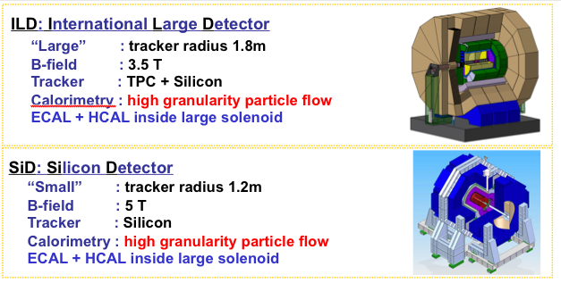
Validated ILC concepts
CLIC detector concepts will be based on SiD and ILD.
Modified to meet CLIC requirements

Slide 7
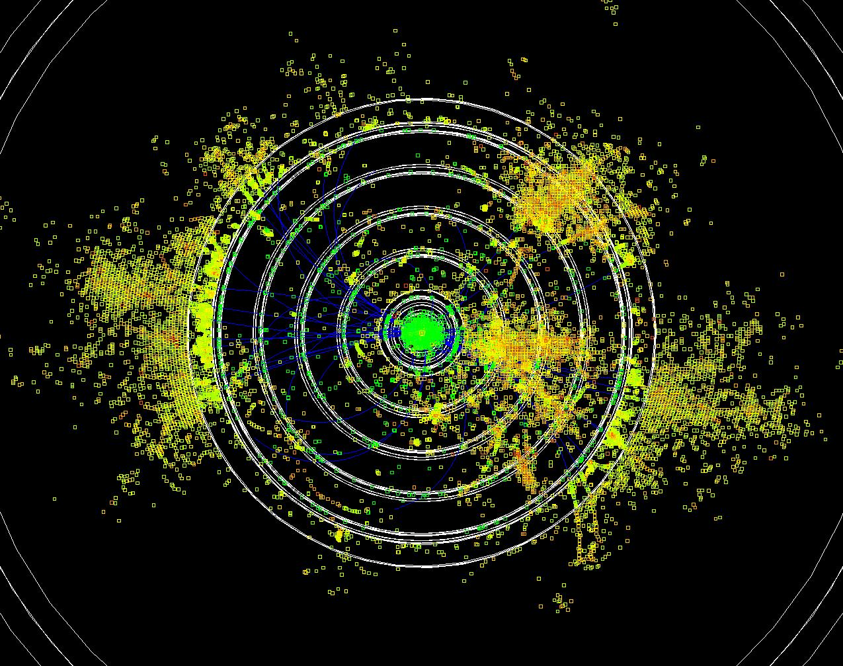
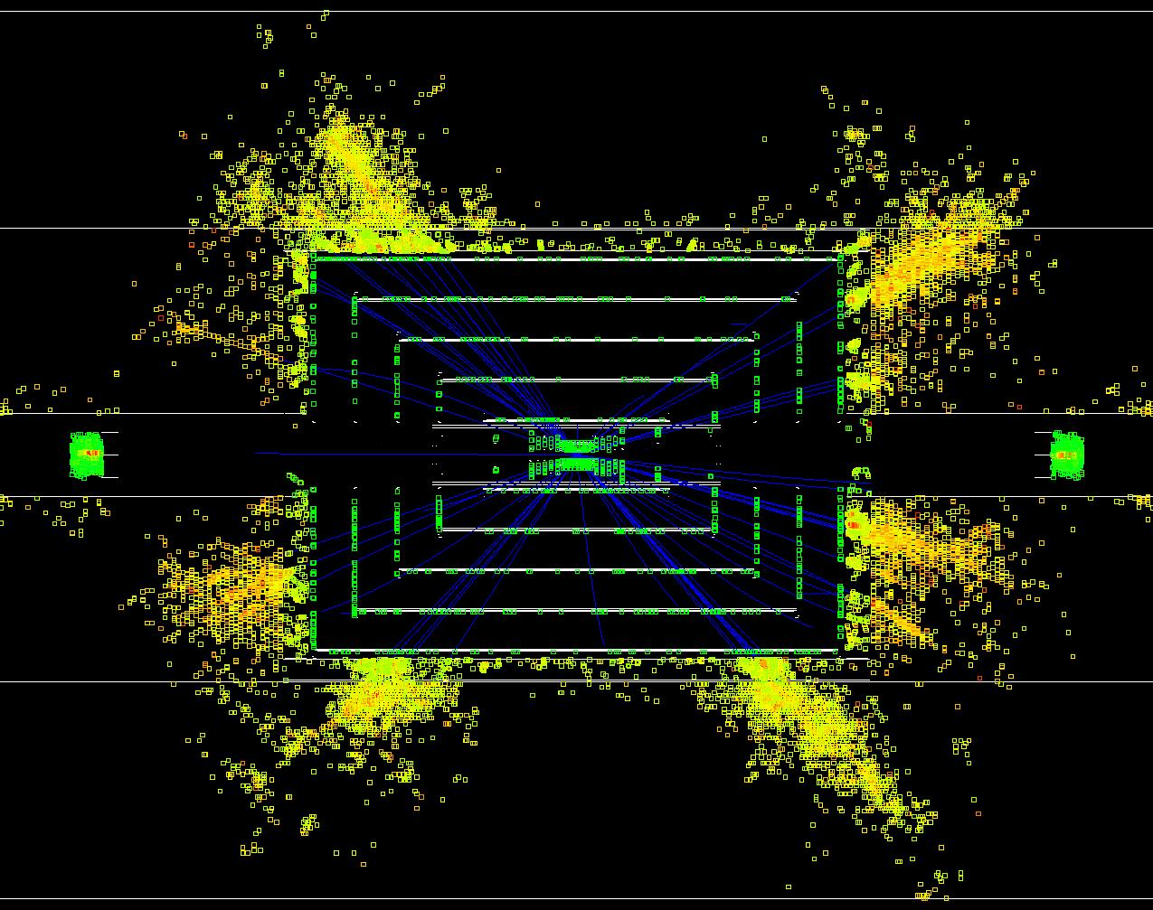
CLIC tracking/calorimetry issues
Due to beam-induced background and short time between bunches:
  High occupancy in the inner regions (incoherent, tridents)
  Jets scale and resolution are affected (γγ=>hadrons)
  Time-stamping is a must for almost all detectors
Narrow jets at high energy
  Calorimeter has to measure high-energy particles (leakage)
  Separation of tracks in dense jets
3TeV e⁺e⁻ ⎝ t t^{bar}

Slide 8
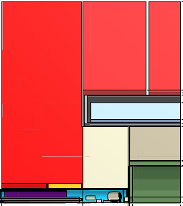
the ILC concepts adapted to CLIC
“CLIC_SiD”
Changes to the ILC detectors:
20 mrad crossing angle
Vertex Detector to 25-30 mm inner radius, due to Beam-Beam Background
HCAL barrel with 7.5 Λ_{i} with 1 cm tungsten plates
HCAL endcap with 7.5 Λ_{i} with 2 cm steel plates
Forward (FCAL) region adaptations (see next talks)
~7.0m
~6.2m
z=0

Slide 9
CLIC CDR
The CDR will have 3 volumes:
  1 Executive summary (~50 pages)
  2 The CLIC accelerator and site facilities (~800 pages)
  Physics and detectors at CLIC (~150 pages)
Main aim of the CDR:
Accelerator:
demonstrate the feasibility of the CLIC technology
design of a linear collider based on CLIC technology
Feasibility issues ⬄ to be addressed in the CDR
Performance issues and cost optimisation ⬄ to be addressed in the TDR phase
Physics and Detectors:
Describe the CLIC physics potential
Demonstrate that CLIC physics can be measured with adequate precision

Slide 10
CLIC physics/detector CDR
The CLIC CDR will present the CLIC_ILD and CLIC_SiD concepts and their detector technologies.
Performances will be demonstrated with either CLIC_ILD or CLIC_SiD (presenting some results for each).
Dedicated working groups are addressing specific aspects:
WG1: CLIC physics potential
WG2: Physics observables related to jets
WG3: Physics observables related to tracks
WG4: Vertex detector technology
WG5: Engineering, layout, solenoid, cost
WG6: CLIC benchmark studies
Current focus of the work: gear up for detector benchmark simulations
Deadline for final document ~Aug. 2011 (present to CERN Council in Dec. 2011)

Slide 11
CLIC “editing” status
Status of CDR preparation following dedicated meetings for each of the chapters

Slide 12
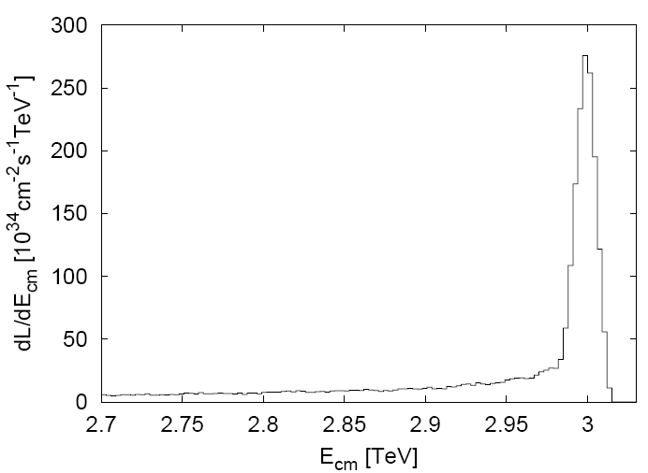
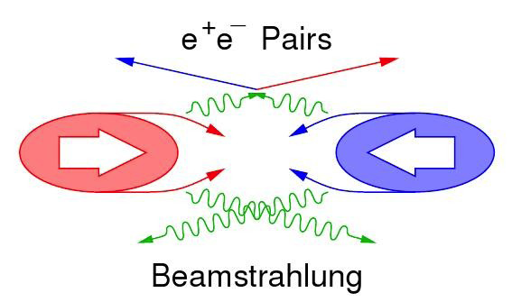
Beam-induced background
Main backgrounds:
CLIC 3TeV beamstrahlung ΔE/E = 29% (10×ILC_{value})
  Coherent pairs (3.8×10⁸ per bunch crossing) <= disappear in beam pipe
  Incoherent pairs (3.0×10⁵ per bunch crossing) <= suppressed by strong solenoid-field
  “Tridents” <= give an impact “similar” to incoherent pairs
  γγ interactions => hadrons (3.3 hadron events per bunch crossing)
In addition: Muon background from upstream linac
CLIC luminosity spectrum
30% in “1% highest energy”

Slide 13
Beam-induced backgrounds and forward-region studies
Subject are covered in the talks of Andre Sailer and Konrad Elsener
  Forward region layout and optimisation
  Suspension and stability of QD0
  Background events, including trident events
  Radiation doses in Beamcal
In the next slides: Update on γγ => hadron background
Until now, slightly different models were used by ILC and CLIC communities (some differences in: production cross section, inv. mass cut-off, software tools/version).
  A systematic study was done => agree on a common method
  Results on characteristics of the γγ=>hadron background

Slide 14
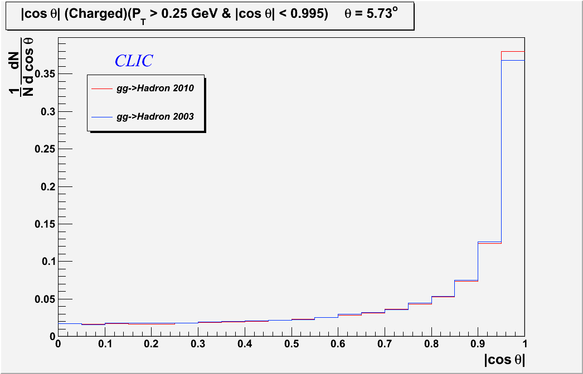
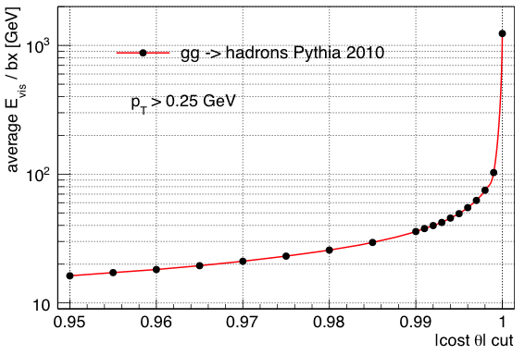
γγ=>hadron background (1)
# particles
average Energy per BX
6°
The yy=>hadron background is forward-peaked
D. Dannheim, O. Sahin, CERN

Slide 15
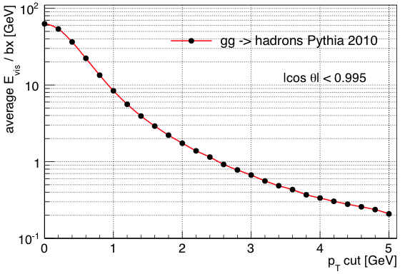
γγ=>hadron background (2)
Per bunch crossing:
3.3 such events
~28 particles into the detector
50 GeV
Forward-peaked
15 TeV dumped in the detector per 156 ns bunch train !
we need time-stamping and optimal selection methods
average Energy per BX
D. Dannheim, O. Sahin, CERN

Slide 16
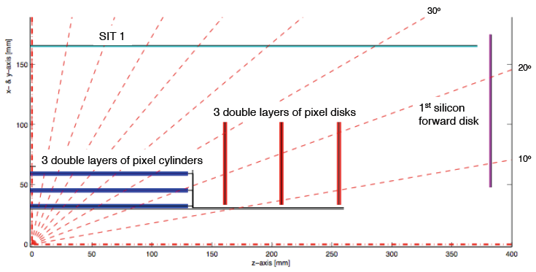
CLIC vertex detector (1)
Current CLIC_ILD vertex detector model
Stand-alone Monte Marlo models and some full simulation studies have been carried out.
A detector layout is proposed: compatible with required precision, background conditions, flavour tagging capabilities, tracking coverage

Slide 17
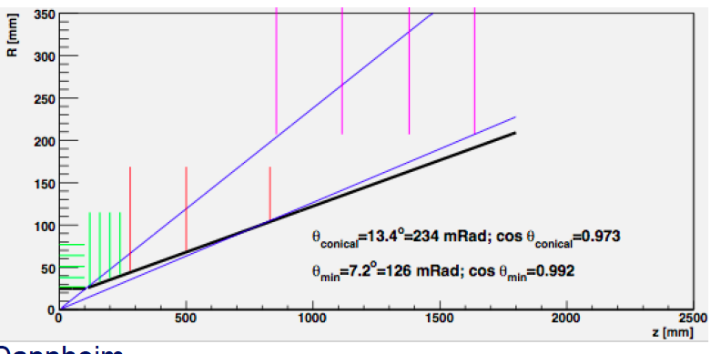
CLIC vertex detector (2)
Current CLIC_SiD vertex detector model
C. Grefe, CERN+Bonn

Slide 18
CLIC vertex detector (3)
Requirements for the vertex detector need to be determined more precisely. Global needs:
Single-layer position resolution ~3μm – 5 μm
    Typically achieved with 20*20 micron pixels
Single-layer material thickness 0.1%X₀ – 0.2%X₀
Time-stamping ~5-10 ns (?)
  Still needs more study with full simulation
Occupancy
  Will be at the ~10% level for the innermost layer
  Therefore we need multi-hit capability
Triggerless readout over the 156 ns bunch-train
  With full data readout in less than 200-400 μsec to allow power-pulsing
Very challenging hardware project

Slide 19
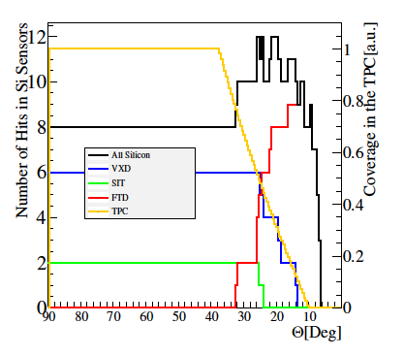
CLIC_ILD tracking coverage
A. Sailer, CERN+Berlin

Slide 20
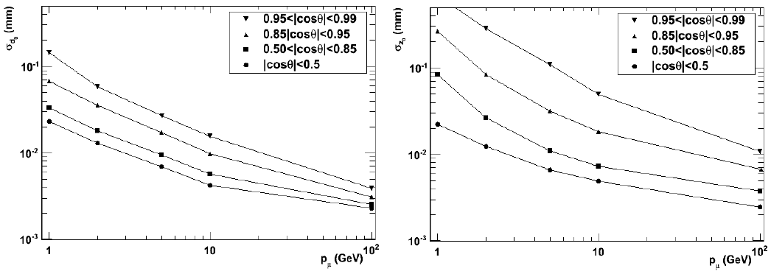
CLIC_ILD impact parameter
Impact parameter resolution for single muons
R-Φ
Z
5 μm
M. Battaglia, UCSC+CERN

Slide 21
Calorimetry and particle flow
Tungsten-based HCAL motivation:
  To limit longitudinal leakage CLIC HCAL needs to be rather deep
  A deep HCAL pushes the coil/yoke to larger radius (would give a significant increase in cost and risk for the coil/yoke)
  A tungsten HCAL (CLIC option) is more compact than Fe-based HCAL, (ILC option) while Geant4 performance (resolution) is similar
  Increased cost of tungsten barrel HCAL compensates gain in coil cost
Particle-flow calorimetry for CLIC:
  ILC calorimeters are based on particle flow
  At high energies, jets become more dense => a-priori not clear whether PFA provides adequate resolution at CLIC
  New, more flexible, version of Pandora PFA code was written (Cambridge Univ.)
  Can be used for CLIC_ILD and CLIC_SiD detector simulations

Slide 22
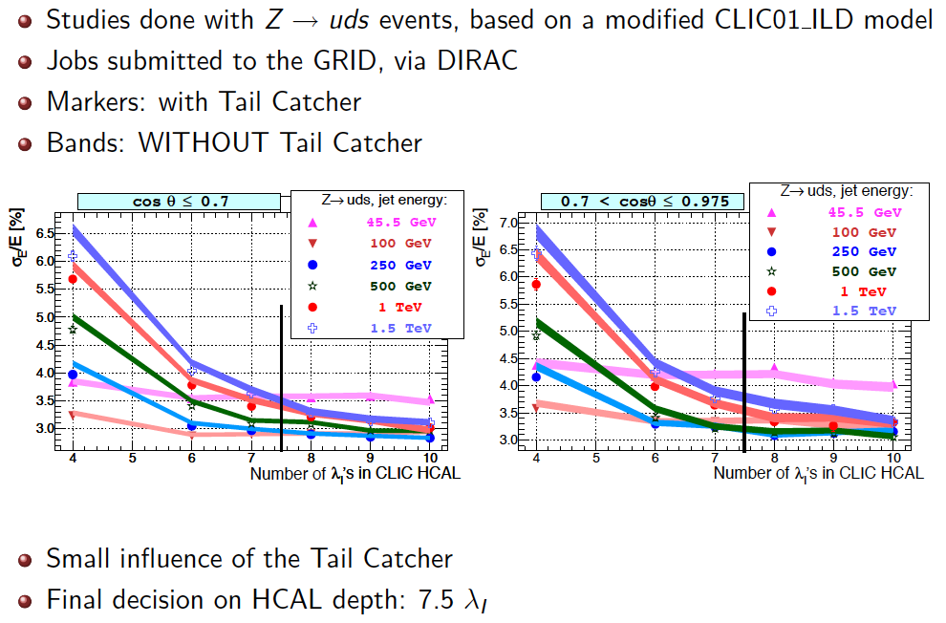
HCAL depth studies, Pandora PFA
A. Lucaci-Timoce, CERN

Slide 23
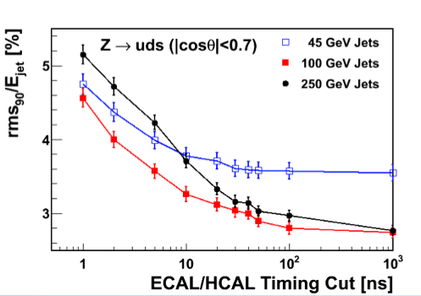
Tungsten-based HCAL and R&D
CLIC CDR HCAL depth is 7.5Λ_{i}. Absorber choices:
  10 mm tungsten platen in the barrel (70 layers)
  20 mm steel plates in the end-cap (60 layers)
The hadronic shower development in tungsten is slower than in steel, because the shower in tungsten has an important slow-neutron component.
This needs to be understood well, because we also need precise time-stamping to distinguish physics from background
=> Test beam prototype !
M. Thomson, Cambridge

Slide 24
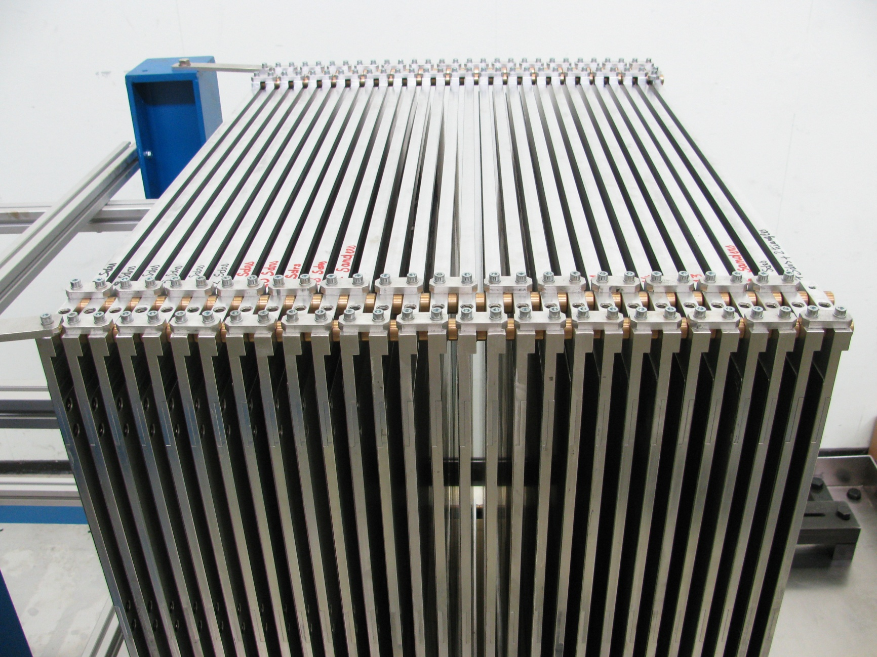
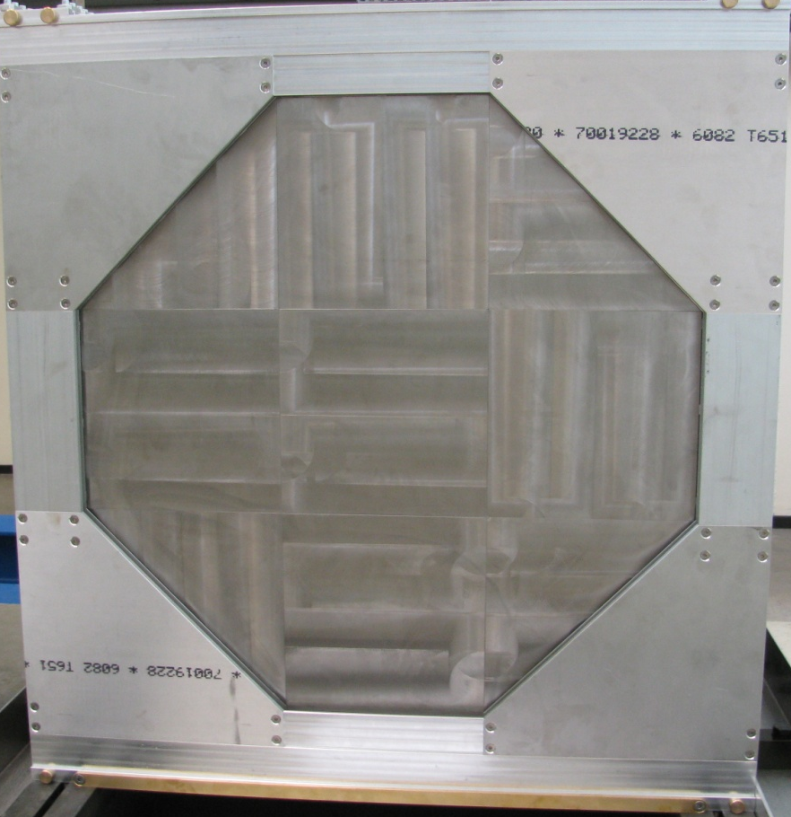
Tungsten HCAL prototype
Check Geant4 simulation in test beam
  Prototype tests performed within CALICE collab.
  Use 30-40 layers of Tungsten, 1 cm thick, 80 cm Ø
  Use different active materials
  Start in Nov 2010, with 30 W plates, and scintillator planes
Tungsten stack
W-plane

Slide 25
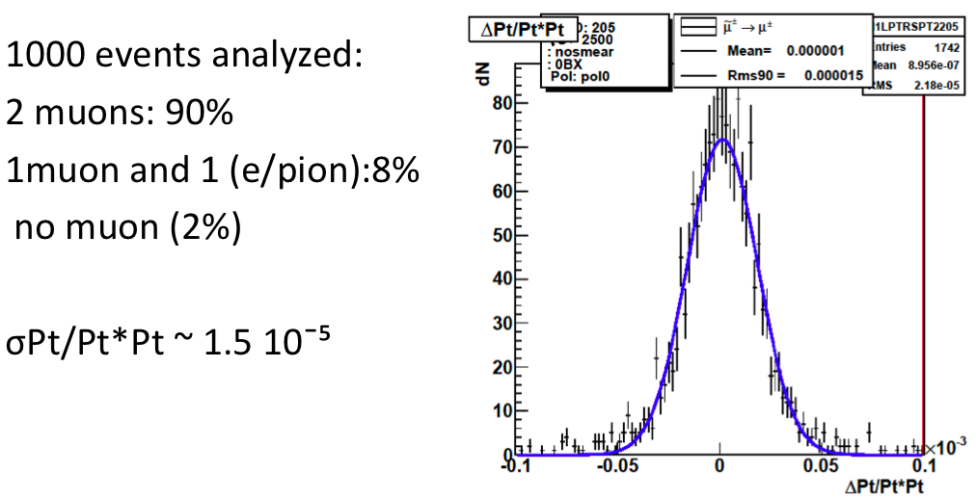
Pandora PFA and particle ID
Smuon (di-muon) events at 3 TeV
JJ.Blaising, Annecy

Slide 26
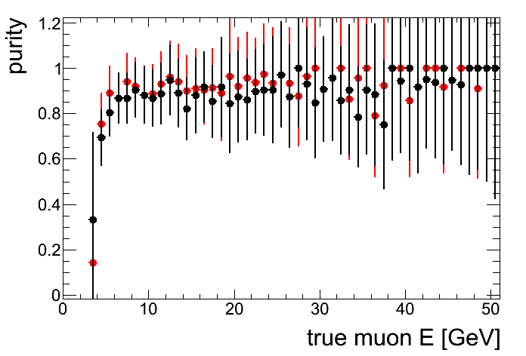
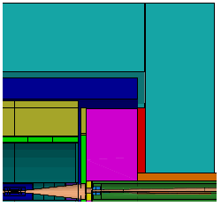
Muon measurements
Working towards an optimised yoke system and muon ID
Taking engineering and magnetic field contraints into account
Tail catcher function
Muon ID, integrated with calorimeter and tracker => linked to PFA
Currently considering: 3 layers (tail catcher) + 2*3 layers (muon id)
Instrumented yoke
Efficiency and
“work in progress”
Instrumented yoke plug
E. van der Kraaij, CERN

Slide 27
and also…
In addition: many other activities on…
CLIC physics potential (kick-off @ IWLC)
Polarisation working group
Detector requirement studies, using benchmark processes
Detector benchmark studies
Grid development and event generation
Magnet system
Cost
…
.. All activities in direct contact with ILC groups

Slide 28
CLIC detector R&D, overview
CLIC hardware/engineering R&D (needed beyond ILC developments):
Vertex detector
  trade-off between pixel size, amount of material and timing resolution
Hadron calorimetry
  Tungsten-based HCAL (trade-off between Energy and time resolution)
Solenoid coil
  Large high-field solenoid concept, reinforced conductor (CMS/ATLAS experience)
R&D to support mechanical stability modeling
  In view of sub-nm precision required for FF quadrupoles (QD0)
Time stamping
  Needed for (almost) all subdetectors (typically 5-10 nsec resolution required)
Power pulsing
  In view of the 50 Hz CLIC time structure => allows for low-mass detectors

Slide 29
Summary
CLIC detector studies are well under way
Community is growing, in close contact with ILC groups
Work currently focuses on CLIC physics/detector CDR (Mid-2011)
Detector requirements globally “understood”
Detector geometries for CDR simulations are being finalised
Software tools for CDR benchmark studies are being finalised (~1 month)
Physics benchmark studies for the CDR are starting
Hardware R&D has really started
Time schedule for the CDR is tight, but feasible
Welcome to join !

Slide 30
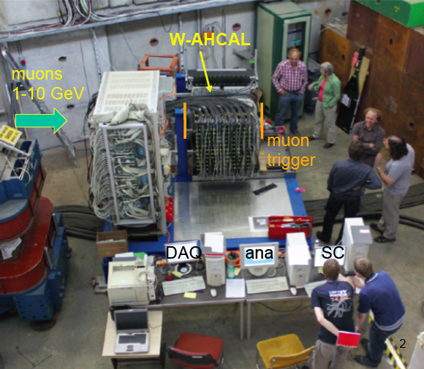
Thank you !

Slide 31
Spare Slides

Slide 32
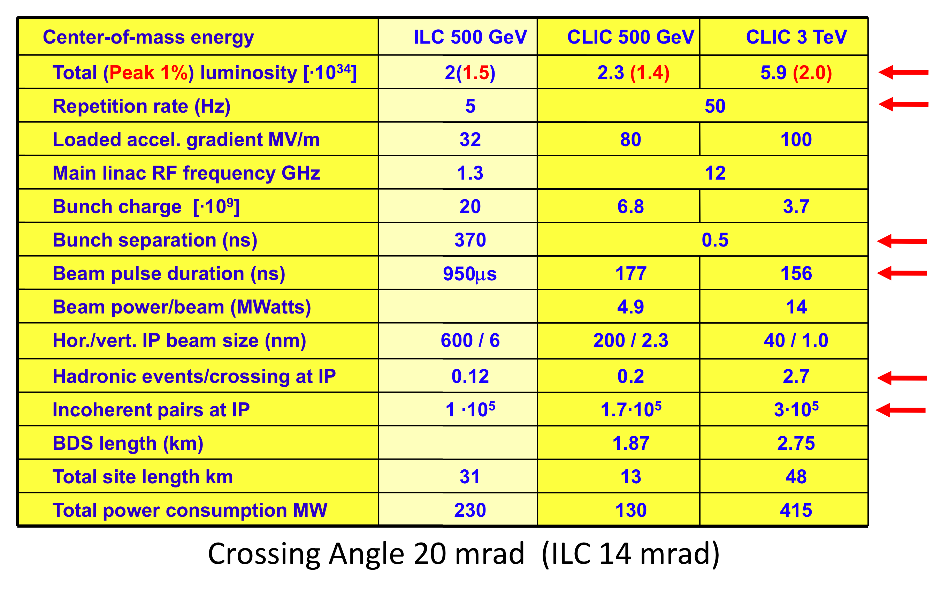
CLIC parameters

Slide 33
CLIC time structure
CLIC and ILC time structure
Train repetition rate 50 Hz
CLIC
CLIC: 1 train = 312 bunches 0.5 ns apart 50 Hz
ILC: 1 train = 2820 bunches 308 ns apart 5 Hz

Slide 34
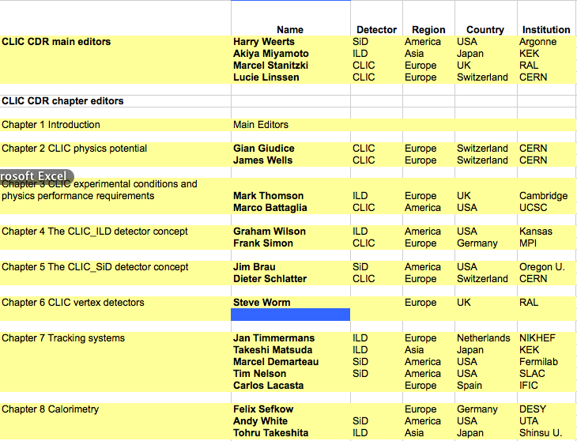
Vol. 3 CDR editors (1)

Slide 35
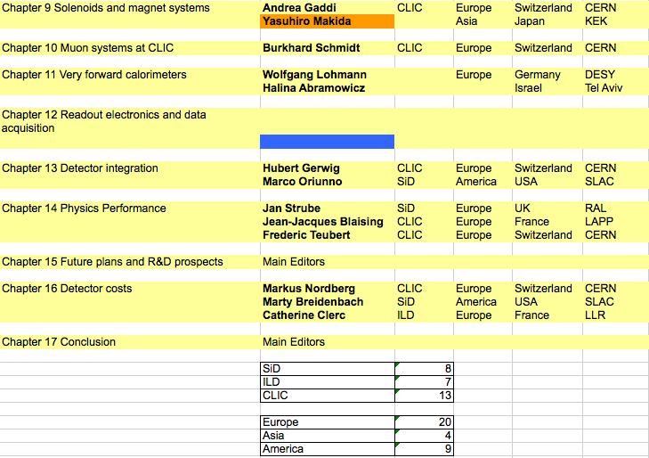
Vol. 3 CDR editors (2)

Slide 36
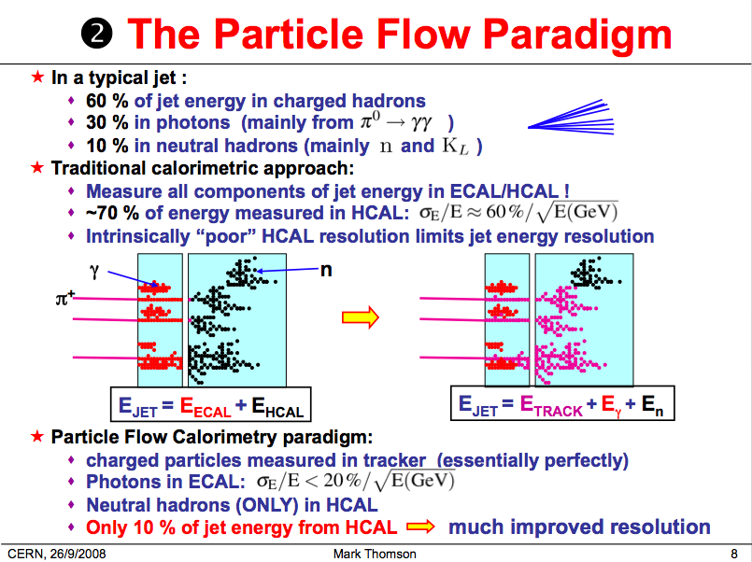
Mark Thomson

Slide 37
LINKS
and
MAILING LISTS

Slide 38
Links
LCD project web page:
http://lcd.web.cern.ch/LCD/
LCD internal notes:
http://lcd.web.cern.ch/LCD/Documents/Documents.html
Wiki page with various documentation:
https://twiki.cern.ch/twiki//bin/view/CLIC/Detector
For example, in the wiki page you can find the SiD’ and ILD’ modified detector geometries for CLIC, and the software documentation
LCD indico pages:
http://indico.cern.ch/categoryDisplay.py?categId=1954

Slide 39
How to join our mailing lists
For a list/description of our working groups, see our indico page:
http://indico.cern.ch/categoryDisplay.py?categId=1954
If you want to join one or several of our working groups you can subscribe to the respective mailing lists, by following the e-groups link:
https://groups.cern.ch/Pages/GroupSearch.aspx?k=lcd-wg
In case you encounter any problems, please contact:
Kate.ross@cern.ch
Lucie.linssen@cern.ch

