Slide 1
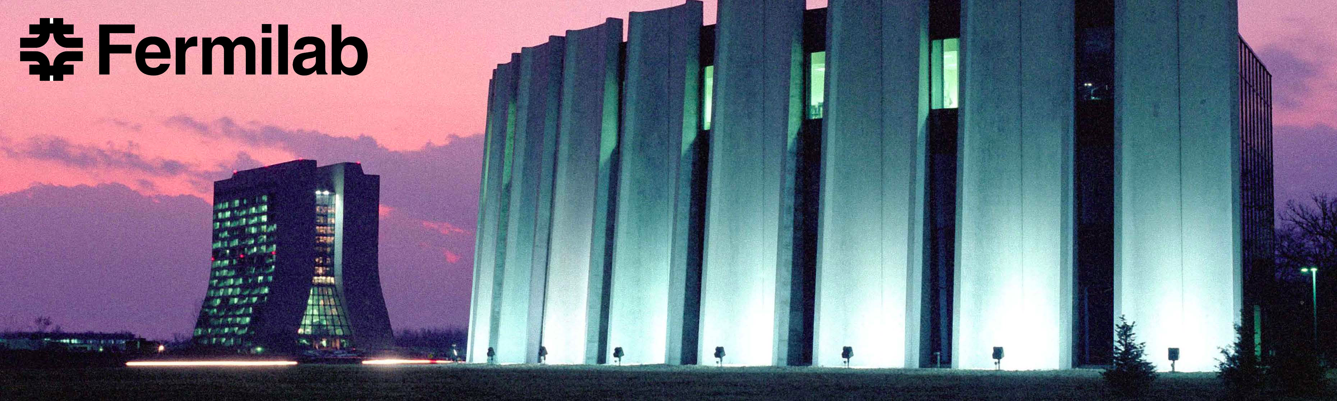
Fermilab Perspectives in Computing and Data Management
Victoria White,
Associate Lab Director for Computing Science and Technology/CIO
May 16, 2011- Data Preservation Workshop
Notes:
Overview of the Scientific Computing program

Slide 2
Scientific Computing at Fermilab
Scientific computing at Fermilab provides the computing facilities, expertise, partnership and support for the lab’s scientific research programs
    High Throughput Computing for our data intensive sciences
    High Performance Computing for simulation sciences
    Cyber Infrastructure in support of science
    Partnership and technical expertise
    Education and Outreach

Slide 3
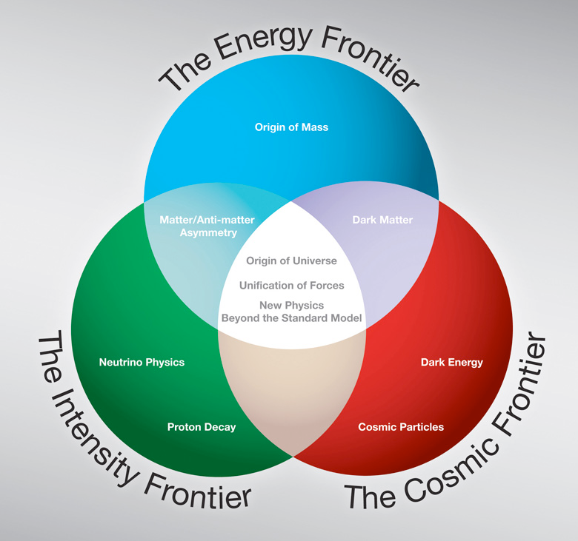
Fermilab Scientific Program: basic research at the frontiers of high energy physics and related disciplines.
Built on:
Accelerators,
Detectors,
Computing

Slide 4
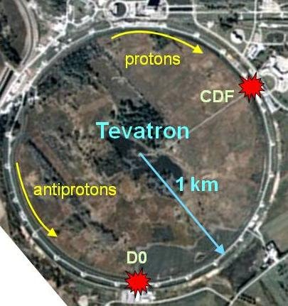
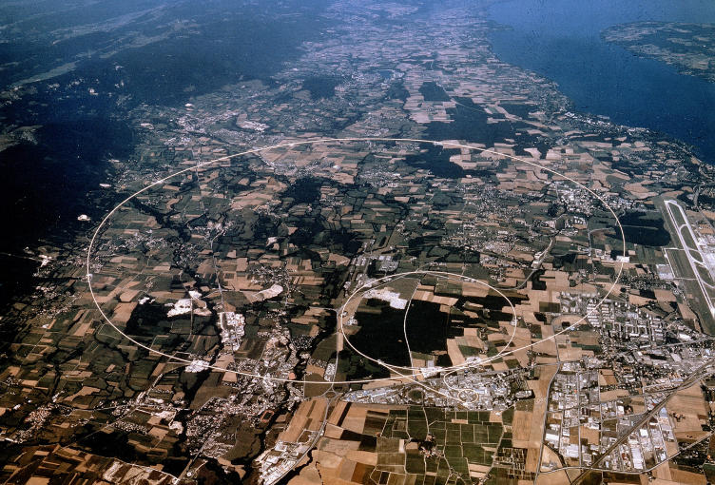
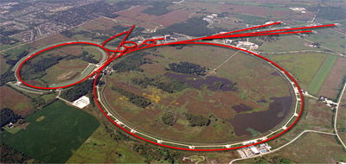
Accelerators for research into the nature of energy and matter (particle physics)
CERN – Large Hadron Collider (LHC) in Geneva Switzerland
Fermilab Accelerator Complex

Slide 5
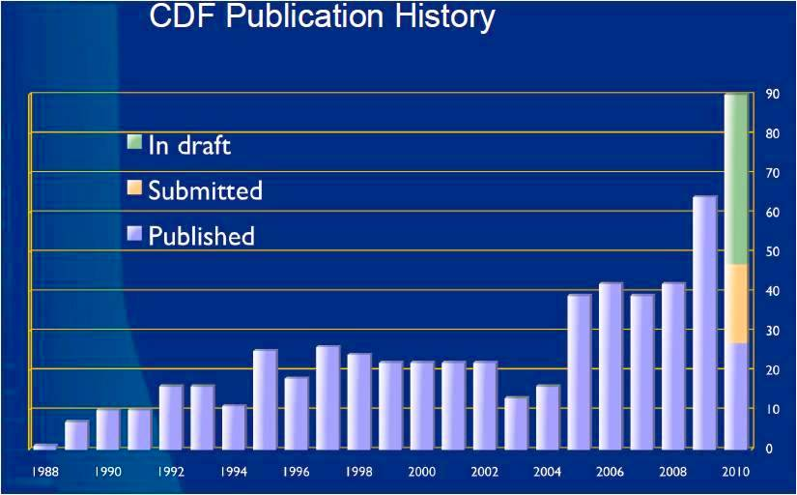
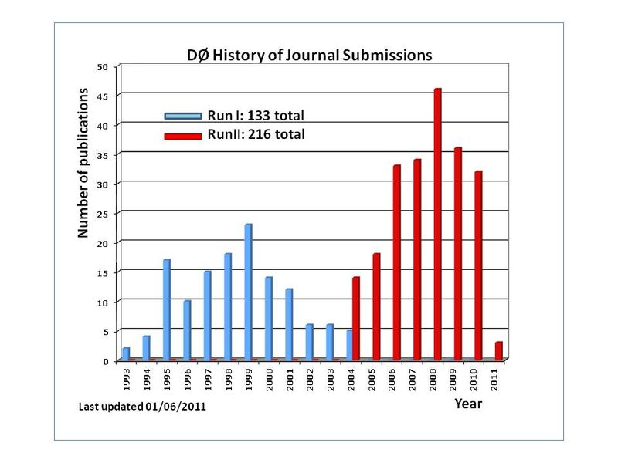
Tevatron in the news: looking ahead
CDF and D0 expect the publication rate to remain stable for several years.
Analysis activity:
  Expect > 100 (students+ postdocs) actively doing analysis in each experiment through 2012.
  Expect this number to be much smaller in 2015 though data analysis will still be on-going.
40
CDF Publications each year
D0 Publications each year

Slide 6
Tevatron “Data Preservation” note
Collaborations are still strong
All the data management systems and access to conditions data is working well
All the codes are maintained and authors are not yet far removed
Many distributed sites can help with computation – for simulation and analysis
BUT – full reprocessing of the data today is still prohibitively costly
  Selective partial reprocessing is in the plans for both CDF and Dzero

Slide 7
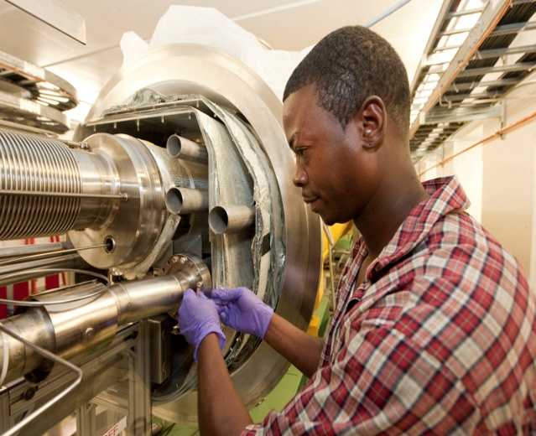
Fermilab Energy frontier roadmap
Tevatron
(CDF,D0)
LHC
LHC
LHC Upgrades
ILC??
LHC
ILC, CLIC or
Muon Collider
Now
2013
2016
2019
2022

Slide 8
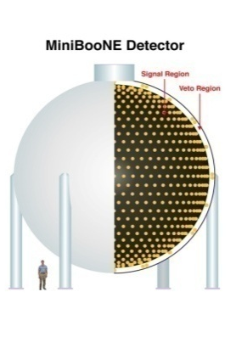
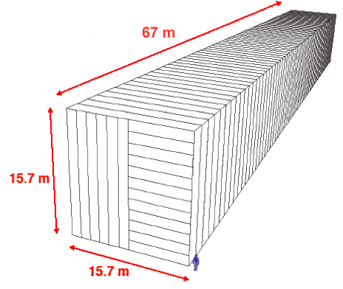
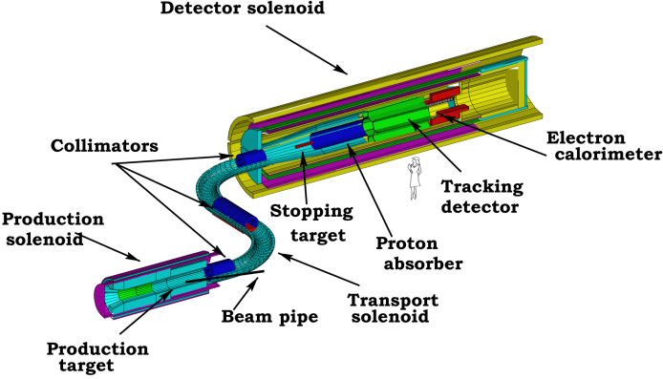
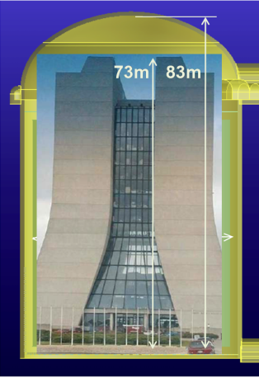
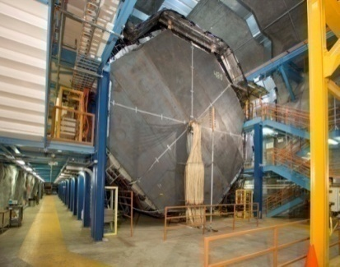
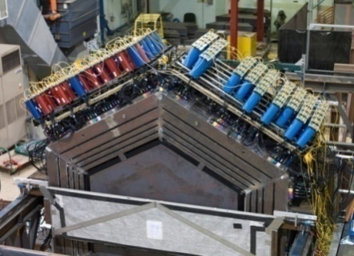
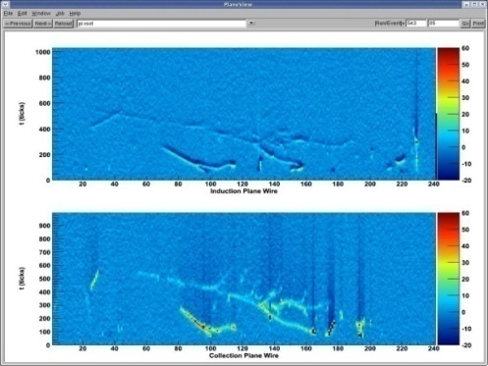
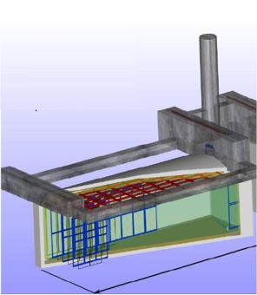
Intensity frontier roadmap
MINOS
MiniBooNE
MINERvA
SeaQuest
NOvA
MicroBooNE
g-2
SeaQuest
LBNE
Mu2e
Project X+LBNE
μ, K, nuclear, …
ν Factory ??
Now
2013
2016
2019
2022

Slide 9
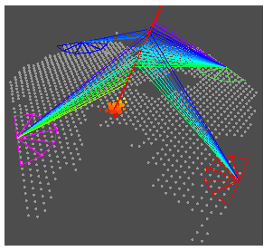
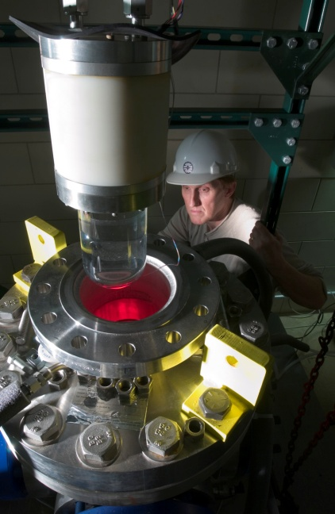
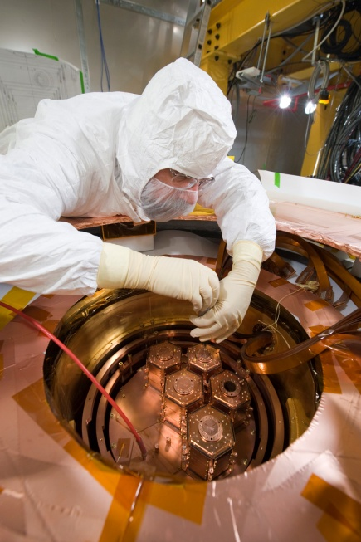
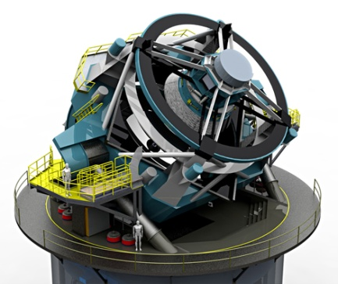
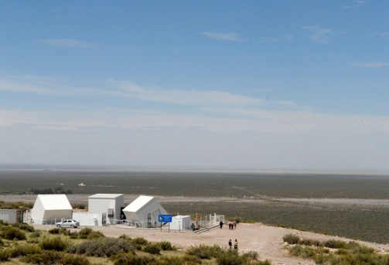
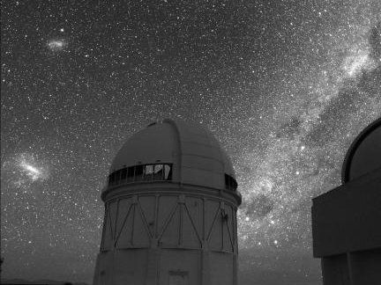
Cosmic frontier roadmap for Dark Matter (DM) and Dark Energy(DE)
DM: ~1 ton
DE: LSST
WFIRST??
BigBOSS??
DM: COUPP
~ 10 kg
DE: SDSS
P. Auger
DM: ~100kg
DE: DES
P. Auger Holometer?
DE: LSST
WFIRST??
Now
2013
2016
2019
2022

Slide 10
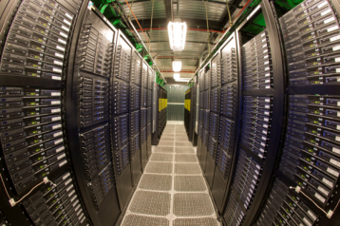
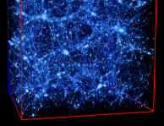
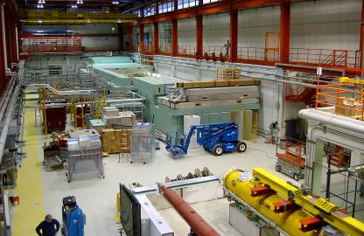
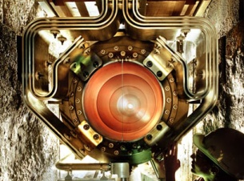
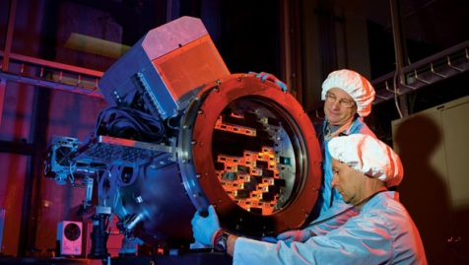
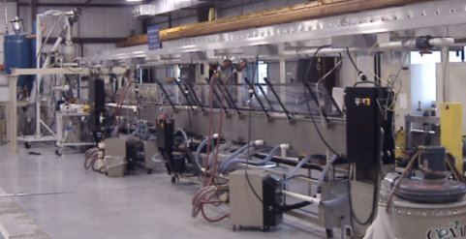
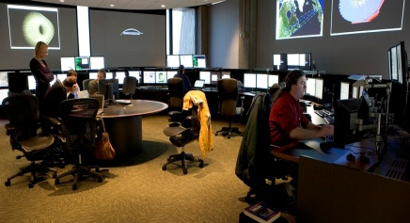
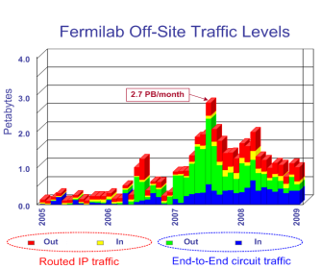
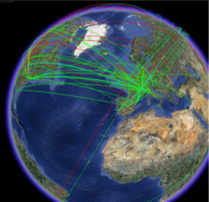
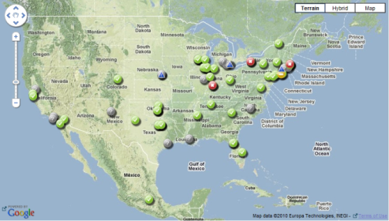
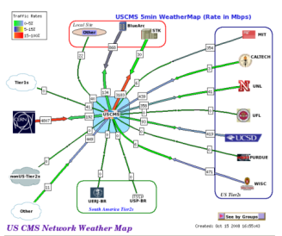
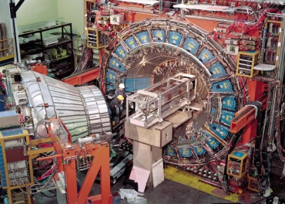
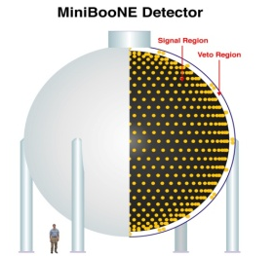
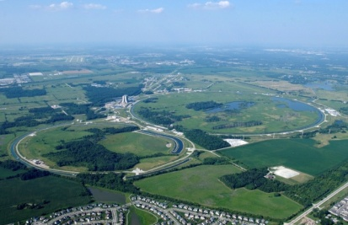
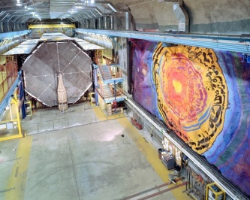

Science using Large Scale User Facilities
Large Scale User Facilities: Skill | Energy Frontier | Intensity Frontier | Cosmic Frontier
Theory | Lattice QCD National Facility | Lattice QCD National Facility | Cosmological Computing
Accelerator Technologies | NML Accel Test Facility, MuCOOL Test Area, Muon Collider, ILC | NML Accel Test Facility, NuMI, LBNE, Mu2e, Project X, Neutrino Factory
Advanced Instrumentation | Silicon Detector Facility Center | LAr R&D Facility, Extruded Scintillator Facility | LAr R&D Facility, Silicon Det. Facility Center (DES CCD packaging)
Simulation
Data Analysis & Distributed Computing | LHC Physics Center, Open Science Grid, CMS Tier-1 Center, Advanced Network, Massive Data Storage | Open Science Grid | Survey Data Archive
Systems Integration, Operations, Project Management | Tevatron Complex, CDF/DZero detectors, LHC Remote Oper. Center, Testbeam | NuMI & BNB (ν beams), Neutrino detectors, Soudan Underground Lab, Testbeam / small expt.s | Testbeam, Soudan Underground Lab., Silicon Detector Facility Center, Pierre Auger
10

Slide 11
The Fermilab Scientific Program
 | Applications | Type of Computing | Computing Facilities
EXPERIMENT | Detector simulation Event simulation Event processing Data analysis. DAQ software triggers | High Throughput and Small Scale Parallel (<= number of cores on a CPU) | Fermilab campus grid (FermiGrid) Open Science Grid (OSG) World Wide LHC Computing Grid (WLCG) Dedicated clusters FermiCloud
COMP SCI | Accelerator modeling Lattice Quantum ChromoDynamics (LQCD) Cosmological simulation | Large Scale Parallel High Performance Computing | Local “mid-range” HPC clusters Leadership class machines: NERSC, ANL, ORNL, NCSA etc.
 | Data acquisition and event triggers | Custom computing | Custom, programmable logic, DSPs, embedded processors.

Slide 12
Computing required for experiment data (on all frontiers)
Triggers to reduce and select data for recording
Reconstruct Raw data -> physics summary data
Analyze reconstructed data
Create simulated (MC) data needed for analysis
Reprocess data and regroup processed data
Store and distribute data to collaborators worldwide
Software tools & services and expert help at times (e.g. detector simulation, generators, code performance)
Long-term curation of data and preservation of analysis capabilities after experiment ends
Software frameworks, algorithms and performance tools
Support for Collaboration on a national and worldwide scale

Slide 13
Data Storage at Fermilab - Tape

Slide 14
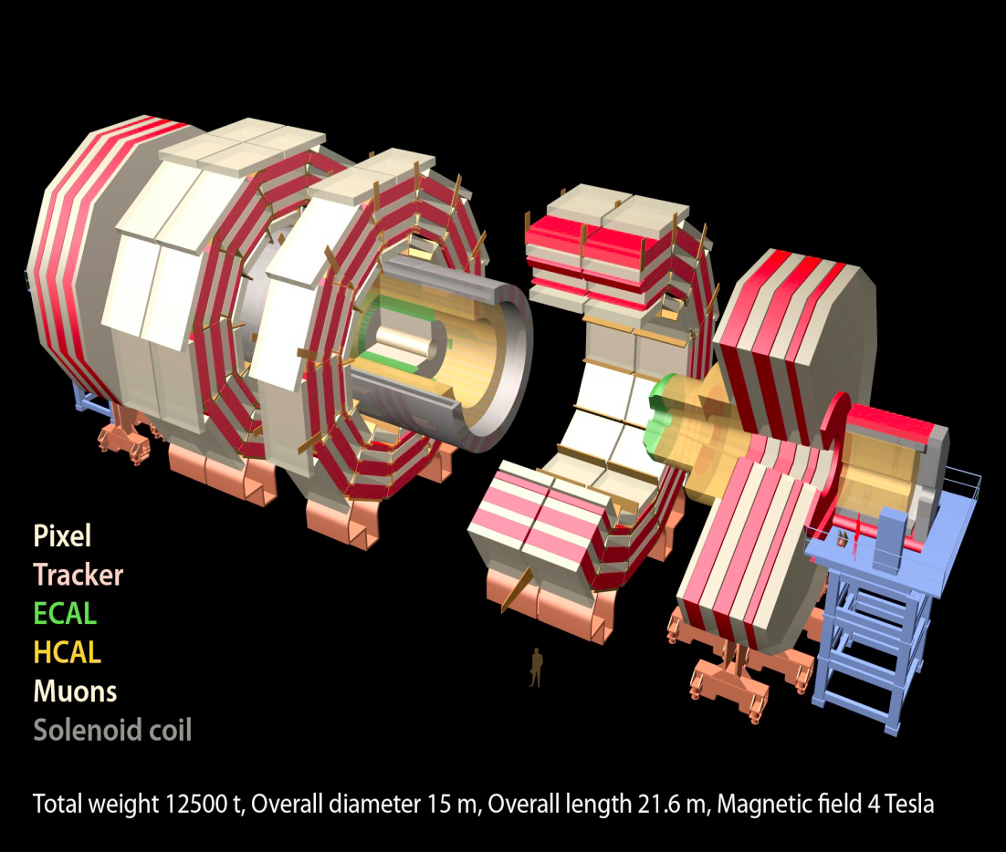
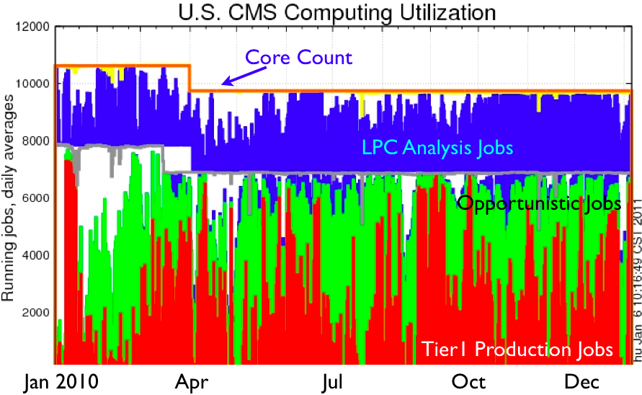
CMS Tier 1 at Fermilab
The CMS Tier-1 facility at Fermilab and the experienced team who operate it enable CMS to reprocess data quickly and to distribute the data reliably to the user community around the world.
Fermilab also operates:
LHC Physics Center (LPC)
Remote Operations Center
U.S. CMS Analysis Facility
Notes:
2010 Data Taking was successful. Scientific Results published within weeks of data being acquired.
Computing system has had flexibility to handle
trigger rates at 300 Hz and much higher in peaks, T0 kept up
more reprocessing passes than expected (19)
full 2010 pp dataset reprocessed in 10 days plus one week debugging/postmorterm
large transfer rates, full-mesh transfer topology
5 PB from T0 and other T1’s to T1
Most T2’s can get data from any T1 or T2
3.1 billion events simulated
with underlying experimental conditions changing throughout!
Workflows were performed at expected locations from Day 1
2011 will have quick startup, with peak luminosity for the year reached as soon as May -- 16 interactions/event!
RECO/AOD event sizes double from 2010 values to 0.8/0.2 MB/event

Slide 15
Today: data processing and data
In modern distributed computing systems the bulk of the processing is located away from the archives
Prompt Processing
Archival Storage
CERN
Tape
FNAL
Tier-1
Tier-1
Tape
Tape
Tier-2
Tier-2
Tier-2
Tier-2
Chaotic
Analysis

Slide 16
More Efficient Networking
In the presence of next generation networking and network aware applications, sites could be treated as less independent
  Benefits of centralized computing combined with distributed
Tier-1
Tier-1
Tape
Tape
Tier-1
Tier-1
Tier-2
Tier-2
Tier-2

Slide 17
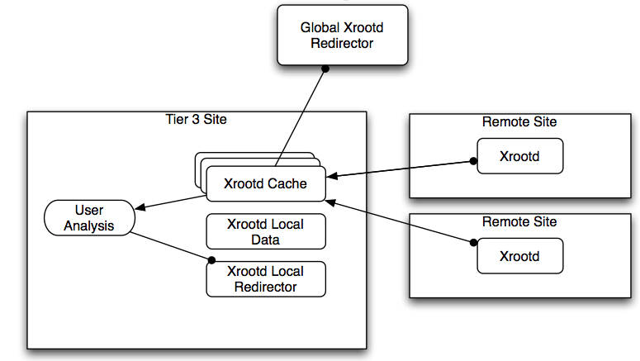
Any Data, Anywhere, Any time: Early Demonstrator
Root I/O and Xrootd demonstrator to support the CMS Tier-3s and interactive use
Cost? Value? - will have to be quantified

Slide 18

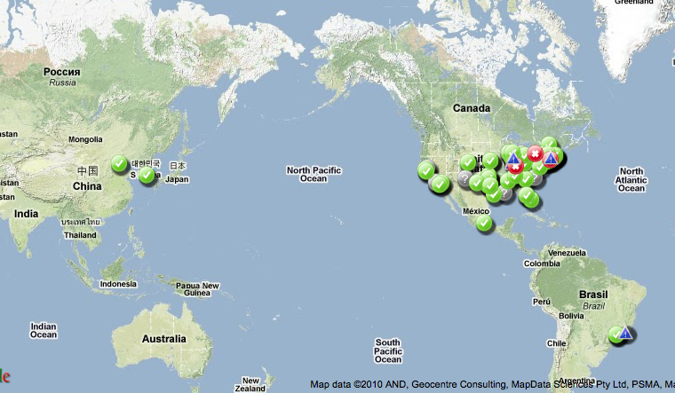
Open Science Grid (OSG)
The Open Science Grid (OSG) advances science through open distributed computing. The OSG is a multi-disciplinary partnership to federate local, regional, community and national cyberinfrastructures to meet the needs of research and academic communities at all scales.
Total of 95 sites; ½ million jobs a day, 1 million CPU hours/day; 1 million files transferred/day.
It is cost effective, it promotes collaboration, it is working!
The US contribution and partnership with the LHC Computing Grid is provided through OSG for CMS and ATLAS

Slide 19
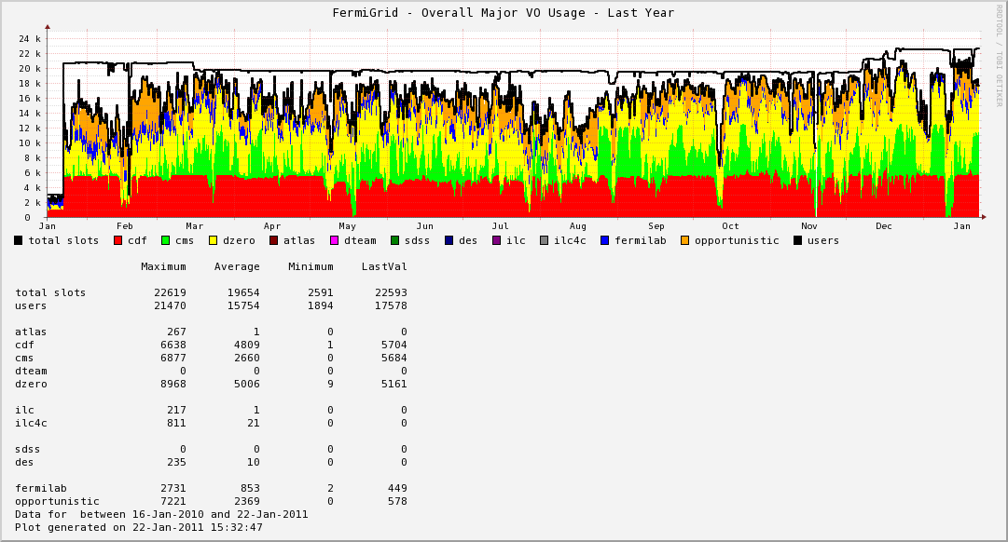
FermiGrid – campus grid and gateway to OSG
23k slots
CDF
FermiGrid Slot Usage
Past year
CMS
D0
Other Fermilab
Opportunistic
http://fermigrid.fnal.gov

Slide 20

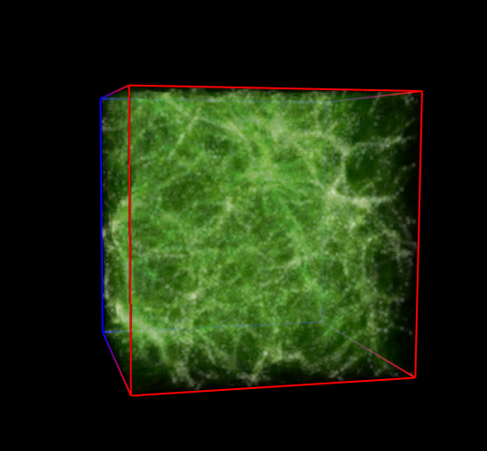
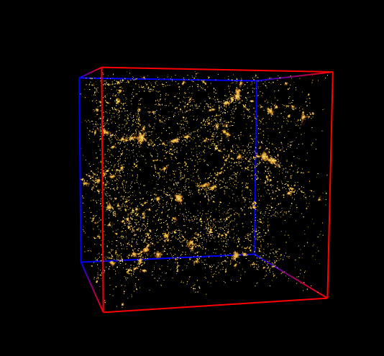
Computing for Theory and Simulation Science – needs HPC
Lattice Gauge Theory calculations (LQCD)
Accelerator modeling tools and simulations
  Fermilab leads the COMPASS collaboration
Computational Cosmology:
Dark energy, matter
Cosmic gas
Galaxies
Simulations connect fundamentals with observables

Slide 21
Lattice Gauge Theory: significant HPC computing at Fermilab
Fermilab is a leading participant in the US lattice gauge theory computational program funded by Dept of Energy (OHEP, ONP, and OASCR).
Program is overseen by the USQCD Collaboration (almost all lattice gauge theorists in the US)
  USQCD’s PI is Paul Mackenzie of Fermilab.
Purpose is to develop software and hardware infrastructure in the US for lattice gauge theory calculations.
  Software grant through the DOE SciDAC program of ~ $2.3 M/year.
  Hardware and operations funded by the LQCD Computing Project of ~$3.6M/year.
http://www.usqcd.org/

Slide 22
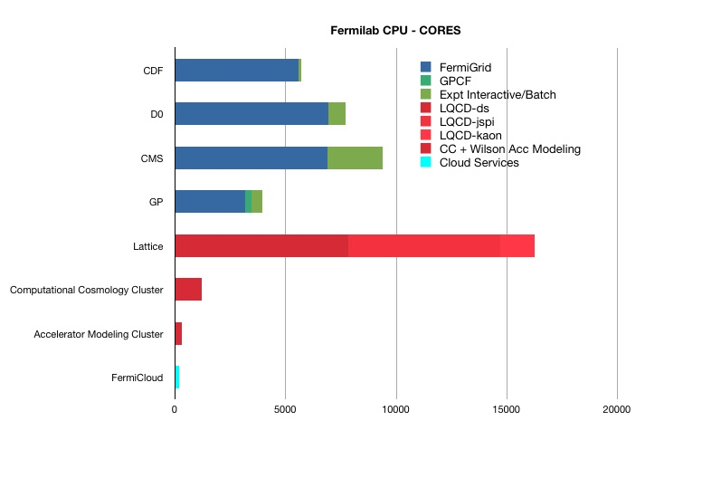
FNAL CPU – core count for science

Slide 23
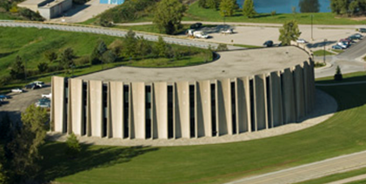
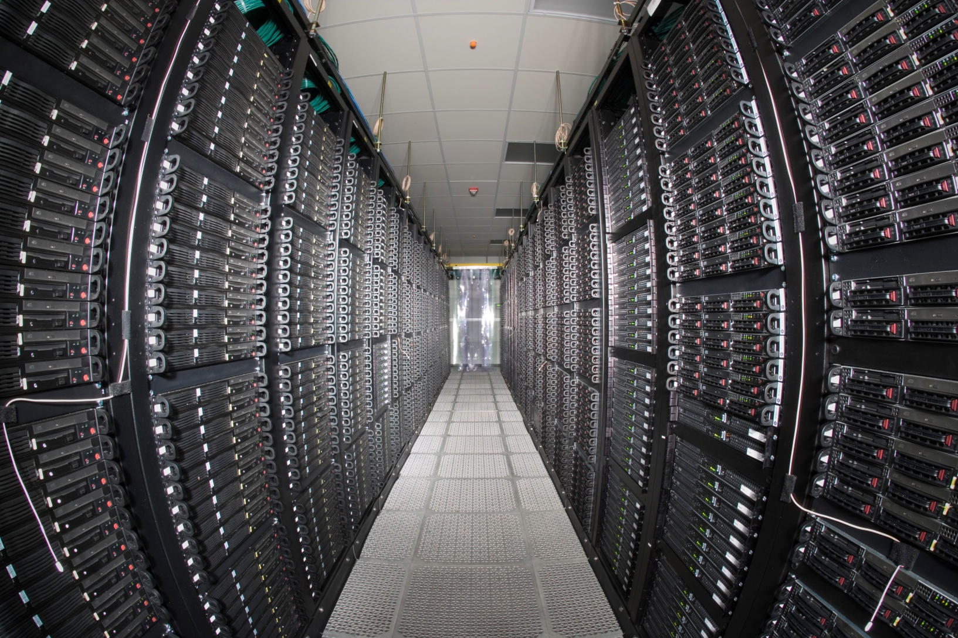
Fermilab Computing Facilities
Feynman Computing Center (FCC)
  High availability services – e.g. core network, email, etc.
  Tape Robotic Storage (3 10000 slot libraries)
  UPS & Standby Power Generation
  ARRA project: upgrade cooling and add HA computing room - completed
Grid Computing Center (GCC)
  High Density Computational Computing
  CMS, RUNII, Grid Farm batch worker nodes
  Lattice HPC nodes
  Tape Robotic Storage (4 10000 slot libraries)
  UPS & taps for portable generators
Lattice Computing Center (LCC)
  High Performance Computing (HPC)
  Accelerator Simulation, Cosmology nodes
  No UPS

Slide 24
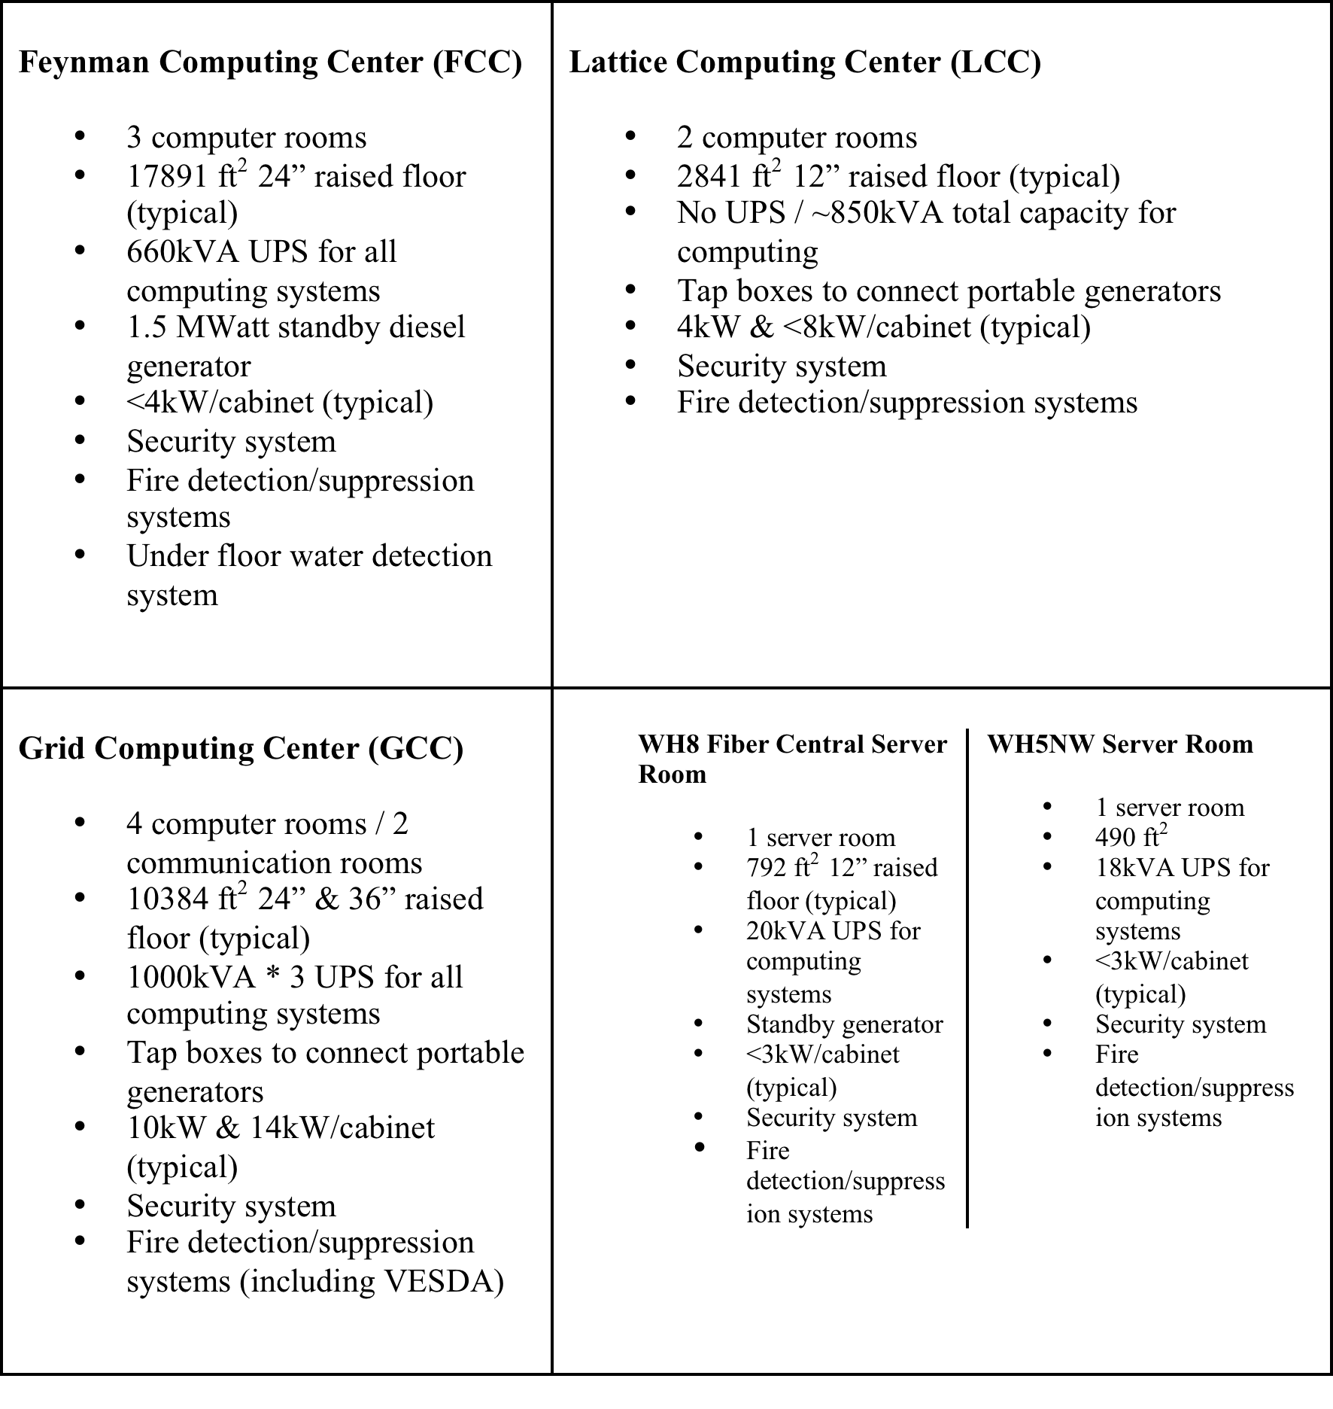
Computer Centers
EPA Energy Star award 2010

Slide 25
Reliable high speed networking is key

Slide 26
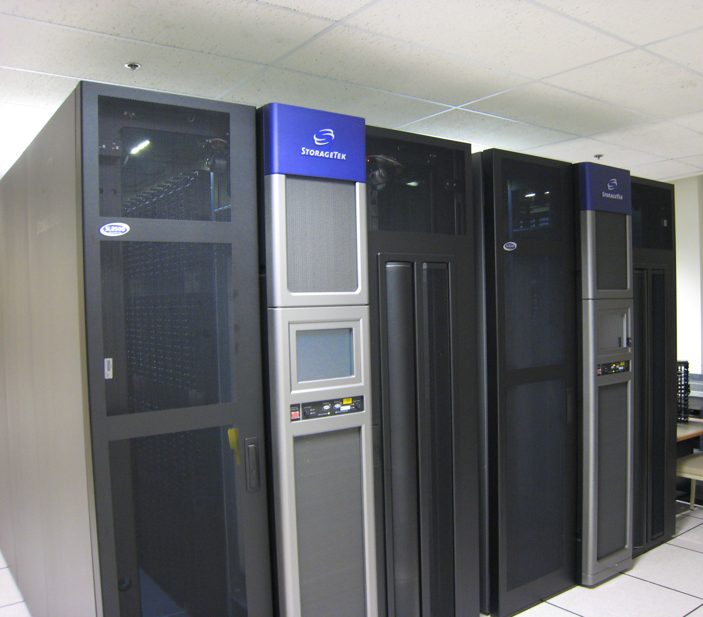
Large and growing datasets for all scientific programs: continuous migration to denser media
Mass Storage (tape)
  6 ORACLE/StorageTek SL8500 Libraries.
  Total of 60,000 slots (tapes)
  4 in GCC, 2 in FCC
    Allows for geographical distribution of data
  141 tape drives
    Primarily LTO4 (800 Gbytes/tape)
    LTO5 and T10000C coming online
  26 Petabytes of stored data

Slide 27
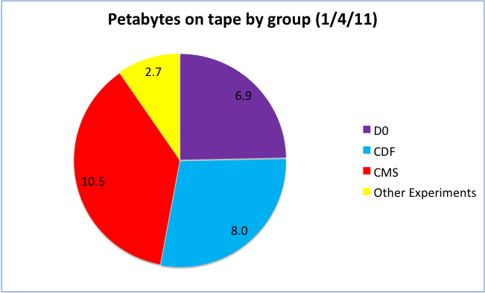

Data on tape - total
Other Experiments
27

Slide 28
Data lives a long time (and is migrated to new media many times)
L- legacy tape
$ -contributes funding

Slide 29


Disk Storage Services
Large cache storage for D0, CDF, CMS (1, 1, 7 PB)
BlueArc storage area network (1.3 PB)
Lustre (distributed parallel I/O used on Lattice QCD and Cosmology clusters and CMS in test)
AFS – legacy system

Slide 30
FermiCloud: Virtualization likely a key component for long term analysis
The FermiCloud project is a private cloud facility built to provide a testbed and a production facility for cloud services
A private cloud—on-site access only for registered Fermilab users
  Can be evolved into a hybrid cloud with connections to Magellan, Amazon or other cloud provider in the future.
Unique use case for cloud - on public production network, integrated with the rest of the infrastructure.

Slide 31

Data Preservation and long-term analysis: general considerations
Physics Case
Models
Governance
Technologies

Slide 32
Experiment/Project Lifecycle and funding
Project
specific
Project specific
Shared
services
Shared services
Shared
services
Shared services
Early Period
R&D, Ideas, Simulations
LOI, TDR, Proposals
Mature phase
Construction, operations, analysis
Final data-taking
and beyond
Final analysis,
data preservation
and access

Slide 33
Summary thoughts: tradeoffs and value
Need to build Data Preservation MODELS – just like we have computing models, risk registers, ROI (return on investment) models
  In the end it is about the value of data and the value of
    A) doing the upfront work to make data accessible and usable – up to being “open access”
    B) doing the end-game work to keep the codes, databases, data management systems, workflows and analysis tools alive
  Value is a function of cost; probability and scientific impact of extracting new science; interests and capabilities of scientists/students/the public to extract new science from old data
Technology is not the main problem – need the value proposition to be easy to articulate.

