Slide 1
Global Job Monitor
Current Status and Plans
L Sargsyan(YerPhI),J.Andreeva,
L. .Kokoszkiewicz, E.Karavakis
S&C Workshop 5/04/2011

Slide 2
Outline
Motivation
Architecture of Global Job Monitor
Results of consistency check
Prodsys UI
Plans

Slide 3
Motivation
  Use flexible structure of the sw components, which will provide
  easy support/maintenance in a long term
  Use dashboard framework as a foundation for ATLAS job monitoring
  Decrease load on operations PanDA DB
Fully decouple data source from the user interface

Slide 4


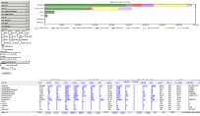
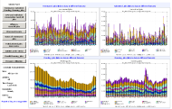
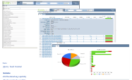
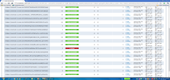
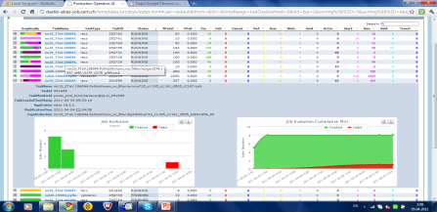
Architecture of Global Job monitoring
Job summary UI
PanDA DB
Historical view UI
AKTR
DB
PanDA collector
Dashboard Job
Repository
(Dashboard DB)
Analysis Job
Monitoring UI
MSG server
(ActiveMQ)
API retrieves data in JSON
Tier3 monitoring data
ProdSys collector
Prodsys UI
AKTR static pages
Instrumented GANGA UI
atlas_prodsys
DB
4

Slide 5
Most of user requests going through Monitoring DB
Panda DB is used for only operations and accessed by the PanDA operators only through the UI
Monitoring DB aggregates information from various sources
  Production DBs, meta data for production tasks
  GANGA jobs not going through PanDA
Potentially Tier3 jobs
Consistency!

Slide 6
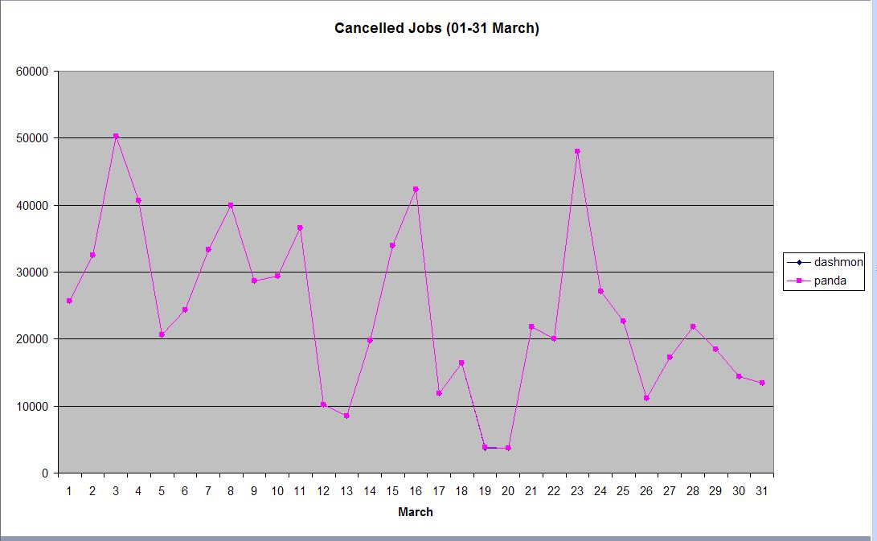
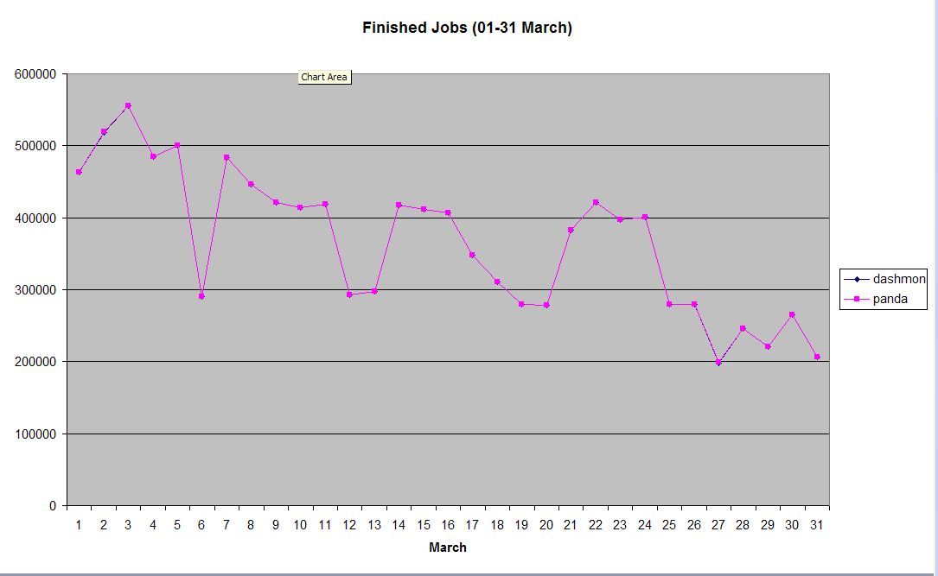
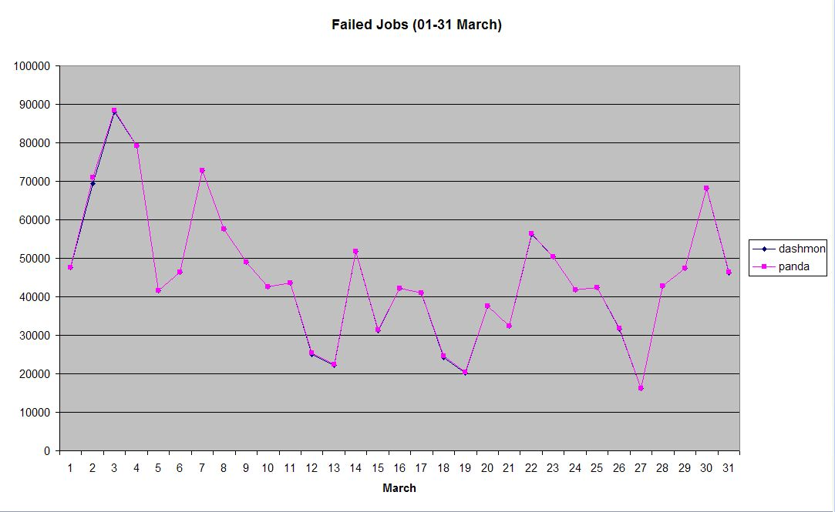
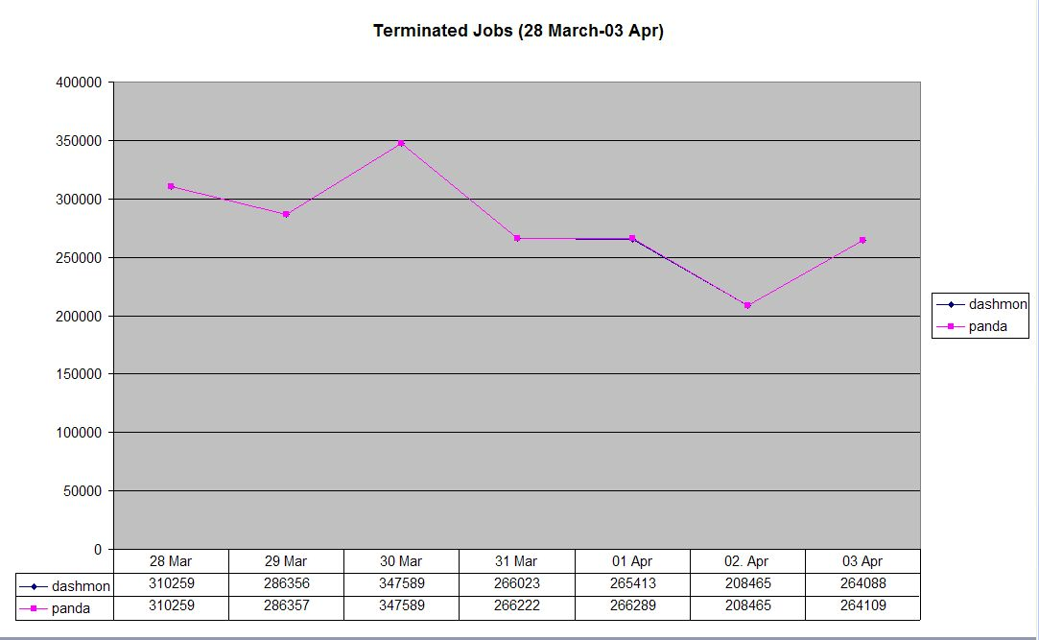
Results of consistency check

Slide 7
Prodsys UI (1/3)
Components
Collectors:: Retrieve task/job data from PanDA and ProdSys DBs
Dashboard DB: designed for monitoring, uses aggregated tables
Web application level:
  Information for UI available in JSON, XML format
    User interface is implemented with jQuery
  Common hBrowse framework for ‘Task monitoring for the analysis users” and production operators is used for the UI implementation
  Design of the user interface is driven by the needs of the production operators (task oriented)
URL http://dashb-atlas-job.cern.ch/templates/prodsys/index.html

Slide 8
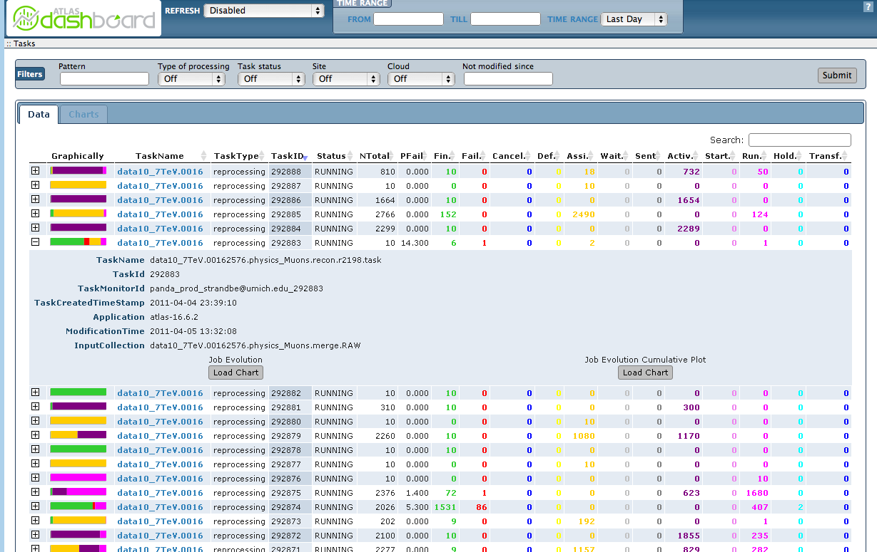
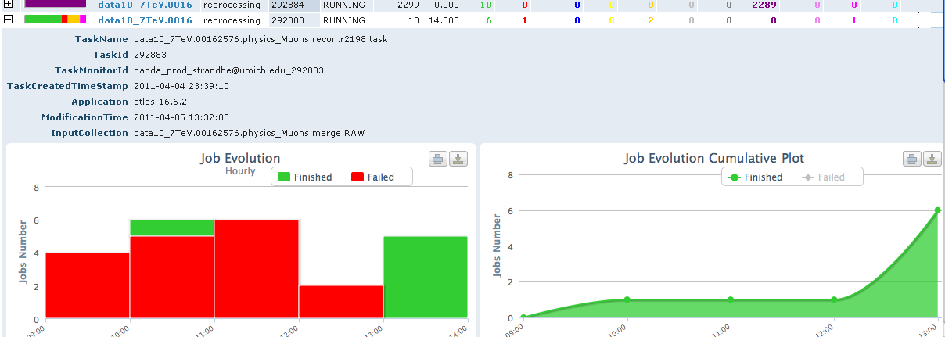
Filters : time range, processing type, task status, site, cloud not modified since…
Prodsys UI (2/3)
Columns can be sorted and grepped for a particular value
List of selected tasks with number of jobs per status
Task meta information
Task evolution in time

Slide 9
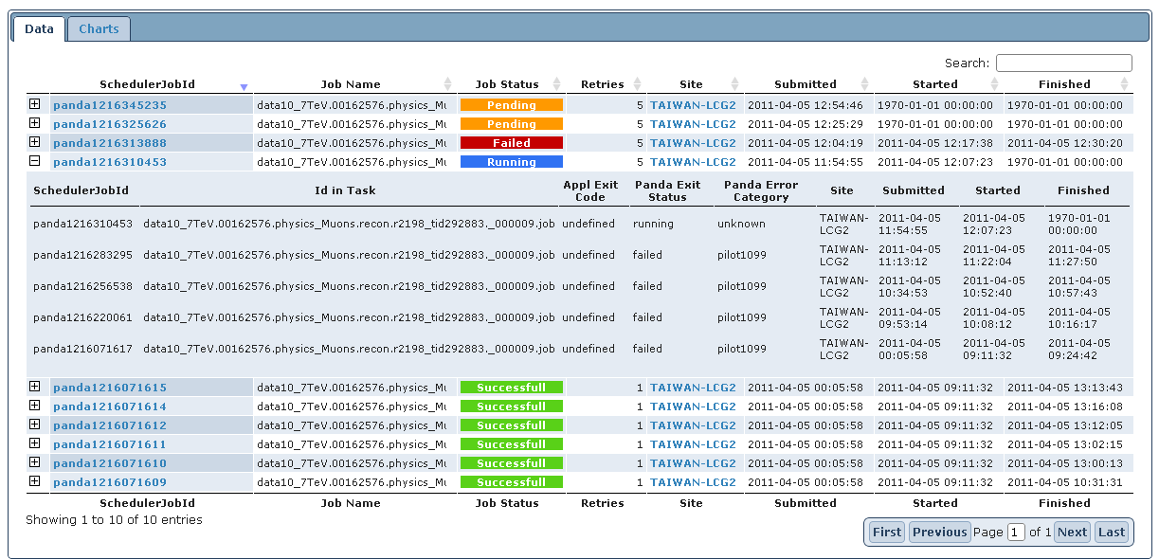
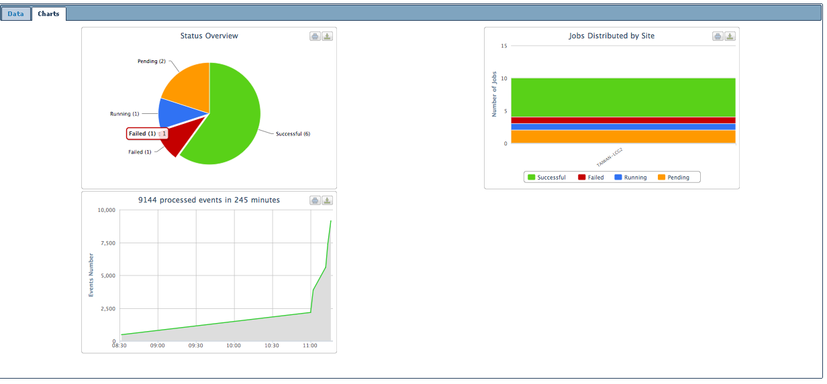
Prodsys UI (3/3)
List of jobs for chosen task
Resubmission history
# of processed events
Distribution by site

Slide 10
Plans
Production operators UI
  Preparation data for production jobs in aggregated tables
  Extend content of the information on the UI:
    Additional graphical distribution
    Detailed failure diagnostic
  Overview page with plots :
    Accounting like page for production tasks

Slide 11
Prototype is up and running http://dashb-atlas-job.cern.ch/templates/prodsys/index.html
Waiting for your feedback atlas-adc-monitoring@cern.ch

