Slide 1

b Production Cross Sections and Fragmentation Fractions at LHCb
Laurence Carson
(University of Santiago de Compostela)
on behalf of the LHCb collaboration
Phenomenology 2011 Symposium
University of Wisconsin-Madison
May 9th – 11th 2011

Slide 2
Overview
Beauty production cross section in √s = 7 TeV pp collisions can be compared to QCD predictions
  also needed to estimate sensitivity to New Physics in B decays
Will present two measurements of σ(pp→bbX)
  using b→D⁰Xμν and using b→J/ψX
Ratio of fragmentation fractions f_{s} /f_{d} needed for precise measurement of B_{s} branching fractions, e.g. B_{s}→μμ
Long-standing disagreement in fragmentation fractions f_{Λb}/(f_{u}+f_{d}) measured at LEP and at TeVatron
Will present measurements of f_{s} /f_{d} and f_{Λb}/(f_{u}+f_{d}) using semileptonic modes, and of f_{s} /f_{d} using hadronic modes

Slide 3
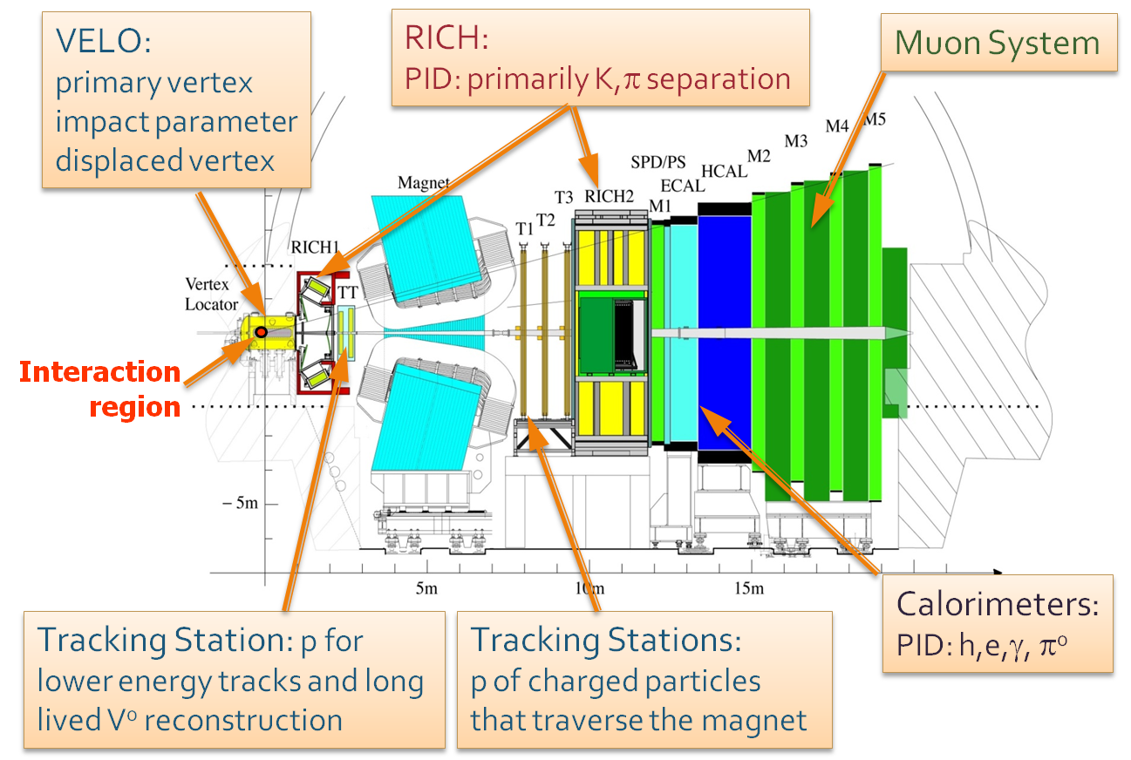
The LHCb Experiment
Single forward arm spectrometer covering 2.0 < η < 5.5 (η= -ln[tan(θ/2)])

Slide 4
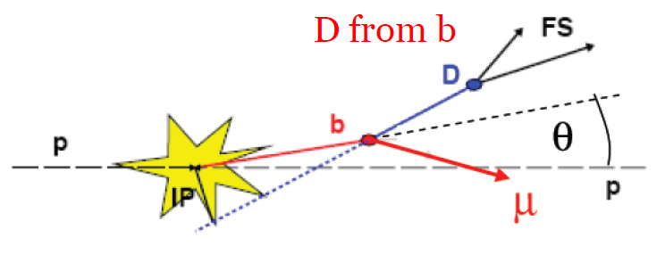
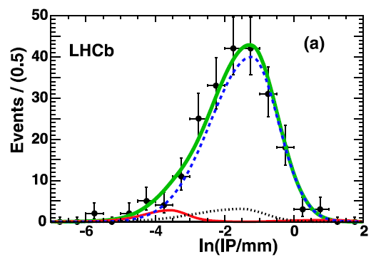
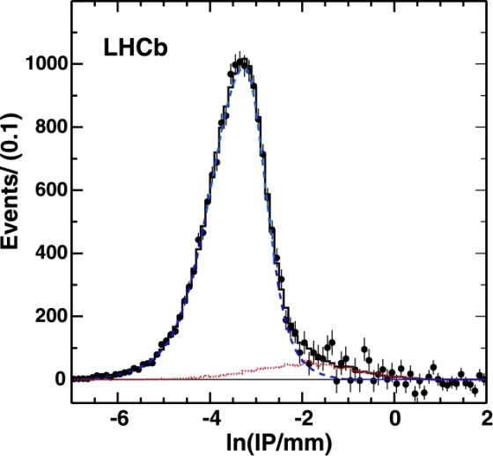
b Cross Section using b→D⁰Xμν
Vertex D⁰(→Kπ) with right-sign μ, cut on Impact Parameter (IP) of μ then distinguish prompt D⁰ and D⁰ from B using IP of D⁰
Two independent samples used: 3nb⁻¹ taken with unbiased trigger, and 12nb⁻¹ requiring single muon trigger
B
IP D⁰ (NO μ requirement)
IP of D⁰ (μ required)
~3 nb⁻¹
~12 nb⁻¹
D from b
Prompt D
Fake D subtracted
Prompt D
Fake D
D from b

Slide 5


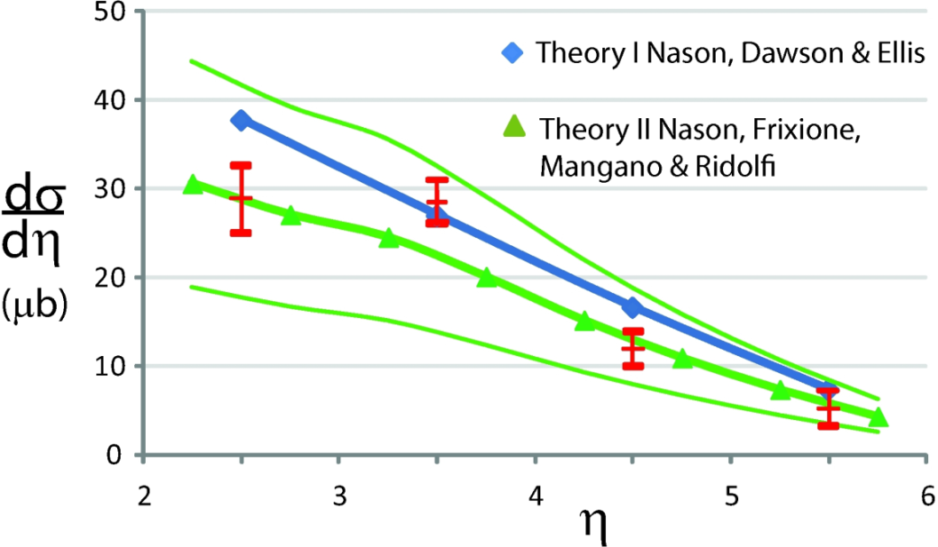
b Cross Section using b→D⁰Xμν
Use:
15nb⁻¹ used
(MCFM)
Dominant systematics
(FONLL)
Source | Size
Tracking efficiency | 10%
Luminosity | 10%
Branching/frag. fractions | 8%
theory error
η
For 2 < η < 6 (measured):
σ(pp→bbX) = (75.3 ± 5.4 ± 13.0) μb
(stat) (syst)
Extrapolate to 4π (using Pythia):
σ(pp→bbX) = (284 ± 20 ± 49) μb
Using TeVatron (instead of LEP) fragmentation fractions gives:
σ(pp→bbX) = (338 ± 24 ± 58) μb
(increase of 19%)
Published in Phys. Lett. B 694, 209 (2010)

Slide 6
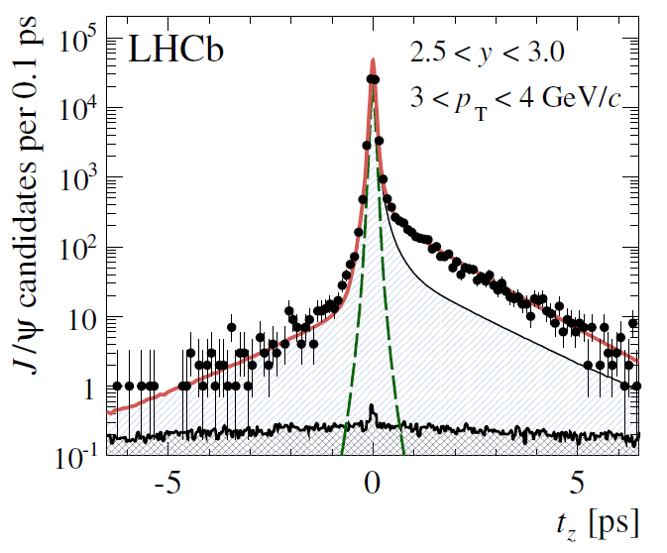
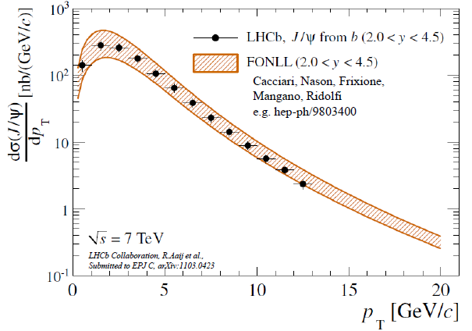
b Cross Section using b→J/ψX
Reconstruct J/ψ→μμ, using both single muon and dimuon triggers
Prompt J/ψ
J/ψ from b
Fit to pseudo-proper time,
in bins of p_{T} and y
Dominant systematics:
Source | Size
Tracking efficiency | 8%
Luminosity | 10%
B.R.(b→J/ψX) | 9%
5.2pb⁻¹ used
σ(pp→bbX) = (288 ± 4 ± 48) μb
(with LEP fragmentation fractions, 2% change when using TeVatron fractions is included in syst. error)
Submitted to Eur. Phys. J C
Preprint: hep-ex/1103.0423
(also prompt J/ψ cross section)

Slide 7
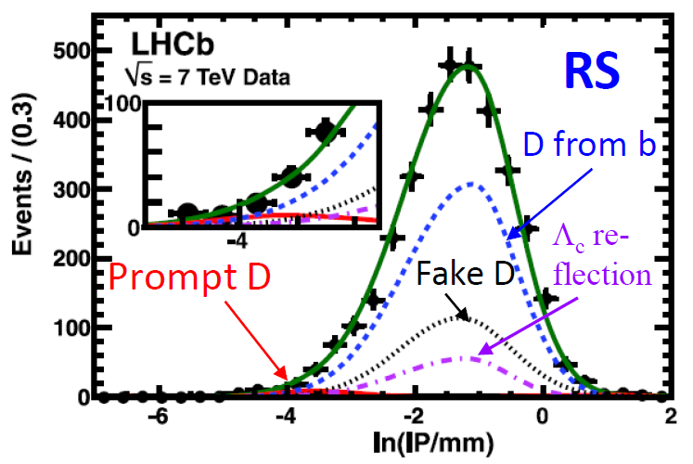
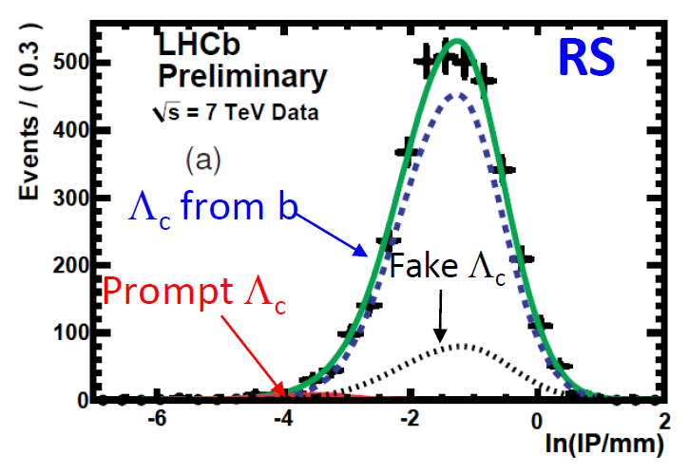
Fragmentation Fractions using Semileptonic Decays
Can measure f_{s}/(f_{u}+f_{d}) and f_{Λb}/(f_{u}+f_{d}) using D⁰Xμν, D⁺Xμν, D_{s}Xμν, Λ_{c}Xμν
Similar strategy to x-sec measurement, but must correct for cross-feeds from such decays as B_{s}→D_{s1,2}(→D⁰K)Xμν, B^{0/+}→D_{s}KXμν, and Λ_{b}→D⁰pXμν
Use Γ_{SL}(B⁺) = Γ_{SL}(B⁰) = Γ_{SL}(B_{s}) (known to hold within 1% from e.g. HQET) and Γ_{SL}(Λ_{b}) /Γ_{SL}(B⁰) = 1.04 ± 0.02
3pb⁻¹ used
b→D_{s}Xμν
b→Λ_{c}Xμν

Slide 8
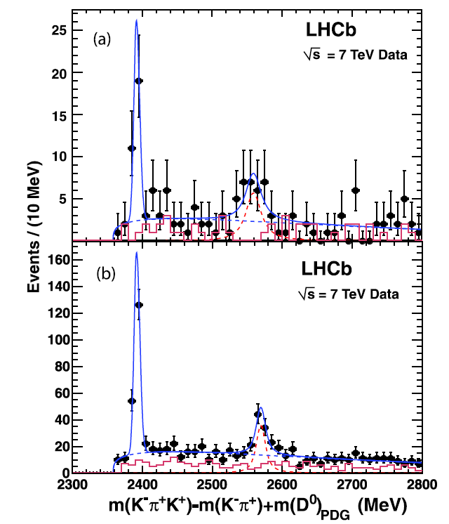
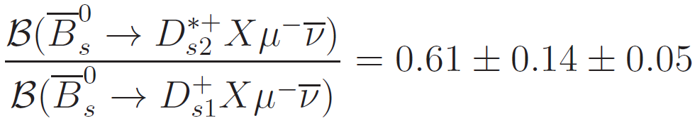
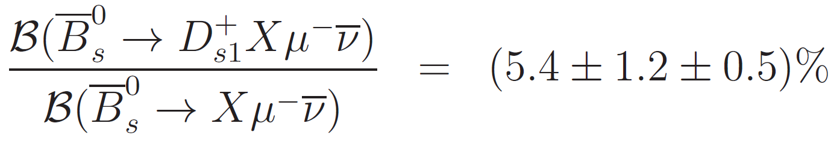
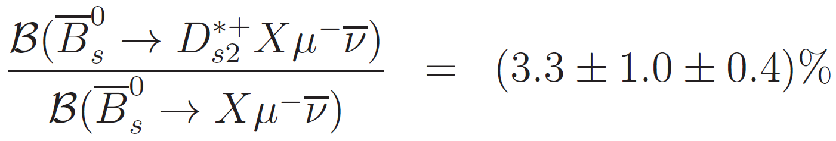
First observation of
Evidence for resonance seen whilst checking b→D⁰KXμν mass spectrum
Confirmed in larger data sample, with significance of ≈8σ
• RS D⁰K⁺
• WS Kaon: D⁰K⁻
3pb⁻¹
D_{s1}(2536)⁺→D^{*0}K⁺ missing γ/π⁰
20pb⁻¹
D_{s2}*(2573)⁺→D⁰K⁺
Also: measured mass and width of
confirmed DØ observation of D_{s1} mode
Published in Phys. Lett. B 698, 14 (2011)

Slide 9
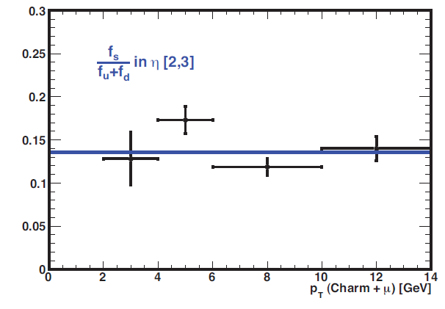
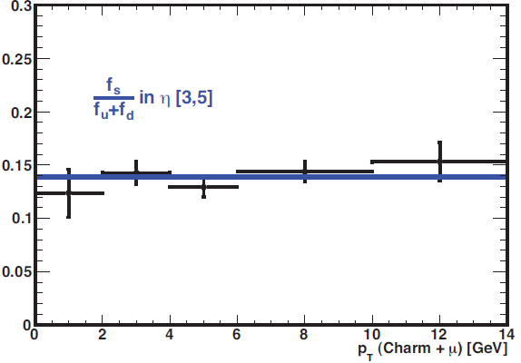
Semileptonic f_{s}/(f_{u} + f_{d}) Result
+ 0.012
f_{s}/(f_{u} + f_{d}) = 0.130 ± 0.004 (stat)
(syst)
– 0.011
cf. LEP: 0.128 ± 0.012 (HFAG), and TeVatron: 0.135 ± 0.016 (CDF semilep.)
3pb⁻¹ used
Dominant systematics
No evidence for dependence of f_{s}/(f_{u} + f_{d}) on either η or p_{T}
Source | Size
Branching fractions of charm hadrons | ±5.5%
Subtraction of B_{s}→D⁰KXμν bkg | +4.1% -1.1%
Good agreement with LEP and TeVatron values

Slide 10
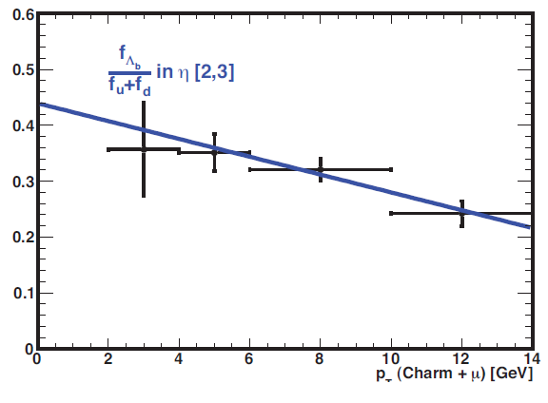
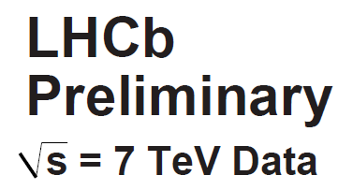
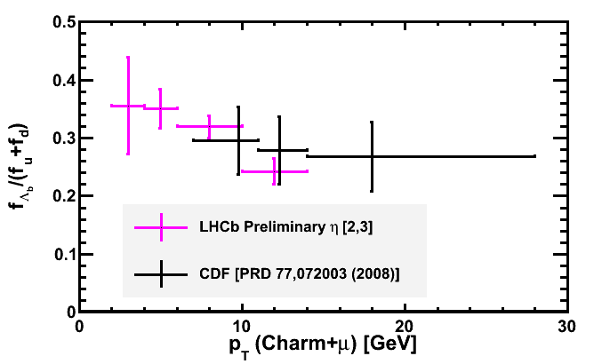
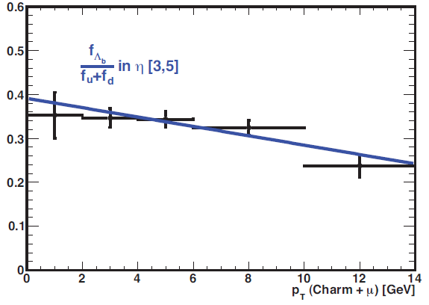
Semileptonic f_{Λb}/(f_{u} + f_{d}) Result
Slope with p_{T} not consistent with zero.
Parameterising with straight line gives:
f_{Λb}/(f_{u}+f_{d}) = (0.401 ± 0.019 ± 0.106) – (0.0120 ± 0.0025 ± 0.0012)*p_{T}/GeV, for p_{T} < 14 GeV
3pb⁻¹ used
26% uncertainty on BR(Λ_{c}→pKπ) completely dominates the systematics
cf. LEP: 0.112 ± 0.031 (< p_{T} >≈40 GeV),
+ 0.129
(< p_{T} >≈14 GeV)
CDF: 0.281 ± 0.012
- 0.103

Slide 11
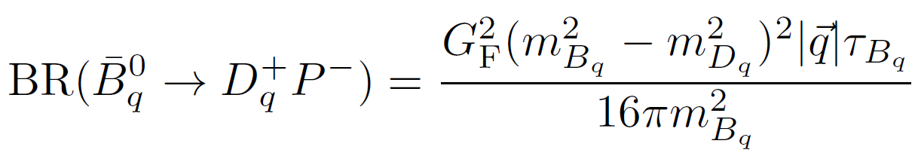
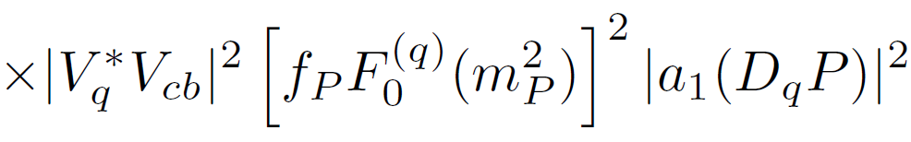
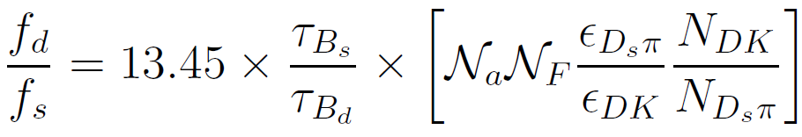
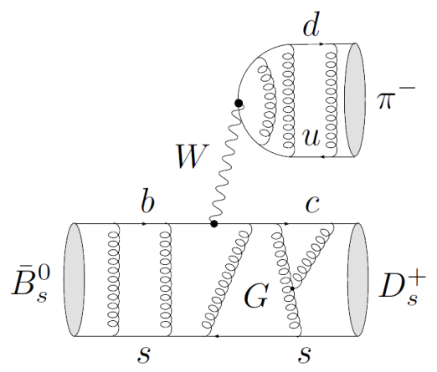
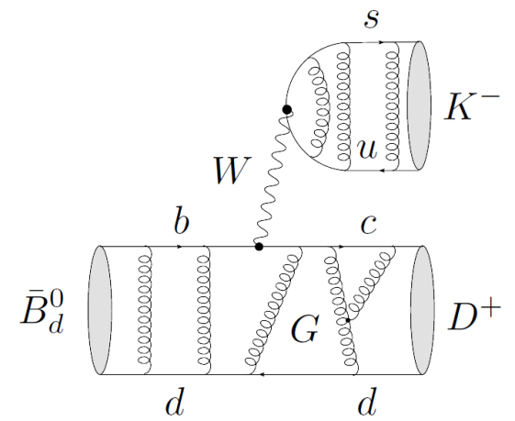
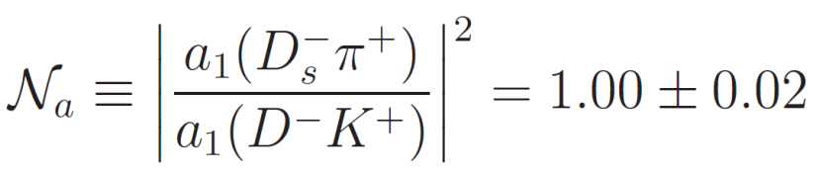
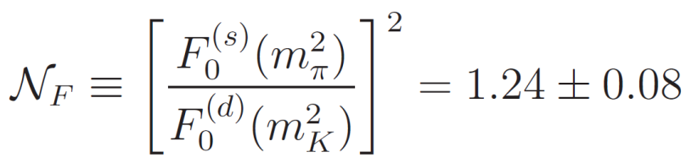
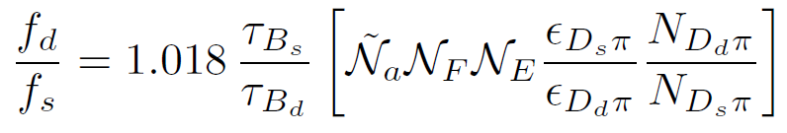

f_{s}/f_{d} using Hadronic Decays
Decays B_{d}→D⁻K⁺ and B_{s}→D_{s}⁻π⁺ involve only tree level diagrams, hence ratio of branching fractions is theoretically calculable
form factor
deviation from factorisation
Phys. Rev. D 82, 034038 (2010)
Similar situation for B_{d}→D⁻π⁺ and B_{s}→D_{s}⁻π⁺, but with exchange diagram
Phys. Rev. D 83, 014017 (2011)

Slide 12
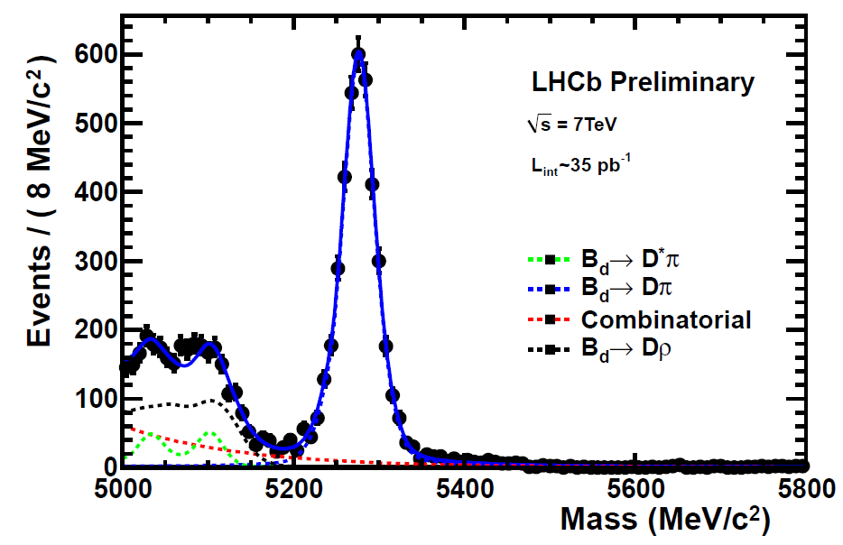
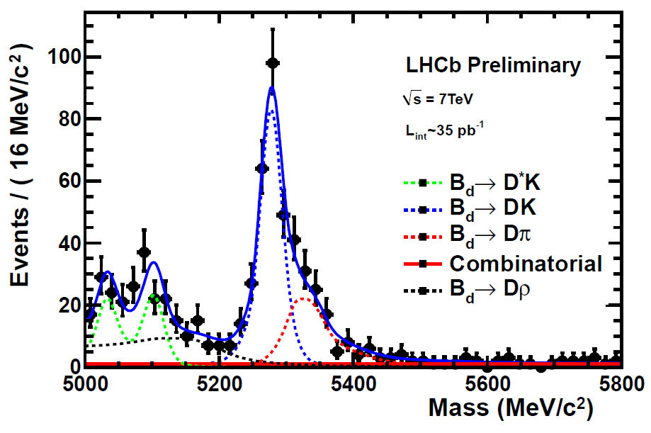
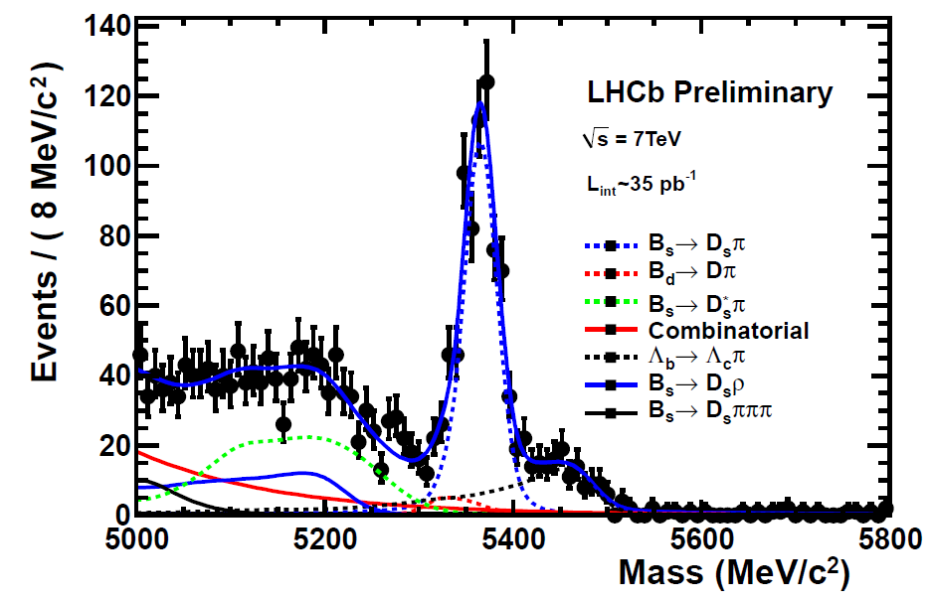
f_{s}/f_{d} using Hadronic Decays
Multivariate selection designed to minimise efficiency differences between modes. Effect of PID cuts evaluated using D* control samples.
N_{Dπ} = 4103 ± 75
N_{DK} = 252 ± 21
N_{Dsπ} = 670 ± 34
From B_{s}→D_{s}⁻π⁺ and B_{d}→D⁻K⁺: f_{s}/f_{d} = 0.250 ± 0.024 ± 0.018 ± 0.017
(stat) (syst) (theory)
From B_{s}→D_{s}⁻π⁺ and B_{d}→D⁻π⁺: f_{s}/f_{d} = 0.256 ± 0.014 ± 0.018 ± 0.026
Combine, accounting for correlated uncertainties:
f_{s}/f_{d} = 0.253 ± 0.017 ± 0.018 ± 0.020
LHCb-CONF-2011-013
35pb⁻¹ used
Agrees well with semileptonic result
Also: extract World’s best BR(B_{d}→D⁻K⁺) (see talk of M. Whitehead)

Slide 13
Conclusions
LHCb has measured the b cross section in √s = 7 TeV pp collisions:
σ(pp→bbX) = (284 ± 20 ± 49) μb (LEP fractions)
(b→D⁰Xμν, 15nb⁻¹)
σ(pp→bbX) = (338 ± 24 ± 58) μb (TeVatron fractions)
σ(pp→bbX) = (288 ± 4 ± 48) μb (b→J/ψX, 5.2pb⁻¹)
In agreement with (and more precise than) QCD predictions
LHCb has measured the ratios of fragmentation fractions:
f_{s}/f_{d} = 0.272 ± 0.008 ± 0.024 (semileptonic, 3pb⁻¹)
f_{Λb}/(f_{u}+f_{d}) = (0.401 ± 0.019 ± 0.106) – (0.0120 ± 0.0025 ± 0.0012)*p_{T}/GeV, for p_{T} < 14 GeV (semileptonic, 3pb⁻¹)
f_{s}/f_{d} = 0.253 ± 0.017 ± 0.018 ± 0.020 (hadronic, 35pb⁻¹)
f_{s}/f_{d} in good agreement with LEP and TeVatron; p_{T} dependence of f_{Λb}/(f_{u}+f_{d}) may reconcile different measurements
Also: first observation of , and World’s best BR(B_{d}→D⁻K⁺)

Slide 14
Backup

Slide 15
LHCb Acceptance
Pythia production cross section (14TeV)
p_{T}
100 μb
230 μb
η
b’s are produced at low angles, and in the same hemisphere
Nice overlap of acceptance with GPDs

Slide 16
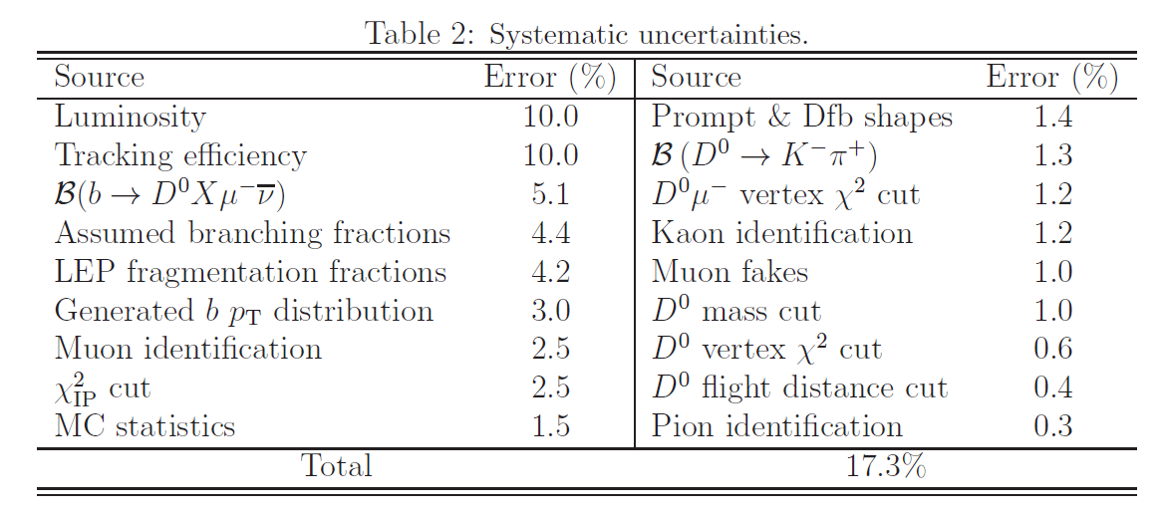
Systematics for b→D⁰Xμν

Slide 17
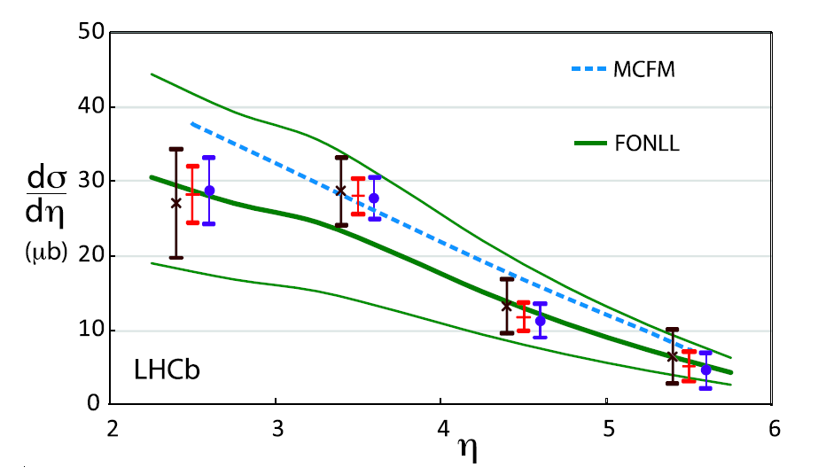
Combination for b→D⁰Xμν
Unbiased trigger, 3nb⁻¹
Single muon trigger, 12nb⁻¹
Combination

Slide 18
Muon Identification
π misID = (0.71±0.05)% from K_{S} (also Λ)
Eff. = (97.1±1.3)% from J/ψ tag & probe
Most misID is due to π→μ decays in flight

Slide 19
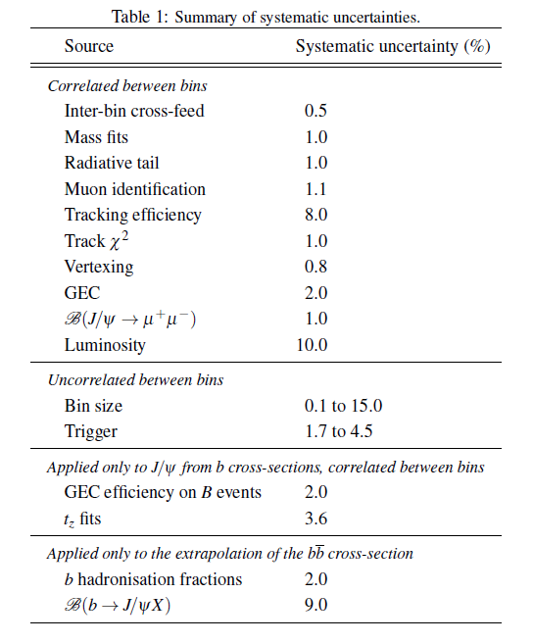
Systematics for b→J/ψX

Slide 20
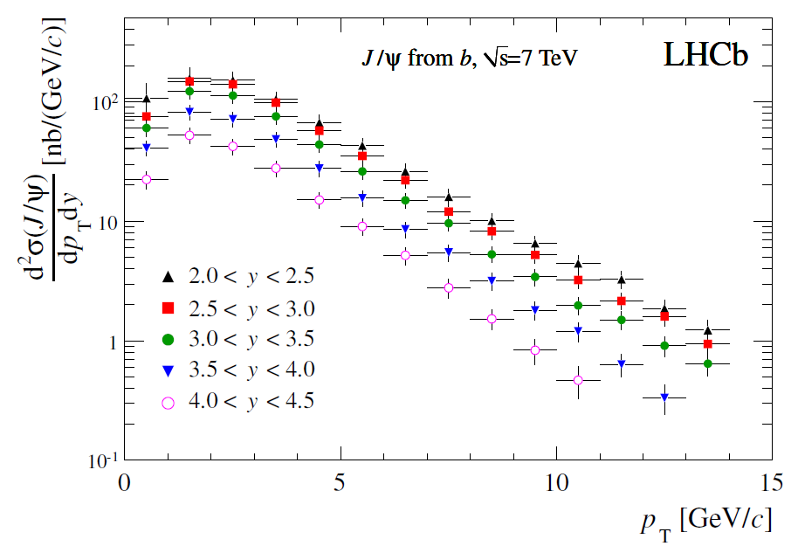
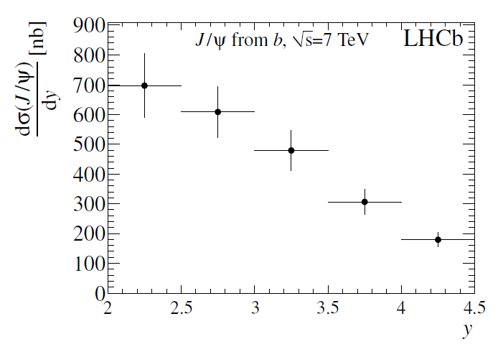
b→J/ψX dependence on y

Slide 21
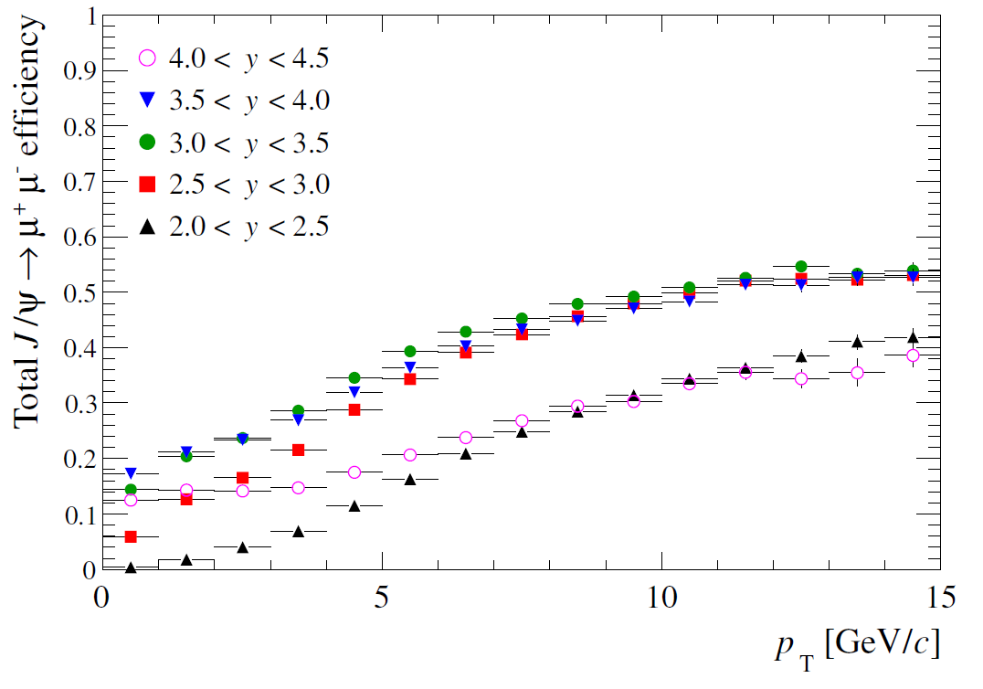
b→J/ψX efficiencies from MC
Efficiencies for prompt J/ψ and for J/ψ from b assumed equal (no cuts on impact parameter or decay length)

Slide 22
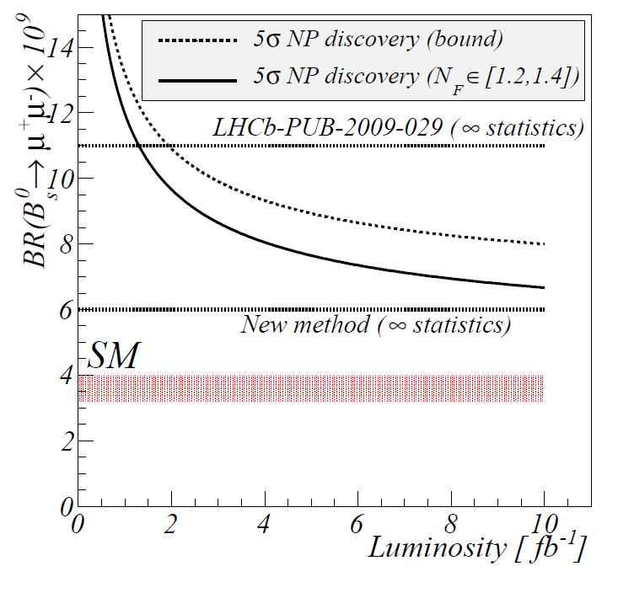
f_{s}/f_{d} for B_{s}→μμ
Reach with σ(f_{s}/f_{d}) = 13% (current PDG)
Reach with σ(f_{s}/f_{d}) = 7% (our ambition!)
Phys. Rev. D 82, 034038 (2010)

Slide 23
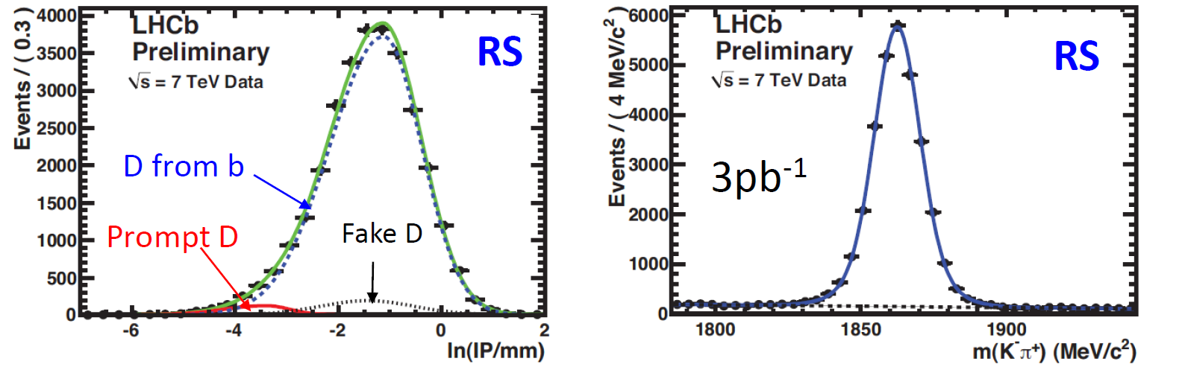
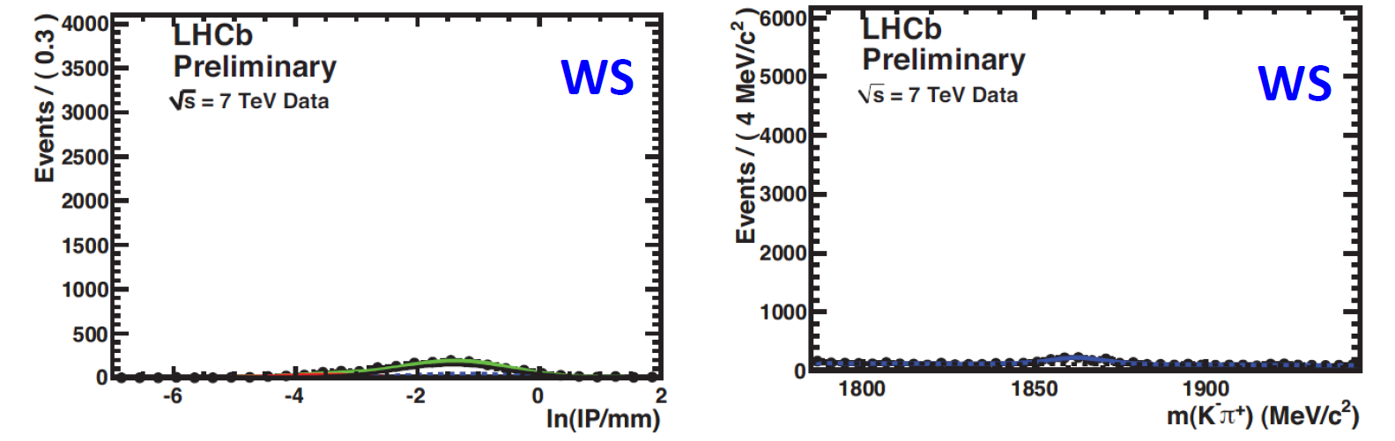
Semileptonics: b→D⁰Xμν

Slide 24
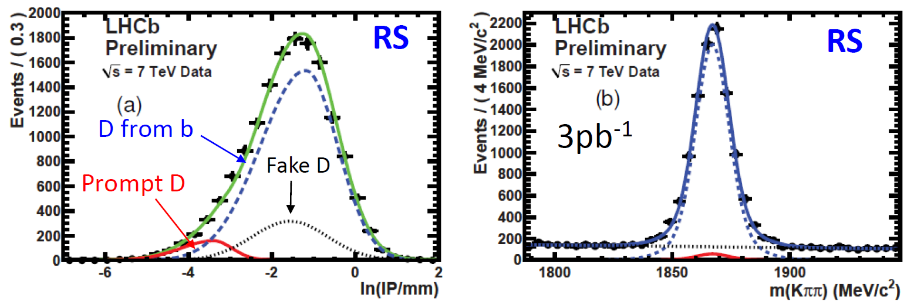
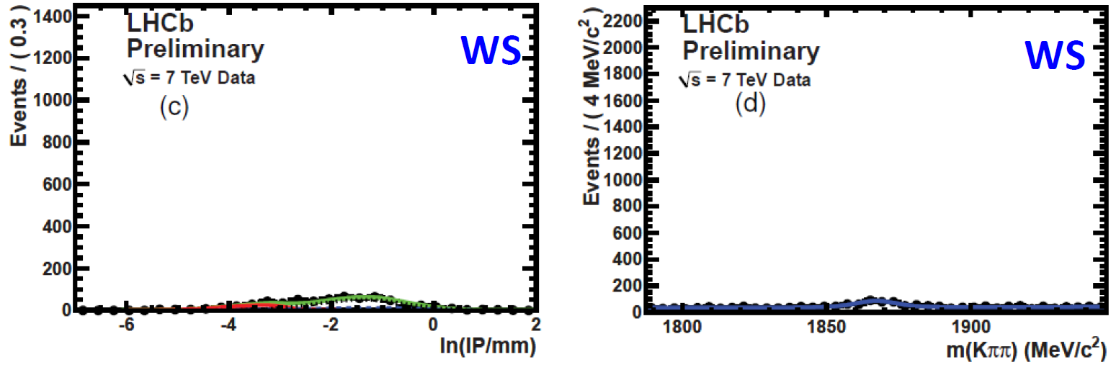
Semileptonics: b→D⁺Xμν

Slide 25
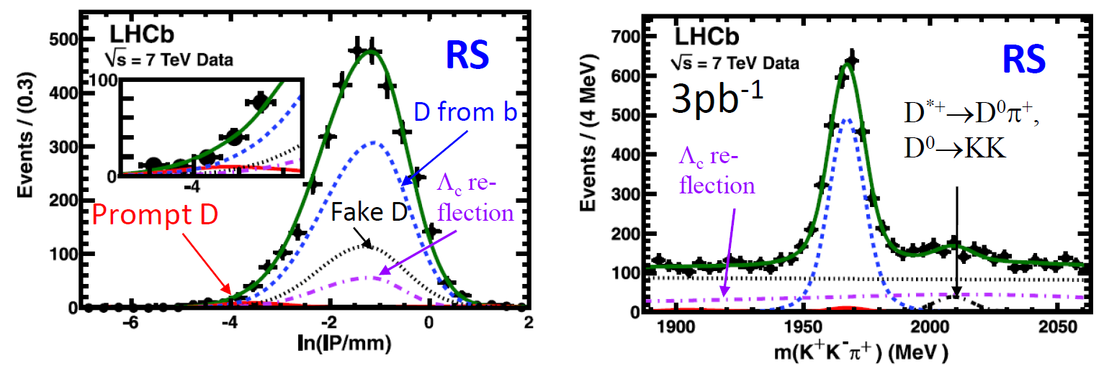
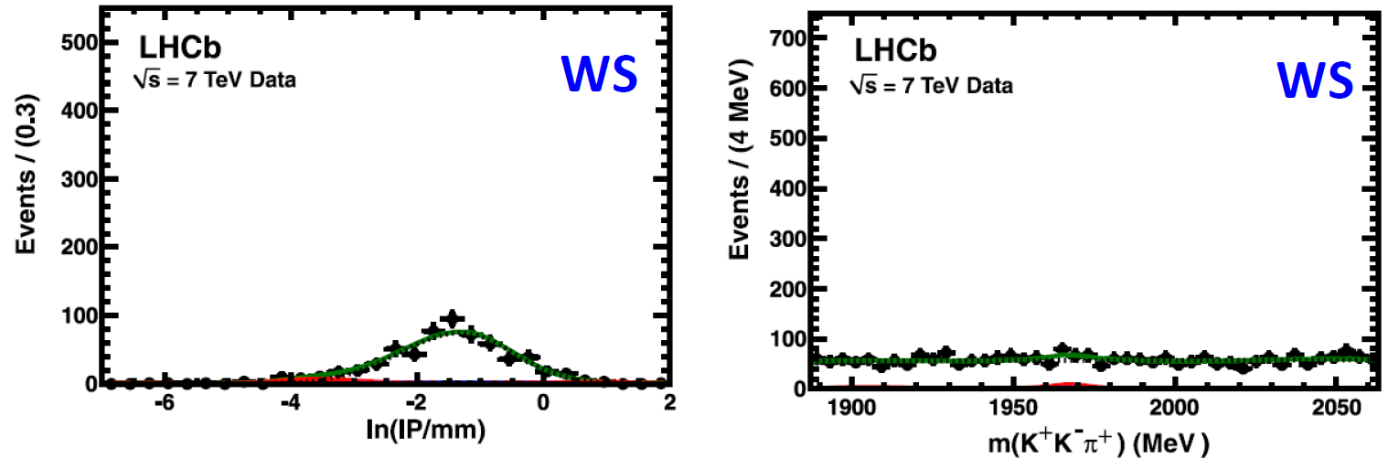
Semileptonics: b→D_{s}Xμν

Slide 26
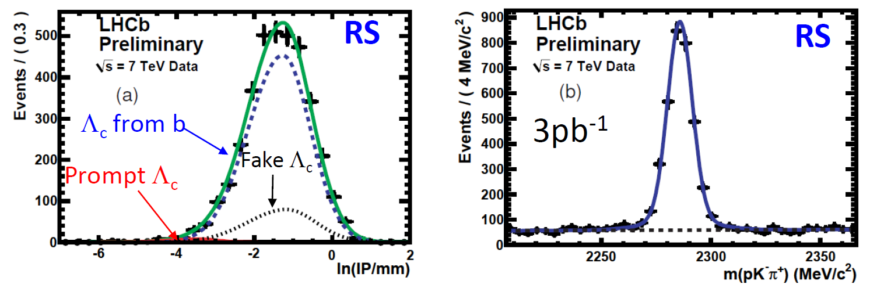
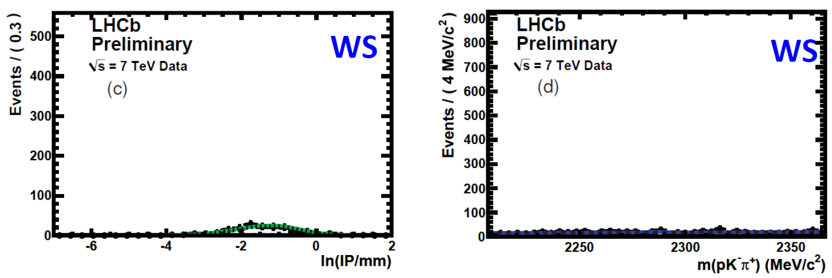
Semileptonics: b→Λ_{c}Xμν

Slide 27
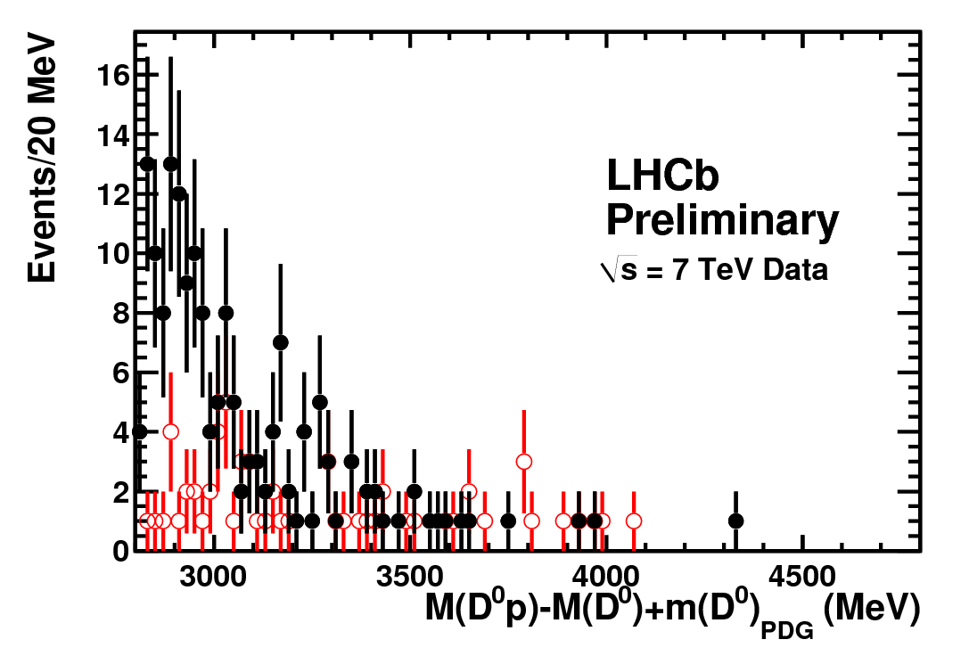
Semileptonics: b→D⁰pXμν
• RS D⁰p
WS D⁰p
3pb⁻¹
Possible contributions from Λ_{c}(2880)⁺ and Λ_{c}(2940)⁺ , both of which can decay into D⁰p

Slide 28
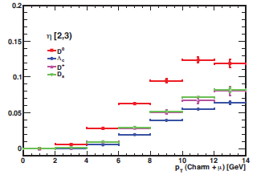
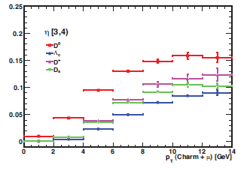
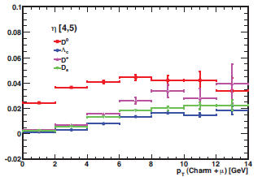
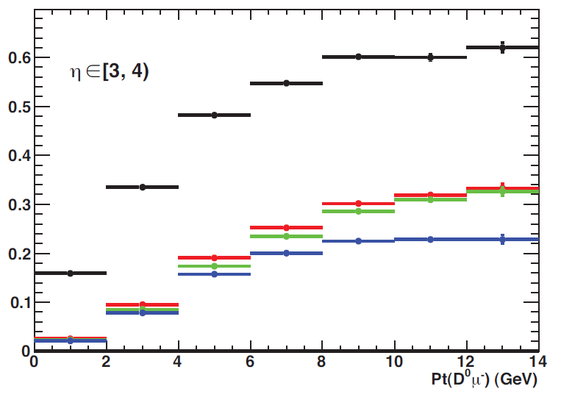
Semileptonics: Efficiencies
Efficiency breakdown for D⁰μ
Track acceptance and reconstruction
Muon selection & trigger
K and π p_{T} cuts
PID cuts

Slide 29

Semileptonics: Cross-check

Slide 30


Systematics for Semileptonic f_{s}/(f_{u} + f_{d})

Slide 31




Deviations from Factorisation
X_{P} ≈ 1 within <1% (X_{V} is exactly 1)
Can use B Factory results to obtain:
No evidence for deviation of ratio of any |a₁|’s from 1.
Use of LHCb measurements can improve value for B_{d}→D⁻K⁺
Phys. Rev. D 83, 014017 (2011)

Slide 32







Exchange diagram in B_{d}→D⁻π⁺
Can be constrained using
Babar, PRL 96 011803 (2006)
Ratio of tree amplitudes is
Hence extract
Phys. Rev. D 83, 014017 (2011)
Use this to estimate
To allow for differences between D and D* cases

Slide 33


Systematics for Hadronic f_{d}/f_{s}
Efficiency and misID of tight Kaon ID cut used to select B_{d}→D⁻K⁺

