Slide 1
One more thing …
PIXEL2012 LOC

Slide 2
Proceedings
http://www-conf.kek.jp/pixel2012/, then
  Paper submission (http://www-conf.kek.jp/pixel2012/paper.html)
Proceedings Pixel2012
The contributions to Pixel2012 will be published as a special issue of Nuclear Instrumentations and Methods in Physics Research, Section A (NIMA).
Length of the contributions:
  30 min. talk (25+5 mins Q/A): 7-8 pages
  20 min. talk (17+3 mins Q/A): 5-6 pages
  Poster presentaion: 5-6 pages
Submission to this journal proceeds totally online and you will be guided stepwise through the creation and uploading of your files. Please, take into account the submission
DEADLINE: October 29, 2012 .
Then, follow the “Instructions for online paper submission”.

Slide 3
Next PIXEL(2014)

Slide 4
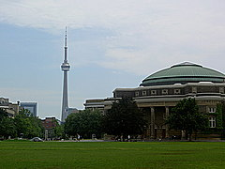
Next PIXEL(2014)
Toronto, CANADA
William Trischuk, Univ. Toronto

Slide 5

Next PIXEL(2014)
Toronto, CANADA
William Trischuk, Univ. Toronto
Co-chaired by
Harris Kagan, Ohio-State Univ.

Slide 6
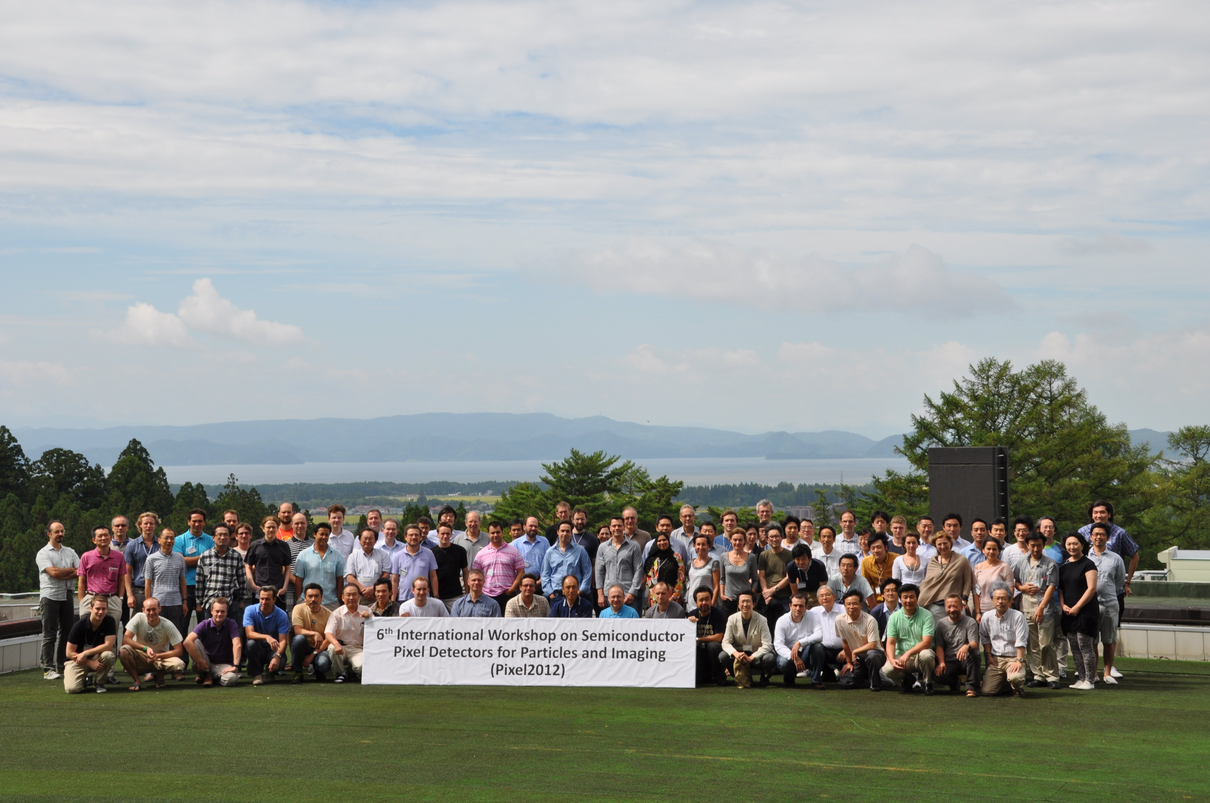
さよなら (Good bye) and
再会（See you again)

