Slide 1
RF strategy, limits and issues
A. Butterworth
L. Arnaudon, Ph. Baudrenghien, O. Brunner, E. Ciapala, W. Hofle, J. Molendijk, E. Shaposhnikova, J. Tuckmantel, D. Valuch

Slide 2
Outline
How to push the RF voltage at flat top
  if larger longitudinal emittance is required for reduction of IBS
Do we have enough available RF power
  to handle increasing beam intensity?
Protection of RF equipment at high beam intensity
Bunch length at injection/ramp
  reduce heating (kicker, collimators, cryogenics)
Dipole oscillations at injection
25ns bunch spacing
Conclusions

Slide 3
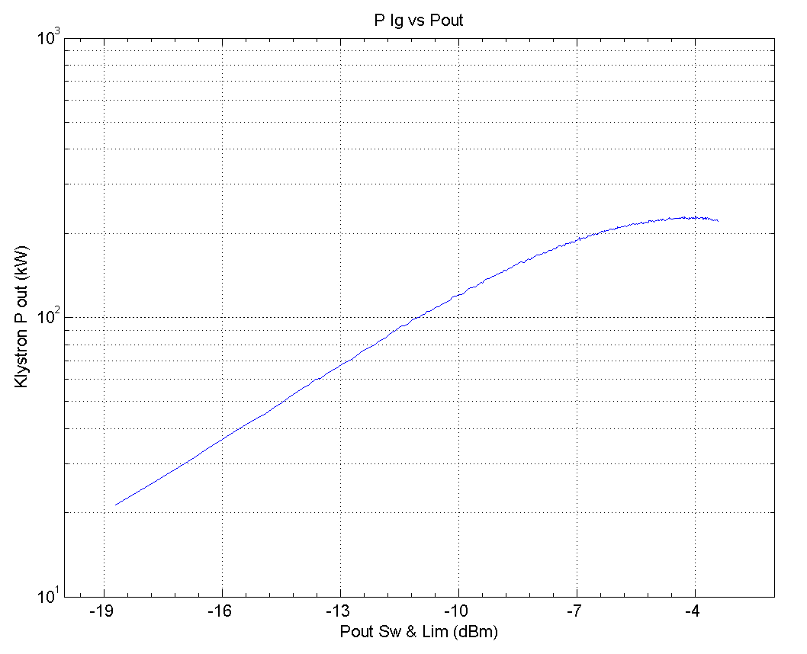
RF voltage & power on flat top
Currently 12 MV (1.5 MV per cavity)
  120kW klystron power with 1.15e11 x 1380 @ 50ns and Q_{ext} = 60k
  increasing to around 130kW with 1.5e11
  With the present DC settings (50kV, 8A) we should not exceed ~150 kW RF to keep far
  enough from saturation to
  provide gain for the RF
  feedback.
150 kW
50kV, 8A
J. Molendijk

Slide 4
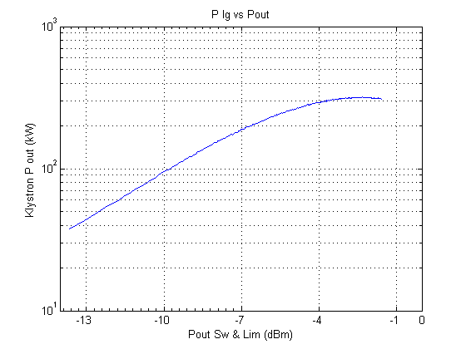
Increasing the RF voltage
Increasing 12MV→14MV would require 165kW @ Q_{ext}=60k
  already above our 150kW limit
Increase Qext:
  with Q_{ext}=80k we could get 14 MV total (1.75 MV/cav) with 134 kW/klystron average.
  on beam 2, cavity 3B2 is "sick" and stands 1.3 MV only
  the other 7 cavities would have to provide 1.815 MV, requiring 142 kW
  gain in bucket area is only 8%
  cf. bunch
  length increase from 1.2 to 1.3 ns
  increases emittance
  by 17%
Change DC working point:
  e.g. 58kV, 8A
  saturation at 300kW
  but reliability may suffer:
  probably more crowbar trips
200 kW
58kV, 9A

Slide 5
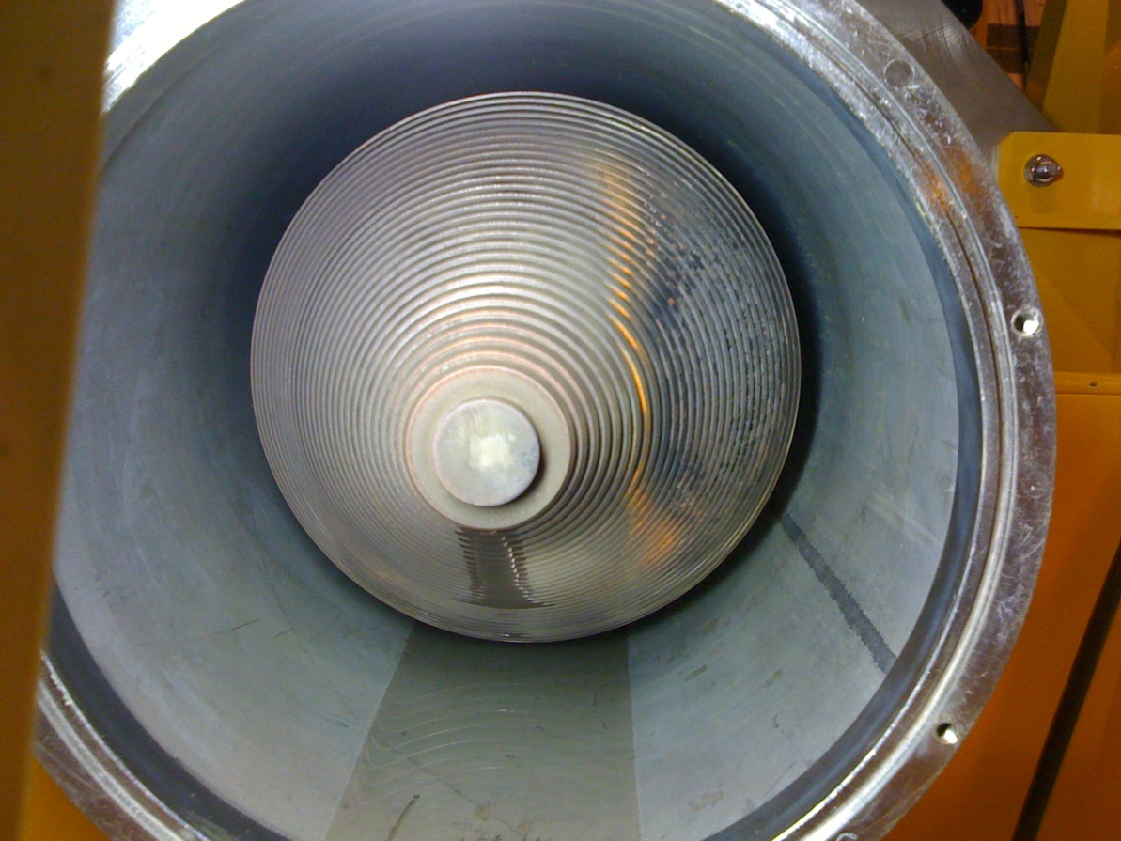
Klystron DC power issues
Klystron DC working point is currently 50kV, 8A
  to increase available power, need to increase HV, cathode current or both
58kV, 9A has been validated
  simulation (power distribution on
  collector)
  already run >500 hours in 2009/10
  collectors show signs of overheating
  need to minimize time spent with full
  power on collector
  reduce HV and/or cathode current
  when no beam (sequencer?)
New collectors, improved cooling:
  4 out of 16 klystrons already modified
  4 more in Christmas stop 2011/12
  then will be able to increase voltage without risk in half of the cavities
  Please switch off klystrons if no beam for more than a few hours !!

Slide 6
RF equipment protection (1/3)
Return power from high intensity beam in a tripped cavity can damage the RF equipment
200kW return power limit set as safe limit
  now exceeded with 1380 bunches
Must protect:
  main power
  coupler
  window
  circulator load
  HOM couplers
  klystron
Main Power Coupler
(ceramic window)
Wattcher LO
(reflected power)
Wattcher HI (fast)
[SIS] (slow)
Veto
Arc
detector
MC Vacuum
HOM Power [SIS]
HOM coupler
RF Switch
HOM Temperature [SIS]
Klystron
Circulator
Beam
Cavity
Helium pressure (cavity quench)
Helium level (Cryo OK)
Generates RF Veto
Generates Beam Interlock
[SIS]: Software interlock
Circulator load
(330kW max)
Since 17 June, all RF interlocks also generate a beam dump

Slide 7
RF equipment protection (2/3)
This configuration leaves us open to spurious dumps…
The main culprits were the Arc Detectors:
  Main coupler:
    new electronics everywhere: shorter coincidence window
    new system in development with 4 redundant sensors & majority voting (end of year)
    investigating radiation-tolerant fibres
  Waveguide:
    low-pass filters to reject radiation-induced pulses, seems to be successful
So far we have not seen any dumps due to spurious RF trips

Slide 8
RF equipment protection (3/3)
The current situation (all RF interlocks generate a beam dump) is conservative but safe
  in case of excessive false dumps, a new firmware has been prepared for the interlock modules which would remove some of the interlocks from the beam dump chain
    including some useful ones (Wattcher LO, Cavity vacuum, Cryo OK)
  decided not to install it unless absolutely necessary
In the longer term, a rationalization of the interlock system is under study
  separate RF from beam interlocks
  for end of year or LS1

Slide 9
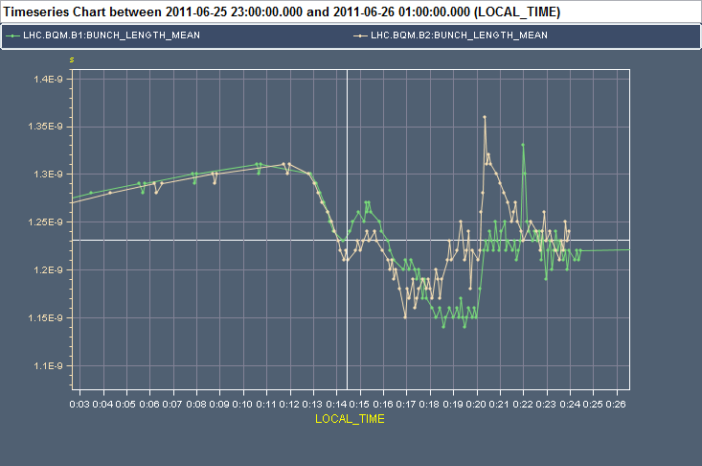
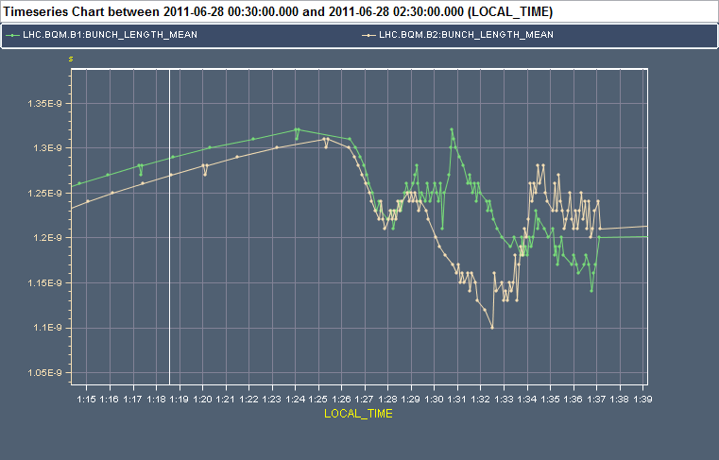
Bunch length in ramp
Optimise blowup in LHC to reduce undershoot?
  studies done in June
  revisit parameters
    start excitation earlier?
  improve update rate of BQM data
Bunch length at injection
  longer bunches from SPS?
  blowup batch by batch on flat bottom possible in theory using (future) longitudinal feedback system
    not yet implemented, will take time to develop → not for this year!
Bunch length on flat top
  could increase target bunch length but impact on lifetime above ~1.3ns?
1.15ns
1.1ns
Last 2 physics ramps before TS

Slide 10
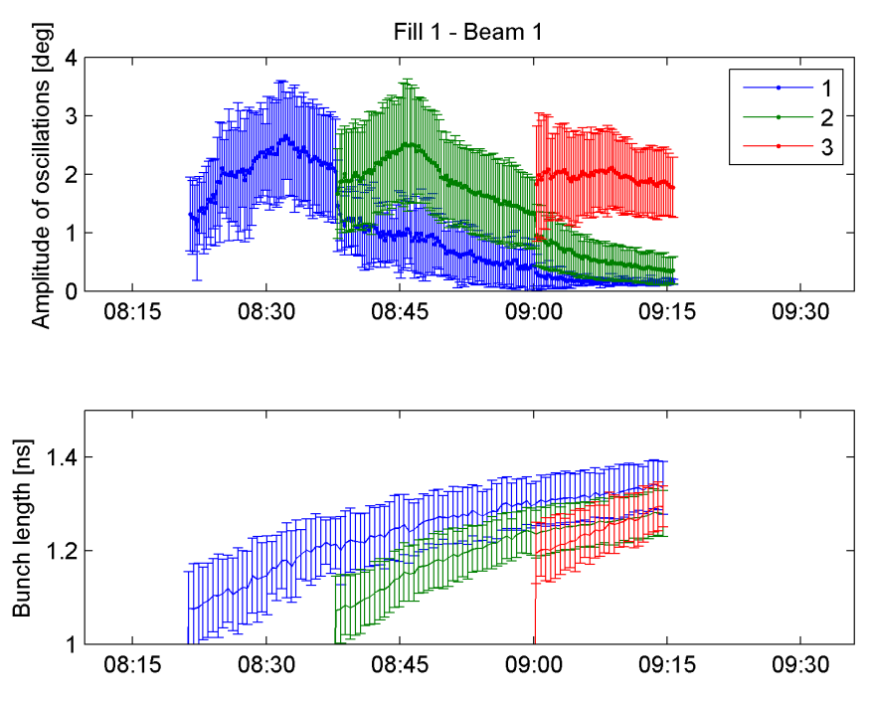
Long-lasting dipole oscillations
Observed at injection:
  amplitude grows for 5-10 minutes, then damping with a time constant ~ 30 min
  quite insensitive
  to total intensity, number
  of bunches per batch
  and distance between
  batches
  suggests not multi-bunch
  instability
  (but more analysis needed)
  dependence on bunch
  length
  not yet a problem for normal
  operation, but need to keep
  an eye on it
Top: Amplitude of dipole oscillation (min, max, mean over all bunches of a given batch).
Bottom: Bunch length from BQM. Evolution for Fill 1, Beam1.
(P. Baudrenghien et al.)

Slide 11
25ns bunch spacing: RF
No hard limit for going to 25ns
  first tests of capture gave good results
  still need to analyze our data
  if vacuum in IP4 is degraded, longer conditioning times

Slide 12
Transverse damper
No issues with 50 ns bunch spacing
No issues with high bunch intensity, but
  automatic gain adjustment needed for efficient running at increased and different bunch intensity (settings management)
Time needed for 25 ns bunch spacing commissioning: delay adjustment critical
Expect less good noise performance with 25 ns (reflections on cable, addressed in future shutdowns), adaptation of signal processing if gain → 20 MHz an issue
Ahead:
  blow-up with noise for efficient loss maps
  use of damper data for MDs very useful, more work needed (efficient “data mining”)

Slide 13
Conclusions
Ideally we change nothing…
Some headroom to increase voltage, power, emittance, bunch length if necessary
but need to be careful with operation of the klystrons
Equipment protection at high total beam intensity: we play safe with interlocks
Further improvements to controlled longitudinal blowup?
25ns bunch spacing:
  No show stopper from RF
  ADT needs time for setting up, expect less good noise performance

Slide 14
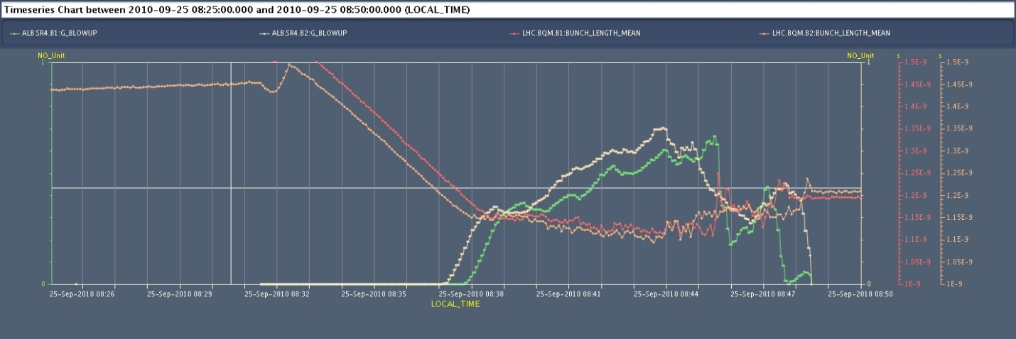
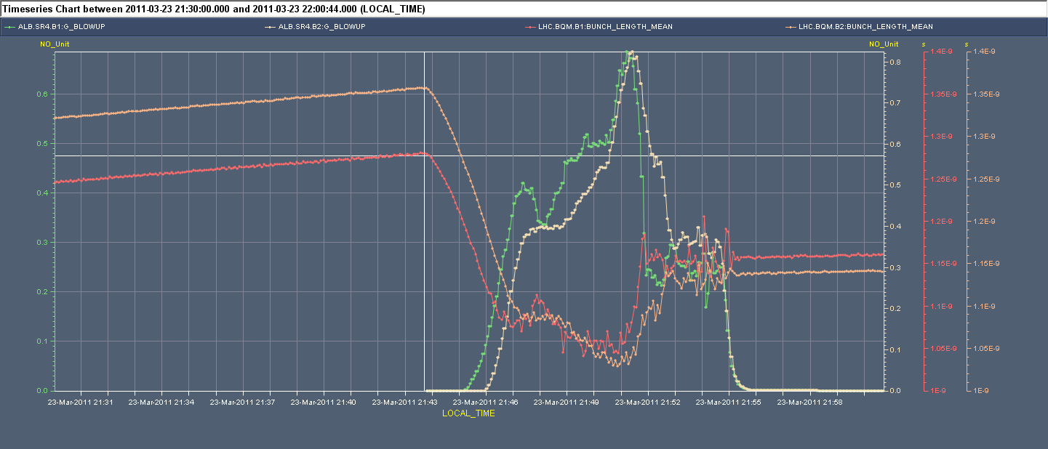
Why more tricky in 2011?
Situation 2010: Thanks to the matched capture the bunch shape is not changed much at injection. It is ~1.5 ns at the start of the ramp. The first part of the ramp proceeds smoothly without blow-up, with adiabatic bunch length reduction till it reaches the demanded 1.2 ns.
Bunch Length Mean and Noise Amplitude during Ramp
Situation 2011: Because the capture voltage is mismatched, the 1.5 ns long SPS bunch shrinks to ~1.20 ns after capture. With a 1.2 ns target value for bunch length, excitation must start immediately as soon as the ramp starts. We typically end-up a bit short of the demanded 1.2 ns and observe “jumps” in bunch length measurements when bunch profile changes (non-adiabatic)

