Slide 1


Pushing the LHC peak luminosity in 2011:
Beam instabilities
Giovanni Rumolo
in the Mini-Chamonix Workshop
Friday 15.07.2011, Jiva Hill Park Hotel
With the invaluable contributions of: W. Hoefle, K. Li, E. Métral, N. Mounet, F. Roncarolo, B. Salvant, E. Shaposhnikova, M. Taborelli, C. Yin-Vallgren
BE-ABP-ICE

Slide 2
Goal & outline
Based on observations, theory and simulations, review possible instability mechanisms and extrapolate stability criteria for
  50ns beams with N_{b} up to 1.7e11 ppb and ε_{x,y}<2μm
  Nominal 25ns
Instabilities driven by the machine impedance:
  Single bunch: Head-tail instabilities and TMCI
  Excitation of coupled bunch modes
Electron cloud effects on the beam
  Build up conditions
  Coherent instabilities & tune footprint
    Thresholds
    Parameter dependence
Longitudinal instabilities

Slide 3
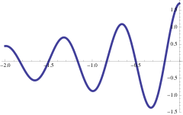
Impedance driven instabilities: possible effects
Single bunch instabilities
  Headtail modes
    Modes |m|≥1 unstable when Q’>0
    At all intensities, however with growth rate proportional to bunch intensity
    Can be damped with tune spread with amplitude (octupoles)
  Transverse Mode Coupling Instability
    Only above an intensity threshold (N_{b} > N_{th})
    The threshold is usually increased by positive chromaticity and octupoles
    Possibly cured by a high bandwidth feedback system
∫W(z-z‘)λ(z‘)<x>(z‘)dz‘
z

Slide 4
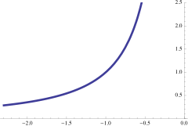
Impedance driven instabilities: possible effects
Single bunch instabilities
  Headtail modes
  Transverse Mode Coupling Instability (TMCI)
Coupled bunch instabilities
  Rigid bunch oscillations
    At all intensities, however with growth rate proportional to bunch intensity
    Can be damped with transverse feedback
  Higher order modes
    Are characterized by both intra-bunch and bunch-to-bunch oscillation
    Can be Landau damped with octupoles
∑W(kd)Ν(kd)<x>(kd)
d

Slide 5
Overview on possible instabilities (transverse plane)
Single bunch instabilities
  Headtail modes
  Transverse Mode Coupling Instability (TMCI)
Coupled bunch instabilities
  Rigid bunch oscillations
  Higher order modes
Electron cloud effect
  In general, multi-bunch effect, because bunch trains are needed to build up an electron cloud
  Can be source of Electron Cloud Instability (ECI)
    By coupling the motion of subsequent bunches through a bunch-to-bunch wake (rigid or headtail modes). E.g. horizontal coupled bunch ECI is observed in the SPS and suppressed with the damper
    By coupling the motion of head and tail of the same bunch and exciting a headtail mode. E.g. vertical single bunch ECI is observed in the SPS and suppressed with high chromaticity
Transverse emittances, ε_{x,y}
Protons per bunch, N_{b}
Bunch spacing, number of bunches, number of batches
Transverse emittances, ε_{x,y}

Slide 6
Overview on possible instabilities (transverse plane)
Single bunch instabilities
  Headtail modes
  Transverse Mode Coupling Instability (TMCI)
Coupled bunch instabilities
  Rigid bunch oscillations
  Higher order modes
Electron cloud effect
  In general, multi-bunch effect, because bunch trains are needed to build up an electron cloud
  Can be source of Electron Cloud Instability (ECI)
    By coupling the motion of subsequent bunches through a bunch-to-bunch wake (rigid or headtail modes). E.g. horizontal coupled bunch ECI is observed in the SPS and suppressed with the damper
    By coupling the motion of head and tail of the same bunch and exciting a headtail mode. E.g. vertical single bunch ECI is observed in the SPS and suppressed with high chromaticity

Slide 7
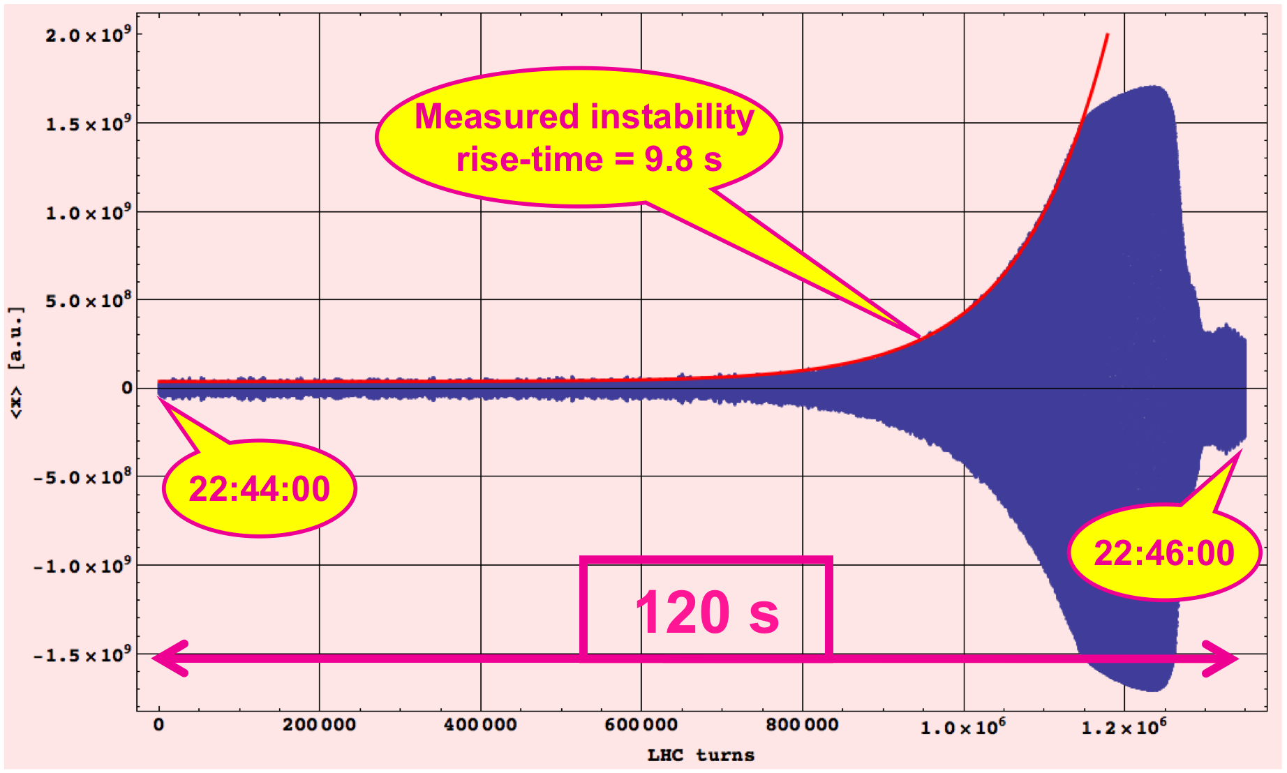
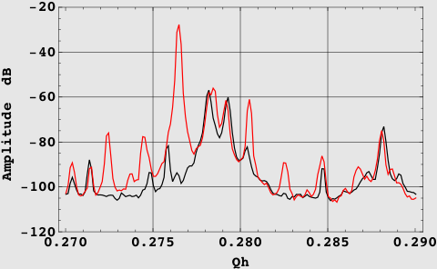
Single bunch instabilities Headtail modes
First observed in the LHC on acceleration of the nominal bunch
  Excited on the ramp (around 2 TeV) with ~6 Q’ units
  Measured rise time of ~10s
  Clearly a mode m=-1, as seen from the spectrum
  Suppressed with Landau damping through octupoles
Beginning of instability
Advanced phase of instability
Courtesy E. Métral

Slide 8
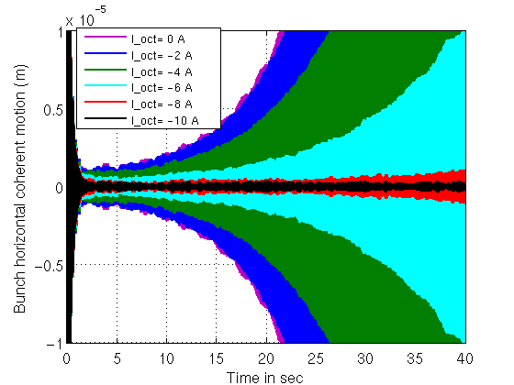
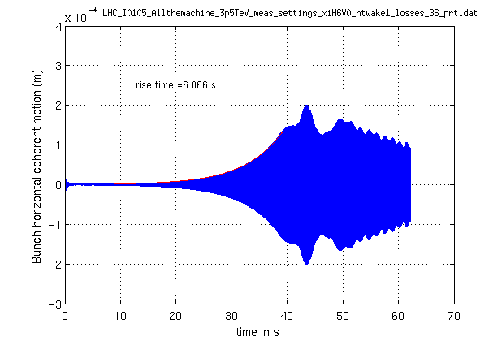
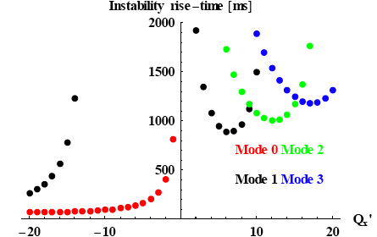
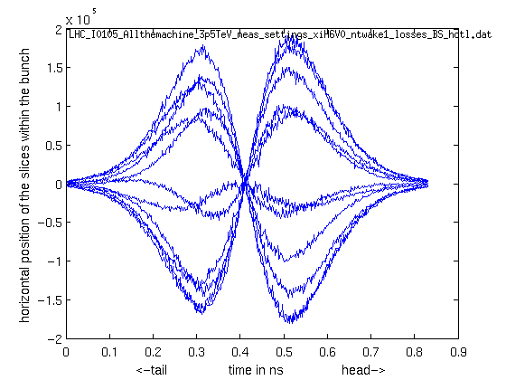
Single bunch instabilities Headtail modes
Explained and reproduced with simulations and theory (nominal intensity)
  Growth rate proportional to bunch intensity
  Efficiency of octupole stabilization depends on transverse emittance
Depending on chromaticity control or requirements, larger bunch intensity and smaller transverse emittances might take stronger octupole currents for the suppression of this instability
HEADTAIL simulation
HEADTAIL simulation
Courtesy E. Métral, B. Salvant

Slide 9
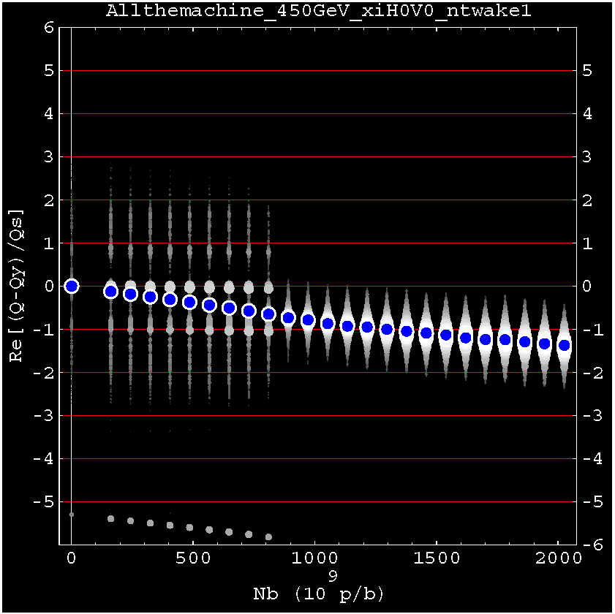
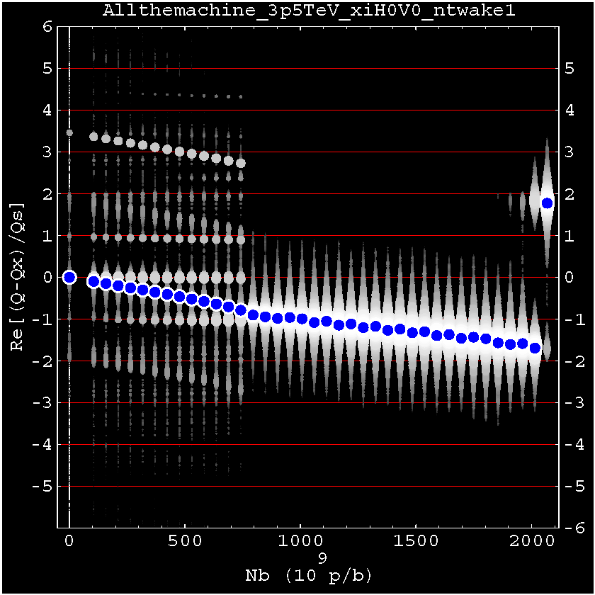
Single bunch instabilities
TMCI
Not observed experimentally with intensities presently injected into the LHC
  Up to 2.8 x 10¹¹ p at 450 GeV
  Up to 1.7 x 10¹¹ p at 3.5 TeV
Indeed simulated thresholds with our impedance model are higher with the nominal collimator settings at both injection and top energy
HEADTAIL simulation @450 GeV
HEADTAIL simulation @3.5 TeV
N_{th} = 8 x 10¹¹ p
N_{th} = 8 x 10¹¹ p
Courtesy B. Salvant

Slide 10
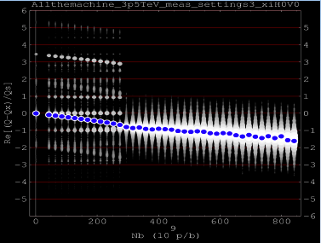
Single bunch instabilities
TMCI
However, tight collimator settings (presently considered , at least at flat top) lower the TMCI threshold by more than a factor 2
Even with these settings, single bunch intensities up to 3 x 10¹¹ should not suffer from TMCI
This threshold can be actually lower if:
A significant contribution to the global short range wake is still missing from the LHC impedance database
The multi-bunch effect plays an important role
HEADTAIL simulation @3.5 TeV
N_{th} ≈3 x 10¹¹ p
Courtesy N. Mounet

Slide 11
Overview on possible instabilities (transverse plane)
Single bunch instabilities
  Headtail modes
  Transverse Mode Coupling Instability (TMCI)
Coupled bunch instabilities
  Rigid bunch oscillations
  Higher order modes
Electron cloud effect
  In general, multi-bunch effect, because bunch trains are needed to build up an electron cloud
  Can be source of Electron Cloud Instability (ECI)
    By coupling the motion of subsequent bunches through a bunch-to-bunch wake (rigid or headtail modes). E.g. horizontal coupled bunch ECI is observed in the SPS and suppressed with the damper
    By coupling the motion of head and tail of the same bunch and exciting a headtail mode. E.g. vertical single bunch ECI is observed in the SPS and suppressed with high chromaticity

Slide 12
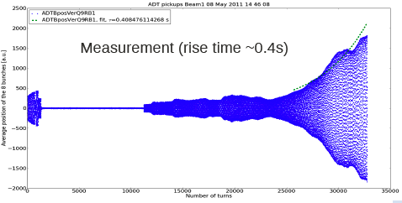
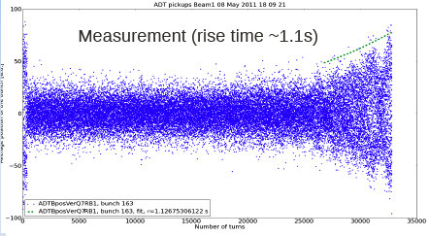
Coupled bunch instabilities
Rigid bunch mode (m=0)
Damped by the transverse feedback system in routinely operation
LHC MD 8th May 2011
  Inject two batches of 12 and 36 bunches (50ns spacing)
  Switch off the feedback system with ~0 chromaticity (it was tried both at injection and top energy)
  Coupled bunch instability (mode 0) excited
@450 GeV
@3.5 TeV
Courtesy N. Mounet

Slide 13
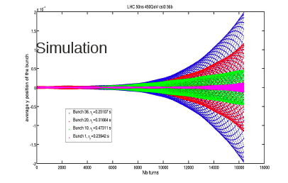
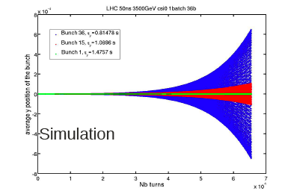
Coupled bunch instabilities
Rigid bunch mode (m=0)
HEADTAIL simulations (multi-bunch mode) could reproduce the measured rise times within a factor 1.4 at injection and 2 at top energy
Higher charge per bunch, higher number of bunches, closer spacing (25ns), tighter collimator settings could all contribute to decrease the rise times measured during the MD, but should be still in a range in which the damper can suppress this unstable mode. Simulations could be used to check this
HEADTAIL simulation @450 GeV
HEADTAIL simulation @3.5 TeV
Courtesy N. Mounet

Slide 14
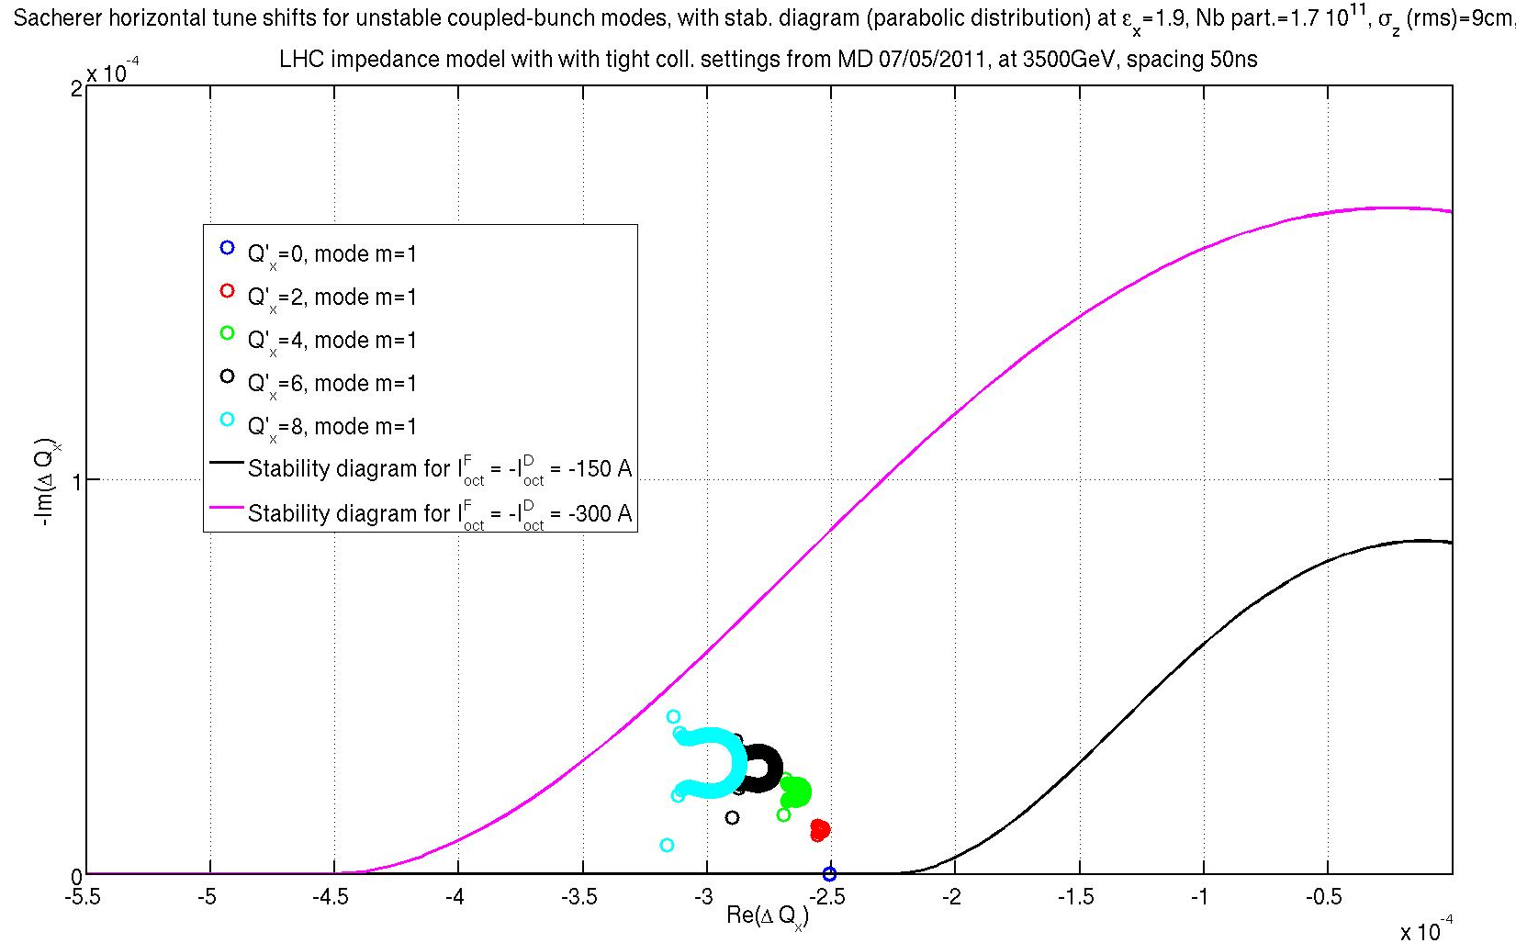
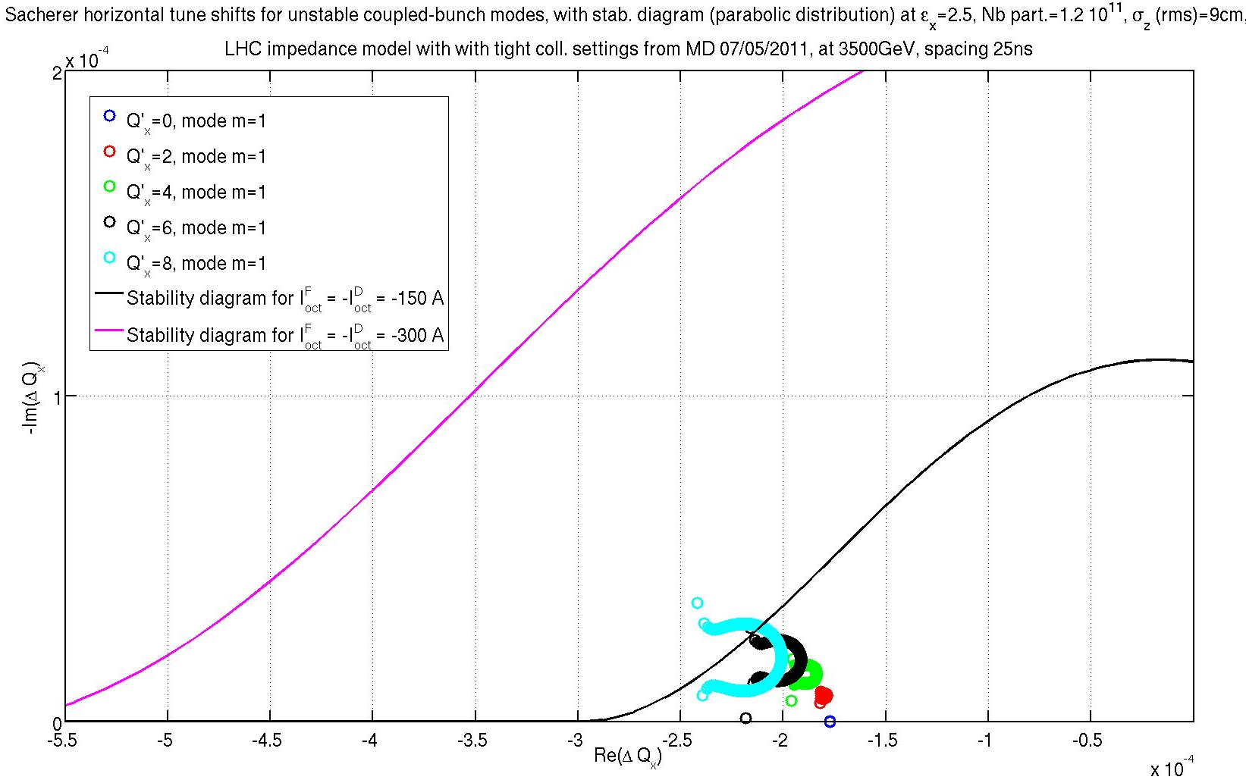
Coupled bunch instabilities
Headtail modes (m≥1)
The growth rates of the coupled bunch headtail modes m=1 are evaluated analytically with Sacherer’s formula
Worst case considered → tight collimator setting at 3.5 TeV
Two cases have been checked
  25ns with 1.2 x 10¹¹ ppb and 2.5μm transverse emittance, Q’ from 0 to 8 units
  50ns with 1.7 x 10¹¹ ppb and 1.9μm transverse emittance, Q’ from 0 to 8 units
Stability boundary for I_{oct}=-300A
Stability boundary for I_{oct}=-300A
Stability boundary for I_{oct}=-150A
Stability boundary for I_{oct}=-150A
25ns, 1.2 x 10¹¹ ppb, ε_{x,y}=2.5μm
50ns, 1.7 x 10¹¹ ppb, ε_{x,y}=1.9μm
Courtesy N. Mounet

Slide 15
Overview on possible instabilities (transverse plane)
Single bunch instabilities
  Headtail modes
  Transverse Mode Coupling Instability (TMCI)
Coupled bunch instabilities
  Rigid bunch oscillations
  Higher order modes
Electron cloud effect
  In general, multi-bunch effect, because bunch trains are needed to build up an electron cloud
  Can be source of Electron Cloud Instability (ECI)
    By coupling the motion of subsequent bunches through a bunch-to-bunch wake (rigid or headtail modes). E.g. horizontal coupled bunch ECI is observed in the SPS and suppressed with the damper
    By coupling the motion of head and tail of the same bunch and exciting a headtail mode. E.g. vertical single bunch ECI is observed in the SPS and suppressed with high chromaticity

Slide 16
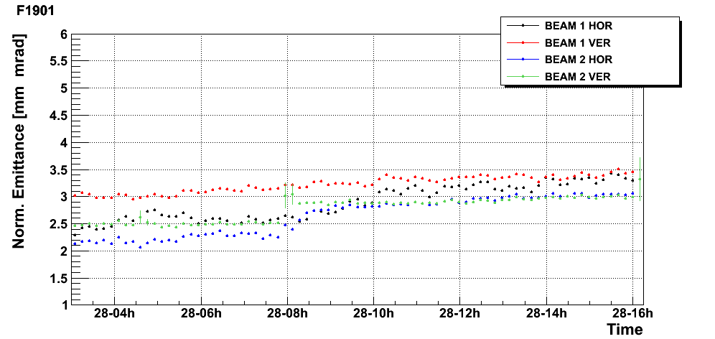
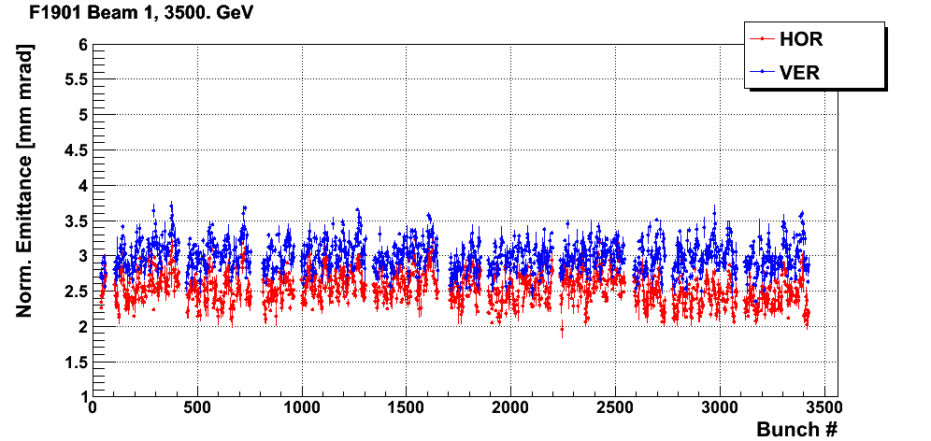
Electron cloud effects
Considerations on the build up
Build up is stronger with closer bunch spacing (in the LHC range)
  SPS experience
    Threshold SEY_{max} is about 1.7 with 50ns beams and 1.3 with 25ns beams (nominal intensity)
    Surface scrubbing leads to SEY_{max}=1.5-1.6 on StSt (measured) and saturates at this value
  LHC
    Presently, nominal 50ns beams do not suffer from obvious electron cloud limitations (after 10 days dedicated scrubbing + few months of “free scrubbing” with physics) → SEY_{max} ≤ 1.7
    First injections of 25ns beams in batches of 24 bunches → difficult to conclude on electron cloud effects on the beam
Courtesy M. Taborelli
StSt
DLC
1380 bunches per ring
ε growth < 2% /h
DLC cond. and StSt cond.
a-C
50 ns threshold (simul.)
Courtesy F. Roncarolo

Slide 17
Electron cloud effects
Considerations on the build up
Build up is stronger with closer bunch spacing (in the LHC range)
  SPS experience
    Threshold SEY_{max} is about 1.7 with 50ns beams and 1.3 with 25ns beams (nominal intensity)
    Surface scrubbing leads to SEY_{max}=1.5-1.6 on StSt (measured) and saturates at this value
  LHC
    Presently, nominal 50ns beams do not suffer from obvious electron cloud limitations (after 10 days dedicated scrubbing + few months of “free scrubbing” with physics)
    First injections of 25ns beams in batches of 24 bunches → difficult to conclude on electron cloud effects on the beam
Effect of bunch intensity
  Simulations suggest a decrease of the electron cloud activity when increasing the intensity per bunch of 50ns beams to values higher than nominal
  Lack of clear experimental verification in the SPS
Effect of transverse emittances
  Little influence expected when the SEY is far above the threshold value for build up
  Smaller emittances can significantly enhance the electron cloud when SEY is close to the threshold value for build up

Slide 18
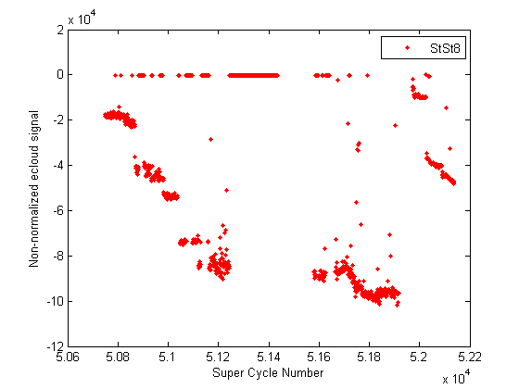
Electron cloud effects
Considerations on the build up
SPS MD on 11th May 2011
Increasing the intensity:
1, 2, 3 batches 50ns, 1.4 x 10¹¹ ppb ε_{x,y}=1.6μm
4 batches 50ns, 1.4 x 10¹¹ ppb ε_{x,y}=2.5μm
4 batches 50ns, 1.4 x 10¹¹ ppb ε_{x,y}=1.6μm
4 batches 50ns, 1.6 x 10¹¹ ppb ε_{x,y}=1.9μm
Courtesy C. Yin Vallgren

Slide 19
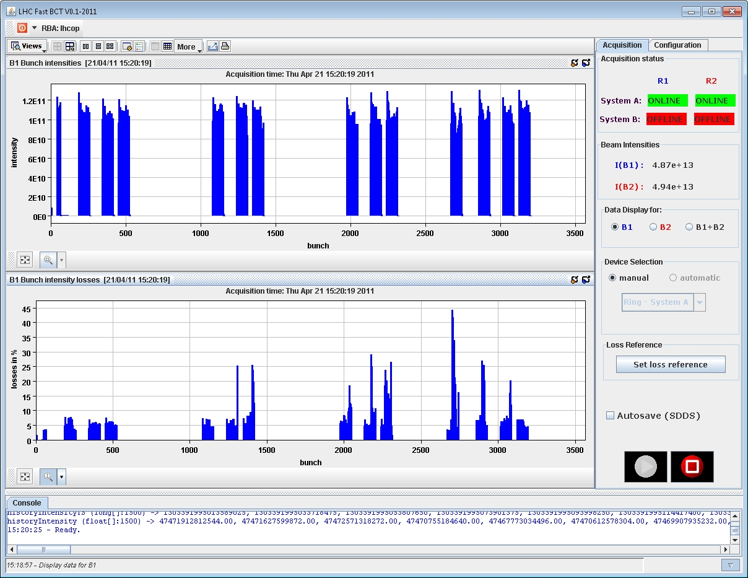
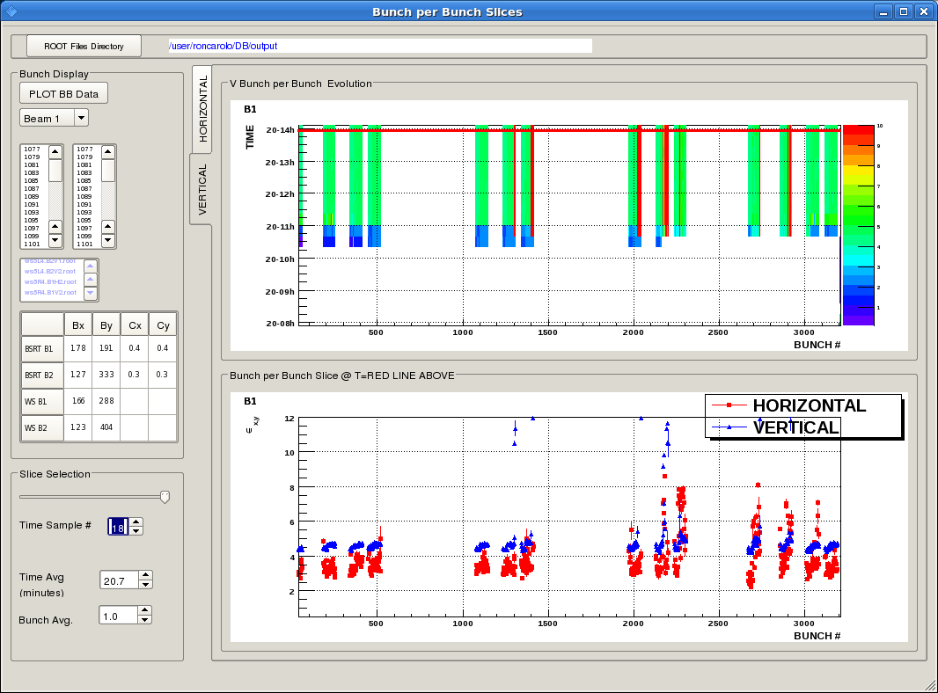
Electron cloud effects
Single bunch ECI
During the scrubbing run and first physics runs, some bunches at the tails of batches were observed to suffer from emittance growth (BSRT) and larger losses (FBCT), probably a signature of coherent instability
ECI can be enhanced by:
  More electron cloud
    50ns with higher charge per bunch (?) and smaller transverse emittances
    25ns (at least one order of magnitude more)
  Smaller transverse emittances
    Due to stronger pinching effect
    Experimental verification at the SPS in 2008
Beam 1 (flat top screen shots), Fill 1728

Slide 20
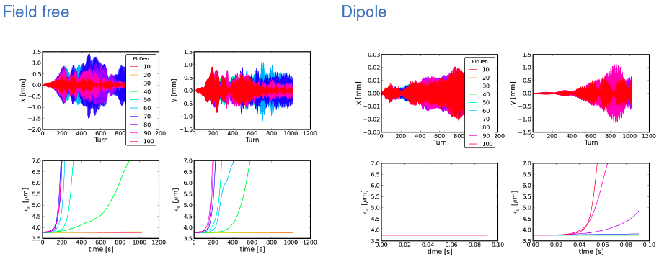
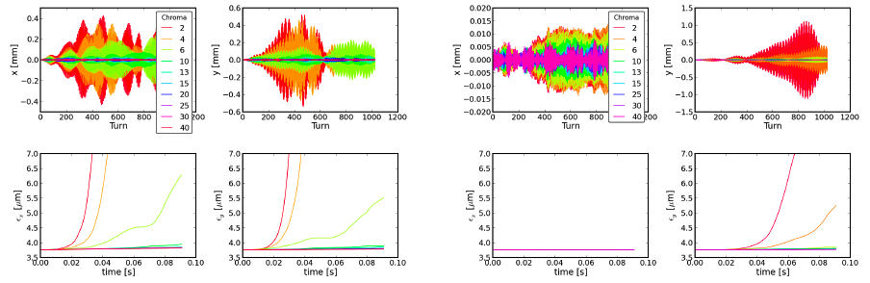
Electron cloud effects
Single bunch ECI
HEADTAIL simulations of ECI @ 450 GeV and ε_{x,y}=1.5 to 3.5μm , electron cloud density threshold value for the onset of the ECI
  Field-free region (total length ~30% of the ring) → 1 – 1.4 x 10¹² m⁻³
  Arc dipoles (total length ~60% of the ring) → 0.85 – 1.1 x 10¹² m⁻³
Threshold values are probably about a factor 2 lower if the electron cloud is present both in the dipoles and in field-free regions. These densities are compatible with central densities from 25ns beams
Q’=15 is sufficient to recover stability
Courtesy K. Li

Slide 21
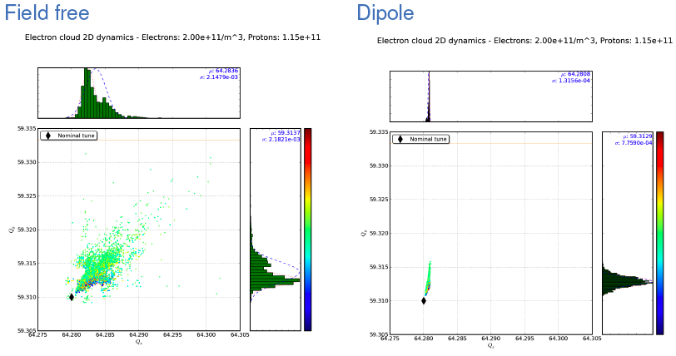
Electron cloud effects
Tune footprint
HEADTAIL simulations @ 450 GeV with electron cloud density values below threshold for the onset of the ECI are used to quantify possible tune spreads from electron cloud
Courtesy K. Li
ΔQ_{y}=0.02
ΔQ_{y}=6 x 10⁻³

Slide 22
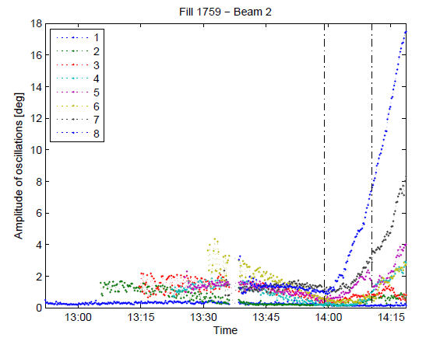
Longitudinal plane
Dipole and quadrupole instabilities
Loss of Landau damping is observed at injection in the LHC
  For intensities above 1.5 x 10¹¹ ppb and longitudinal emittances below 0.75 eVs without phase loop
  The phase loop works well for single bunch injection but is less efficient for multi-bunch injections
  Oscillation growth is very slow and stops when the longitudinal emittance has grown above the threshold value
Dipole oscillations can also become unstable along the ramp for intense bunches
Quadrupole oscillations are excited at flat top for small longitudinal emittances
There is no observation of longitudinal coupled bunch instabilities
Both can be stabilized by longitudinal emittance blow up along the ramp
Courtesy E. Shaposhnikova

Slide 23
Summary
 | 50ns with higher N_{b} and lower ε_{x,y} | 25ns nominal
Single bunch headtail instabilities | More Landau damping required | Present Landau damping settings sufficient
TMCI | Both safely below threshold, multi-bunch effect?
Coupled bunch instabilities (m=0) | Transverse feedback
Coupled bunch instabilities (headtail modes) | More Landau damping required | Present Landau damping settings marginally sufficient
Electron cloud build up | Larger than now, maybe more scrubbing needed | Significantly larger than now, efficiency of scrubbing?
Single bunch ECI | Higher chromaticity setting to suppress it during scrubbing | Higher chromaticity setting to suppress it, if e-cloud level tolerable

