Slide 1
Beam Preparation in Injectors and Beam Characteristics
K.Cornelis
BE-OP-SPS

Slide 2
Content
Drifting beam parameters
Emittances and intensity
Scraping strategy.
Considerations on filling strategy and SC composition
Conclusions

Slide 3
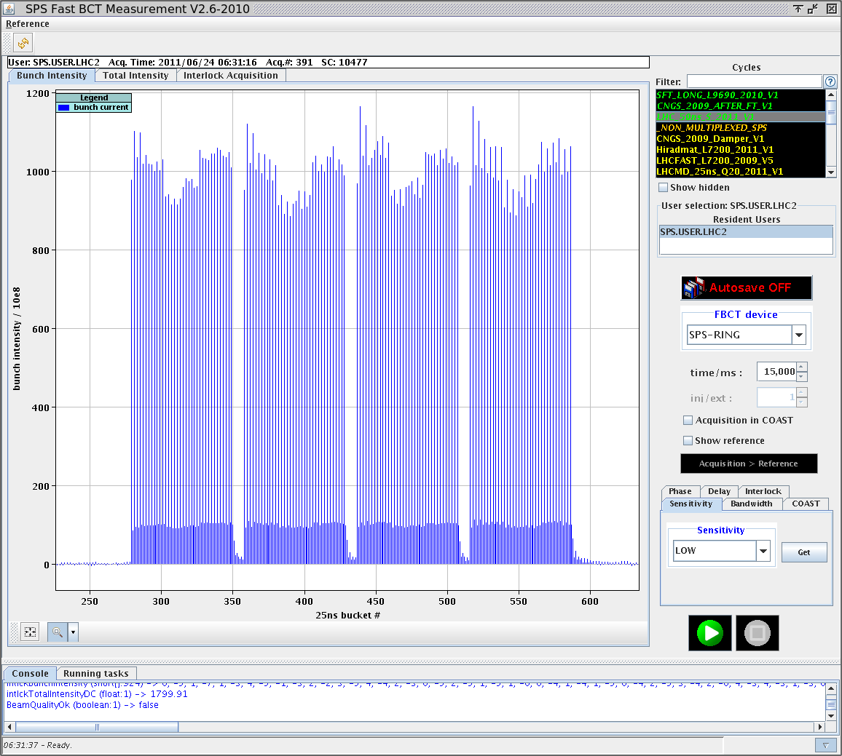
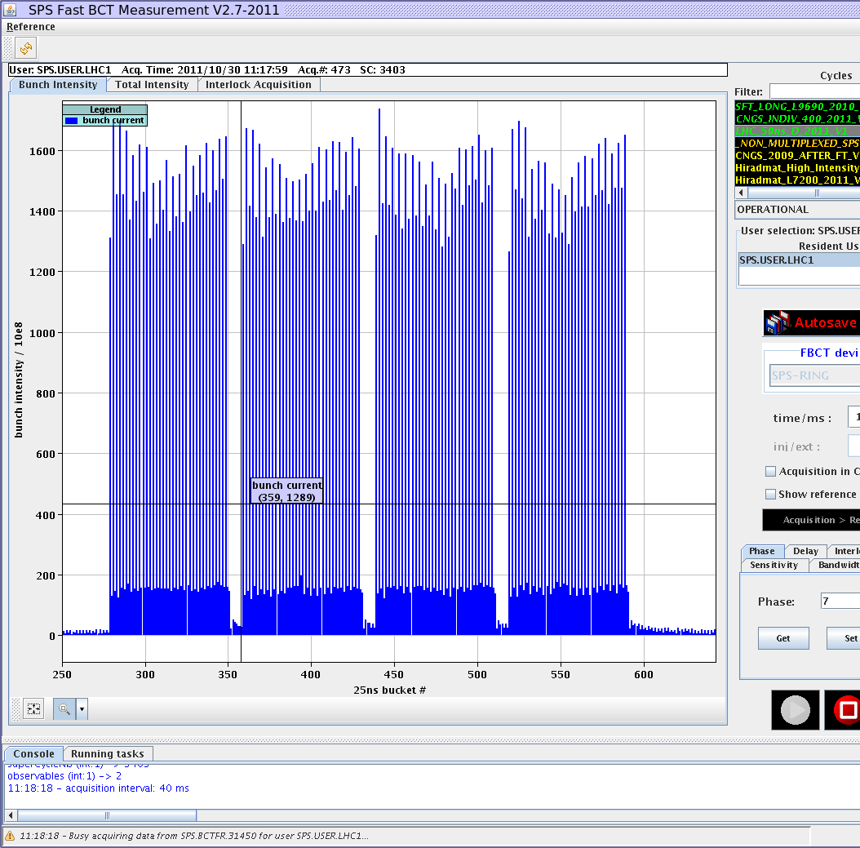
Drifting beam parameters (examples)
Booster ring 1 and 2 lower intensity
Bunch splitting

Slide 4
Drifting beam parameters
parameter | frequency | Remarks
PSB Ring intensity | Almost every fill | Relatively easy
PSB-PS Transfer | Checked and corrected when emittances too high | Easy when tools are working.
Splitting | Every fill | Needs skill
PS-SPS transfer (inj. oscillations) | Almost every fill | Easy and quick
Injection phase | Almost every fill | Easy and quick
Longitudinal blow-up in SPS | Every couple of days | Becomes tricky for high intensities ( > 1.4 10¹¹)
These checks and adjustments can be done by the OP-crew in 10 to 20 minutes. However, if beam requirements go outside the operational parameter window (e.g. Intensity increase, change of longitudinal emittance etc.) some of these adjustments need expert intervention.

Slide 5
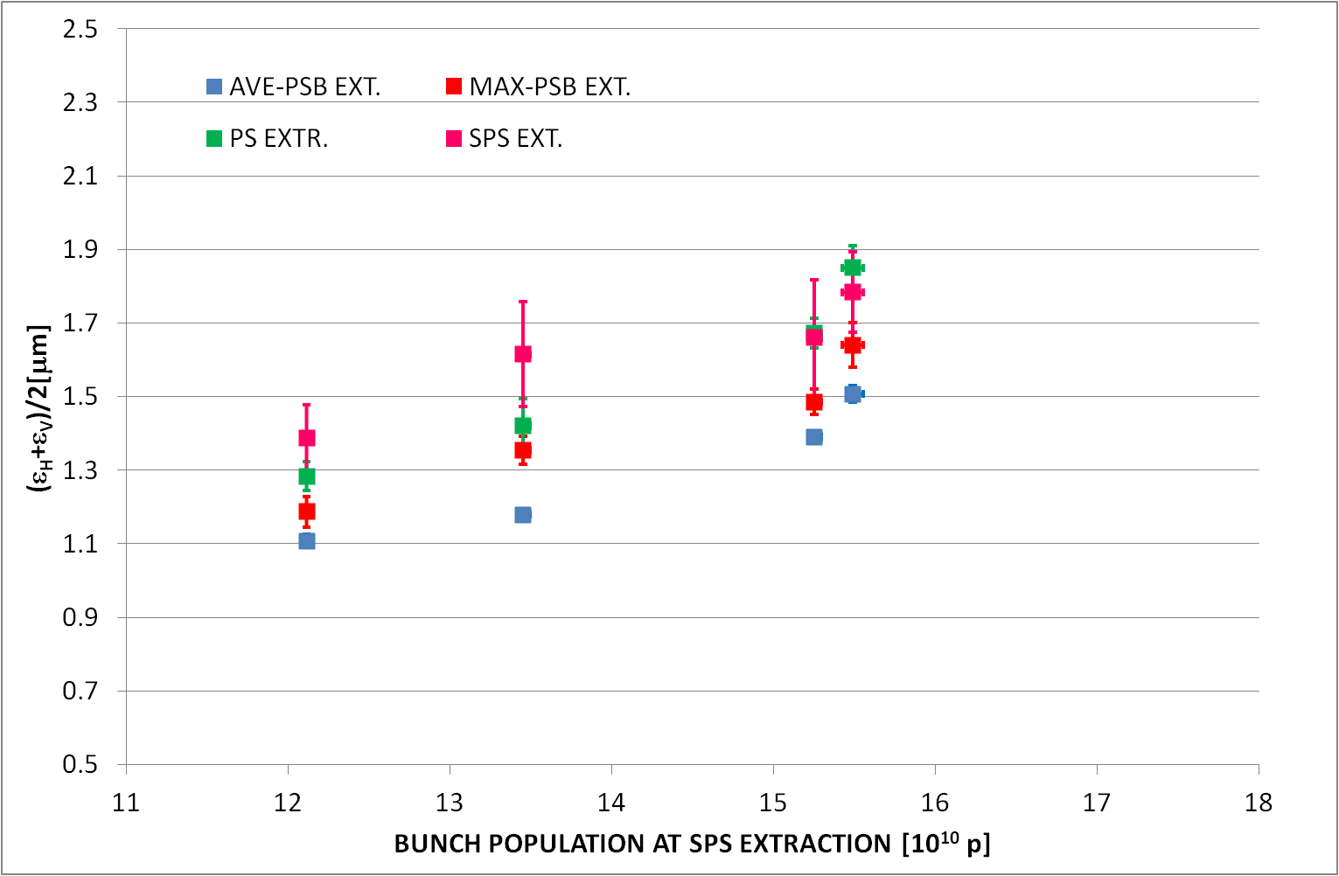
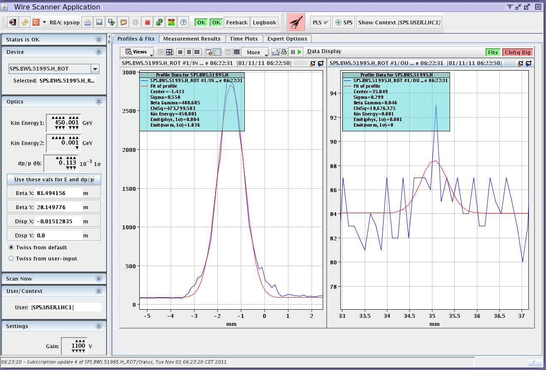
Emittance and Intensity
Booster ring 1 and 2 poorer performance
For higher intensities there is bigger scatter at 450 GeV in SPS.
Presence of tails at 450GeV for high intensity.
Request for bunch by bunch measurement with WS and a continues measurement (ionisation beam profile)

Slide 6
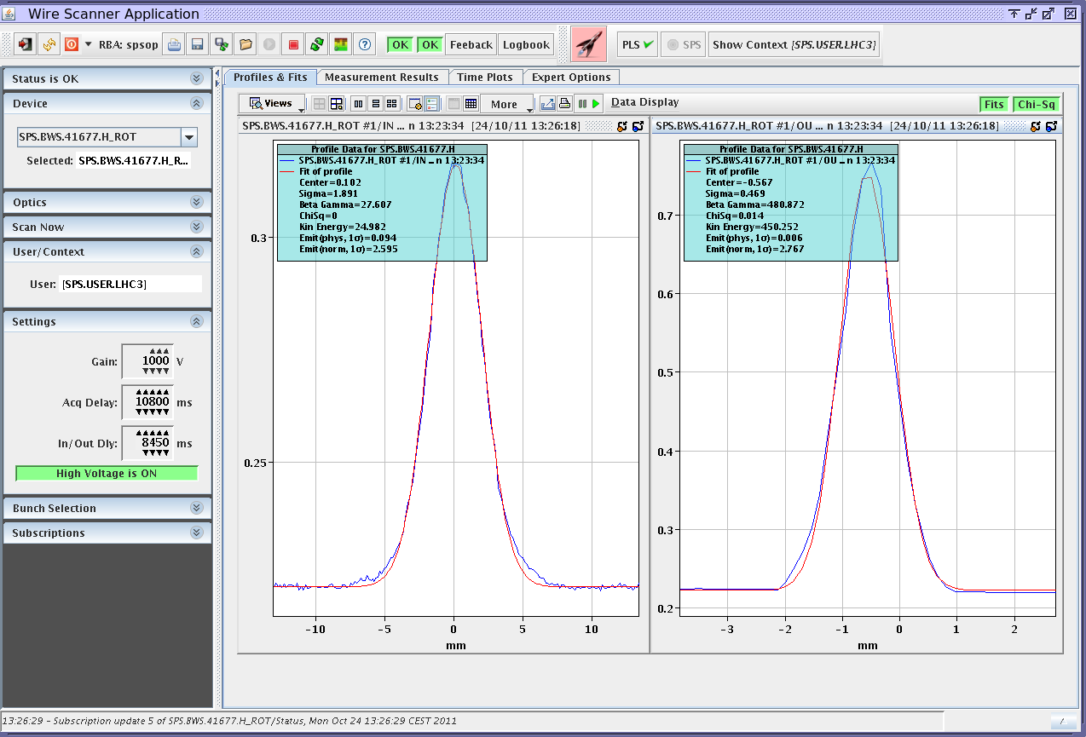
Emittance 25 nsec beam
Intensity | < 1.15e11
εH | 2.6-3.0 μm
εV | 2.6-3.0 μm
Nice gaussian beams

Slide 7
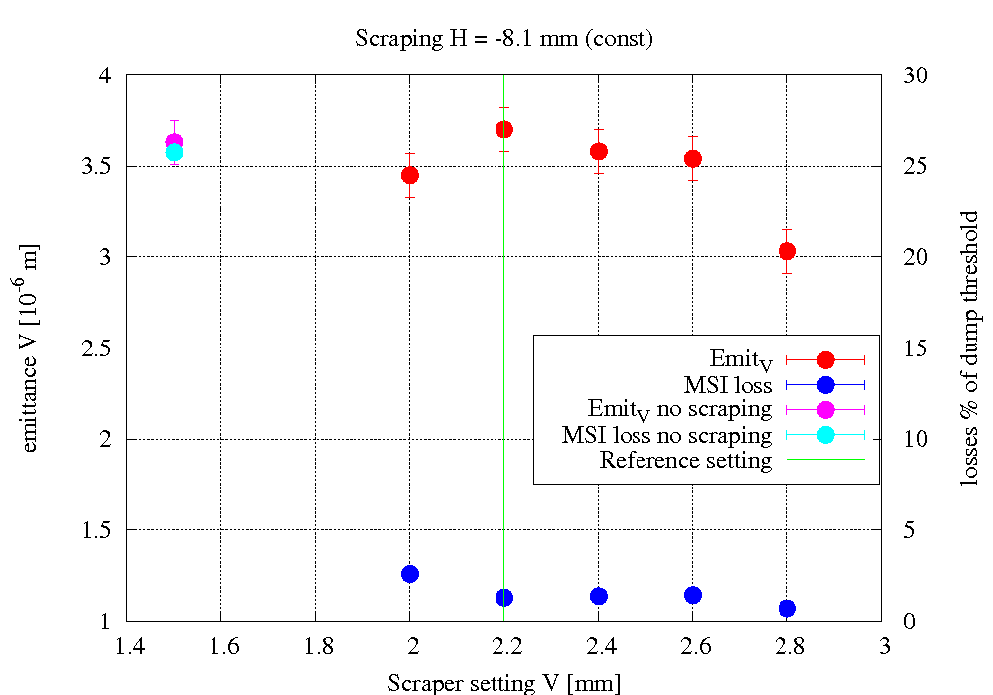
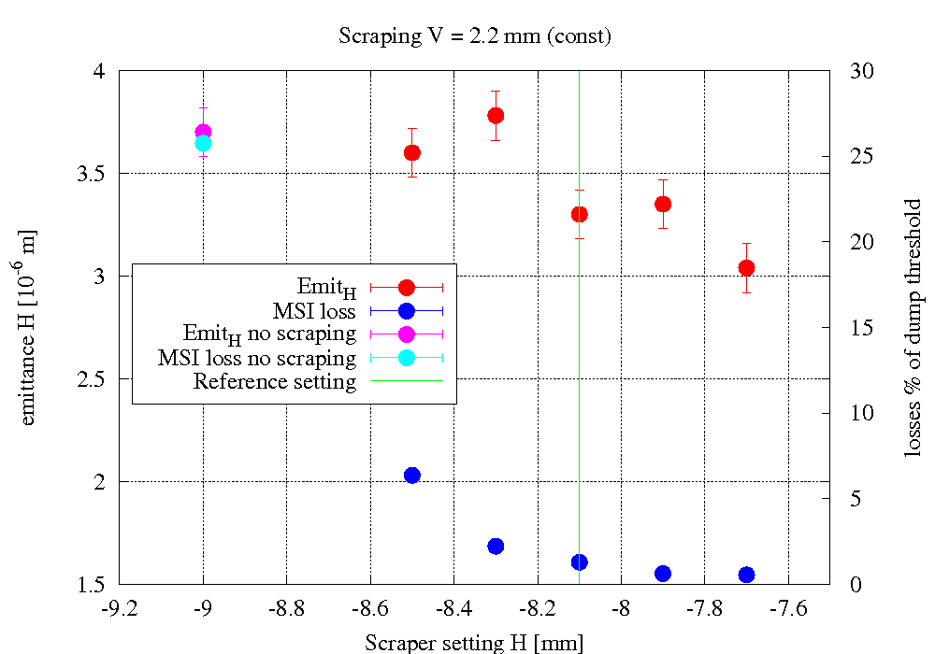
Scraping
Scraping studies showed the importance of the scraping position. The scraper has to cast a shadow on the transfer line collimators. In this way even large emittances can be transferred.
Courtesy to Lene Drosdal

Slide 8
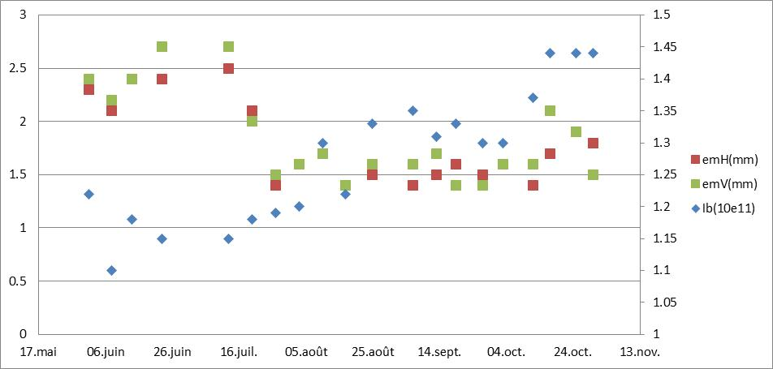
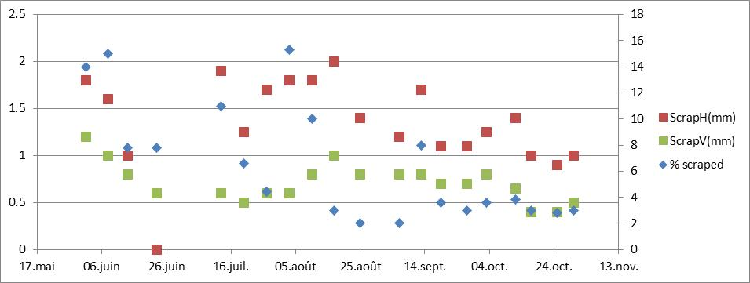
Scraping, Emittances and Intensities.
em
int
%
Deeper scraping

Slide 9
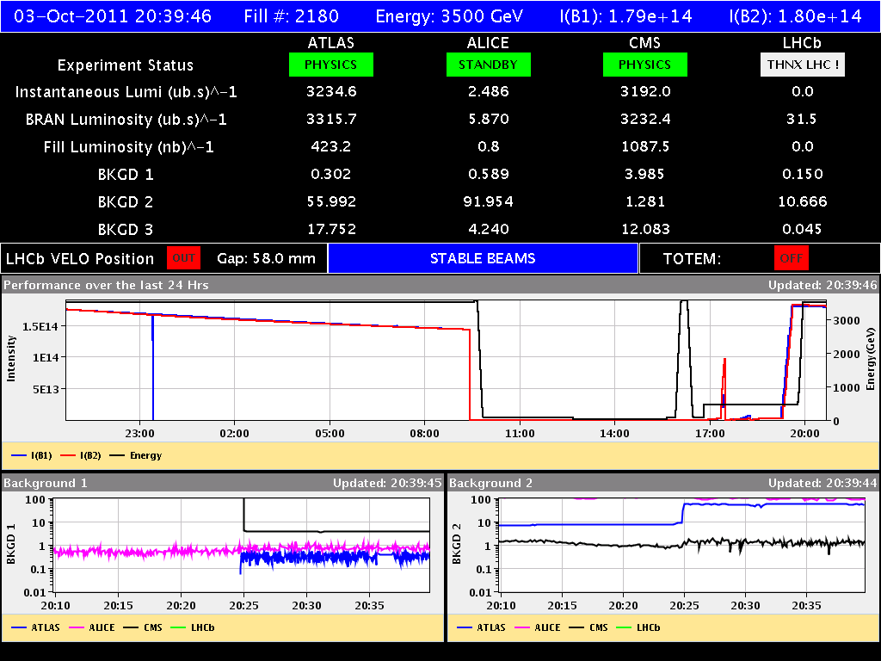
Pre-filling and Filling Strategy
LHC filling cycle check (no adjustments)
Inject 12b
Adjustments of
beam parameters
Start filling

Slide 10
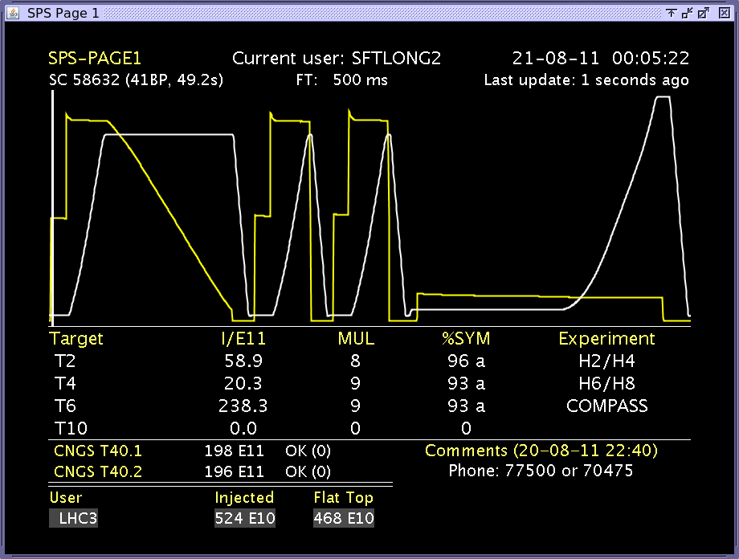
Filling SC in 2011
Minimal changes to SC length in order to have space for the numerous PS users and avoid permanent reshuffling.
FT always present. Most NA experiments have short scheduled periods and suffer more from interruptions.
Long flat top of FT cycle gives space in for PS users.

Slide 11
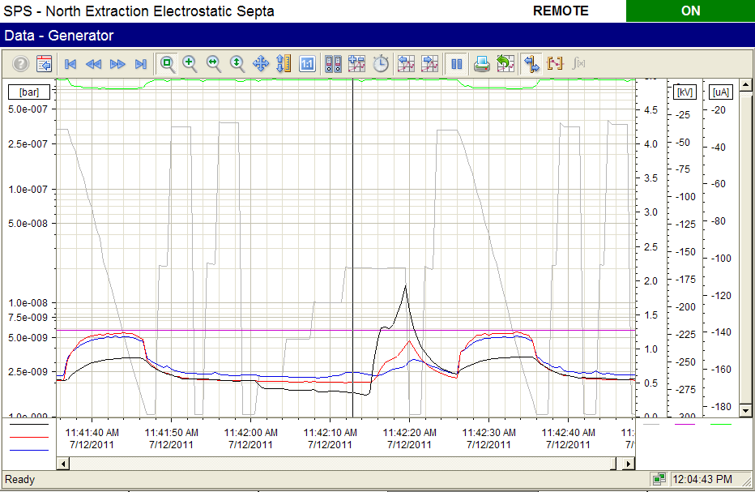
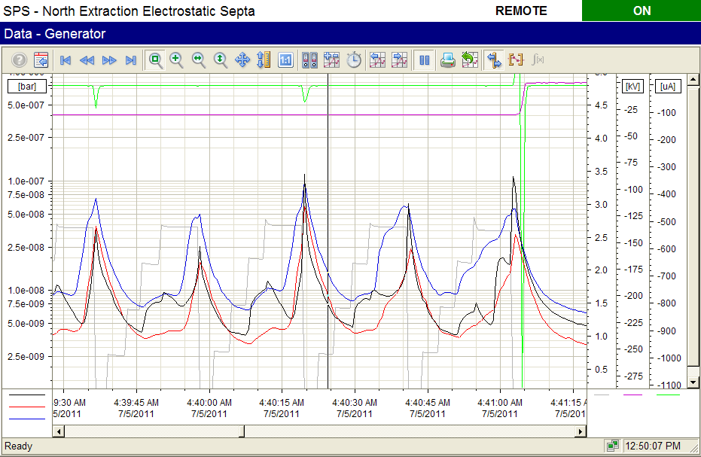
Dealing with ZS sparks
Pressure rise during injection and acceleration under control by scrubbing.
Pressure rise at beam dump always present even at the end of the run.
Consequent filling cycles with high intensity not possible (ZS needs recovery time).
New spark interlock during LHC cycle : beam dump on spark.
For bunch intensities > 1.45 10¹¹ frequent sparks and ZS needs to put at 110kV, which implies no slow extraction.

Slide 12
Considerations for 2012
The switching between 12b and 36b by using the concept of spare cycle. PS has to keep the extraction and TT2 steering equal for both cycles.
If ZS sparking problem persists with high intensities, we can take FT cycle out of the filling super cycle.
In this case, and if necessary, we could shorten the super cycle for filling, e.g. keeping only one or two CNGS’s. This would have a negative effect on PS users.
During the actual filling, timing sequences should be frozen, no changing and no loading.

Slide 13
Conclusions
During 2011run, the injectors increased the beam brightness in several steps. Injector operators gained a lot of experience for preparation, adjustment, and optimisation of the filling process.
Several Beam parameters drift and need to be checked and adjusted just before the filling.
Changing the parameters outside a pre-defined operational window (such as intensity) needs a pre-warning, since expert intervention is certainly needed.
Just increase the scraping when there are losses at LHC injection is rarely the best solution.
Since in 2012 we will most certainly run with high intensities (ZS sparks)we might have to review the filling cycle sequence.

