Slide 1
Session 1
Review 2011, efficiency, turn-around
G. Papotti,J. Wenninger
M. Pojer, M. Albert, A. MacPherson,
W. Venturini

Slide 2
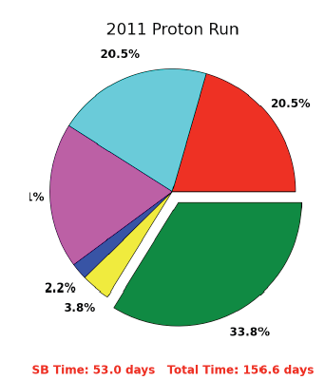
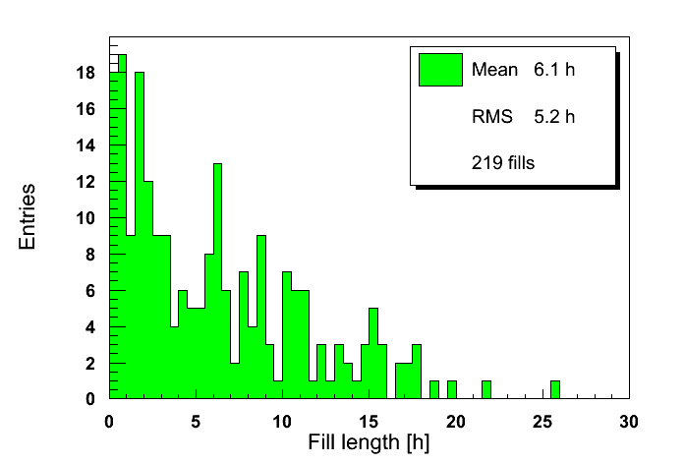
Efficiency
Effective efficiency: ~34% ➔ 1 h SB – 2 hours ‘off’
  MD, TS removed.
Massi by JW
Mean = 6.1 hours

Slide 3
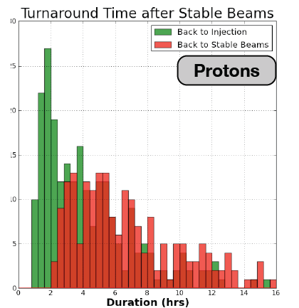
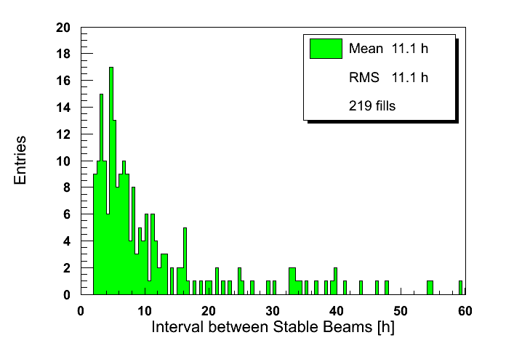
Turn-around mystery…
About the definition of turn-around and histogram limits..
  “I only believe the stats that I distorted myself”
Massi by JW
Mean = 5.4 hours
Mean = 11.1 hours
Efficiency SB =

Slide 4
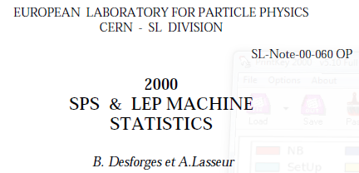
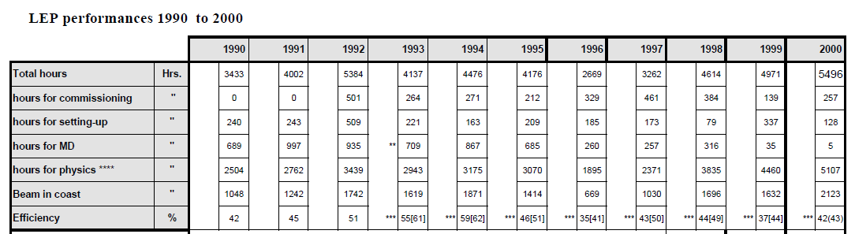

LEP
Efficiency of stable beams: 35% to 59%
More or less equivalent definition
34%

Slide 5
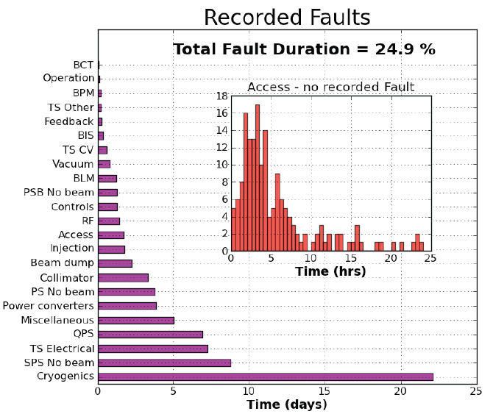
Faults accounting
Tedious job – will never be 100% ‘fair’ (fault shadowing).
  But can be improved… for example injection phases.
Need consistent handling on time scales >> single shift.
Need a person to follow fault tracking on time scale of a week.
  Obvious candidates.

Slide 6
Turn-around 2011 - 2010
Turnaround still largely dominated by machine availability.
When there are no faults, injection is the dominating factor.
Improvements in spread due to automation / sequencing.
  Ramp, squeeze, adjust.
  Also safer - fewer human errors !!!

Slide 7
Turn-around improvements (1)
IP1/5/8 = 1.0/1.0/3.0 m → 554 s
= 0.7/0.7/3.0 m → 697 s
= 0.6/0.6/3.0 m → 784 s
4 TeV squeeze
Combined Ramp & Squeeze – gain ~ 6 mins
  All IRs to ~3 m (also ALICE for sat-main).
  More complicated ramp, but no optics correction needed before 3m (in 2011). Smaller ups&downs of LSS quad currents.
  VdMs : should be OK – tbc.
  OFB and QFB reference – OK.
  Injection with collision tunes.
  Need another ramp for 90m, but ramp commissioning is no problem (see ATS).

Slide 8
Turn-around improvements (2)
B3 & Q decay on FT – gain 6 mins
  Trim MCS using FIDEL like correction scheme (no squeeze functions for MCS).
  Could glue squeeze to ramp into one function.
    Watch out for extra-complication for QFB/OFB – requires significant changes and commissioning. OFB limited presently by linear changes, places strong constraints on Xing and separation bump fcts.
Ramp-down – gain 11 mins
  Pretty transparent if no HW issue.
  Test during HWC – easy to fall back !
General consideration:
  Faster cycle can also help significantly for MDs.
  Combined R&S experience for 7 TeV operation – could of course test only in MD…
  Watch out for MKI heating effect during HI p operation.

Slide 9
Turn-around improvements (3)
From adjust to stable beams before performing lumi scans.
  Ensure LHCb and ALICE luminosities will not go through the roof !
  No issue from MP side.
  Need experiments consensus.
A ‘charming’ idea:
LHCb proposal to collide as soon as IR8 squeeze finished – while other IPs still squeeze (and later collide).
  Challenge to keep the beams colliding stably, squeeze with FBs in parallel to lumi leveling – flair of ‘combined lumi leveling by offset and beta*’.
  Risk of lumi hitting values well above max of 4E32 cm-2s-1.
  Keep this for ‘later’…

Slide 10
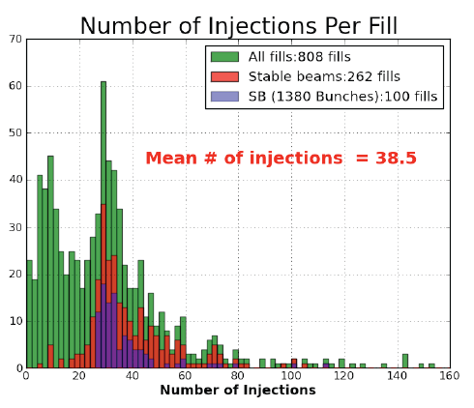
Injection
Injection is the phase where the LHC ‘encounters’ the rest of the complex.
  There are colleagues working on the other machines – cannot always ask them to immediately stop all current activities in order to fill LHC. Must accept occasional overhead.
Steering:
  As long as lines drift, some overhead for steering – must streamline with clean references (and if necessary new TCDI setups).

Slide 11
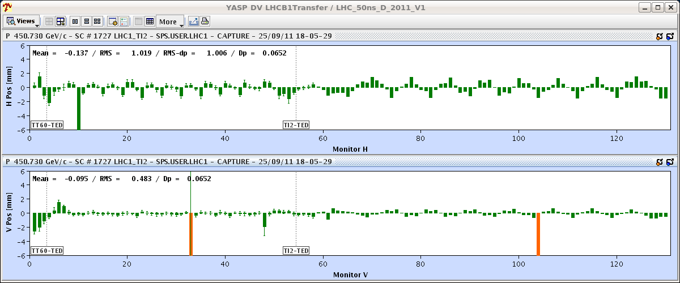
Line steering during ramp down?
Use 12b beam.
Need ‘perfect’ reference, use only upstream steerers.
Line must be stable over ~2 hours !
LHCb and ALICE need to give injection permit !
Could (should) be tried !

