Slide 1
QPS - analysis of main problems, areas to target, possible improvements
R. Denz, TE-MPE-CP
Evian 2011

Slide 2
Outline
Introduction
Basic fault statistics
Teething problems & EMC related problems
Tune feedback compatibility
Quench heater power supplies
Circuit breakers
Radiation induced faults
Interventions
Summary

Slide 3
QPS - protection of superconducting elements in the LHC
Circuit type | Quantity
Main bends and quads | 24
Inner triplets | 8
Insertion region magnets | 94
Corrector circuits 600 A | 418
Total | 544
The size of the system is the principal problem as it asks for very low failure rates not always easily to achieve. Due to the same reason mitigation and consolidation measures are normally not straightforward to implement.
Protection system type | Quantity
Quench detection systems | 7568
Quench heater discharge power supplies | 6076
Energy extraction systems 13 kA | 32
Energy extraction systems 600 A | 202
Data acquisition systems | 2532
System interlocks (hardwired) | 13722

Slide 4
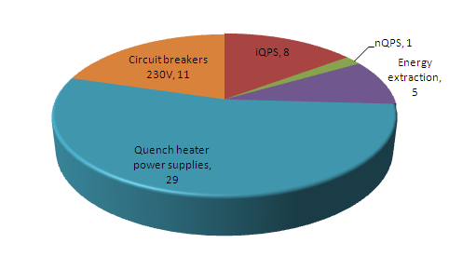
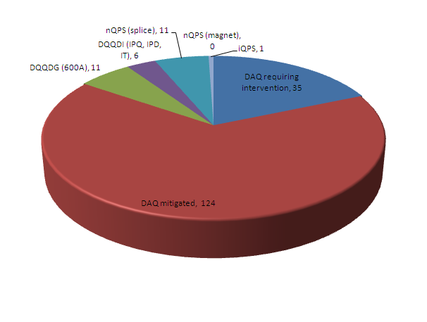
QPS – basic fault statistics
QPS and QPS related hardware faults causing interventions (54 outside TS).
QPS radiation induced faults (190).

Slide 5
Teething problems & EMC related faults
Communication problems, local bus instabilities, bad connections, noisy boards, corrupted data … → almost completely resolved
  Tedious process basically in 2009 and 2010
  Exercise partially to be repeated after LS1
Frequent trips of protection systems for insertion region magnets during thunderstorms and general perturbations of the electrical network
  Concerns basically Q9 and Q10 and usually does not dump the beam (anyhow gone) but fires quench heaters
  Problem is related to the warm instrumentation cable length and routing
    To be modified and protection systems upgraded within LS1
  As a temporary resolution it is proposed to raise the voltage detection threshold for these circuits
    U_{TH} = ± 400 mV safe up to 4 kA → ECR issued for implementation during Xmas break

Slide 6
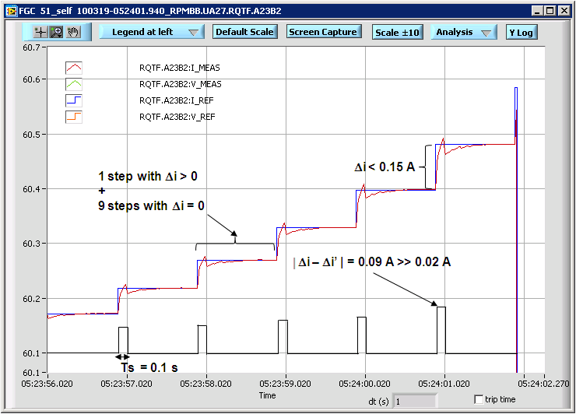
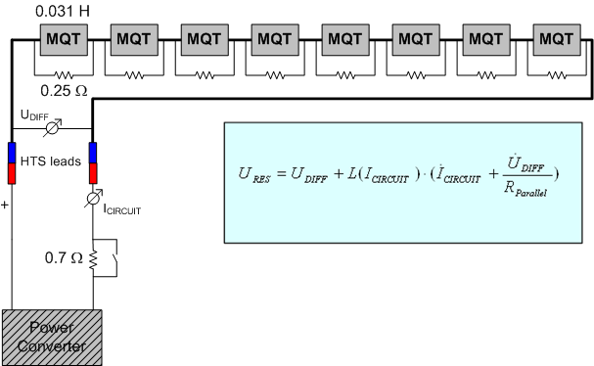
Tune feedback compatibility
The tune feedback applies only small changes in current but creates a voltage signal, which QPS cannot distinguish from a real quench
As first mitigation measure the discrimination time of the detection systems has been increased to t_{EVAL} = 190 ms
In 2011 there were still a significant number of trips e.g. during squeeze
  re-evaluation of detection settings has been launched (→ A. Verweij)
Detection settings for 2012 run (ECR in preparation)
  ±2V, t_{EVAL} = 190 ms, |I| < 100 A
  ±100 mV, t_{EVAL} = 190 ms, 100 A ≤ |I| ≤ 200 A, |I_{MAX}| ≤ 200 A
If the tune feedback is applied with |I| > 100 A (e.g. after LS1) further mitigation and consolidation measures will become necessary.
Plot courtesy H. Thiesen

Slide 7
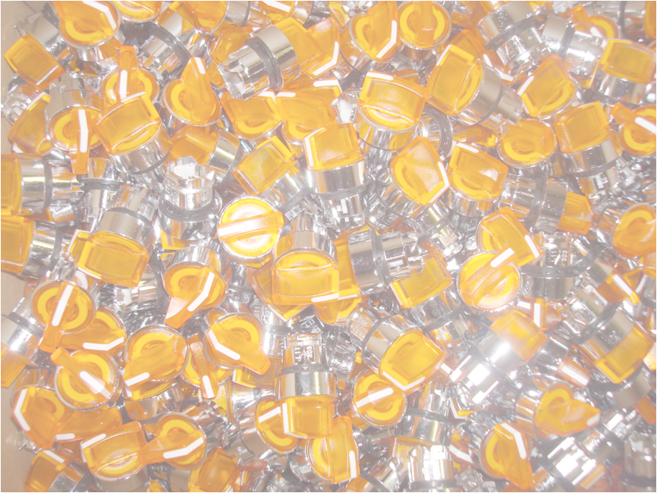
Quench heater discharge power supplies
The principal cause of failure of the quench heater discharge power supplies is related to a malfunction of the mains switch.
The fault is caused by the mechanical breakdown of one of the plastic materials used for the construction of the switch, most likely due to an excess of hardener in its composition.
Repair campaign has been launched in 2010 with the objective to replace all 6076 faulty switches during technical stops of the LHC until spring 2012.
  In addition implementation of the 3 out of 4 condition for the MB quench heater power supply availability (no injection inhibit in case of loss of one power supply) within the R2E firmware upgrade for MB DAQ systems
Still 29 interventions necessary in 2011 but
  23 in the shadow of other machine accesses; only 3 outside normal working errors
Many thanks to BE-OP for their continuous support during the repair campaign!!!
Period | Qty. | Total
Xmas break 2010/2011 | 916 | 916
2011 TS #1 | 268 | 1184
2011 TS #2 | 316 | 1500
2011 TS #3 | 396 | 1896
2011 TS #4 | 392 | 2288
2011 TS #5 | 412 | 2700
Xmas break 2011/2012 (planned) | 3376 | 6076

Slide 8
Circuit breakers
Spurious opening of F3 circuit breakers without obvious reason
  F3 and F4 circuit breakers are used to protect the distribution lines powering the QPS racks installed in the LHC tunnel
  Any spurious trip causes a fast power abort of the concerned sector and requires an access for re-arming
    F4 circuit breakers do not show this kind of problem but are a different make and have a higher rating
  12 trips in 2011 causing 4 dumps out of stable beam conditions
Fault is frequent enough to cause trouble and ask for remedy but too rare to be traced down easily or to be reproduced in the lab
  Measurements and fault analysis done in close collaboration with EN-EL
In order to come to a conclusion prior to LS1 a proposal has been made to swap the F3/F4 circuit breakers on concerned QPS racks
  One sector swapped during TS#5, more to come during Xmas break 2011/2012
  In the best case the problem will disappear; in case the F3 breakers continue to trip these devices must be replaced during LS1

Slide 9
Radiation induced faults
Due to functional requirements a significant amount of QPS and EE equipment is exposed to radiation during LHC operation
  LHC tunnel
    Main magnet protection, nQPS, some 13kA EE systems (e.g. point 3)
  Partly shielded areas (RR13, 17, 53, 57, 73, 77, UJ14, 16, 56)
    IPQ, IPD, IT, 600 A protection, EE 600 A, EE 13 kA
Fault analysis has to be done very carefully as not all problems are related to radiation
  Equipment faults, EMC, bad connections, circuit breakers, real triggers (very rare but not excluded)
Radiation induced faults are responsible for most of the QPS triggers in stable beam conditions
  Consolidation measures prior to LS1 necessary
Confirmed radiation induced faults are transmitted regularly to the R2E project to be included in their statistics

Slide 10
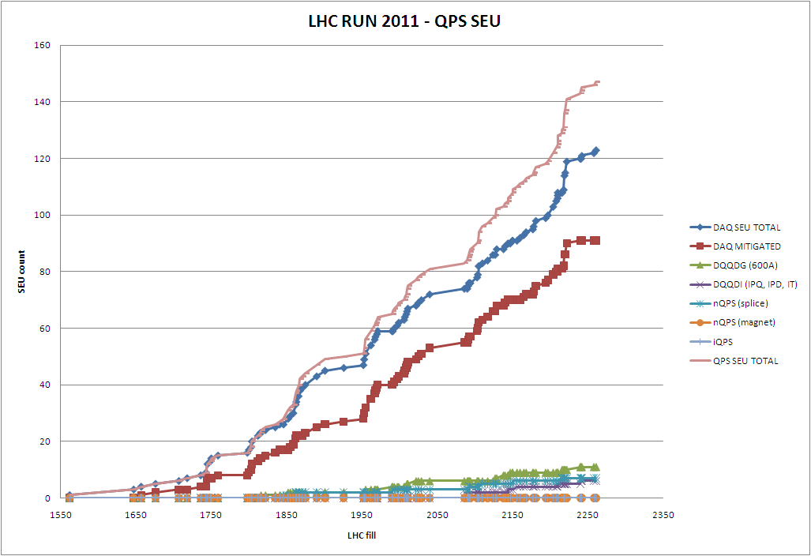
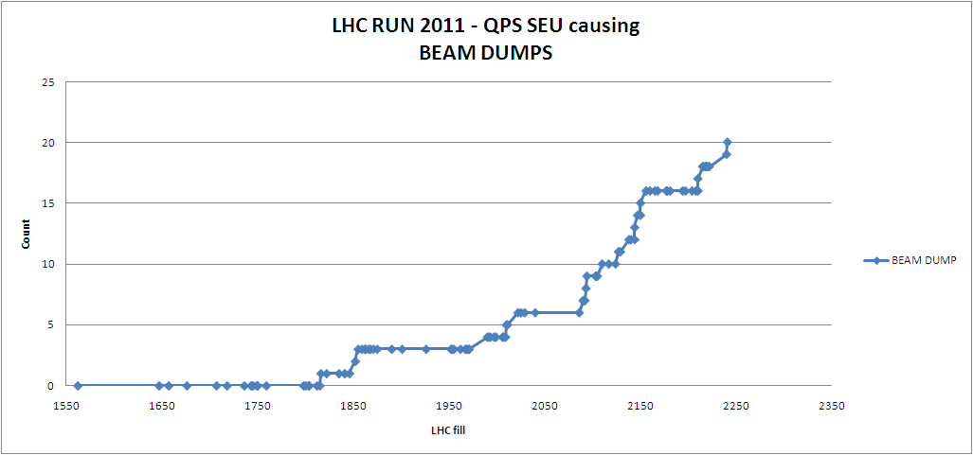
Radiation induced fault statistics 2011 - proton run
147

Slide 11
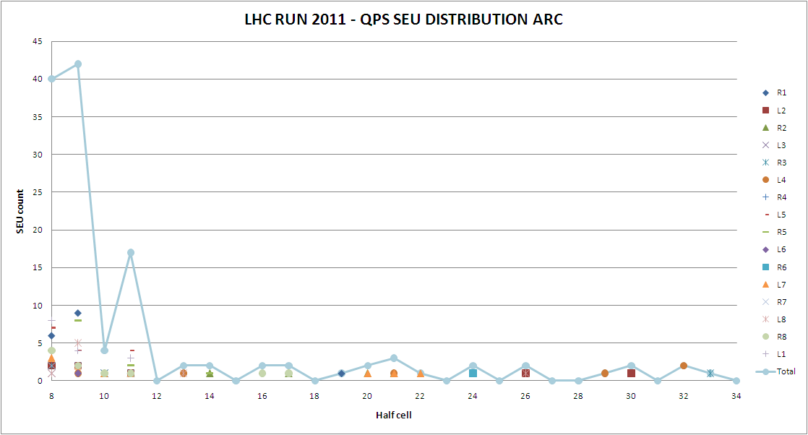
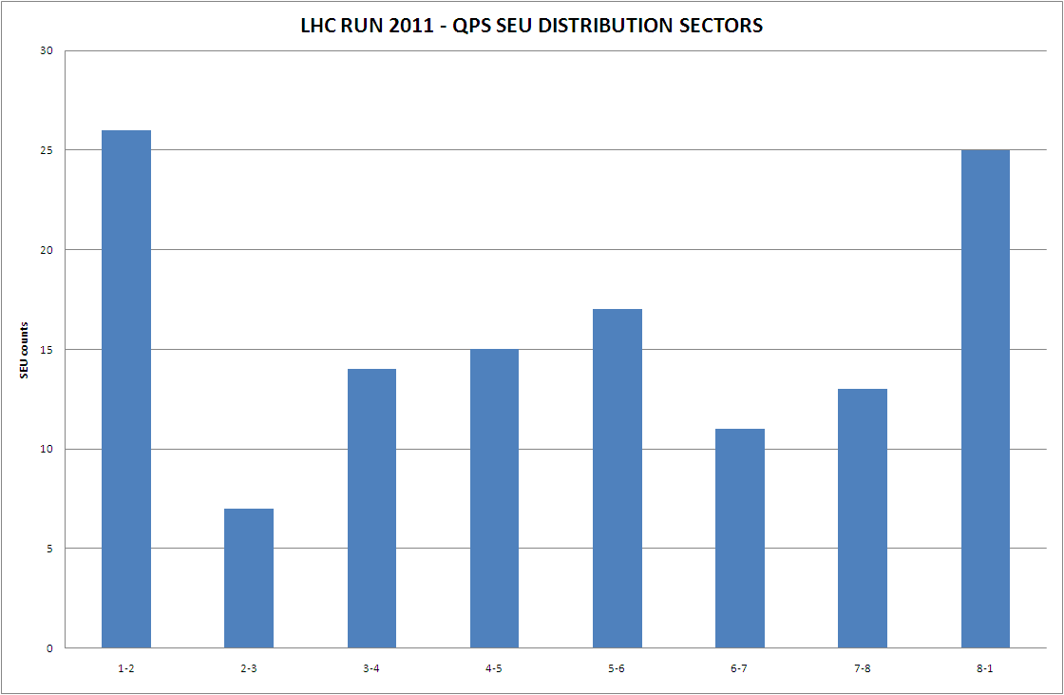
Radiation induced fault statistics 2011 - distribution

Slide 12
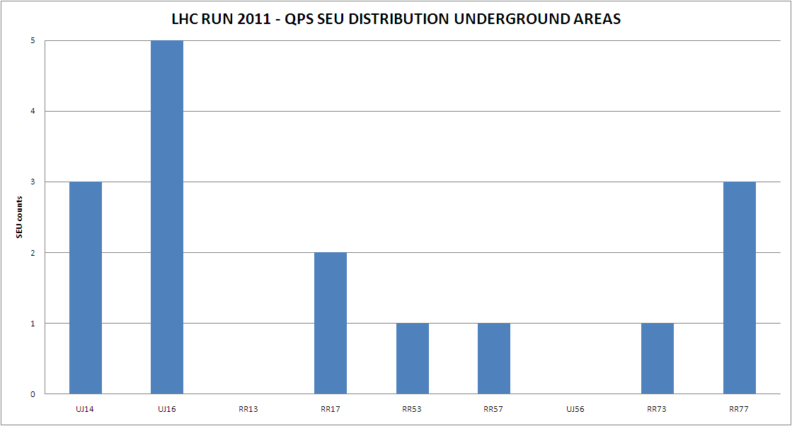
Radiation induced fault statistics 2011 – spurious triggers
System | Locations
DQQDI (IPQ, IPD, IT) | UJ14, UJ16 (2x) , RR17, RR53, RR57
DQQDG (600 A) | UJ14 (2x), UJ16 (3x), RR17, RR73, RR77 (3x)
nQPS (splice protection) | B8L1, B11L5, B11R5, B9L8

Slide 13
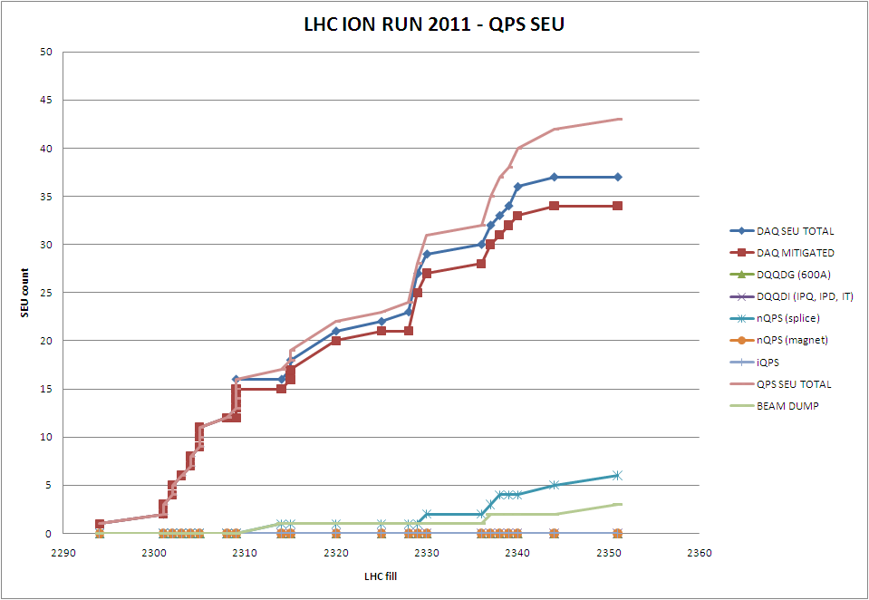
Radiation induced fault statistics 2011 – ion run
43
1st destructive event
3

Slide 14
Radiation induced fault statistics 2011 – spurious triggers
Detection system type | Exposed systems | Radiation induced spurious triggers
DQQDL (MB & MQ protection, analog, radiation tolerant) | 4032 | 0
DQQDS (MB & MQ protection, digital, radiation tolerant) | 1632 | 0 (1 caused by host controller during ion run)
DQQDG (600 A, digital, partly hardened) | 250 out of 836 | 10
DQQDI,T (IPQ, IPD, IT, digital, partly hardened) | 138 out of 408 | 6
DQQBS (nQPS splice protection, partly hardened) | 2068 | 6 (2 during ion run)
DQQDC (HTS lead protection, partly hardened) | 508 out of 1198 | 0
  DQQDG and DQQDI,T are hardware equivalent and differ only in firmware
  DQQBS and DQQDC are hardware equivalent and differ only in firmware
  DQQBS and DQQDC have on board redundancy A/B (two interlock channels)

Slide 15
Mitigation and consolidation measures – DAQ systems
Firmware upgrade for DQAMCMB and DQAMCMQ as first mitigation measure
  Deployment completed during TS#5 (1624 units)
  Upgrade includes 3 out of 4 condition for MB quench heater power supply availability (no injection inhibit in case of loss of 1 power supply)
Full consolidation requires hardware upgrade (new board)
  Incriminated chip is located on quench detection board type DQQDL
    Replacement already successfully exploited with DQQDS board
  Design completed, prototype testing phase started
  Production covering DS areas 02/2012, procurement of components started
Replacement of the fieldbus coupler chip (MicroFip™) by NanoFip^{CERN}
  Significant development and integration work to be done
  First fieldbus segments to be upgraded during LS1
  Auto power-cycle option for MicroFip™ currently being evaluated as intermediate solution

Slide 16
Mitigation and consolidation measures – nQPS splice protection
Firmware upgrade
  Triplication of digital filters and other modifications
  Expected to cure a significant amount but not all faults
  Development completed - type tests to be completed
  Partial deployment during Xmas break (half cells 8 to 11 around IP1, 2, 5, and 8)
Hardware upgrade
  Technology evaluated – two possible options
    FPGA based version using high resolution ADC
      Additional radiation test campaign for ADC wishful
    Standard technology with optimised firmware and modified evaluation logic
      Using three instead of two redundant processors and majority voting
      This option could be implemented on a relatively short timescale but requires a more detailed study
  Design in 2012 → installation in hot zones during LS1

Slide 17
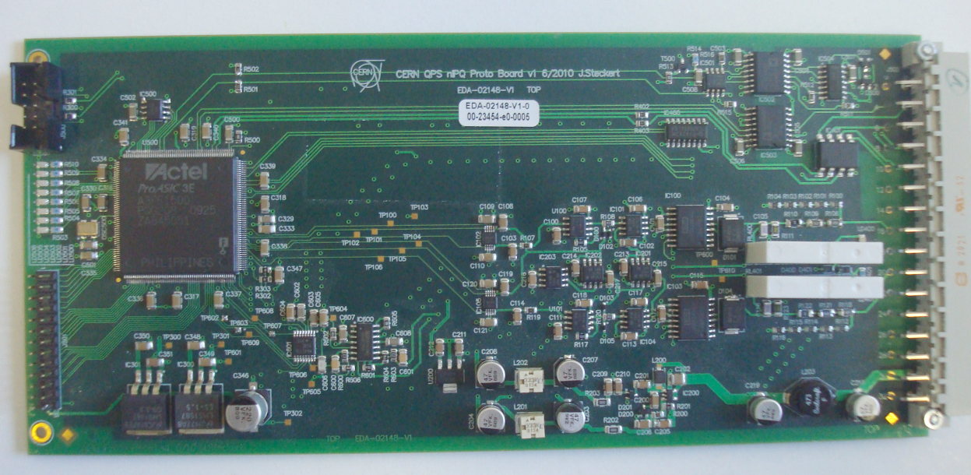
Mitigation and consolidation measures – IPQ, IPD and IT protection
New digital quench detection systems type nDQQDI
  Similar to symmetric quench detection board developed for nQPS
    Core is flash based FPGA ProAsicTM A3PE1500
  Board design and firmware development by J. Steckert
  New board is (of course) not fully compatible with previous version
    Some specialist work required to integrate it into QPS supervision
  200 boards including spares required for consolidation (starting 2012)
    UJ14,16,56, RR13,17,53,57
Prototypes are currently under test and the series production will be launched early 2012.

Slide 18
Mitigation and consolidation measures – 600 A protection
New digital quench detection systems type nDQQDG
  Similar to nDQQDI board developed for nQPS
    Core is flash based FPGA ProAsicTM A3PE3000
  High dynamic range of the current reading requires a high resolution ADC or a complex digital to analog feedback circuit
    Fast high resolution 24 bit ∑Δ ADC TI ADS1271
    Modulator part successfully radiation tested by TE-EPC
  Firmware is by far more complex than for nDQQDI
    Complex digital filter system including non-linear filters
    Numerical derivative of current, look-up tables for circuit inductance
    Algorithms well known but transfer to FPGA not trivial
  300 boards including spares required for consolidation (starting mid 2012)
    UJ14,16,56, RR13,17,53,57,73,77
    1st prototype to be delivered before the end of the year

Slide 19
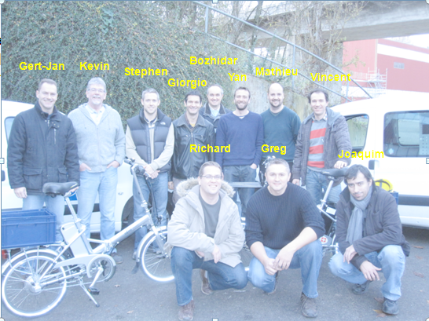
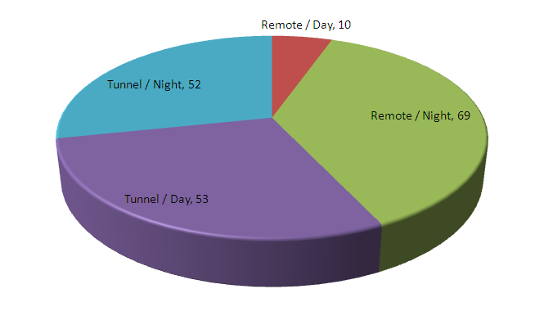
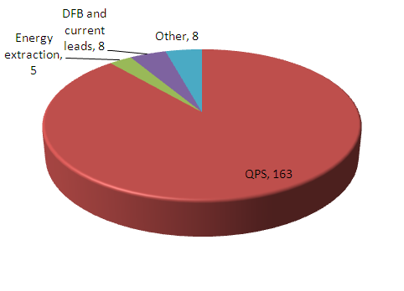
Interventions – MPE stand-by service
During the LHC exploitation a round-the-clock support to operation in case of system faults is ensured by a standby service team formed by equipment specialists. In the event of a hardware fault the performance of the stand-by service is crucial in order to minimize the machine downtime.
Intensive training and growing experience of the team members allowed to reduce the average time for an intervention in the LHC from 2.3 hours in 2010 to 1.3 hours in 2011

Slide 20
Summary
During the LHC exploitation in 2010 and 2011 the protection system for superconducting circuits of the LHC demonstrated its reliability and capability to ensure the integrity of the protected superconducting elements.
While most of the radiation induced faults are transparent to LHC operation, the number of beam dumps caused by spurious triggers is close to reach the maximum admissible limit.
  Some consolidation measures to be applied already during Xmas break 2011/2012
  The proposed measures will not lead to zero radiation induced trips but allow to limit the number of faults despite increasing luminosity
The maintenance of the system will require a continuous effort and further developments will be necessary to adapt the system to the evolution of the LHC.
None of the observed faults caused a total loss of magnet and/or circuit protection.
  Redundancy of the protection systems is essential

