Slide 1
Lecture 4
Hadronic heavy-quark decays
Hsiang-nan Li
Oct. 22, 2012

Slide 2
Outlines
Naïve factorization
QCD-improved factorization
Perturbative QCD approach
Strong phases and CP asymmetries
Puzzles in B decays

Slide 3
Introduction
Why B physics?
Constrain standard-model parameters
CKM matrix elements, weak phases
Explore heavy quark dynamics
Form factors, penguins, strong phases
Search for new physics
SUSY, 4th generation, Z’…
Need B factories and critical comparison between data and QCD theories.

Slide 4
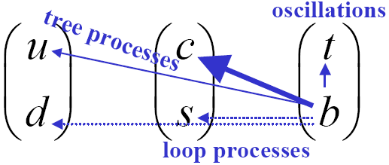
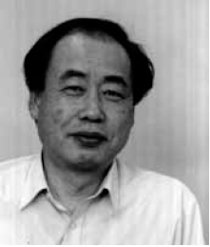
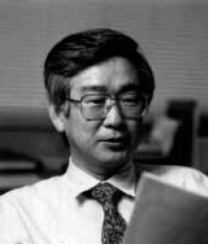
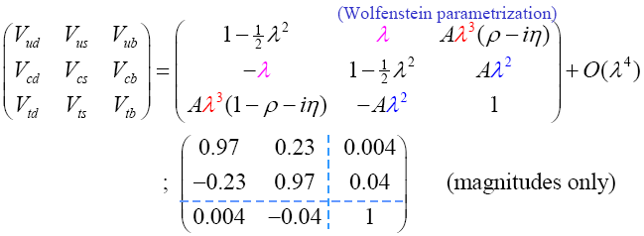

Cabbibo-Kobayashi-Maskawa Matrix
Weak phase, CP

Slide 5


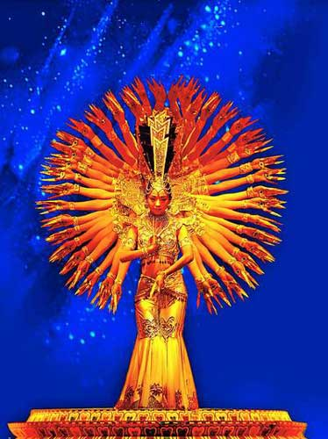
CP violation
Thumb only on the right---P violation
Thumbs on the right of right hand, and on the left of left hand---CP conservation
God is fair: He gives L to particle and R to antiparticle.
CP conserved here?
If she loses one arm, CP at 10⁻³
Anti- particle
particle
Thousand-hand
Guan Yin

Slide 6
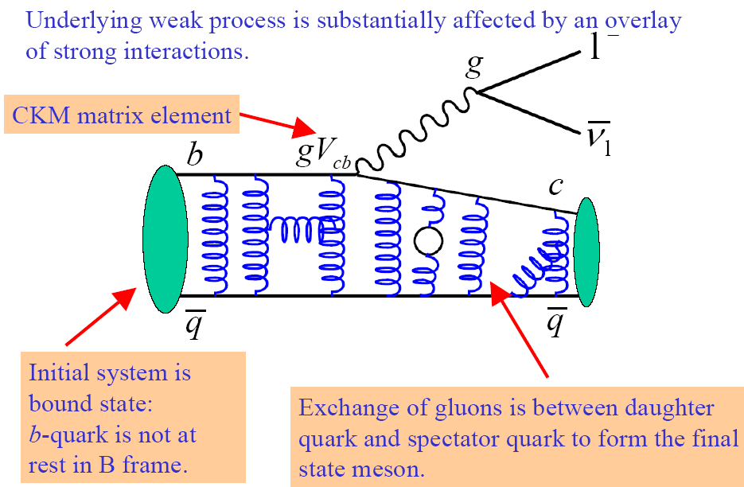
B transition form factors

Slide 7
Form factors
Measurement of structure of a bound state
If bound state, effective strength dependent on momentum transfer
It is like structure functions in DIS
Are form factors calculable?
b
point particle -> constant strength

Slide 8
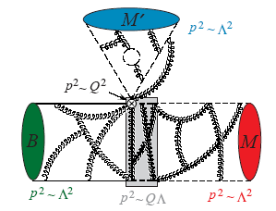
Nonleptonic decays
Much more complicated
Involve scales m_{W}, m_{b}~Q, and Λ
Are they calculable?

Slide 9
Naïve factorization

Slide 10


Effective Hamiltonian
First step, derive effective weak Hamiltonian by integrating out m_{W}
Dynamics with scale m_{W} is organized into Wilson coefficient C_{i}
The rest dynamics lower than m_{W} goes into 4-fermion operators O_{i}
H=V_{CKM}Σ_{i}C_{i}(μ)O_{i}(μ)
Their μ (factorization scale) dependence cancels.
Buras,Buchalla, 1995

Slide 11
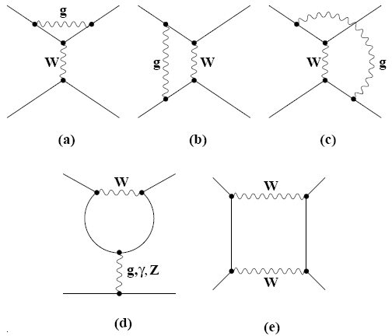
Diagrams at scale m_{W}
b
box
also contributing
to B-Bbar mixing
penguin

Slide 12
Factorization assumption
A= < Dπ|H_{eff}|B> ~ C(μ) <Dπ|O(μ)|B>
FA was proposed to deal with the hadronic matrix element (Bauer, Stech, Wirbel 85).
f_{π}
f_{D}
form factor
not calculable
F^{BD}
F^{Bπ}
Color-allowed
Color-suppressed

Slide 13
Color transparency
B
D
Lorentz contraction
small color dipole
decoupling in space-time
from the BD system
Nonfactorizable corrections negligible for
color-allowed amplitudes.
Expect large corrections in color-suppressed modes due to heavy D, large color dipole.
No strong phase.
No systematic improvement of precision

Slide 14
Incompleteness of FA
FA cannot be complete: form factor and decay constant are physical, independent of μ. Predictions depend on μ via C(μ).
Nonfactorizable contributions must exist, especially in color-suppressed modes. They may be small in color-allowed decays, which are insensitive to μ.
Power corrections, like strong phases, are crucial for CP violation.
FA was used for decades due to slow experimental and theoretical progress.

Slide 15
Go beyond FA
Great experimental (Babar, Belle) and theoretical (factorization approaches) progress around 2000.
Rare (including color-suppressed) decays with BR down to 10⁻⁶ and CP asymmetries can be measured precisely at B factories.
Explore nonfactorizable and power corrections, or even new physics.
Theorists need to go beyond FA.

Slide 16
Theoretical approaches
Hadronic B decays involve abundant QCD dynamics of heavy quarks.
Complexity of B decays dragged theoretical progress till year 2000, when we could really go beyond naïve factorization.
Different approaches developed: PQCD, QCDF, SCET.
Predictive power and data discriminate different approaches.

Slide 17
QCD-improved factorization
Beneke, Buchalla, Neubert, Sachrajda, 1999

Slide 18
QCD corrections to FA
Add gluons to FA
Nonfactorizable corrections appear at this order

Slide 19
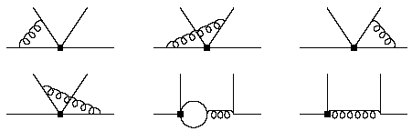

Hard kernels
T^{I} comes from vertex corrections
T^{II} comes from spectator diagrams
x
q
1
Magnetic penguin O_{8g}
soft divergences cancel in pairs

Slide 20
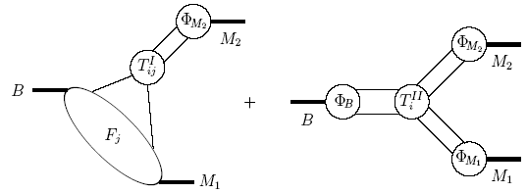
QCDF
Based on collinear factorization
Compute corrections to FA, ie., the heavy-quark limit.
Due to end-point singularity in collinear factorization
distribution amplitude
like PDF in DIS
perturbative
nonperturbative

Slide 21
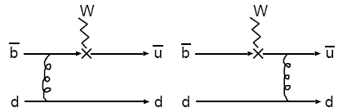
B -> π form factors
x runs from 0 to 1. The end-point region is unavoidable.
Collinear factorization gives end-point singularity. Form factors not calculable
P_{B}-xP_{π}
k-xP_{π}
k
xP_{π}

Slide 22
Breakthrough and challenge
It is amazing that higher-order corrections to FA are calculable!
Study of two-body hadrnic B decays can be improved systematically
But, when going to higher powers, challenge appeared….
End-point singularity avoided by absorbing it into form factors, but reappeared at higher powers

Slide 23
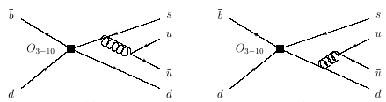
End-point singularity
Singularity appears at O(1/m_{b}), twist-3 spectator and annihilation amplitudes, parameterized as X=(1+ρ e^{iφ})ln(m_{b}/Λ)
For QCDF to be predictive, O(1/m_{b}) corrections are better to be small ~ FA.
Data show important O(1/m_{b}). Different free (ρ,φ) must be chosen for B-> PP, PV, VP.

Slide 24
Perturbative QCD approach
Keum, Li, Sanda, 2000

Slide 25
kT factorization
If no end-point singularity, collinear factorization works. If yes, small x region is important, and k_{T} factorization is more appropriate.
k_{T} factorization for exclusive processes is basically the same as for inclusive process (small x physics).
Based on collinear and k_{T} factorizations, QCDF and PQCD have been developed for exclusive B decays.

Slide 26
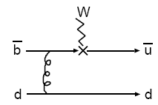
Smearing of end-point singularity
Including parton k_{T} accumulated through gluon emissions
1/(xm_{B}²+k_{T}²)
B
x’, 0_{T}
x, k_{T}
is finite

Slide 27
Factorization of form factor
Form factors are calculable, if TMD is known
Factorization of two-body hadronic B decays changed!
TMD

Slide 28
Three scales
Start with lowest order diagram for B -> Dπ
This amplitude involves three dramatically different scales: m_{W}, m_{b}, and Λ
Radiative corrections generate large logs ln(m_{W}/m_{b}), ln(m_{b}/Λ), which must be summed to all orders to improve perturbation.
d
u
W⁻
b
u
g

Slide 29
Two clusters of corrections
Two clusters
Sum ln(m_{W}/m_{b}) first (integrating out W boson), giving effective weak Hamiltonian, and then sum ln(m_{b}/Λ), giving Sudakov and RG evolutions.
PQCD approach incorporates factorizations of effective weak Hamiltonian and IR divergences.
d
u
Generate ln(m_{W}/m_{b})
W⁻
b
u
Generate ln(m_{b}/Λ)
g

Slide 30



Effective Hamiltonian
also a kind of factorization theorem.
Radiative corrections give new operators (operator mixing) O₁ -> O₁,O₂
Effective Hamiltonian
μ is renormalization scale
b
Full diagram
μ−independent
Soft (effective) diagram
4-fermion operator O₂
μ−dependent
Hard part
Wilson coefficient
μ−dependent
Different color flows
->
CKM matrix elements

Slide 31

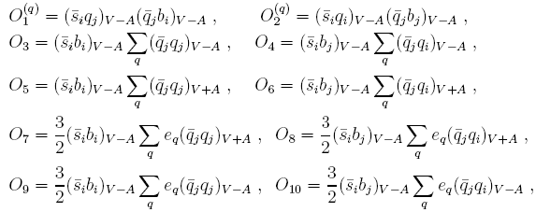
QCD and EM penguins
Radiative corrections also introduce QCD and electroweak penguins

Slide 32

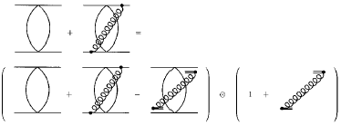
Factorization of IR divergence
Use soft divergence for demonstration.
Factorization formula
full diagram
current conservation
μ_{f}-independent
soft diagram
eikonalized
μ_{f}-dependent
hard part
μ_{f}-dependent
μ_{f} is factorization scale
TMD wave function
hard
kernel

Slide 33
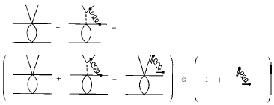
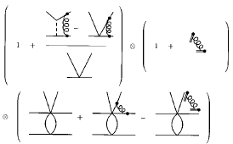
Three-scale factorization
A=C(m_{W},μ) * H(t,μ,μ_{f}) * φ(μ_{f},1/b)
for any gluon, isolate
IR divergence first
Precisely speaking, it is
cancelled by another gluon
then shrink W line to
get effective Hamiltonian
hard scale t² ~Λm_{b}
can choose μ=μ_{f}

Slide 34
Four scales actually
Strictly speaking, there are 4 scales: m_{W}, m_{b}, t ~ (Λm_{b})^(1/2), Λ.
There are 3 clusters. The cluster of hard kernel splits into one for weak b ->u vertex, and another for hard gluon.
The above are scales in Soft-Collinear Effective Theory
d
u
W⁻
b
u
g

Slide 35
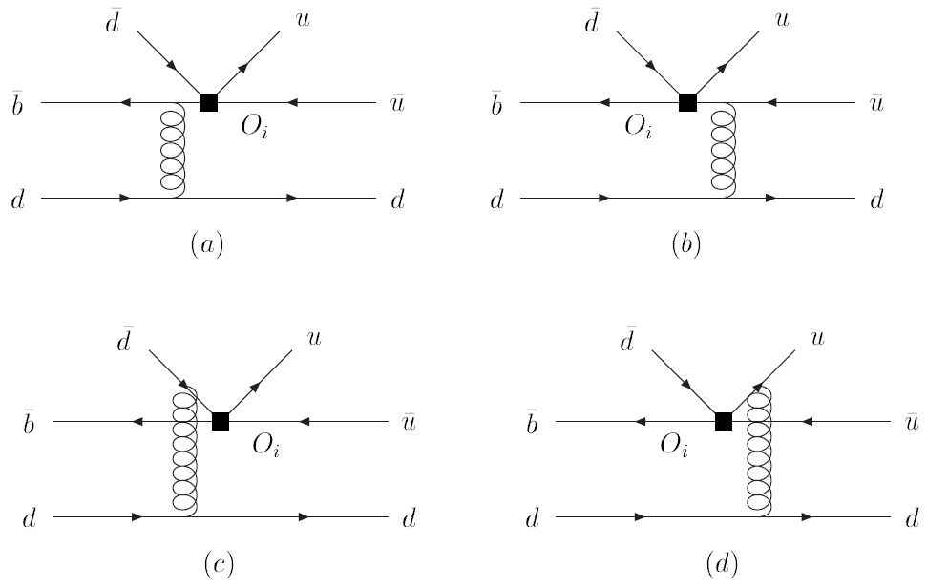
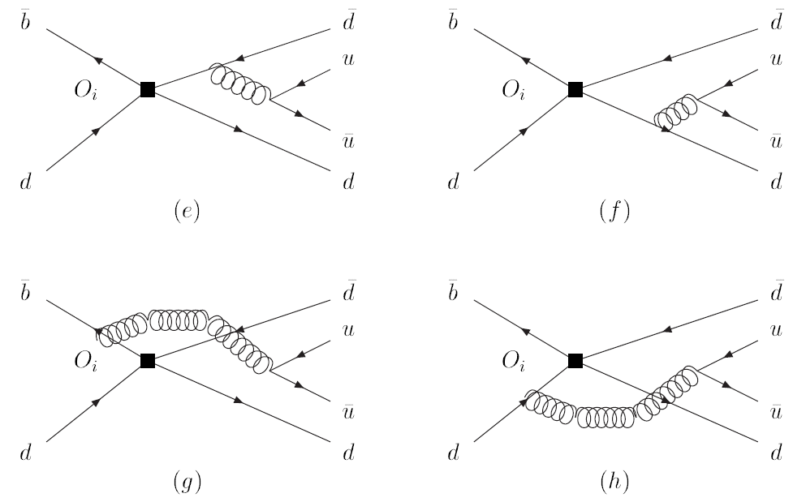
Feynman diagrams
emission diagrams
annihilation diagrams

Slide 36
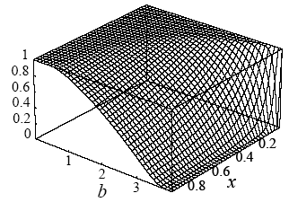

Sudakov effect increases kT
Physical picture: large b means large color dipole. Large dipole tends to radiate during hard scattering. No radiation in exclusive processes. Small b configuration preferred.
suppression at large b
becomes stronger at
larger energy
Small x

Slide 37
Strong phase and CP violation
annihilation marks most crucial difference between QCD and PQCD

Slide 38
(V-A) and (V+A) currents
For (V-A)(V-A), left-handed current
Pseudo-scalar B requires spins in opposite directions, namely, helicity conservation λ₁=s₁. p₁=(-s₂ ) .(-p₂ ) =λ₂ .
For (V-A)(V+A)=(S-P)(S+P), scalar current
b
spin (this configuration is not allowed)
fermion flow
p₂
p₁
momentum
b
Survive helicity conservation,

Slide 39
Small annihilation?
Annihilation is of higher power
But what is the power suppression factor?
If Λ/m_{B} , annihilation is negligible
But it turns out to be 2m₀/m_{B} ~ 0.6 for
Introduced by pseudoscalar-current matrix element (for twist-3 DA φ^{S})
What is impact of sizable annihilation?

Slide 40


Principle value
Loop line
can go on-shell
B
k_{T}
Strong phase
Bander-Silverman-Soni
mechanism, strong
phase source in FA
loop with the weight factor from
k_{T} distribution function (TMD)

Slide 41
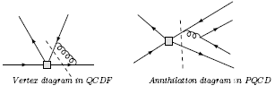
Sources of strong phase
Annihilation is assumed to be small, down by α_{s}/m_{b} in QCDF,
but calculable and sizable in PQCD
Different sources lead to different direct CP asy.

Slide 42
Large strong phase
A_{CP}(K⁺π⁻)~ -0.1 implies sizable δ_{Τ} ~ 15º between T and P from annihilation (PQCD, 00)
If δ_{T}=0
T exp(iφ₃)
If δ_{T}=0
T exp(iφ₃)
Br
P
P
Br = Br
T exp(-iφ₃)
Br = Br
Direct CP
T exp(-iφ₃)

Slide 43
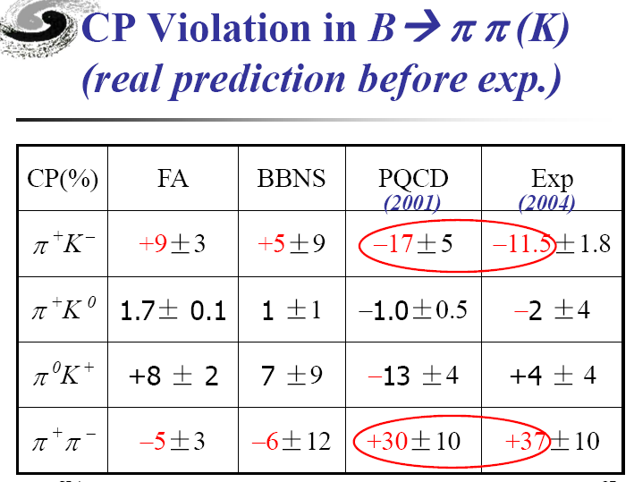

Slide 44
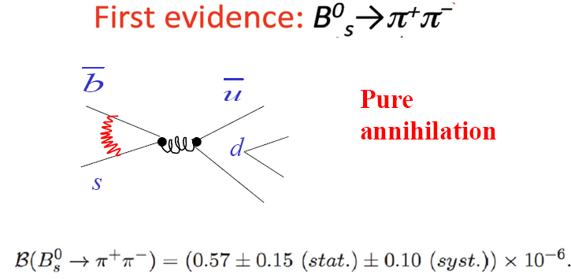


Ali et al., 2007
QCDF prediction smaller by an order of magnitude

Slide 45
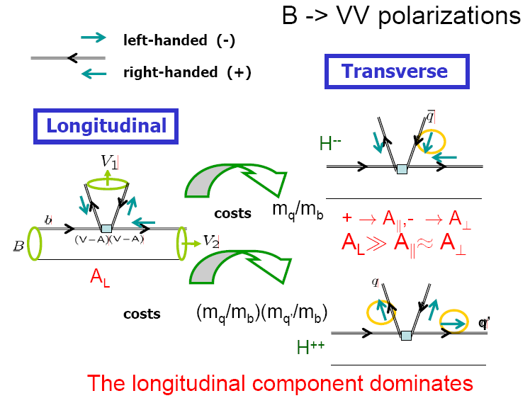

Slide 46
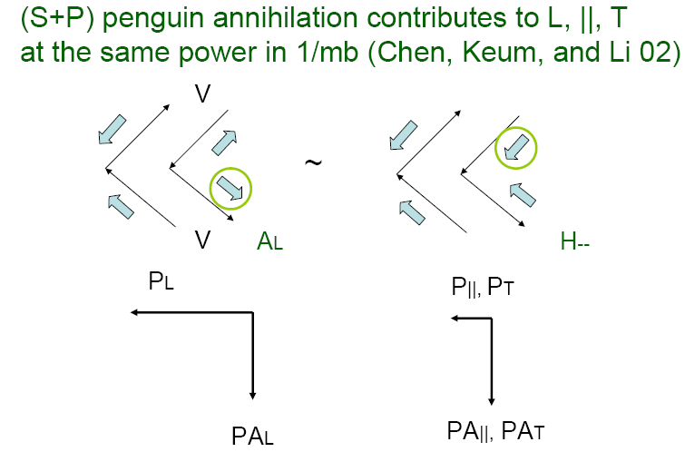

Slide 47
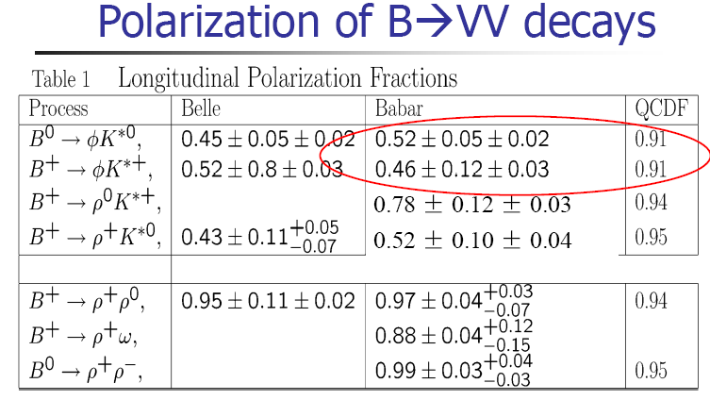

Slide 48
Direct CP asymmetries, pure annihilation branching ratios,
B->VV polarizations all indicate sizable annihilation

Slide 49
Puzzles in B decays

Slide 50
Puzzles in B physics
much larger than predictions
much different from
lower than
New physics or QCD effect?
If new physics, how about
If QCD, but is normal
How to resolve these puzzles?

Slide 51
Quark amplitudes
2 color traces ⇒ N_{c}²
1 color trace ⇒ N_{c}
d,s
u
b
W
u
u
u
d,s
Color-allowed tree T
Color-suppressed tree C
d,s
d,s
u
u
u
γ, Z
u
g
QCD penguin P
Electroweak penguin P_{ew}

Slide 52
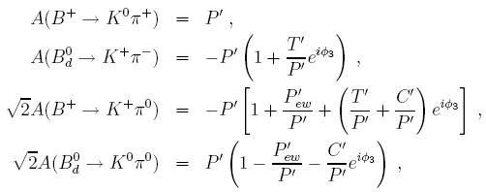

Kπ parameterization
(C₂/C₄)(V_{us}V_{ub}/V_{ts}V_{tb}) ~ (1/λ²)(λ⁵/λ²) ~ λ

Slide 53
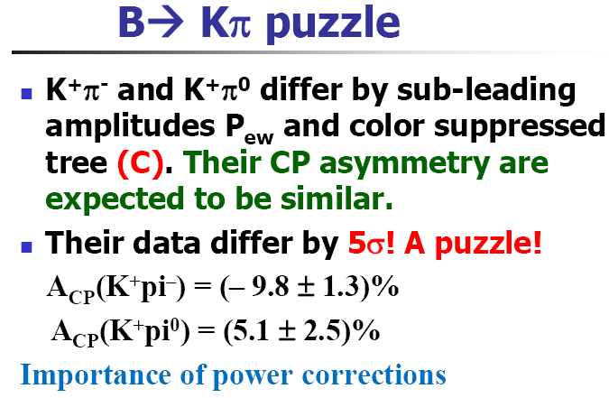

Slide 54
Explanation 1
How to understand positive A_{CP}(K⁺π⁰)?
Large P_{EW} to rotate P (Buras et al.; Yoshikawa; Gronau and Rosner; Ciuchini et al., Kundu and Nandi)
new physics?
T exp(iφ₃)
P
T exp(-iφ₃)
P_{EW}

Slide 55
Explanation 2
Large C to rotate T (Charng and Li; He and McKellar). mechanism missed in naïve power counting?
C is subleading by itself. Try NLO…. An not-yet-finished story
T exp(iφ3)
(T+C) exp(iφ₃)
P
(T+C) exp(-iφ₃)

Slide 56
Summary
Naïve factorization of hadronic B decays relies only on color transparency.
Fully utilize heavy-quark expansion. Combine effective Hamiltonian (separation of m_{W} and m_{b}) and IR divergence factorization (separation of m_{b} and Λ).
Factorization theorem can explain many data, but some puzzles remain
New physics or complicated QCD dynamics? More hard working is needed

