Slide 1
Beam Current Limit for HL-LHC
R. Assmann, CERN
Thanks to
B. Goddard, J. Tuckmantel, J.M. Jimenez,
S. Roesler, F. Zimmermann, G. Rumolo,
L. Rossi, L. Tavier, E. Jensen,
W. Hoefle, E. Metral, S. Redaelli,
J. Uythoven, E. Chapochnikova, …
Chamonix 2012

Slide 2
Introduction
Follow-up on 2010 talk on the same subject.
Can the LHC accept more than ultimate intensity in the LHC?
2010 answer: “With enough money everything is possible…;-)”
“Mit genuegend Geld ist bei uns alles moeglich...;-)”
So what did the experts in the meanwhile achieve without upgrade money but experience and hard work?
Update of the issues that were pointed out to me.
Everybody focuses on more immediate problems (including myself), so difficult to get complete picture within available time. Thanks to all who send me input!
No guarantee for completeness.

Slide 3
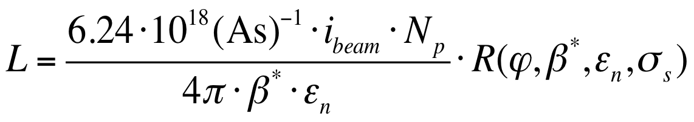
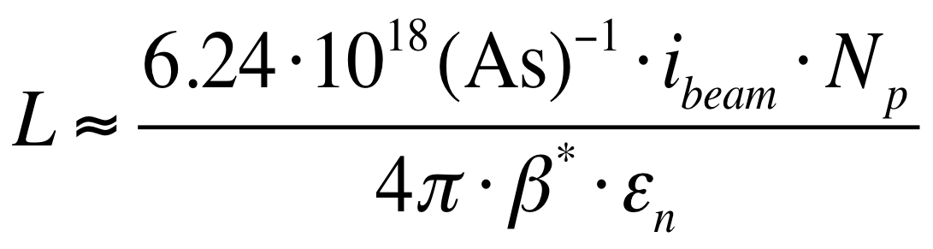
Why Do We Care?
Bunch Intensity
LHC: Total beam current
HL-LHC: LHC Machine
LIU: INJECTORS
LHC: beta*
(optics, collimation, MP)
Normalized Emittance

Slide 4
Some Notes…
The MD results for beam-beam (see Werner Herr et al) have shown that there is no head-on beam-beam limitation in the LHC up to very high bunch currents (2.5e11 p).
Therefore injectors can push the LHC performance by increasing the brightness. Very successfully done in 2011 already. LIU will take it even much further.
However, there will be limits to this approach:
  Risk due to strongly increased energy density in the beam (will come back to this).
  Beam dynamics effects: IBS blow-up (see John Jowett et al).
  Noise induced emittance growth can take over → often additive components and not multiplicative.
Therefore: Advance also bunch population and total current. We can then make an optimal trade-off!

Slide 5
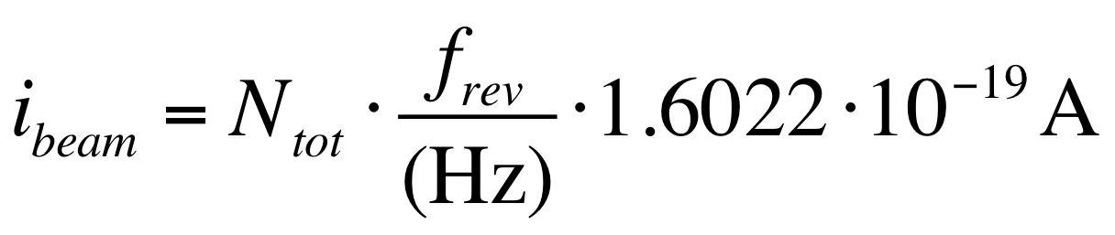
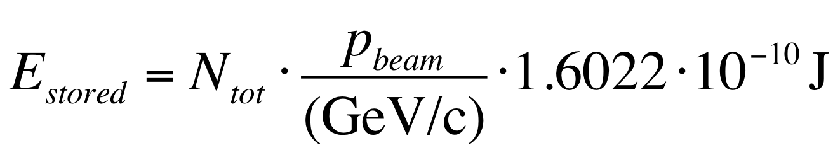
Beam Current and Stored Energy
Beam current calculated with:
Stored energy calculated with:
N_{tot} = total number of protons
p_{beam} = beam particle momentum
f_{rev} = revolution frequency

Slide 6
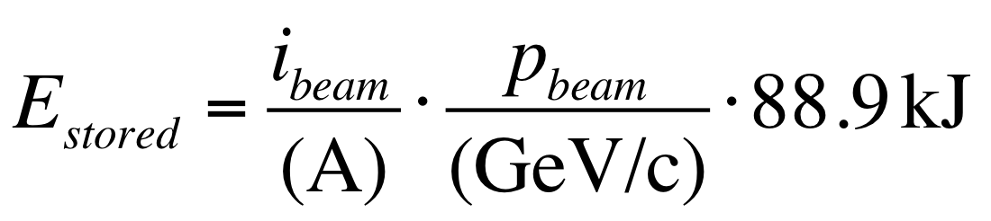
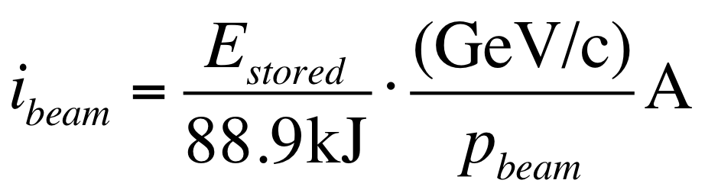
Some Useful Engineering Formulae
e.g. for 2011: p = 3500 GeV/c
Therefore: 109 MJ ←→ 0.35 A

Slide 7
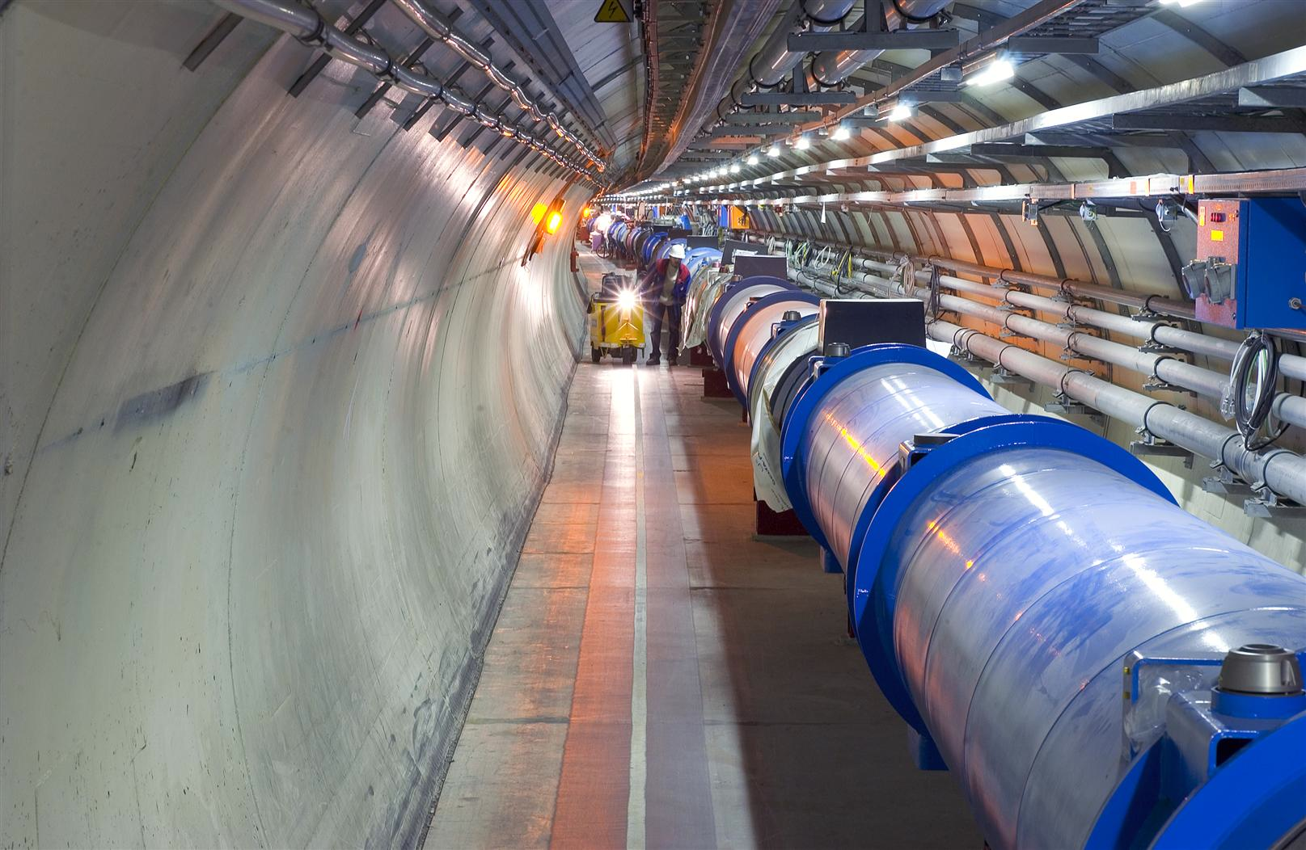
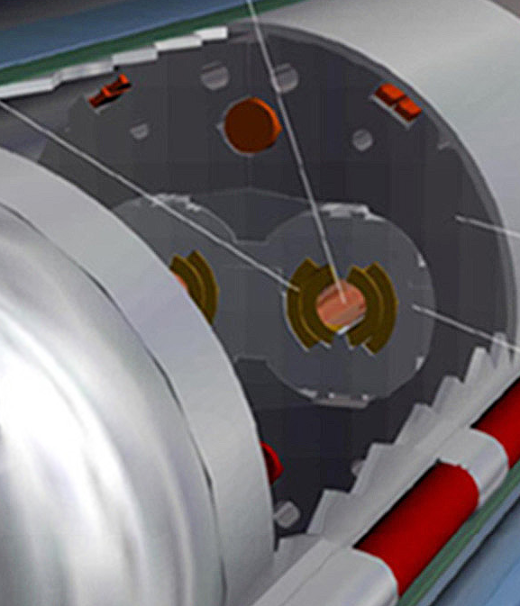
Quench Limit versus Stored Energy
Beam
362 MJ ➔ 580 MJ ➔ 1000 MJ
56 mm
SC Coil:
quench limit
5-30 mJ/cm³

Slide 8
Implications of High Beam Currents
Higher beam currents carry higher electro-magnetic fields and generate higher image currents:
  RF heating of accelerator components
  Transient beam loading
  Impedance-induced instabilities
  Stronger accelerating fields in the beam pipe with impact on electron cloud, UFO’s, discharges, …
Higher beam currents carry more protons and more stored energy:
  More synchrotron photons and therefore more secondary electrons are generated. More heat load to the cryo system.
  Less tolerance to beam loss and more risk for quenches.
  More activation of accelerator components.

Slide 9
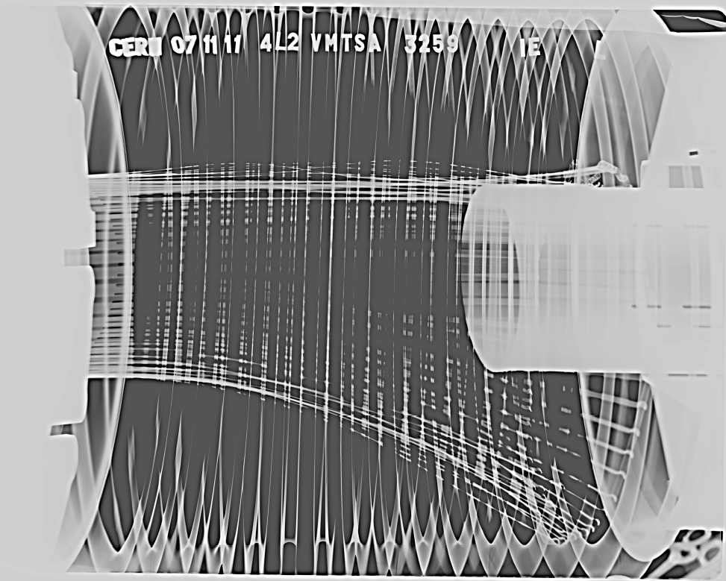
We See Worrisome Heating Effects…
2/3 design current
1/3 design stored energy
➔ Not bad at all!
See talk V. Baglin!
Is being fixed: But will there be additional surprises?

Slide 10
2010 to Today
How did we do, compared to our expectations in Chamonix 2010?

Slide 11
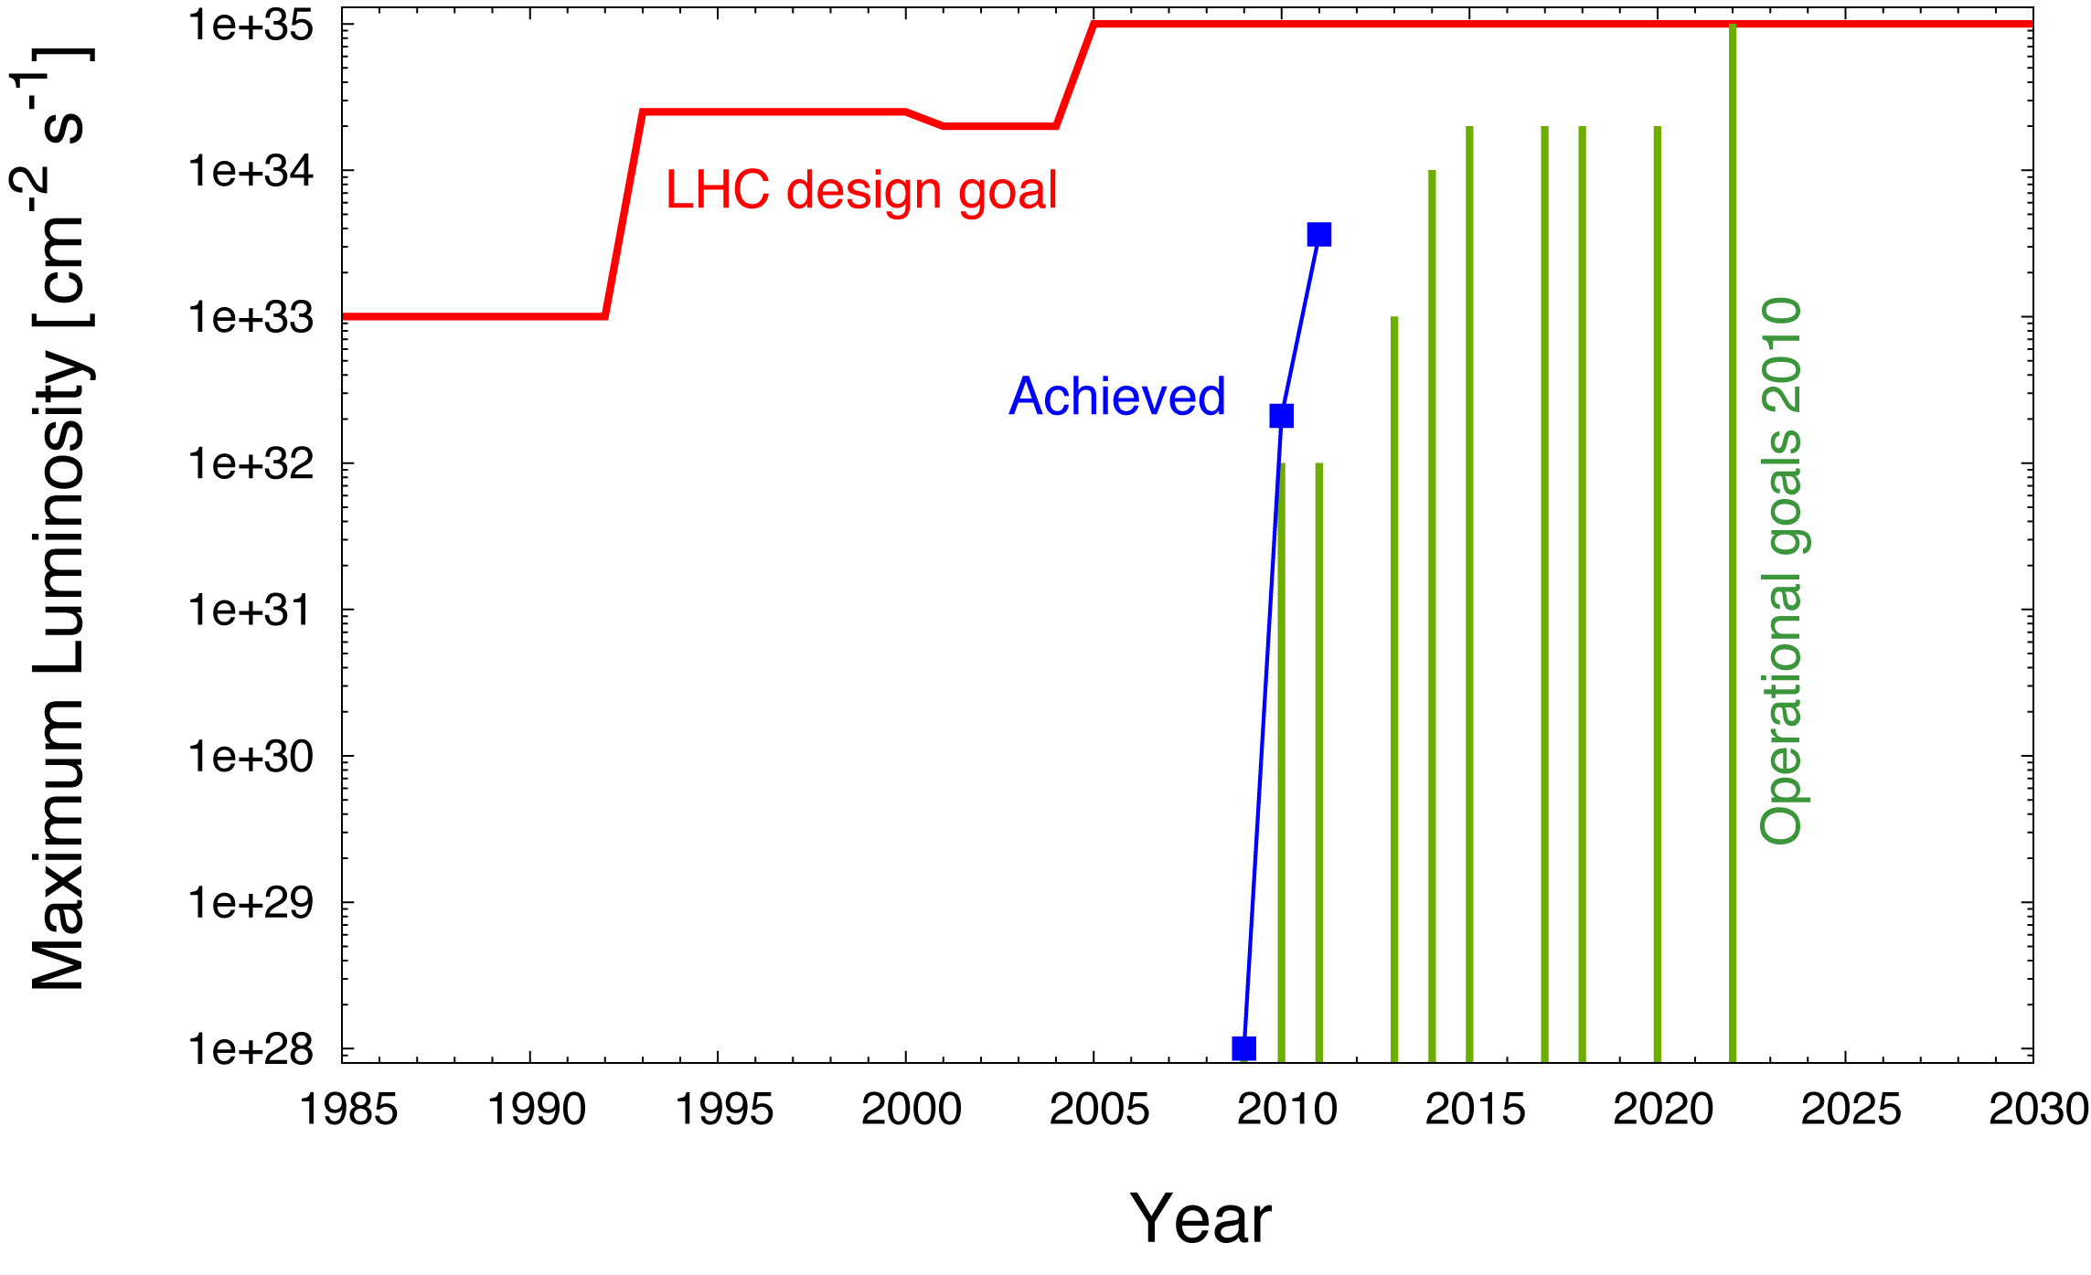
LHC Luminosity Compared to Ultimate Design
3 times original LHC design luminosity already reached!

Slide 12
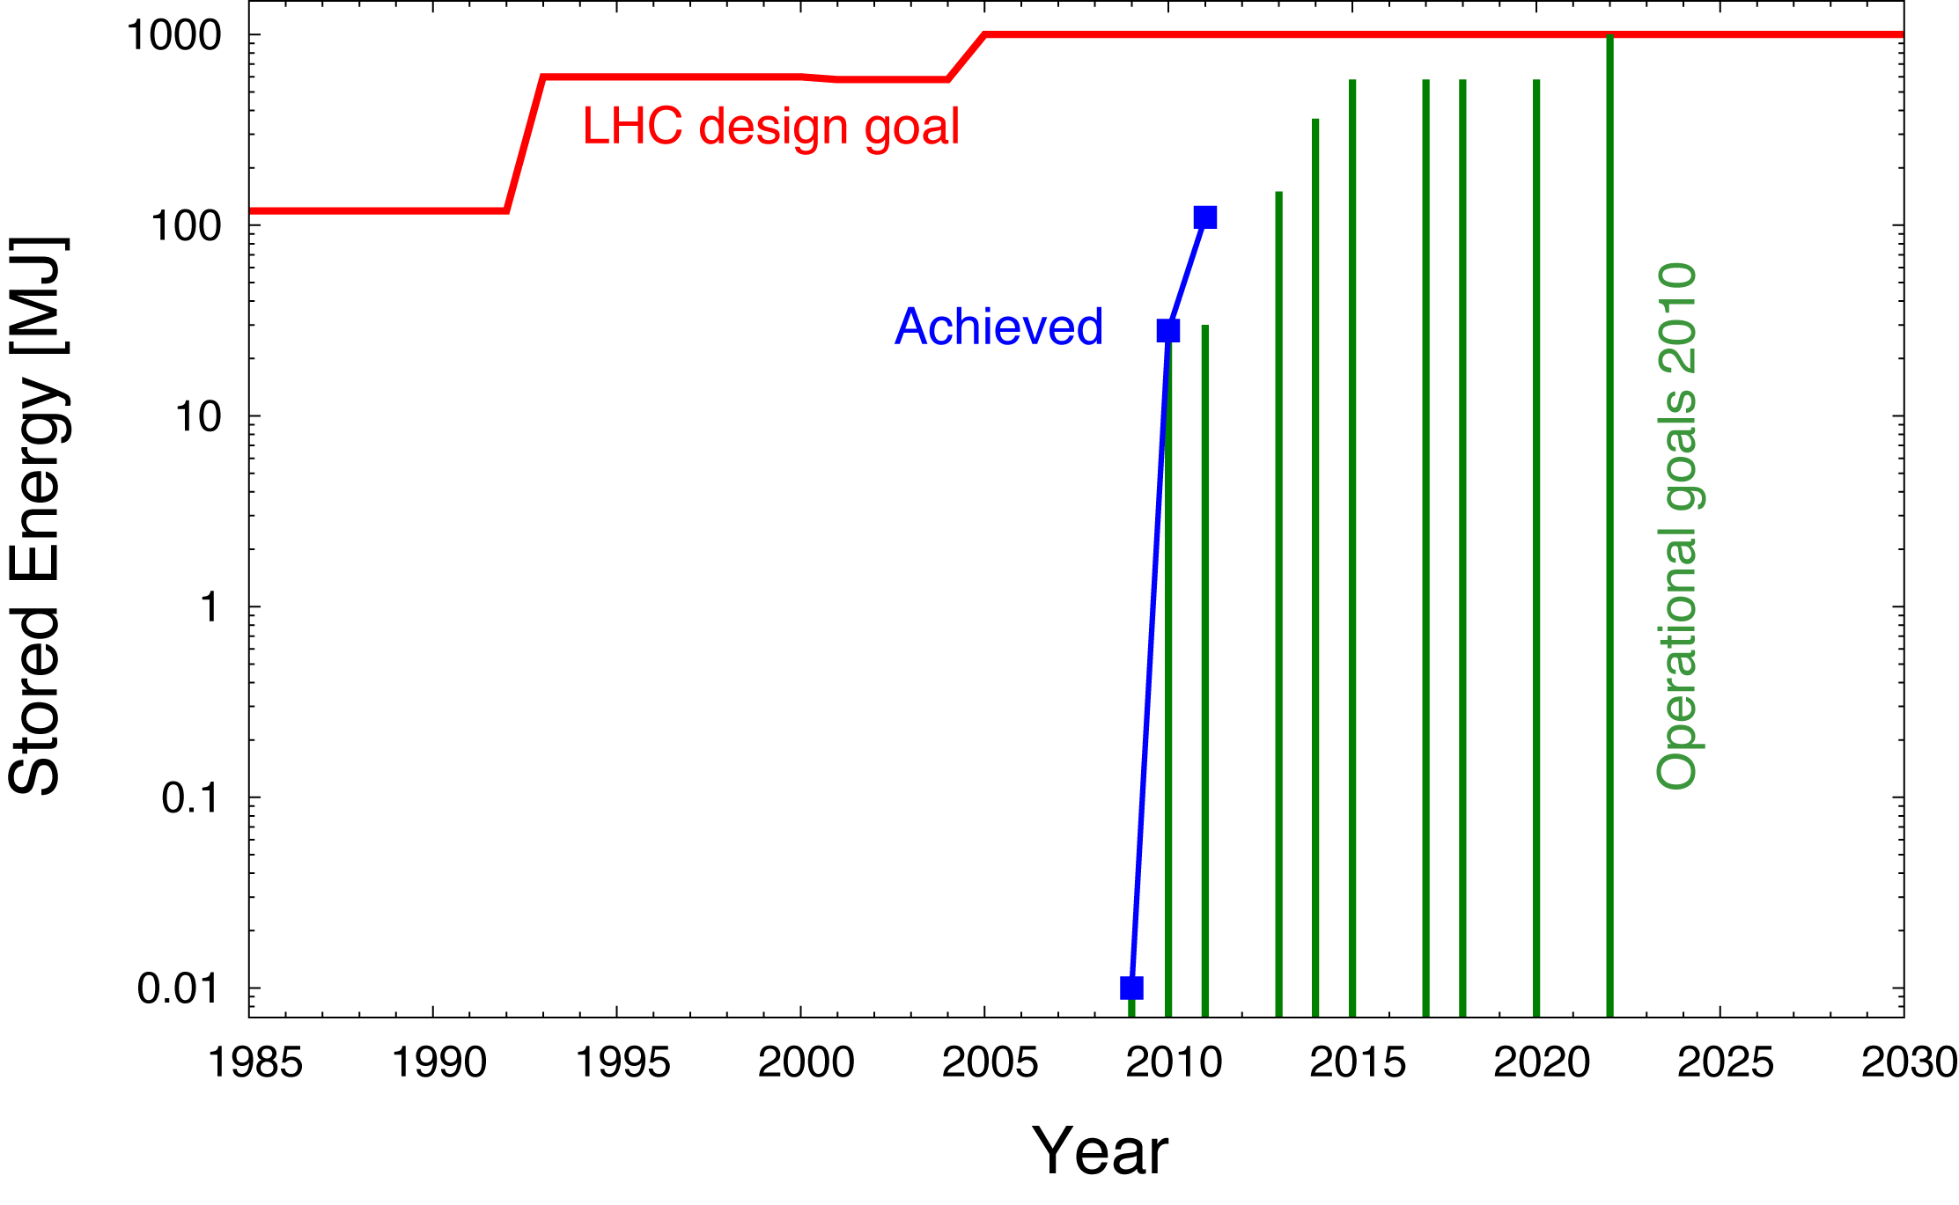
LHC Beam Current: Is Part of this Success!

Slide 13
LHC Stored Energy
We did better than foreseen! This already illustrates that it is good to review again the expected HL-LHC current limitations!
By the way, we reached also the original LHC design goal in stored energy!

Slide 14
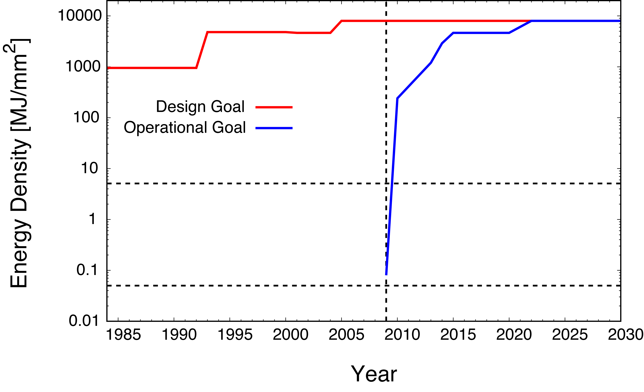
LHC Challenge: Transverse Energy Density
Achieved
Damage limit fiber-reinforced
graphite (collimator, absorber, …)
Damage limit metal
Transverse energy density is pushed further, way above damage limits of
materials! At some point classical protection is not feasible. Must look at
advanced technologies (➔ SLAC rotatable collimator).

Slide 15
Smaller Emittance versus Higher Intensity
Transverse energy density depends strongly on beam energy (γ) and is independent of number of protons (N_{p}^{tot}) over normalized emittance (ε_{n}):
Higher intensity or smaller emittance put similar strain on material survival!
Must be watched carefully to avoid a bad surprise when we have the first abnormal dump with high intensity…
HiRadMat: Robustness of a spare tungsten collimator will be tested in 2012! Recommend same for TCDQ, …

Slide 16
Going Through Systems…
RF
Vacuum
e-cloud
Cryo
Magnets
Injection and Protection
Collimation
R2E
RP

Slide 17
LHC RF System (J. Tuckmantel, E. Jensen, E. Chapochnikova, W. Hoefle, …)
Problem is handling of transients, e.g. at edge of abort gap (high intensity ➔ gap ➔ high intensity).
Confident for ultimate intensity. Hope to extend to 25ns with 2e11 p per bunch (25% above ultimate).
To go beyond, the following options can be considered:
  Increase the available RF power IN the cavity
  New transmitters, requiring possibly some civil engineering to house a larger installation.
  New coupler, that would probably not fit on the existing cavities and cryostats (ports).
  HOM coupler power capability to be assessed for higher intensity.
  Other (not yet present) installations (as 200 MHz capture or 800 MHz HH) are not foreseen for higher currents than ultimate.

Slide 18
LHC RF System
Summary:
For a beam current higher than 1 – 1.3 times ultimate one would probably need a revisited RF system with some new hardware, including transmitters, couplers and/or cavities.
Clear that detailed RF analysis is required for any upgrade beyond ultimate.
Input from J. Tuckmantel, E. Jensen, W. Hoefle, E. Chapochnikova, …

Slide 19
LHC Vacuum System (J.M Jimenez)
Ion-induced Vacuum Instability in LHC arcs
  LHC design for LHC Ultimate i.e. 0.87 A/beam
  Hard limit with the DQ interconnect due to the cold BPM (1.12 m)
    Critical current = 1.6 A/beam
    2808 bunches / 2.5e11 ppb = 1.3 A (2808 bunches / 2.1e11 ppb = 1.1 A)
    1404 bunches / 3.5e11 ppb = 0.89 A (close to ultimate scenario)
Increase of Synchrotron Radiation (photon flux and photo-electrons) should have a limited effect
Fast pressure transients which can lead to the closure of the sector valves during the setting of the collimators with high proton intensities ⇨ the use of collimator jaws with BPMs should limit that risk

Slide 20
LHC Vacuum System (J.M Jimenez)
Thermal induced desorption. In case of huge flux of protons onto the collimator jaws, we should expect the pressures to rise resulting from the combination of the proton induced desorption and thermal stimulated desorption. The vacuum stability RELIES on the cooling of the collimator jaws (<50 °C MAX)
  Pumping layout can be revisited but at significant cost
In case of strong halo or beam losses, we should also expect a faster deterioration of the bake-out material on the collimators but also on the chambers of the downstream magnets (wrapping technology)
  Dynamic Pressure will also rise despite the use of NEG coatings

Slide 21
LHC Vacuum System (J.M Jimenez)
Upgrade beyond ultimate might require:
  New pumping layout around collimators, inner triplets and possibly other equipments
  New and more resistant permanent bakeout equipment
    Beampipes in Warm magnets cannot be easily exchanged
  Handling of pressure transients at sector valves
  Lifetime of NEG coated beampipes if submitted to strong halo
Critical current is a design value, cannot be changed and is a hard limit

Slide 22
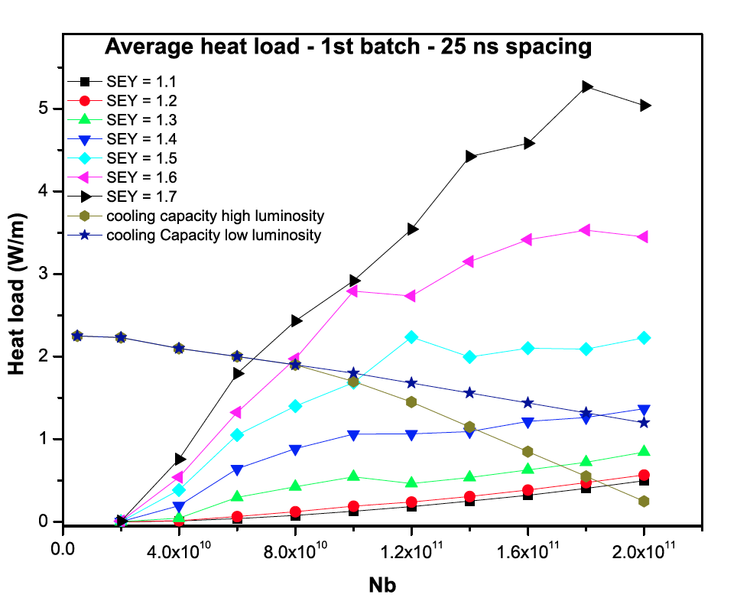
E-Cloud Heat Load (F. Zimmermann & H.M Cuna)
More heat load with higher bunch intensities!
5 W/m

Slide 23
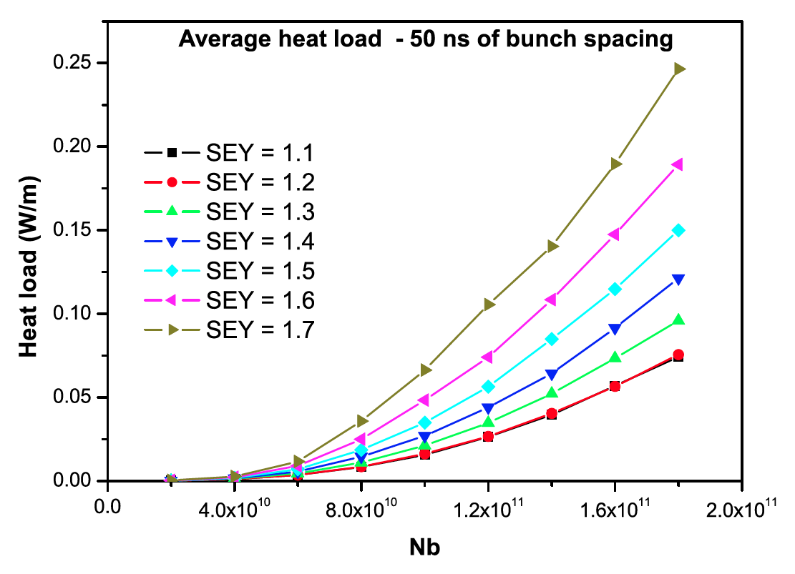
E-Cloud Heat Load (F. Zimmermann & H.M Cuna)
0.25 W/m

Slide 24
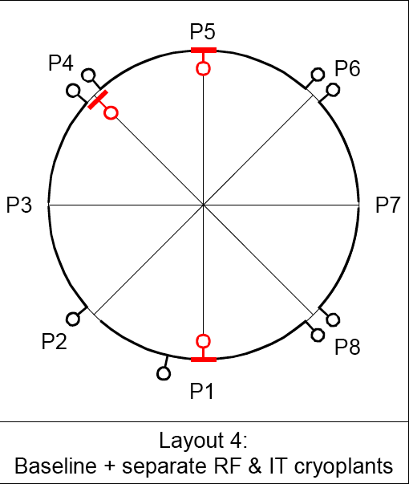

LHC Cryo System (L. Tavian)
Above ultimate requires 3 new cryoplants in addition to the 8 existing cryoplants for nominal intensity.
Limitations in beam screen cooling loops → see next slide…

Slide 25
Cryo limitation : Arc Beam Screen Cooling
(L. Tavian)
Available capacity arc beam-screen cooling (Ex-LEP cryo-plants):
12000 kW → ~ 2.1 W/m per aperture

Slide 26
LHC Magnets (L. Rossi, L. Bottura, …)
The magnet system has been designed to withstand the so-called ultimate intensity with 25 ns spaced bunches of 1.7 e11.
Triplet limitations ➔ new triplets in HL-LHC.
Main magnets: So far, no indication for a high quench risk from beam losses (collimation, BLM’s, …).
Also, so far no problems in some special magnets (e.g. Q6 in IR7), or in corrector magnets which are potted.
The DSL (SC link in 3-4) has increased cooling. No immediate worry…
Radiation damage to magnets (also warm magnets) to be considered…

Slide 27
Injection & Protection (B. Goddard, J. Uythoven)
In case of different filling schemes:
  SPS extraction kicker maximum flat-top length is presently about 10 us for both LSS4 and LSS6
  Kicker magnets had originally longer waveforms, so extending length back should not be too difficult, there is space in the PFN. Need to check switches for CNGS like operation (MKE4).
  LHC injection kicker maximum flat top length is about 8.0 us, with a rise time of 1 us and fall time of about 2.5 us. Changing any of these numbers on MKI would require big investment, and might not even be technically possible for the rise/fall time.
MKI: heating. Getting back to 24 stripes gains factor 3 above limitation we touched in 2011. Additional factors can be gained by cooling or change of ferrite material.
  Pulse length of MKI can be increased by building the same PFNs but longer. Rise and fall time are already pretty optimum.

Slide 28
Injection & Dump Protection
TCDI transfer line protection devices (14) were specified to work for ULTIMATE intensity. Simuations showed that these are already on the limit at this intensity/emittance, mainly because of the high energy deposition in the downstream TL masks and magnets (e.g. at MSI the mask temperature reaches over 990 C). So again a redesign would be needed, probably with longer TCDIs and maybe even new layout/optics.
TDI - not sure of what the limits are. However likely to need redesigning, maybe with TCDD.
TCLI - will be similar to TCDI.

Slide 29
Injection & Dump Protection
TCDS - FLUKA studies with the upgraded version (as installed) showed that this is limited to ULTIMATE intensity - anything above this the Ti part of the diluter will deform plastically.
TCDQ - preliminary FLUKA results show that an upgrade is required to reach even nominal intensity. This will be straightforward and done in next shutdown (replacing C by C-C blocks), but the operational limit is not yet known and anyway the device will be designed to go only to ultimate (reduces protection of Q4).

Slide 30
Injection & Dump Protection
TDE - OK for ULTIMATE intensity - going above this will require an upgrade of the dilution kicker system, to increase the sweep length by increasing the frequency - more MKB tanks will be required - no technical feasibility or integration study made yet.
A 'superbunch' with intensity concentrated in a few bunches is very bad for the dump (no sweep possible)
VDWB - OK for ULTIMATE intensity - going above this will need study.
BTVDD - OK for ULTIMATE intensity - going above this will need study.

Slide 31
Dilution with spiral sweep
Jan: 4 times longer sweep pattern is not going to give you the possibility of 4x more intensity as the beam will be swept over parts which are already ‘hot’
Dilution kicker frequency increased – x4 sweep length
  14 to 56 kHz… would require ~4 times more kicker length
  Increase sweep length (higher f₀ ⇒ more kickers)
  Upgrade dump block (longer, lower density C);
  Upgrade protection devices (longer, lower density C, more λ_{r}).
108 cm sweep length
400 cm sweep length
  At 7 TeV would allow currents of ~4 A in distributed bunches
  At 14 TeV would allow ~1 A in distributed bunches

Slide 32
Injection & Dump Protection
In conclusion there are lots of potential issues with protection devices; most are already at their technological limits and we would have to start working on 'disposable' or sacrifical absorbers, or make significant layout changes.
My question: Concept of SLAC rotatable collimator applicable? To be looked at…

Slide 33
LHC Collimation (R. Assmann, S. Redaelli)
System delivers predicted efficiency! Higher than predicted quench margins and excellent beam lifetime: Collimation efficiency limit at ~4 times nominal intensity (based on recent quench margins)!
Primary, sec. collimators robust for ultimate intensity: Design accident (nominal): ~1 MJ in ~200 ns ➔ 0.5 kg TNT
Above ultimate we expect onset of damage due to thermo-mechanical shock waves…
Can be tested in HiRadMat facility. Helps to push to limit.
If damage is found, require new design for primary and secondary collimators.
Must evaluate impedance for higher beam energy and intensities. At some point might be show-stopper!

Slide 34
R2E Limits (M. Brugger)
SEEs & Intensity or Integrated Luminosity:
  P1/5/8 (critical areas + DS)
  -> scale with integrated luminosity
  ARC (+UX45/65)
  -> depend on beam intensity (+residual gas pressure)
Critical Areas:
  UJ14/16/56/76
  -> ready for nominal/ultimate and beyond >LS1
  US85: ok for nominal, LHCb upgrade to be reviewed
  RRs:
    Impact reduced by shielding + 600A patch + FGClite >LS1
    Power-Converter R&D -> patches, replacements LS1-LS2
    RR73/77 horizontal link option for LS1.5/LS2
    ready for nominal between LS1/LS2
    ultimate/HL after deployment of rad-tol PCs and/or SCLs

Slide 35
R2E Limits (M. Brugger)
ARCs (and part of DS, +UX45/65)
  Nominal ok for >LS1 with FGClite deployment and QPS
  Ultimate/HL-LHC: long-term damage to be evaluated
Open questions for ultimate intensity/high-luminosity:
  US/UW85: impact of LHCb-upgrade -> additional mitigation
  UX45/65: long-term residual gas development in LSS4/6
  -> actions to be clarified for LS1.5/LS2
Important: beyond SEEs, cumulative damage will likely become limiting factor
  High priority on radiation tests (+test facilities!)
  Foresee/Maintain dedicated monitoring
  Allow for system flexibility (system exchange between more or less exposed locations, e.g, ARC/DS)

Slide 36
HL-LHC RP Aspects: Activation
S.Roesler
Residual dose rates around loss points scale with intensity (collimators, dumps, etc) and/or luminosity (low-beta insertions, TAS, TAN).
Examples (assume few hours cooling time):
nominal HL-LHC
(scaling by factor of 5)
IR7 collimators/magnets 1-20 mSv/h 5-100 mSv/h
low-beta insertions 0.5-2 mSv/h 2.5-10 mSv/h
Compare to limits : >100 mSv/h Prohibited area,
2-100 mSv/h High radiation area
0.05-2 mSv/h Limited stay area
Consequences:
  remote handling becomes essential
  fast accesses difficult or impossible
  high reliability of components (low maintenance & failure) essential

Slide 37
HL-LHC RP Aspects: Activation of Air
Activation of air scales with intensity and/or luminosity. Airborne releases are estimated for nominal parameters and yield up to a few µSv/year for the reference group of the population. Scaling by a factor of 5-10 may give values exceeding the threshold value of 10 µSv/year above which optimization of the releases must be demonstrated.
This may require modifications of the ventilation system:
  installation of absolute filters
  modification of ventilation schemes
  …

Slide 38
HL-LHC RP Aspects: Shielding
The shielding of underground areas accessible during operation must protect personnel from normal losses (e.g., pp collisions) as well as accidental beam losses. Thus, doses scale with luminosity (normal losses) or total beam intensity (accidental beam-losses).
Example:
  Shielding of the LHCb counting rooms between UX85A and UX85B. Dose in UX85A due to accidental loss of one beam:
  Nominal: 5 mSv
  Compare to annual dose limit: 20 mSv
Consequences: shielding of accessible areas might not always be adequate and might have to be re-enforced.

Slide 39
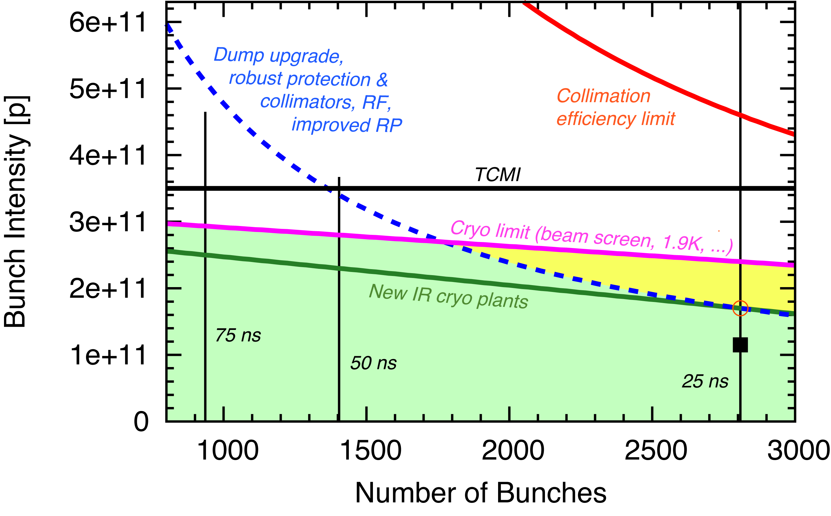
Summary

Slide 40
Thank you for your attention…

Slide 41
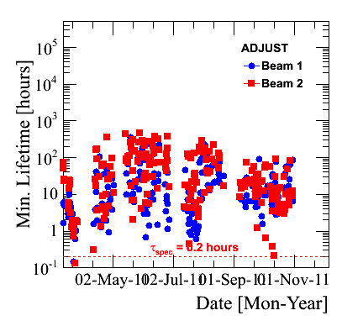
Excellent Beam Lifetimes in Adjust Mode
“adjust” = going into collisions → usually peak loss in whole fill
Lifetime = minimum lifetime
May July Sep Nov
Date

