Slide 1
Transverse Damper in 2012
presented by W. Hofle
Special acknowledgements:
H. Bartosik, V. Lebedev, D. Valuch, V. Zhabitsky
BE-OP, BE-RF

Slide 2
Transverse Damper in 2012
where do we stand end of 2011
plans for 2012 – new features
performance with 25 and 50 ns
what changes with increased energy
running at higher gains in ramp
noise: a feedback view
tune measurement: feasibility and plans

Slide 3
Where do we stand end of 2011
procedures for setting-up well established & highly automized
running with feedback on @50 ns spacings at all times
tests with 25 ns spacing show criticality of set-up of delay
abort gap cleaning and injection cleaning fully operational
fine setting-up of feedback phase done, in line with expectations, but will re-visit in 2012
contribution to noise from cabling identified, correction. i.e. re-cabling of pick-ups for one system (H.B2) done this stop.
batch selective excitation demonstrated
see Evian talk by D. Valuch
also re-commissioning
in 2012 see D. Valuch @Evian

Slide 4
ADT through the cycle

Slide 5
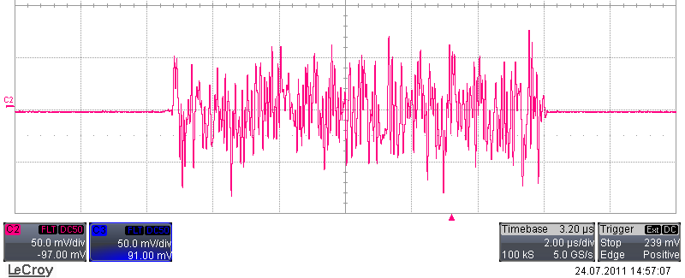
Gated excitation
gate, 11 μs (example)
white noise generated on FPGA running at 40 MS/s
after VME upgrade available for all dampers
tested on all dampers of beam 2 (H and V plane)
noise can be filtered by IIR lowpass filter
D. Valuch, M. Jaussi, D. Jacquet, T. Levens

Slide 6
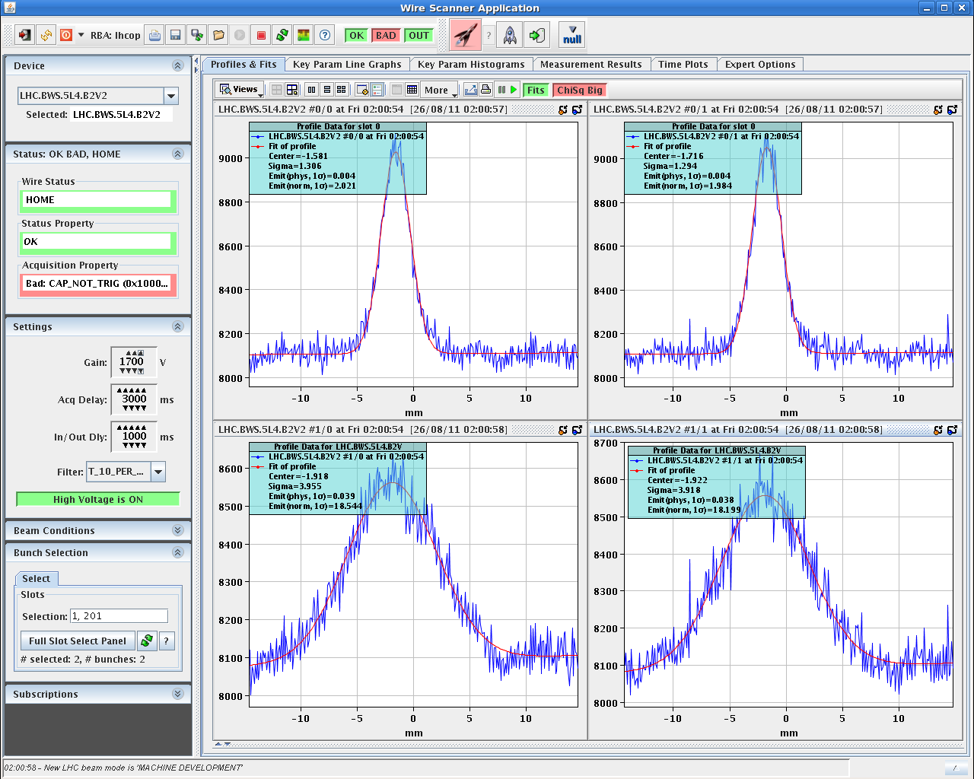
Selective blow-up (2 pilots)
hardware / firmware
ready for aperture tests
and quench tests
2 μm
18 μm
stops at 18 μm
→ aperture

Slide 7
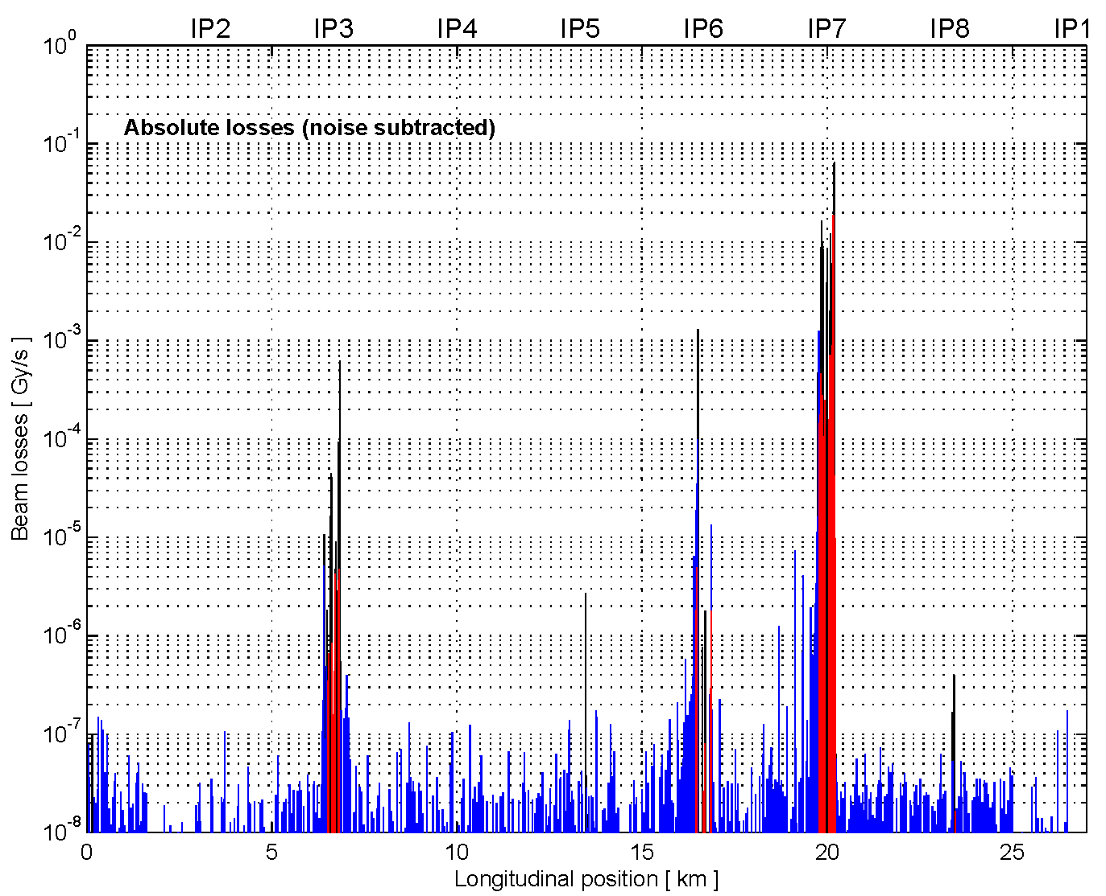
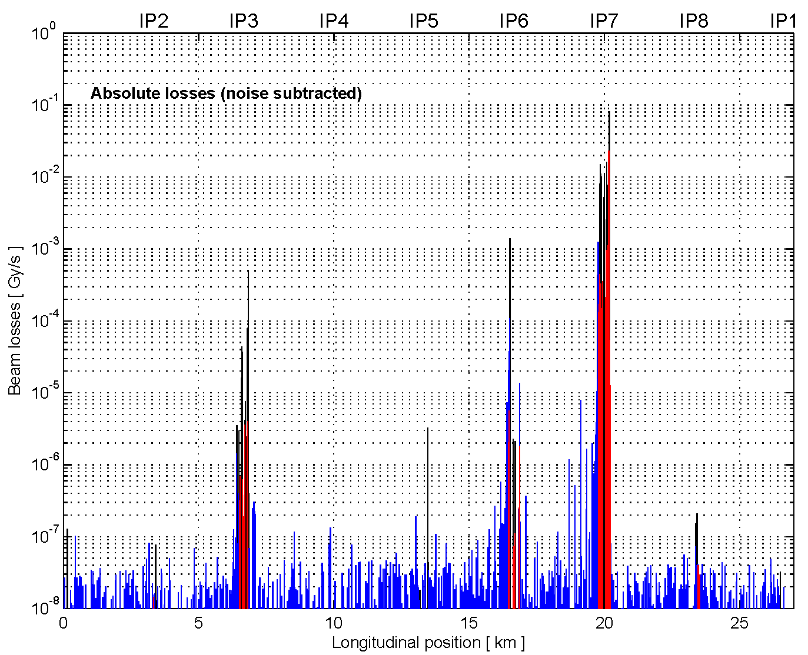
Comparison loss maps
damper (ADT blow-up) loss map
3rd order resonance
S. Redaelli, R. Schmidt, D. Valuch,
D. Wollmann, M. Zerlauth et al.

Slide 8
Plans for 2012 – new features (1)
user interface for loss maps (purely software effort), “expert” interface → later sequencer (?)
observation of two selectable bunches in a continuous way for tune measurement with data streamed to software in packages of 4096 turns, tests for software interface pending
for tune measurement: gain modulation within a turn to have lower gain for a witness bunches train (leading 12 bunches)
“dead-band” / “dead-band” with commutation of FB sign later to be considered (“dead-band” → do not damp oscillation before it reaches x μm, x adjustable)
tune measurement from witness bunch train (ADT data or BBQ)

Slide 9
Plans for 2012 – new features (2)
bunch mask based observation (more than 8 bunches) permitting online injection quality checks along batch (current observation limited to 8 bunches)
automatic setting of bunch intensity dependent gain, permitting observation of pilot bunches at injection: still some procedure to protect equipment to be defined
post mortem data display for ADT to be commissioned

Slide 10
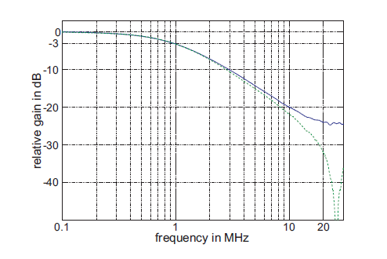
Performance with 25 ns and 50 ns spacing
50 ns: 10 MHz bandwidth required and available
25 ns: 20 MHz bandwidth required more difficult set-up
for 25 ns frequency response improvements under study (also important for abort gap cleaning): cable dispersion, and entire amplifier change under scrutiny
kick @ 10 MHz,
10% left
measured on power amplifier
(blue curve on kicker,
green on anode of tetrode)
LHC-PROJECT-REPORT-1148

Slide 11
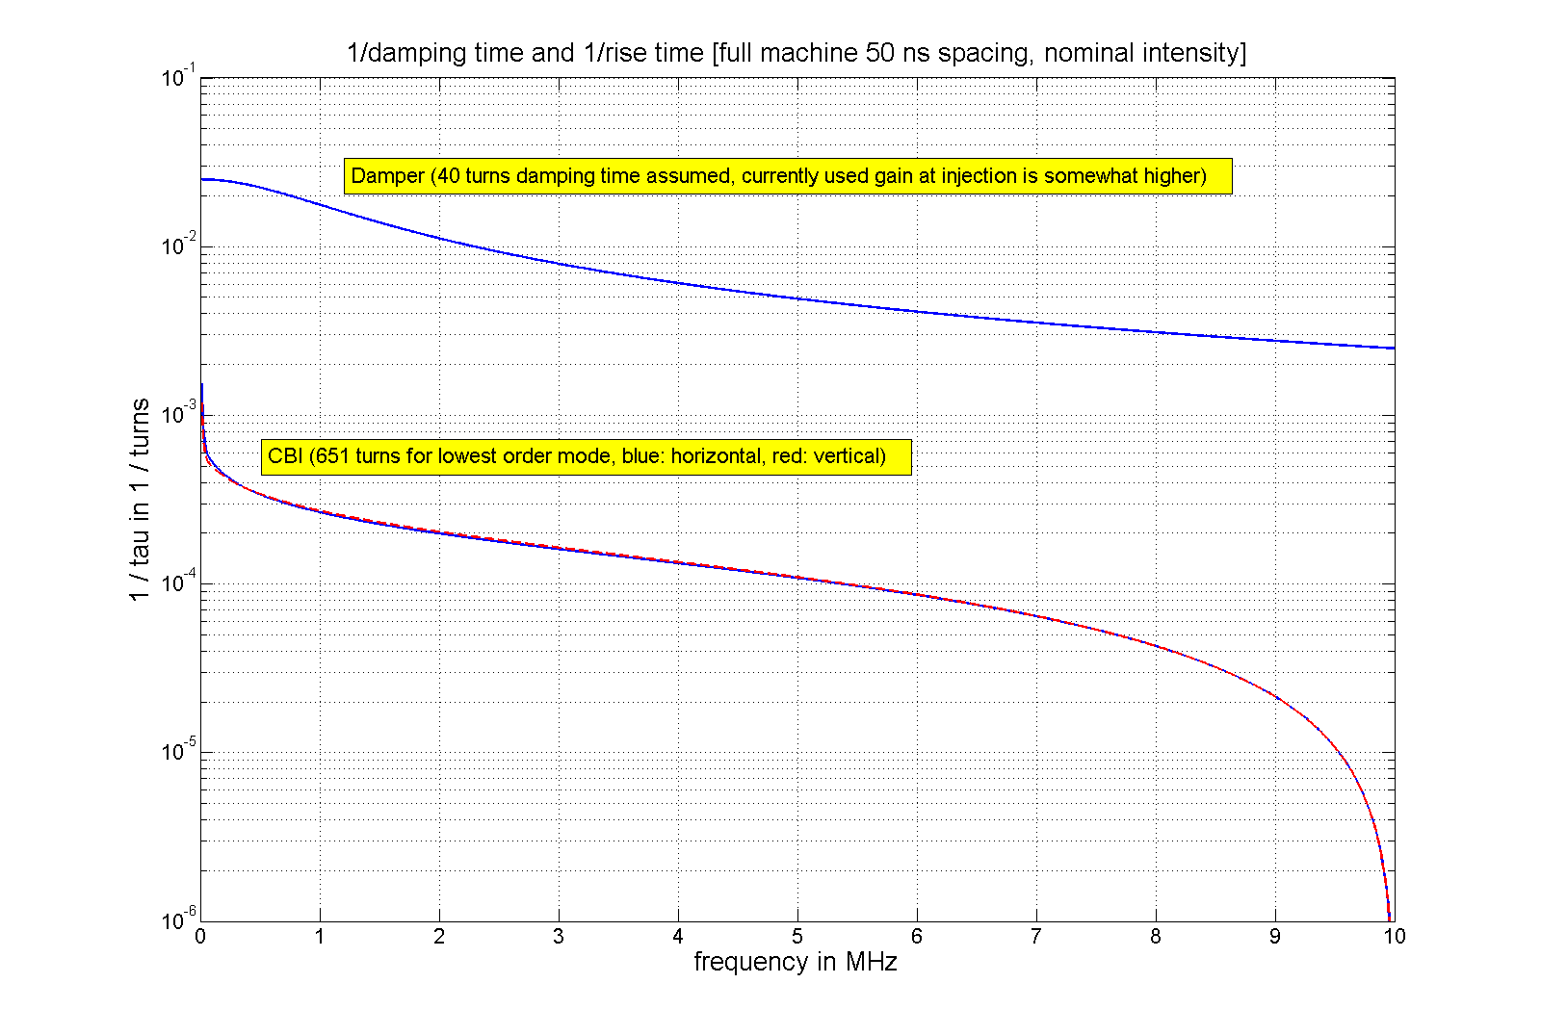
50 ns spacing
40 turns, 1/40 = 0.025
1.2x10¹¹ per bunch
50 ns spacing well
under control
with damper
instability calculation by N. Mounet

Slide 12
Transverse damper adjustments
T_{beam}
Key elements:
  beam position monitor(s)
  signal processing system
  power amplifiers
  kickers (electric field)
T_{signal}
Key parameters:
  Feedback loop gain
  phase and
  delay

Slide 13
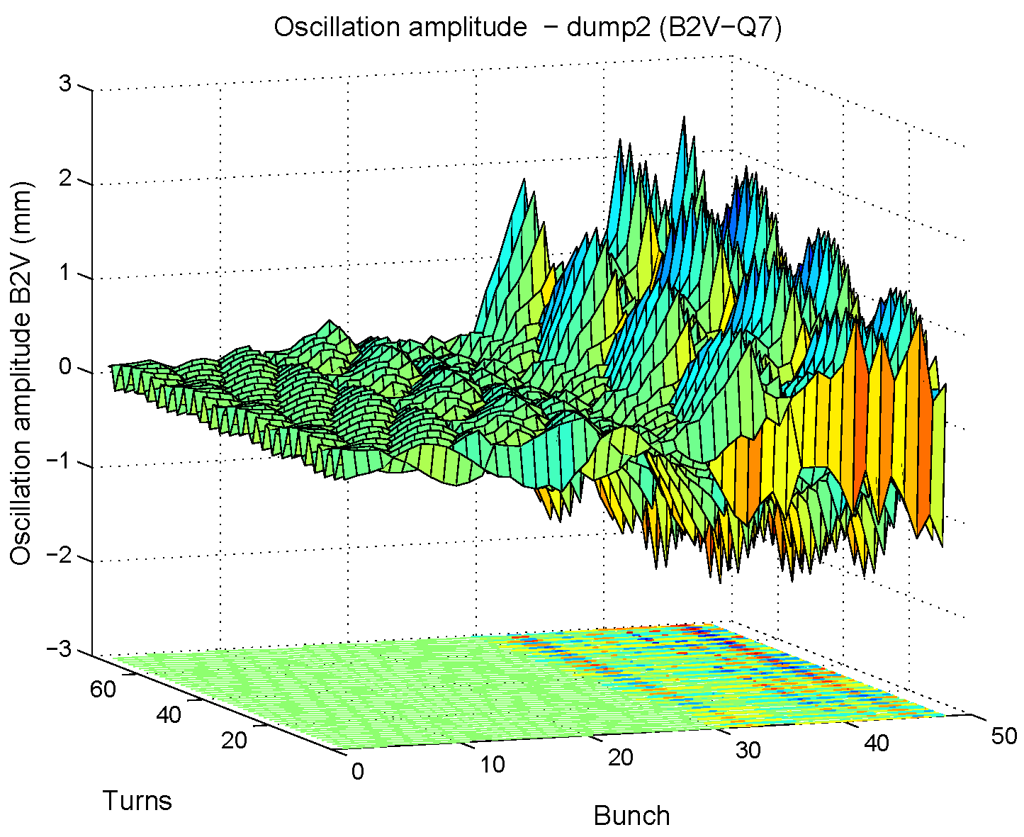
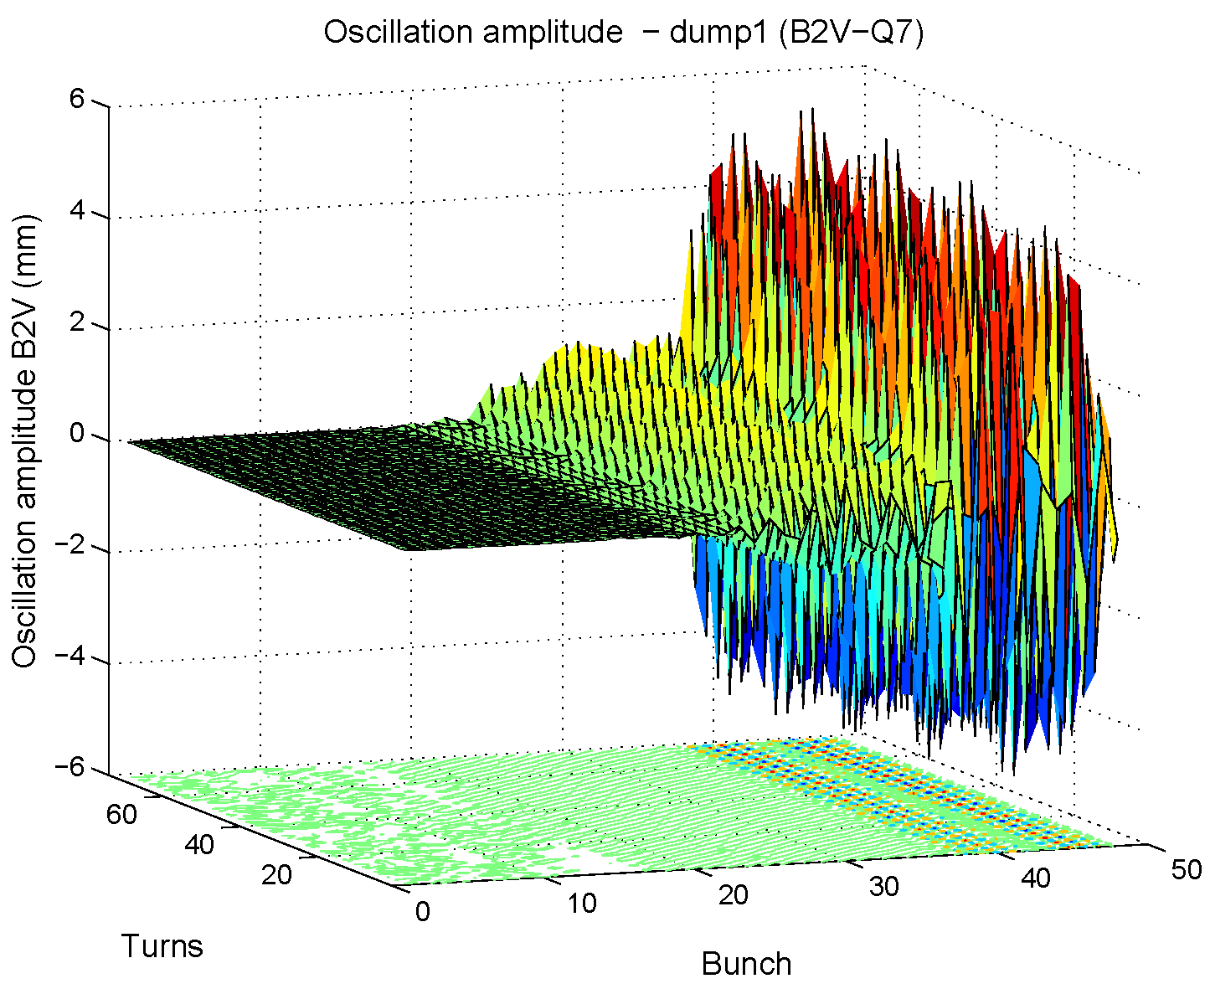
1st test with 48 bunches @25 ns spacing (1)
damper off, vertical plane
damper on, vertical plane
data from post mortem
offline-analysis
26th August 2011: two injection attempts at Q’=2, one with damper on, one with damper
off; subsequent MDs with 25 ns done with high Q’ (e-cloud instability)
see MD note under approval,
H. Bartosik, W.Hofle

Slide 14
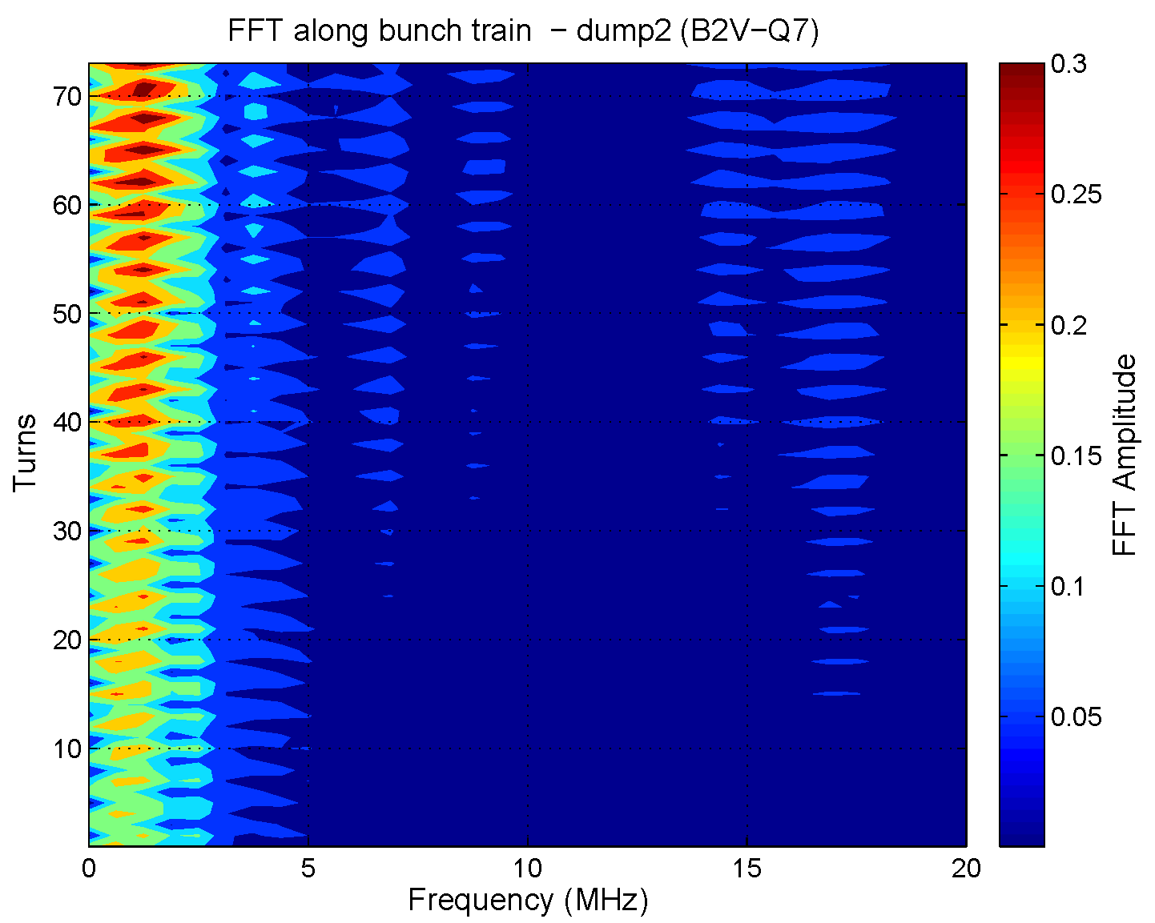
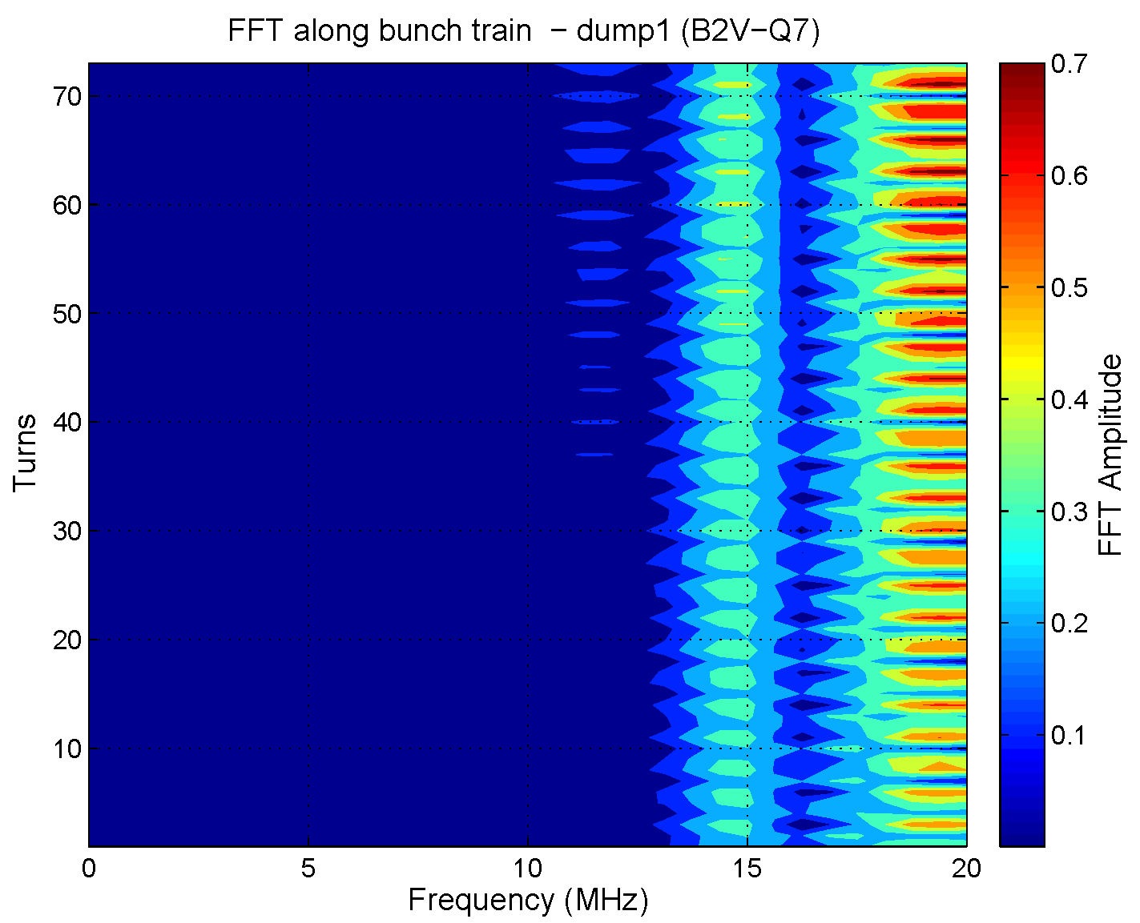
1st test with 48 bunches @25 ns spacing (2)
damper off, vertical plane
damper on, vertical plane
damper off: frequencies of instabilities < 2.5 MHz
damper on: frequencies above 14 MHz unstable:
but delay was not yet correct
MD note under approval,
H. Bartosik, W.Hofle

Slide 15
What changes with increased energy ?
impedance higher with collimators closer to beam
physical beam size smaller, impact of noise higher
marginal changes for 4 TeV, not an issue
7 TeV → reduction of noise advised (keep performance)
7 TeV, higher electronic gain required due to stiffer beam → means saturation, we run out of steam, re-shuffling of gain with some low power amplifiers needing re-design (for LS1)

Slide 16
Running at higher gains in ramp
maximum gain given by stability limits of feedback + beam
impact of noise other than from damper pick-ups on emittance increase is reduced at high gain
no dependence on gain of impact of damper pick-up noise on emittance
higher gain and higher pick-up noise makes tune signal seen by BBQ noisier, i.e. noise floor outside tune rises
this is an undesired effect for the measurement of the tune
MDs planned for 2012

Slide 17
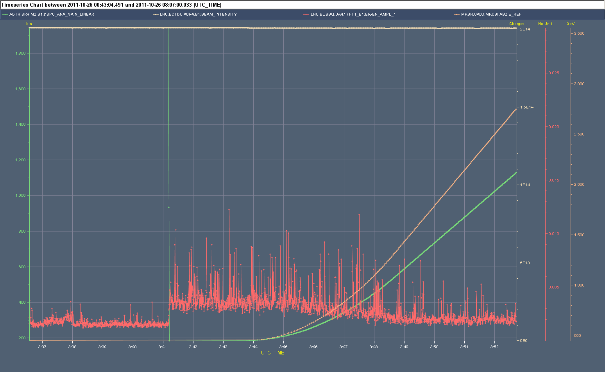
How we ran in 2011 with 50 ns beam
damper gain hor beam 1
(linear scale) HIGH @450 GeV
before prepare for ramp
increase of damper
(electronic) gain in ramp
To maintain approx.
same damping rate
ramp (energy)
drop of damper
gain
increased BBQ amplitude
= more residual beam oscillations
=> potentially leading to blow-up;
but signal needed for tune feedback
which is switched on here
BBQ hor Beam 1
amplitude
Injection plateau
prepare for
ramp
ramp

Slide 18
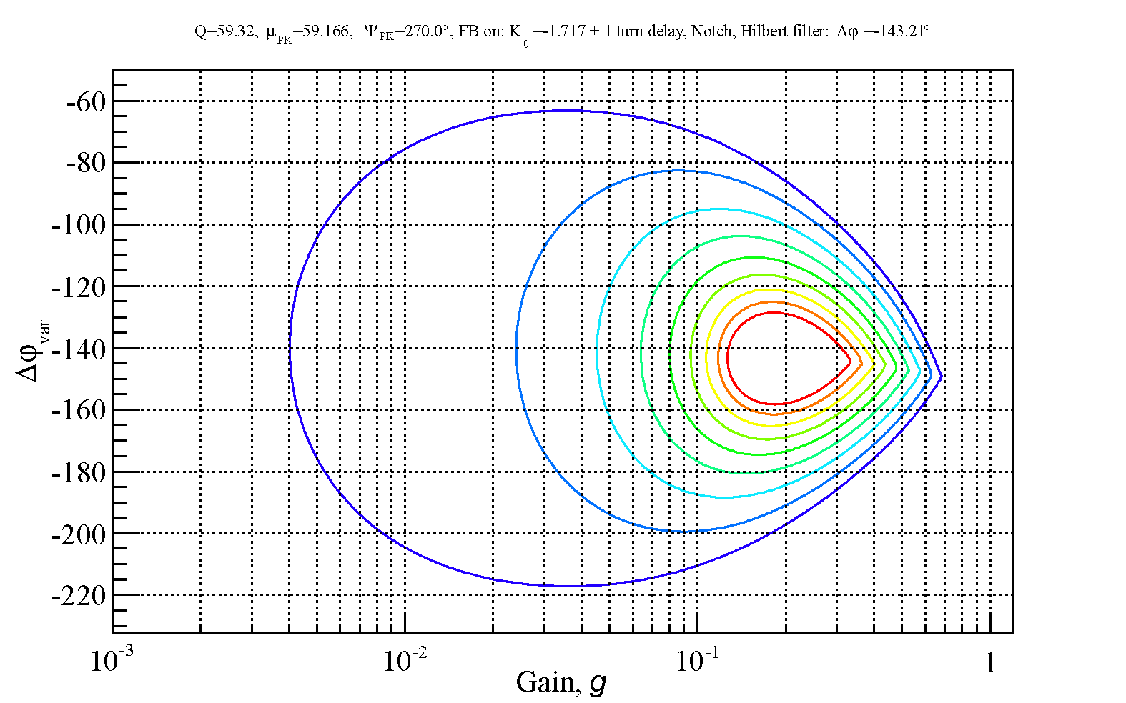
Gain limit from stability
faster than 10
turns damping
range of operation
contour
lines
at n/80
turns
n=1…8
and 0.002
(1/τ)
design
(40 turns
damping)
gain is the fraction of detected oscillation that is corrected in a single turn
V. Zhabitsky et al.

Slide 19
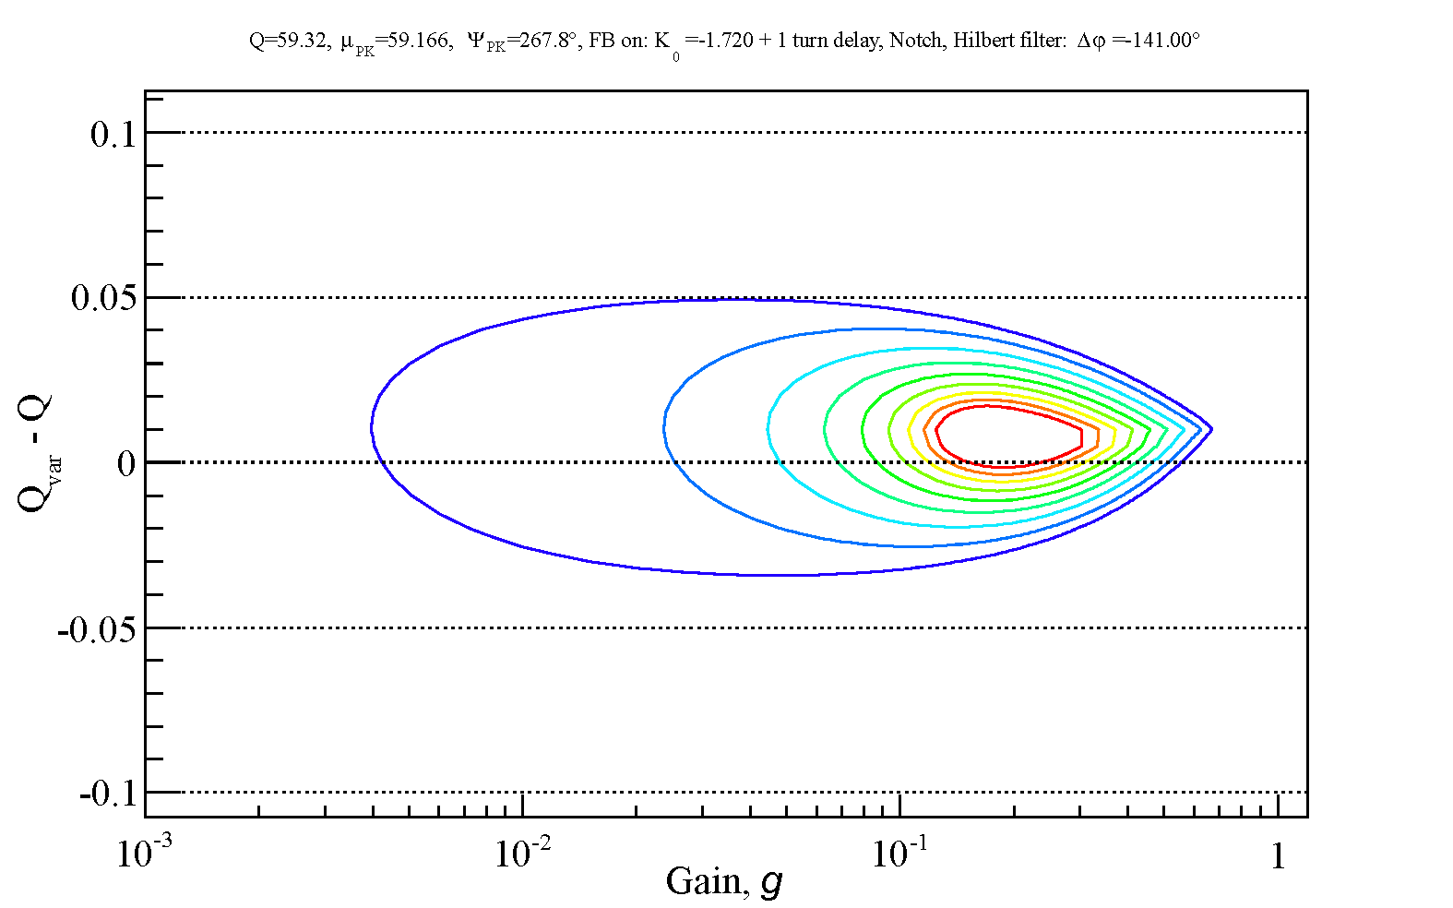
Damping : variation with tune
range of operation
report in preparation, looked at 8 pick-ups, injection and collision
some small optimizations possible, like in plot above
consider beam-beam tune shift for future (pi-mode !)

Slide 20
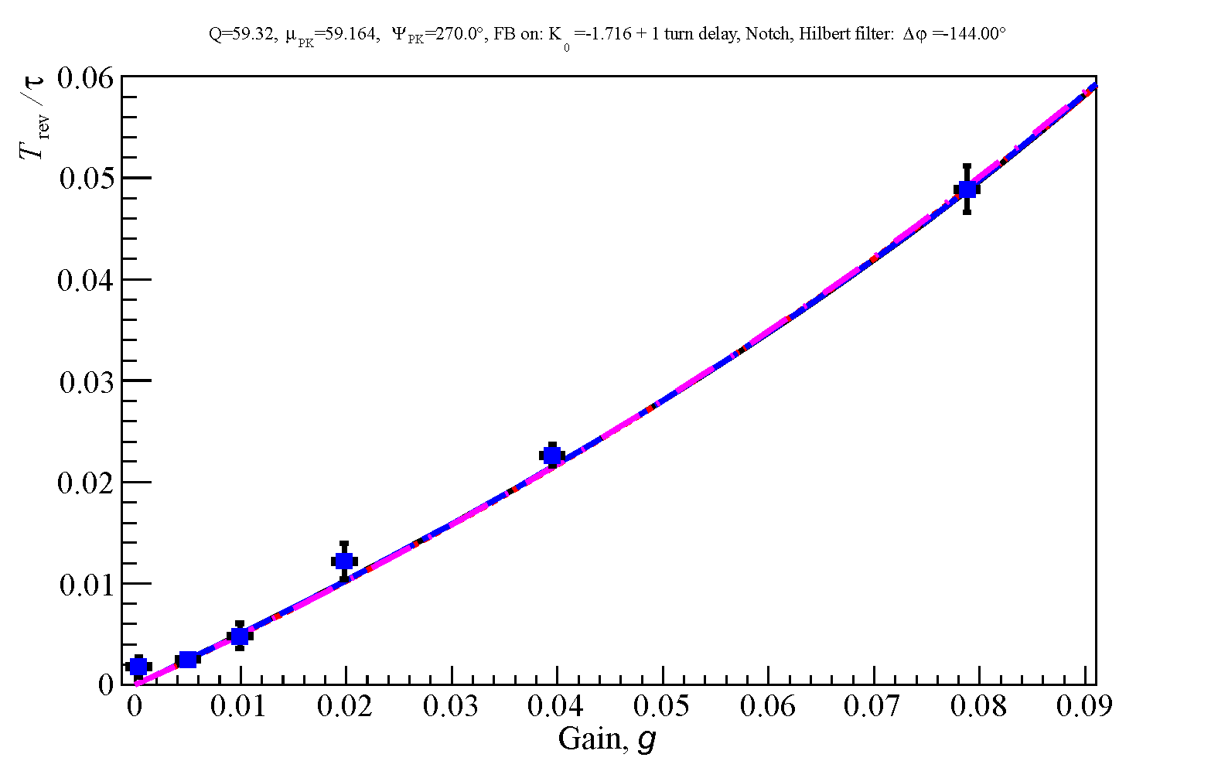
Damping time : variation with gain
measurements
versus
expectation
vertical, beam 2 @3.5 TeV

Slide 21
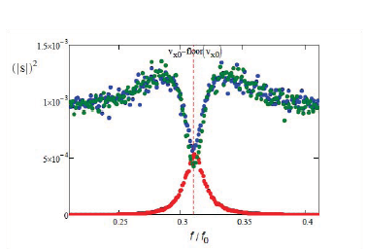
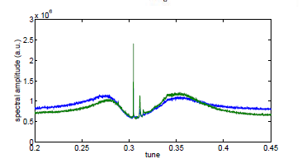
Tune from residual damper signal
PU signals with noise
simulated
measured (2 PU signals)
beam motion below
damper detection level
i.e. not visible for damper
V. Lebedev, W. Hofle, D. Valuch
et al. IPAC 2011

Slide 22
Closed loop transfer function N(s)→Y(s)
beam
system input
system output
G(s)
perturbation
PU
F(s)
feedback
visible
to damper
open loop
output of closed loop
closed loop transfer function

Slide 23
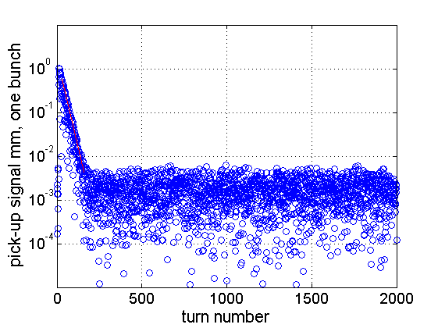
Tune Measurement: feasibility and plans
abs. value of pick-up signal
simulated
damping of 1 mm error, and simulated noise floor matching observed fluctuation on PU signals (2 μm rms, 5 μm peak)

Slide 24
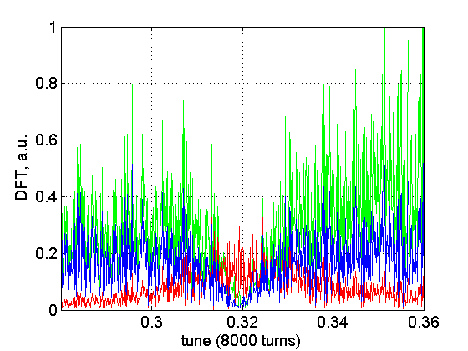
Tune Measurement: feasibility and plans
kick
signal
PU signal
actual beam
(not visible
by FB)
numerical simulation with correctly adjusted feedback phase
8000 turn FFT → relatively noisy

Slide 25
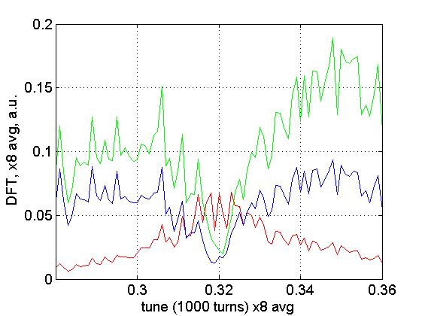
Tune Measurement: feasibility and plans
tune (nominal 0.32, collision V-plane)
kick
signal
PU signal
actual beam
(not visible
by FB)
numerical simulation with correctly adjusted feedback phase
average of eight 1000-turn FFT from a set of 8000 turns,
one bunch, minimum of PU signal gives tune

Slide 26
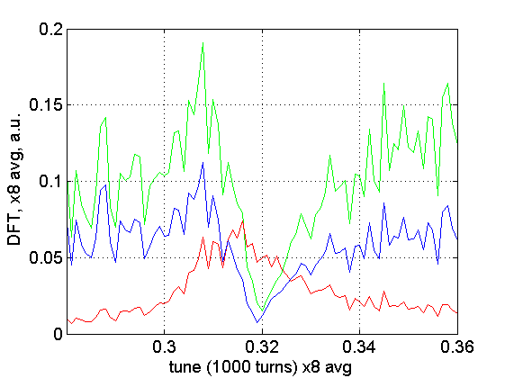
Tune Measurement: feasibility and plans
tune (shifted by reactive part of FB)
kick
signal
PU signal
actual beam
(not visible
by FB)
numerical simulation with badly adjusted feedback phase (30º off)
average of eight 1000-turn FFT from a set of 8000 turns,
one bunch, minimum of PU signal gives un-shifted tune !

Slide 27
Summary tune measurement
lower ADT gain for first bunch train of 12 bunches
implement in ADT observation of two selectable bunches
observe results of lower gain, incl. on BBQ (gated BBQ ?)
check practical feasibility of tune from residual damper signal
implement final solution in LS1

Slide 28
Summary
a number of new features under development
50 ns well under control
25 ns requires attention for setting-up
improvements for lower noise under way
improvements for frequency response under way
compatibility with tune measurement system
to be tackled with witness bunches for 2012 run

Slide 29
Spare slides

Slide 30
Beam Position module (Bpos)
Calculates normalized beam position bunch by bunch, independent of intensity
many different sources
contribute to noise
16 bit ADCs

Slide 31
Beam Position module (Bpos)
Normalized bunch position calculation
angle φ_{ΔΣ} determined during
setting-up, different settings required for
different gains in pre-amplification chain
propagation of noise from 4 ADCs
to final beam position measurement

Slide 32
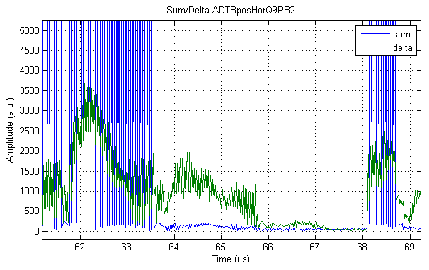
Plans for TS 2011 and 2012 run
recabling of one system:
  7/8” coaxial cable damage during the initial installation.
  Evaluation of a new type transmission line without of cable without
  corrugation.
delta signal
noise contribution from cable
the first to eliminate
last batch
no beam

