Slide 1
Beam Energy in 2012
Preamble
What changed since Chamonix 2011 that allows us to change the beam energy?
What did not change and what are the constraints?
What is the envisaged maximum beam energy for 2012 run?
Chamonix 2012, Session 4 – Strategy for 2012
Andrzej Siemko
With inputs from:
Z. Charifoulline, K. Dahlerup-Pedersen, R. Denz, F. Savary, Ch. Giloux, M. Koratzinos, E. Ravaioli, R. Schmidt, J. Steckert, H. Thiesen, A. Verweij and F. Bordry

Slide 2
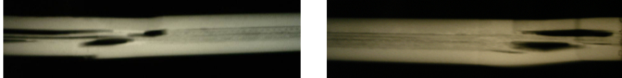
Brief recall of copper stabilizer issue
Despite correct splice resistance between SC cables, a 13 kA joint can burn-out in case of a quench, if there would be a bad bonding between the SC cable and the copper bus, coinciding with a discontinuity in the copper stabilizer
Resistance measurements and -ray pictures have shown the presence of many of such defective joints in the machine, limiting the safe operating current

Slide 3
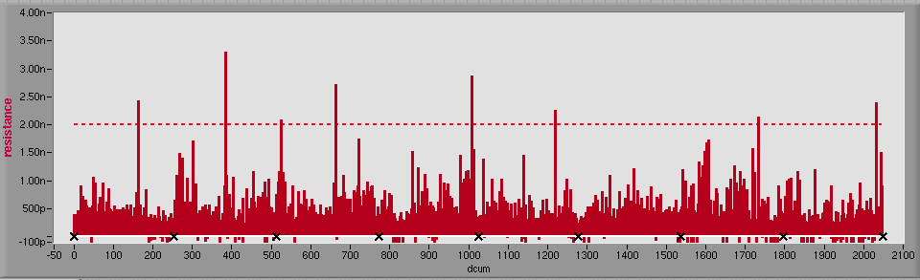
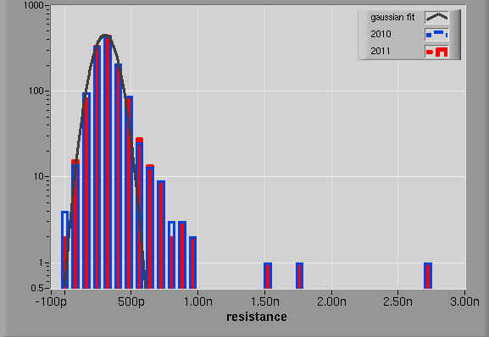
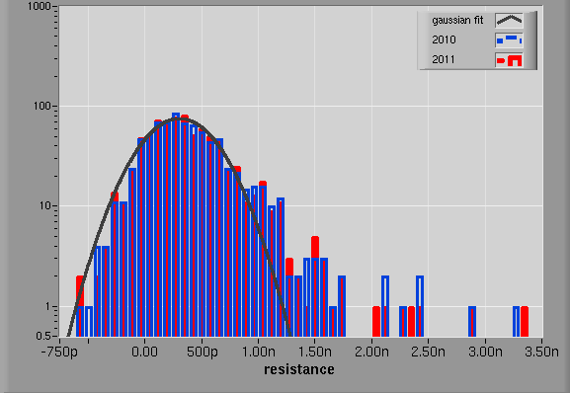
Status of SC cable splice resistances in LHC
Maximum Splice Resistance in a Bus Segment over the LHC ring (R_{spl,max}*)
2nΩ
12 23 34 45 56 67 78 81
Dipole Buses
Quad Buses
2010: 304±85pΩ
2010: 303±309pΩ
2011: 303±82pΩ
2011: 305±309pΩ
(*) R_{spl,max} = R_{segment} - (n-1)·R_{spl,average}

Slide 4
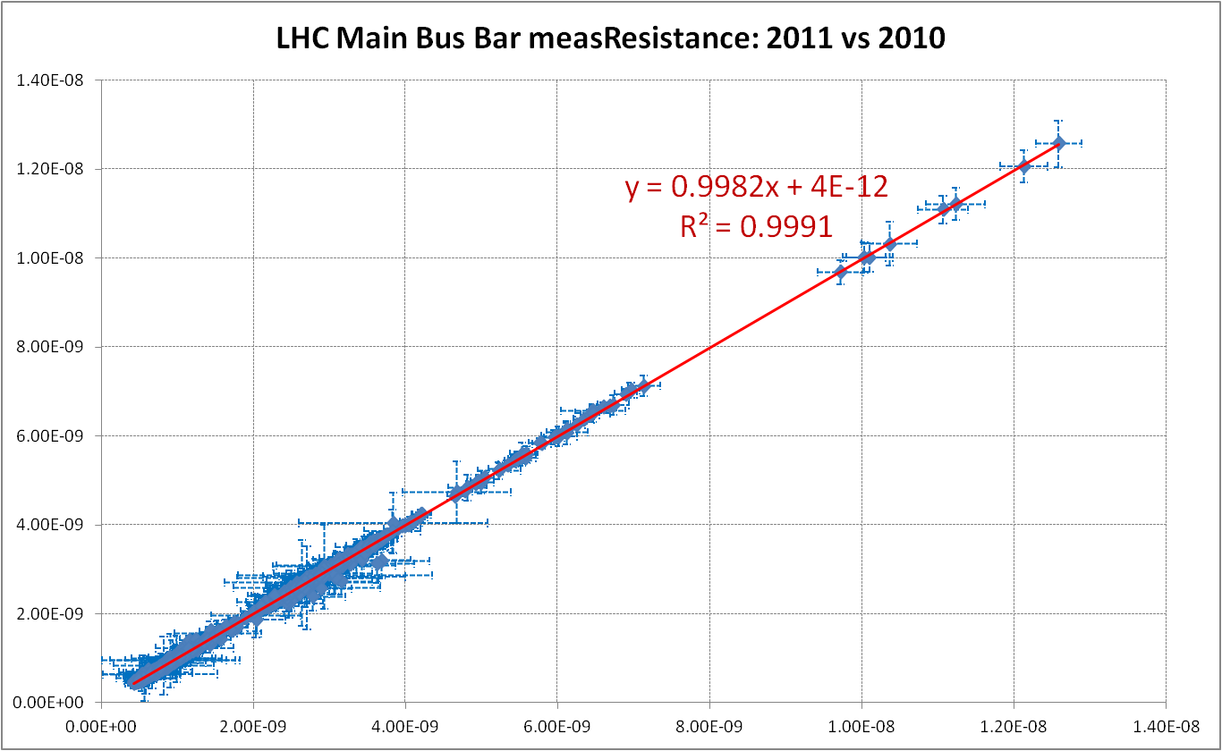
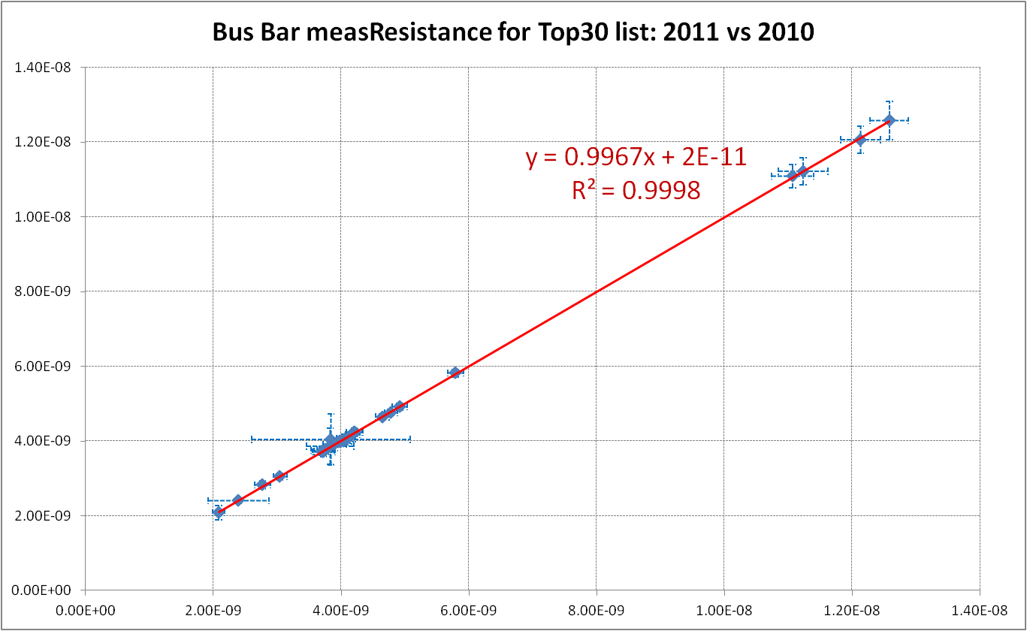
SC splice resistances - long term stability
NO CHANGES
OBSERVED! ☺
2011
2011
2010
Top 30 list: R_{spl,max}>1.2nΩ
R_{spl,max} = R_{segment} - (n-1)·R_{spl,average}
No deviations are visible.
2010

Slide 5
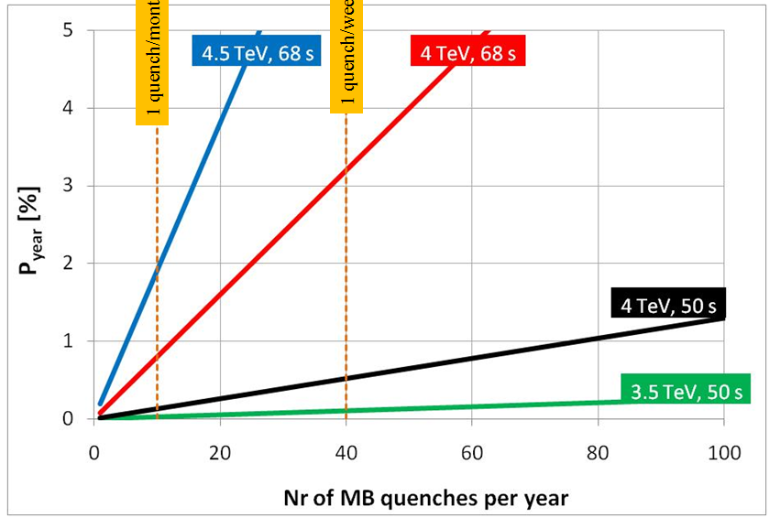
Brief recall of Chamonix 2011…
Chamonix 2011 conclusions regarding the beam energy (Steve Myers):
  Stay at 3.5TeV for 2011.
  We should operate in 2011 with the "snubber" capacitors to reduce further the possible number of quenches.
  “Thermal amplifier” to be developed during 2011 to allow measurements during Christmas shutdown for a deterministic decision on a possible energy increase for 2012.
Main arguments against running above 3.5 TeV
Risk of multiple magnet quench events Unknown number of quenches to be expected in 2011
A. Verweij Chamonix 2011

Slide 6
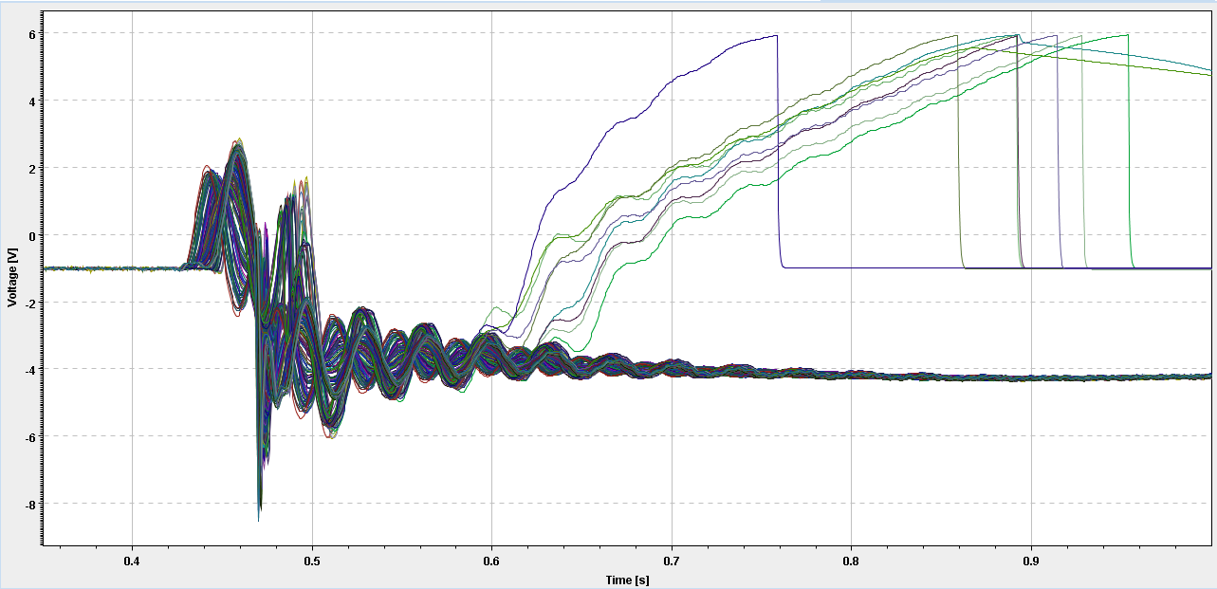
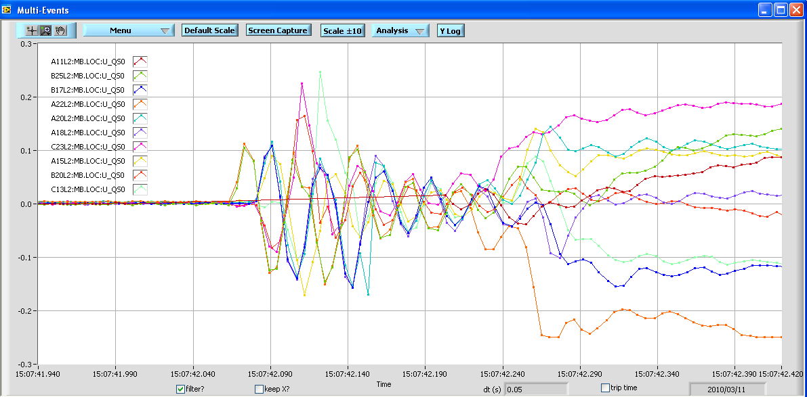
Multiple magnet quench events
Due to the quench detection system vulnerability to withstand the effects of a hostile environment and various transient signals produced by circuit elements, a number of multiple magnet quench events was experienced in 2010
Example of multiple magnet quench
  11.3.2010,
  sector 12, 15:07:42
  10 quenched magnets by oQPS
  FPA during -10A/s ramp @ ~2kA
Umag (SymQ buffers whole sector except: B16L2, B19L2, B20L2)
U_{QS0}

Slide 7
Multiple magnet quench ranking in 2010
# of magnets quenched | Date | Sector | Condition | Cause
50 | 24.02.2010, 19:08:23 | 78 | ~3.2kA coasting | SymQ → adaptive filter triggered during PC trip. During manual abort 20min later filter was not active → big dUmag_{max}
25+5 | 17.03.2010, 02:23:15 | 56 | ~2kA, 10A/s ramp | oQPS → EM transients caused by FPA during ramp beyond common mode rejection of DQQDL SymQ → 5 magnets fired due to loss of references (fired by oQPS) in comparison cell
10 | 11.03.2010, 15:07:42 | 12 | ~2kA -10A/s ramp | oQPS → EM transients caused by FPA during ramp beyond common mode rejection of DQQDL
10 | 13.02.2010, 15:44:52 | 12 | ~5.5kA 10A/s ramp | oQPS → EM transients caused by FPA during ramp beyond common mode rejection of DQQDL
7+2 | 17.02.2010, 19:49:29 | 34 | ~3.5kA, 10A/s ramp | oQPS → EM transients caused by FPA during ramp beyond common mode rejection of DQQDL SymQ → 2 magnets fired due to loss of references (fired by oQPS) in comparison cell

Slide 8
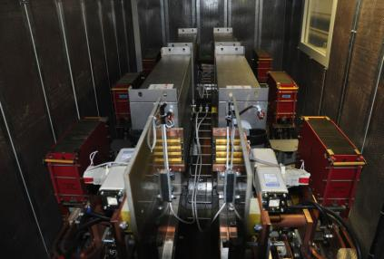
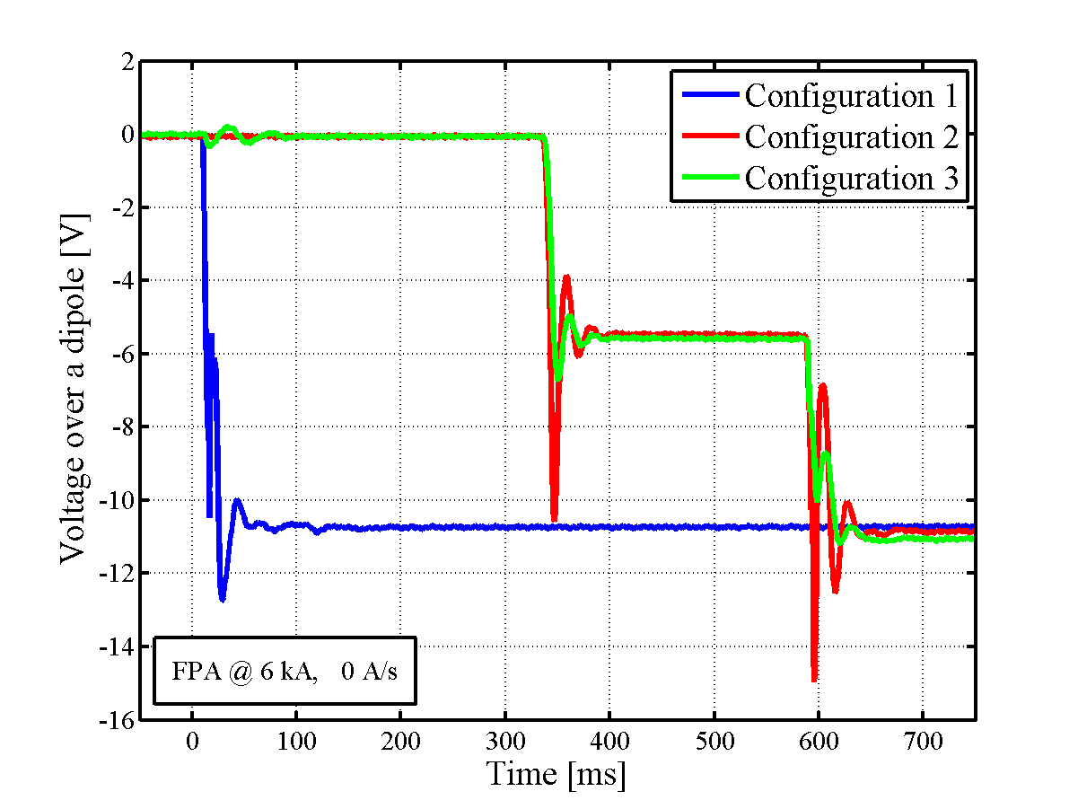
QPS consolidation work all over the year
Main improvements:
  Snubber capacitors installed in RB circuits during 2010/2011 Xmas break
  Delay between the power converter switching-off and the opening of the extraction switches
  Modification of the resistance in the filter at the output of the RB power converter
Configuration 1
Before March 2011
Configuration 2
Delay between the power-converter switching-off and the opening of the extraction switches
Configuration 3
Delay between the power-converter switching-off and the opening of the extraction switches
Snubber capacitor in parallel to the extraction switches
Additional resistance in the filter at the output of the power-converter

Slide 9
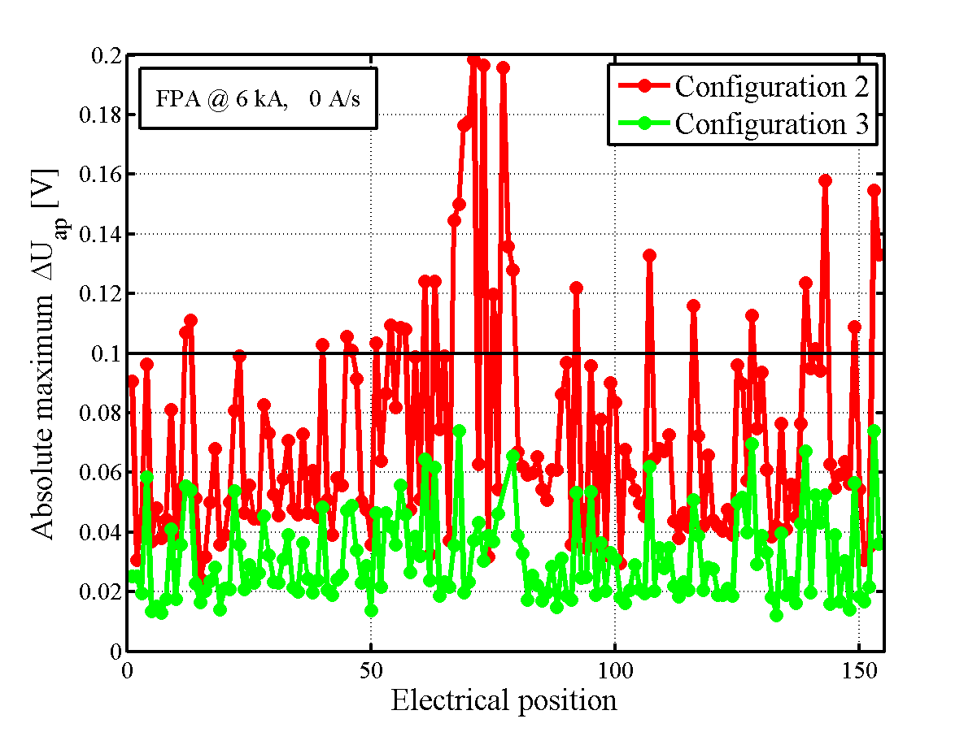
Results of the consolidation efforts
Simulations have demonstrated that the amplitudes of the voltage oscillations seen by the quench detectors were reduced well below the threshold limits
Configuration 2
Delay between the power-converter switching-off and the opening of the extraction switches
Configuration 3
Delay between the power-converter switching-off and the opening of the extraction switches
Snubber capacitor in parallel to the extraction switches
Additional resistance in the filter at the output of the power-converter

Slide 10
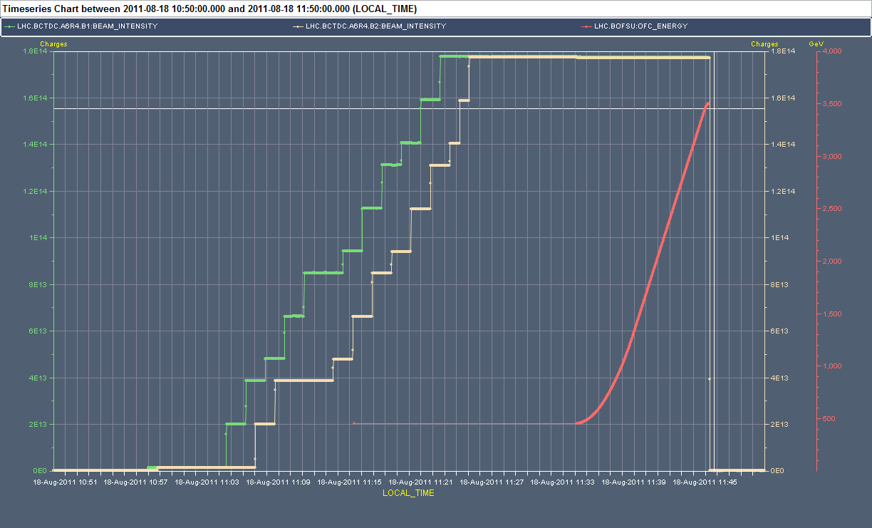
…ultimate test of QPS vulnerability to transient effects
QPS vulnerability to transient effect was unintentionally tested during total power cut on 18 August 2011, close to the most critical moment: maximum current and still ramping
No single magnet quench observed !!!
If such event occurred in 2010, massive QPS trips would became apparent around the ring

Slide 11
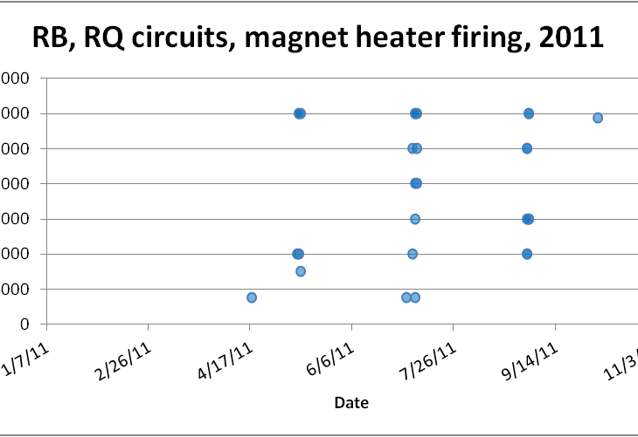
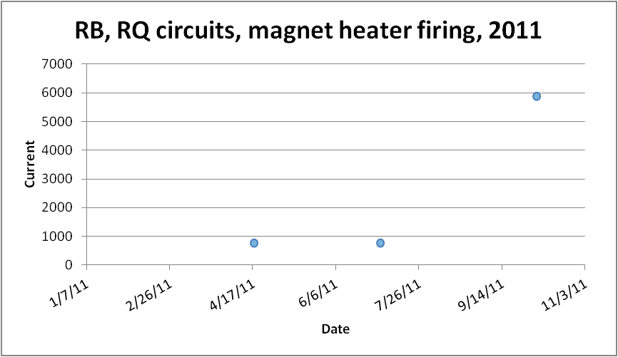
RB, RQD/F: quench statistics during 2011
Intentional and unintentional quenches in 2011
Most quenches during the quench propagation tests
Unintentional quenches only
(1)
A. Siemko, Chamonix 2012, Session 4
Only one unintentional quench in 2011 at top energy
(11)
(3)

Slide 12
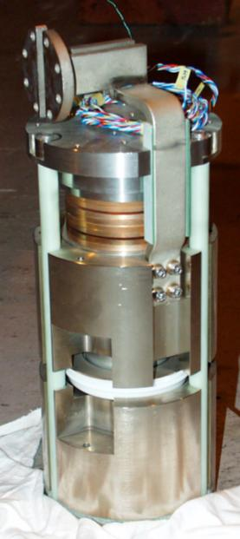
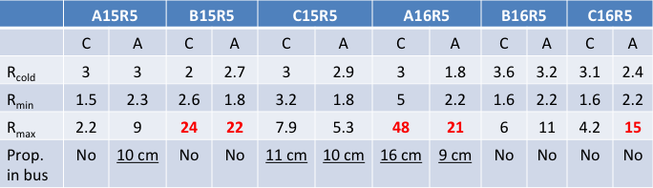
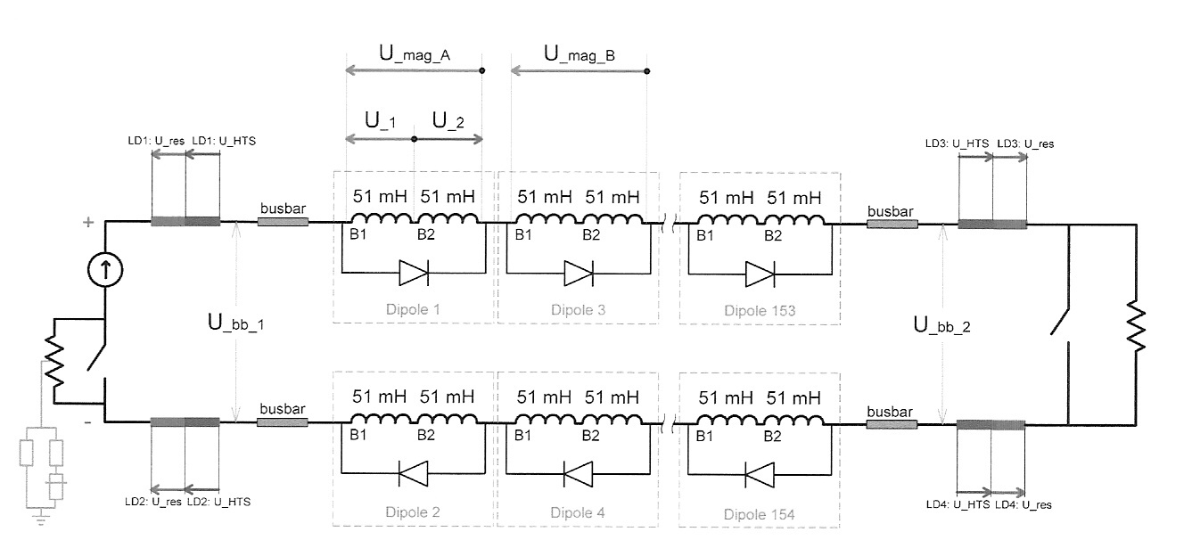
Quench propagation tests in 2011
Positive quench propagation test results, but…
Abnormally high resistances observed in the diode circuits that may be an issue, in particular if located in the “half-moon” joints
C=Cathode, A=Anode, Resistances in μΩ
R_{c,moon}
Lower diode busbar
Upper
heat sink
R_{c,hs}
R_{c,diode}
Lower
heat sink
A. Verweij, CMAC, 22 Aug 2011

Slide 13
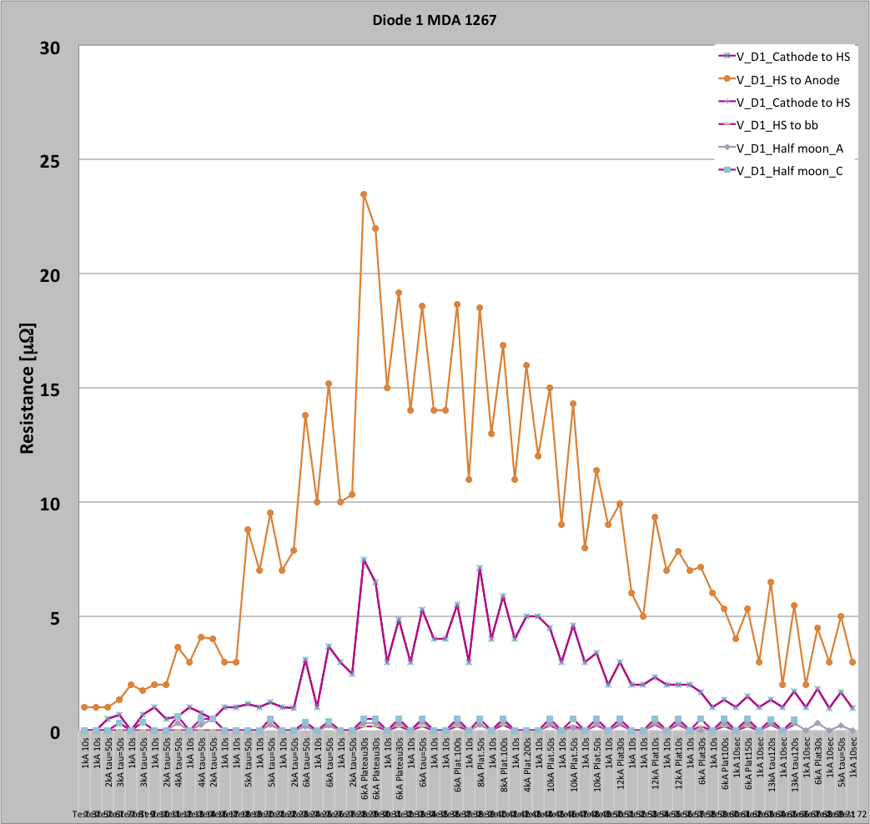
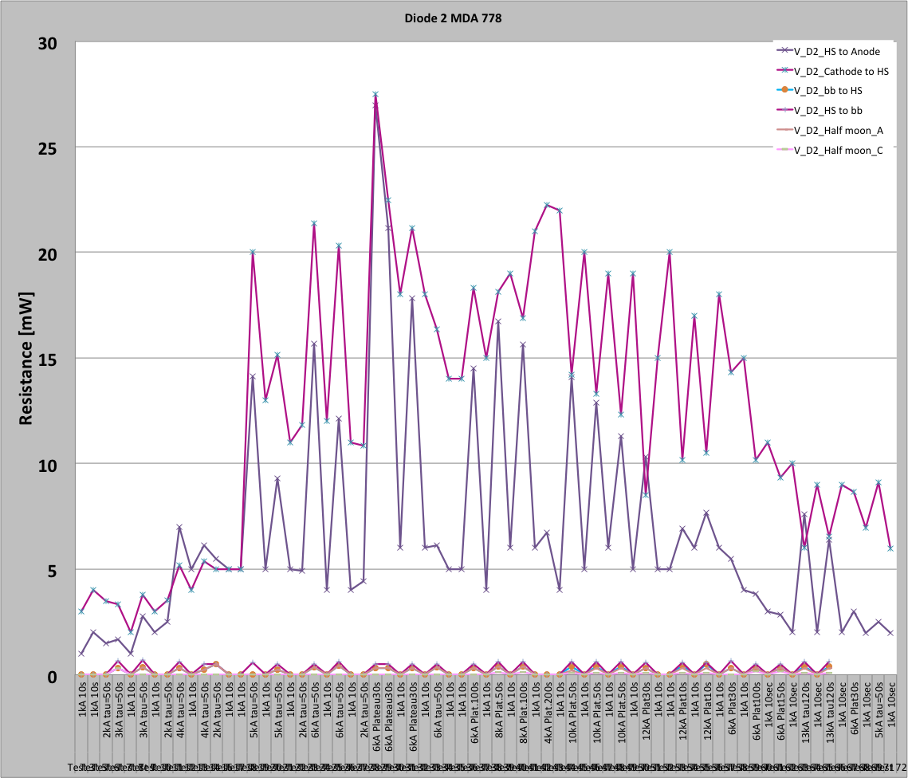
Resistance of diode contacts – SM18 tests
SM18 test setup allows for measuring resistances of all contacts in diode assembly
Preliminary results are encouraging:
  behaviour observed in the tunnel was basically reproduced
  excess resistance appearing at intermediate currents was localized in contacts between diodes and heat sinks, which are much less critical then half-moon contacts (heat absorbed by heat sink)
  Resistances of bolted contacts were stable

Slide 14
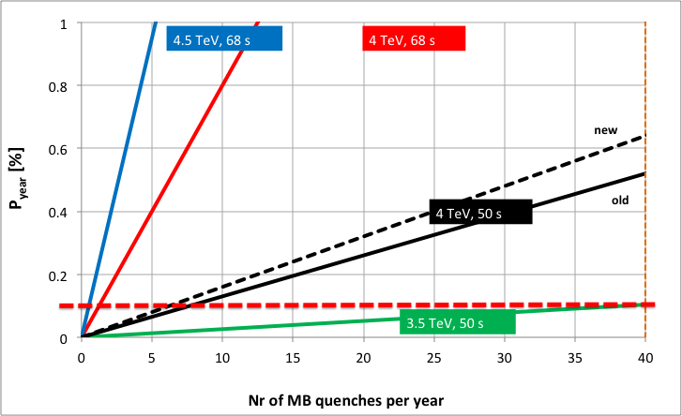
Update on burn out probability calculations
Additional resistance in by-pass diode stacks (discovered durind 2011 run) needs to be taken into account
1 quench/week

Slide 15
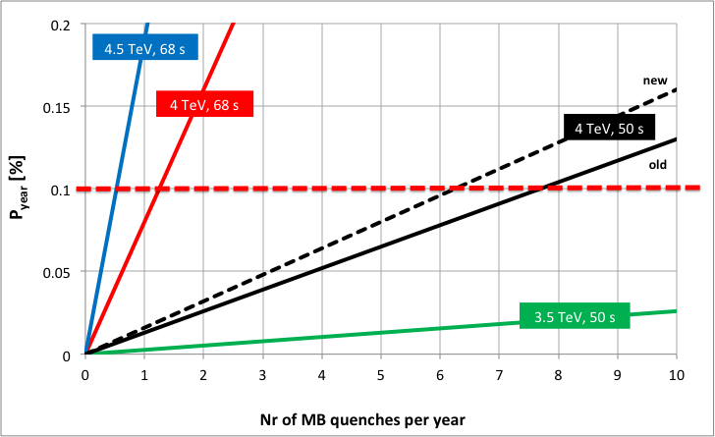
What is the envisaged maximum beam energy?
1 quench/month
If during 2012 the number of high current quenches stays below 5-6 then we have the same probability of burn-out as during 3.5 TeV run in 2011 with 40 quench limit

Slide 16
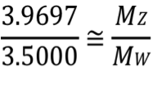
Maximum beam energy for 2012
Probability of burn-out of the defective 13 kA joints at 4 TeV can now be maintained at the same level as for the 3.5 TeV run in 2011
Main risk at 3.5 TeV and main risk at 4 TeV are the same: down-time of 8-12 months
No show-stoppers from equipment point of view to operate LHC at beam energy of up to 4.00 TeV
3.9697 TeV might be an interesting option from a precise measurement and precise data analysis point of view (arXiv:submit/0309492 [hep-ph] 31 Aug 2011)

Slide 17
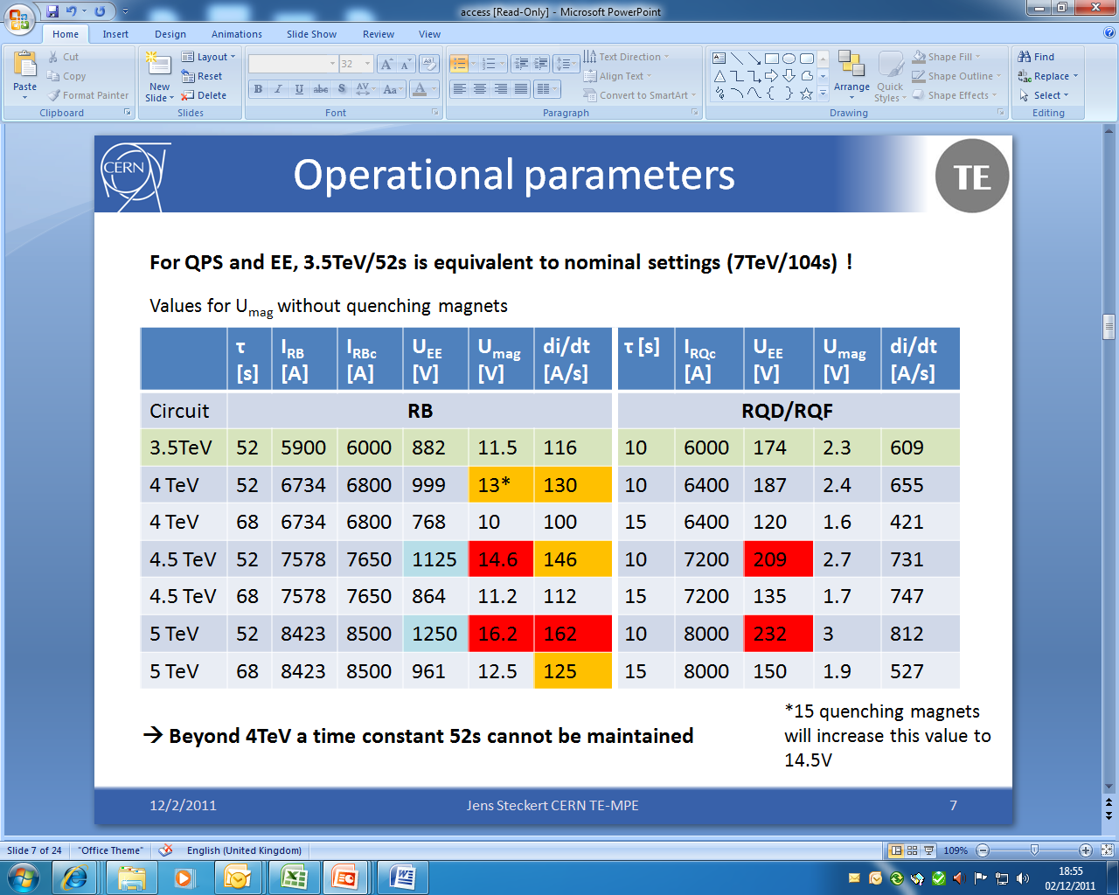
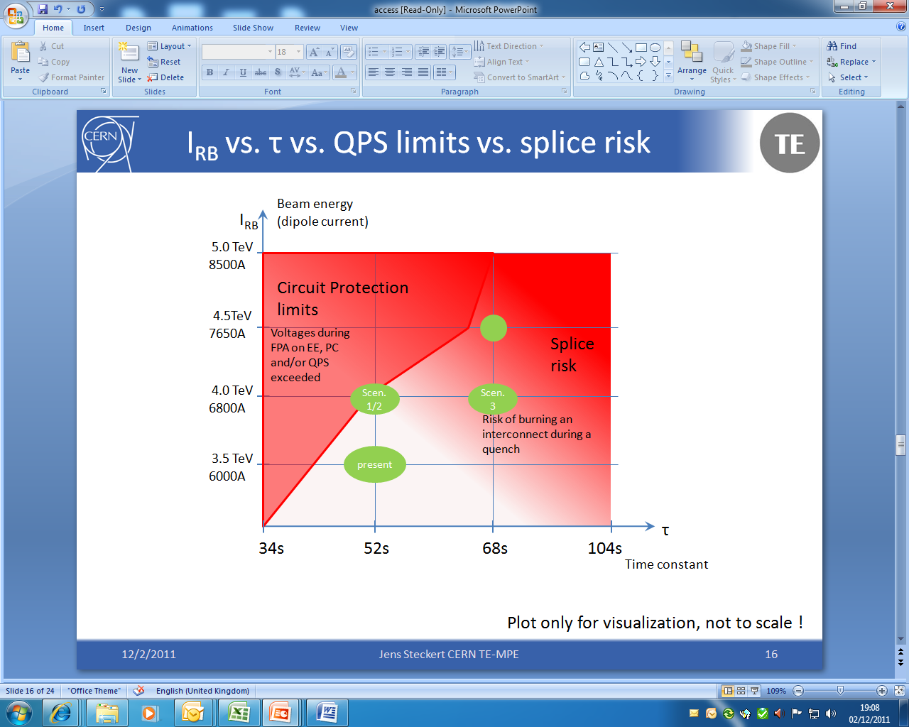
Existing hardware constraints
At present QPS configuration the energy extraction and quench detection systems are limiting beam energy at 4.00 TeV
No other hardware constraints up to 4 TeV
**
OK
τ (time constant)
Ref: J. Steckert, Chamonix 2011
Beyond 4 TeV the energy extraction time constants for both, RB and RQ circuits must be reconfigured → major operation

Slide 18
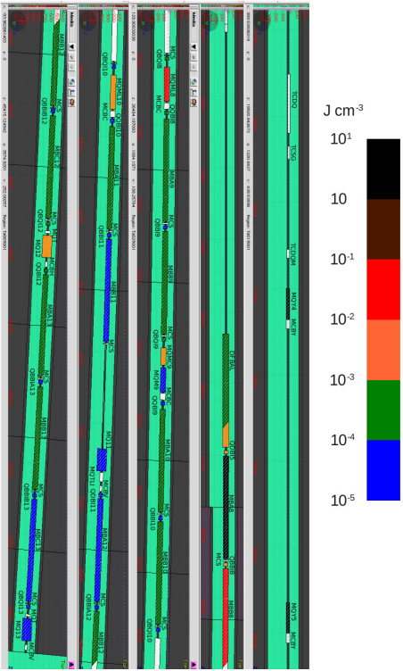
…and worries
Case of an asynchronous beam dump:
  Multiple quenches of the magnets in the matching section and at the beginning of the DS can be expected
  Energy, of the order of 1 Joule per cm³, would be deposited in MQY.4R6, MQY.5R6, and MB.A8R6
  Some tenths of Joules per cm³ would be released in MB.B8R6 and MQML.8R6
…fortunately the busbar joints in sectors 56 and 67 are relatively good
@4.5 TeV
Sector | Measured at 1A at: | Max R_excess (uΩ at warm) | Approximate Emax (5 magnet quenches)
12 | At warm | 39±9 | 4.5TeV
23 | At cold | 80±40 | -
34 | At warm | 36±8 | 4.8TeV
45 | At warm | 53±15 | 3.6TeV
56 | At warm | 20±7 | 5.8TeV
67 | At warm | 31±9 | 4.8TeV
78 | At cold | 90±30 | -
81 | At cold | 120±40 | -
R. Versaci, et al.
CERN-ATS-Note-2011-081 TECH.

Slide 19
Conclusion
Main arguments against 4TeV during Chamonix 2011 were:
  Number of spurious quenches observed over 2010, in particular several events involving large number of dipoles
  Very small margin for nQPS (symmetric quench detectors) at 4TeV with τ = 52s. In case of simultaneous quench of 15 dipoles the nQPS symmetric quench detectors are saturating and are blind
In 2011 the number of spurious quenches was radically reduced. This was achieved mainly thanks to the snubber capacitors installation and improvements introduced to the power converters and energy extraction delays
In 2011 no quenches observed during hardware commissioning and only 1 high current, single magnet spurious quench with beams
  Better operational procedures with beams > 100 MJ
  Efficient BLM protection
No show-stoppers from equipment point of view to operate LHC in 2012 at maximum beam energy of up to 4.00 TeV

Slide 20
Annex slides

Slide 21
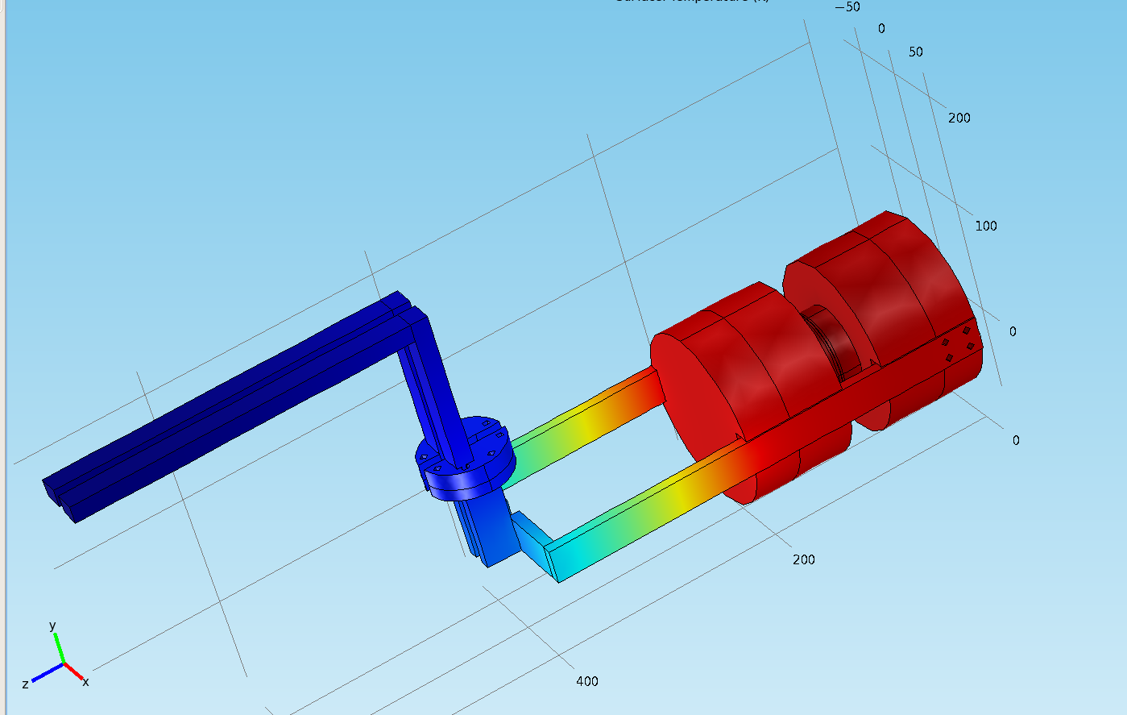
Simulations – MB diode
Simulations are performed using the codes Comsol and QP3, giving very similar results.
Comsol output for the final temperature after a 6 kA quench
with zero contact resistances
(adiabatic conditions)
7/02/2012
95 K
50 K
A. Siemko, Chamonix 2012, Session 4
60 K
21
A. Verweij, TE-MPE, 26 Aug 2011

Slide 22
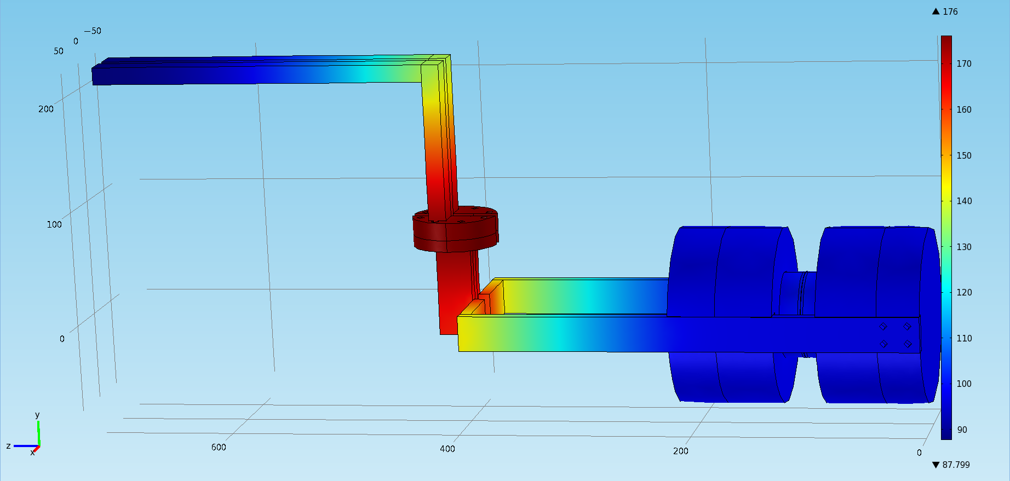
Simulations – MB diode
Comsol output for the final temperature after a 6 kA quench with R_{c,moon}=40 μΩ
(adiabatic conditions)
7/02/2012
90 K
180 K
95 K
A. Siemko, Chamonix 2012, Session 4
22
A. Verweij, TE-MPE, 26 Aug 2011

Slide 23
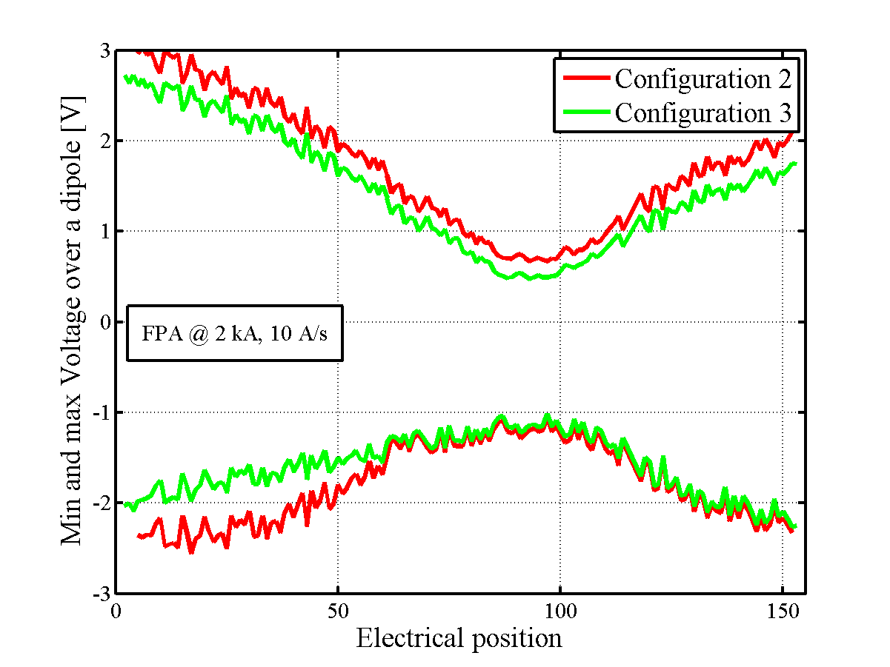
Maximum and Minimum values of the Voltage across each dipole
Fast Power Abort at 2 kA, 10 A/s
Configuration 2
Delay between the power-converter switching-off and the opening of the extraction switches
Configuration 3
Delay between the power-converter switching-off and the opening of the extraction switches
Snubber capacitor in parallel to the extraction switches
Additional resistance in the filter at the output of the power-converter

Slide 24
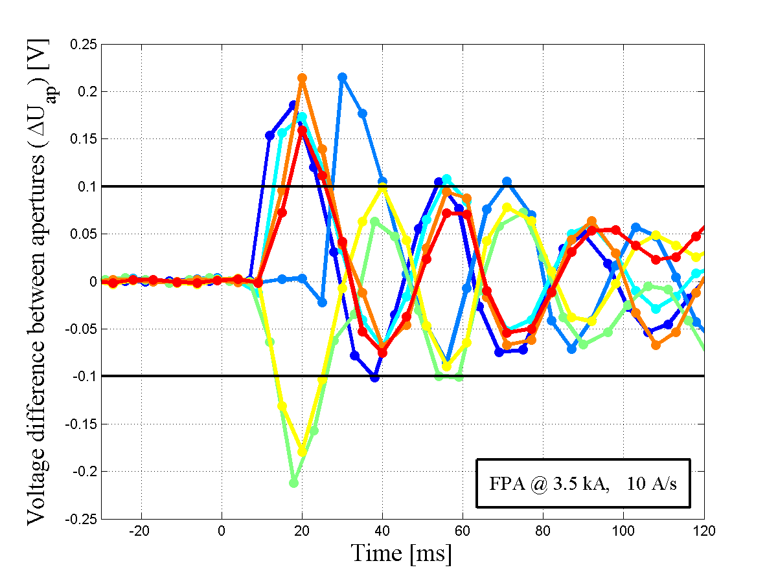
Event on 17th February 2010, Sector 34
Voltage difference between the two apertures of a dipole
Fast Power Abort at 3.5 kA, 10 A/s
The Quench Protection System triggered and fired the quench heaters of 11 dipoles.
Cause: The voltage oscillations caused by the switching-off of the power converter and by the opening of the extraction switches travel along the dipole chain, and cause a different voltage drop across the two apertures of the magnets.

Slide 25
Propagation test : diode => interconnect

