Slide 1
ATLAS
2008 Report and 2009/2010 Plans reprocessing simulation production planning
WLCG Workshop in Prague
March 21-22
Kors Bos
CERN & NIKHEF
Slides from LHCC review
and ADC internal review
and some more …

Slide 2
2008 cosmics data re-processing

Slide 3
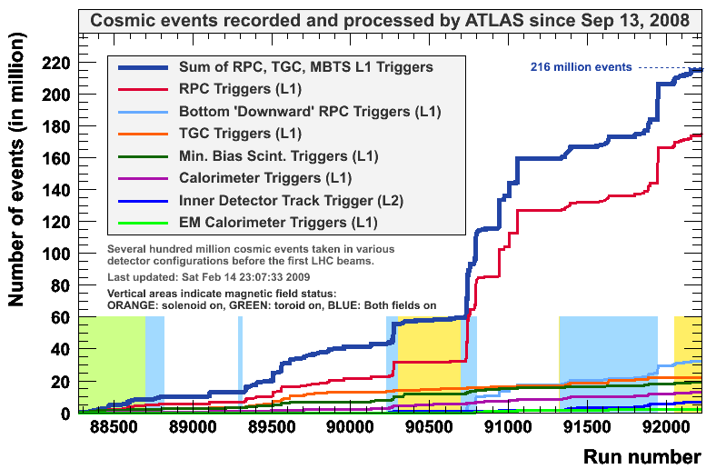
Cosmics data
284 million events
513 TB input data: 127 runs, 11 streams, 771 datasets, 330 559 files
117 TB output data: 8321 containers, 2 164 416 files

Slide 4
(Re-) Processing
Data:
  Cosmics data taken in August-November
  Few runs of single-beam events the week of Sept 10th
All RAW data were processed at Tier-0 → ESD, AOD, DPD, TAG
Distributed according to the Computing Model
  But extra RAW copy was kept on disk also in T1’s
Good data selected (about 35%)
Software validated on Dec. 22
Sites validated
  Taipei and Germany failed
Good data re-processed
  Mainly (90%) using the disk copy
  Using conditions data files i.s.o. database
  Many Tier-1’s were working on a best efford basis

Slide 5
Input data distribution
Data from Taipei and Karlsruhe were re-distributed
Later also a fraction of the SARA data and PIC data

Slide 6
Job efficiency
Tier-1: | CERN | CA | ES | FR | IT | ND | NL | UK | US | Sum
Total jobs | 26348 | 20707 | 364 | 48288 | 13619 | 12561 | 23472 | 54360 | 128764 | 329609
Done jobs | 26015 | 20150 | 364 | 46937 | 13018 | 12281 | 23167 | 51344 | 124667 | 317943
Fraction [%] | 94.7 | 97.3 | 100 | 97.2 | 95.6 | 97.8 | 98.7 | 94.5 | 96.8 | 96.5
Aborted jobs | 1459 | 557 | 0 | 1351 | 601 | 280 | 305 | 3016 | 4097 | 11666
Fraction [%] | 5.3 | 2.7 | 0 | 2.8 | 4.4 | 2.2 | 1.3 | 5.5 | 3.2 | 3.5
CERN | CA | ES | FR | IT | ND | NL | UK | US
1.16 | 1.02 | 1.18 | 1.11 | 1.83 | 1.14 | 2.85 | 2.31 | 1.39
Re-tries
Re-assigned jobs:
ES 15932
NL 6033
IT, CA, UK 6409

Slide 7
Second try: tomorrow
Patches to the software
  Increased the memory footprint with 100 MB ☹
  Not essentially different (better calibration)
Run from tape now
  Bulk pre-staging tested except in Lyon
Karlsruhe in now, but Taipei’s share done @CERN
Input data
  370MB DB file - same for every job
  16MB DB file - 138 different files, 1 per run
  2GB RAW data - all different
Pcache used in some places: RAL, NIKHEF
Some Tier-2’s participating
Now we will all be watching

Slide 8
Memory
Many jobs failed because of memory usage (re-tries)
With newer release situation got worse
  Even more jobs failed in site validation
  Needed to switch off some functionality (monitoring)
  This is not acceptable for the real data
Memory usage not quite understood
  Only for short period in initialization and first event
  Less later on
Will run at RAL with 3 GB virtual memory limit
  Carefully watch CPU/Wall time for swapping
  Expect little effect
If so we may ask other sites to do the same

Slide 9
Future plans
We may try again during the summer
Needs much more automation
  Not move data around by hand
Better monitoring
  Shifters should be involved and report errors
Taipei must participate & Lyon must pre-stage automatically
Physically remove input data copy from disk
Output ESD data must be archived on tape
Reduce #retries, reduce job failures, process 100% of all events
Test together with writing (FT/HITS/ESD) data to tape
Hopefully other experiments will be using tapes as well

Slide 10
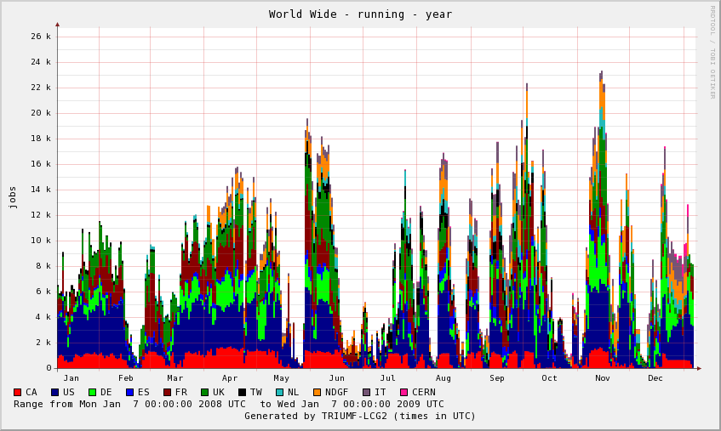
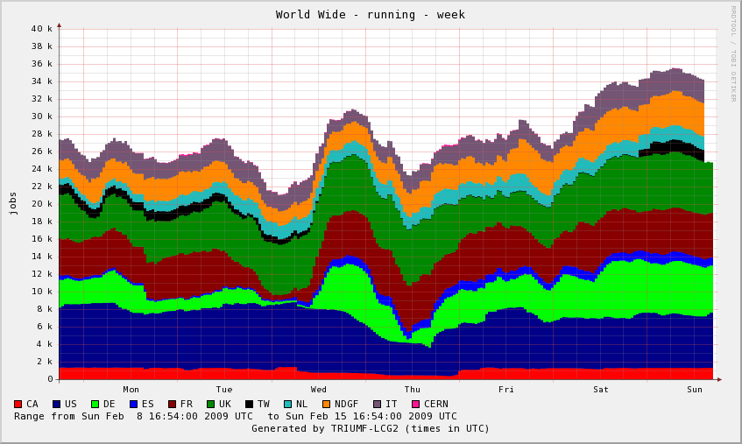
Simulation Production
Simulation production in 2008 used most of the available CPU capacity
  But not all the time
Production will continue, using now Geant4.9
  The Geant4 step now takes ~1000 kSI2k-s/event
Fast simulation samples are produced in addition, for large statistics studies
  Atlfast-II takes on average ~100 kSI2k-s/event
All 2008
20k —
Last week
30k —

Slide 11
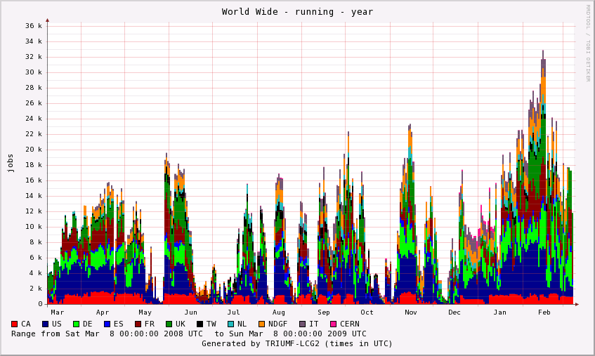
Experience in 2008 (1)
Running
Jobs
Main structures due to release schedule, validation latency, modest requests for simulation
Fine structure due to short job and error latencies, and of course problems
Start
Panda-NDGF
integration
Panda
task
brokering
Reprocessing
FDR2 production

Slide 12
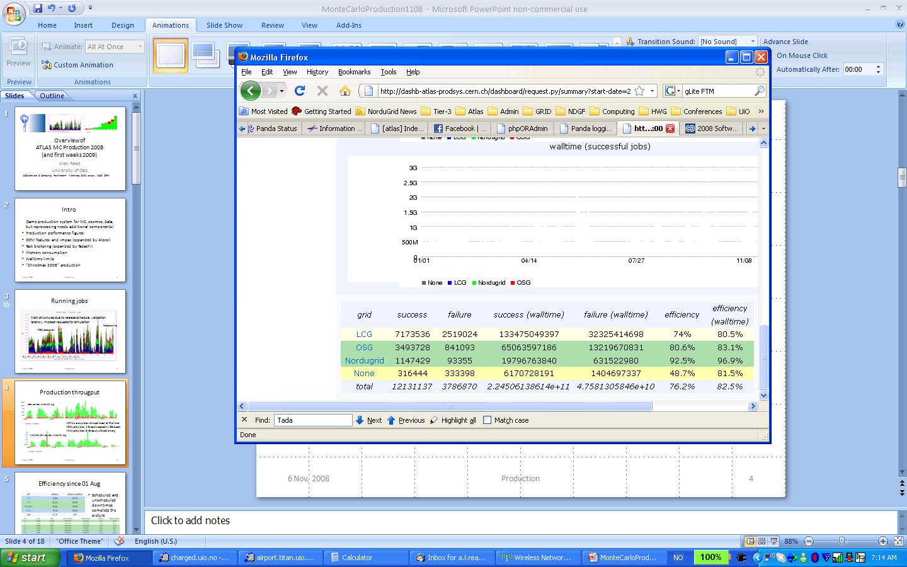
Experience in 2008 (2)
Jan-Dec 2008
CPU’s are under-utilized on average
  Capacity ~60k jobs/day, 14-20k CPU’s (25-30k peak)
  Utilized: 33k jobs/day, 6.9k CPU’s (successful jobs)
  Nearly 20% of walltime used for failed jobs
25% of jobs and 20% of walltime are used for failed jobs (mixture of grid and athena)

Slide 13
Experience in 2008 (3)
Successes
  Saturation of CPU resources (for long simulation jobs only)
  Production system can produce 100 TB/week of MC
  Efficiencies over 90% (for short periods of time)
  Task brokering by software introduced Q3/Q4 2008
  Complaints from physics groups about tasks with lack of progress dramatically reduced
Issues
  Insufficient space for the MC results Production System is capable of producing
  More or less always at least one Tier-1 unavailable
    Only a few weeks a year with all 10 Tier-1’s + clouds working well
  Huge rate of elog and GGUS tickets, hard for anybody to follow the many issues (related to previous point)

Slide 14
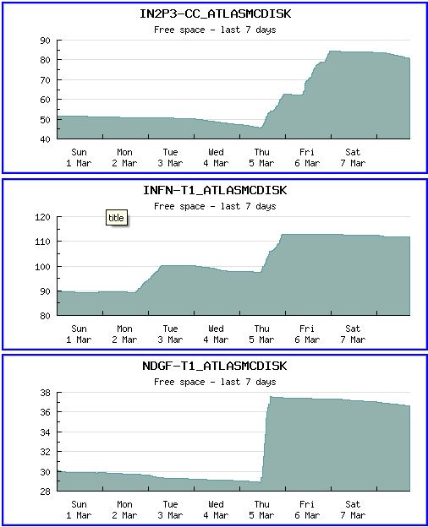
Space for MC production
We are now deleting old MC results to make room for new ones

Slide 15
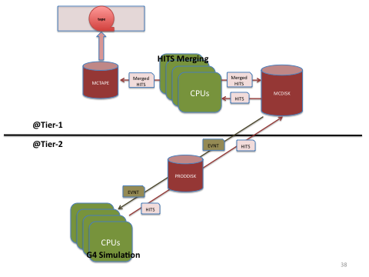
HITS production
G4 simulation takes ~1000 sec/evt
digi+reco takes ~20-40 sec/evt
EVNT = 0.02 MB/event
HITS = 2.0 MB/event
RDO = 2.0 MB/event
ESD = 1.0 MB/event
AOD = 0.2 MB/event
TAG = 0.01 MB/event

Slide 16
HITS merging
Geant4 job in T2: 50 events/job → takes 14 hrs
Output HITS file: 50 * 2MB = 100 MB uploaded from T2 to T1
Merge in T1: 20 HITS files → 1 JumboHITS file of 1000 events (2 GB)
JumboHITS file written to MCTAPE
Small HITS files deleted from disk
No HITS left on MCDISK
That is a big difference as that is about 50% of all data on that disk
This now works
Digi + Reco can be ran from tape and produces the same output
needs same pre-staging as for re-processing
Also logfiles are merged and written to tape

Slide 17
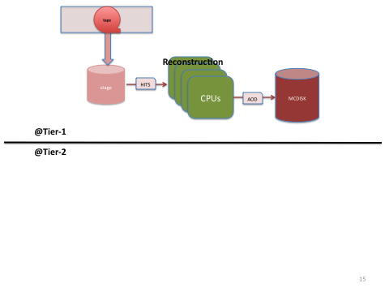
digi+reco from tape
JumboHITS file with 1000 events staged from tape
Reconstruction takes 20 – 40 seconds/event
digi+reco job takes 6 – 12 hours/file
Output AOD file: 1000 * 0.2 MB = 200 MB still too small!

Slide 18
AOD merging
At production peak we replicated 1.5M AOD files/day
This is too much, no room left soon for other data transfers
Must merge 10 AOD files into JumboAOD files
JumboAOD file has 10,000 events and is 2 GB
This would bring the number of file replications down
We could even go to 20:1
But we need to see with analysis groups
(Almost) all components exist
But has not been done yet
Need to be tried a.s.a.p.

Slide 19
Future plans
MC09 will soon start (wait for final release, final geometry)
Using new Geant4 release
Produce samples for 10 TeV running
Produce samples for cosmic ray running
Improvements on
  More atomization (blacklisting, re-scheduling, brokering)
  Reduce latencies due to transfer time-outs
  Better matchmaking (not everywhere 2 days queues with 2+ GB)
  ..
Serve all clouds from Panda dbase on Oracle@CERN
Panda for NDGF using ControlTower

Slide 20
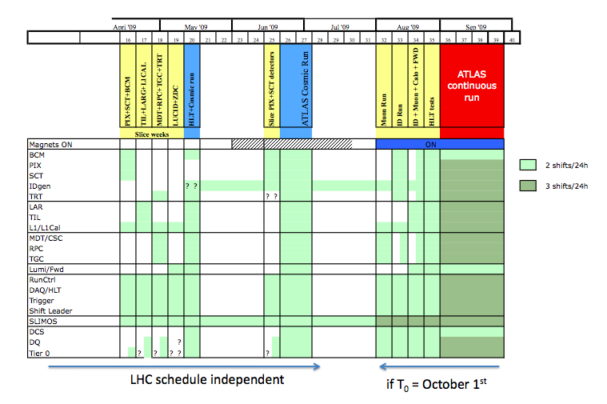
Detector Commissioning Schedule

Slide 21
Backup slides
I only show 20 slides now
But have more slides if appropriate for during the workshop

Slide 22
Stress-tests of distributed analysis (1)
HammerCloud (HC) is a Distributed Analysis stress testing system
  It’s a database with command-line and web front-ends used for scheduling, running, and reporting on Ganga-based DA stress tests.
  One specifies where, what, when, and how many jobs to run; HC runs the test and reports the results.
    At present it can run tests on EGEE/WMS and NDGF/ARC sites.
    Panda support needs work (in progress).
Presently we submit large numbers of input data intensive jobs.
  Focusing on finding site limitations, e.g. heavy loads on storage and network resources.
  But looking out for grid limitations, e.g. broker, WMS, client.
Specifically, HC runs an AOD muon analysis everywhere right now
  Each HC run processes an entire dataset (200 files)
Soon analyses of real cosmics datasets will be added (with database access)

Slide 23
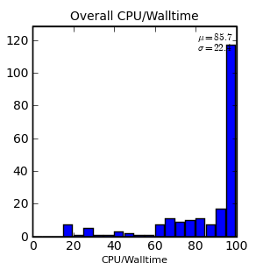
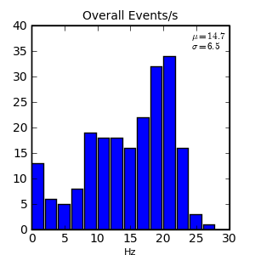
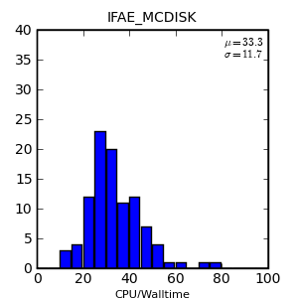
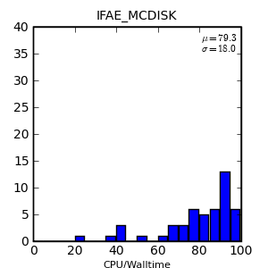
Stress-tests of distributed analysis (2)
The initial target for these tests was for sites to achieve >80% success efficiency and >15 Hz event rate
        Example of a good site:
In several cases we found out that
default access methods could be
changed or the local hardware
setup had limitations
        Example of improvements:
Every site has a different hardware setup
  Every site needs a separate investigation and optimisation
  Adding CPUs and disks is not enough if the internal network is not correspondingly upgraded at the same time
CPU eff.
Event rate
CPU eff.
POSIX I/O
CPU eff.
FileStager

Slide 24
Evolution of the computing model (1)
The computing model is fundamentally unchanged since the Computing TDR (2005)
Some model parameters have been adjusted all along, based on our experience with real data (cosmics) and intensive simulation campaigns during the last few years, and to reflect reality:
  ESD and AOD sizes doubled to 1 MB and 0.2 MB/event to include more information needed to study detector performance
    We try to avoid to go back to RAW (from ESD) or ESD (from AOD) when not necessary
    Sizes will most probably decrease again as we gain experience with real data
  Full simulation processing times increased from 100 to 1000 kSI2k-s/ev to allow for a very detailed detector geometry and much better physics models in Geant4
    This level of detail is needed for some physics processes
    We have developed a complete suite of full, medium and fast simulations that we will use and mix according to the physics needs and the availability of CPU capacity
    Tuning the Geant4 parameters on real data will help us to optimise CPU usage
  For reconstruction, CPU time is in the correct ballpark (15 kSI2k-s/event) at low luminosity, but more work is needed for higher luminosities (>2x10³³ cm⁻²s⁻¹)
    Targeted effort for memory reduction is now starting to pay off (improvements in the forthcoming s/w release)

Slide 25
Evolution of the computing model (2)
The DPDs (Derived Physics Data), mentioned in the C-TDR, have been in the meantime defined and implemented in the same data formats as ESD and AOD:
  Commissioning DPDs are subsets (skims) of ESDs for particular detector studies
  Physics DPDs are subsets (skim/slim/thin) of AODs for physics studies
  DPDs are in principle distributed like AODs (a full set per Tier-1 and per Tier-2 cloud)
We’ll have to take operational decisions if the available disk is << than the pledge
  We may have to delete AOD/DPD datasets from (some) Tier-1s and leave them only in Tier-2s for user analysis
  Or recognise that not all Tier-1s (and their Tier-2 clouds) are equal and adjust AOD/DPD replicas accordingly
In the meantime, we have developed tools to collect statistics on dataset usage and we will use it to evaluate how many replicas are needed for different dataset families

Slide 26
What is DDM
Distributed Data Management System
  Baseline Service for Data Distribution and Consolidation, MonteCarlo production and Reprocessing, Data Analysis
  Provides functionalities for Data Organization (bookkeeping) and Data Transfers
    Data Organization based on Datasets
      Collection of Files
      Unit of data location and data replication, data deletion
    Data Transfers based on Subscriptions
      Placement policy, which DDM tries to enforce
DDM is a Distributed Service
  Central Catalogs, Accounting Service
    Hold dataset definitions, subscription requests, Dataset Locations
  Site Services, Deletion Service
    Triggering actions to enforce subscriptions
  Other WLCG services at sites
    FileTransferService for data movement (at T1s), StorageElements (at T1/T2s), File Catalogs (at T1s) hold information about single files placement
  Command Line Interfaces

Slide 27
Readiness status of DDM
Since Jan 2008, DDM is constantly under testing
  Weekly Functional Test (low transfer rate)
    Test both ATLAS specific and WLCG services at sites
Challenges
  Test particular aspects of DDM, mostly scalability and reliability under stress
  CCRCs (Feb and May 2008)
    Full Scale Test of the system at 150% of nominal data taking rate
      Includes T0-T1, T1-T1 and T1-T2 transfers
      Mostly a throughput test
  10M files test (Jan 2009)
    Test of the system moving large number of files
      1M files imported by each T1 in 10 days
Real Activity
  Detector Data Distribution
    Little beam events, lots of cosmics + reprocessing data
  MonteCarlo data Distribution and Consolidation

Slide 28
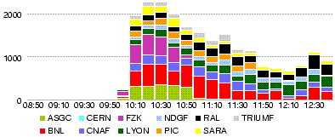
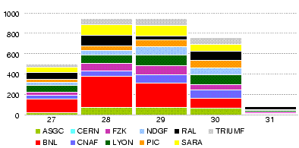
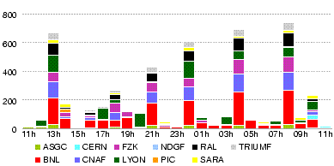
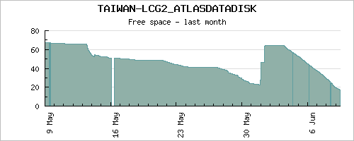
Experience in 2008: CCRC08
T0->T1s throughput
12h backlog recovered in 90 minutes
MB/s
Nominal Rate
MB/s
MB/s
T1->T2 transfers
1 PB data deleted in 1 day

Slide 29
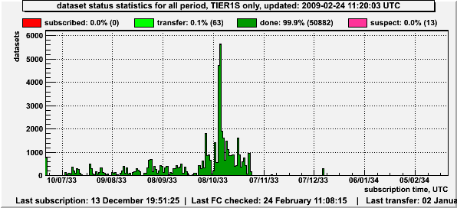
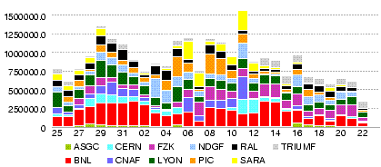
Experience in 2008: production data
15 days of problematic period in Detector Data Exports
    October 2009
  Consequence of (Agreed) change in T0 workflow
    To deal with data distribution long (1 day) runs
  DDM limitation dealing with > 5K concurrent subscriptions
Improvements in DDM
  Tested in 10M files test (Jan 2009)
  Further changes in T0 workflow
    Will be tested in a few weeks
Detector Data Distribution
10 M file test showed expected improvements in DDM scalability
  Can now handle > 10K simultaneous subscriptions
  100K files transfer per day per T1
Results are already obsolete
  MC production and Data Consolidation moved > 30M files in 30 days.
This is NOT A POSITIVE ASPECT: ATLAS data are fragmented in too many files of small size.
MC production and
Data Consolidation

Slide 30
Experience in 2008: new functionalities
DDM offers an accounting system
  Currently per site, will be extended to groups per site
DDM offers a central deletion service
  Big step forward, 1 year ago dataset deletion needed intervention from the sites
  Partial Synchronization of various components
    DDM, ProdDB, AMI
DDM offers a Consistency service
  On demand verification of consistency information between catalogs
SS now also handle data staging from Tape
  Partially tested during reprocessing preparation
We have a subscription interface to validate and handle user requests.
  Placement of ATLAS data into production areas
We now have an Integration Testbed
  Includes all services (also monitoring)
    Very important for validation of new SW releases, packaging, etc ..
  Offers more clear workflow for service deployment

Slide 31
Experience in 2008: Users and Groups
Clients for user dataset upload/download exist
  Include support for logging data access patterns
    Dataset popularity per site/user etc …
    very important to improve data placement and for the system modeling
  Should be used as common library by every system
    Production system and Analysis frameworks: work in progress, good cooperation
But still … DDM offers very little support for group and user analysis
  DQ2 clients need to be more resilient against failures
  Minimal infrastructure for User Dataset replication
  Deletion of user datasets is very problematic
    Needs central operation intervention
This is due (IMHO) to
  Difficulty to understand user requirements
    We need to give more thinking to it, was not the primary use case so far
    Need to collect and focus more on User Community requirements
      Reference person from User Community?
      Logging of access patterns is a good starting point.
  Absence of User Support
    Many times DDM operations and DDM development must take care of it

Slide 32
Experience in 2008: other issues
Staging from Tape is part of DDM
  The baseline service is there but is the most untested part of the system
    Both at the level of DDM but also Storage Services at T1s
Situation of the CERN site
  Internal data replication works at 100MB/s but we have too much fragmentation of CASTOR disk pools
    Not transparent to users
    This is being followed up with CASTOR team at CERN
      Promising setup for the beginning of April, better support for analysis activities
  ATLAS Should appoint a CONTACT person at CERN
    We have for all T1s and several T2s
    This is a almost full time job
      CERN is a very peculiar Grid/NonGrid site
Data Management operations still suffer from service unavailability at sites
  Need to handle this in a more automatic way
    ATLAS Grid Information System

Slide 33
Work plan for 2009/10 and beyond
Short Term Plans (next 4 months)
  Developement
    Integration with ATLAS Information System (including possible extensions)
    Full Support for Groups (accounting, quotas, placement requests)
    Full support for Datasets deletion (might be more mid term plan)
    Hardening of Staging Services
    Several minor (but important) improvements at various DDM services.
    TRAINING!!!
  Operations
    Improved Documentation for Users and Groups.
    Aim for 100% dataset completion at final destinations
      Includes more monitoring about problematic subscriptions and files
    Final setup of Storage infrastructure
      Mostly has to do with Users and Groups
    Heroic effort in dark and inconsistent data cleanup
    Large scale test (including new T0 dataflow)
      And more focus to staging tests.

Slide 34
Work plan for 2009/10 and beyond
Medium Term Plan (2009/10): preserve the current functionality “streamlining” the system.
  Automate operation model
    Based on first months experience
  Re-implementation of subscription catalogue
    Merge of Location/Subscription/Deletion catalogues
    Will provide a state machine for subscription requests
  Implementation of automatic data placement policies
    Possibly based on dataset importance and popularity
  Revisit deployment model (could go to Long Term)
    Fully distributed file catalogues? Centralized file catalogues?

