Slide 1
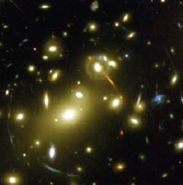
Neutrino Mass Measurements
Particle Physics Cosmology
What is the neutrino mass scale?
Hamish Robertson, ESPP12, Kracow, Sept. 11, 2012

Slide 2
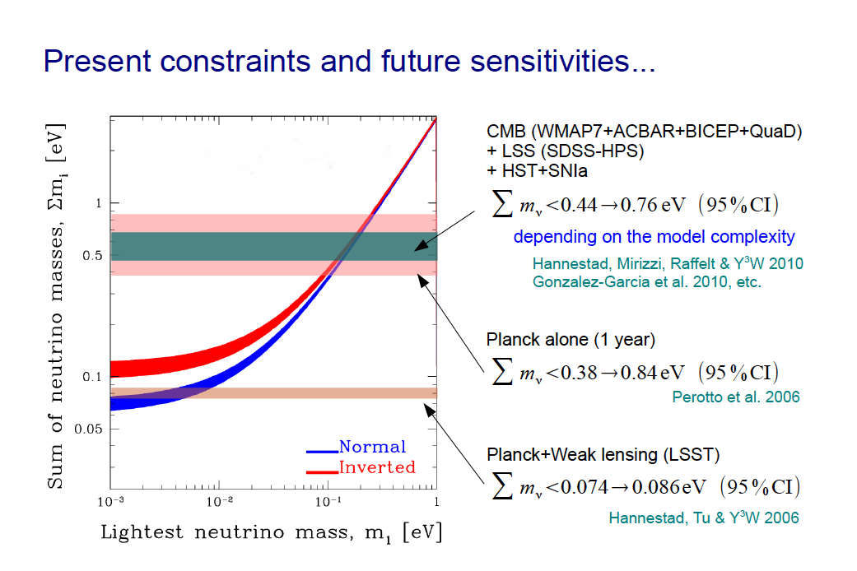
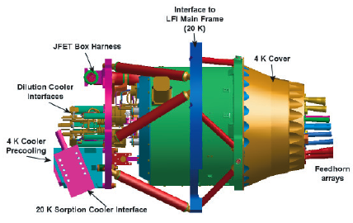
Y.Y.Y. Wong

Slide 3
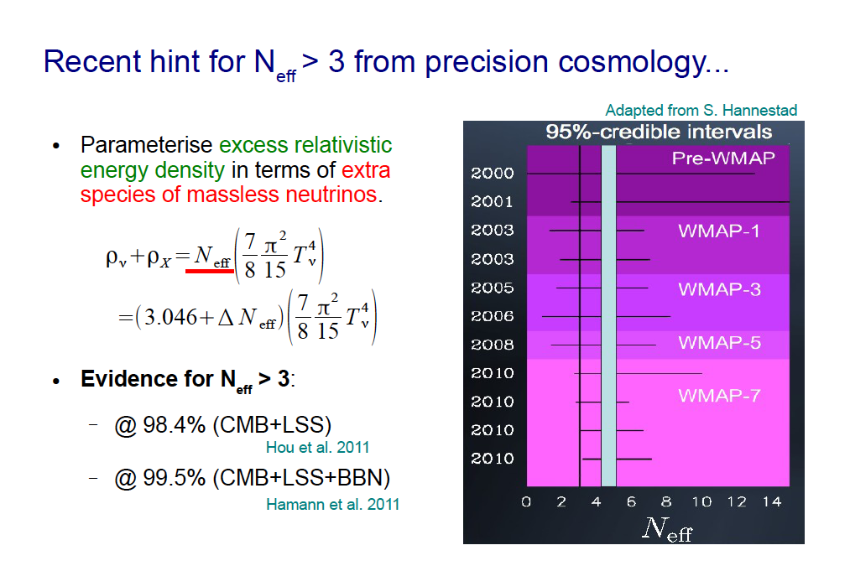
Y.Y.Y. Wong

Slide 4
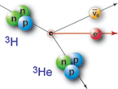

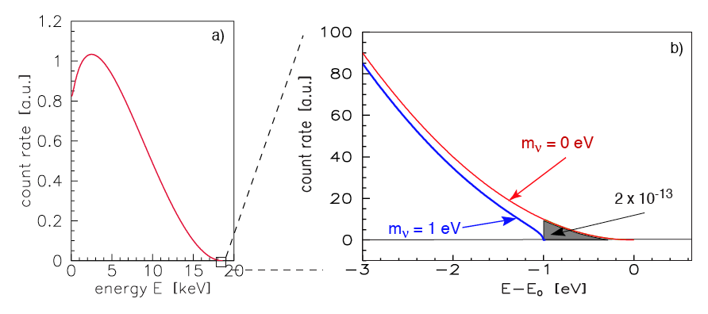
Neutrino mass from Beta Spectra
With flavor mixing:
mixing
neutrino masses
from oscillations
mass scale

Slide 5
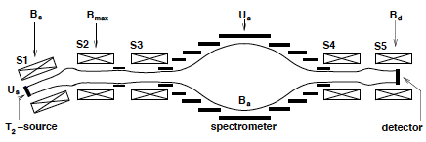


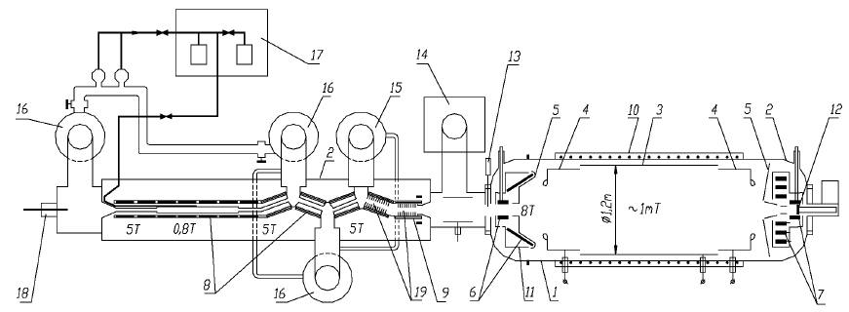
Current status of direct mass measurement
Mainz: solid T₂, MAC-E filter
C. Kraus et al., Eur. Phys. J. C40, 447 (2005)
Troitsk: gaseousT₂, MAC-E filter
V. Aseev et al., PRD in press (2011)
Together:…
m_{v} < 1.8 eV (95% CL)

Slide 6
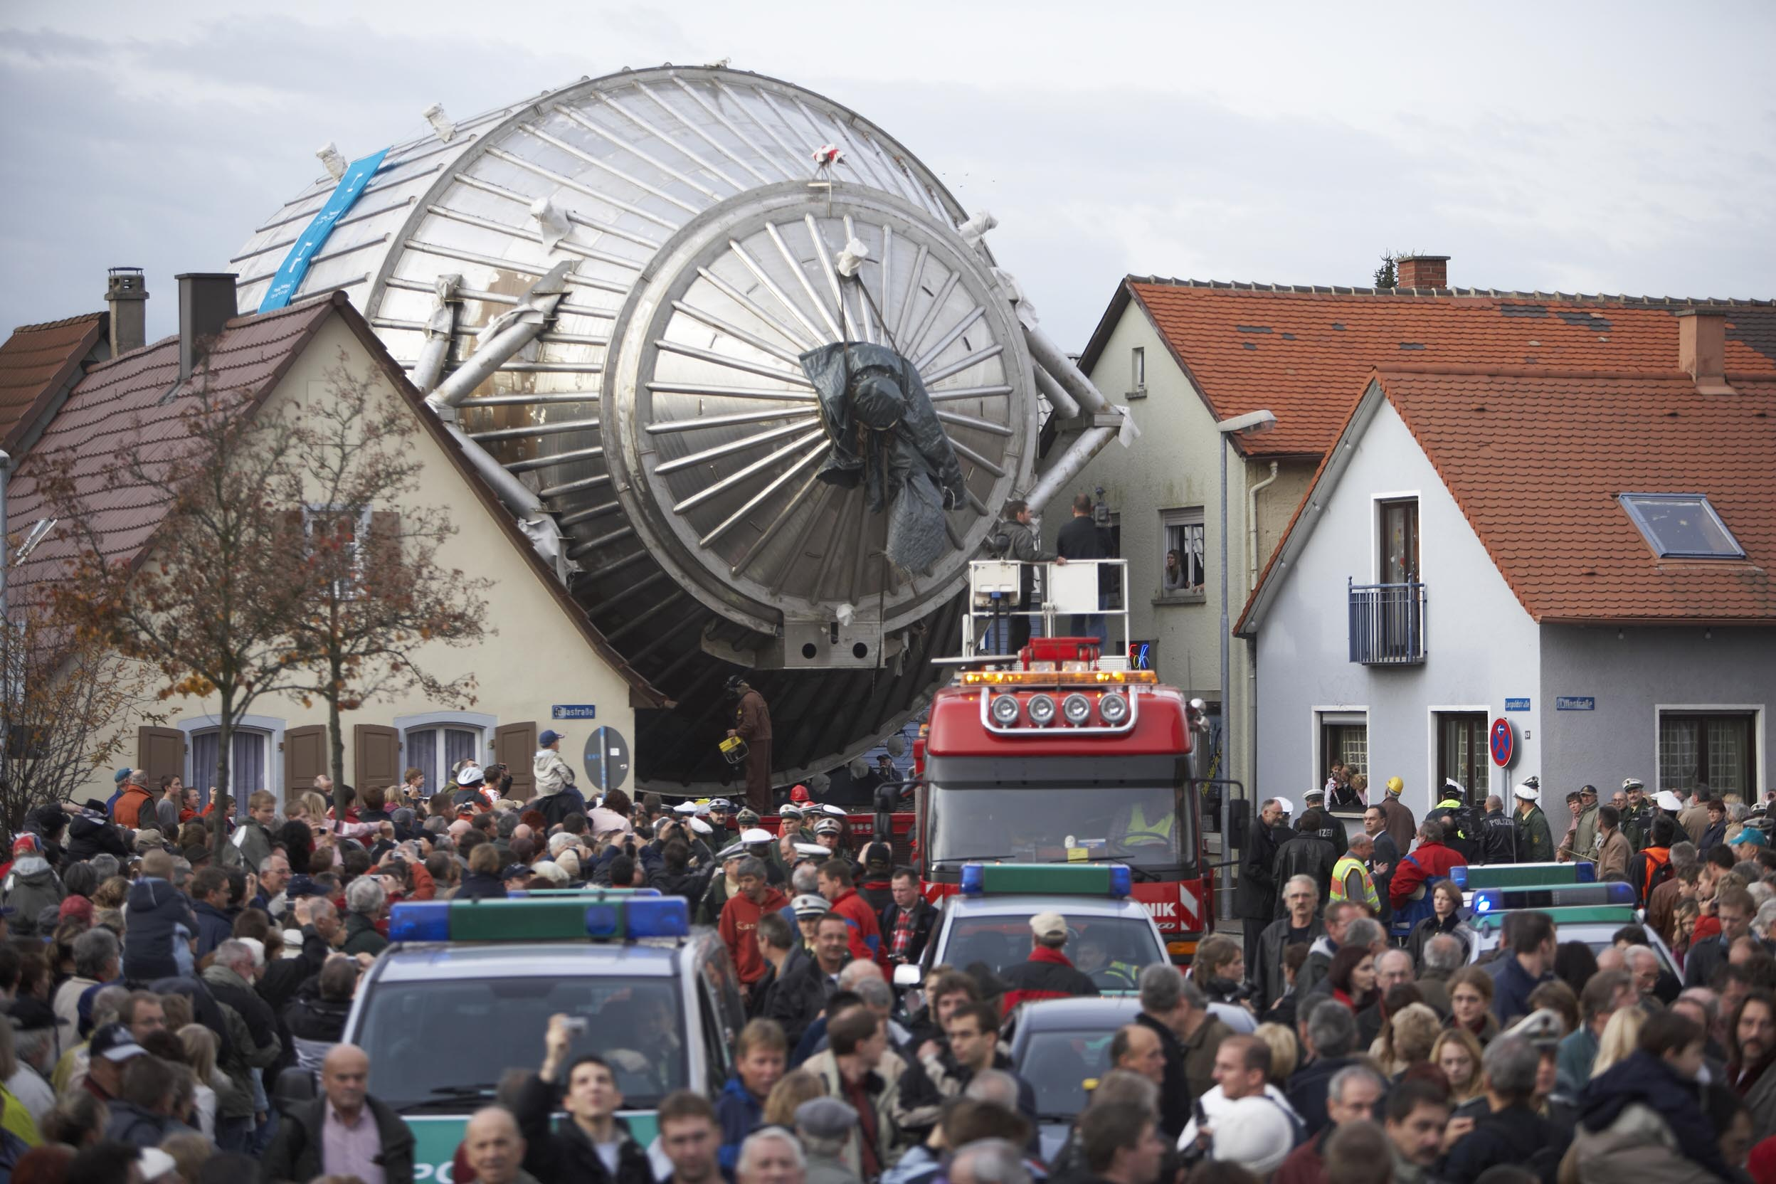
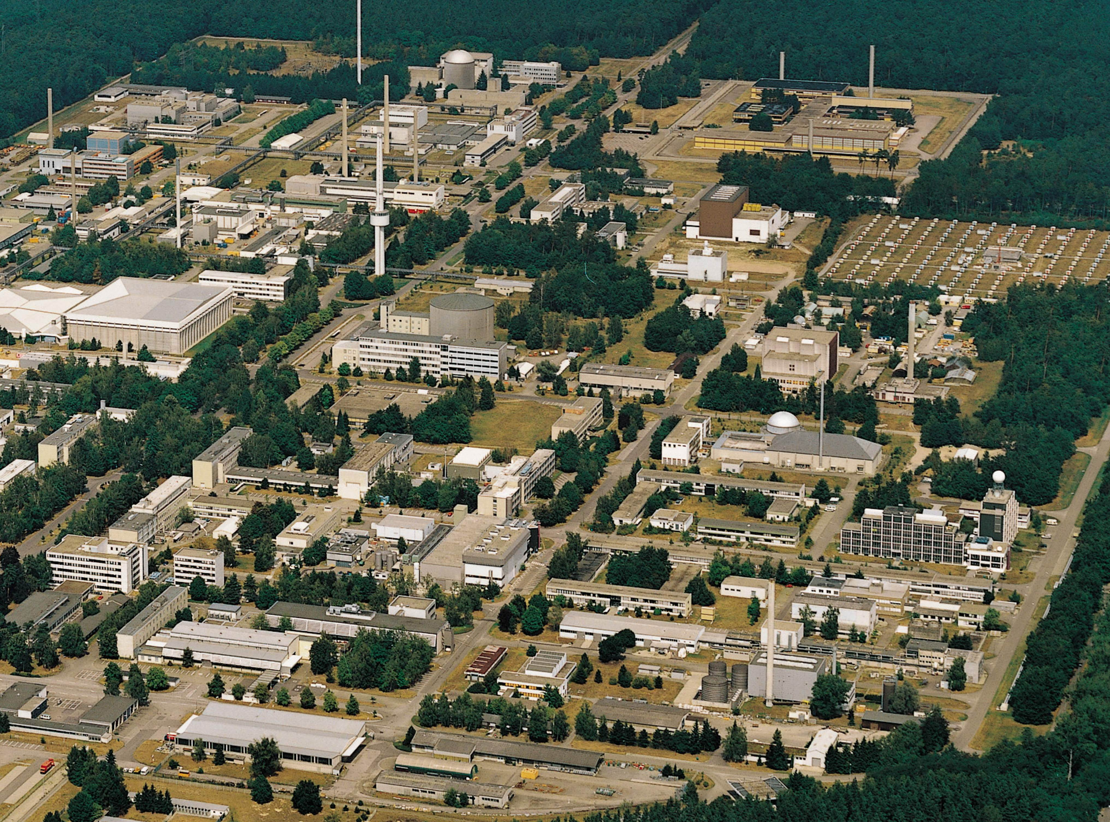

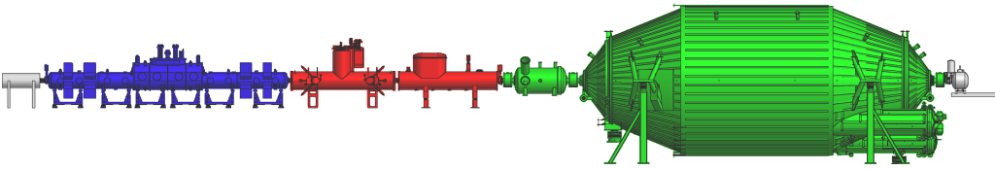
KATRIN
At Karlsruhe Institute of Technology
unique facility for closed T₂ cycle:
Tritium Laboratory Karlsruhe
TLK
Size of experiment now:
Diameter 10 m.
Next diameter: 300 m!
~ 75 m long with 40 s.c. solenoids

Slide 7
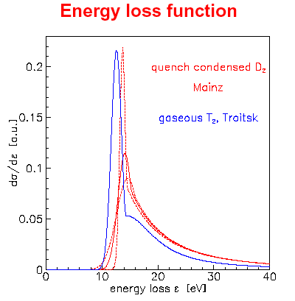
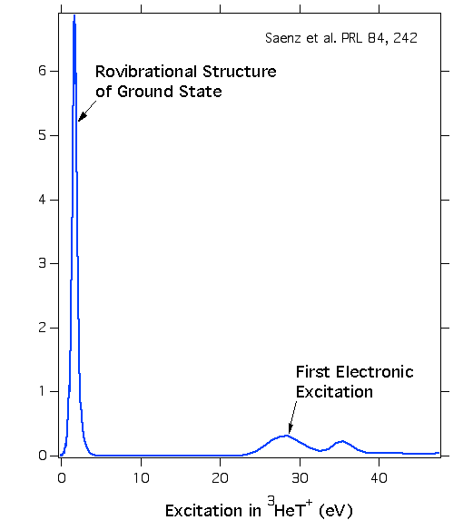
A window to work in
Molecular Excitations

Slide 8
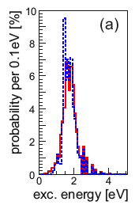
A window to work in
Molecular Excitations
σ = 0.36 eV
Rovibrational states of THe⁺, HHe⁺ molecule

Slide 9
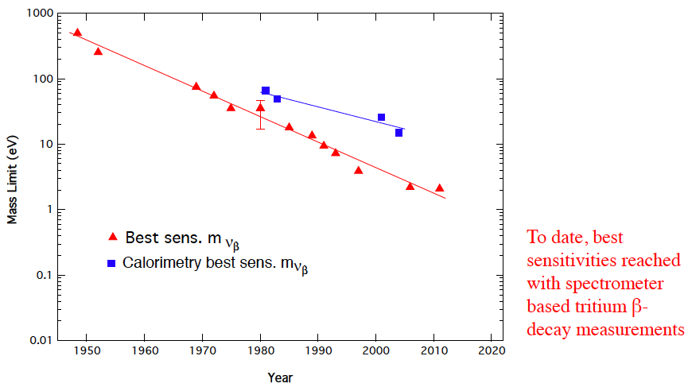
Neutrino Mass Limits from β decay
¹⁸⁷Re (Genoa, Milano)
³H
KATRIN
Inv. Hierarchy <m_{e}>
Oscillation lower bound <m>
J.F. Wilkerson & HR

Slide 10

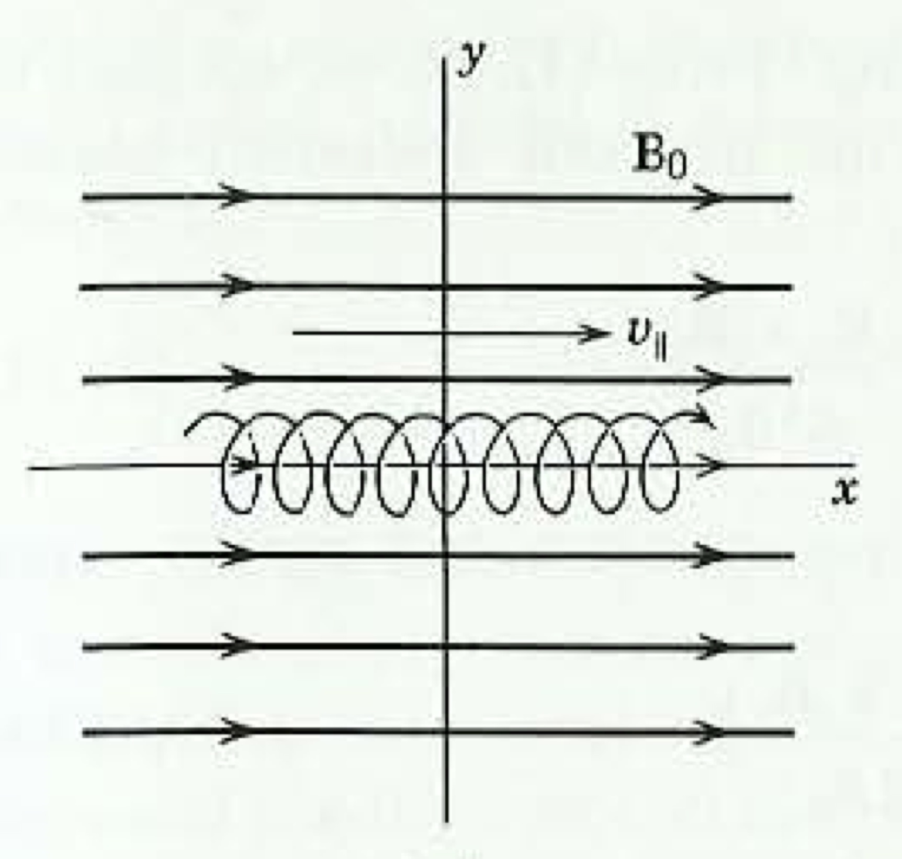
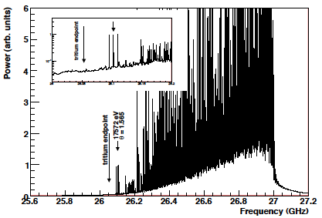
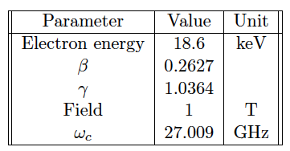
Cyclotron radiation from tritium beta decay
(B. Monreal and J. Formaggio, PRD 80:051301, 2009)
Radiated power ~ 1 fW

Slide 11
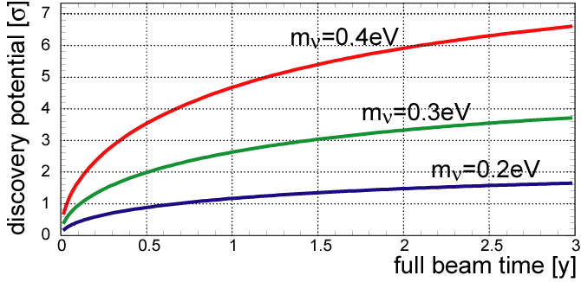
Neutrino mass: some milestones
Construction
Running
KATRIN:
Project 8:
Proof concept
Prototype
Phase I
Planck:
Analysis 1
Analysis 2
2012
2013
2014
2015
2016
2017
2018

