Slide 1
Beam-Beam Effects during Beam Dump Process
Tobias Baer
March, 21st 2013
Beam-Beam Workshop 2013
Thanks to: S. Fartoukh, W. Herr, M. Hostettler, T. Pieloni, J. Wenninger

Slide 2
Content
1. Observations and Introduction
2. End-of-Fill Tests
4. Extrapolation and Outlook
3. Status of Simulations

Slide 3
Content
1. Observations and Introduction
2. End-of-Fill Tests
4. Extrapolation and Outlook
3. Status of Simulations

Slide 4
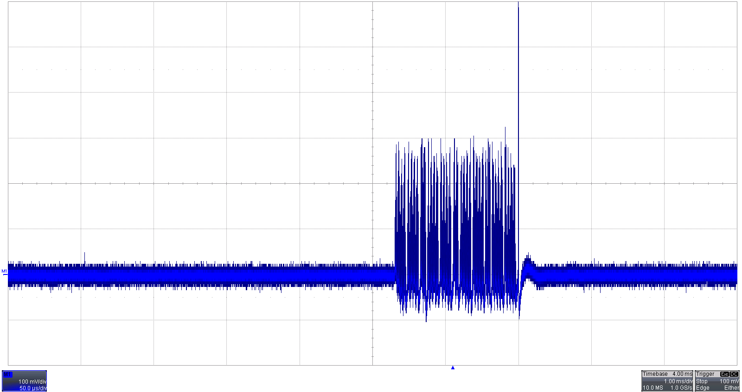
Beam Dump on 8.7.2012
Beam dump trigger by B2 LL-RF (cryo problem). Unusual single-turn losses on B1 in before beam dump.
100mV
1 turn
Dump B1
1 turn
300mV · 1380b ≈ 0.6 Gy/s at BLMEI.06L7.B1E10_TCHSH.6L7.B1 RS1
50µs
08.08.2012 20:46
Signal from B1 diamond BLM in IR7.

Slide 5
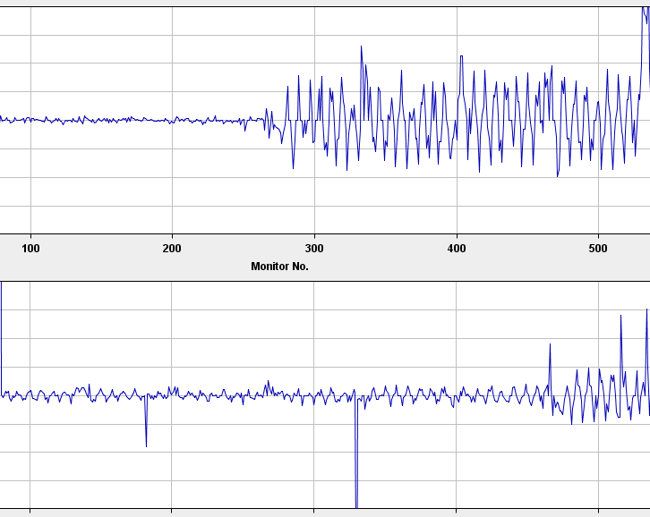
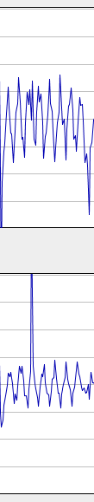
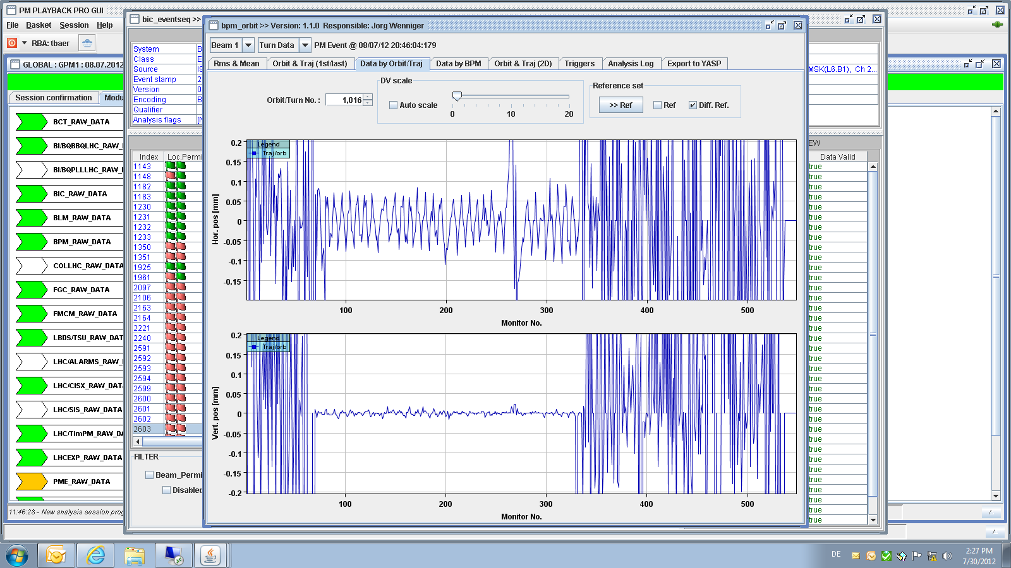
Event Sequence
Dump trigger for B2 first.
Perturbation of B1 trajectory downstream of IR5 due to missing (horizontal) long-range beam-beam deflections in IP5.
CMS
IR5
Dump
IR4
IR6
IR3
IR7
Coll.
IR2
IR8
ALICE
IR1
LHCb
200µm
ATLAS
B1 H
Measurement is a convolution of all bunches!
IR5
IR8
IR1
IR2
IR5
200µm
B1 V

Slide 6
Content
1. Observations and Introduction
2. End-of-Fill Tests
4. Extrapolation and Outlook
3. Status of Simulations

Slide 7
End-of-Fill Tests
Test 1 on 13.12.2012 08:26:54 (fill 3425):
At end of 25ns MD
72 bunches colliding in IP1/5 + 12 non-colliding bunches
25ns spacing
Crossing angle: -65µrad vertical (IP1), +65µrad horizontal (IP5)
≈1.0·10¹¹ protons per bunch
Normalized emittance ≈3.15µm·rad (from luminosity)
Test 2 on 02.10.2012 12:44:33 (fill 3121):
At end of 50ns physics fill
1230 bunches with 50ns spacing
Crossing angle: -145µrad v (IP1), +145µrad h(IP5), (+IP2/8)
≈1.1·10¹¹ protons per bunch

Slide 8
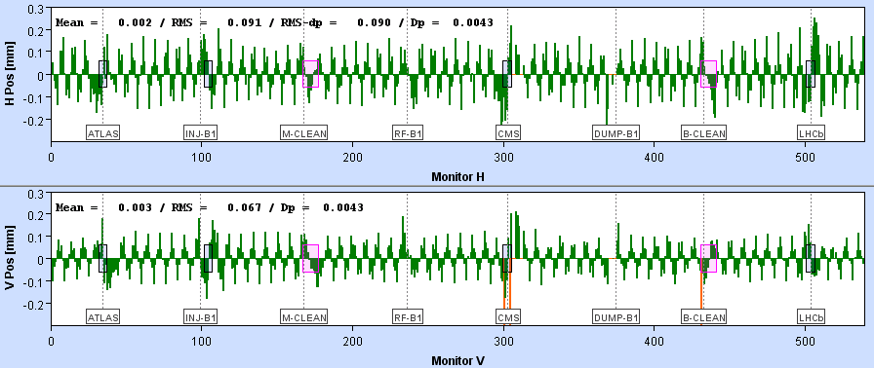
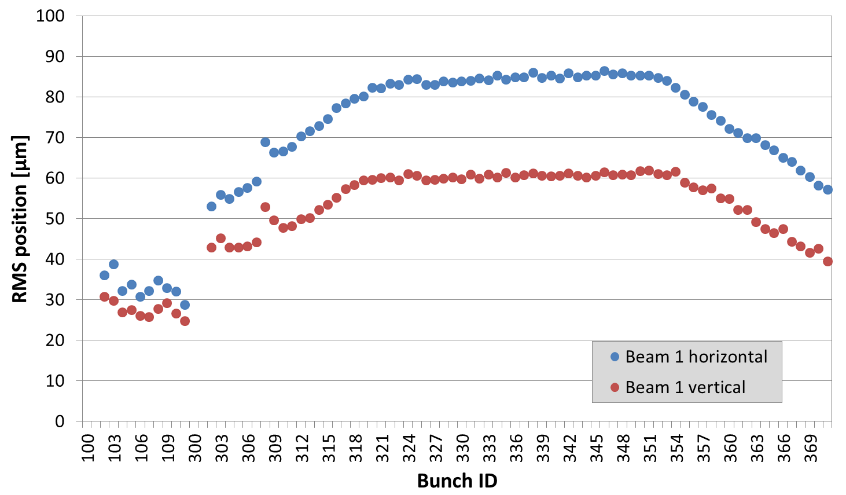
Closed-Orbit Effect
Closed orbit difference (B1) for bunches with full long range interactions.
Bunch-by-bunch RMS position difference from arc BPMs.
For bunches with full long range interactions:
≈85µm in horizontal plane. ≈60µm in vertical plane.
non-colliding bunches

Slide 9
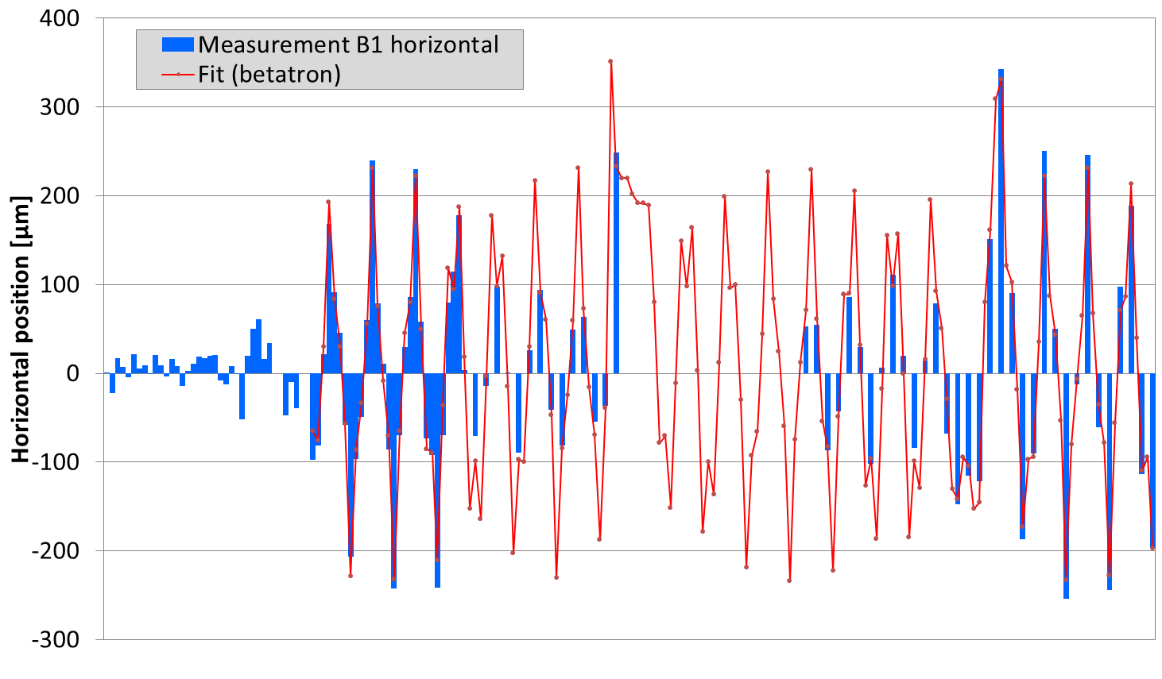
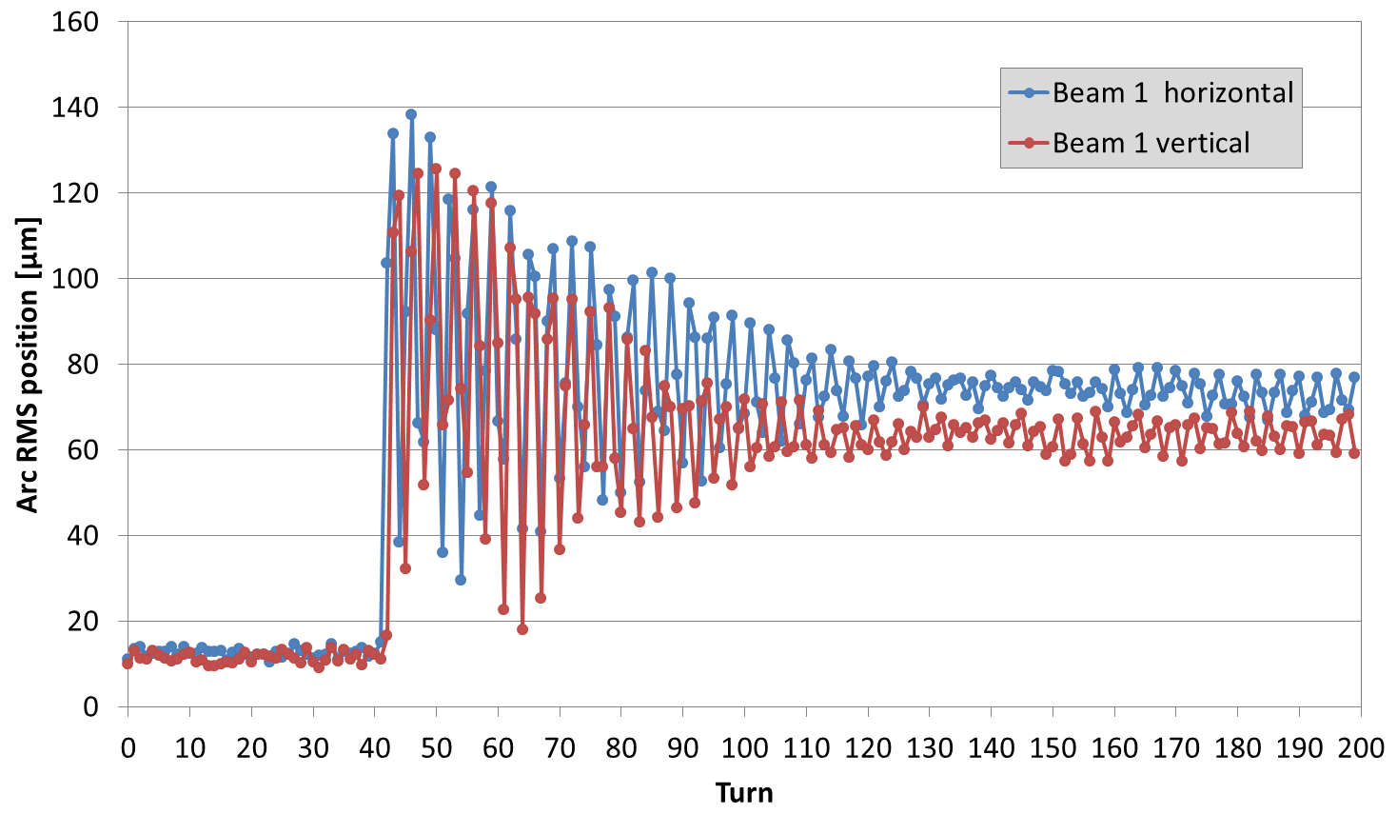
Turn-by-turn
Horizontal perturbation in first turn for bunches with full long range interactions.
Perturbation in the arc of ≈230µm = 0.6σ_{nom}
at TCP.C6L7.B1: -130µm = -0.4σ_{nom}
Oscillation is damped in ≈100 turns.
Amplitude smaller in vertical plane.
IP5
TCP.C
Dump B2
Arc BPMs between IR5 and IR8 only.

Slide 10
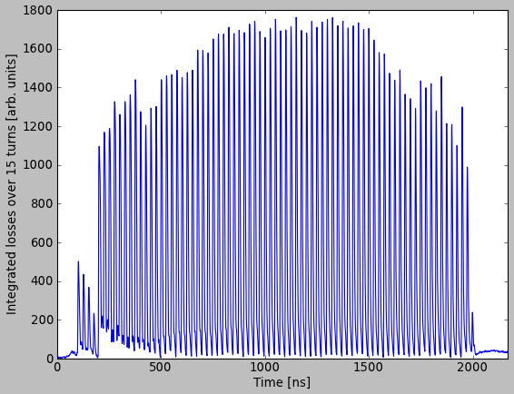
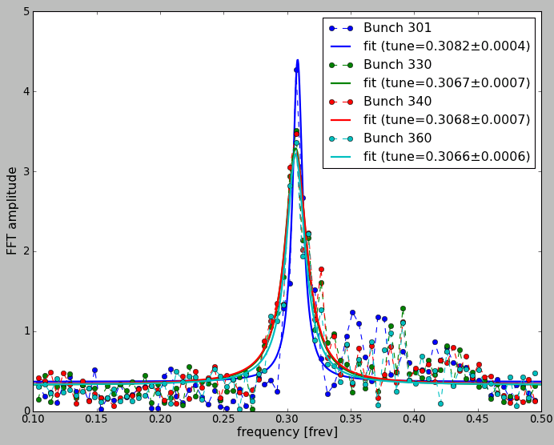
Beam Losses
Bunch-by-bunch beam losses from Diamond BLM in IR7 with PACMAN structure.
Bunch-by-bunch tune estimate from losses indicates that horizontal losses are dominant (BBQ H/V: .307/.320).
Frequency resolution is limited by acquisition buffer length. May be significantly improved during LS1.

Slide 11
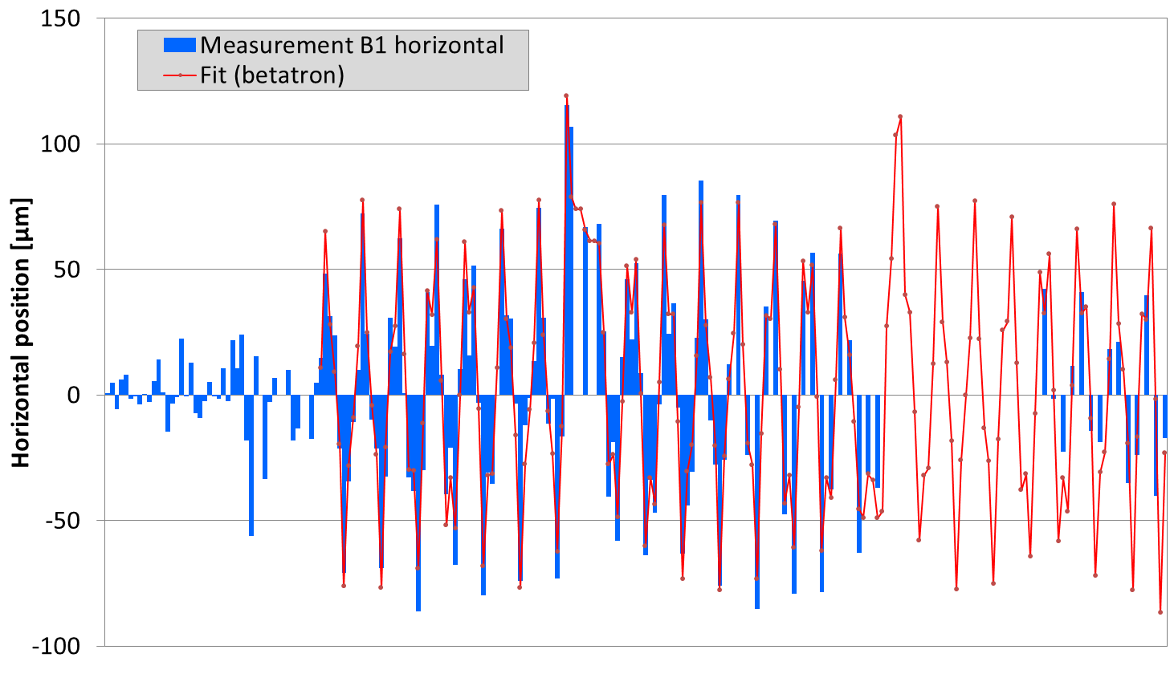
EOF Test for 50ns
Perturbation amplitude in the arc in first turn of
Horizontal: ≈75µm = 0.2σ_{nom} TCP.C: -44.6µm = -0.13σ_{nom} Vertical: ≈90µm = 0.25σ_{nom} TCP.D: 43.3um = 0.17σ_{nom}
Beam dump after 5 turns due to beam losses at collimators above BLM dump thresholds (1230 bunches).
IP5
TCP.C
Beam 1 horizontal trajectory perturbation for bunches with full long range interactions in first turn after dump of beam 2.

Slide 12
Content
1. Observations and Introduction
2. End-of-Fill Tests
4. Extrapolation and Outlook
3. Status of Simulations

Slide 13
MadX Simulations
Using MadX Beam-beam module:
Twiss of B2 with markers at LRBB locations.
Installing beam-beam elements at LRBB (and HO) locations for B1. Separation from twiss and survey (s position relative to IP).
Tracking single particle on closed orbit and ≈1500 macro particles in gaussian distribution for few turns without beam-beam interactions.
Continue tracking for few turns with beam-beam with negative charge (to simulate missing beam-beam interaction).
Compare simulated difference to closed orbit with measurement for bunches with full LR interactions.

Slide 14
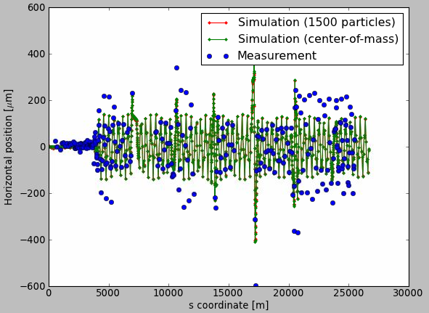
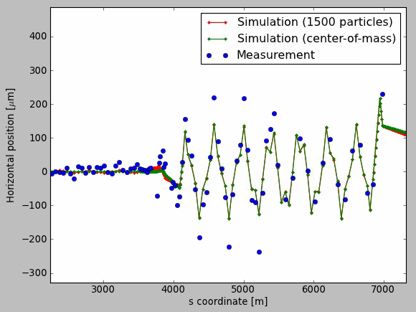
First Turn Horizontal
Phase of oscillation very well explained.
Simulated oscillation amplitude 40% smaller than measured amplitude.
Good agreement between simulations of Gaussian beam and particle in bunch centre.
IP5
IP1
IP5
Simulation and measurement for bunches with full long range interactions. Not all BPMs have a valid acquisition, in some areas data is only available for BPMs at low beta function.

Slide 15
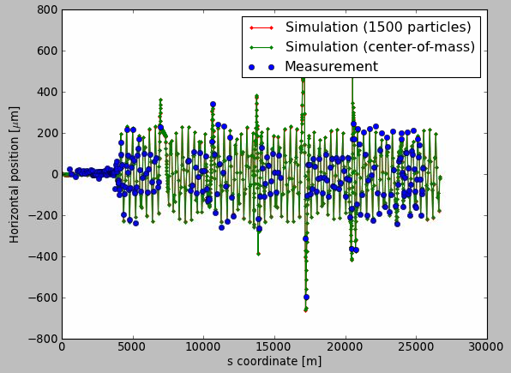
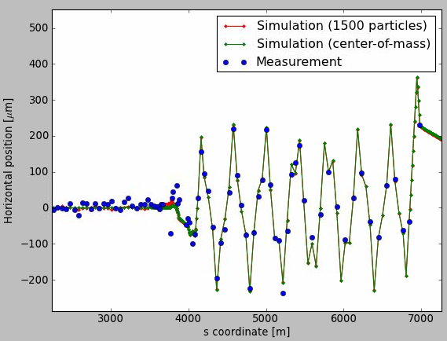
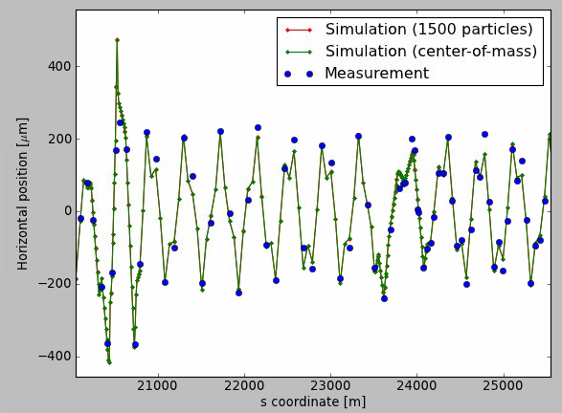
First Turn Horizontal
Difference can be explained by e.g.:
65% Increase of B2 intensity
or 40µrad crossing angle (instead of 65µrad).
IP5
IP1
Simulations with increase of B2 intensity by 65%.

Slide 16
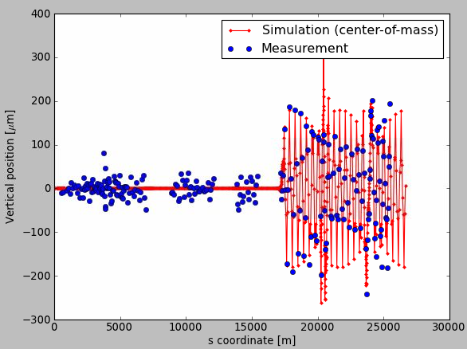
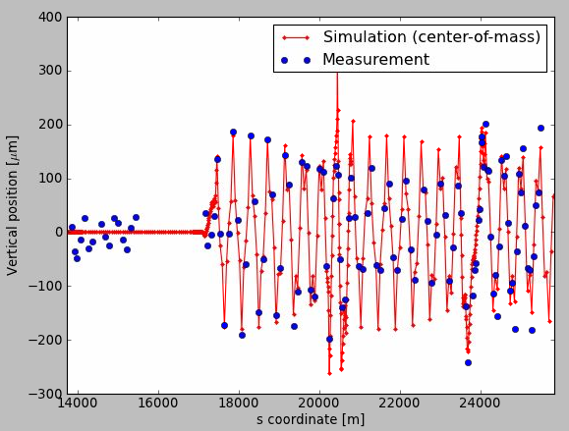
First Turn Vertical
Simulated oscillation amplitude 25% smaller than measured amplitude.
Difference can be explained by e.g.: 35% increase of B2 intensity or 45µrad crossing angle.
IP1
IP1
Simulation and measurement for bunches with full long range interactions. Not all BPMs have a valid acquisition, in some areas data is only available for BPMs at low beta function. Simulations with increase of B2 intensity by 35%.

Slide 17
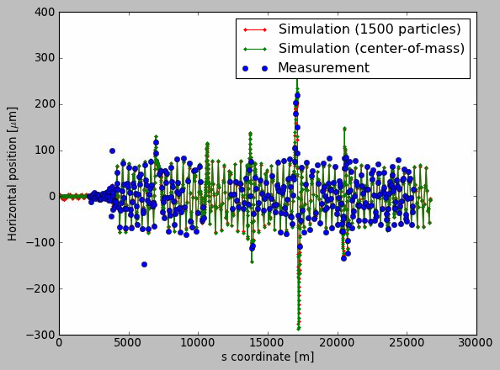
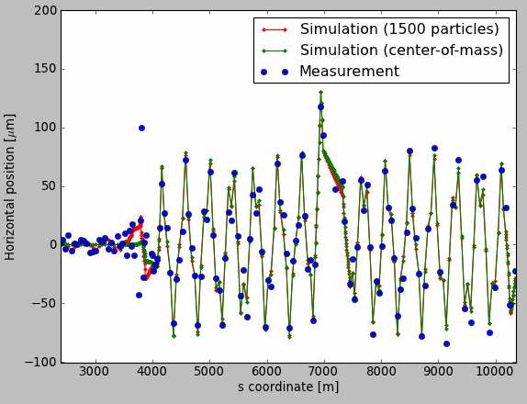
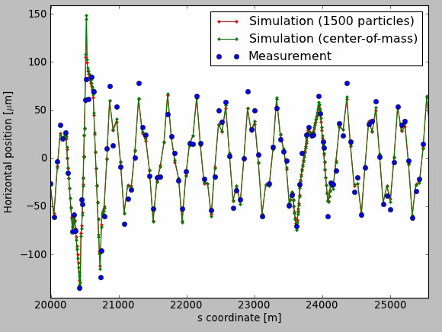
50ns Test: First Turn Horizontal
Simulated horizontal oscillation amplitude is 40% smaller than measured amplitude.
Difference can be explained by e.g.:
65% Increase of B2 intensity
for vertical plane: 50% increase of B2 intensity needed.
IP5
IP1
Simulations with increase of B2 intensity by 65%.

Slide 18
Content
1. Observations and Introduction
2. End-of-Fill Tests
4. Extrapolation and Outlook
3. Status of Simulations

Slide 19
Improvements for Simulation
Approximations made:
No start from self-consistent orbit. But effect should be negligible (≈0.2σ) for nominal separation (≈10σ). Self-consistent simulation is foreseen (T. Pieloni).
No separation at IP assumed. But deflection from separation at IP is ≈90º out of phase.
What else could explain the difference?
Unclear: Observed deflections for 25ns test are larger in horizontal plane than in vertical plane. Uncertainty of crossing angle?
Other (non beam-beam) two beam effects? Image currents/impedance?

Slide 20
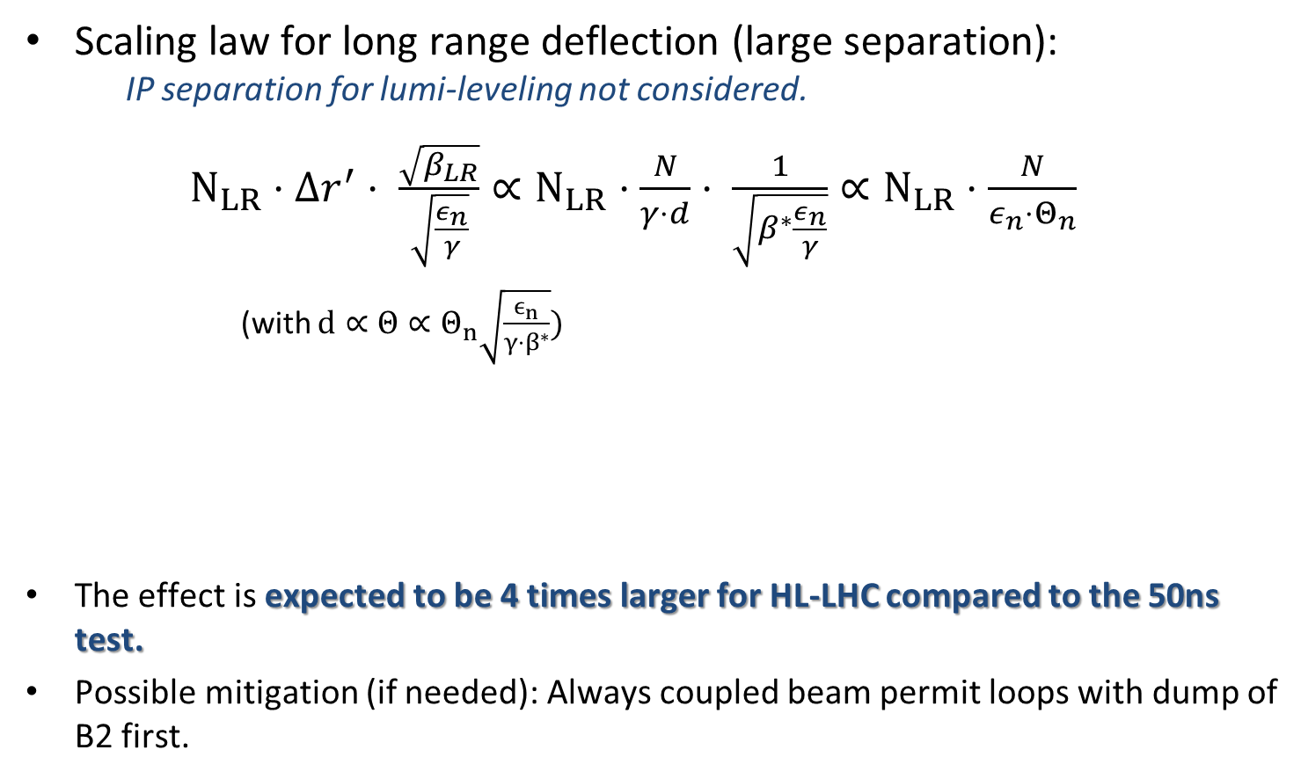
Extrapolations
Scaling law for long range deflection (large separation): IP separation for lumi-leveling not considered.
$N_{LR}⋅Δr^{′}⋅ \frac{\sqrt{β_{LR}}}{\sqrt{\frac{ε_{n}}{γ}}}∝N_{LR}⋅\frac{N}{γ⋅d}⋅ \frac{1}{\sqrt{β^{∗}\frac{ε_{n}}{γ}}}∝N_{LR}⋅\frac{N}{ε_{n}⋅Θ_{n}}$
(with $d∝Θ∝Θ_{n}\sqrt{\frac{ϵ_{n}}{γ{⋅β}^{∗}}})$
The effect is expected to be 4 times larger for HL-LHC compared to the 50ns test.
Possible mitigation (if needed): Always coupled beam permit loops with dump of B2 first.
PRELIMINARY
Independent of β* and γ!
relative to: | 50ns test | 25ns test
Post LS1 (25ns, ε_{n,nom}=3.5µm·rad) | 2.1 | 0.7
HL-LHC (N=2.2·10¹¹, ε_{n,nom}=2.5µm·rad) | 4.0 | 1.35

Slide 21
Summary
An unexpected ultra-fast beam loss mechanism during the beam dump process was observed in 2012. The effect can be (partly) explained by the missing long-range beam-beam deflections after a beam dump.
Observed single-turn trajectory perturbation of up to 230µm = 0.6σ_{nom} with 25ns, 65µrad crossing angle. 75µm/90µm (H/V) in 2012 physics conditions. Resulting beam losses above BLM dump thresholds.
Dedicated MadX simulation have well agreement for phase of oscillation, but simulated oscillation amplitudes are 25% - 40% smaller than measured.
Scaling of the effect to HL-LHC era shows that effect may increase up to ≈0.8σ (preliminary).

Slide 22
Thank you
for your Attention
Tobias Baer
CERN BE/OP
Tobias.Baer@cern.ch
Further information:
T. Baer, “Fast Beam Losses during Beam Dump Process”, 143th LMC, July 2012.

Slide 23
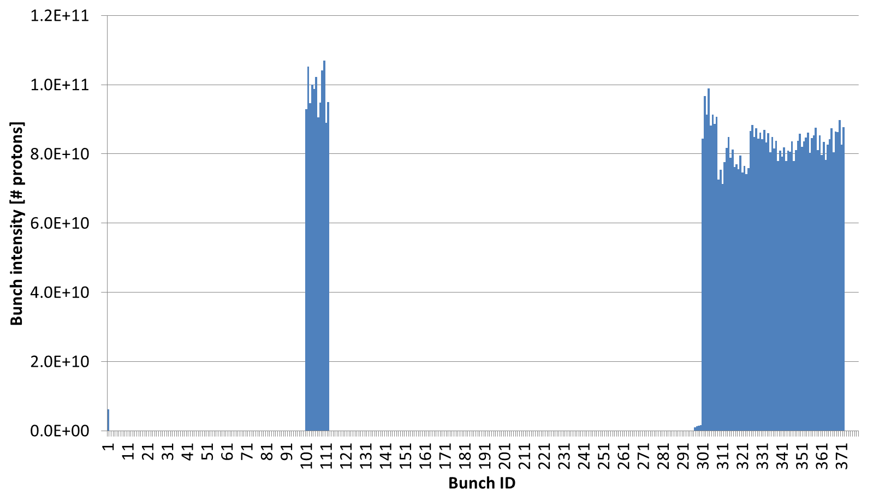
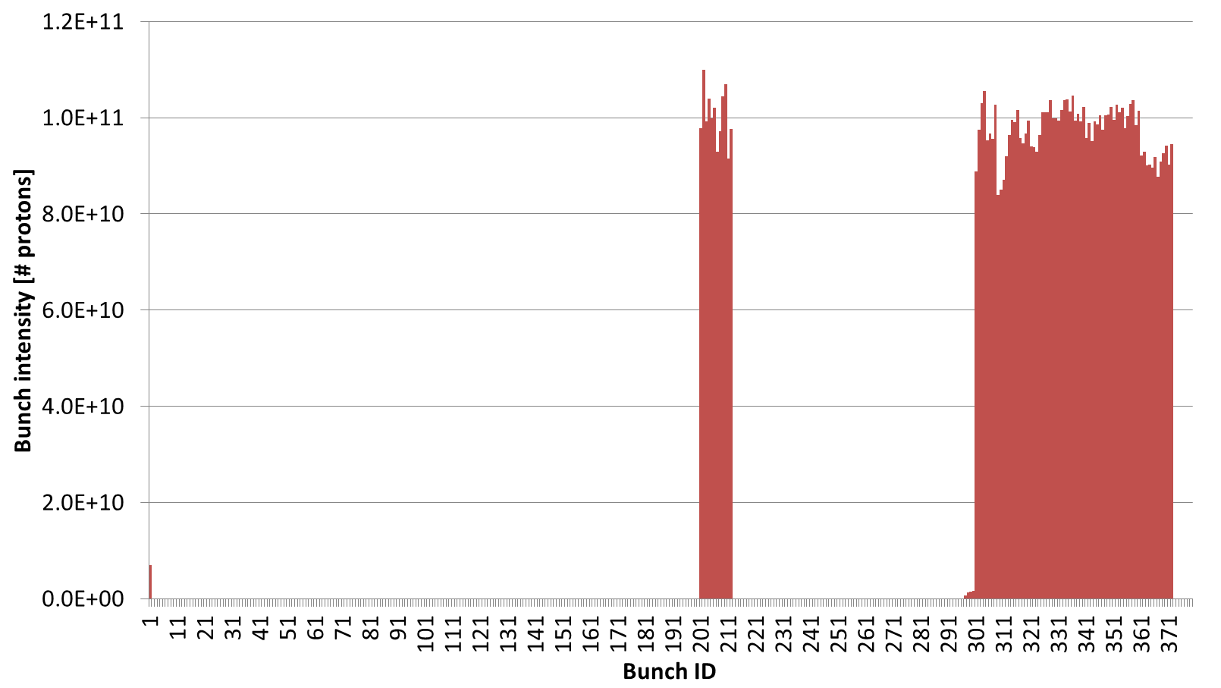
25ns Test Intensities
Beam 1
Beam 2

Slide 24
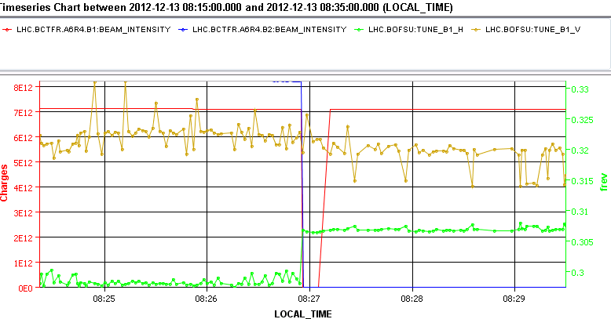
25ns Test: Tune shift
Horizontal tune shift: ≈ 0.009
Vertical tune shift: ≈ -0.003

Slide 25
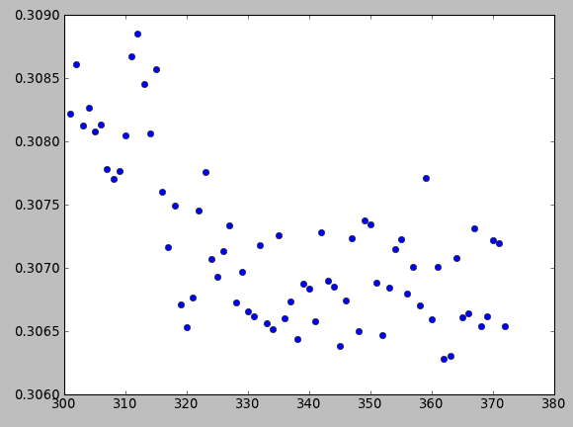
25ns Test: Bunch-by-bunch Tune
Beam 1 tune evolution along batch after dump of Beam 2.

Slide 26
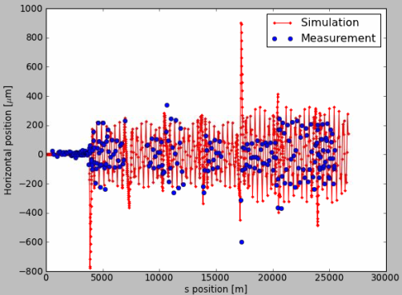
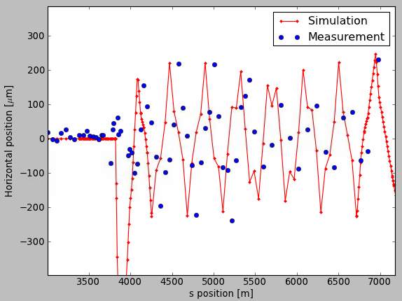
Deflection from IP5 Separation
Simulation for ≈2.5σ separation in IP5 no long-range encounters B2 intensity ≈1.7e12 p/b (to increase scale)
Phase of simulated oscillation is out of phase with measurement.

