Slide 1
Frontier Physics Research in the school Classroom
Sofoklis A. Sotiriou and Angelos Lazoudis
Ellinogermaniki Agogi, Greece

Slide 2

I think the classroom can help. It is up to schools, and to all
initiatives that can educate, including reliable Internet
sites, to ensure that young people gradually acquire the
Correct understanding of scientific procedure. A most difficult
task, Because even knowledge transmitted by schools is often
Deposited in the memory like a sequence of miraculous episodes:
Madame Curie who come home one evening and discovers
Radioactivity thanks to a mark on a sheet of paper, ......Galileo
who sees a lamp swaying and suddenly discovers everything, even
that the world rotates…
It is the duty of a man of learning not
only to do scrupulous research but also to present his
Knowledge effectively. Scientists sometimes still feel it’s
not dignified to take an interest in popularization, although
masters in the field include Einstein and Heisenberg.
But if we are to teach a nonmagical view of science, we
cannot expect it to come from the mass media. The
Scientific community itself must construct it bit by bit in the
collective awareness, starting with the young.

Slide 3
In recent times fewer young people seem to be interested in science and technical subjects. Why is this?
Does the problem lie in wider socio-cultural changes, and the ways in which young people in developed countries now live and wish to shape their lives? Or is it due to failings within science education itself?

Slide 4

PISA 2006

Slide 5
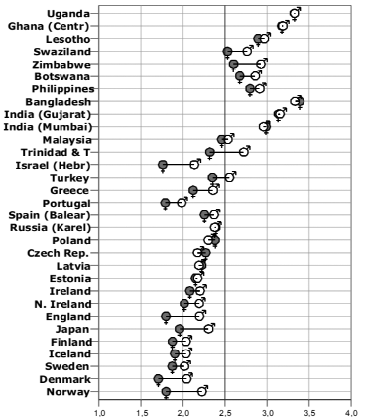
The ROSE study of students’ attitudes to science in
more than 20 countries has found that students’ response to the statement ‘I like school science better than other subjects’ is increasingly negative the more
developed the country. In short, the more advanced a country is, the less its young people are interested in the study of science.

Slide 6
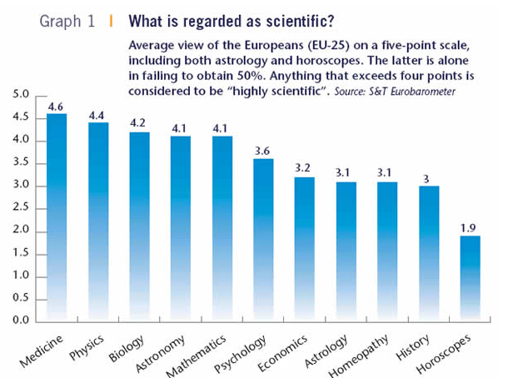
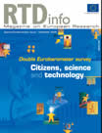
Double Eurobarometer survey

Slide 7
The Rocard Report on Science Education (2007)
Science Education in Europe:Critical Reflections (J. Osborne, J. Dilon, 2008)

Slide 8
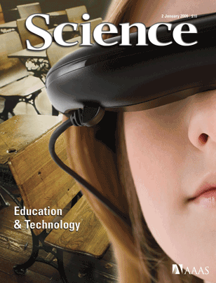
Redefining Science Education
There is a major mismatch between opportunity and action in most education systems today. It revolves around what is meant by "science education," a term that is incorrectly defined in current usage. Rather than learning how to think scientifically, students are generally being told about science and asked to remember facts. This disturbing situation must be corrected if science education is to have any hope of taking its proper place as an essential part of the education of students everywhere.
Bruce Alberts, Science, January 2009
As students become absorbed with technology-based games, educators grapple with how best to use technology. Immersive simulations represent one way in which new media can enhance traditional learning experiences.
http://www.sciencemag.org/cgi/content/full/323/5913/43

Slide 9
Current Trends Science Education
A reversal of school science-teaching pedagogy from mainly deductive to
inquiry-based methods provides the means to increase interest in
science.
Inquiry-based science education (IBSE) has proved its efficacy at both
primary and secondary levels in increasing children’s and students’ interest and
Attainments levels while at the same time stimulating teacher motivation. IBSE is
effective with all kinds of students from the weakest to the most able and is fully
compatible with the ambition of excellence. Moreover IBSE is beneficial to
promoting girls’ interest and participation in science activities. Finally, IBSE and
traditional deductive approaches are not mutually exclusive and they should be
combined in any science classroom to accommodate different mindsets and age
group preferences.

Slide 10
Current Trends Science Education
Renewed school’s science-teaching pedagogy based on IBSE
provides increased opportunities for cooperation between
actors in the formal and informal arenas.
Due to the nature of its practices, IBSE pedagogy is more likely to
encourage relationships between the stakeholders of both formal and
informal education. And it creates opportunities for involving firms,
scientists, researchers, engineers, universities, local actors such as
cities, associations, parents and other kinds of local resources.

Slide 11
Current Trends Science Education
Scientific disciplines in school have to be enlarged.
The introduction of problem oriented fields of studies instead
Of more traditional disciplines would attract the interest of
more young people.

Slide 12
Modeling
„Problem solving competence“ in PISA
Structure model
Level model
Problem solving process
  understand the problem
  characterize the problem
  representation of the problem
  solving the problem
  reflection of the solution
  communication of the solution
Levels
  III „reflective and communicative problem solver “
  II „advanced problem solver“
  I „beginning problem solver“
  < I “no problem solver”

Slide 13


Structuring Educational Activities
Theory
Testing
understanding the problem
understanding and characterizing the Problem
characterizing the problem
representing the problem
representing the problem
Problem solving competence
solving the problem
solving the problem
reflecting on the solution
reflecting and communicating the solution
communicating the solution
Construct
Partial abilities
Partial abilities
(r = .81 – .92)
PISA 2003
Koppelt & Tiemann 2008, 2009

Slide 14
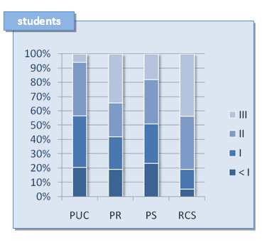

Slide 15
Re-imagine science education
The message is clear.
There are shortcomings in curriculum, pedagogy and assessment, but the deeper problem is one of fundamental purpose. School science education has never provided a satisfactory education for the majority. Now the evidence is that it is failing in its original purpose, to provide a route into science for future scientists.
The challenge therefore, is to re-imagine science education: to consider how it can be made fit for the modern world and how it can meet the needs of all students; those who will go on to work in scientific and technical subjects, and those who will not.

Slide 16
The role of teachers
Teachers are key players in the renewal of science
education. Among other methods, being art of a
network allows them to improve the quality of their
teaching and supports their motivation.
Networks can be used as an effective component of
teachers’ professional development, are complementary to
more traditional forms of in-service teacher training and
stimulate morale and motivation.

Slide 18
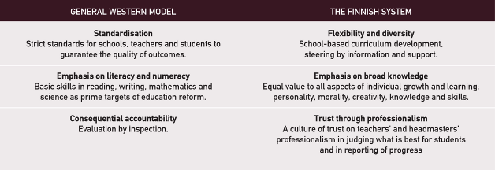

Slide 19
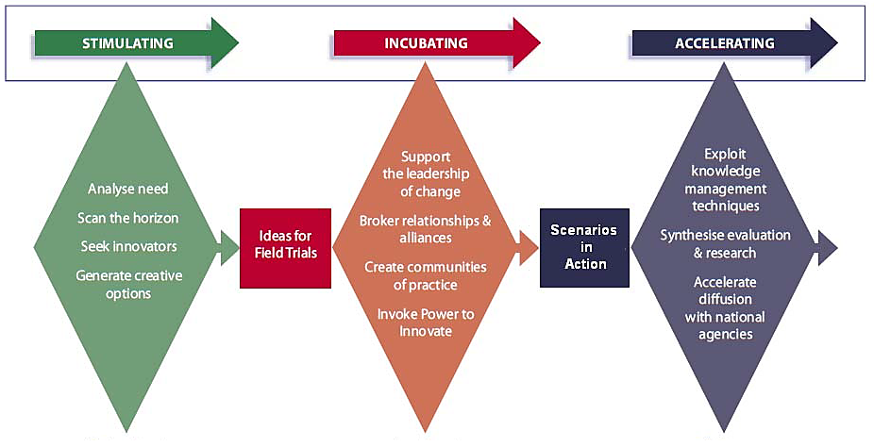

Slide 20
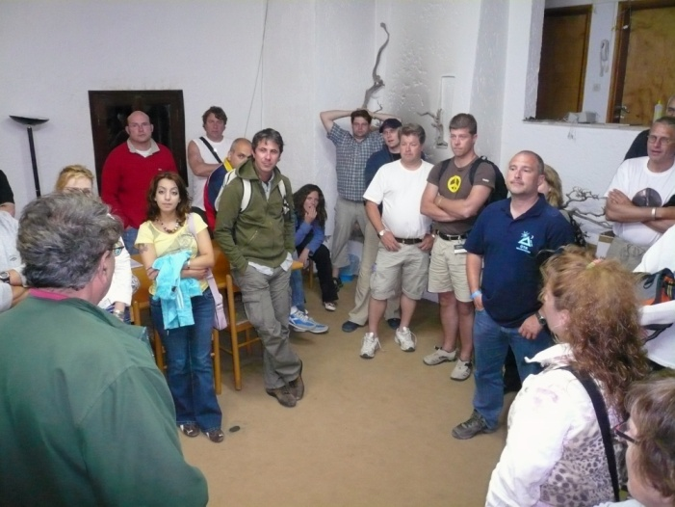
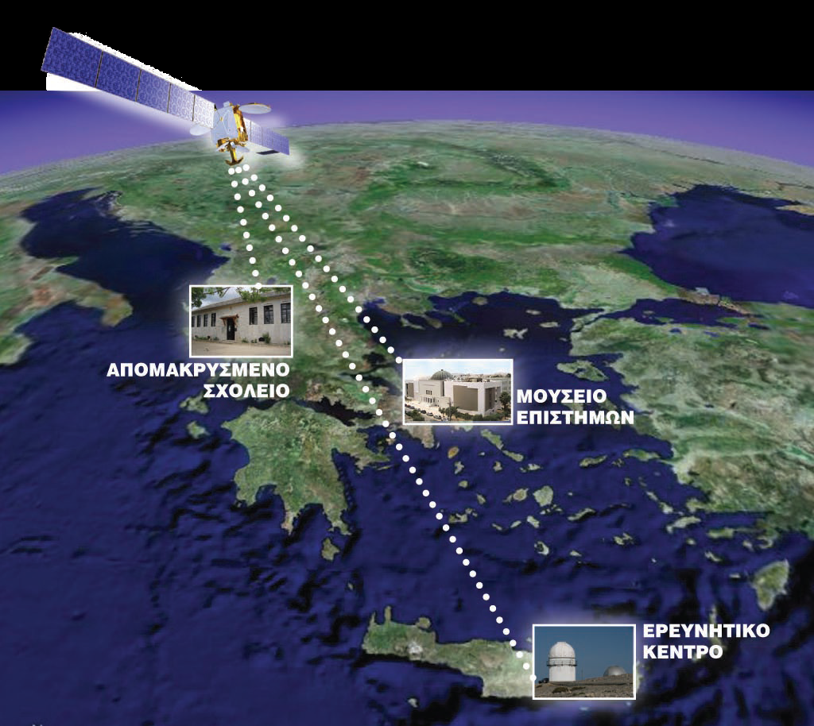
Creating effective links between schools and the research community

Slide 21
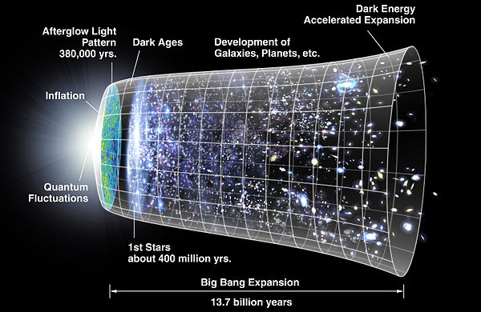

Slide 22
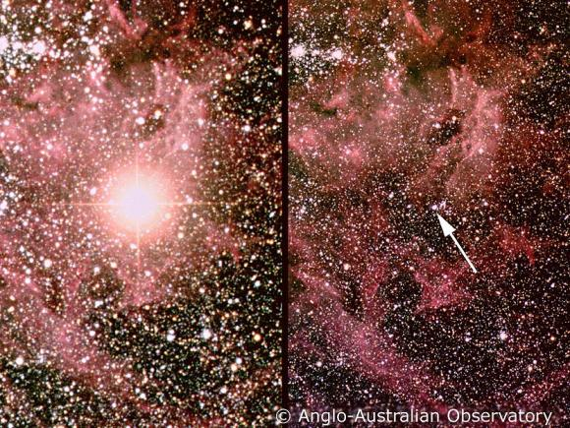
http://www.nobelprize.org/nobel_prizes/physics/laureates/2011/

Slide 23
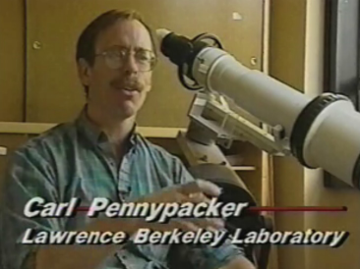
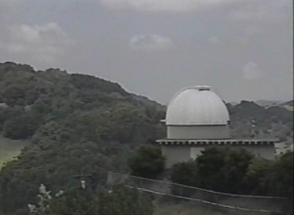
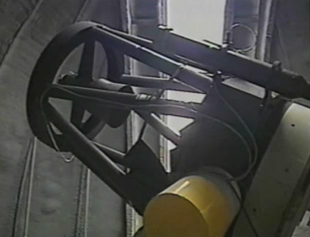
Ingredients for a successful path: The discovery of SN in classroom
A scientist bringing real data and the scientific method to schools
A robotic telescope and an innovative teacher

Slide 24
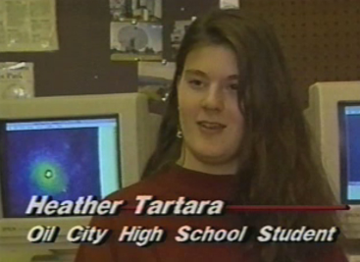
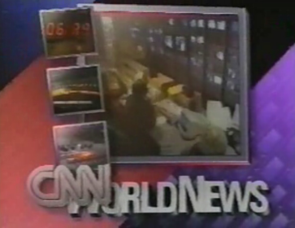
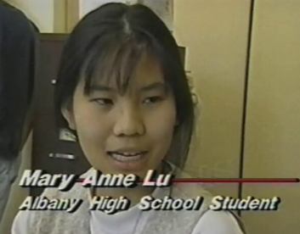
The outcome: Students producing scientific results while learning curriculum content
Students that co-authored on the scholarly publications relating to the supernova discovered in 1994 in the Whirlpool Galaxy . The teacher Tim Spuck and the students made news reports around the world.

Slide 25
Effective Community Building

Slide 26
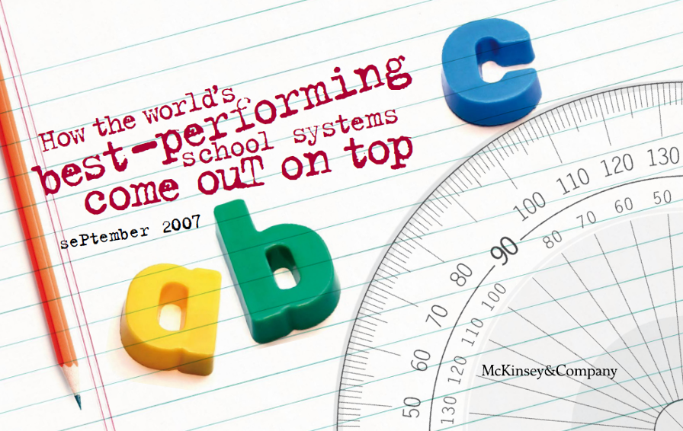
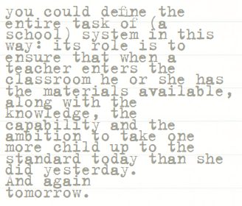
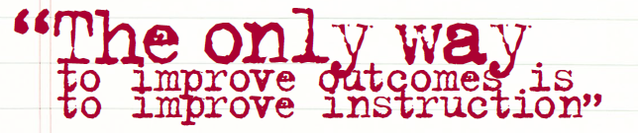

Slide 27
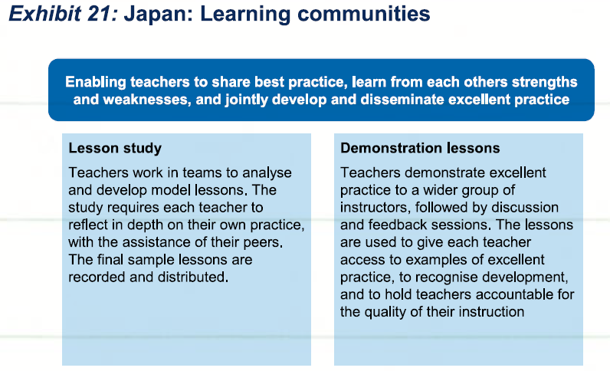

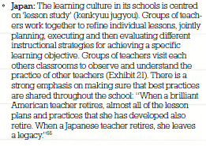

Slide 28
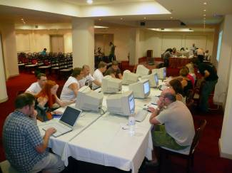
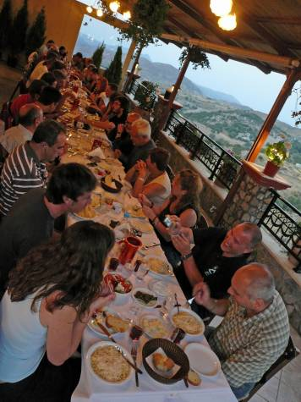
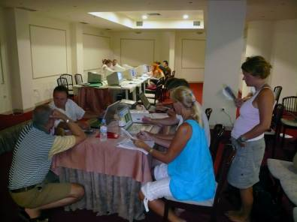
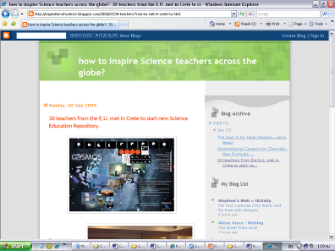
Building a community of practice
http://www.inspirational-science.blogspot.com/

Slide 29
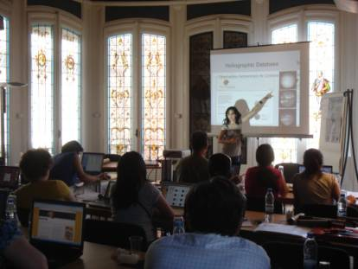
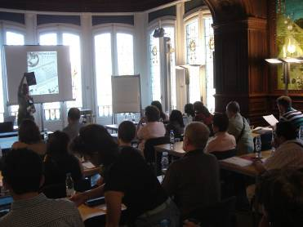
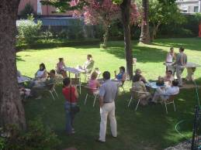
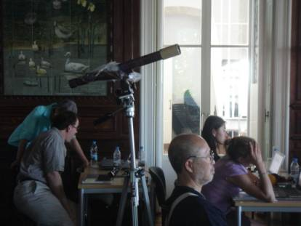
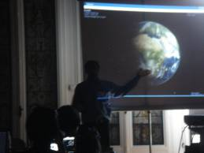
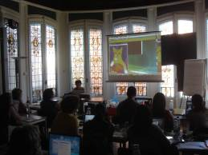
Sharing our experiences
Is the best resource
we can have.

Slide 30
special emphasis on building a network of the teachers that would form a community of practice.
A purpose to believe in: “I will change if I believe I should” The first, and most important, condition for change is identifying a purpose to believe in. In our case, we must persuade teachers of the importance of scientific literature in terms of social value, importance to their students and personal achievement through learning and teaching these important subjects. We must carefully craft a “change story” underlining the benefits that the project can offer to all the involved actors. Furthermore, we must cultivate a sense of community, making the teacher feel part of a cohesive multi-national team. This sense of belonging will prove very important for motivating teachers and asking them to take then next, possibly “painful” steps, of learning new skills.

Slide 31
special emphasis on building a network of the teachers that would form a community of practice.
Reinforcement systems: “I will change if I have something to win”. From a pure behaviouristic point of view, changing is only possible if formal and informal conditioning mechanisms are in place. These mechanisms can reinforce the new behaviour, penalize the old one or, preferably do both. In our case, we can use informal reinforcement patterns in order to make teachers commit more to our project. A short list of such methods could include competitions, challenges, promoting the best teacher created project or lesson plan, offering e.g. the participation to a summer school as rewards.

Slide 32
special emphasis on building a network of the teachers that would form a community of practice.
The skills required for change: “I will change if I have the right skills”. A change is only possible if all the involved actors have the right set of skills. In the case of our project, we should make sure that our training program is designed in such a way that teachers acquire all the skills they will need, both technical and pedagogical.

Slide 33
special emphasis on building a network of the teachers that would form a community of practice.
Consistent role models: “I will change if other people change”. A number of “change leaders” will need to be established, acting as role models for the community of teachers. These very active and competent teachers will be a proof of concept for their colleagues that the change is indeed feasible, acceptable and beneficial for them. To achieve that we will have to identify the high flyers among the participating teachers and pay special attention into motivating them, supporting and encouraging them.

Slide 34
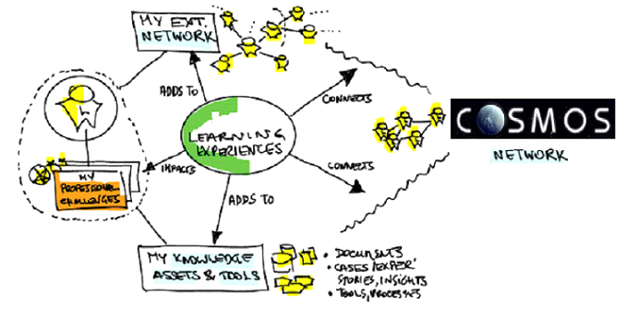
Collaborative Learning and community development

Slide 35
Building communities of practice
http://www.inspirational-science.blogspot.com/

Slide 36
Digital Content on
Discover the COSMOS Portal
(May 2012)
105,000 Educational Materials on HEP and Astronomy
2,000 weblinks
500 videos and animations
500 Tests and students activities
400 Detailed Lesson Plans
Educational Software and applications
Training Materials
http://portal.discoverthecosmos.eu

