Slide 1
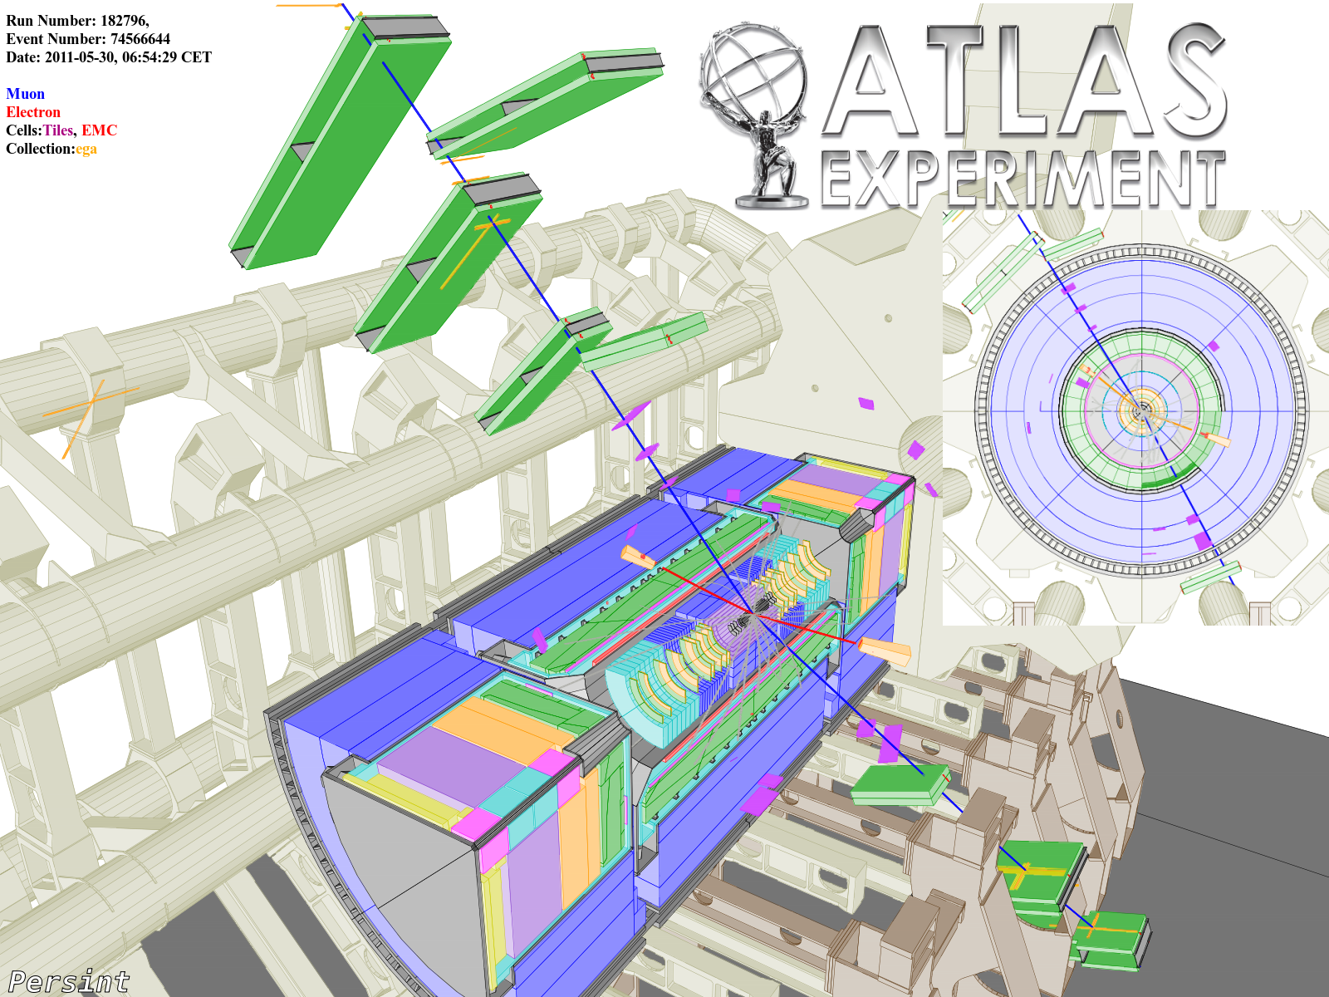
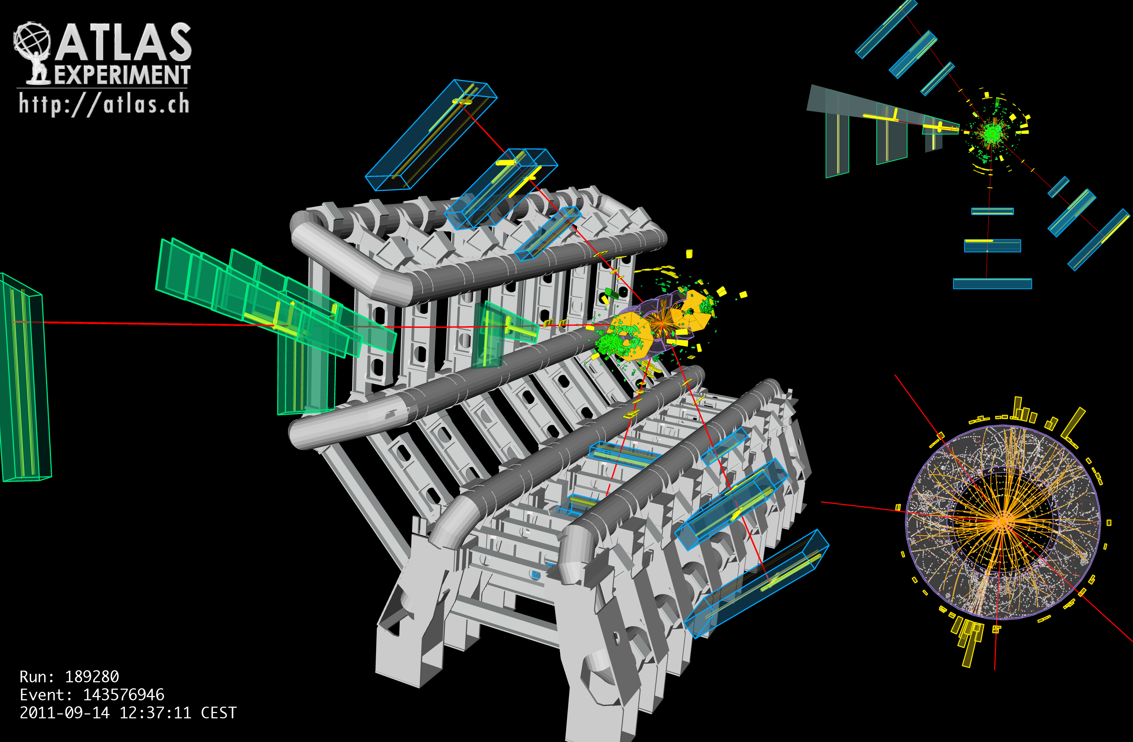
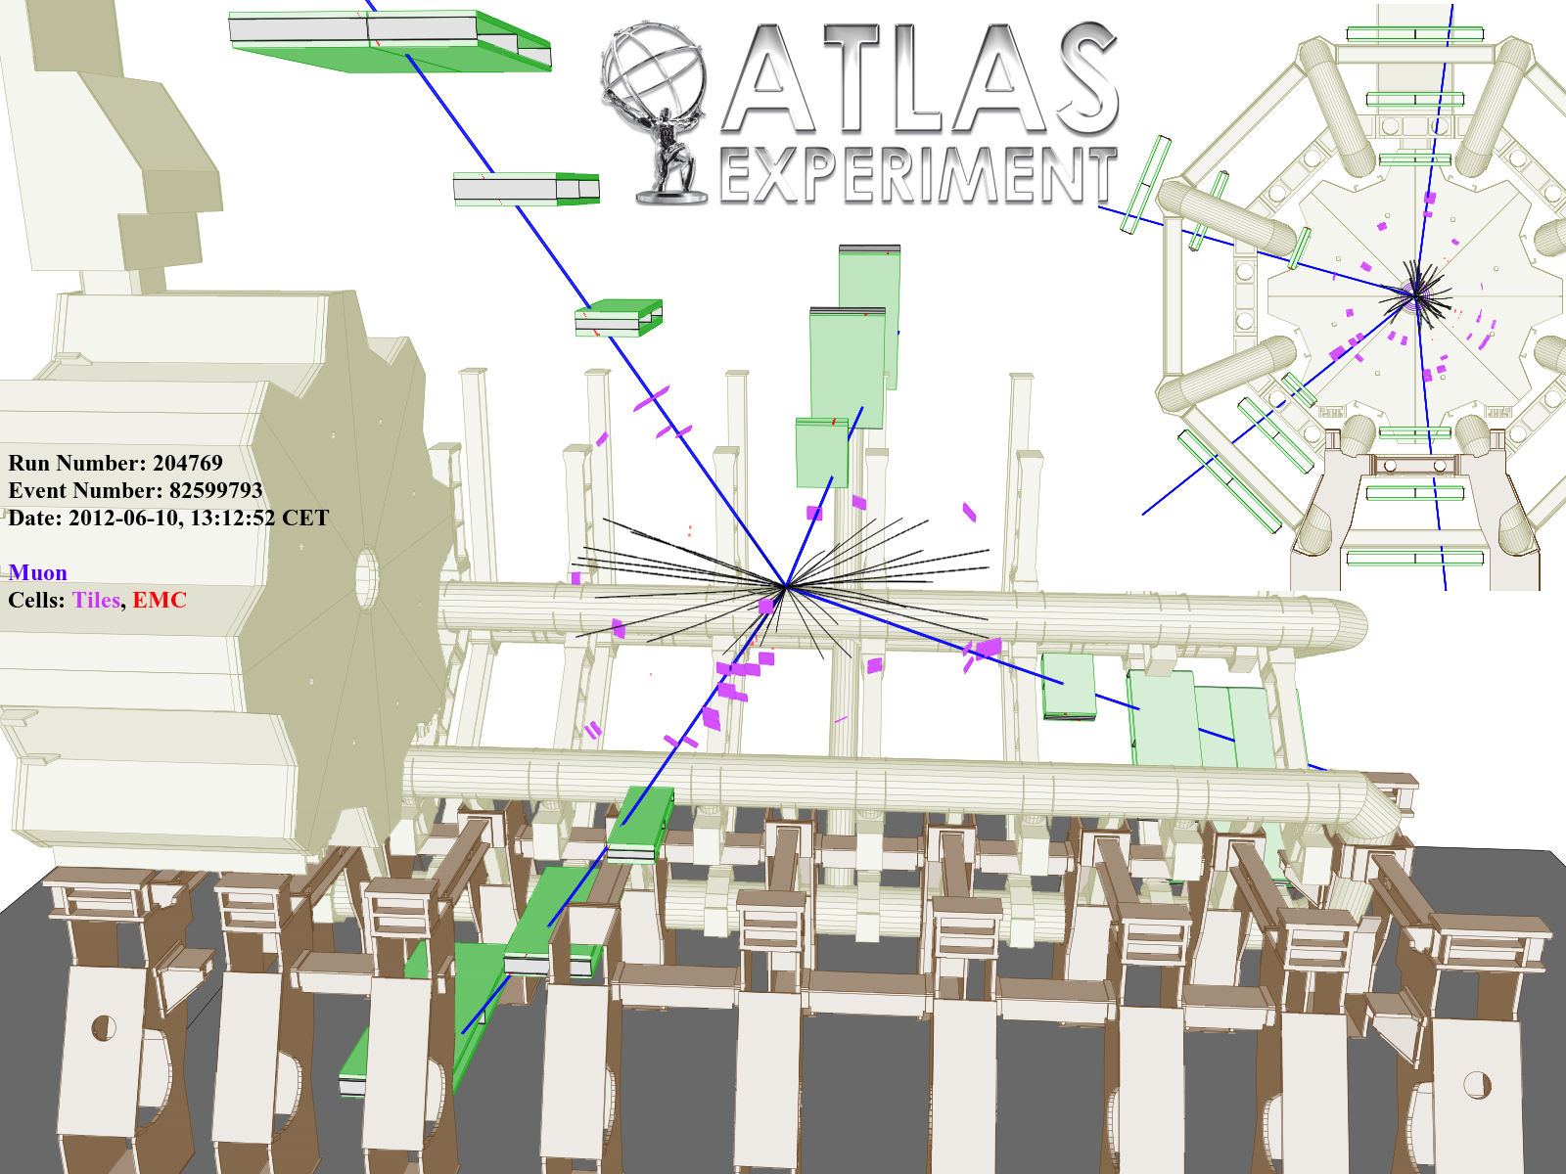
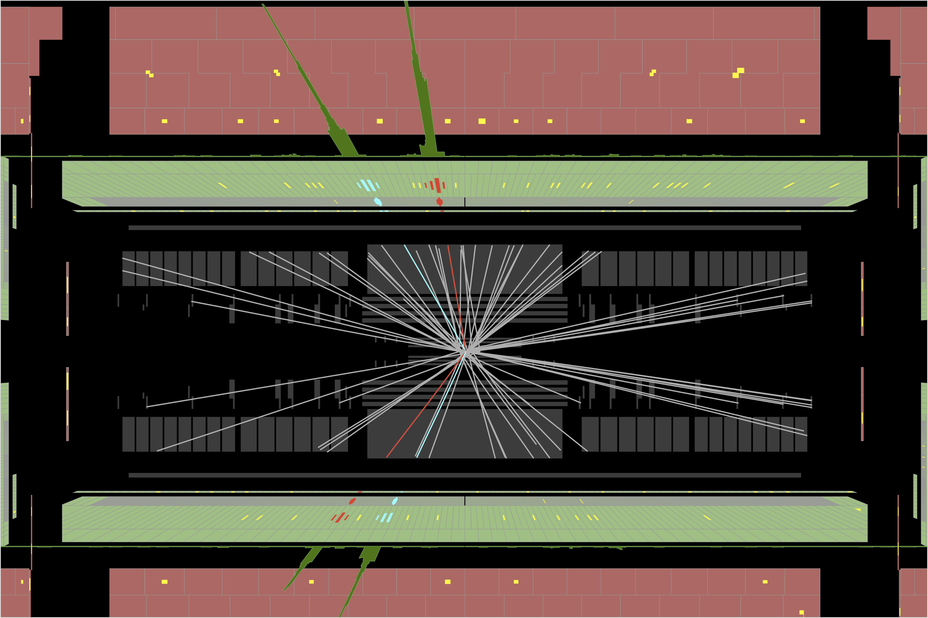
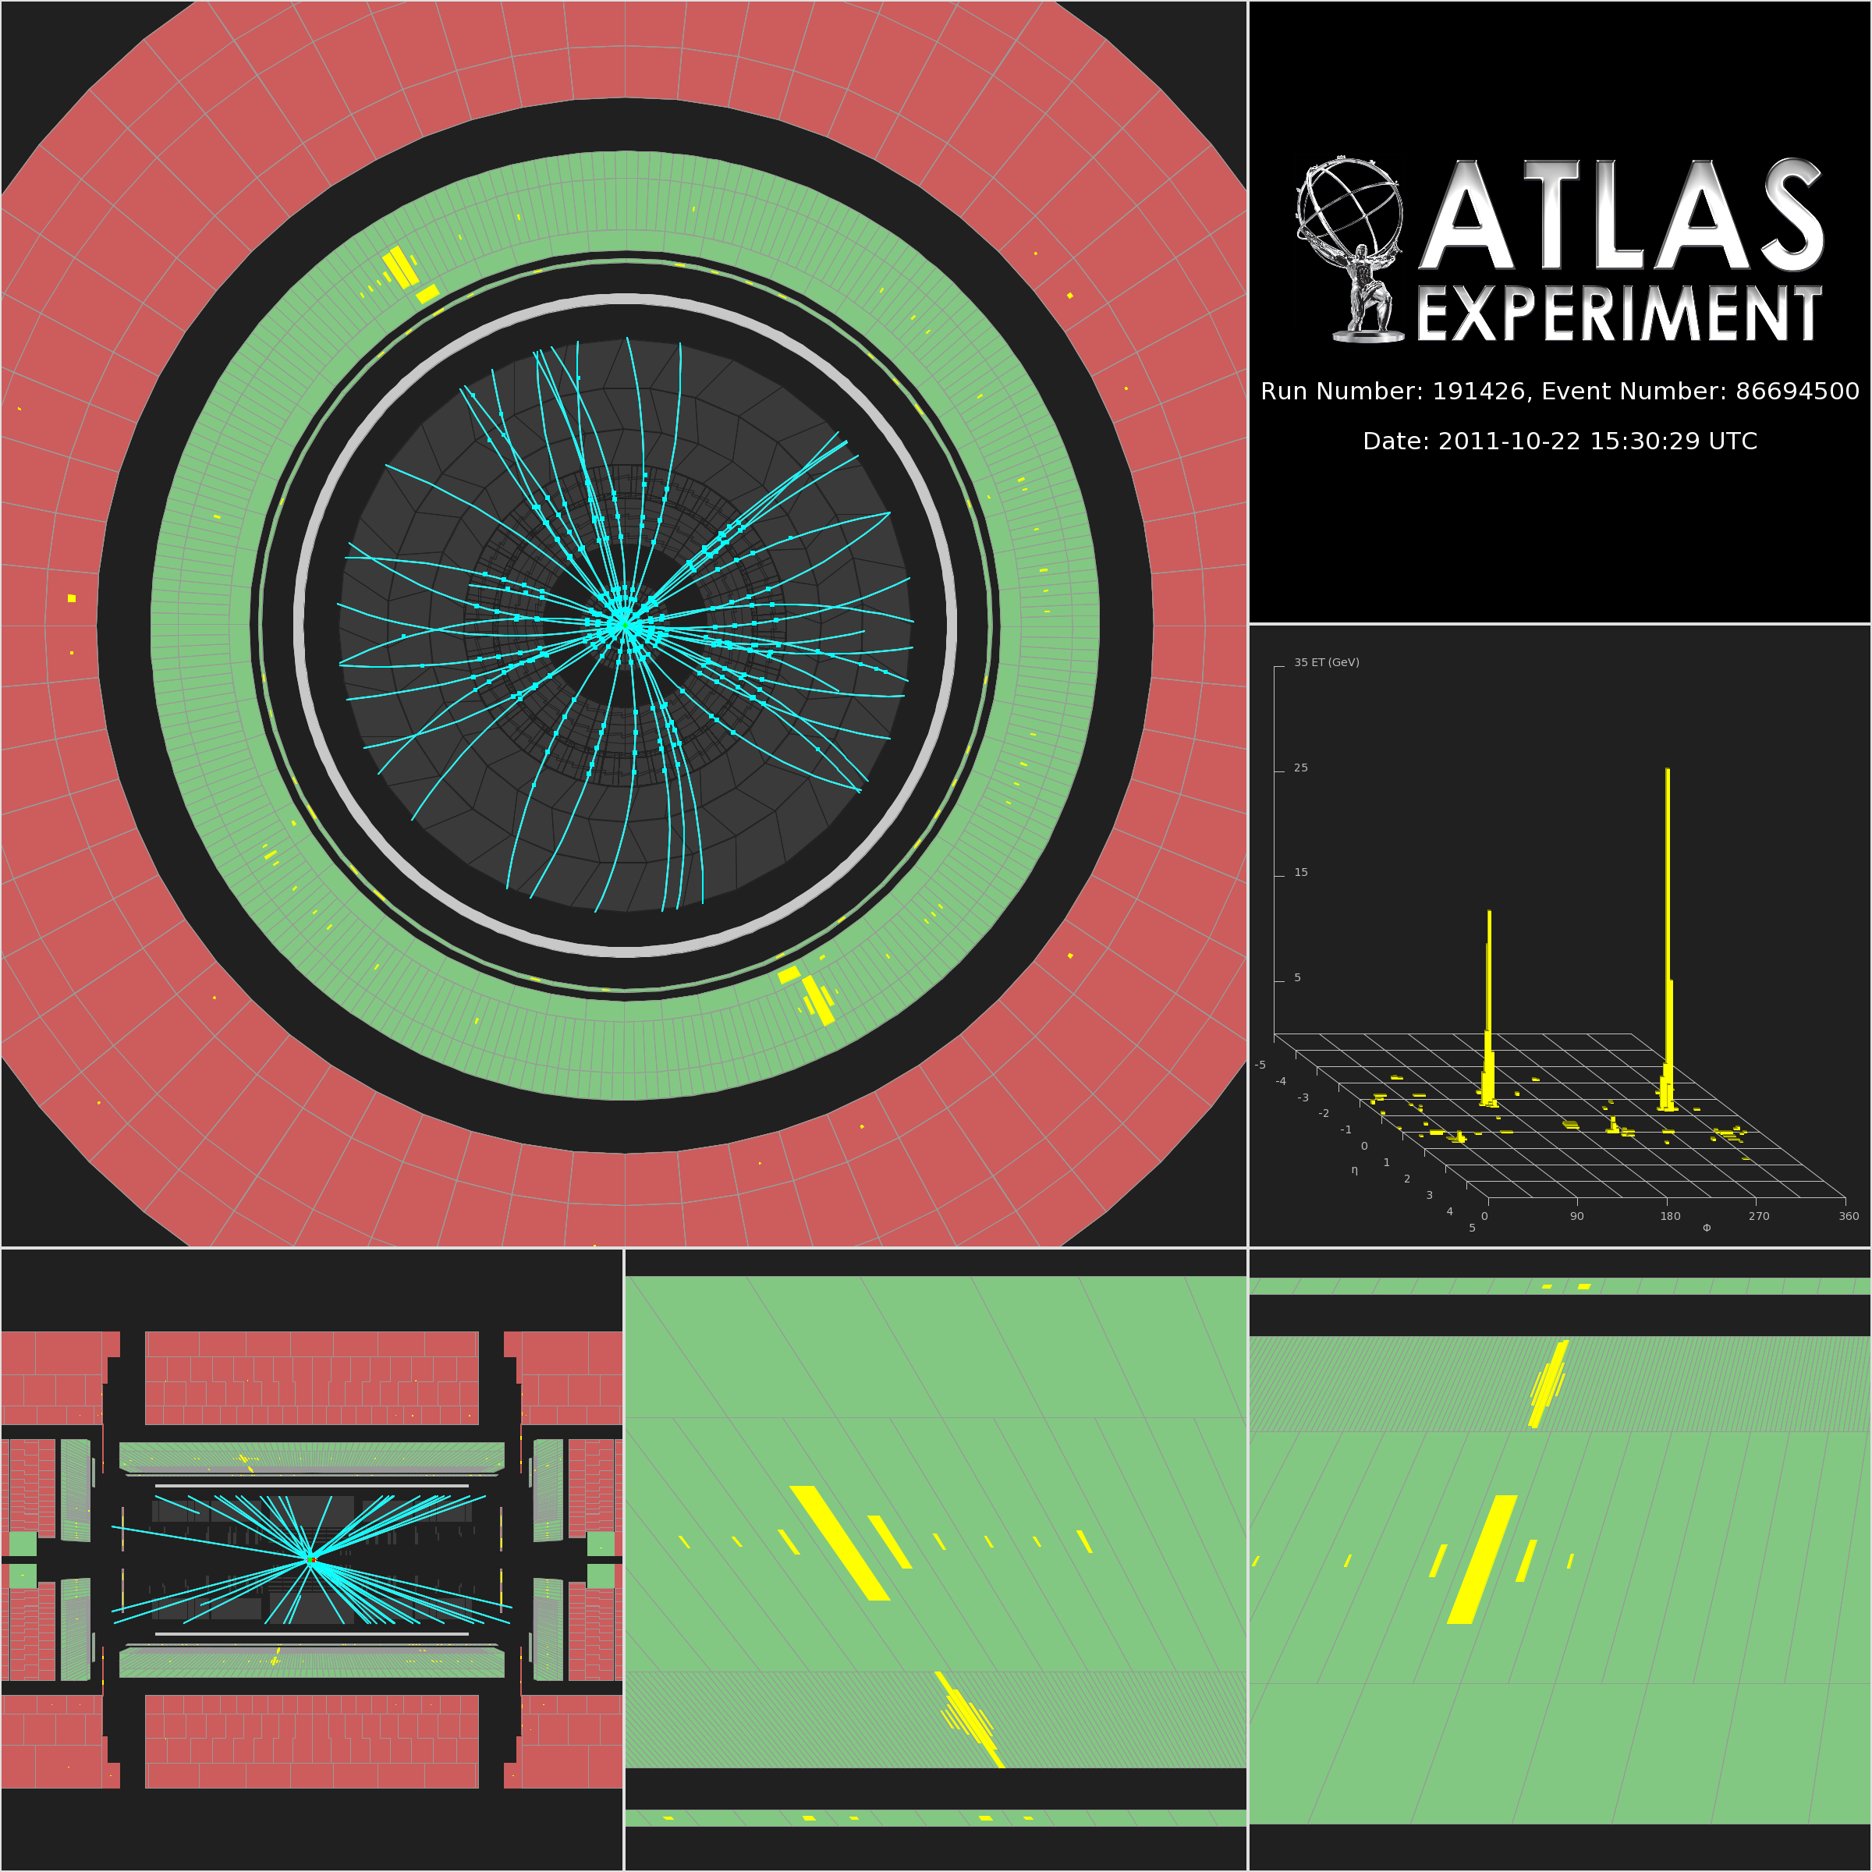
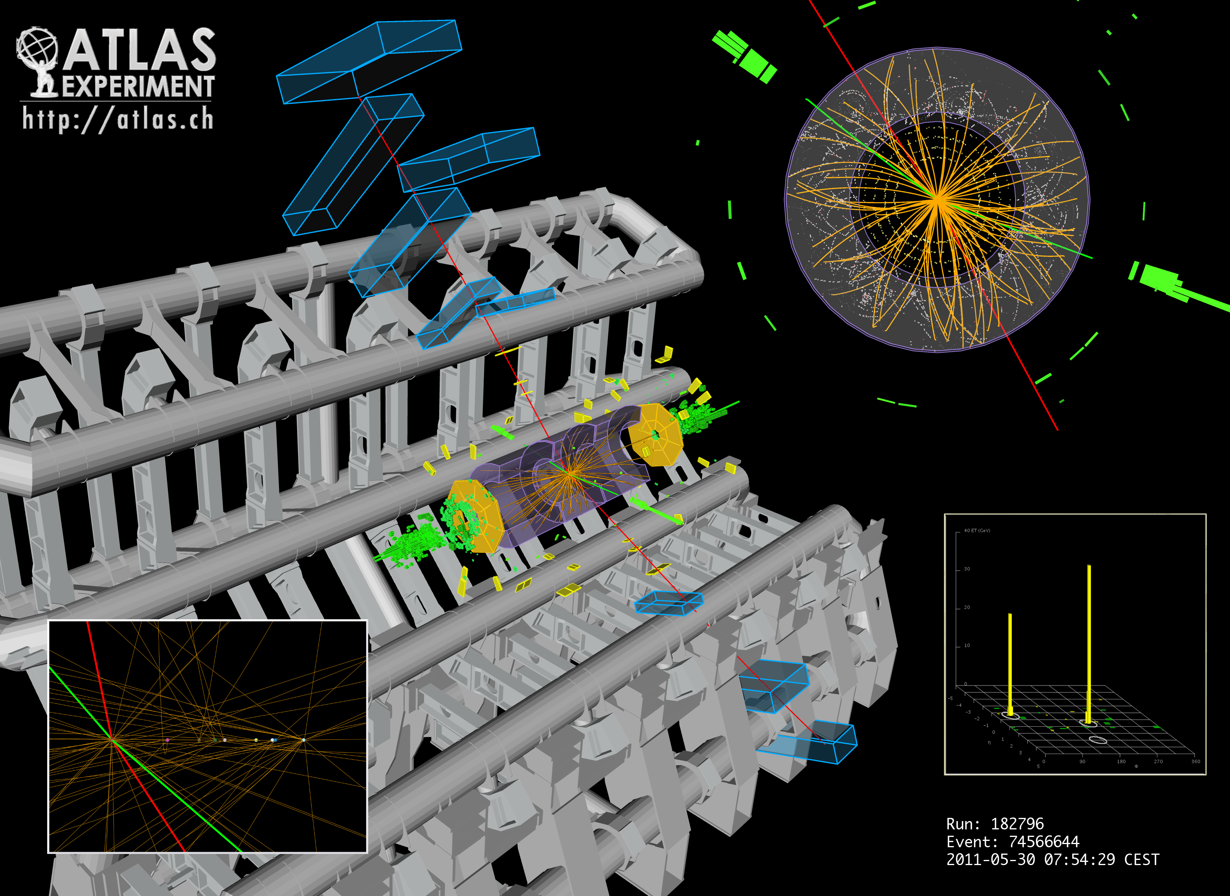
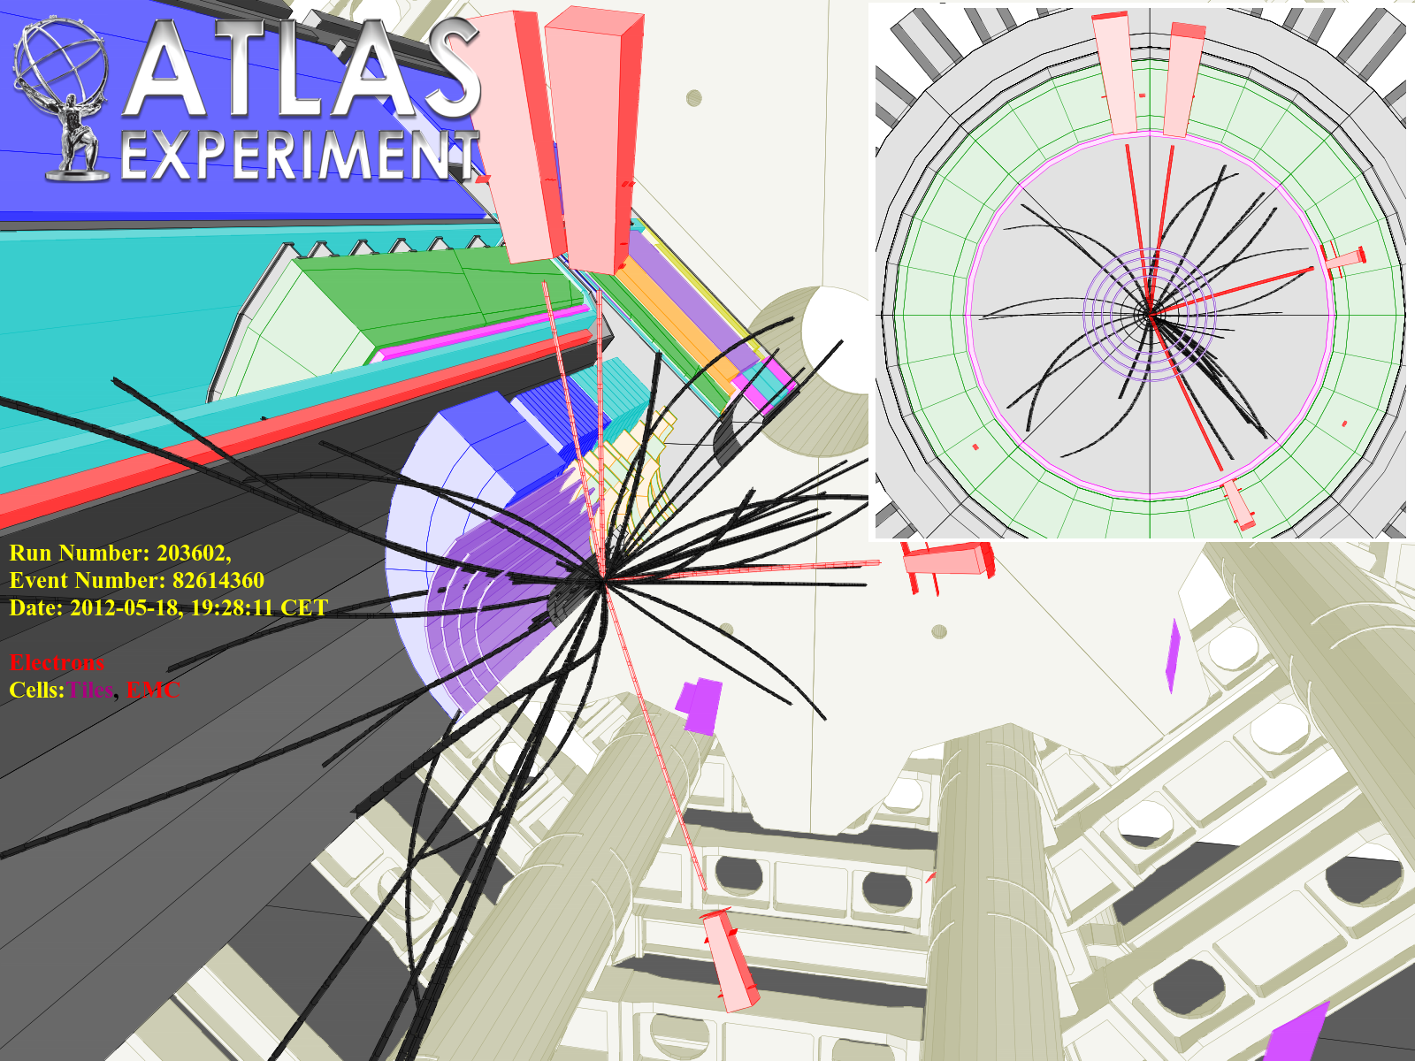
Status of Standard Model Higgs searches in ATLAS
Fabiola Gianotti (CERN),
representing the
ATLAS Collaboration
Using the full datasets recorded in 2011 at √s= 7 TeV and 2012 at √s=8 TeV: up to 10.7 fb⁻¹
Fabiola Gianotti (CERN), representing the ATLAS Collaboration

Slide 2
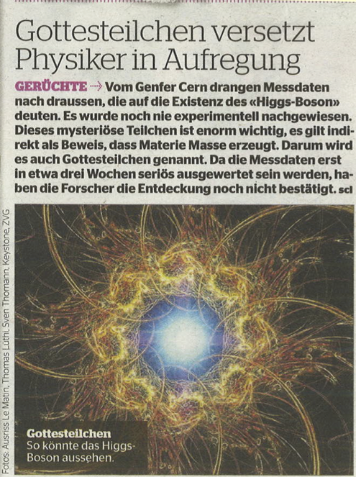
Blick am Abend
Tuesday, 19 June 2012
“This is how the Higgs
boson could look”

Slide 3
We present updated results on SM Higgs searches based on the data recorded
in 2011 at √s=7 TeV (~4.9 fb⁻¹) and 2012 at √s=8 TeV (~5.9 fb⁻¹)
Results are preliminary:
2012 data recorded until 2 weeks ago
harsher conditions in 2012 due to ~ x2 larger event pile-up
new, improved analyses deployed for the first time
H → γγ and H→ 4l: high-sensitivity at low-m_{H}; high mass-resolution; pile-up robust
analyses improved to increase sensitivity → new results from 2011 data
all the data recorded so far in 2012 have been analyzed
results are presented here for the first time
Other low-mass channels: H→ WW^{(*)}→ lνlν, H→ ττ, W/ZH→ W/Z bb:
E_{T}^{miss} in final state → less robust to pile-up
worse mass resolution, no signal “peak” in some cases
complex mixture of backgrounds
understanding of the detector performance and backgrounds in 2012 well advanced, but results not yet mature enough to be presented today
→ 2011 results used here for these channels for the overall combination

Slide 4

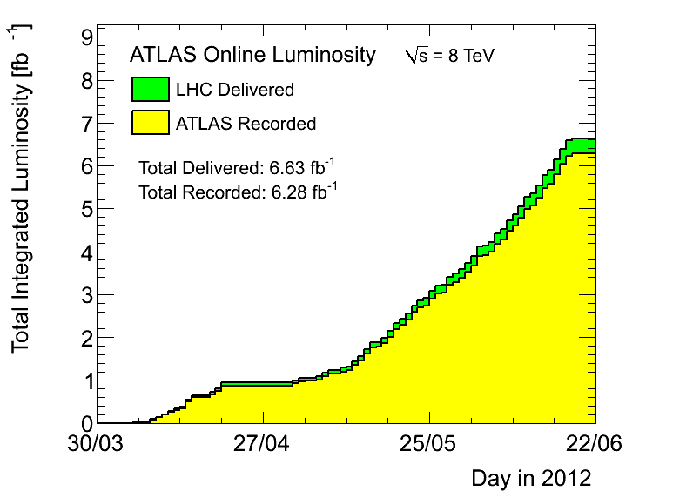
2012 data-taking so far …
Peak luminosity in 2012:
~ 6.8 x10³³ cm⁻² s⁻¹
Fraction of non-operational detector channels:
(depends on the sub-detector)
few permil (most cases) to 4%
Data-taking efficiency = (recorded lumi)/(delivered lumi):
~ 94.6%
Good-quality data fraction, used for analysis :
(will increase further with data reprocessing)
~ 93.6%

Slide 5
2012 data-taking so far …
Peak luminosity in 2012:
~ 6.8 x10³³ cm⁻² s⁻¹
of the delivered luminosity used for these results
(slightly larger fraction than in 2011):
in spite of the very fresh data
in spite of the harsher conditions
~ 90%

Slide 6
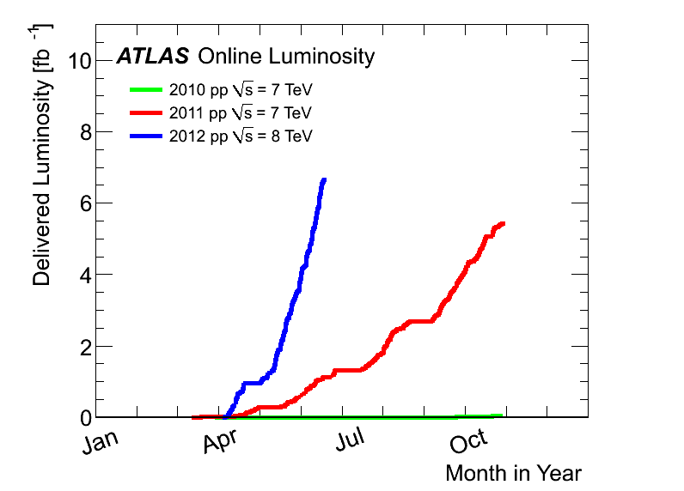
Luminosity delivered to ATLAS since the beginning
2012:
6.6 fb⁻¹
at 8 TeV
2011
5.6 fb⁻¹
at 7 TeV
2010
0.05 fb⁻¹
at 7 TeV

Slide 7
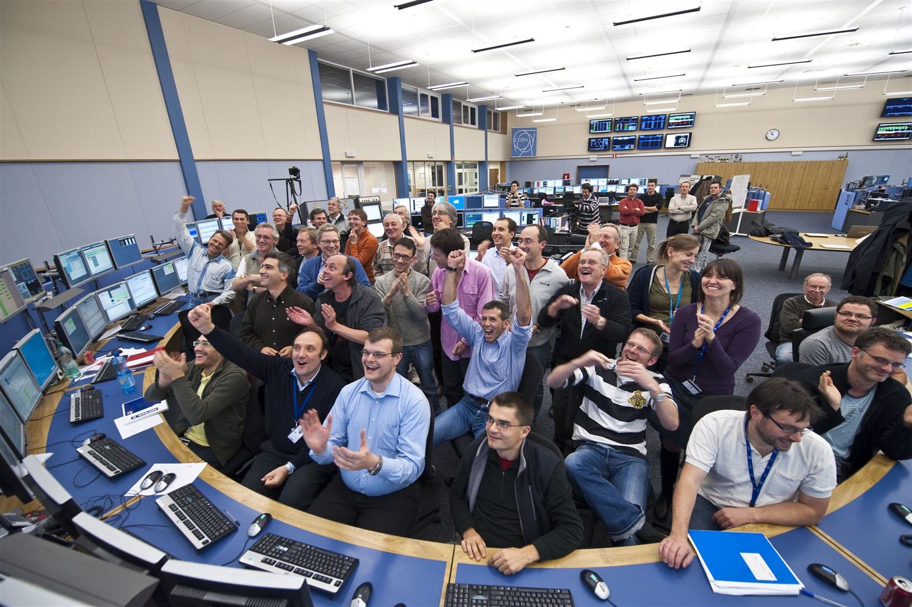
BIG THANKS
To the whole LHC exploitation team, including the operation, technical
and infrastructure groups, for the OUTSTANDING performance of the
machine, and to all the people who have contributed to the conception,
design, construction and operation of this superb instrument

Slide 8
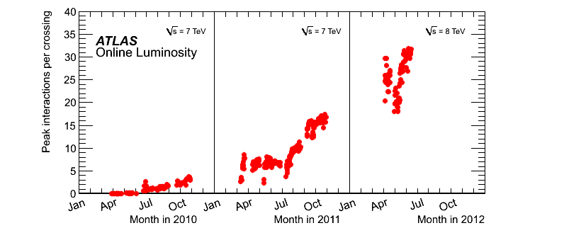
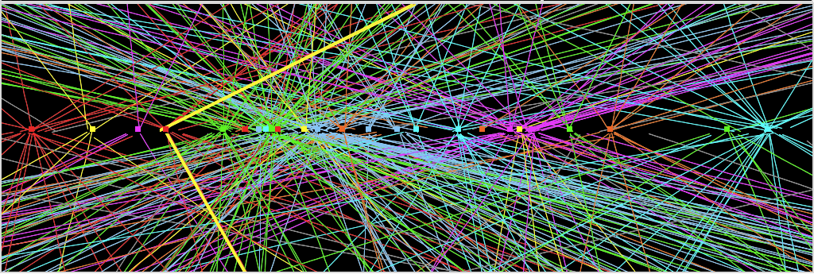
The BIG challenge in 2012: PILE-UP
Experiment’s
design value
(expected to be
reached at L=10³⁴ !)
Z→ μμ event from 2012 data with 25 reconstructed vertices
Z→ μμ

Slide 9
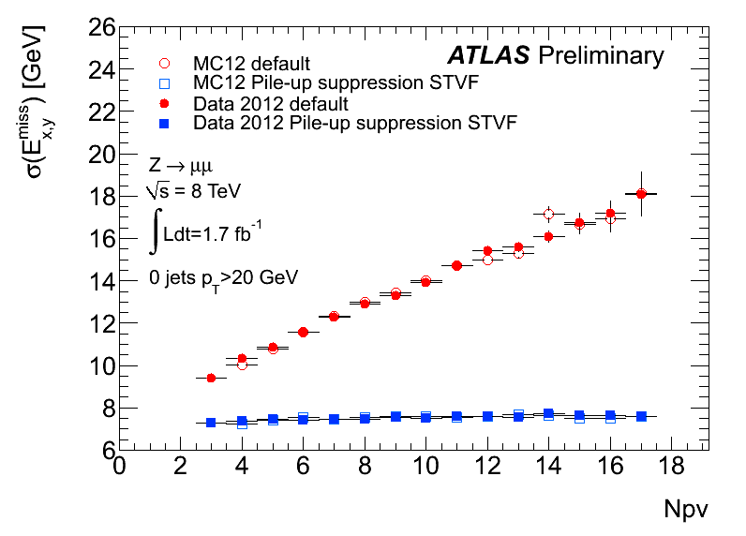
Huge efforts over last months to prepare for 2012 conditions and mitigate impact of
pile-up on trigger, reconstruction of physics objects (in particular E_{T}^{miss}, soft jets, ..),
computing resources (CPU, event size)
Pile-up robust, fast trigger and offline algorithms developed
Reconstruction and identification of physics objects (e, γ, μ, τ, jet, E_{T}^{miss}) optimised to be
~independent of pile-up → similar (better in some cases!) performance as with 2011 data
Precise modeling of in-time and out-of-time pile-up in simulation
Flexible computing model to accommodate x2 higher trigger rates and event size as well as physics and analysis demands
Understanding of E_{T}^{miss}
(most sensitive to pile-up) is
crucial for H→ WW^{(*)} → lνlν ,
W/ZH→W/Zbb, H→ττ
E_{T}^{miss} resolution vs pile-up in
Z→ μμ events before and
after pile-up suppression
using tracking information
Note: number of reconstructed
primary vertices is ~ 60% number
of interactions per crossings
Number of reconstructed primary vertices

Slide 10
Trigger in 2012
Optimization of selections (e.g. object isolation) to maintain low un-prescaled thresholds
(e.g. for inclusive leptons) in spite of projected x2 higher L and pile-up than in 2011
Pile-up robust algorithms developed (~flat performance vs pile-up, minimize CPU usage, ...)
Results from 2012 operation show trigger is coping very well (in terms of rates, efficiencies, robustness, ..) with harsh conditions while meeting physics requirements
Lowest un-prescaled thresholds (examples)
L1: up to ~ 65 kHz
Item p_{T} threshold (GeV) Rate (Hz)
5x10³³
Incl. e 24 70
Incl. μ 24 45
ee 12 8
μμ 13 5
ττ 29,20 12
γγ 35,25 10
E_{T}^{miss} 80 17
5j 55 8
L2: up to ~ 5 kHz
EF: ~ 400Hz
Note: ~ 500 items in trigger menu !
Managed to keep inclusive un-prescaled lepton
thresholds within ~ 5 GeV over last two years
in spite factor ~ 70 peak lumi increase

Slide 11
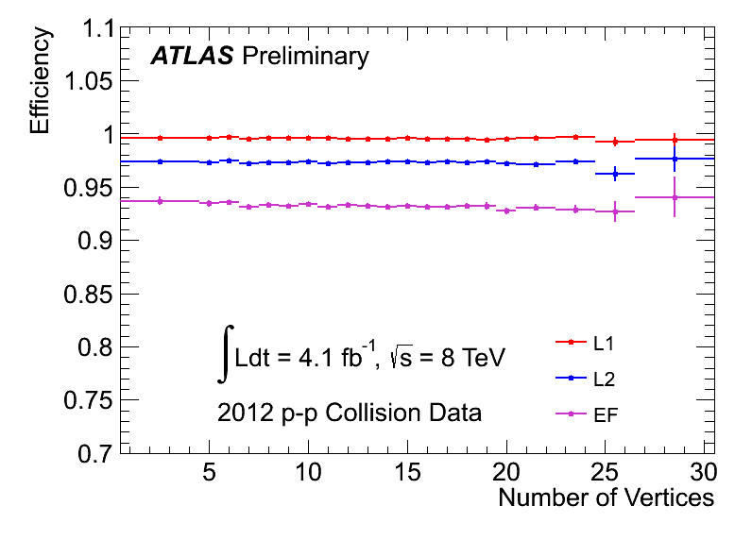
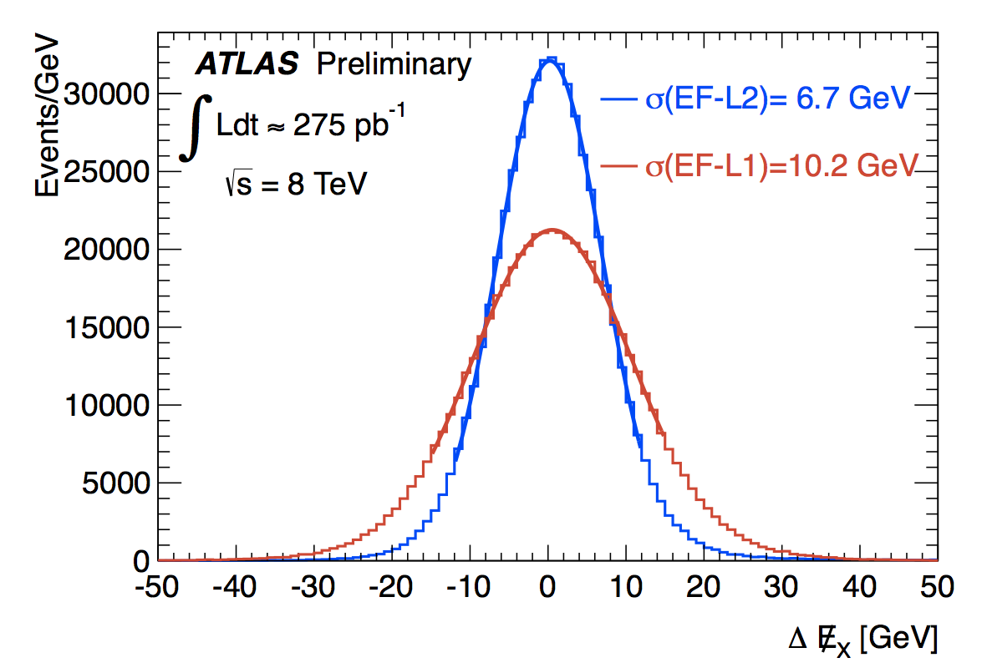
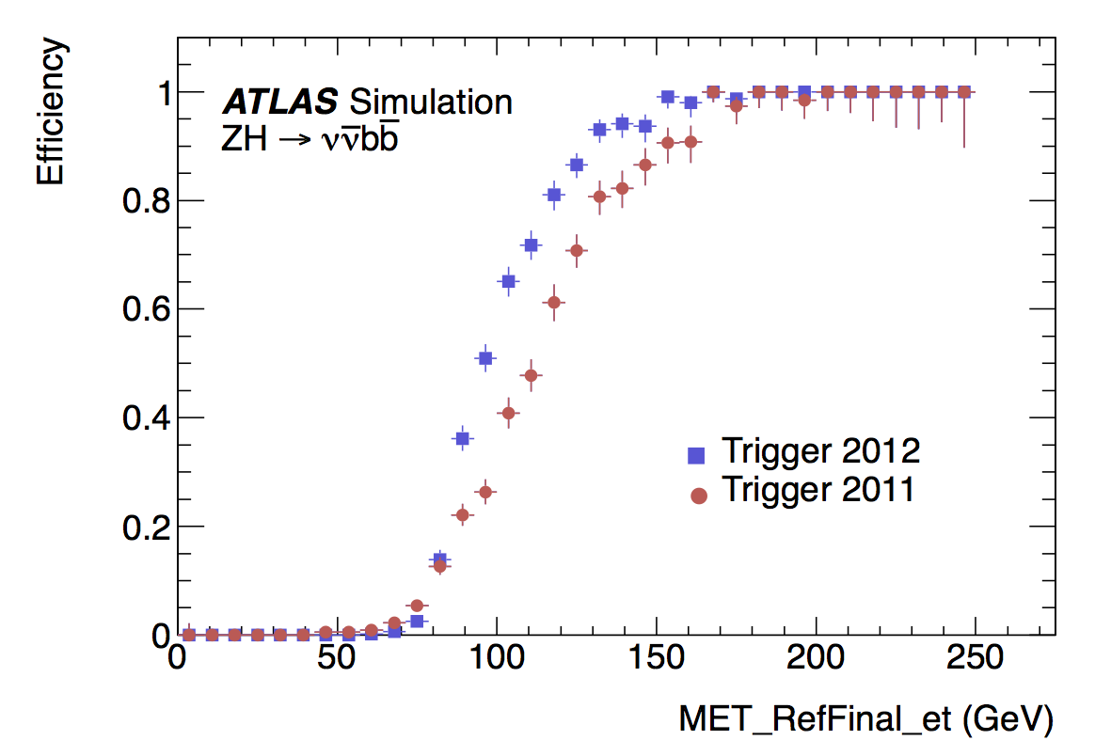
Efficiency of inclusive electron
trigger (E_{T} thresholds as low as 24)
as a function of “pile-up”
From Z→ ee events
Many improvements in E_{T} ^{miss} trigger:
e.g. pile-up suppression, L2 fast front-end
board sums instead of L1 only → same
threshold as in 2011, sharper turn-on curve
x-component
resolution
Red: 2011
Blue: 2012
Offline E_{T} ^{miss} (GeV)

Slide 12
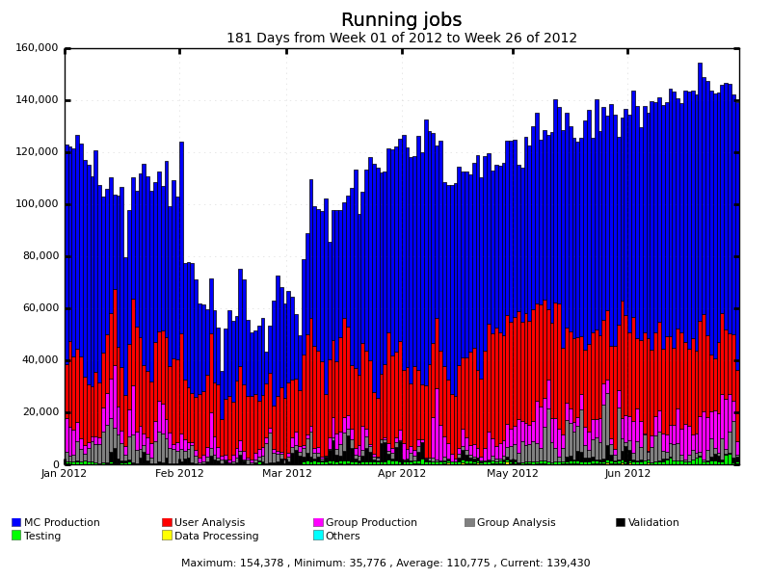
It would have been impossible to release physics results so quickly without
the outstanding performance of the Grid (including the CERN Tier-0)
Number of concurrent ATLAS jobs Jan-July 2012
Includes MC production,
user and group analysis
at CERN, 10 Tier1-s,
~ 70 Tier-2 federations
→ > 80 sites
100 k
> 1500 distinct ATLAS users
do analysis on the GRID
Available resources fully used/stressed (beyond pledges in some cases)
Massive production of 8 TeV Monte Carlo samples
Very effective and flexible Computing Model and Operation team → accommodate high
trigger rates and pile-up, intense MC simulation, analysis demands from worldwide
users (through e.g. dynamic data placement)

Slide 13
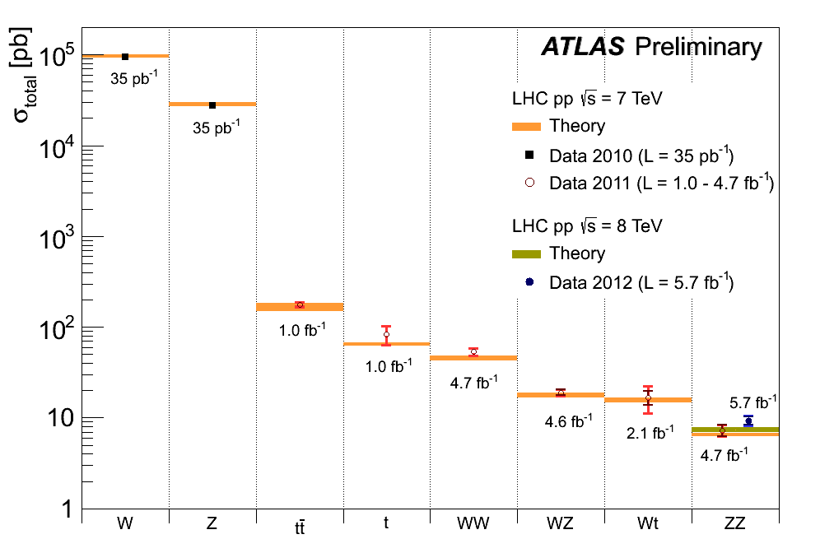
Most recent electroweak and top cross-section measurements
Inner error: statistical
Outer error: total
Important on their own and as foundation for Higgs searches
Most of these processes are reducible or irreducible backgrounds to Higgs
Reconstruction and measurement of challenging processes (e.g. fully hadronic tt,
single top, ..) are good training for some complex Higgs final states

Slide 14
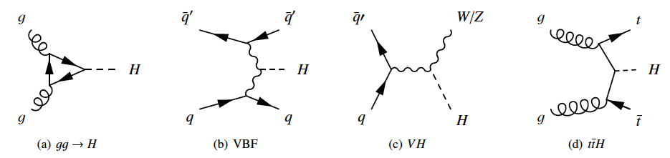
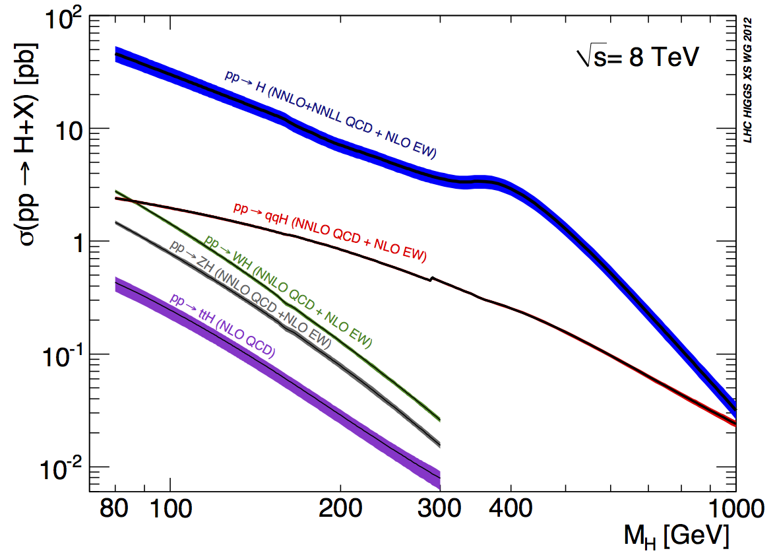
SM Higgs production cross-section and decay modes
Most sensitive channels
120<m_{H}<130 GeV:
H→ WW^{(*)}→ lνlν
H→ γγ, H→ 4l
H→ ττ, W/ZH→ W/Z bb
√s=7 → 8 TeV:
Higgs cross-section increases by ~ 1.3 for m_{H} ~ 125 GeV
Similar increase for several irreducible backgrounds: e.g. 1.2-1.25 for γγ, di-bosons
Reducible backgrounds increase more: e.g. 1.3-1.4 for tt, Zbb
→ Expected increase in Higgs sensitivity: 10-15%
Note: huge efforts and progress from theory community to compute NLO/NNLO
cross-sections for Higgs production and for (often complex !) backgrounds

Slide 15
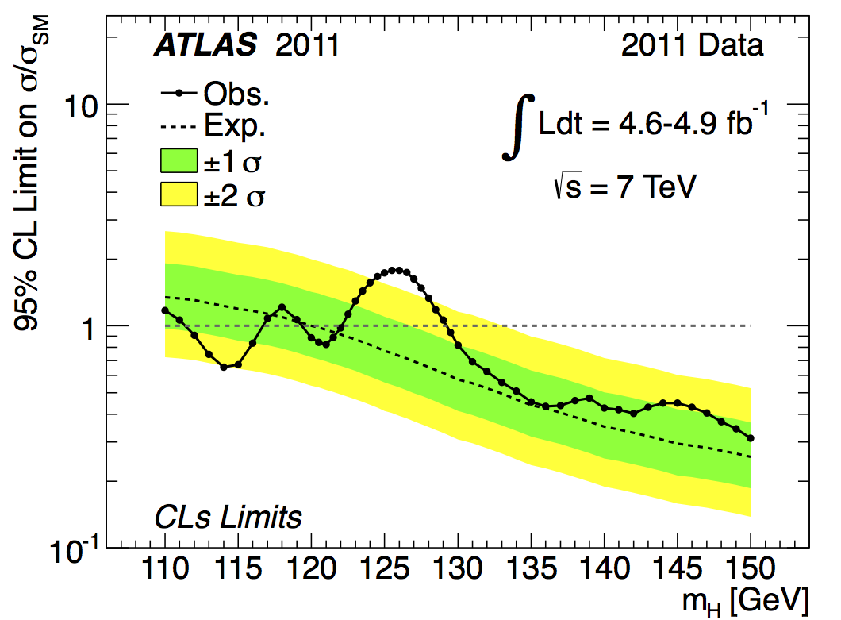
Status of ATLAS searches … until this morning
Results on the full 7 TeV dataset submitted for publication
Combination of 12 channels:
H→ γγ
W/ZH→W/Z bb (3 final states)
H→ ττ (3 final states)
H→ ZZ(*) → 4l
H→ WW(*) → lνlν
H→ ZZ → llqq
H→ ZZ → llνν
H→ WW → lνqq
Excluded at 95% CL
111.4 < m_{H} < 122.1 GeV (except 116.6-119.4)
129.2 < m_{H} < 541 GeV
Expected if no signal:
120-560 GeV
Excluded at 99% CL
130.7 <m_{H} < 506 GeV

Slide 16
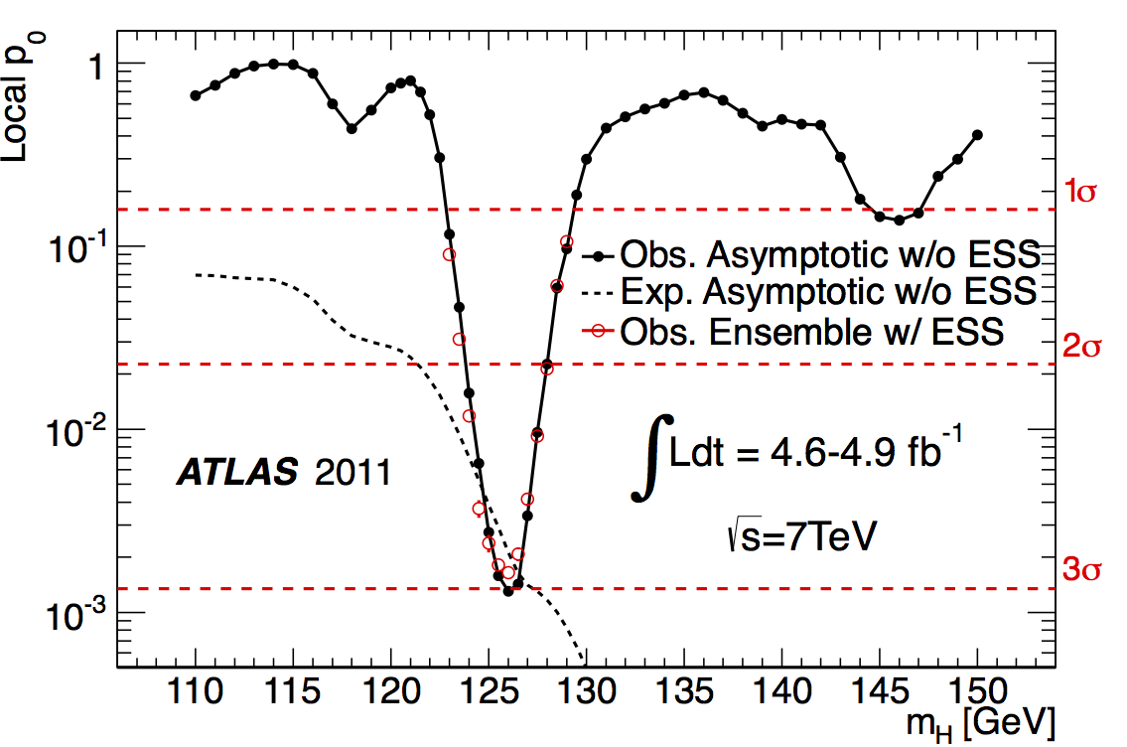
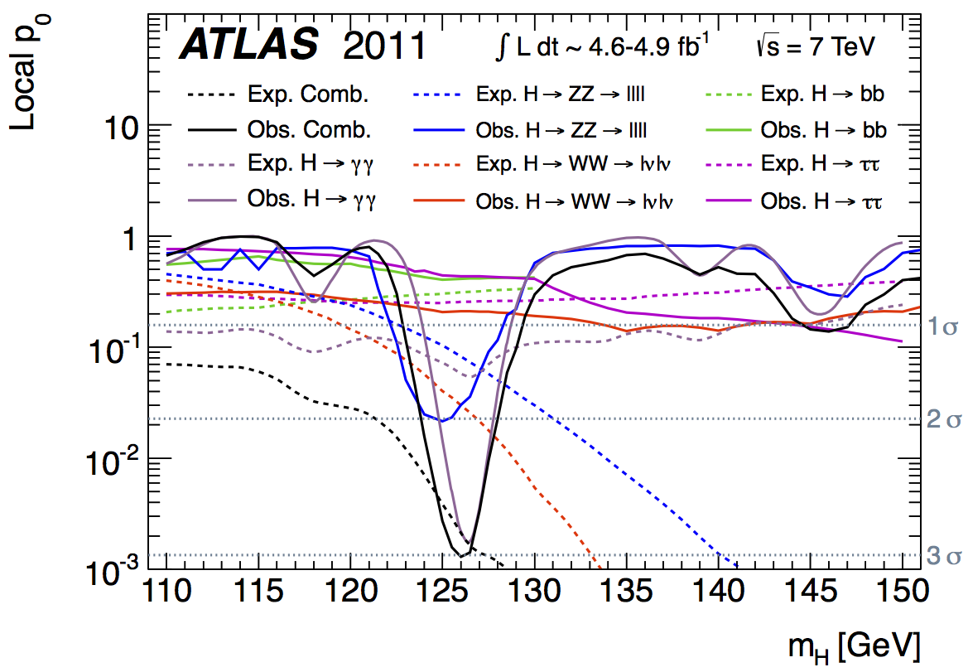
Status of ATLAS searches … until this morning
Consistency of the data with the background-only expectation (p-value)
Expected from SM
Higgs at given m_{H}
2.9 σ excess observed for
m_{H} ~ 126 GeV
Local significance Observed Expected from SM Higgs
Total 2.9 σ 2.9 σ
H→ γγ 2.8 σ 1.4 σ
H→ 4l 2.1 σ 1.4 σ
H→ lνlν 0.8 σ 1.6 σ
Probability to occur anywhere
over 110-600 (110-146 GeV):
15% (6%) (Look-Elsewhere Effect)

Slide 17
What’s new in the results presented today ?
Experience gained with the 2011 data propagated to reconstruction and simulation
(improved detector understanding, alignment and calibration, pile-up, …)
In particular: improved reconstruction and identification of physics objects → sizeable gain in efficiency for e/γ/μ, pile-up dependence minimized, smaller systematic uncertainties
→ Huge amount of painstaking foundation work !
Sensitivity of H → γγ and H → 4l analyses improved using the following procedure:
optimization only done on MC simulation
then looked at 2012 data in signal sidebands and background control regions
(note: large and sometimes not well-known backgrounds estimated mostly with
data-driven techniques using background-enriched-signal-depleted control regions)
→ validate MC simulation
signal region inspected only after above steps satisfactory
Improved analyses applied also to 2011 data → updated H→ γγ, 4l results at 7 TeV
Presented here:
H→ γγ, 4l results with full √s=7 TeV and √s=8 TeV datasets (~10.7 fb⁻¹) and
improved analyses
new overall combination
(all channels other than H→ γγ, 4l based on 7 TeV data)

Slide 18
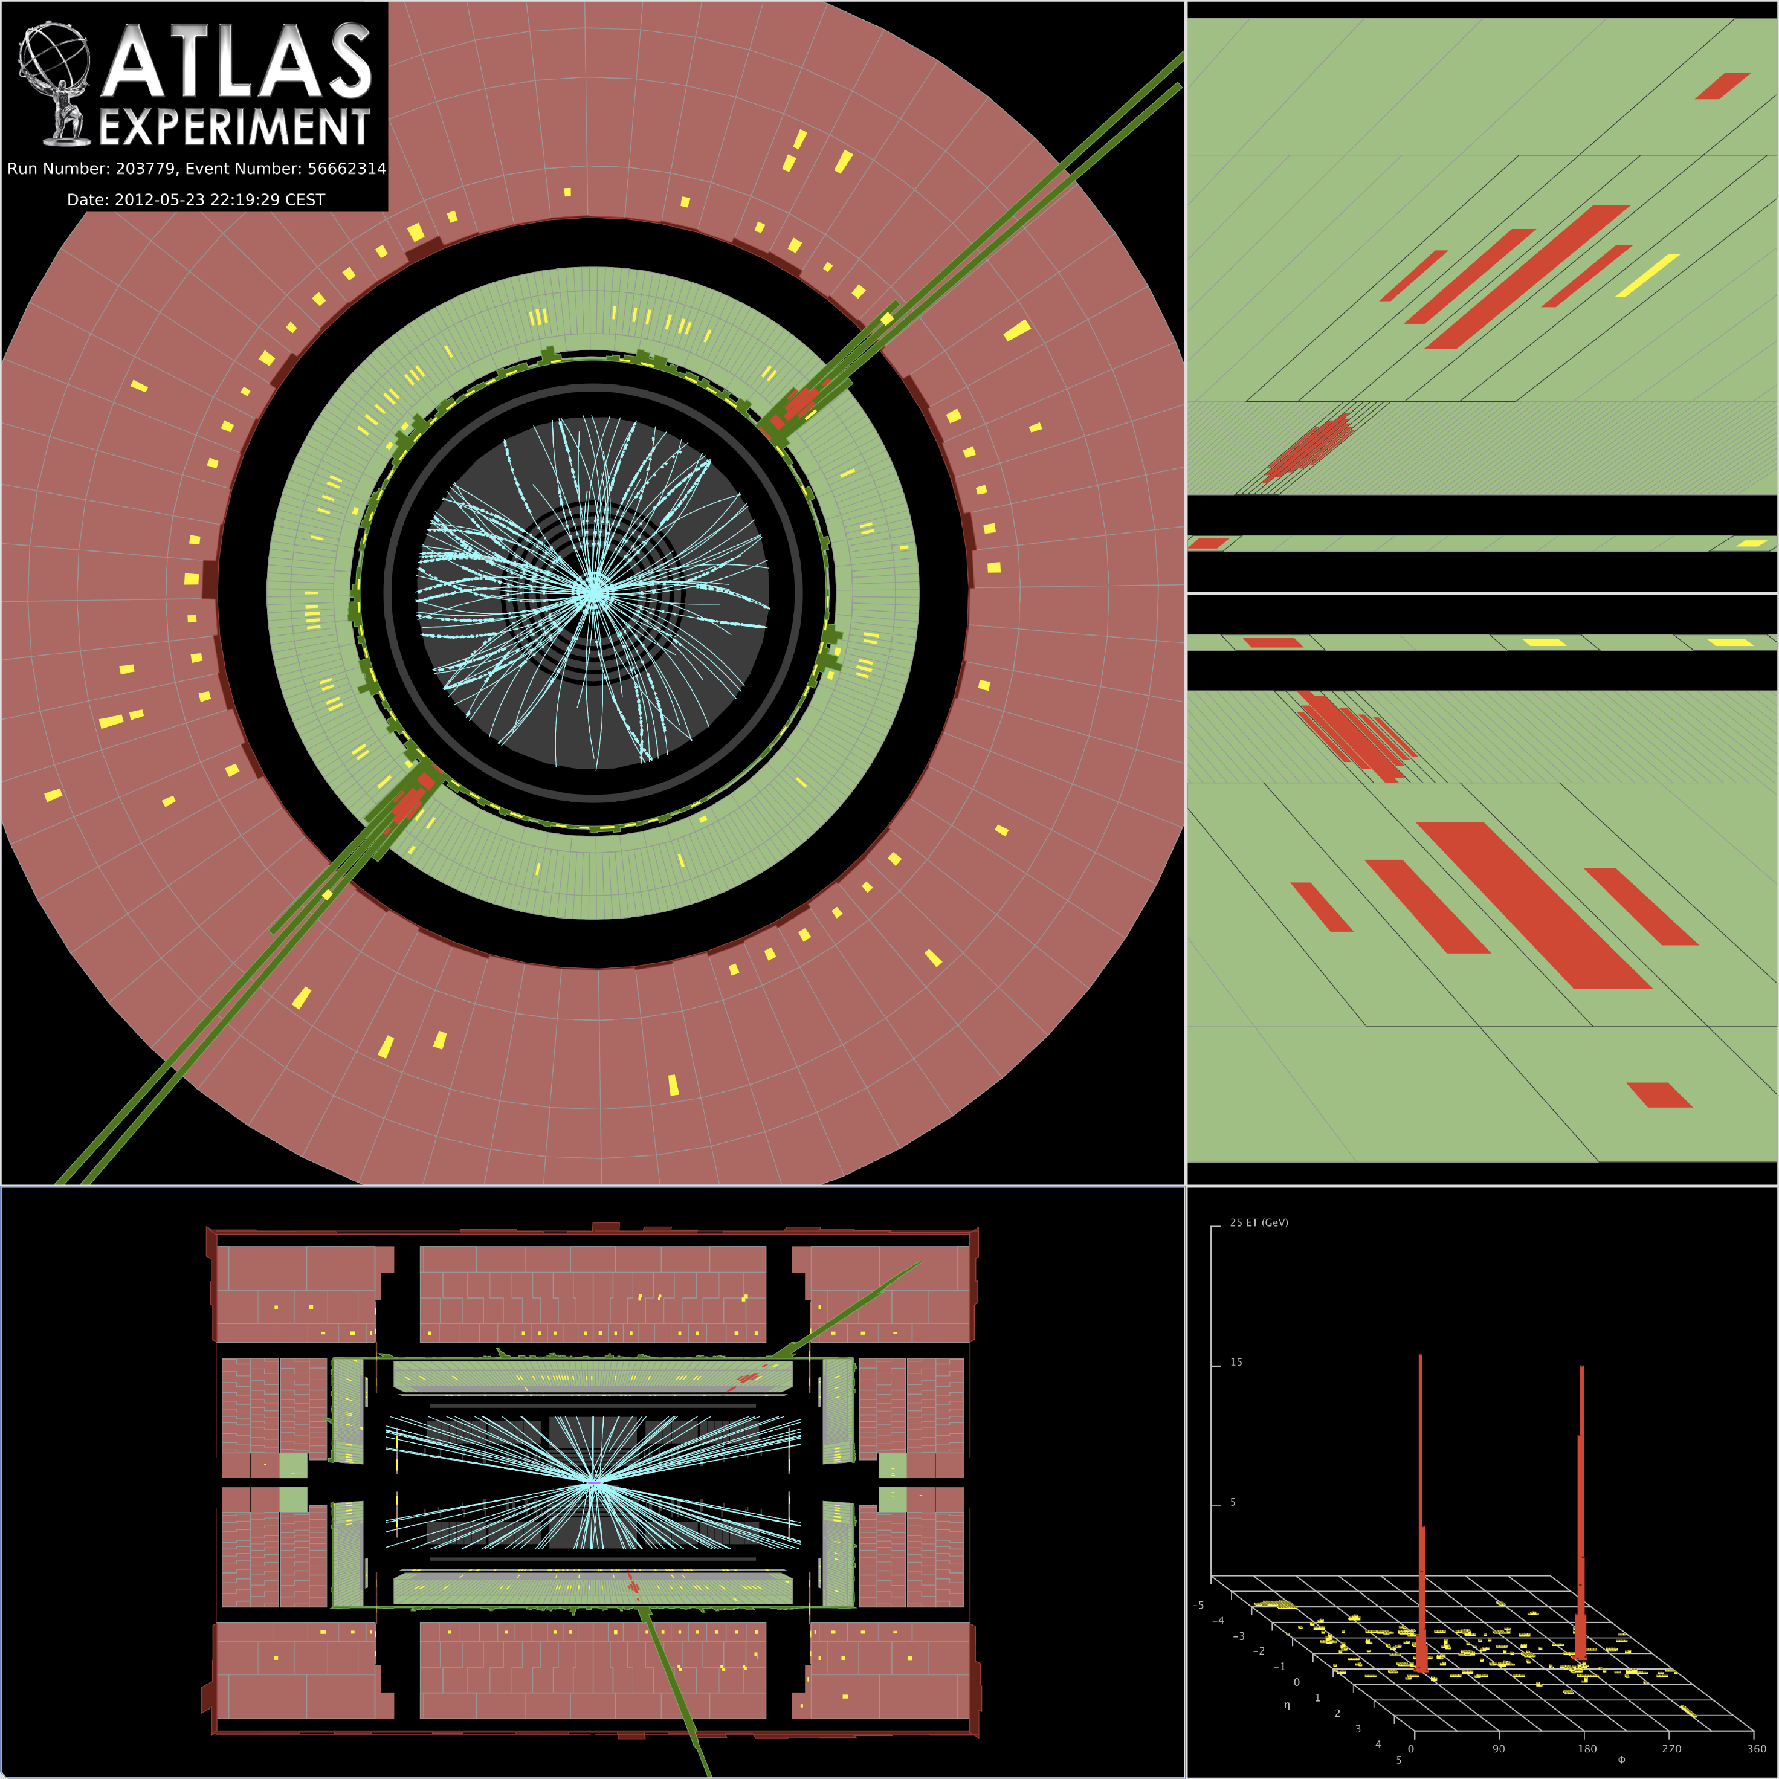
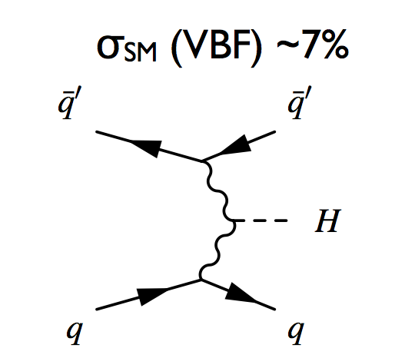
H → γγ
110 ≤ m_{H} ≤ 150 GeV
σ x BR ~ 50 fb m_{H} ~ 126 GeV
Simple topology: two high-p_{T} isolated photons
E_{T} (γ₁, γ₂) > 40, 30 GeV
Main background: γγ continuum (irreducible, smooth, ..)
To increase sensitivity, events divided in 10 categories based on γ rapidity,
converted/unconverted γ; p_{Tt} (p_{T}^{γγ} perpendicular to γγ thrust axis); 2jets
Main improvements in new analysis:
2jet category introduced → targeting VBF process
γ identification (NN used for 2011 data) and isolation
Expected gain in sensitivity: + 15%
Background fit procedure also improved
2 jets with
p_{T} > 25-30 GeV
|η|<4.5
|Δη|_{jj} > 2.8
M_{jj} > 400 GeV
|Δφ| (γγ-jj) > 2.6
After all selections, expect (10.7 fb⁻¹, m_{H}~ 126 GeV)
~ 170 signal events (total signal efficiency ~ 40%)
~ 6340 background events in mass window
→ S/B ~ 3% inclusive (~ 20% 2jet category)
Expected gain in sensitivity: 3%
Crucial experimental aspects:
excellent γγ mass resolution to observe narrow signal peak above irreducible background
powerful γ identification to suppress γj and jj background with jet → π⁰ → fake γ
(cross sections are 10⁴-10⁷ larger than γγ background)

Slide 19
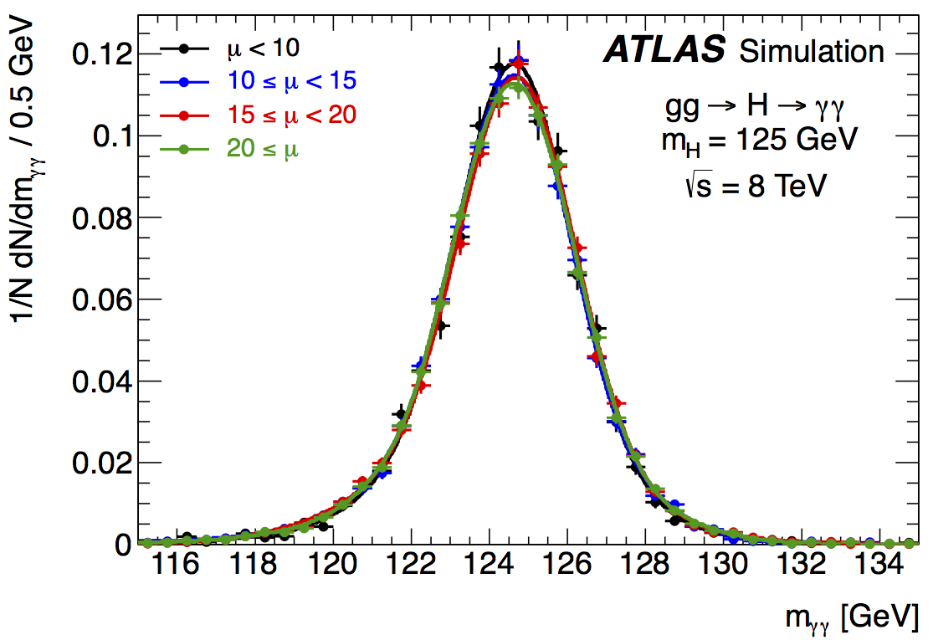
Mass resolution
Stability of EM calorimeter response vs time
(and pile-up) during full 2011 run better than 0.1%
m²_{γγ}= 2 E₁ E₂ (1-cosα)
Present understanding of calorimeter
E response (from Z, J/ψ → ee, W→ eν
data and MC):
E-scale at m_{Z} known to ~ 0.3%
Linearity better than 1% (few-100 GeV)
“Uniformity” (constant term of resolution): ~ 1% (2.5% for 1.37<|η|<1.8)
Electron scale transported to photons using
MC (small systematics from material effects)
Mass resolution not
affected by pile-up
Mass resolution of inclusive sample: 1.6 GeV
Fraction of events in ±2σ: ~90%

Slide 20
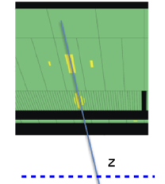
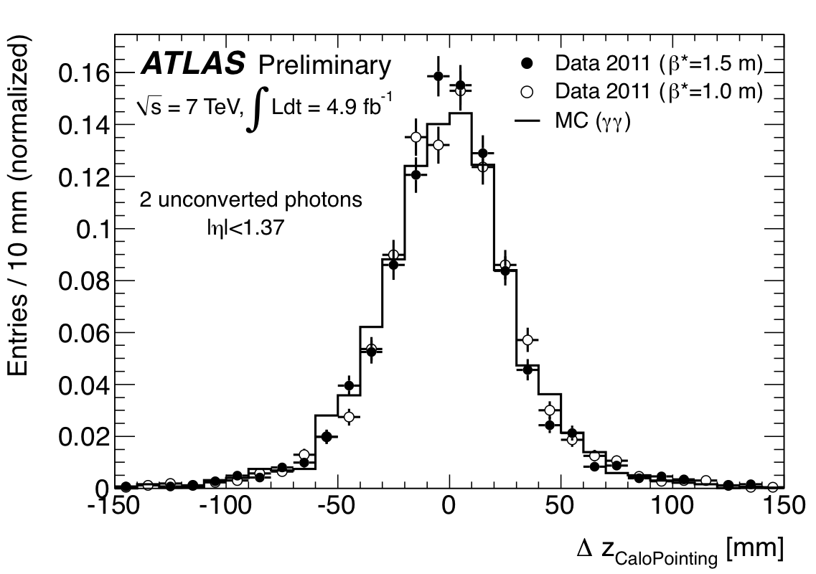
m²_{γγ}= 2 E₁ E₂ (1-cosα)
α=opening angle of
the two photons
High pile-up: many vertices distributed over
σ_{Z} (LHC beam spot) ~ 5-6 cm
→ difficult to know which one has produced the γγ pair
ϑ
Primary vertex from:
EM calorimeter longitudinal (and lateral) segmentation
tracks from converted photons
Measure γ direction with calo
→ get Z of primary vertex
Z-vertex measured in γγ events
from calorimeter “pointing”
Note:
Calorimeter pointing alone reduces
vertex uncertainty from beam spot
spread of ~ 5-6 cm to ~ 1.5 cm
and is robust against pile-up
good enough to make contribution to mass
resolution from angular term negligible
Addition of track information (less
pile-up robust) needed to reject fake
jets from pile-up in 2j/VBF category
σ_{Z} ~ 1.5 cm
Z (γ₁) – Z (γ₂)

Slide 21
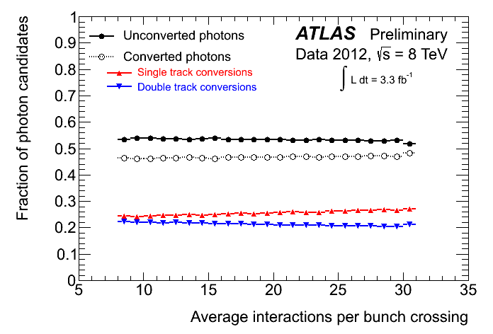
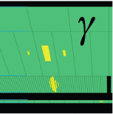
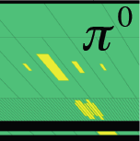
γ reconstruction, γ/jet separation
Fraction of converted and unconverted
γ vs pile-up is now stable (within 1%)
small migration between categories,
accurate specific calibration
Data-driven decomposition of selected γγ sample
High γγ purity thanks to:
R_{j} ~10⁴
ε (γ) ~ 90%
γγ ~ 75-80%
E_{T}~ 32 GeV
E_{T}~ 21 GeV
γj ~ 20%
jj ~ 2%
η-strips

Slide 22
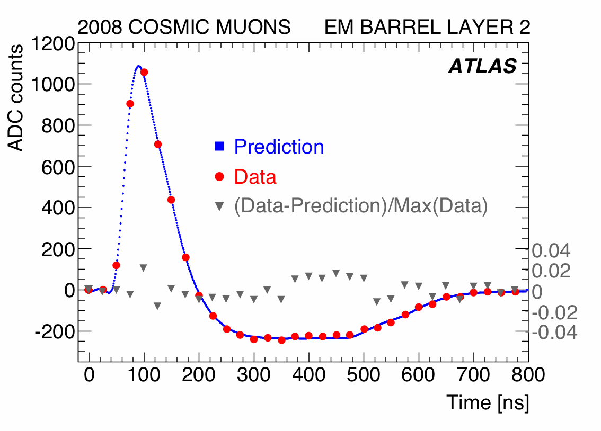
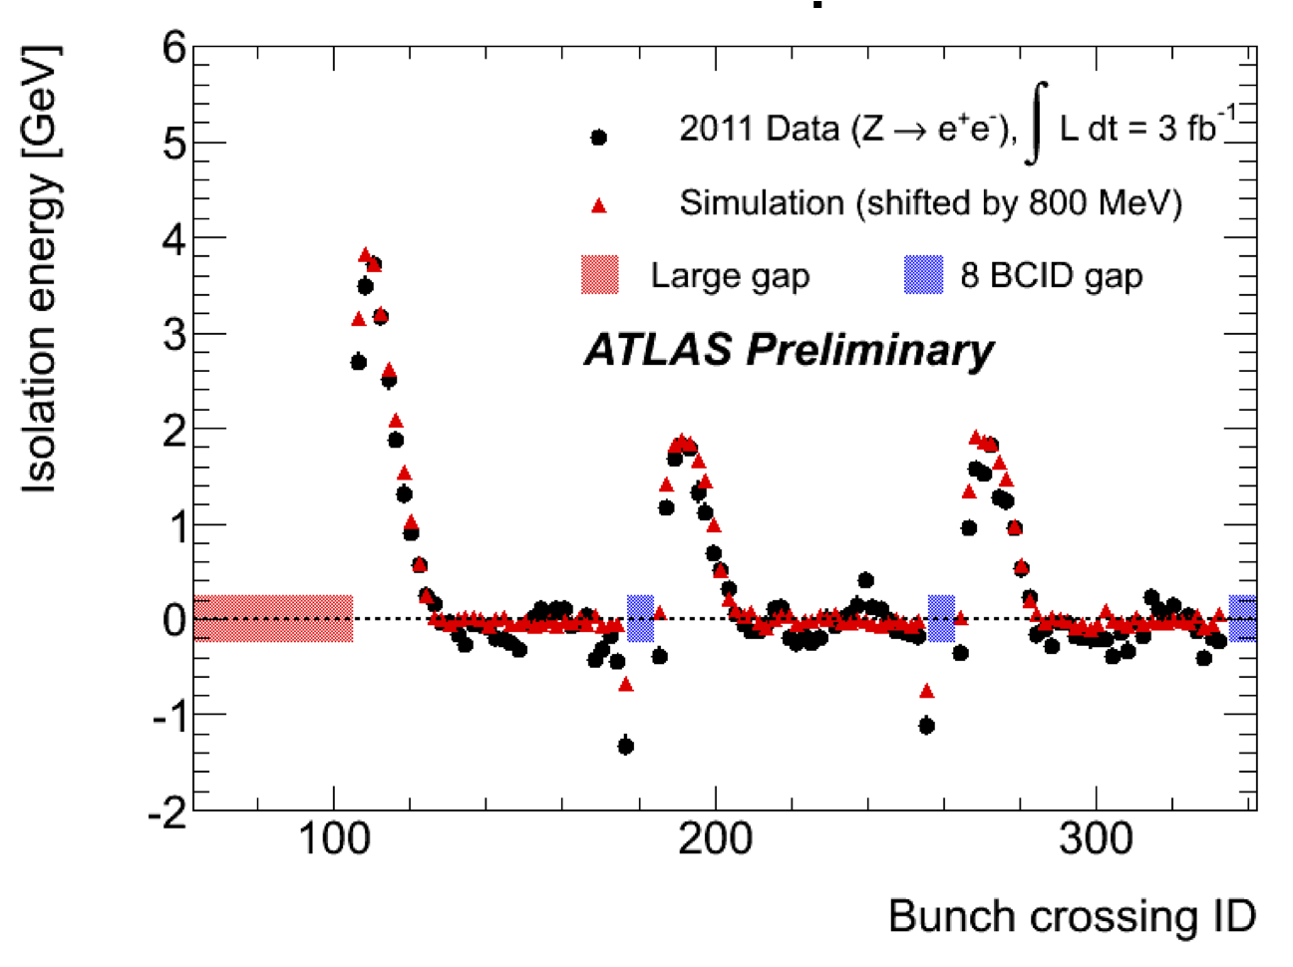
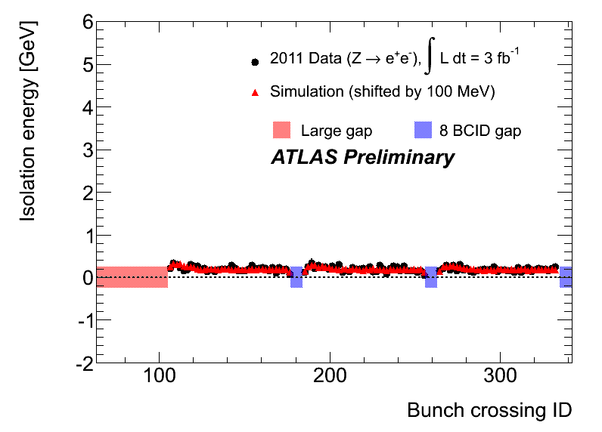
Photon isolation requirement: E_{T} < 4 GeV inside cone ΔR < 0.4 around γ direction.
Pile-up contribution subtracted using an “ambient energy density” event-by-event
If subtraction is not perfect, residual
dependence of the isolation energy on
the bunch position in the train observed,
due to impact of out-of-time pile-up
from neighbouring bunches convolved
with EM calorimeter pulse shape.
Calorimeter
bipolar pulse
shape: average
pile-up is zero
over ~ 600 ns
(~12 bunches)
Beginning of the train: no cancellation
from previous bunches
Corrected recently with
improved subtraction algorithm
From 12 bunches inside the
train: full cancellation
Effect well described by (detailed !) ATLAS simulation

Slide 23
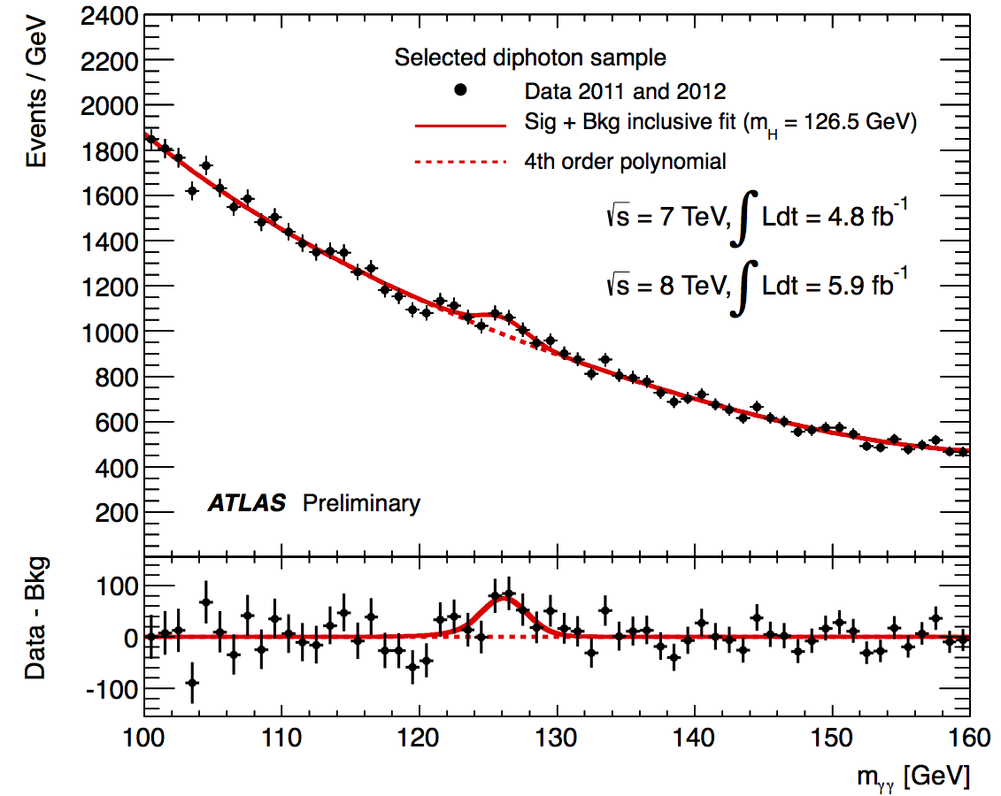
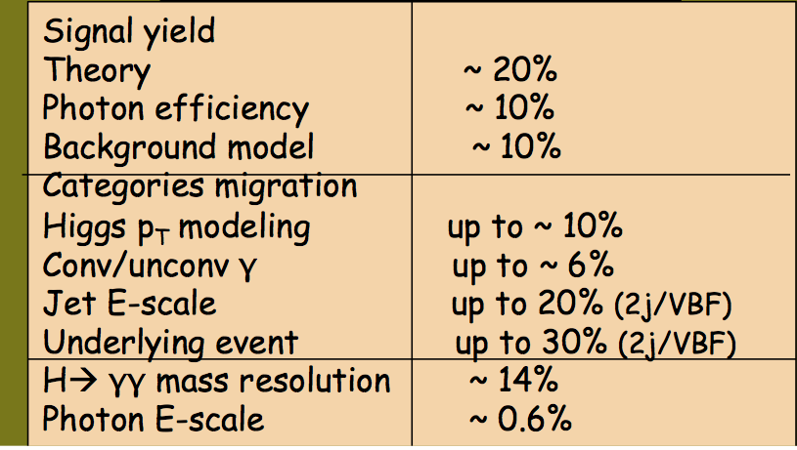
Total after selections: 59059 events
m_{γγ} spectrum fit, for each category, with
Crystal Ball + Gaussian for signal plus
background model optimised (with MC)
to minimize biases
Max deviation of background model from
expected background distribution taken
as systematic uncertainty
Main systematic uncertainties

Slide 24
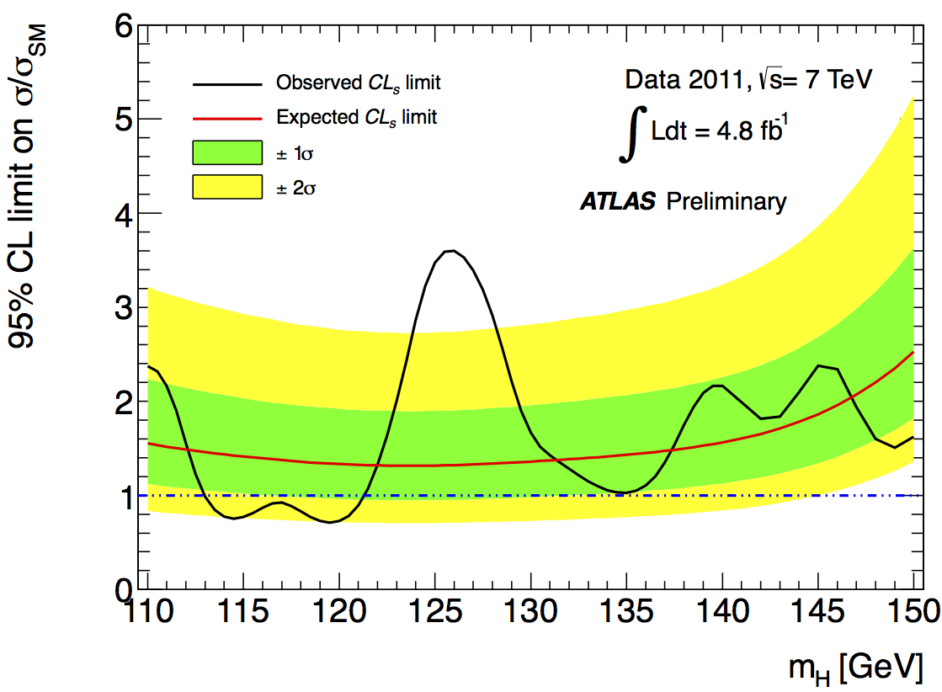
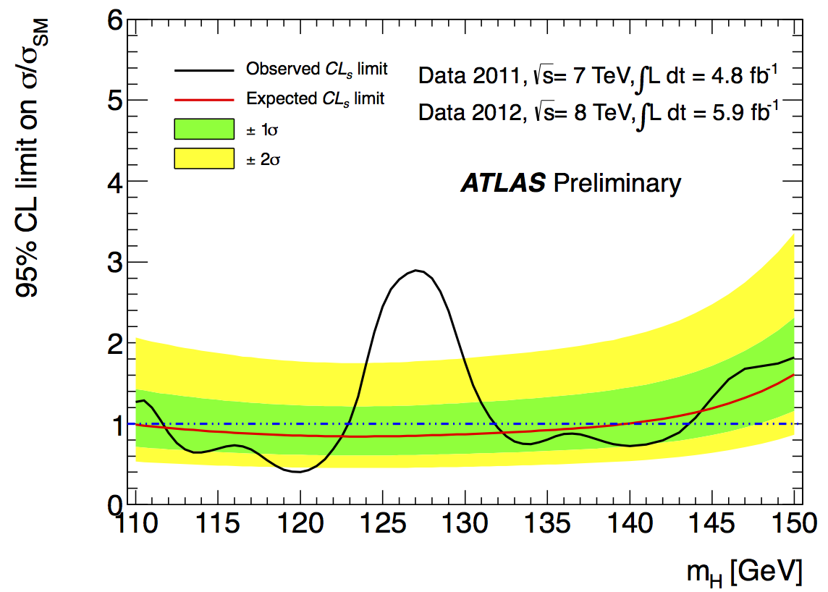
2011 data
Excluded (95% CL):
112-122.5 GeV, 132-143 GeV
Expected: 110-139.5 GeV
2011+2012 data
2012 data

Slide 25
Consistency of data with background-only expectation
Points indicate impact
of 0.6% uncertainty on
photon energy scale:
~ 0.1 sigma
Expected from
SM Higgs at
given m_{H}
Data sample m_{H} of max deviation local p-value local significance expected from SM Higgs
2011 126 GeV 3x10⁻⁴ 3.5 σ 1.6 σ
2012 127 GeV 3x10⁻⁴ 3.4 σ 1.9 σ
2011+2012 126.5 GeV 2x10⁻⁶ 4.5 σ 2.4 σ
Global 2011+2012 (including LEE over 110-150 GeV range): 3.6 σ

Slide 26
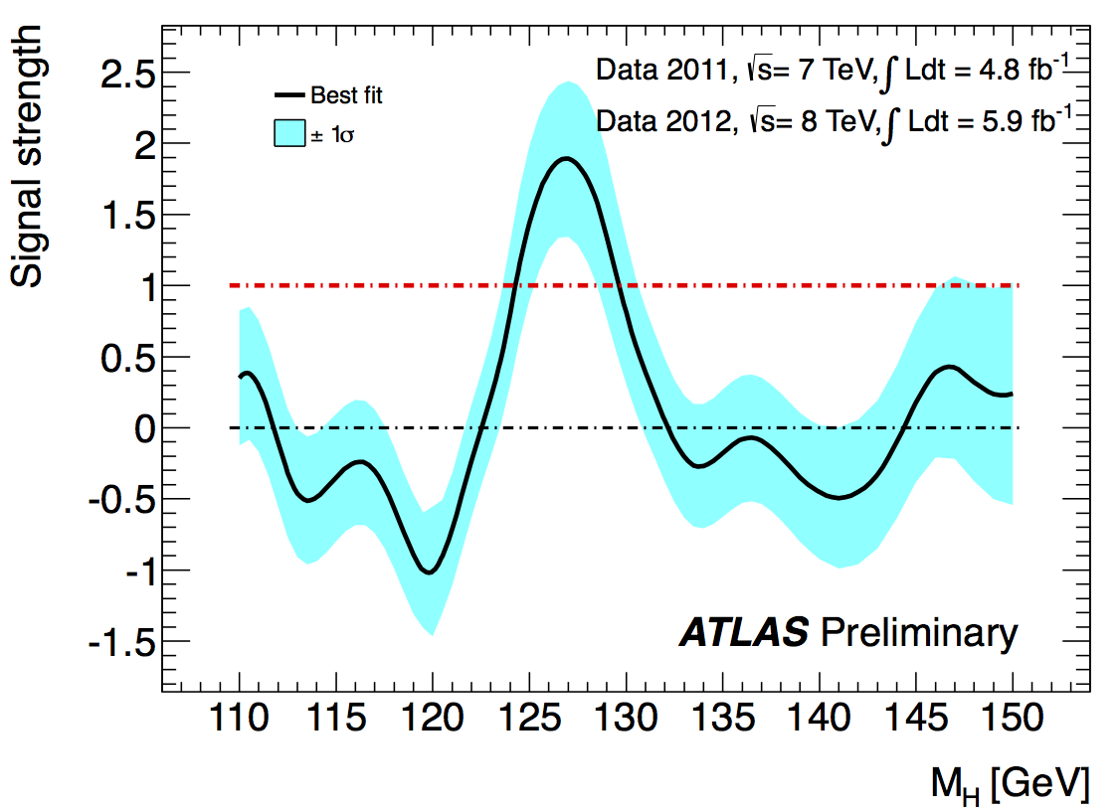
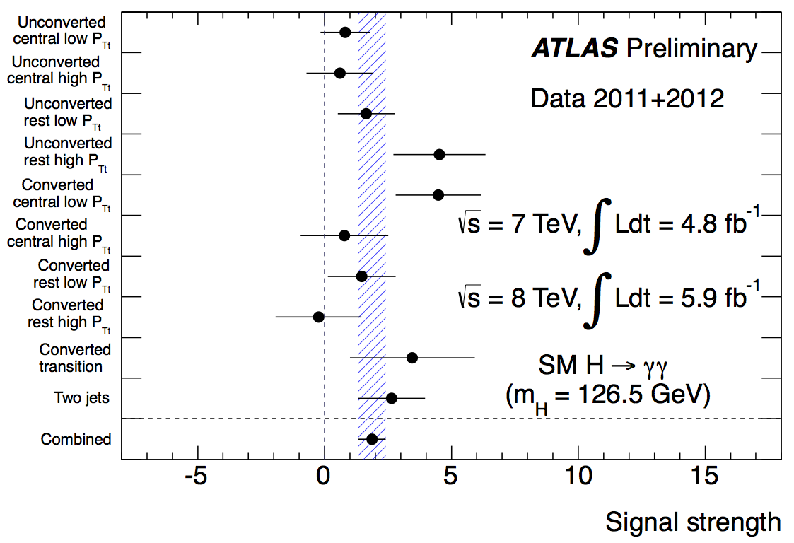
Fitted signal strength
Normalized to SM Higgs expectation
at given m_{H} (μ)
Best-fit value at 126.5 GeV:
μ=1.9 ± 0.5
Consistent results from various
categories within uncertainties
(most sensitive ones indicated)

Slide 27
H → ZZ^{(*)} → 4l (4e, 4μ, 2e2μ)
110 < m_{H} < 600 GeV
σ x BR ~ 2.5 fb m_{H} ~ 126 GeV
Tiny rate, BUT:
-- mass can be fully reconstructed → events should cluster in a (narrow) peak
-- pure: S/B ~ 1
4 leptons: p_{T}^{1,2,3,4} > 20,15,10,7-6 (e-μ) GeV; 50 < m₁₂ < 106 GeV; m₃₄ > 17.5-50 GeV (vs m_{H})
Main backgrounds:
-- ZZ^{(*)} : irreducible
-- low-mass region m_{H} < 2m_{Z} : Zbb, Z+jets, tt with two leptons from b-jets or q-jets → l
Suppressed with isolation and impact parameter cuts on two softest leptons
Crucial experimental aspects:
High lepton acceptance, reconstruction & identification efficiency down to lowest p_{T}
Good lepton energy/momentum resolution
Good control of reducible backgrounds (Zbb, Z+jets, tt) in low-mass region:
→ cannot rely on MC alone (theoretical uncertainties, b/q-jet → l modeling, ..)
→ need to validate MC with data in background-enriched control regions
Main improvements in new analysis:
kinematic cuts (e.g. on m₁₂) optimized/relaxed to increase signal sensitivity at low mass
increased e± reconstruction and identification efficiency at low p_{T} , increased
pile-up robustness, with negligible increase in the reducible backgrounds
→ Gain 20% (4μ) to 30% (4e) in sensitivity compared to previous analysis

Slide 28
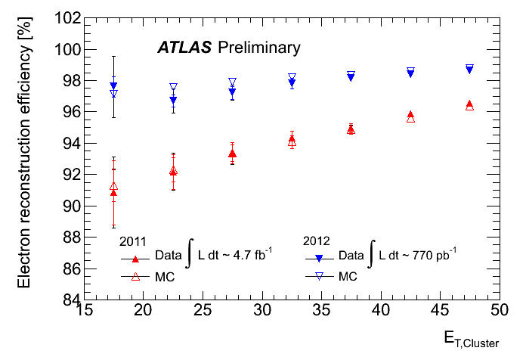
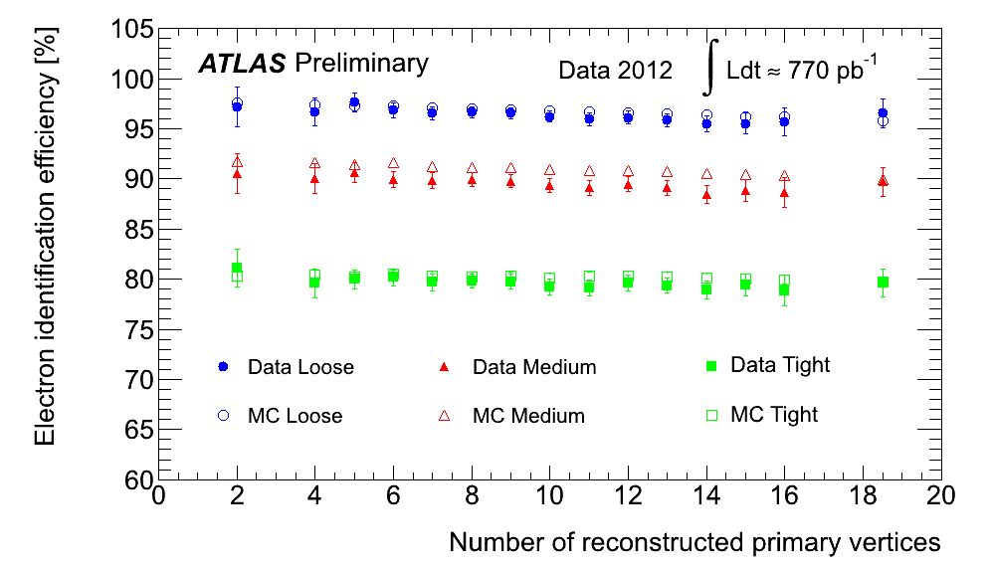
High efficiency for low-p_{T} electrons (affected by material) crucial for H→ 4e, 2μ2e
Improved track reconstruction and fitting to recover e± undergoing hard Brem
→ achieved ~ 98% reconstruction efficiency, flatter vs η and E_{T}
Re-optimized e± identification using
pile-up robust variables (e.g. Transition
Radiation, calorimeter strips) → achieved
~ 95% identification efficiency, ~ flat
vs pile-up; higher rejections of fakes
Results are from Z→ ee data and MC
tag-and-probe

Slide 29
High efficiency for low-p_{T} electrons (affected by material) crucial for H→ 4e, 2μ2e
Improved track reconstruction and fitting to recover e± undergoing hard Brem
→ achieved ~ 98% reconstruction efficiency, flatter vs η and E_{T}
Total gain in reconstruction and identification efficiency for
electrons from H→ 4e: ~ 8% average up to 15% at p_{T} ~ 7 GeV
Total acceptance x efficiency for H→ 4e: ~23% (+60% gain)
Re-optimized e± identification using
pile-up robust variables (e.g. Transition
Radiation, calorimeter strips) → achieved
~ 95% identification efficiency, ~ flat
vs pile-up; higher rejections of fakes
Results are from Z→ ee data and MC
tag-and-probe

Slide 30
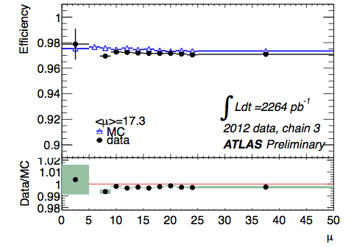
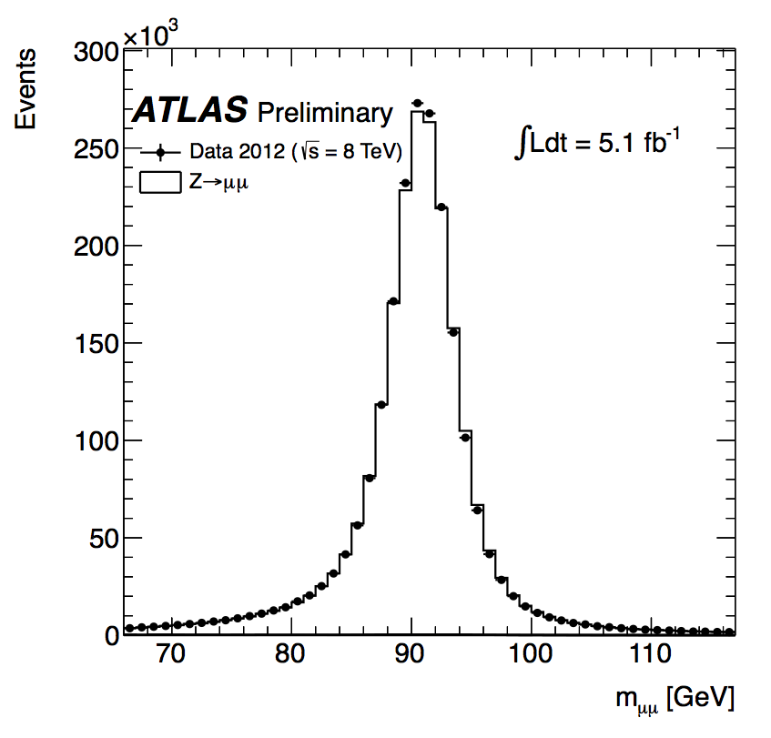
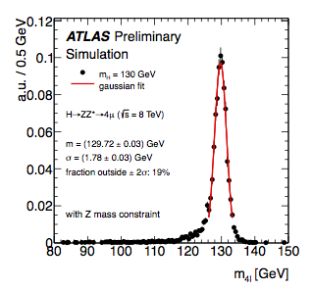
Muons reconstructed down to p_{T} = 6 GeV
over |η|<2.7
2012 Z→ μμ data
Reconstruction efficiency ~ 97%,
~ flat down to p_{T} ~ 6 GeV and over |η|~2.7
Total acceptance x efficiency
for H→ 4μ: ~ 40% (+45% gain)
2012 Z→ μμ mass peak
H→ 4μ mass spectrum
~ 2M Z→ μμ
Mass
resolution
~ 2 GeV

Slide 31
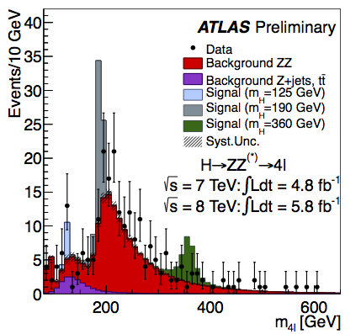
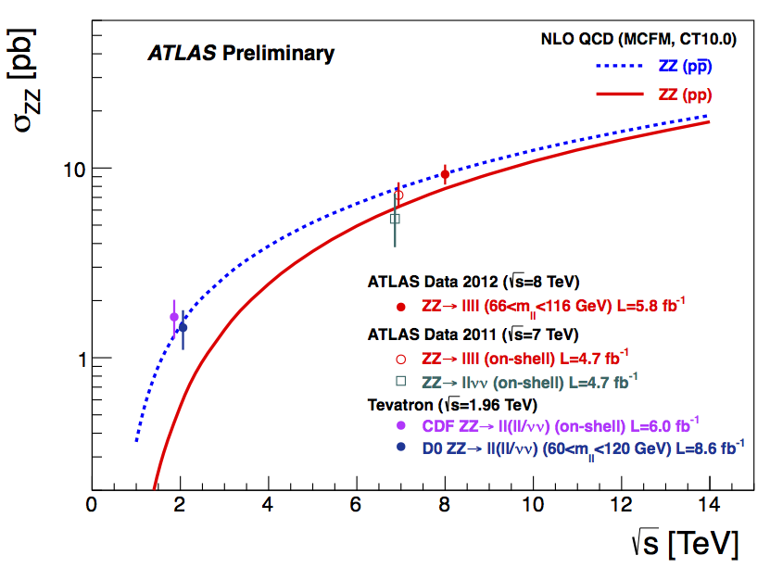
H→ 4l mass spectrum after all selections: 2011+2012 data
m(4l) > 160 GeV
(dominated by ZZ background):
147 ± 11 events expected
191 observed
~ 1.3 times more ZZ events in data
than SM prediction →in agreement
with measured ZZ cross-section in 4l
final states at √s = 8 TeV
Measured σ (ZZ) = 9.3 ± 1.2 pb
SM (NLO) σ (ZZ) = 7.4± 0.4 pb
Discrepancy has negligible impact on the
low-mass region < 160 GeV
(no change in results if in the fit ZZ is constrained
to its uncertainty or left free)

Slide 32
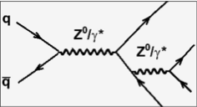
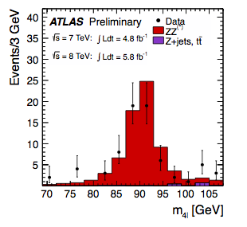
H→ 4l mass spectrum after all selections: 2011+2012 data
Peak at m(4l) ~ 90 GeV from
single-resonant Z→ 4l production
Enhanced by relaxing cuts on
m₁₂, m₃₄ and p_{T}(μ₄)
Observed: 57 events
Expected: 65 ± 5

Slide 33
H→ 4l mass spectrum after all selections: 2011+2012 data

Slide 34




The low-mass
region
2011 data
m4l <160 GeV:
Observed: 39
Expected: 34± 3
2012 data
2011+2012 data

Slide 35


Reducible backgrounds from Z+jets, Zbb, tt giving 2 genuine + 2 fake leptons
measured using background-enriched, signal-depleted control regions in data
Typical control regions:
leading lepton pair (l₁l₂) satisfies all selections
sub-leading pair (l₃l₄): no isolation nor impact parameter requirements applied
l₃l₄ = μμ → background dominated by tt
and Zbb in low mass region
l₃l₄ = ee → background dominated by
Z+jets in low mass region
Data well described by MC within uncertainties (ZZ excess at high mass …)
Samples of Z+”μ” and Z+”e” used to compare efficiencies of isolation and impact parameter cuts between data and MC → good agreement → MC used to estimate background contamination in signal region
Several cross-checks made with different control regions → consistent results

Slide 36

4μ candidate with m_{4μ}= 125.1 GeV
p_{T} (muons)= 36.1, 47.5, 26.4, 71 .7GeV m₁₂= 86.3 GeV, m₃₄= 31.6 GeV
15 reconstructed vertices

Slide 37

4e candidate with m_{4e}= 124.6 GeV
p_{T} (electrons)= 24.9, 53.9, 61.9, 17.8 GeV m₁₂= 70.6 GeV, m₃₄= 44.7 GeV
12 reconstructed vertices

Slide 38

2e2μ candidate with m_{2e2μ}= 123.9 GeV
p_{T} (e,e,μ,μ)= 18.7, 76, 19.6, 7.9 GeV, m (e⁺e⁻)= 87.9 GeV, m(μ⁺μ⁻) =19.6 GeV
12 reconstructed vertices

Slide 39



2011 data
2012 data
Excluded (95% CL):
131-162, 170-460 GeV
Expected:
124-164, 176-500 GeV
Excluded (95% CL):
130-170 GeV
Expected: xxxx GeV
2011+2012 data

Slide 40


Consistency of the data with
the background-only expectation
Fitted signal strength
Best-fit value at 125 GeV: μ=1.3 ± 0.6
Data sample m_{H} of max deviation local p-value local significance expected from SM Higgs
2011 125 GeV 1.1% 2.3 σ 1.5 σ
2012 125.5 GeV 0.4% 2.7 σ 2.1 σ
2011+2012 125 GeV 0.03% 3.4 σ 2.6 σ
Global 2011+2012 (including LEE over full 110-141 GeV range): 2.5σ

Slide 41










Combining all channels together:
H→ γγ, 4l: full 2011 and 2012 datasets (~ 10.7 fb⁻¹ ) and improved analyses
all other channels (H→ WW^{(*)}→ lνlν, H→ ττ, WH→ lνbb, ZH→ llbb, ZH→ ννbb,
ZZ → llνν, H→ ZZ → llqq; H→ WW→lνqq): full 2011 dataset (up to 4.9 fb⁻¹)

Slide 42


Combined results : exclusion limits
Previous ATLAS
results
ATLAS today
Excluded at 95% CL
110-122.6 129.7-558 GeV
Expected at 95% CL if no signal
110-582 GeV
Excluded at 99% CL
111.7-121.8 GeV 130.7-523 GeV

Slide 43


Combined results: consistency of the data with the background-only
expectation and significance of the excess
Expected from
SM Higgs
at given m_{H}
Expected from
SM Higgs
at given m_{H}
Excellent consistency (better than 2σ !) of the data with the background-only
hypothesis over full mass spectrum
except in one region

Slide 44


Combined results: the excess
5σ
Expected
from SM
Higgs at
given m_{H}
Expected
from SM
Higgs at
given m_{H}
Maximum excess observed at
m_{H} = 126.5 GeV
Local significance (including energy-scale systematics)
5.0 σ
Probability of background up-fluctuation
3 x 10⁻⁷
Expected from SM Higgs m_{H}=126.5
4.6 σ
Global significance: 4.1-4.3 σ (for LEE over 110-600 or 110-150 GeV)

Slide 45


Combined results: fitted signal strength
Normalized to SM Higgs expectation at given m_{H} (μ)
Best-fit value at 126.5 GeV:
μ = 1.2 ± 0.3
Good agreement with the expectation for a SM Higgs within the present statistical
uncertainty

Slide 46


Combined results: sharing of the excess between years …
Similar expected significances in both years
(more luminosity and larger cross-section
in 2012, but only two channels included)
Max deviation Observed (exp.)
at m_{H} significance
2011 data 126 GeV 3.5 (3.1) σ
2012 data 127 GeV 4.0 (3.3) σ
… and over channels
Sensitivity (expected and observed) driven
by “high-resolution” channels (γγ, 4l).
“Low-resolution” channels (lνlν, bb, ττ)
crucial to understand the nature of the
“signal”, measure its properties, and
assess consistency of the overall picture

Slide 47


Combined results: consistency
of the global picture
Are the 4l and γγ observations
consistent ?
From 2-dim likelihood fit to signal
mass and strength →curves show
approximate 68% (full) and 95%
(dashed) CL contours
SM
Best-fit signal strengths, normalized to the
SM expectations, for all studied channels,
at m_{H} = 126.5 GeV,

Slide 48




Evolution of the excess with time
Energy-scale
systematics
not included

Slide 49
The next steps …
ATLAS plans to submit a paper based on the data presented today at the end
of July, at the same time as CMS and to the same journal
H→ WW^{(*)} → lνlν channel: plan is to include results in the July paper
H→ ττ , W/ZH → W/Z bb: first results with 2012 data expected later in the Summer
MORE DATA will be essential to:
Establish the observation in more channels, look at more exclusive topologies
start to understand the nature and properties of the new particle
This is just the BEGINNING !
We are entering the era of “Higgs” measurements
First question: is the observed excess due to the production of a SM Higgs boson ?
Note:
we have only recorded ~ 1/3 of the data expected in 2012
the LHC and experiments have already accomplished a lot and much faster than expected

Slide 50

Conclusions

Slide 51
We have presented preliminary results on searches for a SM Higgs boson using the full data sample recorded so far for H→ γγ and H→ 4l (√s=7, 8 TeV, ~10.7 fb⁻¹ ) and
the 2011 data (√s=7 TeV, ~ 4.9 fb⁻¹) for the other channels
Impressive accomplishment of the experiment in all its components: first results with full 2012 dataset were available less than one week from “end of data-taking”,
with a fraction of good-quality data used for physics of ~ 90% of the delivered luminosity
We have looked for a SM Higgs over the mass region 110-600 GeV in 12 channels
We have excluded at 99% CL the full region up to 523 GeV except 121.8< m_{H}<130.7 GeV
We observe an excess of events at m_{H} ~ 126.5 GeV with local significance
5.0 σ
The excess is driven by the two high mass resolution channels:
H→ γγ (4.5 σ) and H→ ZZ* → 4l (3.4 σ)
Expected significance from a SM Higgs: 4.6 σ
Fitted signal strength: 1.2 ± 0.3 of the SM expectation
If it is the SM Higgs, it’s very kind of it to be at that mass → accessible at
LHC in γγ, ZZ*→ 4l, WW*→ lνlν, bb, ττ

Slide 52

ATLAS today’s main result (preliminary):
5.0 σ excess at m_{H}~126.5
These accomplishments are the results of more than 20 years of
talented work and extreme dedication by the ATLAS Collaboration,
with the continuous support of the Funding Agencies
More in general, they are the results of the ingenuity,
vision and painstaking work of our community
(accelerator, instrumentation, computing, physics)
ICHEP
Melbourne

