Slide 1
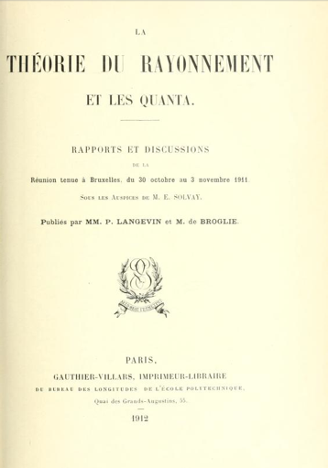
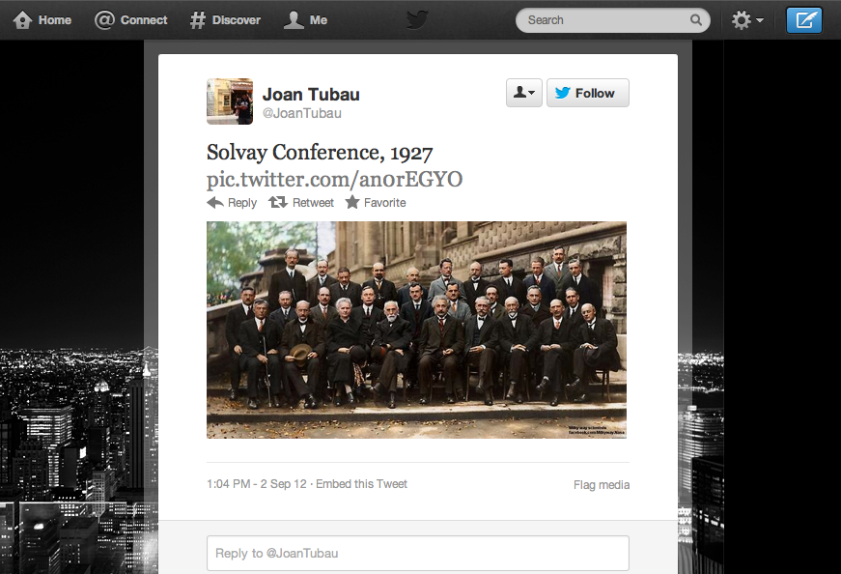
Conference proceedings tradition and future prospects

Slide 2
An outline of the session
Elsevier
  Eleonora Presani
EDPSciences
  Eléonore Jardillier
IOP
  Nina Couzin
arXiv
  David Ruddy
Indico
  Tim Smith
The role of conferences in the accelerator community
  Volker Schaa, JACoW
The future role of proceedings
  Tony Doyle, ATLAS

Slide 3
User community expectations
Quick publication of proceedings
Open Access to all papers
… more and more, copyright to be retained by the author. Published CC-BY
Ability to go back to papers/slides over time
Challenges to overcome
Proceedings is outside the scope of SCOAP³
Each conference organizer, and they are many, ought to find the most appropriate solution

Slide 4
Negotiating OA to proceedings
A series of standard offers available
  Works in general very well
  Many organizers are still stuck with old habits
Gets quickly complicated if to be published within a hybrid subscription journal …
  To which level are the papers peer-reviewed?
  Level of editorial involvement of the publisher?
  What is a reasonable APC for a conference paper

Slide 5
A period of confusion … nice alternatives are crystallizing out
Proceedings play different roles for different communities
  Main communication channel for accelerator physicists
  Less clear for hep-th and hep-ex
Unclear situation with regards to copyright, OA, fees etc. creates delays and additional work
Could we identify a “win-win” that would make everybody happy?

