Slide 1
ICAN applications overview
or
What can we do with a really big fibre laser?
Laura Corner
John Adams Institute for Accelerator Science, Oxford University, UK

Slide 2
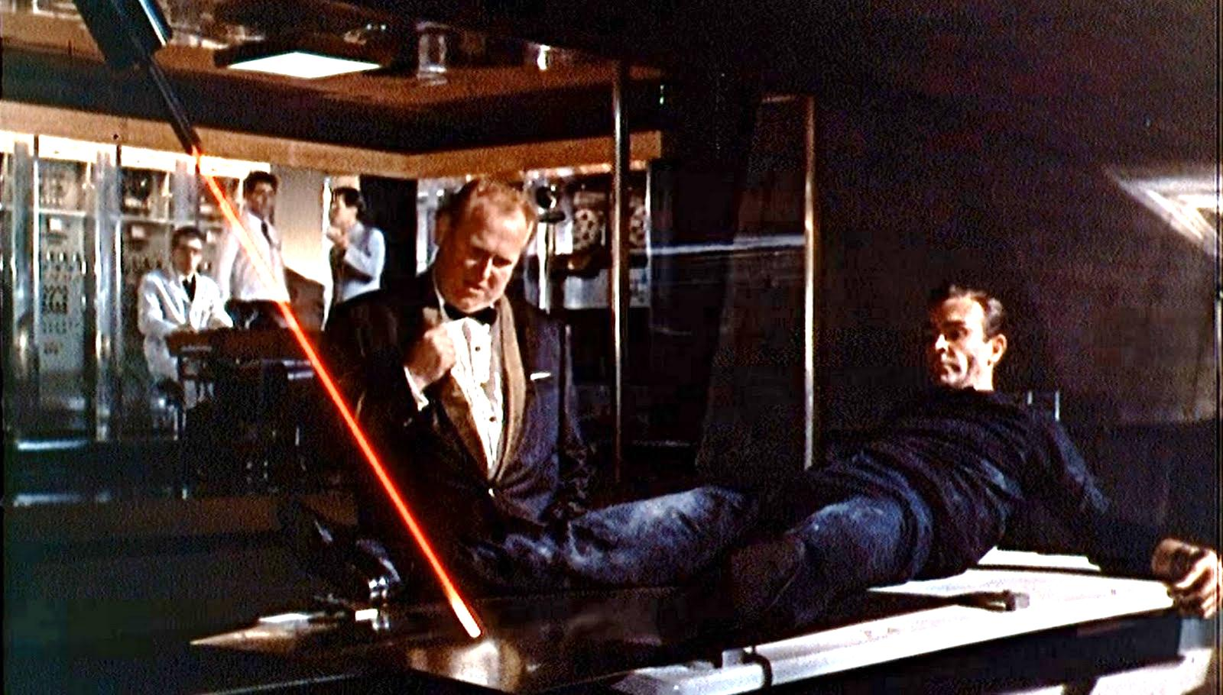

Slide 3
Outline
Overview of ICAN advantages
Applications introduction
Lasers for γγ colliders
Other research aspects driven by ICAN lasers

Slide 4

ICAN – a new approach
Instead of building one big laser, add together lots of small ones!
Use the advantages of fibre lasers to build systems with:
High peak and average power
High electrical efficiency
kHz rep. rates
Excellent beam quality – defined by cavity or
individually addressable fibres – control wavefront.
Drive down running costs, increase data taking rates, explore experimental parameter
space, reduce experiment size, increase access.
Benefit many areas of science and industry and encourage new innovation
Lasers drive ideas!

Slide 5
ICAN applications session
Required laser system toward laboratory search for low-mass Dark Matter and Dark Energy candidates - Dr. Kensuke Homma
ICAN for structured electron and ion acceleration - Prof. Alexander Pukhov
Relativistic Protons and their Applications - Dr. Olivier Napoly
Higgs factories based on Photon Colliders - Prof. Mayda Velasco
Laser-acceleration of energetic ions - Prof. Julien Fuchs
Radio-isotopes production with high average power intense lasers - Prof. Jean-Claude Kieffer
Accelerator-Driven System Reactors - Dr. Bernard Carluec
Contributions to:
Fundamental physics, HEP
Medical applications
Particle acceleration
Green energy, societal challenges
Light sources – driving FELs for scientific/industrial applications
Security – compact THz sources
Neutral atom acceleration

Slide 6
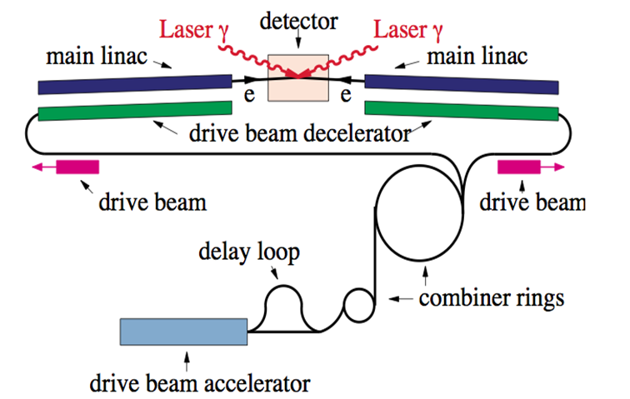
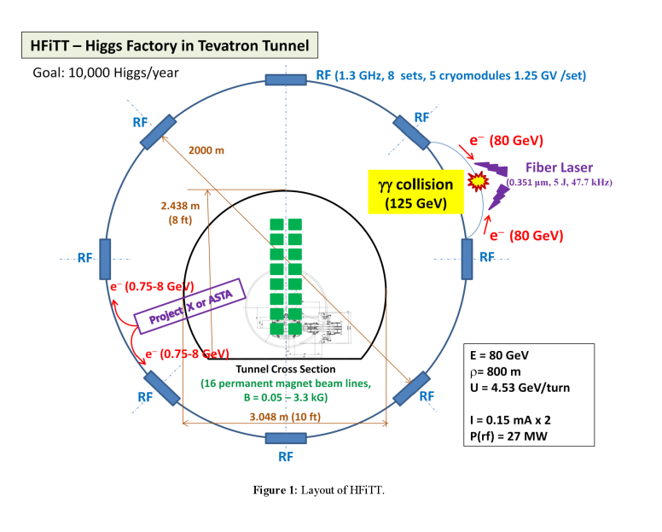
Lasers for Higgs factories – recent interest in γγ colliders as Higgs factories.
2 recent proposals: SAPPHiRE – Small Accelerator for Photon-Photon Higgs production
using Recirculating Electrons and HFiTT – Higgs Factory in Tevatron Tunnel.
High energy γs created by Compton scattering laser from electron beam.
SAPPHiRE
arXiv:1208.2827
HFiTT
arXiv: 1305.202v2

Slide 7
Closer look at laser parameters for Higgs factory – specifications from papers:
 | SAPPHiRE | HFiTT
wavelength | 351nm | 351nm
pulse energy | 5J | 5J
repetition rate | 200kHz | 47.7kHz
pulse duration | 5ps (σ – 11.8ps FWHM) | 1.5ps (σ – 3.5ps FWHM)
Assume 50% THG conversion efficiency¹ so 10J @ λ ∼ 1um, 200kHz / 47.7kHz.
Total power = 10J * rep. rate = 2MW or ~ 0.45MW.
Conventional laser wall plug efficiency: 0.1 – 1%
Electricity requirements: 45 – 450MW, 200MW – 2GW.
X 2 for two laser systems.
No such MW average power laser.
Can’t afford the electricity bill……….
¹ conservative – can be 80% Opt. Comms. 34, 469 (1980)

Slide 8
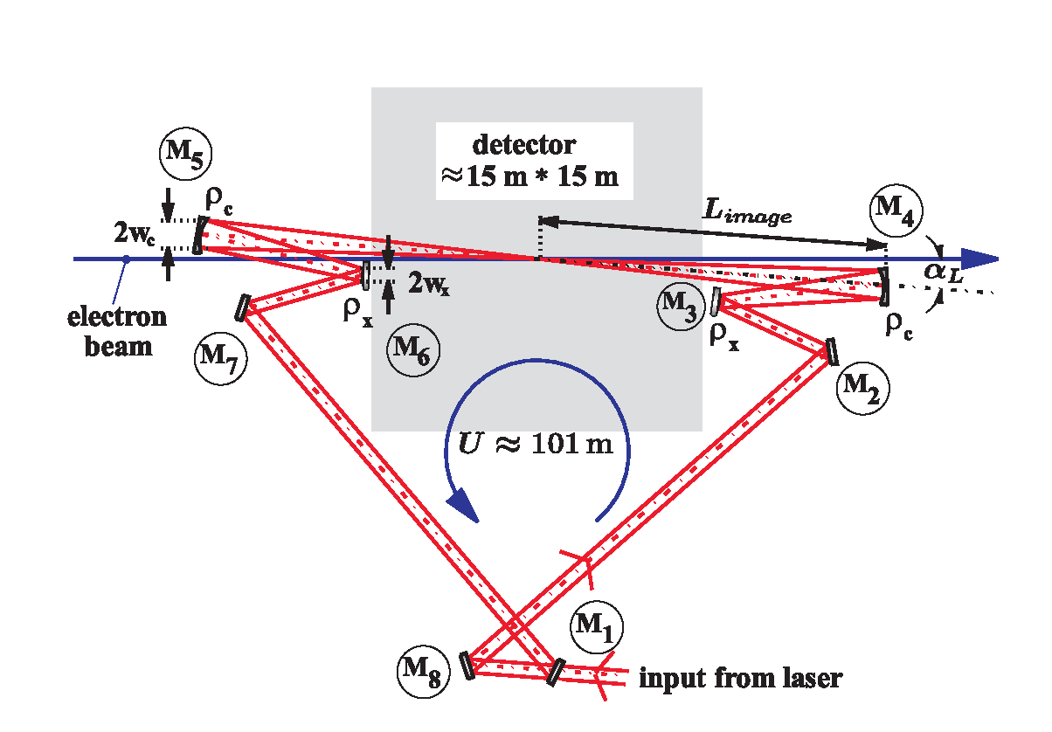
Any other options?
‘Thin laser target’ γγ collider proposal (Zhang, arXiv:1211.3756)
Reduce required peak laser power by energy recovery on electron beam – increase beam current.
Laser specifications: 395nm, 500mJ, 666fs, 1MHz – laser power in nir 1MW: no overall reduction.
Recirculating cavity – reuse one laser pulse for multiple interactions
Advanced designs developed for TESLA/ILC
Clever designs but major concerns remain with:
Stabilisation
Locking
Injection
Optics damage
Klemz et. al. NIM A 564, 212 (2006)

Slide 9
Assume can make 5J, 5ps pulse at 351nm.
Is a recirculation cavity possible?
Ignoring injection, dispersion, simple feasibility analysis.
Proposed cavities for TESLA¹/ILC² ∼ 100m in length (can this be stabilised?)
Use 150m length, 10 roundtrips between e⁻ bunches (SAPPHiRE).
For different mirror R, how much light reaches e⁻ bunch 2nd time, 10 roundtrips?
Individual mirror R | 2 interactions 8 mirror cavity | 2 interactions 4 mirror cavity
99.99% | 0.992 | 0.996
99.9% | 0.923 | 0.961
99.5% | 0.670 | 0.818
99% | 0.488 | 0.669
¹NIM A 472, 79 (2001)
²NIM A 564, 212 (2006)
If source 10J, 10Hz each pulse has to make 2 x 10⁴ interactions, 2 x 10⁵ roundtrips.
Not possible – no light left – 0.9999 ^ (8 * 2 x 10⁵) = 0.

Slide 10
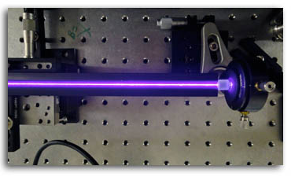
ICAN lasers for γγ colliders
Problems – Laser specifications for proposed colliders very demanding.
High average power/peak power, high repetition rate, high efficiency.
Recirculating cavities have problems with alignment, stabilisation, injection, efficiency.
All difficult for current laser technology – BUT exactly the problems the ICAN architecture is designed to overcome!
ICAN laser – 10sJ, 10kHz, ~1ps, 30% efficient
HFiTT specs: electrical power
requirements: 2 x 1.6MW – possible!
Interleave pulses from 5 ICAN lasers?
No cavity
Laser light available for diagnostics etc.
Will the lasers for γγ colliders
look like this in the future?

Slide 11
More research!
Proposed ICAN laser 10skHz – big impact on experiments – ability to experimentally
explore much bigger parameter space. Development needs to start now.
Faster diagnostics
Faster target regeneration
Gas/solid
Better detectors
Typical experiment
New infrastructure
More radiation shielding
More expert fibre laser scientists
Fantastic opportunities for PhD/young scientists to learn fibre lasers and applications

Slide 12

Summary
ICAN lasers offer exciting advantages over conventional laser technology.
Many current applications hugely enhanced – rep. rate, efficiency, size, access.
Stimulate new innovation in experiment design and analysis.
Drive new experiments in fundamental physics - but also enable major shifts in
energy, medicine, industry.
What other amazing possibilities are there?

