Slide 1
R2E – Experience and Outlook for LS1
G. Spiezia for the R2E Project
!!! Many Thanks To Everybody !!!

Slide 2
Overview
Radiation levels and source terms
Failures observed during 2012
What’s to be expected for LS1

Slide 3

R2E Mitigation Strategy
1st Safety Critical
Immediate Relocation
2nd Shielding
“Fast” & Global Improvement
Highest Impact on Operation:
Relocation
Shielding
3rd Most Sensitive
Relocation
Shielding
New Design
4th Remaining

Slide 4
Radiation levels and scaling

Slide 5
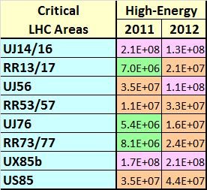

Radiation Levels
Predictions versus Observations
(scaled to exp. lumi)
…and Today
1.1x10⁸
1.8x10⁷
1.2x10⁸
1.8x10⁷
Decrease: TCL closed
5.5x10⁷
Increase: Tight Collimators
3.0x10⁷
2.6x10⁸
6.5x10⁷
Critical areas well within predictions for radiation levels
Operational parameters can have important impact
Other areas not to be forgotten:
  e.g, UX45
    2011: 2.6x10⁶
    2012: almost 2x10⁷cm⁻²
Notes:
Quick explanation: monitors (various) + operation (Lumi + Losses)
Good agreement with predictions + P4 behaviour
Showing also doses in the DS/ARC?

Slide 6
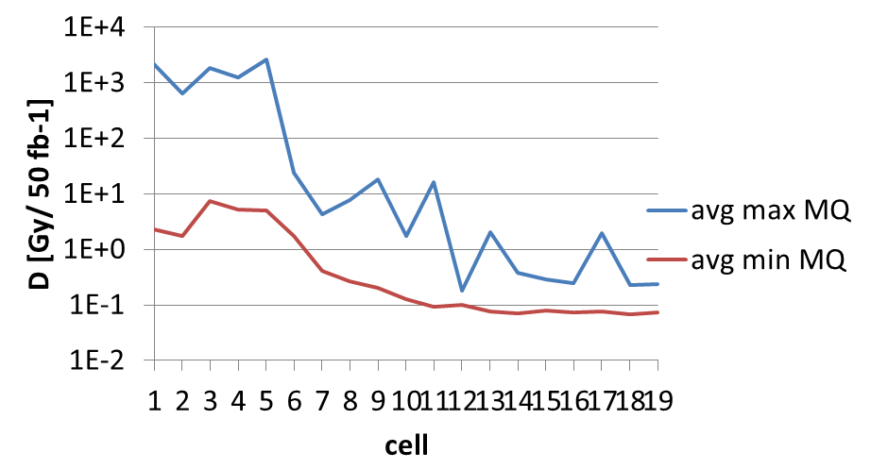
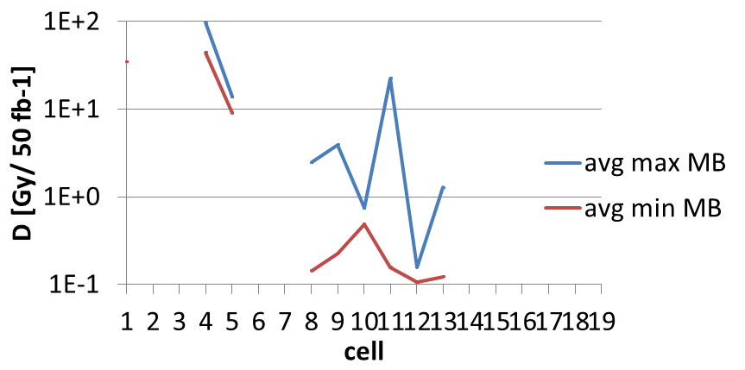
Effect of Operation
Leakage into DS
  Cells 7-10: ~10Gy
  <Cell17: ~1Gy
  >Cell17: ~0.1Gy
Currently relatively
low vacuum activity
?How will this
possibly change
with 25ns?

Slide 7
Failures analysis

Slide 8
Information collection
R2E weekly shift to collect information
Analysis
  Radiation levels at the failure location
  Failure mode and comparison with the rad-test
  Rate of the failures
  Iteration with the equipment owners
What we store:
  Location
  Date-Time failure
  Equipment/Component
  Consequence of the failure
  Beam fill

Slide 9
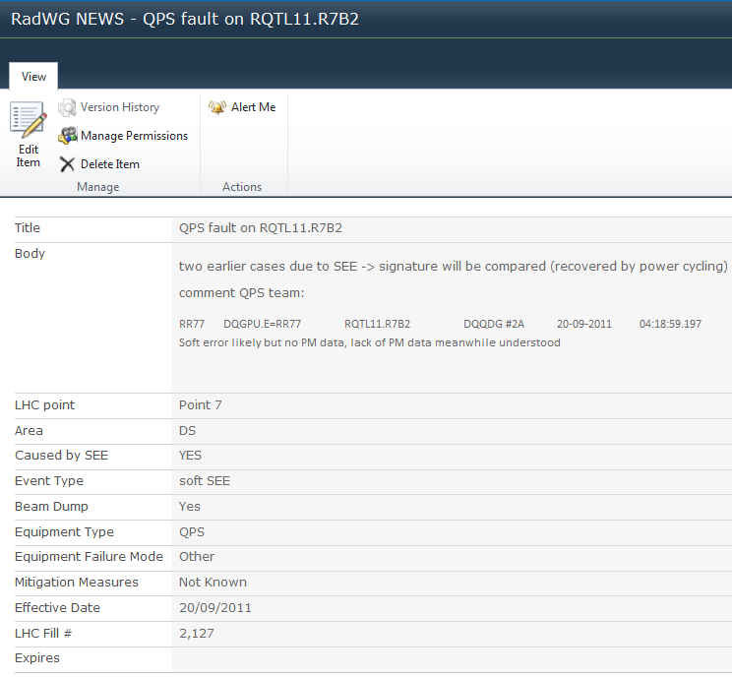
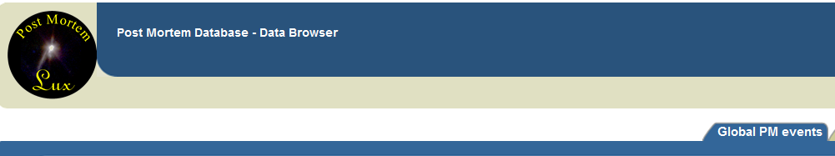
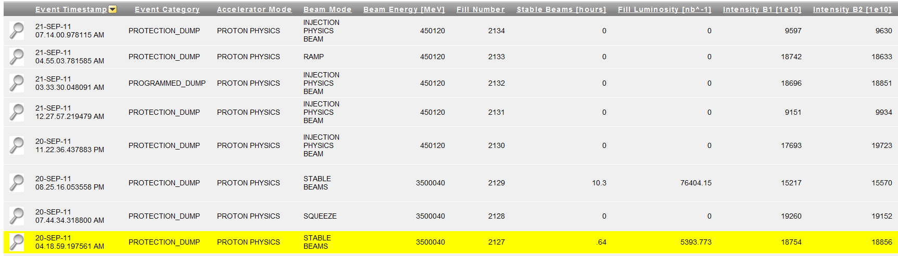
Information collection
Rad WG web site-Detail
Post Mortem Database
Link with the fill number
Details on radiation failure

Slide 10
Mitigation Measures XMas 2011
Shielding thanks to EN/MEF
  P1 (UJ 14/16) – various equipments
  Gain factor ~2. Take into account shielding efficiency and radiation level increases.
Relocation
  Cryogenic equipment from Point 4/6/8
  B/P/WIC equipment from UJ56 US85
  EN/EL UPS from UJ56
  No events anymore
Equipment actions
  QPS: Fw, Hw updates
  EPC: Fw updates
  CRYO: Hw updates (Temperature sens)

Slide 11
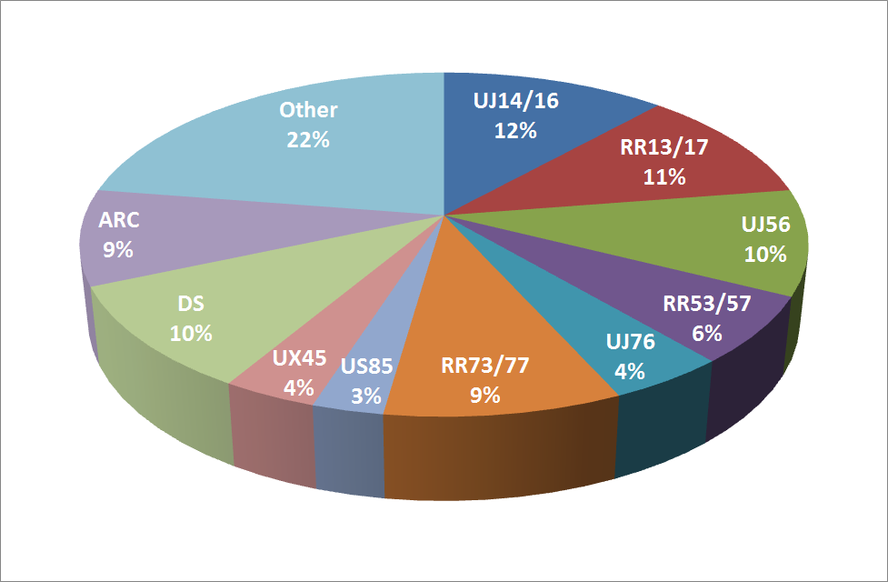
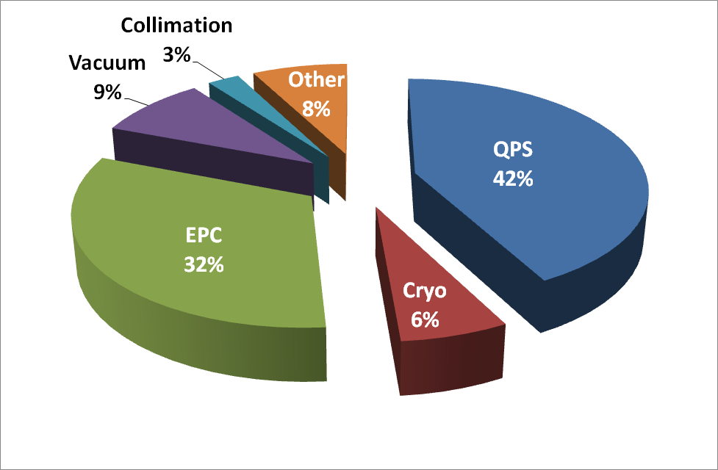
Failure Overview
Status November 2012
Dump Confirmed | Dump TBC | No Dump | No Dump TBC
58 | 10 | 36 | 7
Destructive failures
Dump Confirmed | Dump TBC | No Dump | No Dump TBC
17 | 1 | 4 | 0
Notes:
PM-DB Extraction -> slope for this year
Area/Equipment (both for confirmed/possible) -> Ruben help!

Slide 12
QPS
Dump | Dump/TBC | No Dump | No Dump/ TBC
32 | 2 | 22 | 1
Locations: UJ14/16, UJ56, RRs P1/P7, DS
Failure types:
  Digital detection system for nQPS (very few)
  600A protection (DSP based system)
  uFIP communication
  DAQ&uFip: no dump but required access
Mitigations:
  New DAQ system under design (FPGA)
  Firmware upgrades
  BricoFip (mid-term)/NanoFip (long-term)
Main Impact: caused most of the R2E dumps

Slide 13
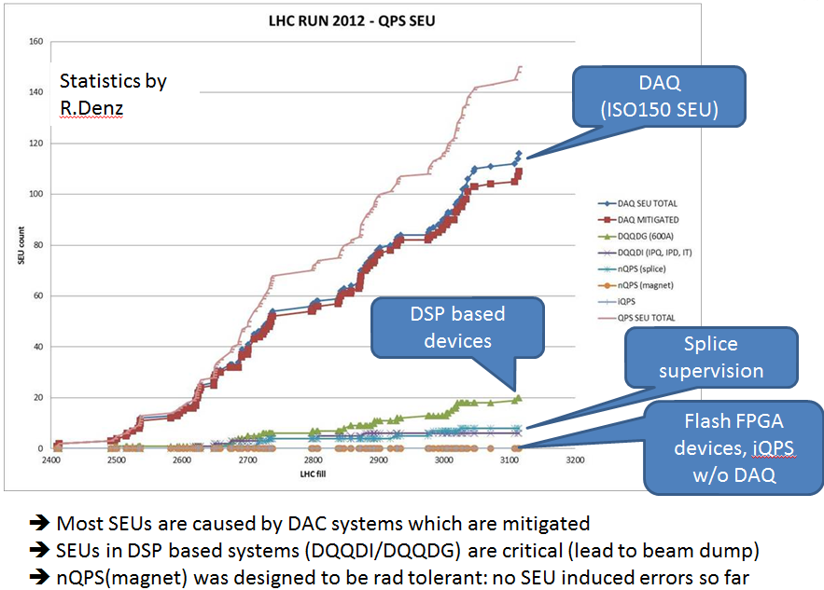
QPS – Detail
2011: 3.5 dumps per fb⁻¹
2012: 1.4 dumps per fb⁻¹
1/3 of errors in UJ14/16/56
© R. Denz, J. Steckert
R2E consolidation
2012: 27 R2E trips during stable beam
>LS1: with all foreseen measures in place: 1
Notes:
Observed failures & Analysis

Slide 14
Power Converter
Dump | Dump/TBC | No Dump | No Dump/ TBC
14 | 0 | 11 | 0
Status November 2012
Locations: UJs, RRs, ARC
Failure types (only confirmed ones kept in follow-up):
  600A: Aux Power Supply [14 events]
  FGC [10 events]
  120A failure [1 event]
Mitigations:
  AC/DC power supply problem understood, corrected during LS1
  New FGClite design (on-going)
  Radiation tolerant power converters (started)
Main Impact:
  Many destructive failures
Notes:
Observed failures & Analysis

Slide 15
Cryo
Dump | Dump/TBC | No Dump | No Dump/ TBC
4 | 2 | 1 | 0
Locations: UJ56, UJ76, UX45, US85
Failure types
  Mecos AMB
  Profibus communications
Mitigations
  AMB case (UX45, UX65, US85): Relocation under study [Mecos, S2M]
  Profibus: Relocation from UJs during LS1
  31 events mitigated due to autoreset
Main Impact
  Important contribution to R2E downtime

Slide 16
Vacuum
Dump | Dump/TBC | No Dump | No Dump/ TBC
4 | 3 | 0 | 0
Locations: UJ76, UX45
Failure types
  Loss of the PLC control (soft)
  Power supply (destructive failures)
Mitigations
  Relocation from UJ76

Slide 17
EN/EL
Dump | Dump/TBC | No Dump | No Dump/ TBC
1 | 0 | 0 | 0
Locations: US85
Failure types
  IGBT failure
Mitigations
  Relocation from US85 to UA83
  Remain REs
  Recently tested at H4

Slide 18
Collimation control
Dump | Dump/TBC | No Dump | No Dump/ TBC
1 | 0 | 2 | 0
Locations: UJ16, UJ56
Failure types
  Loss of communication
Mitigations:
  Relocation

Slide 19
RF Equipment
Dump | Dump/TBC | No Dump | No Dump/ TBC
1 | 2 | 0 | 0
Locations: UX45
Failure types
  Power supply
  Vacuum gauge
Mitigations
  Cases are still under investigations
  Radiation effects to confirm

Slide 20
Access system
Dump | Dump/TBC | No Dump | No Dump/ TBC
0 | 0 | 5 | 0
Locations: P1, P5
Failure types
  Functionality loss of the MAD/PAD system
  Difficult to relate to Radiation
  Higher failure rate in exposed areas
Mitigations
  Relocation
Main Impact
  Downtime during access

Slide 21
Downtime due to Failures
A preliminary analysis was done taking into account
  RadWG list PM database and e-logbook entries
  Time interval between beam fills
  Manual iteration → avoid downtime due to other failures

Slide 22
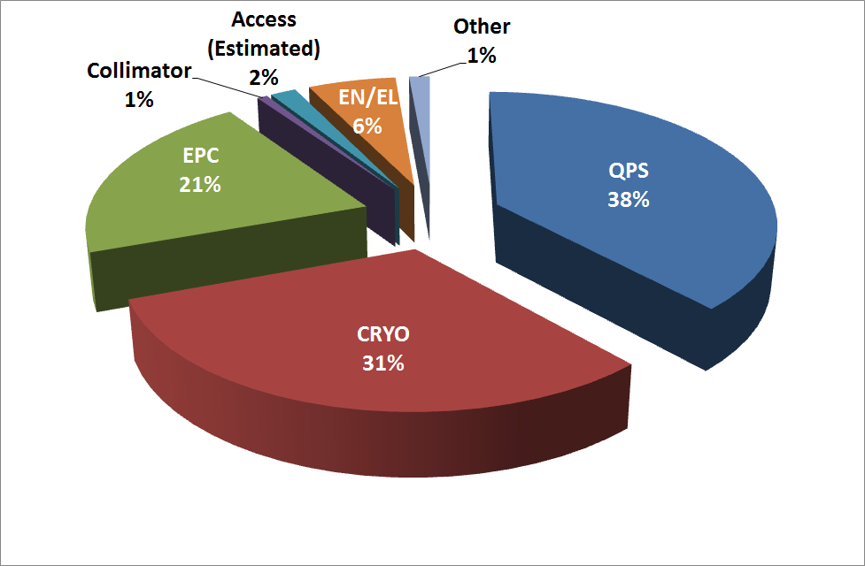
Downtime Analysis
Total R2E related downtime ~250h-300h
Mainly based on dump cases (others difficult to track)
Status November 2012
Notes:
Update of table -> Petra

Slide 23
Summary and outlook for >LS1

Slide 24
What Changes After LS1
Main impacted systems – observed failure signatures:
  Equipment Upgrades
  New developments
  Relocation (UJs, US85, UX45 partly)
  Shielding (RRs)
Remaining (future) commercial systems:
  Full relocation (except REs)
  No new installation in critical areas without radiation tests & developments
  Equipment inventory for P4 (UX45)
Enormous
Effort during
LS1
Notes:
Power-Converters (Tunnel + RRs)
P4 remaining (25ns?)
QPS and other tunnel equipment (incl. future requirements)

Slide 25
What Remains After LS1
Tunnel Equipment:
  DS/ARC will be more and more loaded
  Long-term damage to be considered in cells 8-13
  Impact of 25ns operation to be evaluated
  Future upgrades/changes/new installations
RRs & Power Converters
  FGClite prototype available, available in time and to be deployed
  Power-part R&D started & component tests on-going
Areas to be watched
  UX45, UX65, UX25, UJ/UA23, UJ/UA87 (+REs)
Notes:
Observed failures & Analysis

Slide 26
What do we expect for LS1
Equipment | Dump 2012 | >LS1 Expectations
QPS | 31 | 5
Power Converter | 14 | 3
Cryo | 4 | 1
EN/EL | 1 | 0
Vacuum | 4 | 2
Collimation | 1 | 0
Other |  | 5
10-20 Expected Dumps

Slide 27
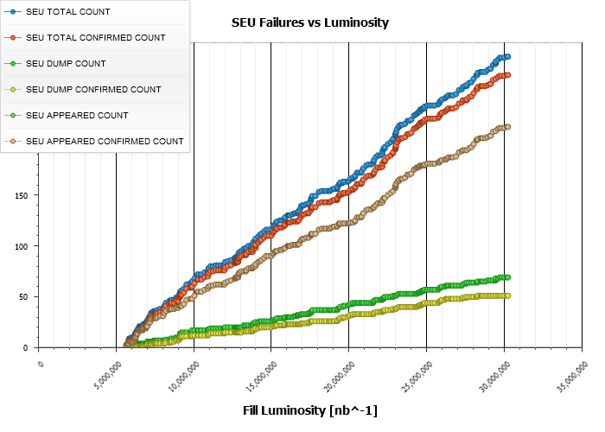
R2E: Past/Present/Future
2012 SEE Failure Analysis
Several shielding
campaigns prior 2011 +
Relocations ‘on the fly’
+ Equipment Upgrades
2011
Status November 2012
~12 dumps per fb⁻¹
2011/12 xMasBreak
‘Early’ Relocation
+ Additional Shielding
+ Equipment Upgrades
~3 dumps per fb⁻¹
2012
R2E-Project aiming for …
>LS1 (nominal -> ultimate)
< 0.5 dump per fb⁻¹
Equipment relocations @ 4 LHC Points
(>100 Racks, >60 weeks of work)
Additional shielding
Critical system upgrades (QPS, FGC)
Notes:
Extract latest PM-DB plot

Slide 28
Conclusions
2011, xMasBreak and previous actions very efficient
2012 Failures
  Within Chamonix predictions
  … and the winner is: QPS + EPC (+Cryo)
LS1: ~10-20 dump events
  Mitigations
    Enormous relocation campaign (4+ Points)
    Remaining shielding
    Numerous system upgrades (QPS, EPC)
  To be taken into account
    Long-Term Damage & 25ns Operation
Notes:
Long-Term damage -> rad levels TID in DS

Slide 29
THANK YOU

Slide 30
Back-up

Slide 31
Radiation Levels
Predictions based on the integrated luminosity for many critical areas
Cum lumi (fb⁻¹) | 2011 | 2012
ATLAS | 5.3 | 23.1
CMS | 5.4 | 23.1
ALICE | 4.8 (pb⁻¹) | 9.7 (pb⁻¹)
LHCb | 1.2 | 2.2
Cumulated lumi ~1.5x larger than initially foreseen for 2012
Notes:
Quick explanation: monitors (various) + operation (Lumi + Losses)
Good agreement with predictions + P4 behaviour
Showing also doses in the DS/ARC?

Slide 32
UJ: Effect of Operation
High Energy Hadron Fluence [Φ/cm⁻²]
Area | 2011 | 2012 | 2011/fb⁻¹ | 2012/fb⁻¹ | Comments
UJ14 | 2.8*10⁸ | 1.4*10⁸ | 5.1x10⁷ | 7.9x10⁶ | Physics deb.
UJ16 | 2.2*10⁸ | 1.1*10⁸ | 4.2x10⁷ | 6.2x10⁶ | Physics deb.
UJ23 | 1.5*10⁶ | 2.6*10⁶ | 2.8x10⁵ (*) | 1.5x10⁵ (*) | Injection
UJ56 | 3.9*10⁷ | 1.3*10⁸ | 7.2x10⁶ | 7.3x10⁶ | Physics deb.
UJ76 | 6.4*10⁶ | 6.0*10⁷ | 1.2x10⁶ (*) | 3.4x10⁶ (*) | Collimation
UJ87 | 3.0*10⁶ | 2.6*10⁶ | 5.7x10⁵ (*) | 1.5x10⁵ (*) | Injection
(*) = ATLAS/CMS luminosity
P1: decrease by factor of 6x, thanks to additional shielding
P7: increase due to tight collimator settings
P2/8: reduction because of cleaner injections in the LHC

Slide 33
RR: Effect of Operation
High Energy Hadron Fluence [Φ/cm⁻²]
Area | 2011 | 2012 | 2011/fb⁻¹ | 2012/fb⁻¹ | Comments
RR13 | 7.2*10⁶ | 1.4x10⁷ | 1.4x10⁶ | 7.9x10⁵ | Physics deb.
RR17 | 8.4*10⁶ | 2.0x10⁷ | 1.6x10⁶ | 1.1x10⁶ | Physics deb.
RR53 | 1.2*10⁷ | 2.0x10⁷ | 2.3x10⁶ | 1.1x10⁶ | Physics deb.
RR57 | 1.0*10⁷ | 2.0x10⁷ | 1.9x10⁶ | 1.1x10⁶ | Physics deb.
RR73 | 7.7*10⁶ | 4.2x10⁷ | 1.5x10⁶ (*) | 2.4x10⁶ (*) | Collimation
RR77 | 1.1*10⁷ | 2.1x10⁷ | 2.1x10⁶ (*) | 1.2x10⁶ (*) | Collimation
(*) = ATLAS/CMS luminosity
P1/5: decrease up to a factor of 2x (1.5-2x) due to TCL.4 closure
P7: asymmetry L/R (also observed in operation)

Slide 34
UX: Effect of Operation
High Energy Hadron Fluence [Φ/cm⁻²]
Area | 2011 | 2012 | 2011/fb⁻¹ | 2012/fb⁻¹ | Comments
UX45 | 2.6*10⁶ | 1.4x10⁷ | 4.3x10⁵ (*) | 8.2x10⁵ (*) | Beam-gas
UX65 | N/A | ~1.x10⁶ | N/A | N/A | Beam-gas
UX85 | 2.1*10⁸ | 2.8x10⁸ | 1.7x10⁸ (**) | 1.6x10⁸ (**) | Physics deb.
US85 | 4.4*10⁷ | 7.0x10⁷ | 3.7x10⁷ (**) | 4.1x10⁷ (**) | Physics deb.
(*) = ATLAS/CMS luminosity
(**) = LHCb luminosity
P4: increase, beam-gas coupled with higher cumulative current in the machine
  How much can/will it go up in view of 25ns operation?

Slide 35
Predictions for >LS1
Areas | HEH Fluence
 | 2012 | Nominal
 |  | Lumi =50fb-1 | Lumi=100fb-1
UJ14/16 | 1.60E+08 | 3.95E+08 | 7.90E+08
RR13/17 | 2.50E+07 | 5.00E+07 | 1.00E+08
UJ56 | 1.50E+08 | 3.65E+08 | 7.30E+08
RR53/57 | 2.50E+07 | 5.00E+07 | 1.00E+08
UJ76 | 6.00E+07 | 1.70E+08 | 3.40E+08
RR73/77 | 5.00E+07 | 1.20E+08 | 2.40E+08
UX85b | 3.50E+08 | 3.52E+08 | 3.52E+08
US85 | 8.80E+08 | 9.02E+07 | 9.02E+07
 | TID
DS | 25 | 50 | 100
ARC | 1 | 1 | 2
© M. Calviani & MCWG

Slide 36
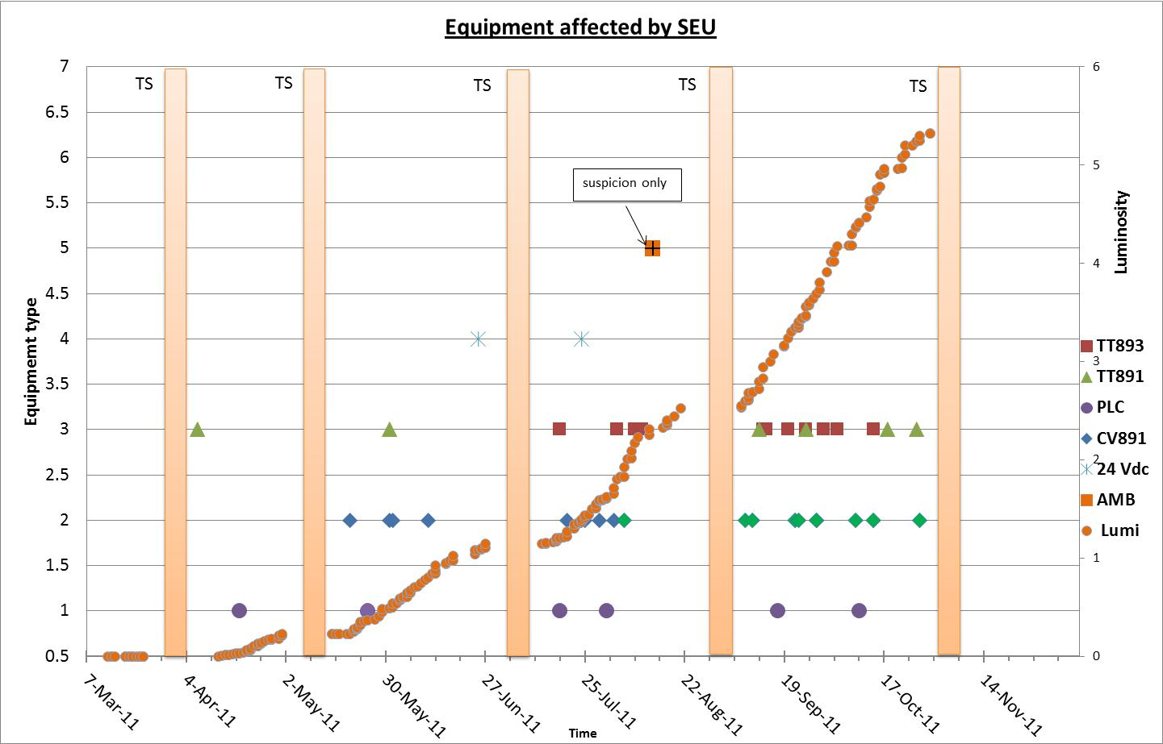
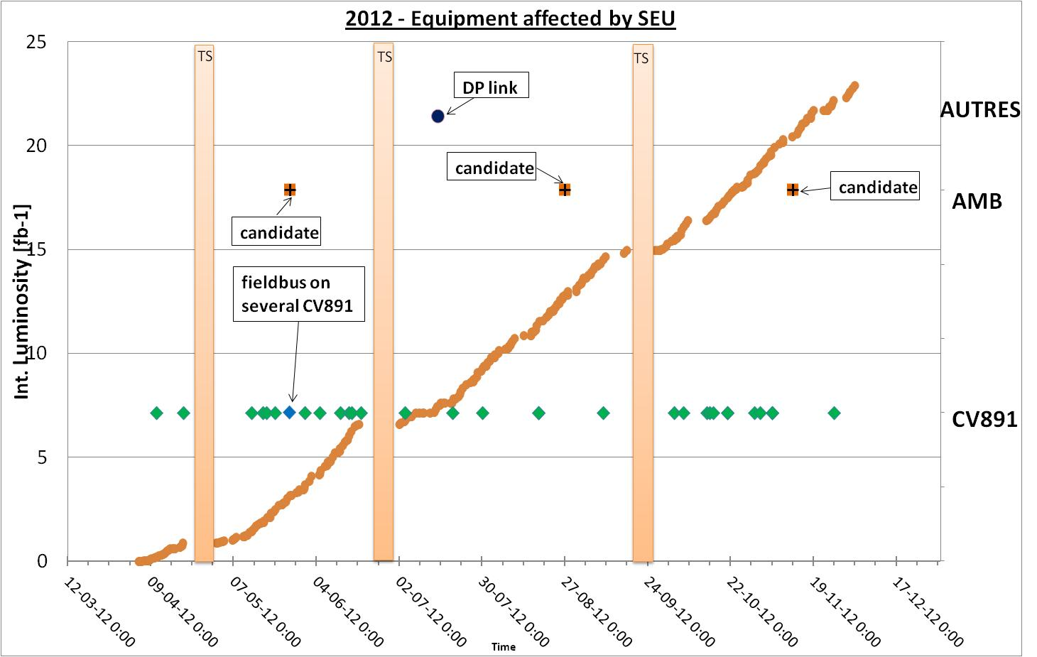
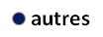
Cryogenics
© A. Suraci et al. TE-CRG-OA
2011
2012
-
4.3
4.3
3.2
CV891/fb-1
2.3
1.9
0.7
1.5
Better cleaning/control of the beam
?
xMasBreak Actions very efficient
Mecos AMB Events (P4/8)
TS2/3 Period interesting
Notes:
Observed failures & Analysis

Slide 37
Downtime analysis
Example
Beam Stop |  | (Next Beam Ramp) |  | Delay [h:m] | Accounted [h:m] | shadow | Manual Change | Access (yes/no) | Dump (yes/no) | Group | Point | Area | Failure Type | Comment
Date (2012) | TimeStamp | Next Date (2012) | Next TimeStamp
10-Apr | 06:48:55 | 10-Apr | 15:54:00 | 09:05:05 | 04:50:00 |  |  | yes | yes | QPS | 5 | UJ56 | Protection 600A
16-Apr | 14:21:54 | 16-Apr | 17:57:00 | 03:35:06 | 00:40:00 |  |  | no | no | EPC | 7 | ARCs | FGC COD
19-Apr | 10:10:00 | 19-Apr | 17:39:00 | 07:29:00 | 02:00:00 |  |  | yes | no | QPS | 5 | DS | DAQ system | during access to RF

Slide 38
Mitigation Measures LS1-details
Equipment actions
  Cryo.
    Relocation of the AMB from UX45
    Better distribution of the charge for 24V DC
  QPS.
    Relocation from UJs
    Firmware update (RR)
    DSP replaced by FPGA
    Auto reset of MicroFip → Then, NanoFip

