Slide 1
LHCC
TOTEM STATUS REPORT
Status of Roman Pot Consolidation & Upgrade Program
Physics Analysis Highlights

Slide 2
TOTEM
Status of Roman Pot Consolidation & Upgrade Program
RP 210 m / 220 m (special runs)
RP 210 m / 220 m (low β* & high luminosity)
Consolidation & upgrade work packages
RP integration of tracking / timing detectors
RP – horizontal insertion at low β* (2012)

Slide 3
Overview
Consolidation program: TOTEM
(approved by TOTEM management)
Upgrade program (proposal) : TOTEM+CMS
(under approval by CMS)
-> Layout of RP stations - combination of consolidation program with upgrade program
Work packages related to consolidation & upgrade
-> Status of work packages and schedule – issues on critical path
Observations during insertion of horizontal RPs in November 2012 (high luminosity, low β*)
and impact on consolidation and upgrade work
-> Optimization of RP housing (beam heating), ferrite study

Slide 4
Presentation of TOTEM Roman Pot consolidation & upgrade plans in different meetings
1) CMS-TOTEM (management) meeting on 5.10.2012
2) 14th LTEX meeting on 8.11.2012
3) 1st LHC workshop on Collider Experiment Interface on 30.11.2012 (CERN)
4) Results and prospects of forward physics at the LHC on 12.2. 2013
Implications for the study of diffraction, cosmic ray interactions, and more (CERN)
5) 16th LTEX meeting 14.2.2013
+ several CMS-TOTEM technical meetings , TOTEM collaboration upgrade meetings (2012-2013), ATLAS-AFP (February 2013), ATLAS-ALFA (January 2013)
consolidation & upgrade

Slide 5
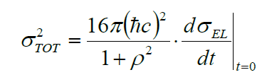
Main goals of TOTEM experiment
- Measurement of total cross section
Forward multiplicity
Diffractive physics
(soft & hard diffraction, jets)
TOTEM detectors integrated in CMS (T1, T2)
TOTEM detectors integrated in LHC (RP)
Using luminosity from CMS
Luminosity independent
ρ parameter from compete fit
TOTEM (stand alone)
TOTEM&CMS at low / highβ*, special runs
TOTEM&CMS at low β* and high luminosity
consolidation & upgrade

Slide 6
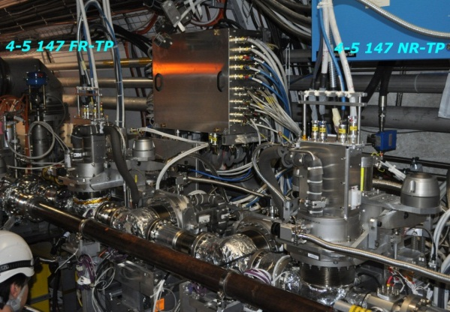
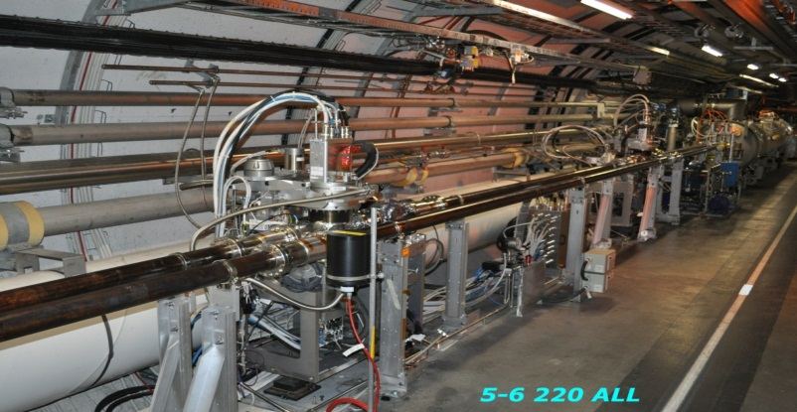
Present RP installation at IP5
TOTEM RP-147 m (near-far)
TOTEM RP-220 m (near-far)
Near
2 vertical RP
top/bottom
1 horizontal RP
Far
2 vertical RP
top/bottom
1 horizontal RP
Near
2 vertical RP
top/bottom
1 horizontal RP
Far
2 vertical RP
top/bottom
1 horizontal RP
outgoing
beam
~ 1.5 m
~ 5 m
Q6
CMS ip5
~ 220 m
CMS ip5
~ 147 m
consolidation & upgrade

Slide 7
Roman Pot consolidation & upgrade strategy
CONSOLIDATION
- Remove RP147 m stations & patch panel (allows installation of TCL4)
- Relocation of RP147 m stations (including Si strip detectors) in +/- 210 m region
- Exchange of ferrites of all RPs
UPGRADE (Roman Pot station)
- Installation of additional new RP stations (horizontal) in +/-220 m region
(2 new RP stations in each sector (4/5), (5/6))
UPGRADE (Roman Pot detector)
- Integration of new pixel detectors in the (relocated RP147m) RPs in 210 m region
- Integration of new timing detectors in the new horizontal RPs
Guideline :
Reinstallation of RP 147m stations with Si strip detectors in +/- 210m region (during LS1)
The relocated horizontal RP station (147 m) can be equipped with Si pixel detectors
The new horizontal RPs could be installed during LS1 and equipped immediately/successively with new timing detectors.
The present 220 m stations must not be affected (touched) by any upgrade activity, until the high beta special runs after LS1 are finished.
(Research Board approved stand alone program of TOTEM at full LHC energy)
The timing detectors are installed downstream relative to the tracking detectors. (high material budget).
Depending on the running scenario after LS1 (physics high β*/low β*, calibration, alignment), relevant RPs are inserted or retracted (parking position).
Consolidation
RP147&RP220
-> during LS1
Upgrade
Roman Pot station
-> during LS1 or
In end of year technical stops after LS1
(break of vacuum)
Upgrade
Roman Pot detector
-> during LS1 or
in short technical stops after LS1
consolidation & upgrade

Slide 8
Remarks on Roman Pot detectors
The TOTEM physics program at high β*, special runs and p-A will be performed with the RP detectors at +/- 220 m and optionally in combination with the relocated RP detectors from +/- 147 m in the region of +/- 210 m (vertical)
New Si pixel detectors integrated in the horizontal (relocated) RPs in the +/- 210 m region and additional new RP stations equipped with timing detectors in the region of +/- 220 m from IP5 are presently discussed in the framework of “detector upgrade studies” by TOTEM in collaboration with CMS.
(related to diffractive physics at low β* and high luminosities)
consolidation & upgrade

Slide 9
Roman Pot consolidation & upgrade overview (schematic)
Relocated stations from 147 m
Existing TOTEM RP-220 m (near-far)
New RP stations
New
Si pixel tracking detectors
in horizontal RPs
New
LHC component
New
timing detectors
New
New
LHC component
2 vertical RP
1 horizontal RP
TRACKING
Detector
2 vertical RP
1 horizontal RP
TRACKING
Detector
Near
2 vertical RP
top/bottom
1 horizontal RP
1 horizontal RP
TIMING Detector
1 horizontal RP
TIMING
Detector
Far
2 vertical RP
top/bottom
1 horizontal RP
outgoing
beam
TCL-4
shielding
TCL-6
Q6
~ 5-10 m
~ 5 m
12 RPs can be operated simultaneously !
CMS ip5
~ 220 m
consolidation & upgrade

Slide 10
Roman Pot (schematic-phase 1)
CALIBRATION & Alignment -RUNNING with high β* & low luminosity
Possibility to test new timing & tracking detectors in the LHC environment –>
Tests in combination with existing RP detectors
Existing TOTEM RP-220 m (near-far)
New horizontal RP
equipped with pixel
tracking detectors
New horizontal RP
equipped with
timing detectors
New
New
(2 vertical RP top/bottom)
1 horizontal RP
TRACKING
Detector
(2 vertical RP
top/bottom)
1 horizontal RP
TRACKING
Detector
Near
2 vertical RP
top/bottom
1 horizontal RP
1 horizontal RP
TIMING Detector
1 horizontal RP
TIMING
Detector
Far
2 vertical RP
top/bottom
1 horizontal RP
outgoing
beam
shielding
TCL-6
Q6
~ 5-10 m
~ 5 m
CMS ip5
~ 220 m
consolidation & upgrade

Slide 11
Roman Pot (schematic-phase 1)
PHYSICS-RUNNING with low beta* & high luminosity horizontal and vertical RPs (far) are retracted (parking position) & vertical RPs (near) are retracted (parking position) horizontal RP near inserted
Existing TOTEM RP-220 m (near-far)
New horizontal RP
equipped with pixel
tracking detectors
New horizontal RP
equipped with
timing detectors
ver
t
hor
i
z
ver
t
outgoing beam
(2 vertical RP)
1 horizontal RP
TRACKING
Detector
(2 vertical RP)
1 horizontal RP
TRACKING
Detector
hor
I
z
1 horizontal RP
TIMING Detector
1 horizontal RP
TIMING
Detector
optional
optional
shielding
TCL-6
Q6
~ 5-10 m
~ 5 m
CMS ip5
~ 220 m
consolidation & upgrade

Slide 12
Roman Pot (schematic-phase 1)
PHYSICS-RUNNING with high β* & low luminosity
NEW installed horizontal RPs (timing) are retracted (parking position)
Existing TOTEM RP-220 m (near-far)
New horizontal RP
equipped with pixel
tracking detectors
New horizontal RP
equipped with
timing detectors
2 vertical RP
1 horizontal RP
TRACKING
Detector
2 vertical RP
1 horizontal RP
TRACKING
Detector
1 horizontal RP
TIMING Detector
1 horizontal RP
TIMING
Detector
Near
2 vertical RP
top/bottom
1 horizontal RP
Far
2 vertical RP
top/bottom
1 horizontal RP
optional
shielding
TCL-6
Q6
~ 5-10 m
~ 5 m
outgoing beam
CMS ip5
~ 220 m
consolidation & upgrade

Slide 13
Roman Pot (schematic-phase 2)
PHYSICS-RUNNING with low β* & high luminosity
ALL horizontal RPs are inserted
Existing TOTEM RP-220 m (near-far)
New horizontal RP
equipped with pixel
tracking detectors
New horizontal RP
equipped with
timing detectors
(2 vertical RP)
1 horizontal RP
TRACKING
PIXEL/Strip
Detector
(2 vertical RP)
1 horizontal RP
TRACKING
PIXEL Detector
1 horizontal RP PIXEL
Detector
2 vertical RP
tracking
1 horizontal RP
TIMING Detector
1 horizontal RP
TIMING
Detector
1 horizontal RP TIMING
Detector
2 vertical RP
tracking
outgoing
beam
shielding
TCL-6
Q6
~ 5 m-10 m
~5 m
CMS ip5
~ 220 m
consolidation & upgrade

Slide 14
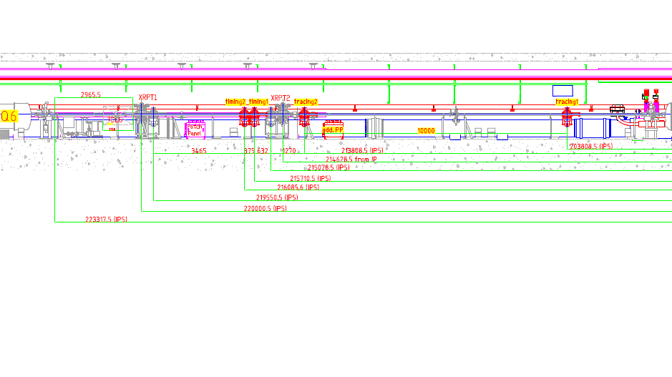
RP Integration study timing & tracking
Sector 4/5
Consolidation:
147 m relocated RP station
Upgrade:
Si-pixel detectors
Upgrade:
new RP station
new timing detector
consolidation & upgrade

Slide 15
Overview
Consolidation program: TOTEM
(approved by TOTEM management)
Upgrade program (proposal) : TOTEM+CMS
(under approval by CMS)
-> Layout of RP stations - combination of consolidation program with upgrade program
Work packages related to consolidation & upgrade
-> Status of work packages and schedule – issues on critical path
Observations during insertion of horizontal RPs in November 2012 (high luminosity, low β*)
and impact on consolidation and upgrade work
-> Optimization of RP housing (beam heating), ferrite study
work packages & schedule

Slide 16
MAIN Work packages
LS1 and beyond
TOTEM -> consolidation
extraction & service of RP147 m
re-installation of RP147 m at 210 m (upstream of RP220 m near)
extension of services from 147 m to 210 m
extraction & re-installation of RP220 m & service work
service work on RP 220 m vacuum
service work on RP 220 m motor drive (hardware & software)
service work on RP (ferrite, RF housing)
TOTEM -> upgrade
installation of 2new RP horizontal stations on each side of IP5 (downstream of RP 220 m near, upstream of RP 220 m far)
adaptation of horizontal RPs to be used for low β*
production new RP housing, optimized for RF heating and beam feedback
installation of electrical services for new detectors (standard services will be re-used from RP147)
installation of new tracking/timing detectors
LHC beam line modifications at +/- 220 m -> consolidation + upgrade
adaptation of beam line for installation of RP147m at 210m (consolidation) and new horizontal RPs (upgrade)
LHC collimators -> consolidation + upgrade
installation of TCL4 (4/5, 5/6)
installation of TCL6 (4/5, 5/6) + relocation of cooling components close to +/- RP220m far.
work packages & schedule

Slide 17
Sharing of work overview with CERN groups (not complete)
EN-MEF-LE (coordination, synchronization with LHC planning & scheduling)
PH-DT (RP mechanics, vacuum, motor, services, cable production .. ..)
PH-ESE (electronic issues, fibers, HV cables…)
EN-CV-DC (RP cooling system)
EN-MEF-SI (cables)
EN-MME-DI (new RP production)
EN-ICE-SIC (FESA)
TE-VSC-LBV (ferrite – vacuum measurements, beam pipe)
TE-MPE-PE (LHC machine protection)
DGS-RP-AS (radiation protection)
PH-UCM (RP engineering, integration,…)
BE-ABP-ICE (RP – RF study & optimization)
BE-OP-LHC (Operation of RP – CCC)
BE-ABP-LCU (collimators)
TOTEM
work packages & schedule

Slide 18
Work packages –> Roman Pot tunnel installation
(CMS, PH-DT, EN-CV, BE-ABP-ICE, LTEX)
WP1-T: removal & reinstallation of RP147 m
(radio protection, RP storage , machining of flanges, ferrite, anti collision switch?)
WP2-T: removal & reinstallation of RP220 m
(anti collision switch, ferrite)
WP3-T: transfer of supplies from 147 m -> 210 m
(motor power lines, patch panel, LV, + new HV cable)
WP4-T: installation of new fibres
WP5-T: RP@147 m motor & mechanics
(preparation for reuse at 210 m)
WP6-T: Flanges – interface to LHC
WP7-T: beam-pipe & TCL
work packages & schedule

Slide 19
LS1 activity -> TIMELINE
(main activities in tunnel)
ferrite study & replacement
anti collision system
calibration
re installation of RPs
220 m / 147 m
installation of detector-
packages &movement tests &
re commissioning
of RPs & laser calibration
extraction of
detector packages
147 m / 220 m
extraction of RP 147 m
+ RP 220 m station +
patch panel
installation of services lines in tunnel
cables - cooling
installation of new RP station
->critical path<-
May 2013
APRIL
2014
March 2013
June 2013
  1. September
  2014
break vacuum
147 m/ 220 m ?
bake out starts
end of work in tunnel
work packages & schedule

Slide 20


Roman Pot at 147 m & 220 m
patch panel
TCL 6
Position of new RPs
Relocation of RPs & patch panel from 147m to 200m
patch panel
(relocated from 147m)
work packages & schedule

Slide 21
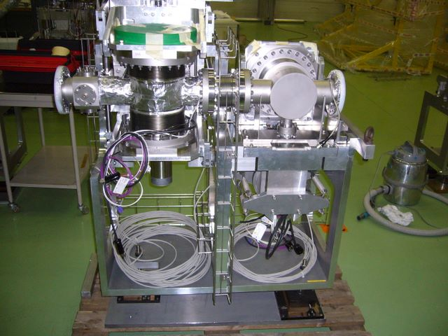
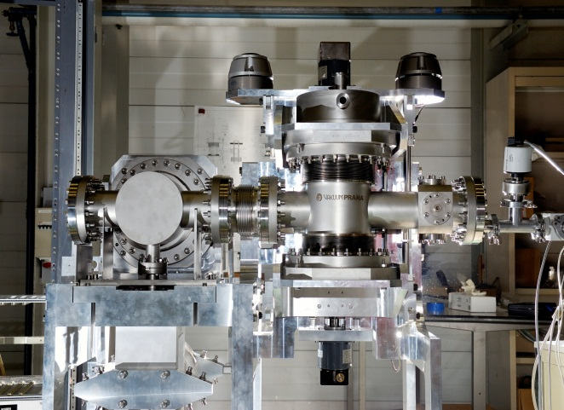
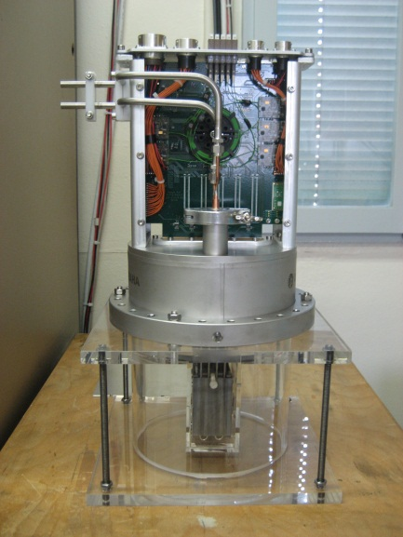
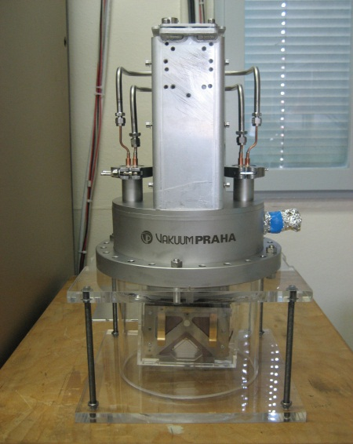
Roman Pot & detector package
Temporary location of RP 147m components in H8 TOTEM test beam line after dismounting
work packages & schedule

Slide 22
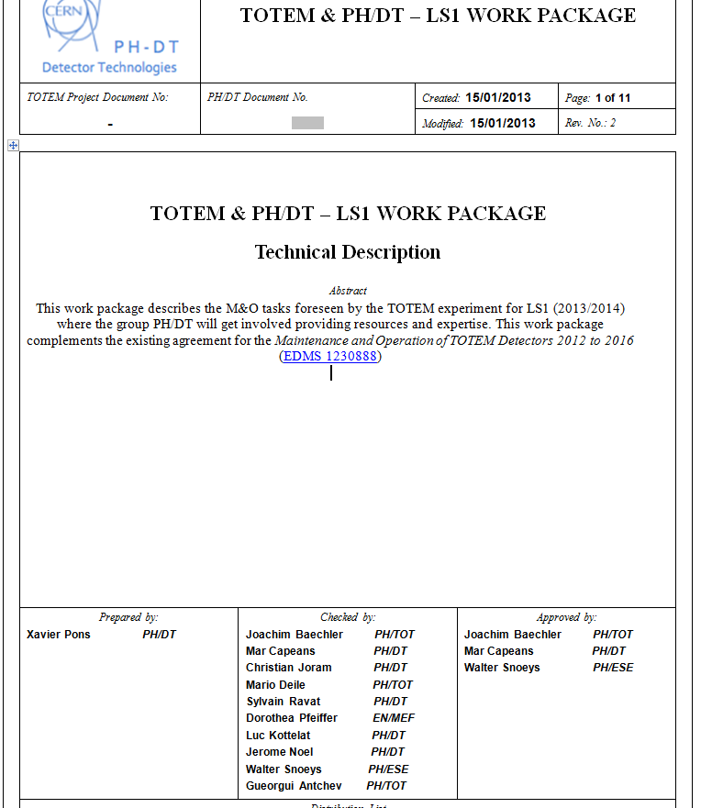
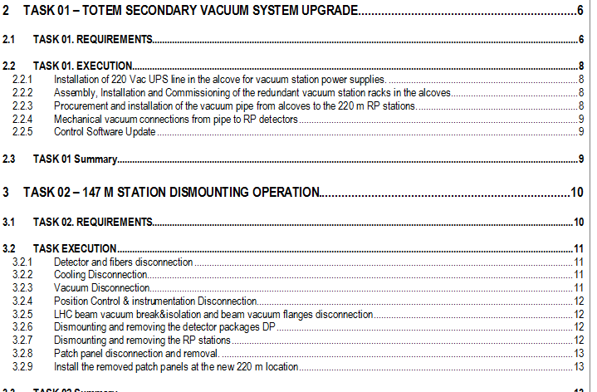
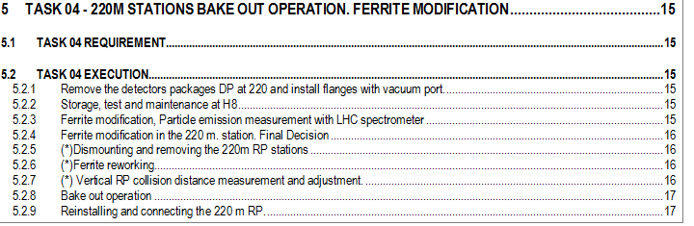
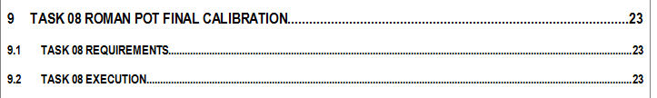
TOTEM & PH-DT L1 work package
-> activities of PH-DT (summarizes not all activities)
Main tunnel activities
work packages & schedule

Slide 23
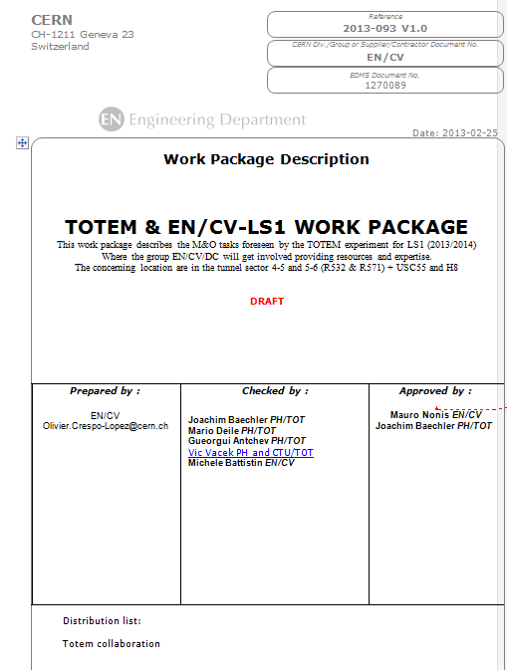
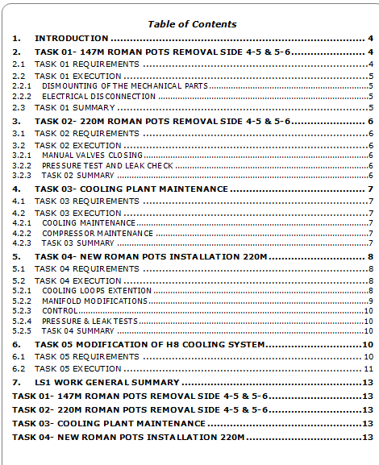
Work package EN-CV
(maintenance of pumps and prolongation of cooling lines from 147m to 220m)
work packages & schedule

Slide 24
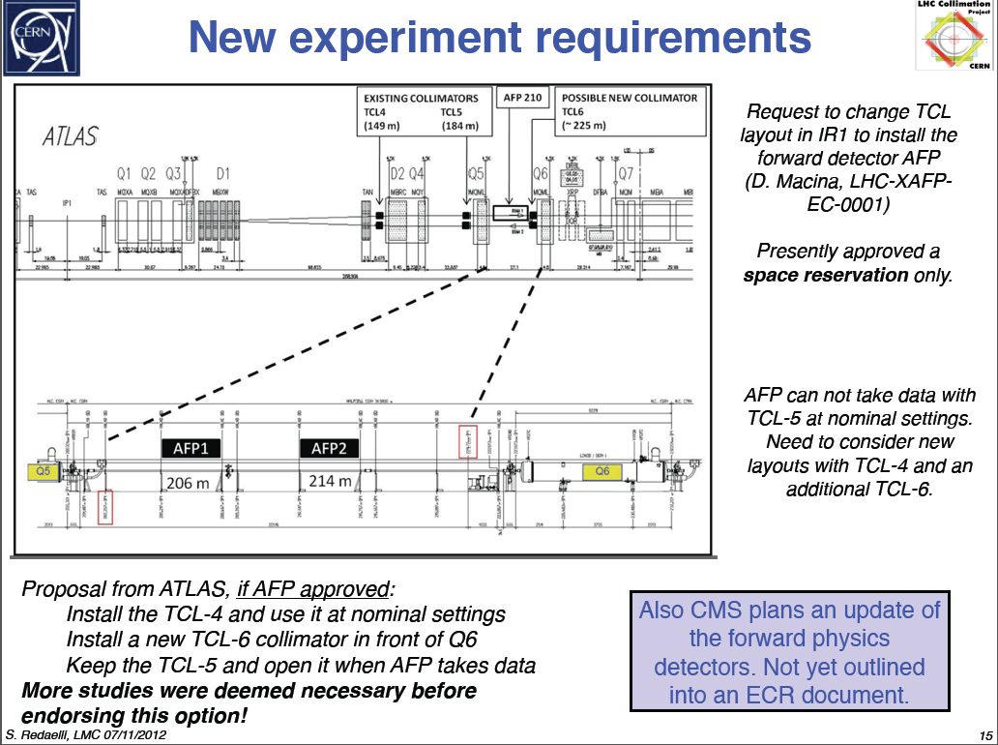
COLLIMATOR requirements for forward physics
work packages & schedule

Slide 25
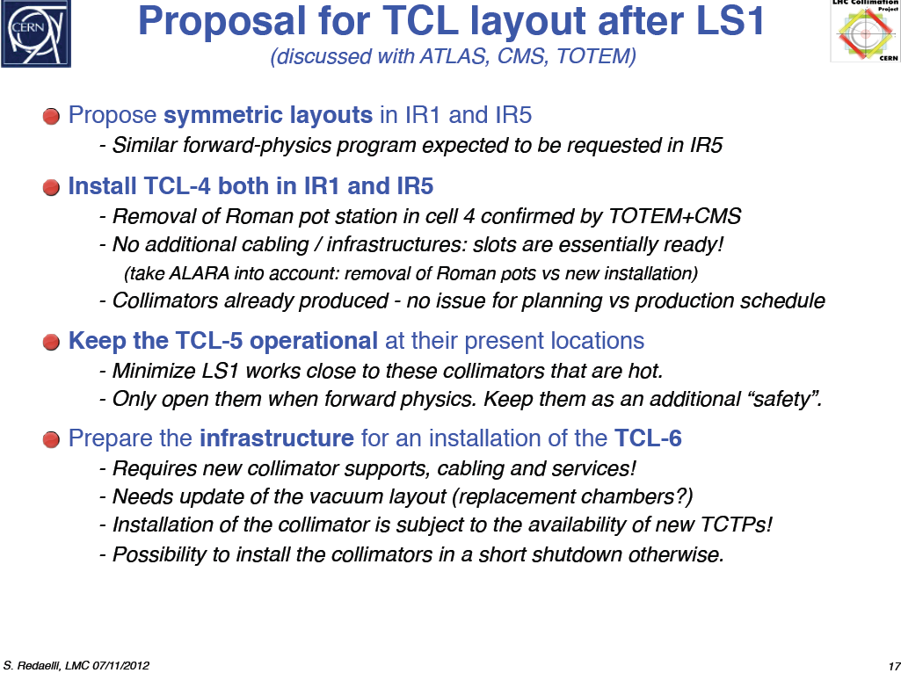
COLLIMATOR
TCL4 & TCL6
work packages & schedule

Slide 26
Work packages –> Detector Sensor
CMS-TOTEM
WP1-D: Si Pixel
WP2-D: Timing-Detector
WP3-D: Timing-TDC
WP4-D: Timing-Clock distribution
WP5-D: Readout board interface to CMS
work packages & schedule

Slide 27
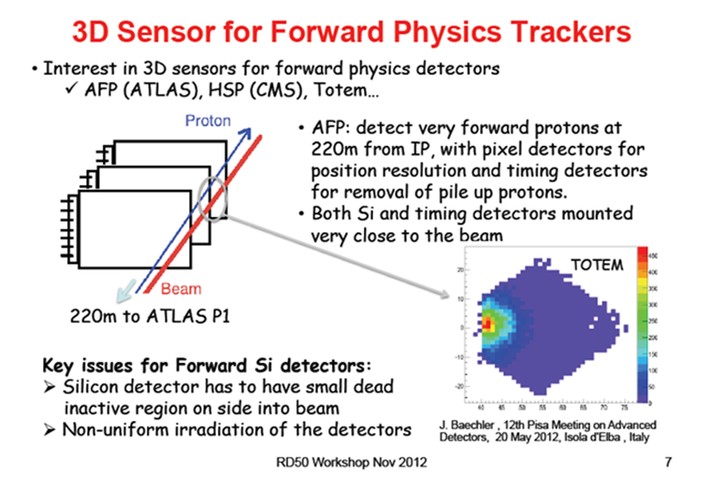
TOTEM-RP study of 3D sensors
TOTEM-RD50 (G. Pellegrini) [IBL – CNM]
HPS
work packages & schedule

Slide 28
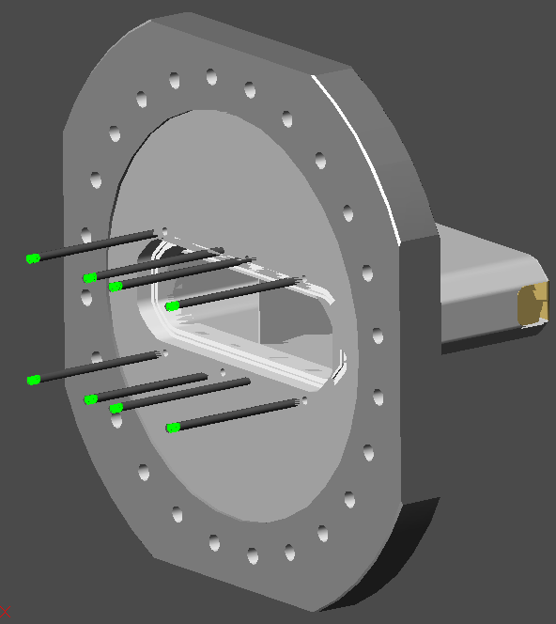
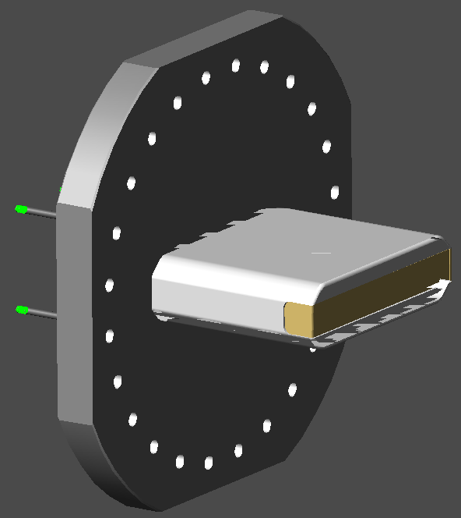
Possible housing for timing detector
Flange size big enough to integrate the timing detector
Housing rotated by 90°
Impedance not favorable
work packages & schedule

Slide 29
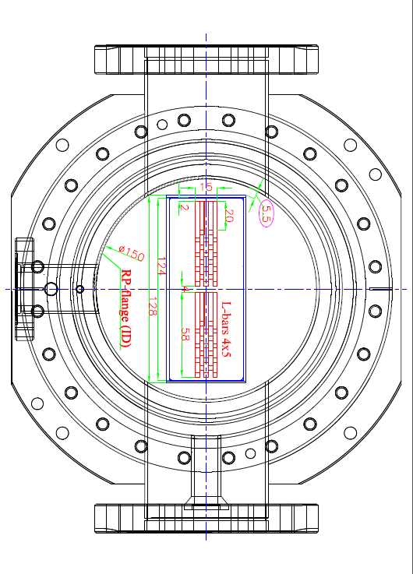
Roman Pot (rotated by 90°)
Integration of Cherenkov timing detector
work packages & schedule

Slide 30
Integration study of C-timing detector in RP (CMS-TOTEM)
work packages & schedule

Slide 31
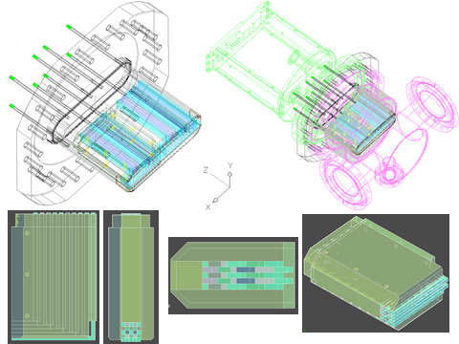
Horizontal RP with Cherenkov timing detector
work packages & schedule

Slide 32
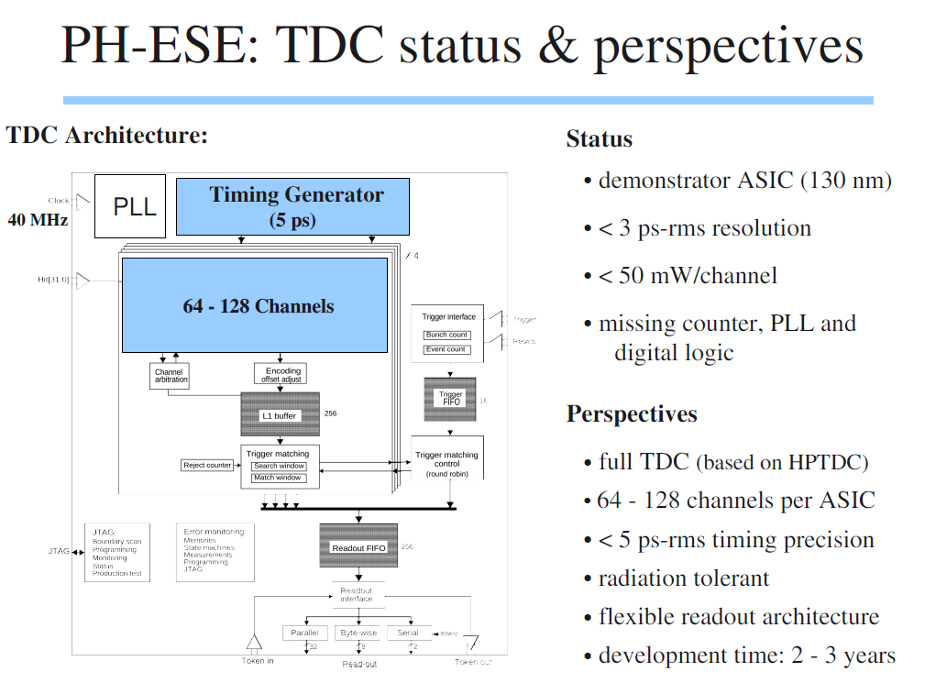
work packages & schedule

Slide 33
Work packages –> Optimization
WP1-O : optimal position and geometry of new RPs (RF, physics)
WP2-O: optimal shape & size of sensors
WP3-O: particle timing – vertex reconstruction
WP4-O: detector position
WP5-O: Material budget
work packages & schedule

Slide 34
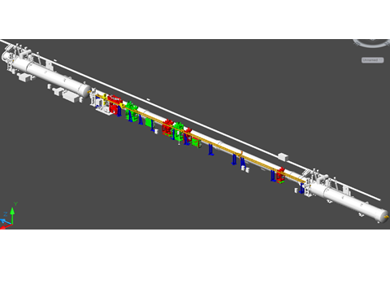
RP Integration study
New components
Existing components
work packages & schedule

Slide 35
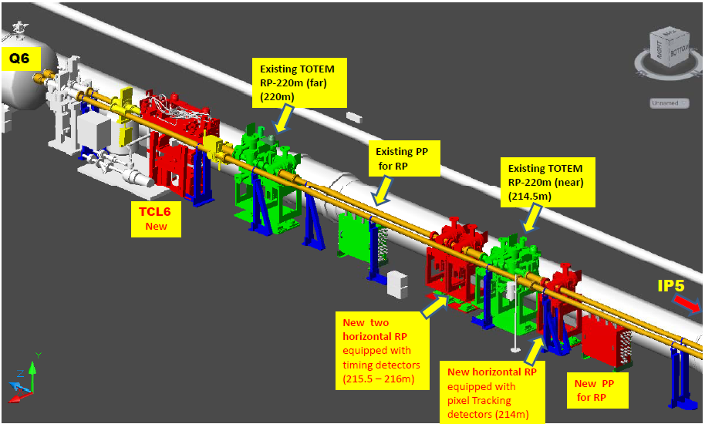
Integration study of TCL6 and
Roman Pots
work packages & schedule

Slide 36
Overview
Consolidation program: TOTEM
(approved by TOTEM management)
Upgrade program (proposal) : TOTEM+CMS
(under approval by CMS)
-> Layout of RP stations - combination of consolidation program with upgrade program
Work packages related to consolidation & upgrade
-> Status of work packages and schedule – issues on critical path
Observations during insertion of horizontal RPs in November 2012 (high luminosity, low β*)
and impact on consolidation and upgrade work
-> Optimization of RP housing (beam heating), ferrite study
insertion at low β*
beam heating – LHC vacuum – RP optimization- rates

Slide 37
Roman Pot (TOTEM) <-> LHC
In 2011 and 2012 specific RP tests & insertions were performed at standard LHC settings to study:
Roman Pot <-> LHC : RP heating & beam stability
Roman Pot detector : rates & background
Observations during low β* run (2012):
[LHC-MPP M. DEILE, December 2012]
Insertion of RP horizontal at 220m ->
insertion at low β*
beam heating – LHC vacuum – RP optimization- rates

Slide 38

List of Insertions at β* = 0.6 m
Date | Pots involved | min. dist. | Observations, Result | Consequence
16.10. | all V all H | 12 σ 30 σ | no problem dump on XRPH.A6R5.B1 (slow losses, 5s) | no UFO activity
05.11. | all H | 30 σ | dump on XRPH.A6R5.B1 (slow losses, 5s) | no UFO activity
14.11. | all H | 32mm ~ 270 σ | dump on XRPH.A6R5.B1 (fast losses) | UFO activity in 6L5
16.11. | H, not A6R5.B1 | 14 σ ∼ 2mm | no problem, beams separated by 4σ | slow losses (5s) in each ramp until conditioning (heat up) of beam screen in Q6
(*)
(*) The (fast) UFOs in 6L5 were later found to originate from TCL5 [Tobias]
insertion at low β*
beam heating – LHC vacuum – RP optimization- rates

Slide 39
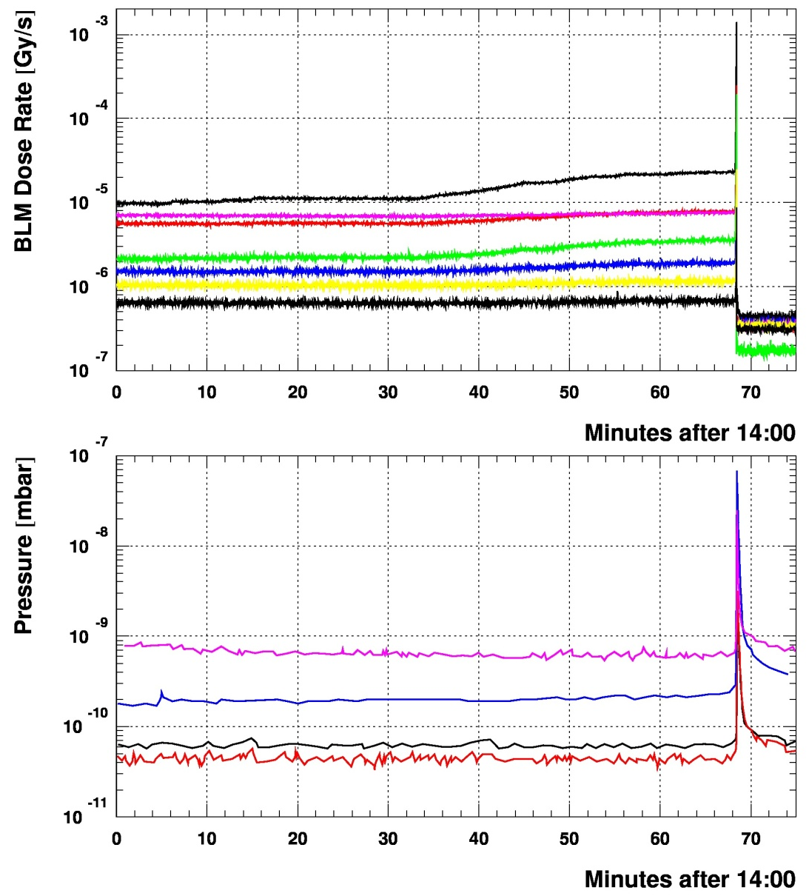
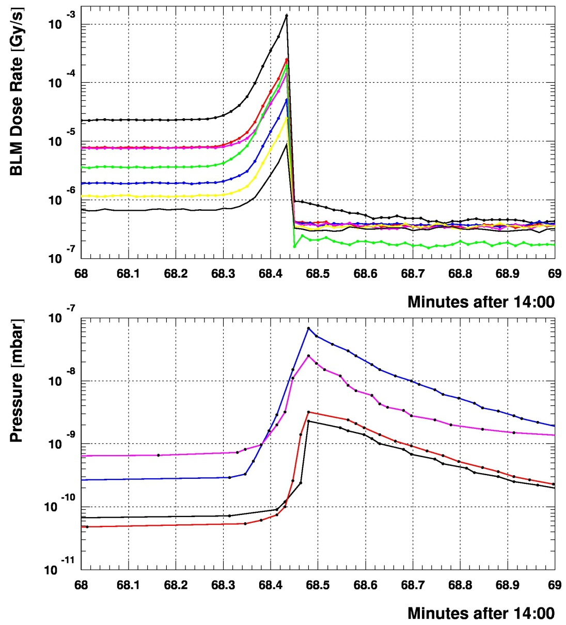
Comparison BLMs & Beam Vacuum
05.11.2012
Sector 5-6
BLMEI.06R5.B1E10_XRP
BLMQI.06R5.B1E30_MQML
BLMQI.06R5.B1E10_XRP_MQML
BLMQI.06R5.B2I30_MQML
BLMQI.06R5.B1E20_MQML
BLMQI.06R5.B2I20_MQML
BLMQI.06R5.B2I10_MQML
VGPB.235.6R5.B.PR (4 m downstream of Far: Q6 entrance)
VGI.77.6R5.B.PR (6 m upstream of Near)
VGPB.2.6R5.B.PR (14 m upstream of Near: Q5 exit)
VGPB.4.6R5.B.PR (14 m upstream of Near: Q5 exit)
insertion at low β*
beam heating – LHC vacuum – RP optimization- rates
Note: no pressure increase in any gauge further upstream (cell 5R5).

Slide 40
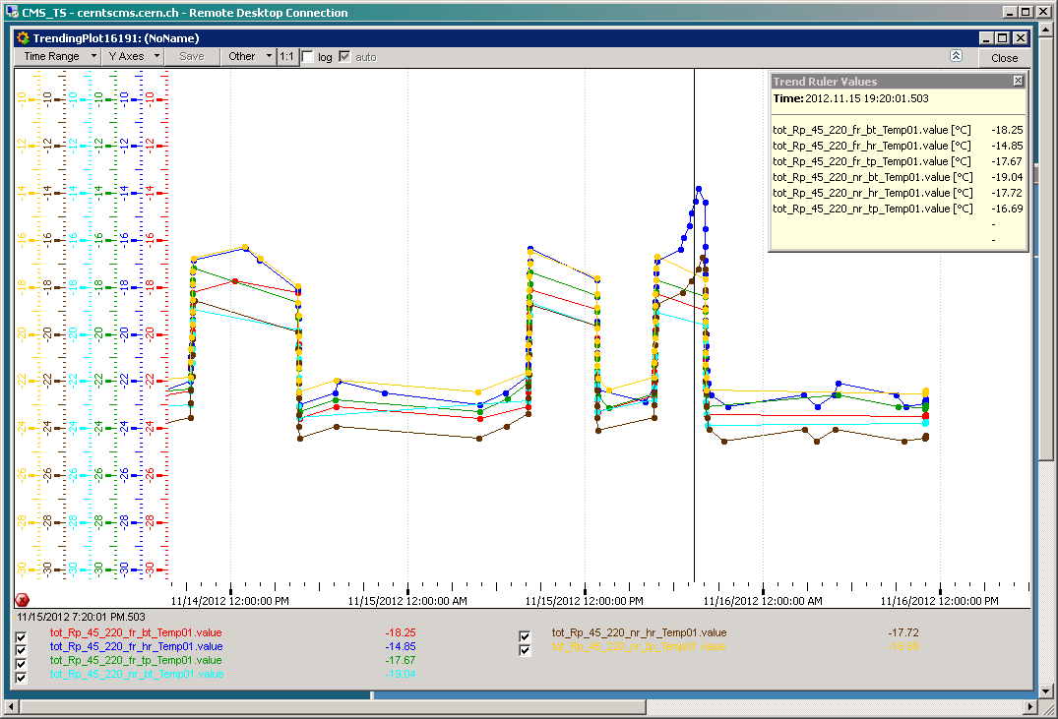
Temperature Sensors on Detector Hybrid Boards: Sector 4-5 (Beam 2)
Highest temp. ever measured
dump at 13:52
other pots in garage
45-220-F-H moving towards beam
45-220-N-H moving towards beam
Run mode
Run mode
Readout chips in
run mode
Readout chips in sleep mode
Sleep mode
Sleep mode
insertion at low β*
beam heating – LHC vacuum – RP optimization- rates
Main temperature effect from chips changing to run mode; small additional increase (3 deg.) from pots moving very close to
the beam. UFOs cannot be resolved.

Slide 41
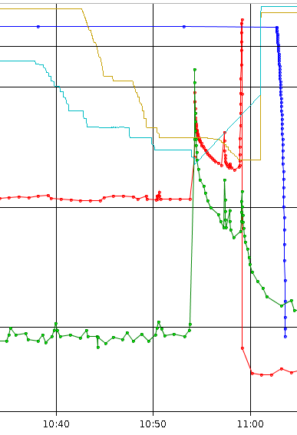
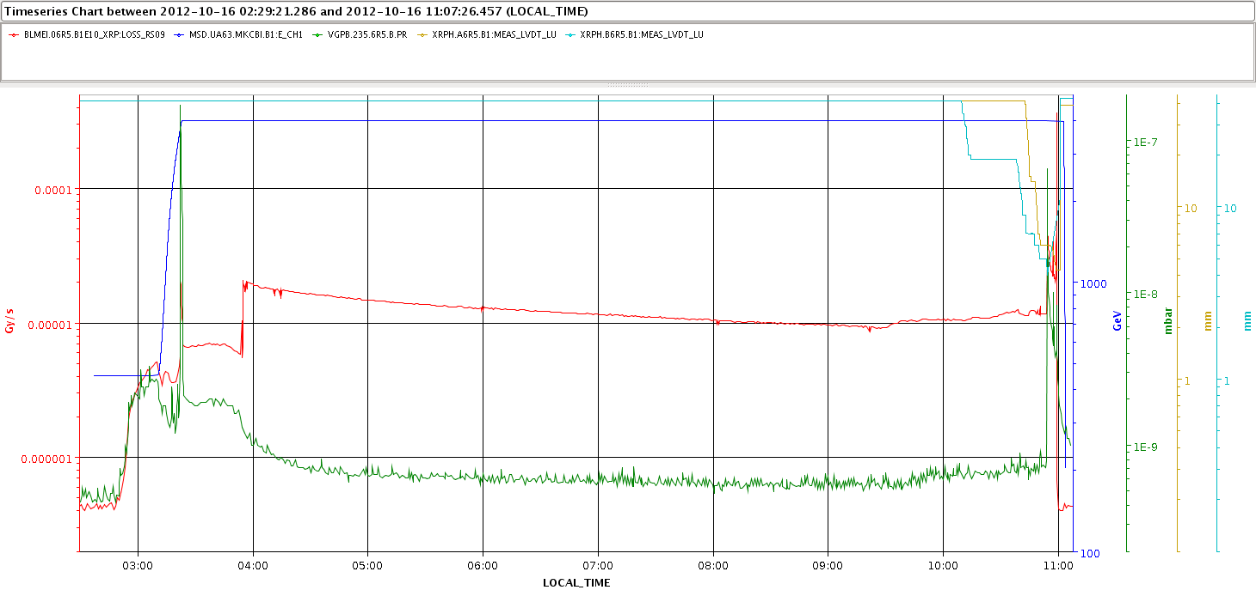
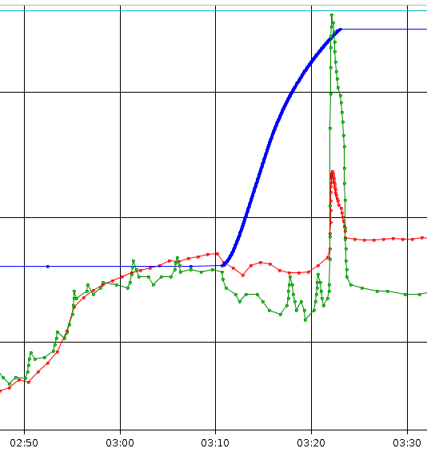
Fill 3188 with RP Insertion, Cell 6R5 _
insertion at low β*
beam heating – LHC vacuum – RP optimization- rates
BLM and vacuum spike,
no dump

Slide 42
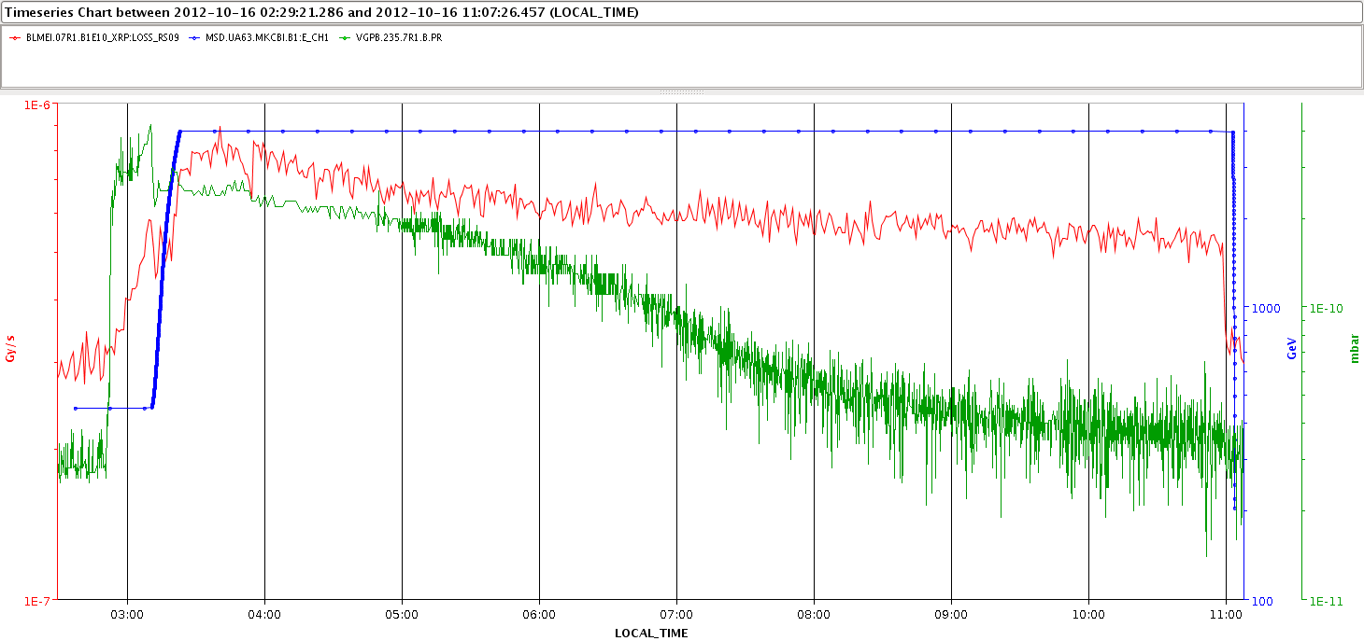
Fill 3188, Cell 7R1 (ALFA)
slight vacuum degradation at injection,
no spike in ramp
insertion at low β*
beam heating – LHC vacuum – RP optimization- rates

Slide 43
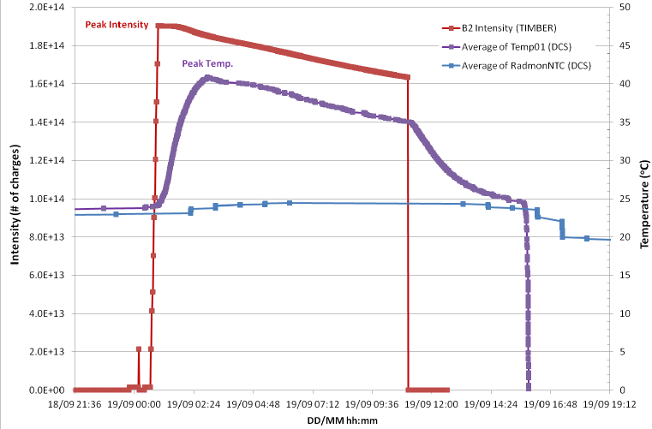
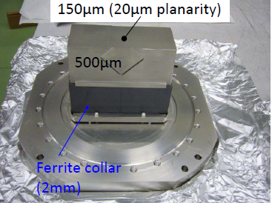
EM coupling of RP
(RP in garage position)
The temperature in the Roman Pot increases due to the EM coupling with the LHC
-> cooling of RPs is mandatory when LHC beam is injected
-> modification of evaporative cooling system by integrating a safe mode to operate above dew point in case of vacuum problem
Cooling of RP was switched off
insertion at low β*
beam heating – LHC vacuum – RP optimization- rates

Slide 44
Summary main observations
Temperature increase in RP due to LHC beam
LHC vacuum degradation in the region of RP147 m and RP220 m
-> Optimization of ferrite
-> Optimization of RP housing
insertion at low β*
beam heating – LHC vacuum – RP optimization- rates

Slide 45
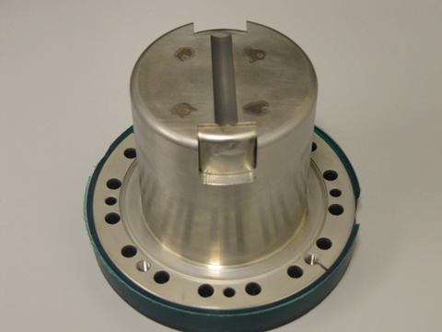
RP optimization
RP optimization ongoing – highest priority
Ferrite treatment during LS1
OLD TOTEM RP prototype
TOTEM – RP
insertion at low β*
beam heating – LHC vacuum – RP optimization- rates

Slide 46
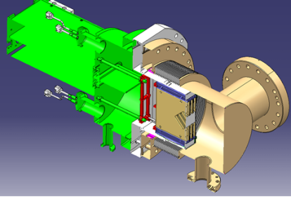
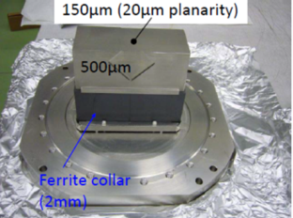
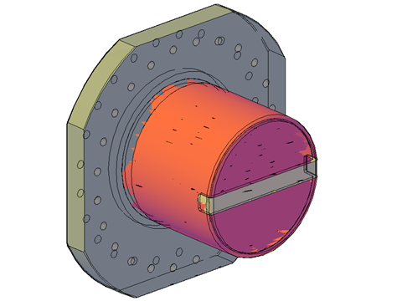
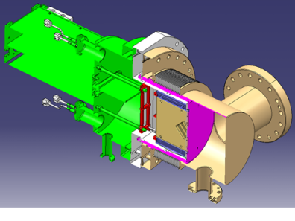
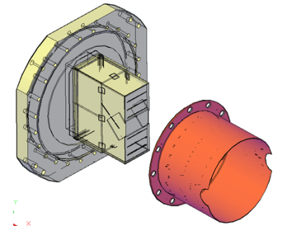
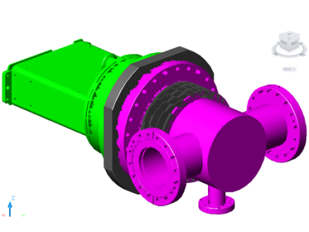
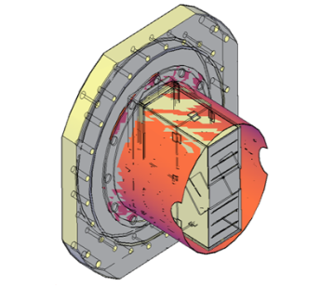
Optimization of RF characteristics
(first preliminary results B. Salvant, BE-ABP-ICE)
Rectangular (rotated-90°) RP with ferrite
-> ~ 300 W
Present RP housing
Study of new RP housing
Study of possible RF shielding
for existing RP
Ideal cylindrical RP (without gap cylinder/flange)
no ferrite
-> < 10 W
Study is ongoing
Not all issues are solved yet !
insertion at low β*
beam heating – LHC vacuum – RP optimization- rates

Slide 47
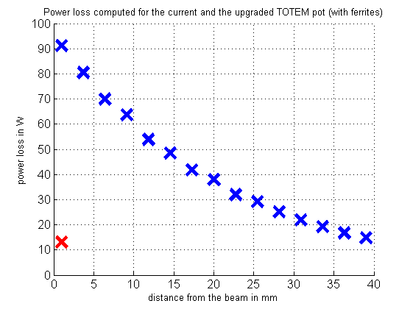
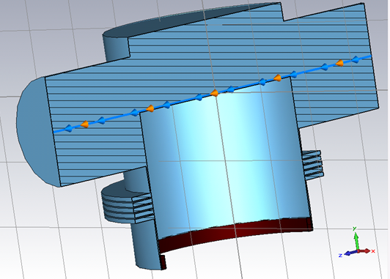
Computed power loss present RP box <-> RP cylindrical (B. Salvant)
current TOTEM pot (with ferrites)
upgraded TOTEM (with ferrites)
insertion at low β*
beam heating – LHC vacuum – RP optimization- rates

Slide 48
Comparison of rectangular and cylindrical RP
insertion at low β*
beam heating – LHC vacuum – RP optimization- rates

Slide 49
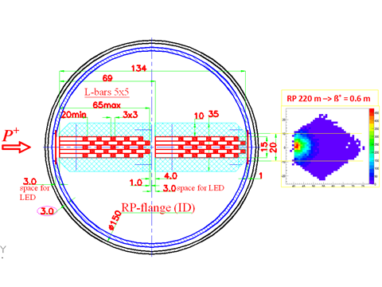

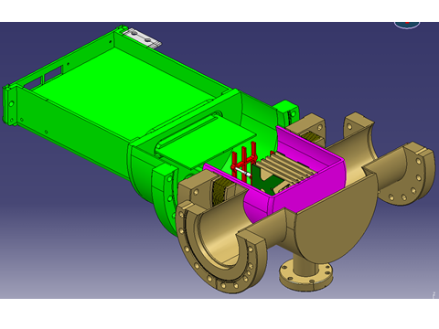
Integration study: cylindrical pot with integrated Cerenkov timing detector / Si detector
insertion at low β*
beam heating – LHC vacuum – RP optimization- rates

Slide 50
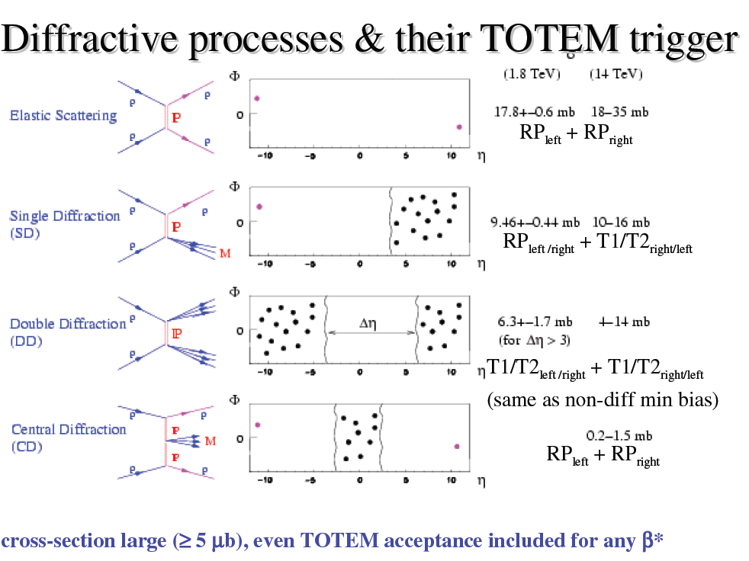
Rate & background measurement
insertion at low β*
beam heating – LHC vacuum – RP optimization- rates

Slide 51
Horizontal RP Rate at 14 σ
 | 56-F | 45-N | 45-F
Rate for 1368 b with beam separation | 2 MHz | 1 MHz | 3 MHz (incl. showers from N)
separation lumi factor | 1 / 15.7 | 1 / 18.6 | 1 / 22.6
Rate for 1368 b without separation | 31 MHz | 19 MHz | 68 MHz (22.6* 3 MHz)
Rate for 1 b without separation | 23 kHz | 14 kHz | 50 kHz
Hits per bx w/o separation | 2.0 | 1.2 | 4.4 (50 kHz/11.2kHz)
Expected rates
after LS1 are different
(L, bunch scheme)
Beam conditions (fill # 3288):
1.6 x 10¹¹ p/b
E = 4 TeV
β* = 0.6 m
ε_{n} = 2.8 μm rad
μ = 31 (without separation)
L = 6.7 x 10³³
Revolution frequency: 11.2 kHz
average crossing rate : 11.2 * 1368 = 15.3 MHz
average interaction rate (without separation) : 15.3 * 31= 47.4 MHz
expected SD rate per arm within acceptance:
~ 0.4 / bx (event rate / bunch crossing)
insertion at low β*
beam heating – LHC vacuum – RP optimization- rates

Slide 52







Roman Pot detector system study of combination: Si strip- Si pixel- timing (schematic)
RP – 200 m
RP + 200 m
CMS ip5
SHOWER
beam halo
pileup bunch crossing
tracking
timing
PIXEL
detector
40 MHz-VFAT
Si-strip detector
trigger
CMS jet trigger &
double arm coincidence
trigger
insertion at low β*
beam heating – LHC vacuum – RP optimization- rates

Slide 53
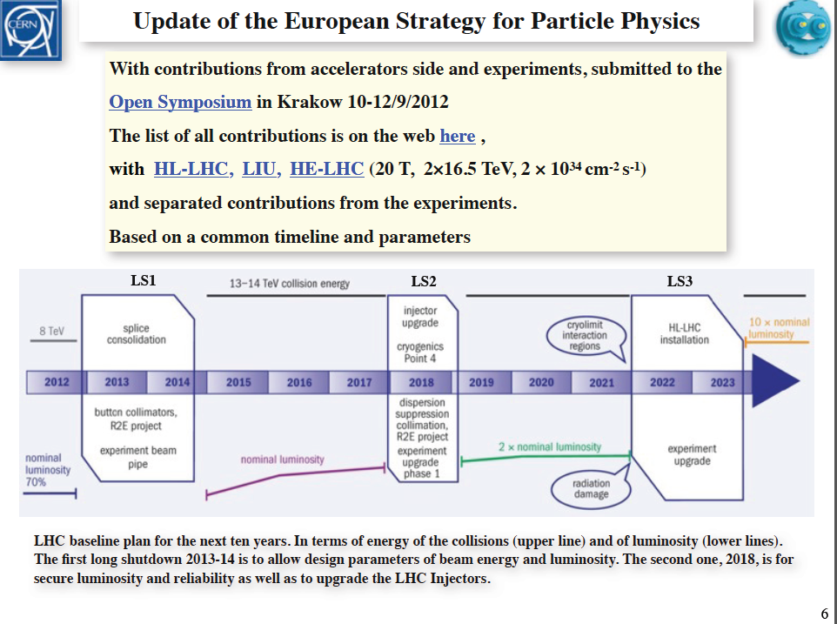
TOTEM standalone operation presented at 1st LHC workshop on Collider Experiment Interface on 30.11.2012 (CERN)
Water cooled cables
TOTEM operation with RP +/- 220 m - and optionally in combination with +/-210 m
after LS2 in special runs possible (covered by TOTEM consolidation program)
insertion at low β*
beam heating – LHC vacuum – RP optimization- rates

Slide 54
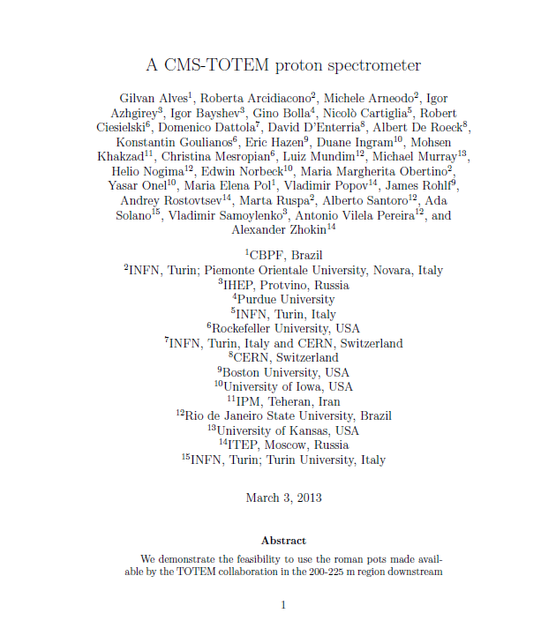
Proposal for upgrade

Slide 55
Conclusion (1)
TOTEM has confirmed the complete dismounting of RP 147 m stations during LS1 (as early as possible)
The removal of the RPs at +/- 147 m allows the installation of TCL4
The RPs of +/- 147 m will be reinstalled in the +/- 210 m region
The re-use of service infrastructure (patch panel, cooling) was studied
Installation of additional horizontal RPs in region of +/-220 m of ip5 during LS1 is proposed (CMS-TOTEM document submitted to CMS management)
These new horizontal RP detectors will allow tracking & timing at low β* and high luminosity
Integration studies were performed by TOTEM and CMS to integrate a “Cherenkov “timing detector in a (horizontal) RP
Impedance studies for the horizontal RPs are ongoing
Studies are ongoing to improve the RP geometry (RF, material budget)

Slide 56
Conclusion (2)
Insertion tests (~2 mm) have shown, that the LHC is not affected by the RP
The vacuum in the 147 m and 220 m region is very likely influenced by the ferrites
Insertion of the RP lead to a temperature increase (measured on cooled e-cards)
The installation of TCL6 is mandatory !
The developments of Roman Pots as ‘carriers’ for tracking and timing detectors with the potential to approach the LHC beam to very close distances are ongoing.
(cylindrical RP for timing detector, possible RF shield around existing horizontal RPs)
Installation of new RPs during LS1 is realistic
The combination of the existing TOTEM RPs (alignment, trigger) with new RPs, equipped with tracking and timing detectors is under study
The TOTEM-CMS upgrade program will combine challenging developments :
timing detectors ~ 10 ps, TDC ~ 5 ps, low jitter clock distribution, 3D pixel, innovative cooling etc.

Slide 58
Physics Analysis Highlights

Slide 59
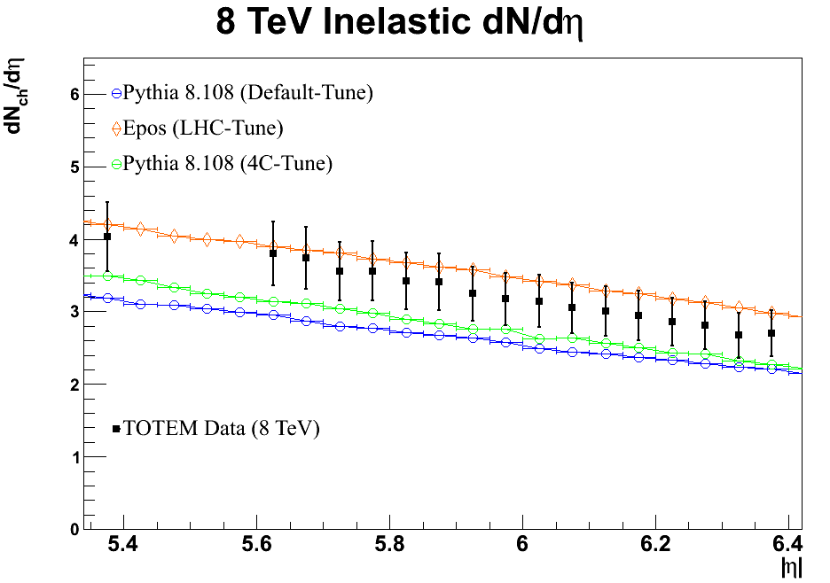
Common TOTEM-CMS data & analysis
PRELIMINARY
At least a charged particle in T2.
P_{T} > 40 MeV/c.

Slide 60
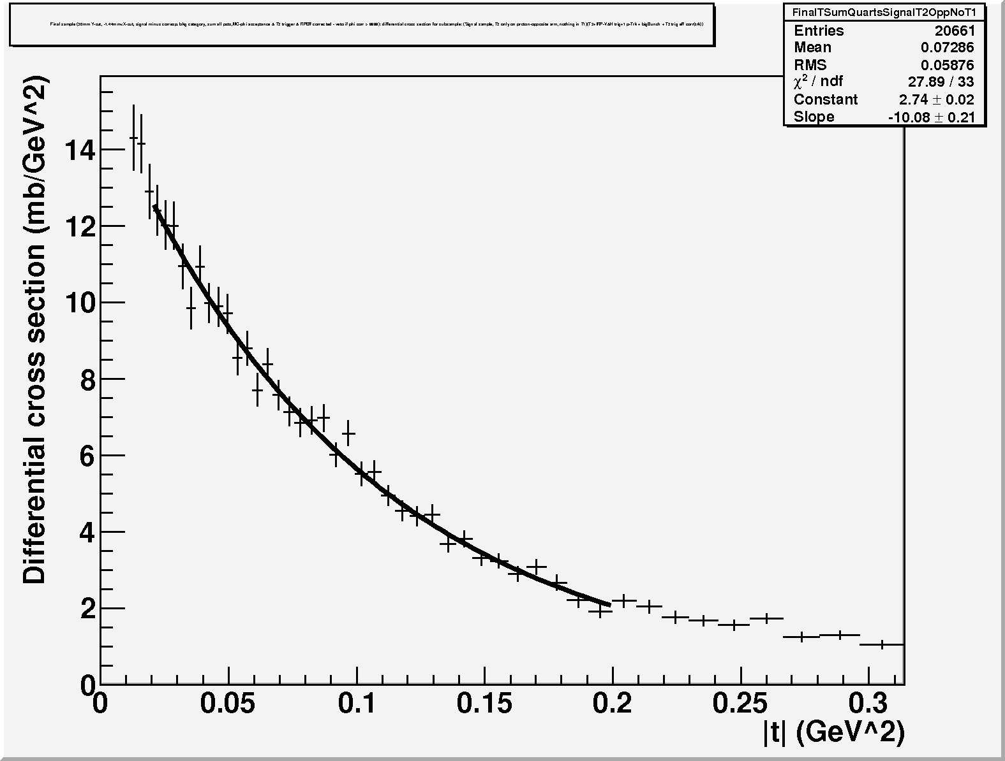


Soft single diffraction t-spectra at 7 TeV
dσ/dt ∼ Ce^{−Bt}
dσ/dt ∼ Ce^{−Bt}
B = 10.1 GeV⁻²
B = 8.5 GeV⁻²
p + T2 opposite arm, M_{SD} ≈ 3.4 – 7 GeV
p + T1 opposite arm, M_{SD} ≈ 7 – 350 GeV
∼1.8 mb
∼3.3 mb
dσ/dt ∼ Ce^{−Bt}
Uncertainty estimated on slope
B ∼ 15 %
B = 6.8 GeV⁻²
p + T1 same arm, M_{SD} ≈ 0.35 – 1.1 TeV
Preliminary
∼1.4 mb

Slide 61
Study of Hadronic-Coulomb interference region at low-t (B*=1km)
Started theoretical study of phase models and rho evaluation with different methods.

