Slide 1
Exploring Cosmic Microwave Background
Chao-Lin Kuo
Physics Department & SLAC PPA, Stanford University
Kavli Institute for Particle Astrophysics and Cosmology

Slide 2
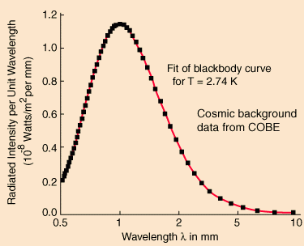
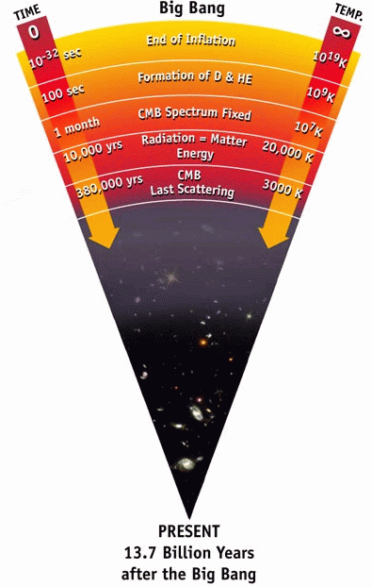
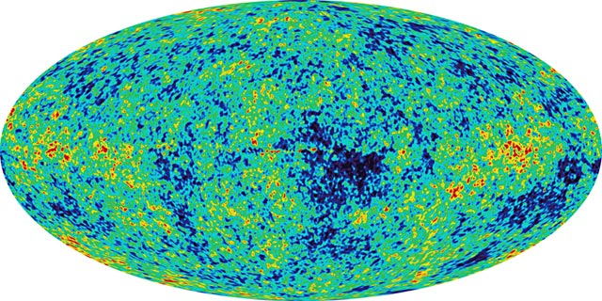
Cosmic Microwave Background (CMB)
ionized
neutral
1. blackbody emission law
WMAP
2. angular anisotropy → power spectrum
3. And, it is polarized! (Rees, 1968)
WMAP
website
Notes:
We study the cosmic microwave background (CMB). As we look further and further , the universe was hotter and hotter, eventually the atoms become ionized, forming a opaque wall everywhere we look. That is the CMB. CMB has a very distinct photon emission law, that of a perfect blackbody at 2.7 K. Different directions have slightly different temperature. This is a temperature map of the sky made by the WMAP satellite.

Slide 3
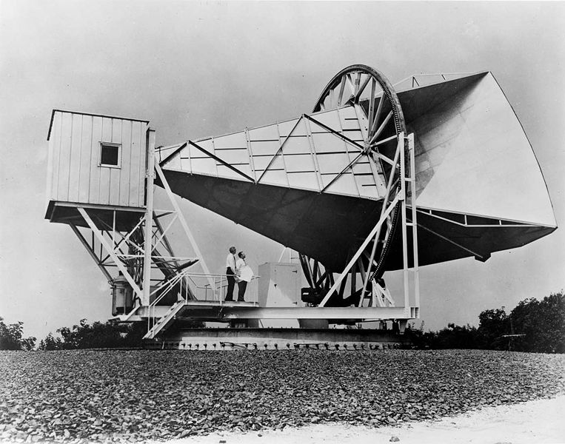
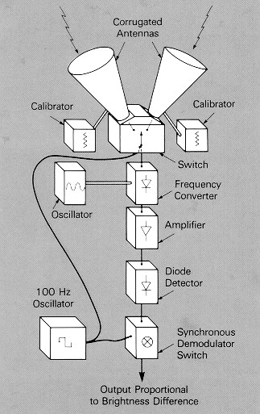
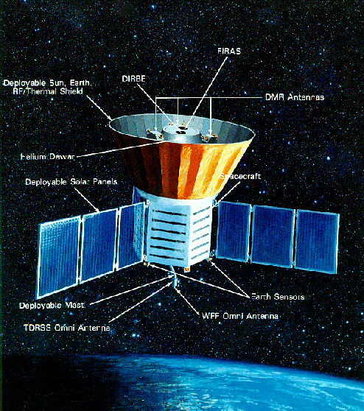
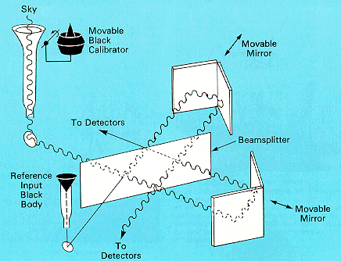
Cosmic Microwave Background
THE Horn antenna
COBE
  DMR
  FIRAS
DMR
COBE, 1990
FIRAS

Slide 4
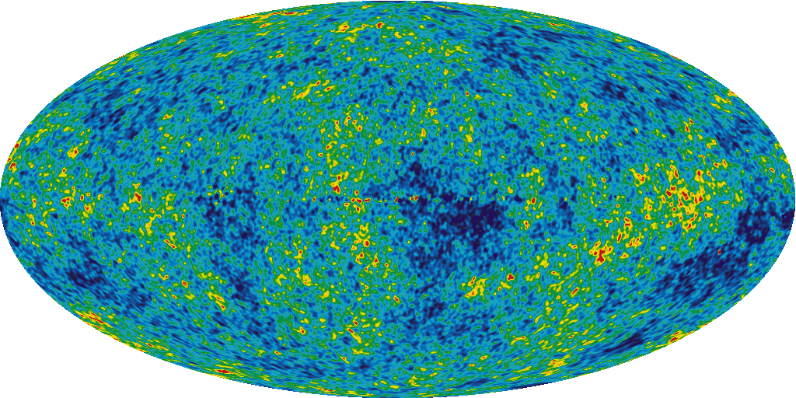
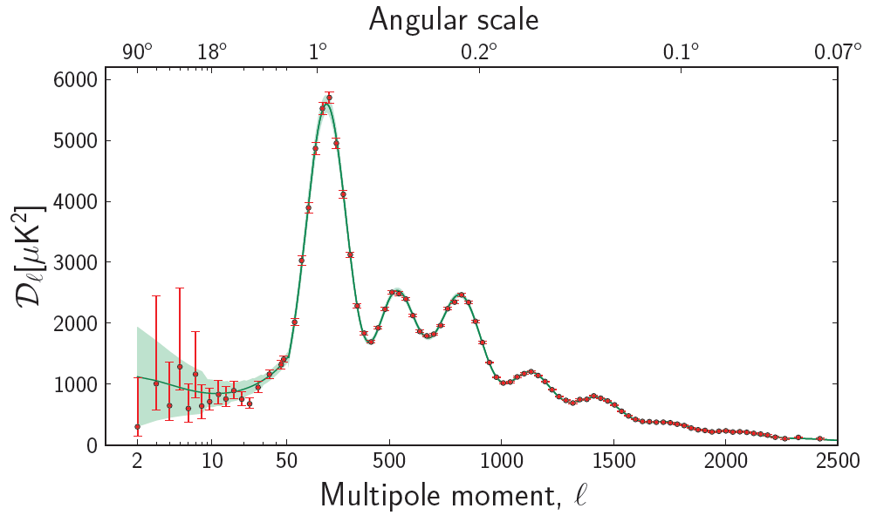
CMB angular power spectrum
Large scales
Small scales
Fourier Analysis
C. L. Kuo CMB polarization

Slide 5
The intrinsic significance of the CMB
Its effects: seeds for gravitational instability, which create everything you see today (galaxies, stars, planets, animals, …)
Its origin: quantum gravity process in the very early universe (one of the very few ways to study QG)
C. L. Kuo CMB polarization
Notes:
Getting editorial here

Slide 6
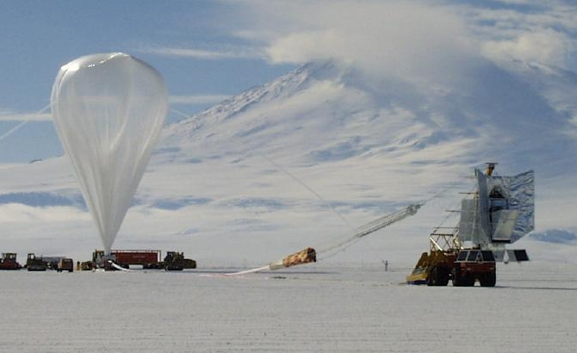
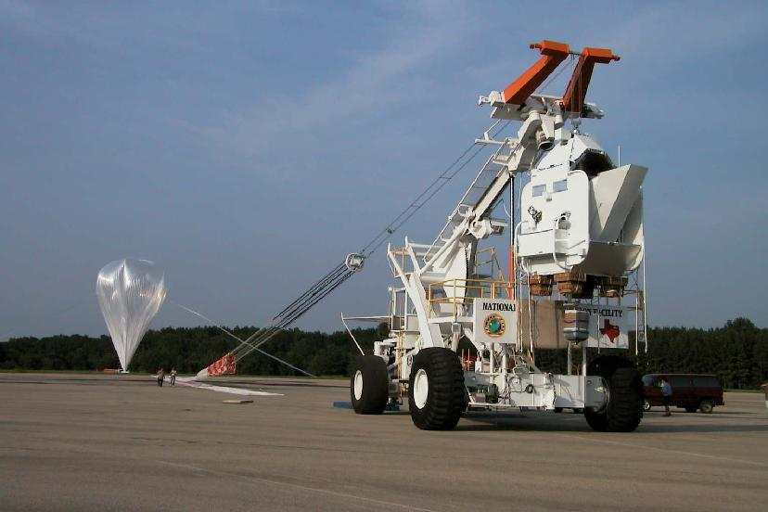
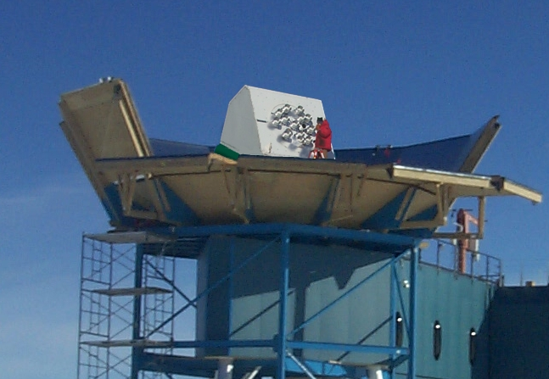
Boomerang, Maxima, DASI
The race to the peak..
1996-2001

Slide 7
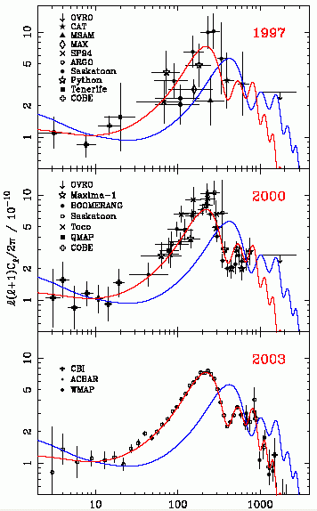
Progress in CMB experiments in the past 15 years

Slide 8
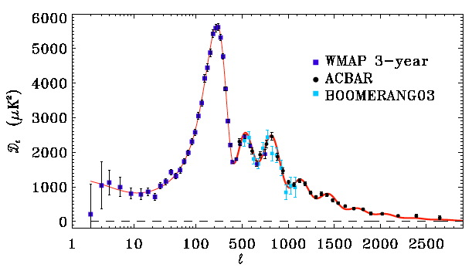
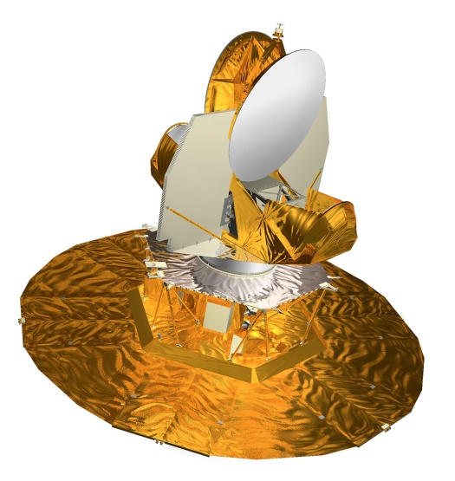
CMB temperature power spectrum circ. 2008

Slide 9
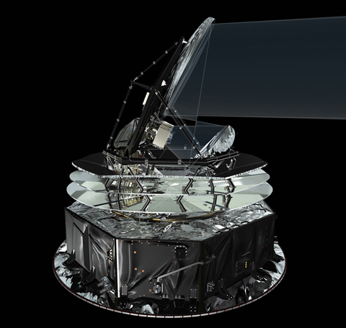
CMB temperature power spectrum, summer 2013
Planck

Slide 10
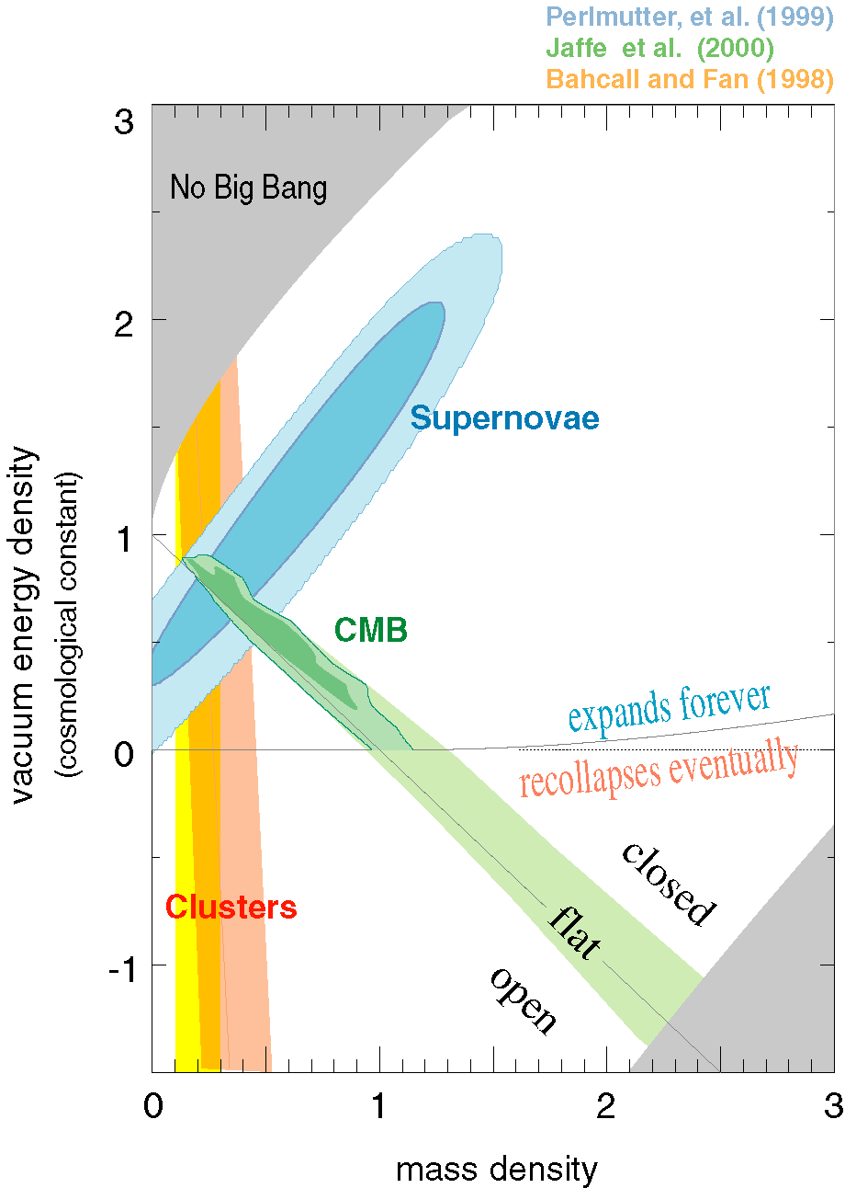
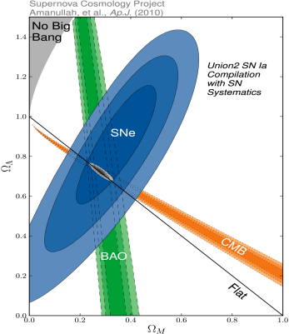
2000-2013
SN:
Ω_{M}-Ω_{Λ}/2
Ω_{Λ}
CMB:
Ω_{M}+Ω_{Λ}
LSS/Clusters:
Ω_{M}
Flat geometry
Ω_{DM} (dark matter) ~ 25.9%
Ω_{B} (baryon) ~ 4.8%
Ω_{Λ} (dark energy) ~ 69.3%
Ω_{M}

Slide 11
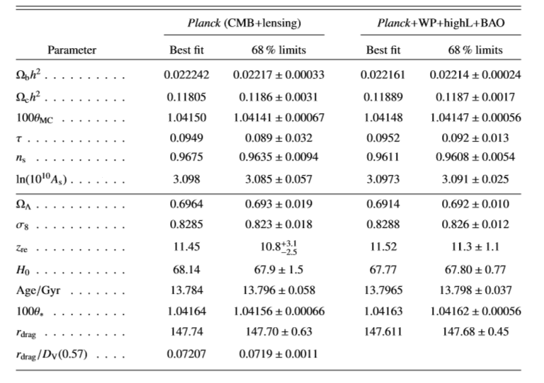
Cosmological parameters

Slide 12

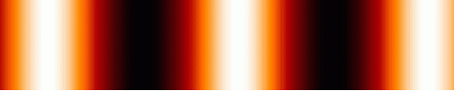
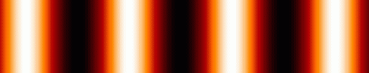
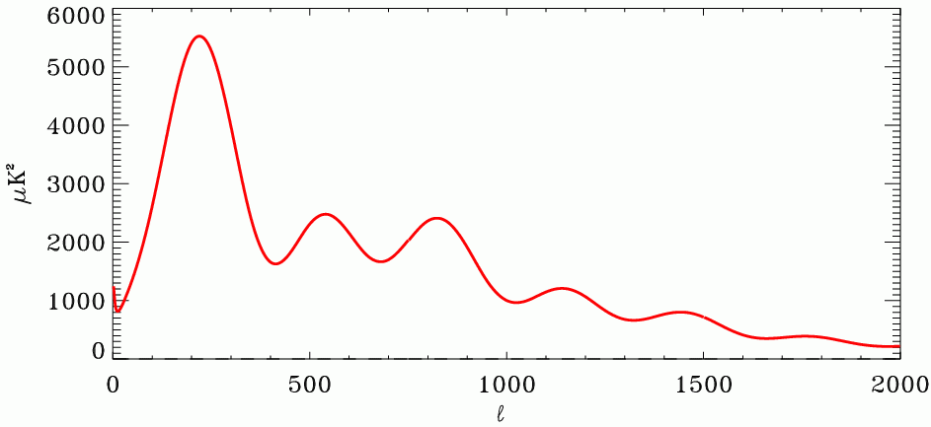
CMB power spectrum
baryon
/photon
Dark matter
potential
γ
Damping tail
large scale
0.5 deg
small angular scale
* Acoustic peaks (Sakharov) – compression/rarefaction of plasma in dark matter potential well
* Not are the acoustic peaks observed – they are in perfect agreement with BBNS !
Notes:
CMB is linear, exactly calculable, the measurement is clean, no room for bias, alternative interpretations, etc.

Slide 13
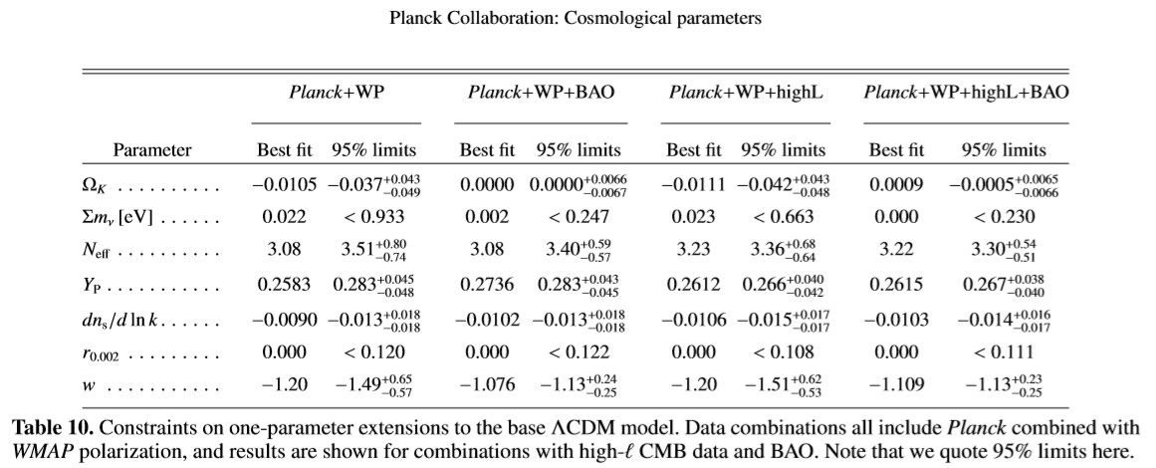
New Physics?

Slide 14
B-mode theorem
Polarization fields can be linearly decomposed to E and B mode
Linear, scalar perturbation cannot generate B-mode polarizations
No cosmic variance
(Seljak & Zaldarriaga; Kamionkowski et al, 1997)
E
B
C. L. Kuo CMB polarization

Slide 15
CMB is polarized. Why?
point source
Induced by radiation anisotropy through Thomson scattering
Generated only at the ionized/neutral interface (completely ionized: no anisotropy; completely neutral: no electrons to scatter)
e⁻
observer
C. L. Kuo CMB polarization

Slide 16
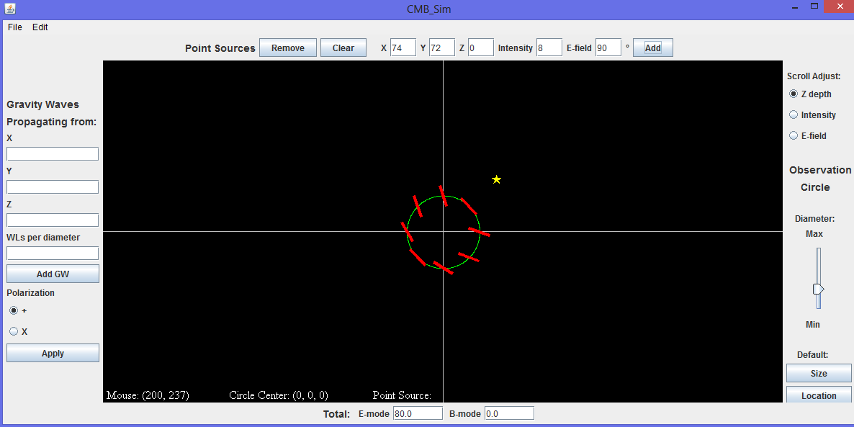
B-mode is forbidden for density perturbations
(Seljak& Zaldarriaga, 1997; Kamionkowski et al., 1997)
point source
observer
e⁻
C. L. Kuo CMB polarization

Slide 17
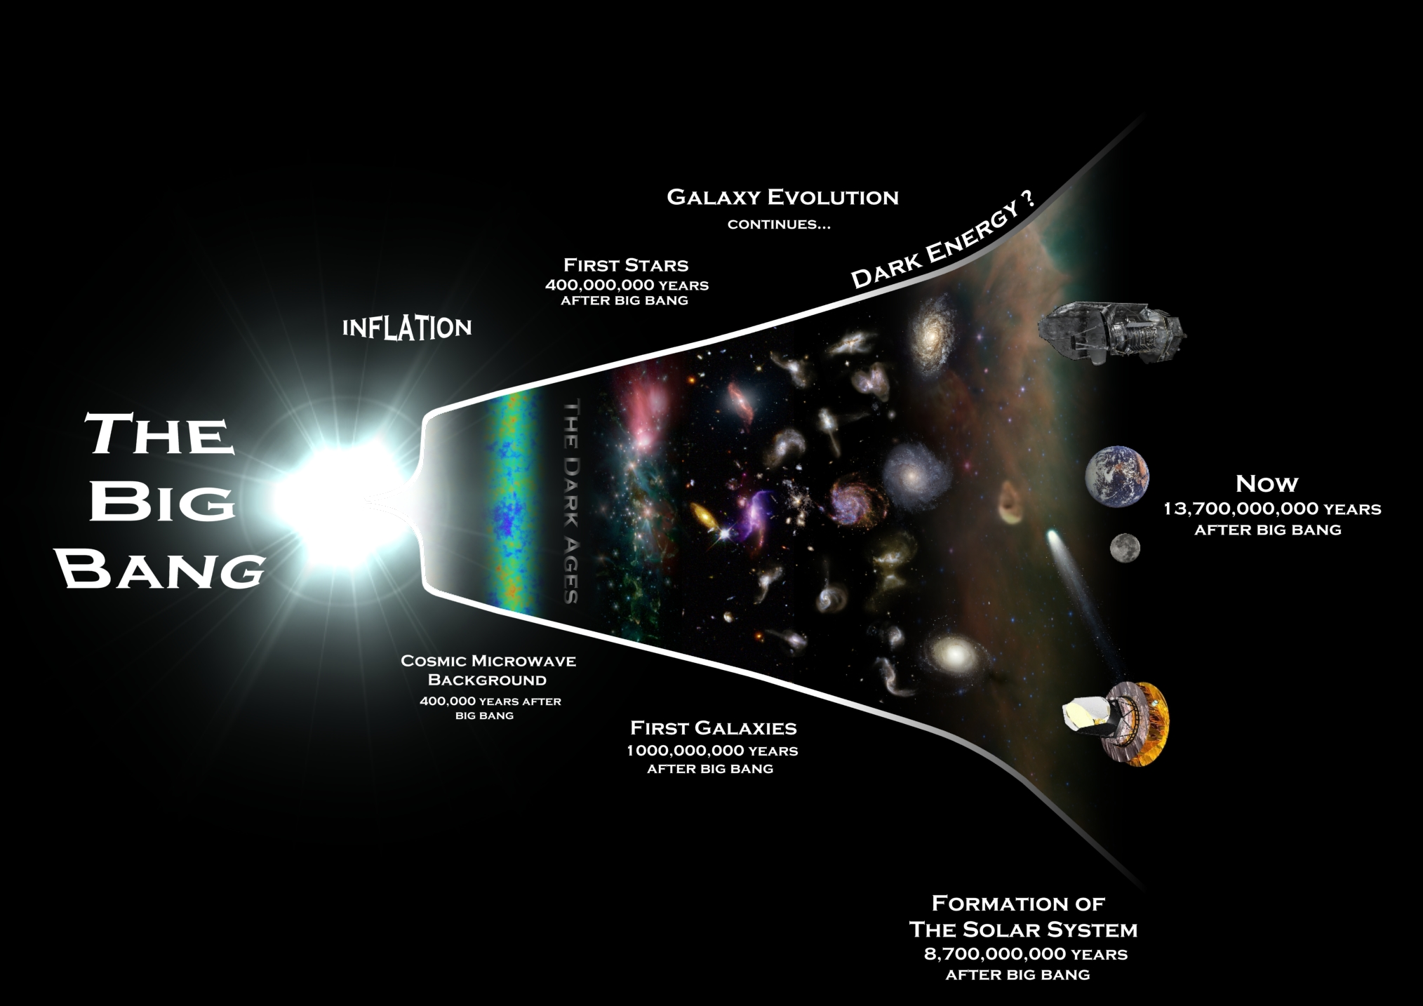
Cosmic Frontier
CMB probes cosmology
and physics of inflation

Slide 18
Cosmic Frontier
CMB probes cosmology
and physics of inflation
Transparent to photons
opaque to photons, but
transparent to gravity waves

Slide 19
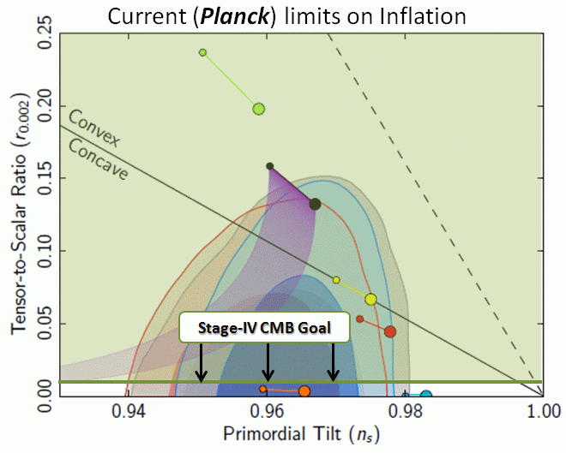
Experimental Probes of Inflation
Inflation predicts
  Flatness; scalar perturbations with very specific properties/statistics
  All confirmed by Planck and other exp., except for “tensor”
“Tensor” generates “B-mode” polarization in the CMB
  Measures the energy scale of Inflation, likely ~ 10¹⁶ GeV (grand unification)
  Unique probe of extreme high energy physics
  Evidence that gravity is quantized, if detected
  Inflation: nearly exponential growth of space.
    (30 orders of magnitude)
    Two related parameters: η, ε
    n_{s} = 1 – 4ε + 2η (<1 at 6σ !!)
    r = 16 ε (the goal)

Slide 20
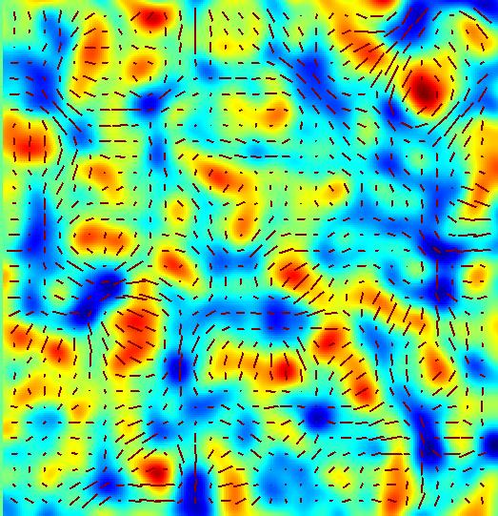
How big is the signal?
CMB = 2.725 K blackbody (peaks at λ~1.5 mm)
Temperature fluctuation ~ 100 μK
Polarization ~ 10 μK
B-mode polarization ~ ? μK
[For ground based experiments]
Atmosphere+telescope ~ 20 K
Degree of polarization <10⁻⁷
C. L. Kuo CMB polarization

Slide 21
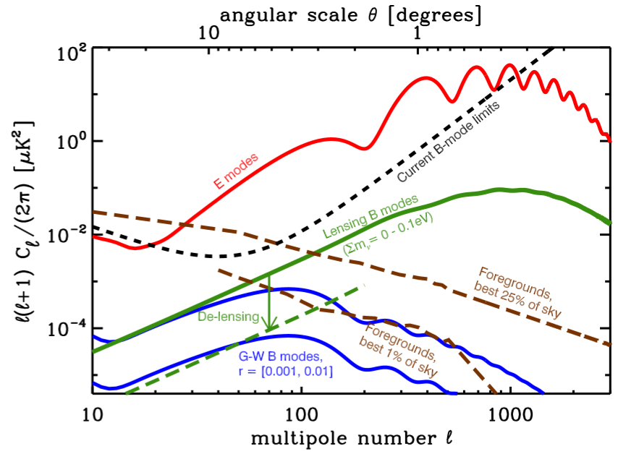
Gravitational Waves & Lensing
95% limits:
r< 0.72 BICEP ‘09 indirect limit (TT) r< 0.12 Planck+WMAP
r< 2.2 QUIET ’10 +with more priors

Slide 22
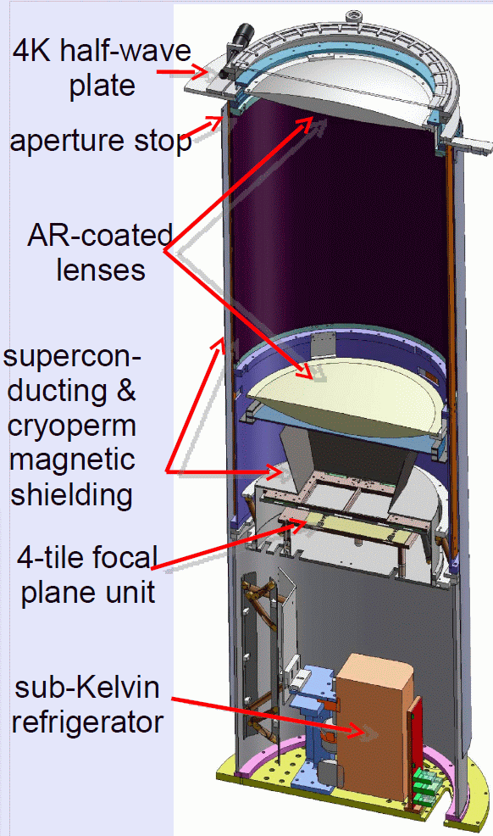
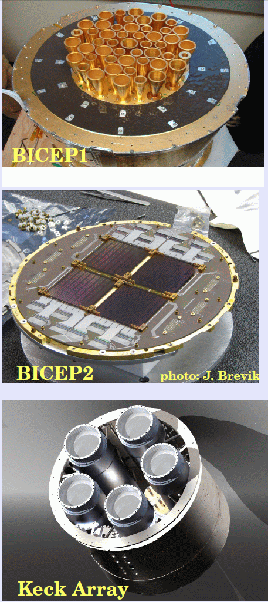
BICEP1/BICEP2/Keck Array (Caltech/Stanford/Harvard/UMN)
90/150GHz
25/24 elements
2005-2008
Best limit on B-mode
150GHz
256 elements
Taking data for 1yr
10x survey speed than
BICEP1
150GHz
256x5 elements
Deployed in 2010/11
cryogen free Dewars
* All with small refractors (25cm) ;
observing from the South Pole
* Will likely reach T/S ~< 0.05 by 2013

Slide 23
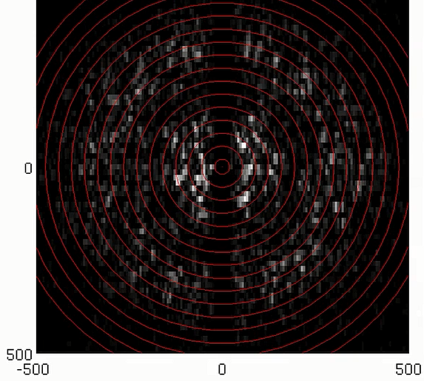
Integration

Slide 24
Cryogenic detectors in astronomy
Operating temperature: 50 mK ~ 300 mK
Very wide frequency coverage: cm through γ-ray
Photon noise limited sensitivity down to cm-wave
Photon counting capability for ν > far-IR
Spectrophotometric detector for ν > optical
Currently limited by pixel counts: multiplexing readout and large-scale fabrication processes needed
Heat detectors
Photon direct detectors
Bolometers:
Superconducting (TES) & Semiconducting (NTD) detectors
Hot electron bolometers (HEB)
Superconducting tunnel junctions (STJ)
Microwave kinetic inductance detectors (MKID)
C. L. Kuo CMB polarization

Slide 25
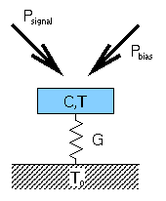
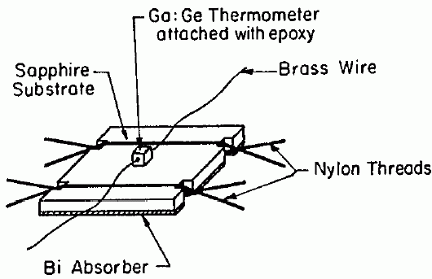
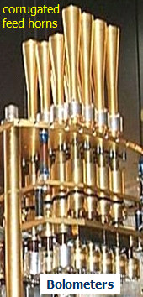
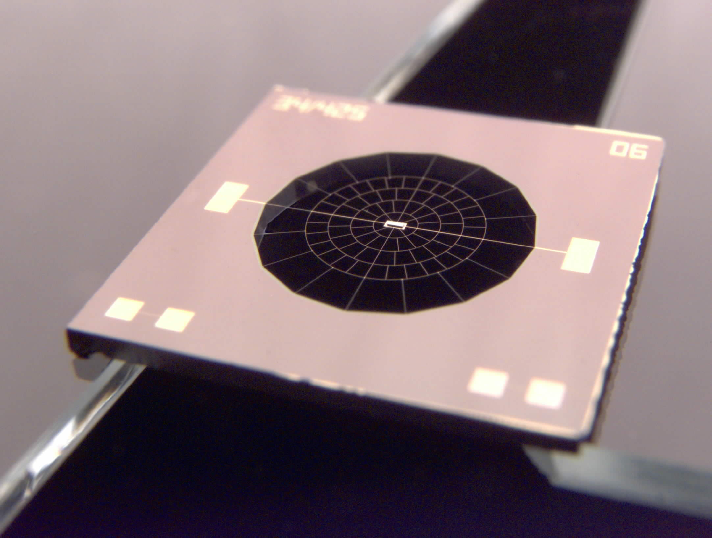
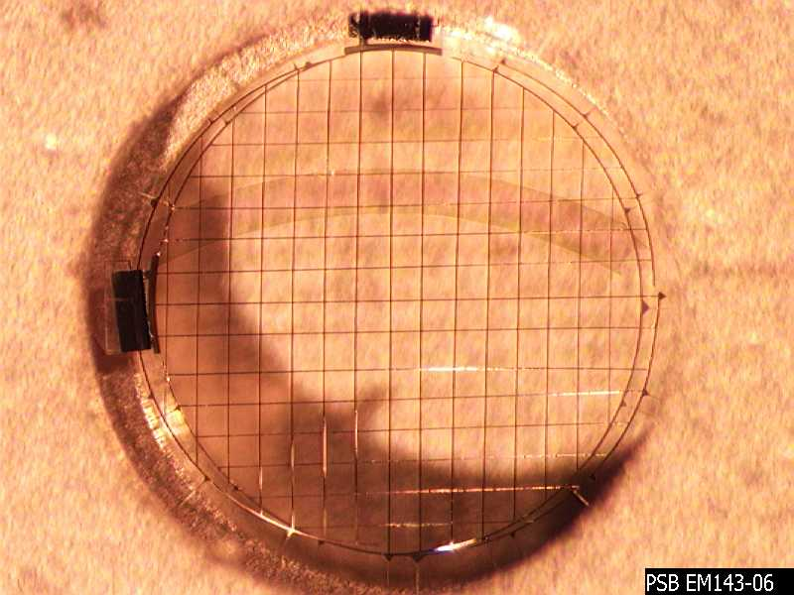
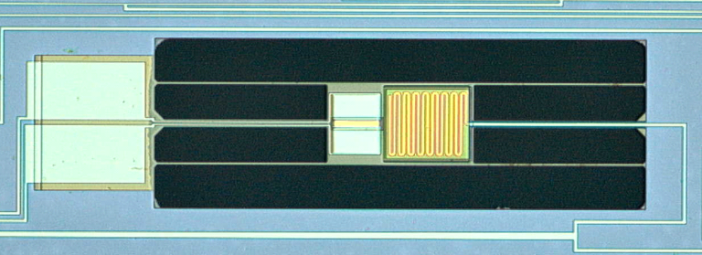
Bolometric CMB detectors
1980s
acbar
thermistor
Richards et al
1990s
NTD Ge
filters
Absorber
J. Bock et al
‘Spider-web’ bolometer
2000
Typically <0.3 K
polarization
sensitive
bolometer
* Bolometers: thermal photon detectors
for far-IR through mm-wave
* Sensitivity determined by G, T
* Thermistor = semiconductor
or superconductor
(TES=Transition Edge Sensor)
W. Jones et al
2006
Microstrip-coupled
TES bolometer
Deposited Ti film

Slide 26
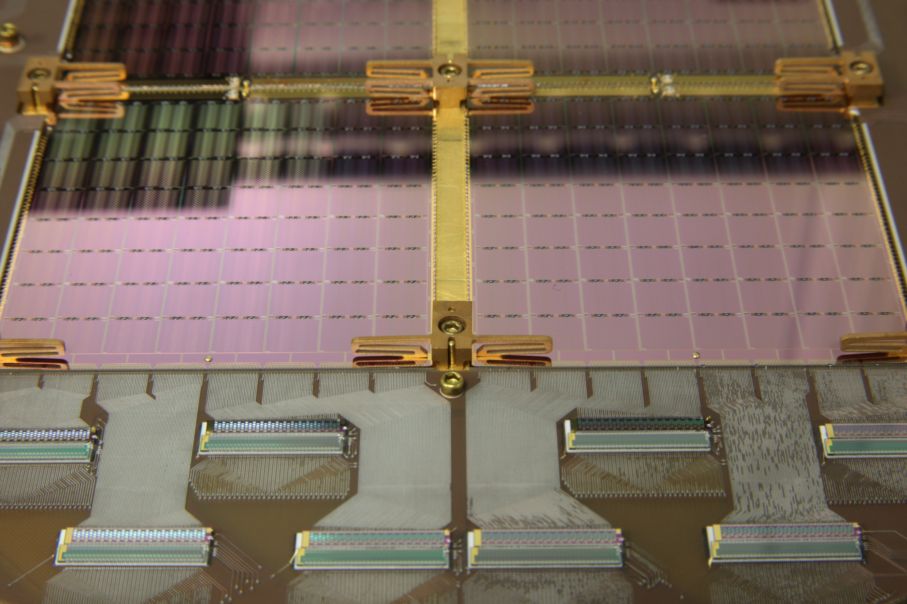
C. L. Kuo CMB polarization

Slide 27
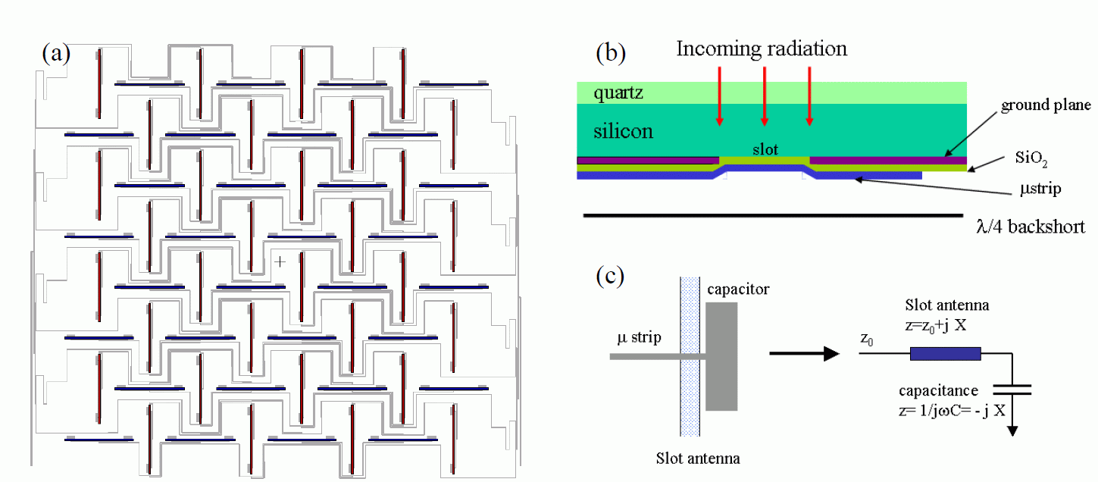
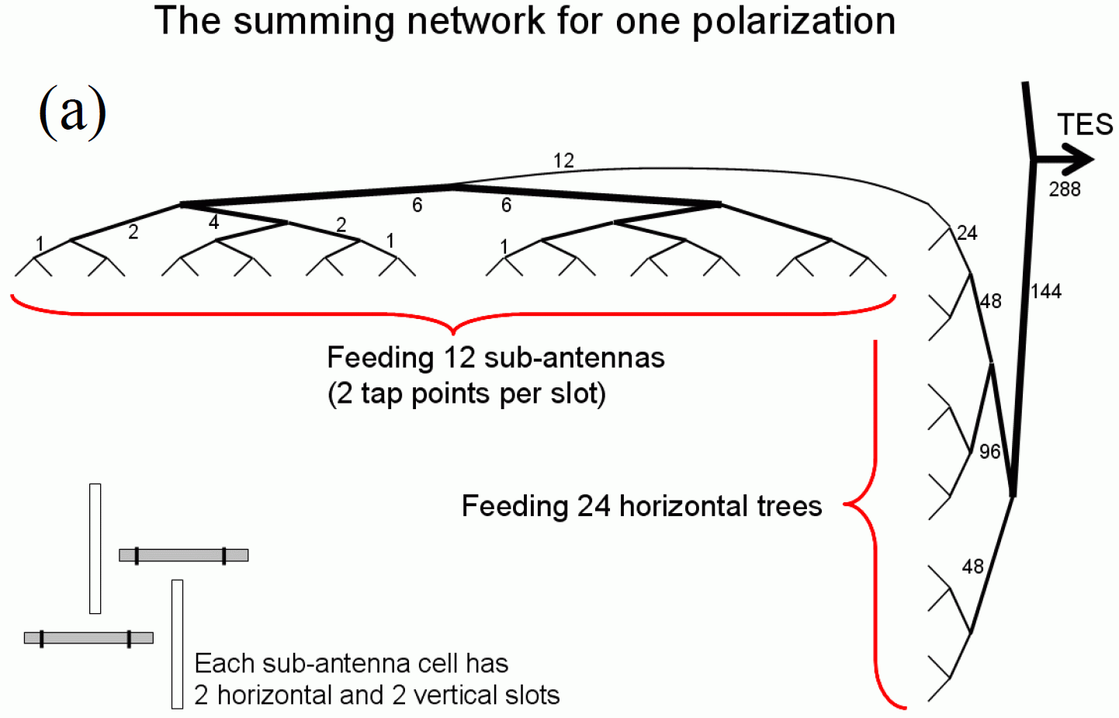
C. L. Kuo CMB polarization

Slide 28
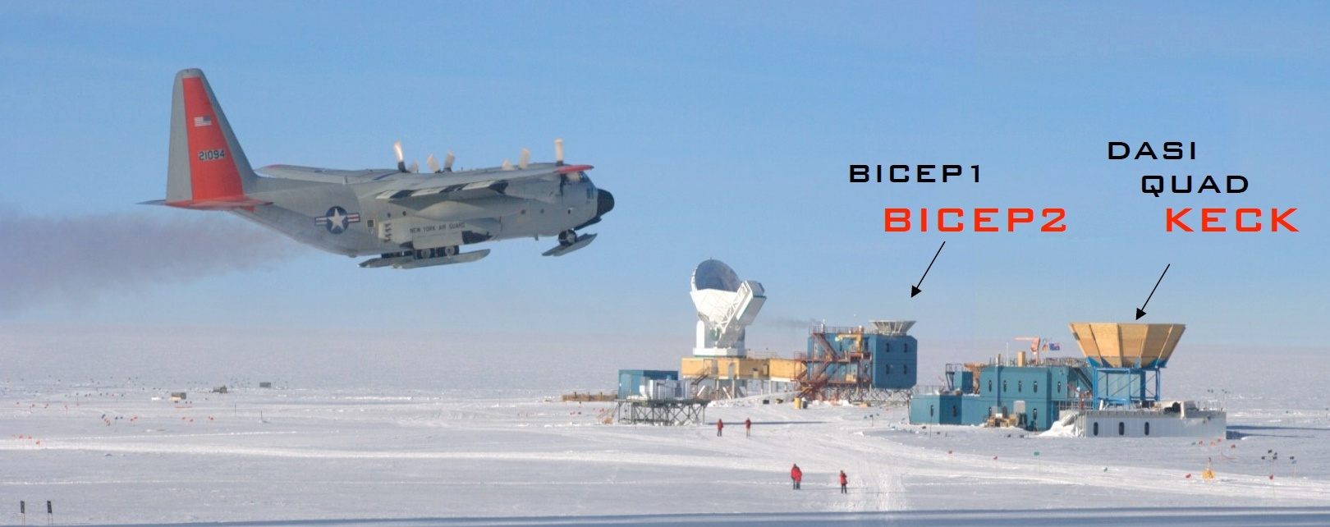
South Pole is an excellent site for CMB observation
High elevation, low temperature → low water vapor
Continuous observation for >9 months
Excellent infrastructure/support (NSF-Office of POLAR Program)
SPT
ACBAR
C. L. Kuo CMB polarization

Slide 29
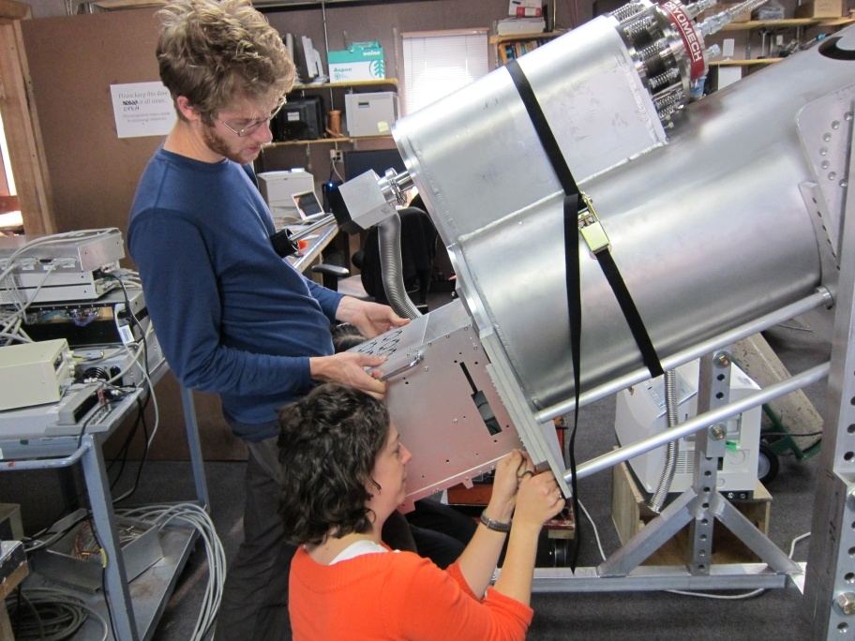
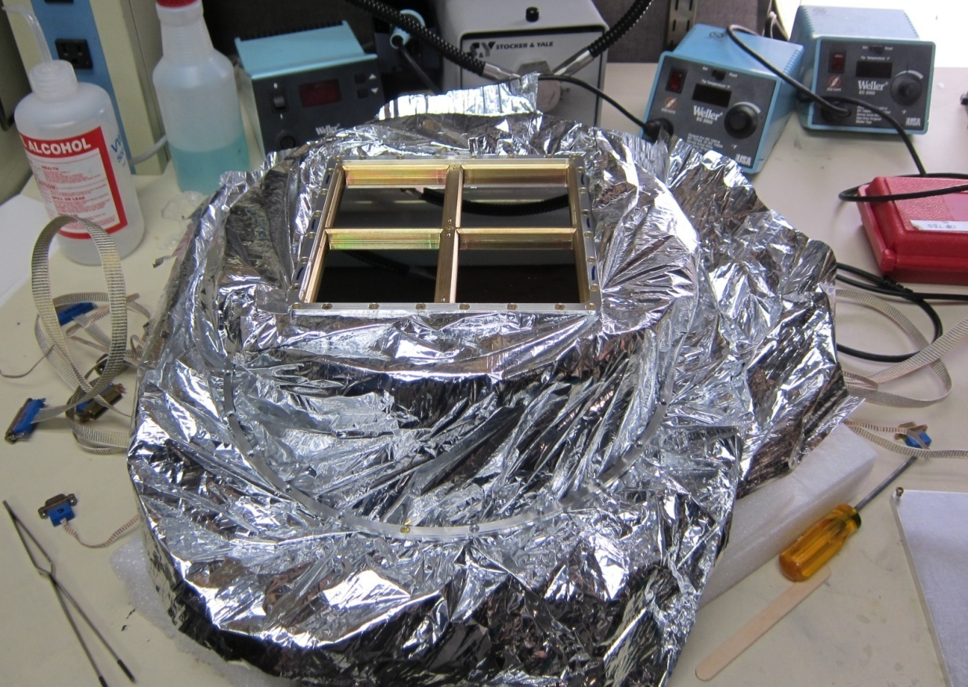
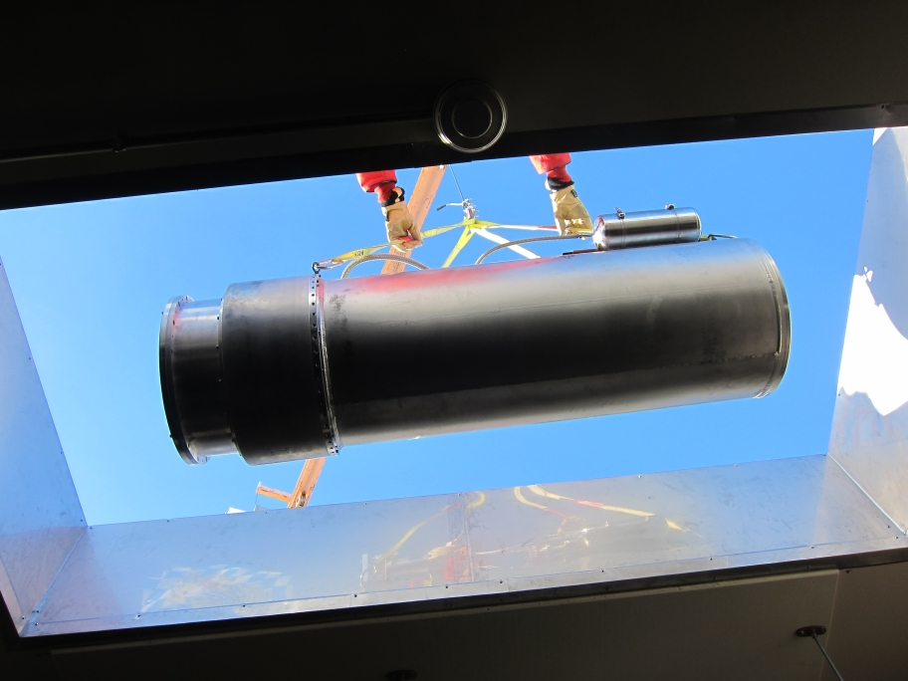
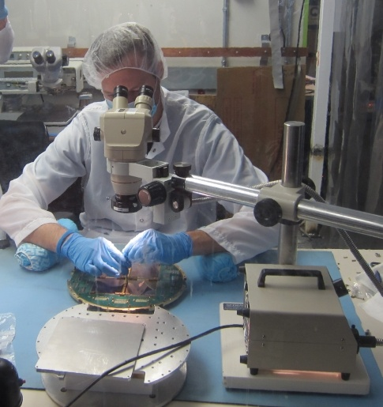
C. L. Kuo CMB polarization

Slide 30
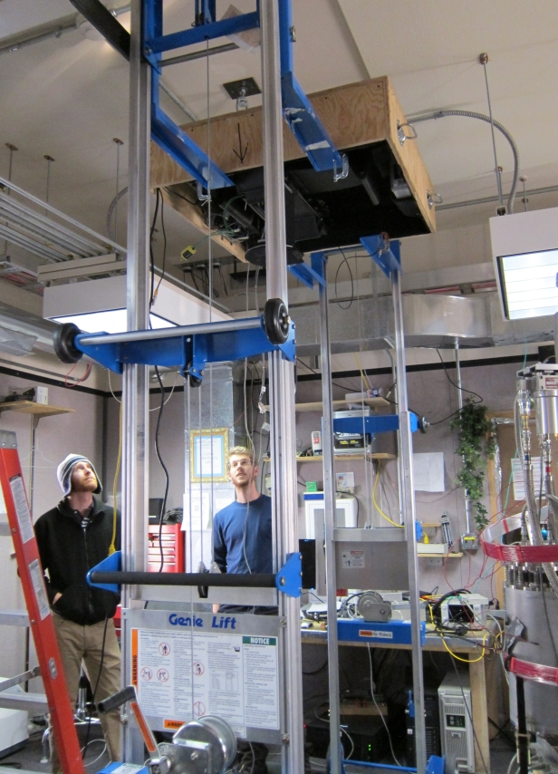
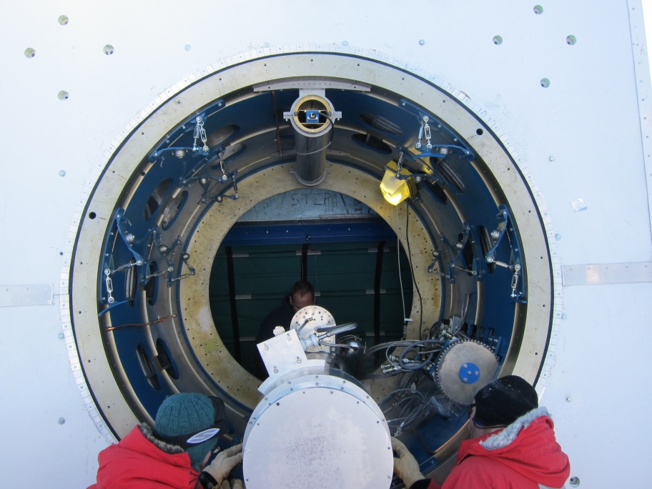
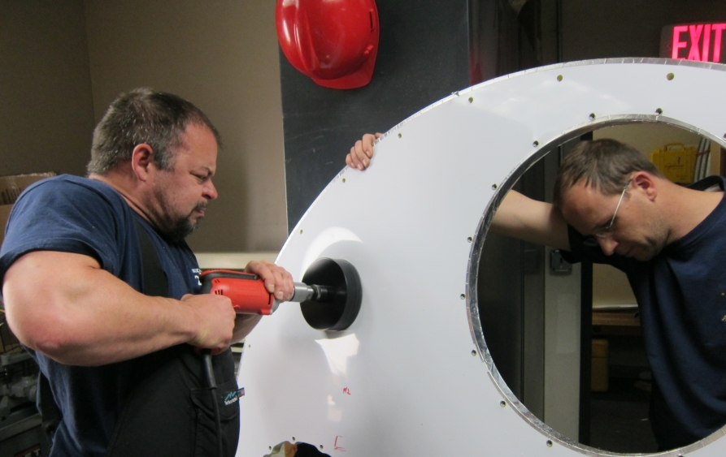
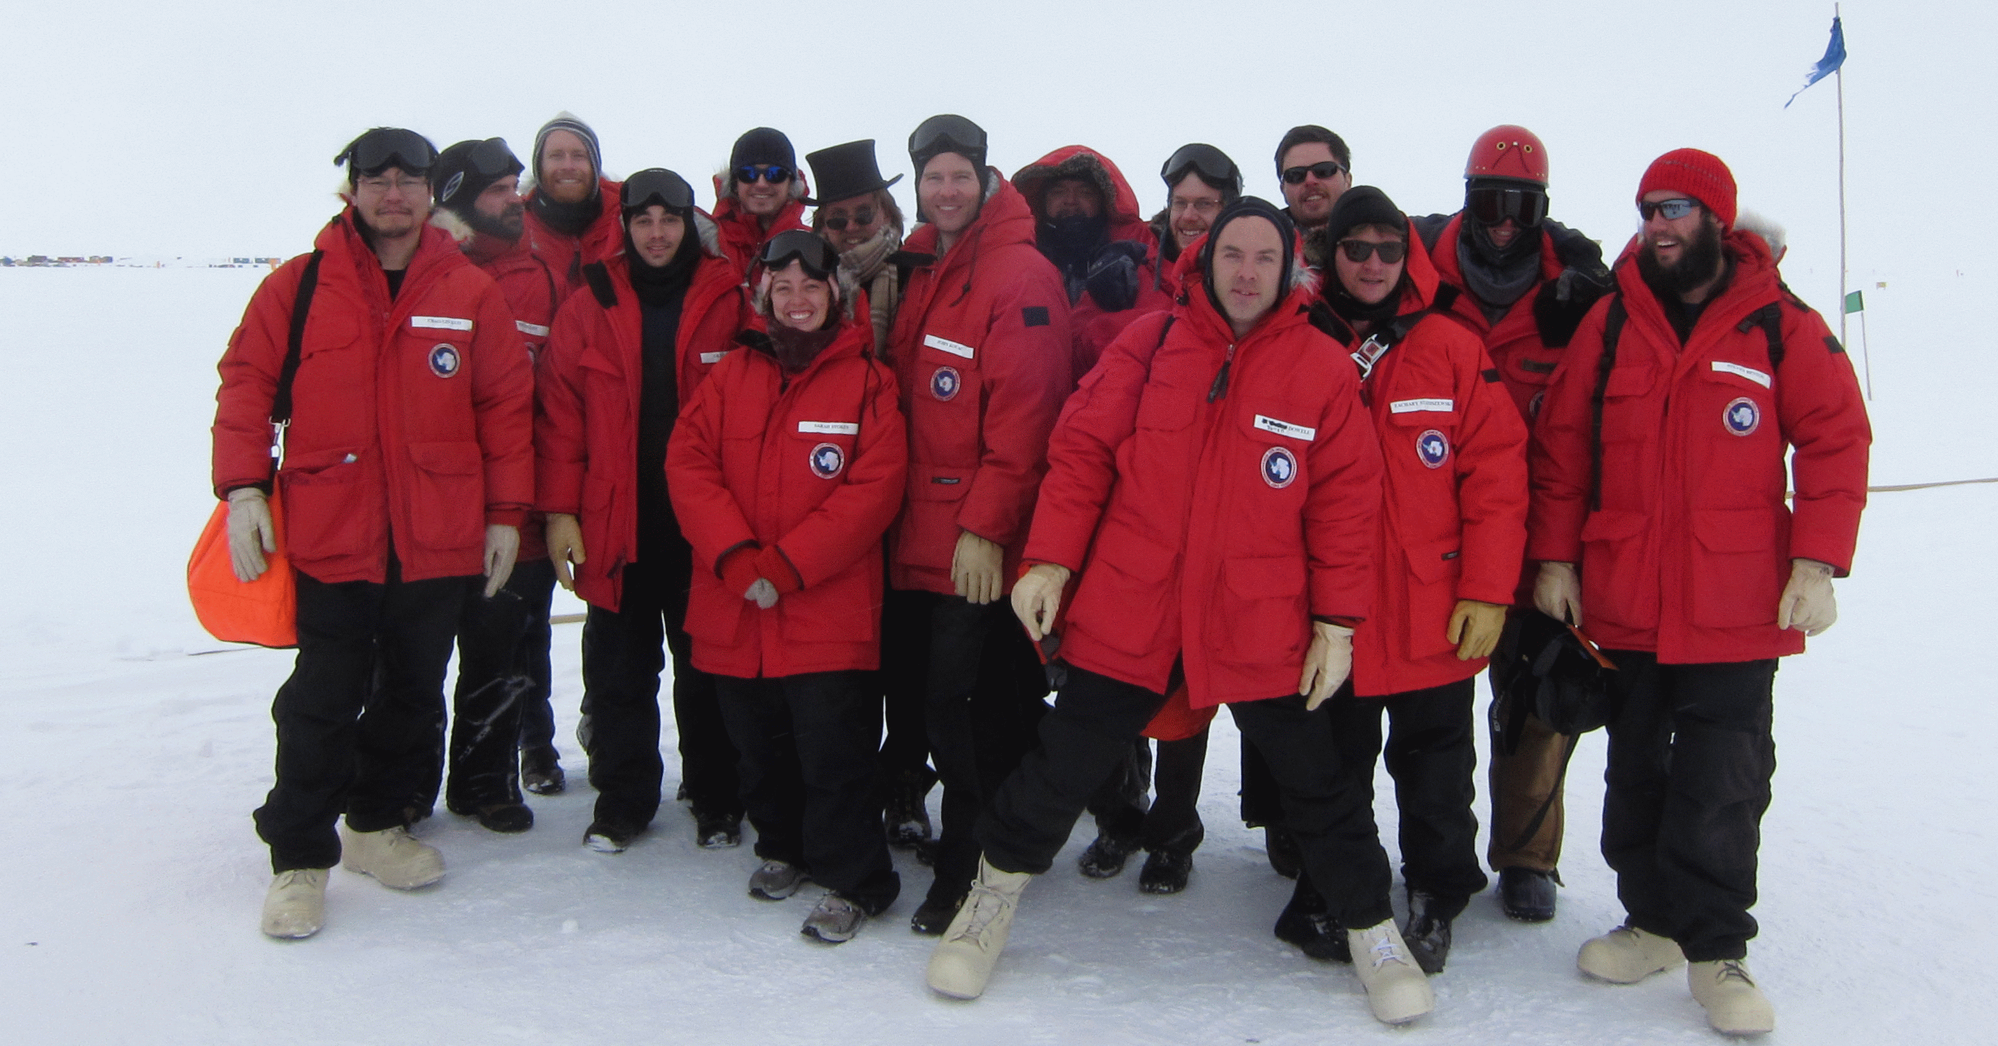
C. L. Kuo CMB polarization

Slide 31
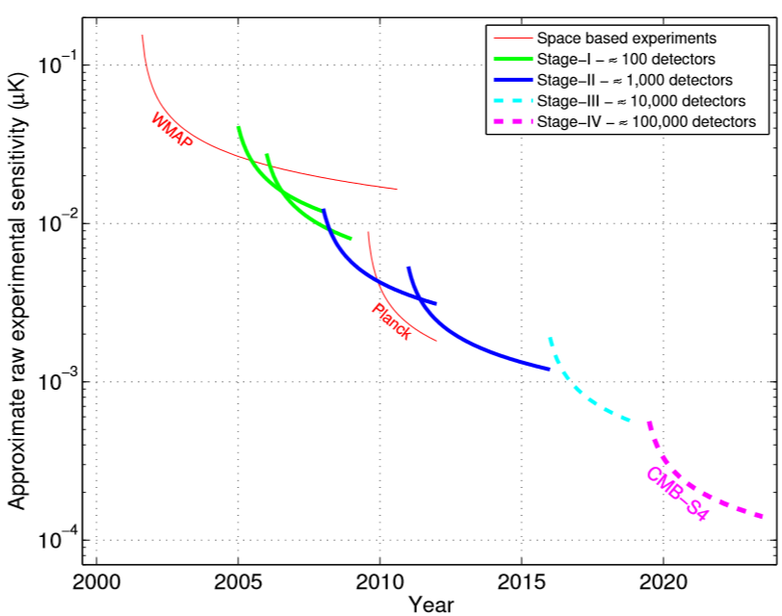
Experimental Progress

Slide 32







BICEP (2006–2008) BICEP2 (2010–2012) Keck (2011– ) BICEP3 (2014- )
BICEP MOUNT
EXISTING
BICEP MOUNT
DASI MOUNT
98 NTDs (95/150 GHz) | 512 TESs (150 GHz) | 2560 TESs (150 GHz) | 2560 TESs (95 GHz)
0.93°/0.60° FWHM | 0.52° FWHM |  | 0.37° FWHM
18° FOV | 17° FOV |  | 26° FOV
44 m² deg² AΩ | 44 m² deg² AΩ | 222 m² deg² AΩ | 502 m² deg² AΩ optical throughput

Slide 33







Large-scale instrumentation at National Labs
Stage-IV CMB
Duplicate (>10x)
Focal planes
(physical size limited by
IR loading, size of
vacuum window, lenses)
Fermi-LAT
Super CDMS
LCLS Detectors
R&D with Cornell Univ.
SLAC made 10 million pixels in total so far via robotic assembly
80 square meters of silicon sensors
Silicon LAT assembled at SLAC
Scaling up of Germanium sensors and fab throughput

Slide 34

C. L. Kuo CMB polarization
Notes:
See through the surface of last scattering

Slide 35
Lensing can generate B-mode
(Zaldarriaga & Seljak, 1999)
point source
observer
e⁻
for an arbitrary circle
on the sky

Slide 36

Effects of neutrino mass

Slide 37


CMB Lensing as a neutrino exp.

Slide 38

Thank you !

