Slide 1
The exercise today, two parts
Analyse some real proton-proton collisions in CMS
  Identify particles, determine what happened
  From analysing many events, can get an insight into some fundamental physics!

Slide 2
Designing a detector: what do we want to look for?
- the stable particles left over from decays of unstable particles that we can create in our collisions, e.g. W⁺, W⁻, Z⁰ (and H⁰)
W⁺ → μ⁺ + ν
W⁺ → e⁺ + ν
W⁺ → hadrons
W⁻ → μ⁻ + ν
W⁻ → e⁻ + ν
W⁻ → hadrons
Z⁰ → e⁺ + e⁻
Z⁰ → μ⁺ + μ⁻
H⁰ → γ + γ
Hadrons could be:
π⁺, π⁻, Κ⁺, Κ⁻, Λ..
A particle “i” will move away from the interaction point with momentum p_{i} and energy E_{i}
Notes:
Now go to the board and design the detector: start with charged particles – identify charge through the direction of the bend (left-hand rule); amount of curve depends on momentum through R=p/0.3B
After charge, need particle identification: electrons (and photons), hadrons, muons…..
Then talk about conservation of energy – to get missing energy – as a VECTOR!
Then come back to the real layout of CMS

Slide 3
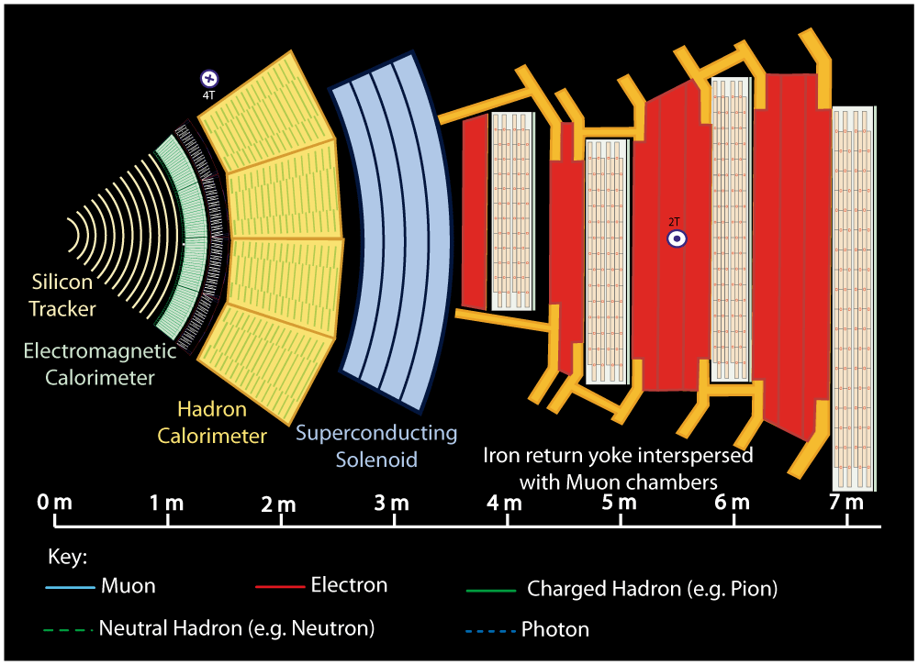
A slice through the CMS detector
Notes:
Buttons. Click on any particle type to display the relevant slide with animations. Clicking again will return to this slide.
Recommend putting this slide in the middle of your presentation and putting the other 5 slides at the end.
If you have any difficulties, contact David.Barney@cern.ch

Slide 4
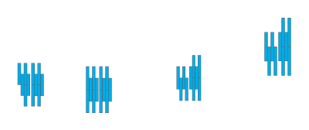


Notes:
Muon: passing through CMS, bending in the field (both ways, depending on when it is inside or outside of the solenoid) leaving hits in the Tracker layers and the muon chambers before escaping completely

Slide 5
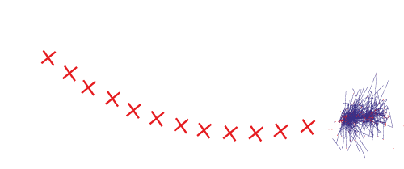
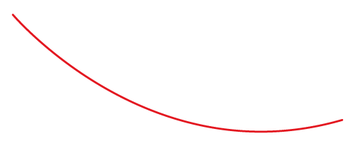

Notes:
Electron: Bending in the magnetic field, leaving hits in the tracker layers and being “stopped” by the electromagnetic calorimeter

Slide 6
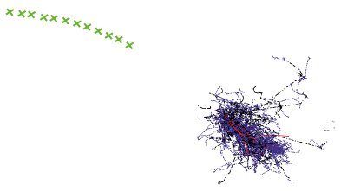
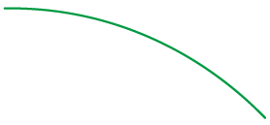

Notes:
Charged hadron: Bends in the magnetic field and leaves signals in the tracker layers; passes through the electromagnetic calorimeter leaving essentially no signal, and is “stopped” by the hadron calorimeter

Slide 7
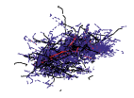

Notes:
Neutral hadron: Does not bend in the magnetic field and does not leave any signal in the tracker layers; passes through the electromagnetic calorimeter leaving essentially no signal, and is “stopped” by the hadron calorimeter

Slide 8

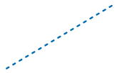

Notes:
Photon: passes through the tracker without bending in the magnetic field or leaving hits, is “stopped” by the electromagnetic calorimeter

Slide 9
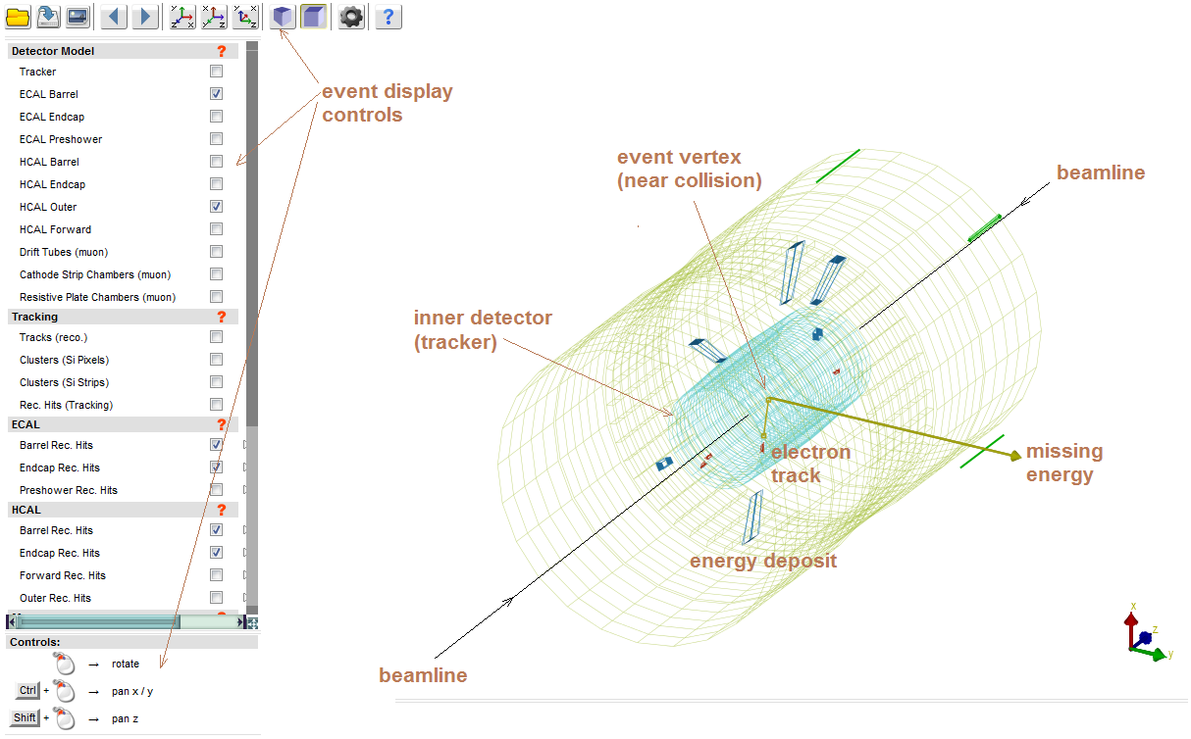
The event display software: iSpy

Slide 10
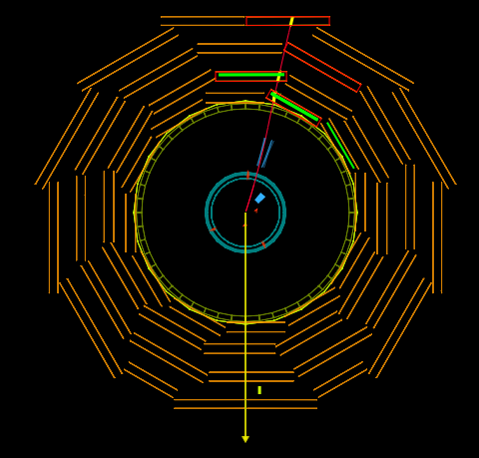
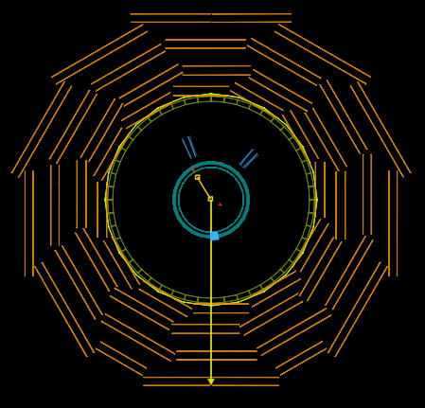
Particle identification in CMS
Muon (red track) traversing whole detector, leaving hits in outer layers. Missing energy represented by yellow arrow
Electron (yellow track) stopping in the ECAL. Missing energy represented by yellow arrow

Slide 11
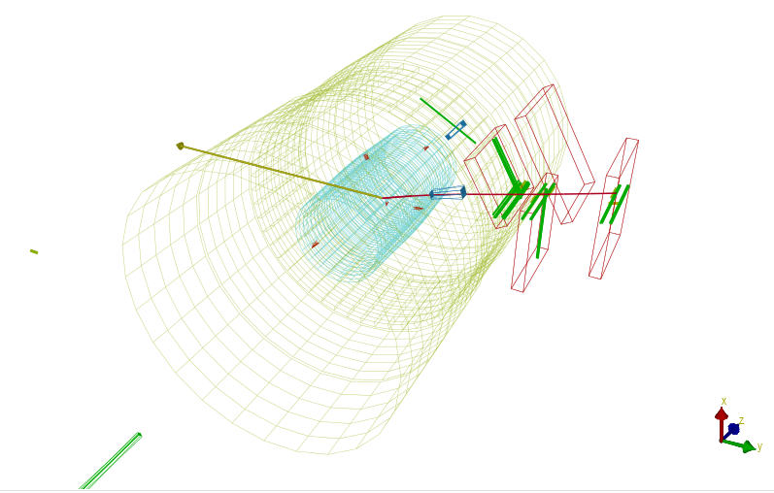
A W decaying to a muon and a neutrino (not seen directly)
Signature: Signal in muon detectors + missing energy

Slide 12
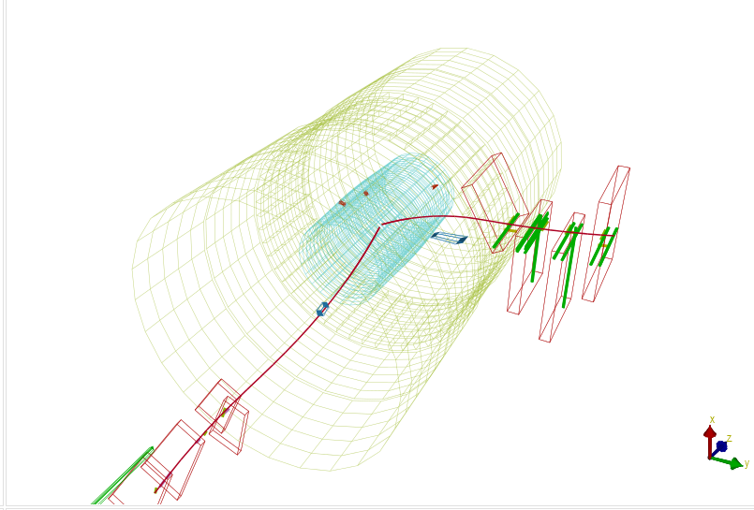
A Z⁰ decaying to two muons
Signature: Two signals in muon detectors

Slide 13
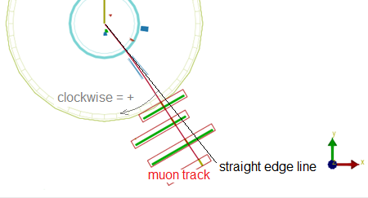
How to measure the charge
Clockwise bend = +ve charge

Slide 14




Today’s exercise - objective
Quarks inside a proton can be “excited” (due to the high energy collision), and transform to a different type of quark, emitting a W
Down quark could transform to an up quark
by emitting a W⁻
Today: Try to measure the ratio between the number of
W⁺ and W⁻ produced in collisions in CMS
  Why? – see later!
up
down
W+
positron
Anti-electron neutrino

Slide 15
Today’s exercise – getting started
Split into teams of two
  Each team (numbered 1-6) will look at 50 events
  Open your Firefox browser with two tabs
  Event display software
    http://www18.i2u2.org/elab/cms/event-display
  Spreadsheet for results
    http://docs.google.com
    Username/email: CMSmasterclasses
    Password: CMSmasterclass
    Select the “mc_1900_events_ISEF2013” file
    Select the tab corresponding to your group number

Slide 16
Event classification & particle id
  Click on the icon to see a transverse view
  Make sure the “Drift tubes (muon)” box is checked
  Click on the file folder icon to open the folder called “masterclass-2012” and then select “mc_n.ig” where “n” is the number of your group. Finally, select the first event in the list and click the “load” button
  Make sure the “Missing Et (reco)” box is checked
  Perhaps uncheck the “Tracks (reco)” box….
  Rotate, zoom etc. to get an idea of whether you are seeing signs of a Z⁰ or W⁺ or W⁻
  Follow the instructions in the spreadsheet
  To go to the next event, click the icon
  Try to get through about 30 events in 45 minutes

Slide 17
Discussion of one result
W⁺/W⁻ ratio: gives an insight into the inner structure of the proton
What did you expect to find?
What does this mean?
That the “simple” model of the proton (uud) is not quite correct……

