Slide 1
Status and Challenges for Detectors in Nuclear Physics
Yacouba Diawara
ERDIT Meeting, CERN 11-12 April 2013
Notes:
I recently joined the IAEA

Slide 2
Some Important Facilities and Experiments:
Nuclear spectrometry (incl. radioactive beams, AGATA, GERDA, NUSTAR, FAIR, Spiral2)
Hadron physics (Jefferson lab, PANDA at FAIR)
Heavy ion physics (RHIC, ALICE)
Ion beam accelerators
Spallation sources and research reactors
Nuclear applications (dosimetry, environmental monitoring, cultural heritage)
Etc ….
Notes:
Here is a list of some important facilities and experiment in nuclear physics. The list is not complete and it shows how challenging is to summarize the various detectors used in these facilities.

Slide 3
Presentation
1 - Overview of the different types of detectors used in nuclear physics
2 - Few applications at the IAEA
3 - Future directions
4 - Conclusions
Notes:
Two applications being conducted in our team at the IAEA will be shown.

Slide 4
Overview
Various types of radiation detectors are used depending on the energy and the type of particle to be counted and the purpose of the measurement.
The 3 mains types of radiation detectors are the gas-filled detectors, the scintillators-based and the semiconductor detectors

Slide 5
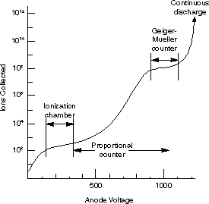
Gas-filled Detectors
Description
The 3 main regions
Ionization chamber: The output signal is proportional to the particle energy dissipated in the detector. The measurement of particle energy is possible.
Only strongly ionizing particles (α, protons, fission fragments, or heavy ions) are detected.
Application: Beam monitoring
Notes:
The charge collected stays constant despite a change in the voltage. No new charge is produced.

Slide 6
Gas-filled Detectors
Description
Proportional Counters
Charge multiplication takes place and the output signal is proportional to the particle energy deposited in the detector.
Measurement of any charged particle is possible.
Applications: Counters, LPSD and 2D detectors
Notes:
The electrons produce secondary ionization that results in charge multiplication. Particle identification and energy measurement are possible.

Slide 7
Gas-filled Detectors
Description
Geiger Counter
Operation in avalanche mode. The signal is strong and no amplifier is required and their signal is independent of the particle type and its energy.
GM provides information only about the number of particles.
Application: Geiger counter
Notes:
Another disadvantage is their relatively long dead time 200 to 300ms

Slide 8
Status & Challenges
The technologies of these detectors are mature and commercially available.
The challenges are for high rate applications where the polymerization effect is still an issue.

Slide 9
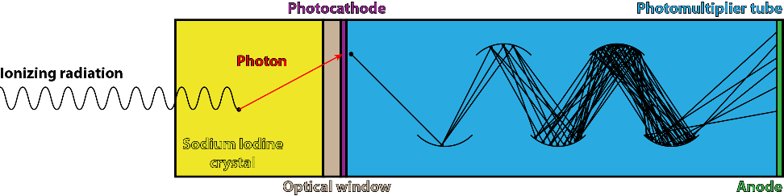
Scintillator Detectors
Scintillators materials produce spark or scintillation of light when ionizing radiation passes through them. The operation is in 2 steps:
Absorption of the incident radiation energy and production of the photons.
Amplification of the light by a PMT or an APD
They can be divided in 3 groups: inorganic Scintillators, organic Scintillators and gaseous Scintillators.

Slide 10
Inorganic Scintillators
Applications
Properties of some inorganic scintillators
NaI(Tl), CsI are the most commonly used for ϫ-rays. (sizes up to 0.75m Dia, 0.25m thick). Used for all nuclide identification applications
CaF₂ (Eu) efficient for β particles and X-rays with low ϫ sensitivity.
LiF/ZnS for neutron imaging with wavelength shifting-fiber detector
Mterial | λ(nm) | ε(%) | dec(μs)
NaI(Tl) | 410 | 100 | 0.23
CaF₂(Eu) | 435 | 50 | 0.94
CsI(Na) | 420 | 80 | 0.63
CsI(Tl) | 565 | 45 | 1.00
Bi₄Ge₃O₁₂ | 480 | 8 | 0.3
CdWO₄ | 530 | 20 | 0.9
⁶LiI(Eu) | 470 | 30 | 0.94
Notes:
NaI(Tl) is recommended for all nuclide identification applications because it provides the best currently available energy resolution for gamma rays in a room temperature detector that is relatively inexpensive and available in a wide variety of sizes. BGO is heavier and thereby has higher intrinsic efficiency at higher energies, useful for measuring the 2.6 MeV gamma ray associated with highly enriched Uranium (HEU). CsI has good light output but poorer resolution than NaI, however it can be used with electronics that provide very low power consumption for portable applications.

Slide 11
Organic Scintillators
Applications for crystal, liquid, plastic and gaseous scintillators
Properties of some organic scintillators
Crystal have faster response time compared to inorganic faster timing resolution.
Liquid scintillators are used in large volume to increase the efficiency and reduce ϫ/n ratio.
Mixture of noble gases: lowϫ, short decay, Light output per MeV doesn’t depend on the charge or the mass of the particle. Suitable for heavy charged particles (α, fission fragments, ….
Material | λ(nm) | ε(%) | dec(ns)
Anthracene | 445 | 100 | 30
NE-102 | 385 | 65 | 2
NE-110 | 350-450 | 60 | 3
NE213 | 350-450 | 60 | 2
Pilot B | 350-450 | 68 | 2
Pilot ϒ | 350-450 | 64 | 3
Notes:
Organic crystal scintillators are aromatic hydrocarbon compounds which contain benzene.
Their luminescence typically decays within a few nanoseconds. They are very durable, but their response is anisotropic (which spoils energy resolution.
Their luminescence typically decays within a few nanoseconds. They are very durable, but their response is anisotropic (which spoils energy resolution

Slide 12
Organic Scintillators
Plastic scintillators
Plastic scintillators have similar properties to those of liquid scintillators.
They don’t need a container and can be machined in any size or shape and inert to water, air and many chemical.
Applications include large area detector array for neutron measurements and ϫ-ray large area space telescope
Notes:
The advantages of plastic scintillators include fairly high light output and a relatively quick signal, with a decay time between 2‐4 nanoseconds, but perhaps the biggest advantage of plastic scintillators is their ability to be shaped

Slide 13
Scintillators: Status & challenges
Future works will be focused on the light output conversion and gamma discrimination while maintaining a fast decay time.
Transparent scintillators are attractive
The phoswich detector (which measures low level of radiation in presence of considerable background) needs to be improved for neutron spectroscopy, CT and SPECT. Coincidence measurement in α/β/ϫ spectrometry

Slide 14
Semiconductors
Operate like ionization chambers
Si and Ge are the most used but CZT, HgI₂ and CdTe are promising.
Ge(HPGe, GeLi), Si have a very good energy resolution (for spectroscopy applications) but requires continuous cooling and are therefore bulky and expensive.
CZT and HgI₂ can operate at room temperature for Mossbauer spectroscopy with a limited energy resolution.

Slide 15
Semiconductors: Challenges
Damages are seen with particle fluence in the order of 10¹² (P/m²) for heavy ions and 10¹⁴ (α or n /m²) for both Si and Ge.
Future directions will focus on improving the radiation damage on semiconductors.
Diamond or SiC are viable candidates

Slide 16
Some IAEA Projects
Active personal dosimeter
Continuous air particle monitors
Area monitoring and Environmental monitoring
Foot and surface contamination monitoring
Whole body counter
Portal monitor and passive detection
Coincidence and anticoincidence detection systems
Nuclear medicine
X-ray spectrometry
Detection of Nuclear materials/non-proliferation issues
Unmanned aerial vehicles for radiation detection
Portable Gamma spectroscopy
Notes:
Activities in bold are related to our team research projects.

Slide 17
The Proposal for the UHVC Project
To develop a multipurpose Ultra High Vacuum Chamber (UHVC) for applying simultaneously various complementary and advanced variants of X-Ray Spectrometry (XRS) techniques, including:
Total Reflection X-ray Fluorescence Analysis (TXRF)
Grazing Incidence XRF analysis (GIXRF)
Near Edge X-ray Absorption Fine Structure (NEXAFS)
X-ray Reflectometry (XRR)
under different excitation modes:
laboratory x-ray source
synchrotron radiation
charged particle beams

Slide 18
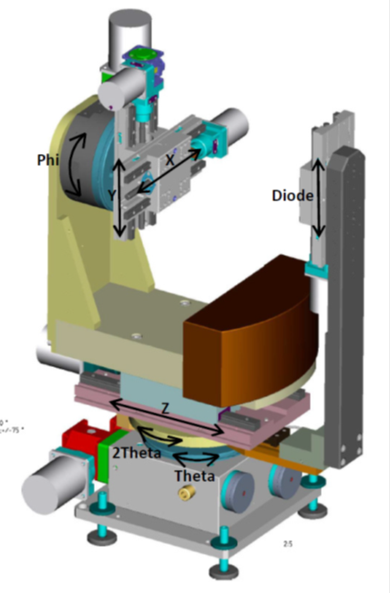
UHVC Instrumentation: Motorized 7-axis sample manipulator
The sample manipulator includes:
Four (4) linear stages (‘X’, ‘Y’, ‘Z’, ‘Diode’)
Three (3) goniometers (‘Theta/2Theta’, ’Phi’)
Aiming at moving the sample to be investigated in various directions/ orientations with respect to the exciting
X-ray beam or/and with respect to the detectors.
X-ray Detectors:
Ultra Thin Window (UTW) Silicon Drift Detector (SDD, 30 mm², FWHM <133 eV @ Mn-Ka, 75 eV @ C-Ka) and photodiodes (Si)
The ‘Theta’ axis would provide an accuracy better than
0.15 mrad in the range of
-5-110 degrees

Slide 19
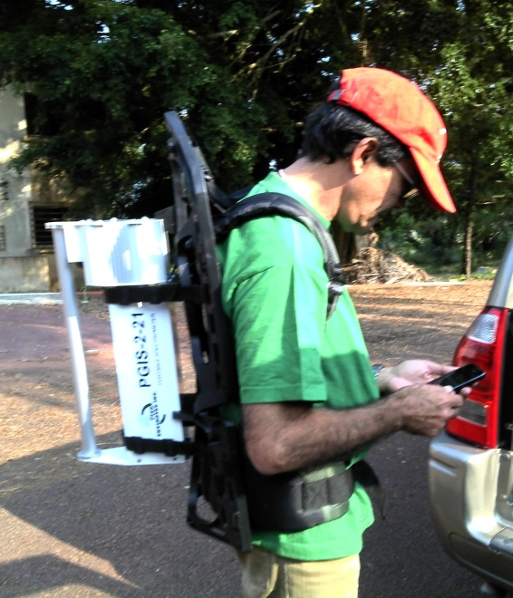
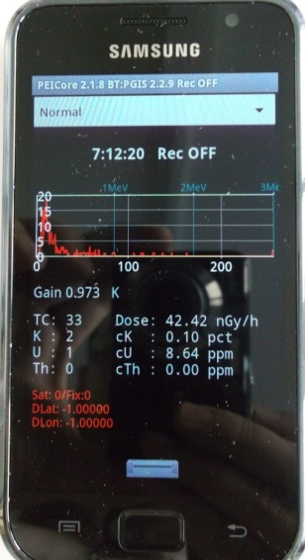
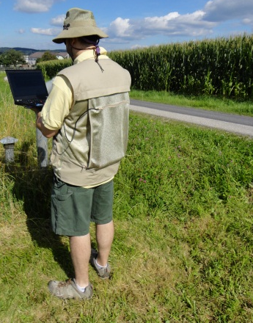
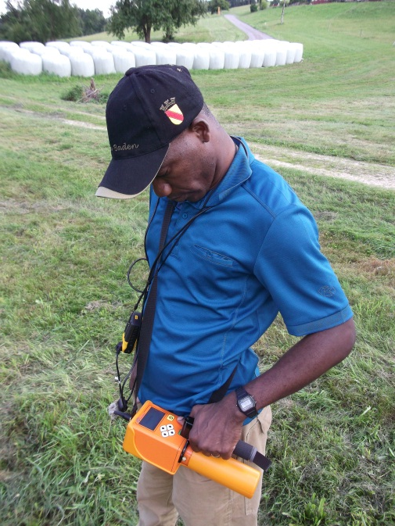
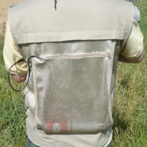
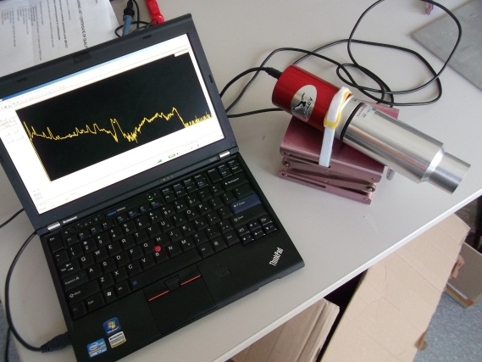
“Backpack” Systems
NaI(Tl) 0.347l; Android controlled
  PGIS-2-21
  PicoEnvirotec
  Remediation:
    Gabon, Azerbaijan
BGO 1x1.5”;
  Gamma Surveyor II
  GF Instruments
  Gabon, Austria
LaBr (1x1.5”) + OSPREY
  Canberra
  Austria (Soil Erosion)
Notes:
We currently have 3 packpack systems ready for deployment by NSAL.
These have been used on NSRW missions and for research in conjuction with NAFA-SWMNCL.
In development is a custom suite based around CeBr detector, and a separate CeBr spectrometer has also been procured (awaiting delivery).
Each detector uses different data acquisition methods and has independent GPS.

Slide 20
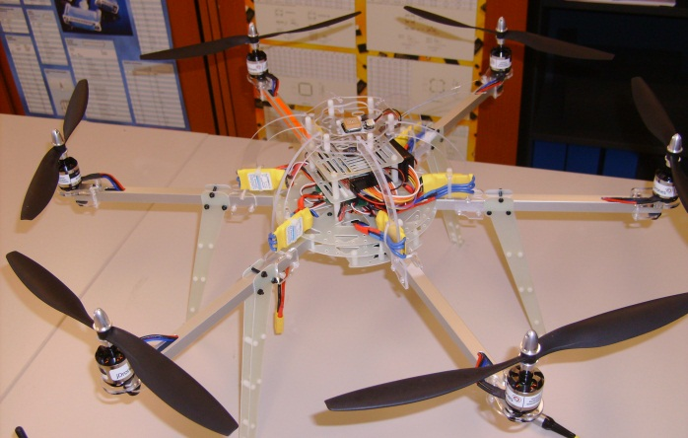
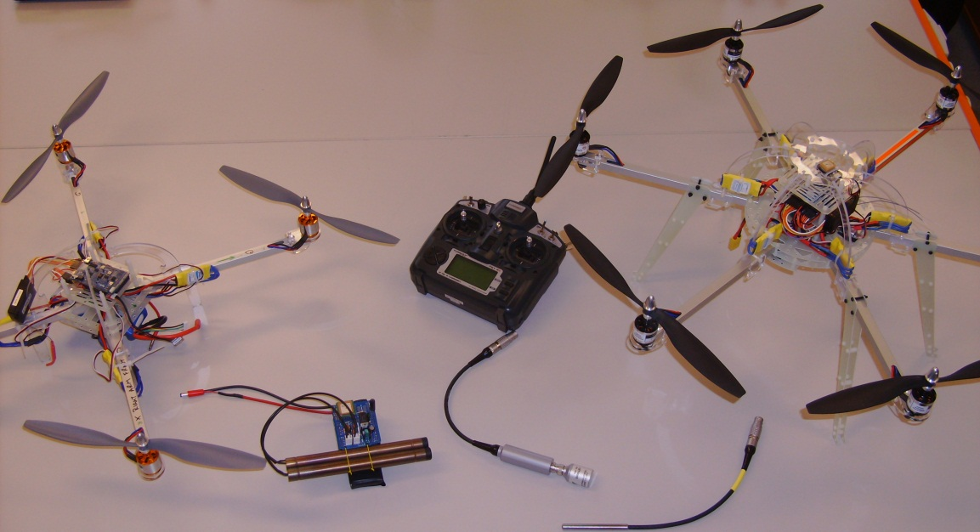
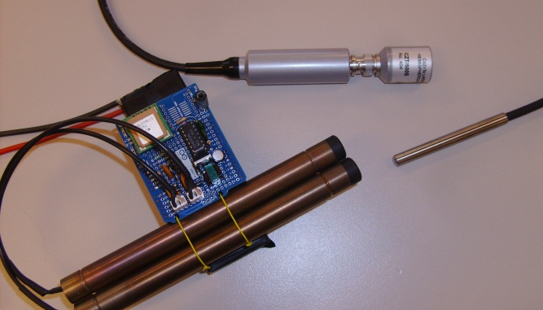
Aerial Radioactivity Monitoring
Quad-/Hexa-copter drones
Electric motors
LiPo batteries
Semi-autonomous
  GPS
  Autopilot
Radiation monitoring
  Doserate (GM)
  Spectroscopic (e.g. CZT)
Open source
  Example is Arduino controlled
Notes:
Shown is our existing quad-copter (centre left ) and the new hexa-copter (centre right and inset top left).
The drones are powered by rechargeable LiPo batteries (one is attached on the quadcopter) for testing we’re using a 4 cell 14.8V 3000mAh battery. So far the battery life exceeds any flight test we have performed (<5mins) and with no detector attached.
The quadcopter weighs 1.3 kg and the hexacopter 1.6kg, ready to fly cost is $799 and $999, respectively.
These particular drones are arduino based, brand name is Arducopter.
The selection of these particular drones was because they were based on arduino (an Italian project for an open-source single board microcontroller) which I also use/introduced for electronics training. Hence I wanted to demonstrate the power of the hardware I was teaching the fellows with.
Three detectors are shown (centre bottom, inset bottom right). The brown tubes coupled to the blue boards are a custom built GM tube, using again arduino controllers. Also shown on top of the board at the bottom (silver square) is a GPS receiver. The same one is on both ‘copters.
Adjacent beneath (bottom right inset) is a larger (0.5cm3) CZT detector for low energy gamma-ray spectroscopy. Above this to the left slightly is another CZT device, in this case an ultra slim probe.
These devices are part of our programme for developing the detectors, readout and control systems for larger vehicles (where we would accompany the mission) and for the low cost programme (where we would send out kits, instructions, software and remote support).

Slide 21
Future tasks
Establish a list of experiments in nuclear physics and determine in detail the detector requirements.
Many other detectors not mentioned here are being used in nuclear physics. They include the MCP, the Anger camera, the SSND, the APD, the SiPM, the Cherenkov detectors, the calorimeters, etc

Slide 22
Conclusions
Future efforts will focus on improving the timing/spatial resolution for some experiments while the efficiency and the energy resolution be important for the others.
Thanks to all the NASL team.

