Slide 1

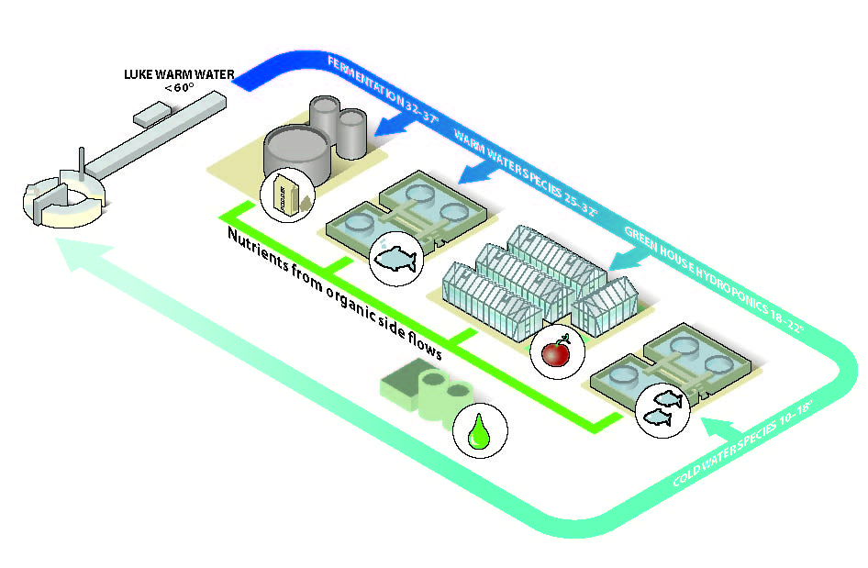
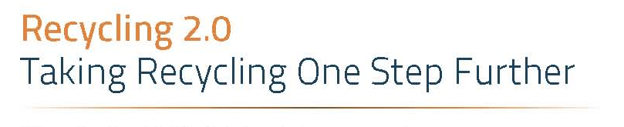
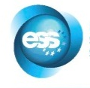
Surplus Energy and food production.
Anders.kiessling@slu.se
Illustration Peter Lönnegård & FredrikIndebetou
Notes:
Why? Is research of food production intimitly connected with knowledge of surplus heat and then especially low grade heat < 60 C.

Slide 2
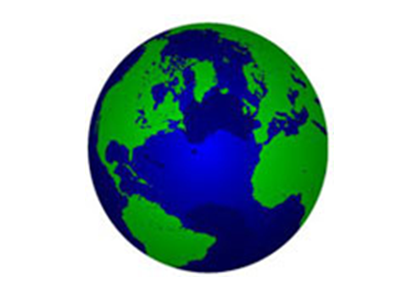
Illustration A.Kiessling
Notes:
START WITH ECO-SYSTEM, or eco-services/resource LIMITATIONS of 1) Nutrients, 2) Land and 3) Water
We live in a nearly closed system except for energy. Still mankind tend to focus use of short and long term stored energy and neglect the resilience of our ecosystems. This is maybe most apparent in our food production system, in spite …….

Slide 3
The linear flow of nutrients,
which by default will lead to deprivation at one point and accumulation at another
Illustration A.Kiessling
Notes:
1) Nutrients In spite we in theory understand that our planet is a closed system (except energy), in food production, we act like nutrients are linear and energy needs to be recycled.
Free trade is often used as excuse not to consider sustainable eco system resilience.
Aquaculture fabricated feeds are a perfect example on not respecting the system, starting with phosphate from Morocco/West Sahara => huge soy monocultures of Brazil => Feed factories at cost => off shore farms => over the continentel shelf => 100-300.000 years later show up as fish again.

Slide 4
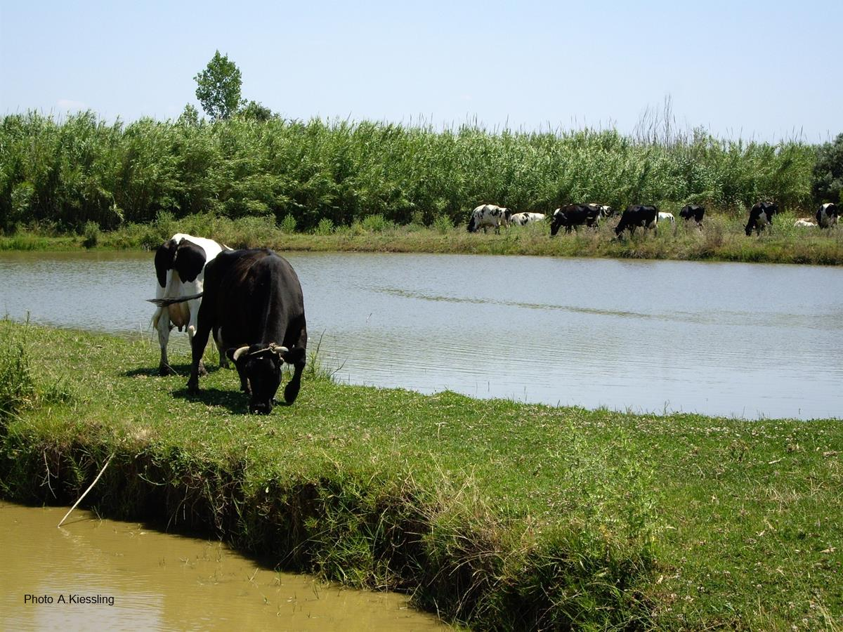
Food productivity, on the other hand,
Is a direct function of this energy influx in
combination with access to fresh water.
Notes:
Aquaculture has had exactly the same development as seen in the agricultural sector, i.e. competes for arable land and fresh water resources.

Slide 5
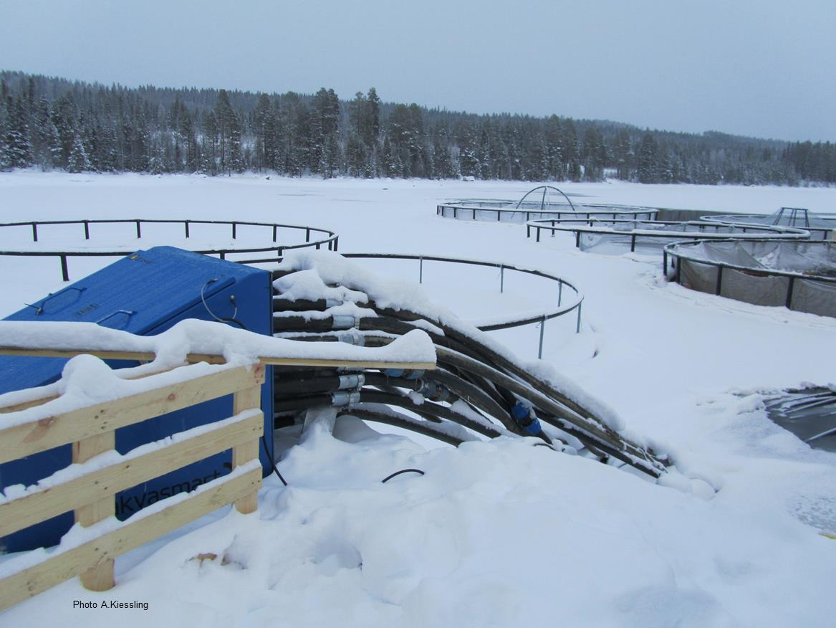
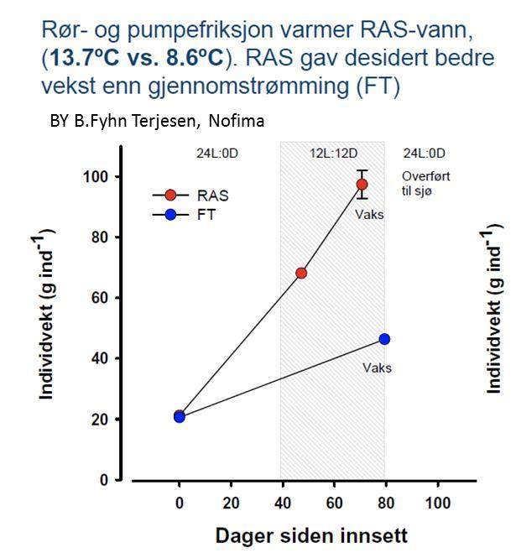
An increase in temperature from 8.6 to 13.7 ºC
doubled the growth rate in salmon smolt.
Τ = 5 C
Τ = 5 C
Weight (average) in grams
Days
Notes:
An example
These three first slides give a clear indication where we are heading with this presentation, but let us first reverse a bit

Slide 6
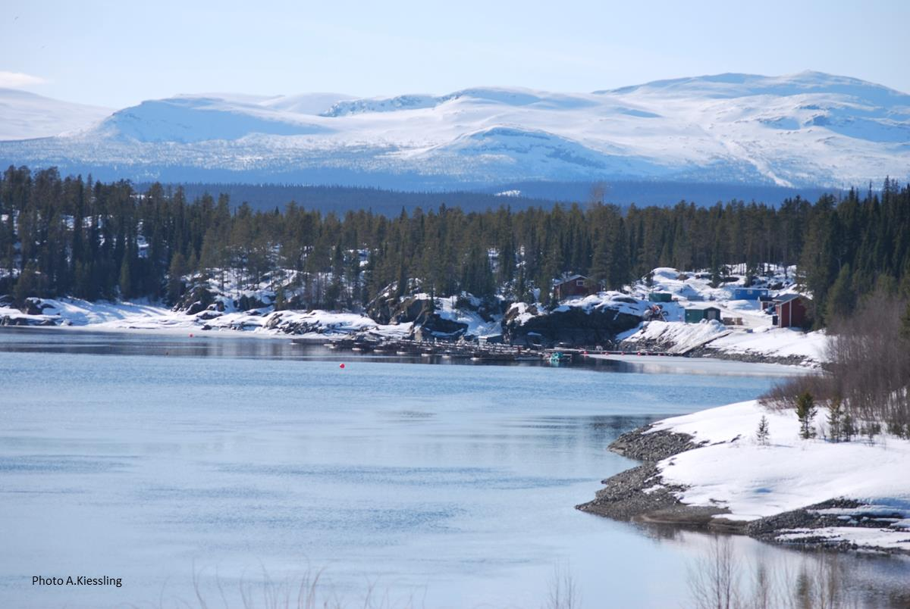
Surplus Heat
Enormous amounts of heat < 60 ºC is lost as cooling, ventilation or insufficient insulation.
In Sweden it is estimated to 150 TWh => ¼ of Swedish energy use.
In EU it is estimated to 500 billions Euro in petrol equivalents.
Growth of fish, plants, algae are all stimulated by a moderate increase in temperature.
Notes:
We are not creating a circular system but one a infinity system

Slide 7
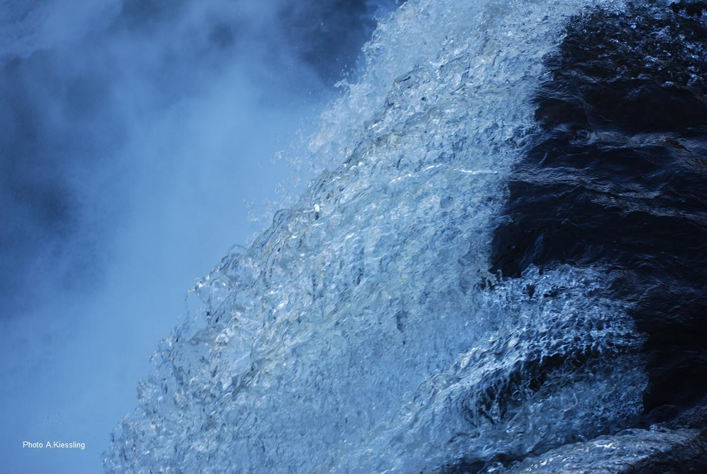
Example of mass production of low grade surplus heat :
Ringhals Nuclear power plant 163 m³ / sec
Södra Cell Pulp mill 100.000 m³ / day (1.2 m³ / sec)
10 ºC over ambient due to environmental legislation

Slide 8
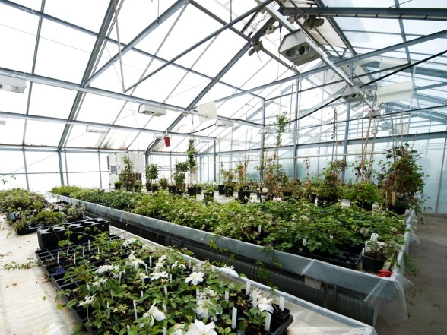
Is there an advantage to produce in water when utilising low grade surplus heat ?
0
0
0
25 C
25 C
70-80 C
70-80 C
25 C
Production
Production
25 C
Illustration A.Kiessling
Notes:
Hydroponics

Slide 9
Luke warm water
< 60 ºC
Cooling chain: From heat to food
FEED
Low temp drying
40-60 ºC
FOOD
Bio generators
Microbes
yeast
Bacteria
32-35 ºC
Micro
Algae
Warm water species
Tilapia, shrimp and
domestic
Like perch, pike perch, turbot
22-32 ºC
Green house
Hydroponics
18-22 ºC
CO₂
O₂
Cold water species: salmonids, white fish, sturgeon, carp fishes, eel, crayfish etc.
10-18 ºC
Nutrients from organic side flows: Food waste, bio diesel, bio gas, etc
Illustration A.Kiessling

Slide 10
Present production systems
Animal (non arable land) based
food production system
47% of soy and 60% of corn produced in the US is used in animal feed.
(Grace Communication Foundation)
And about ¼ of world catches of fish is used as animal feed.
(FAO, 2012)
Food Production
Feed**
Fossil based fertilizers*
Plant (arable land and irrigation) based
food production system
Time
*European farmers use about 9 million tons of fertilizer per year
**European farmers import the equivalent of 50 million tones of soybean per year.
Illustration A.Kiessling
Notes:
OBS finns också allt. För mat som insekter, alger, mikrober, cell-culture meat/petri dish meat etc

Slide 11
The Problem !! We end up with less food
Animal (non arable land) based
food production system
Fluctuating and increasing prices
And if combined with local weather effects =>
The OECD/FAO Outlook warns: A wide-spread drought such as the one experienced in 2012, on top of low food stocks, could raise world prices by 15-40 percent."
Food Production
Plant (arable land and irrigation) based
food production system
Time
Illustration A.Kiessling
Notes:
OBS finns också allt. För mat som insekter, alger, mikrober, cell-culture meat/petri dish meat etc

Slide 12
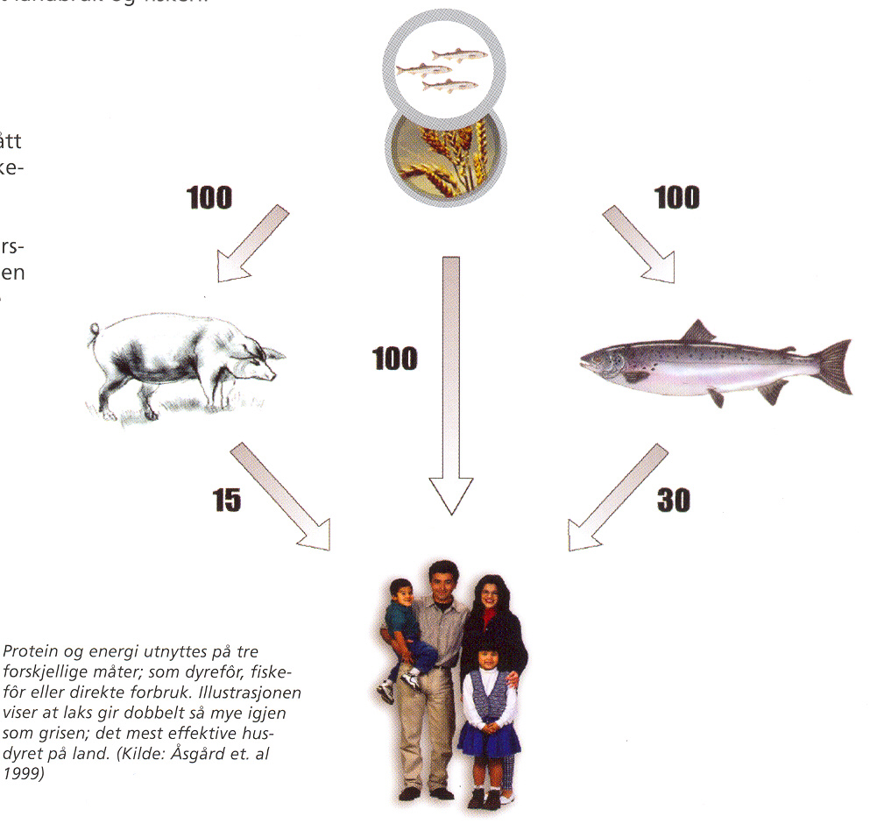
Animal or Man ?
Alternative feed
Alternative feed
Aquaculture
Fastest growing food system
Has a special role in closing the :
“Nutrient loop”
Original compost by Ewos, based
on Åsgård et al. 1999
Notes:
At present man and animal is in direct competition for the same feed stuff. With development of complementary feed stuff a significant lessen of pressure on the traditional agro system would be possible.

Slide 13
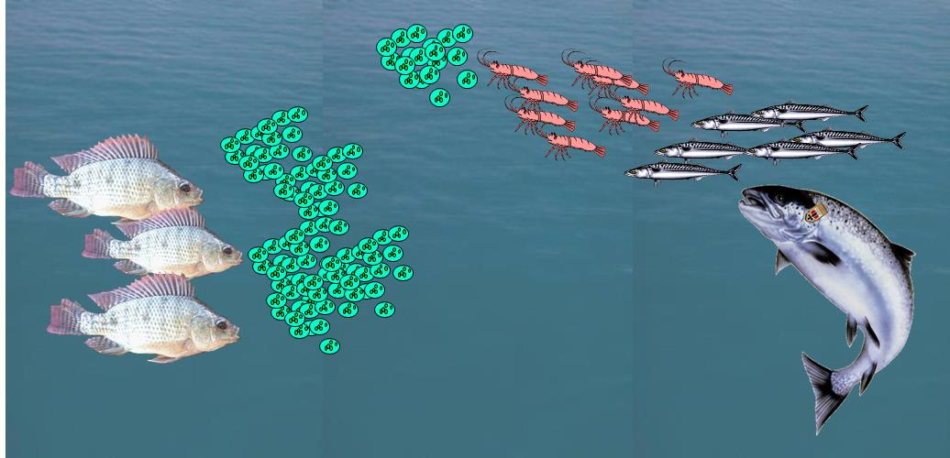
Microbes are the base of the food web evolution of all higher animals including ruminants.
By Sergio Zimmermann
Growth rate / day:
Bacteria every 20 min => 2⁷²
Yeast every 2 h => 2¹²
Micro algae once a day => 2¹
Notes:
This is an interesting slide. The algae is the equivalent to the terrestrial chloroplast in the leaf. Turn water and CO2 into Glucose and O2, making glucose the most common organic molecule in out part of the universe. In the leaf the glucose is used form the structural component cellulose, while in the aquatic environment it is used to make chitin in the cytoskeleton in the form of the second most common organic molecule, chitin, including nitrogen.

Slide 14
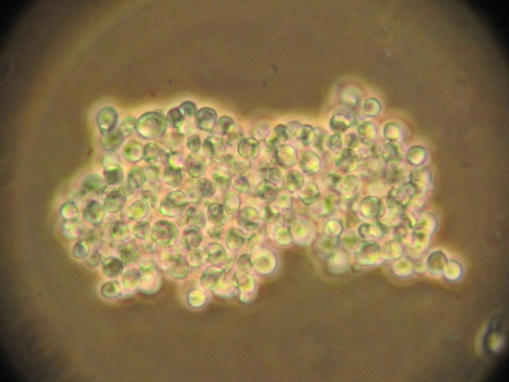
Microbes have high levels of RNA (10-15%) due to high protein synthesis.
Living cells metabolizing the N in RNA to:
In mammals uric acid => kidney stones and gout
RNA relay the information of DNA to the protein synthesis
To water
Fish
=> Has all enzymes to eat large amounts of microbes
Picture courtesy of Matilda Olstorpe

Slide 15
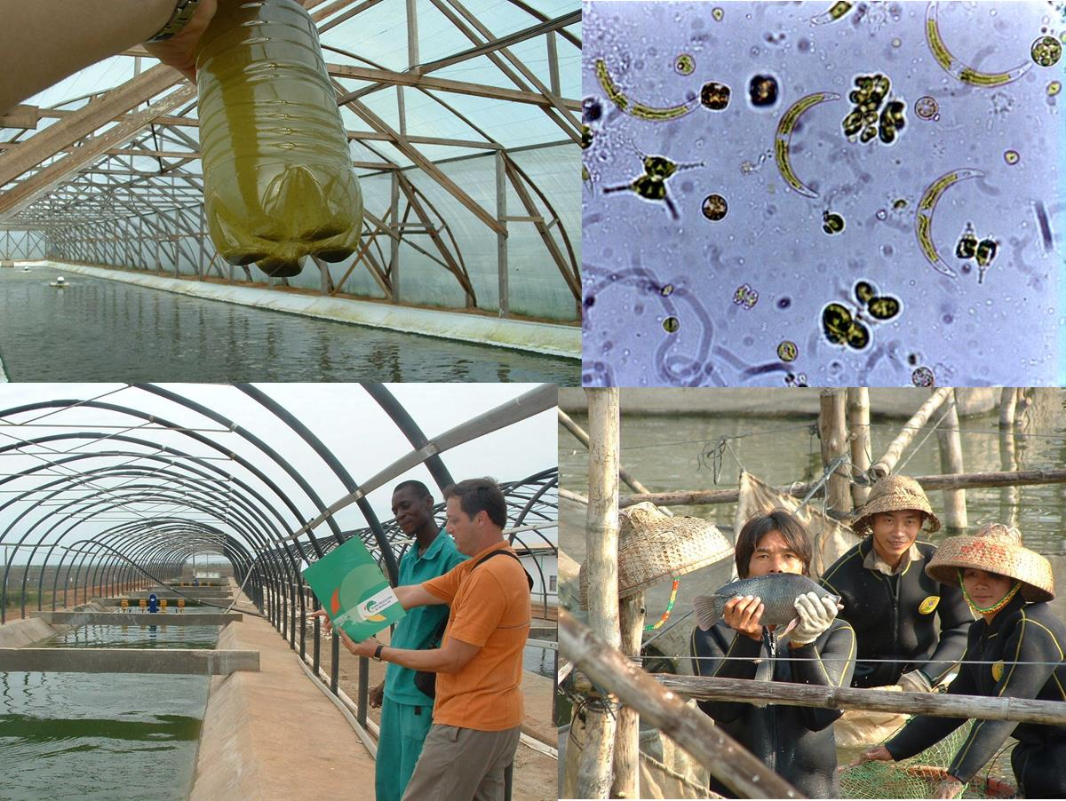
25-30 ºC
Green water farming
By Sergio Zimmermann
Notes:
15
Live feed
Surplus energy needed in temperate climate. Algae dominate i.e. provide carbon chain and O2

Slide 16
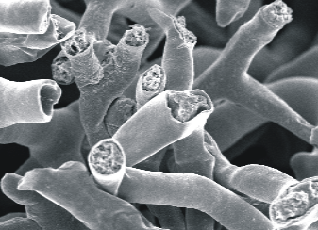
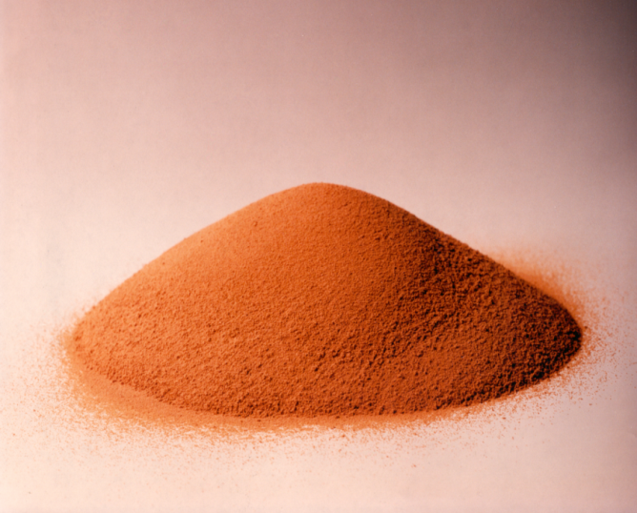
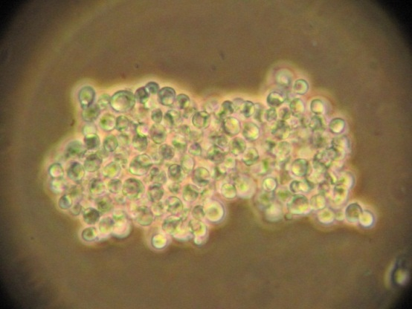
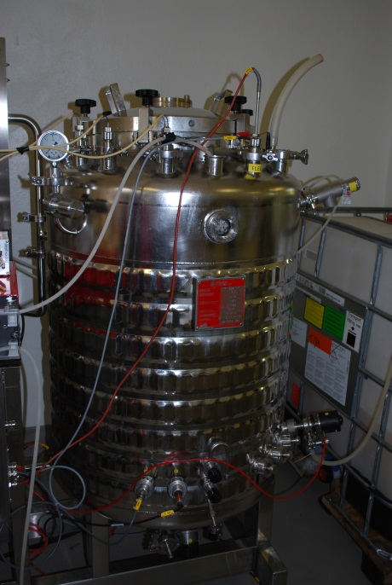
Microbial protein / Bio-protein meal
Micro fungi
Need low temp drying (otherwise reduced quality)
10% DM in bio-generator
90% DM in protein meal
Need 30 mil. ton protein to aquaculture alone 2030
=> Dry 48 mil. ton water
Yeast
Bacteria
Notes:
All protein bio but homologues to bio-energy. Growth rate max. Produced in a cellear with no discards to surronding environment. Zygomyzet, Saccarymysis, Methylococcus capsulatus

Slide 17
Swedish Yeast company. Produce 20.000 ton yeast/year
10 mg of yeast => 150 ton, in a week.
Global protein production by wheat: 1.74 x 10³ ton protein => 9.7 x 10⁶ ton protein (low in lysine, arginine and methionine).
If use same amount of yeast protein using: (1.74 x 10³ ) / 10⁻⁵ ) x 150 x 52 = 1.4 x 10¹² ton protein (amino acid composition as fish meat)
If makes salmon feed of 40% protein (90% DM), with a FC of 1 and a slaughter yield of 60% => 3.3 x 10¹² ton of salmon
Present production and harvest of fish, given as fillet, is roughly 1.2 x 10⁸ ton of fish
To dry that amount of yeast (48% protein content) one needs 4.2 x 10¹⁵ kwh (1.5 kwh/kg yeast)
Present global soy meal production is roughly 113 million ton 1.3 x 10⁸ ton soy meal (48% protein) => 3.6 x 10¹¹ kwh (mainly fossil) 1.3 x 10⁸ ton fish meal (72% protein) => 5.8 x 10¹¹ kwh (mainly diesel) 1.3 x 10⁸ ton yeast (48 % protein) => 1.9 x 10¹¹ kwh (low temp (surplus) energy)
Picture courtesy of Matilda Olstorpe
Notes:
Not only are we more effective but we moved the energi source away from primary fossil energy, but also into the low temperature range.
Använt
40% foder protein (medel )tilapia/karp ca 30% och marina ca 50%. Lax 40%.
Foderkonvertering 1
Filleutbyte på lax 60% och snitt andra odlade och vilda arter 50%.
Färdigt proteinmjöl 90% DM

Slide 18
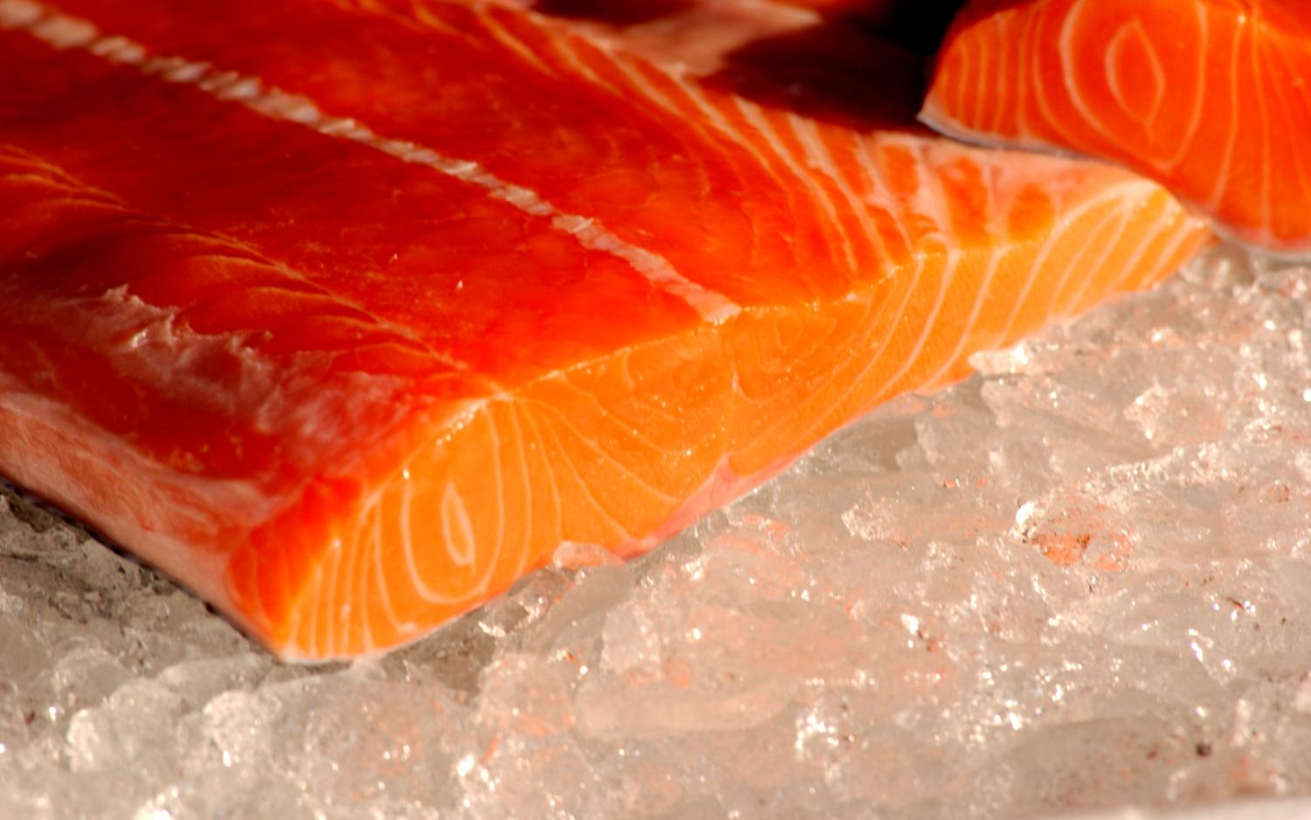
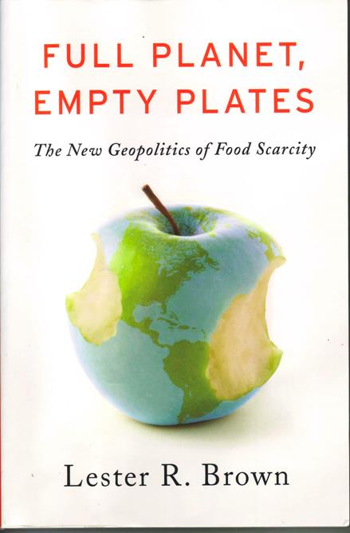
Do we need to care ?
Photo courtesy of Aquabest
Notes:
Now we know:
Man is not swimming with the current coming to using natural resources.
We use a heck of a lot of energy of fossil type in the food production.
We allow our production animals to eat our food
We know that we have ability to produce feed sources in a controlled manner using low temp heat and recaptured nutrients.
The next big question is: DO WE NEED IT?
Do we need it:
A few postulates motivating a need to “think outside the box” coming to future food production.

Slide 19
Food is second to drinking water the most central priority to man
Global food security is based on wheat, soy, corn, rice.
We loose arable land due to present farming practices and human activities.
We treat our fresh water as waste baskets and in the same time is many rivers dry even before reaching the sea due to irrigation.
We postulate: As we must turn to more sustainable farming techniques and a more sensible use of artificial fertilizers, plant production will not single handed be able to ensure global food security as we increase from 7 to 9-10 billion people.
I.e. We need to invest in next generation feed systems capable of producing food independent of large land areas, massive input of artificial fertilizers and huge fresh water resources.
WE need to go from less to more control of our food production.
Photo courtesy of Aquabest
Notes:
One could say we are at the same point as when 150 years ago sailing ships were exchanged for machine driven ones, the level of control and efficiency became a matter of technology rather under control of man.
A few postulates motivating a need to “think outside the box” coming to future food production.

Slide 20
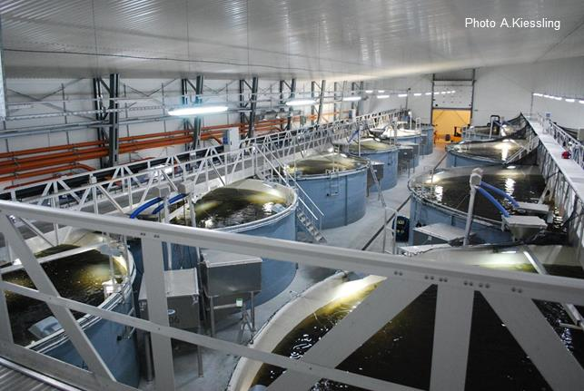
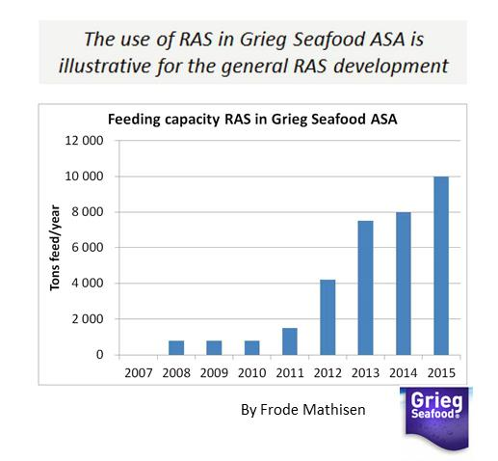
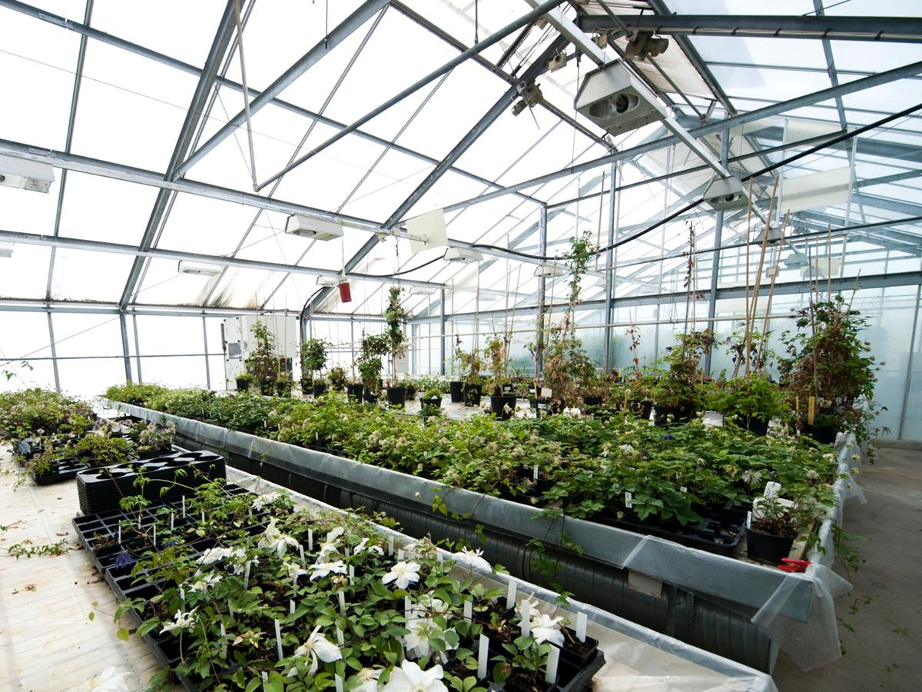
This is already happening and the reason is increased control of:
1. Temperature (production time)
2. Infectious diseases/parasites
3. Feed use / feed waste / effluents.
But we are only in the beginning of this development.
Notes:
Norwegian salmon farming started to use RAS in order to save water, then one discovered a mort of 20-25% was cut to nearly zero thanks to effective sterilisation of incoming water. In addition did one discover a doubling of growth rate, i.e. halving of production time, because one could keep the fish constantly at ideal growing temperatures. Finally feed efficiency is better due to better control of waste feed, diseases and stress factors, with a reduction from average 1.1-1.3 kg/kg growth to 0.7-0.8 kg per kg growth. This with a feed price of 1.5 euro per kg. This has resulted in a nearly total change in strategy in world salmon smolt production from FTS to RAS (flow trough system, recycling aquaculture systems.

Slide 21
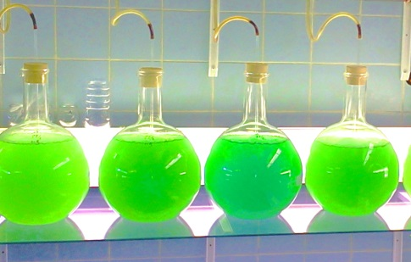


Food for thought
Photo A.Kiessling
CO₂
O₂
Bio-protein
Reactor
N & P
Ozon
UV
Harvest Station
Utilisation model 3
Bio-Energy
Reactor
C & H
Utilisation model 2
Utilisation model 1
By A.Kiessling
Notes:
Example or food for thought illustrating the fact that the relationship between energy and food production do not need to be limited to the diesel used in the tractor or fishing vessel.

Slide 22
Surplus Energy and food production.
Thanks for your attention
Illustration Peter Lönnegård & FredrikIndebetou
Notes:
Thank you

