Slide 1





High Temperature Cooling of Cryoplants and RF Systems at the European Spallation Source
2nd Workshop Energy for Sustainable Science at Research Infrastructures
CERN, Geneva Switzerland
October 23-25, 2013
John Jurns
john.jurns@esss.se

Slide 2
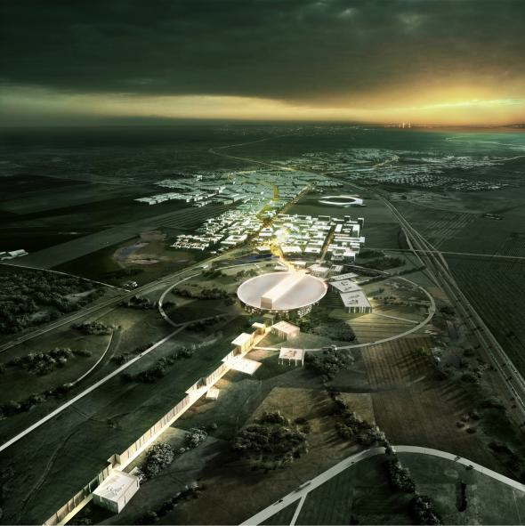
ESS Overview
Spallation Neutron Source
Being built in southern Sweden
482.5m long, 5MW, proton linear accelerator at 2.5 GeV, 5 mA
2.86 ms pulses, ≈14Hz (60 ms period)
Solid tungsten metal target
22 neutron instruments
To support a 5000-strong user community
450 staff
First protons in 2019
Full design specifications 2025
Photo - Henning Larson Architects

Slide 3
Energy Philosophy and Heat Recovery Strategy
ESS has committed to an energy management strategy* that minimizes cost, lowers environmental impact, and factors out variability in energy. The ESS energy management strategy is based on four pillars:
Responsible – optimize energy efficiency and lower energy consumption to 270 GWh/yr from the original estimate of 310 GWh/yr
Renewable – Invest in renewable energy production sufficient to cover ESS integrated annual electricity use
Recyclable – Provide a cooling system that recycles waste heat to the city of Lund district heating system and/or other potential customers
Reliable – Provide stable electricity and cooling supplies for ESS operations
* ESS-0002126 “Energy Policy”

Slide 4
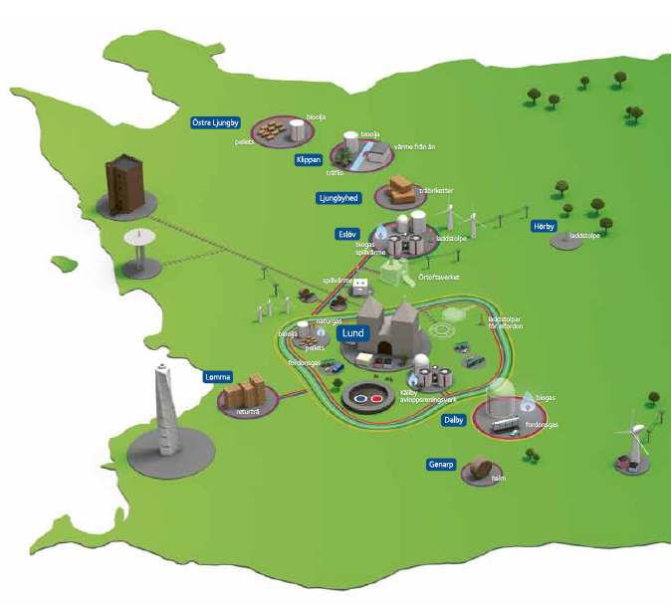
      Lund District Heat System
Lund District Heat system will be source for ESS cooling, and customer for ESS recycled heat
Lund population ~ 111,000
~80% of population served by Lund district heat system
LDH system description
  300 km network
  10,000 m³ of water circulating
  74% of heat from renewable & recycled sources
  Plan for towards zero carbon by 2020
  1,087 GwH heat produced in 2012
Interface with ESS
  Supply temperature to ESS – 45 C
  Return temperature to LDH – 80 C
ESS

Slide 5
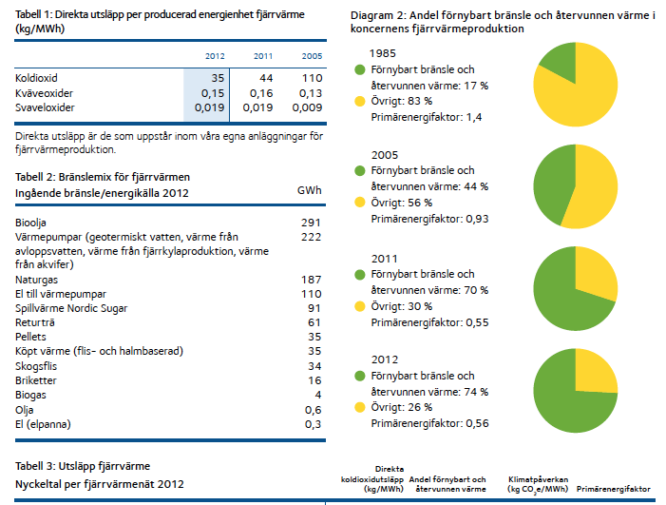
Lunds Energi progress towards zero carbon
Direct emissions per unit of energy district heating
Share of renewable fuels and recycled heat in the consolidated district heating production
Renewable fuels & recycled heat 17%
Other 83%
Fuel mix for district heat input fuel energy
Renewable fuels & recycled heat 44%
Other 56%
bio-oil
heat pumps (geothermal water heat from waste water, heat from the cooling output, heat from the aquifer)
Natural gas
electricity to heat pumps
waste heat nordic sugar
recycled wood
pellet
Bought heating wood chips and straw-based
woodchips
briquette
biogas
oil
electricity (electric boiler)
Renewable fuels & recycled heat 70%
Other 30%
Renewable fuels & recycled heat 74%
Other 26%
Lunds Energi Koncernen Hållbarhetsredovisning 2012

Slide 6
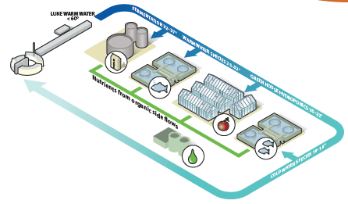
Other potential users of recycled heat
Unfortunately, not all heat recovered from ESS is at warm enough to send directly to LDH
Options to use this heat:
  Use heat pumps to increase temperature
  Find other uses for low grade heat
ESS is investigating use of low grade heat in a hybrid cooling chain to extract heat for things like the production of food, fodder and bio-fuels
More details are outlined in other ESS presentations.
Proposal for a Sustainable Research Facility
ESS Energy Concept Final Report January 2013

Slide 7
Cooling System Overview
ESS will ultimately consume over 40 MW of electrical power, only a small portion of which ends up generating neutrons. Only 5 MW goes into the beam - most of the energy consumed is turned into waste heat.
ESS plans to recycle waste heat to the Lund district heating network, ultimately supplying 20 percent of its total annual requirement.
Cooling system requirements
The cooling and heat recovery system of the ESS plant shall be designed to meet the following requirements:
  Provide reliable and efficient cooling of all parts of the ESS site that requires water cooling
  Transfer as much heat as possible from the cooling system to the city of Lund district heating system and/or other external waste heat recovery systems

Slide 8
ESS cooling system architecture overview
Cooling system - Central Utilities Building
3 cooling water supply temperatures (5/30/50 deg C)
45 deg C supply from Lund district heat system
Heat pumps to raise temperature of CW-L & CW-M return

Slide 9
ESS cooling system architecture (continued)
The scope of the cooling system design is primarily to manage the flow of heat in the technical infrastructure (i.e. – the “machine”). Cooling is accomplished primarily with water. Systems in scope include:
  Accelerator – klystron gallery and linac tunnel
  Target – interface at target internal cooling systems boundary
  Cryoplants – compressor and helium cooling
  NSS – cooling as required for instruments and support equipment
  Test stand – cooling for test stand klystrons, power supplies, etc.

Slide 10
ESS cooling distribution
Lund District Heating System
Central utilities building
Instruments
Instrument cooling
Cryo cooling
Target
cooling substation
SC cavities cooling
RFQ/DTL cooling substation
Ion source cooling
Target
building
Cryoplants
LINAC

Slide 11
Cooling water block flow
Back up cooling
CUB
Lund District Heat
Warm end linac
Cold end linac
Cryoplant & test stand
Target
Klystron gallery
Tunnel
KG low beta
KG high beta
Tunnel
Cryo linac
Test stand
Target
Intermed He
Collector
Circulator
Ion source
Collector
Collector
Couplers
Cryo target
HEBT
Intermed H₂O
Circulator
Load
MEBT
Circulator
Circulator
Collector
Cryo NSS
Direct H₂O
Load
Tetrode collector
Couplers
Load
Load
Circulator
Body
Tetrode filament
Hi accuracy cooling
Body
Body
Load
Modulator
Amplifier
Modulator
Modulator
Body
RFQ
Modulator
LLRF racks
LLRF racks
DTL
LLRF racks
LLRF racks
RFQ/DTL
Spokes
LLRF racks
NSS
External customers
Internal DH
Air compr.
Instruments
HVAC
Labs
HVAC linac
Areas
Tap water

Slide 12
Waste heat summary
Our current estimate of cooling loads and cooling water supply temperature is shown in the table below.
ESS total cooling requirements by system & supply temperature
System | Low temp. 5 C (MW) | Med temp. 30 C (MW) | Hi temp. 50 C (MW) | Total
Linear accelerator | 4,2 | 2,3 | 8,4 | 14,9
Target Station | 7,5 | - | - | 7,5
Instruments | 1,6 | - | - | 1,6
Cryogenic systems | 1,4 | 5,5 | - | 6,9
Miscellaneous | 0 | 0,5 | - | 0,5
Buildings |  | -1,8 |  | -1,8
Total | 14,7 | 6,5 | 8,4 | 29,6
Heat pumps to raise temp. | 4,2 | 6,0 | - | 10,2
~71% of all heat comes from RF equipment and Cryoplants

Slide 13
Waste heat summary
Our current estimate of heat available from the return flows for each of the temperature ranges is shown in the table below.
ESS total heat returned by temperature range
Return flows | (MW) | From RF, cryo (MW)
Low (25 C) | 10,1 | 1,3
Med (40 C) | 5,0 | 3,0
Intermed. (65 C) | 1,4
High (85 C) | 13,1 | 13,1
High (heat pumps) (85 C) | 10,2
Total | 39,8 | 21,8
100% of high grade heat comes from RF equipment and Cryoplants

Slide 14
Plans to optimize heat recovery
Overall design philosophy
  Use highest reasonable temperature for cooling equipment
  Maintain outlet temperature, control flow
TT
Load

Slide 15
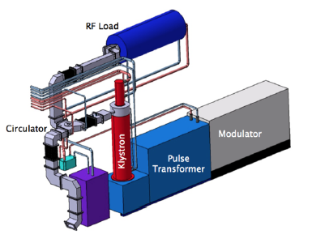
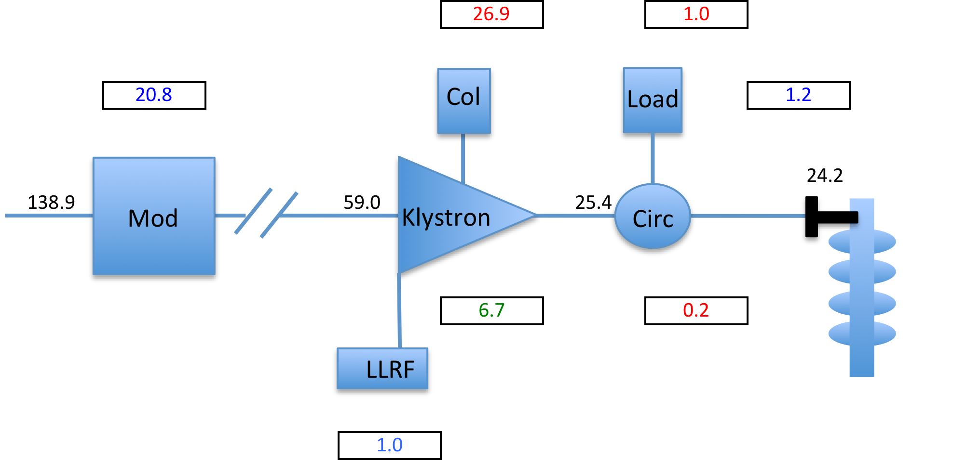
Plans to optimize heat recovery
Klystron gallery equipment
  Klystrons
    Collector – CW-High supply
    Body – CW-Medium supply
  Circulators – CW-High supply
  Loads – CW-High supply
  Modulators – CW-Low supply
  LLRF – CW-Low supply
Typical cooling
Medium β RF
ESS CDR reference
kW
Note – 2 modulators per klystron

Slide 16
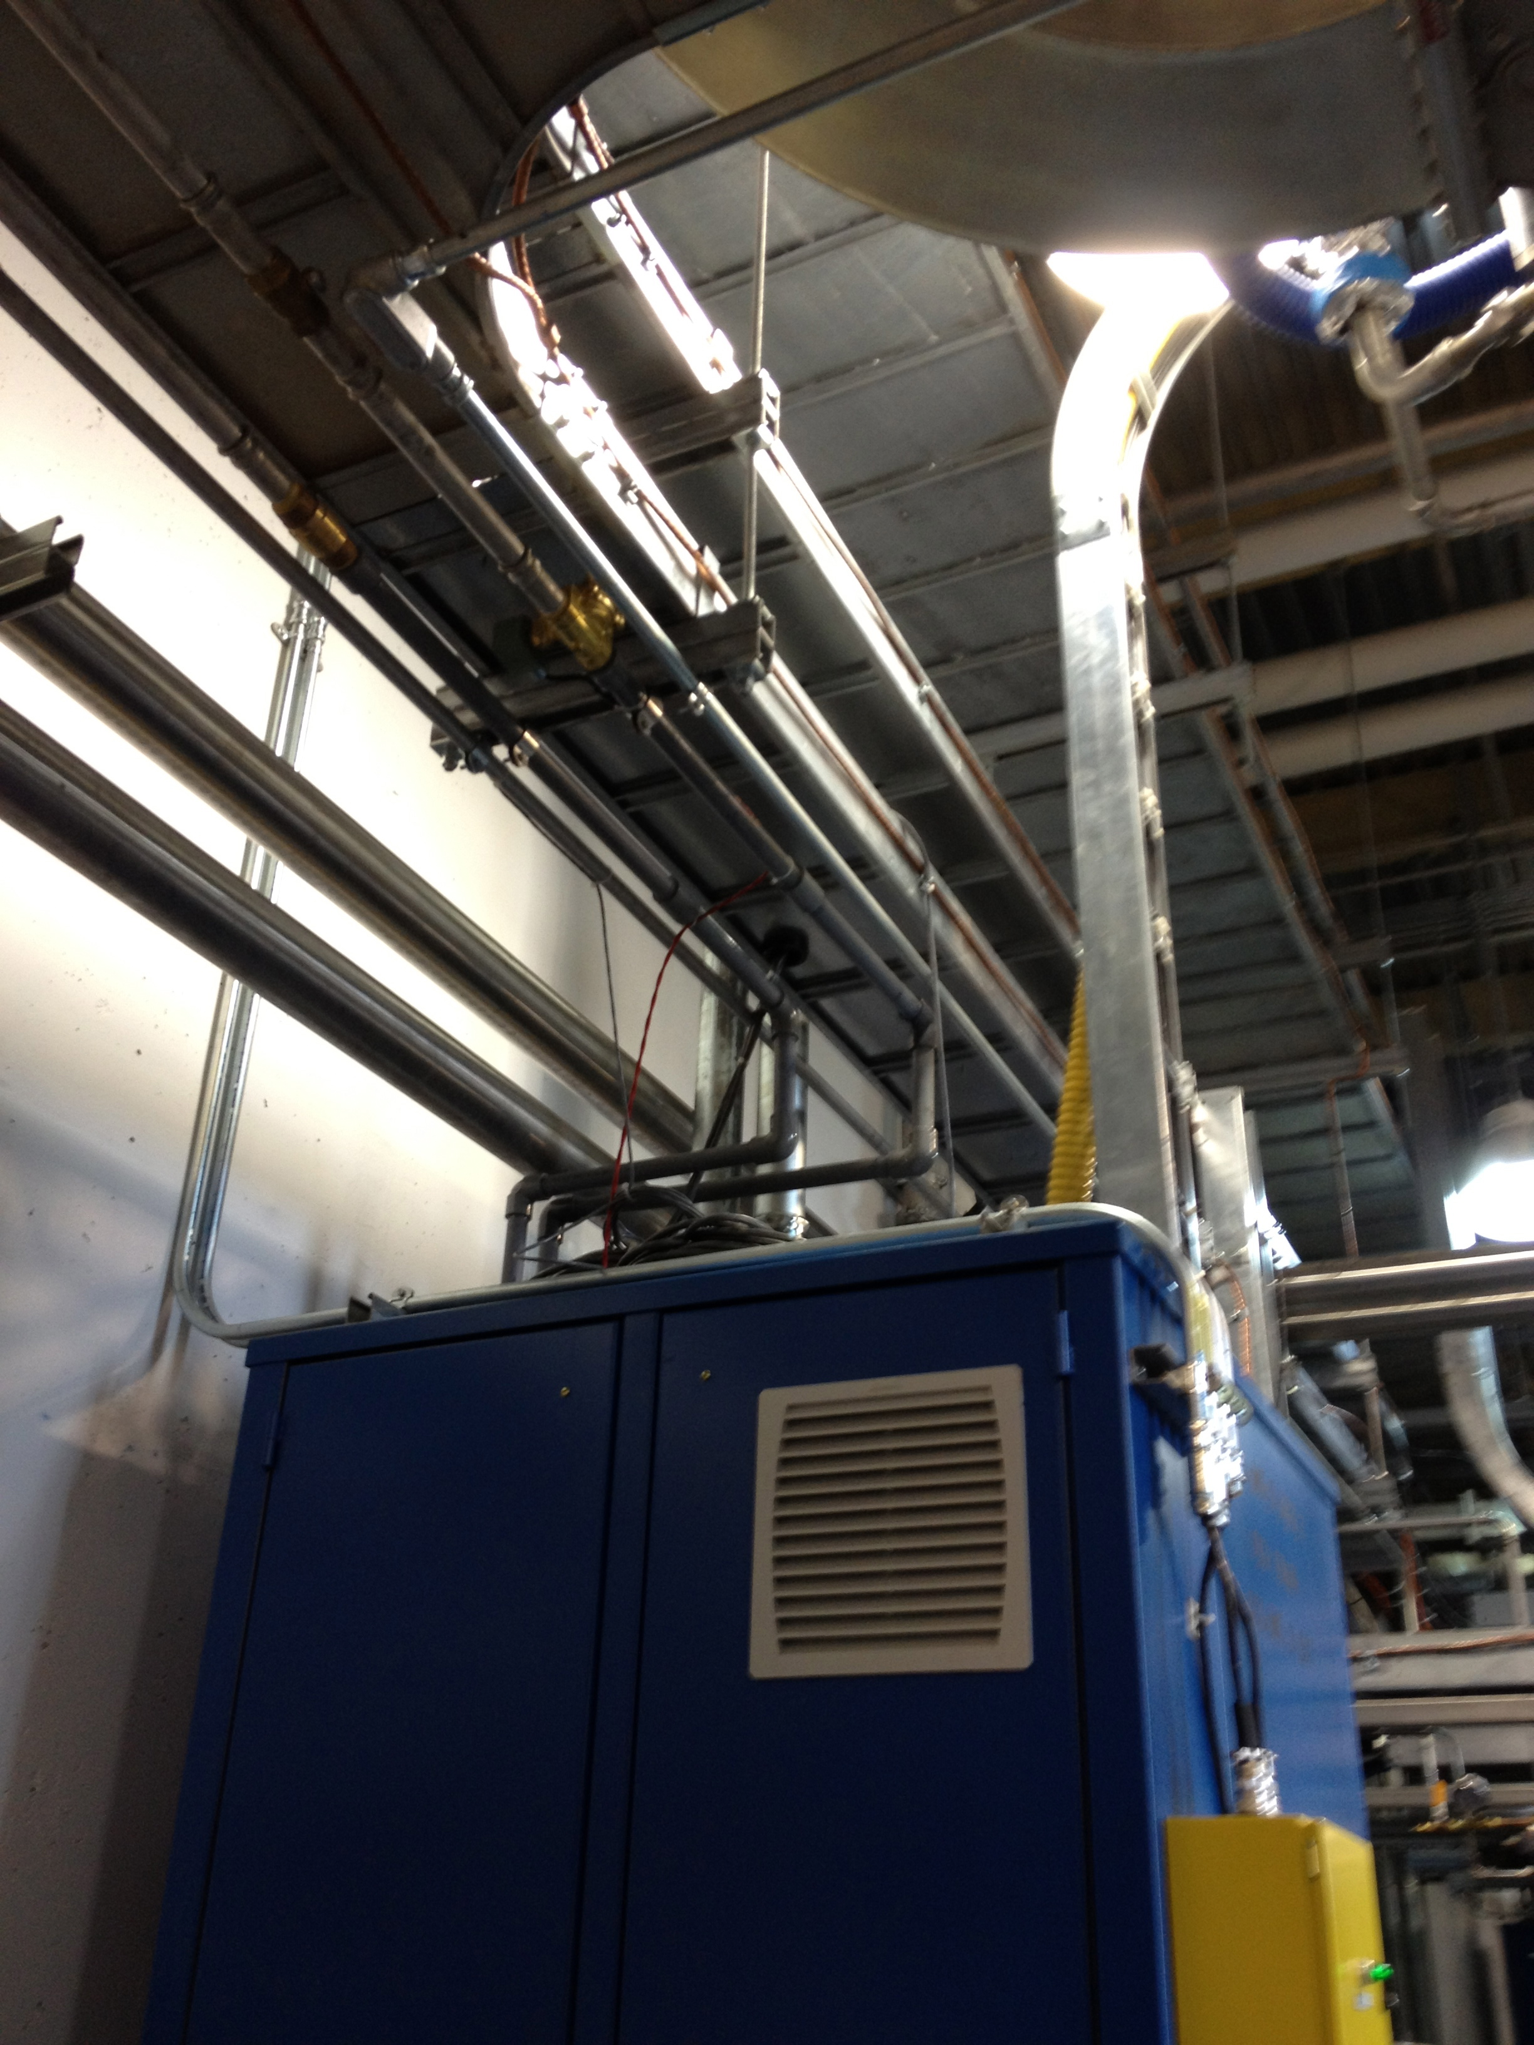
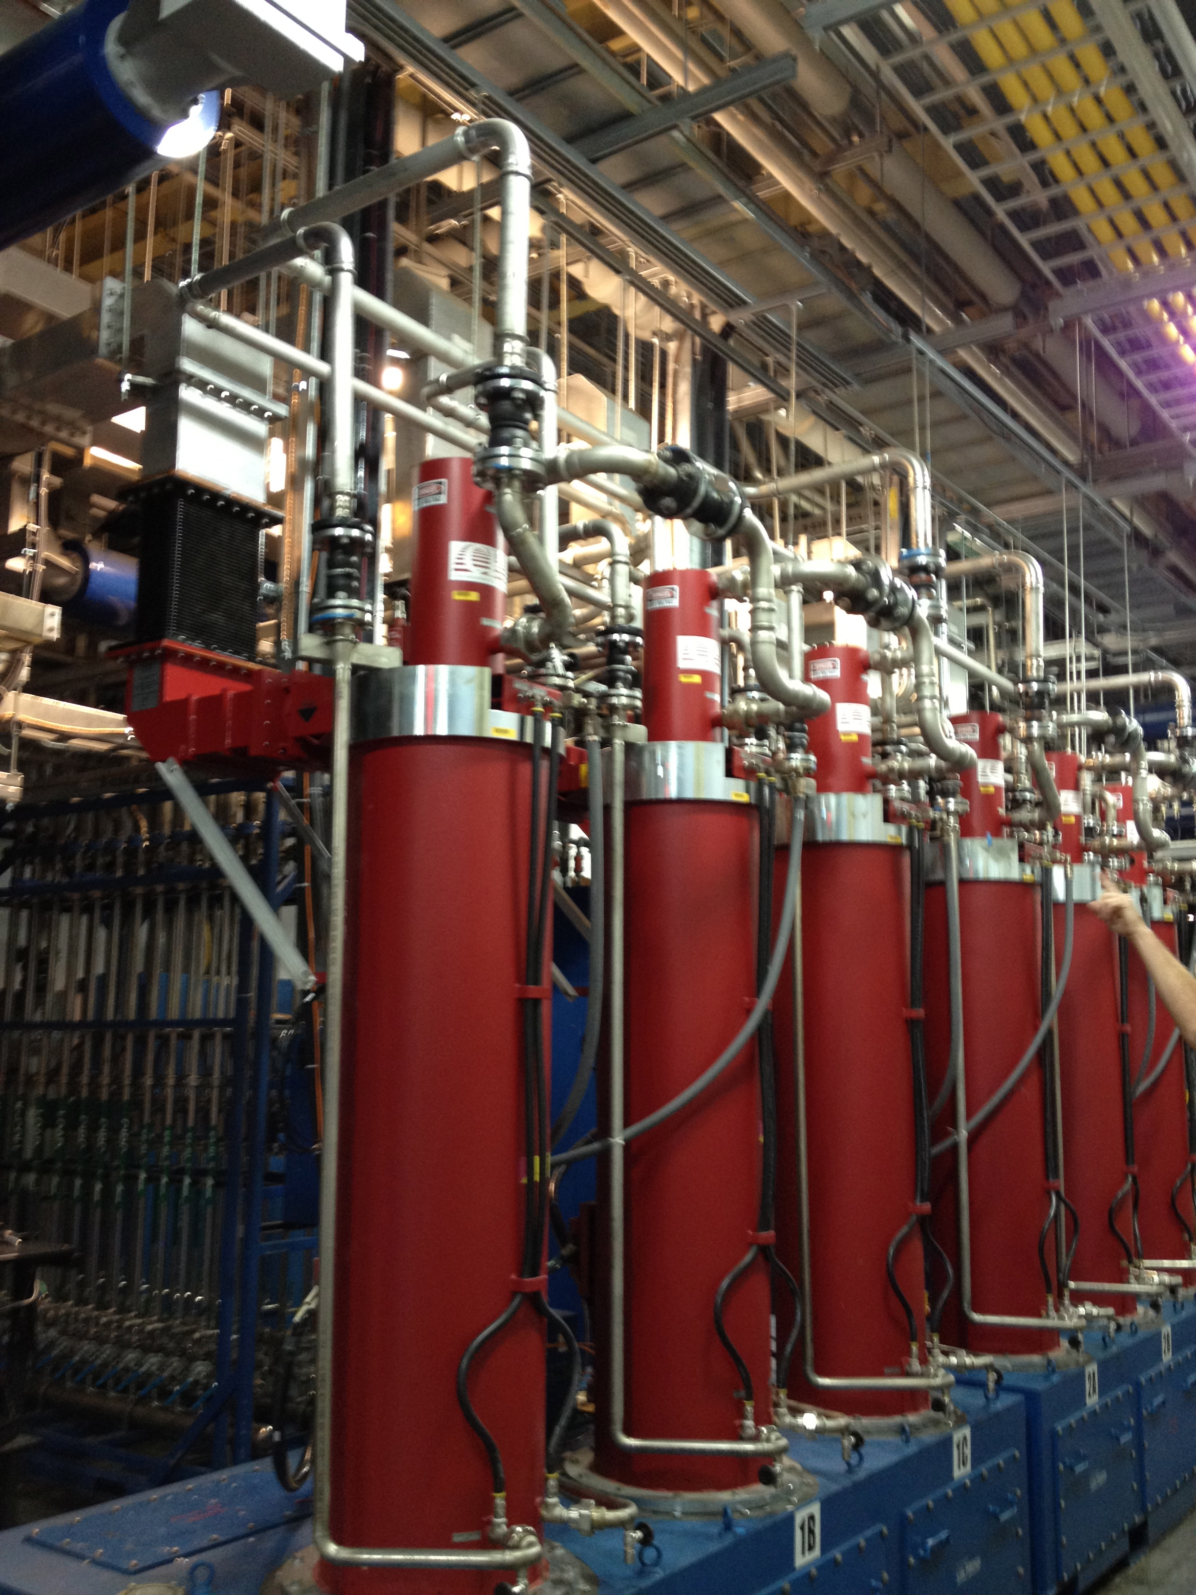
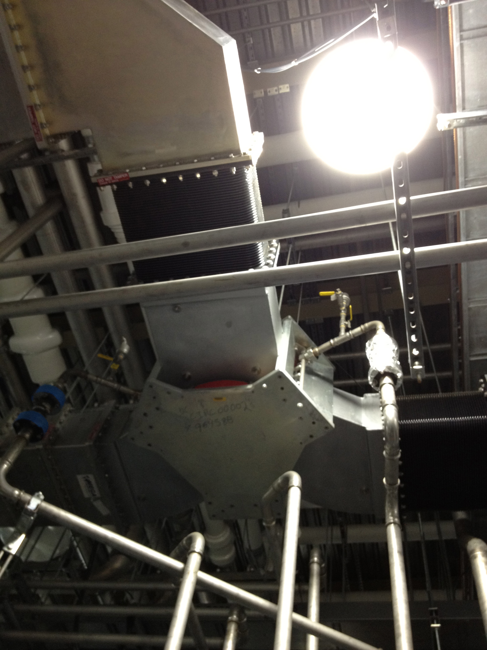
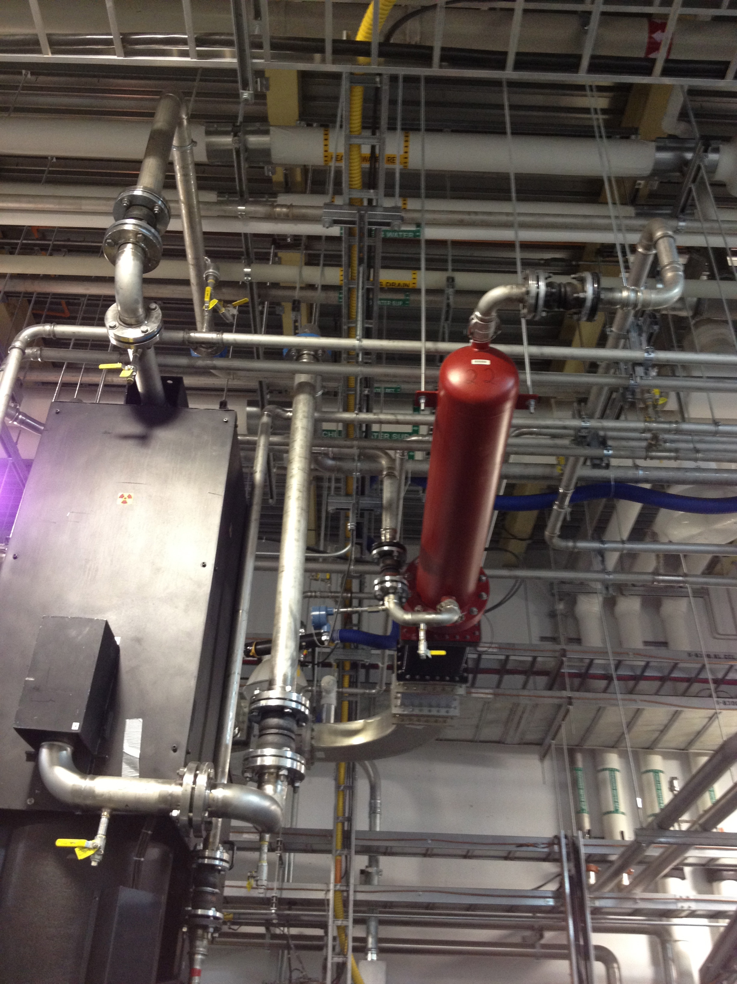
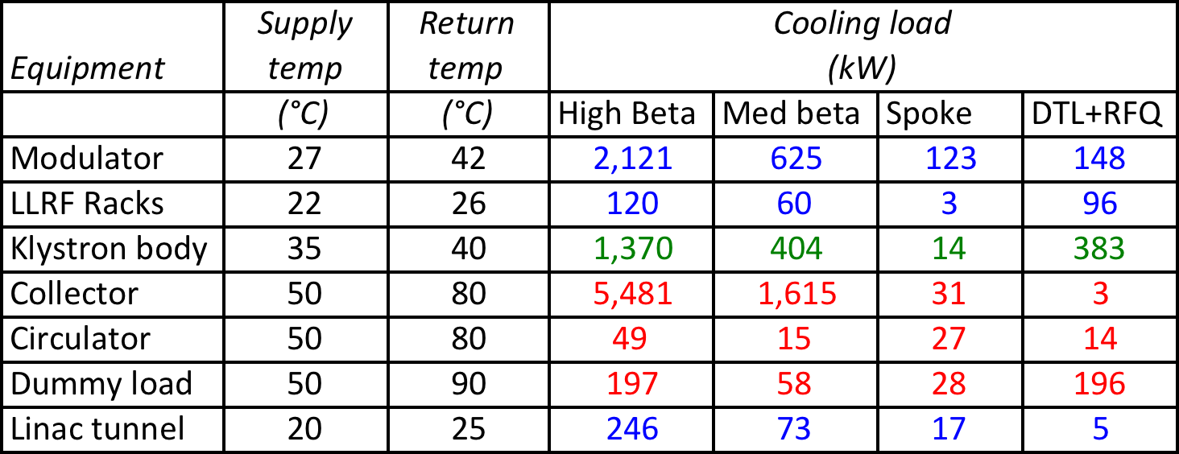
Klystron gallery equipment
Modulator
Klystron
Circulator
Load
Total RF equipment cooling loads, supply & return temperatures
ORNL/SNS site visit photos August 2012

Slide 17
Plans to optimize heat recovery
ESS cryoplants
Cooling for the cryomodules (2 K, 4.5 – 8 K and 40 K)
Cooling for the Target LH₂ Moderator (16 K)
Liquid Helium for the Neutron Instruments
Cooling for the cryomodule test stands (2 K, 4.5 – 8 K and 40 K)
This is accomplished via 3 separate cryoplants
Cryoplant equipment requiring cooling water
  Oil coolers
  Helium coolers
  Motor cooling

Slide 18
Cryoplant Equipment
Cryoplant water cooling requirements
Will likely use a combination cold & warm compression
Turn down capacity & ability to recover from trips quickly are key issues
Turning down cryoplants will result in lower cooling requirements
Cryoplant | Minimum cooling required (kW) | Maximum cooling required (kW)
Linac | 1720 | 4300
Target | 530 | 2200
NSS & Test Stand | 400 | 400
Total | 2650 | 6900

Slide 19
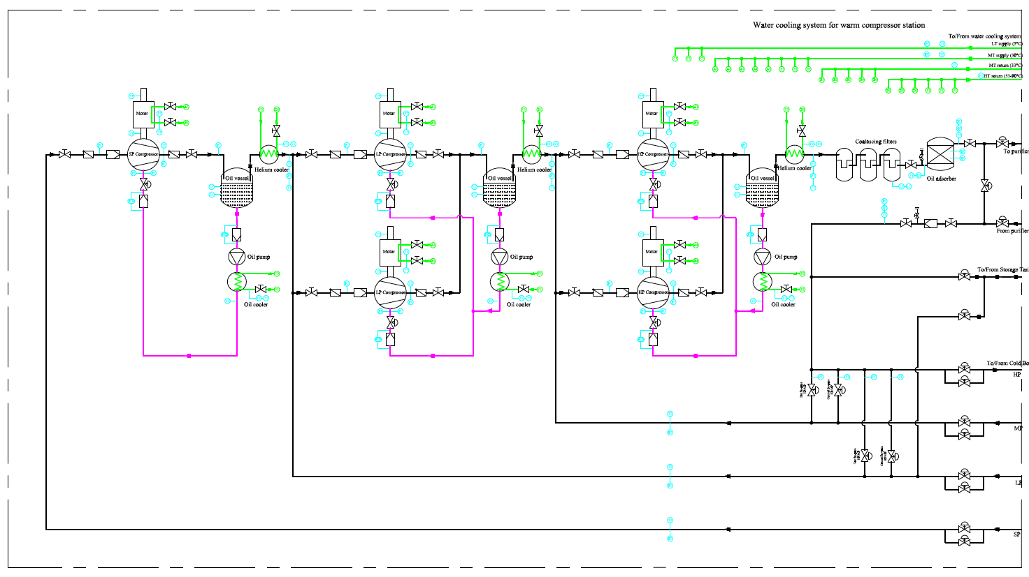
Cryoplant equipment (typical)
Helium coolers low temp supply
Oil coolers, motor medium temp supply
Consider control loop to regulate return temperature for varying cryoplant operation

Slide 20
Klystron operating temperature issues
Can we collect heat from klystrons at a high temperature?
Collector temperature rise typically 20-30 C
Maximum CW outlet temperature must remain below 80-90 C
Depending on klystron operating mode, cooling flow rate can vary 2X
Manufacturers typically specify a flow rate for cooling
Literature review* indicates that failures do not appear to originate primarily at collector, but at the other end of the klystron. Note the electron gun portion of klystron is cooled at a much lower temperature (~40 C).
*Argonne Nat’l Lab 2008 – “The Linac Klystrons Aging & Associated Problems”
SLAC klystrons 1996 – “Advanced RF Power Sources for Linacs”
Based on the above:
Reasonable plan to cool the klystron collectors at 80-90 C
Arrange several klystrons in series to maximize outlet temperature
Confirm plan to vary CW flow with klystron manufacturers

Slide 21
Cryoplant operating temperature issues
Can we collect heat from cryoplants at a high temperature?
Oil cooler temperature should not exceed ~90 C
Cool helium from CW-Low supply to optimize cryoplant performance
Cryoplant operation at reduced capacity may be a candidate for flow control of cooling water to maximize CW return temperature
Standard shell & tube heat exchangers not the most efficient – consider using plate heat exchangers instead to increase CW return temperature
Based on the above:
Maximize CW return temperature
Confirm high temperature CW return with manufacturers
See if PHX are a possibility

Slide 22
Risks and challenges
Risks & Challenges
  Reliability – assess impact of cooling temperature on equipment performance
    Lower operating temperatures – increased equipment reliability
Balance equipment technical requirements with ESS energy goals
  Higher operating temperatures – increased heat recovery
Minimize cost of recovering heat
  More equipment operating at higher temperatures means less energy required for heat pumps
Design system to effectively recover heat under all operating regimes

Slide 23
Summary
ESS has committed to an energy policy that will influence system design
Energy recovery comes at a cost, but also provides benefits
  Energy management innovation in large research facilities
  Better stewards of our environment
  Income! Recovered energy has cash value
Innovation will require close cooperation with system designers, equipment manufacturers, and customers for our recycled energy
Concentrate on areas of greatest return for energy recovery:
  RF systems
  Cryoplants
Stay tuned!

