Slide 1
ALICE-USA Upgrades Kick-off Meeting
May 16, 2013

Slide 2
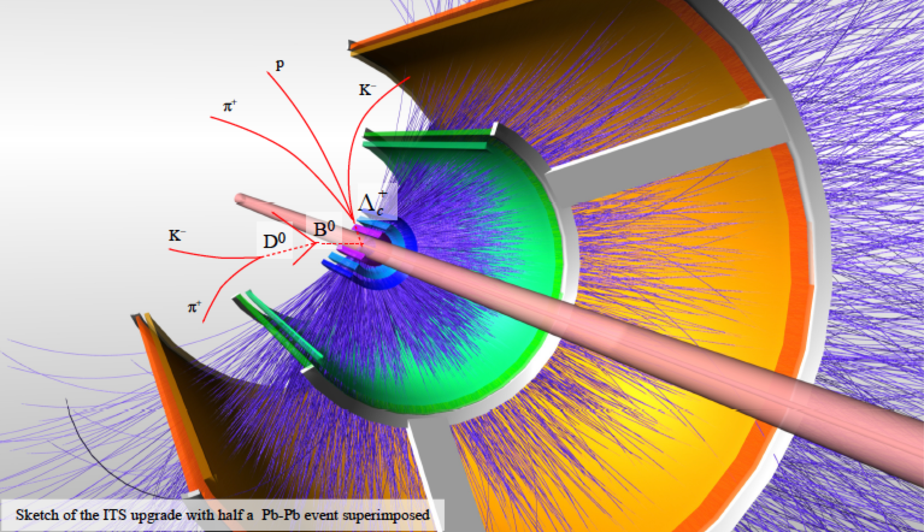
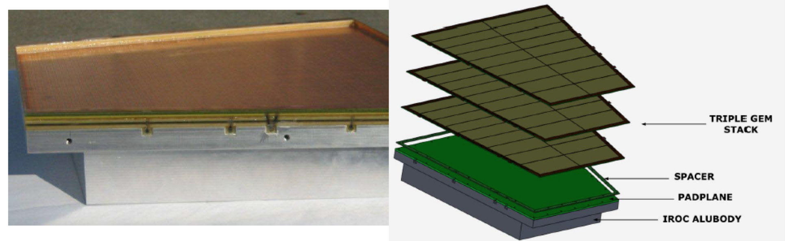
ALICE-USA Consensus:
Participate in ITS and TPC upgrades
Presented to the DOE as a single project:
The obligatory acronym for the project is
BTU (Barrel Tracking Upgrade)
ITS Upgrade
GEM-TPC Upgrade

Slide 3
15:00 Welcome
Tom Cormier: 5 Minutes
15:05 The ALICE upgrade process, physics goals, status and timeline.
Paolo Giubellino: 15 + 5 Minutes
15:25 The ALICE-USA participation in the ITS/TPC ALICE-Upgrade. DOE process and time line for the first ALICE-USA review.
Tom Cormier: 20 + 10 minutes
15:55 General overview of the ALICE-ITS upgrade
Luciano Musa: 25 + 5 minutes
16:25 General overview of the ALICE-TPC
Harry Appelshaeuser: 25 + 5 minutes
16:55. O² Pierre Vande Vyvre 15 + 5
17:15 Discussion of possible US ITS Scope – highlighting areas for ALICE-USA participation.
Peter Jacobs: 25 + 5 minutes
17:45 Discussion of possible US TPC Scope – highlighting areas for ALICE-USA participation.
John Harris: 25 + 5 minutes
18:15 Discussion of preparations of the physics case for the ALICE-USA review. Helen Caines and Mateusz Ploskon: 25 + 5 minutes
18:45 Closing remarks and discussion, Action Items
Tom Cormier: 30

