Slide 1

Pile-Up density at HL-LHC with new shaping and leveling techniques
S. Fartoukh
ECFA High Luminosity LHC Experiments Workshop
1rst -3rd October 2013, Aix-les-Bains, FRANCE

Slide 2
Contents
Two basic LHC upgrade scenarios
→ Main differences: Hardware (with and w/o crab-cavities) and optics
→ Similarities: performance reach and pile-up (μ_{tot}, ∂μ/∂z,...)
Variability with bunch length and bunch profile (Gaussian, rectangular,...)
→ Can we gain something in PU line-density?.. NO
→ Can we gain something in PU time-density?..YES .. but is it enough?
The “crab-kissing” concept: a new approach for reducing, shaping and leveling the PU line-density
Conclusions

Slide 3
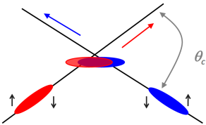
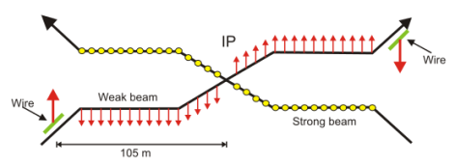
Two basic scenarios (1/3)
Plan A = HL-LHC baseline with crab-cavities (CC)
→``Round’’ optics (β*=15 cm in H and V) →``Large’’ X-angle (590 μrad) with the lumi-loss factor compensated by the CCs
→ Lumi leveling @ 5E34 with β* with full crabbing (i.e. at max CC voltage)
Plan B (..very recent) = back-up with beam-beam wire compensators (no CC)
→ Flat optics: “large” β*(50 cm) in X-plane and “small” β* (10 cm) in || plane
→ “Minimal” X-angle (285 μrad) in the plane of larger β* (thank to the bb wires)
→ Lumi leveling with β* in the parallel separation plane
R. Calaga, F. Zimmermann, et al.
J.P. Koutchouk, F. Zimmermann, et al.
The goal is the same:
Preserve the performance despite of the crossing-angle, while maximizing the luminous region to keep the z-density of Pile-up “reasonable” at 5E34, i.e. μ_{tot} =140 (→200) @ 25 ns.

Slide 4
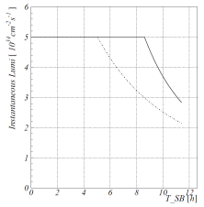
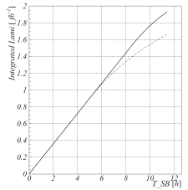

Two basic scenarios (2/3)
→ The two Plans can be optimized in bunch length to give
Lumi profile within SB
Int. lumi profile
Similar performance of ∼ 250 fb⁻¹/y
(for 25 ns, 2.2E11 p/bunch, γε=2.5 μm)
1.35 →1.45 fb⁻¹ after 8h
Same luminous region of 4.4 cm r.m.s. and same peak z-density of pile-up
→ (∂μ/∂z)_{max} = 1.27 PU/mm @ <μ_{tot}>=140
with Gaussian bunch profiles in both cases and σ_{z} = 7.5/10 cm (r.m.s.) for Plan A/B
$\frac{∂μ}{∂z}$ [mm⁻¹]
z [m] w.r.t. IP
Up to 1.27 PU/mm @ <μ_{tot}>=140 and smallest β*

Slide 5
Two basic scenarios (3/3)
If long-range beam-beam wire compensators are proved to be working, what might be the real added value of the crab-cavities?
... See later

Slide 6
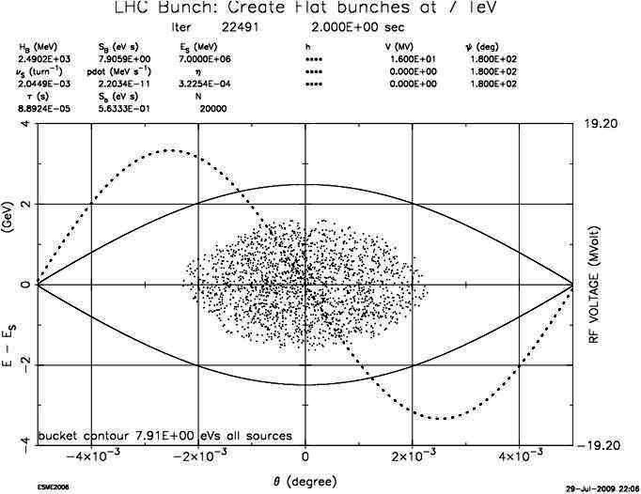
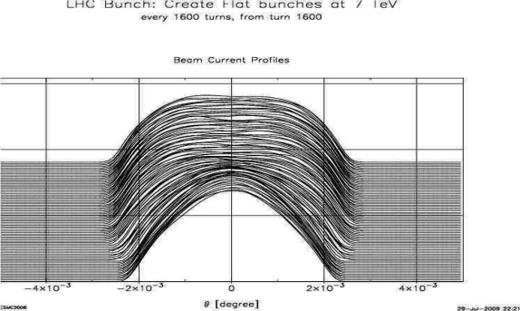
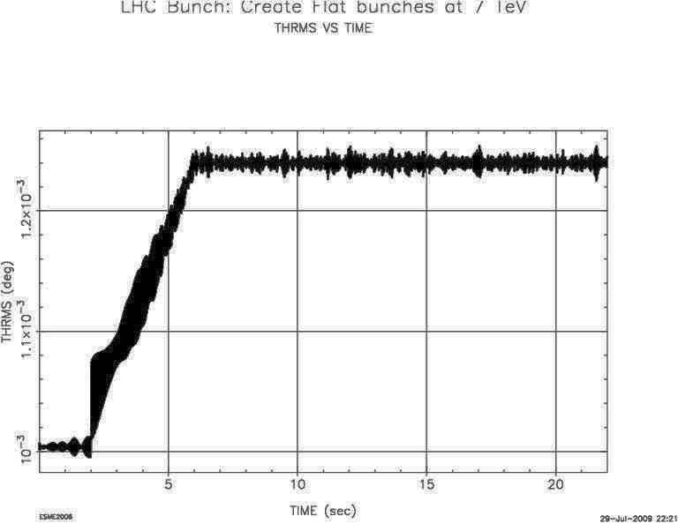
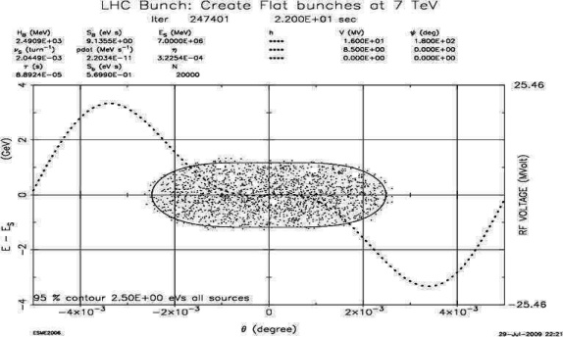
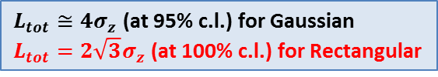
Sensitivity to bunch length & bunch shape (1/3)
→ With new Harmonic RF system (8 MV @ 800 MHz):
Rectangular bunch profile could be shaped
Longer r.m.s. bunch length could be reached up to σ_{z}  12.5 cm r.m.s. (1.45 ns full length)
$L_{tot}≅4σ_{z}$ (at 95% c.l.) for Gaussian
$L_{tot}=2\sqrt{3}σ_{z}$ (at 100% c.l.) for Rectangular
r.m.s bunch length× 25%
ESME simulations, C. Bhat, 2009

Slide 7

Sensitivity to bunch length & bunch shape (2/3)
→ Peak line density of vertices: no gain at low β*
Sensitivity to the bunch shape at constant r.m.s. length.
The z-density becomes triangular for rectangular bunches but the peak does not move
Sensitivity to the r.m.s bunch length at constant shape: No gain for σ_{z} > 9cm due to
  - the RF curvature of the CC deflecting kick for Plan A
  - the increase of the Piwinsky angle for Plan B
  - the hour glass effect for both plans
$\frac{∂μ}{∂z}$ [mm⁻¹]
$\frac{∂μ}{∂z}$ [mm⁻¹]
1.27 PU/mm
Plan A for Gaussian (black) & rectangular (red) bunch profile, both with σ_{z} =7.5 cm r.m.s.
Plan A for Gaussian profile (black) with σ_{z} =7.5/9.0/10.0 cm and rectangular (red) with σ_{z} =12.5 cm

Slide 8
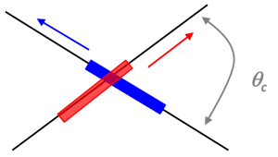

Sensitivity to bunch length & bunch shape (3/3)
→ Peak time density of vertices: net gain
  For longer r.m.s. bunch length
  Even more for rectangular bunches and Plan B (with non-zero Piwinsky angle)
$\frac{∂μ}{∂t}$ [ps⁻¹]
Plan A @ σ_{z} =7.5 cm (Gaussian)
→ 0.34 PU/ps @ <μ_{tot}>=140
Plan B variant @ σ_{z} =12.5 cm (Rectangular)
→0.12 PU/ps @ <μ_{tot}>=140
1 ns
In the best case, still 1.2 pile-up every 10 ps (and loosing ~10% of integrated performance via the geometric loss factor)
Is it really usable??

Slide 9
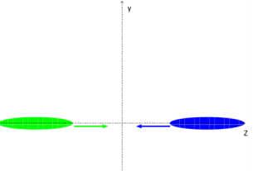
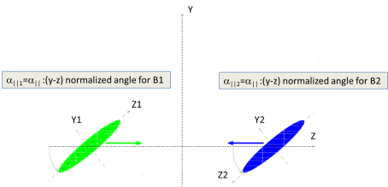
The ``crab-kissing’’ (CK) scheme (1/5)
→ Transposing to the line density the nice behavior which is observed for the time density vs. bunch length and bunch shape ...
Crab-cavities in the || plane (in anti-phase for beam1/2, and flat optics for efficiency)
Usual configuration in the || plane (Plan A/B)
New Configuration in the || plane (Plan C)
Typical “Time Piwinsky angle” of 100-150 μrad
.. A tool for shrinking the collision time, hence leveling the lumi, and much more !
a) Gaussian Bunch profile (no 800 MHz) → lumi leveling at “mitigable” z-density
b) Rectangular Bunch profile (800 MHz) → lumi leveling at strongly reduced z-density
c) Reduced BB tune shift in ALL cases (not discussed)

Slide 10

The ``crab-kissing’’ (CK) scheme (2/5)
$\frac{∂μ}{∂z}$ [mm⁻¹]
HL-LHC w/o CK scheme: Plan A (solid) and Plan B(dotted)
- 12.5 MV crabs in X-plane, round optics (15/15 cm), σ_{z} =7.5 cm (Plan A)
- or bb wire, flat optics (50/10 cm), σ_{z} =10 cm (Plan B)
“HL-LHC+” with CK scheme and Gaussian bunch profile
..adding crab-cavities to Plan B in X and || planes (6 MV+7 MV)
“HL-LHC++” with CK scheme and rectangular bunch profile
... adding a new 800 MHz RF system (still keeping σ_{z} =10 cm)
z [m] w.r.t. IP
→ A net gain by a factor √2 at each step
.... at nearly constant integrated performance (see next slide)

Slide 11
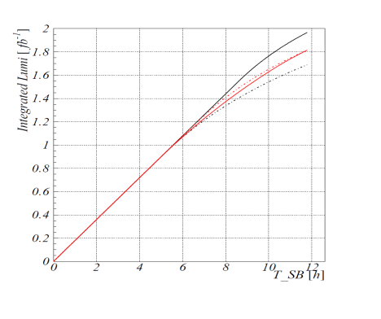

The ``crab-kissing’’ (CK) scheme (3/5)
∼1.40 fb⁻¹ after 8h
$\frac{∂μ}{∂z}$ [mm⁻¹]
→ Very similar delivered luminosity for all these cases
→ but a priori not the same useful luminosity (being quantified)

Slide 12
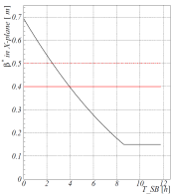
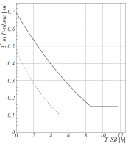
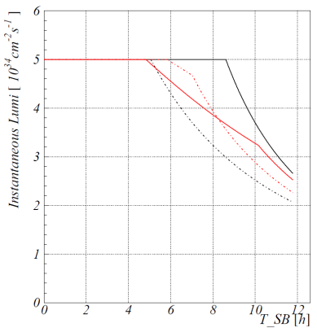
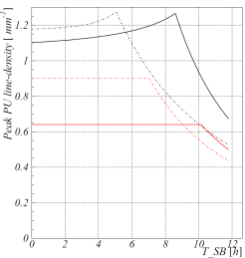
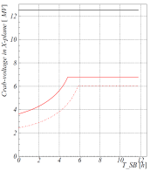
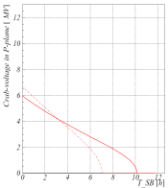
The ``crab-kissing’’ (CK) scheme (4/5)
→ Leveling techniques (...forgetting the details)
W/o CK scheme (black cases): Lumi leveling with β∗ @ <μ_{tot}> = 140
With CK scheme (red cases): “Peak z-density leveling” with CC @ <μ_{tot}> ≤ 140
β∗ in X-plane
β∗ in ||-plane
CC voltage program
in X-plane
CC voltage program
in ||-plane
Lumi profile in SB
Peak z-density in SB

Slide 13
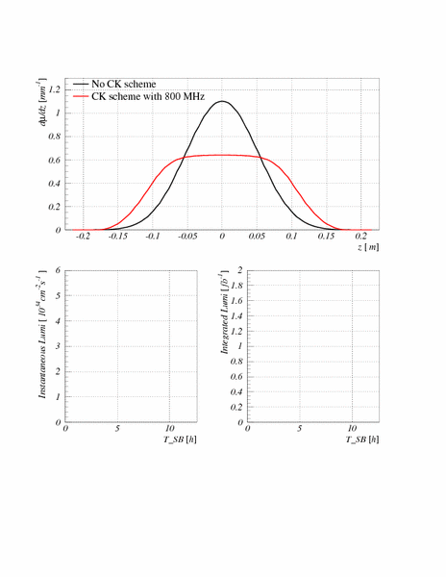
The ``crab-kissing’’ (CK) scheme (5/5)
PU z-density variations in SB (animation)
→ The density shape is changing in stable beam
→ ... but the peak density is halved and stays constant with the CK scheme.
Lumi profile in SB
Perf. profile in SB

Slide 14
Conclusions & Outlooks (1/2)
Strongly relying on high current from the injectors (2.2E11/b @25 ns), various scheme can be built with or w/o crab-cavities to deliver a yearly lumi of ∼250 fb⁻¹. But all these scenarios assume new hardware never tested so far in a pp collider.
Without crab-cavities, however, the detector will have to leave in an high pile-up environment, μ_{tot} =140 @25 ns (→ 200 for the worst collisions) and peak line-density of ∼ 1.3 PU/mm (→ 1.8 PU/mm).
Not discussed but to be kept in mind: any reduction of current or increase of the bunch spacing (50 ns..) will immediately translate into an increase of the peak z-density, if one tries to stick to the target performance.

Slide 15


Conclusions & Outlooks (2/2)
Crab-cavities in specific configuration (CK scheme) remains the key
- To reduce the peak PU line density at constant performance,
- Or to boost the performance at constant PU line density,
- Or (in the worst case of beam current lower than targeted) to mitigate the performance loss at constant PU line density.
$\frac{∂μ}{∂z}$ [mm⁻¹]
HL-LHC vs. LHC2012:
ʃLdt /year ... × 10
μ_{tot} ... × 4
${\left(\frac{∂μ}{∂z}\right)}_{max}$ ... × 4 → 2
HL-LHC baseline and backup (25 ns): 250 fb⁻¹/y , μ_{tot}= 140 @5E34
(BB wire .or. crab w/o CK scheme)
“HL-LHC+” (25ns): 250 fb⁻¹/y , μ_{tot}= 140 @5E34
(BB wire .and. crabs with CK scheme)
“HL-LHC++” (25ns): 250 fb⁻¹/y , μ_{tot}= 140 @5E34
(BB wire .and. crabs with CK scheme .and. 800 MHz)
LHC2012 (50 ns): 25 fb⁻¹/y, μ_{tot}= 40 @7.5E33
z [m]

Slide 16
Backup

Slide 17
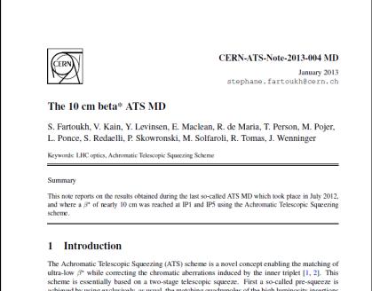
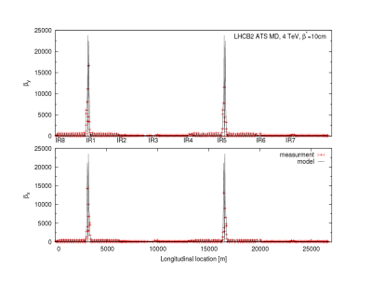
The Achromatic Telescopic Squeeze (ATS) as baseline for the upgrade optics and any scenario (Plan A, B,..)
→ Proof of principle demonstrated in the LHC down to a β∗ of 10-15 cm at IP1 and IP5
ATS principle: β_{arc} ×4
in 81/12/45/56

Slide 18
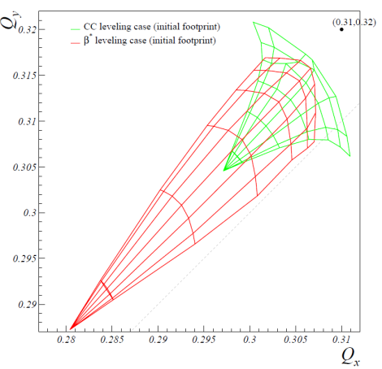
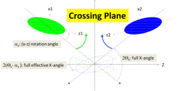
Lumi Leveling, Pile up and beam-beam for Plan A
→ W/o CK scheme, lumi leveling with crabs is “prohibited” by PU density, but up to ΔQ_{bb}= 0.033 with β* leveling in 3 IRs !
Parameters | Leveling with c.-c. | Leveling with β*
# bunches | 2808
bunch charge [10¹¹] | 2.2
emittance [μm] | 2.5
r.m.s. bunch length [cm] | 7.5
full X-angle [μrad] | 590
initial β* [cm] | 15 | 72
c.-c. initial voltage [MV] | - 6.6 | 12.5
initial Piwinsky angle | 4.76 | 0
initial lumi loss factor | 0.21 | 1.0
levelled lumi [10³⁴cm⁻²s⁻¹] | 5.0
initial luminous region [cm] | 1.1 | 4.3
initial bb tune shift for 3 IRs (IR1, IR5 & IR8) | 0.016 (0.011+2×0.0025) | 0.033 (3×0.011)

Slide 19
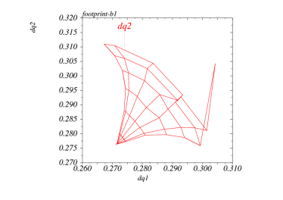
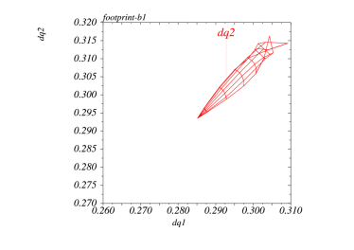

LR compensation with wire for flat optics
→ “Pushy” flat optics (7.5cm/30 cm, SLHCPR49), HL-LHC beam parameters, 10 σ X-angle, 36 LRs per IP (instead of 16 in 2012), 3 IRs, CK-scheme ON
Without wire
ΔQ_{HO} + ΔQ_{LR} = 0.04-0.05 !
With wire at TCT position
→ Strong reduction of LR effect
but still not very clean
Wire at optimal position
→ ... only the Head-on tune
shift & tune spread is left
BB wire at TCT position should be available for test for after LS1

