Slide 1
Addendum to IS534:
“Part I: Beta-delayed fission, laser spectroscopy and shape-coexistence studies with At beams
Part II: Delineating the island of deformation in the light Au isotopes by means of laser spectroscopy
Andrei Andreyev
University of York
on behalf of “Astatine-Gold” Collaboration
INTC, 26th June 2013

Slide 2
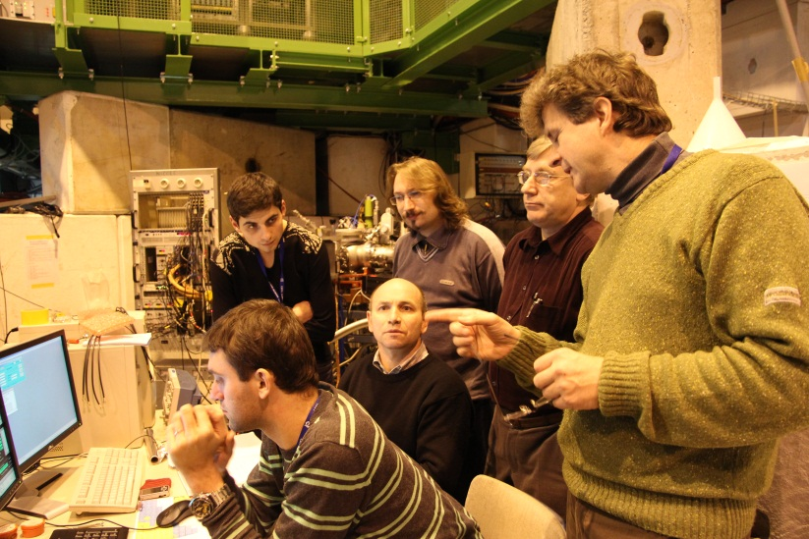
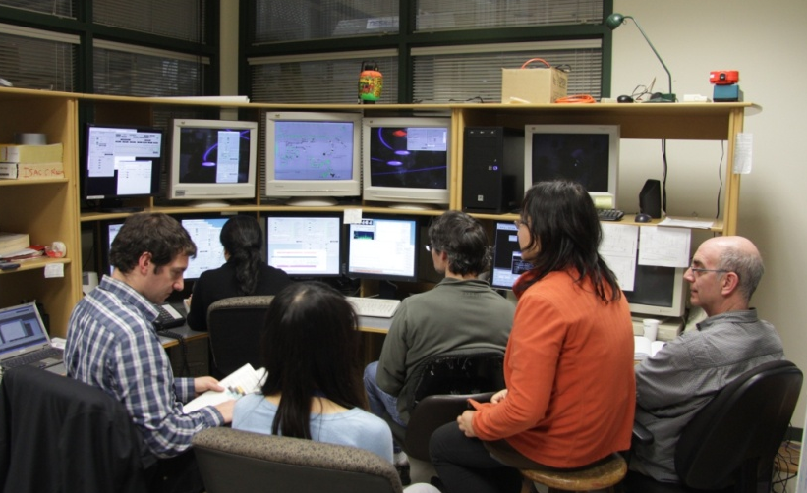
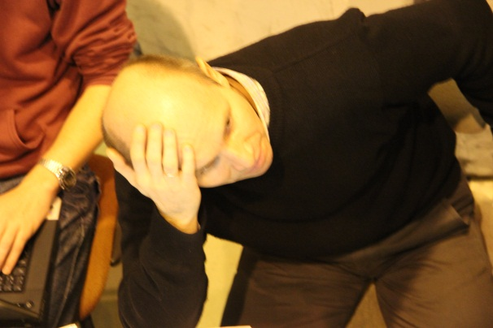
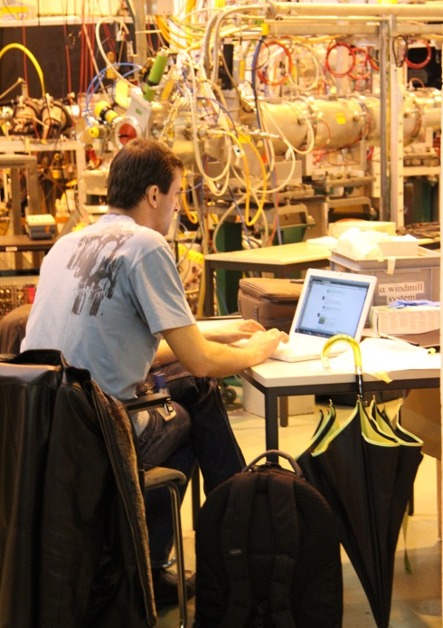
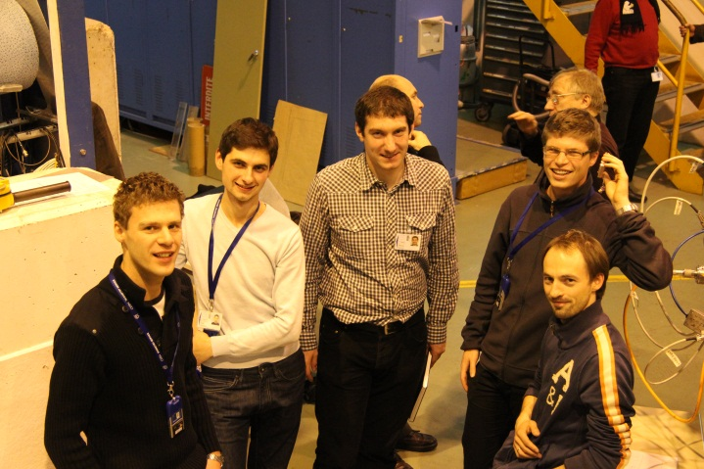
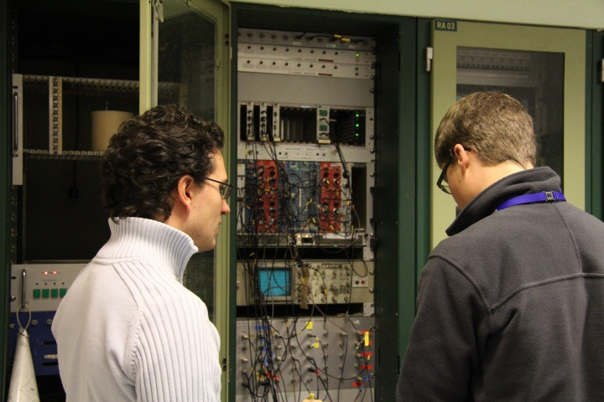
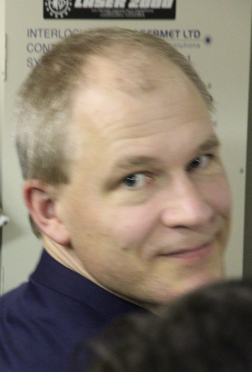
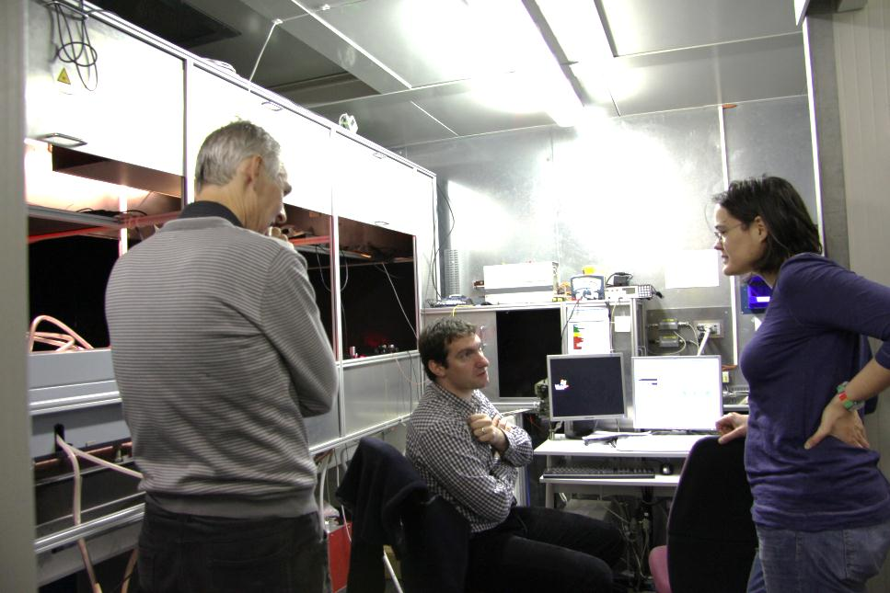
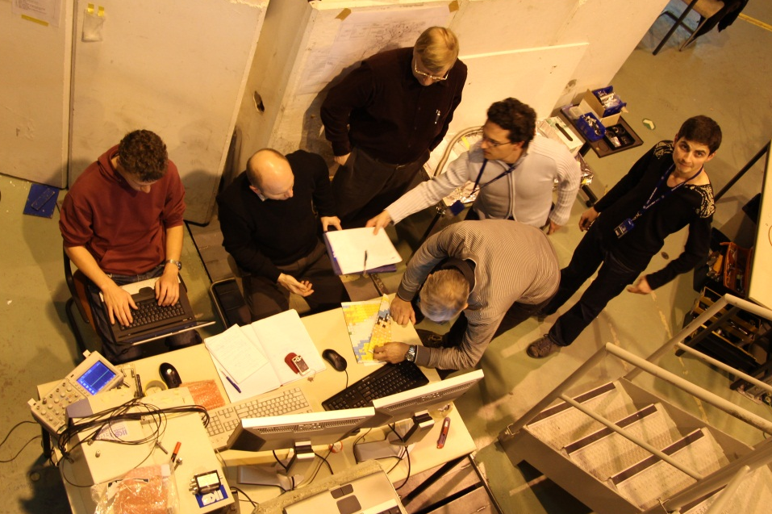
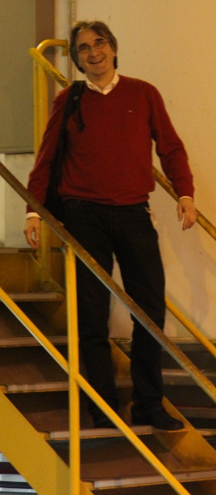

Astatine-Gold collaboration
University of York, United Kingdom
A. N. Andreyev, V. Truesdale
RILIS and ISOLDE, Geneva, Switzerland
S. Rothe, B. A. Marsh, A. M. Sjodin, T. C. Cocolios, V. N. Fedosseev M. D. Seliverstov
Institut für Physik, Johannes Gutenberg-Universität Mainz, Mainz, Germany
S. Raeder, K. D. A. Wendt
Instituut voor Kern- en Stralingsfysica, K.U. Leuven, Leuven, Belgium
L. Ghys, C. Van Beveren, E. Rapisarda, D. Pauwels, D. Radulov, Yu. Kudryavtsev,
M. Huyse, P. Van Duppen
Comenius University, Bratislava, Slovakia
S. Antalic, Z. Kalaninova
PNPI, Gatchina, Russian Federation
A. Barzakh, D. V. Fedorov, P. Molkanov
University of Manchester, UK
K. Lynch, I. Straschnov...
MR-TOF@ISOLTRAP team (IS518): S. Kreim, V. Manea, +...

Slide 3
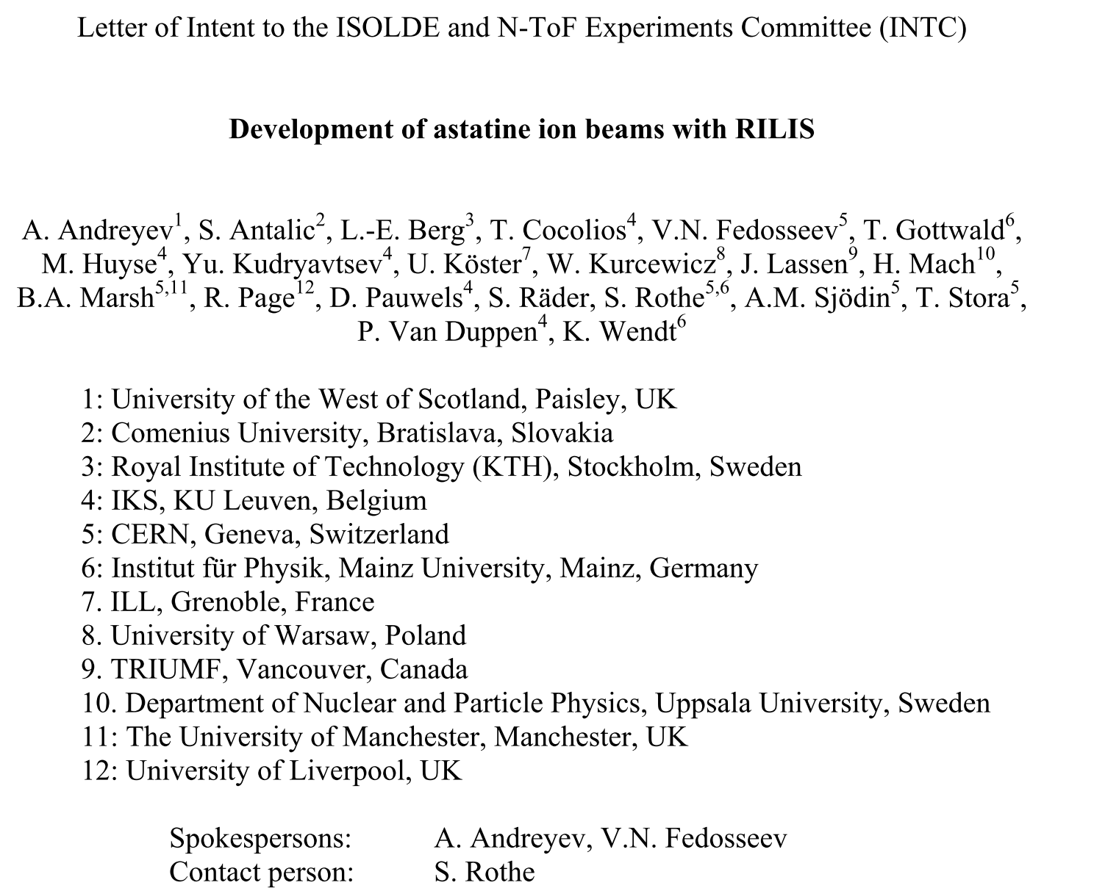
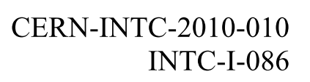
4th February 2010: LoI I086 “Development of Astatine ion beams with RILIS”
The Problem: Element At has no stable isotopes (longest T_{1/2}=8h)
Only ~68 mg of At present in the 1st mile of Earth’ core
Must be produced/studied ‘on-line’ at an accelerator

Slide 4
Five Physics Cases for LoI I086
Studies of the beta-delayed fission (βDF) in At isotopes (Paisley-Leuven-Bratislava-Geneva-Gent-Liverpool-Los Alamos-Tokai- collaboration)
HFS, IS and charge radii measurements within the long chain of At isotopes, from the very neutron-deficient side, across the N=126 neutron closure, up to the most neutron-rich isotopes (Paisley-Leuven-Bratislava-Liverpool - collaboration)
Shape coexistence in the lightest Po isotopes (β⁺/EC -decay products of At), in particular the search for coexisting oblate, prolate and spherical 0⁺ band-heads and corresponding excitations in the odd-A Po isotopes (Paisley-Leuven-Bratislava-Liverpool-JYFL-Warsaw - collaboration)
Search for octupole collectivity in the neutron-rich Rn isotopes (beta-decay products of At) (Madrid, Oslo, Uppsala, Warsaw - collaboration)
Few-nucleon transfer reactions of At isotopes to study single-particle around N=126 and multi-particle multi-hole structures in the neutron-deficient and neutron-rich isotopes. This would need beam energies from HIE ISOLDE.

Slide 5
First determination of the Ionization Potential for the radioactive element At
3 successful on-line development runs
ISOLDE (Nov. 2010, May 2011)
TRIUMF, Canada (Dec. 2010)
Many new atomic levels found
Transition strengths measured
Ionization potential measured (scan of ionizing laser: converging Rydberg levels allow precise determination of the IP)
²⁰⁵At
Ion count intensity a.u.
Total photon energy cm⁻¹

Slide 6
First determination of the Ionization Potential for the radioactive element At

Slide 7
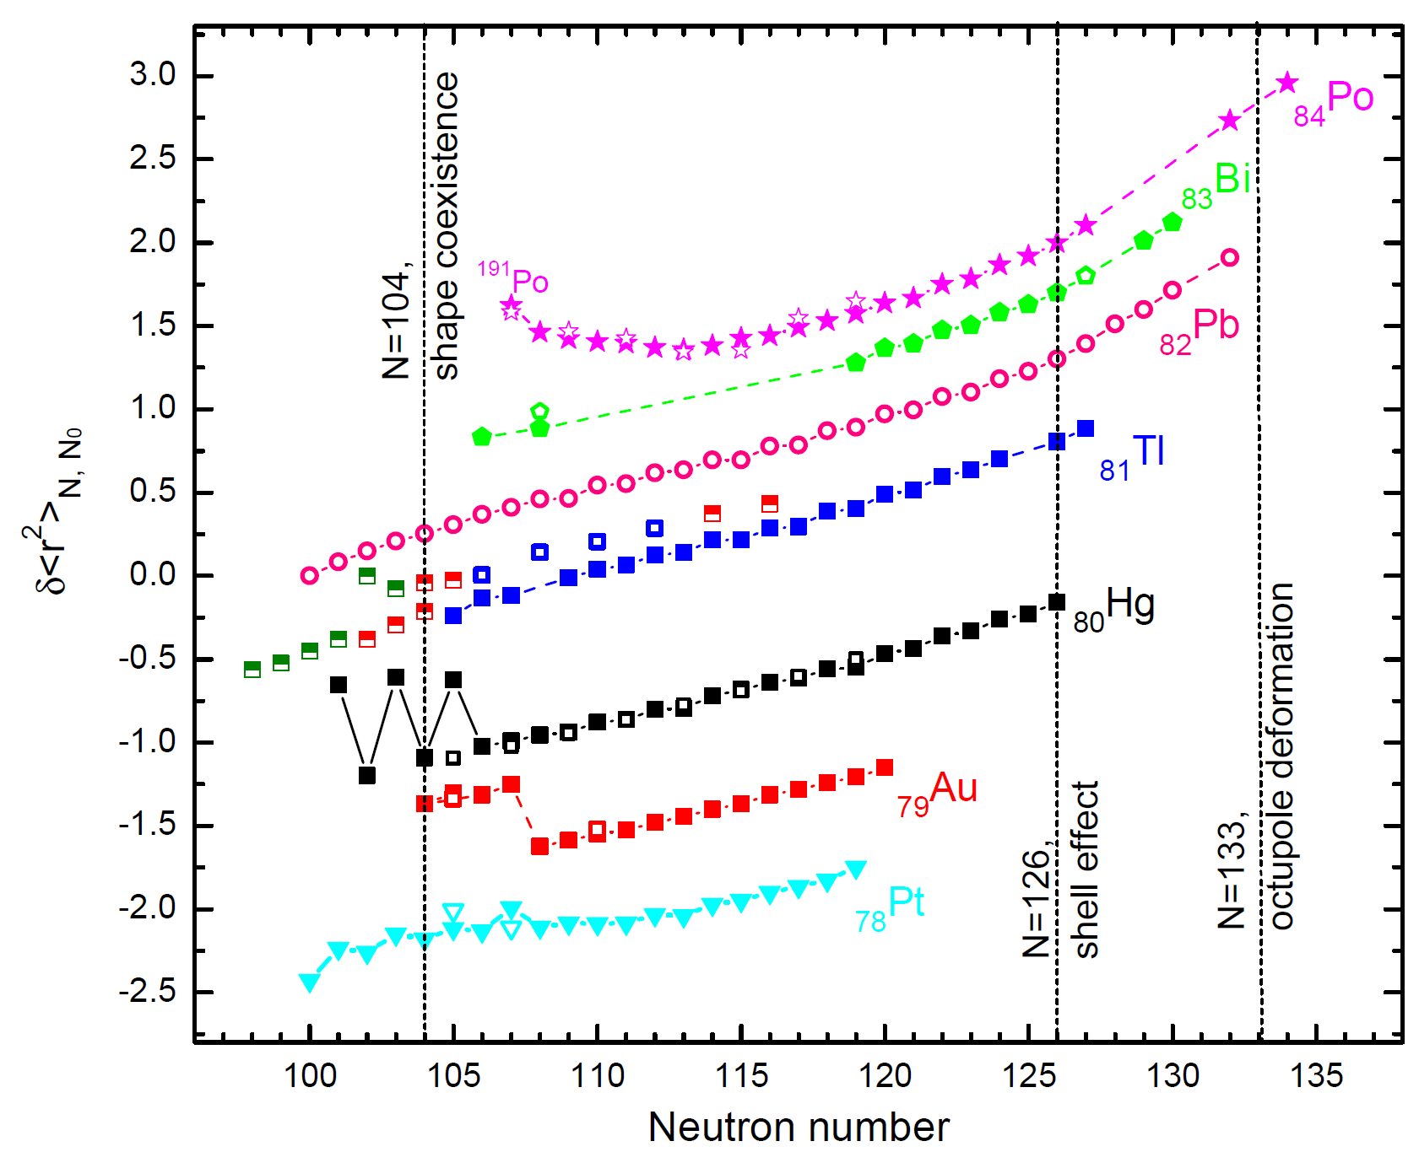
IS534: At and Au Charge Radii
At?
Au?

Slide 8
Windmill System at ISOLDE
A. Andreyev et al., PRL 105, 252502 (2010)
Annular Si
Si
MINIBALL Ge cluster
pure 30 keV beam
from RILIS+ISOLDE
Annular Si
Si
ff
α
30 keV beam
from ISOLDE
ff
C-foil
C-foils
20 mg/cm²
Si detectors
Setup: Si detectors from both sides of the C-foil
Simple setup & DAQ: 4 PIPS (1 of them – annular)
Large geometrical efficiency (up to 80%)
2 fold fission fragment coincidences
ff-gamma coincidences
Digital electronics

Slide 9
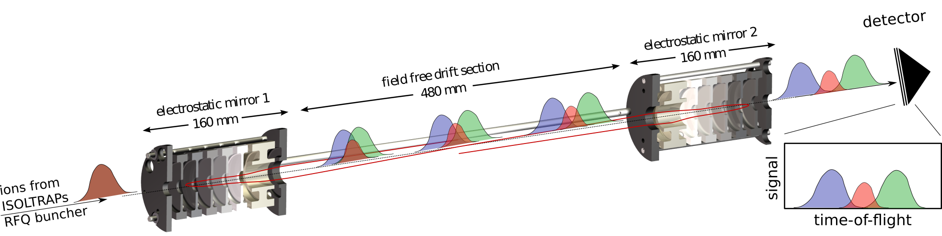
Multi-Reflection Time-of-Flight (MR-ToF) Spectrometer for HFS studies
The WM technique requires waiting for the decay of the isotope (usually, α-decay, to provide selectivity between isotopes/isomers). Not practical for long-lived or stable isotopes (or for β-decaying)
Alternative – to use ‘counting’ ions (instead of waiting for decay)

Slide 10
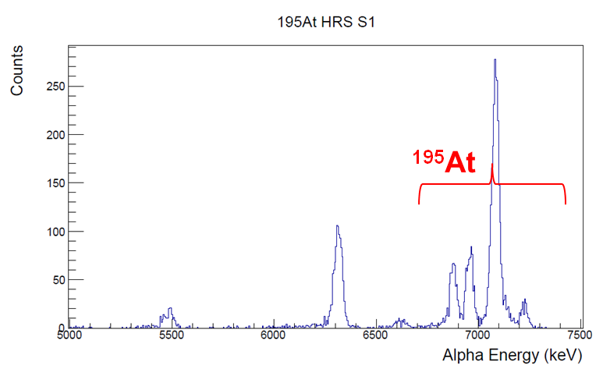
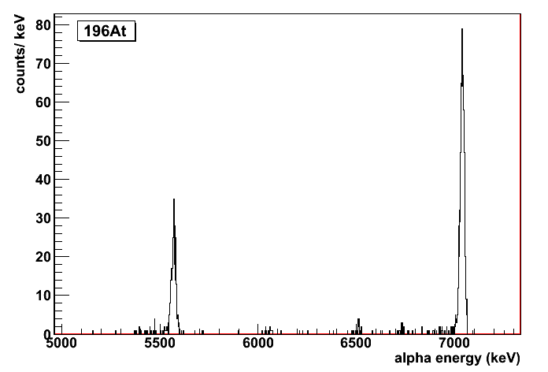
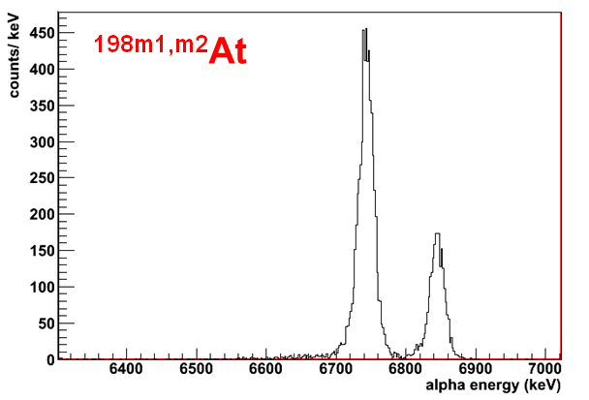
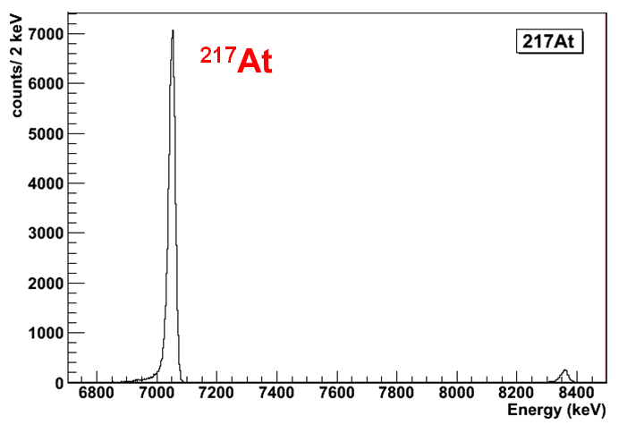
IS534, May/October 2012 examples of alpha spectra from WM
RILIS+SOLDE, IS534
¹⁹⁶At

Slide 11
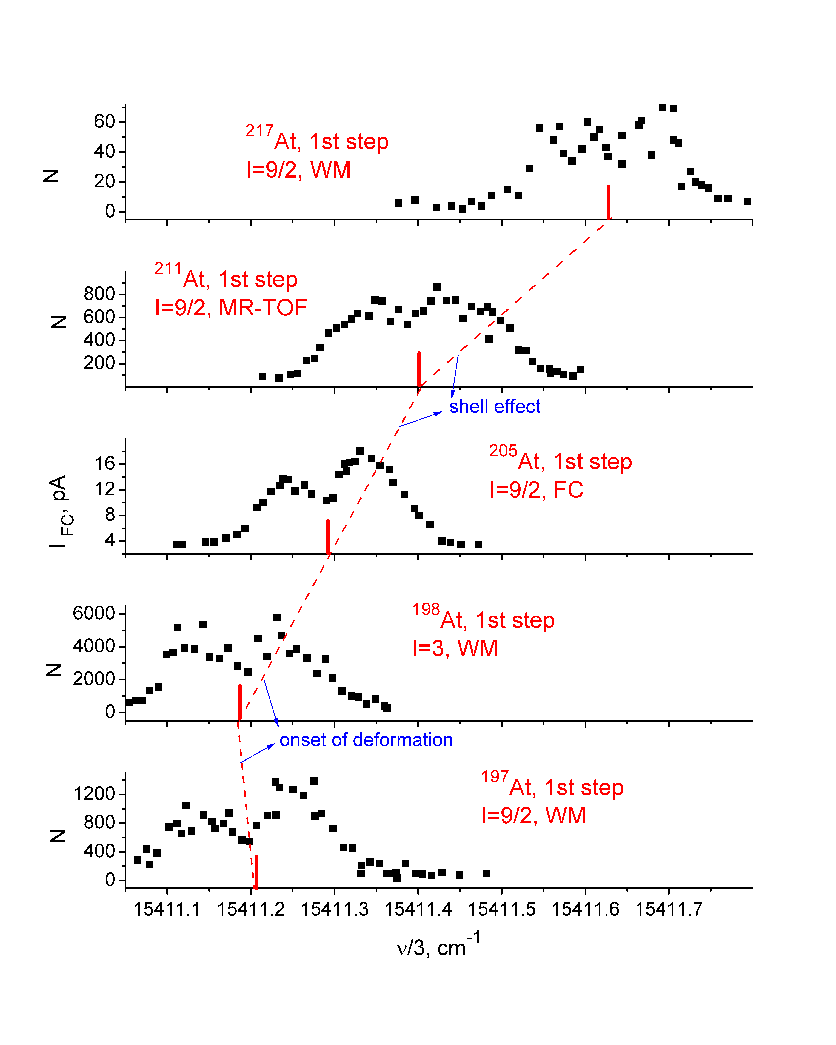
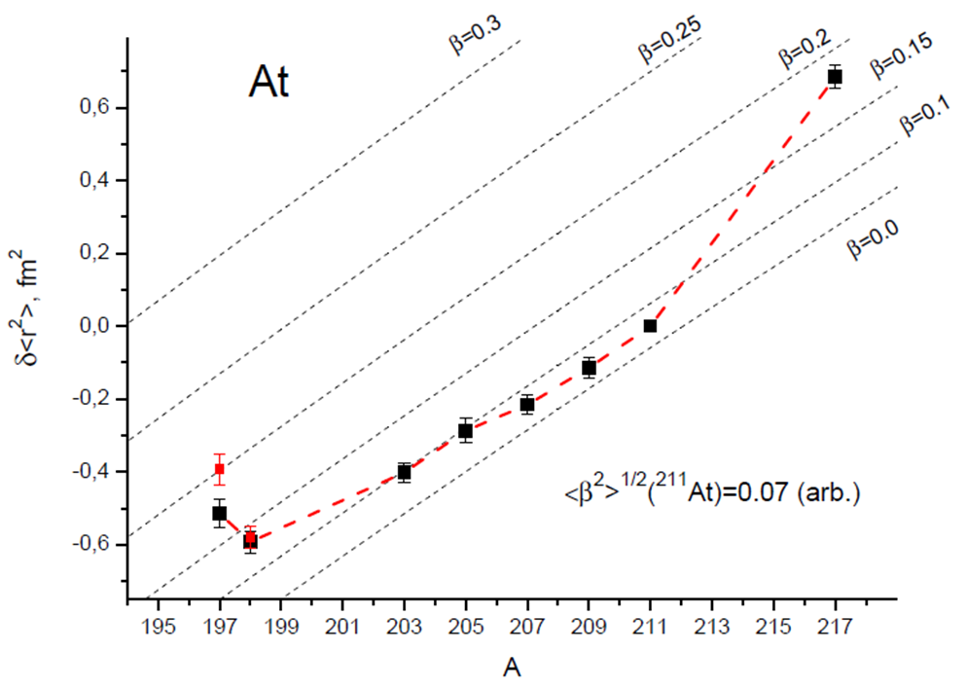
HFS spectra for At isotopes (WM/FC/MR-TOF)
Need ‘missing’ isotopes, need more spectra for some of measured
To complete the IS/HFS measurements we ask 10 shifts of
193-196,202,204,206,208,210,212,218,219At beams (WM/FC/MR-TOF)

Slide 12
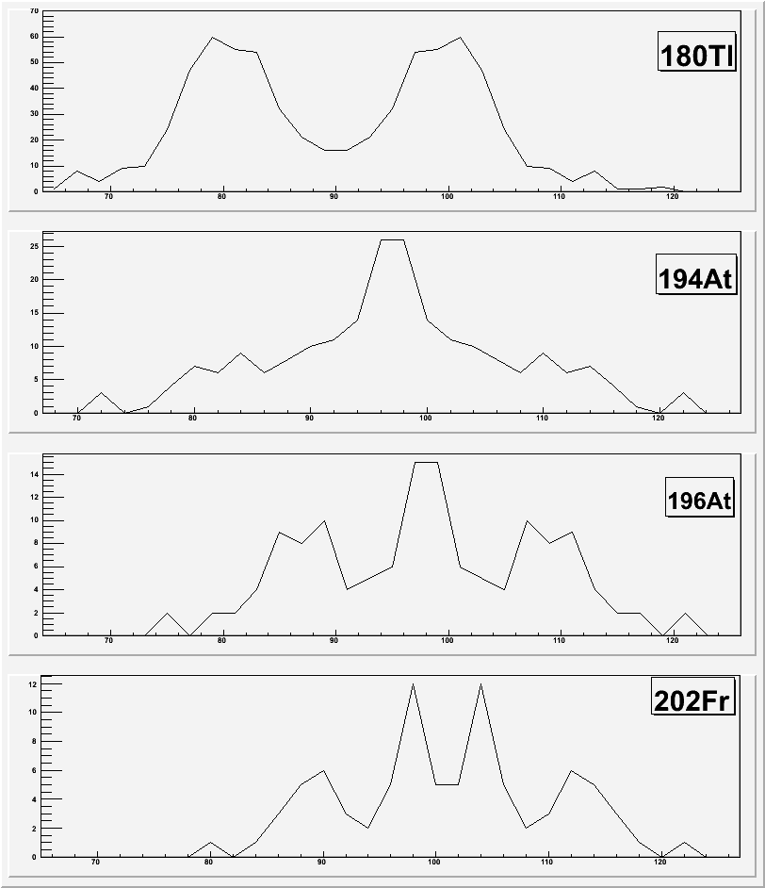
May and June 2012: Mass Distributions Measurements via βDF of ^{194,196}At and ^{200,202}Fr
Gradual transition from asymmetry in ¹⁸⁰Tl to a mixture of symmetric and asymmetric in ^{194,196}At and ²⁰²Fr.
However: ¹⁹⁴At has 2 isomers, thus it’s not clear yet if both or only one isomer fission?
We ask 3 shifts to perform the isomer separation (narrowband) and measure βDF
40 ff/h BB
8 ff/h BB
Fission Fragment Mass
Courtesy L. Ghys, V. Truesdale

Slide 13
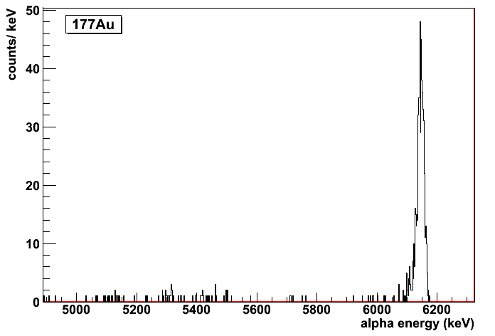
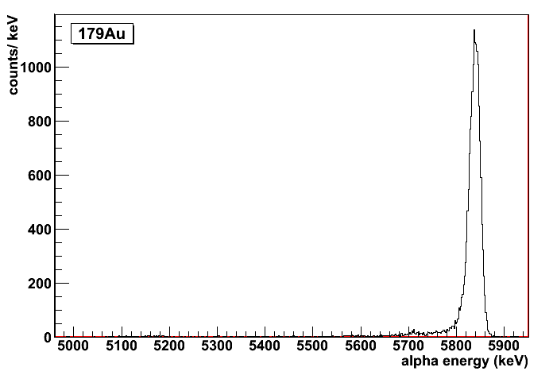
9-12 October 2012: Laser spectroscopy of Au isotopes
¹⁷⁷Au narrowband at gs
¹⁷⁹Au narrowband at gs

Slide 14
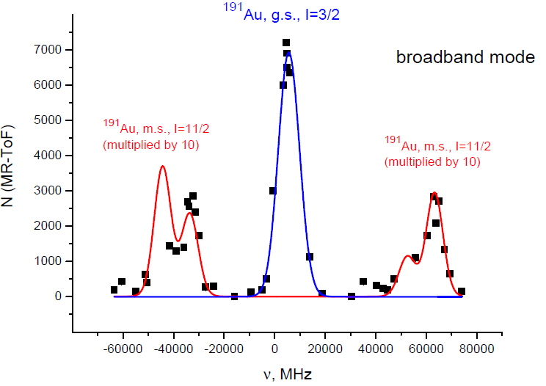
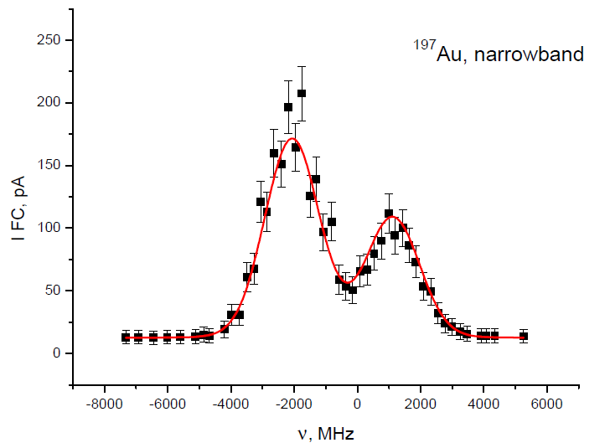
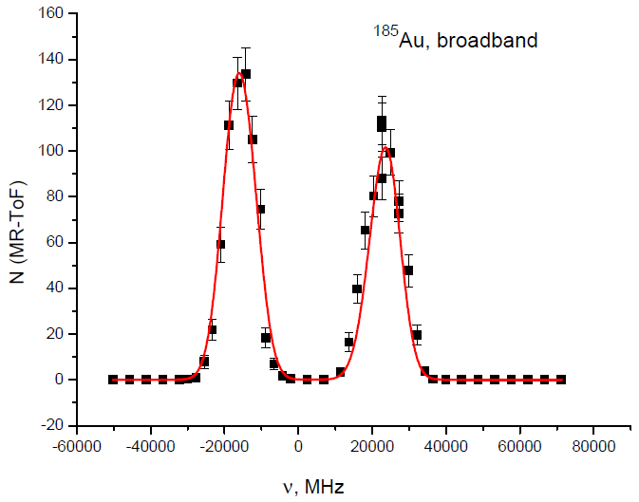
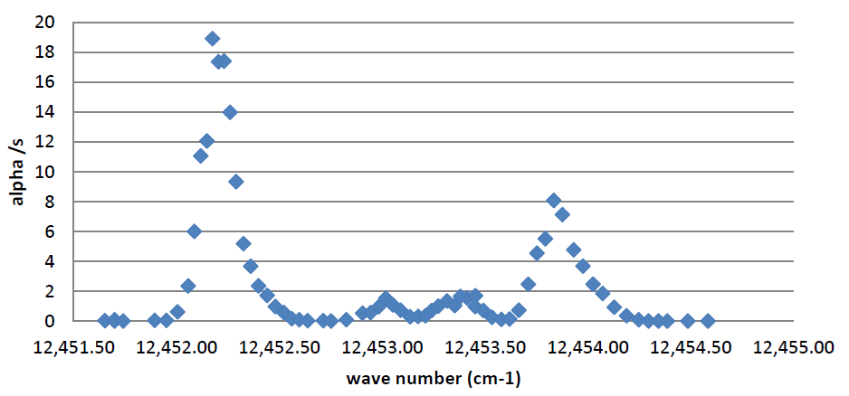
Hyperfine Splitting Scans for ^{178,185,191,197}Au
¹⁹¹Au (MR-TOF)
broadband
¹⁹⁷Au (stable)
narrowband (FC)
¹⁸⁵Au
Broadband (MR-TOF)
New isomeric state
¹⁷⁸Au (WM)
broadband
Ground state

Slide 15
Are the lightest Au isotopes deformed?
?

Slide 16
“Back to sphericity” in Au isotopes
Deformation jump toward less deformed shapes in the light Au isotopes
Shape staggering in ¹⁷⁸Au (large deformation difference between 2 states)
To complete Gold IS/HFS measurements for ¹⁷⁵⁻¹⁸⁴Au: 15 shifts

Slide 17
Beamtime request
Astatine isotopes (13 shifts in total):
10 shifts to complete IS/HFS measurements for
193-196,202,204,206,208,210,212,218,219At (WM/FC/MR-TOF)
3 shifts for βDF of ¹⁹⁴At@WM (isomer separation with RILIS)
Gold isotopes (18 shifts in total)
10 shifts for HFS measurements of ¹⁷⁵⁻¹⁸¹Au with WM
2 shifts for HFS measurements of ^{182,183}Au with MR-TOF
3 shifts for HFS measurements of isomeric states in ^{187,191,193,195}Au using ISOLTRAP's MR-TOF MS
3 shifts for mass measurements of isomeric states
In total: 31 shifts of At and Au beams (most probably divided in 2 runs)

Slide 18
Thank you!

Slide 19
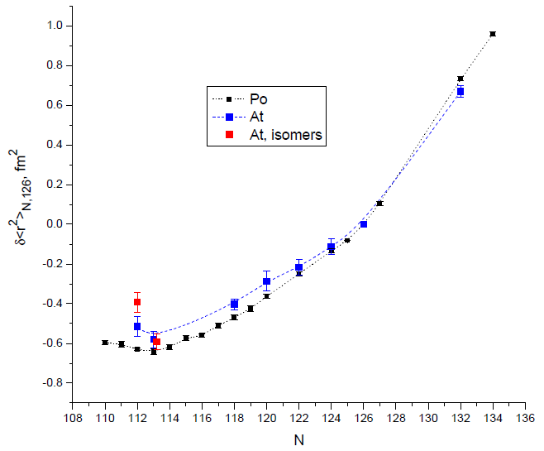
At vs Po charge radii
Sph. LDM
N=126

Slide 20
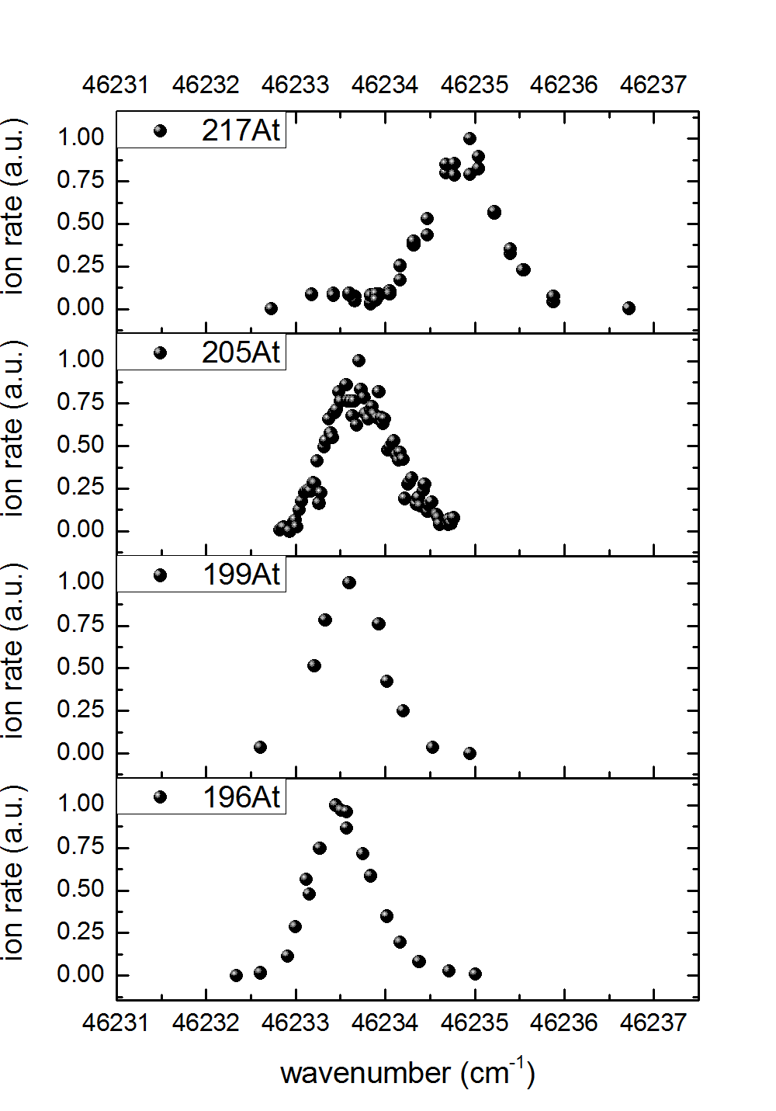
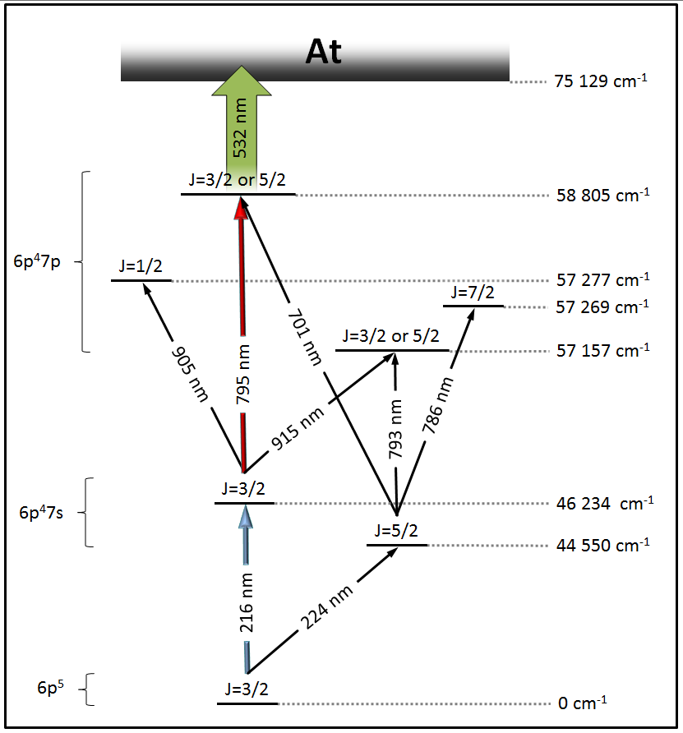
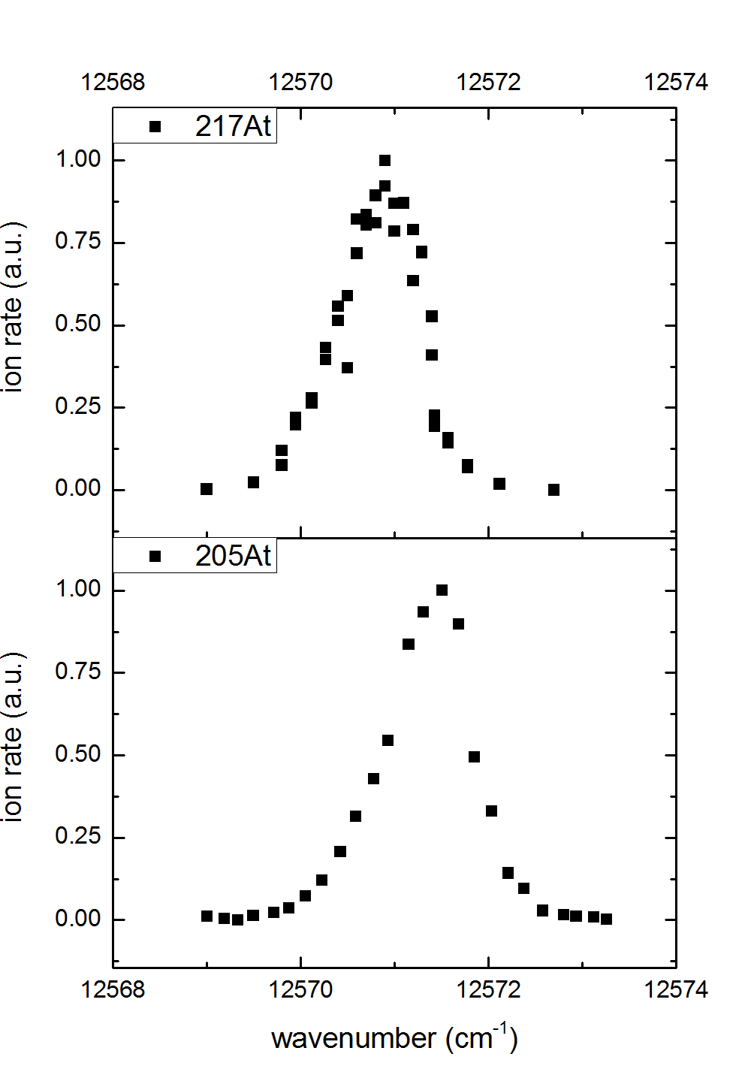
LoI I086: At Laser Spectroscopy in Broadband Mode
Plots: courtesy S. Rothe
216 nm
IS^{217,205}=
~40 GHz
1.3 cm⁻¹
795 nm
IS^{217,205}=
~20 GHz
0.7 cm⁻¹

Slide 21
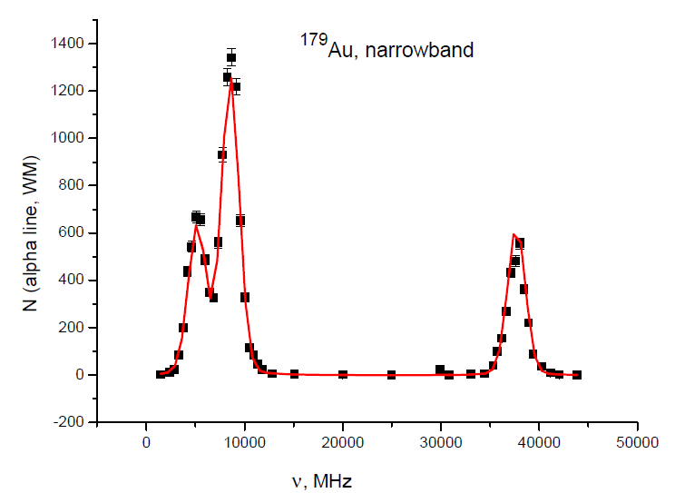
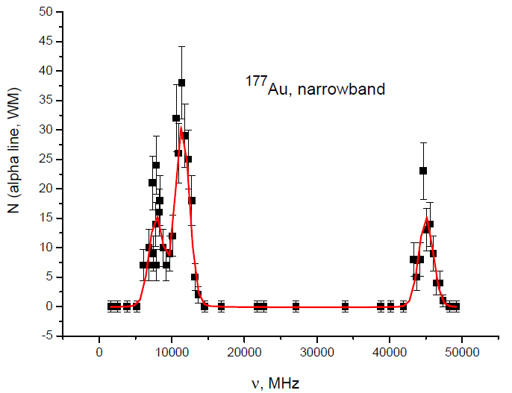
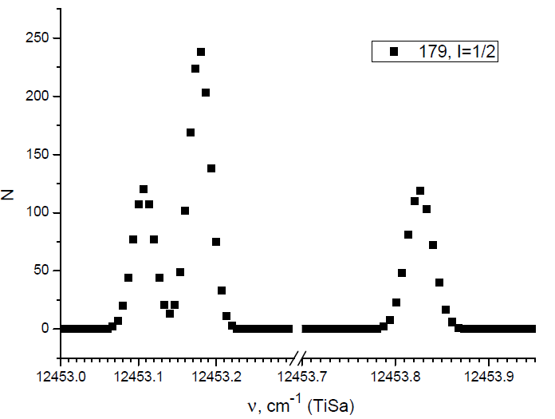
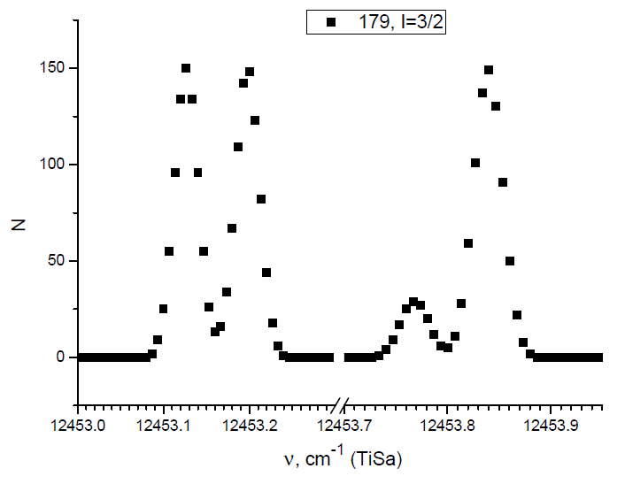
IS534: Hyperfine Splitting Scans (HFS) for ^{177,179}Au
¹⁷⁹Au narrowband
measured (WM)
¹⁷⁷Au narrowband
measured (WM)
¹⁷⁹Au 1/2⁺ calculated
¹⁷⁹Au 3/2⁺ calculated
Ground state spins of ^{177,179}Au are
experimentally determined as 1/2⁺
Calculations courtesy A.Barzakh (Gatchina)

