Slide 1


Accelerating Science and Innovation
Welcome to CERN!
Arjan Verweij
Notes:
1

Slide 2
Intro CERN and LHC
The accelerator
The detectors
Operation
Notes:
2

Slide 3
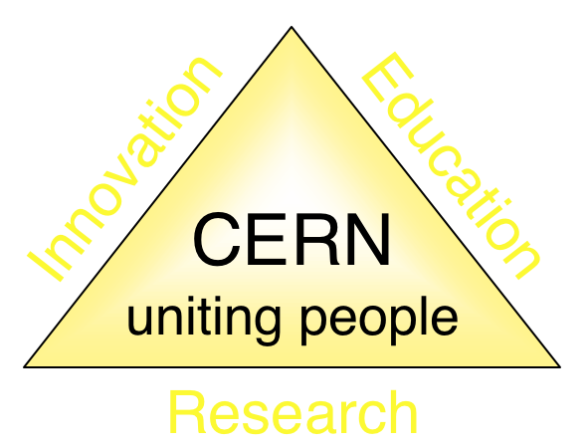
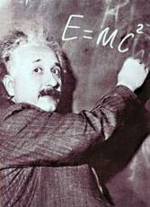
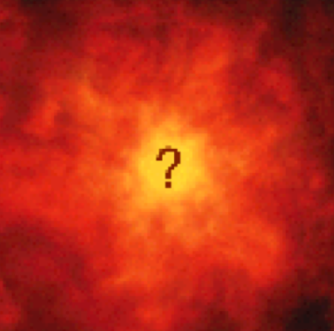


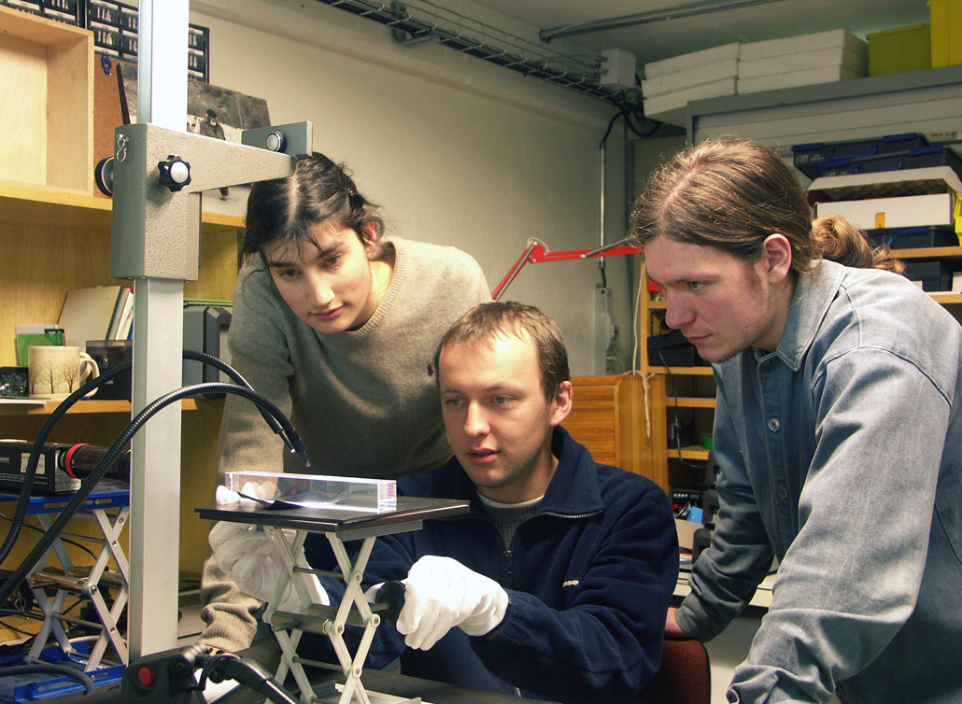
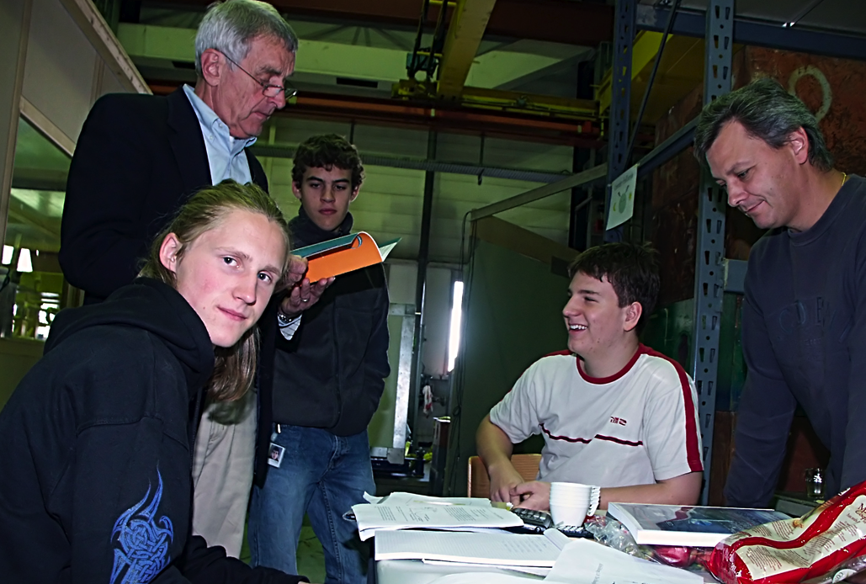
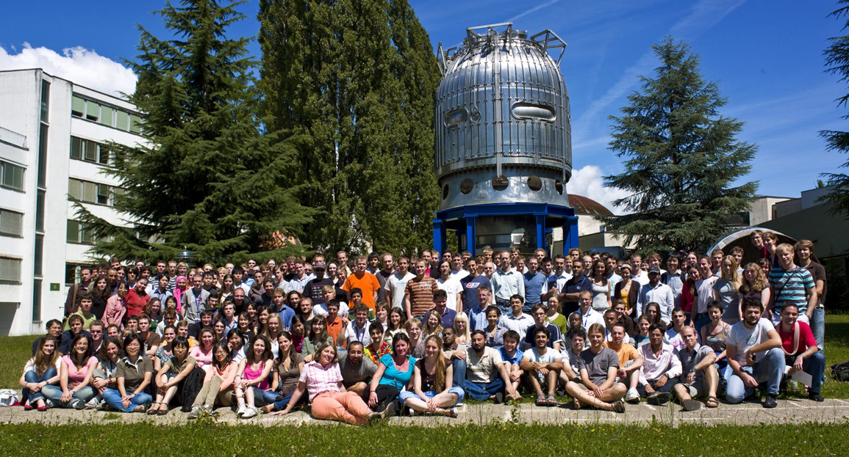
The Mission of CERN
Push forward the frontiers of knowledge
Develop new technologies for accelerators and detectors
Train scientists and engineers of tomorrow (many programs/schools for students, fellows, teachers, …)
Unite people from different countries and cultures
Notes:
3

Slide 4
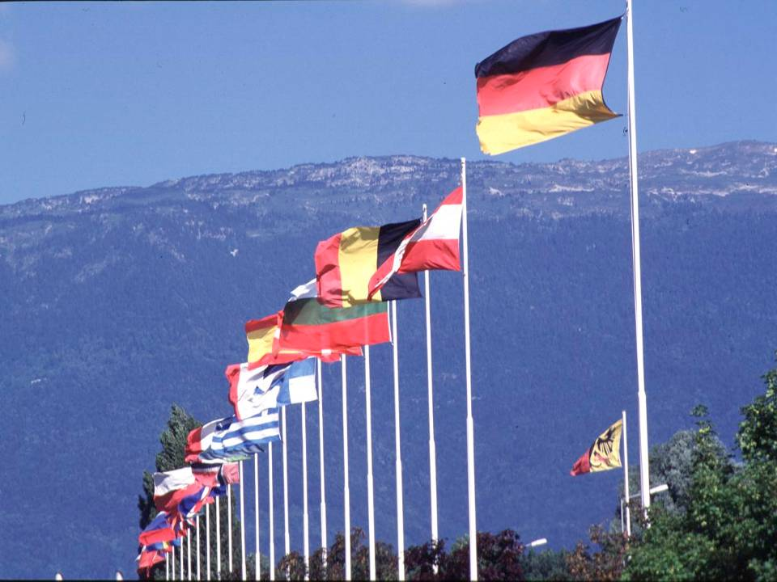

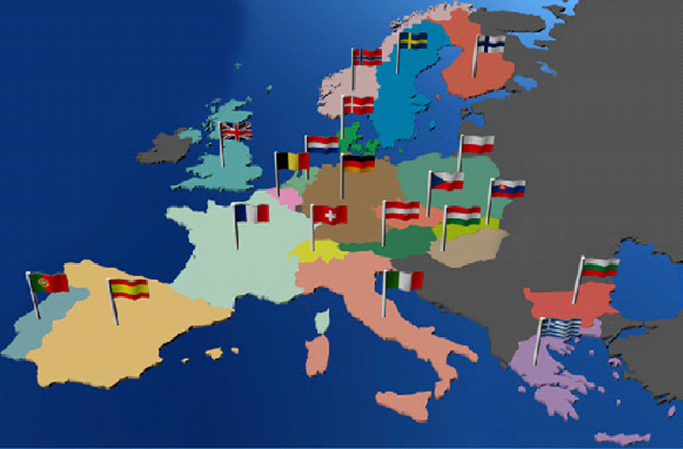
CERN was founded 1954: 12 European States
Today: 20 Member States
~ 2300 staff
~ 1000 other paid personnel
> 11000 users
Budget (2013) ~1000 MCHF
NL contribution ~4.5% (37M€)
Member States: Austria, Belgium, Bulgaria, the Czech Republic, Denmark, Finland, France, Germany, Greece, Hungary, Italy, the Netherlands, Norway, Poland, Portugal, Slovakia, Spain, Sweden, Switzerland and
the United Kingdom
Candidate for Accession: Romania
Associate Members in Pre-Stage to Membership: Israel, Serbia
Applicant States for Membership or Associate Membership:
Brazil, Cyprus (awaiting ratification), Russia, Slovenia, Turkey, Ukraine
Observers to Council: India, Japan, Russia, Turkey, United States of America; European Commission and UNESCO
4
Notes:
4
----- Meeting Notes (09/01/2013 14:16) -----
nnn

Slide 5
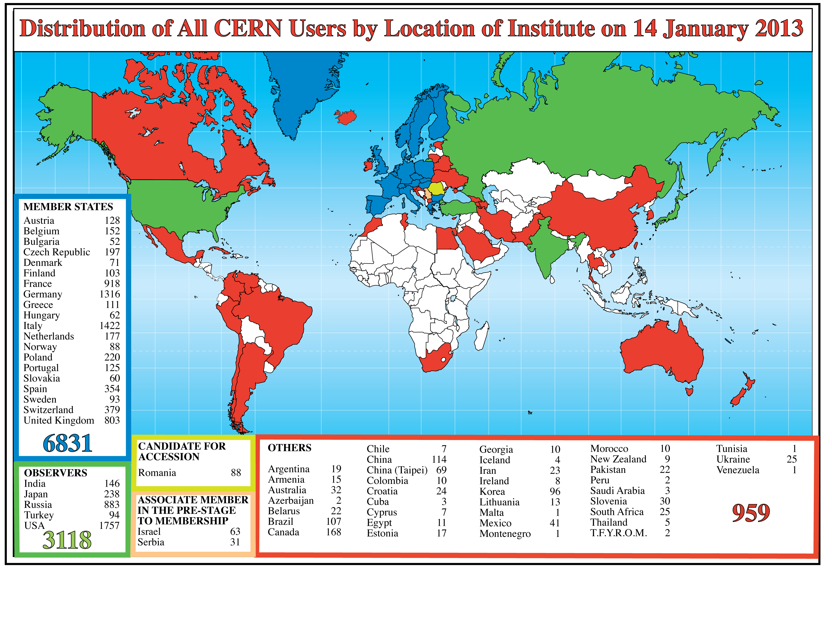
Science is getting more-and-more global
Netherlands:
about 180 users, 70 staff and a few tens of fellows, PhD, and techn. students
Notes:
http://public.web.cern.ch/press/Journalists/CERNHistory.html
http://en.wikipedia.org/wiki/CERN
The original linear accelerator (LINAC 1).
The 600 MeV Synchrocyclotron (SC) which started operation in 1957 and was shut down in 1991.
The Intersecting Storage Rings (ISR), an early collider built from 1966 to 1971 and operated until 1984.
The Large Electron–Positron Collider (LEP), which operated from 1989 to 2000 and was the largest machine of its kind, housed in a 27 km-long circular tunnel which now houses the Large Hadron Collider.
The Low Energy Antiproton Ring (LEAR), commissioned in 1982, which assembled the first pieces of true antimatter, in 1995, consisting of nine atoms of antihydrogen. It was closed in 1996, and superseded by the Antiproton Decelerator.

Slide 6

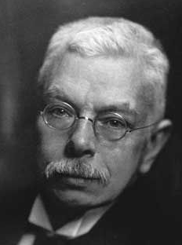
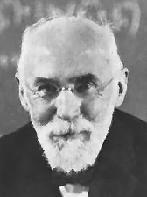
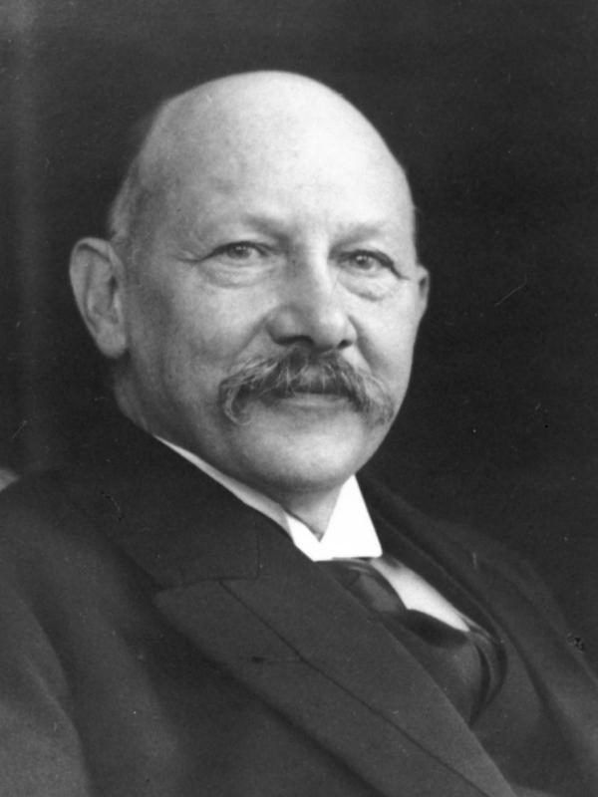
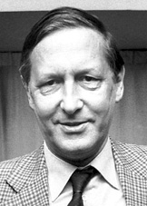
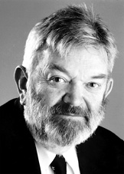
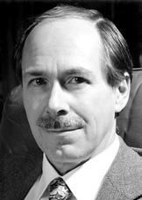
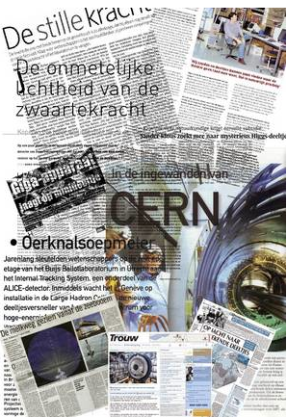
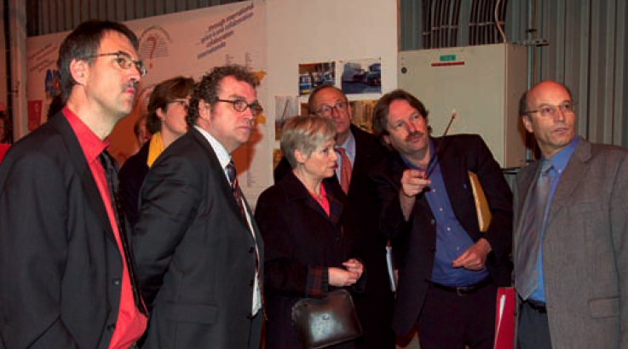
The Netherlands and CERN
The Netherlands is a founding member of CERN
Cornelis Jan Bakker: 2nd Director General of CERN (1955-1960)
Dutch scientists have made very important contributions to the advance of Particle Physics in general and have maintained a strong involvement in CERN
Nobel Prizes in Physics:
related to advance of Particle Physics:
1902: P. Zeeman and H. Lorenz: Zeeman effect
1913: H. Kamerlingh Onnes: Superconductivity
1984: S. van der Meer: Accelerator physics (at CERN)
1999: M. Veltman and G. ’t Hooft: theory of electroweak interactions
2005: CERN Visit of
Maria van der Hoeven (Minister for Education, Culture and Science)
F. Linde
Director NIKHEF
J. Engelen
CSO, CERN
2004 - 2008
H. ten Kate
ATLAS
Media coverage in NL from NIKHEF home page

Slide 7
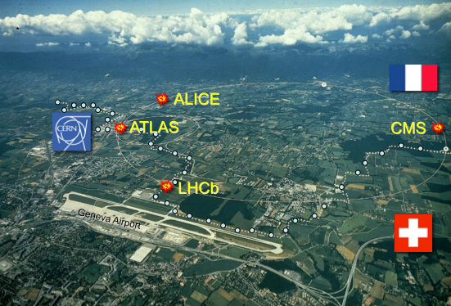
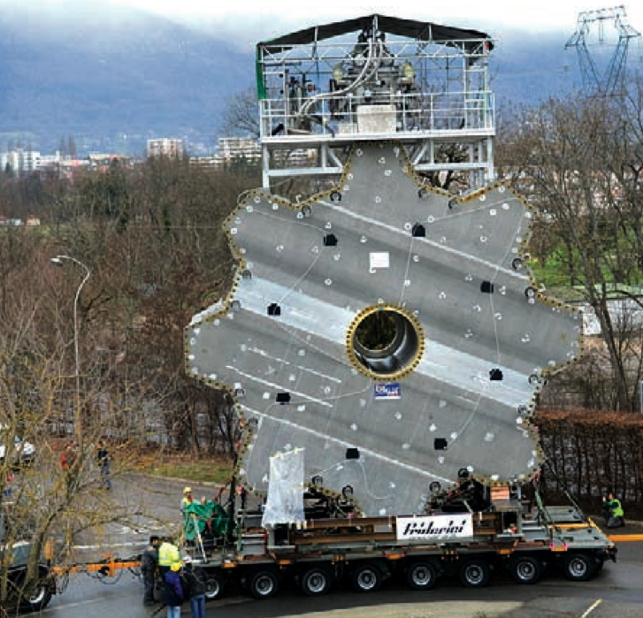
The Netherlands and CERN
Strong involvement in the LHC Experiments
ATLAS, LHCb & ALICE
Particle physics in the Netherlands is coordinated by NIKHEF, a joint venture between FOM and 4 Universities:
Radboud University Nijmegen, Utrecht University, University of Amsterdam
and Vrije Universiteit Amsterdam.
University of Twente contributes at CERN to Superconducting Magnet Technology.
GRID computing: Amsterdam as
centre-of-excellence (via NWO BIG-GRID).
Dutch industry has played an important role.
(example) Vacuum vessels and coils for the end cap toroids were manufactured in the Netherlands by Schelde Exotech and Brush HMA BV.
ATLAS End Cap Toroid

Slide 8

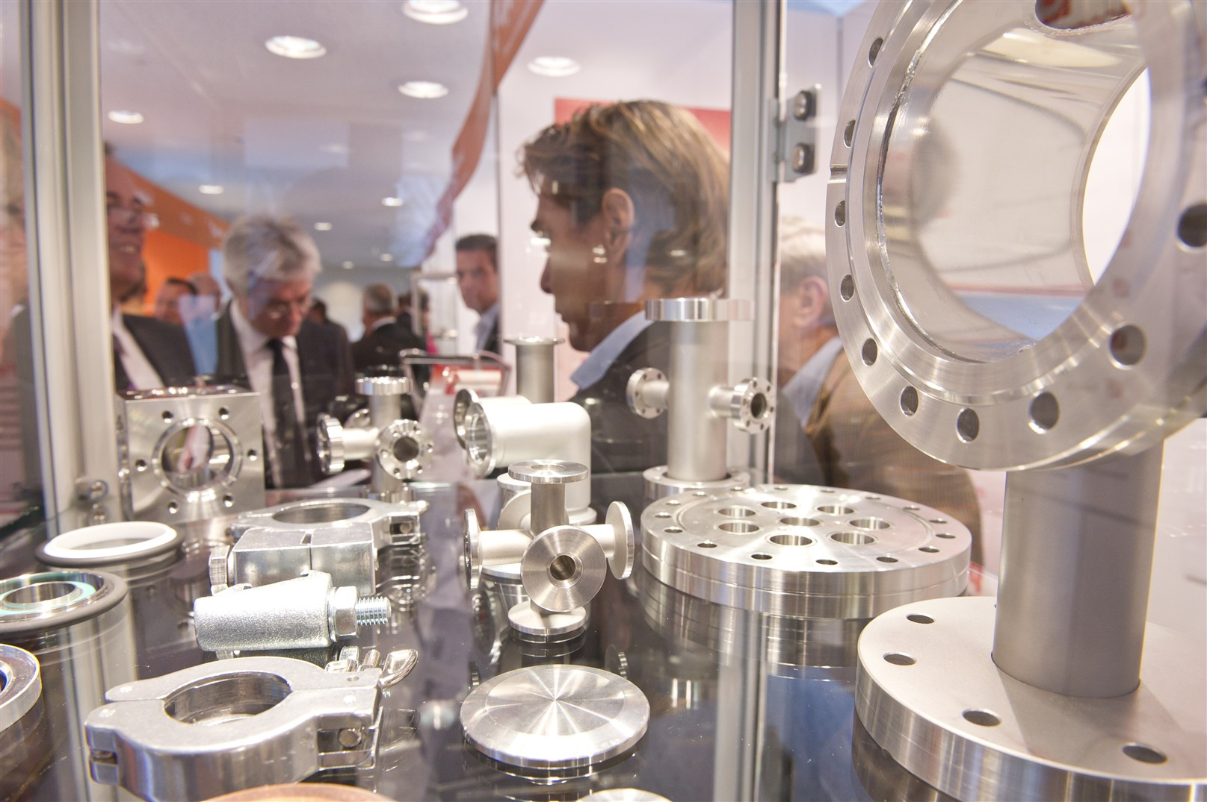
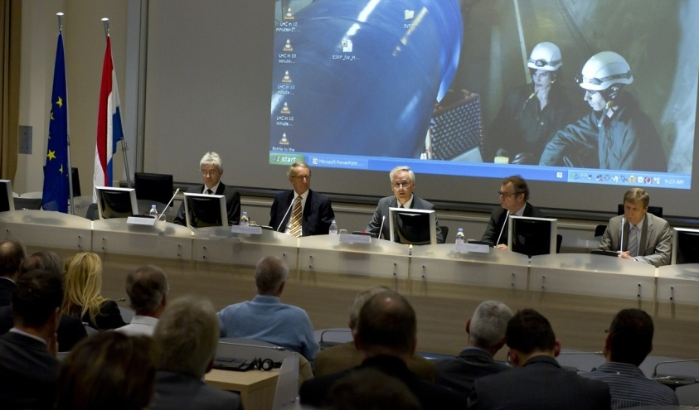
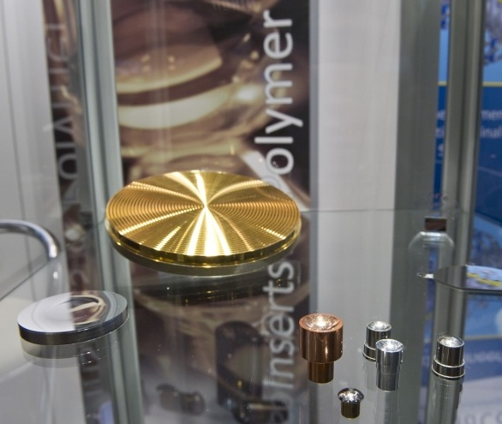
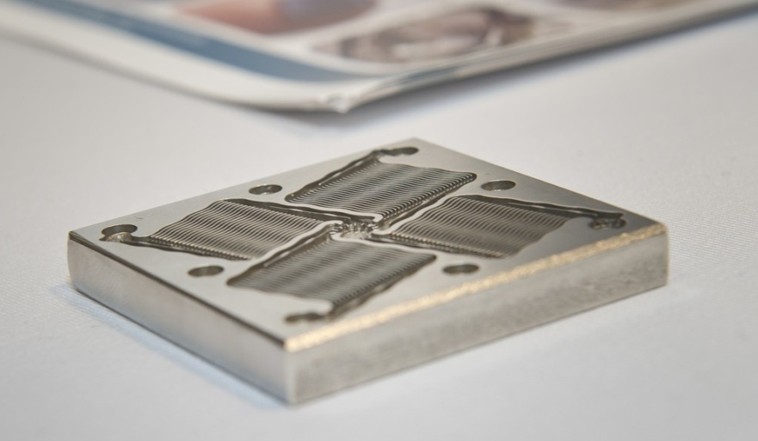
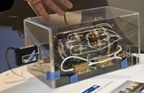
8 - 11 November 2010
Schelde Exotech
Vernooy BV Triumph Group
INCAA Computers
DeMaCo Holland bv
TNO Science & Industry
Janssen Precision Engineering BV
Hositrad VacuumTechnology
Velmon Lastechniek BV
Genius Klinkenberg Int BV
Imtech Industry International B.V.
VDL ETG Projects
Machinefabriek Boessenkool B.V.
Dutch Space B.V.
Heinmande BV
Stirling Cryogenics BV
CryoZone BV
IRMCO bv
ECM Technologies
Sience &Technologies BV
3D Worknet BV
Veenstra-Glazenborg
Bayards Aluminium Constructies BV
Hitec Special Measuring Systems BV
Sumipro BV
Heemskerk Innovative Technology
Heeze Mechanics
Wijdeven

Slide 9
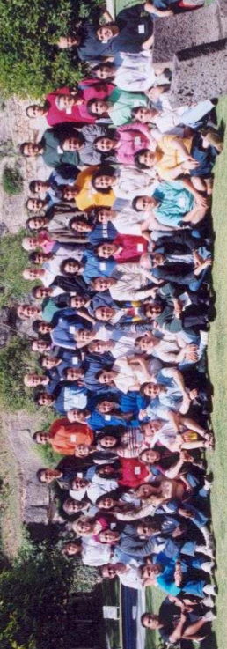

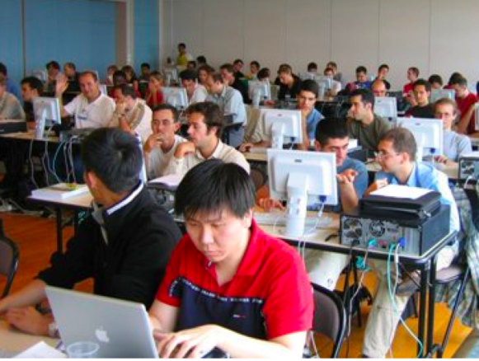
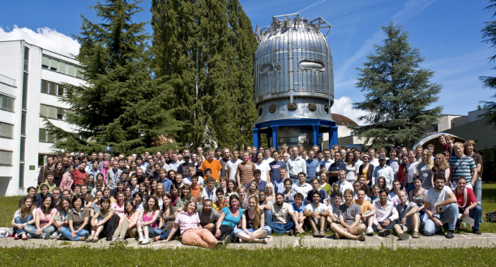
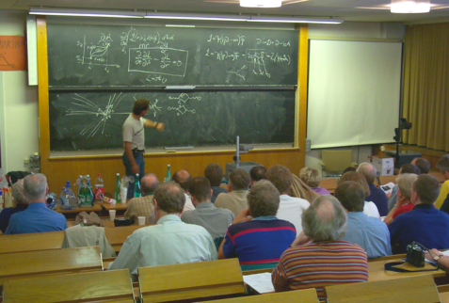
Education activities
2nd Latin American School
of High Energy Physics
Mexico, 2003
Scientists at CERN
Academic Training Programme
Young Researchers
CERN School of High Energy Physics
CERN School of Computing
CERN Accelerator School
School of Computing
Norway, 2008
Physics Students
Summer Students
Programme
CERN Teacher Schools
International and National Programmes
Notes:
9
60 Grössenordnungen

Slide 10
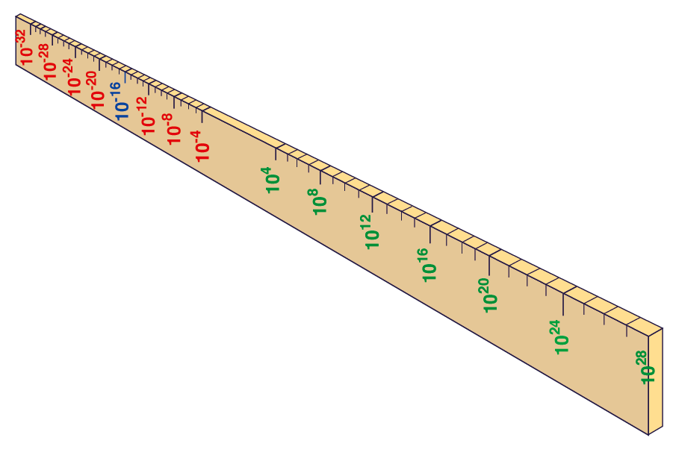
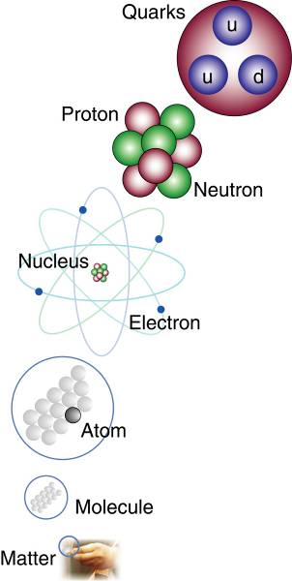
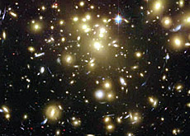
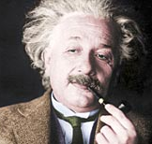

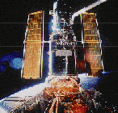
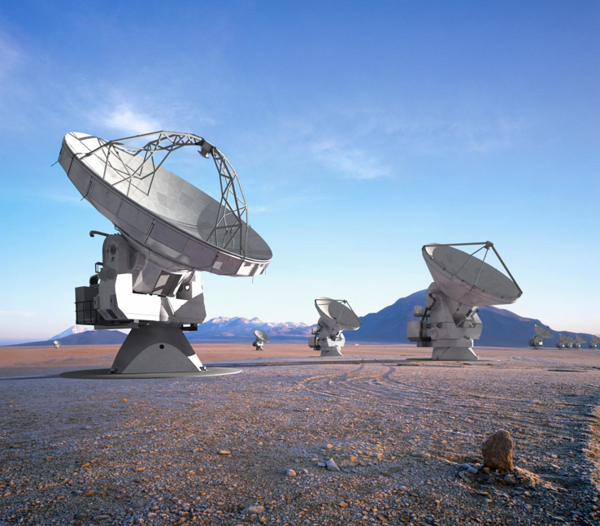
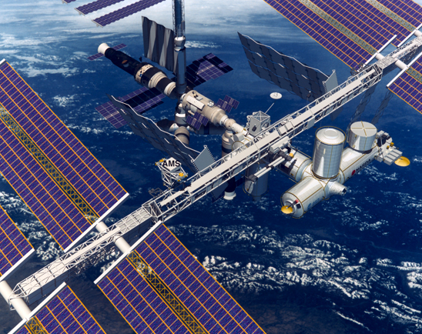
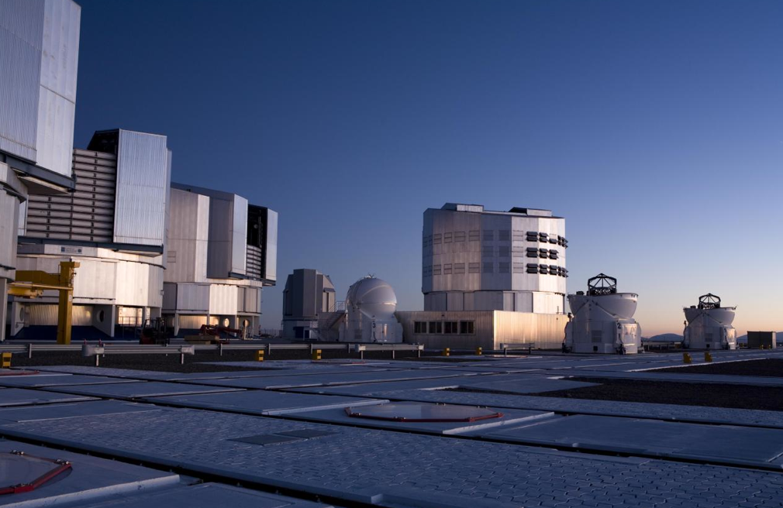
Big Bang
Proton
Atom
Radius of Earth
Earth to Sun
Radius of Galaxies
LHC
Universe
Super-Microscope
Hubble
ALMA
cm
Study elementary constituents of matter and forces controlling them. Study origin and structure of the universe. Increase symbiosis between Particle Physics, Astrophysics and Cosmology
AMS
VLT
Notes:
10
60 Grössenordnungen

Slide 11
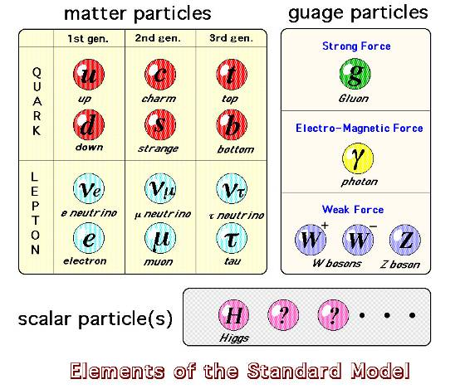
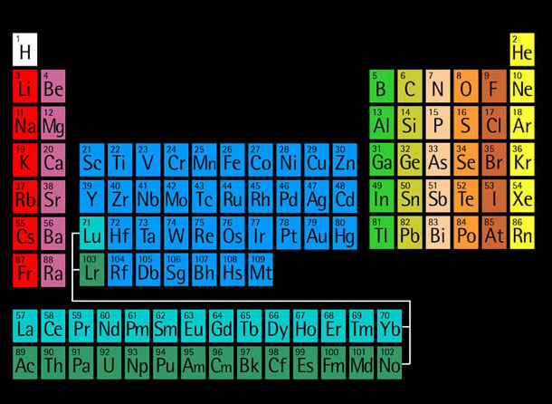
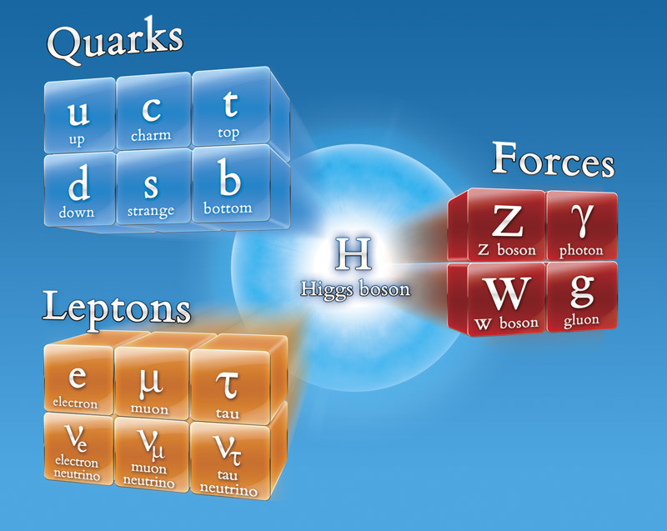
Study of elementary particles
Matter particles
Fermionen:
Bosonen:
Force particles
1964: Quarks
Gell-Mann
x8
1911: Atomic model
Thomson
Rutherford
1900: Atoms where
elementary
11
Notes:
11
60 Grössenordnungen

Slide 12
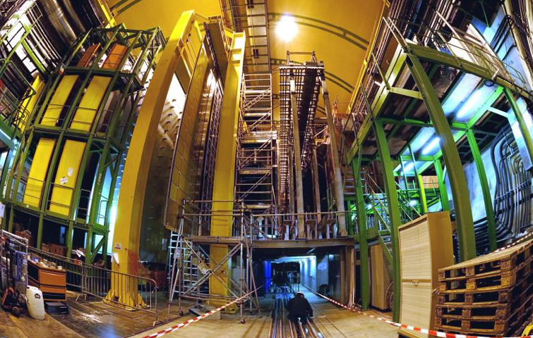


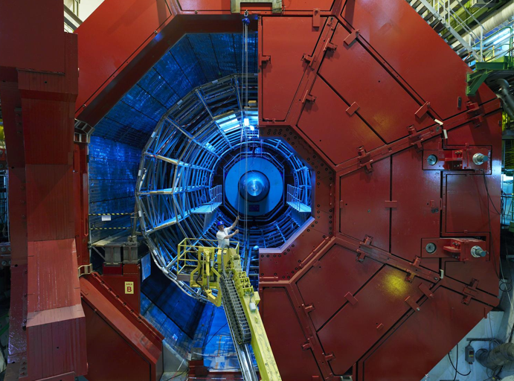

The LHC: Entering a New Era in HE Physics
LHCb
CMS
ATLAS
Exploration of a new energy frontier
in p-p and Pb-Pb collisions
ALICE
LHC ring:
27 km circumference
Notes:
12

Slide 13
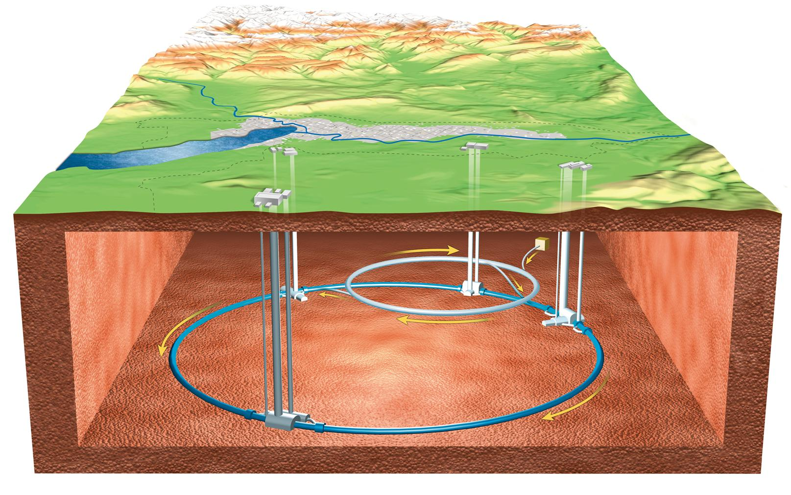
…..and 90-140 meter underground
You are here

Slide 14
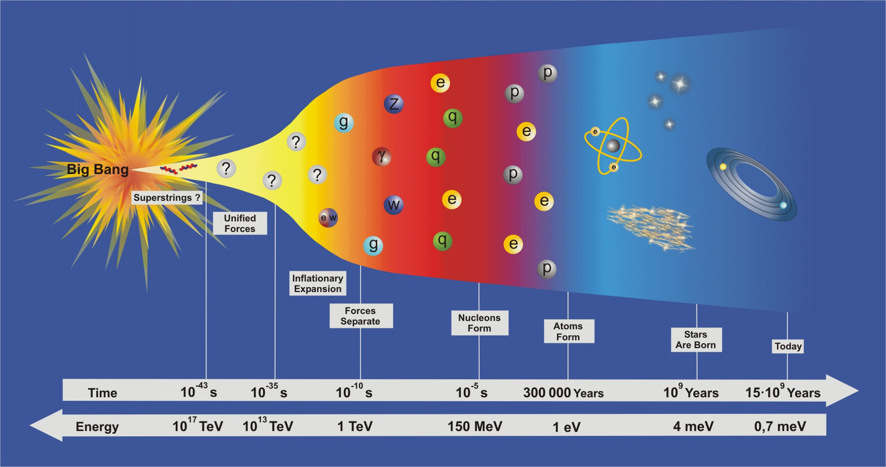
Timeline of the universe

Slide 15
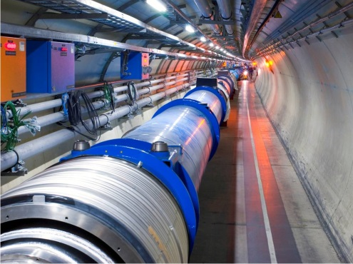
Intro CERN and LHC
The accelerator
The detectors
Operation
Notes:
http://public.web.cern.ch/press/Journalists/CERNHistory.html
http://en.wikipedia.org/wiki/CERN
The original linear accelerator (LINAC 1).
The 600 MeV Synchrocyclotron (SC) which started operation in 1957 and was shut down in 1991.
The Intersecting Storage Rings (ISR), an early collider built from 1966 to 1971 and operated until 1984.
The Large Electron–Positron Collider (LEP), which operated from 1989 to 2000 and was the largest machine of its kind, housed in a 27 km-long circular tunnel which now houses the Large Hadron Collider.
The Low Energy Antiproton Ring (LEAR), commissioned in 1982, which assembled the first pieces of true antimatter, in 1995, consisting of nine atoms of antihydrogen. It was closed in 1996, and superseded by the Antiproton Decelerator.

Slide 16
Some really big numbers
Circumference | 26.7 | km
Total mass lowered in tunnel | 100,000 | ton
Operating temperature | 1.9 | K
He inventory | 800’000 | liters
Power consumption | 120 | MW | =all houses in Geneva canton
Number of bunches | 2808
Protons per bunch | 1.1 x 10¹¹
Bunch spacing | 25 | ns
Stored energy per beam | 350 | MJ | =80 kg dynamite =200 ton train at 200 km/hr
Stored energy in magnets | 11 | GJ
Nr of turns per s | 11245 | turns/s
Particle collisions | 600 million | per sec
Beam life | 0-30 | hrs | 1 hour=2900 times earth-moon
How is all this technically achieved?

Slide 17
Magnetic field for bending
  The force exerted by a magnet field is perpendicular to the magnetic field and the direction of motion of the particle.
Electric field for acceleration
  One eV is the energy a proton gains when traversing a potential difference of one volt.
  For 7 TeV a particle has to traverse 7 000 000 000 000 Volts
  … technically not achievable with a static electric field
B
v
F_{B}
F_{E}

Slide 18
Linear versus Circular Collider
source
main linac
Linear Collider: Single-pass → Few magnets & many cavities
Collision energy scales with length and gradient
Nr of collisions scales with bunch frequency, nr of particles per bunch, beam size
accelerating cavities
N
N
S
S
Circular Collider: Multi-pass → Many magnets & few cavities
Collision energy scales with size of the collider and amplitude of magnetic field
Nr of collisions scales with nr of bunches, nr of particles per bunch, beam size

Slide 19
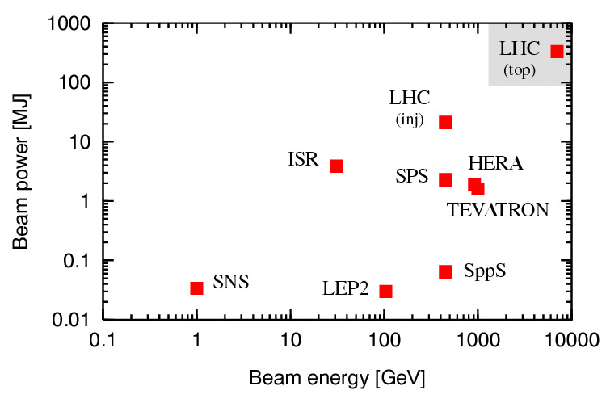
LHC beam energy: E_{TeV} ≅ 0.3 B_{T} R_{km} =7 TeV
LHC beam power=2808x1.15∙10¹¹x7∙10¹²x1.6∙10⁻¹⁹=360 MJ
Notes:
http://public.web.cern.ch/press/Journalists/CERNHistory.html
http://en.wikipedia.org/wiki/CERN
The original linear accelerator (LINAC 1).
The 600 MeV Synchrocyclotron (SC) which started operation in 1957 and was shut down in 1991.
The Intersecting Storage Rings (ISR), an early collider built from 1966 to 1971 and operated until 1984.
The Large Electron–Positron Collider (LEP), which operated from 1989 to 2000 and was the largest machine of its kind, housed in a 27 km-long circular tunnel which now houses the Large Hadron Collider.
The Low Energy Antiproton Ring (LEAR), commissioned in 1982, which assembled the first pieces of true antimatter, in 1995, consisting of nine atoms of antihydrogen. It was closed in 1996, and superseded by the Antiproton Decelerator.

Slide 20
CERN’s accelerator complex, 40 km tunnels
Biggest ring = 27 km circumference
450 GeV to 7 TeV
26 GeV to 450 GeV
50 MeV to 1.4 GeV
50 MeV
(1959)
1.4 GeV to 26 GeV
Notes:
http://public.web.cern.ch/press/Journalists/CERNHistory.html
http://en.wikipedia.org/wiki/CERN
The original linear accelerator (LINAC 1).
The 600 MeV Synchrocyclotron (SC) which started operation in 1957 and was shut down in 1991.
The Intersecting Storage Rings (ISR), an early collider built from 1966 to 1971 and operated until 1984.
The Large Electron–Positron Collider (LEP), which operated from 1989 to 2000 and was the largest machine of its kind, housed in a 27 km-long circular tunnel which now houses the Large Hadron Collider.
The Low Energy Antiproton Ring (LEAR), commissioned in 1982, which assembled the first pieces of true antimatter, in 1995, consisting of nine atoms of antihydrogen. It was closed in 1996, and superseded by the Antiproton Decelerator.

Slide 21
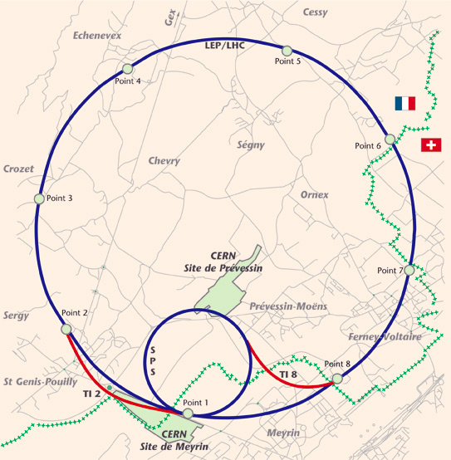
Acceleration
CMS
Dump
Cleaning
Cleaning
Alice
Injection
LHCb
Atlas
Injection
Notes:
http://public.web.cern.ch/press/Journalists/CERNHistory.html
http://en.wikipedia.org/wiki/CERN
The original linear accelerator (LINAC 1).
The 600 MeV Synchrocyclotron (SC) which started operation in 1957 and was shut down in 1991.
The Intersecting Storage Rings (ISR), an early collider built from 1966 to 1971 and operated until 1984.
The Large Electron–Positron Collider (LEP), which operated from 1989 to 2000 and was the largest machine of its kind, housed in a 27 km-long circular tunnel which now houses the Large Hadron Collider.
The Low Energy Antiproton Ring (LEAR), commissioned in 1982, which assembled the first pieces of true antimatter, in 1995, consisting of nine atoms of antihydrogen. It was closed in 1996, and superseded by the Antiproton Decelerator.

Slide 22
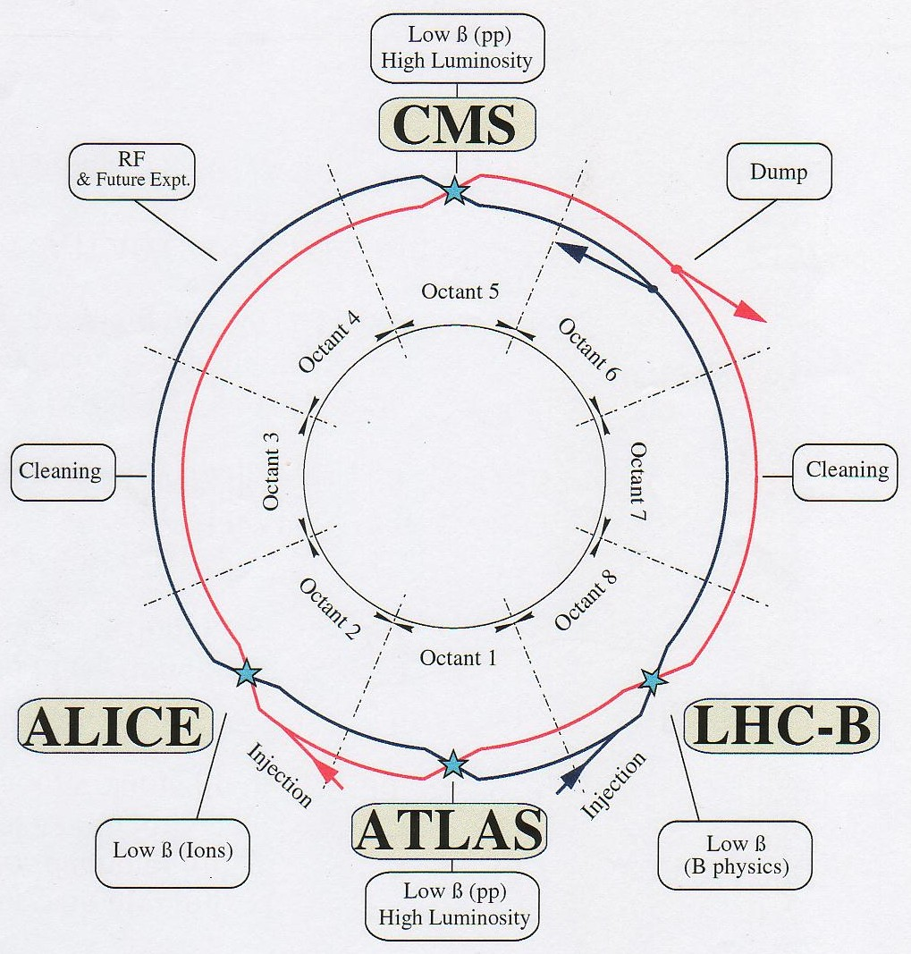
E=0.3*B*R → we need a field B which is as strong as possible → superconducting magnets
Superconducivity: no resistance → large currents in small conductors → high fields.
1232 dipoles magnets for bending
386 quadrupole magnets for focusing
~7000 Correction magnets
Insertion and Final Focusing magnets
… but we need very low temperatures (a few K, -270 °C).

Slide 23
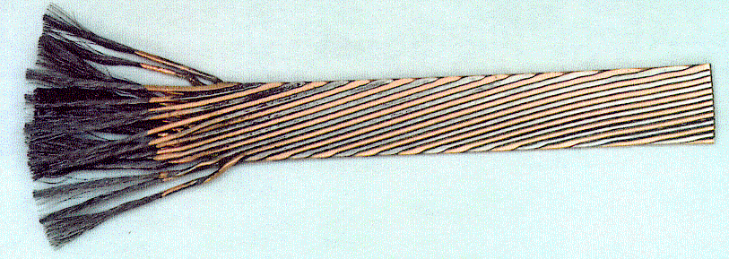
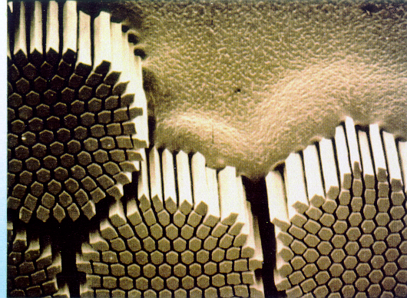
Nb-Ti superconductors
(for LHC we used >250’000 km of SC wire)
6 μm filaments, 15 mm wide cable for 15 m long magnets running at 12 kA….

Slide 24
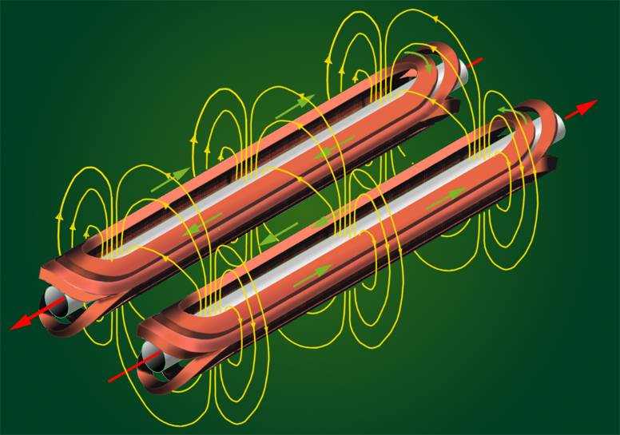
What the beam physicists want
Superconducting Twin aperture dipole magnets to guide two proton beams in opposite directions

Slide 25


What the engineers design

Slide 26

Build, assemble and test at CERN

Slide 27






Installation in the tunnel

Slide 28
Gaining momentum
Magnetic field for bending
  The force exerted by a magnet field is perpendicular to the magnetic field and the direction of motion of the particle.
Electric field for acceleration
  One electron volt (eV) is the energy a proton gains when traversing a potential difference of one volt.
  For 7 Tera eV (TeV) a particle has to traverse 7 000 000 000 000 Volts
  … technically not achievable with a static electric field
B
v
F_{B}
F_{E}

Slide 29


Accelerate in Superconducting Cavities
+
+
+
•
-
-
-
Like a water wave propels a surfer,
an electromagnetic wave accelerates particles

Slide 30


Niobium cladded Radio Frequency cavities
Accelerate in Superconducting Cavities
8 x 2 MV, 5 MV/m

Slide 31
LHCb
ATLAS
CMS
Intro CERN and LHC
The accelerator
The detectors
Operation
ALICE
Notes:
31

Slide 32

Main objectives of the LHC
Find answer to these questions:
Why do particles of the standard model have a mass ?
  Is the Higgs field the generator of particle masses
  To be confirmed by the discovery of the Higgs particle
What happened during the first 10 µs of the big bang?
  The universe consisted of a quark gluon plasma
  Recreate the quark-gluon plasma state with Pb-Pb collisions
Where has all the antimatter gone?
  The universe consist of matter only, something has broken
  the matter antimatter symmetry
Is there any exotic physics out there?
  E.g. Super symmetry, µ black holes,
  dark matter, new dimensions
Atlas,CMS
ALICE
LHCb
All

Slide 33

Detectors: Atlas
Albany, Alberta, NIKHEF Amsterdam, Ankara, LAPP Annecy, Argonne NL, Arizona, UT Arlington, Athens, NTU Athens, Baku, FAE Barcelona, Belgrade, Bergen, Berkeley LBL and UC, HU Berlin, Bern, Birmingham, UAN Bogota, Bologna, Bonn, Boston, Brandeis, Bratislava/SAS Kosice, Brookhaven NL, Buenos Aires, Bucharest, Cambridge, Carleton, Casablanca/Rabat, CERN, Chinese Cluster, Chicago, Chile, Clermont-Ferrand, Columbia, NBI Copenhagen, Cosenza, AGH UST Cracow, IFJ PAN Cracow, DESY, Dortmund, TU Dresden, JINR Dubna, Duke, Frascati, Freiburg, Geneva, Genoa, Giessen, Glasgow, Göttingen, LPSC Grenoble, Technion Haifa, Hampton, Harvard, Heidelberg, Hiroshima, Hiroshima IT, Indiana, Innsbruck, Iowa SU, Irvine UC, Istanbul Bogazici, KEK, Kobe, Kyoto, Kyoto UE, Lancaster, UN La Plata, Lecce, Lisbon LIP, Liverpool, Ljubljana, QMW London, RHBNC London, UC London, Lund, UA Madrid, Mainz, Manchester, Mannheim, CPPM Marseille, Massachusetts, MIT, Melbourne, Michigan, Michigan SU, Milano, Minsk NAS, Minsk NCPHEP, Montreal, McGill Montreal, FIAN Moscow, ITEP Moscow, MEPhI Moscow, MSU Moscow, Munich LMU, MPI Munich, Nagasaki IAS, Nagoya, Naples, New Mexico, New York, Nijmegen, BINP Novosibirsk, Ohio SU, Okayama, Oklahoma, Oklahoma SU, Oregon, LAL Orsay, Osaka, Oslo, Oxford, Paris VI and VII, Pavia, Pennsylvania, Pisa, Pittsburgh, CAS Prague, CU Prague, TU Prague, IHEP Protvino, Regina, Ritsumeikan, UFRJ Rio de Janeiro, Rome I, Rome II, Rome III, Rutherford Appleton Laboratory, DAPNIA Saclay, Santa Cruz UC, Sheffield, Shinshu, Siegen, Simon Fraser Burnaby, SLAC, Southern Methodist Dallas, NPI Petersburg, Stockholm, KTH Stockholm, Stony Brook, Sydney, AS Taipei, Tbilisi, Tel Aviv, Thessaloniki, Tokyo ICEPP, Tokyo MU, Toronto, TRIUMF, Tsukuba, Tufts, Udine/ICTP, Uppsala, Urbana UI, Valencia, UBC Vancouver, Victoria, Washington, Weizmann Rehovot, FH Wiener Neustadt, Wisconsin, Wuppertal, Yale, Yerevan
~ 176 institutions from 38 countries, ~3000 scientist,

Slide 34


ATLAS on surface and underground
  Underground cavern at - 90 m
  2 shafts give access to a 50,000 m³
  cavern for the detector
Cavern length = 55 m
width = 32 m
height = 35 m

Slide 35


ATLAS in Amsterdam
Length
44 m
The largest SC magnet ever built
Diameter
22 m
Weight
~7000 t
Electronic channels
10⁸

Slide 36

ATLAS Experiment: particles detection
Charge identification and momentum measurement require curved trajectories of collision products, thus magnetic field. Superconducting Solenoid for inner trackers, Superconducting Toroids for outer muon tracing.

Slide 37

ATLAS Cavern 2003

Slide 38

ATLAS Cavern 2004

Slide 39

ATLAS Cavern Nov 2005

Slide 40


End-Cap Toroids integration in 2007
2 x 8 coils 4 x 4.5 m²
20 kA, 4.1 T, 250 MJ
140 t cold mass
Partly made in Holland

Slide 41

Installing the beam-pipe (July 2008)

Slide 42

Intro CERN and LHC
The accelerator
The detectors
Operation

Slide 43
Switching everything on….
  Cryogenics
  Magnets
  Powering
  Vacuum
  RF cavities
  Pre-accelerators
  Beam control / diagnostics
  Beam dump
  Detectors
  Transfer lines
  Data taking and analysis
  And much much more …..
…and making it all work as it should

Slide 44

The 7 stages of the LHC for 7 TeV beam energy
Prepare all hardware so that the machine is in a safe, well-known, reproducible state.
Inject two beams from SPS at 0.45 TeV. Each beam consists of 2808 bunches of about 10¹¹ protons running at the speed of light.
Accelerate the beams up to 7 TeV with 16 MV RF power. During the acceleration the bending field has to be increased from 0.5 T to 8.4 T, and the quadrupole field has to be increased to keep the beam focussed. The beam is now about 1 mm diameter.
Squeeze down to 16 µm in front of the four detectors for maximum collision rate. Target: 600 million collisions/s
Collide the circulating beams
Physics/stable beams. The number of protons and hence luminosity goes down.
Dump the beam in case of a problem or if the luminosity becomes too small.

Slide 45

The 6 stages of the LHC
Beam dump
Squeeze
Stable beams
Collide
Ramp down | 35 mins
Injection | ~30 mins
Ramp | 17 mins
Squeeze | 8 mins
Collide | 1 mins
Stable beams | 0 – 30 hours
Ramp
Ramp down/precycle
Injection
Preparation

Slide 46

Circulating beams in 2008 !!
11000 turns/s with a few mm error

Slide 47


Beam dump
350 MJ per beam with beam sigma of about 0.3 mm requires:
extraction (kicker magnets MKD and MSD acting in <3 μs)
dilution (kicker magnets MKB),
absorption (7 m long carbon cylinder with 750 tons of iron and concrete shielding)
Protection (TCDS and TCDQ in case of asynchronous beam dump)

Slide 48



First beam events on 10 Sep 2008 10:19
An exciting day....2 beams for a few hours.

Slide 49

Higgs events
H → ZZ^{(*)} → 4l (4e, 4μ, 2e2μ)
4μ candidate with m_{4μ}= 124.6 GeV

Slide 50


















July 4, 2012
Higgs-like particle found

Slide 51


Balloon
(30 Km)
CD stack with
1 year LHC data!
(~ 20 Km)
Concorde
(15 Km)
LHC experiments will produce 10-15 million GB of data each year (about 20 million CDs!)
LHC data analysis requires a computing power equivalent to ~100,000 of today's fastest PC processors.
Mt. Blanc
(4.8 Km)

Slide 52
Planning
10 Sept 2008: Beam commissioning started
19 Sept 2008: Accident (burn-through of a 13 kA connection causing large damage due to arcing and He overpressure
Oct 08- Nov 09: Repair and implement improved protection
Nov-Dec 2009: Collisions at 2x0.45 TeV and 2x1.2 TeV
2010 Collisions at 2x 3.5 TeV, collision intensity increased by 10⁵
First collisions between Pb Pb.
2011: Take data at 2x3.5 TeV, increase intensity
2012: Take data at 2x4 TeV, Higgs discovered, study Higgs properties
2013-2014: Consolidation and reinforcement 13 kA magnet connections
Machine and beam commissioning
2015-2030?: Collisions at 2x7 TeV
+ Various intensity upgrades.

Slide 53


Veel plezier vandaag!

