Slide 1
European LHC NSI Pilot

Slide 2
Proposed european LHC NSI P2P project collaboration
Géant, SURFnet, NORDUnet and DFN are the European NRENs of the pilot LHC NSI
  Phase 1:
      the institutions KIT, NGDF and SARA are the initial “end sites”
  Phase 2:
      T2 sites will get included
remark : work has to go into --> what triggers NSI to initiate a P2P circuit / what are the drivers/initiators (application driven / network parameter e.g. communication volume threshold between sites)

Slide 3
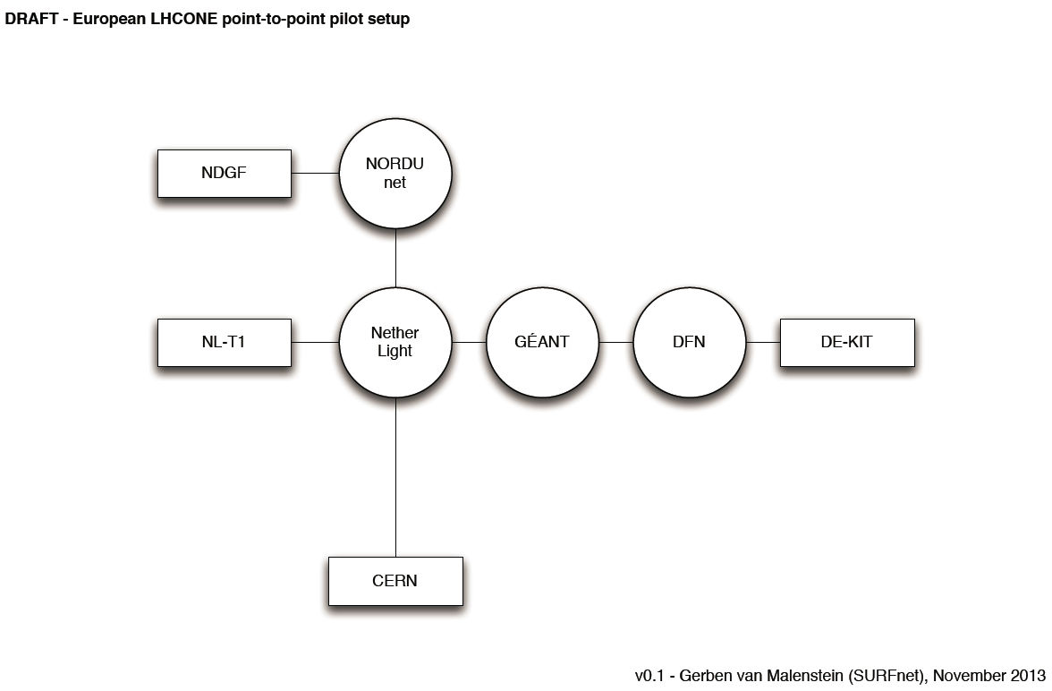
First sketch LHC NSI P2P european collaboration

