Slide 1
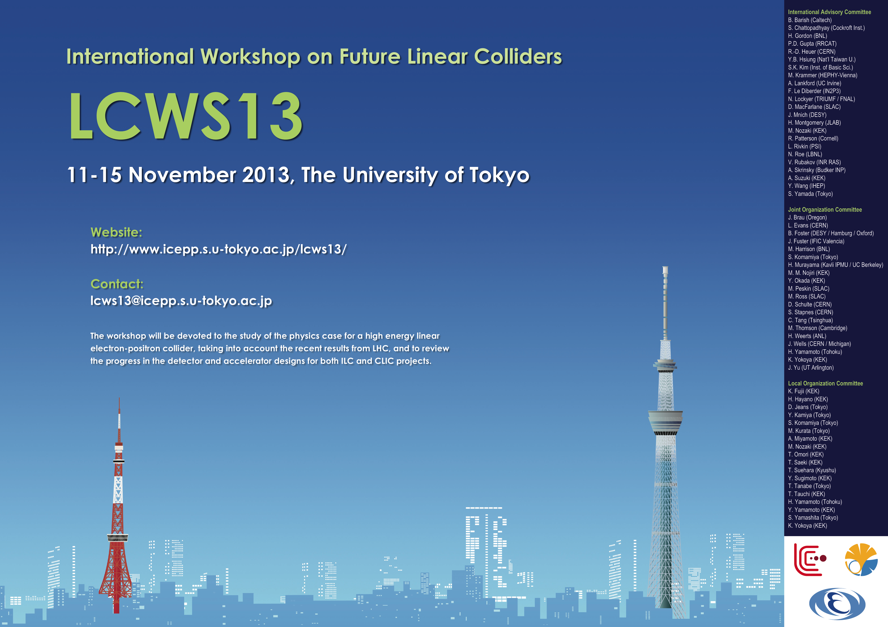


LCWS 2013 Outlook

Slide 2
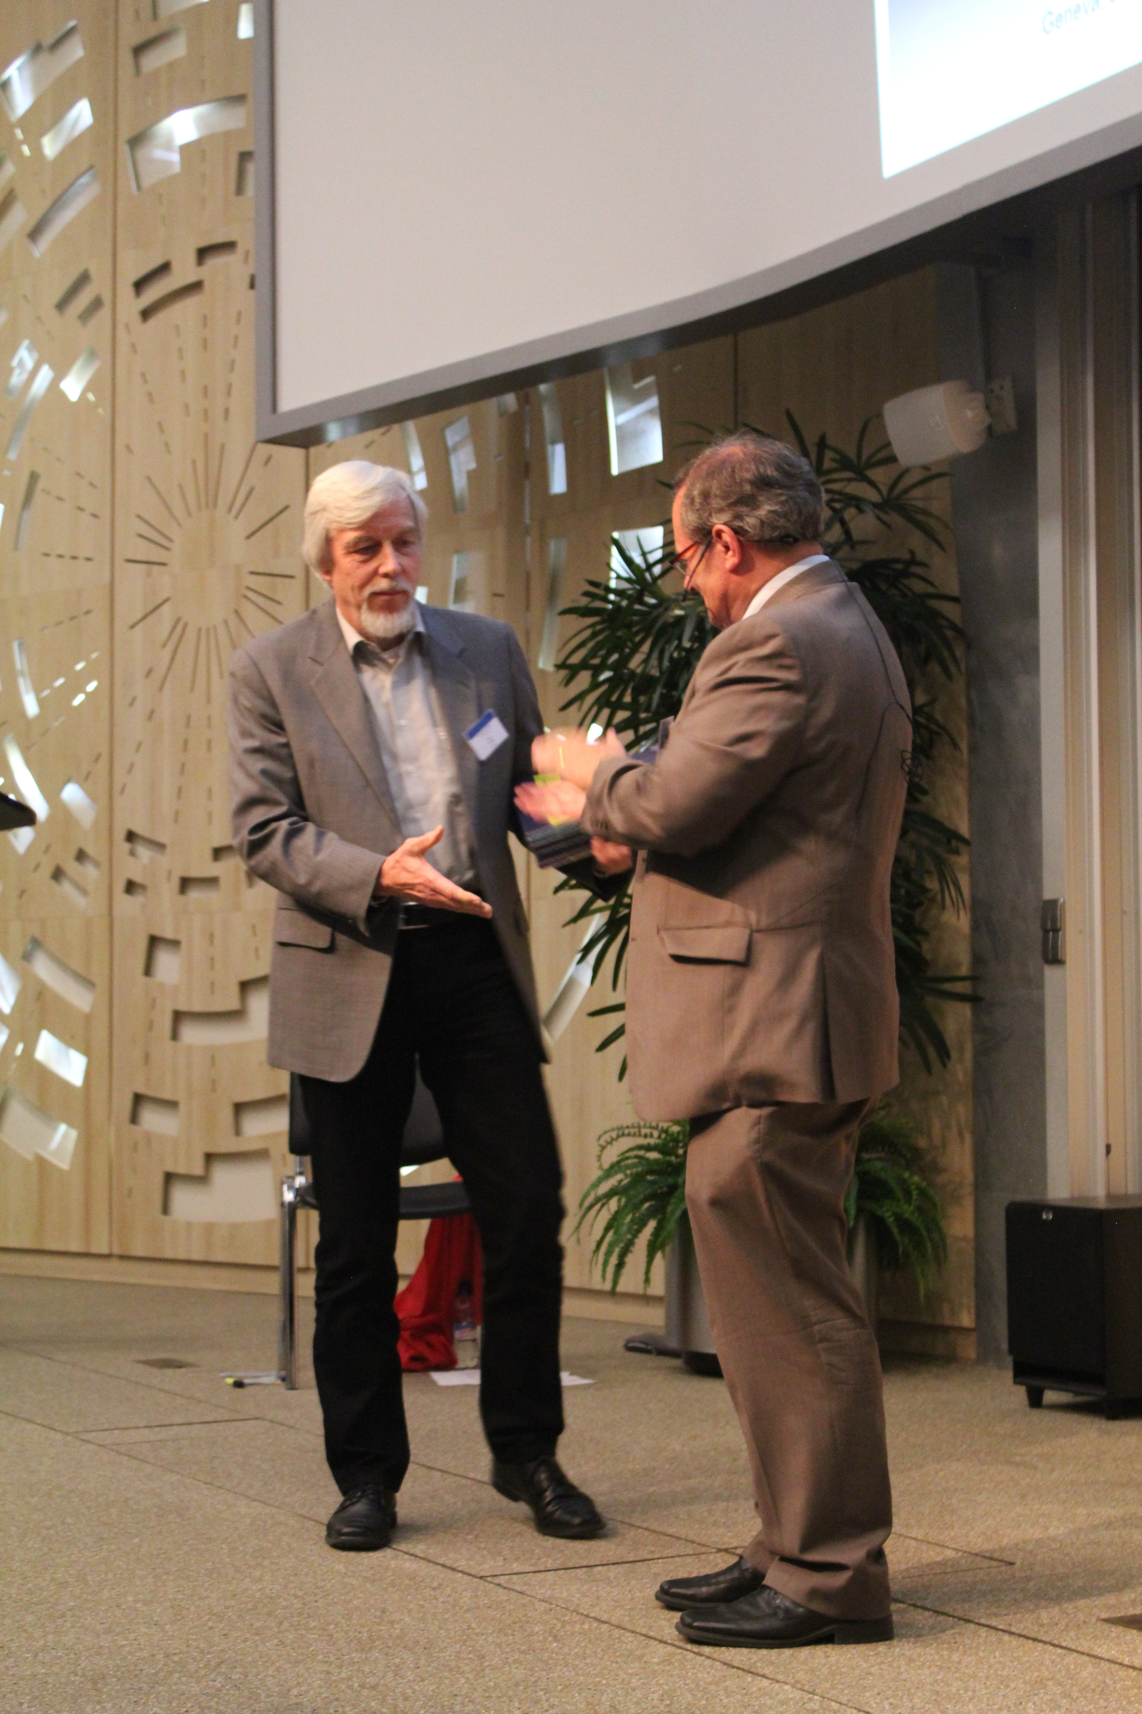
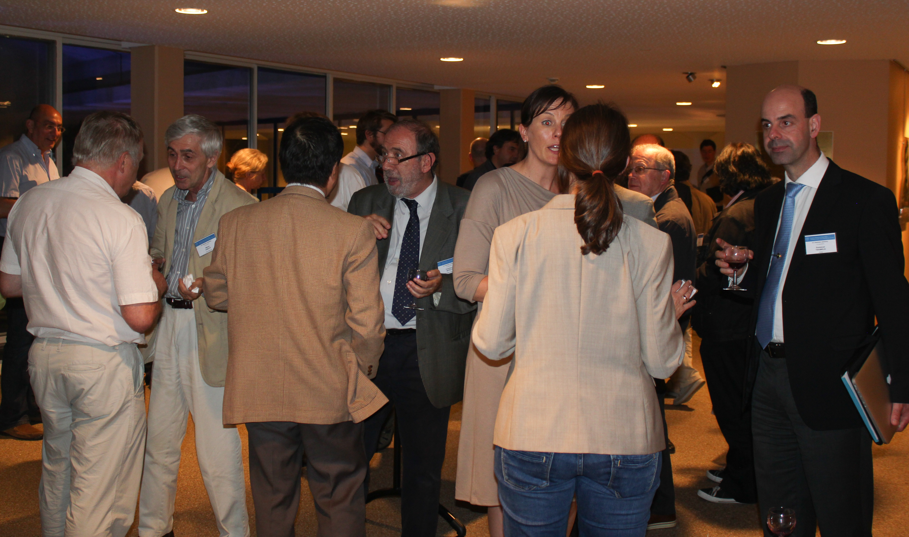
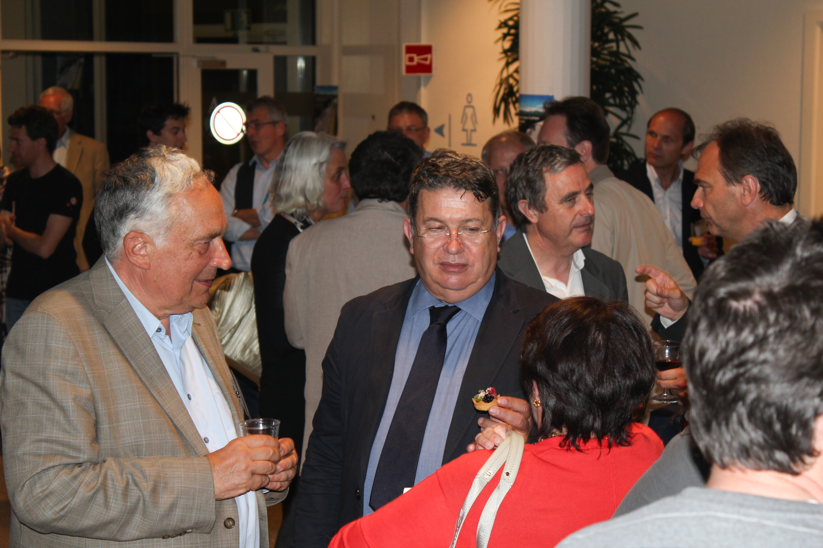
The Lead-up: World-wide Event
On June 12th, ILC TDR was published in Worldwide Event.

Slide 3
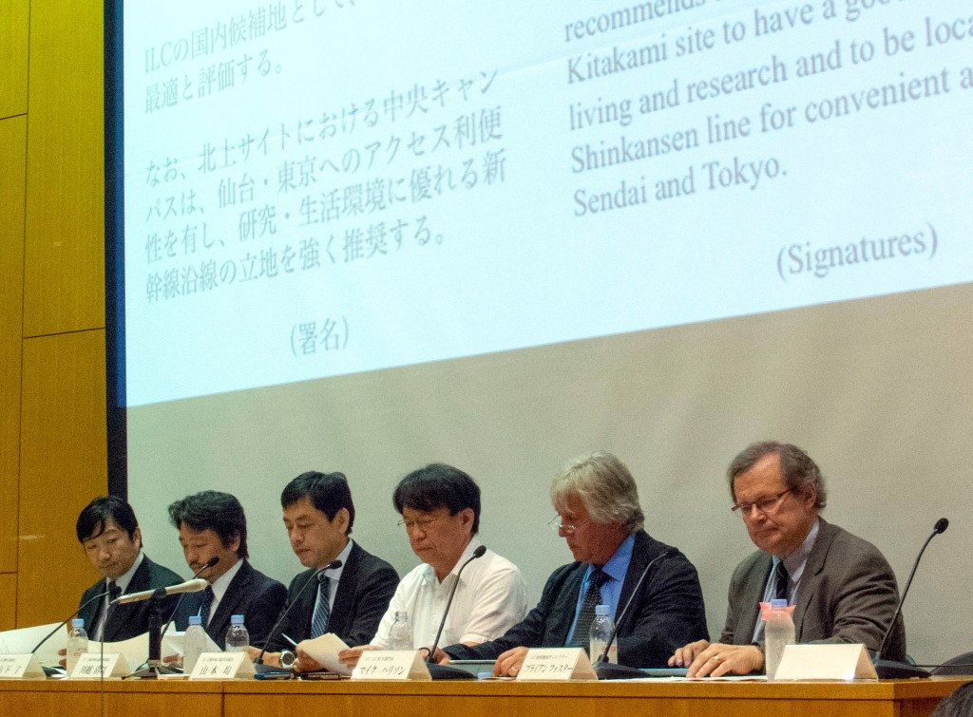
The Lead-up: Site Selection
On August 23rd, Panel recommended northern site for ILC.
End of major phase in ILC development – now what?

Slide 4
Highlights
Talk of Chair of Diet ILC Federation, Mr Kawamura
While not a member of the government, he is a very senior figure in LDP and is known to have the ear of the Prime Minister Mr Abe:
“We are aware that people are usually worried that an increase of academic budget in one field may mean a decrease in other fields. … We shall arrange a dedicated budget to accommodate its much wider implications. It is the responsibility of the government to carry this out.”
2) “The Department of Education has requested the Department of Finance to provide an ILC investigation fund of 50 million yen in next year's budget. … once it has been approved, we members of the house will have achieved one of the most important milestones of recent years.”

Slide 5
Highlights
Talk of Chair of Diet ILC Federation, Mr Kawamura
3)“The Technical Design Report of ILC was issued in December 2012…I would again like to express my appreciation of this effort. I understand that it is now the turn of politicians to respond
to this effort, and to construct a worldwide partnership to realize this project.
4) “I think that most Diet members' knowledge of physics is at high school students’ level. If you allow me, let me take the liberty of pointing out that the understanding of political dynamics by most particle physicists is also at high school students’ level. If physicists and politicians collaborate by using each other's area of expertise, it is certain that we can accelerate the realization of the ILC project.”

Slide 6
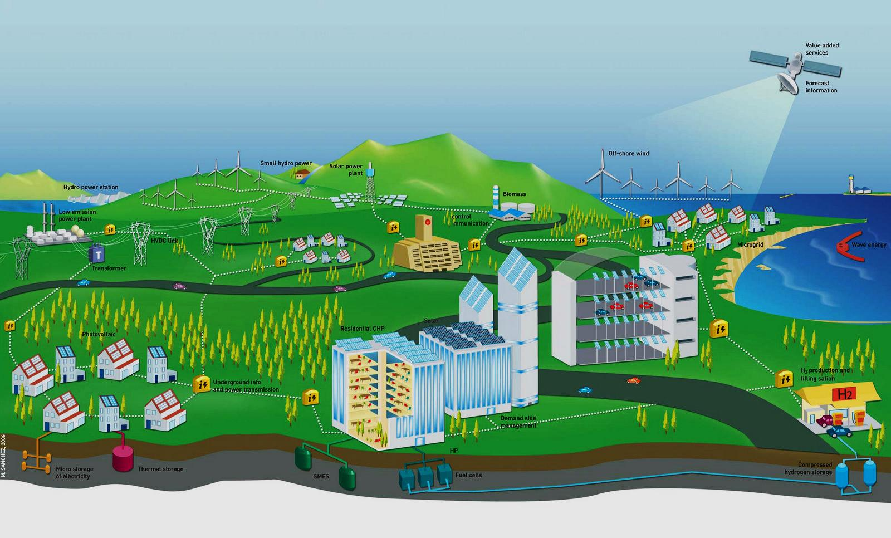
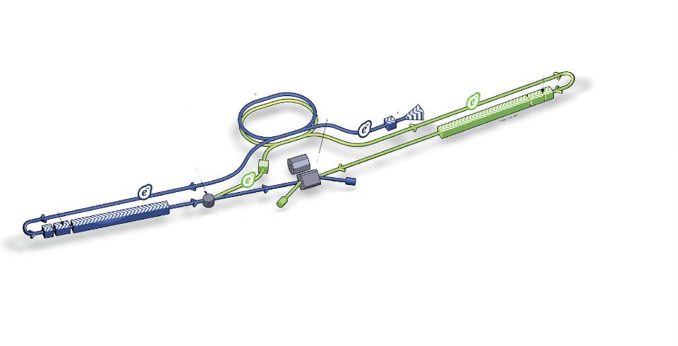

A. Suzuki closing talk
Emphasised necessity for ILC to be a “green” machine.

Slide 7
A. Suzuki closing talk
Interaction with P5 in USA:
The world HEP scientists are strongly disappointed with media remarks about the JSC findings on the ILC project. This damage looks too serious.
Scientists are deeply concerned that the Japanese government would hesitate to advance the realization of the ILC project.
Given these, it is urgent that the government unfolds its view on the JSC findings.
The government should now pay much attention on how to define interests to host the ILC in Japan. It is the next step to start governmental discussions about the budget and man-power sharing.

Slide 8
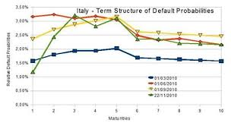
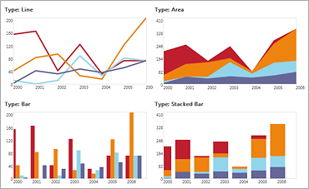
A. Suzuki closing talk
Interaction with P5 in USA:
The world HEP community understands that the next FALC is the best opportunity for the government message.
The Rolf Heuer (CERN), Nigel Lockyer (FNAL) and A.S (KEK) had the consensus that the timeprofiles of budget-breakdown (CFS, accelerator, detector ・・・) and man-power-breakdown are essential for the governmental negotiation.
budget
manpower
year
year

Slide 9
ILC timeline
2013 - 2016
  Negotiations among governments
  Accelerator detailed design, R&Ds for cost-effective production, site study, CFS designs etc.
  Prepare for the international lab.
2016 – 2018
  ‘Green-sign’ for the ILC construction to be given (in early 2016 )
  International agreement reached to go ahead with the ILC
  Formation of the ILC lab.
  Preparation for biddings etc.
2018
  Construction start (9 yrs)
2027
  Construction (500 GeV) complete, (and commissioning start)
  (250 GeV is slightly shorter)

Slide 10
Conclusion
Clear evidence that significant movement going on in Japanese government.
Mr Kawamura’s talk made some very important remarks on government policy to ILC.
Meetings of LCC executive recently with MEXT very useful – although they also indicated the difference in attitude between MEXT and LCC.
Odoi-san, MEXT official in charge of ILC will attend CERN Council in December and travel on to Berlin (BF lunch) and then DESY.
Also contacts have continued with EC in Brussels. BF has meeting with Commission contact person for ILC next week.
Japanese government is very nervous about proposing an ILC without being sure it will be well received.
We know that nothing will happen until they DO propose it. Squaring this circle is the LCC’s task of the next weeks/months.

