Slide 1
SiW ECAL cooling
(+HCAL cooling news)
JCL SACLAY November 28th 2013
Julien GIRAUD - giraud@lpsc.in2p3.fr +33(0)4.76.28.41.13
Denis GRONDIN - grondin@lpsc.in2p3.fr +33(0)4.76.28.41.56
Jean-Christophe IANIGRO - ianigro@ipnl.in2p3.fr +33(0)4.72.43.26.82

Slide 2
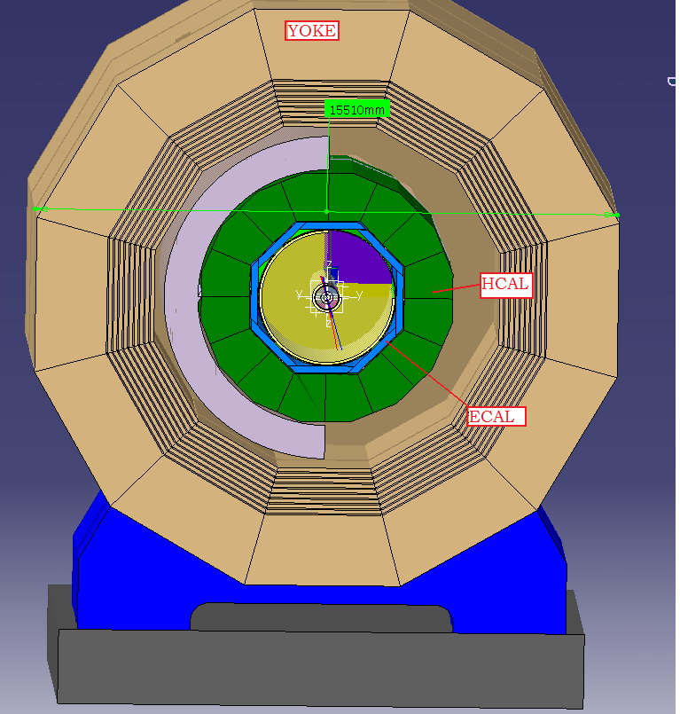
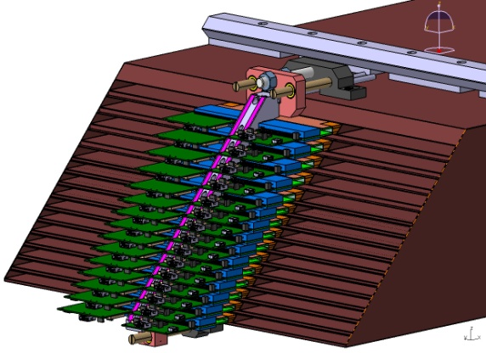
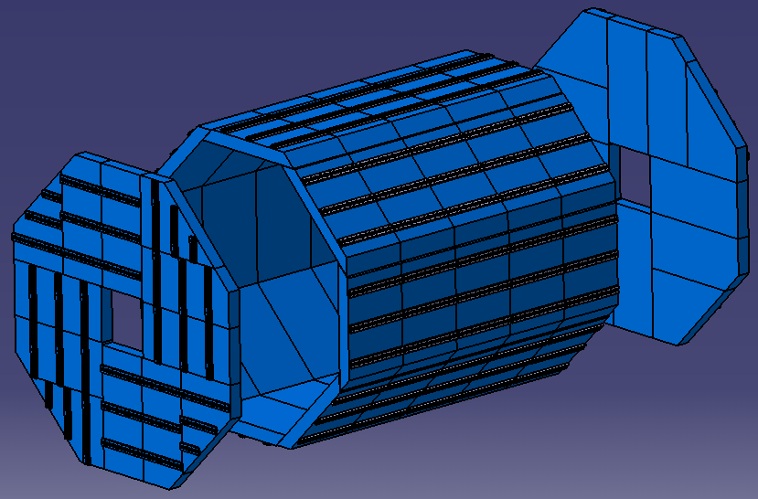
ECAL Cooling: the problem
ECAL detector is surrounded by detectors
(detectors must be “thermal independents”)
(adjacent detector : thermalized at 20°c)
Large exchange surface / low surface power (4500 W)
Exchanger: location determined Cooling front–end
25 mm free opening in DIF for extraction of cooling system
=>Needs:
  - Thermalization @ ambiant temperature
  - Low T° gradient accepted (20 °c)
  - Variation of +/- 2.5°c
Conclusion
=>Choice: leakless water system
Example of requirements for a CO² line
Coaxial line
  Sub-cooled liquid CO₂ at -40 ˚C in a 1.5mm OD pipe: no use here
  2-phase flow CO₂ (return line) at -40 ˚C in a 4 mm OD pipe
The line needs to be flexible to be adapted to many turns and bends in situ
Condensation on the surface has to be avoided
Radiation hard materials
Design constraints
Difficult to use foam insulation (Armaflex) due to space constraints:
To be compared with a CO² diphasic system
  More difficult to implement
  More risky (leaks)
  And more expensive

Slide 3
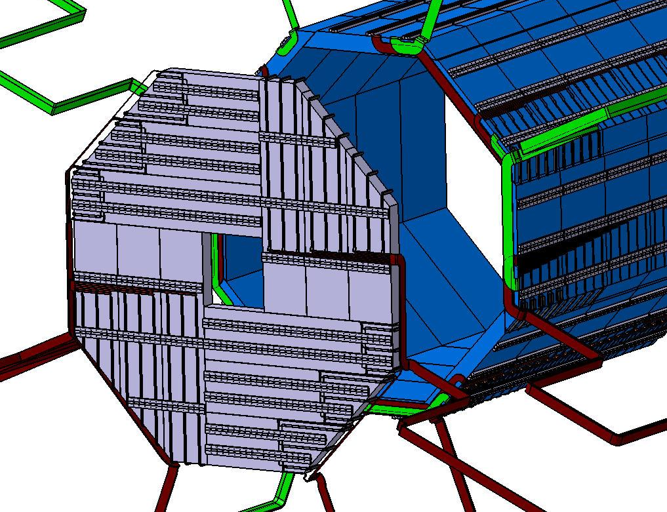
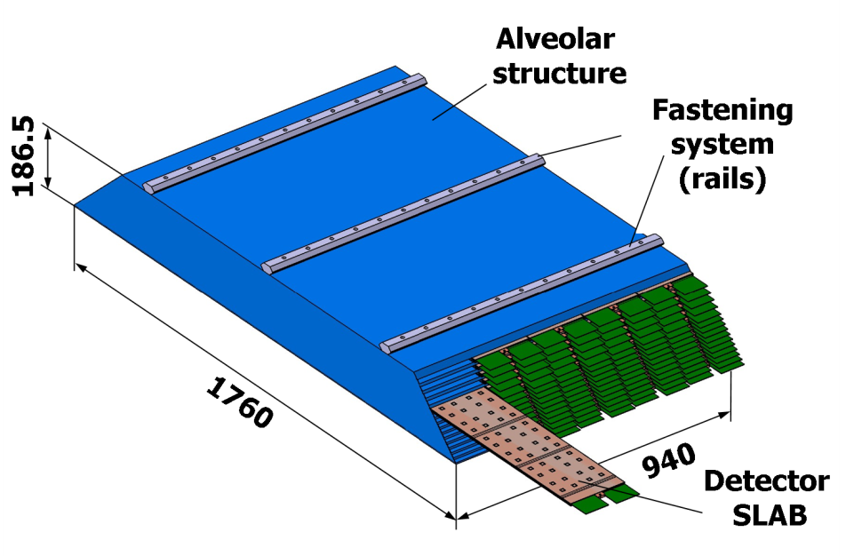
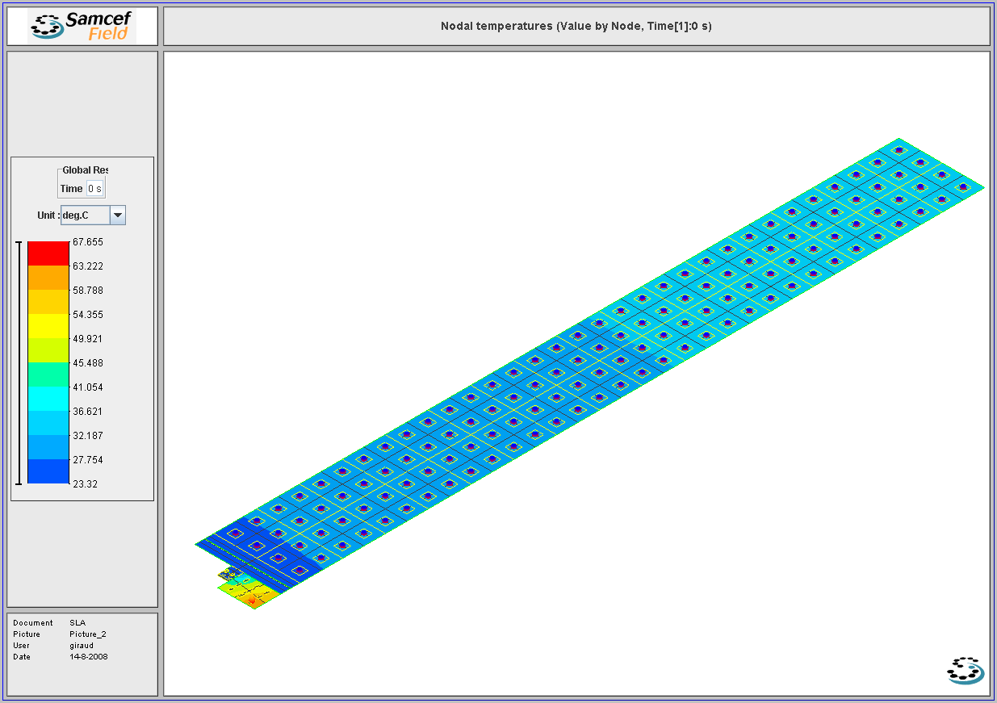
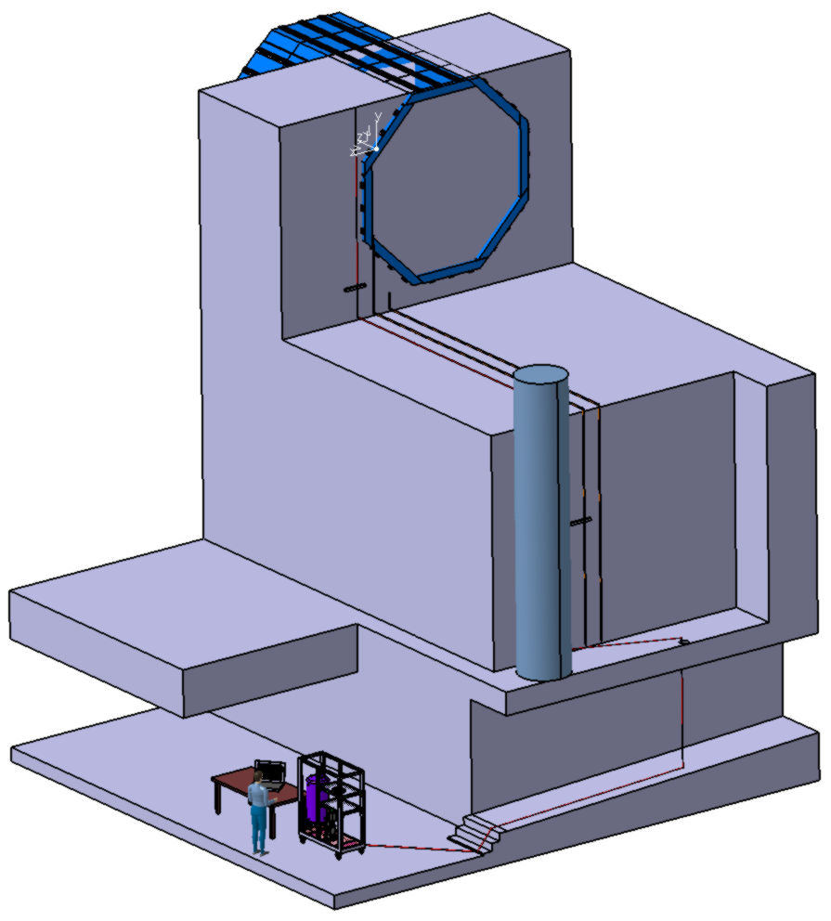
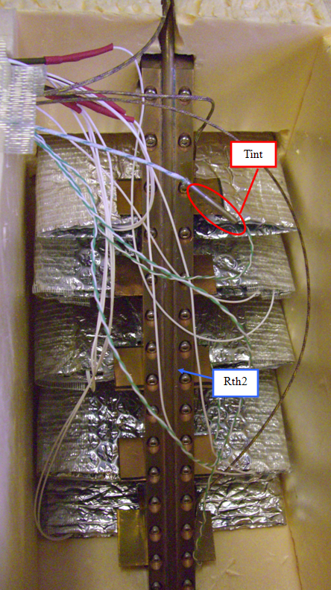
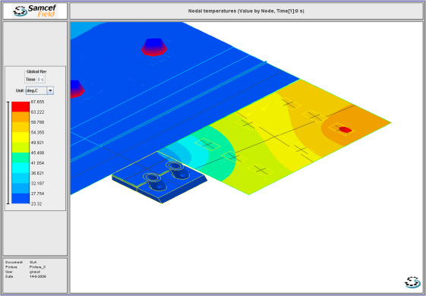
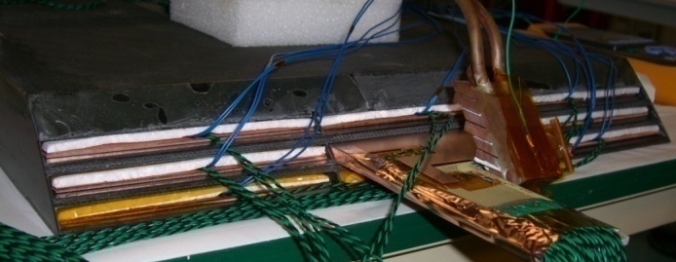
Cooling: leakless water system
Study from the power source to the global cooling
SLAB
Global cooling
True scale leak less loop
4500 W for whole detector
Heat exchanger
Thermal simulation and test on Slab
13m
High Line
Simulation and test on different type of heat exchangers
10 m
Medium Line
4,5 m
full amplitude : 44 °c
ship amplitude : 20 °c
9 m
Low Line
FPGA
5,1 m
cooling station
2,5 m
Cooling Station

Slide 4
Cooling capabilities
/ Electronic consumption
From 4,5 kW to…?
Electronic Front End
SLAB
Heat exchanger

Slide 5
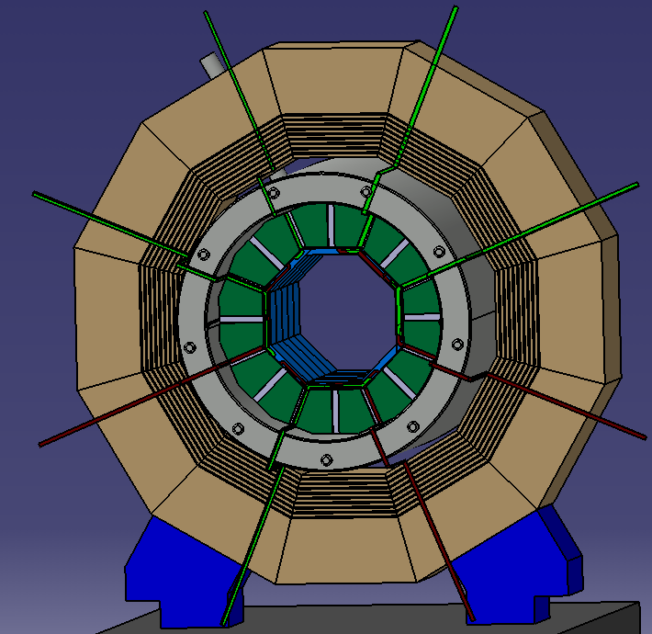
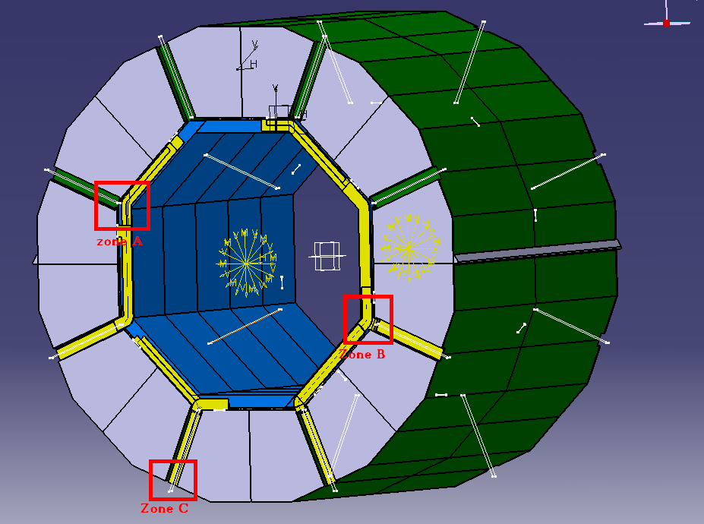
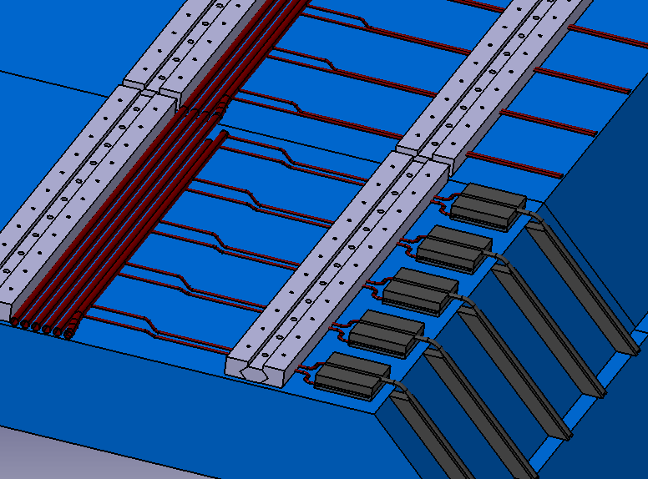
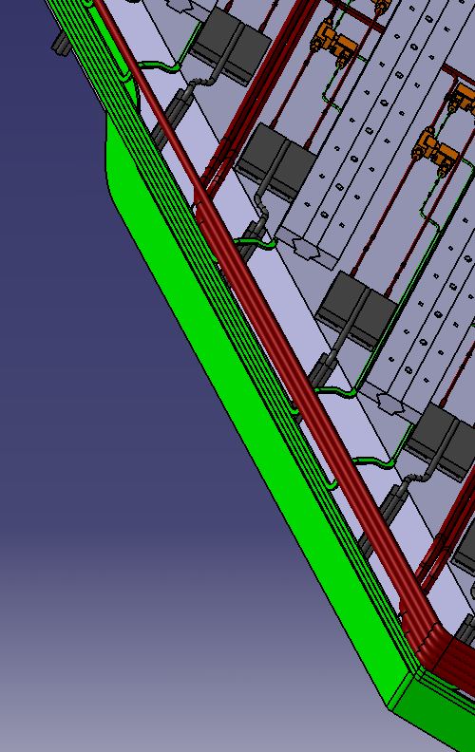
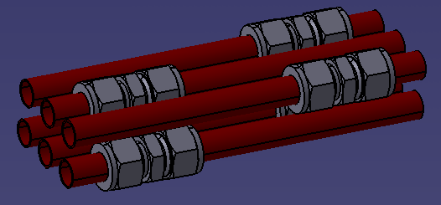
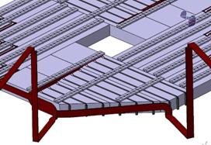
Cooling Integration
ECAL
BAREL integration per module
ILD
Leak less => siphon not possible
ECAL cooling lines crossing ILD
Connection integration
General distribution :
Water circulation under atmospheric pressure
Water temperature input: 18°c
- Water temperature output: 23°c
Maximal power per column: 150 W
Pipes diameter : 13 mm
ECAL End-Cap ~25,5 T
Intrados: integration with cooling lines

Slide 6
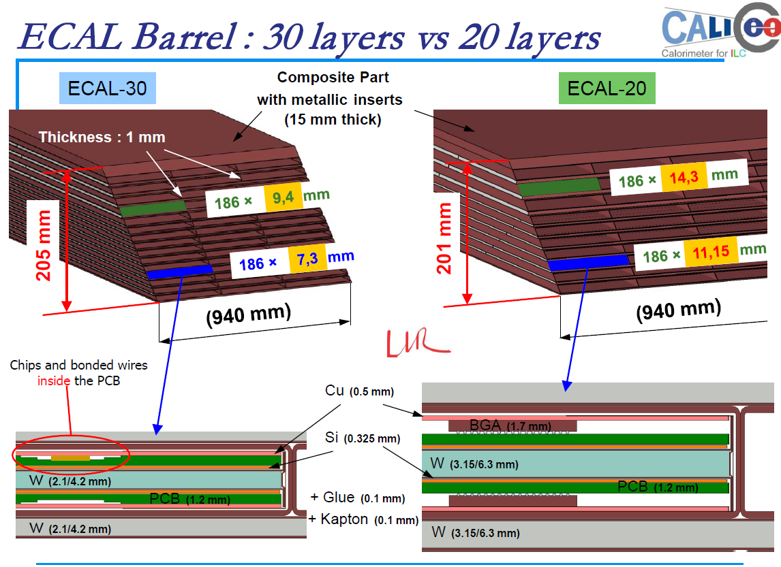
ECAL Cooling/ evolution
This study is based on ILD target
For the incoming "EUDET" prototype (<1 year), skiroc2 chips take about 1ms to stabilize, so it’s 970µs more than
expected and that double or triple the actual consumption
For a ILD prototype (3 ans) it is hoped to have a skiroc3 which solves this pb & a new power-pulsed DIF
(~100mW instead of 1W)
Update needed in thermal study:
Number of SLABs
SLAB constitution (material distribution)
Power variation
- Final geometry
Power location (Front end or SLAB)
- Design: hydraulic safety, hardened
components, cooling supervision of the
representative process

Slide 7
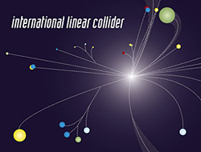
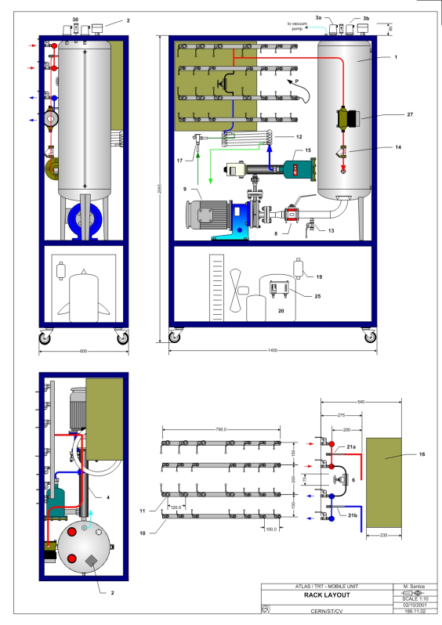
Barrel cooling
Cooling Options after local simulations
Low heat to extract
3 W/m² for GRPC (total HCAL: 500 kW)
Big exchange surface
material with good conductivity
  Leak-less water cooling : no risk for electronic
  and other detectors, pressure between 0,8 and
  1bar (cavitation), balanced network, pneumatic
  activators needed
  Bi-phasic gas like CO2 : High Pressure (100 bars),
  expensive connections (no leak), small diameter
  tubes, important exchange coefficient
  Mono-phasic gas like C6F14
Atlas cooling plant
HCAL / cooling studies / IPN Lyon

Slide 8
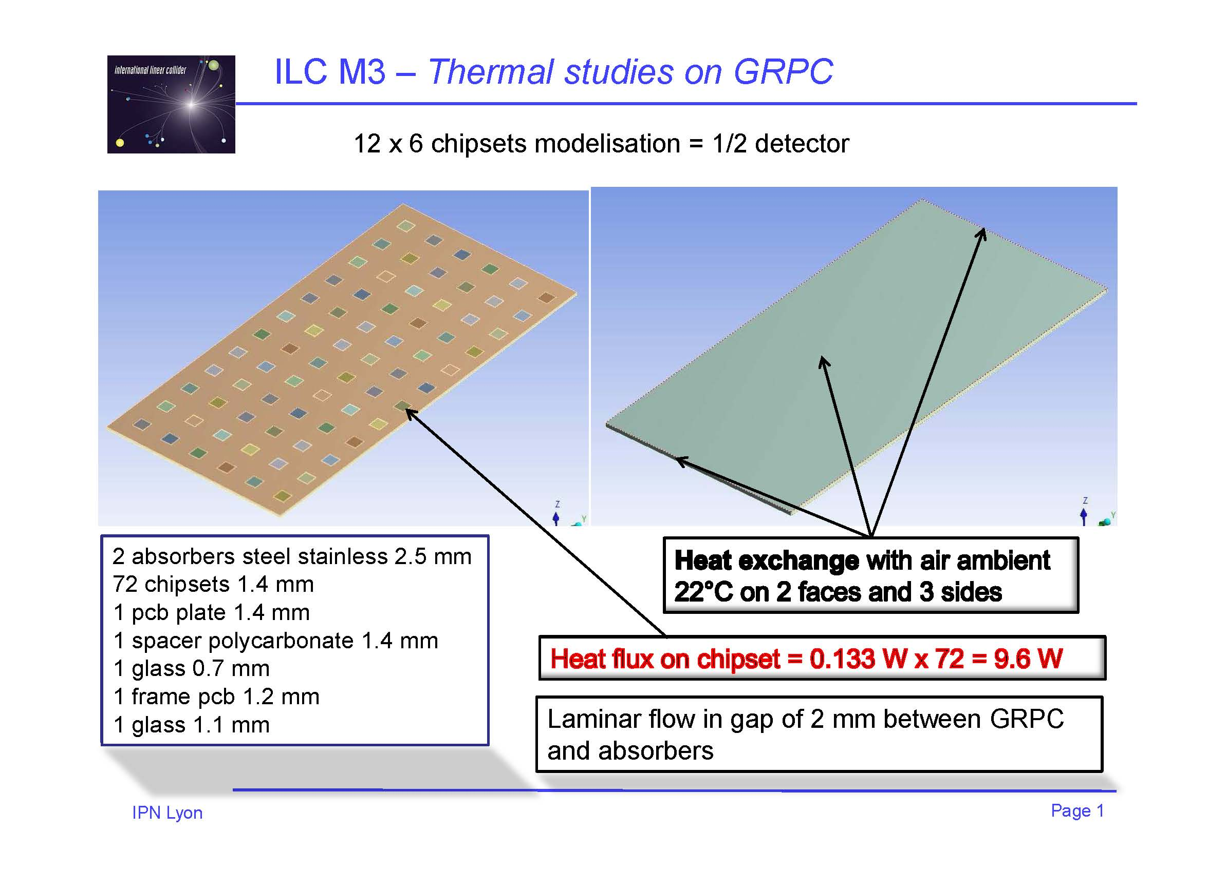

Slide 9
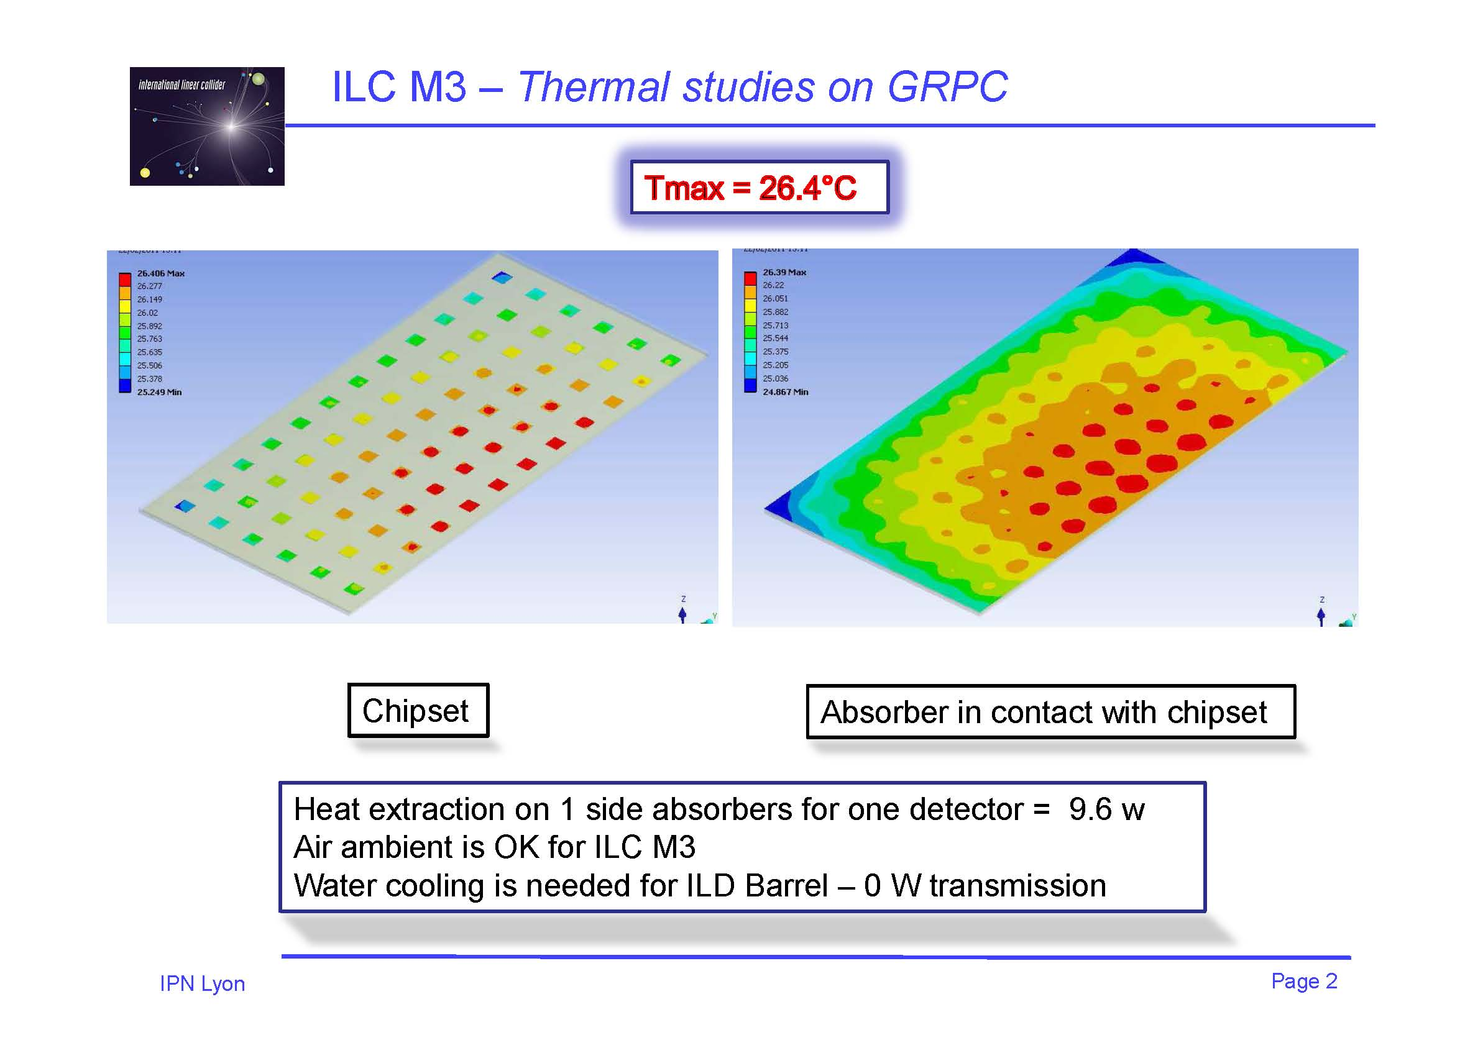
C6F14

