Slide 1
Lecture 3
Muon Detection
The detector technologies.

Slide 2
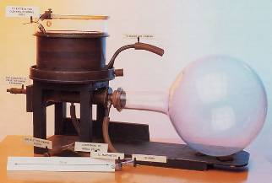

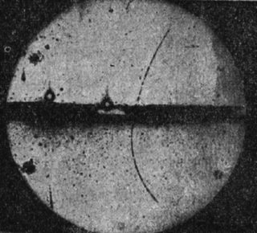
Very early detectors
The very early detectors like cloud chambers (or later bubble chambers used saturated water vapour in which small droplets developed that could be photographed. They were originally developed to study the formation of rain clouds
Cloud chamber
(1911 by Charles T. R. Wilson, Nobel Prize 1927)
These type of detectors were used until the 1980ies. They did what today’s huge detectors do in a single device. They measured everything, however, with limits.
They were good (actually great) for single track measurements but could not contain high energy showers.
In addition, they were slow and very manpower intense to analyse the photographs.
Was used for the discovery of the positron
(1932 by Carl Anderson, Nobel Prize 1936) and the µ)
upward going positron

Slide 3
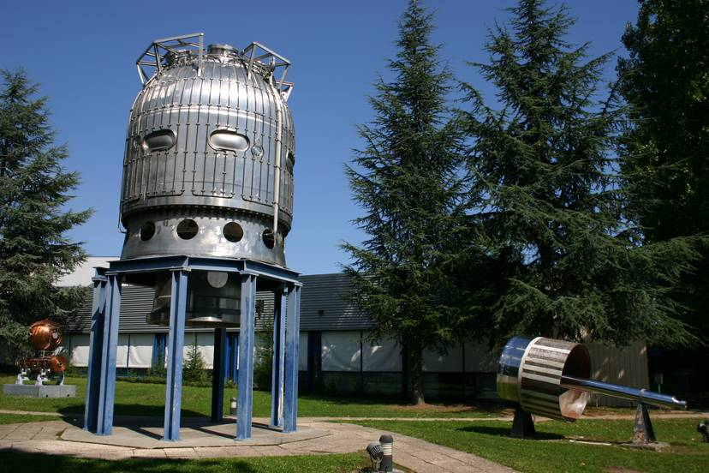
The last bubble chamber at CERN (BEBC)
The hydrogen acted as a target (for incoming particles) and as a detector

Slide 4
Scanning Photographs

Slide 5
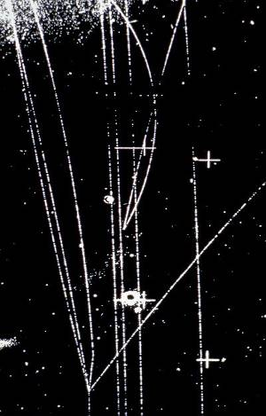
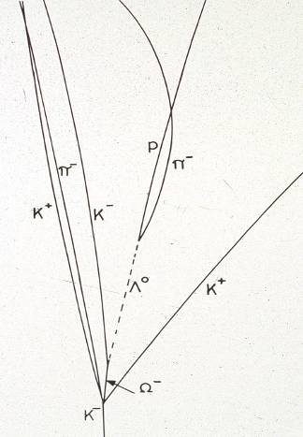
Particle colliding with a proton in liquid hydrogen
- A “Bubble Chamber”
Many people employed to look through these photos to understand what happened!

Slide 6
The early detectors, cont’d
Geiger tubes
The other type of detector that was used in the muon discovery experiment were Geiger tubes, they served as triggering device.
Tubes are still heavily used as muon detectors, however, in the form of drift tubes (see later)
Lead
absorb.
Cloud
chamber
Street & Stevenson, PhysRev. 52(1937)1003

Slide 7
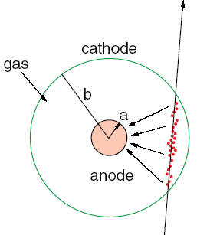
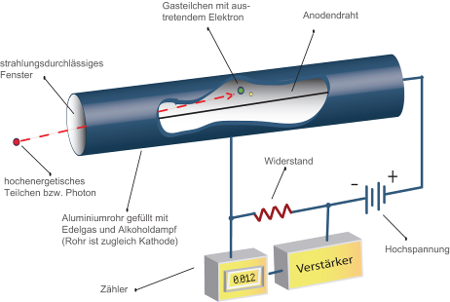
Geiger-Müller counter (1928)
Tube filled with inert gas + organic vapour
High voltage between wire and tube
Central thin wire (20 – 50 µm)
Charged particle ionizes the gas, the electrons move to towards the anode wire, the ions towards the tube wall.
Strong increase of the field close to the wire
When E>10 kV/cm the electrons start ionizing themselves the gas, leading to an electron avalanche and a measurable signal on the wire
The organic substances act as “quencher”

Slide 8
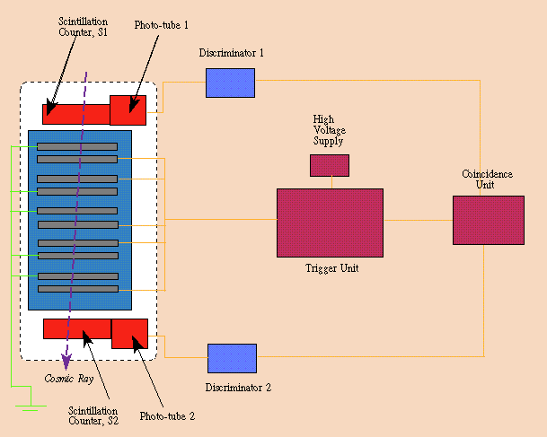
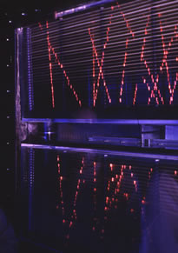
A big step forward – spark chambers
The third type of detector that we have met is the spark chamber that played a crucial role in the discovery of the muon neutrino in 1962.
Pairs of metal plates are connected to a HV potential of several 10 kV creating a strong electrical field between the plates. Charged particles passing across the plates ionize the gas and create a conducting trace that leads to a spark between the two plates which is then photographed.
To avoid saturation, HV is only applied for a few ms, triggered, e.g., by a coincidence in two scintillators.
Spark chambers were used in the 1960ies and 70ies

Slide 9
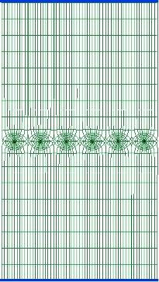
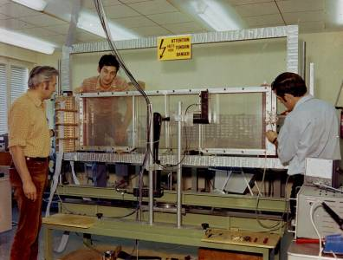
Multiwire proportional chamber
Invented in 1968 by Georges Charpak (Nobel Prize 1992)
A simple idea, generalizing the Geiger-Müller tube to a multi-channel setup, without the internal tube walls.
cathode plane (-)
anode plane (+),
many wires,
a few mm apart
charged particle
cathode plane (-)

Slide 10
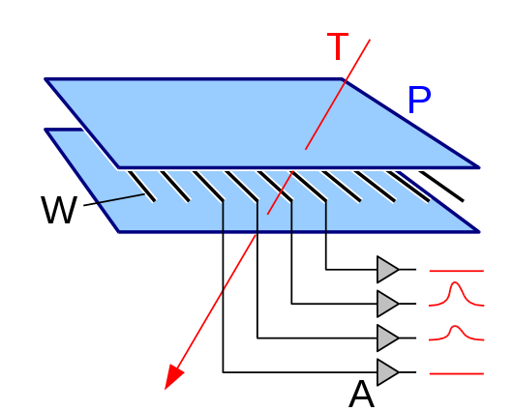
Multiwire proportional chamber II
The invention of the MWPC chamber revolutionized the field, very quickly wire chambers were used all over
It opened the door for constructing large area (and volume) tracking detectors.
The accuracy that can be reached with MWPCs is a function of the wire distance, typical wire distances are d=1–2 mm
σ_{x} = d/√12 ≈ 300 µm (for d=1 mm)
Another limitation with the original MWPC was that the fact that wires measure only one coordinate

Slide 11
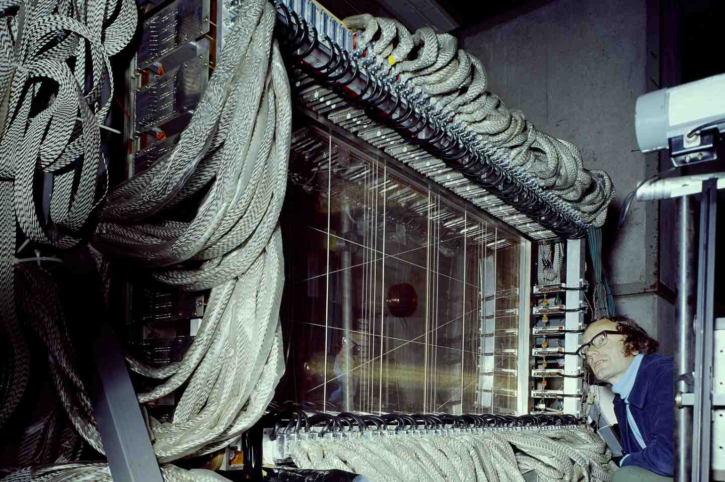
MWPC of NA2 muon detector (1977)

Slide 12
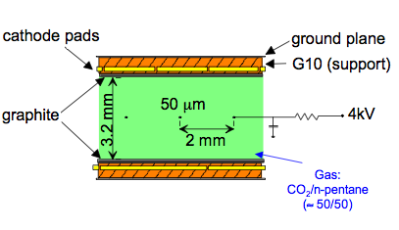
MWPC and 2nd coordinate
cathode strips
Several approaches to extract the 2nd coordinate from MWPCs were used
Crossed wire planes, restricted to small areas and low occupancy (ghost tracks)
Charge division: resistive wires read out from the two sides
Time division: comparing the signal arrival time at the two wire ends
Segmented cathode planes, picking up the induced signal, leading to a number of variants of the MWPCs, still today heavily in use
  Cathode Strip Chambers (CSCs)
  Thin Gap Chambers (TGCs)
TGC

Slide 13
Charge interpolation
With the introduction of the pick-up electrodes separated by an insulator and a layer of graphite two problem of the MWPCs got solved, the limited spatial resolution and the rate limitations.
The charge (from the avalanche on the wire) that gets induced on the cathode strips is spread out and usually extends over several strips. By charge interpolation spatial resolutions much better than the d/√12 can be achieved.
The graphite layer, inside the active gas volume, serves to transport the ions out of the detector, thus reducing the rate problems.
cathode strips
TGC

Slide 14
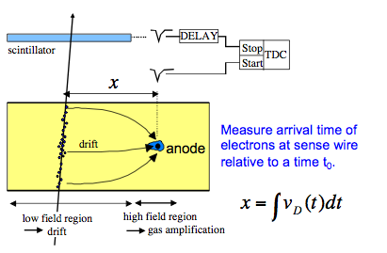
Drift chambers
A natural evolution of the MWPC was the drift chamber, it solved a number of shortfalls of the MWPCs.
First studies: T. Bressani, G. Charpak, D. Rahm, C. Zupancic (1969)
First operation of a drift chamber: A.H. Walenta, J. Heintze, B. Schürlein (NIM 92 (1971) 373)
By measuring the arrival time of the signals on the wire the distance between track and wire is determined
Using this technique spatial resolutions much below 100 µm have been achieved
At the same time the number of wires in a drift chamber is drastically reduced compared to a MWPC
Drift distances can extend to several cm; the drift chambers of the WA1 neutrino detector of Lecture 1 had a drift space of 3 cm and a wire distance of 6 cm.

Slide 15
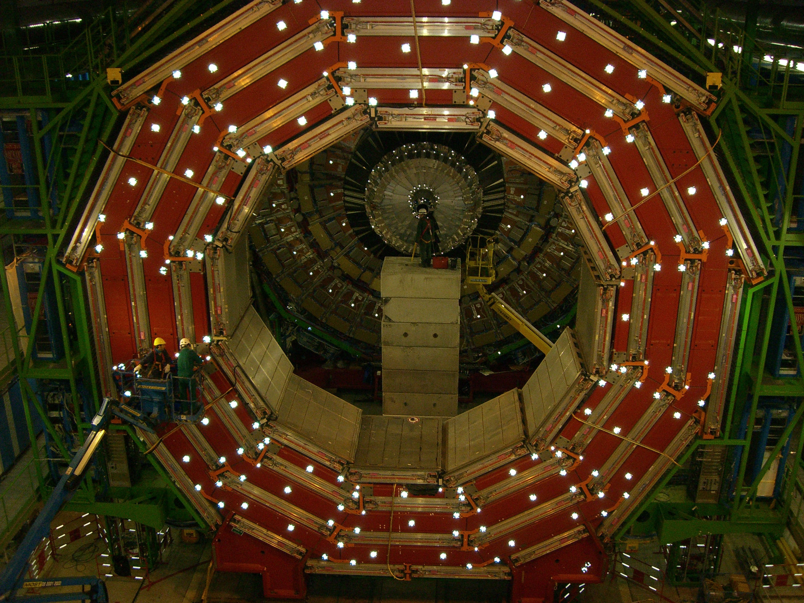
CMS barrel muon system
Drift chamber/RPC packages in the barrel
Tracking & triggering
4 measurement stations
8 layers in phi, 4 layers in z/station
Cathode Strip Chambers (CSC) and RPCs in the end-caps

Slide 16
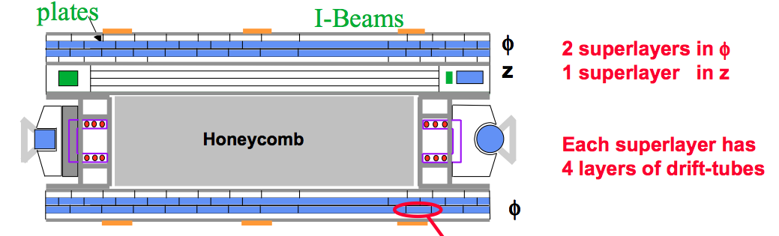
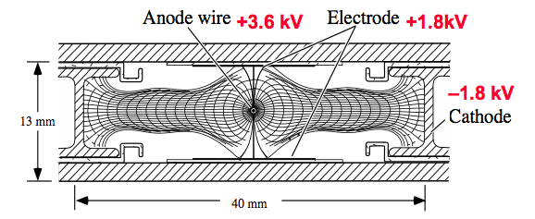
The CMS drift cells
Operated with Ar:CO₂ mixture
400 ns maximum drift time
250 µm resolution/cell

Slide 17
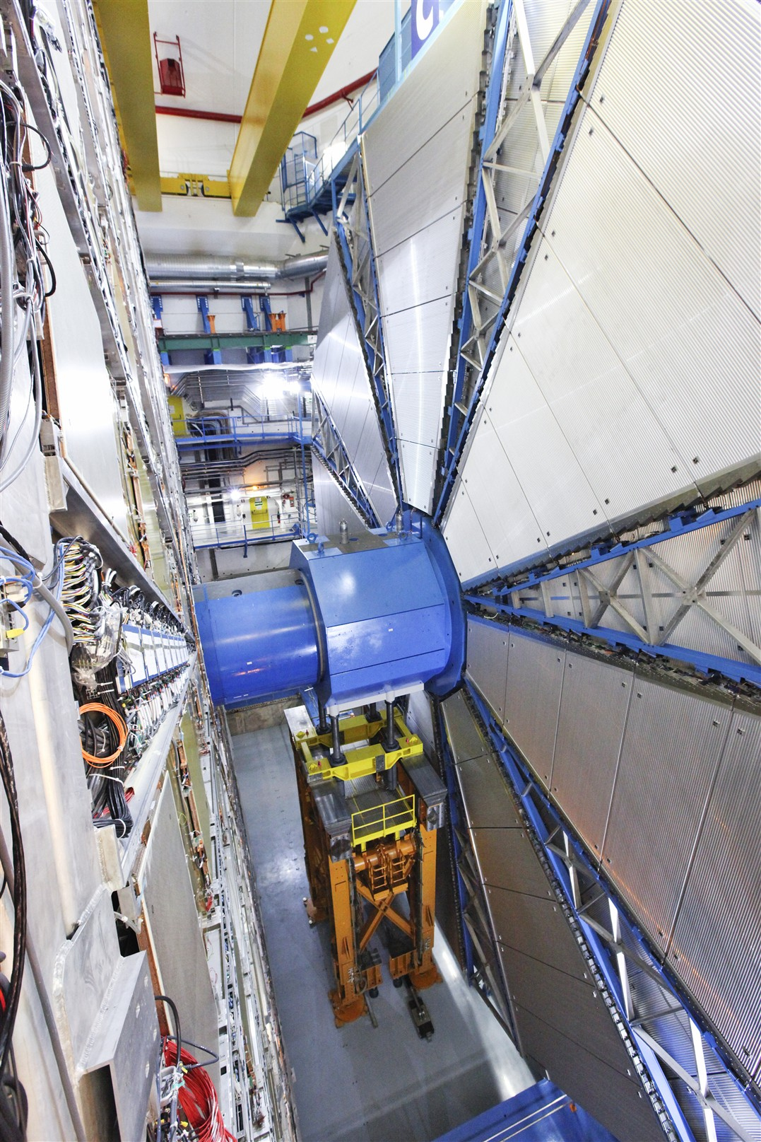
The ATLAS drift tubes
It looks as if we are back to the good old Geiger-Müller tube. Almost.
Applying the drift chamber concept to a single tube makes all the difference
In ATLAS 375 000 drift tubes are used as precision muon detectors, arranged in 1200 chambers, each consisting of 6 or 8 tube layers.
They cover an area of about 5500 m².
The largest chambers employ drift tubes of >7 m length.

Slide 18
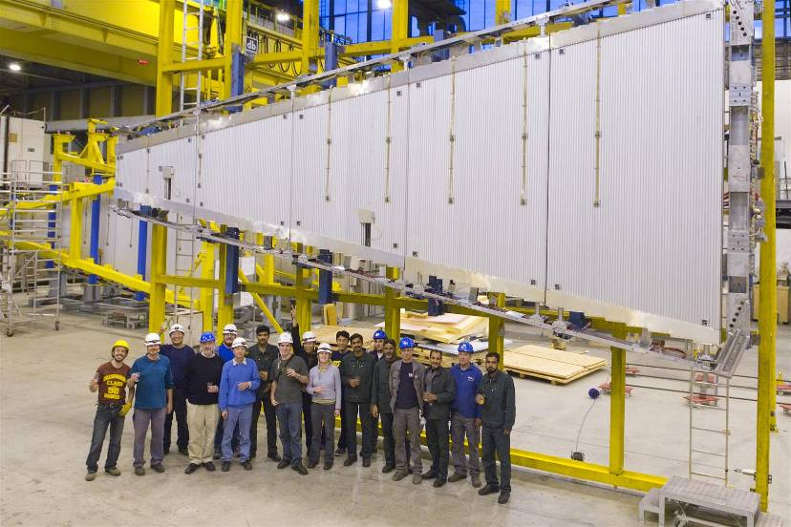
A sector of the ATLAS MDT Big Wheel
Composed of 30 mm Drift tubes

Slide 19
The ATLAS drift tubes
The drift tubes are arranged in 1200 chambers, each consisting of 6 or 8 tube layers. Typical chamber dimensions are 2 x 4 m² in area and 0.5 m high.
The deformation of the chambers being monitored, we call them Monitored Drift Tube Chambers (MDT)

Slide 20
Alignment
The ATLAS muon chambers have been constructed with extremely high precision
  The drift tubes were located to typically 10–15 µm (rms)
An in-plane monitoring system (RASNIK) installed in each chamber is used to follow any deformation of the chambers during installation and operation within a few µm
The RASNIK was installed during construction and is periodically readout
The location of one chamber with respect to the other is achieved by a grid of optical monitoring lines throughout the detector
RASNIK principle

Slide 21
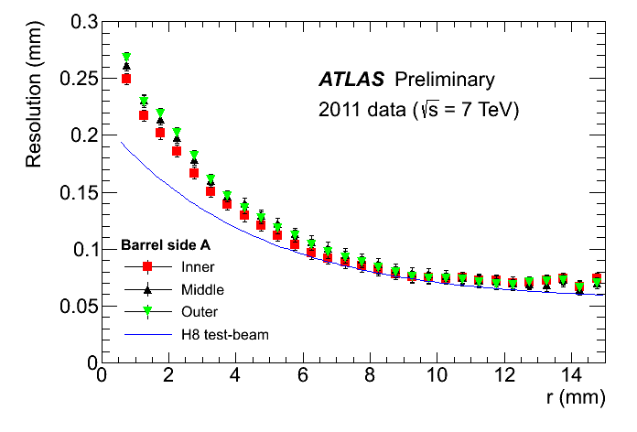
The ATLAS MDTs
The MDT tubes have a diameter of 30 mm, the anode wire is 20 µm thick.
The tubes are operated with an Ar:CO₂ (93:7) gas mixture at 3 bar absolute pressure.
By measuring the signal arrival time the distance of the track to the wire can be determined with a resolution of O(100 µm) per tube (except close to the wire)

Slide 22
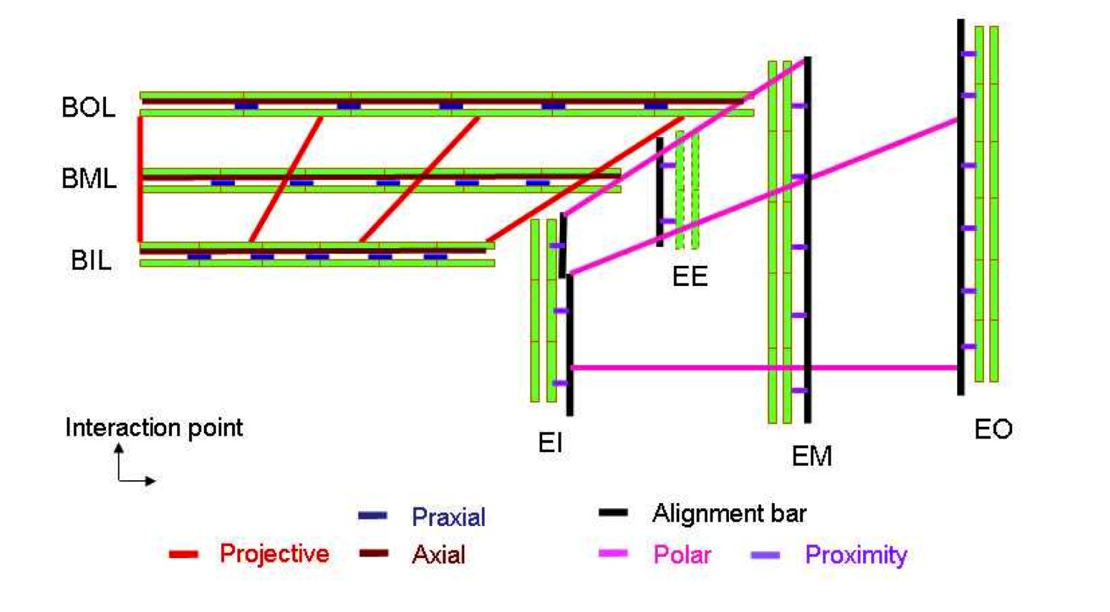
The ATLAS muon alignment system
Goal: interconnect projective towers

Slide 23
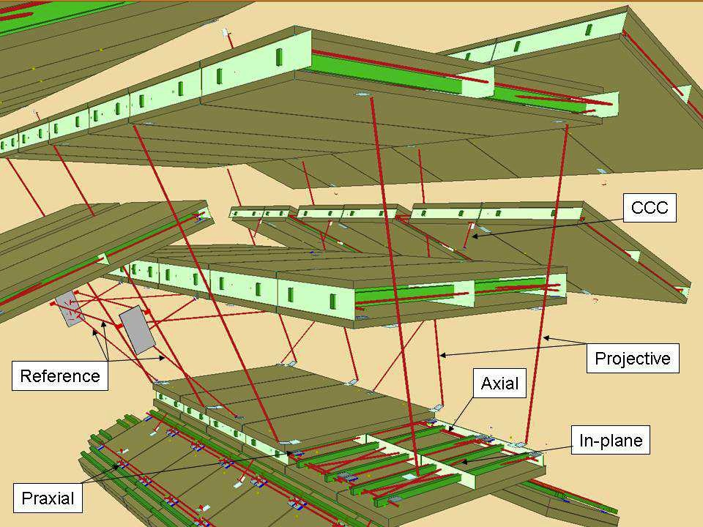
The ATLAS muon barrel alignment
Only the chambers in the odd sectors (between coils) are projectively ‘aligned’.
The chambers of the even sectors are aligned with tracks through chamber overlaps

Slide 24
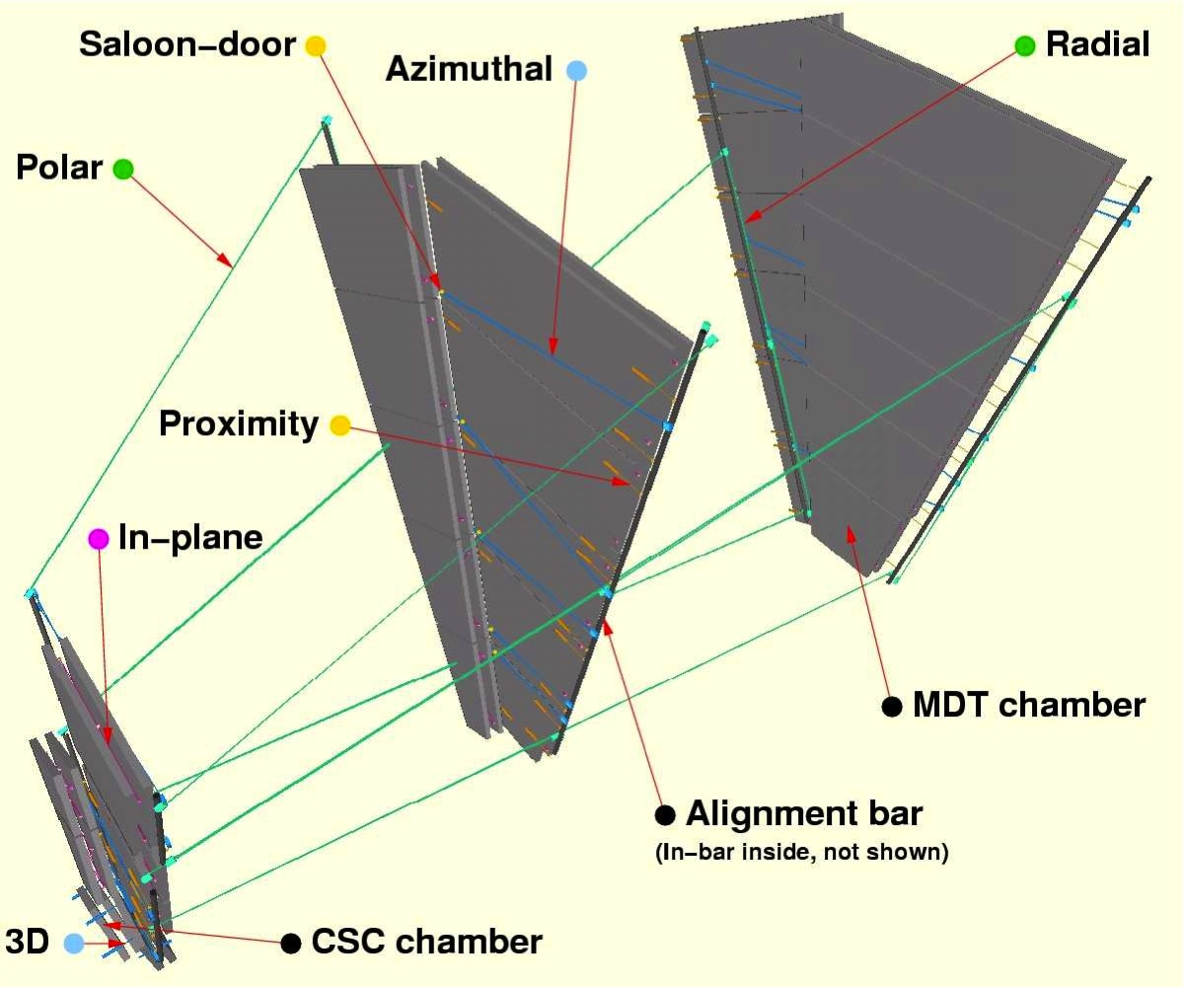
The ATLAS muon end-cap alignment
A set of alignment bars, optically interconnected, creates an external reference system.
Azimuthal optical lines monitor the relative position of the chambers to these bars.

Slide 25
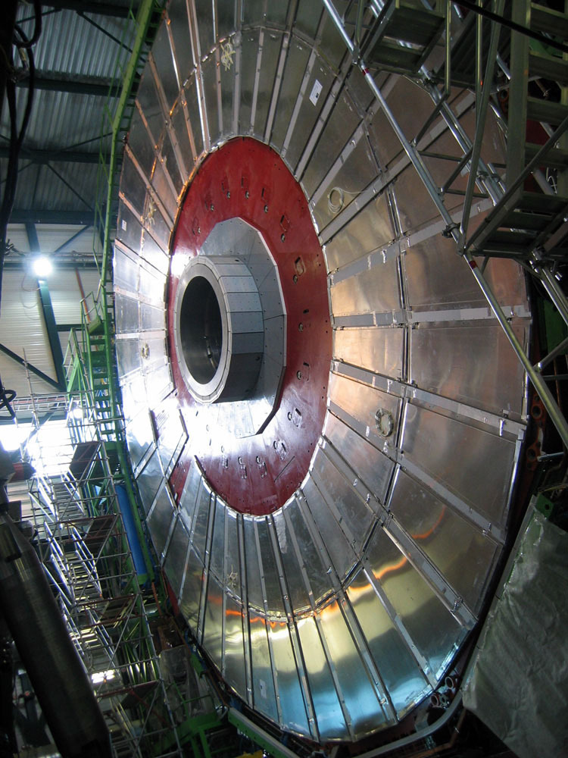
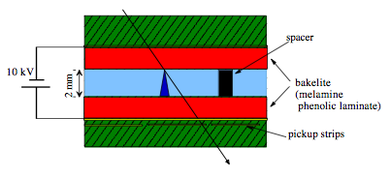
Resistive Plate Chambers (RPC)
RPCs are heavily used in CMS and ATLAS as trigger detectors, plus in many other experiments … as TOF detectors taking advantage of their superb time resolution
They are parallel-plate detectors without wires, similar to the spark chambers
They are operated at typically 5 kV/mm either in streamer or avalanche mode
Gas: C₂H₂F₄:iC₄H₁₀ :SF₆ (96.7:5:0.3)
RPCs installed on the CMS detector

Slide 26
RPC con’t
RPCs are robust detectors, they have no wires to break
The signal formation happens in the conversion gap as soon as the ionization electrons amplify and the avalanche develops. The signal is induced instantly on the readout strips placed on the outside of the resistive plates. RPCs are therefore fast detectors and achieve time resolutions in the ns range (or better)
In standard RPCs the resistive plates are bakelite with a bulk resistivity of ≈10¹⁰ Ohm/cm (CMS, ATLAS, Babar, …)
In multi-gap timing RPCs glass plates (with a bulk resistivity of ≈10¹² Ohm/cm) are more commonly used
The weak point of the RPCs is their rate limitation owing to the high bulk resistivity in the resistive plates, leading to local charging up, followed by a loss of efficiency.
RPCs are considered safe up to rates of about a few kHZ/cm²

Slide 27
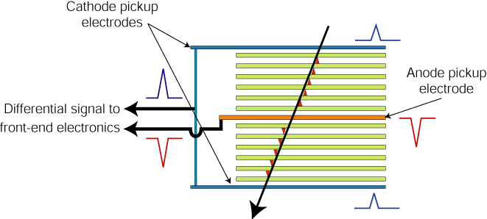
Multi-gap RPCs as TOF detectors
In ALICE time resolutions of 50 ps have been reached (C. Williams et al.)

Slide 28
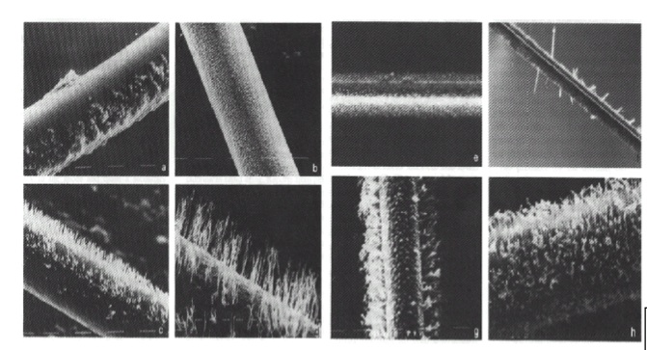
Problems with wire chambers
Gas impurities or high currents may lead to the development of deposits on the wires in the form of tiny whiskers (polymerization of chemical elements in the gas)
These may lead to HV instabilities and inefficiencies and in the worst case they may make chambers completely unusable
Measures against ageing:
  Careful choice of materials (no Si or similar)
  Highest gas gas purity
  Avoid exceedingly high currents

Slide 29
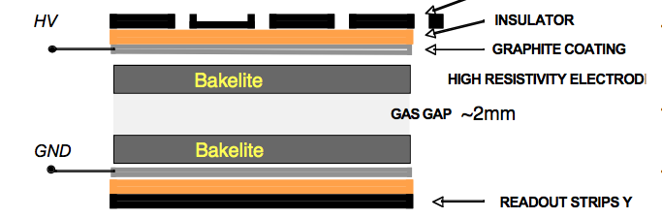
Problems with RPCs
RPCs do not suffer from deposits on the wires, however, surface impurities may lead to similar effects on the parallel surfaces, with the risk of discharges, given the high potential of 5 kV/mm between the plates.
While RPC are extremely fast detectors, their weakness is their limited rate capability owing to the charging up of the resistive plate
Another weak point is the moderate spatial resolution that can be reached since the exact point of conversion is not known

Slide 30
Future muon detectors

Slide 31
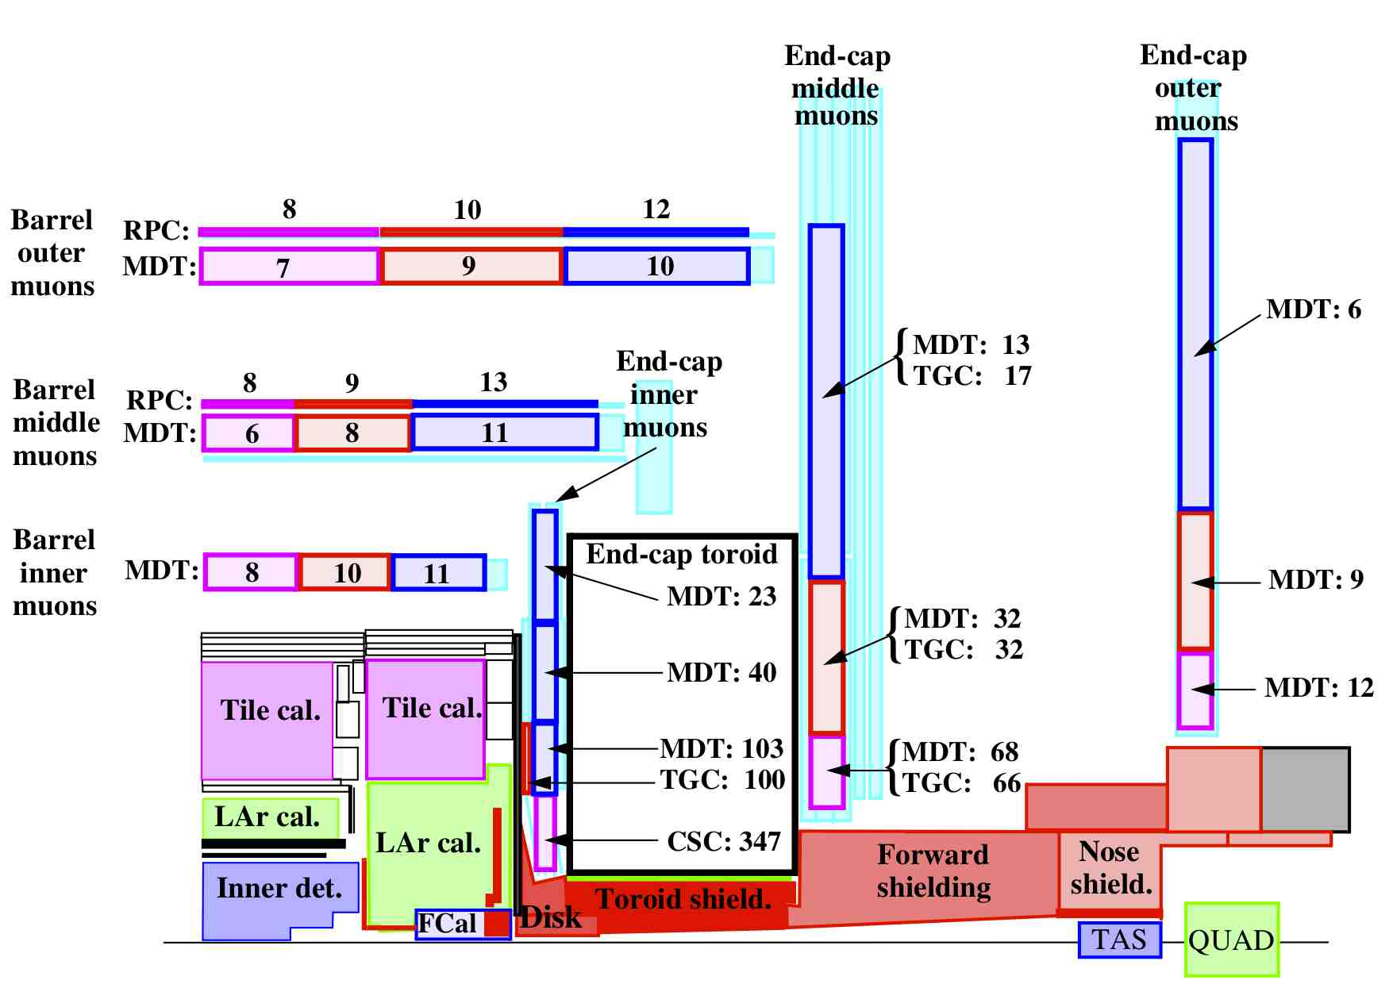
Count rates^{*)} in the ATLAS Muon System at √s = 14 TeV for L = 10³⁴ cm⁻²s⁻¹
Rates in Hz/cm²
*) ATLAS Detector paper, 2008 JINST 3 S08003

Slide 32
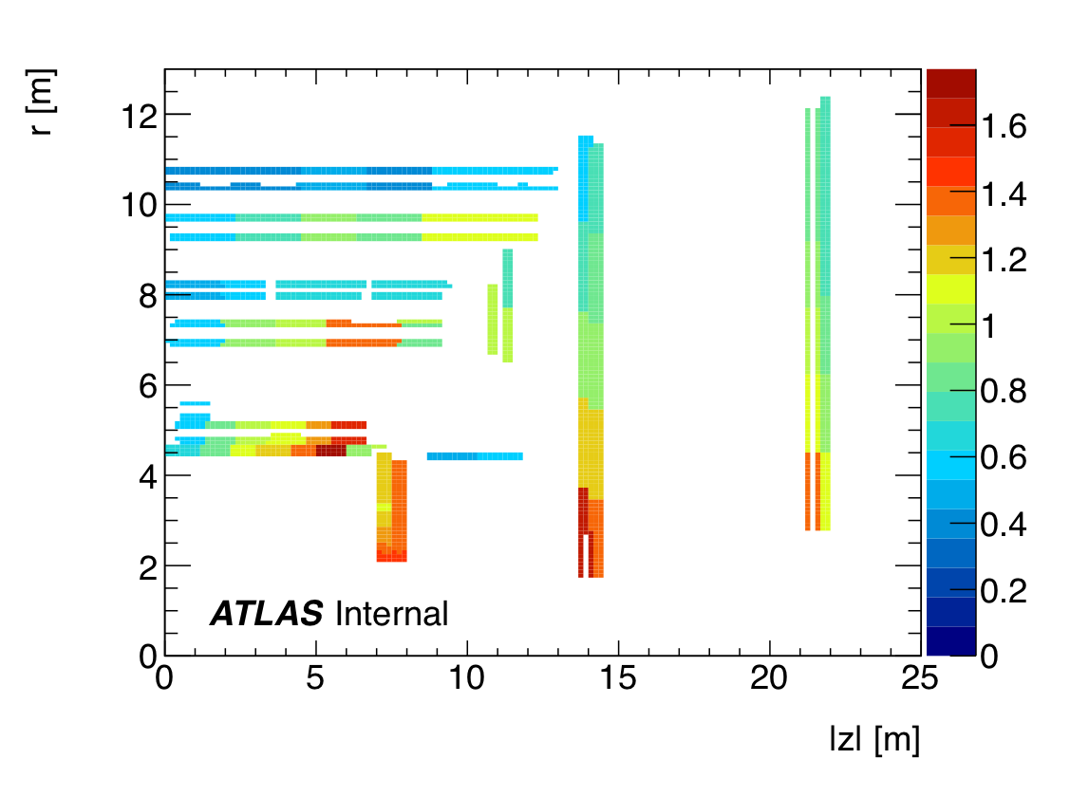
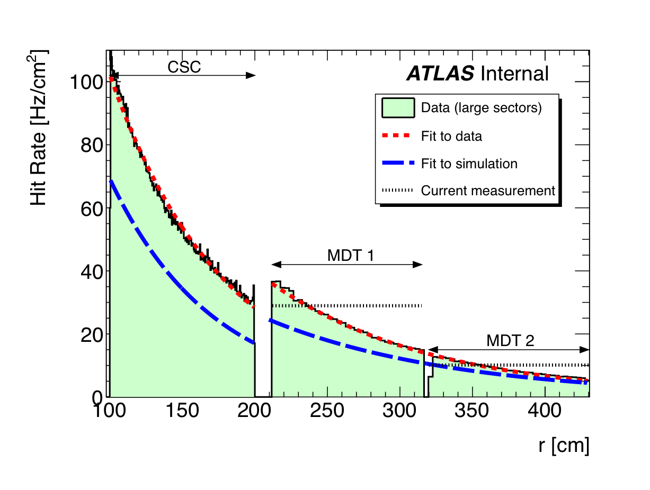
Rates: measurement vs simulation
Measured and expected count rates and in the Small Wheel detectors Data correspond to L = 0.9 x 10³³ cm⁻²s⁻¹ at √s = 7 TeV
Expect: 10 kHz @ 7 x 10³⁴ cm⁻²s⁻¹
Ratio between MDT data and FLUGG^{*)} simulation (CSC region not shown)
Rate in Hz/cm² as a function of radius in the large sectors
^{*)} FLUGG simulation gives rates about factor 1.5 – 2 higher than old simulation

Slide 33
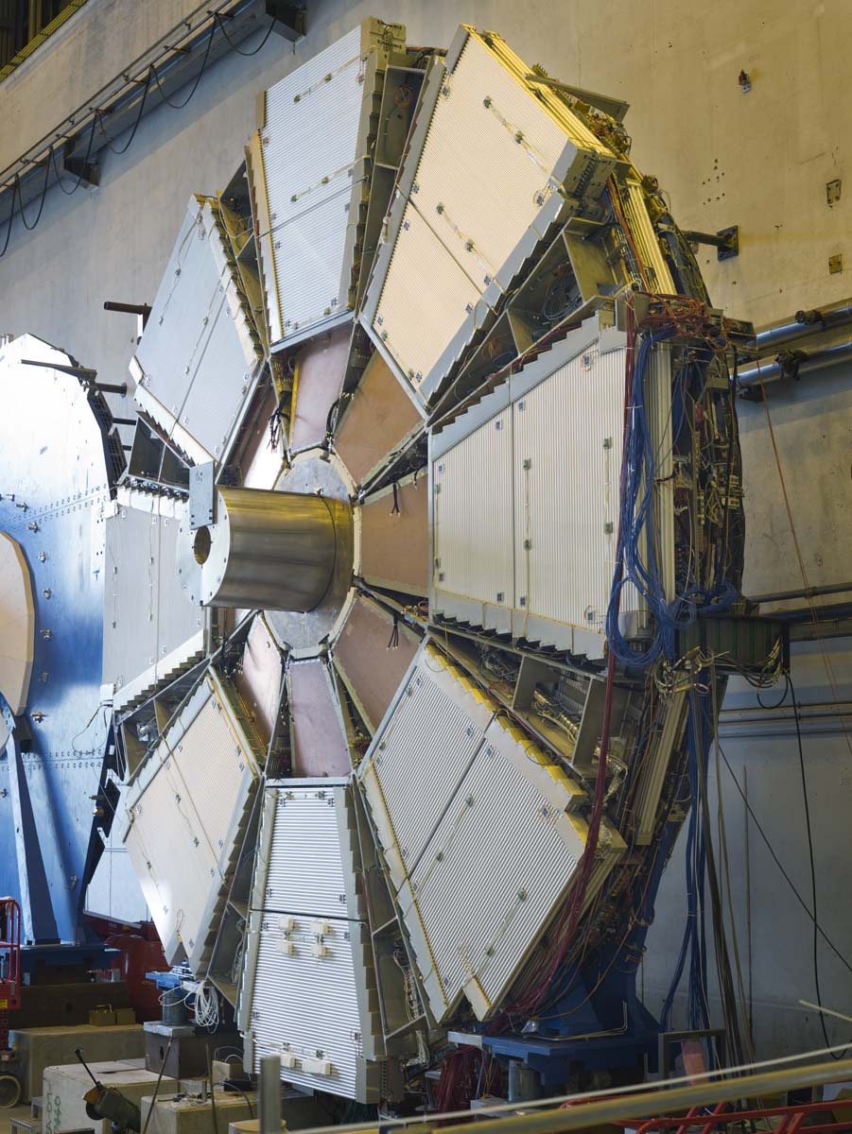
MPGDs: muon detectors for the future
In ATLAS the first station of the end-cap muon system (Small Wheel) is most affected. In the most forward region the rates could reach up to 10–15 kHz/cm² at full luminosity after the LHC upgrade
None of the currently installed detectors (MDT, CSC, TGC) can cope with such rates
It has been decided to replace the detectors on the Small Wheel with a new generation of muon detectors: Micromegas and sTGCs.
TGC
(not visible)
MDT
CSC

Slide 34
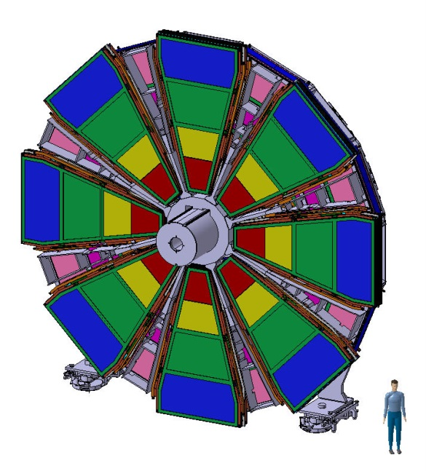
The ATLAS New Small Wheel
Two main objectives:
Cope with higher rates
Add trigger capability to the first end-cap station to fight fake triggers
Detectors:
8 layers of sTGCs with much finer readout (and trigger) granularity (3.2 mm compared to 20–30 mm of TGCs now installed)
8 layers of Micromegas (MM) with a readout strip pitch of 0.4 mm, comprising 2 M readout channels and 1200 m² of detector area
Both detectors will deliver precision coordinates and LVL1 trigger information, i.e., track angle and position to confirm LVL1 candidates from Big Wheel

Slide 35
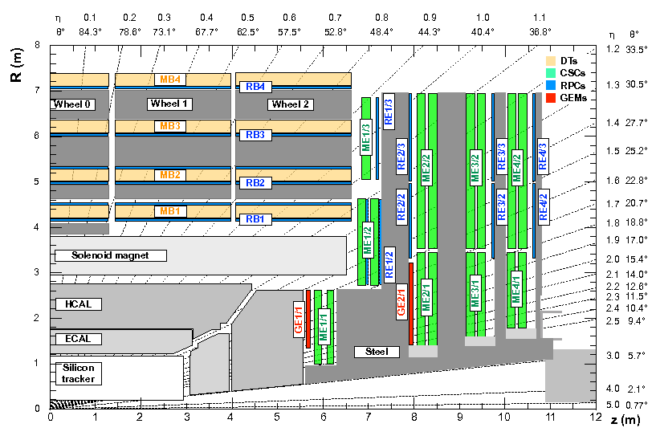
CMS GEM project
Installation of two rings of Triple-GEM detectors in the forward direction

Slide 36
Why Micro Pattern Gaseous Detectors?
Both MMs and GEMs fulfil a number, if not all, of requirements for the new generation of muon chambers
They are capable of operating at very high rates, they work in magnetic fields, they are radiation hard and age well.
Their shape and readout segmentation can be adapted to the needs. They are parallel plate structures with straight-forward field shapes.
In particular the MMs can be operated at very low HV owing to the extremely thin amplification gap.
Both MM and GEM have been, for years, successfully used in the COMPASS experiment as vertex detectors and demonstrated their high-rate capability.
Both types of detectors start being industrially produced opening the field for on-the-shelf detectors.

Slide 37
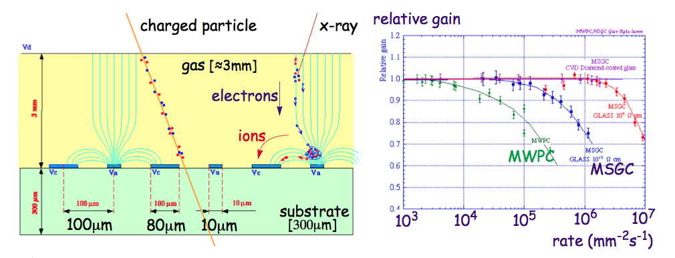
Microstrip gaseous detectors
A. Oed, NIM A 263 (1988) 352
Very precise readout structures produced using PCB technology (lithography)
Very good spatial resolution
No wires, small conversion (drift) gap, moderate HV
Short ion evacuation path => high rate capability

Slide 38
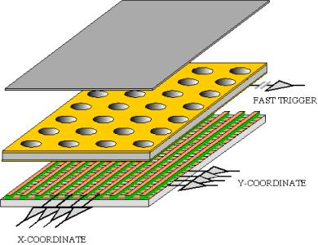
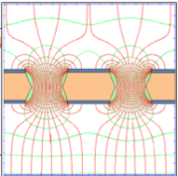
Gas Electron Multiplier (GEM)
GEM
The GEM (gas electron multiplier) was invented by F. Sauli at CERN, (R. Bouclier et al., NIM A 396 (1997) 50).
It is a parallel plate structure with perforated Cu-clad Kapton foils. By applying a potential between conducting foil surfaces a strong field develops inside the holes
The electron multiplication takes place in the field inside the holes
Typical hole diameters are 70–120 µm and the Kapton foils are about 50 µm thick

Slide 39
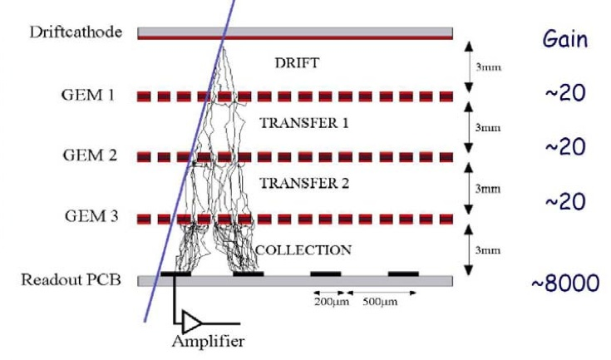
GEMs
GEM
GEMs have been successfully used in a large number of detectors and reached excellent performance in high rate environments (e.g. COMPASS, NA48, …)
Most of the time triple-GEM structures were used to avoid HV breakdown. By keeping the amplification in each of the GEM foils low and by spreading the electron avalanche sparking can be reduced to a very low level.

Slide 40
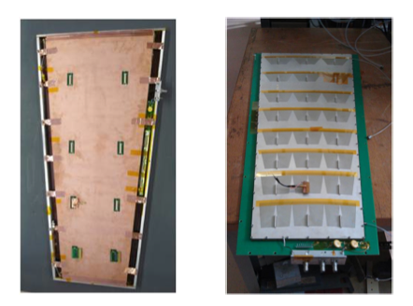
GEMs for the CMS upgrade
CMS started about five years ago to develop detectors based on the GEM technology to be installed in the forward nose of the CMS end-caps
They have constructed a few full-size test chambers and successfully tested them. They showed that they can operate without problems inside a magnetic field. Spatial resolutions close to 100 µm have been reported.
2 x 2 GEMs will be installed as demonstrator system in the 2016 shutdown in CMS.
The full system is expected to be installed in the 2018 LHC shutdown.
100 cm

Slide 41
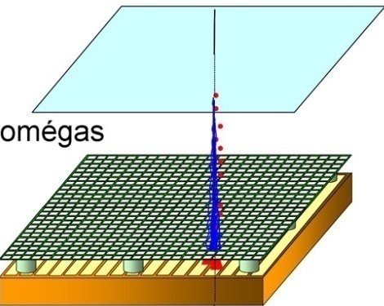
Micromegas
Micromegas (I. Giomataris et al., NIMA 376 (1996) 29) are parallel-plate chambers where the amplification takes place in a thin gap, separated from the conversion region by a fine metallic mesh
Depending on the gas a few mm of conversion gap are sufficient to achieve efficiencies close to 100%; in argon an average of 35 ionization electrons are produced in a 5 mm gap.
The thin amplification gap (short drift times and fast absorption of the positive ions) makes it particularly suited for high-rate applications
The weak point of the MMs were their vulnerability to sparking
MM
-800 V
Conversion & drift space
-550 V
(few mm)
Mesh
Amplification
Gap 128 µm
The principle of operation
of a micromegas chamber

Slide 42
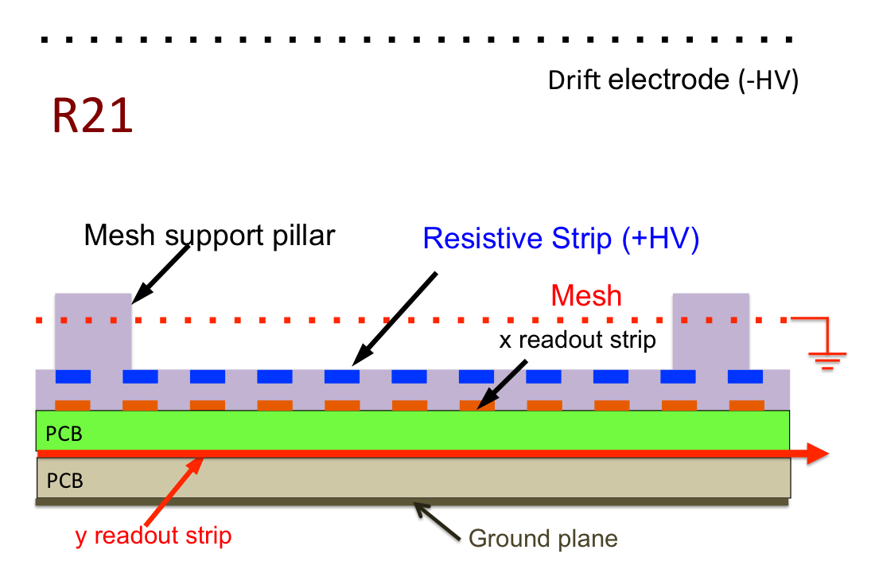
Micromegas
The break-through came with the introduction of a layer of resistive strips above the readout structure, making the MMs spark tolerant without degrading their performance( T. Alexopoulos et al., NIMA 640 (2011) 110)

Slide 43
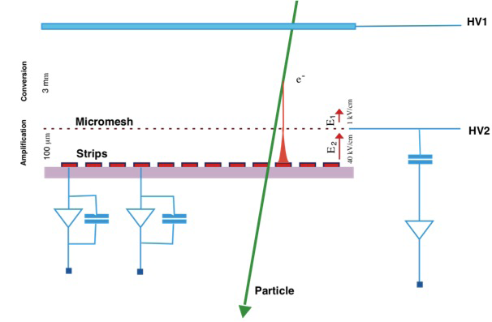
Micromegas as µTPC
‘Wide’ drift region (typically a few mm) with moderate electric field of 100–1000 V/cm
Narrow (100 µm) amplification gap with high electrical field (40–50 kV/cm); a factor E_{m}/E_{d}≈70–100 is required for full mesh transparency for electrons
With drift velocities of 5 cm/µs (or 20 ns/mm) electrons need 100 ns for a 5 mm gap
By measuring the arrival time of the signals a MM functions like a TPC
=> Track vectors for inclined tracks

Slide 44
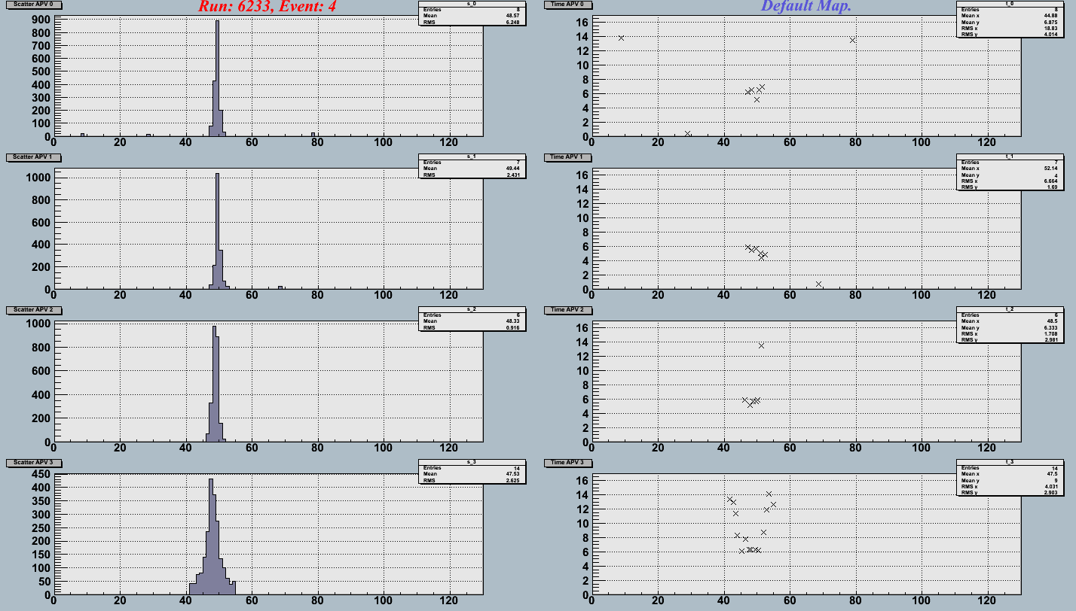
Pion track measured in four micromegas detectors
R11
Charge (200 e⁻)
R12
Time bins (25 ns)
R13
R15
v_{e} ≈ 4.7 cm/µs
Strips (250 µm pitch)
Strips (250 µm pitch)

Slide 45
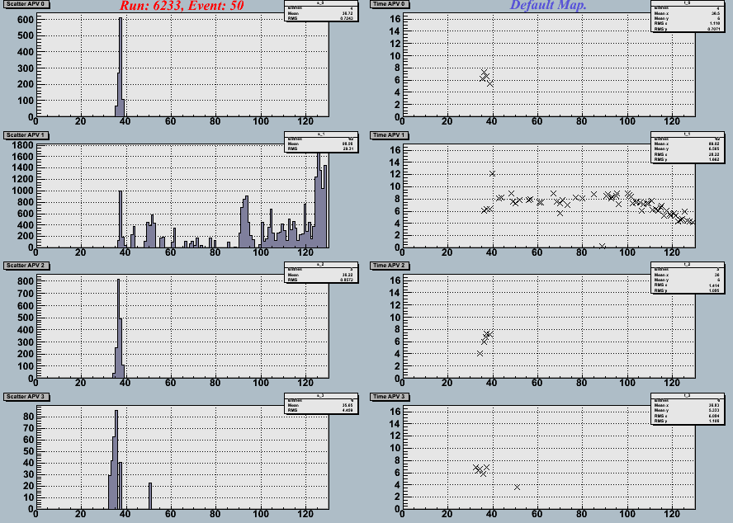
Pion track measured in four micromegas detectors
R11
R12
Charge (200 e⁻)
Time bins (25 ns)
Delta ray
R13
R15
Strips (250 µm pitch)

Slide 46
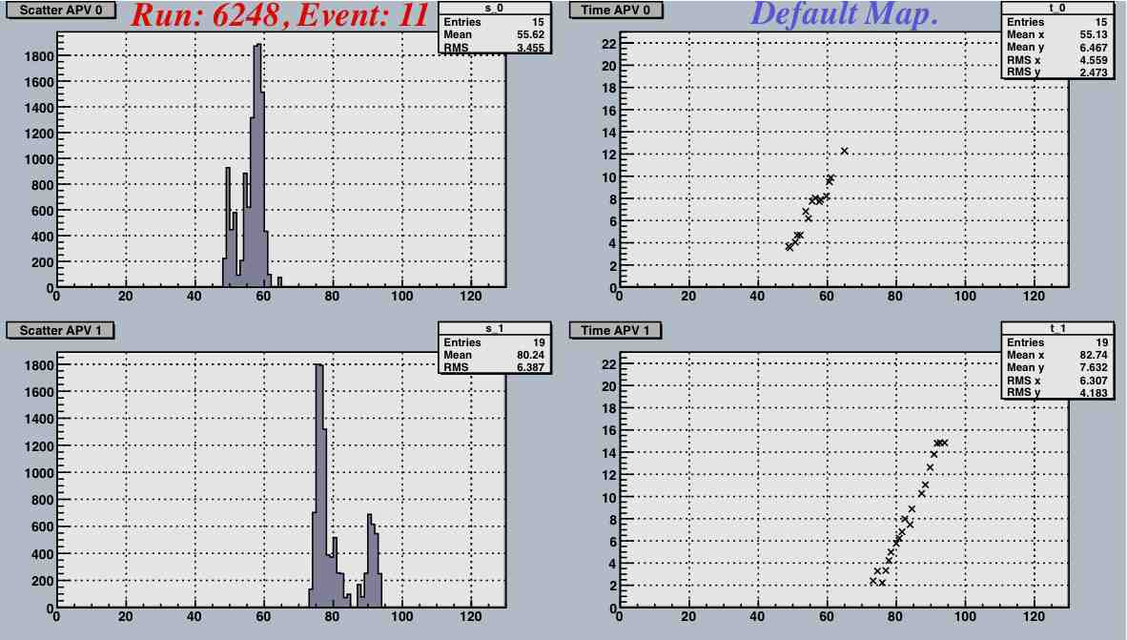
Inclined tracks (40°) – µTPC
R11
Charge (200 e⁻)
Time bins (25 ns)
R12
v_{e} ≈ 2 cm/µs

Slide 47
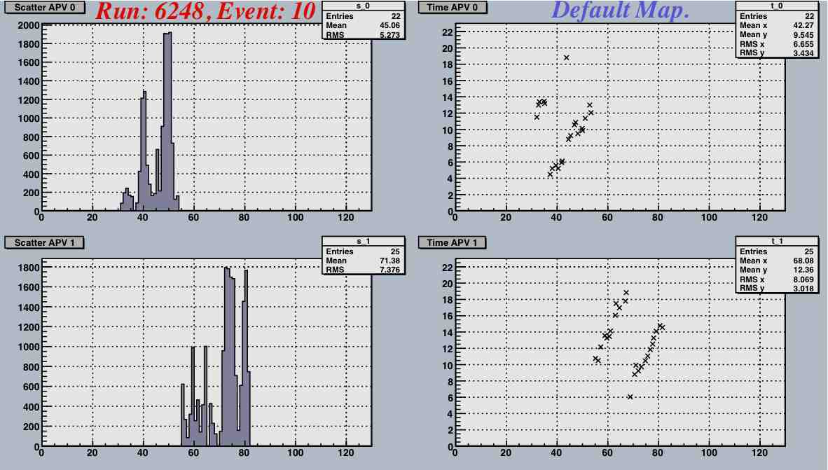
… and a two-track event
R11
v_{e} ≈ 2 cm/µs
Charge (200 e⁻)
Time bins (25 ns)
R12

Slide 48
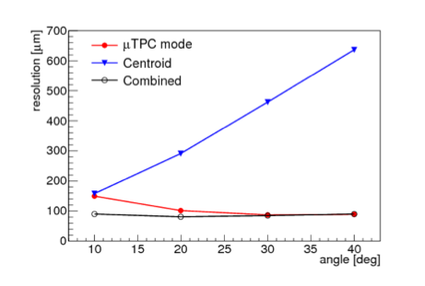
MM performance
Efficiency ≥99% per plane
Gas gain: ≈10⁴
Very good spatial resolution for vertical tracks
Spatial resolution degrades quickly with track inclination
µTPC mode recovers resolution, combining the two leads to spatial resolutions below 100 µm independent of track angle
250 µm
strip pitch
Strip pitch: 0.4 mm
(MM + Si telescope)
σ_{MM} = 36 ± 7 µm

Slide 49
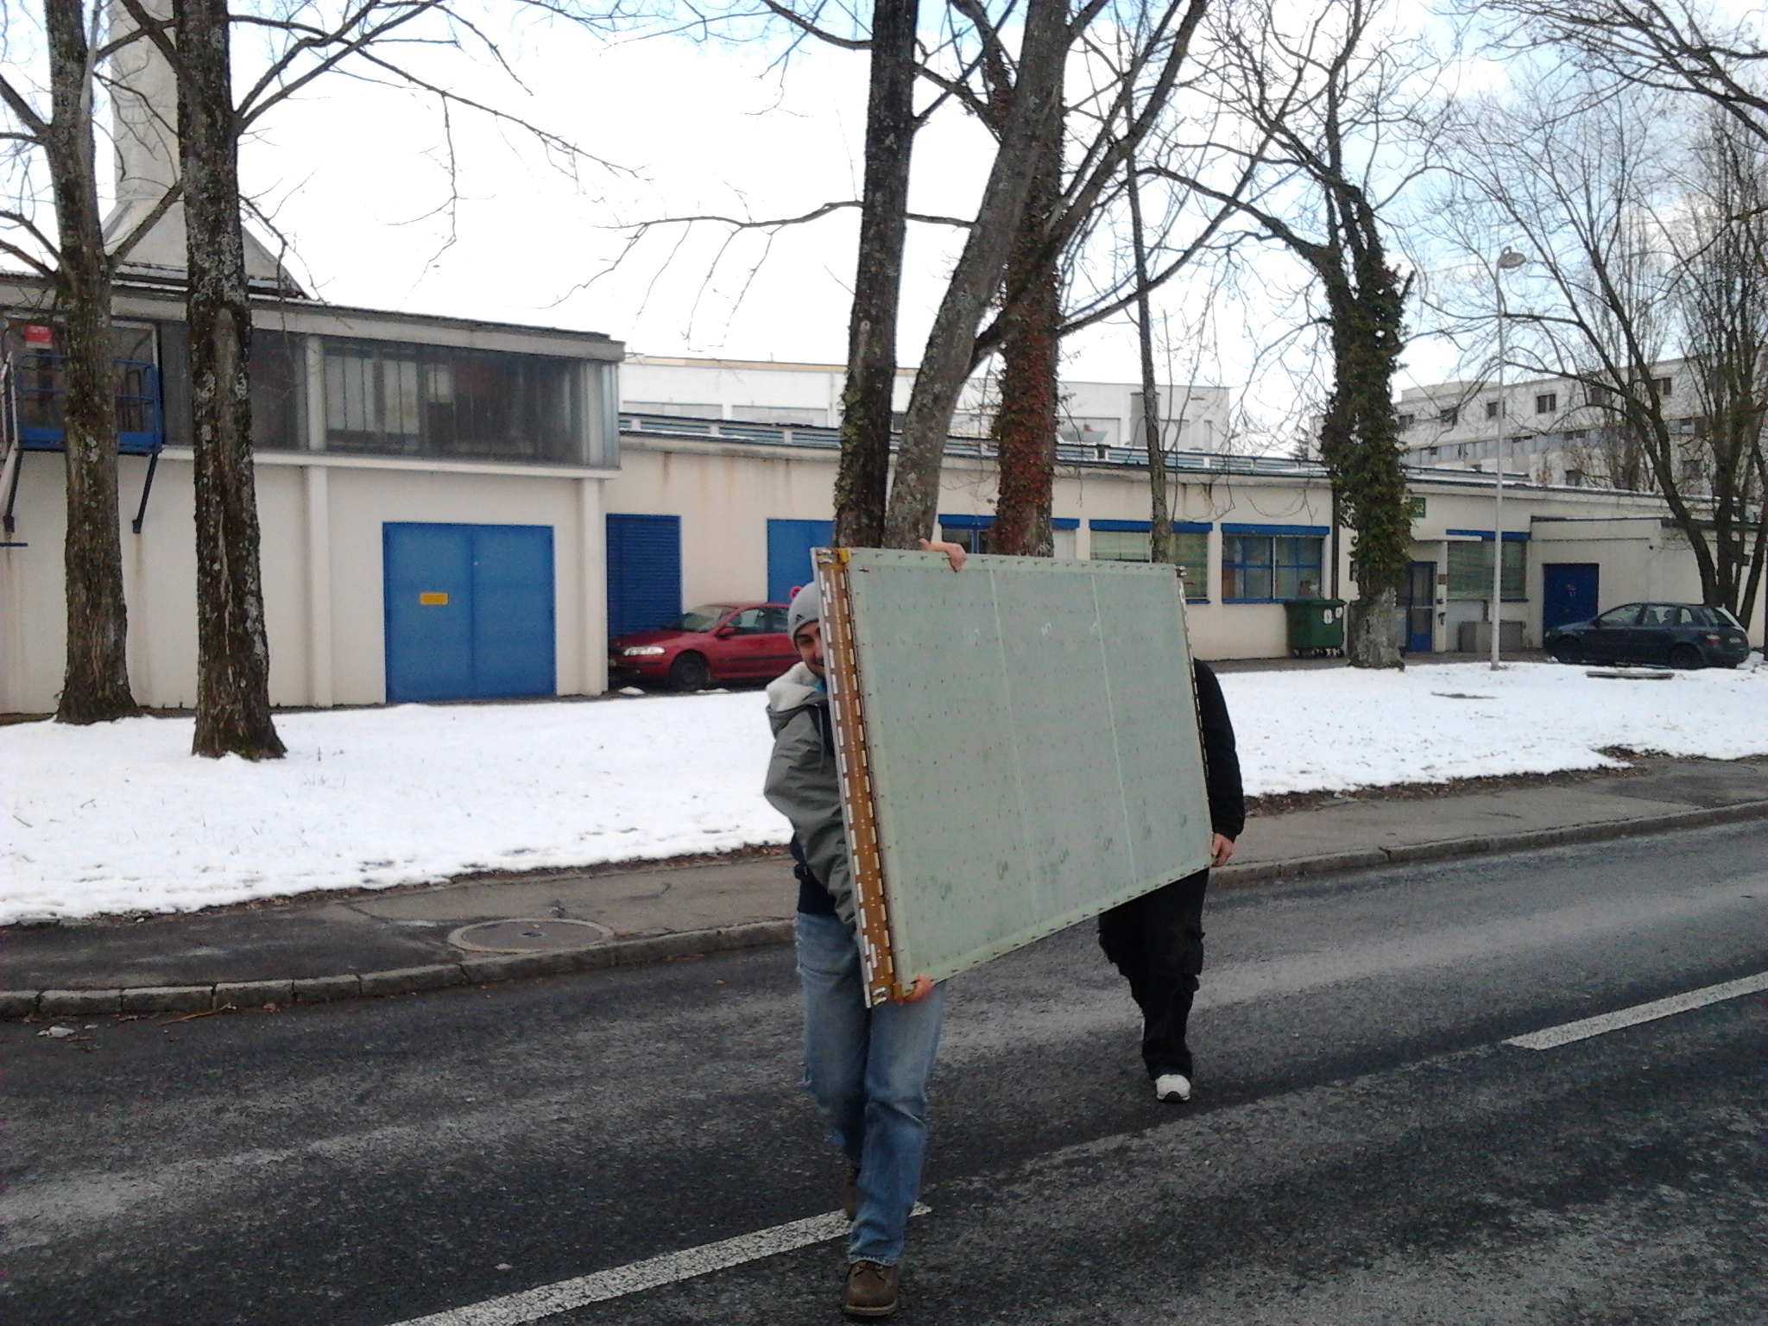
Micromegas as muon chambers
The first large-area micromegas detector has been constructed early 2013
Now ATLAS is preparing for Module-0 detectors for the NSW, to be constructed in the 2nd half of 2014
128 detector quadruplets, each 2–3 m² in size, will be constructed in France, Italy, Germany, Greece, and Russia, starting next year.
Installation in ATLAS will take place in 2018/2019
15 Jan 2013

Slide 50
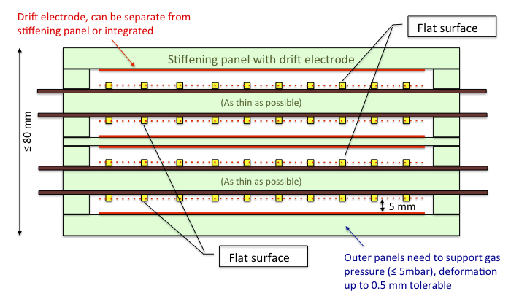

The ATLAS New Small Wheel II
Micromegas stack
sTGC
Drift panel (10 mm)
Micromegas
Spacer – 40 mm
Double faced drift panel (10 mm)
Read-out panel (10 mm)

Slide 51
Conclusions
Muon detection started with cloud chambers (and Geiger-Müller tubes!) some 80 years ago
The main break-through in tracking detectors came with the invention of the MWPC in the 1960ies and their variants in the following years; they are still widely used.
A new trend came with wireless, parallel-plate chambers such as RPCs and more recently with the a large variety of MPGDs (GEMs, MMs, micropics, THGEM, …)
MPDGs are probably the new generation of muon detectors being robust, radiation hard and showing no signs of ageing, while at the same time they are able to cope with high rates and reach excellent spatial resolution and are, at the same time, fast enough to serve as trigger detectors.

