Slide 1



CMOS MAPS in Planar and 3D Technologies: TID Effects and Bulk Damage Study
Lodovico Ratti
Università degli Studi di Pavia and INFN Pavia
lodovico.ratti@unipv.it

Slide 2


Acknowledgment
L. Gaioni, M. Manghisoni, V. Re, G. Traversi
Università di Bergamo and INFN Pavia, Italy
C. Andreoli, E. Pozzati, A. Manazza, V. Speziali, S. Zucca
Università di Pavia and INFN Pavia, Italy
S. Bettarini, F. Forti, F. Morsani, G. Rizzo
Università di Pisa and INFN Pisa, Italy
L. Bosisio, I. Rashevskaya
Università di Trieste and INFN Trieste, Italy
V. Cindro
Jožef Stefan Institute, Ljubljana, Slovenia
The activity was carried out in the framework of a few projects funded by the Italian Ministry for University and Research (PRIN projects), INFN (SLIM5 and VIPIX) and the EU (AIDA)

Slide 3

Motivation
Experiments at the future particle colliders (B-Factories, ILC) or upgrade of present colliders (HL-LHC) will set severe requirements for silicon vertex trackers
CMOS monolithic sensors have some attractive features to offer
full integration (in a CMOS technology) of the front-end electronics and the sensitive part in the same substrate
the sensitive region is limited to a few tens of microns ➔ substrate can be thinned down with negligible signal loss and improved impact parameter resolution
Design/layout (DNW monolithic sensors) and/or technological (SOI, HV CMOS, quadruple well) solutions may help overcome some limitations in the use of PMOS devices and design circuits with the required complexity for data sparsification an time stamping
One weak point of MAPS devices is their moderate radiation hardness
ionizing radiation may degrade the analog performance (noise, gain) in the front-end channel and increase the sensor leakage
bulk damage may deteriorate the charge collection properties and again increase the leakage in the sensor
Radiation tolerance study is of paramount importance both to qualify the devices for the foreseen applications and to improve the design

Slide 4
Content
DUTs and irradiation sources and procedures
DNW MAPS in planar and 3D, 130 nm CMOS technology
See the talks by V. Re and G. Traversi on Monday
MAPS in a quadruple well, 180 nm CMOS technology
⁶⁰Co γ-rays up to 10 Mrad(SiO₂), 1 MeV eq. neutrons from a nuclear reactor up to 10¹⁴ cm⁻², annealing (100° C/168 h)
Total ionizing dose tests
Effects on the front-end electronics (noise, gain), dependence on design and technology
Effects on the collecting electrode (leakage current)
Bulk damage tests
Effects on the collecting electrode (charge collection, leakage current), dependence on resistivity
Indirect effect on front-end electronics (gain)
Lessons learned and conclusion

Slide 5
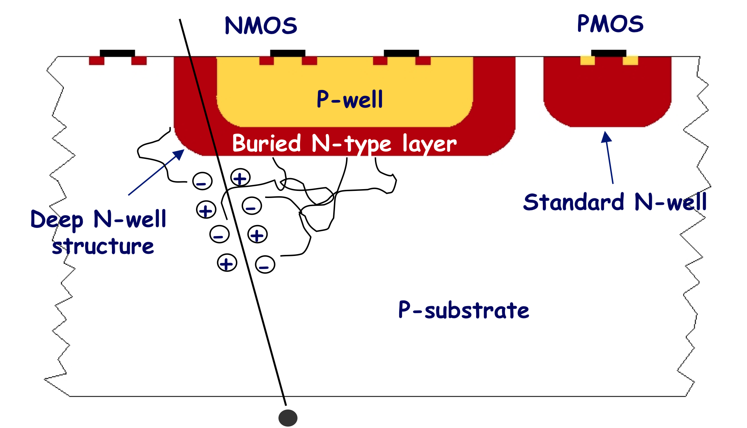
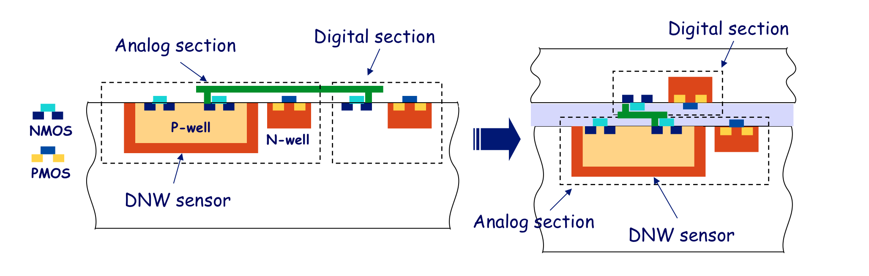
Planar and 3D DNW MAPS
Deep N-well monolithic pixels
A large DNW is used to collect the charge released in the substrate
A classical readout channel for capacitive detectors is used for Q-V conversion → gain decoupled from electrode capacitance
NMOS devices of the analog section are built in the deep N-well
Full CMOS for high performance analog and digital blocks → charge collection inefficiency depending on the relative weight of NW with respect to DNW
From planar to 3D
sensor and analog front-end can be integrated in a different layer from the digital blocks
less PMOS in the sensor layer → improved collection efficiency
more room for both analog and digital power and signal routing
Tier 1: collecting electrode and NMOS parts of the analog front-end (and a few PMOS)
Tier 2: discriminator PMOS parts, digital front-end and peripheral digital readout electronics

Slide 6
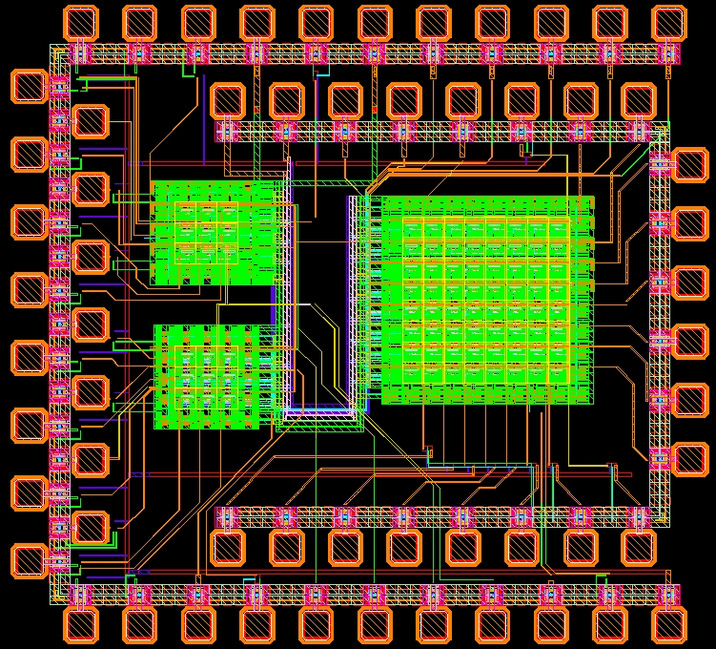
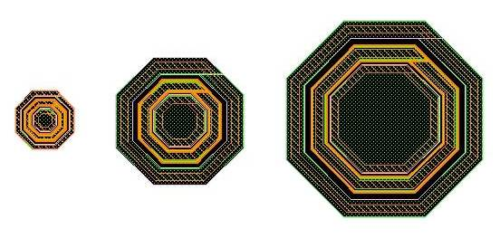
Planar DNW MAPS
Apsel3T1 test chip
130 nm CMOS DNW-MAPS
Matrices with different size (3x3, 8x8) and layout of the collecting electrode
Up to 9.7 Mrad(SiO₂), 9 rad/s dose rate, 100ºC/168 h annealing cycle, DUTs biased as in the real application
Charge sensitivity, ENC, ⁵⁵Fe and infrared laser characterization
Single 130 nm NMOS devices
Narrow channel transistors
Up to 9 Mrad(SiO₂), gate at 1.2 V, all other terminals grounded
Static characterization
DNW diodes
DNW diodes
Three devices with different size
Up to 3.3 Mrad(SiO₂)
A=4000 μm² P=318 μm
Leakage current
A=16100 μm² P=638 μm
A=55000 μm² P=1194 μm

Slide 7
Front-end channel
Planar DNW MAPS
50 um
Thoroughly described in IEEE TNS., vol. 56, no. 4, pp. 2360-2373, Aug. 2009.
Elementary cell (M1 type)
V_{F}
50 um
G_{m}
M_{F}
e_{n}
A(s)
Qδ
+
I_{leak}
C₁
C_{F}
C₂
V_{t}
Sensor and front-end (analog and digital, not shown) electronics integrated in a 50 μm pitch pixel
Selectable peaking time (200 and 400 ns), 30 μW/channel power dissipation, C_{D}≈300 fF, W/L=14 um/0.25 um for the preampli input device

Slide 8
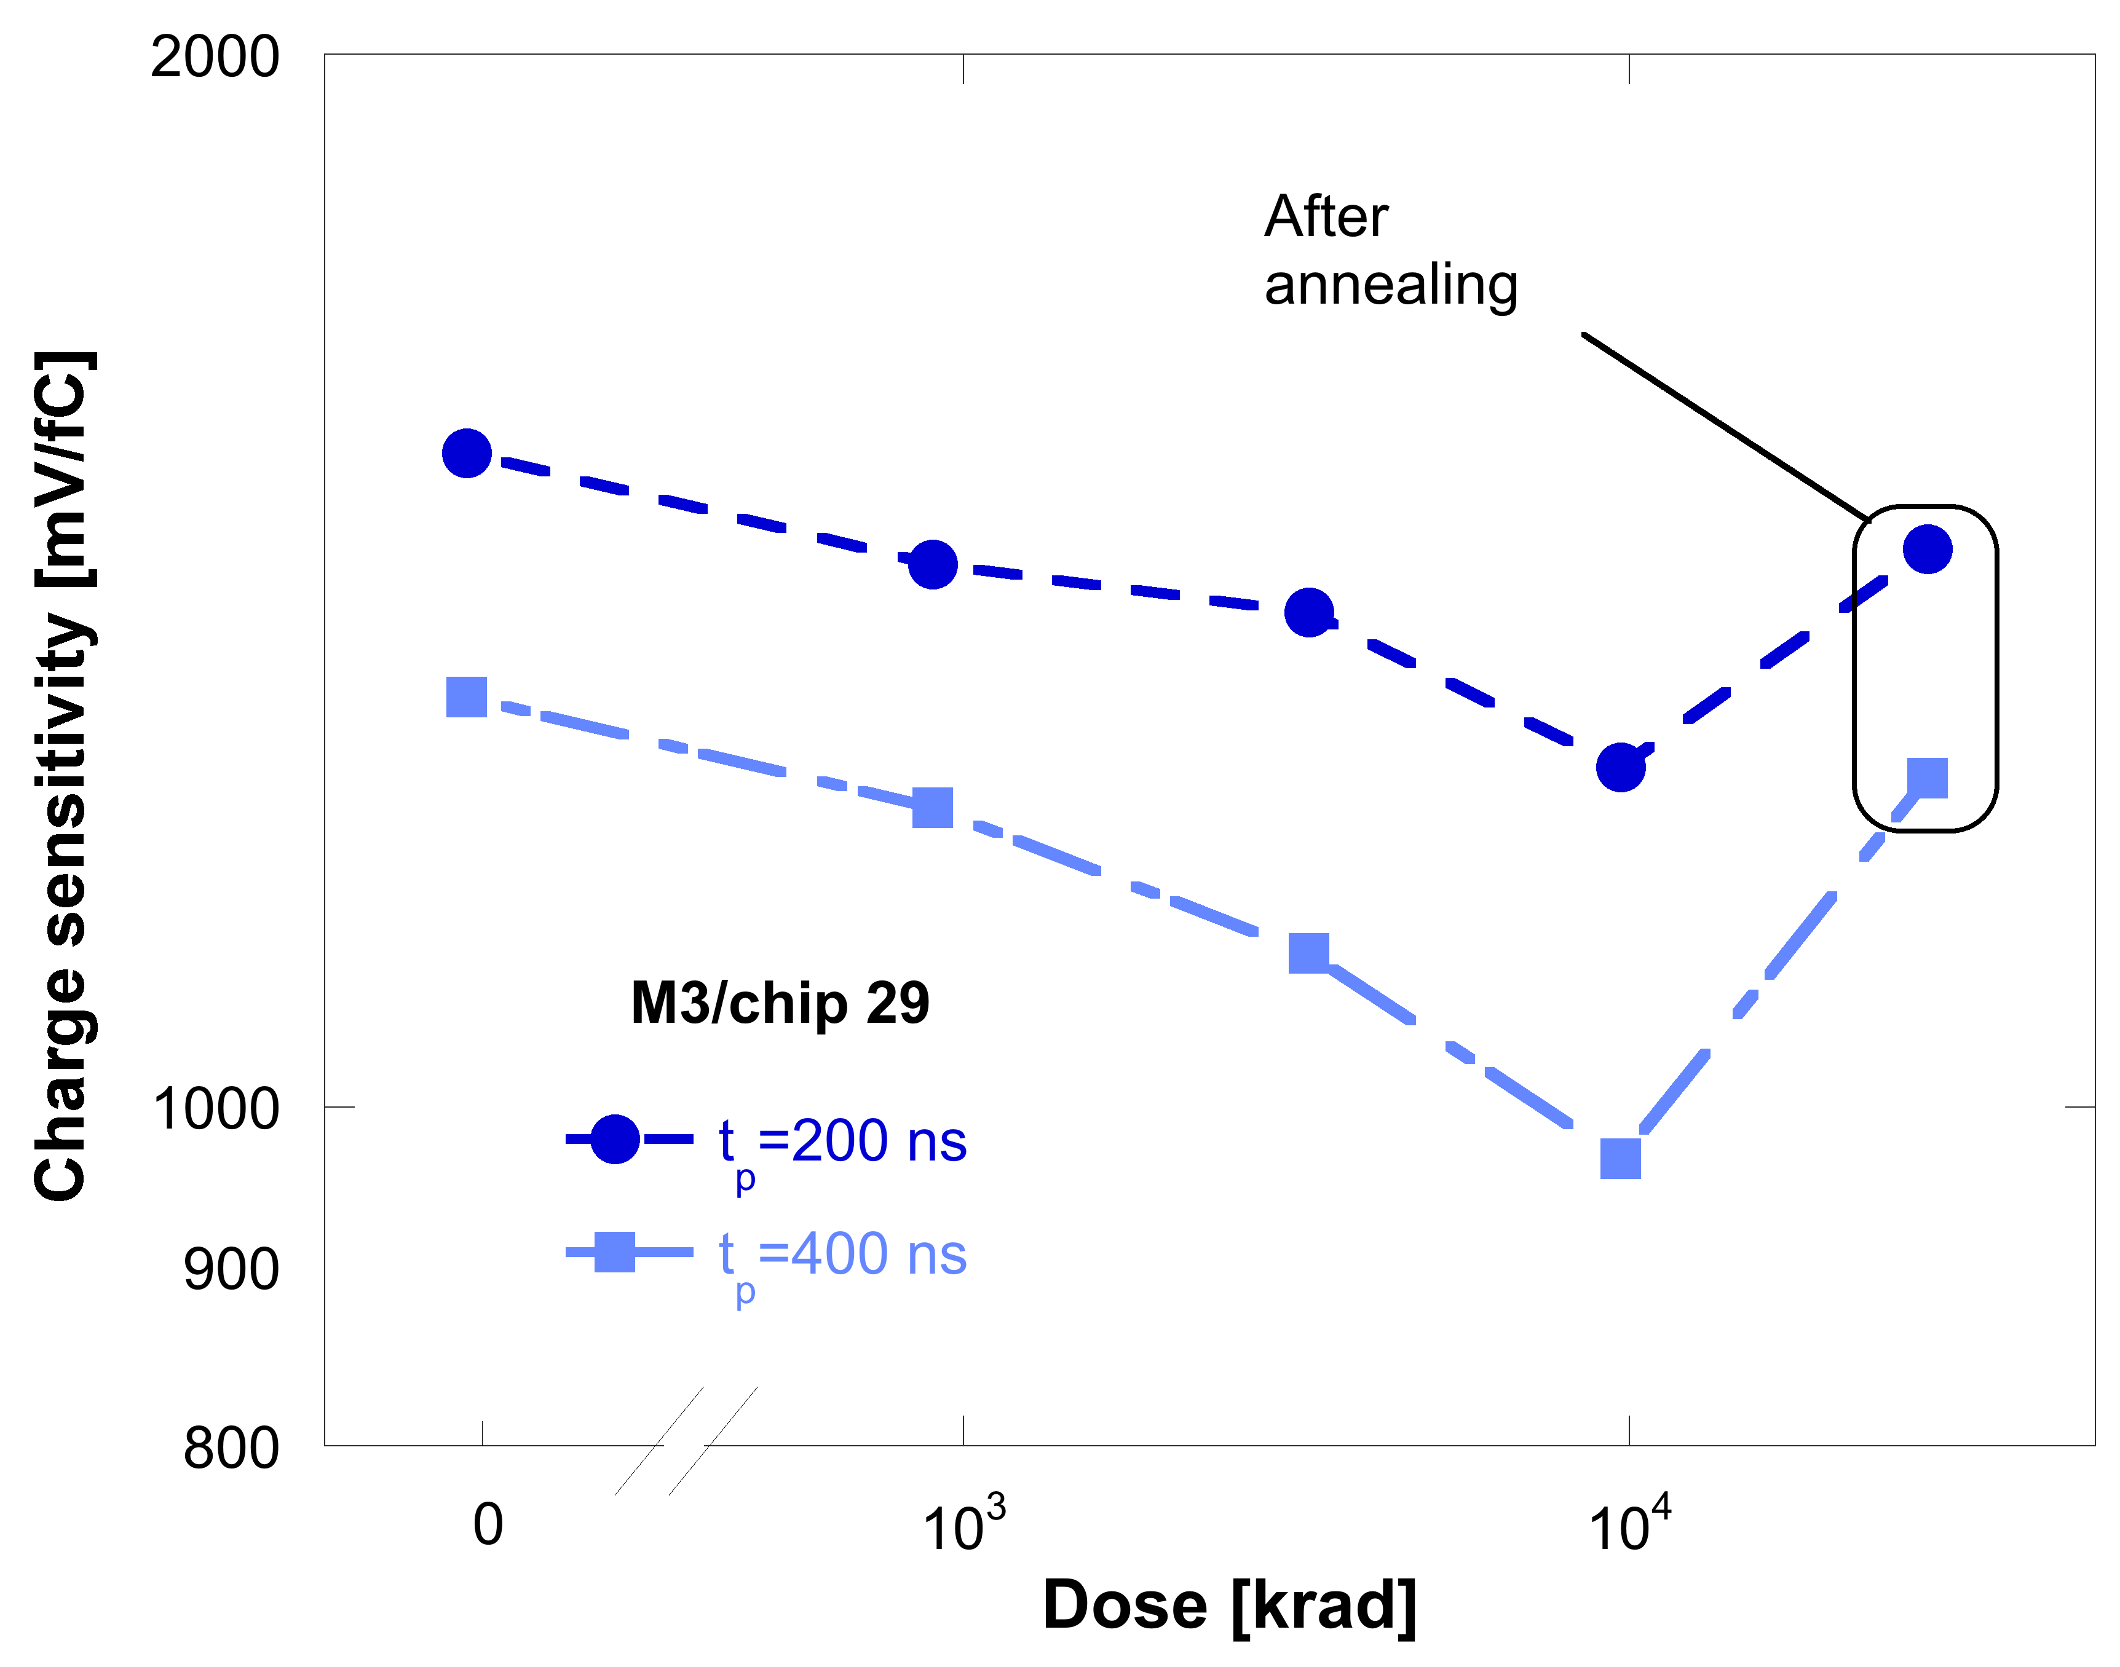
Charge sensitivity
Planar DNW MAPS
About 20-25% decrease after the last irradiation step (9700 krad)
Sizeable recovery after annealing
Change in charge sensitivity results from:
Threshold shift in the preampli feedback MOSFET (RINC effect)
Increase in leakage current in the detector (partially compensating the first effect)
Change in the feedback transconductance and gain-bandwidth product in the shaper
Radiation damage mechanisms discussed in IEEE TNS., vol. 56, no. 4, pp. 2124-2131, Aug. 2009.

Slide 9
RINC effect
Planar DNW MAPS
Radiation Induced Narrow Channel (RINC) effect ➔ significant change in threshold voltage and drain leakage current in N- and PMOSFETs with narrow (<1 um) channel
Due to charge trapped in the shallow trench isolation (STI) affecting electric fields in the main channel
Responsible for threshold shift in the preampli feedback MOSFET (W/L=0.18 um/10 um)
Shift of tens of mV in irradiated narrow channel devices (to be compared with a few mV in wide channel MOSFETs)
RINC effect discussed for the first time by F. Faccio and G. Cervelli in IEEE TNS., vol. 52, no. 6, pp. 2413-2420, Dec. 2005.

Slide 10
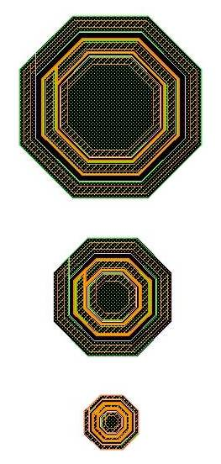
Sensor leakage
Planar DNW MAPS
Found to balance RINC effect in the preampli feedback MOSFET in tests on previous MAPS versions (Apsel2T)
Leakage current proportional to the diode perimeter → compatible with charge buildup in the field oxide and/or creation of traps at SiO₂/Si interface, accounting for surface generation current increase

Slide 11
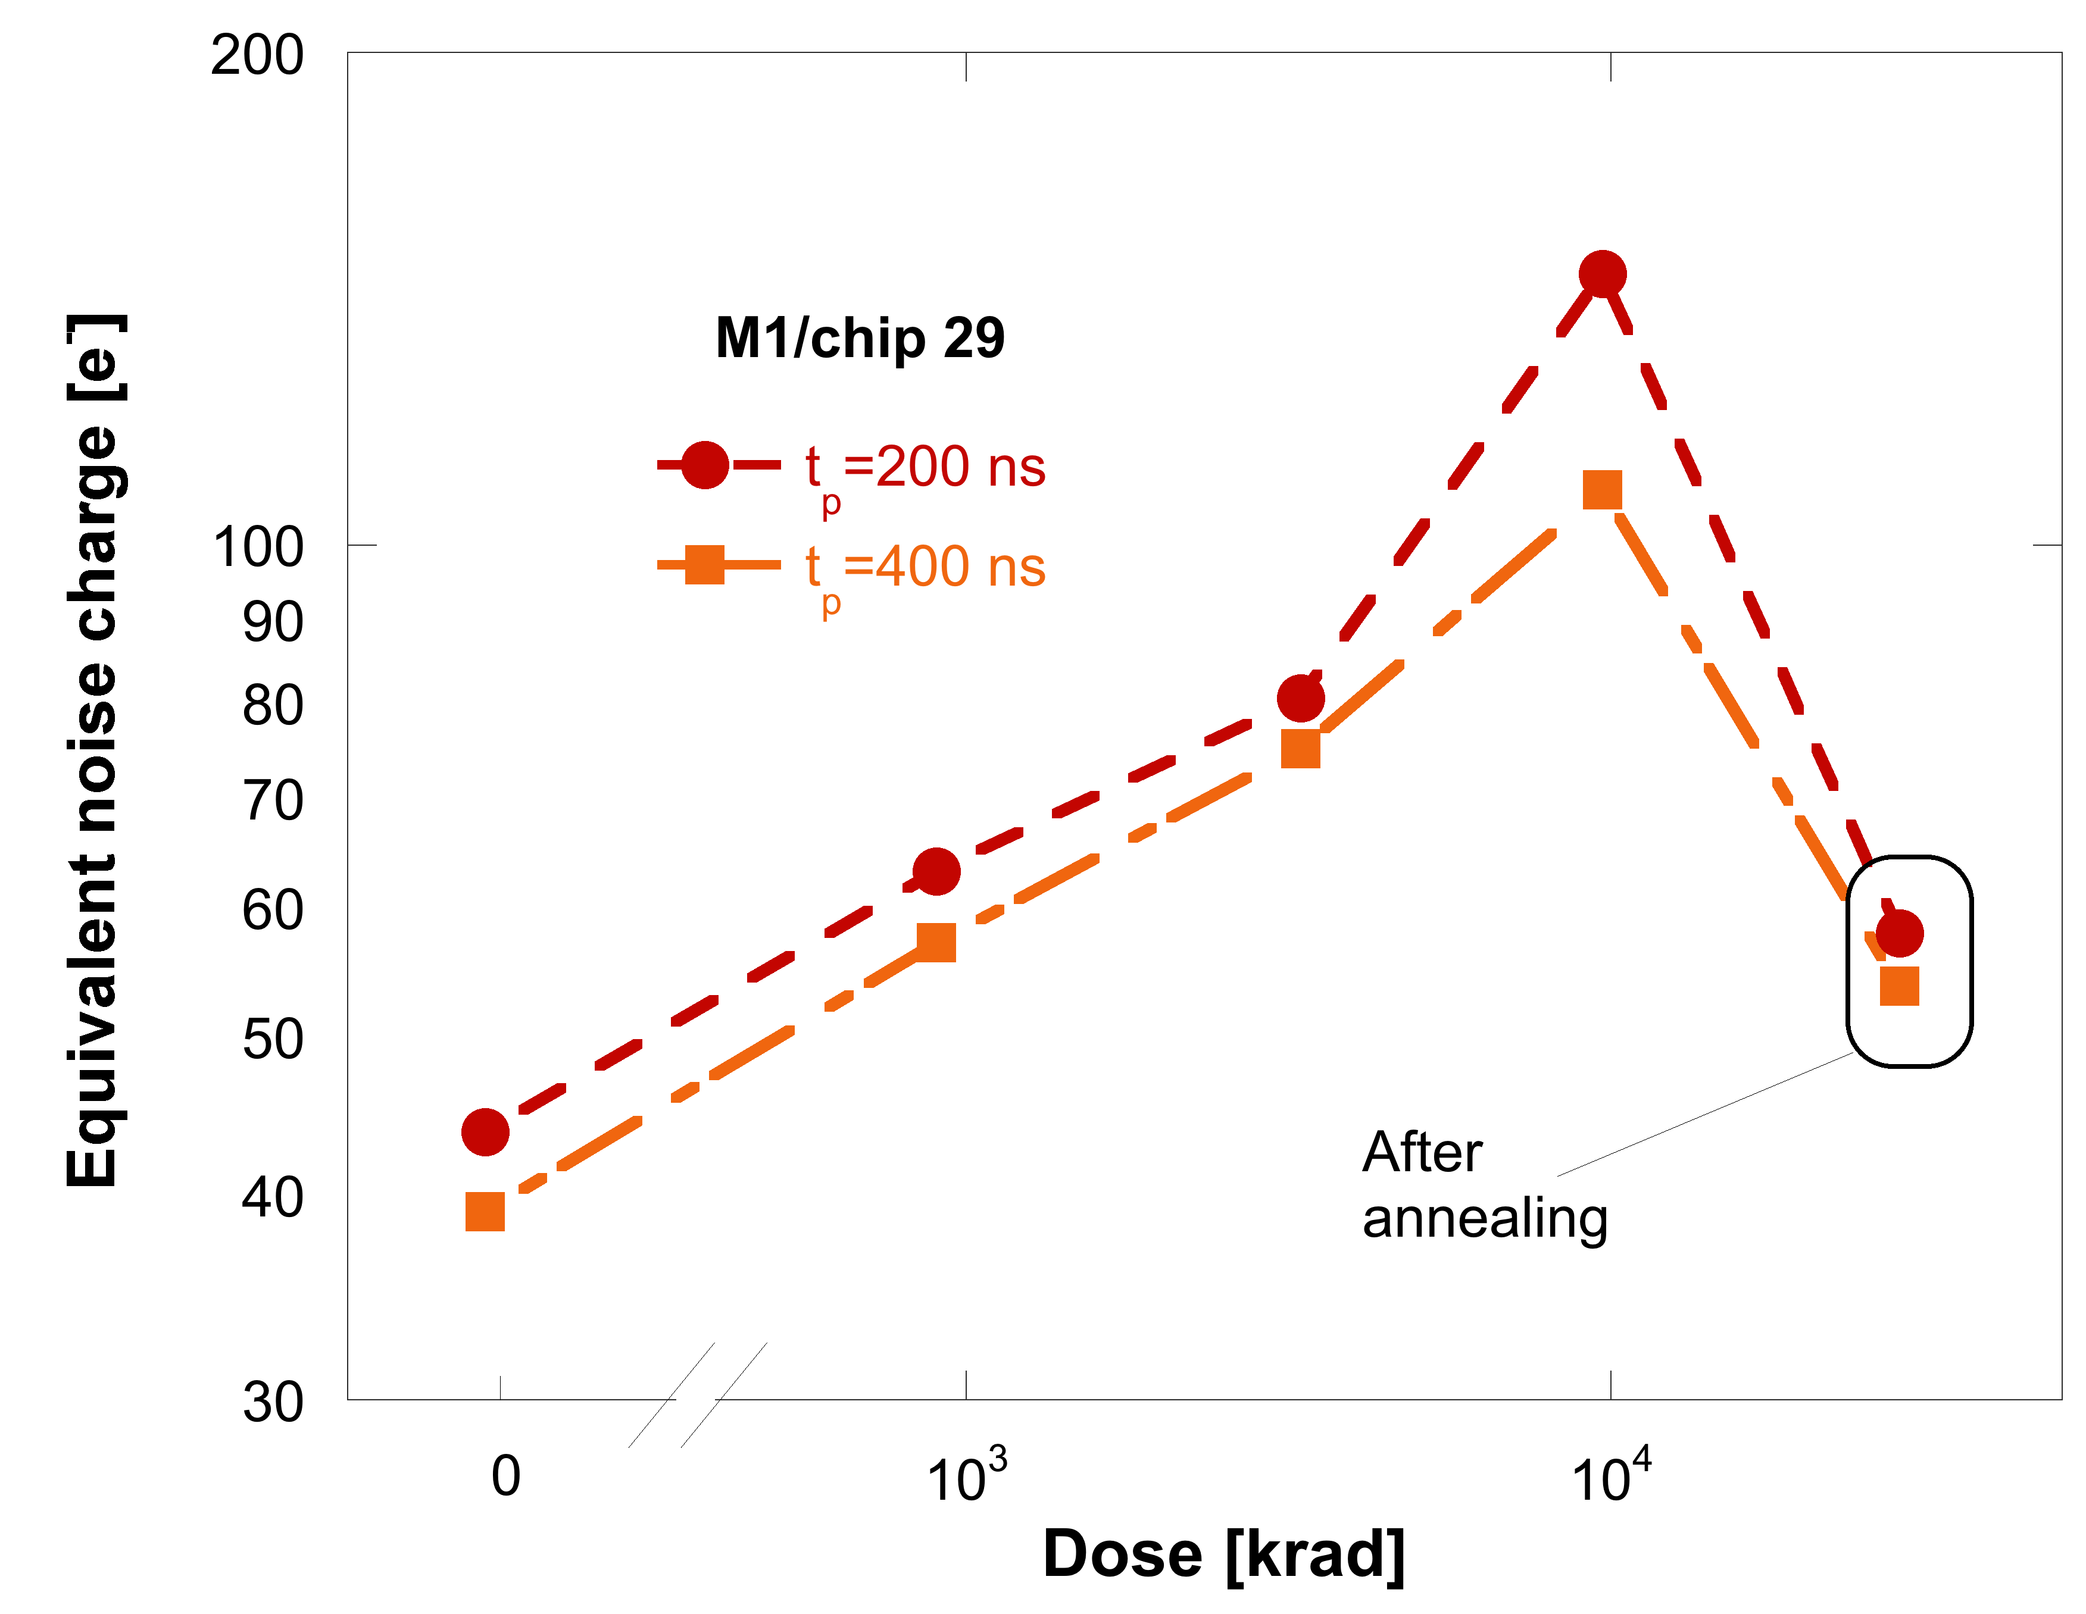
Equivalent noise charge
Planar DNW MAPS
Main contributions from the preampli input device (channel thermal and flicker noise)
Other, low frequency (parallel) noise terms negligible at the considered peaking times
Increase in excess of 100% in equivalent noise charge (ENC) after the last irradiation step
Sizeable recovery after the annealing cycle
Main contribution to noise degradation likely to come from flicker noise increase
Radiation induced increase in flicker noise is discussed in IEEE TNS., vol. 54, no. 6, pp. 1992-2000, Dec. 2007.
channel thermal noise
flicker noise

Slide 12
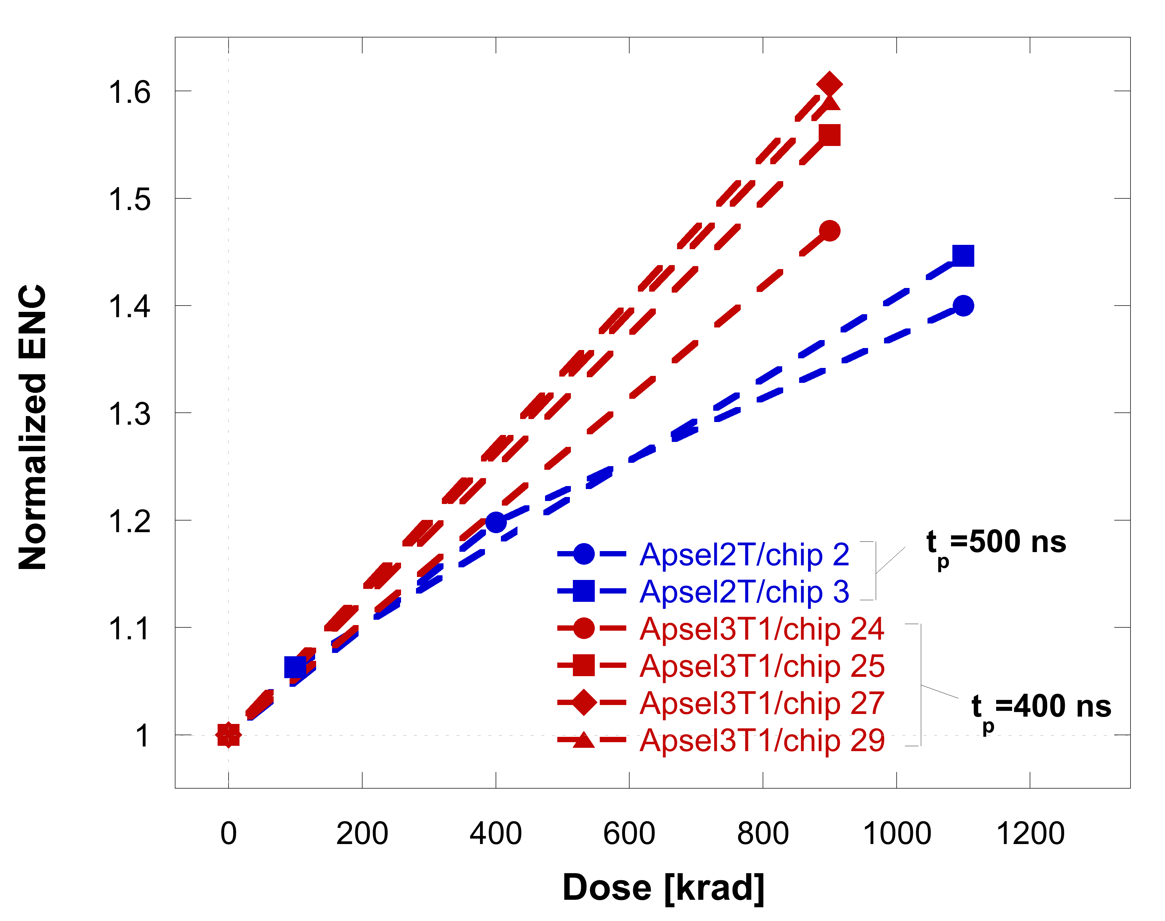
Equivalent noise charge: hole build-up in the STI
Planar DNW MAPS
W/L=14/0.25
I_{D}=20 μA
4 fingers
W/L=16/0.25
I_{D}=30 μA
3 fingers
1
Apsel3T1
Apsel2T
2
parasitic devices
parasitic devices
n_{f}
STI
STI
Parasitic devices turned on by positive charge trapped in the STI
Increase in flicker noise
Each parasitic device (two per finger) provides its contribution to the overall noise
Flicker noise degradation is worse in devices with larger number of fingers and smaller drain current density
Finger number
Current density

Slide 13
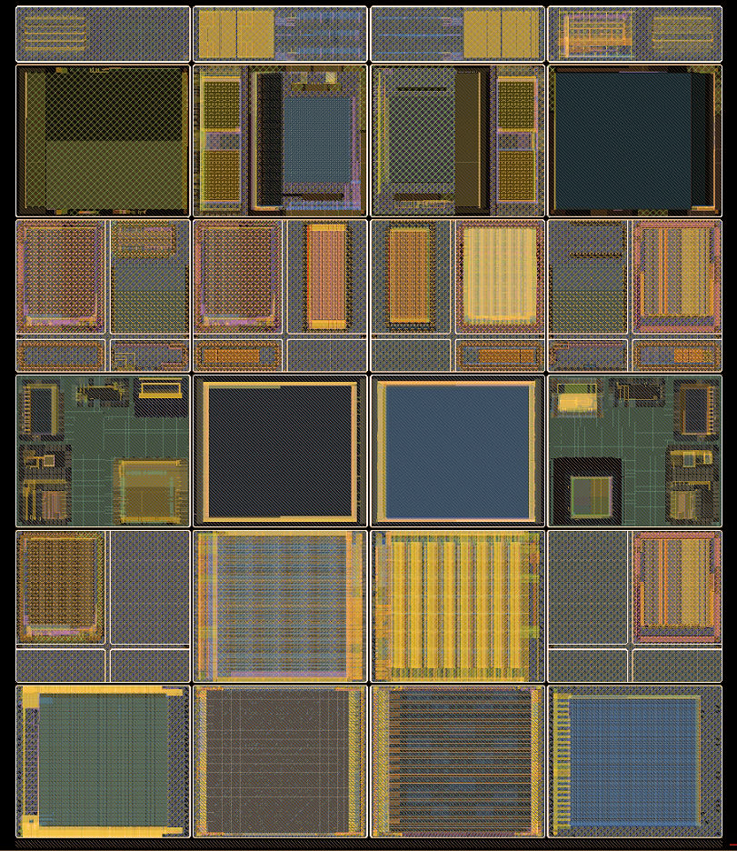
Vertically integrated DNW MAPS
A couple of different solutions (sharing the same analog front-end architecture) for different experimental environments
3D-IC Consortium chip
~ 2.5 cm
Apsel5T-TC, B-factory experiments – 40 um pitch, triggerless digital readout
single transistors
SDR1, ILC experiments – 20 um pitch, token passing readout scheme
Single transistors irradiated up to 10 Mrad(SiO₂), MAPS up to ~800 krad(SiO₂) with ⁶⁰Co
~ 3.2 cm
MAPS
1st layer
2nd layer
V_{fbk}
AVDD
AVDD
DVDD
V_{t}
out
in-pixel
logic
AGND
C_{F}
DGND

Slide 14
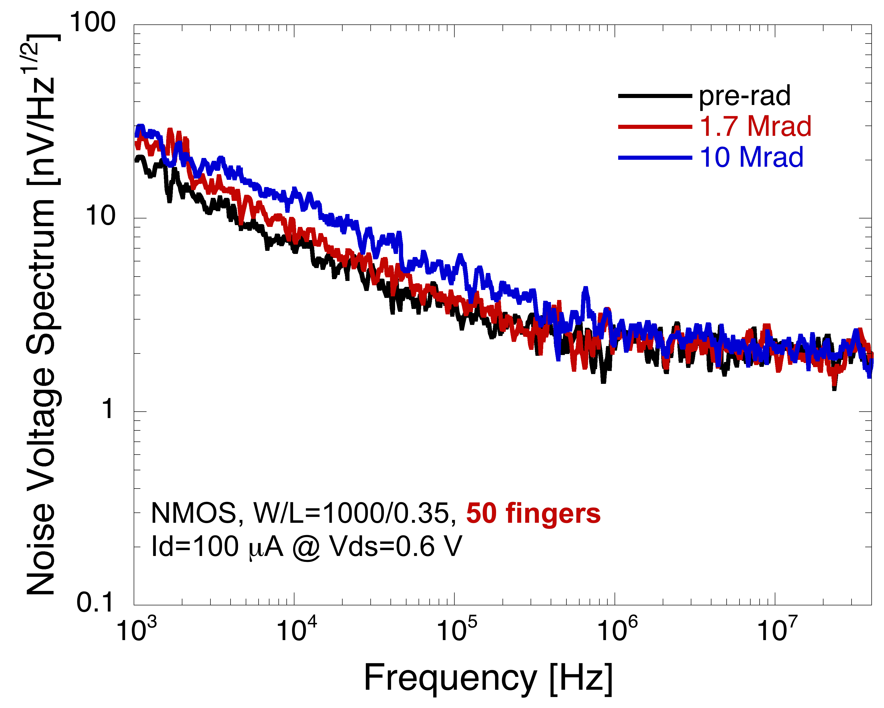
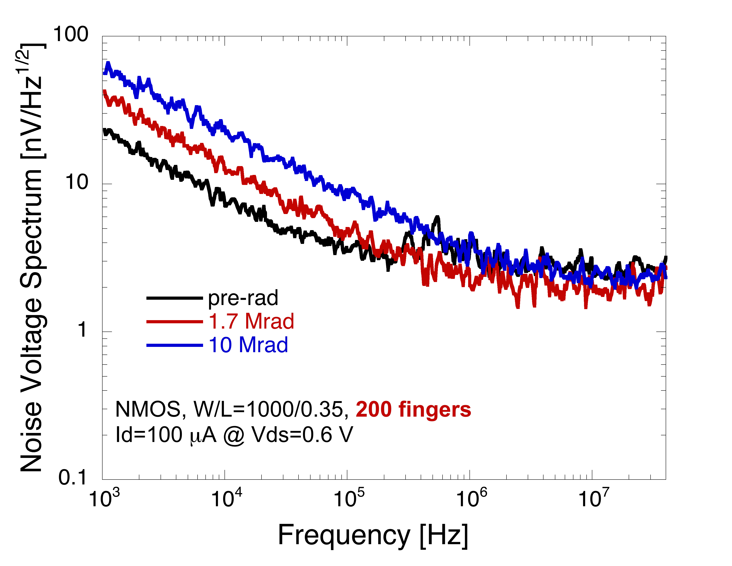
Single transistors in 3D technology
3D DNW MAPS
Single devices biased in the worst case condition (NMOS gate at VDD, all the other terminals grounded)
Noise increase at low frequency in irradiated devices is related to excess noise contributions from lateral parasitic MOSFETs turned on by positive charge build-up in STI oxides

Slide 15
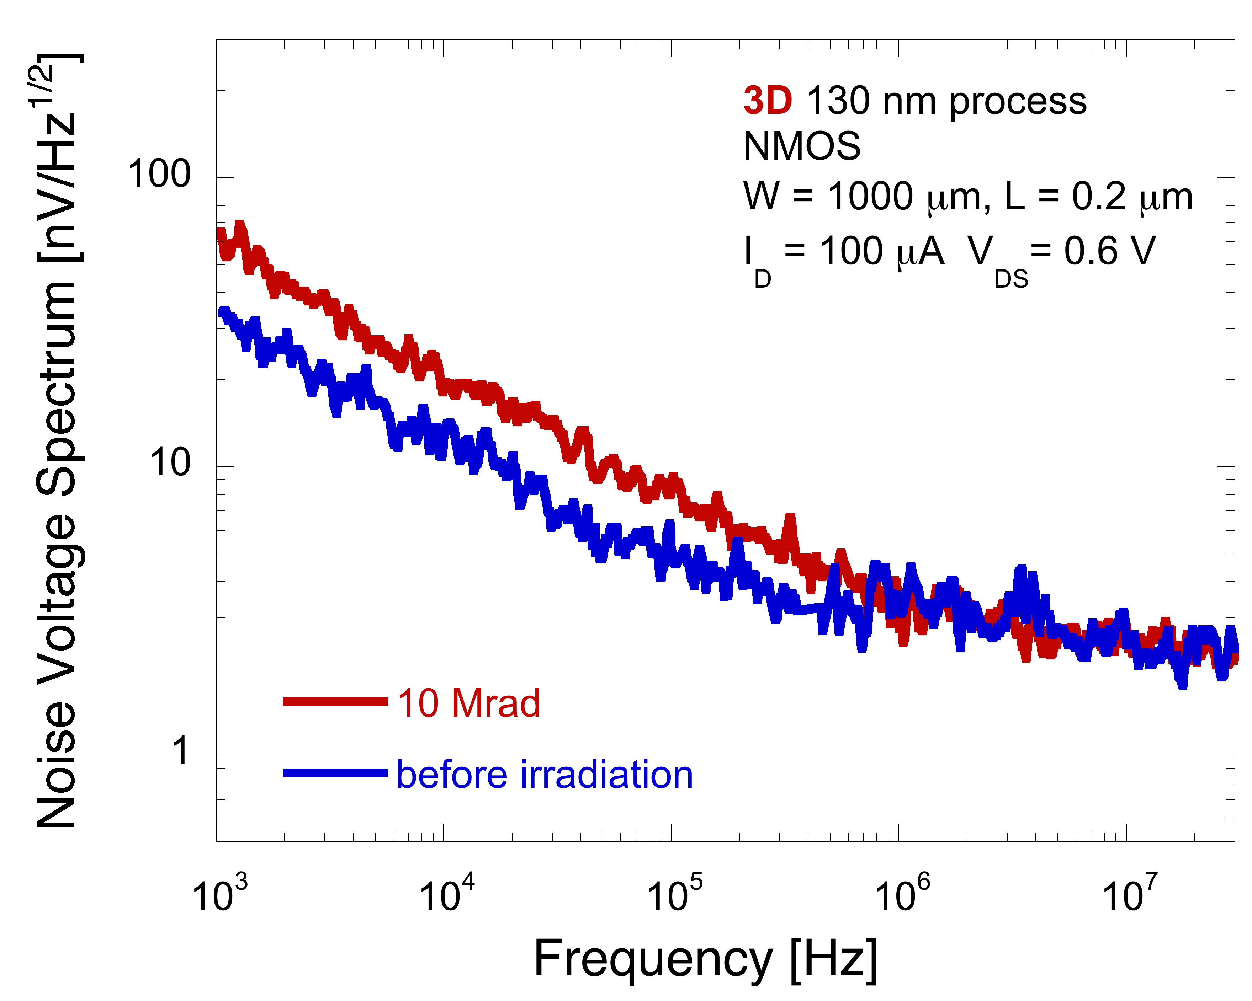
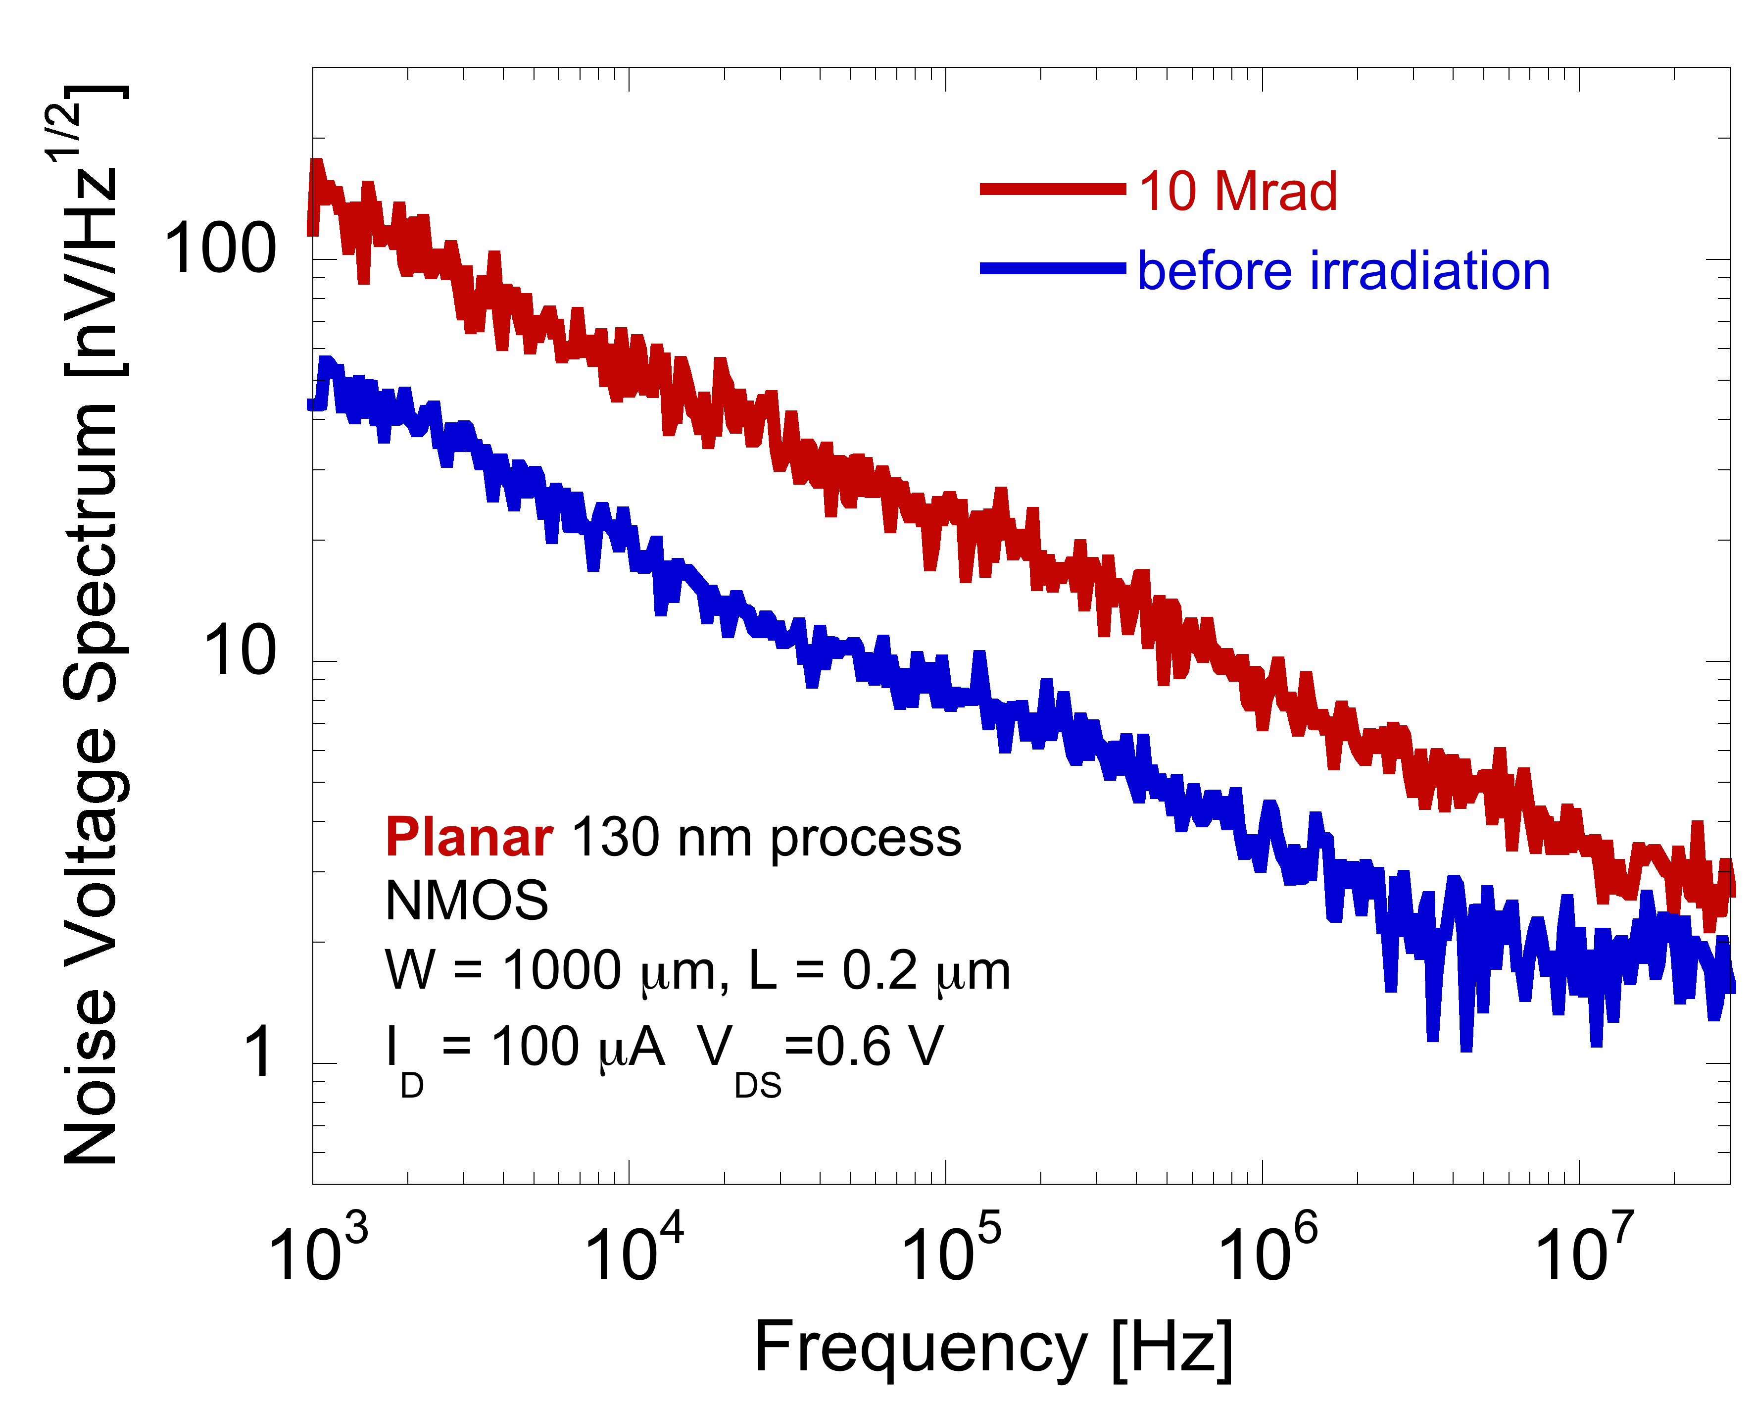
Comparison with planar technology
3D DNW MAPS
3D processing steps do not result in any significant degradation of the radiation tolerance features
Smaller sensitivity to ionizing radiation than planar devices from the same CMOS generation – likely due to oxide processing details and different bulk doping levels

Slide 16
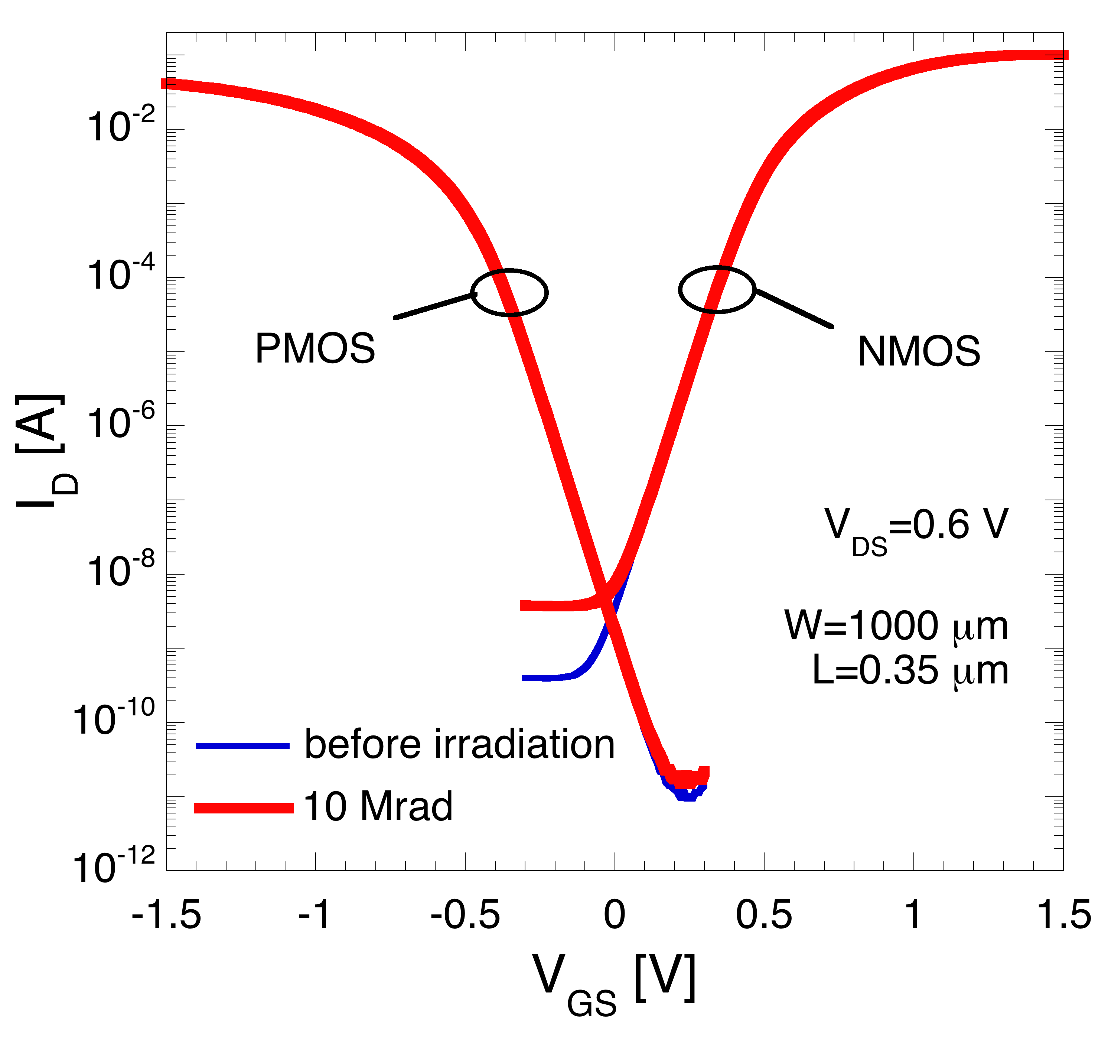
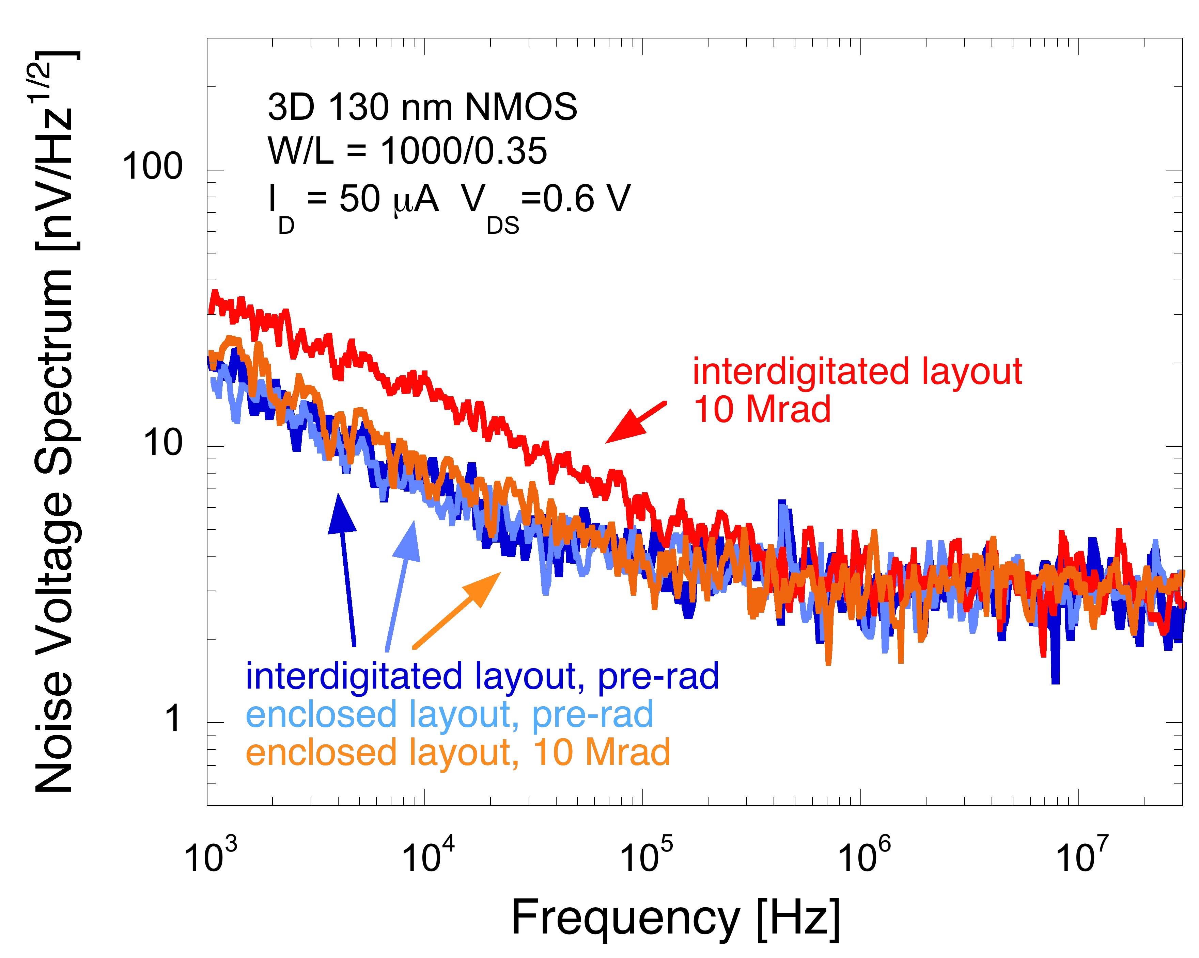
Enclosed layout
3D DNW MAPS
Increase in the off-state current for NMOS transistors, negligible change in PMOS transistors
Use of enclosed layout techniques, as in other technologies in the same and other nodes, improves the tolerance to ionizing radiation

Slide 17
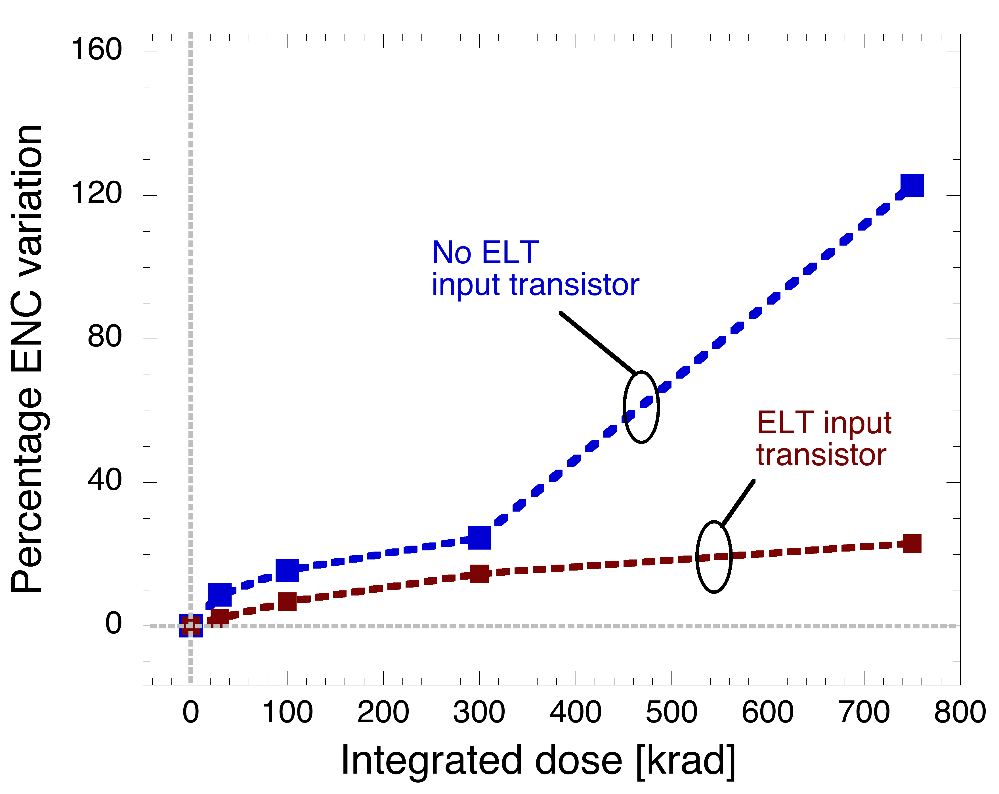
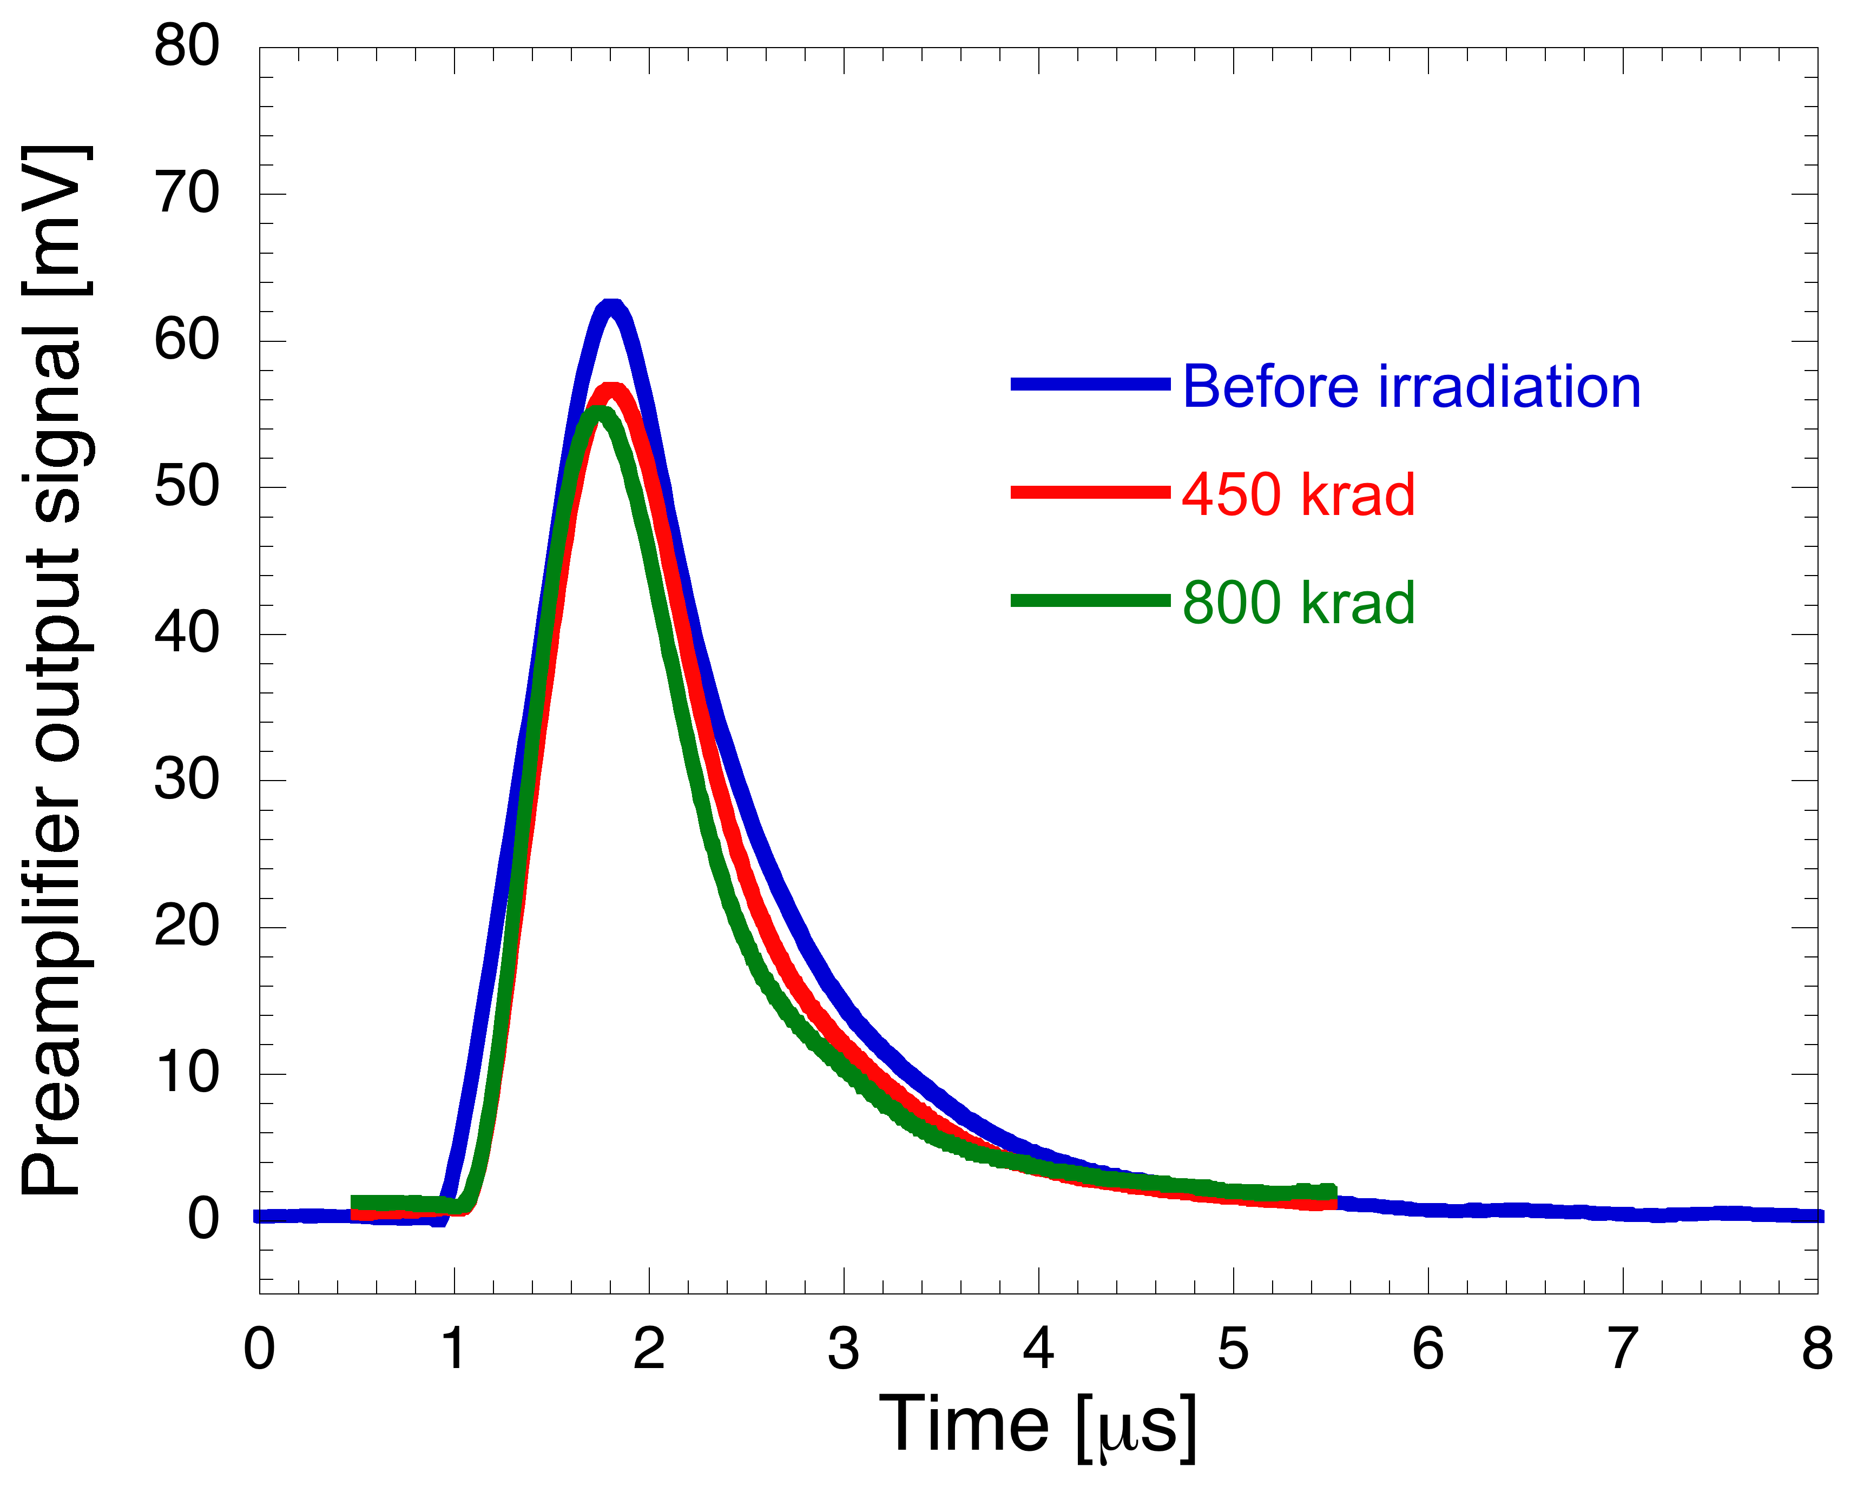
Monolithic sensors
3D DNW MAPS
Radiation tolerance improvement provided by enclosed layout techniques is confirmed by 3D MAPS characterization – smaller ENC increase detected in devices with enclosed layout input transistors
Charge sensitivity found to decrease by 10% at about 800 krad TID
Apsel5T-TC
SDR1

Slide 18
Quadruple well MAPS
50 um
50 um
Deep P-well used to avoid parasitic collection by the N-wells containing PMOS devices
Starting wafers with different epi-layer resistivity available, ~10 Ωcm (std res) or ~1 kΩcm (hi res)
3x3 matrices with different epi-layer resistivity, 12 um in thickness (also 5 and 18 um options available)
Test structures irradiated up to
10¹⁴ 1 MeV n/cm² with intermediate steps at 2x10¹², 7.2x10¹² and 2.7x10¹³ n/cm²
~11.5 Mrad(SiO₂) γ-rays TID, with intermediate steps at 1 and 3 Mrad(SiO₂)
DUTs biased as in the real application during gamma-ray irradiation

Slide 19
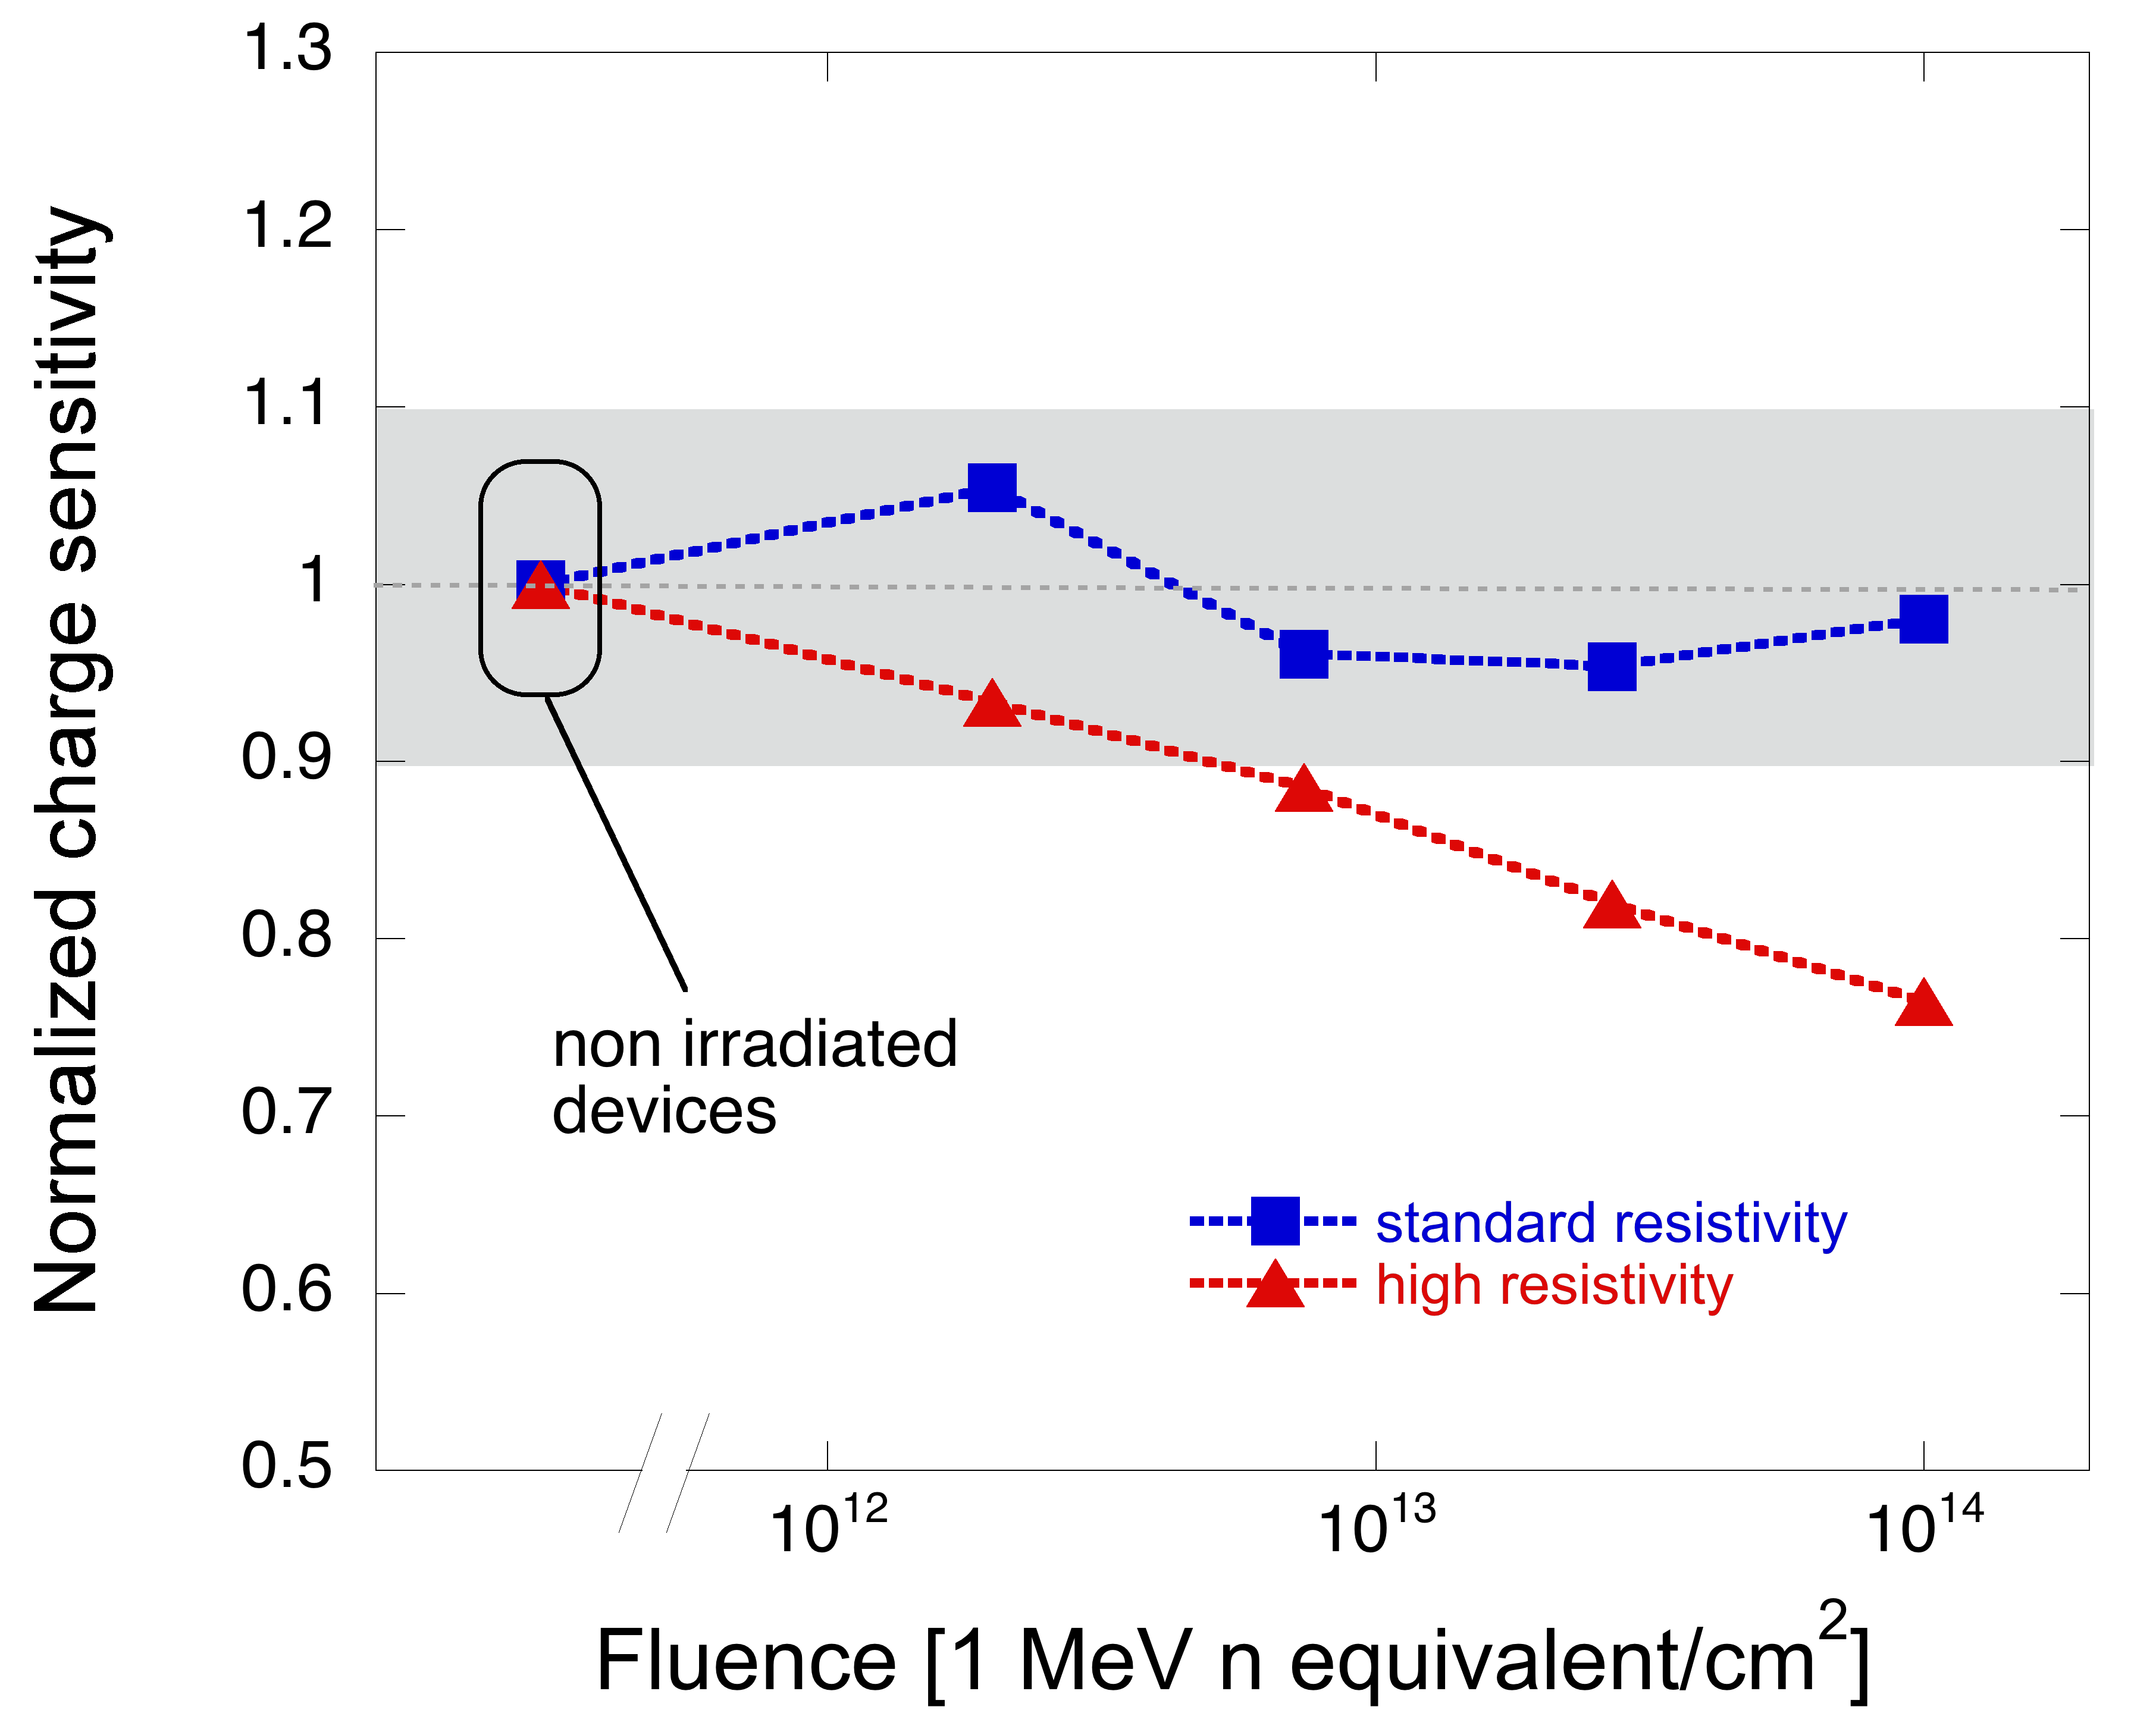
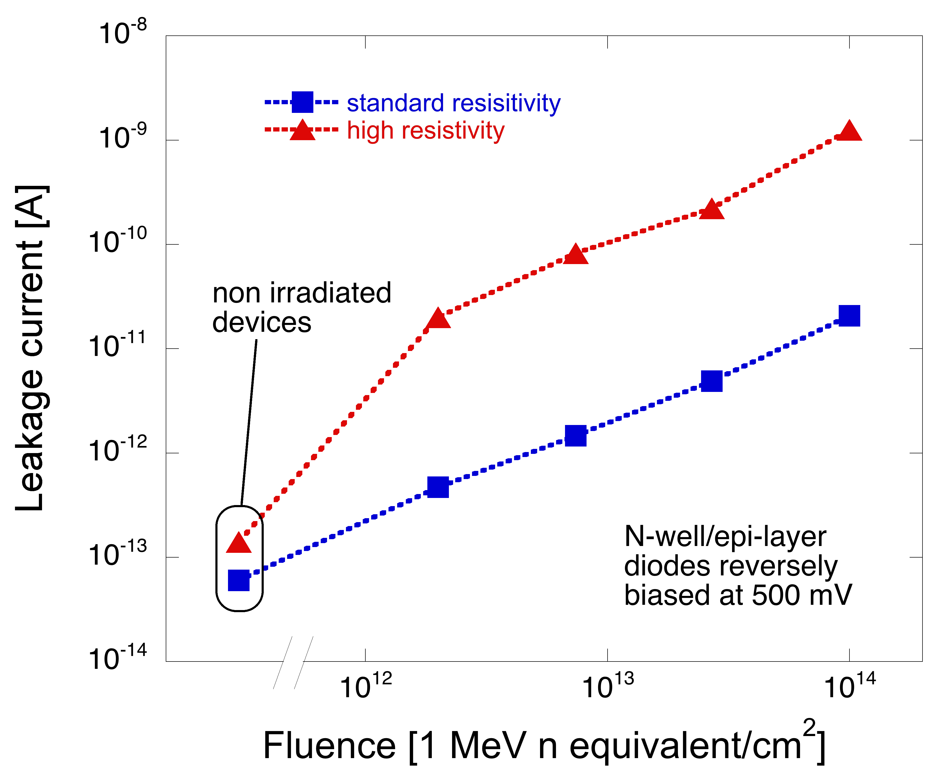
Quad. well MAPS
Bulk damage: gain degradation vs epi-layer resistivity
Non negligible charge sensitivity decrease in the samples with high resistivity epitaxial layer – likely due to an increase in the leakage current from the collecting electrodes → increase in the preamplifier feedback conductance

Slide 20
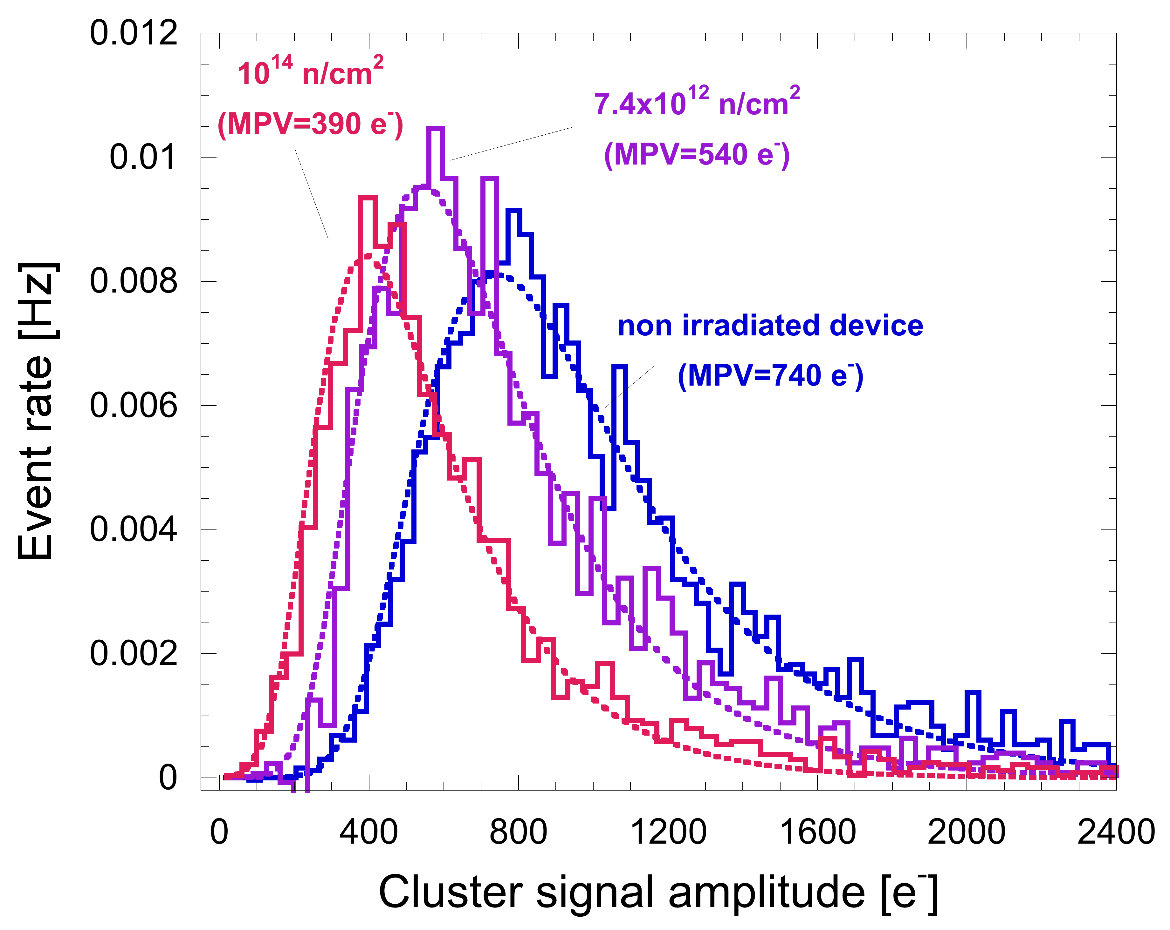
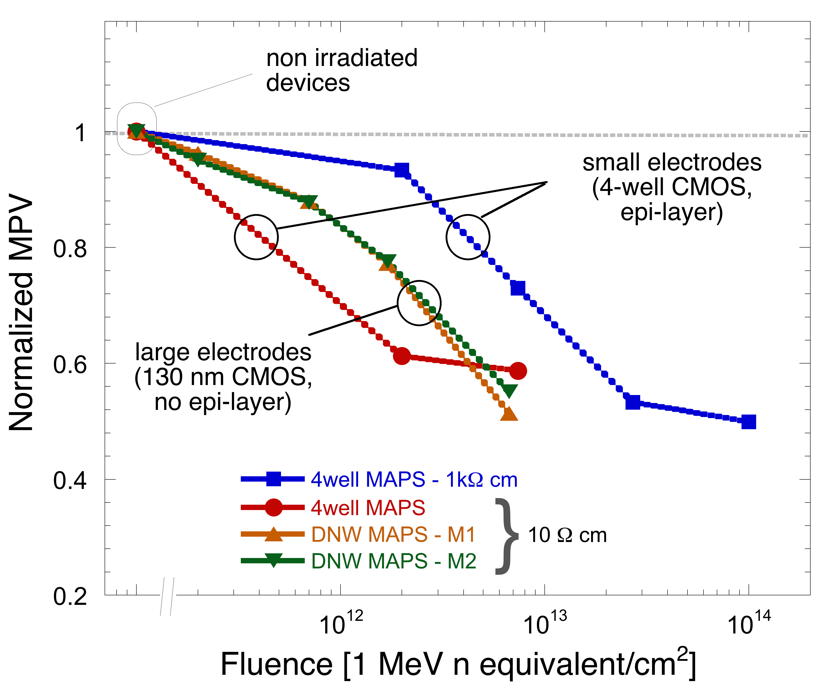
Quad. well MAPS
Bulk damage: charge collection degradation
Charge collection degradation evaluated through ⁹⁰Sr spectrum measurements
Significantly higher tolerance detected in samples with smaller doping concentration in the sensitive layer – larger electrodes also help at relatively small fluences

Slide 21
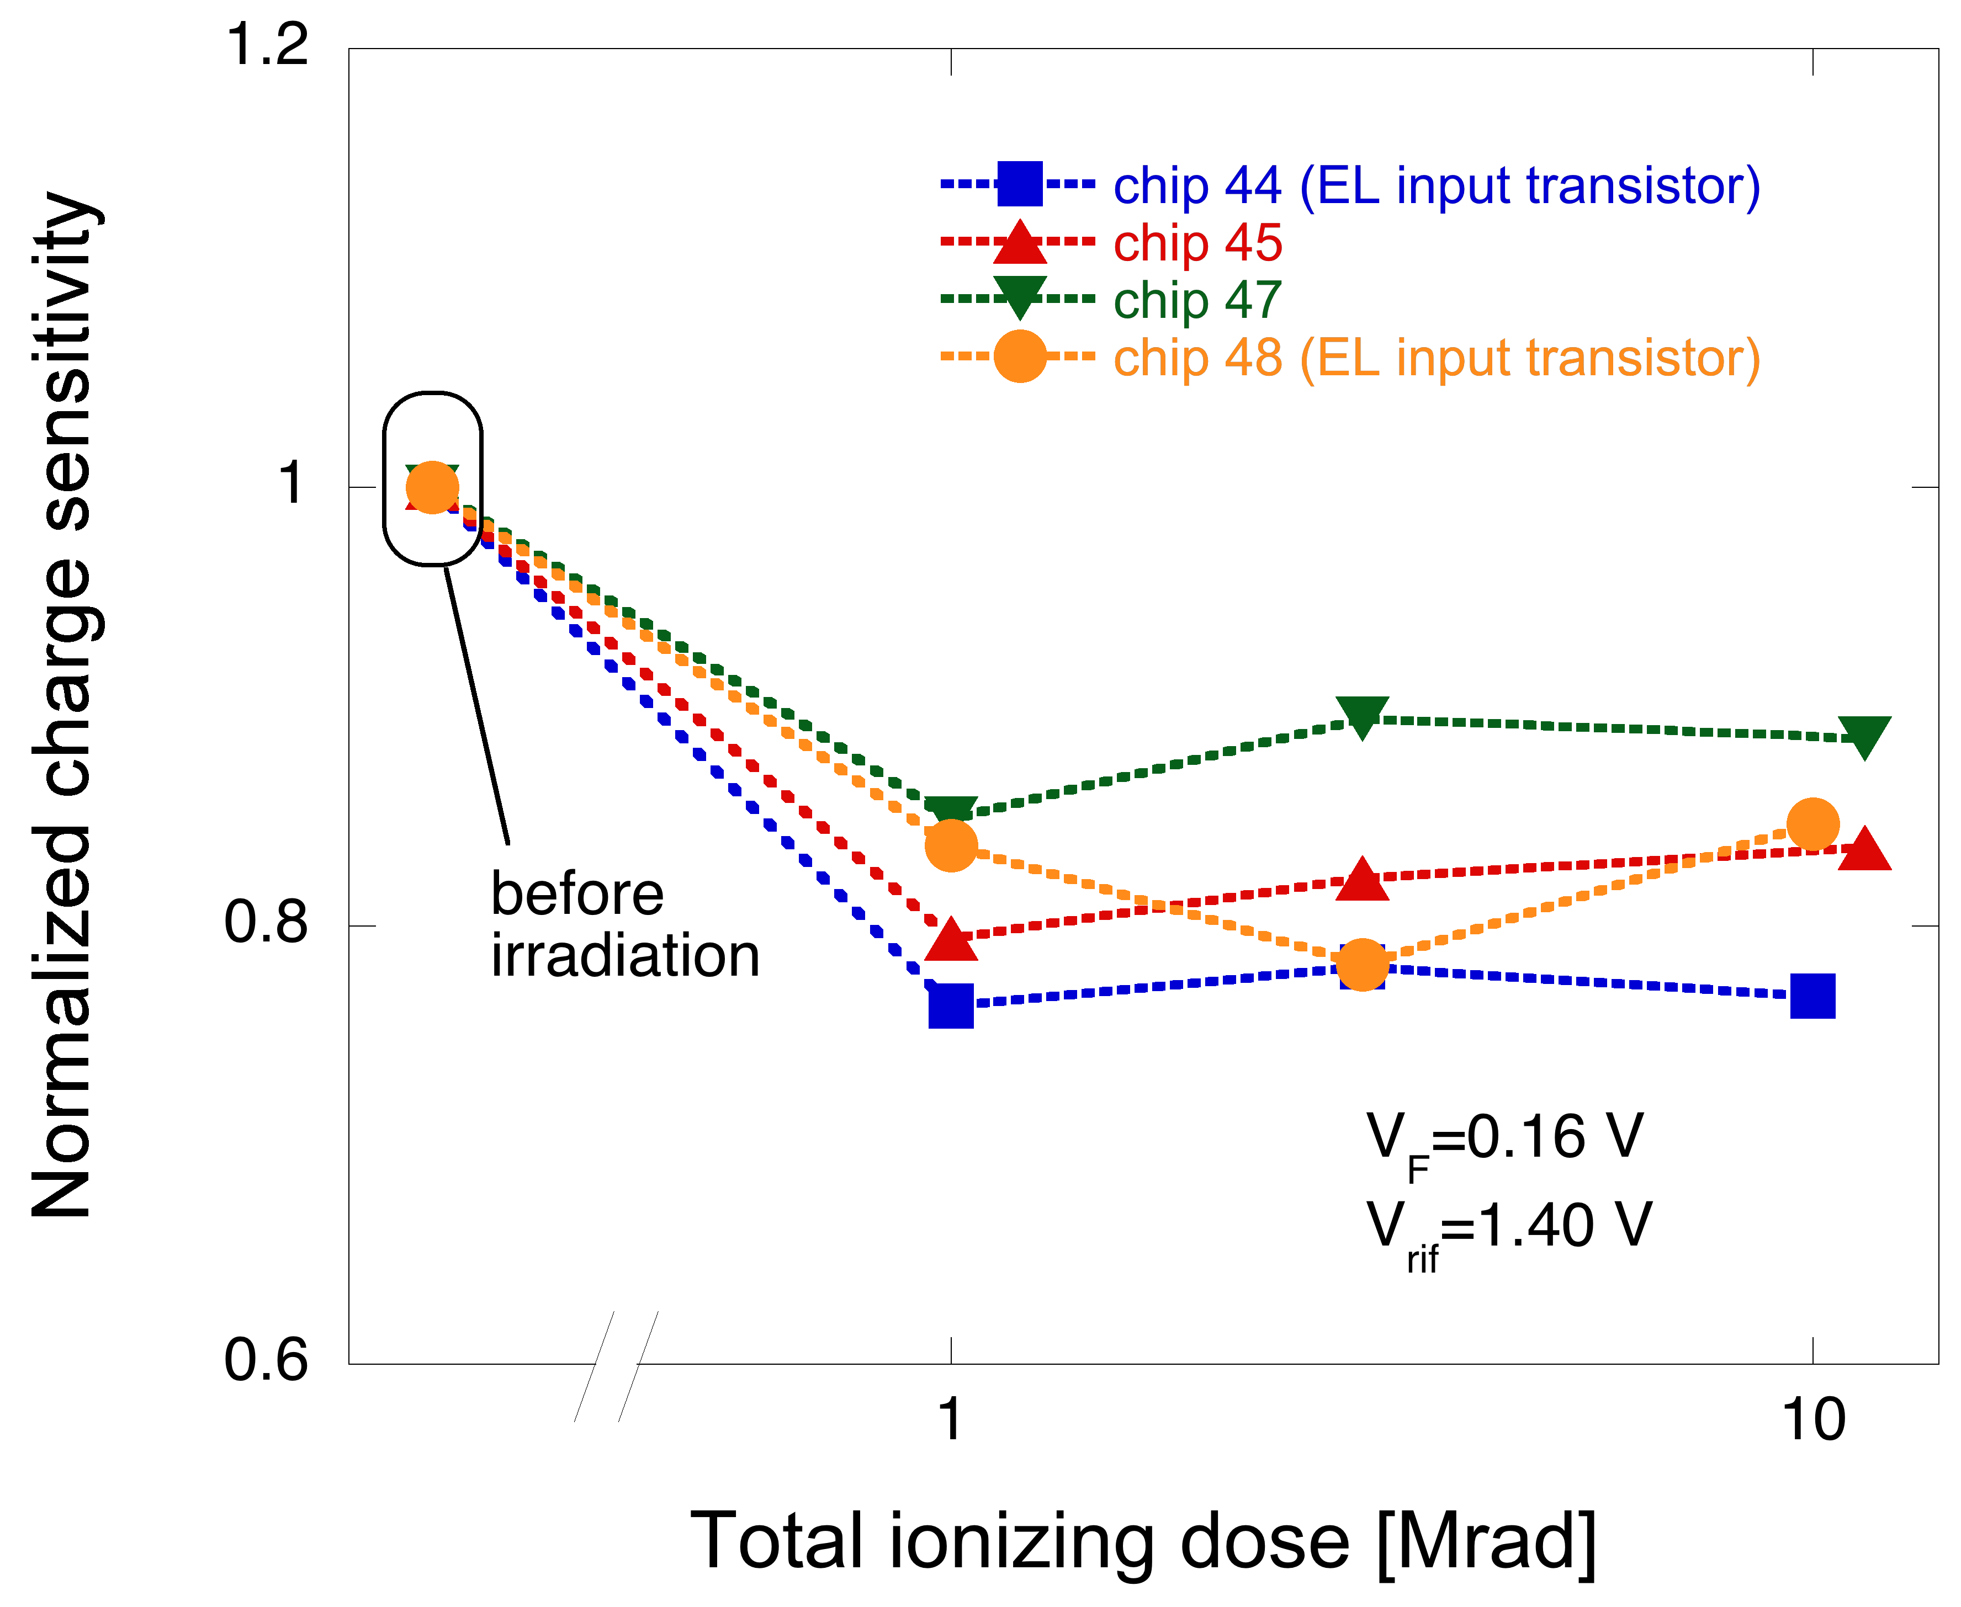
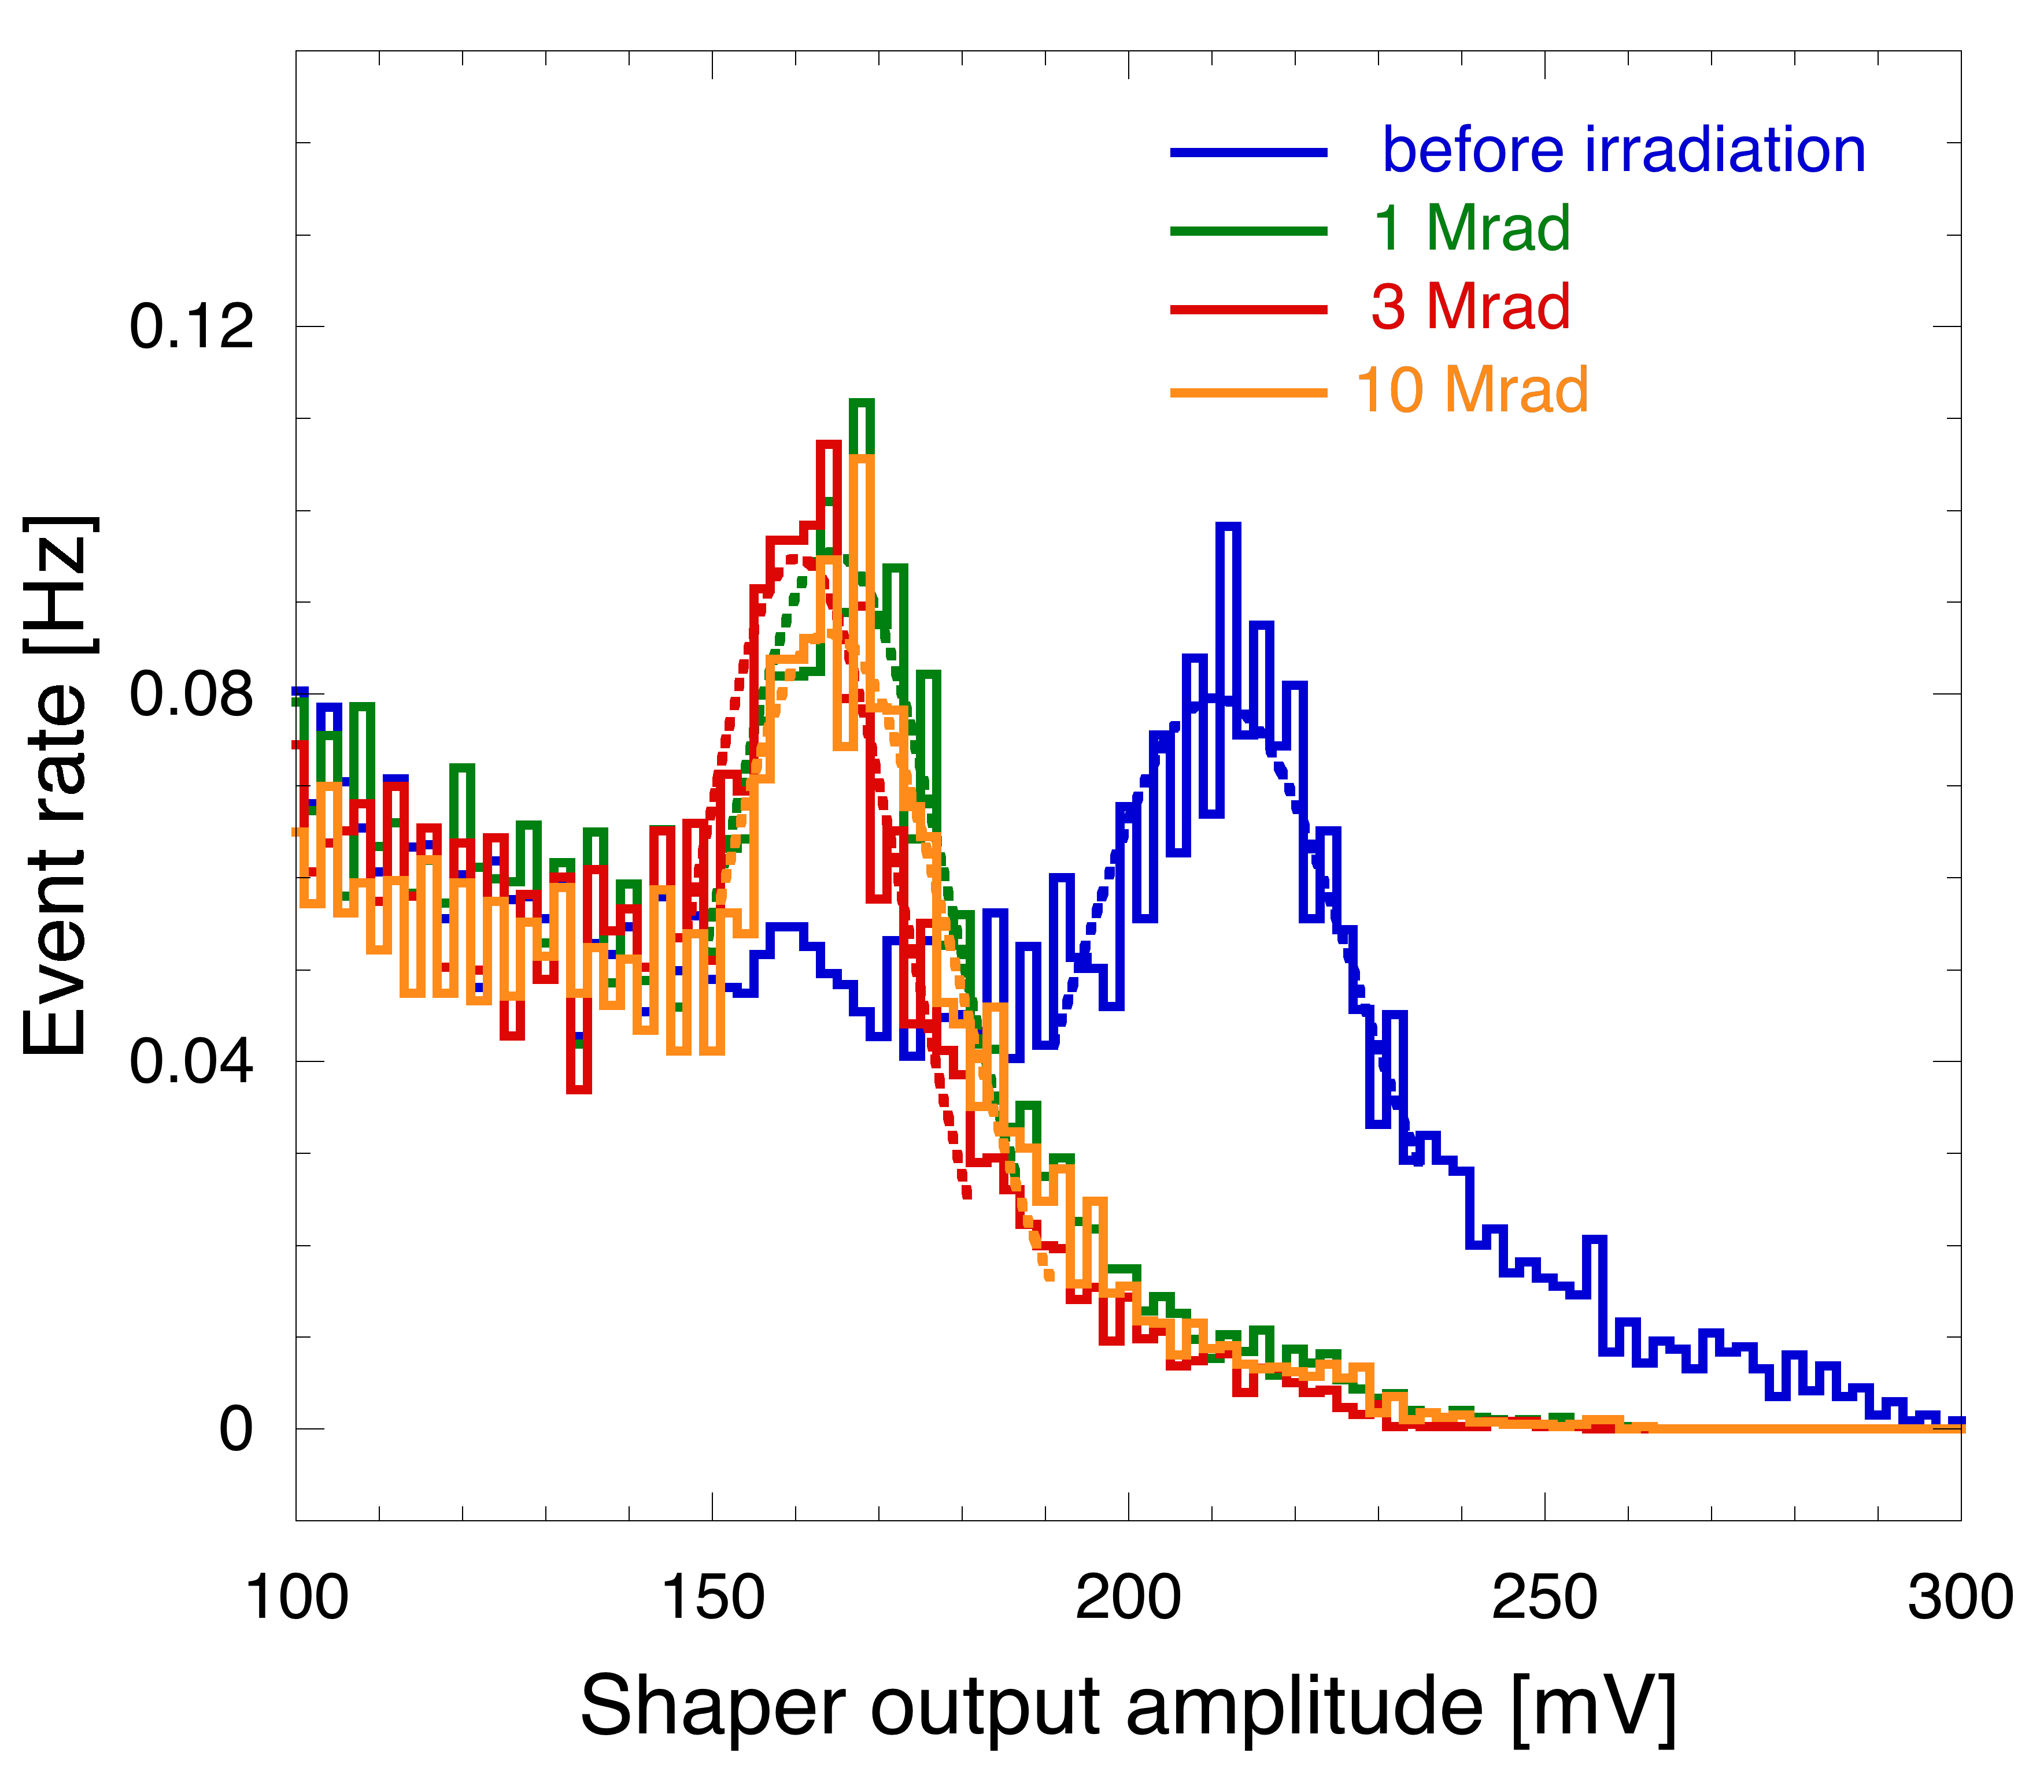
Quad. well MAPS
TID effects: gain degradation
Charge sensitivity decreases with the first step, no significant change at higher doses (direct charge injection measurements confirmed by ⁵⁵Fe spectra) – likely due to effects taking place both in the charge preamplifier and in the shaper

Slide 22
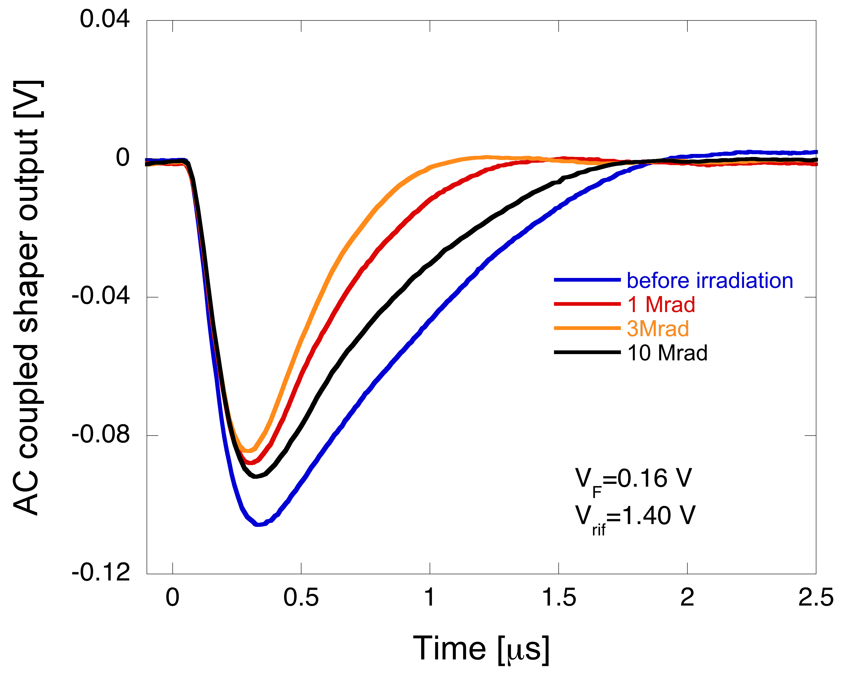
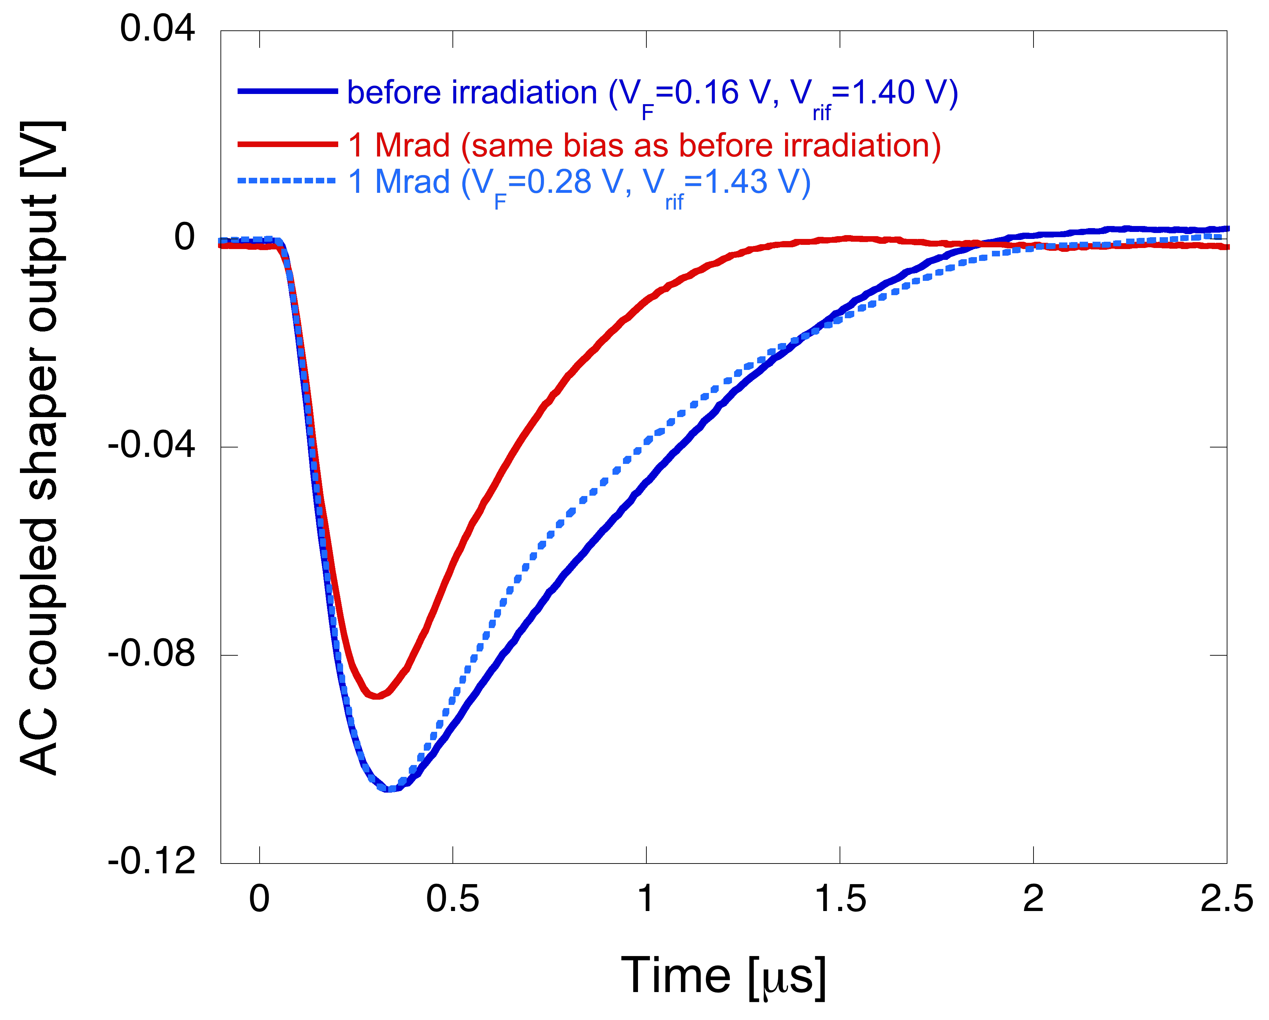
Quad. well MAPS
TID effects: shape change in the channel response
Change in the response peak, peaking time and slope after the first step – due to detector leakage increase and radiation induced narrow channel effects in the shaper feedback network
Virtually complete recovery in slope and peaking time after the final step

Slide 23
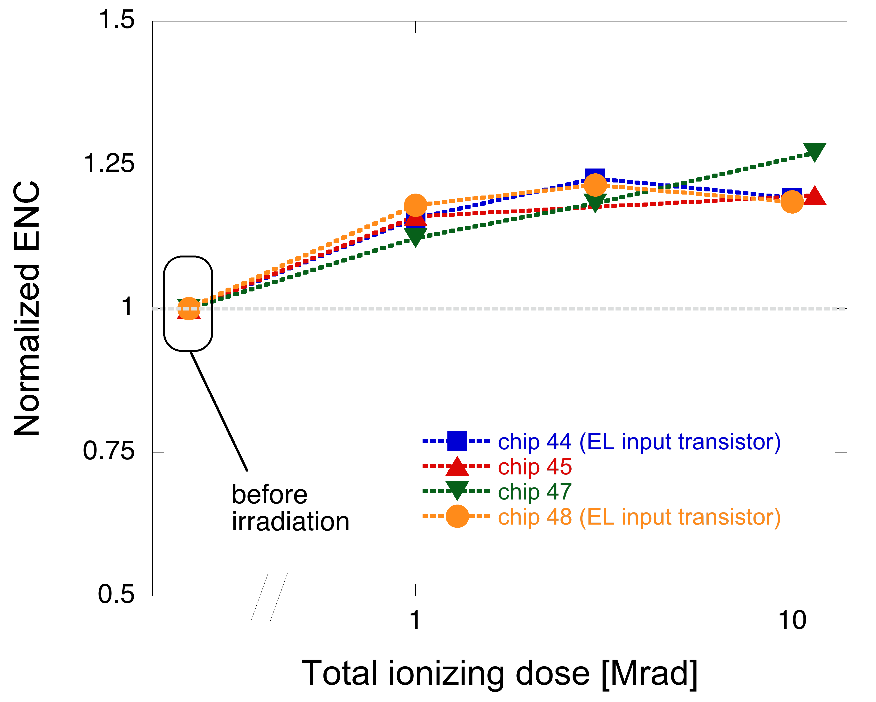
Quad. well MAPS
TID effects: noise degradation
Equivalent noise charge increases by 20% after 1 Mrad(SiO₂), small increase after the subsequent steps up to about 25%
Increase probably due to 1/f noise increase in the preamplifier input device (induced by border traps density increase in the gate oxide)
Use of an enclosed layout input transistor in the charge preamplifier makes no significant difference

Slide 24
Lessons learned and conclusion
Careful design is needed to minimize performance degradation in CMOS monolithic sensors exposed to radiation (while complying with the limited amount of area and power available, especially in a pixel sensor)
minimize finger number and/or use enclosed layout to avoid noise increase in the preampli input device particularly when peaking times well in excess of 100 ns are used
avoid using narrow channel transistors in critical front-end points (e.g., feedback network, current sources)
use compensation networks to counteract the increase in the sensor leakage current
large area collecting electrodes help (compromise with noise/power dissipation needed)
Some technology options may substantially improve the tolerance to bulk damage
use a sensitive layer with a low doping concentration (but beware of the possible higher sensitivity to radiation in terms of leakage current)
Characterization of carefully planned test structures may be extremely helpful in understanding what is going on in relatively complex devices such as hybrid pixel-like MAPS when they are exposed to radiation

