Slide 1
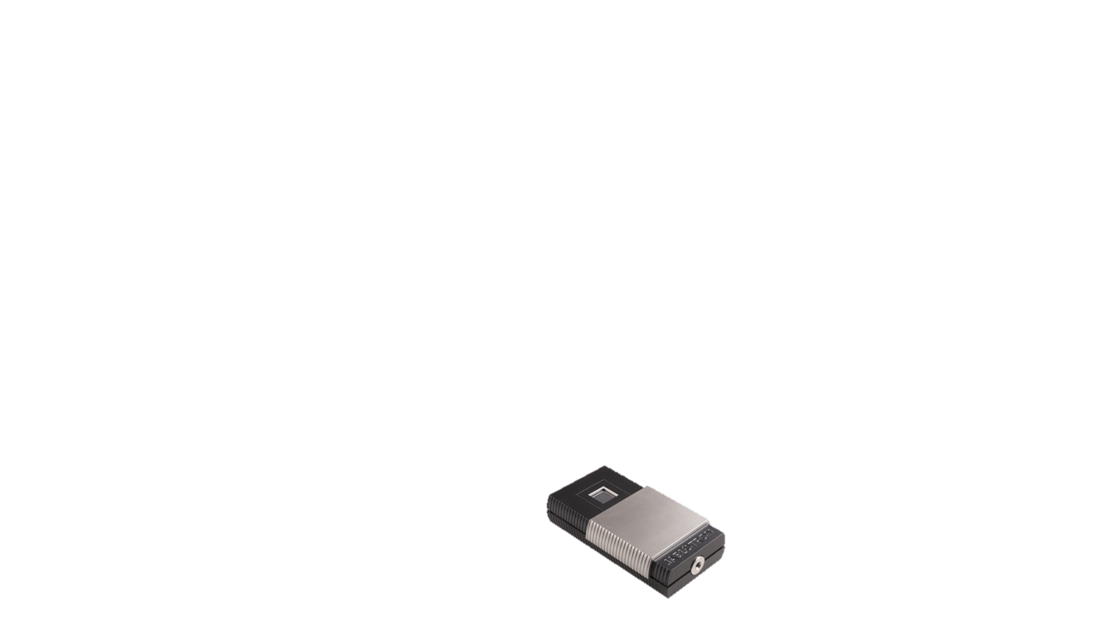
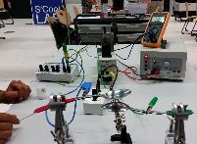
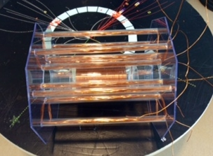
The Particle Detector
Giorgio Vacchiano
LeaH pedder
Marina silva
The Ion trap
Marek Balazovic
Markus Fransson
Hamdan Draghmeh
The ATLAS MAGNET
Lizelle Swanepoel miriam rosenfeld
Julia Aldehoff
Support: Alexandra Feistmantl - Vincent Darras - Julia Woithe
Working Group 4 – S‘Cool LAB

Slide 2

Particle detector
HST 2015
Giorgio Vacchiano (it)
LeaH pedder (USA)
Marina silva (PT)

Slide 3
Subject
Particle camera MX-10 JABLOTRON
BASED ON PIXEL DETECTOR IN LHC
http://www.jablotron.com/en/about-jablotron-1/about-us/international-cooperation/jablotron-mx-10-1.aspx
  Characteristics
  Edu-kit

Slide 4
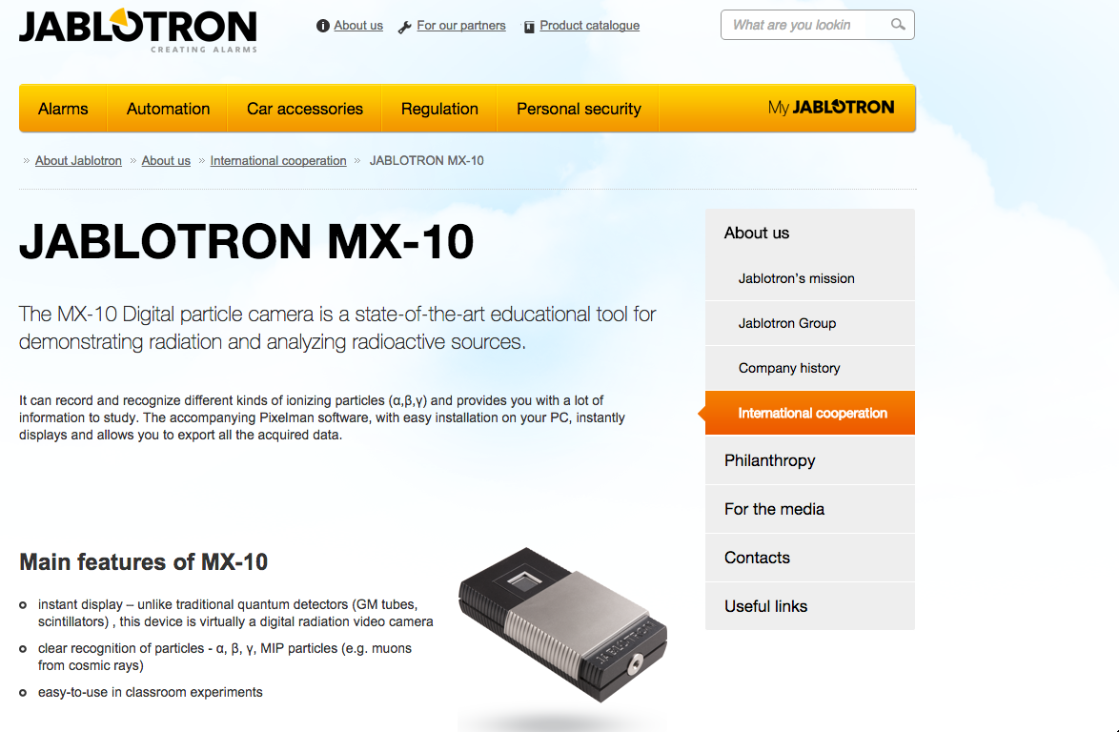
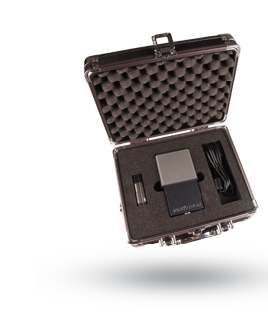
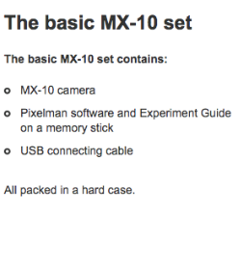

Slide 5
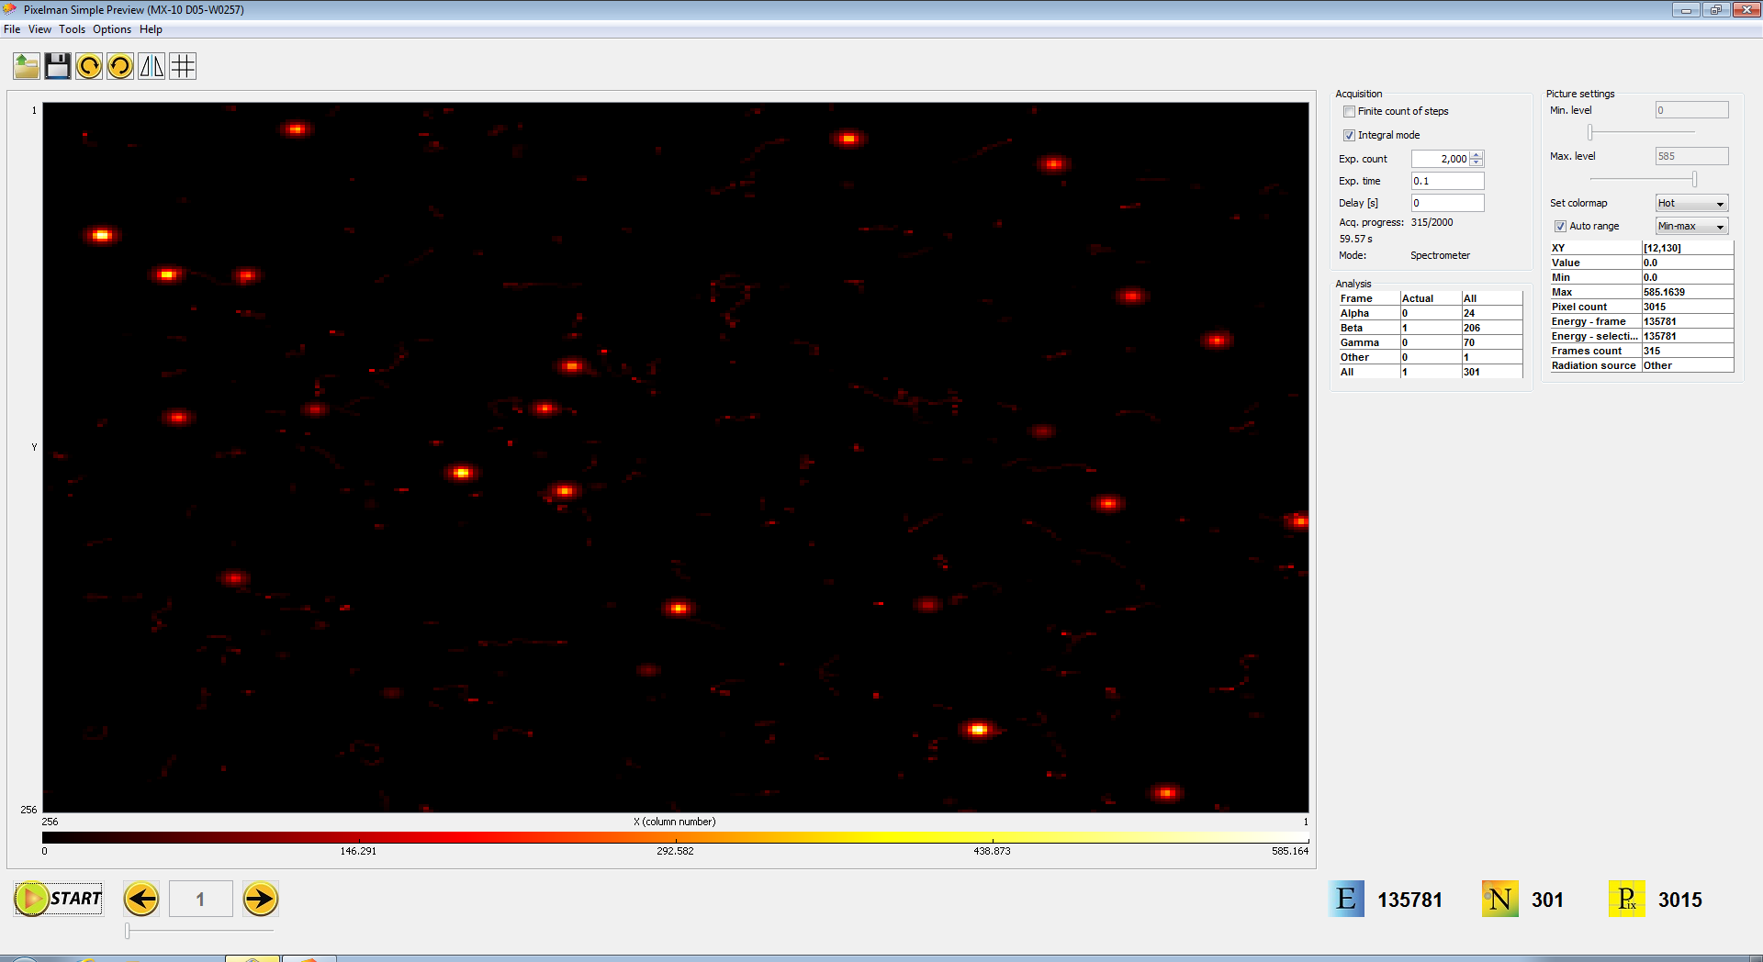
Software

Slide 6



Curricula
 | USA | PORTUGAL | ITALY
AGE | 15-18 | 13-14 | 18-19
COMPULSORY | No | Yes | No
CONTENTS | Electromagnetic spectrum Energy Nuclear physics Modern physics | Electromagnetic spectrum Tecnology and equipment using radiation | Electromagnetic spectrum Nuclear physics Radioactivity

Slide 7
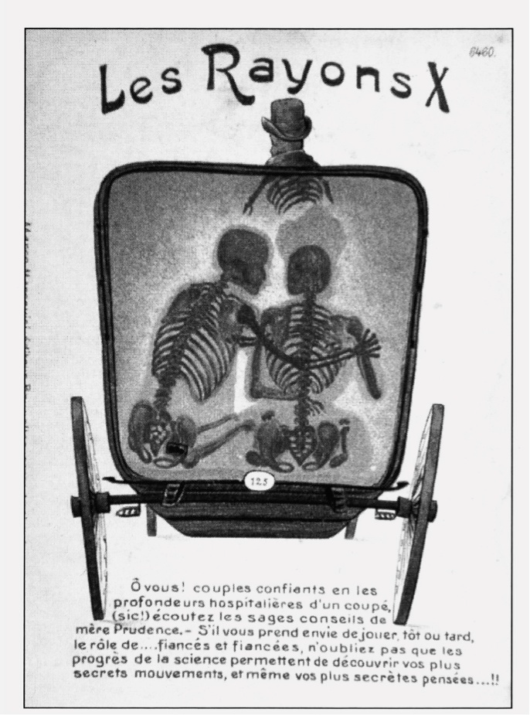
Students’ conceptions
Don’t know the meaning of “radioactivity”, misunderstanding with radio waves
“Radiation” has a frightening conotation
No natural sources emit radiation, only the industrial because radiation is artificial
There is no background radiation, we live in a free radiation environment
Radioactivity is unstoppable
Natural radiation is different from the one from radioactive sources
Radiation is carried by the wind
Radiation is danger because it is invisible
Irradiation of objects results in radioactive objects

Slide 8
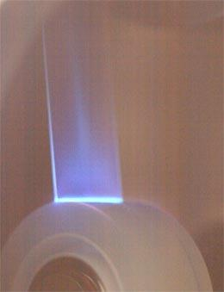
OUR PROPOSAL
Shielding test
Al shielding
Pb shielding
Paper shielding
Distance
Thickness of Al
Tape X-rays

Slide 9
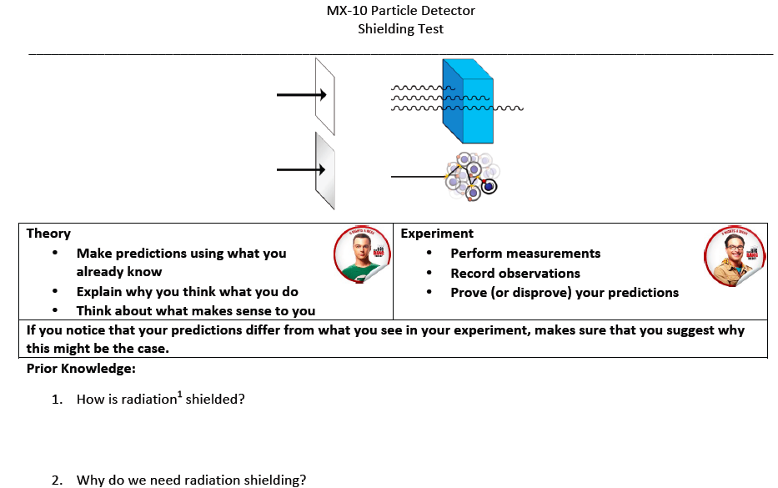
Protocols

Slide 10
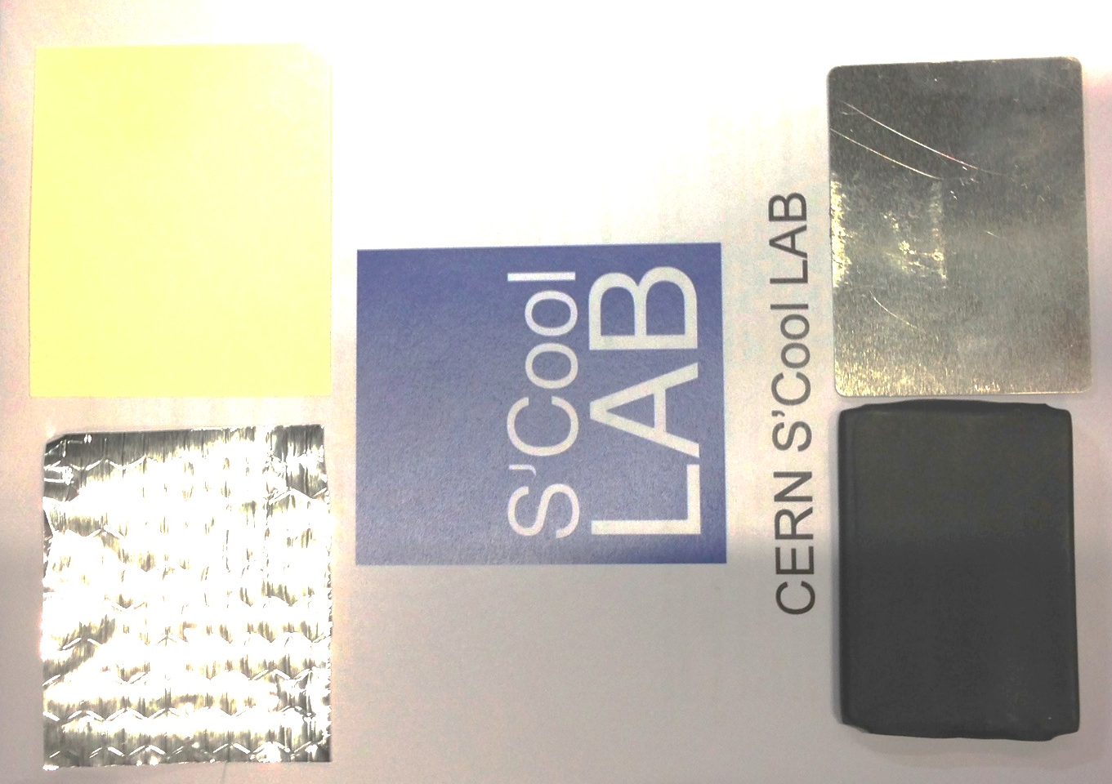
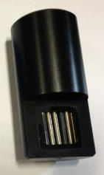
Shielding test
Aluminium foil
Paper
Radioactive
source
Aluminium
shielding
Lead shielding

Slide 11
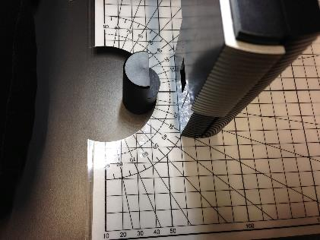
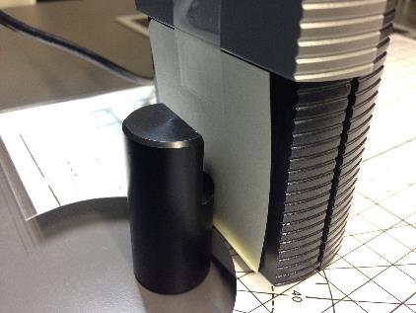
Shielding test
Without shielding
With shielding

Slide 12
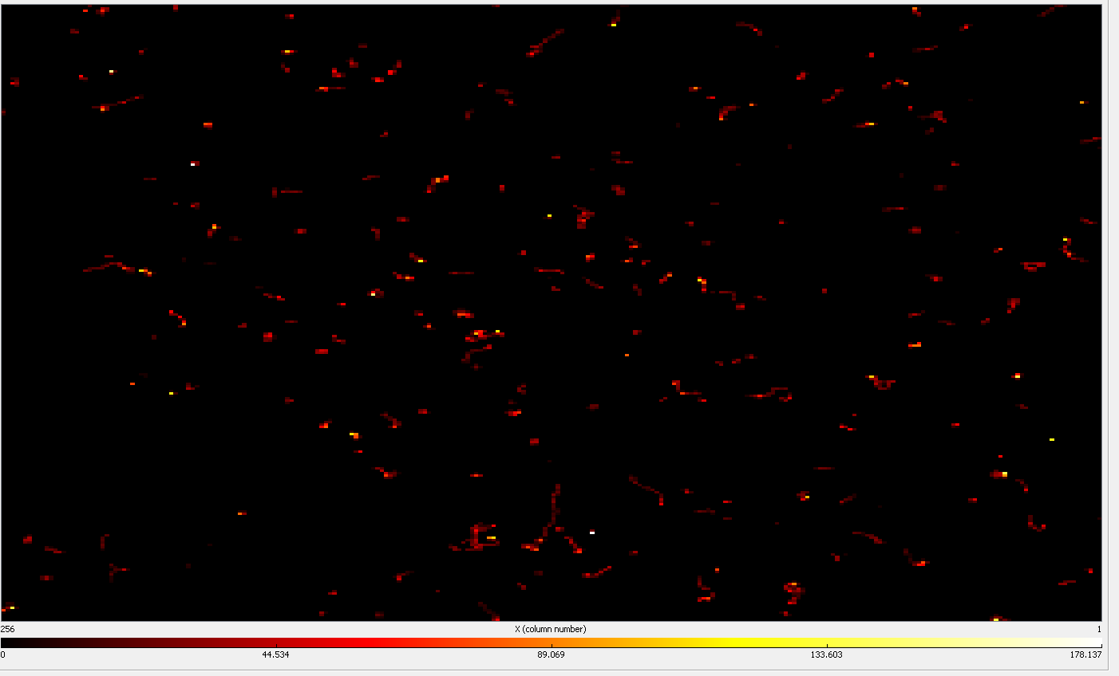
Shielding test
Without shielding
With paper shielding

Slide 13
Shielding test
Total energy as function of distance to the source of radiation

Slide 14
Shielding test
Total energy as function of thickness of aluminum foil

Slide 15
Shielding test
Total energy with different shielding

Slide 16
Shielding test
Number of particles detected with different shielding

Slide 17
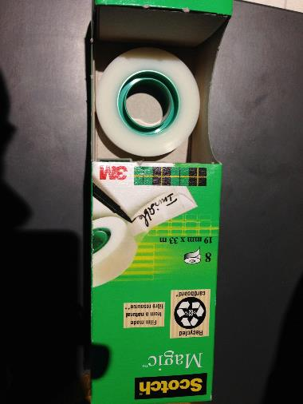
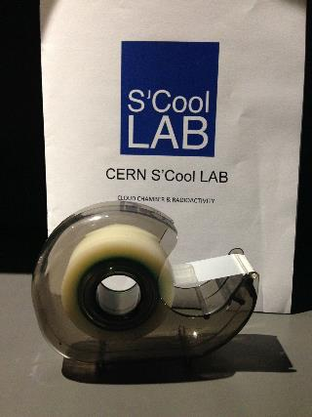
Tape X-rays

Slide 18
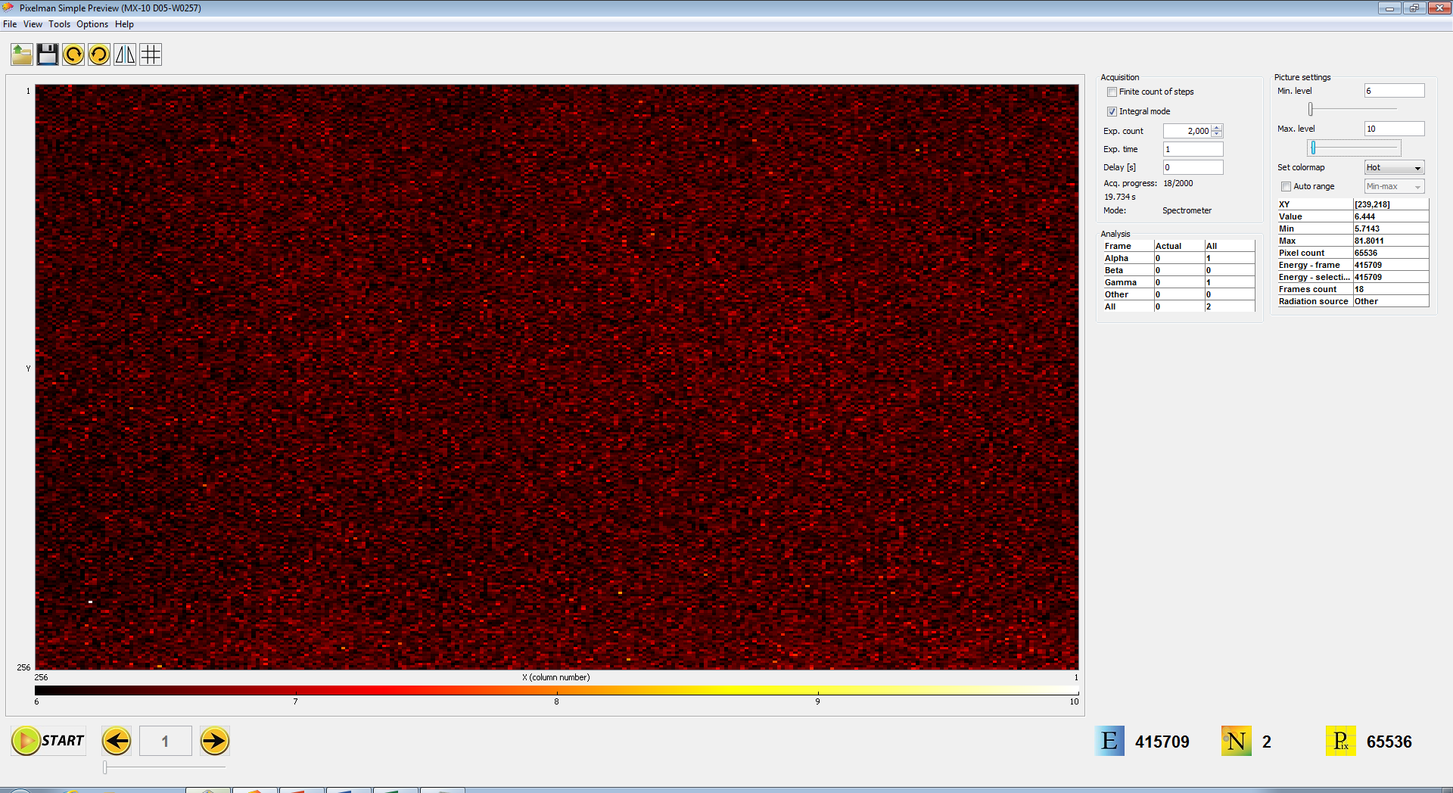
TAPE X-Rays

Slide 19
Tape x-rays

Slide 20
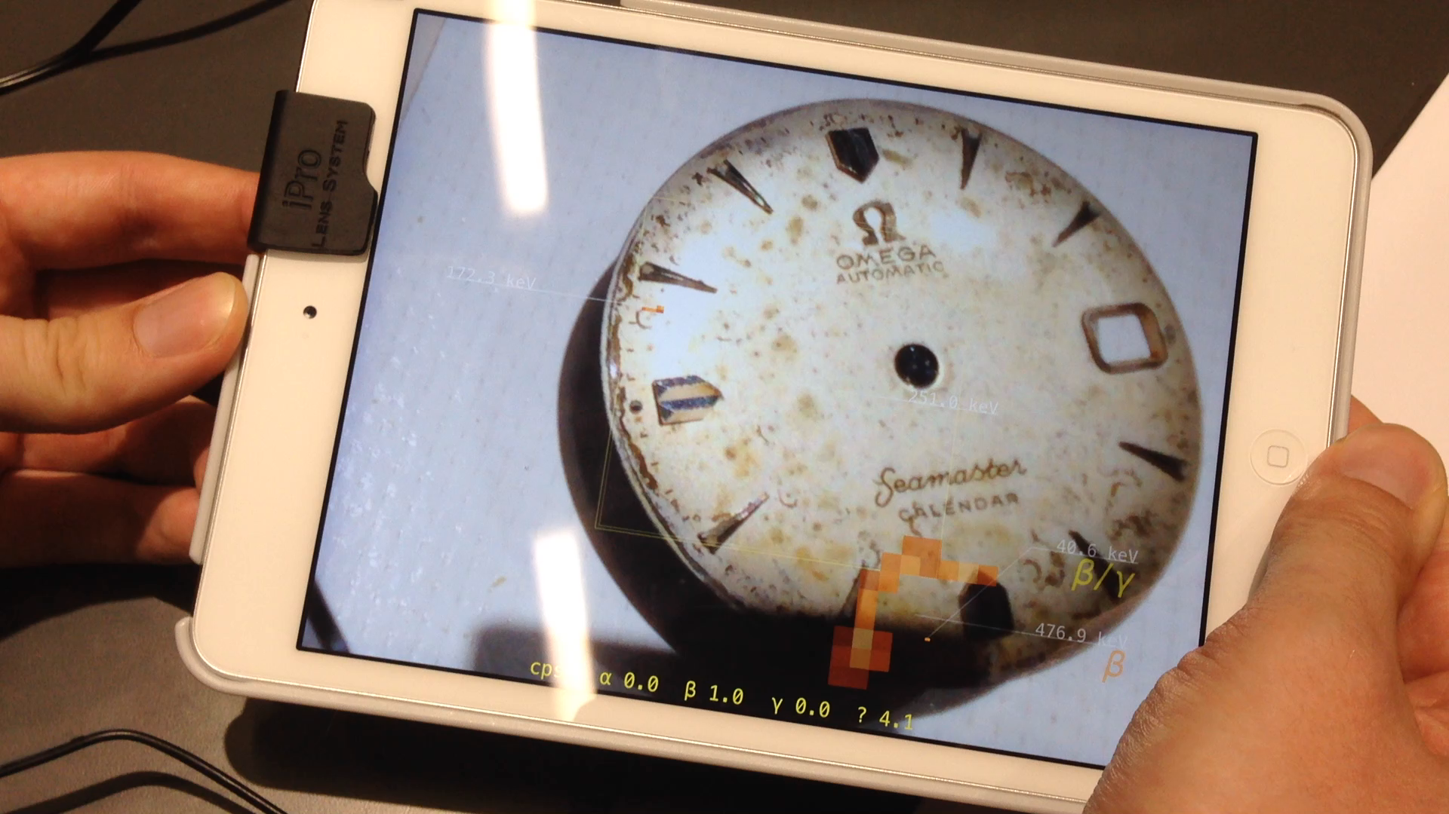
Alternative
Android app for comic rays detection
  http://wipac.wisc.edu/deco
App with built in particle detector
  https://youtu.be/9ibceYbzScw

Slide 21
Sources
Sticky tape generates X-rays, Nature, 22-oct-2008
  http://www.nature.com/news/2008/081022/full/news.2008.1185.html
Becky Parker
  You’re never too young to be a research scientist
  TEDxCERN
  https://www.youtube.com/watch?v=MTv1N-BLTiM
Eijkelhof, H. (1990), Radiation and risk in physics education
  http://rpd.oxfordjournals.org/content/68/3-4/273.full.pdf+html
Neumann, S. (2014). Three Misconceptions About Radiation – And What We Teachers Can Do To Confront Them. The Physics Teacher, 52, doi:10.1119/1.4893090
  http://scitation.aip.org/docserver/fulltext/aapt/journal/tpt/52/6/1.4893090.pdf?expires=1437573291&id=id&accname=2098973&checksum=8E4CFEB927CAA55165B5947116D63681
Rego, F. & Peralta, L. (2006). Portuguese students’ knowlodge of radiation physics. Physics Education, 41 (3).
  http://iopscience.iop.org/0031-9120/41/3/009/pdf/0031-9120_41_3_009.pdf

Slide 22
Discussion time 1!

Slide 23




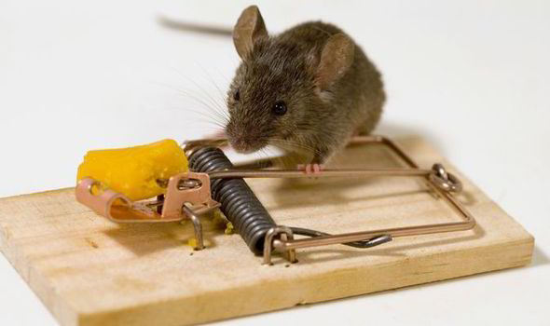
ION
Cern HST 2015, Workgroup 4, Hands on activities
Trap
Cheese
Hamdan.daraghmeh@yahoo.com
balazovicm@gmail.com
markusfranssonph@gmail.com
Marek Balazovic, Markus Fransson, Hamdan Draghmeh

Slide 24
What is an iontrap?
A quadrupole ion trap
Its also called "Paul" traps in honor of Wolfgang Paul.
Shared the Nobel Prize in Physics in 1989 for this work

Slide 25
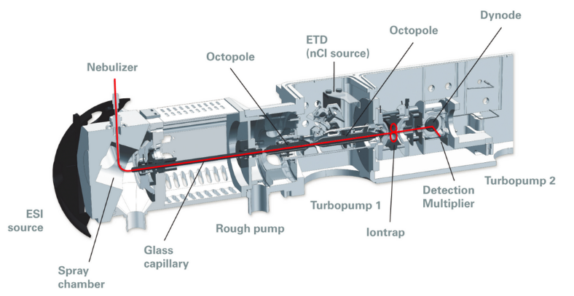
Applications
Iontrap had been used in Mass spectrometry (MS)

Slide 26
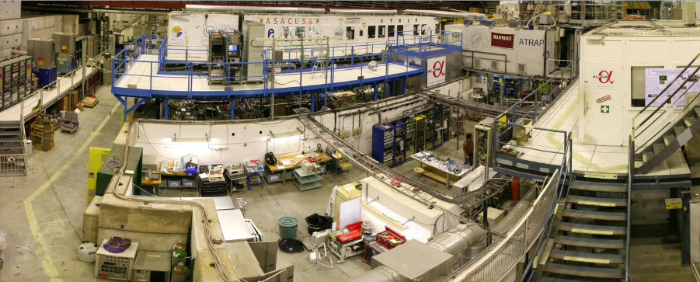
Trapping antimatter
In CERN experiments such as ATHENA and ALPHA. Iontrap was evolved to capture and trap the antimatter.

Slide 27

Demonstration example

Slide 28
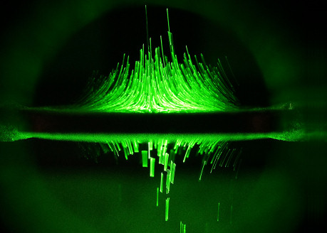
Why our project?
(www.newtonianlabs.com)
$ 7490…

Slide 29
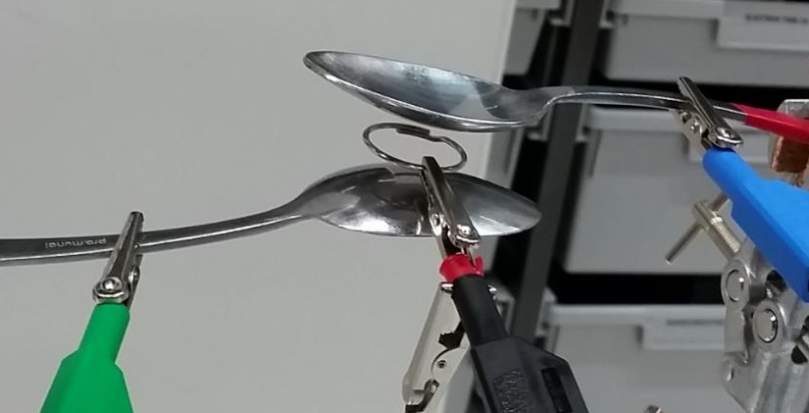
Why our project?
Make this cheap and visible and easy to build

Slide 30
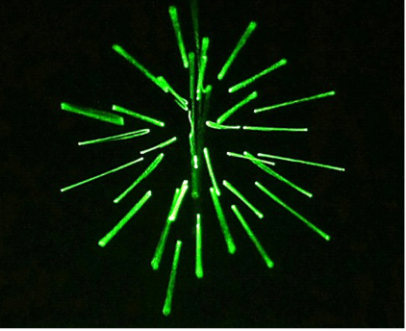
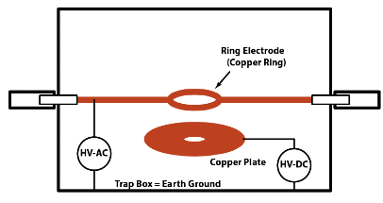
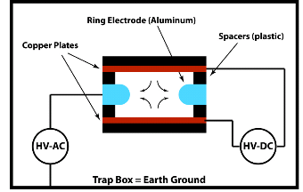
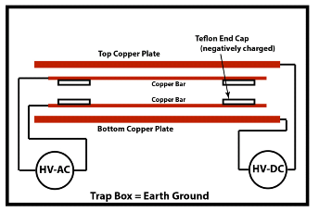
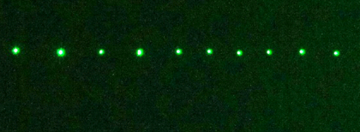
Types of simple traps
The RING trap
The LINEAR trap

Slide 31
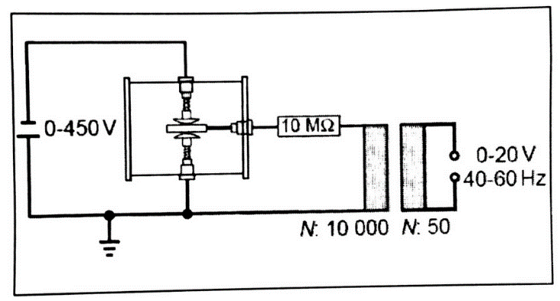
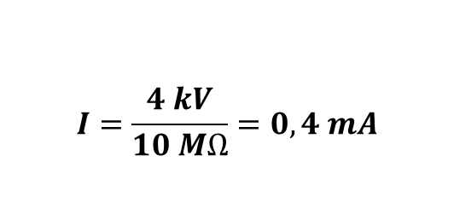
Our setup
alternating
1 mA => slight tingle
10 mA => respectable shock
100 mA => possibly lethal

Slide 32
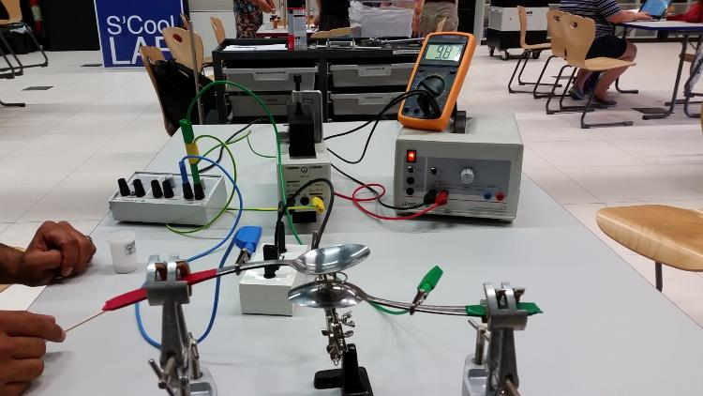
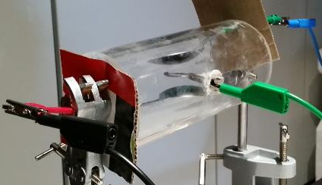
Our setup

Slide 33
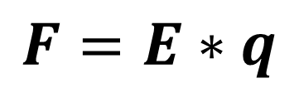
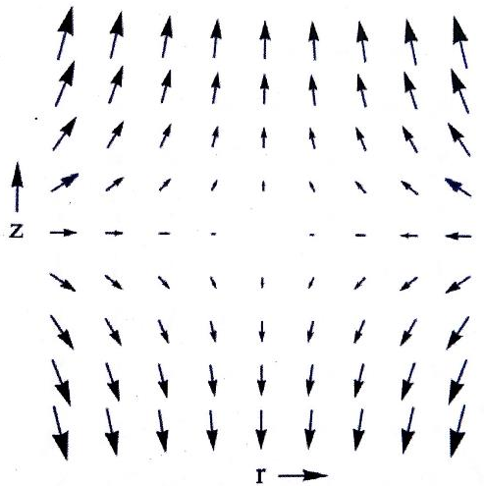
Physical principle

Slide 34
Physical principle
Almost homogeneuos electric field to balance gravity

Slide 35
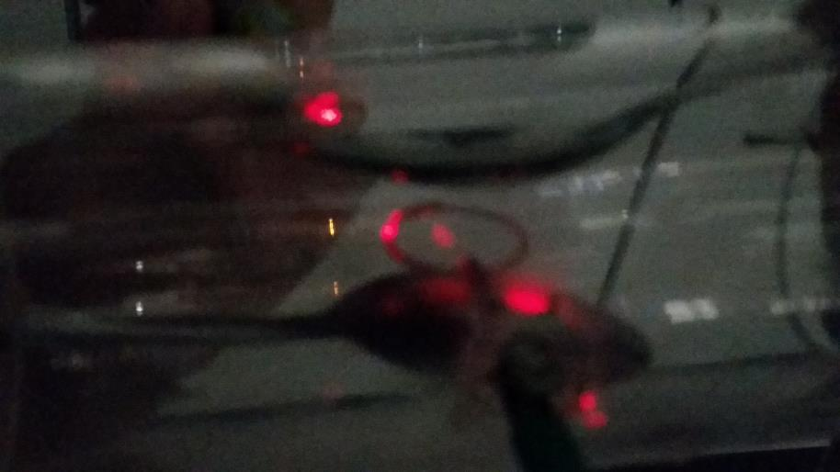
Results

Slide 36
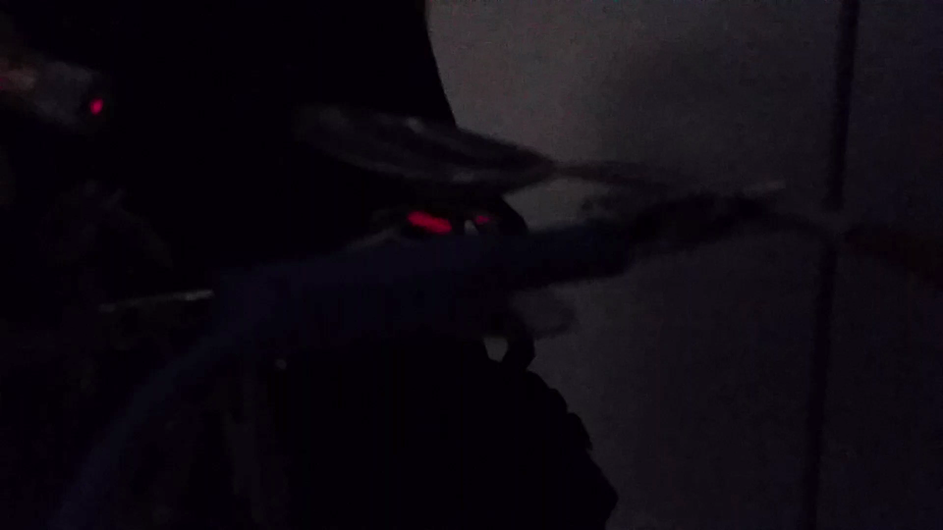
Results

Slide 37
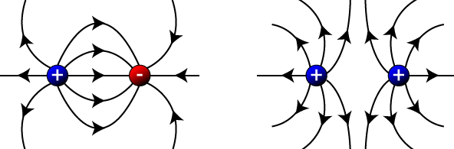
Questions/Tasks for students
Connections with Curriculum
Electric field
Basic characteristics of electric field, electric charge, electric force, electric lines
Harmonic oscillation
Modern physics
Antimatter, Mass-spectroscopy

Slide 38
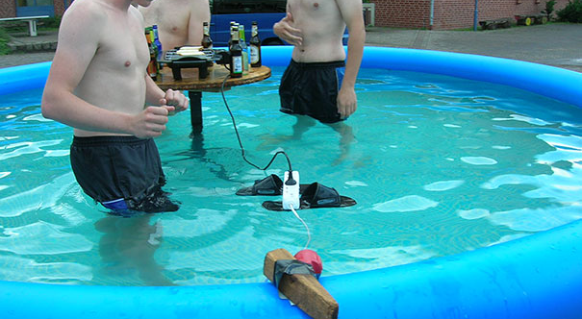

Slide 39
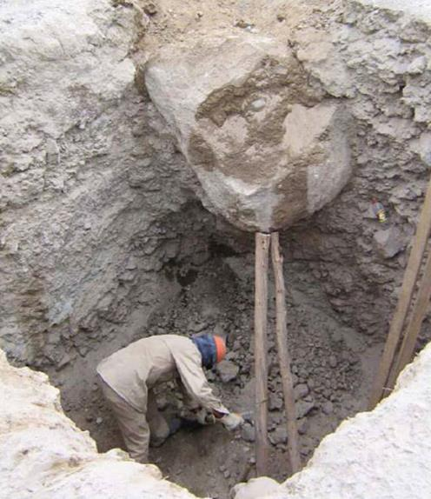
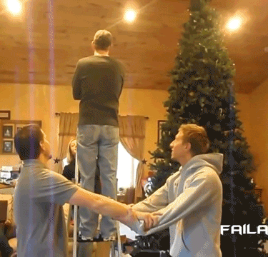

Slide 40
METHODS
Interactive demonstrations
Students project

Slide 41
Questions/Tasks for students
Measure the weights of the spores
What do you see in the trap? (points or lines) Why?
How does the HV/AC affects the movement of the particles?
What would happen if the
i) Diameter of the ring is increased?
ii) Voltage [DC] is increased?
iii) DC supply is switched off?
iv) frequency of AC is increased/decreased?
How can particles sometimes move slow?

Slide 42
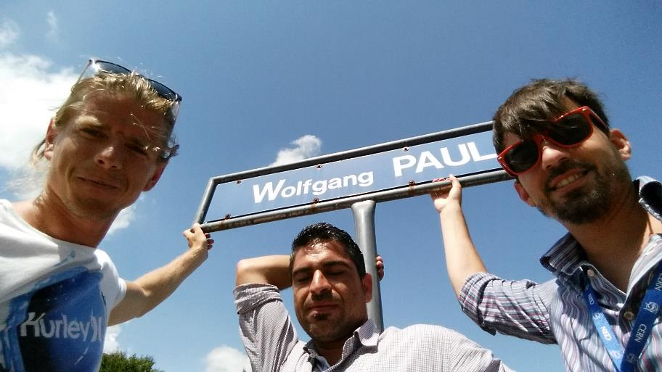
And that´s all for this HST!

Slide 43
Discussion time 2!

Slide 44
Appendix

Slide 45
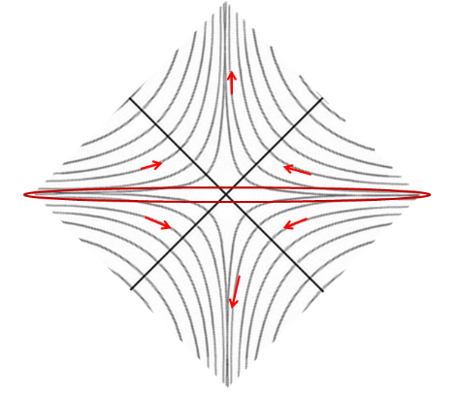
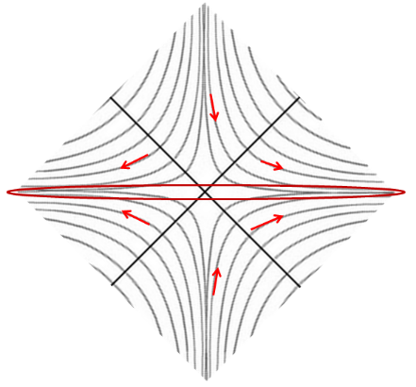
1. Draw E-field Forces on ions!
2. What will the motion be like?

Slide 46
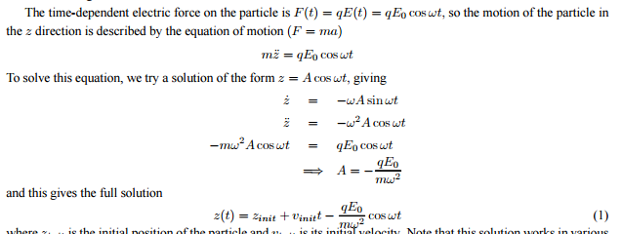

Slide 47
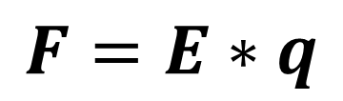
Physical principle

Slide 49
ATLAS magnetic field model
Lizelle Swanepoel
Miriam Rosenfeld
Julia Aldehoff

Slide 50
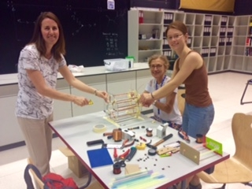
Workgroup

Slide 51
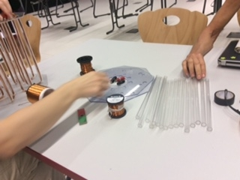
Ingredients
We built a 1:100 model of the Atlas magnet system
Coppe r wire
Plexiglass cutouts
16 plexiglass tubes (1x25 cm )
1 plexiglass tube (7.5x25 cm )
1 plexiglasstube (6x15 cm )
Compass needles
Cables
Transformer
Connectors

Slide 52
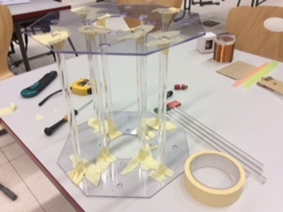
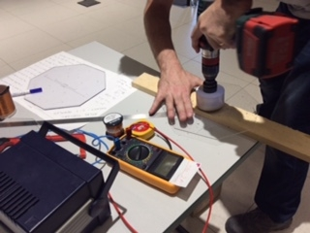

Working

Slide 53


Magnetic components
Picture of the solenoid

Slide 54


The final model

Slide 55


The final model

Slide 56


Introducing the activity
http://www.atlas.ch/photos/lhc.html
http://www.voxeurop.eu/files/the_independent.750.jpg

Slide 57


Model vs. reality
toroid magnets
solenoid magnet
Picture of the model
different coils ⇨ 2 magnetic fields solenoid and toroid
Picture from Bernhard Holzer‘s presentation

Slide 58








Lab circus to study magnetic fields
1 bar magnet
1 wire
1 loop of wire
1 coil
Solenoid model
2 bar magnets
https://commons.wikimedia.org
made with persint
https://commons.wikimedia.org
http://www.cibermitanios.com.ar/2008/05/10-simulaciones-fisicas-asombrosas.html
http://www.physics.ucla.edu
http://www.trincoll.edu/~cgeiss/stuff/the%20rocky%20road/ch_1/ch1_p1.htm
https://commons.wikimedia.org
http://www.askamathematician.com

Slide 59


Advanced experiments
2 experiments to show how charged particles (e⁻) react in a magnetic field
these illustrate the fundamental principle of deflection using appropriate hand rules
http://www.dieter-heidorn.de/Physik/VS/StrukturMaterie/K08_Elektronen/ K08_Elektronen.html

Slide 60


Particle deflection in ATLAS detector
Simulation of the electron and positron
Prediction with the Lorentz-force
http://atlas.physicsmasterclasses.org/en/wpath_teilchenid1.htm

Slide 61

Particle deflection in ATLAS detector
Deflection of the muon is more complex
http://atlas.physicsmasterclasses.org/en/wpath_teilchenid1.htm

Slide 62


A simulation for the toroid field
made with persint

Slide 63

A simulation for the toroid field
made with persint

Slide 64

Measurement of the magnetic field
Different methods to use:
  Compasses
  Magna Probe (3D-compass needle)
  Smartphone app (teslameter)
  Hall-Probe
  (exact magnetic field
  strength in Tesla)

Slide 65

Curricular context
Period
  11th or 12th grade
Topic
  Electrodynamics
  particle physics
  (consolidating previous and extending knowledge)
https://encrypted-tbn1.gstatic.com/images?q=tbn:ANd9GcSSZh4lNd9wvZvJcG3ytWFp4NHOj9hrrXDlH-PuGQns-KcDzlm7Rg

Slide 66


List of references
ATLAS animation:
http://atlas.physicsmasterclasses.org/en/wpath_teilchenid1.htm
Persint: http://irfu.cea.fr/Phocea/Vie_des_labos/Ast/ast_sstechnique.php?id_ast=3113

Slide 67
Thank you for your attention!
Any questions?

