Slide 1
STRUCTURE OF MATTER
Discoveries and Mysteries
Rolf Landua
CERN

Slide 2
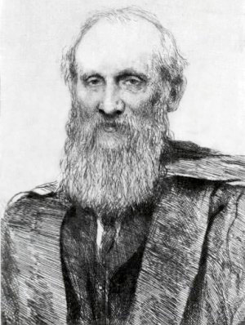
PREFACE
This is a lecture about 100 years of particle physics.
It covers about 100 years of ideas, theories and experiments.
More than 50 Nobel prize winners on particle physics
This is a broad overview about the main discoveries.
In the early 1900s, most physicists believed that physics was complete, described by classical mechanics, thermodynamics, and the Maxwell theory.
“There is nothing new to be discovered in physics now. All that remains is more and more precise measurement. “ (Lord Kelvin, 1900)
DARK CLOUDS:
1) Blackbody radiation - Quantum Physics
2) Michelson-Morley experiment - Special Relativity
Lord Kelvin

Slide 3

Particles
Fields
Electromagnetic
Weak
Strong
1895
1
1900
e⁻
Brownian motion
Photon
Radio-activity
1905
Atom
Special relativity
1910
Nucleus
Quantum mechanics
Wave / particle
Fermions / Bosons
1920
p⁺
1930
e⁺
n
Spin Antimatter
Fermi Beta-Decay
Yukawa
π exchange
1940
μ ⁻
π
1950
Particle zoo
QED
P, C, CP violation
τ⁻
p⁻
2
1960
νe
W bosons
Higgs
νμ
u
d
s
EW unification
1970
GUT
QCD
Colour
c
SUSY
1975
τ⁻
STANDARD MODEL
1980
ντ
b
Superstrings
g
W
Z
1990
3 generations
t
2000
ν mass
2010

Slide 4
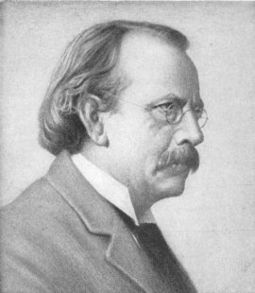
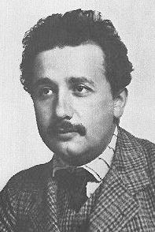
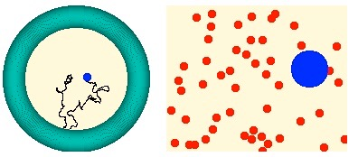

MATTER IS MADE OF PARTICLES
1897: ELECTRON - the first ‘discrete’ building block of matter
J.J. Thomson
1905: ATOMS ARE REAL - Explanation of Brownian Motion (Perrin)
A. Einstein

Slide 5
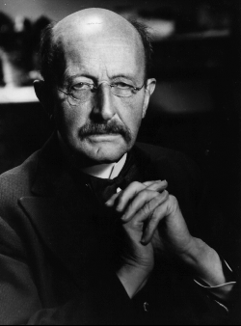
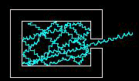


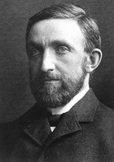
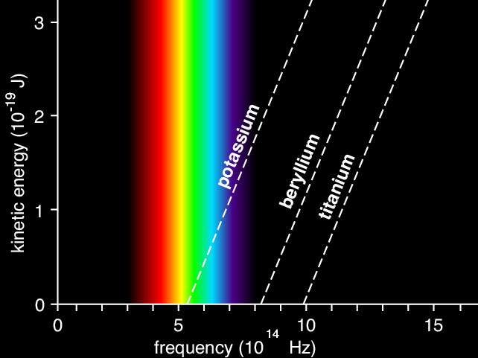
ENERGY COMES IN QUANTA
1900: ELECTROMAGNETIC RADIATION IS EMITTED IN QUANTA
ε = h ν
M. Planck
1902: PHOTOELECTRIC EFFECT
“The electron energy does not show the
slightest dependence on the light intensity”
P. von Lenard
1905: LIGHT IS EMITTED AND ABSORBED IN QUANTA
Emax = hν - W
“My only revolutionary contribution to physics”
A. Einstein

Slide 6
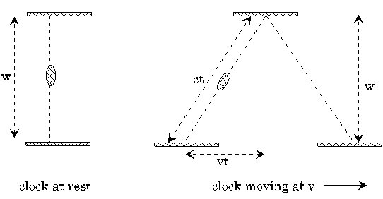

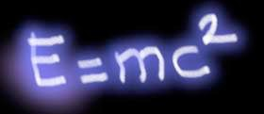
SPECIAL RELATIVITY
1905: SPEED OF LIGHT IS ALWAYS CONSTANT
c²t² = v²t² + w²
A. Einstein
1) Time dilation, space contraction
2) Modification of Newton’s laws, relativistic mass increase.

Slide 7
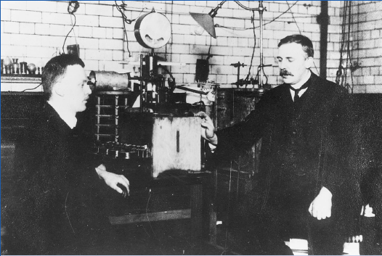
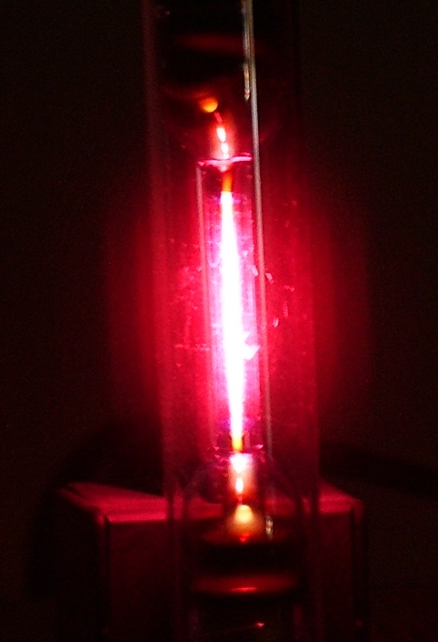
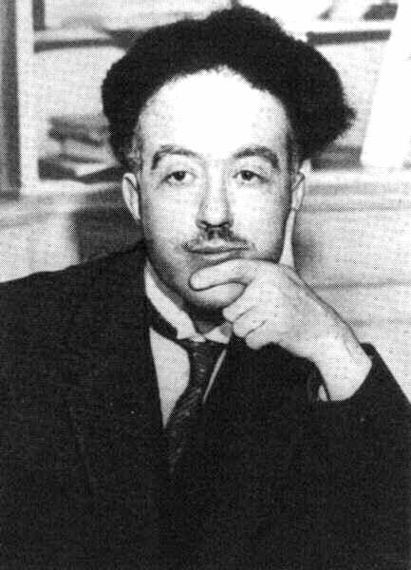
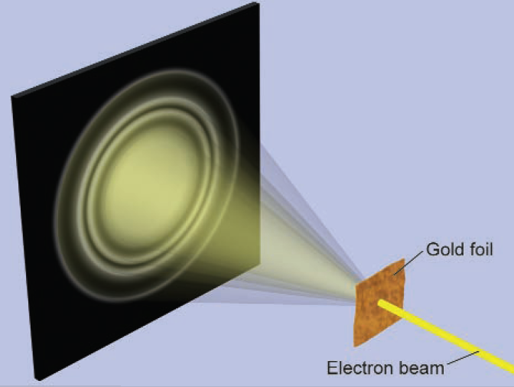

THE BEGINNING OF ATOMIC PHYSICS
1909: NUCLEI: very small + heavy within (almost) empty atom
Rutherford
1913: BOHR MODEL- (empirical) explanation of discrete spectral lines
(using Planck’s constant h) to quantize angular momentum
Hydrogen
1923: DE BROGLIE
Particles are waves
L. de Broglie

Slide 8
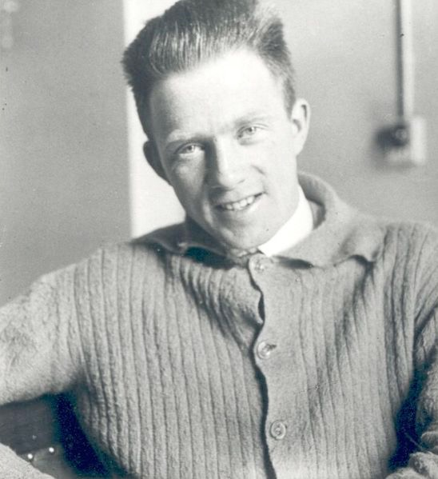
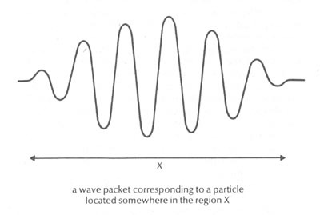

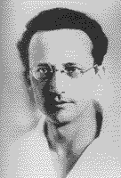
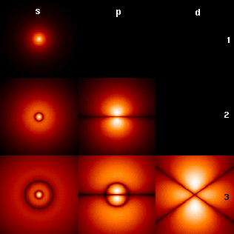
QUANTUM MECHANICS
1923: UNCERTAINTY RELATION
Heisenberg
  1926: SCHRÖDINGER EQUATION
Schrödinger
  (electrons in atoms form ‘standing waves’)
Interpretation (Born, 1927):
ψ = probability amplitude
|ψ|² = probability

Slide 9
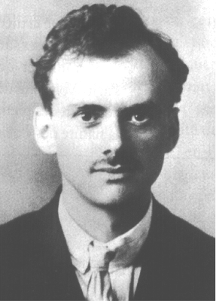


RELATIVISTIC QUANTUM MECHANICS
e⁻
Spin
e⁻
Ψ =
e⁺
Antimatter
Paul A.M. Dirac
(1928)
e⁺
CONSEQUENCES:
ELECTRON SPIN EXPLAINED
ANTIPARTICLES MUST EXIST !
ELECTRONS OBEY ‘PAULI PRINCIPLE’ (1940) - FERMIONS

Slide 10
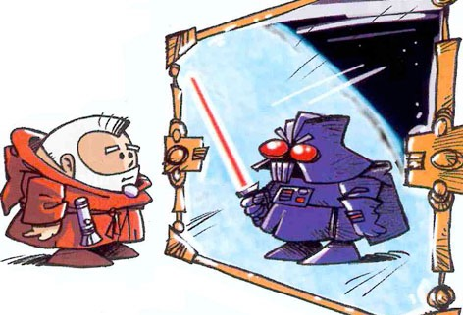
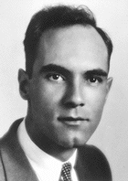
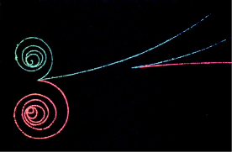
ANTIPARTICLES
1932: POSITRON DISCOVERY
EVERY PARTICLE HAS AN ANTIPARTICLE
Anderson
WHEN ENERGY CONVERTS TO MASS,
PARTICLES AND ANTIPARTICLES ARE PRODUCED

Slide 11
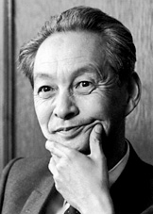
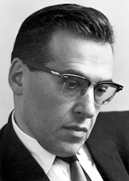
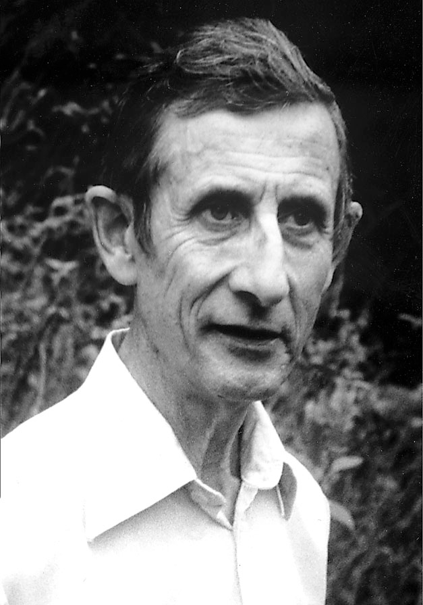
QUANTUM FIELD THEORY (1927 - 1948)
It was known that the electromagnetic field consists of photons
S.I. Tomonaga
How could the interaction between electrons and photons
be correctly described, respecting quantum mechanics and special relativity?
J. Schwinger
Many people worked on this problem ...
F. Dyson

Slide 12
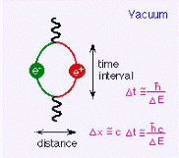
EMPTY SPACE HAD BECOME COMPLICATED !
Quantum physics says that ‘oscillators’ (e.g. field quanta) cannot be at absolute rest (uncertainty relation)
The lowest energy states of e.g. electromagnetic fields can produce (virtual) electron-positron pairs: VACUUM FLUCTUATIONS

Slide 13
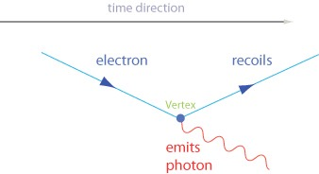
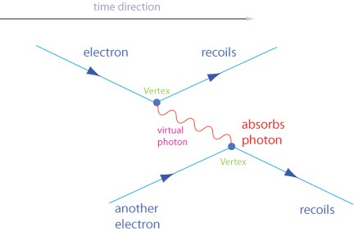
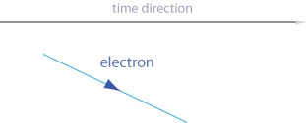
Quantum Electrodynamics (QED)
R.P. Feynman

Slide 14
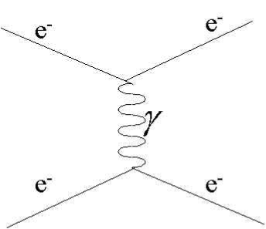
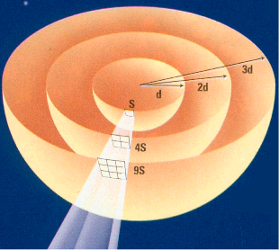
QED: Charged particles interact by exchanging photons
1) Massless virtual photons are continuously emitted by electric charges
2) The 1/r² law comes from the probability to hit another particle at distance r
(directly connected with the 3 dimensions of space)
1/r² law
QED became a model for other interactions

Slide 15
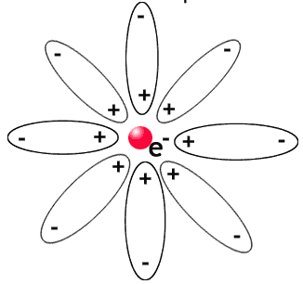
RENORMALIZATION : HOW TO DEAL WITH INFINITIES
The ‘naked’ electron + vacuum fluctuations = measured electron
(“infinite” - “infinite” = “finite”)
vacuum fluctuations modify its charge and mass
(‘Debye shielding’)

Slide 16
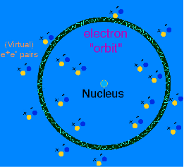
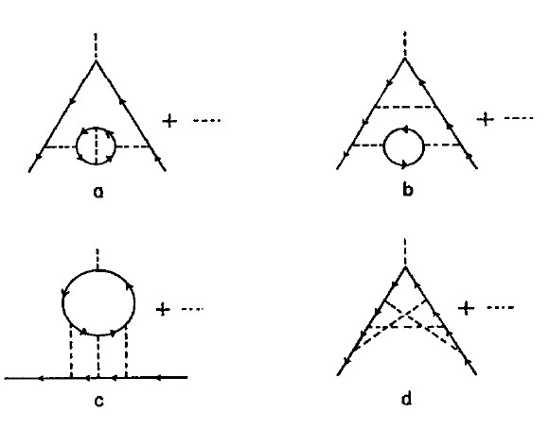

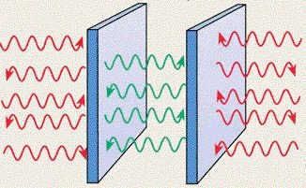
Vacuum fluctuations have observable effects
... and Quantum Electrodynamics allows to calculate them precisely
Electron (anomalous)
magnetic moment
Lamb Shift
(shift of atomic energy levels)
SPOOKY !
Casimir effect
(force on two uncharged metal plates)

Slide 17
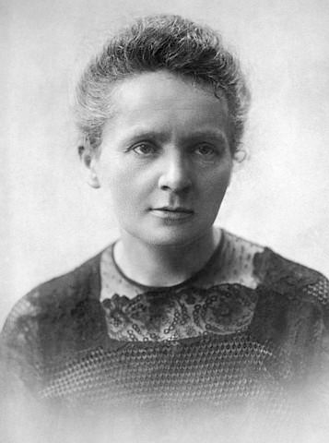
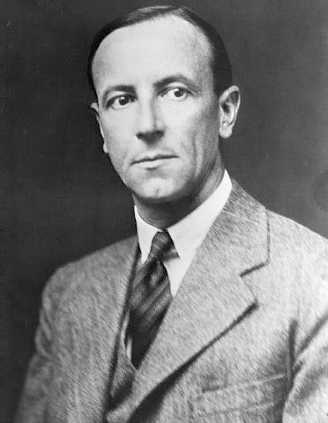
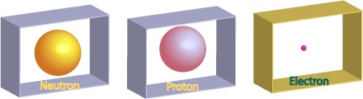
THE BEGINNING OF NUCLEAR PHYSICS
1895-1900: RADIOACTIVITY - strange radiation phenomena
M. Curie
1903: Alpha-, Beta-, Gamma-Radiation known
(different penetration; Alpha = He-Nucleus)
E. Rutherford
1911: Nucleus positive, small - surrounded by electrons
1932: DISCOVERY OF THE NEUTRON
J. Chadwick

Slide 18
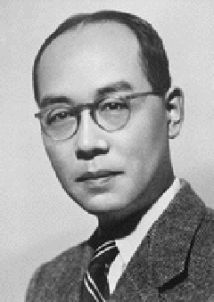
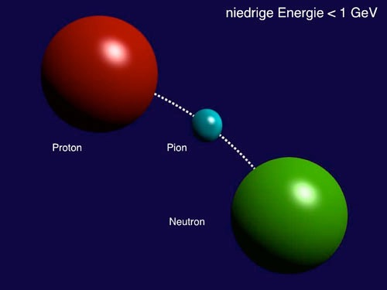
Fields
‘Strong’ interaction
The “Strong Interaction” - Nuclear forces
What keeps the protons and neutrons together in the nucleus?
1) This force must be stronger than the electromagnetic repulsion
2) It must be of short range (~ 1-2 fm) to explain the size of nuclei
Yukawa’s idea:
a massive particle (“pion”) is exchanged between two nucleons
Yukawa (1934)

Slide 19
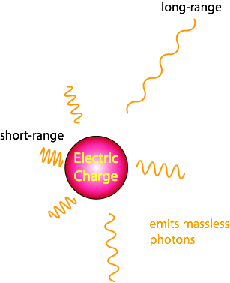
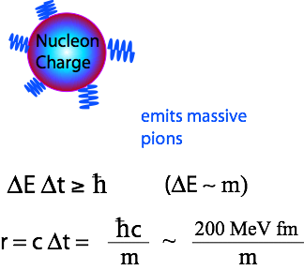

Electromagnetic
vs
Nuclear
Coulomb law
Yukawa potential ~ Modified “Coulomb” law

Slide 20
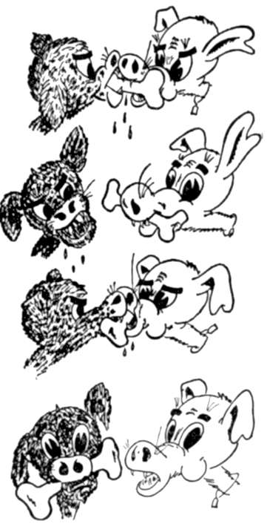
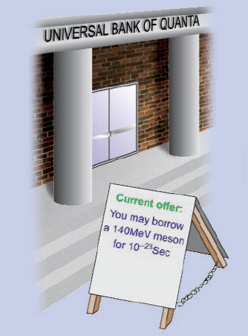
Fields
‘Strong’ interaction
Metaphors for ‘particle exchange’
G. Gamov
Allowed by uncertainty relation: 1.4 fm ~ 140 MeV

Slide 21
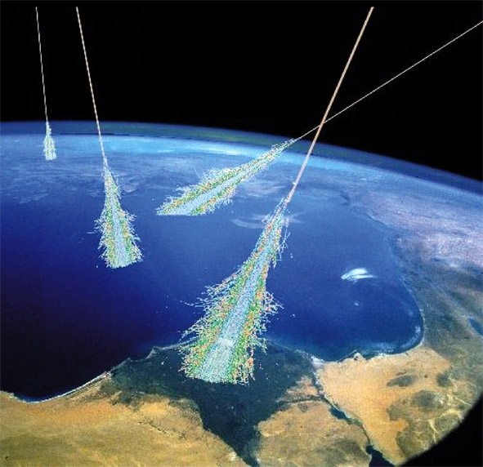
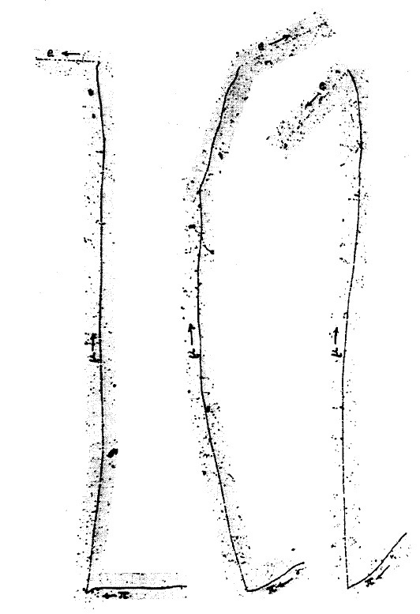
1937
1913: Cosmic Rays were discovered
      Physicists went on mountain tops for experiments!
1937: Negative particle with M ~ 200 me
      Very longe range in matter !? Not Yukawa’s “pion” !
    Muon = ‘heavy electron’
    Who ordered that ?
1948: Discovery of the ‘pion’

Slide 22
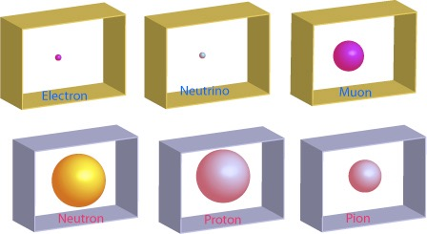
1948
In 1948, the particle spectrum started to look ugly:

Slide 23
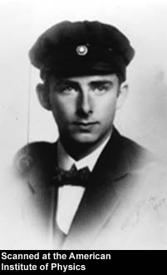
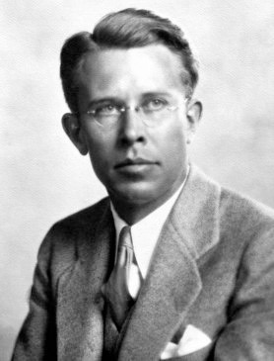
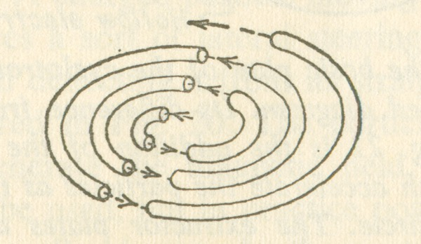

1931 - 1955
Accelerators
"Man-made cosmic rays"
Rolf Wideroe, 1928
Ernest Lawrence, 1931
Cyclotron
Linear accelerator
Use magnetic field to bend particles into circular orbit
Particles pass through same accelerating gap many times and reach higher energies
Accelerate particles between electrode gaps
Tune RF frequency to match particle motion
1931: 80 keV
1932: 1000 keV
1939: 19 MeV*
1946: 195 MeV ("synchrocyclotron")
* first limitations by relativistic mass increase

Slide 24

1931 - 1955
Accelerators (2)
1947: US constructs two 'synchrotrons'
Brookhaven (1952) - 3 GeV
Berkeley (1954) - 6.2 GeV ('antiproton')
Synchrotron
1954: Europe competes with US
Similar to cyclotron, but change magnetic field to keep particles on the same orbit
(also overcomes relativistic mass increase)
CERN (1959) - 24 GeV
Brookhaven (1960) - 30 GeV
Detectors
Geiger counters
Cloud chambers
Emulsions
Bubble chambers
Cerenkov counters
Photomultipliers
Spark chambers
After 1967:
Wire chambers
Drift chambers
Calorimeters

Slide 25
Particle zoo
1950- 1968
With new accelerators and detectors,
the "particle zoo" grew to more than ~ 200 'elementary particles'
Mesons
BARYONS
π ⁺
π ⁻
π ⁰
Δ⁺⁺, Δ⁺, Δ⁰, Δ⁻
Pions
K⁺
K⁻
K⁰
η'
Delta
Λ⁰
Kaons
Eta-Prime
η
Σ⁺, Σ⁰, Σ⁻
Lambda (strange!)
φ
Eta
Sigma (strange!)
Phi
Ξ⁰, Ξ⁻
ρ ⁺
ρ ⁻
ρ º
Sigma(very strange!)
Rho
What was the underlying structure ?

Slide 26



1963
SU(3) - Classification scheme based on ‘quarks’
1) 3 types of “quarks” : up, down, strange
u
d
s
2) Carry electric charges: +2/3, -1/3, -1/3
+2/3 e
-1/3 e
-1/3 e
3) Appear in combinations:
  Meson = quark+antiquark
  Baryon = quark(1) + quark(2) + quark(3)
Gell-Mann, 1963
(G. Zweig, 1963, CERN)

Slide 27
Some mesons (quark+antiquark):
u
u
πº
+2/3 e
-2/3 e
u
d
π⁺
u
d
s
+2/3 e
+1/3 e
+2/3 e
-1/3 e
-1/3 e
π⁻
d
u
-1/3 e
-2/3 e
u
d
s
-2/3 e
+1/3 e
+1/3 e
u
s
K⁺
+2/3 e
+1/3 e

Slide 28



1967 Discovery of quarks
Electron-Proton scattering (1956)
1956 Hofstadter: measured finite proton radius
Stanford Linear Accelerator Centre
1967 Friedmann, Kendall, Taylor (SLAC):
              ‘hard scattering’ of electron on three ‘point-like particles’
Measured cross-sections perfectly
compatible with presence of
2 up- and 1 down-quark in proton

Slide 29
1973
The concept of “Colour” charge
PROBLEM: three fermions are not allowed to be in
identical states (Pauli exclusion principle)
Δ⁺⁺
u
u
+2/3 e
u
+2/3 e
+2/3 e
Since the three up-quarks must have parallel spin -
there are in a symmetric state
The three quarks must be different in one quantum number: “colour”
(Bardeen, Fritzsch, Gell-Mann)

Slide 30

Quantum Chromo Dynamics
this has nothing to do
with our visible colours,
just an analogy
Theory constructed in analogy to QED
QCD: 3 different charges (“colour charge”) [red, green, blue]*
‘Strong force’ between quarks is transmitted by (8) gluons
Dogma of QCD: Only colour-neutral bound states are allowed, explains:
MESONS = Quark-Antiquark
BARYONS = 3-Quark states

Slide 31


1973
GLUONS CARRY COLOUR CHARGE : SELF-INTERACTION !
At low energies, QCD long-range forces increase
with distance. These forces keep the quarks as ‘prisoners’.
At high energies, for small distances, the force decreases: asymptotic freedom of quarks
(phenomenon: the quark-gluon plasma)

