Slide 1
STRUCTURE OF MATTER
Discoveries and Mysteries
Part 2
Rolf Landua
CERN

Slide 2
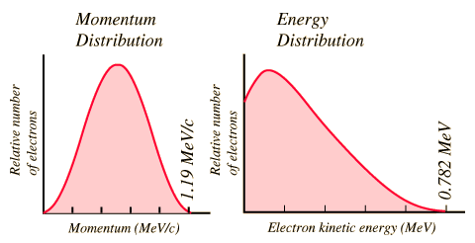
The “Weak Interaction” - What is Radioactivity ?
1911: Continuous (?) energy spectrum of ‘beta’-rays (electrons) - energy conservation?
Z --> (Z+1) + e ?
n --> p + e + ν
1930: Wolfgang Pauli postulates existence of ‘neutrino’:

Slide 3
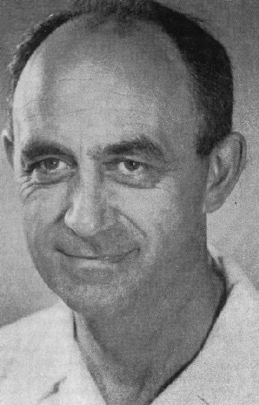
The model of Enrico Fermi : “pointlike interaction”
n
p
ν
e
Enrico Fermi
(1934)
Proposed a phenomenological model of weak interaction
Point-like coupling with strength GF ~ 10⁻⁵ of e.m. interaction
Coupling of two ‘currents’ (proton-neutron / electron-neutrino)

Slide 4
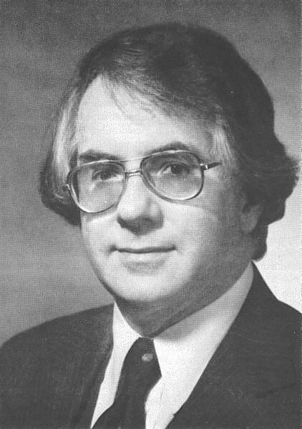
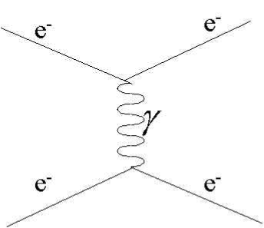
Fermi’s model turned out to be inconsistent at E > 300 GeV
S. Glashow
probability of this reaction > 100% (E > 300 GeV)
n
p
n
p
New Idea (1958)
W⁻
ν
e
Fermi model
ν
e
Weak interaction transmitted by massive vector bosons
(in analogy to photon exchange!)
Large mass (80 GeV) explains
short range (2·10⁻¹⁸ m) and small cross-sections

Slide 5
Unification of electromagnetic and weak interaction
ν
e
ν
ν
W charged current
Zº
Neutral current
e
ν
e
e
Glashow, Salam, Weinberg (1968) - Electroweak Force
• The electromagnetic and weak interaction are different aspects of the same 'electroweak' force
• All quarks and leptons have a 'weak' charge
• There should be a 'heavy photon' (Zº) and two charged vector boson (W±) of mass ~ 50-100 GeV
• The W,Z bosons acquire their mass by interacting with the "Higgs field" (1964)

Slide 6
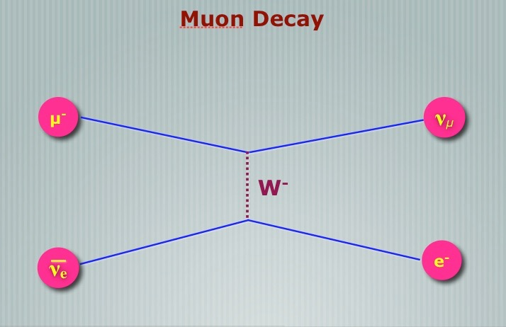
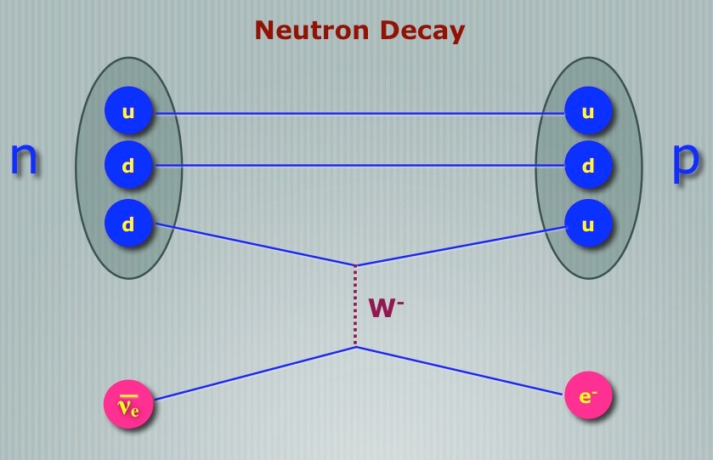
Fields
Electroweak interaction is the SAME for leptons and quarks
~ GF
~ GF
“Universality*” - transmitted by W, Z bosons, same strength!
*Assuming a little bit of ‘quark’ mixing
d' = d cos θc + s sin θc
s' = -d sin θc + s cos θc
θc = Cabbibo angle ~ 20º

Slide 7
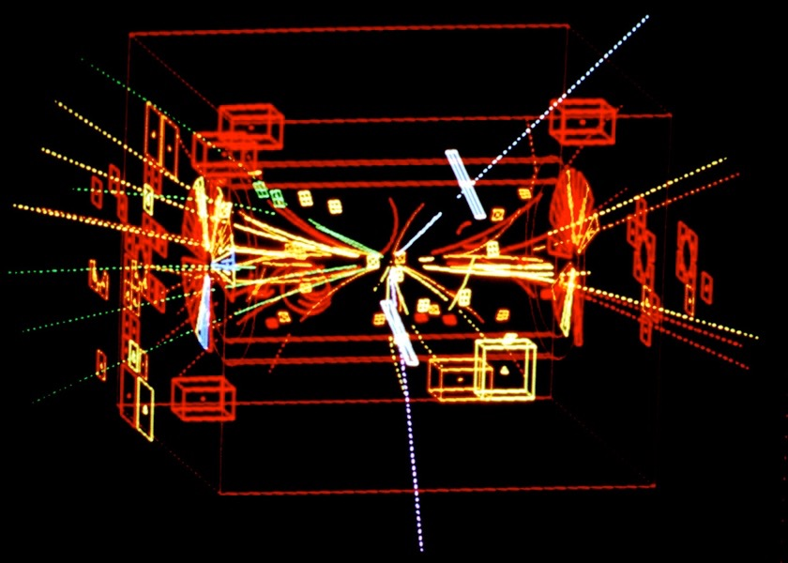
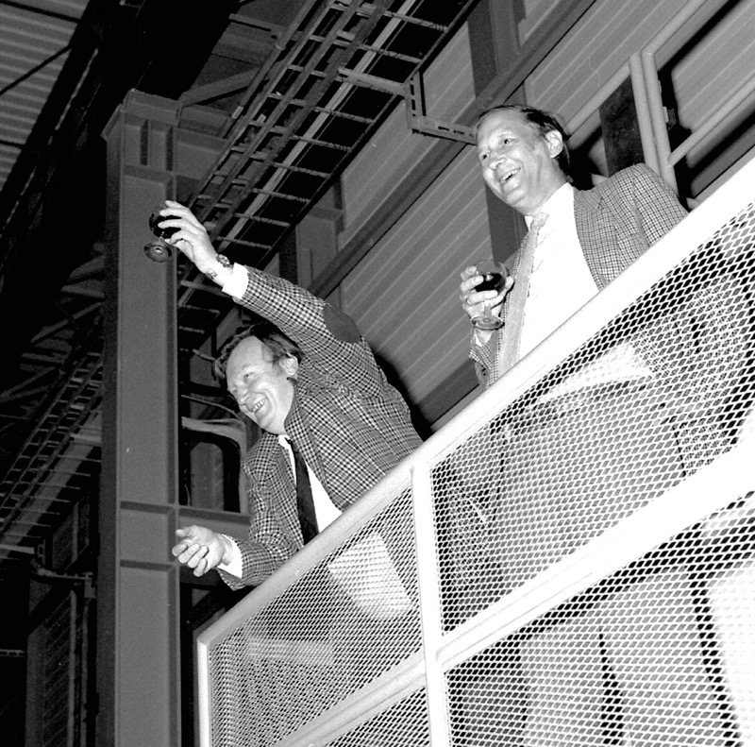
Discovery of the W, Z bosons at CERN (1983)
(C. Rubbia, S. van der Meer)

Slide 8
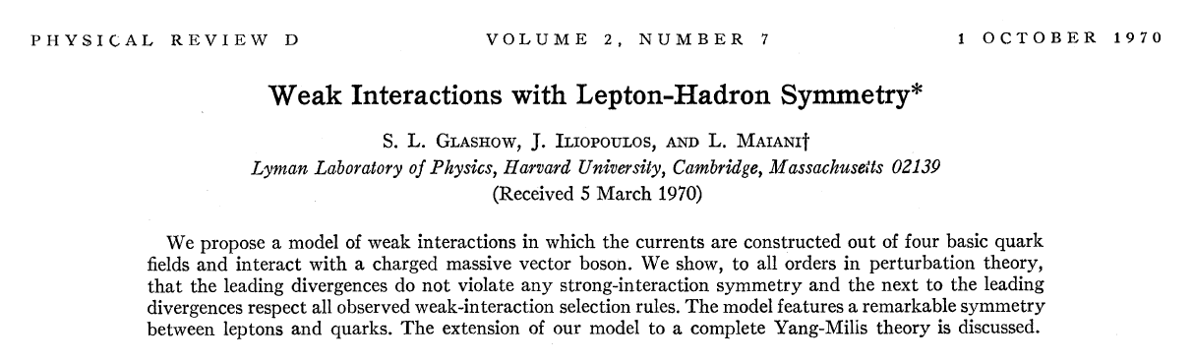
Approaching the ‘Standard Model’ of today
A legendary paper, predicting a new quark (Glashow, Iliopoulos, Maiani)
Quarks
Leptons
u
c
e⁻
µ⁻
The “Standard Model”
of 1970
d
s
νe
νμ

Slide 9
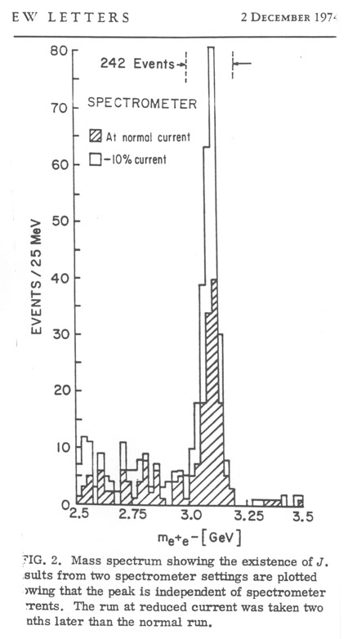
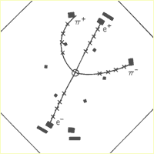
1974
Discovery of the ‘charm’ quark in 1974
NOVEMBER REVOLUTION (11 November 1974)
'Psi' am SLAC (Burt Richter)
'J' at Brookhaven (Sam Ting)
Compromise: J/Psi
“Extremely” long lifetime (~10⁻²⁰ sec)
Decay only possible through electroweak interaction

Slide 10
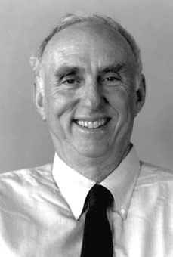
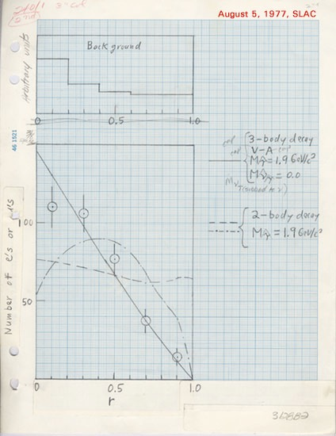
Leptons
1975
But a third family of particles was going to be discovered
A new 'heavy electron' with 3500 x me
... who ordered that?
Martin Perl
THERE MUST BE A WHOLE NEW FAMILY
another neutrino (the ‘tau neutrino’),
and two more quarks (‘top’ and ‘bottom’)
Marty Perl's logbook page

Slide 11
Quarks
1975
The search for the other family members started
new
u
c
t
e⁻
µ⁻
τ⁻
d
s
b
νe
νμ
νt
Quarks
Leptons

Slide 12
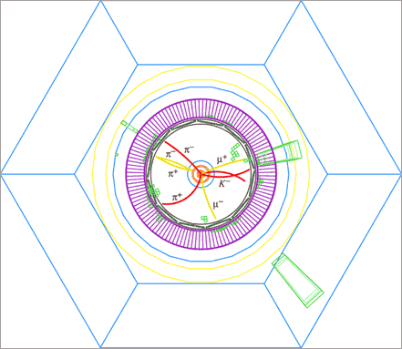
Quarks
1977
Discovery of the ‘Bottom’ Quark (Fermilab)
u
c
t
e⁻
µ⁻
τ⁻
d
s
b
νe
νμ
νt
Quarks
Leptons
In 1977 physicists discovered a new meson called the Upsilon at the Fermi National Accelerator Laboratory.
This meson was immediately recognized as being composed of a bottom/anti-bottom quark pair.
The bottom quark had charge -1/3 and a mass of roughly 5 GeV.

Slide 13
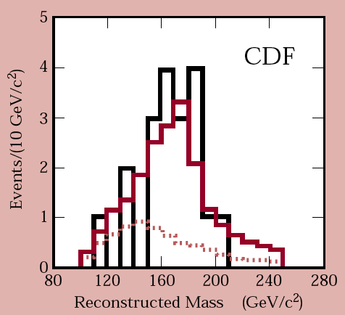
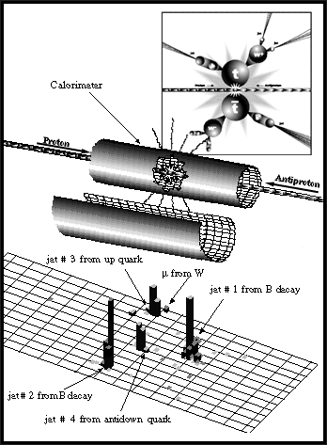
Quarks
1995
u
c
t
Discovery of the ‘Top’ Quark (Fermilab)
d
s
b
Quarks

Slide 14
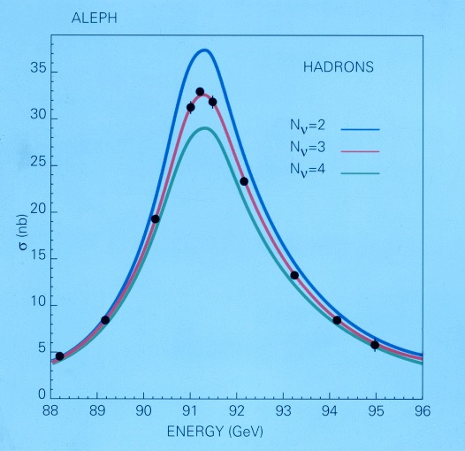
Neutrinos
1992
EXACTLY 3 families of particles
LEP measures the decay width of the Zº particle

Slide 15
Experiments at accelerators have discovered the
whole set of fundamental particles
bottom
top
Higgs
SUSY
???
strange
up - down
charm
L
H
C
electron
muon
neutrinos
tau
neutrino
el
mu
tau
1900
1910
1920
1930
1940
1950
1960
1970
1980
1990
2000
2010
photon
gluon
W, Z

