Slide 2
Potential improvements of the PS 10 MHz cavities driving amplifier
G. Favia
Acknowledgments: V. Desquiens, F. Di Lorenzo S. Energico, M. Morvillo, C. Rossi
LIU-PS Student Day 21 April 2015

Slide 3


Overview
The PS 10 MHz RF system
Beam loading instability and cures
The PS 10 MHz cavities driving amplifier
Improvements of the 10 MHz wideband feedback
Concluding remarks

Slide 4

The PS 10 MHz RF System

Slide 5
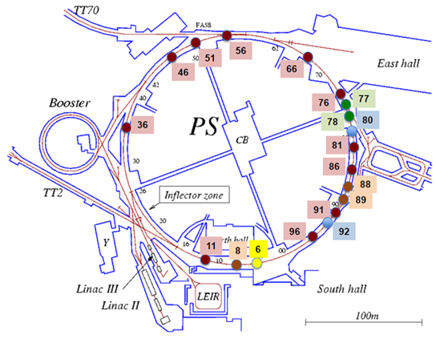
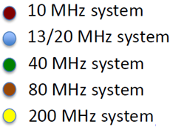

The PS RF system
The PS machine contains cavities operating at different frequencies. The 10 MHz cavities are the most important because they accelerate the bunches to the desired energy and perform beam gymnastic.
The 10 MHz cavities (10+1 double gap cavities tuneable from 2.8 to 10 MHz) are driven by amplifiers based on electron tubes (power up to 60 kW), for reasons of radiation hardness and power dissipation.
The 10 MHz cavities also constitute the major source of instabilities in the PS, that limit the increase of the beam intensity in the framework of the LIU project
New LHC beam planned for the LIU project -> Increased intensity:
$1.3·{10}^{11}$ $→ 2.6·{10}^{11}$ppb at extraction
2

Slide 6
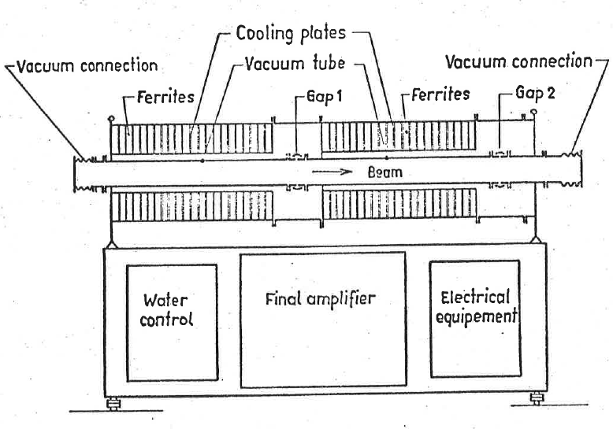
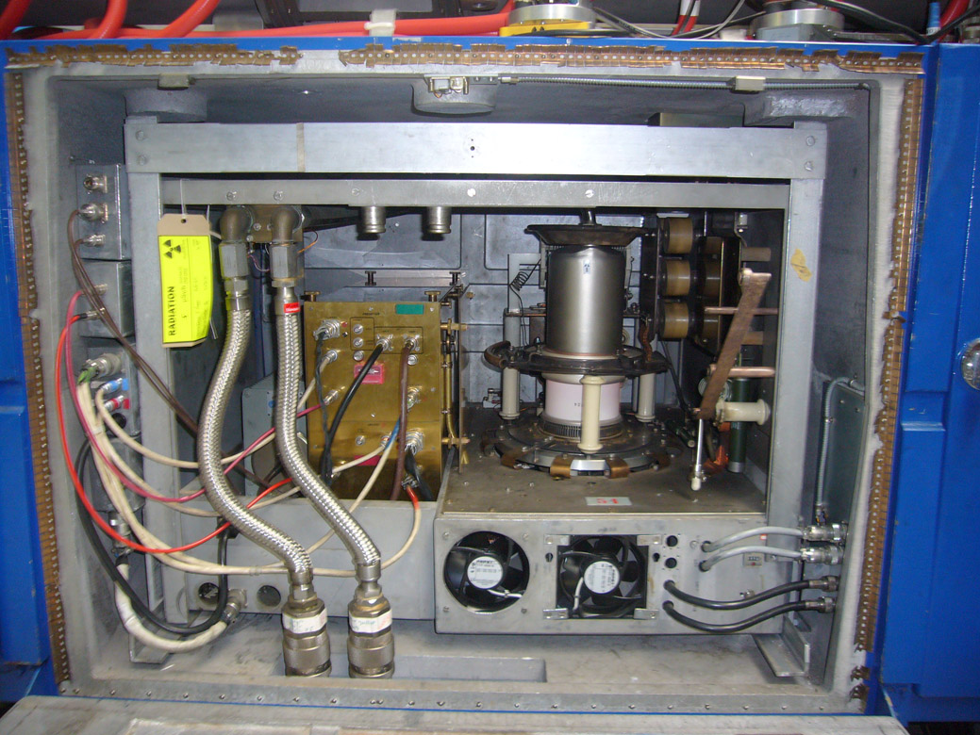
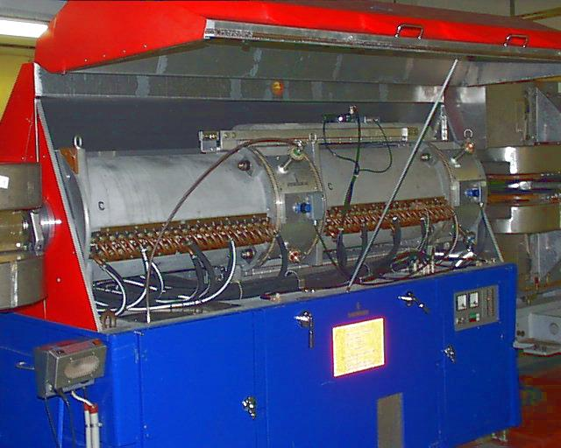
The PS 10 MHz system
Ferrite loaded cavity
Gap voltage 0.5 - 10kVp
Frequency range 2.8 – 10 MHz
Tuning via bias current
that saturates the ferrite
Ferrite loss resistance:
22kΩ/gap @3MHz
10kΩ/gap @10MHz
RF amplifier adopting:
3xYL1056 tubes for predriver and driver
1xRS1084 in the final stage
Housed in the cavity base
Built in 1975, upgraded in 1988
Courtesy of C. Rossi
Courtesy of C. Rossi

Slide 7
Beam loading instability and cures

Slide 8
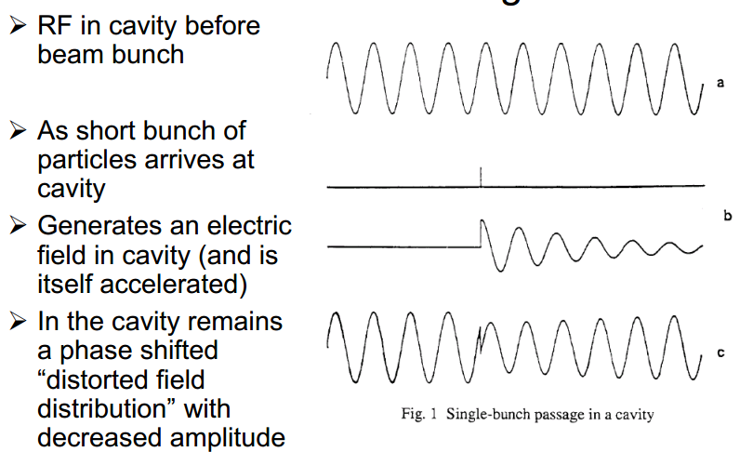
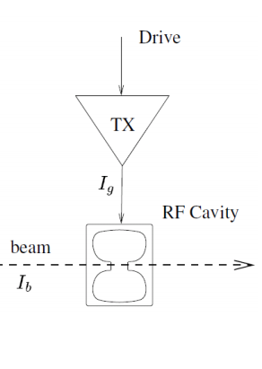

The beam loading instability
Beam loading represents the effect induced by the beam passage in an RF cavity.
RF in a cavity
A short bunch arrives and generates a wakefield
The field in the cavity has a phase and an amplitude distortion
Beam = beam current I_{B} inducing a beam loading voltage V_{B}
Cavity = resonant impedance Z_{RF}
The total voltage seen by the beam is the vector sum of the voltage due to the generator and the beam loading :
$$Vt=V_{RF}+V_{B}=Z_{RF} (I_{G}+I_{B})$$
In stationary conditions, V_{RF} must compensate V_{B} , to keep V_{t} at the desired value.
In transient situations the voltage V_{t} will vary (Transient Beam Loading).

Slide 9
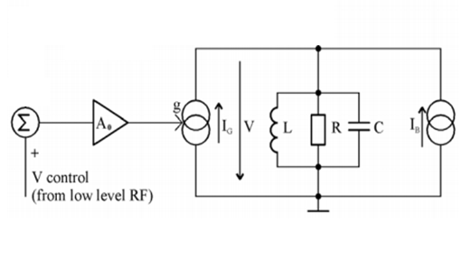


The wideband negative feedback
The impedance of the 10 MHz cavity as observed by the beam would be several kΩ per gap due to the ferrite losses and the final tube anode resistance. This high impedance would lead to strong beam loading.
$$β$$
R = final resistance of the amplifier and cavity losses
$I_{G}$ = current provided by the power RF amplifier
$I_{B}$ = beam current producing a voltage in the cavity called beam loading voltage $V_{B}$
V = total voltage in the cavity ($V_{GAP}$)
BEAM LOADING VOLTAGE
Reduce the impedance seen by the beam
$${V_{B}=I}_{B}·Z_{CAV}$$
minimize the effect of $I_{B}$ -> minimize $V_{B}$
Enclose the cavity in a feedback loop
$$Z_{CAV}^{′}=\frac{Z_{CAV}}{1+Aβ}$$

Slide 10
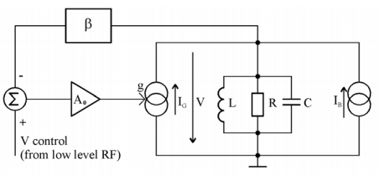
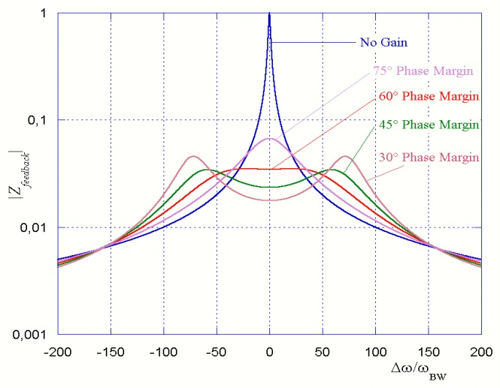
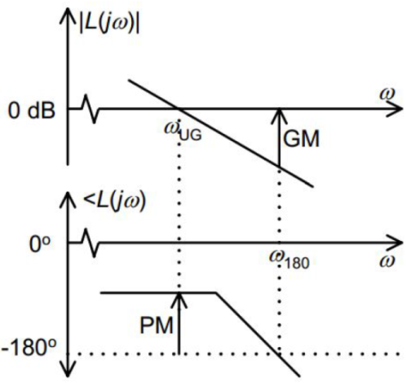
How to decrease Z?
$β$ = feedback factor
Minimize
increase the loop gain G_{L}=A∙β
maximize A (limited by the amplifier maximum rating)
maximize β (limited by the maximum input power)
$$Z_{CAV}^{′}=\frac{Z_{CAV}}{1+Aβ}$$
$A$ = A₀ $g$R = forward gain
LIMITS:
Phase shift introduced
by
cables and electronics
gain margin (m_{g})
and
phase margin (m_{ϕ})
$${|G}_{L}|=\left|A·β\right|=1=0dB$$
INSTABILITY ->
$$τ=\frac{∆φ }{∆ω}$$
$$∠G_{L}={−180}^{º}$$
Increase the margins, by limiting the phase shift

Slide 11
The PS 10 MHz system driving amplifier

Slide 12
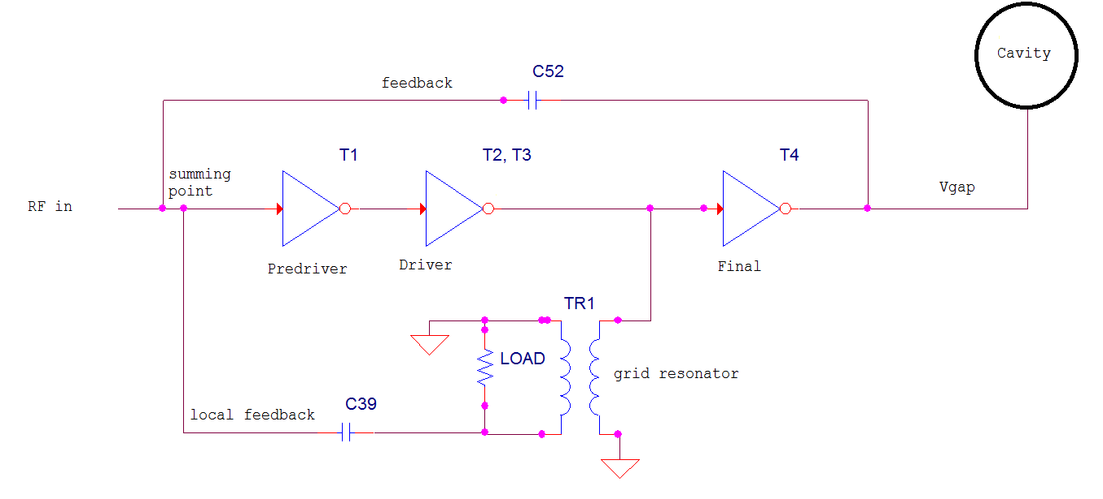
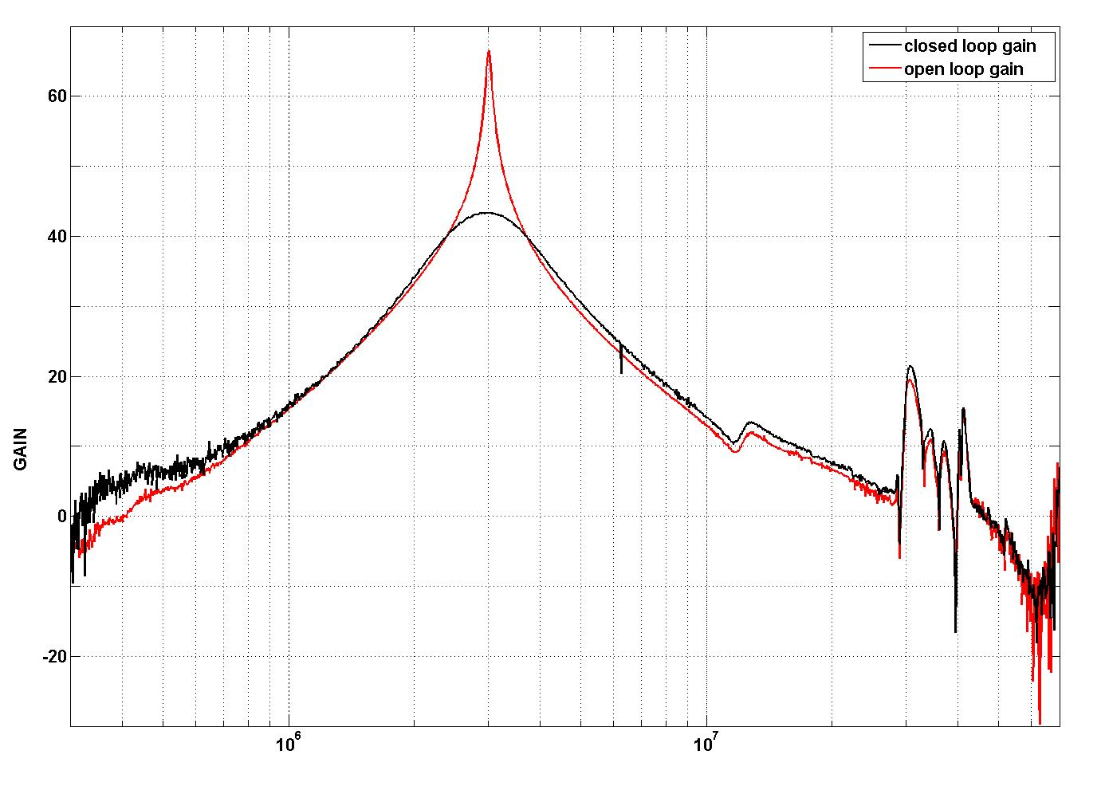
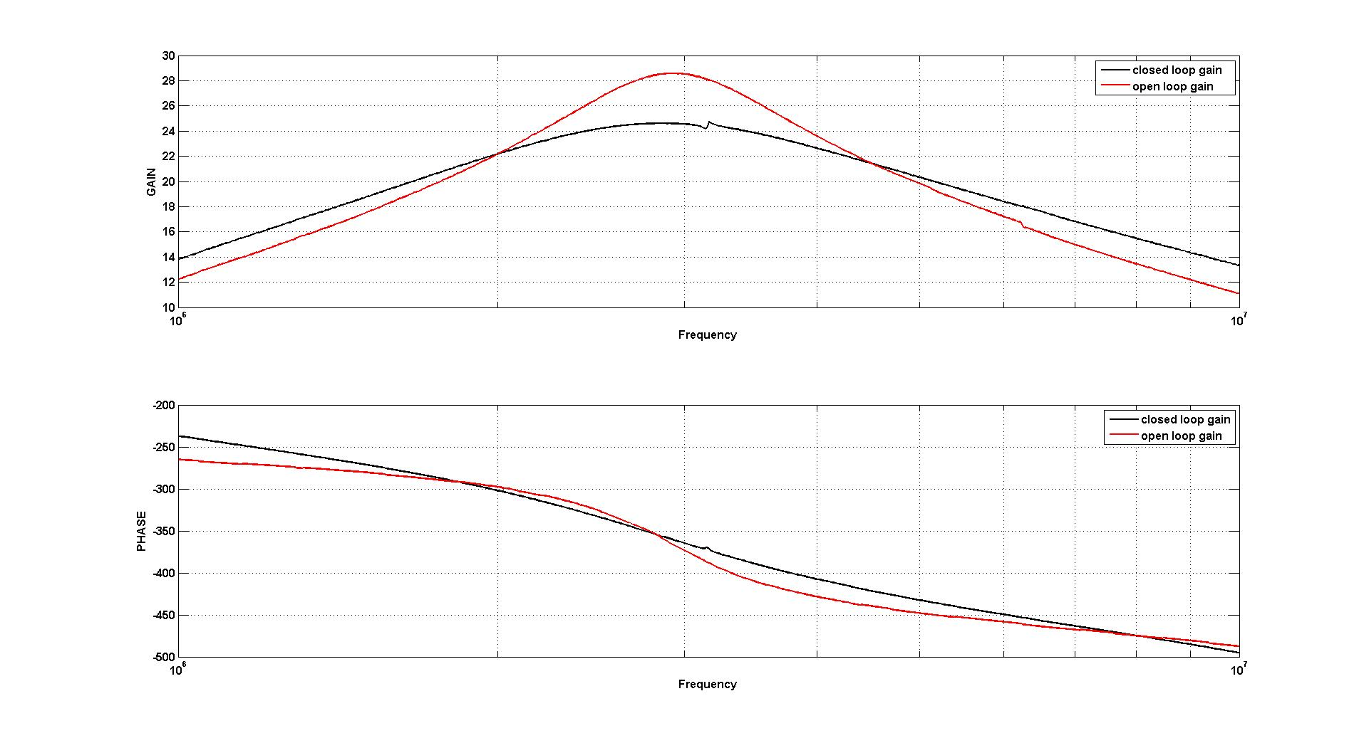
The PS 10 MHz cavities driving amplifier
BW = 65 kHz
BW= 1.25 MHz
LG=21 dB
BW= 3.5 MHz
BW = 1.2 MHz
FREQUENCY TUNING VIA A DC CURRENT
180° PHASE SHIFT FOR THE LOCAL FEEDBACK
LOAD IMPEDANCE TRANSFORMATION FROM 50Ω TO 200Ω(1:4)
Frequency

Slide 13
Improvements of the 10 MHz wideband feedback

Slide 14
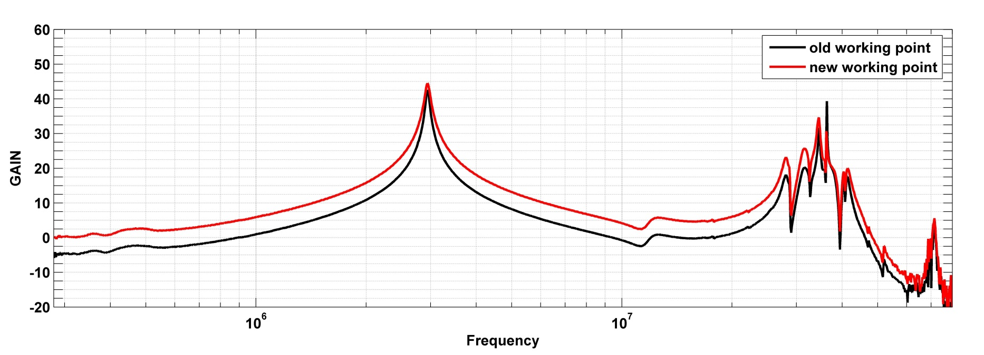
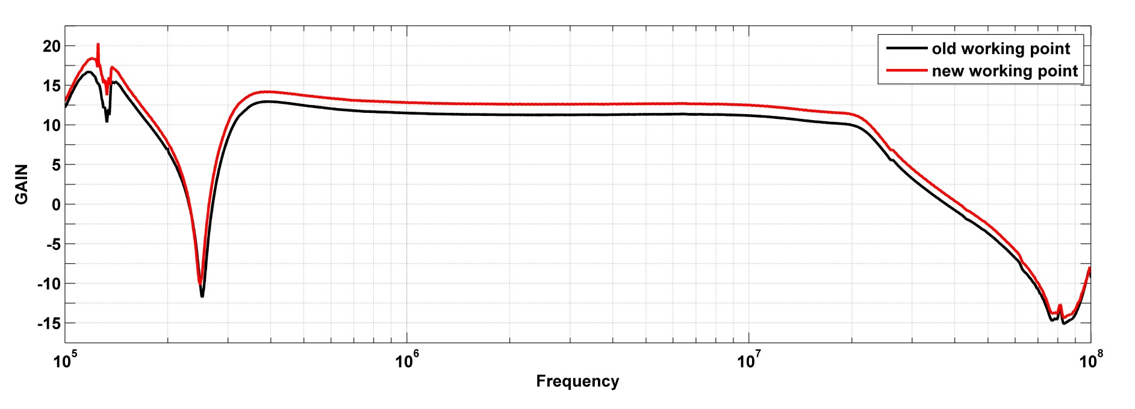
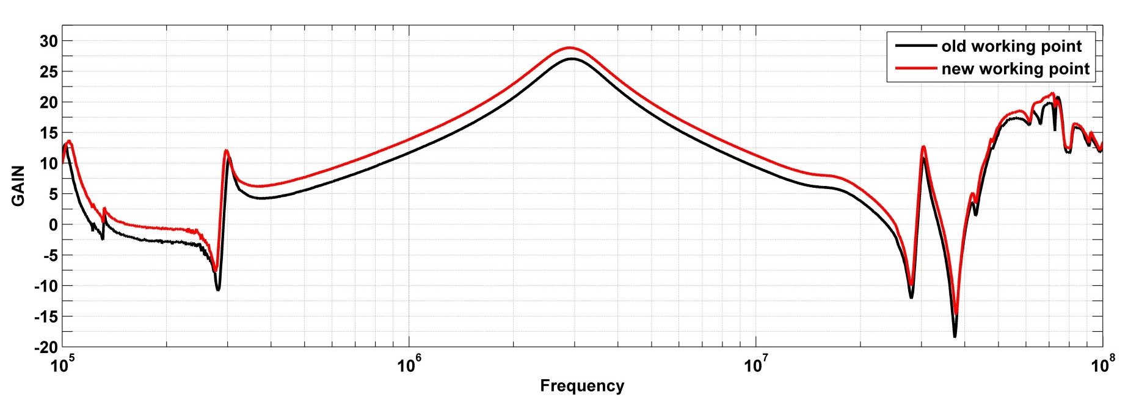
Increase of A
In order to get higher tubes transconductance and hence higher open loop gain, the working point of the tube has been modified.
STAGE | GAIN Old configuration | GAIN New configuration
Predriver | 11.1 dB | 12.76 dB
Driver | 26.7 dB @3MHz 24 dB @3MHz | 28.5 dB @3MHz 26 dB @10MHz
Final | 42.9 dB @3MHz 39.5 dB @10MHz | 44.9 dB @3MHz 43.2 dB @10MHz
TOTAL INCREASE OF GAIN:
~4dB IN THE FIRST TWO STAGES
~2dB IN THE FINAL STAGE

Slide 15

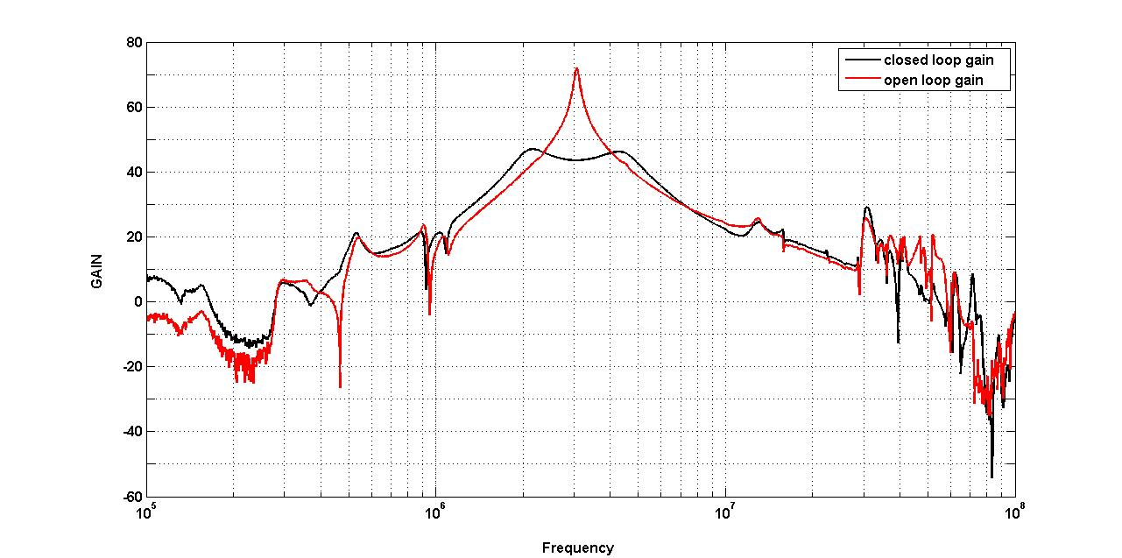
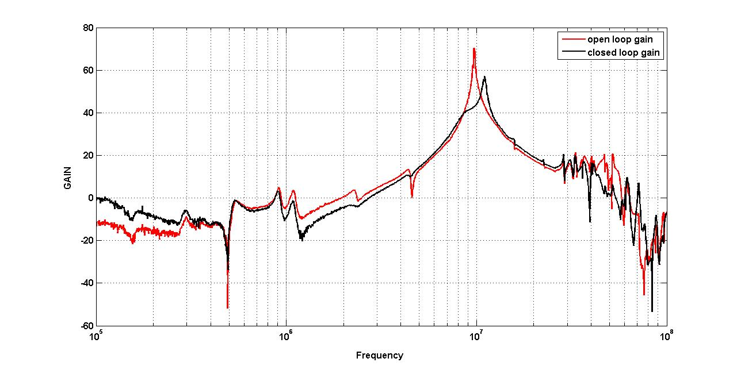
Increase of β
β has been increased by 3 dB → G_{L}= 24 dB
that means more input power needed (but still achievable);
2. A has been increased by 6 dB → G_{L}=30 dB
that means keeping the same input power.
G_{L}=27 dB + stability
3 MHz
10 MHz
10 kvp/gap
NOT ACHIEVABLE!
The additional 6 dB will be distributed in this way:
Starting from G_{L} =24 dB
3 dB will be used for decreasing the cavity impedance;
3 dB will be used for reducing the total group delay by acting on the local feedback or implementing hardware modifications;

Slide 16
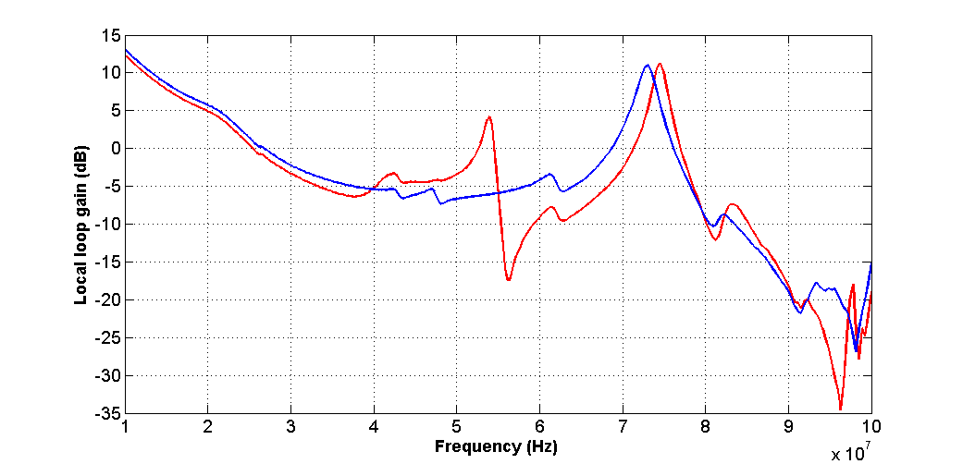
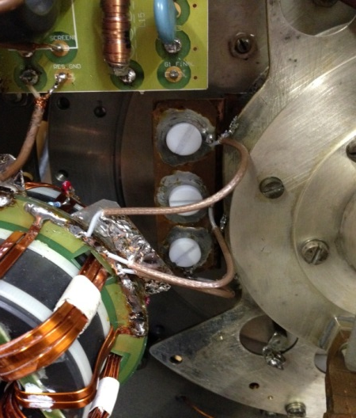
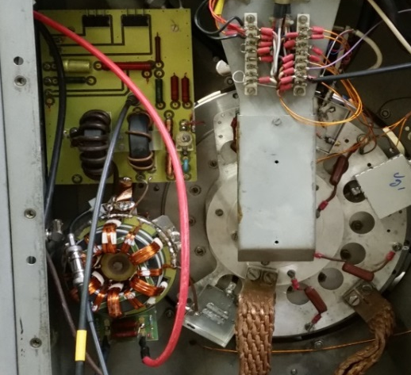
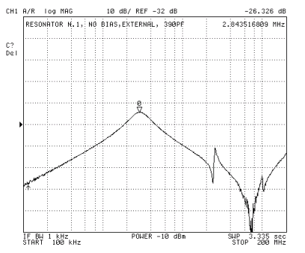
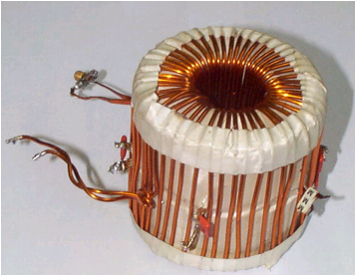
Increase of margins
In order to increase the stability margins hardware modification have been implemented
Improvement of the internal connections and damping of resonances
new connection
old connection
Replacement of the old resonator
New resonator: simpler device, less capacitance and leakage inductance, losses reduced at 10 MHz.
Old resonator: stray capacitance and leakage inductance, high losses at 10 MHz.
OLD | 3 MHz | 10 MHz
DRIVER LOAD | 194 Ω | 120 Ω
3 separated devices
tuneable resonator coil;
200Ω load transformer;
inverter.
NEW | 3 MHz | 10 MHz
DRIVER LOAD | 196 Ω | 177 Ω

Slide 17
Results

Slide 18
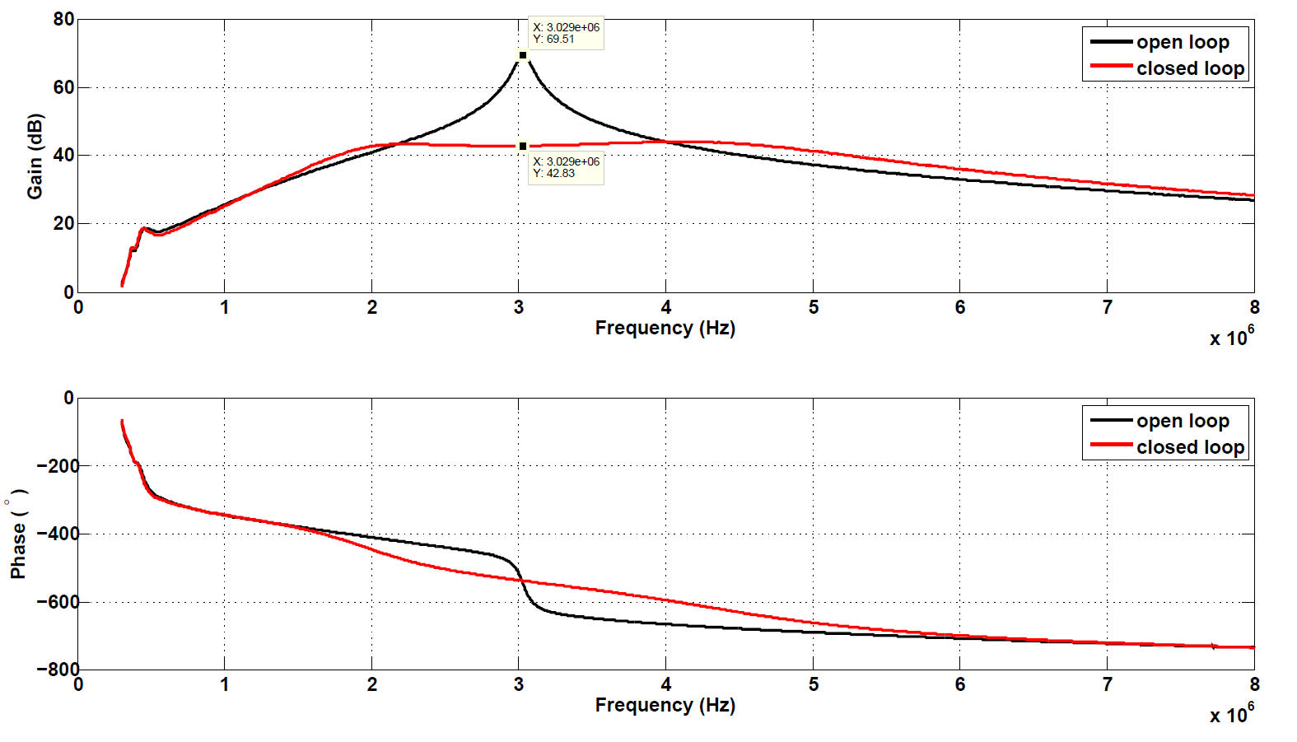
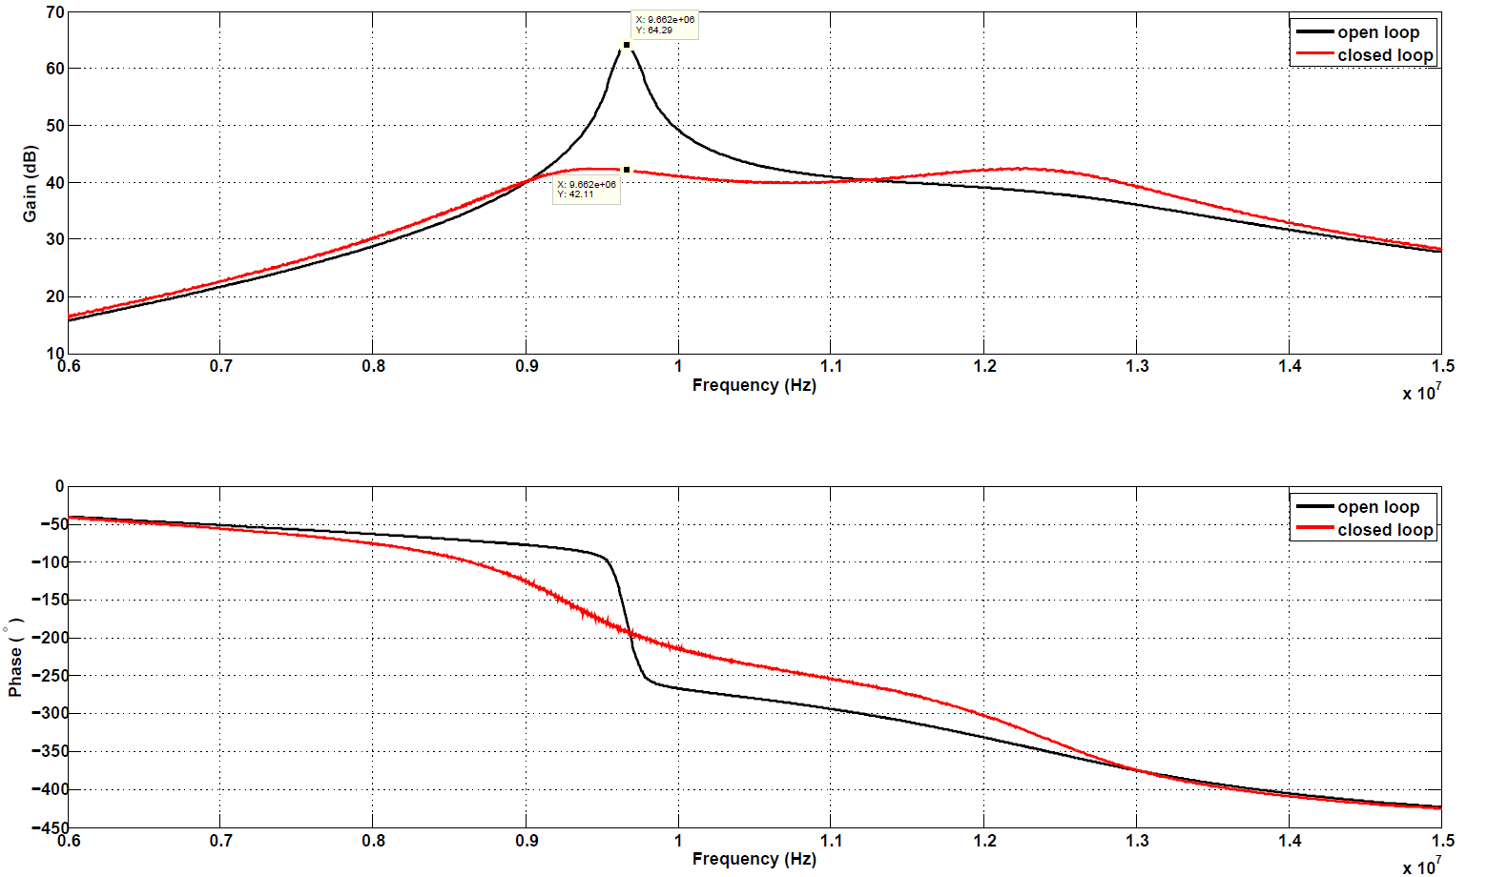
Results
TOTAL LOOP 3 MHz
TOTAL LOOP 10 MHz
69.5 dB
64.3 dB
42.8 dB
42.1 dB
OL=69.5 dB
CL=42.8 dB
OL=64.3 dB
CL=42.1 dB
LG= 26.7 dB
LG= 22.2 dB
INPUT POWER REQUIRED FOR 10 kV_{P}
80 W
INPUT POWER REQUIRED FOR 10 kV_{P}
120 W

Slide 19
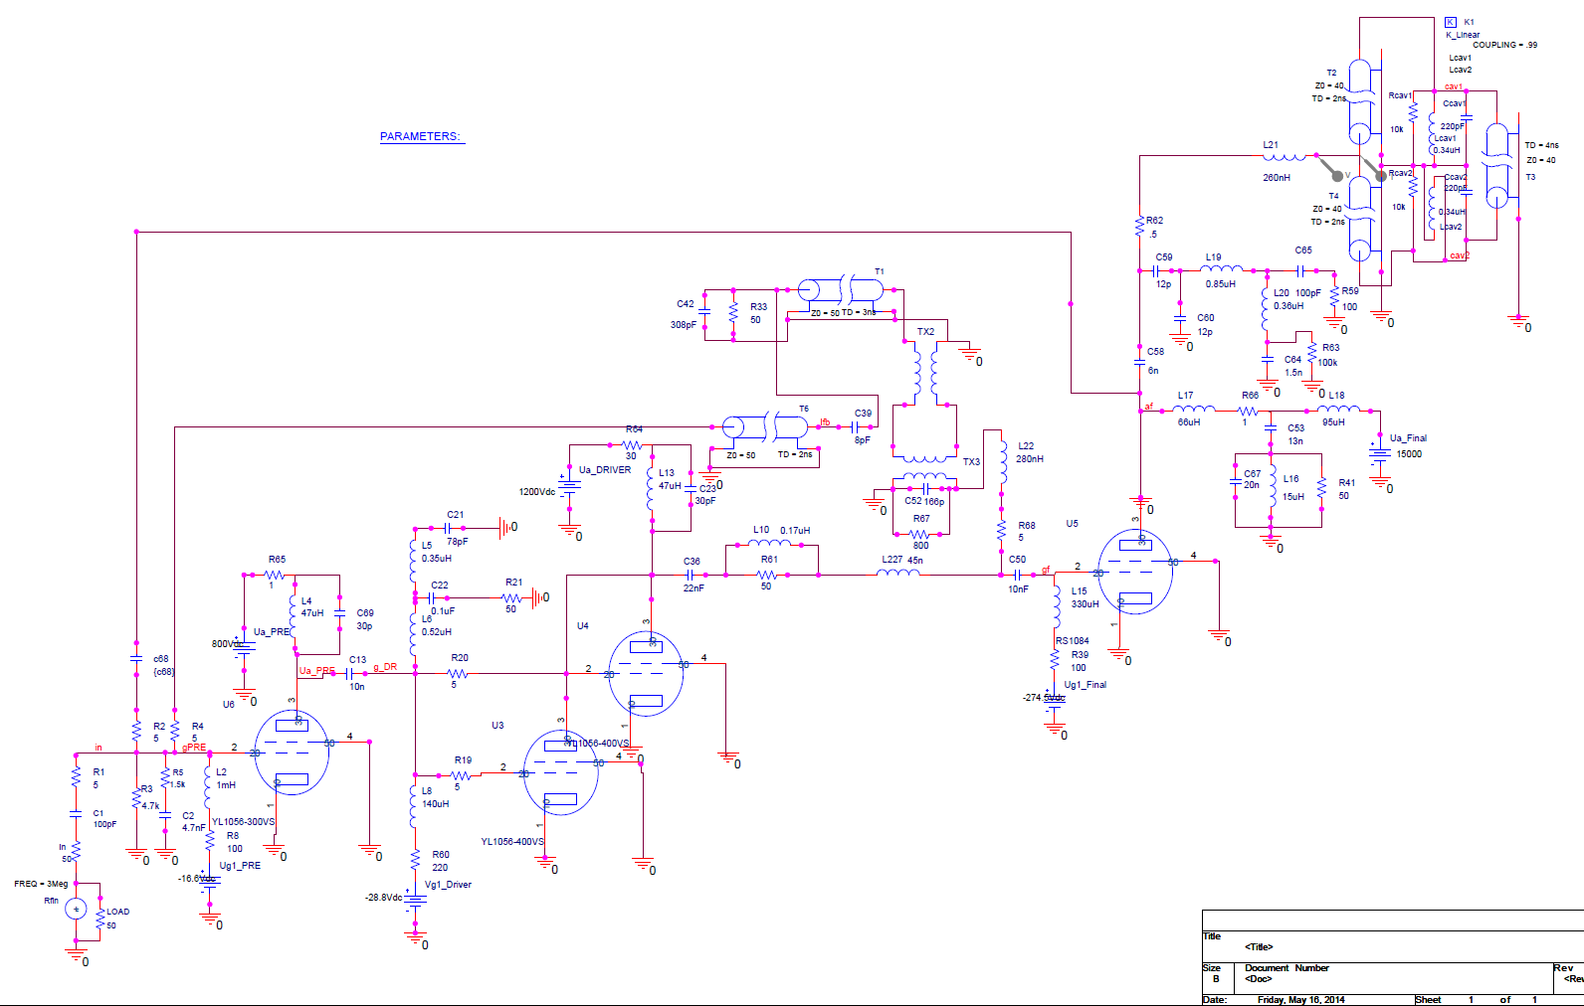
PSPICE model of the 10 MHz amplifier

Slide 20

Summary
Higher amplifier gain is achievable without complete re-designing;
Up to 9 dB of additional loop gain have been demonstrated;
A stable operation with additional 6 dB of loop gain at 3 MHz can be achieved with an achievable input power by implementing few changes to the amplifier
New modifications will be implemented in order to get higher loop gain with less input power at 10 MHz;
The overall feedback pickup will be moved from the anode of the final tube to the cavity, since the cavity acts as a good bandpass filter;
Asymmetries in the distribution of the beam induced voltage in the two cavity gaps will be analyzed;
The possibility to replace the first two stages with solid state amplifiers, or to clearly change technology for the cavity-amplifier system (wideband Finemet© cavity) will be investigated, if necessary.
Next steps

Slide 21
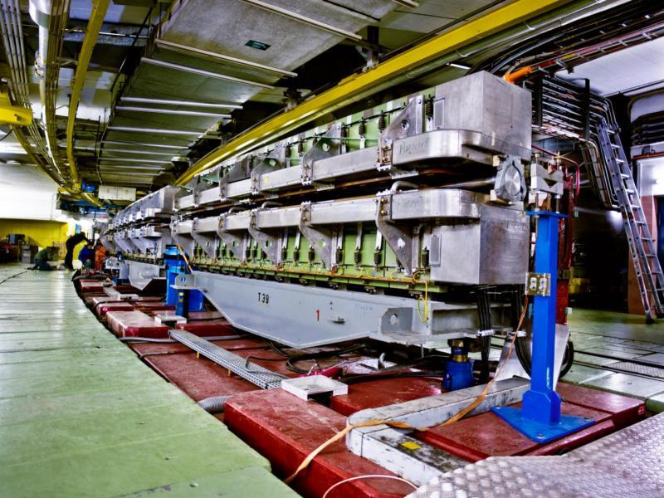
THANK YOU
FOR YOUR ATTENTION

Slide 22
Spare Slides

Slide 24
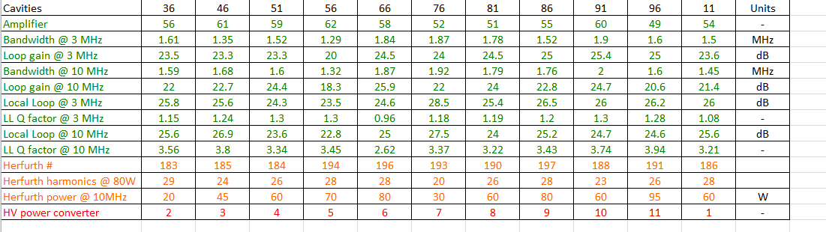
PS ring cavities

Slide 25
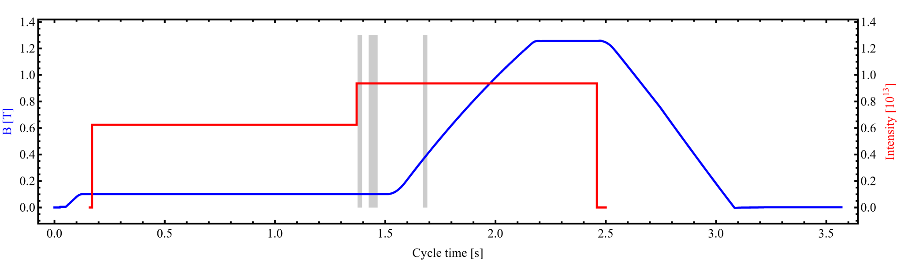
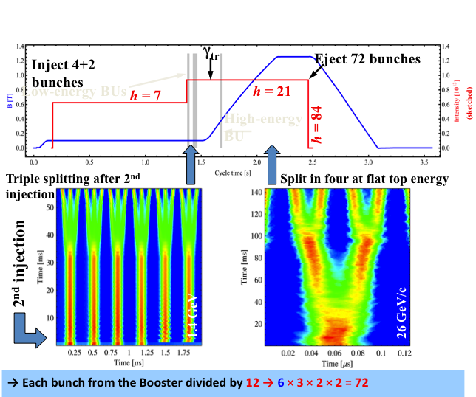
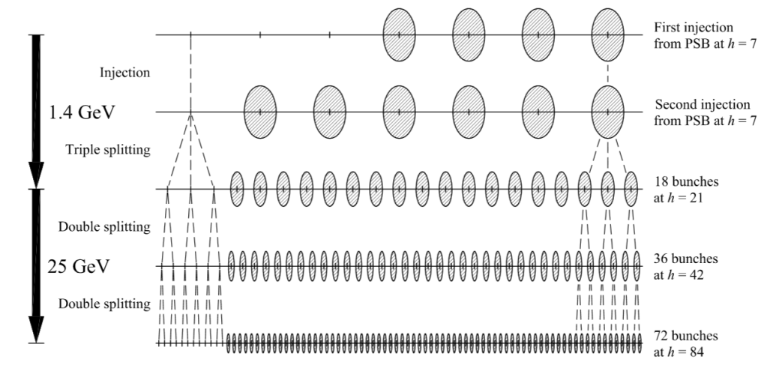
The LHC 25ns Cycle In The PS (pre-LS1)
In the PS different multi-bunch beams are generated: 25, 50, 75 ns LHC physics beams. The 25 ns LHC physics beam is referred to as ‘nominal’ LHC beam.
γ_{tr}
Inject 4+2 bunches
Eject 72 bunches
h = 7
h = 21
Instability
h = 84
Triple splitting after 2nd injection
Split in four at flat top energy
Courtesy of H. Damerau & L. Ventura

Slide 26
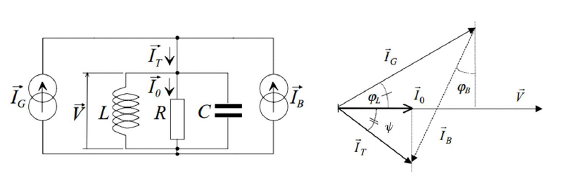




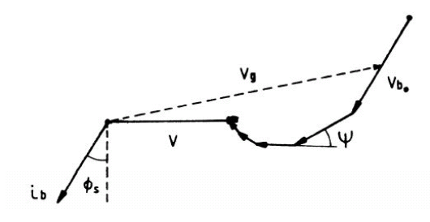
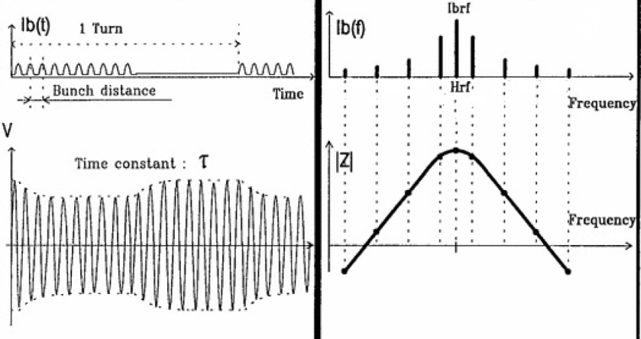

Beam Loading
In stationary conditions, V_{g} must compensate V_{b} , to keep V_{t} at the desired value, providing an extra driving power or detuning the cavity.
STATIONARY BEAM LOADING
TRANSIENT BEAM LOADING
In transient situations the voltage V_{t} will vary. It happens in many circumstances, such as at the injection or when the ring is not filled uniformly. The transient beam loading experienced by the bunch is the result of different spectral components besides the ones at the RF frequency.

