Slide 1

TOTEM STATUS REPORT
Nicola Minafra on behalf of TOTEM Collaboration
LHCC OPEN SESSION
3 June 2015

Slide 2
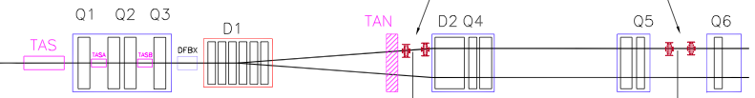
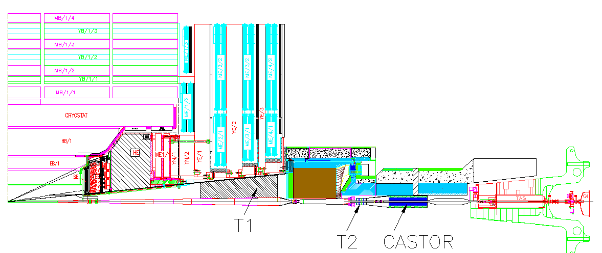
TOTEM Experiment at LHC
T1 and T2
to detect charged particle in inelastic events
Roman Pots
to detect elastic and diffractive protons close to outgoing beam
IP5
~ 10 m
T1
T2
IP5
~ 220 m

Slide 3
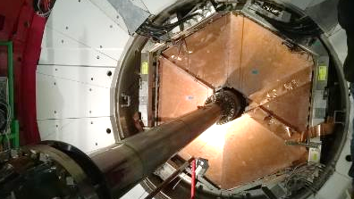

T1 for RUN 2
May
Test and commissioning with beam done
First data at 13 TeV
September
Maintenance activity is over
March
Installation into the CMS end-caps
2014
2015
November
Tested on surface:
Low voltage
HV and gas
Control Loop
DAQ

Slide 4
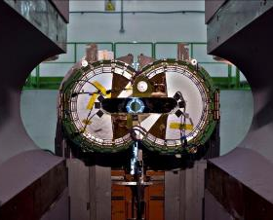
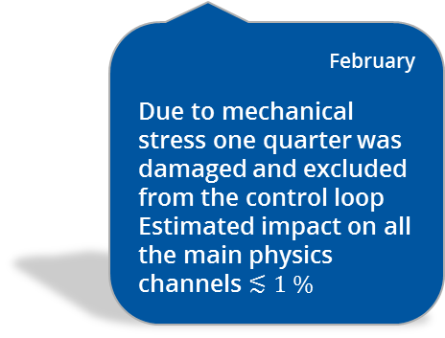
T2 for RUN 2
2015
September
Maintenance activity is over
March
Installation done
May
Calibration with CMS
First data at 13 TeV
2014
2015
October
CMS closed, magnet test was performed
T2 Re-insertion in HF
LV, HV, gas
Detector operation
February
Due to mechanical stress one quarter was damaged and excluded from the control loop
Estimated impact on all the main physics channels $≲1 \%$

Slide 5
Roman Pots for RUN 2
2015
October
26 RPs installed
April
Full RPs configurations qualified by LMC
2014
2015
November
Service lines connected
Detector packages installed
January – February
Commissioning done
Sec. Vacuum & Cooling
Powering
Control loop
RP readout with DAQ
Interlock test - started
RP movement test from CCC
May
Silicon detectors commissioned with beam
Vacuum status of sector 45 & 56 is fine

Slide 6
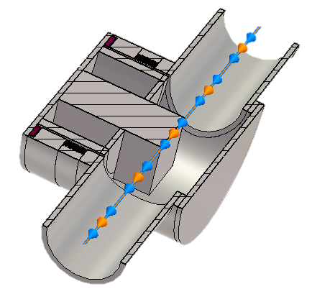
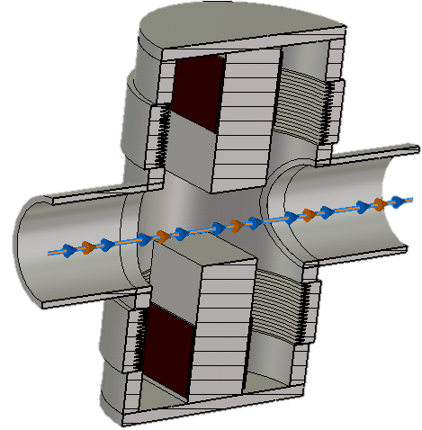
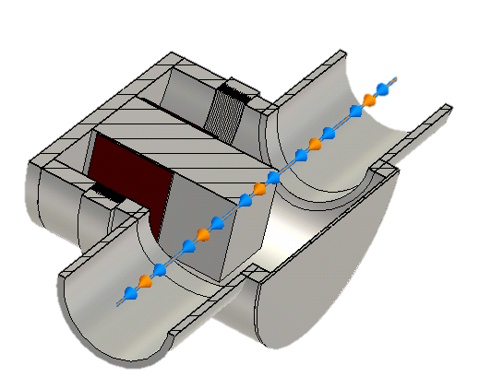
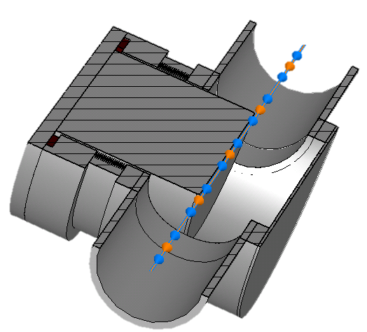
RP configurations approved by LMC
High intensity runs:
2015
  4 Vertical RPs (per arm)
  2 Shielded RPs
  Cylindrical RP
16 Vertical RPs
4 Shielded RPs
for high-luminosity operation
IP5
Dedicated runs (90 m):
  6 Vertical RPs
  2 Horizontal RPs
  1 Shielded RP
4 Horizontal RPs
2 Cylindrical RPs
for time-of-flight detector
IP5

Slide 7
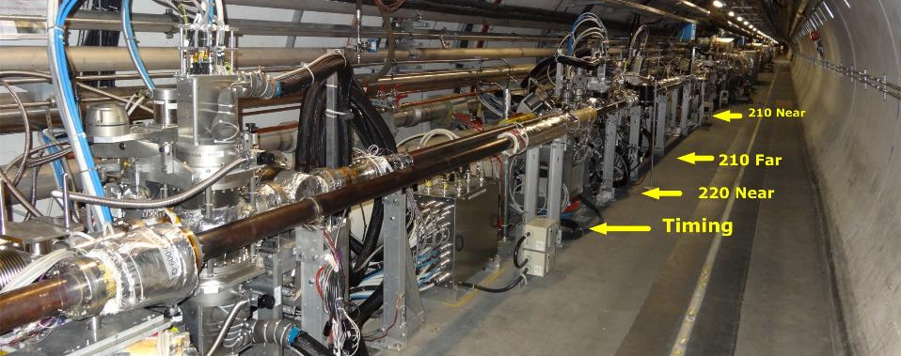
Roman Pots installed in sector 45
220 Far

Slide 8
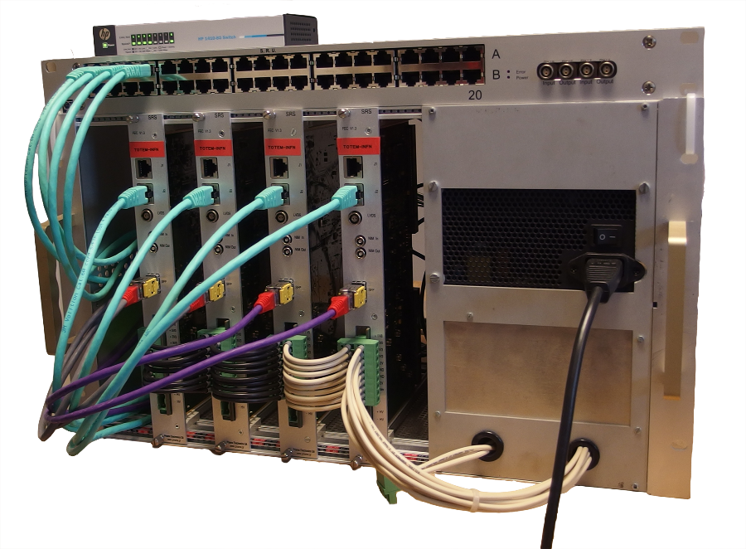
DAQ
The legacy RUN1 DAQ chain has been re-installed in the new IT infrastructure in UCS and PCI to VME interfaces
Performance are the same as in the RUN1 and the system has been commissioned during the first LHC runs
In the meantime the installation in IP5 of the consolidated DAQ (~20x w.r.t. previous DAQ system) is progressing
We are testing some firmware new features before moving the RD51 Front End Concentrator (FEC) cards to UCS for commissioning
Ethernet based DAQ crate
4Gb/s aggregated throughput

Slide 9
Trigger and Operation
The full system was able to take data for the first collisions in the LHC
The bidirectional trigger link between Totem and CMS has been tested
All latencies for the consolidated and upgraded systems have been measured and implemented
The full system has been proven to work
TOTEM is ready to take data any time in dedicated runs

Slide 10
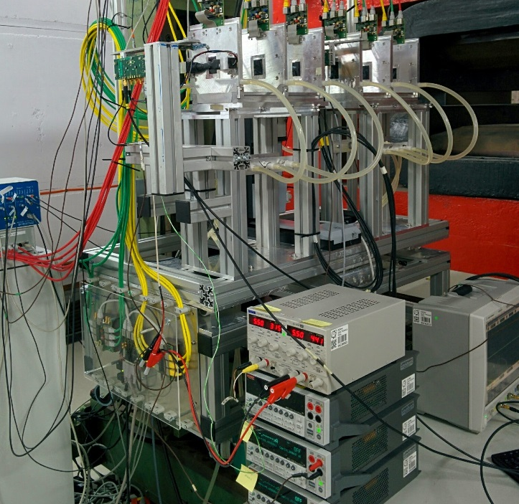
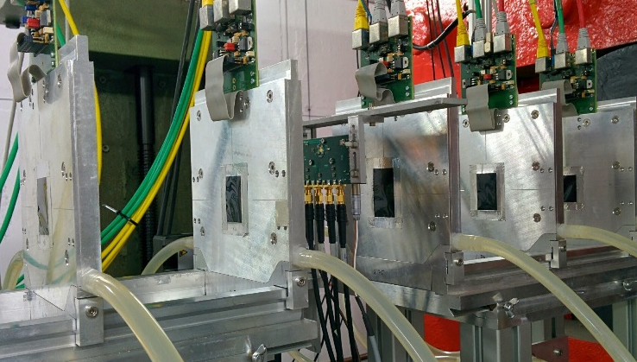
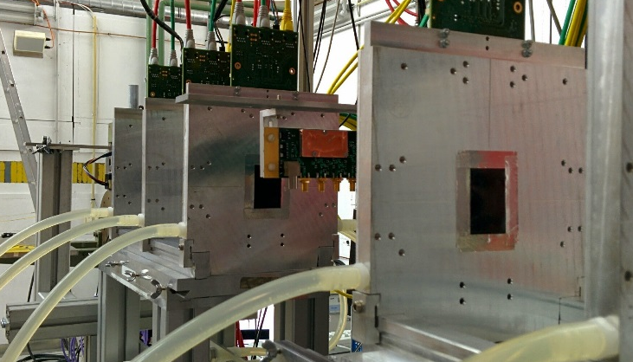
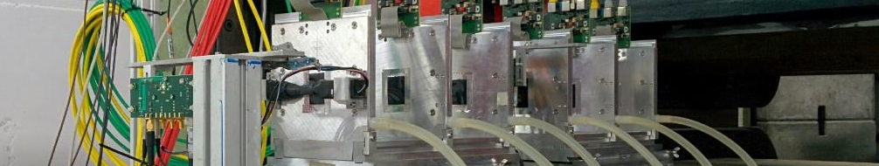
Construction of the
Timing Detectors for Vertical Roman Pots

Slide 11
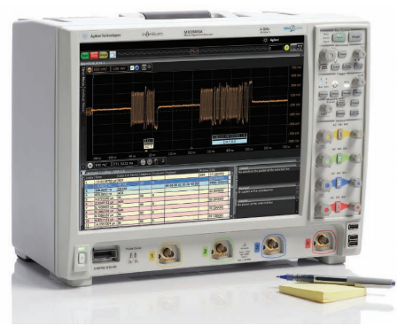
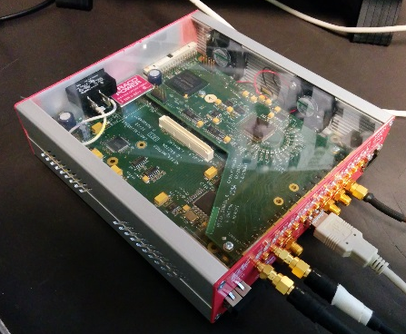
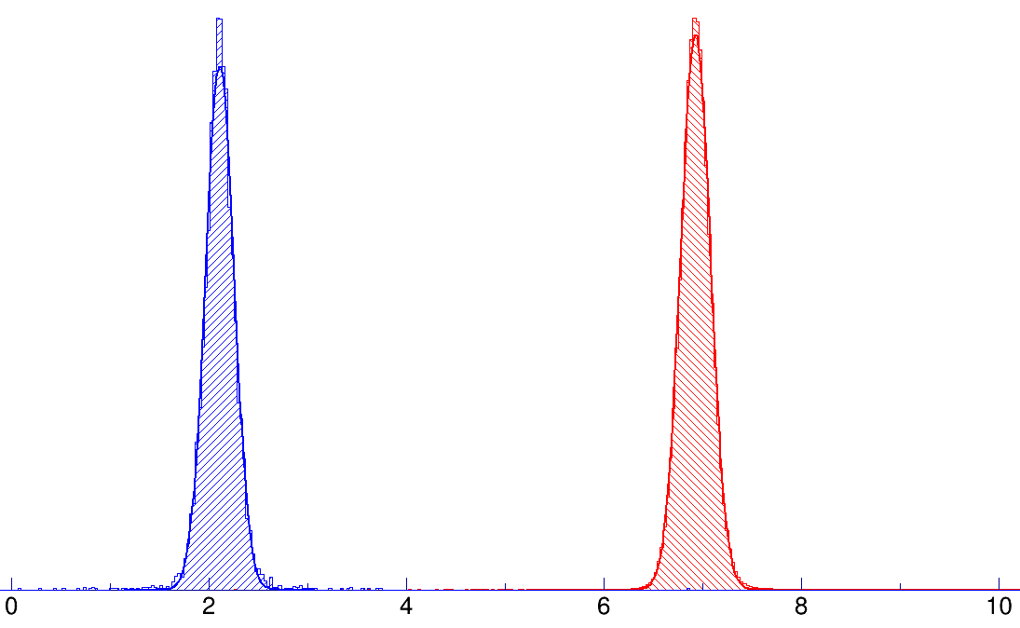


Timing Detectors for Vertical Roman Pots
The tests of the detectors where done acquiring the signal with an oscilloscope
Similar performance has been obtained with the SAMPIC ($\sim 5\%$)
SAMPIC
$$σ \sim {σ_{∆t}}/{\sqrt{2}} \sim 107 ps$$
Oscilloscope
$$σ \sim {σ_{∆t}}/{\sqrt{2}} \sim 102 ps$$
Agilent DSO 9254A
2.5 GHz bandwidth
10 Gs/s
8 bit
> 1000 samples
4 channels
Maximum rate ~100 Hz
SAMPIC
2.5 GHz bandwidth
10 Gs/s (used at 6.4 Gs/s) 11 bit
64 samples
16 channels
Maximum rate ~500 kHz

Slide 12
Timing Detectors for Vertical Roman Pots
The geometry of the pixels is optimized to have a uniform occupancy
The measured time resolution depends on the size of the pixels, because of capacitance, and is compatible with the requirements
17.64 mm²
4.28 mm²
2.94 mm²
5.67 mm²
3.49 mm²

Slide 13
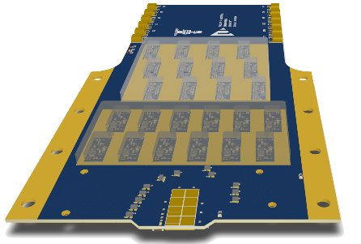
Test of Timing Detector Prototype
Test beam in North Area
10 – 14 June
2015
5 – 11 August
14 – 17 September
Tests will be focused on planes with multiple diamonds:
60 diamonds were purchased and the metallization is in progress
Final front-end and read-out electronics for one full plane is in production

Slide 14
Incremental Installation of the Timing Detectors
June – July
Test on H8 beam line
August
Ready to install picosecond clock distribution
September
Ready install timing detectors
Installation of the full system
2015
2016
Initial step
Test and installation of 48 diamonds:
4 diamonds per plane
3 planes
4 RPs (top & bottom 45 & 56)
Full system
Test and installation of the full timing system:
Full acceptance, ~50 ps time resolution
8 diamonds per plane
4 planes
4 RPs (top & bottom, 45 & 56)

Slide 15



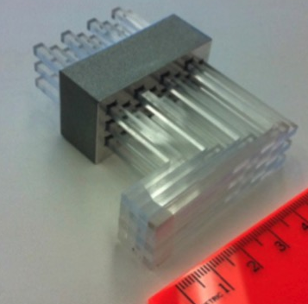
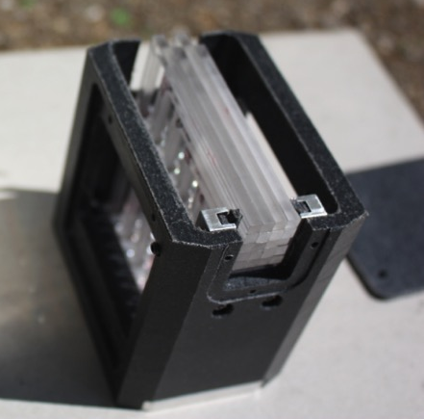
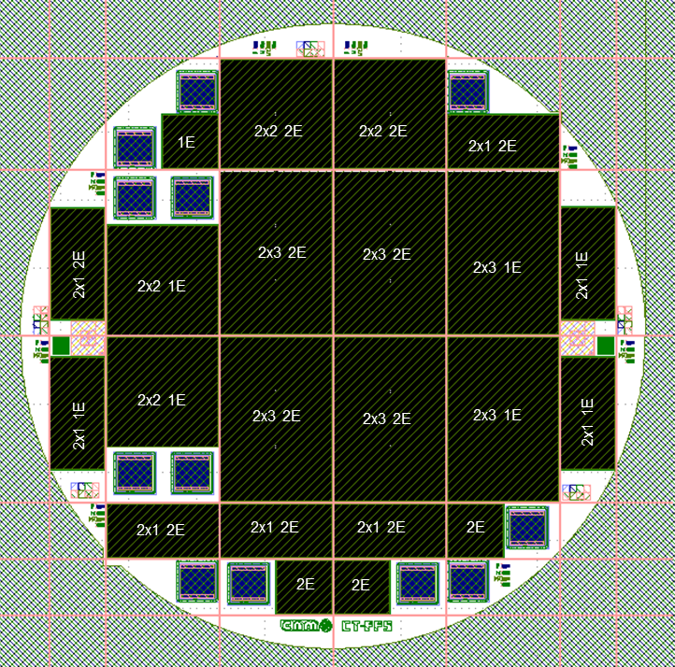
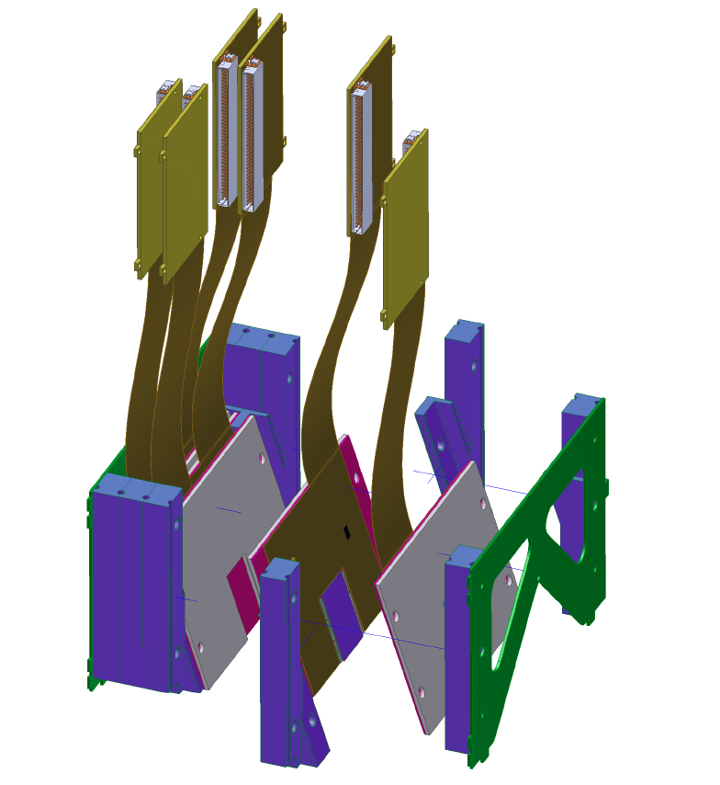
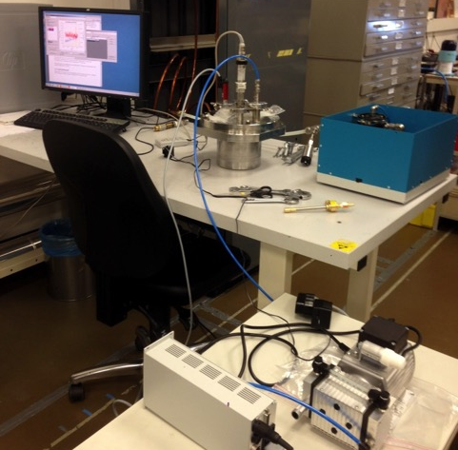
CT-PPS CMS-TOTEM Precision Proton Spectrometer
Construction of the CT-PPS timing and tracking detectors is in progress
A prototype module of the timing Quartic detector was built
Test beams:
Vortex cooling tests are in progress at CERN
Production of 3D pixel sensors
is being pursued at CNM
The sensors are expected to be available in the fall 2015
Fermilab (June)
CERN (August)

Slide 16

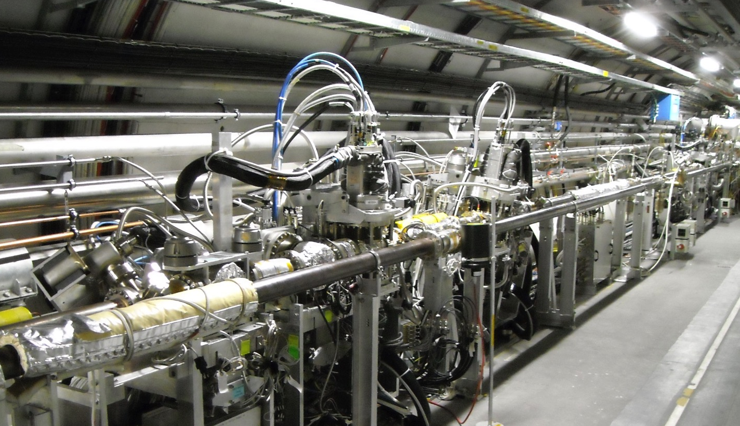

CT-PPS CMS-TOTEM Precision Proton Spectrometer
Preparations for the Exploratory Phase are in progress
6 horizontal RPs are ready for insertion tests at low $β^{∗}$ in 2015
CT-PPS
Timing detector
CT-PPS
Tracking detector
CT-PPS
Tracking detector
Study beam interaction with
Study RP impact on impedance
Start with low-intensity fills and
quartz-like material
budget
end-of-fill insertions

Slide 17
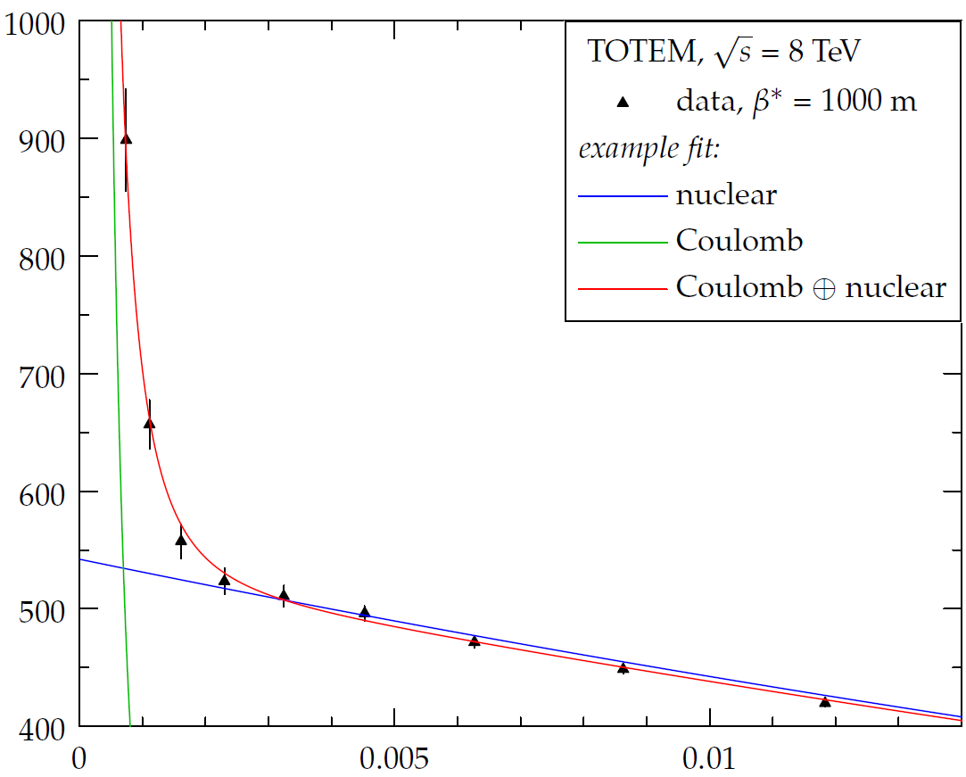

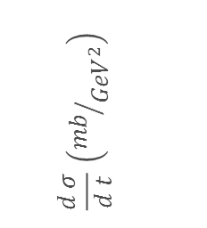

Coulomb – Nuclear Interference in elastic pp scattering
$$\frac{d σ}{d t} ∝ {\left|𝒜_{C}+\left|𝒜_{N}\right|e^{iφ_{𝒜_{N}}}+𝒜_{INT}(𝒜_{N},𝒜_{C})\right|}^{2}$$
$$\frac{d σ}{d t} \left({mb}/{{GeV}^{2}}\right)$$
Coulomb Interaction
Nuclear Interaction
Coulomb – Nuclear Interference
… in progress
$$\left|t\right|\left({GeV}^{2}\right)$$

Slide 18
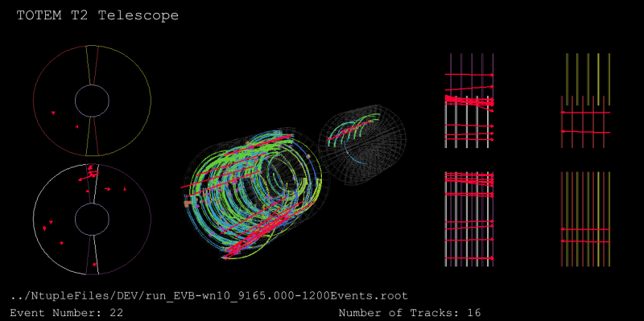
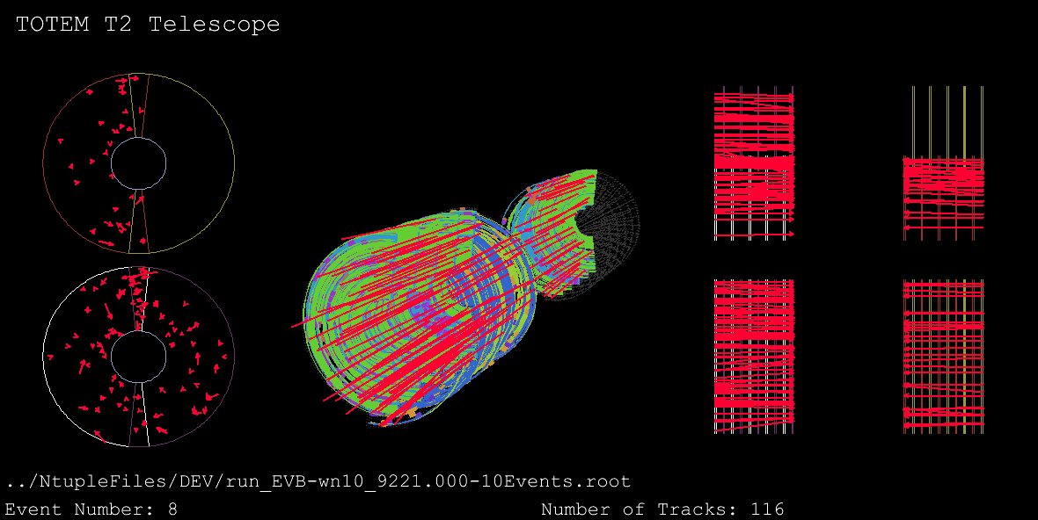
Conclusions
TOTEM is ready for Run 2 at 13 TeV
The upgrade program is on schedule
Today’s event at 13 TeV
First event at 13 TeV
Congratulations
to all LHC people
21 May 2015
3 June 2015

Slide 19

totem.web.cern.ch

Slide 20
RP configurations approved by LMC
2015
New ferrite material (Trans-Tech TT2-111R)
Ferrite bake-out at 1000ºC
8 RPs with improved impedance:
  Shielded horizontal RPs for
  high-luminosity operation
  Cylindrical RPs for new
    timing detector
TCL6 installed to intercept showers from RPs
8 Vertical RPs
4 Shielded RPs
4 Horizontal RPs
2 Cylindrical RPs

Slide 21
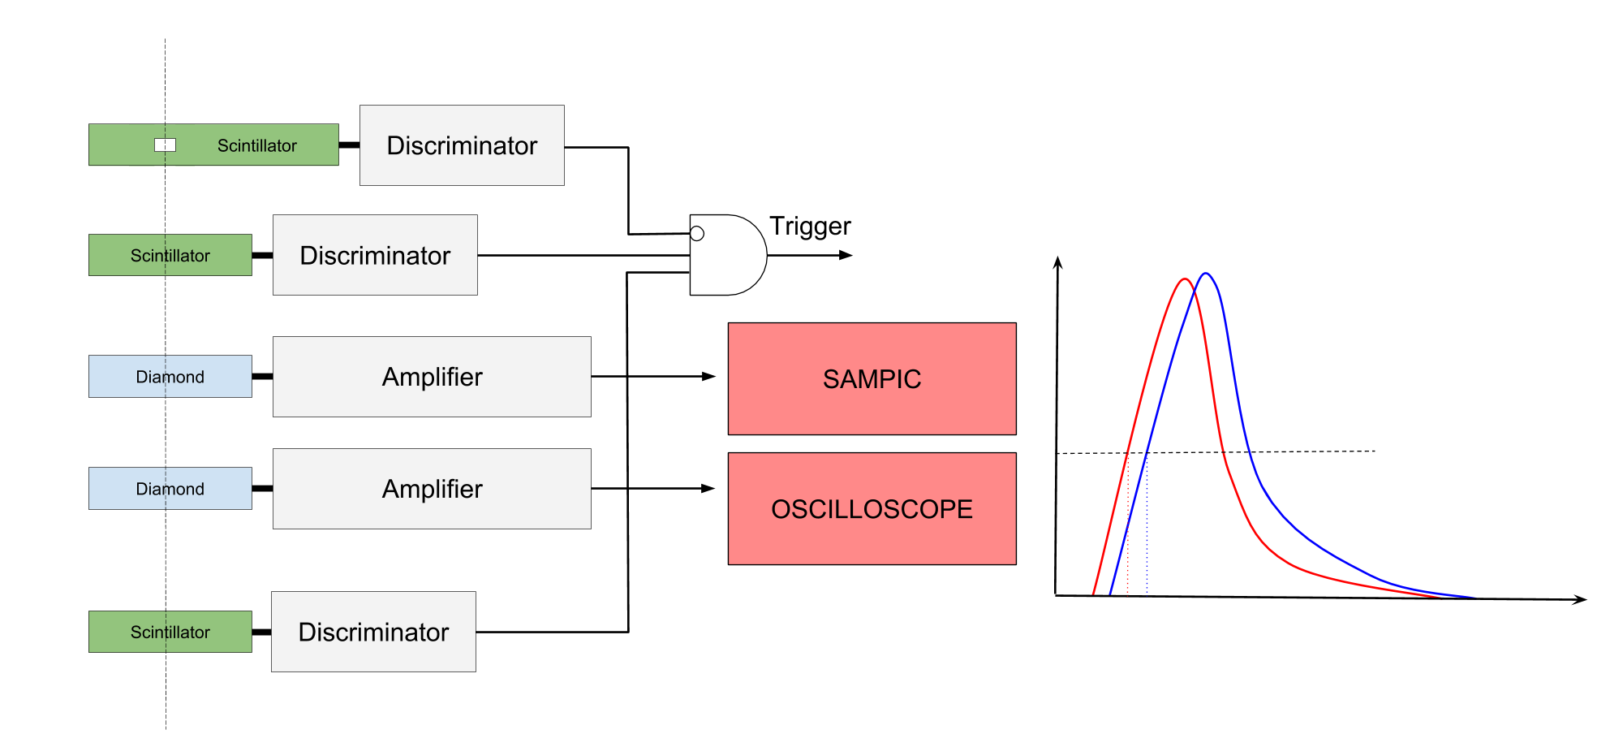



Timing Detector for Vertical Roman Pots
To estimate the time resolution, we measure the time difference between two identical detectors:
$$σ_{∆t}= \sqrt{{σ_{1}}^{2}+{σ_{2}}^{2}} → σ \sim \frac{σ_{∆t}}{\sqrt{2}}$$
SAMPIC
$$σ_{∆t} \sim 152 ps$$
Oscilloscope
$$σ_{∆t} \sim 144 ps$$

Slide 22
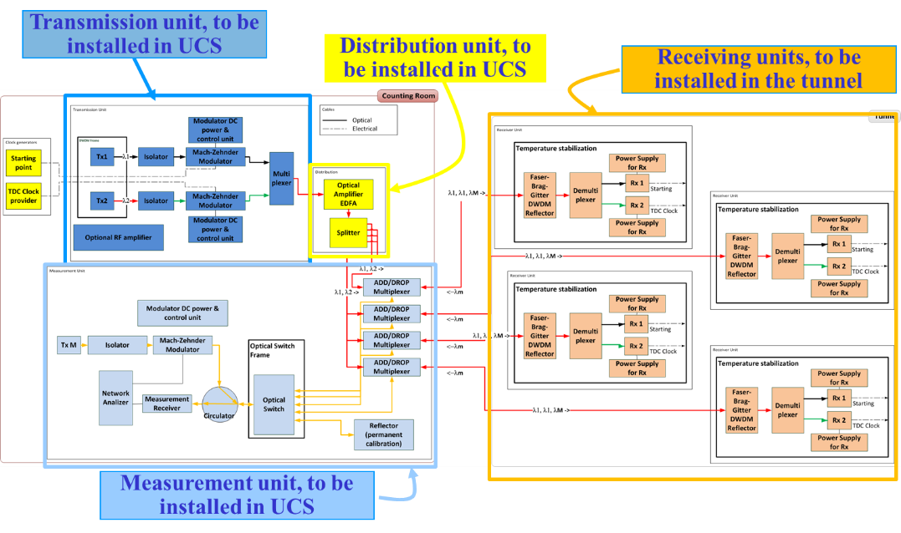
Picosecond Clock Distribution

Slide 23
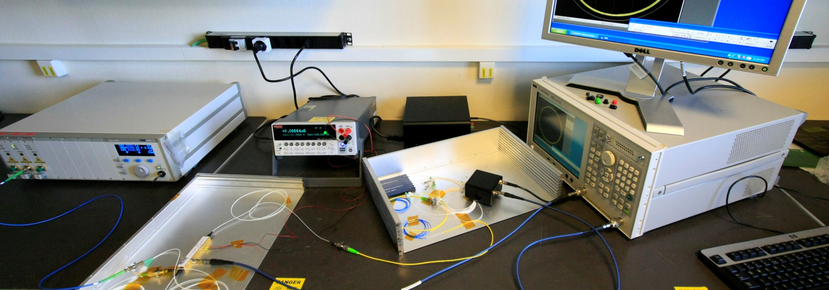
Picosecond Clock Distribution
Complete test of the system in TOTEM electronics lab
MEASUREMENT UNIT
TRANSMISSION
RECEIVER

Slide 24
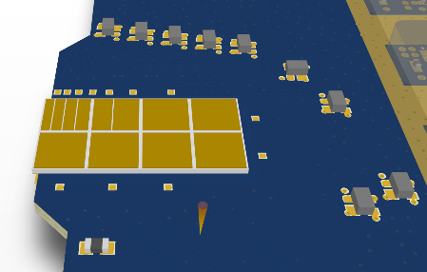
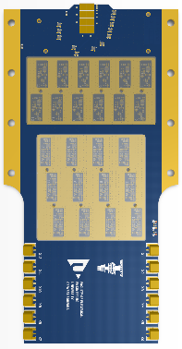
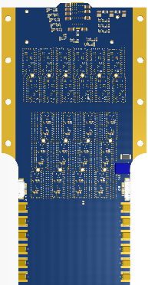
Timing Detector: Diamond Plane

Slide 25
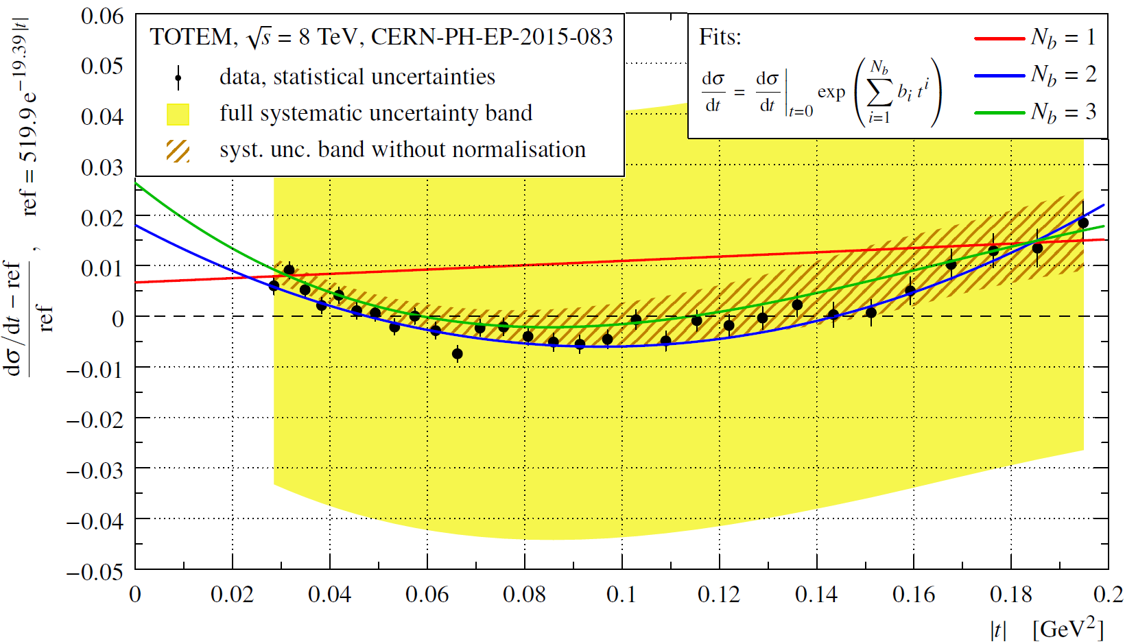

Evidence for non-exponential elastic proton-proton differential cross-section at low |t| and $\sqrt{s}$ = 8 TeV

Slide 26
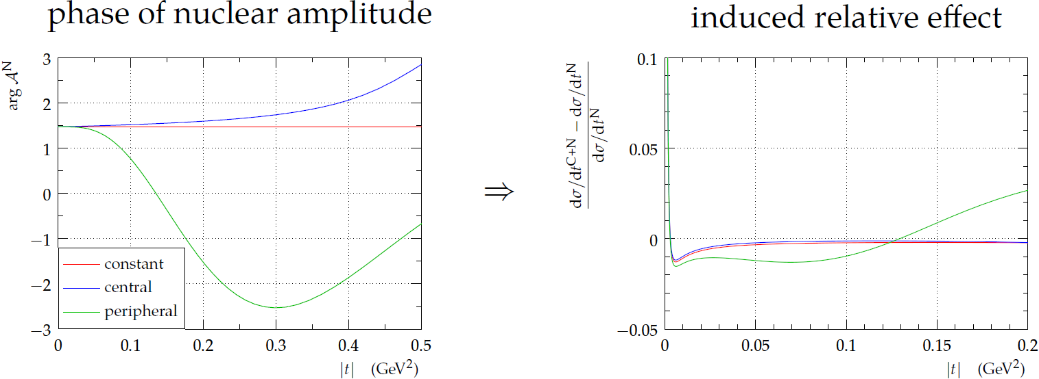

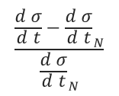


Coulomb – Nuclear Interference Analysis
Phase of Nuclear Amplitude
Induced relative effect
$$\frac{\frac{d σ}{d t}−{\frac{d σ}{d t}}_{N}}{{\frac{d σ}{d t}}_{N}}$$
$$φ_{𝒜_{N}}$$
$$\left|t\right| \left({GeV}^{2}\right)$$
$$\left|t\right| \left({GeV}^{2}\right)$$
The effect of the interference can be calculated doing hypothesis on the behaviour of the phase of the nuclear amplitude

Slide 27


Highlights on Papers
EPJ C
Cover image
Measurement of the forward charged particle pseudorapidity density in pp collisions at √s = 8 TeV using a displaced interaction point
EPJ C (2015) 75:126
New Journal of Physics
“Highlights of 2014”
LHC Optics Measurement with Proton Tracks Detected by the Roman Pots of the TOTEM Experiment
New J Phys (2014) 16045018

