Slide 1

PyECLOUD for PyHEADTAIL: development work
G. Iadarola, A. Axford, H. Bartosik, K. Li, G. Rumolo
Many thanks to:
A. Oeftiger, M. Schenk
Electron cloud meeting – 14 May 2015

Slide 2
The PyECLOUD-PyHEADTAIL simulation setup
We dropped the traditional approach of having separate tools for ecloud buildup and instability
Use PyECLOUD also simulate the interaction beam/ecloud within PyHEADTAIL
→ Possible thanks to the highly modular structure of the two codes (object oriented)
PyHEADTAIL
PyECLOUD
(PyEC4PyHT object)
PyHEADTAIL
v
Initial e- distribution
(from PyECLOUD buildup sim.)
For each slice
Transverse tracking
→ with Q’, octupoles etc.
Longitudinal tracking
Transverse feedback
Impedances
Space charge
…
Generate seed e⁻
PyHEADTAIL bunch
PyHEADTAIL slicer
Evaluate beam slice electric field (Particle in Cell)
Evaluate the e⁻ electric field
(Particle in Cell)
Transverse tracking
→ with Q’, octupoles etc.
Longitudinal tracking
Transverse feedback
Impedances
Space charge
…
Apply kick on the beam particles
PyHEADTAIL bunch
Compute e⁻ motion (t->t+Δt)
(possibly with substeps)
Detect impacts and generate secondaries
Legend: From PyHEADTAIL From PyECLOUD Developed ad hoc

Slide 3
The PyECLOUD-PyHEADTAIL simulation setup
We dropped the traditional approach of having separate tools for ecloud buildup and instability
Use PyECLOUD also simulate the interaction beam/ecloud within PyHEADTAIL
→ Possible thanks to the highly modular structure of the two codes (object oriented)
Advantages of this approach:
Profits from years of optimization and testing work on PyECLOUD and PyHEADTAIL
All advanced e-cloud modeling features implemented in PyECLOUD become naturally available for beam dynamics simulations (arbitrary chamber shape, secondary electron emission, arbitrary magnetic field map, Boris electron tracker, accurate modeling for curved boundary)
From now on the two tools can share most of the work of development and maintenance
This enables several new simulation scenarios:
Scenarios where the electron wall interaction cannot be neglected, e.g. long bunches (PS), doublet beams
Quadrupoles (including triplets, for example we could keep one beam rigid…)
Combined function magnets
… but simulations can become very heavy (>1 Week) → performance optimization is crucial!

Slide 4
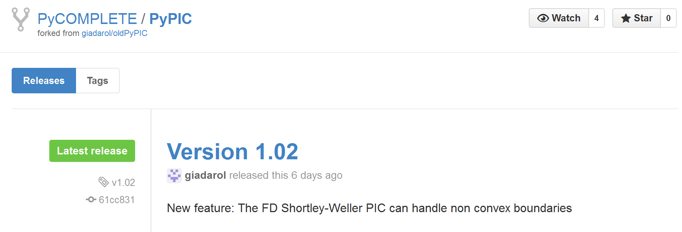
The computational core: PyPIC
A key component of the e-cloud simulator is the Particle In Cell (PIC) Poisson solver (takes >50% of the computational time)
Born as a buildup code, PyECLOUD did not allow to simulate the e-cloud dynamics in free space, extensively used in the past for HEADTAIL simulations → impossible to start the development from a well known model
We decided to reorganize our Particle In Cell (PIC) Poisson solvers
We wrote a Python library (PyPIC) including different PIC solvers having the same interface which can be used as plug-in modules for PyECLOUD but also for other applications (e.g. space charge, beam-beam)
PyPIC is now available on the PyCOMPLETE git repository: https://github.com/PyCOMPLETE/PyPIC/

Slide 5
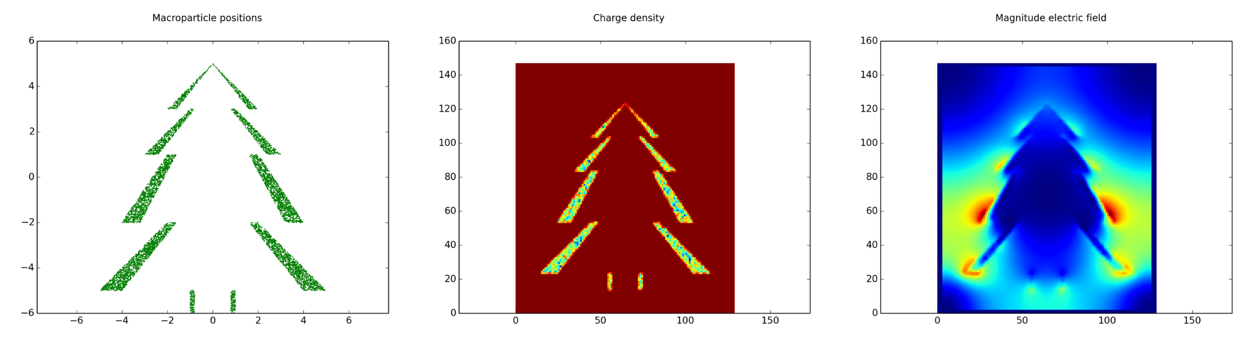
The computational core: PyPIC
A key component of the e-cloud simulator is the Particle In Cell (PIC) Poisson solver (takes >50% of the computational time)
Born as a buildup code, PyECLOUD did not allow to simulate the e-cloud dynamics in free space, extensively used in the past for HEADTAIL simulations → impossible to start the development from a well known model
We decided to reorganize our Particle In Cell (PIC) Poisson solvers
We wrote a Python library (PyPIC) including different PIC solvers having the same interface which can be used as plug-in modules for PyECLOUD but also for other applications (e.g. space charge, beam-beam)
PyPIC is now available on the PyCOMPLETE git repository: https://github.com/PyCOMPLETE/PyPIC/

Slide 6
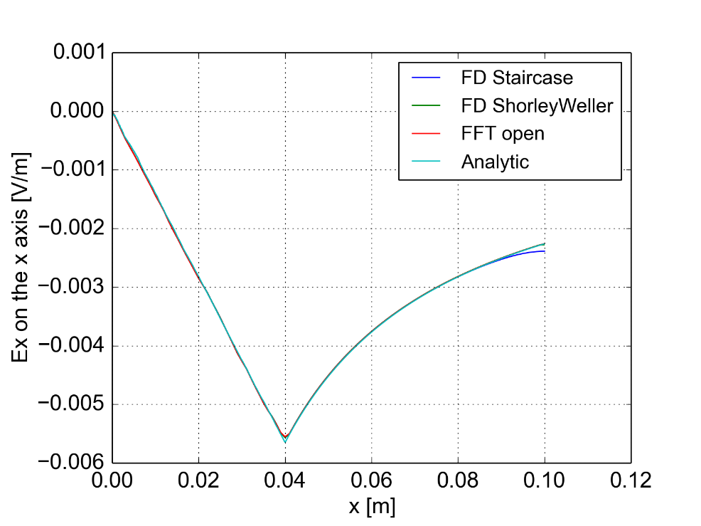
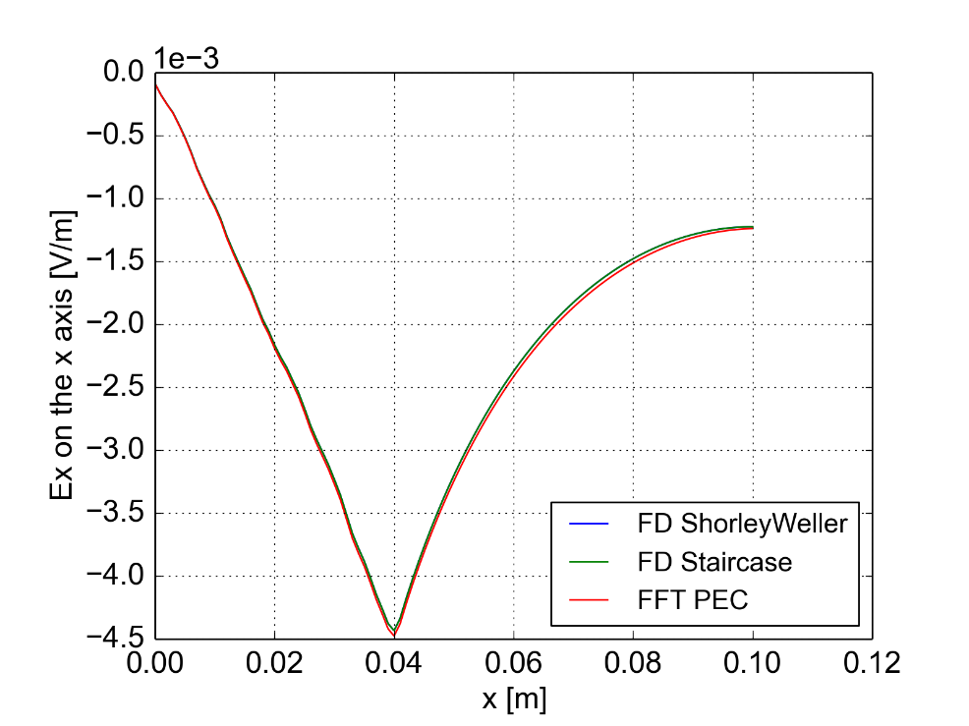
The computational core: PyPIC
PyPIC includes the following solvers:
Open boundary FFT
PEC rectangular boundary FFT
PEC arbitrarily shaped boundary – Finite Differences – staircase approx. of curved boundaries
PEC arbitrarily shaped boundary – Finite Differences – Shortley-Weller method for curved bound.
Bassetti-Erskine (not really a solver, for testing purposes)
+ test scripts: crosscheck the different modules against each other (for special cases in which this is possible)
Uniformly charged cylinder
inside circular boundary
Uniformly charged cylinder
inside square boundary

Slide 7
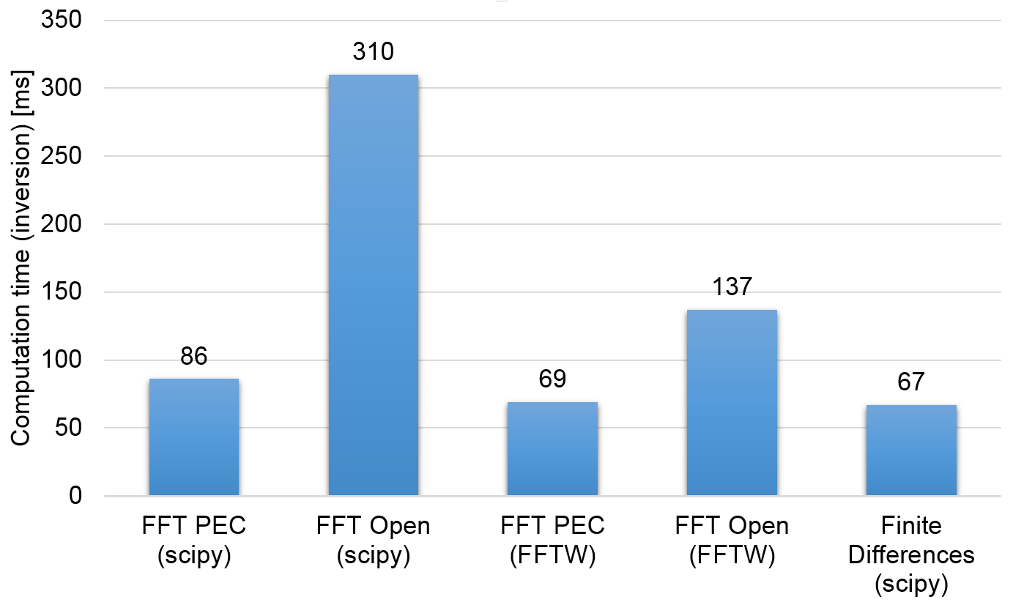
The computational core: PyPIC
In PyECLOUD-PyHEADTAIL simulations the PIC solver is called twice per slice at each e-cloud interaction
e.g. 512 turns x 35 kicks x 64 slices: 2.3 x 10⁶ recalculations!!! → speed is crucial
Performance optimization carried out for all the modules:
FFTW routines used for the FFT based solvers
LU factorization precomputed and stored the FD solvers
Special properties of the relevant matrices have been exploited
FFT is performed block-wise skipping blocks filled with zeros
Trivial equations for points outside the chamber are removed
Open boundary is heavier (2x larger matrix)
For PEC: FFT and FD have similar performances
3.2 x 10⁶ nodes

Slide 8
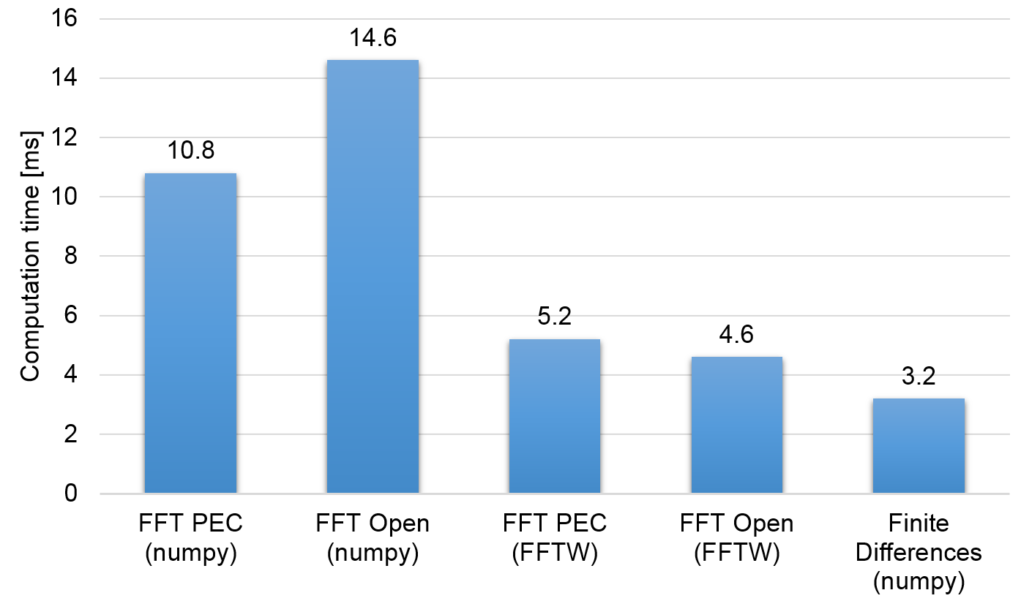
The computational core: PyPIC
In PyECLOUD-PyHEADTAIL simulations the PIC solver is called twice per slice at each e-cloud interaction
e.g. 512 turns x 35 kicks x 64 slices: 2.3 x 10⁶ recalculations!!! → speed is crucial
Performance optimization carried out for all the modules:
FFTW routines used for the FFT based solvers
LU factorization precomputed and stored the FD solvers
Special properties of the relevant matrices have been exploited
FFT is performed block-wise skipping blocks filled with zeros
Trivial equations for points outside the chamber are removed
Situation different for smaller matrices but still FD has the best performance
3.2 x 10⁵ nodes

Slide 9
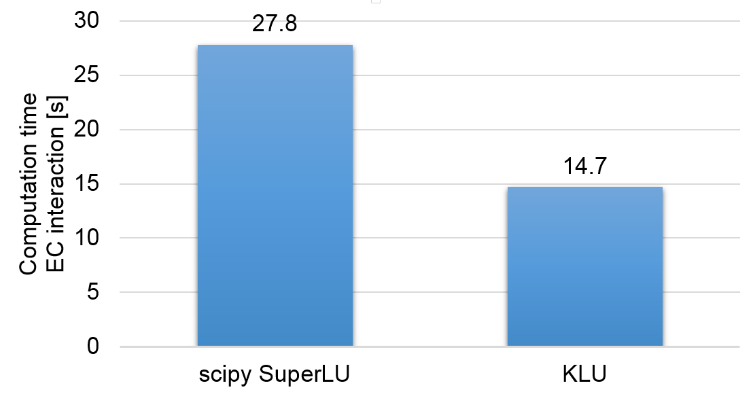
An extra boost to the Finite Difference solver
Even after these optimizations simulation for the LHC at 7 TeV would still take ~8 days
PIC still completely dominant in the profiling → tried to optimize even further:
Iterative method turned out to be slower ☹
Cython wrapped C-implemented SuperLU gave performances similar to scipy ☹
…but we learnt how to use C libraries in Python ☺
Found in literature that a simpler algorithm (KLU) outperforms SuperLU for very sparse matrices
Implemented using Cython to wrap the available C implementation → PyKLU
Available on the PyCOMPLETE git repository
It worked! ☺

Slide 10
Optimization on other modules of PyECLOUD
Performance optimization through Cython and small C parts applied also in other parts of the code:
Polygonal chamber routines
Gives more flexibility → made much easier the implementation of the non-convex case
Boris tracker
Ready for the implementation of the generic multipole
This routines offered also the occasion for first parallelization tests in Cython
Promising (x2 speedup with 4 cores) but for now not in the production version...
Side effect of optimization work: also PyECLOUD buildup simulations became faster
→ x2 gain on HL-LHC triplet simulations between Nov. 2013 and Nov. 2014

Slide 11
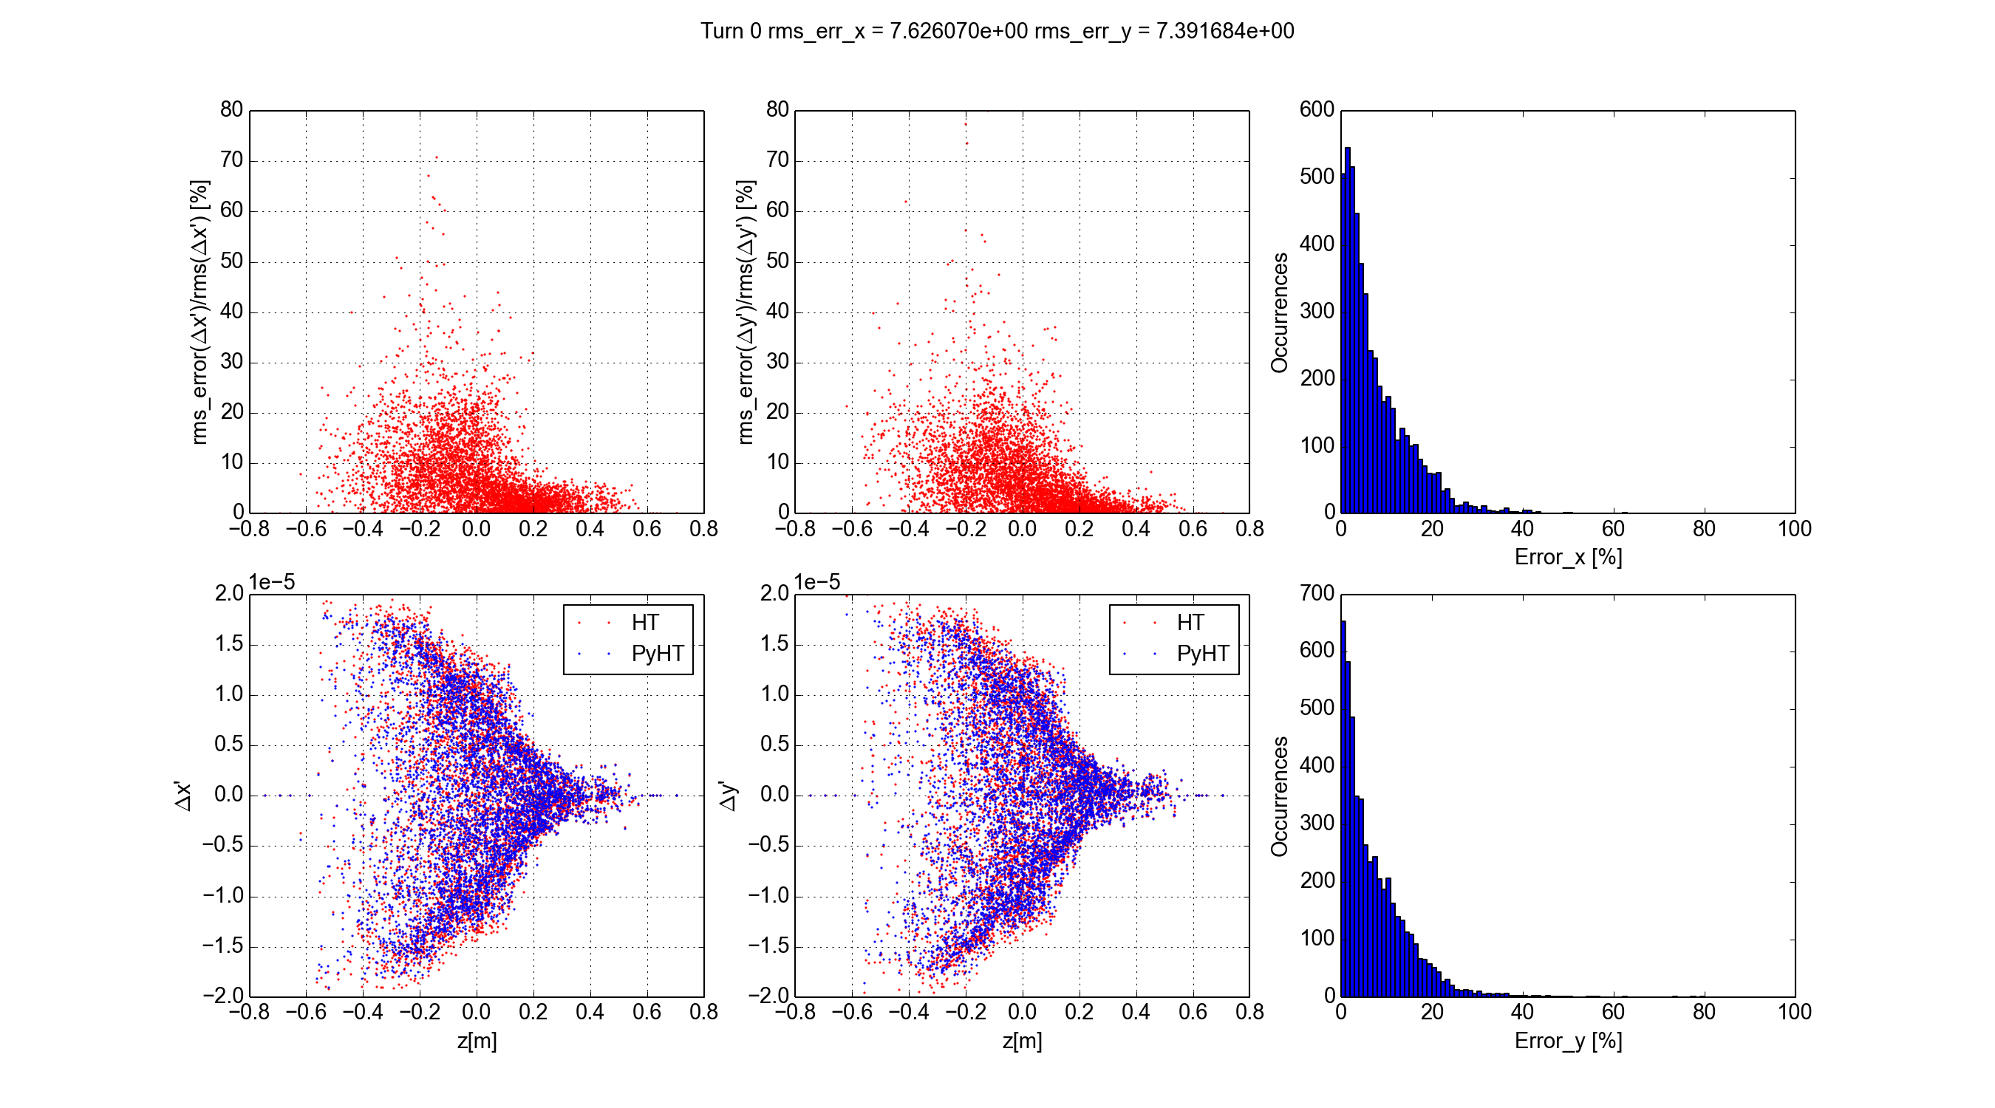
Validation procedure
Very difficult to benchmark directly on instability simulations
Started from more basic but deterministic checks comparing against HEADTAIL for dipole and drift
5000 probe particles start from the same initial conditions in HEADTAIL and PyHEADTAIL
Turn 1
Check on the single e-cloud kick (no betatron motion) change in angle)
e-cloud dynamics is correct
forces are correctly applied on the beam
crosscheck on synchrotron motion

Slide 12
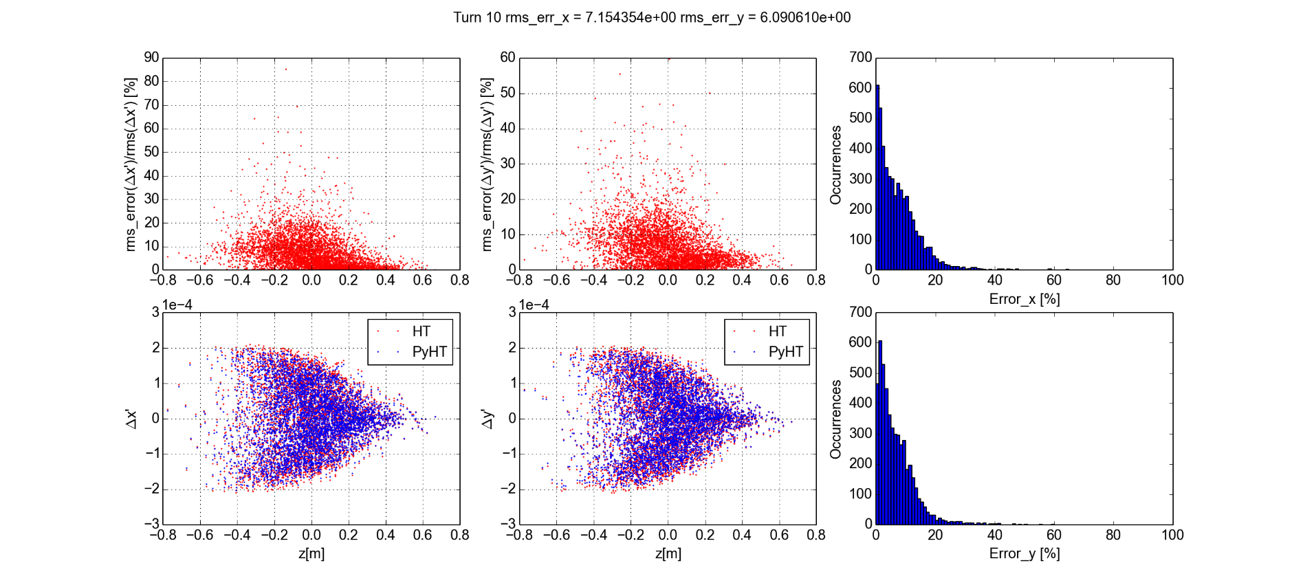
Validation procedure
Very difficult to benchmark directly on instability simulations
Started from more basic but deterministic checks comparing against HEADTAIL for dipole and drift
5000 probe particles start from the same initial conditions in HEADTAIL and PyHEADTAIL
Turn 10
Check on the single e-cloud kick (no betatron motion) change in angle)
e-cloud dynamics is correct
forces are correctly applied on the beam
crosscheck on synchrotron motion

Slide 13
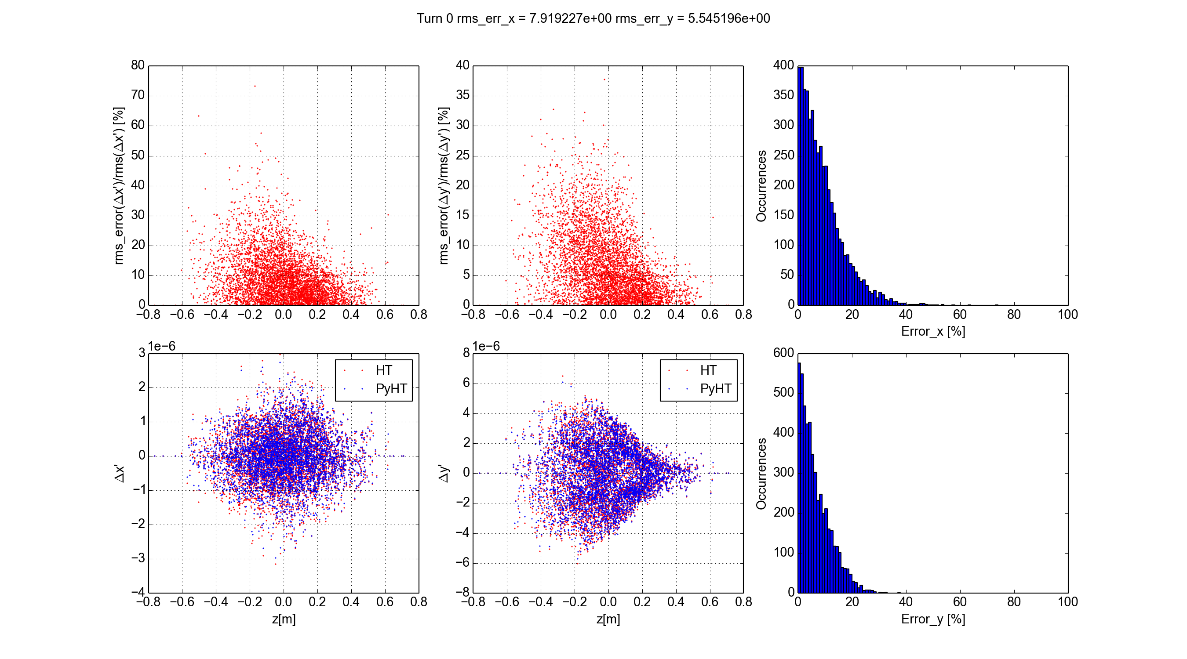
Validation procedure
Very difficult to benchmark directly on instability simulations
Started from more basic but deterministic checks comparing against HEADTAIL for dipole and drift
5000 probe particles start from the same initial conditions in HEADTAIL and PyHEADTAIL
Turn 1, 3 kicks
Check on the single e-cloud kick (no betatron motion) change in angle)
e-cloud dynamics is correct
forces are correctly applied on the beam
crosscheck on synchrotron motion
Check with multiple e-cloud kicks (on the integer)
Phase advance correctly applied

Slide 14
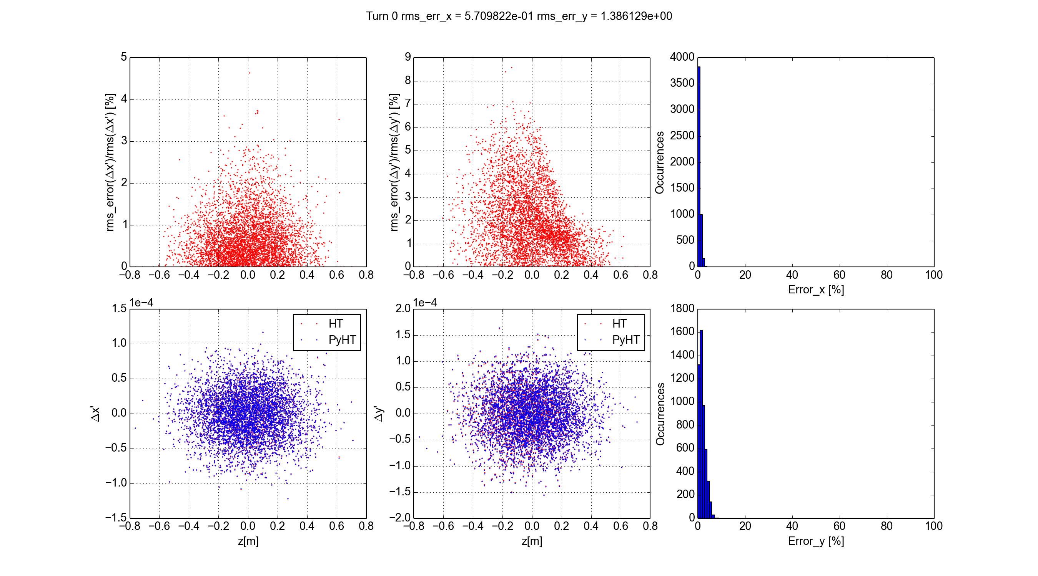
Validation procedure
Very difficult to benchmark directly on instability simulations
Started from more basic but deterministic checks comparing against HEADTAIL for dipole and drift
5000 probe particles start from the same initial conditions in HEADTAIL and PyHEADTAIL
Turn 1
Check on the single e-cloud kick (no betatron motion) change in angle)
e-cloud dynamics is correct
forces are correctly applied on the beam
crosscheck on synchrotron motion
Check with multiple e-cloud kicks (on the integer)
Phase advance correctly applied
Check with betatron motion enabled

Slide 15
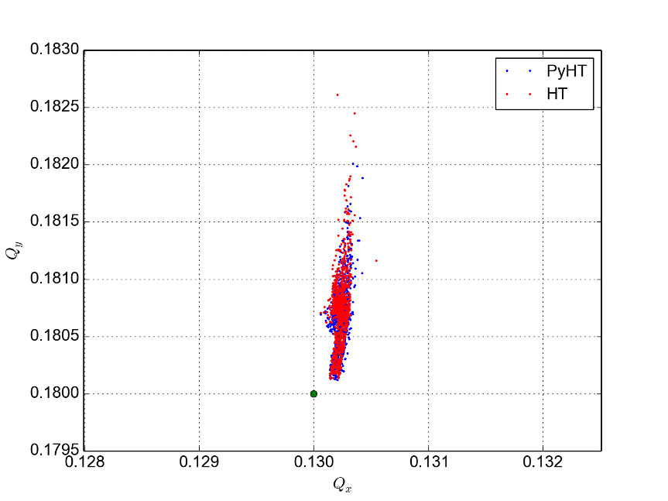
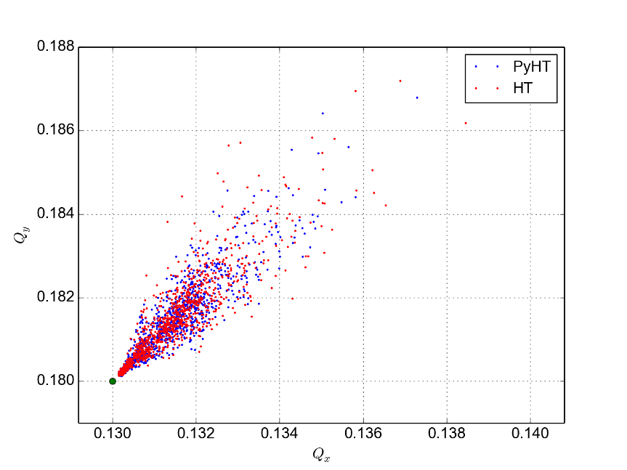
Validation procedure
Very difficult to benchmark directly on instability simulations
Started from more basic but deterministic checks comparing against HEADTAIL for dipole and drift
5000 probe particles start from the same initial conditions in HEADTAIL and PyHEADTAIL
Dipole
Check on the single e-cloud kick (no betatron motion) change in angle)
e-cloud dynamics is correct
forces are correctly applied on the beam
crosscheck on synchrotron motion
Check with multiple e-cloud kicks (on the integer)
Phase advance correctly applied
Check with betatron motion enabled
Check on many turns in stable conditions (bunch by bunch tunes)
simulation is reasonably noise free
Quadrupole

Slide 16
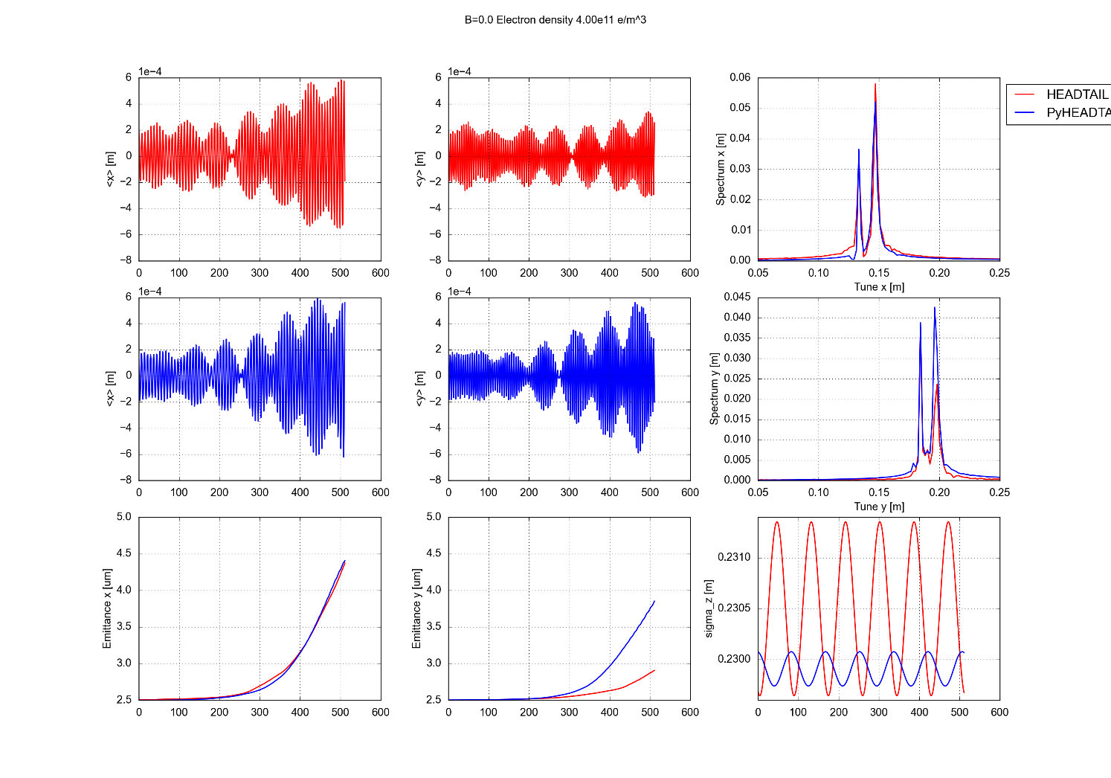
Validation procedure
Very difficult to benchmark directly on instability simulations
Started from more basic but deterministic checks comparing against HEADTAIL for dipole and drift
5000 probe particles start from the same initial conditions in HEADTAIL and PyHEADTAIL
HEADTAIL
Check on the single e-cloud kick (no betatron motion) change in angle)
e-cloud dynamics is correct
forces are correctly applied on the beam
crosscheck on synchrotron motion
Check with multiple e-cloud kicks (on the integer)
Phase advance correctly applied
Check with betatron motion enabled
Check on many turns in stable conditions (bunch by bunch tunes)
simulation is reasonably noise free
Check on many turns in unstable conditions
coherent bunch motion is correct
PyHEADTAIL

Slide 17
Validation procedure
Very difficult to benchmark directly on instability simulations
Started from more basic but deterministic checks comparing against HEADTAIL for dipole and drift
5000 probe particles start from the same initial conditions in HEADTAIL and PyHEADTAIL
HEADTAIL
Check on the single e-cloud kick (no betatron motion) change in angle)
e-cloud dynamics is correct
forces are correctly applied on the beam
crosscheck on synchrotron motion
Check with multiple e-cloud kicks (on the integer)
Phase advance correctly applied
Check with betatron motion enabled
Check on many turns in stable conditions (bunch by bunch tunes)
simulation is reasonably noise free
Check on many turns in unstable conditions
coherent bunch motion is correct
PyHEADTAIL

Slide 18
Validation procedure
Very difficult to benchmark directly on instability simulations
Started from more basic but deterministic checks comparing against HEADTAIL for dipole and drift
5000 probe particles start from the same initial conditions in HEADTAIL and PyHEADTAIL
Check on the single e-cloud kick (no betatron motion) change in angle)
e-cloud dynamics is correct
forces are correctly applied on the beam
crosscheck on synchrotron motion
Check with multiple e-cloud kicks (on the integer)
Phase advance correctly applied
Check with betatron motion enabled
Check on many turns in stable conditions (bunch by bunch tunes)
simulation is reasonably noise free
Check on many turns in unstable conditions
coherent bunch motion is correct
HEADTAIL
PyHEADTAIL

Slide 19
First pilot study
Instability thresholds as a function of the intensity for the SPS at 26 GeV – Q26 vs Q20 – dipoles and drifts
Reasonably “lightweight”, corresponding HEADTAIL simulations already available
Started with simple model and complicated it in steps:
Smooth approximation of the optics, D_{x,y} = 0, no boundary, linear longitudinal motion, uniform initial e⁻ distribution
Nonlinear longitundinal motion
(implemented longitudinal losses)
Realistic chamber shape (see Kevin’s talk)
(implemented transverse losses)

Slide 20
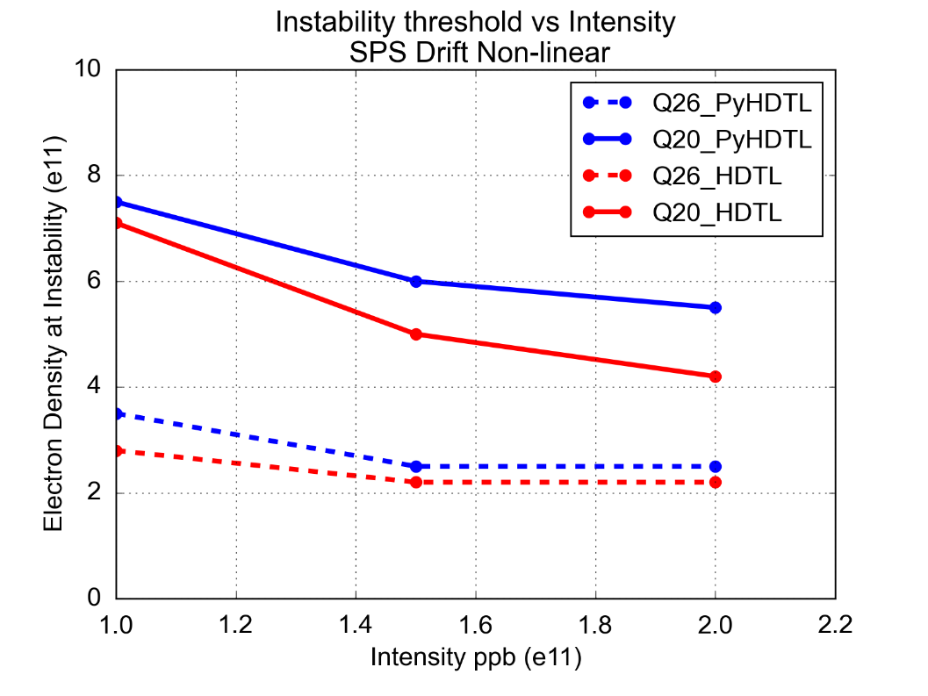
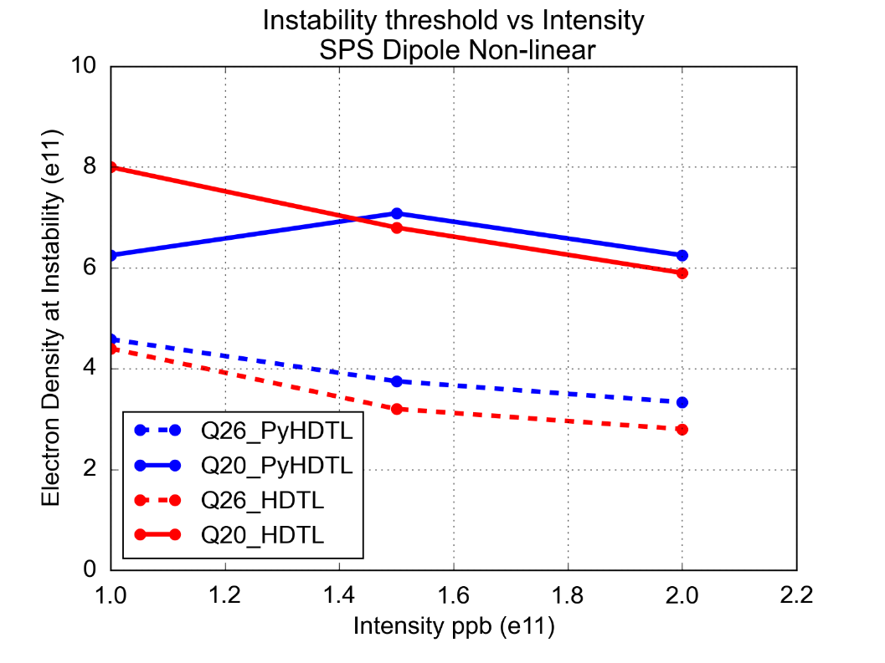
First pilot study
Instability thresholds as a function of the intensity for the SPS at 26 GeV – Q26 vs Q20 – dipoles and drifts
Reasonably “lightweight”, corresponding HEADTAIL simulations already available
Each simulation (512 turns) is divided in few jobs (4x128 turns) launched subsequently (automatic)
Easier to recover crashed simulations
Single Job size can be optimized for lxplus queues
Simulation can be “extended” a posteriori
For the same simulations settings we repeat the simulation 5 times with different seeds and take the average emittance evolution

Slide 21
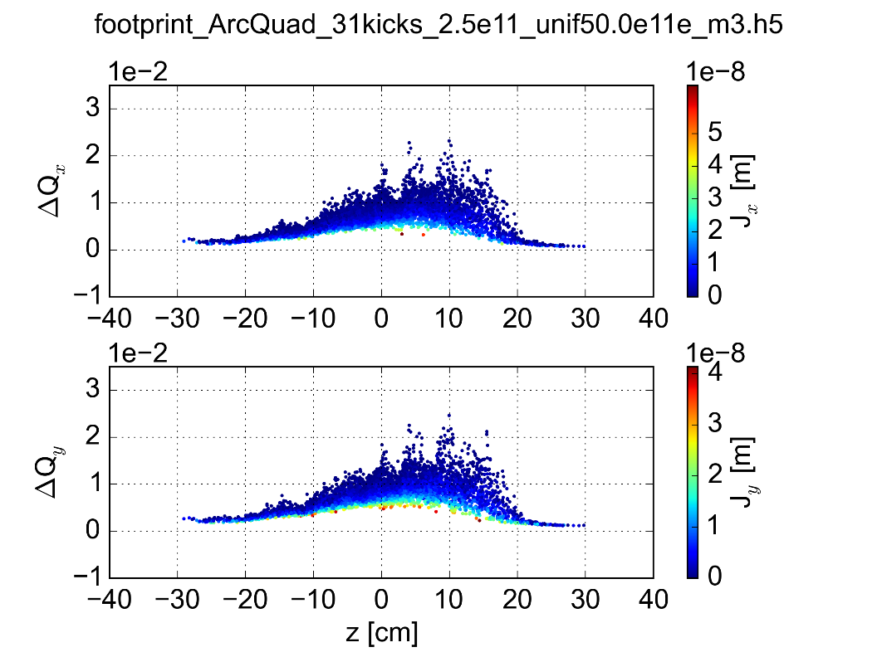
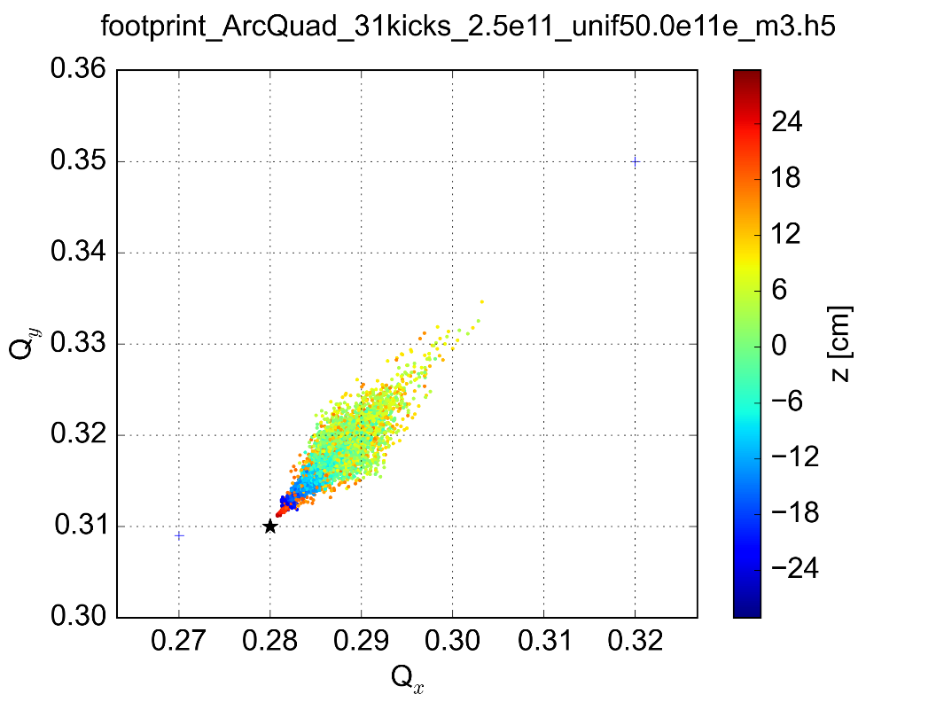
PyECLOUD-PyHEADTAIL at work
Already used for studies for the SPS and for the LHC, profiting already of features that were no available in HEADTAIL:
Quadrupolar field
Realistic chamber shape
Correct tracking of the electrons in the H plane for dipoles
Simulations with recorded pinch field map for tune footprint estimation

Slide 22
Summary and future work
PyECLOUD and PyHEADTAIL can be used together to simulate effects of e-cloud on beam dynamics
Fields from the electrons and from the beam are calculated using PyPIC, a newly developed library including several different Poisson solvers
Important work on performance optimization was necessary to make computational time affordable
Simulation results validated against HEADTAIL New tool already used for SPS and LHC simulations (see following talks)
What next:
We know for quadrupoles we need the distribution from buildup → robust way to get good resolution for buildup still to be developed, some work on job management “infrastructure” also to be done
Investigate effect of non uniform beta function
Other important players (Q’, octupoles, damper), should be included in the simulations
And then to simulate the triplets:
Double de-synchronized pinch
Beta variation along the device
Position variation along the device

Slide 23
Thanks for your attention!

