Slide 1
Future of
our collaboration
???

Slide 2



Science
Beam line for school experiments: proposals, collaborations
Communication between schools
Blogs, Facebook, collaboration website
Schools visit SESAME
Social media campaign: CERN + SESAME
Grants for young researchers
Future of
our collaboration
People
Funding
Crowd funding campaign
Governments

Slide 3
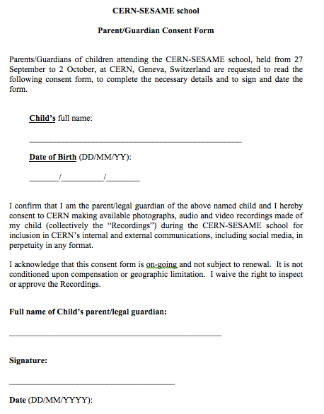
We would love to do interviews with you.
But for all students less than 18 years old,
we need the parents’ consent.

