Slide 1

penStack Manila
26/08/2015
CERN openlab Summer Students Lightning Talks Sessions
Mihai Patrascoiu
Supervisor:
Jose Castro Leon
IT Department
Operating systems and Information Services

Slide 2
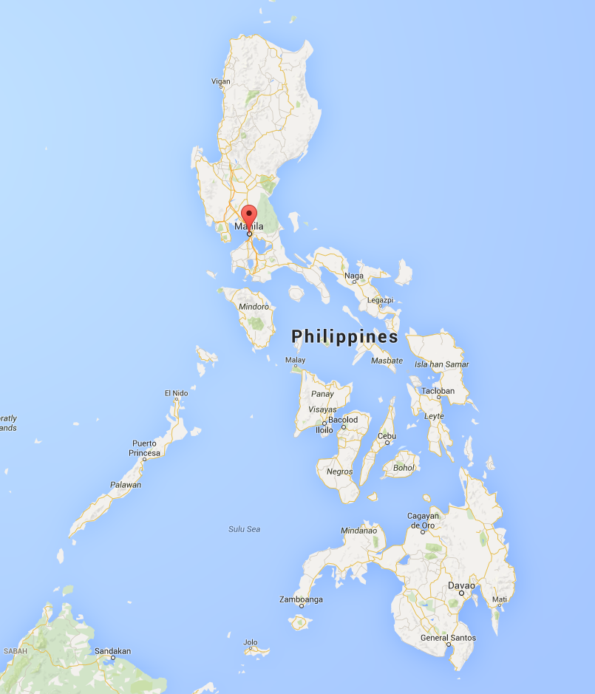


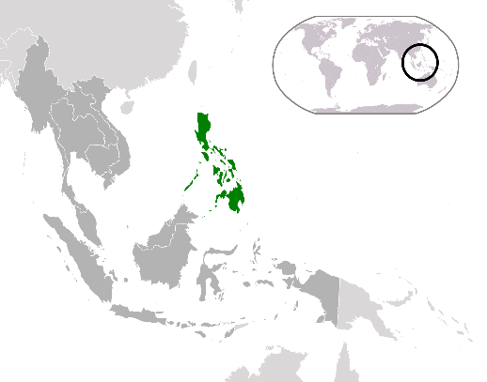
Manila

Slide 3
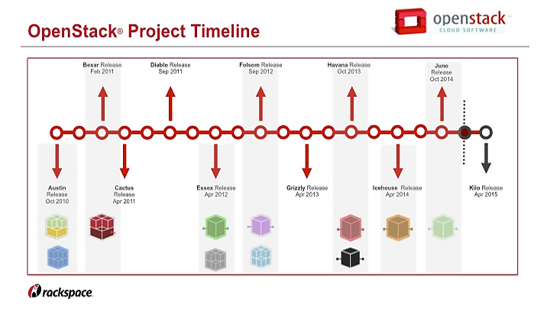
OpenStack Manila
Achieved incubation
status
OpenStack – software platform for managing cloud computing
Manila – OpenStack component. Provides Shares-as-a-Service
Manila started

Slide 4
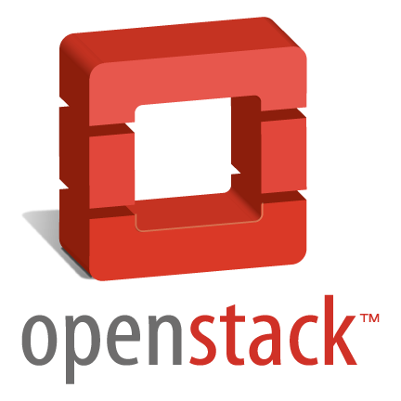


Why OpenStack Manila?
No file based storage system provided by OpenStack
No way to share drives between VMs
Nova
Keystone
Glance
Cinder
Horizon
Ceilometer
Heat

Slide 5
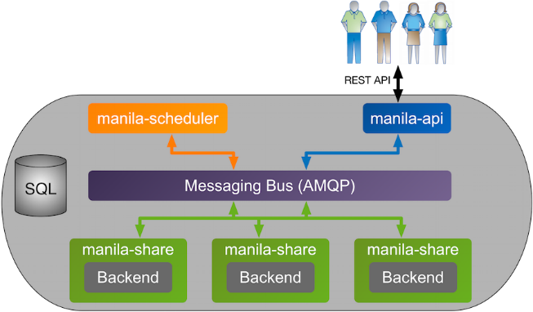
How it works
Backend drivers:
HP
Generic
NetApp
IBM
GlusterFS
NFS-Ganesha
Huawei

Slide 6



Generic Driver
Handling share servers
Share server VMs
Shared volumes
Manila service
create

Slide 7



Generic Driver
Resources Admin
Handling share servers
Share server VMs
Shared volumes
Manila service
create

Slide 8
Generic Driver
Not handling share servers
Existing
share server
Shared volumes
Manila service
interact

Slide 9

Generic Driver
Resources Admin
Not handling share servers
Existing
share server
Shared volumes
Manila service
interact

Slide 10



The Process (part 1)
Create VM
Install OpenStack on VM
Install & configure Manila
Launch VMs
Test shares
test share
+ Manila

Slide 11


The Process (part 2)
New project in CERN Private Cloud: ‘Cloud Share Service – Critical’
Install Manila service
Enable ‘Shares-as-a-Service’
Manila service
Shares-as-a-
-Service
CERN Private Cloud

Slide 12
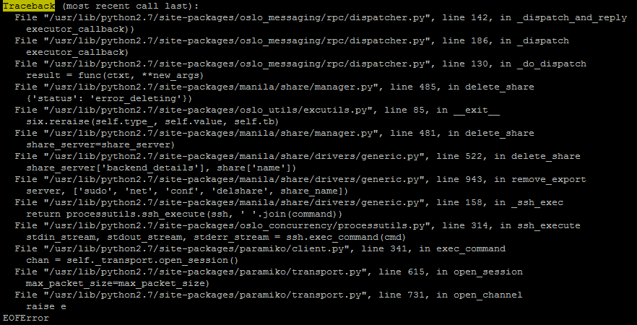
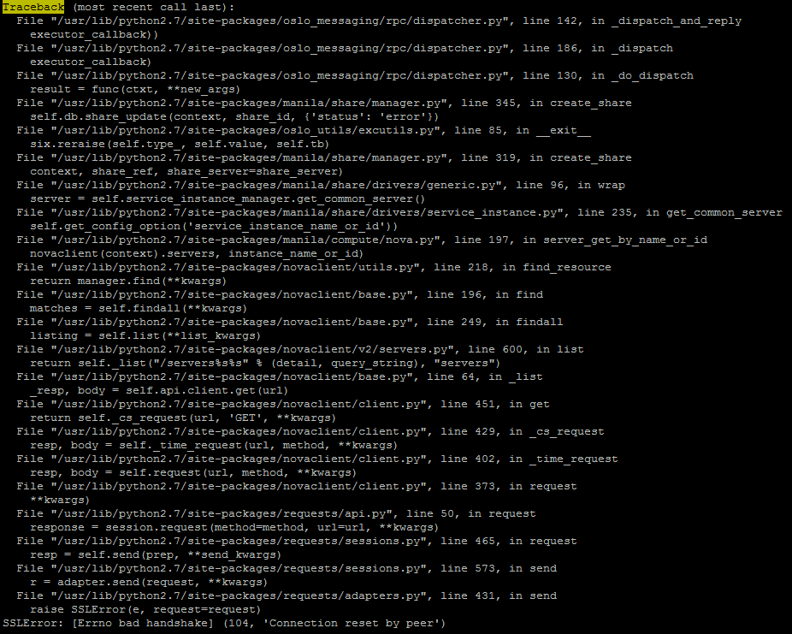

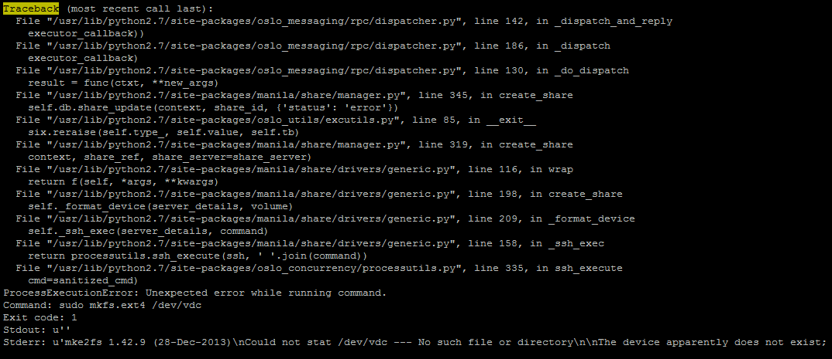

Slide 13
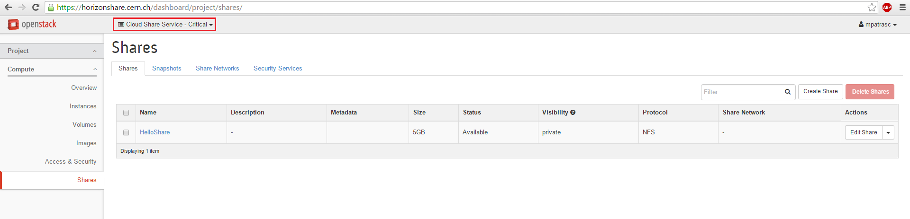
The Process (part 3)
Deploying the Web GUI
Available on: horizonshare.cern.ch

Slide 14
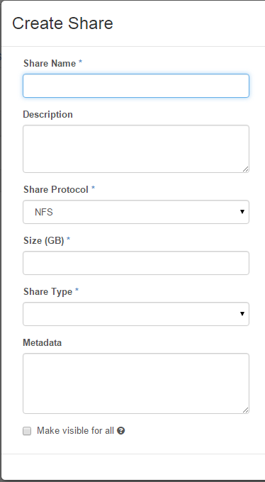
Creating your share
- suitable name
- NFS / CIFS protocol
- size in GB
- customType (generic driver w/o handling share server)

Slide 15
Conclusions
Prototype deployment of Manila
Improve the backend
Ensure scalability & security

Slide 16
Thank You !

