Slide 1

Road to Discovery: Lecture 3
Sarah Eno
U. Maryland

Slide 2
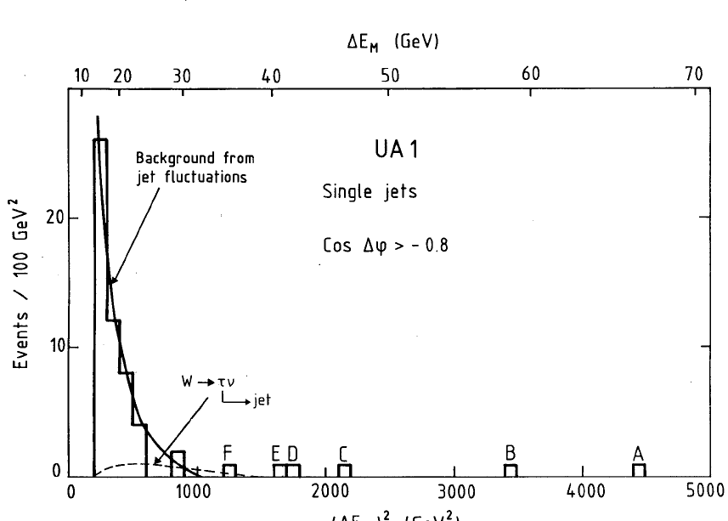
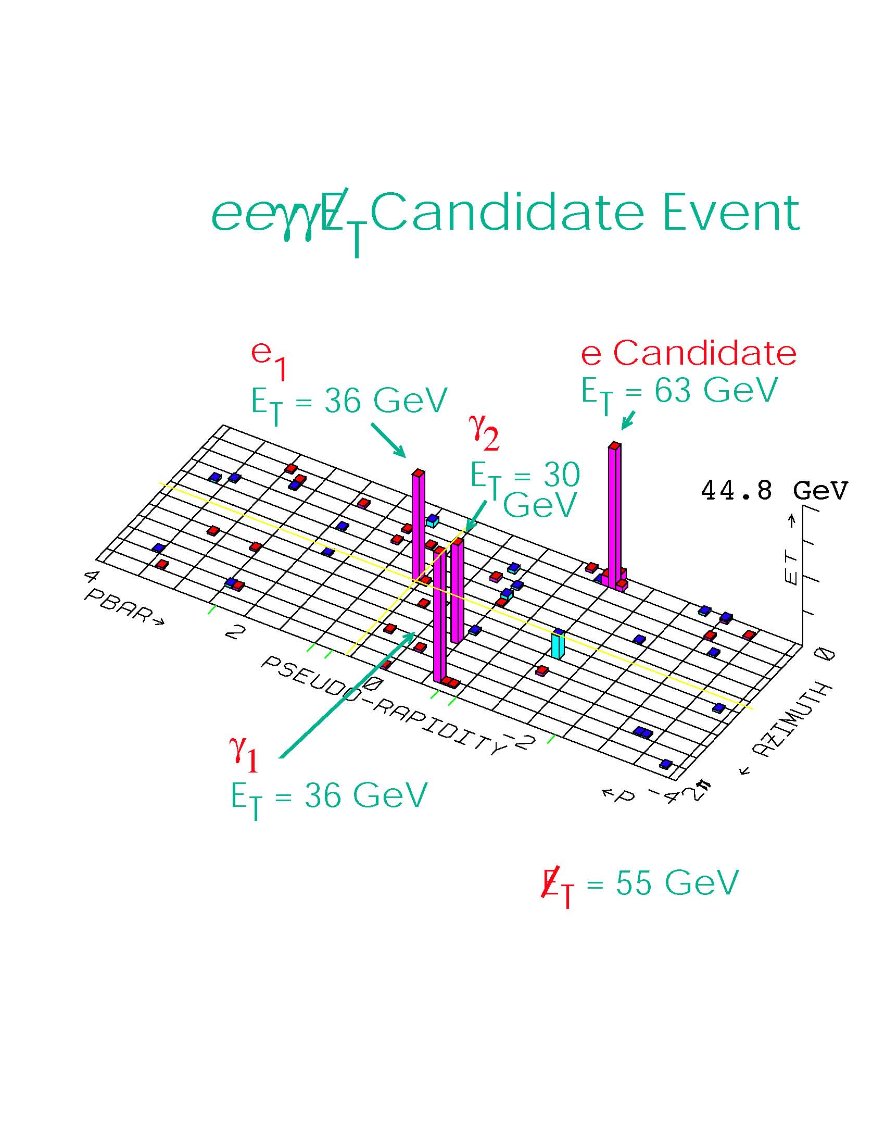
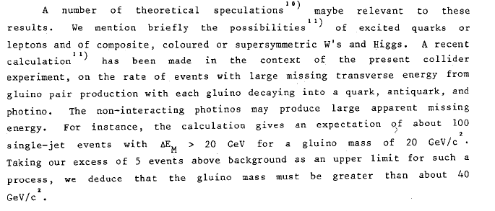
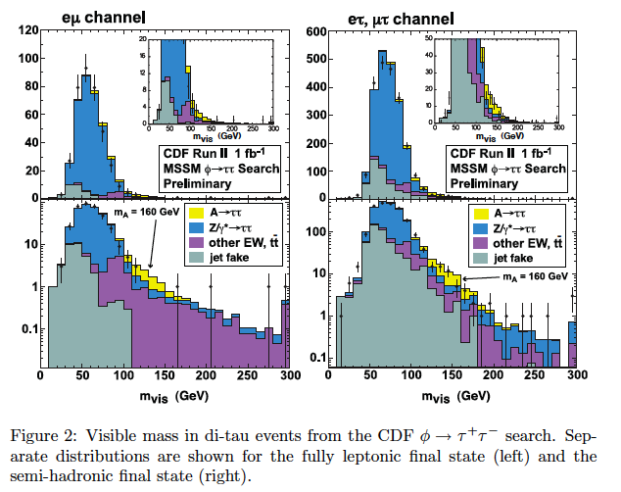
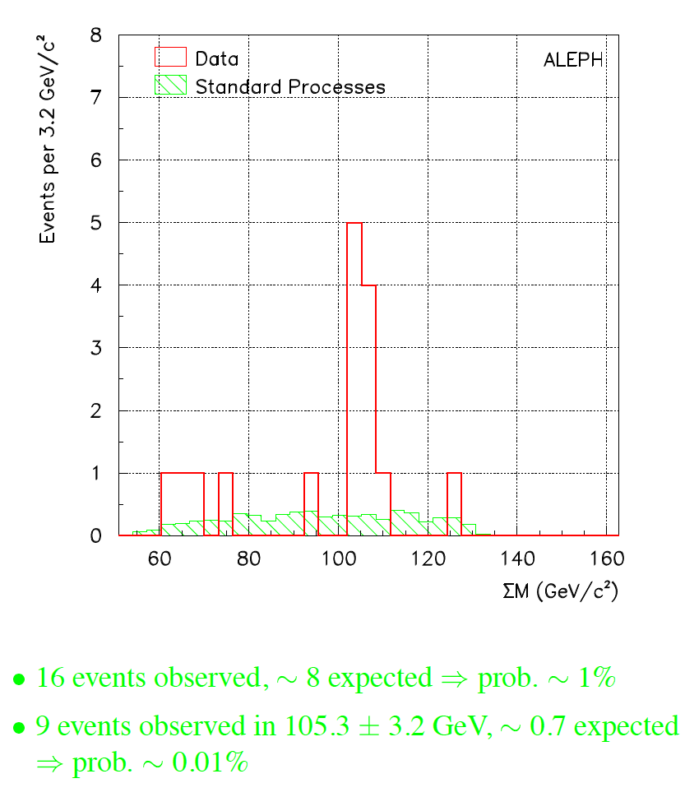
SUSY
Why do people keep “discovering” SUSY?
Phys. Lett. B129, 115 (1984)

Slide 3
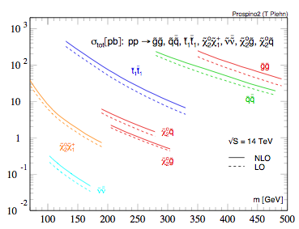
Cross sections
Individual cross sections (vs mass) are ”easy” as the quantum numbers of sparticles are well-defined; total cross section depends on mass spectrum

Slide 4
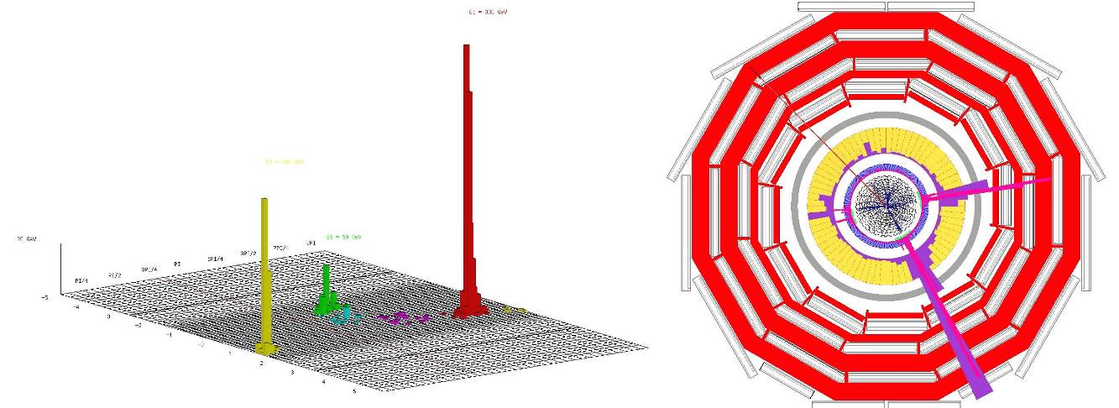
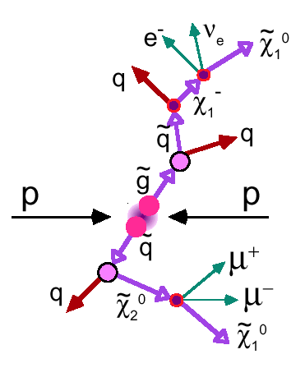
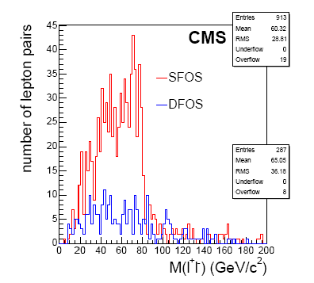
Decays
Because the masses and even the mass hierarchies (and the mixings for the gauginos) are unknown, because the SUSY breaking mechanism is unknown, the signature is not well defined
jets plus MET
leptons plus jets plus MET?
dileptons plus jets plus MET?
same sign dileptons?
Taus? b’s? tops? -> jets + MET + something….
exotica like HSCP, track stubs, photons + MET, etc
signal
background

Slide 5
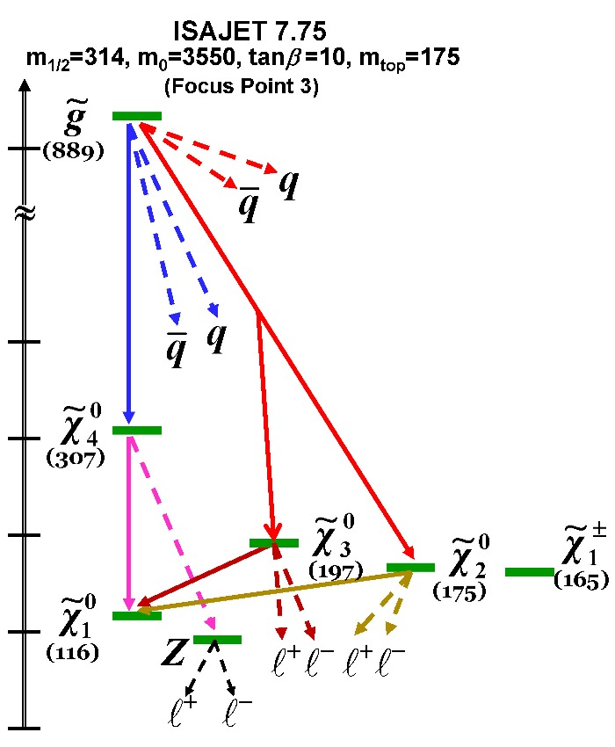
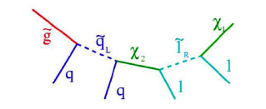
Mass spectrum and decays
Lots of freedom in mass spectrum and decays
Small mass splittings can lead to partons with low p_{T} -> below detector capabilities.
Texas A&M

Slide 6
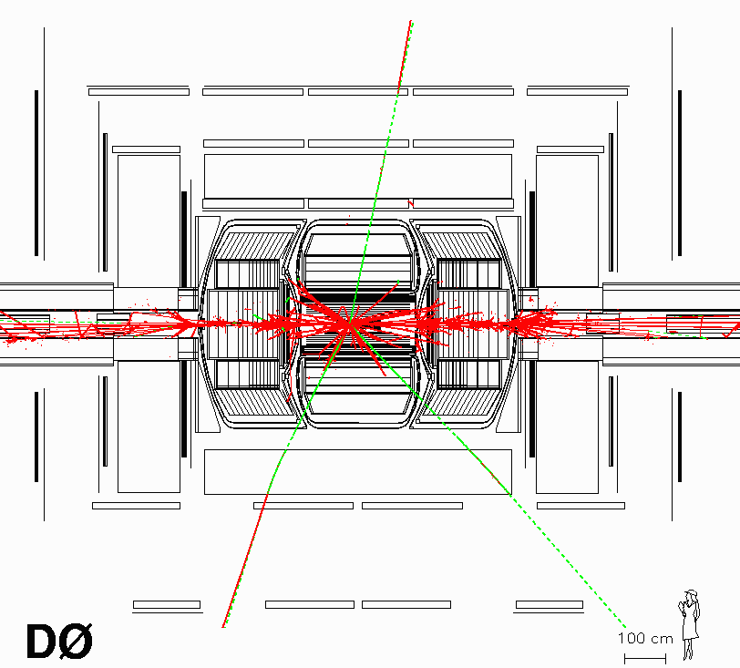
MET in SUSY events
No matter what*, the dark matter candidate shows up as MET, and there will be MET in every SUSY event. (*ignoring RPV susy)
LSP (usually neutralino) does not interaction in the detector -> apparent momentum imbalance in event
LSP usually produced at the end of a long decay chain.
lots of energy goes down beam pipe -> can not use momentum conservation in direction parallel to beam axis to infer z component of neutralino momentum
(two chains -> two neutralinos -> can be some cancellation in MET (two not always better than 1).

Slide 7
SUSY models
To go beyond this kind of generic discussion, need to introduce models.
May not be right, but like those practice problems in the back of the book, is very useful to get us trained.
Unconstrained MSSM is the most “economic” version of SUSY
  Minimal gauge group SU(3)_{C}xSU(2)_{L}xU(1)_{Y}
  Minimal particle content; tree generation of spin ½ quarks and leptons [no right handed neutrino] as in SM; The two Higgs doublets leads to five Higgs particles : two CP even h, H bosons, a pseudoscalar A boson and two charged H^{+/-} bosons
  R parity conservation: Rp = (-1)^{2S+3B+L}
  Minimal set of soft SUSY-breaking terms
  Unconstrained MSSM has 124 free parameters (104 from SUSY breaking terms + 19 parameters of the SM)
Constrained MSSM (or phenomenological MSSM) reduces number of free parameters to 22
  all the soft SUSY-breaking parameters are real => no new source of CP-violation in addition to the one from CKM matrix
  no FCNC at tree level
  the soft SUSY-breaking masses and trilinear couplings of the 1st and 2nd sfermion generations are the same at low energy

Slide 8
mSUGRA
Thus, the idea is the following:
  The many (>100) parameters of weak-scale SUSY should be derived from a minimal set of parameters at the unification scale.
mSUGRA: the “canonical” model
  5 main parameters
    m_{o} , m_{1/2} , A_{o} , tan(β), and sign(μ)
  m_{o} , m_{1/2} are universal scalar and fermion masses
    Like the couplings, one assumes that the spectra of fundamental particles derives from fundamental masses
  m_{3/2} is a 6th free parameter
    Gravitino - could be LSP but in most of the literature it is assumed to be very heavy and ignored.

Slide 9
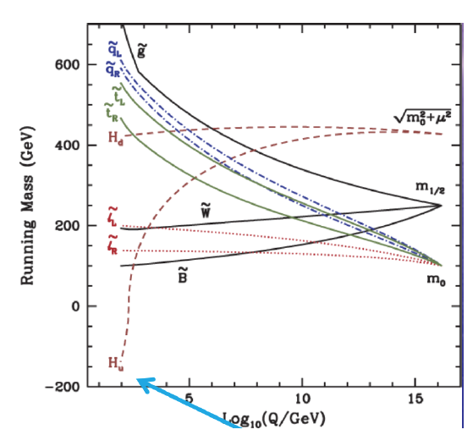
mSUGRA masses
EWK symmetry breaking

Slide 10
mSUGRA
cross section can vary by a factor of 10 (degenerate squarks/gluinos versus heavy squarks)
branching fraction to e/mu can vary from close to 0 to about 10 %
branching fraction to tau can vary from 0 to high
branching fractions to bbbar, on-shell Z’s, top, etc varies wildly over parameter space
jet multiplicity depends strongly on mass hierarchy/splittings. Especially, light gluinos give higher jet multiplicity, lower MET
harder to combine channels: some may be “fake” signals, don’t know relative acceptances
statistical fluctuations can mask true picture
harder to get confidence by seeing “what you expected”

Slide 11
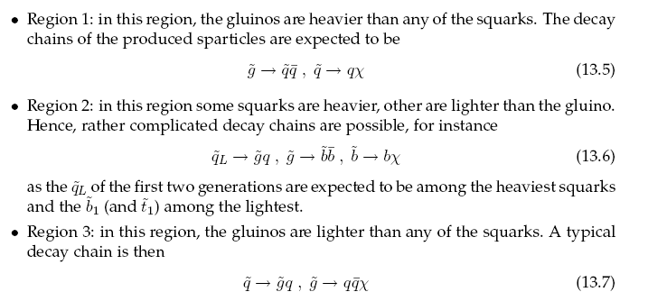
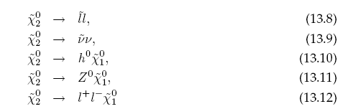
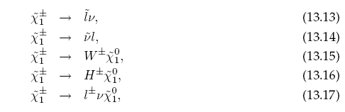
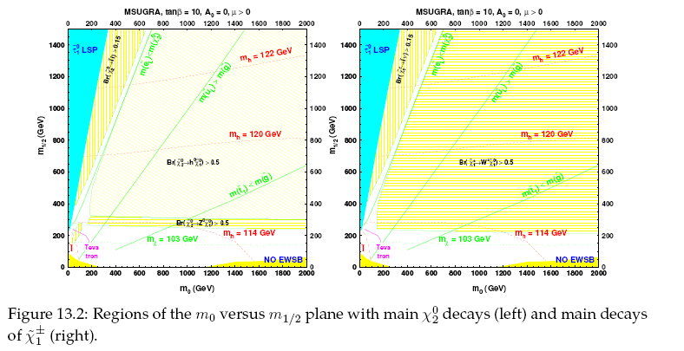
“Vanilla” SUSY: mSUGRA
q_{L} tend to decay directly to lsp, q_{R} has non-negligible BR to below
less jets, harder MET
t, b quarks
More jets, softer MET
CMS pTDR V2

Slide 12
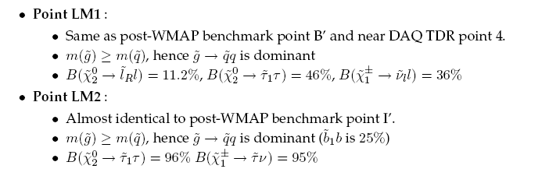
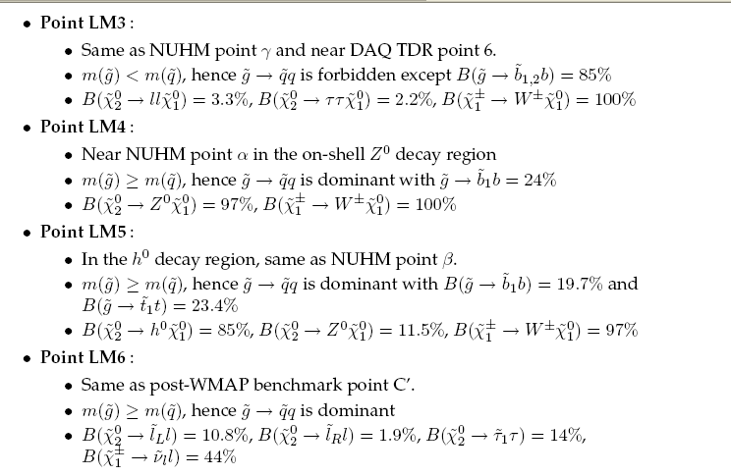
mSUGRA
Lots of leptons and taus
Lots of taus, few e,mu
Lots of W’s, b’s
On-shell Z’s and W’s, b’s
Lots of higgs to bbbar
Like LM1, but fewer taus
CMS pTDR V2

Slide 13
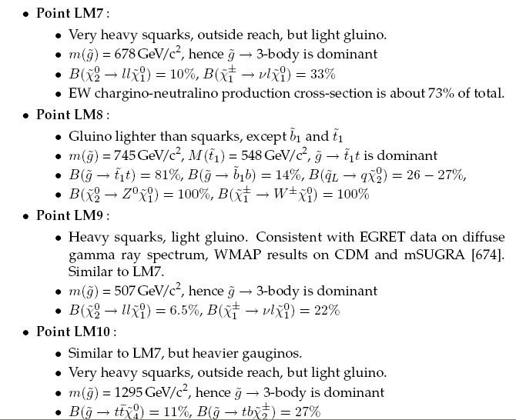
Sorry! Not Enough!
Squarks decouple
Lots of top
Squarks decouple
Lots of top
CMS pTDR V2

Slide 14
ATLAS benchmarks
Benchmarks have been chosen requiring that neutralino relic density matches DM constraints
SUn = mSUgra benchmark n (no reference to simmetry groups!)

Slide 15
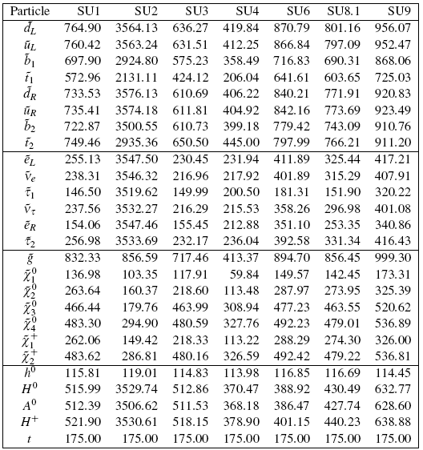
ATLAS benchmarks
January 5th-9th, 2009
Tommaso Lari
15

Slide 16
Discovering SUSY
Show there is something beyond the backgrounds
Measure the properties of the produced particles (including, as much as possible, the dark matter candidate)
Show that what is produced is indeed SUSY (spins)

Slide 17
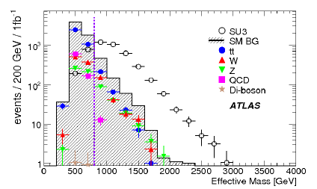
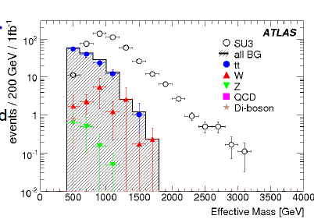
Show there is something
ATLAS 4 jets + MET
Log scale
How to have faith in the background estimation?
ATLAS 1 lepton + Jets +MET

Slide 18
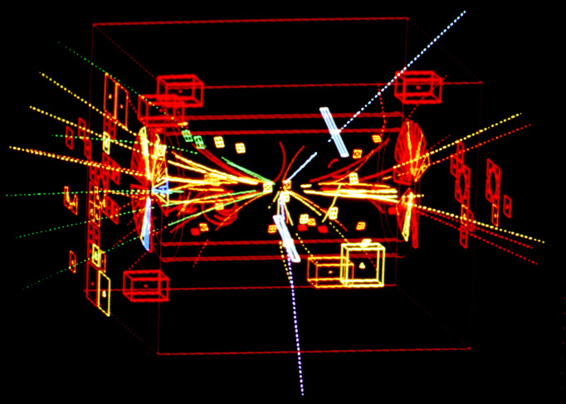
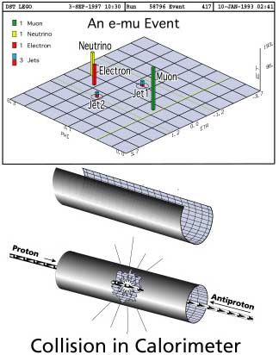
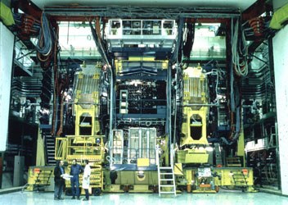
And there are many Backgrounds
CERN Z0 1983
Tevatron, top, 1995
Any final state with neutrinos will also have MET
In jets+Met channel, backgrounds from Z->nunu + jets event, W->lnu+jets when the lepton is lost, and
in lepton+jets channels, large backgrounds from ttbar, W+jets, Z+jets
at LHC energies especially, the QCD corrections to the cross sections and kinematics of these events can be non-negligible.
potentially large and hard-to-estimate background from multijets with MET caused by instrumental effects

Slide 19
How well do we know the backgrounds?
uncertainties on cross sections (and luminosities)
  for top, 5 % at least
  can sometimes be reduced using ratios to Z, etc.
uncertainties on kinematics (especially high pT production)
uncertainties on extra jets
uncertainties on tails of detector resolutions

Slide 20
Kinematics and QCD
It’s easy to do the background subtraction incorrectly.
pythia (LO+LL)
alpgen (LOmultijet+LL)
madgraph (Lomultijet+LL)
MC@NLO (NLO+LL)

Slide 21
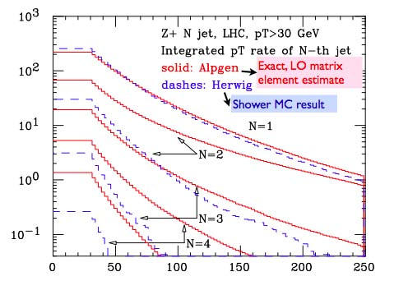
Progress on jets
Mangano et al.

Slide 22
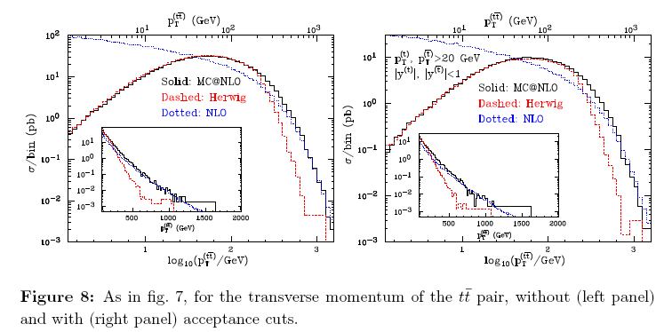
Kinematics
LHC
Herwig is parton shower
MC@NLO matches NLO and PS
Frixione, Nason, Webber, hep-ph/0305252
joint MD-Hopkins Mtg
22

Slide 23
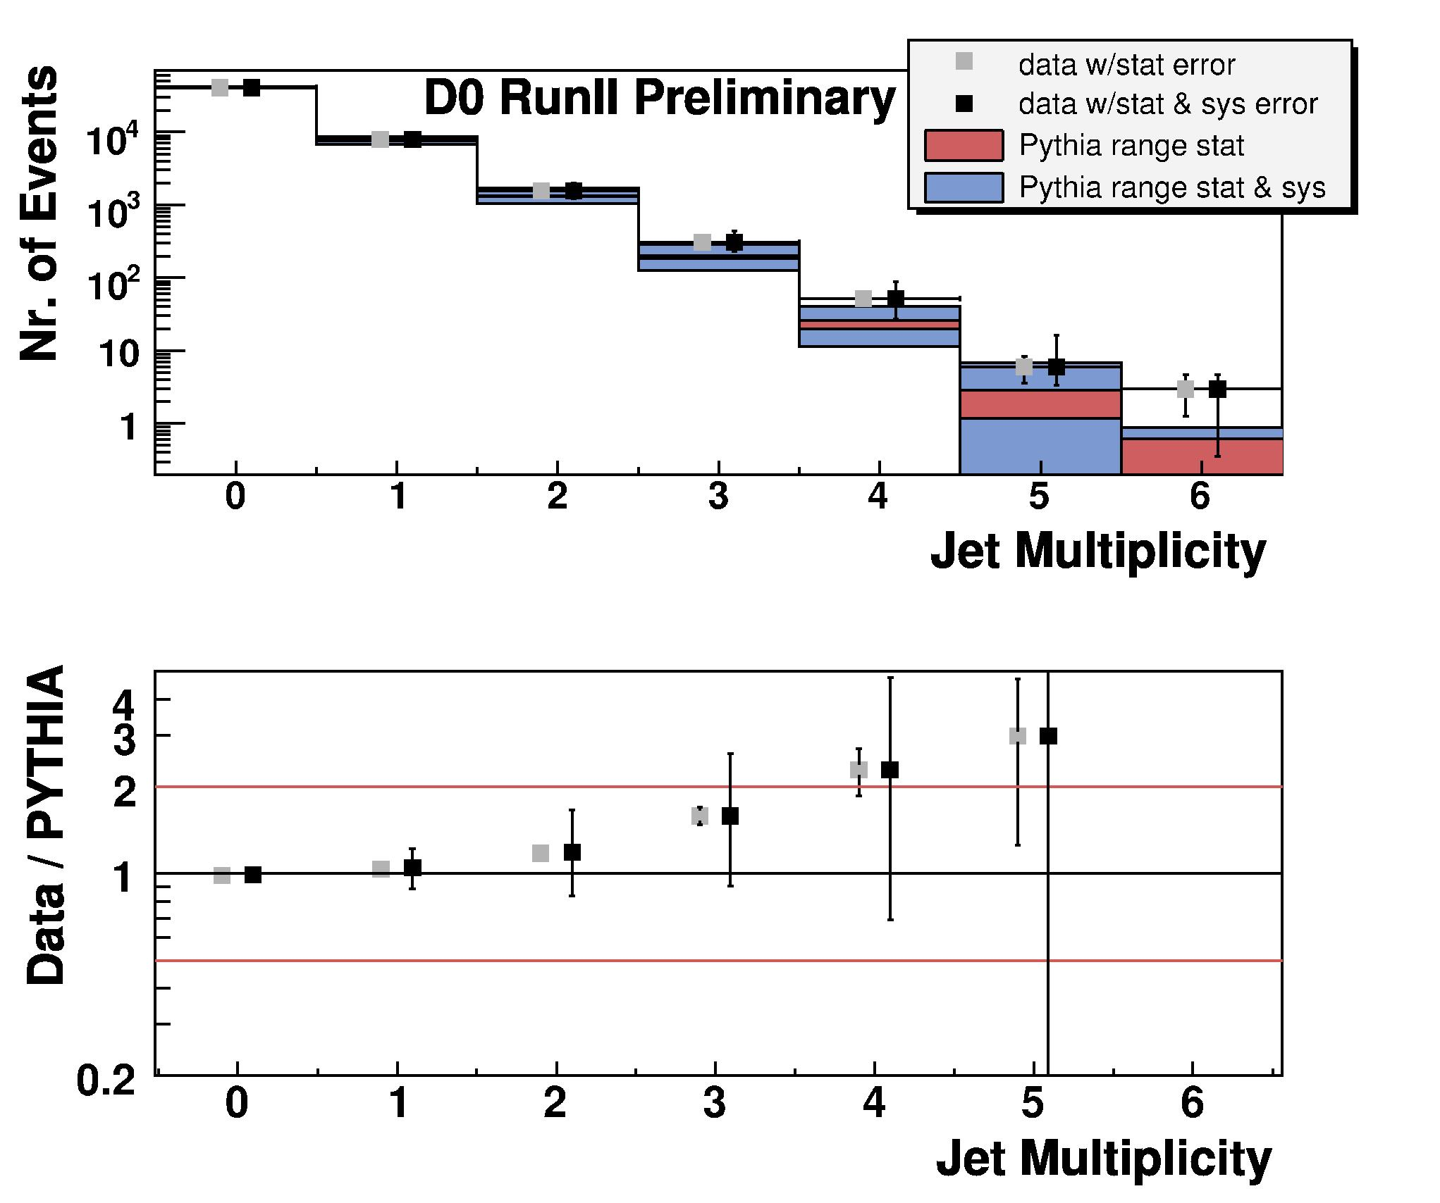
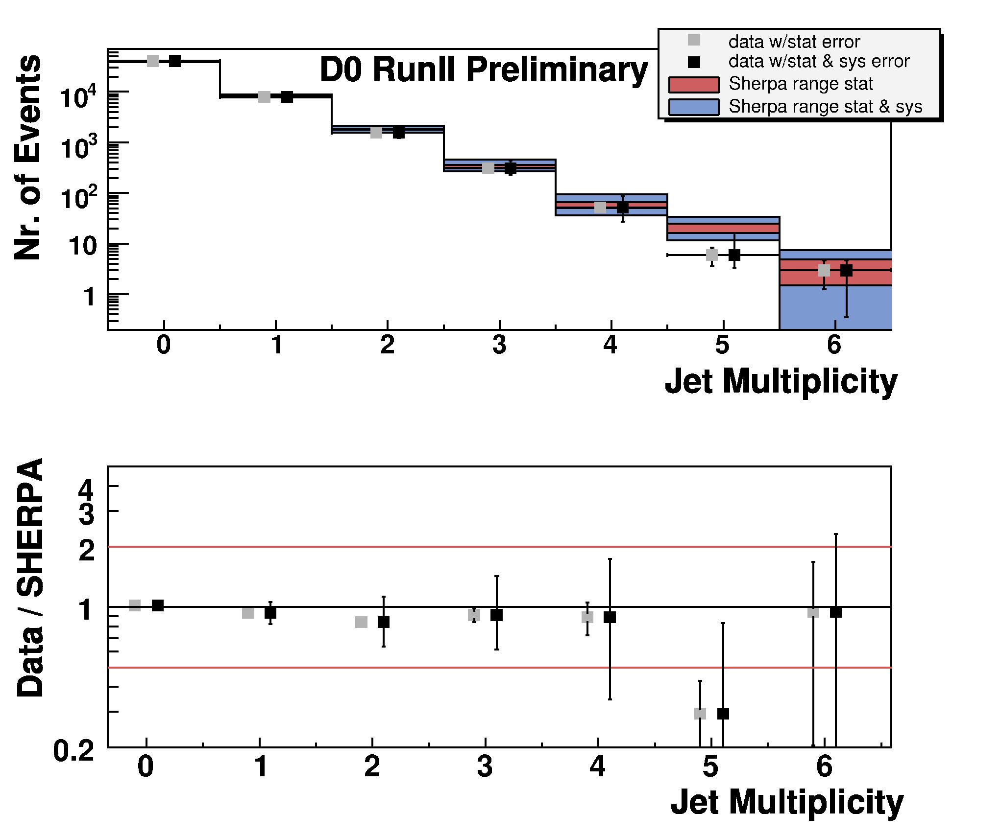
Tevatron Results
Z data
pythia
Sherpa: ME+parton shower (CKKW)
However, just because its good enough for the tevatron, doesn’t mean it will be good enough at the LHC

Slide 24
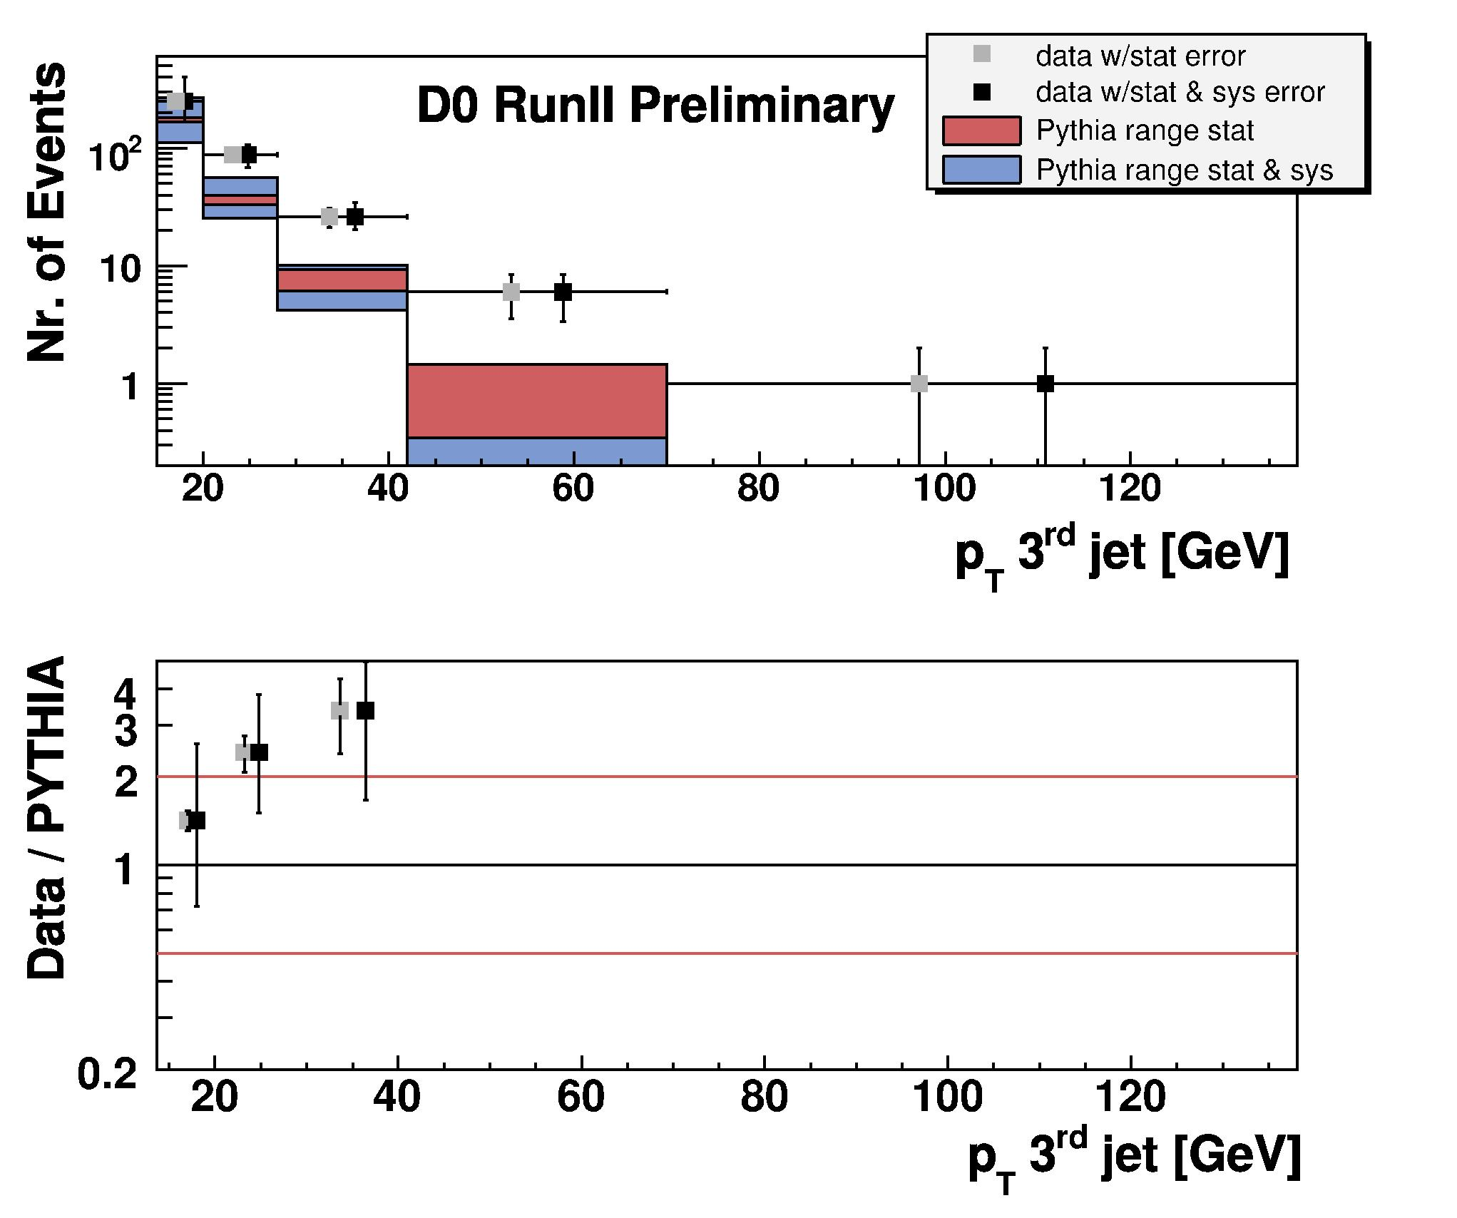
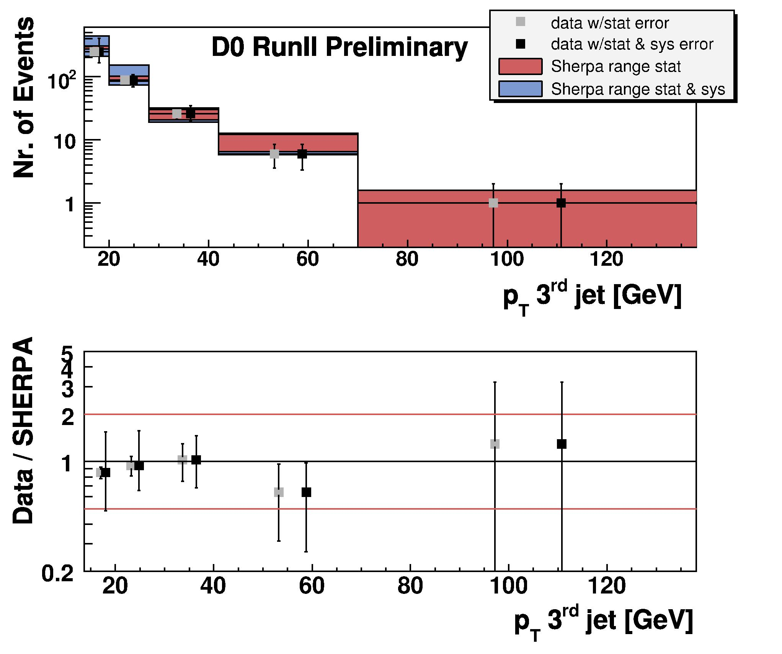
Tevatron Results

Slide 25
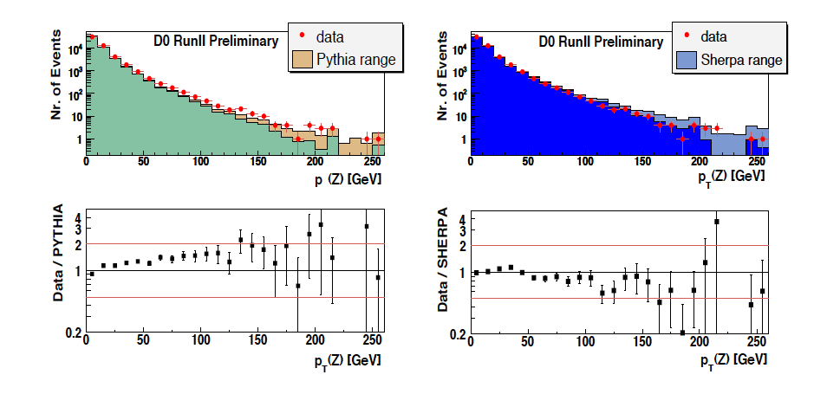
tevatron

Slide 26
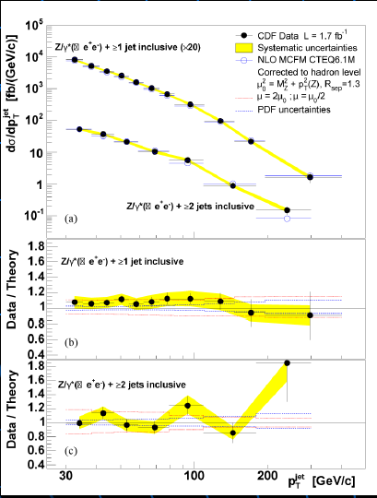
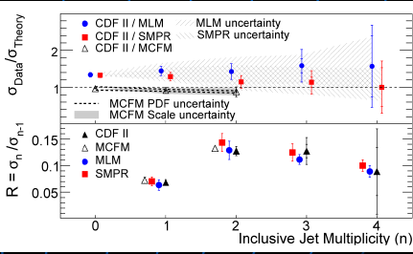
Much Progress in Understanding extra jets

Slide 27
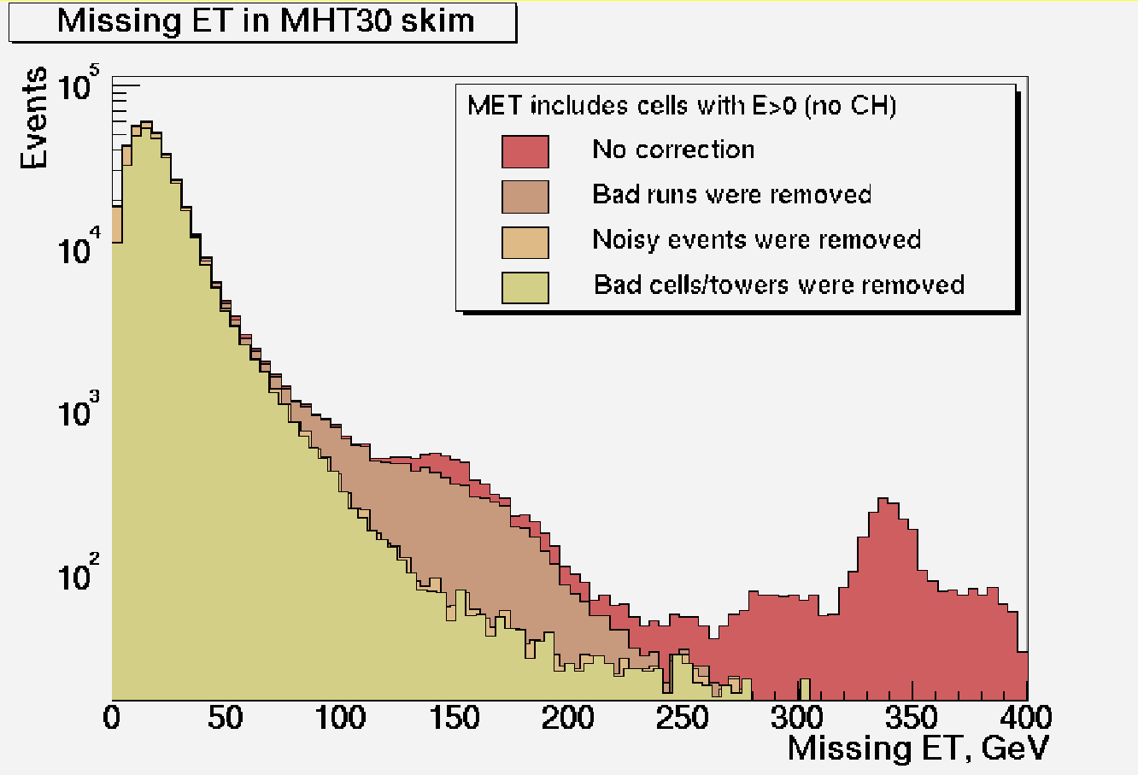
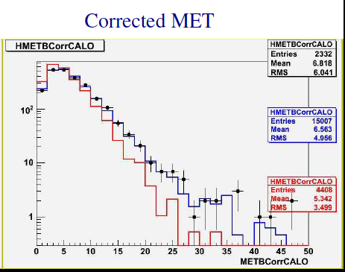
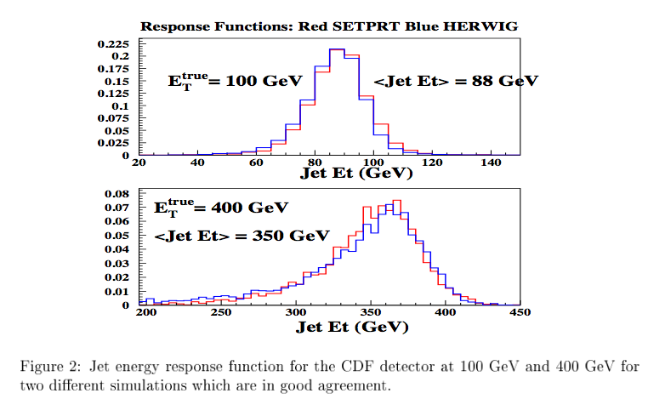
Fake MET/modeling
Can be large instrumental backgrounds to MET at startup (won’t be this bad)
Tails can also be poorly modeled in MC for a variety of reasons.
CDF
Zee MC versus data with and without d0raw2sim: Dzero
The physics of Jets, Hugh Montgomery

Slide 28
Data-based Backgrounds
Since we can not use “signal agrees with expectations” to help us with our discovery, we need to have great faith in our background subtraction. While QCD calculations have made great improvements, and while these detectors are the best every built, and will probably be the best understood ever at startup, real confidence can only come with data-based background subtractions.
Even so, there is a real danger of getting caught by a statistical fluctuation. It is impossible, to my mind, to do a blind search for SUSY.

Slide 29
Example from ATLAS TDR: 1-lepton SUSY
Selection:
Four jets with η< 2.5 and pT > 50 GeV, at least one with pT > 100 GeV.
The transverse sphericity ST > 0.2
MET> 100 GeV and > 0.2Meff (scalar sum of (4 highest) jet, (1) lepton, and MET pT’s)
The transverse mass MT (l+MET) > 100 GeV

Slide 30
Data-driven backgrounds
1. estimation of W and top backgrounds from a control sample formed by reversing one of the selection cuts (on M_{T} ));
2. estimation of the semileptonic ttbar background by explicit kinematic reconstruction and selection of the top mass;
3. estimation of the double leptonic top background, where one lepton is missed, by explicit kinematic reconstruction of a control sample of the same process with both leptons identified;
4. estimation of that same double leptonic top background from a control sample derived by a cut on HT2 (scalar sum of pT’s of 4 lead jets and lepton);
5. estimation of ttbar background by Monte Carlo re-decay;
6. estimation of W and ttbar background using a combined fit to control samples .

Slide 31
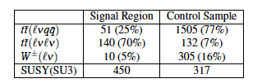
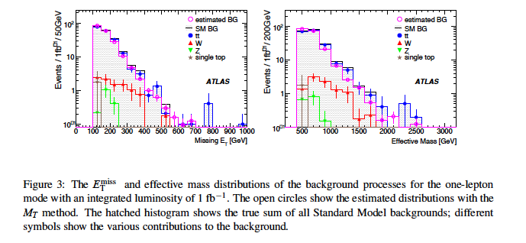

ABCD using m_{T}
Does the MET come from a highly boosted W, with the neutrino along the boost direction ? M_{T} insensitive to boost and should be near W mass.
Background region: use to get MET shape for backgrounds
Low m_{T}, high MET | High m_{T}, high MET (signal)
Low m_{T}, low MET | high m_{T}, low MET
Normalize 100<MET<200
control
extrapolate

Slide 32
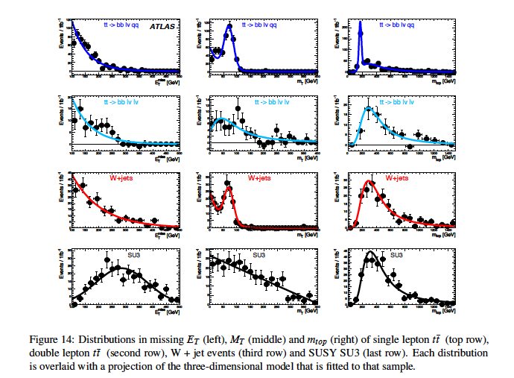
Combined Fit Method
Improve ABCD by using more information (shapes from MC for background pdf’s, with some freedom in shape (fit to mc shape) to allow/absorb differences between data and MC)

Slide 33
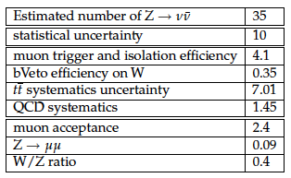
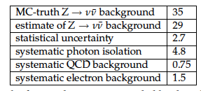
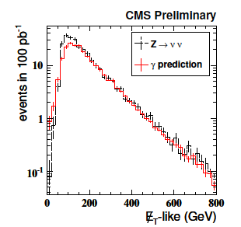
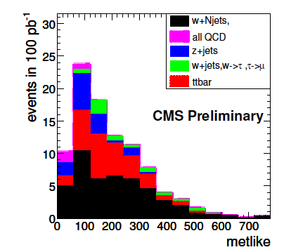
Data-based: jets+MET
Many data-based ways to get Znunu background. QCD is harder.

Slide 34
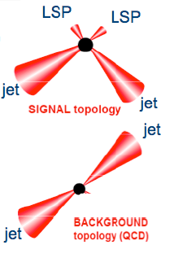
(di)jet +MET with alpha_{T} (1)
SUSY: squark-squark production with M_{gluino} > M_{squark}
Squark decaying to quark+LSP
Final state: di-jet+MET
  2 high pT jets
  MHT = - (p_{T}^{j1}+ p_{T}^{j2})
    not aligned w/ jets
  lepton veto
  third jet veto
Main backgrounds:
  QCD di-jet
  Z->vv +jets
  W+jets, Z->ll and top when leptons are lost

Slide 35

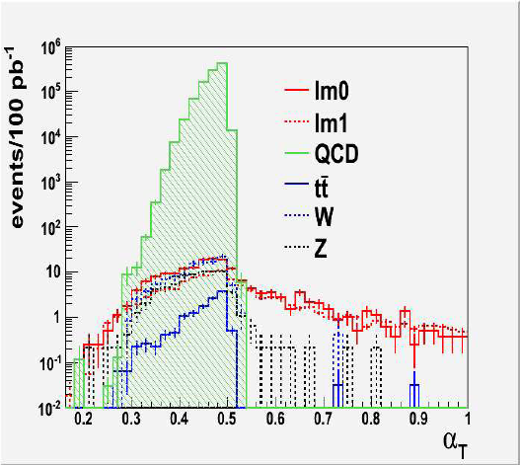
(di)jet +MET with alpha_{T} (2)
QCD background: Randall & Tucker-Smith suggest to use a kinematics variable
for QCD di-jets: α_{T}=0.5 (or smaller if mis-measured E_{T})
  exploits that for QCD jets need to be back-to-back and of equal magnitude
for real MET α_{T} can be greater

Slide 36
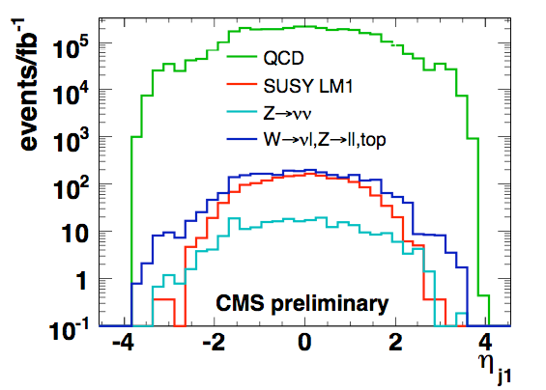
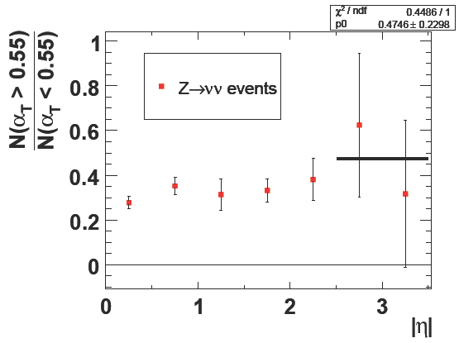
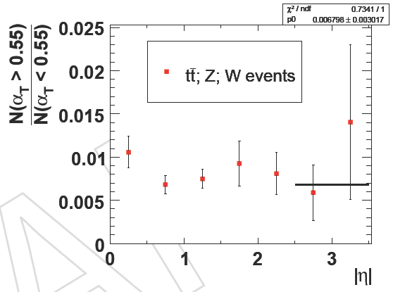

(di)jet +MET with alpha_{T} (3)
Data driven method to estimate the backgrounds:
  Z->νν + jets
  W -> νl, Z->ll, top
  QCD (again)
ABCD method
  need 2 uncorrelated variables: α_{T} and η of the leading jet
  3 out of 4 regions must be signal free

Slide 37


(di)jet +MET with alpha_{T} (4)
Data driven method to estimate the backgrounds: results
w/o signal (closure test) w/ signal (LM1)
Extra checks:
Check the background flatness in η on data by relaxing the HT and as a consequence diluting the (potential) signal
Alternative data driven Z->νν+jets estimation from W->νl+jets
Update: α_{T} definition extended to multi-jet events. Ongoing.

Slide 38

SUSY @ 100 pb⁻¹
Inclusive Jets*MET analysis from P-TDR
  Assume same acceptance – probably too optimistic
CMS AN 2009/016

Slide 39

GMSB
Gauge-mediated supersymmetry breaking has gravitino has LSP instead of lightest neutralino. Phenomenology depends on NLSP.
(Gravitino mass is related to susy-breaking scale. Susy-breaking scale can be quite low for GMSB, so gravitino can be the LSP)
Non-pointing
hscp

Slide 40


Gmsb susy

Slide 41

Non-pointing

Slide 42
Mass Reconstruction
Following slides stolen from Tommaso Lari
Theorists, ATLAS and CMS have done work on deconstructing the particle spectrums (pioneering work by ATLAS)
Di-lepton edges gives mass of slepton.
Strategy is to make mass of all possible combinations of final state particles and let observed min and max values constrain intermediate masses
but need to isolate this decay chain from particles from decay of the other squark (gluino) in the event
and events containing this decay chain from events with other decay chains and other initial states.

Slide 43


mass
With two undetected particles with unknown mass in the final state it is not possible to reconstruct mass peaks
The typical approach is to look for minima (thresholds) and maxima (edges) of visible invariant mass products
2 two-body decays: the invariant mass of p,q (massless
SM particles) has a maximum at
and a triangular shape if the spin of particle b is zero.
3 successive two-body decays
Four invariant mass combinations of the three
visible particles: (12), (13), (23), (123)
For the first three minimum is zero: only one constraint. The last has both non-trivial minimum and maximum: five constraints in total on four unknown masses.
If sufficiently long decay chains can be isolated and enough endpoints
measured, then the masses of the individual particles can be obtained
January 5th-9th, 2009
Tommaso Lari
43

Slide 44
Experimentally very clean
Lepton 4-momentum measured with good resolution and very small energy scale uncertainty (ultimate ~0.1%)
Lepton flavour unambiguos
The combinatorial background cancels in the flavour subtracted distribution:
ATLAS
Physics TDR
The relevant decay chain is
open in a large fraction of
SUSY parameter space.
M_{ll} (GeV)
January 5th-9th, 2009
Tommaso Lari
44

Slide 45


Dilepton edge
SU3 (bulk point), two body decays
Fitting function: triangle smeared with a
gaussian
SU4 (low-mass point near Tevatron
limits), three body decay.
Fitting function: theoretical three-body
decay shape with gaussian smearing
In reality more luminosity is needed to discriminate two-body and
three-body decays from the shape of the distribution. With 1 fb⁻¹
both fitting functions give reasonable χ².

Slide 46
Leptons and jets
Lepton+jets combinations give further mass relations
The two jets with highest p_{T} are likely from squark decay – but which one belongs to the right decay chain?
January 5th-9th, 2009
Tommaso Lari
46

Slide 47

llq edge
lq_{max} edge
llq threshold
lq_{min} edge
For this particular benchmark (bulk point SU3) all constraints measurable
with 1 fb⁻¹ !
January 5th-9th, 2009
Tommaso Lari
47

Slide 48


Full Spectrum
From these edges it is possible to derive the masses of particles in the decay and place limits on parameters of constrained models. Large statistical errors with 1 fb⁻¹. Mass differences better measured than absolute masses.
SU3, full simulation, 1 fb⁻¹
SPS1a, fast simulation, 100 fb⁻¹
ATLAS
Sparticle Expected precision (100 fb⁻¹)
q_{L} ± 3%
Χ⁰₂ ± 6%
l_{R} ± 9%
Χ⁰₁ ± 12%
~
~
~
~

Slide 49

Similar plots from CMS
dielectron
dimuon
Z

Slide 50
Higgs Searches
This is where our experience in the top search can guide us well.
It will take a while (low cross section * BR)
will need to combine channels to get fastest result
properties well-predicted by SM.
As with the top, we already have reasonable constraints on the mass.

Slide 51


Indirect Constraints
March 2009

Slide 52

Higgs + New Physics
In the SM, the relationship between the Higgs mass and EWK observables is one way.
New physics can alter. For example, in SUSY,
    M_{h}² < M_{Z}² + (3G_{F}/(2^{1/2}π²)) M_{t}⁴ ln(1+m²/M_{t}²)
arXiv:0707.3447

Slide 53

Direct Searches
Sadly, don’t even see a hint of a signal starting to form… (observed limit is mostly >= expected)
95%cl indirect limit

Slide 54



Higgs Production at the LHC
Very different production mechanism that most physics we study
For gg, k factor around 1.8!
100 GeV object @ 10 TeV, with hit of about 0.6 for gg -> 100 events is 0.6 pb

Slide 55

How to constrain luminosity
J. Huston

Slide 56


Decay
WW* and bbbar have largest branching fractions, but bbbar cross section is microbarns.
Djouadi, Kalinowski, Spira
LEP limit
95%cl indirect limit

Slide 57



Higgs

Slide 58

The bad news for upcoming run

Slide 59

Fermiophobic Higgs

Slide 60

Higgs to gamma gamma

Slide 61

Higgs to gamma gamma
It’s about resolution and background rejection.
Statistical significance scales with resolution

Slide 62


Plenty of backgrounds
ATLAS TDR

Slide 63

Higgs to γγ
Efficiency 20-30 %

Slide 64




Associated Higgs

Slide 65


qqtautau
Another way to look at the low mass region, but…
Ouch! It will take a while.

Slide 66
ZZ*
It’s about acceptance and resolution (and patience)

Slide 67



HZZ*
If it’s there, though, it should be like the W/Z discoveries at UAX (in slow motion)
CMS
at 5σ sign.
CMS
at 5σ sign.

Slide 68

What about hadronic decays of the Z?

Slide 69

WW*
Big DY, ttbar background, WW
CMS

Slide 70


WW*
How to get a signal out of this mess? The tevatron guys have been working hard on this, since Higgs searches are hard there.

Slide 71


Neutral net

Slide 72


ATLAS

Slide 73
technicolor
won’t see Higgs
may be a while until we see the techni particles

Slide 74

Conclusions
Don’t worry! We are here!

